Slide 1
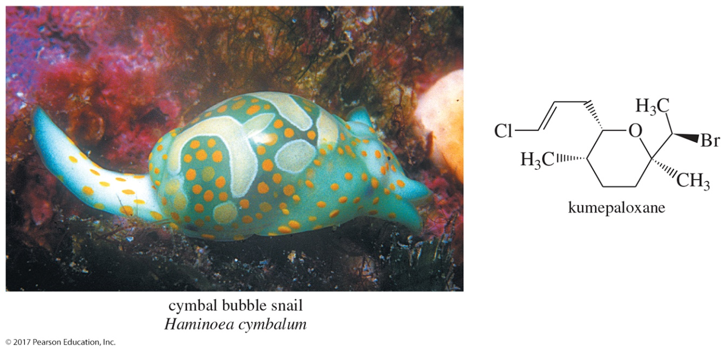
Organic Chemistry, 9th Edition L. G. Wade, Jr.
Chapter 6 Lecture
Alkyl Halides;
Nucleophilic Substitution
Chad Snyder, PhD
Grace College
© 2017 Pearson Education, Inc.

Slide 2
Classes of Alkyl Halides
Alkyl halides: Halogen is directly bonded to an sp³ carbon.
Vinyl halides: Halogen is bonded to an sp² carbon of alkene.
Aryl halides: Halogen is bonded to an sp² carbon on a benzene ring.
H
H
H
C
C
B
r
H
H
alkyl halide
H
H
C
C
H
C
l
vinyl halide
I
aryl halide

Slide 3
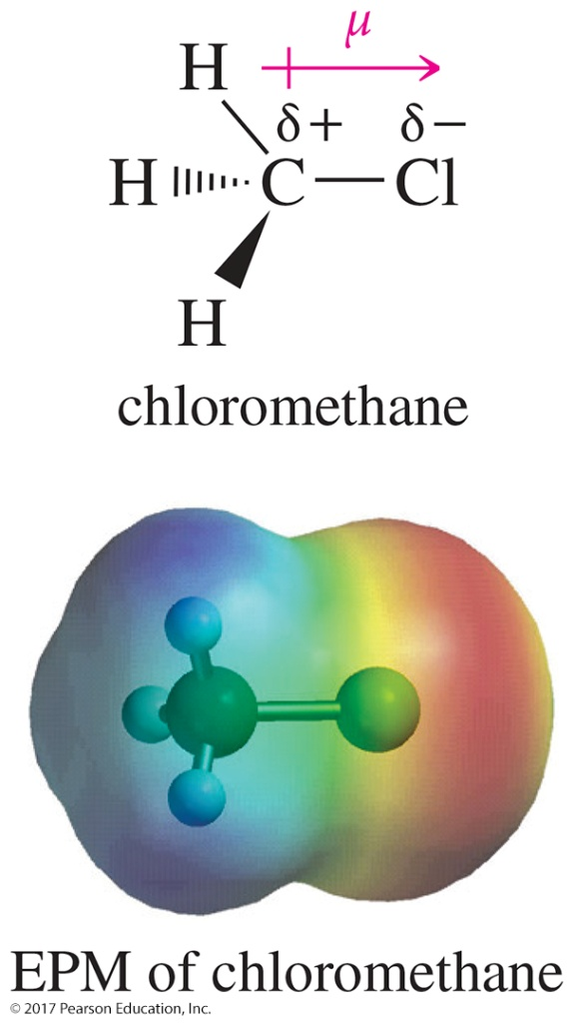
Polarity and Reactivity
Halogens are more electronegative than C.
Carbon–halogen bond is polar, so carbon has partial positive charge.
Carbon can be attacked by a nucleophile.
Halogen can leave with the electron pair.

Slide 4
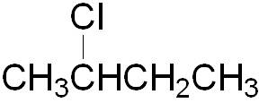
IUPAC Nomenclature
Name as a haloalkane.
Choose the longest carbon chain, even if the halogen is not bonded to any of those carbons.
Use lowest possible numbers for position.
1
2
1
2
3
4
1
2 3 4 5 6 7
2-chlorobutane
4-(2-fluoroethyl)heptane

Slide 5
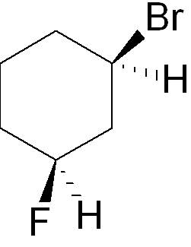
Examples
1 2 3 4 5 6 7 8 9
6-bromo-2-methylnonane
cis-1-bromo-3-fluorocyclohexane

Slide 6
Systematic Common Names
The alkyl groups is a substituent on halide.
It is useful only for small alkyl groups.
isobutyl bromide
sec-butyl bromide
tert-butyl bromide

Slide 7
Common Names of Halides
CH₂X₂ is called methylene halide.
CHX₃ is a haloform.
CX₄ is carbon tetrahalide.
Common halogenated solvents:
CH₂Cl₂ is methylene chloride.
CHCl₃ is chloroform.
CCl₄ is carbon tetrachloride.

Slide 8
Alkyl Halides Classification
Methyl halides: Halide is attached to a methyl group.
Primary alkyl halide: Carbon to which halogen is bonded is attached to only one other carbon.
Secondary alkyl halide: Carbon to which halogen is bonded is attached to two other carbons.
Tertiary alkyl halide: Carbon to which halogen is bonded is attached to three other carbons.

Slide 9
Primary, Secondary, and Tertiary Alkyl Halides

Slide 10
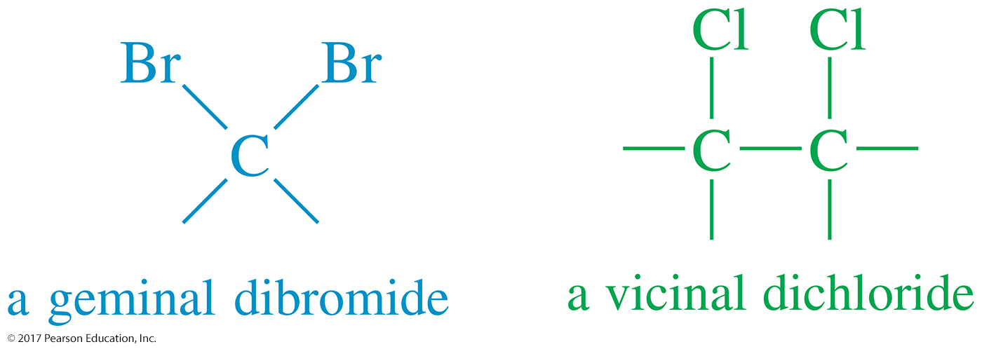
Types of Dihalides
Geminal dihalide: Two halogen atoms are bonded to the same carbon.
Vicinal dihalide: Two halogen atoms are bonded to adjacent carbons.

Slide 11
Uses of Alkyl Halides
Industrial and household cleaners
Anesthetics
CHCl₃ was used originally as a general anesthetic but it is toxic and carcinogenic.
CF₃CHClBr is a mixed halide and is sold as Halothane.
Freons are used as refrigerants and foaming agents.
Freons can harm the ozone layer, so they have been replaced by low-boiling hydrocarbons or carbon dioxide.
Pesticides such as DDT are extremely toxic to insects but not as toxic to mammals.
Haloalkanes can not be destroyed by bacteria, so they accumulate in the soil to a level that can be toxic to mammals, especially humans.

Slide 12
Dipole Moments
Electronegativities of the halides: F > Cl > Br > I
Bond lengths increase as the size of the halogen increases: C—F < C—Cl < C—Br < C—I
Bond dipoles C—Cl > C—F > C—Br > C—I 1.56 D 1.51 D 1.48 D 1.29 D
Molecular dipoles depend on the geometry of the molecule.

Slide 13
Dipole Moments and Molecular Geometry
Notice how the four, symmetrically oriented polar bonds of the carbon tetrahalides cancel to give a molecular dipole moment of zero.

Slide 14
Boiling Points
Greater intermolecular forces, higher b. p.
Dipole–dipole attractions are not significantly different for different halides.
London forces are greater for larger atoms.
Greater mass = higher b. p.
Spherical shape decreases b. p. (CH₃)₃CBr CH₃(CH₂)₃Br 73 °C 102 °C

Slide 15
Densities
Alkyl fluorides and alkyl chlorides (those
with just one chlorine atom) are less dense than water (1.00 g/mL).
Alkyl chlorides with two or more chlorine atoms are denser than water.
All alkyl bromides and alkyl iodides are denser than water.

Slide 16
Preparation of Alkyl Halides
Free radical halogenation (Chapter 4)
Chlorination produces a mixture of products. This reaction is not a good lab synthesis, except in alkanes where all hydrogens are equivalent.
Bromination is highly selective.
Free radical allylic halogenation
Halogen is placed on a carbon directly attached to the double bond (allylic).

Slide 17
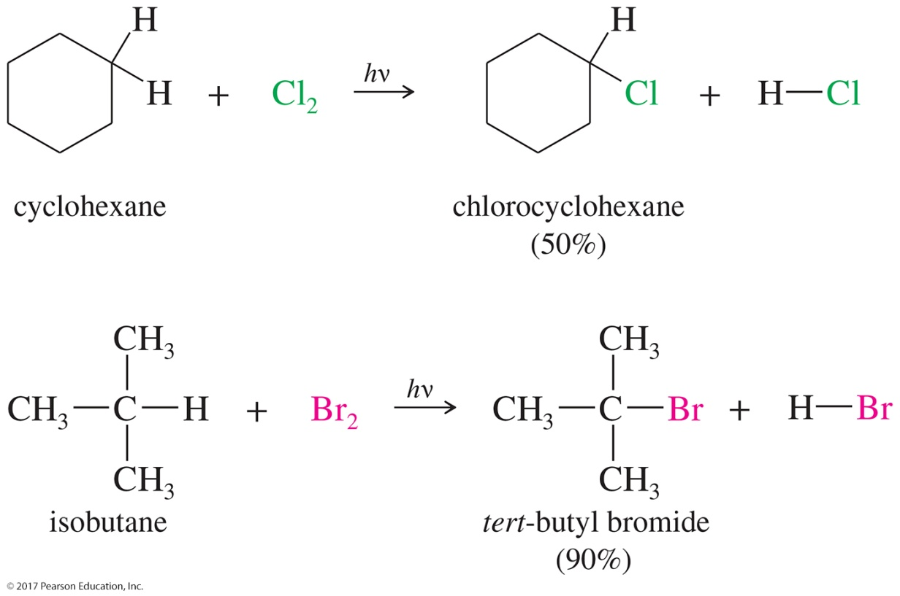
Halogenation of Alkanes
Chlorination is not selective.
Bromination is highly selective: 3° carbons > 2° carbons > 1° carbons

Slide 18
Allylic Bromination
Allylic radicals are resonance stabilized.
Bromination occurs with good yield at the allylic position (sp³ C next to C C).

Slide 19
Reaction Mechanism
The mechanism involves an allylic radical stabilized by resonance.
Both allylic radicals can react with bromine.

Slide 20
N-Bromosuccinimide
N-Bromosuccinimide (NBS) is an allylic brominating agent.
It keeps the concentration of Br₂ low.

Slide 21
Example of Allylic Halogenation with NBS

Slide 22
Reactions of Alkyl Halides

Slide 23
The S_{N}2 Reaction
The halogen atom on the alkyl halide is replaced with the nucleophile (HO–).
Since the halogen is more electronegative than carbon, the C—I bond breaks heterolytically and the iodide ion leaves.

Slide 24
S_{N}2 Mechanism
Bimolecular nucleophilic substitution (S_{N}2)
Concerted reaction: New bond forming and old bond
breaking at same time
Reaction is second order overall.
Rate = k_{r}[alkyl halide][nucleophile]

Slide 25
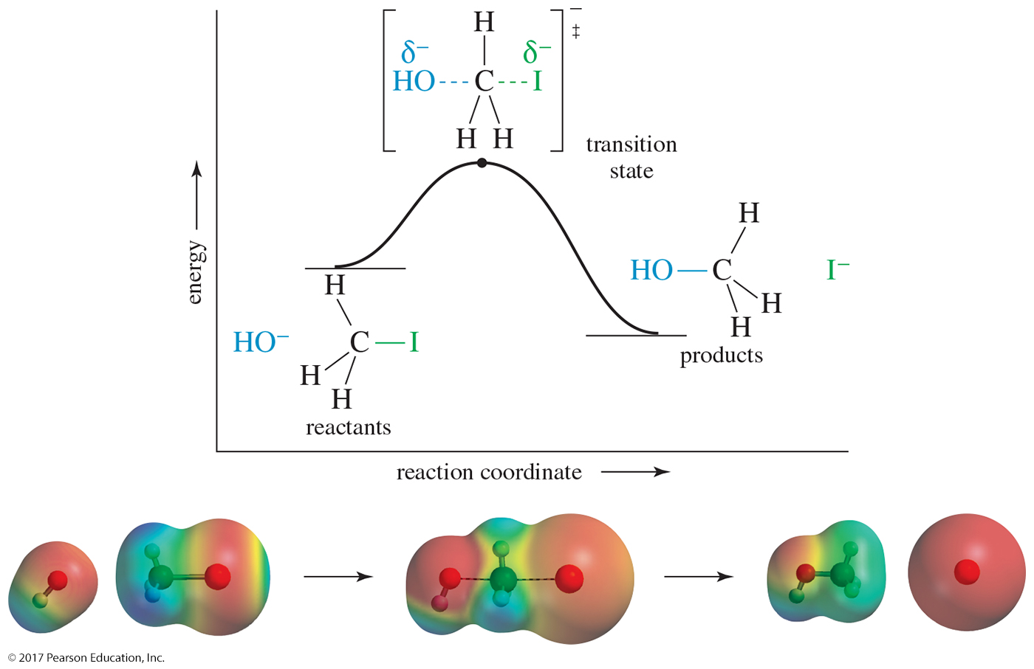
S_{N}2 Energy Diagram
The S_{N}2 reaction is a one-step reaction.
Transition state is highest in energy.

Slide 26
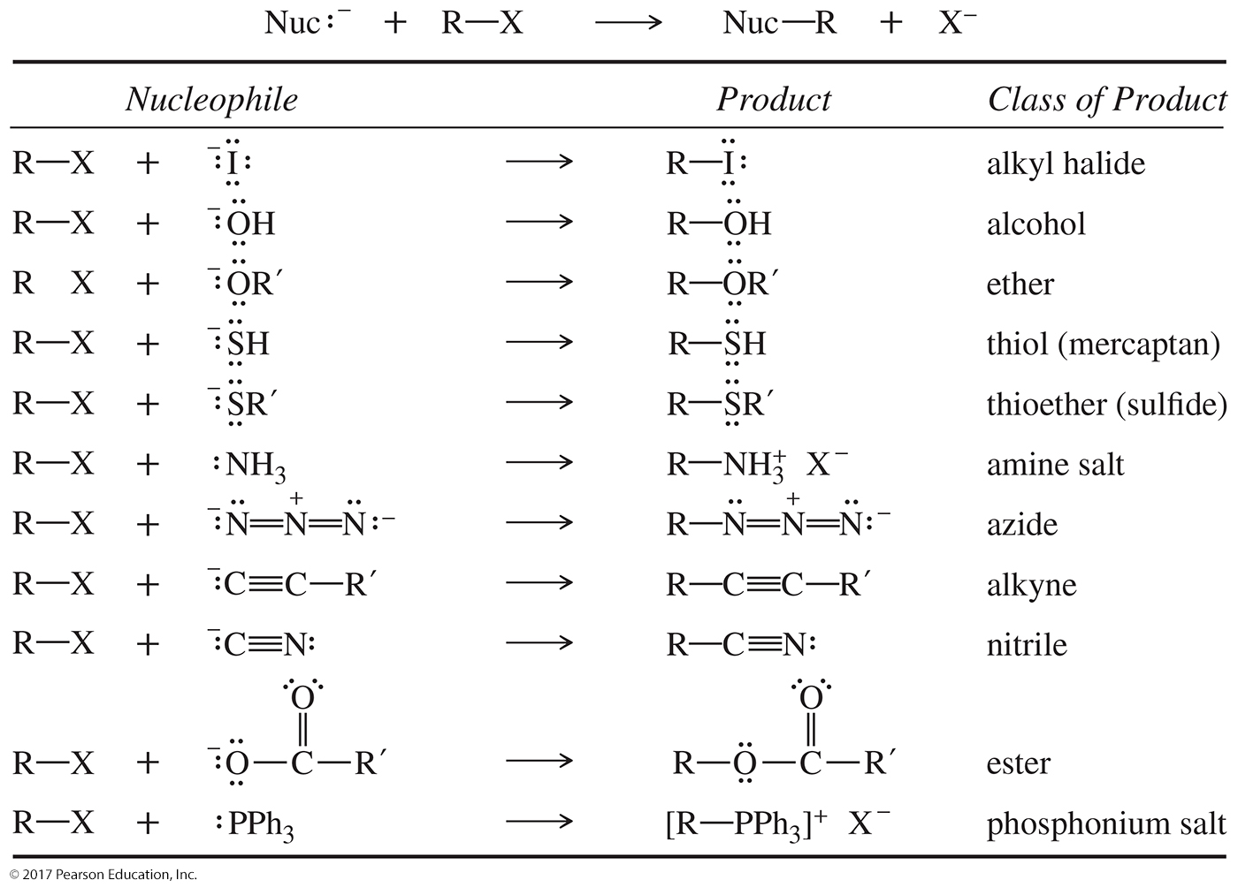
Uses for S_{N}2 Reactions

Slide 27
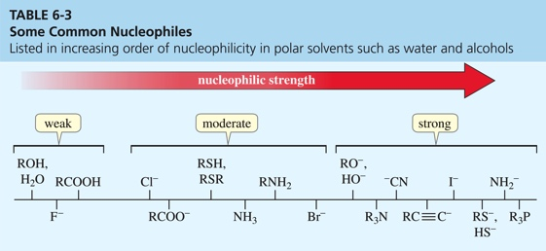
S_{N}2: Nucleophilic Strength
Stronger nucleophiles react faster.
Strong bases are strong nucleophiles, but not all strong nucleophiles are basic.

Slide 28
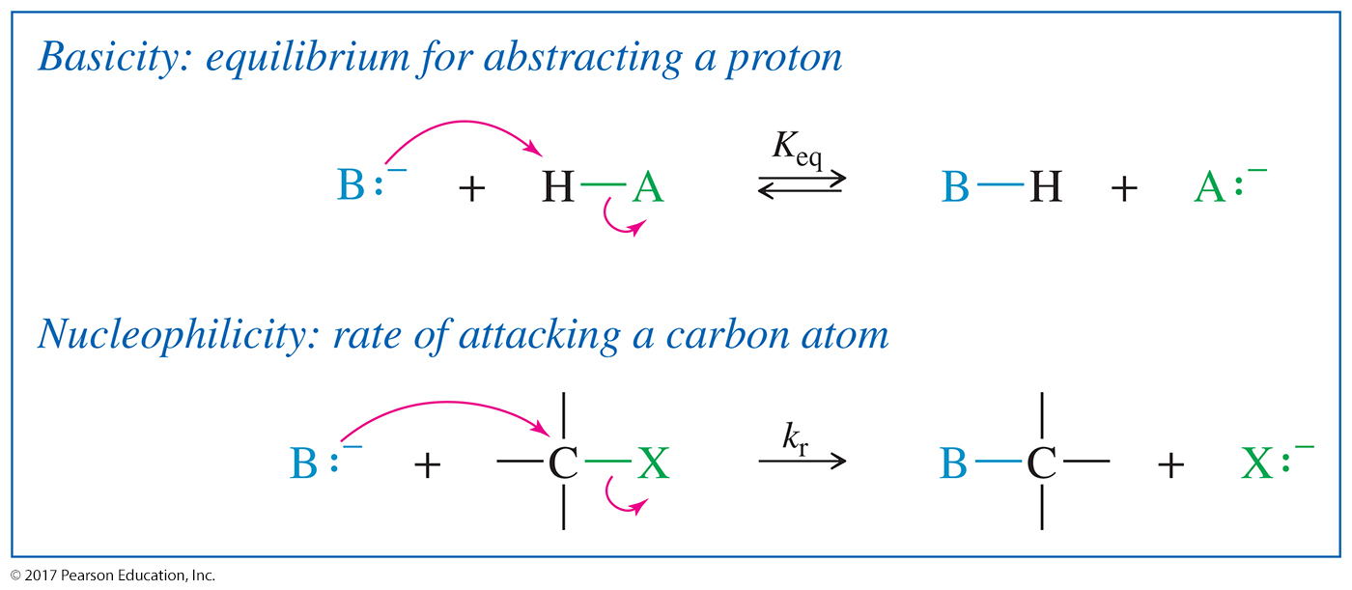
Basicity Versus Nucleophilicity
Basicity is defined by the equilibrium constant for abstracting a proton.
Nucleophilicity is defined by the rate of attack on the electrophilic carbon atom

Slide 29
Trends in Nucleophilicity
A negatively charged nucleophile is stronger than its neutral counterpart:
Nucleophilicity decreases from left to right:
It increases down periodic table as size and polarizability increase:

Slide 30
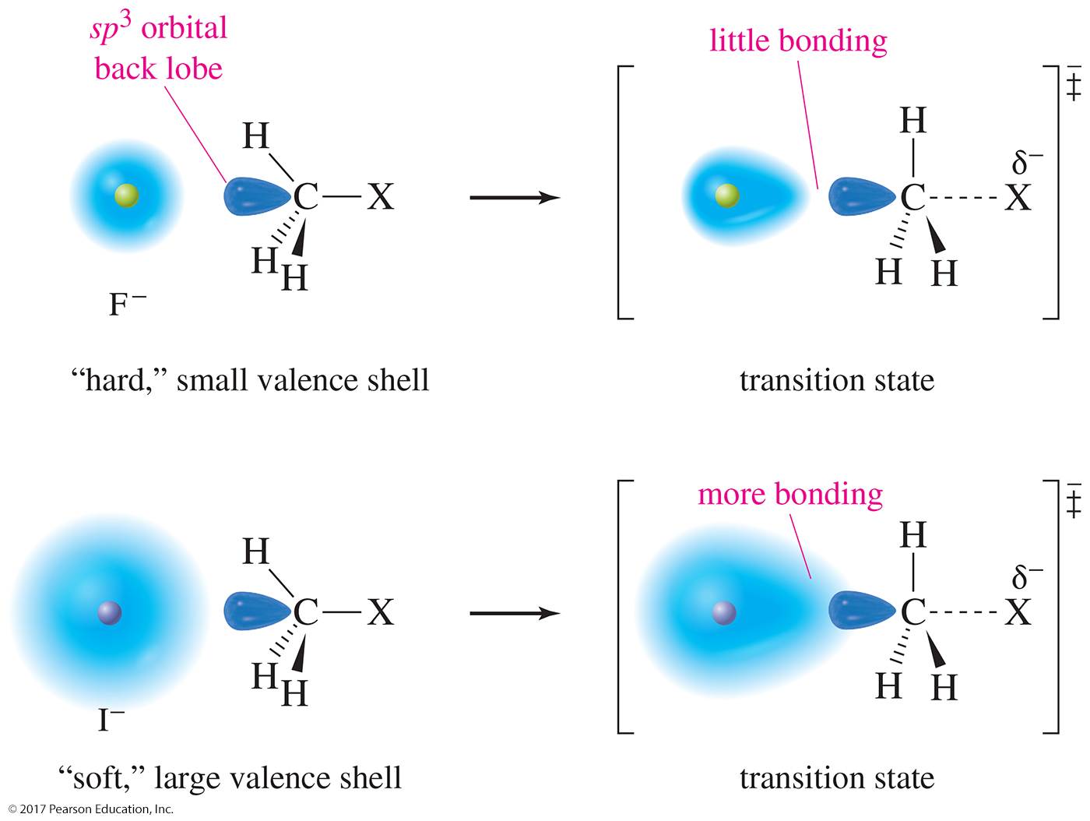
Polarizability Effect
Bigger atoms have a soft shell that can start to overlap the carbon atom from a farther distance.

Slide 31
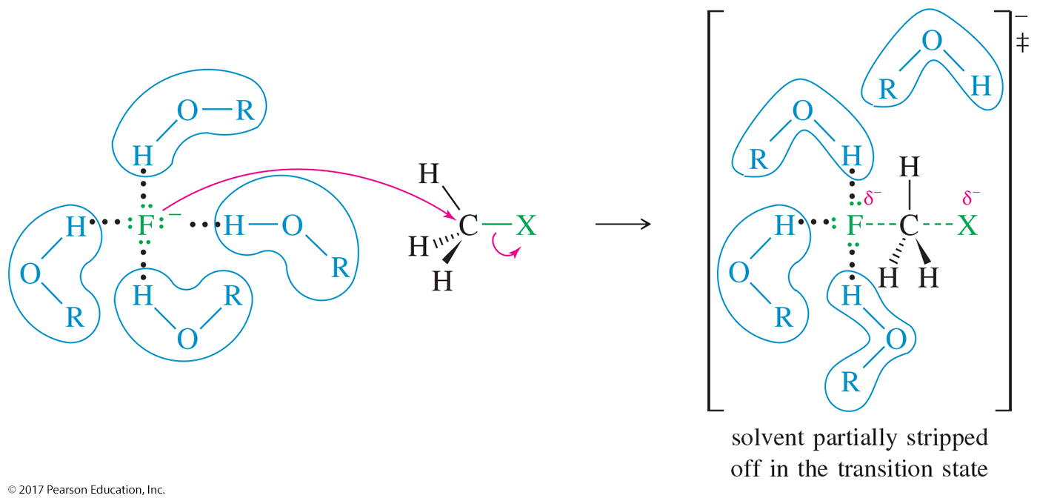
Solvent Effects: Protic Solvents
Polar protic solvents have acidic hydrogens (O—H or N—H) that can solvate the nucleophile, reducing their nucleophilicity.
Nucleophilicity in protic solvents increases as the size of the atom increases.

Slide 32
Solvent Effects: Aprotic Solvents
Polar aprotic solvents do not have acidic protons and, therefore, cannot hydrogen bond.
Some aprotic solvents are acetonitrile: DMF, acetone, and DMSO.
S_{N}2 reactions proceed faster in aprotic solvents.

Slide 33
Crown Ethers
Crown ethers solvate the cation, so the nucleophilic strength of the anion increases.
Fluoride becomes a good nucleophile.

Slide 34
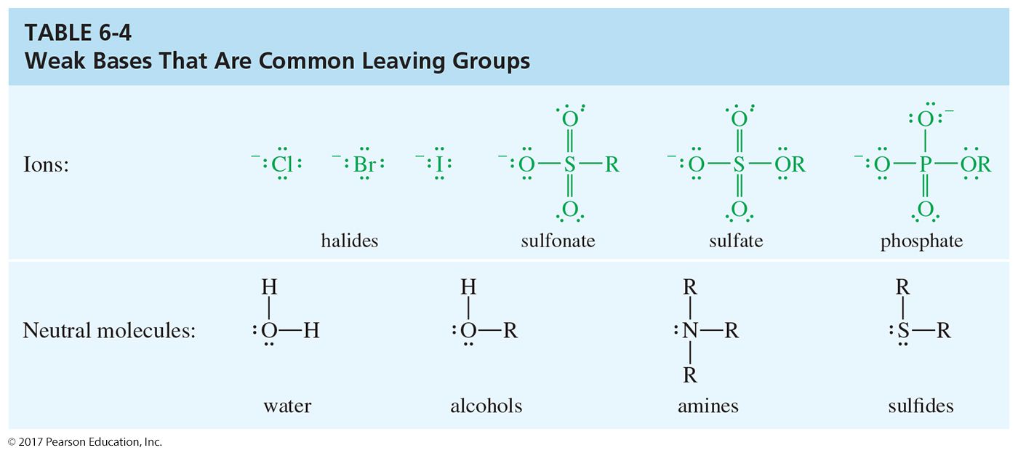
Leaving Group Ability
The best leaving groups are
electron-withdrawing, to polarize the carbon atom.
stable (not a strong base) once they have left.
polarizable, to stabilize the transition state.

Slide 35
Structure of Substrate on S_{N}2 Reactions
Relative rates for S_{N}2:
CH₃X > 1° > 2° >> 3°
Tertiary halides do not react via the S_{N}2 mechanism due to steric hindrance.

Slide 36
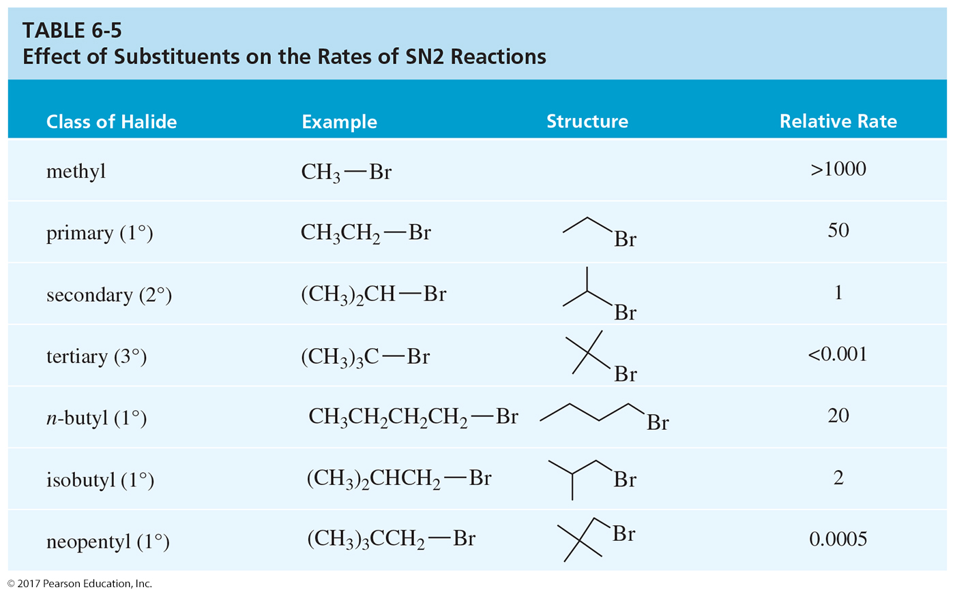
Effect of Substituents on the Rates of S_{N}2 Reactions

Slide 37
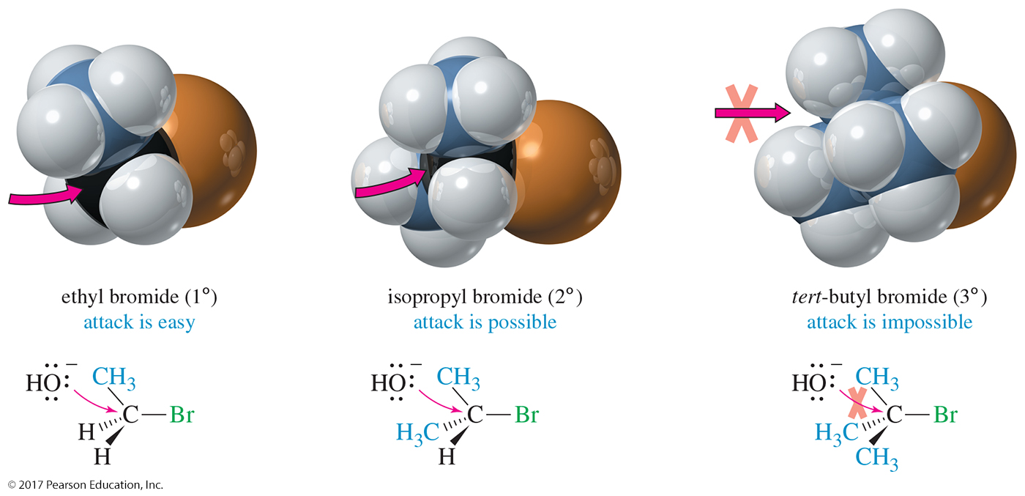
Steric Effects of the Substrate on S_{N}2 Reactions
Nucleophile approaches from the back side.
It must overlap the back lobe of the C—X sp³ orbital.

Slide 38
Stereochemistry of S_{N}2
S_{N}2 reactions will result in an inversion of configuration also called a Walden inversion.

Slide 39
Back-Side Attack in the S_{N}2 Reaction

Slide 40
The S_{N}1 Reaction
The S_{N}1 reaction is a unimolecular nucleophilic substitution.
It has a carbocation intermediate.
Rate = k_{r}[alkyl halide]
Racemization occurs.

Slide 41
S_{N}1 Mechanism
Step 1: Formation of the carbocation
Step 2: Attack of the nucleophile
If the nucleophile is an uncharged molecule like water or an alcohol, the positively charged product must lose a proton to give the final uncharged product.

Slide 42
S_{N}1 Mechanism: Step 1
Formation of carbocation (rate-determining step)

Slide 43
S_{N}1 Mechanism: Step 2
The nucleophile attacks the carbocation, forming the product.

Slide 44
S_{N}1 Mechanism: Step 3
If the nucleophile is neutral, a third step (deprotonation) will be needed.

Slide 45
S_{N}1 Energy Diagram
Forming the carbocation is an endothermic step.
Step 2 is fast with a low activation energy.

Slide 46
Rates of S_{N}1 Reactions
Order of reactivity follows stability of carbocations (opposite to S_{N}2).
3° > 2° > 1° >> CH₃X
A more stable carbocation requires less energy to form.
A better leaving group will increase the rate of the reaction.

Slide 47
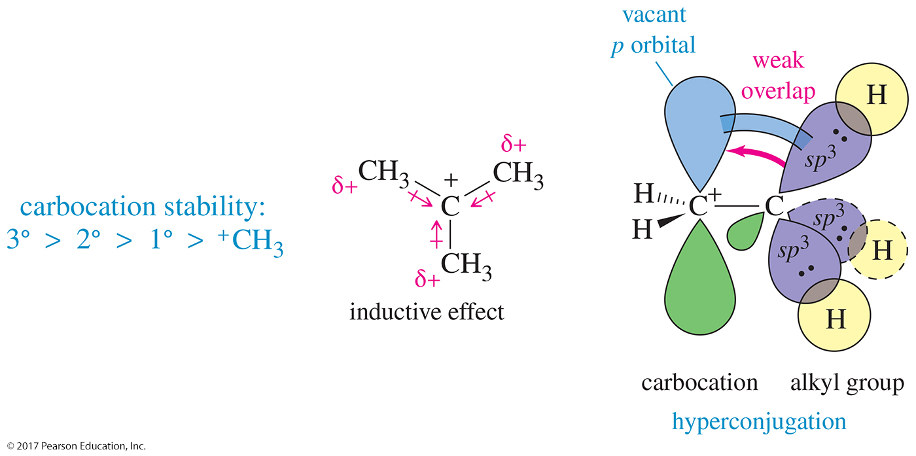
Substituent Effects
S_{N}1 reactivity: 3° > 2° > 1° > CH3X

Slide 48
Solvation Effect
Polar protic solvent is best because it can solvate both ions strongly through hydrogen bonding.

Slide 49
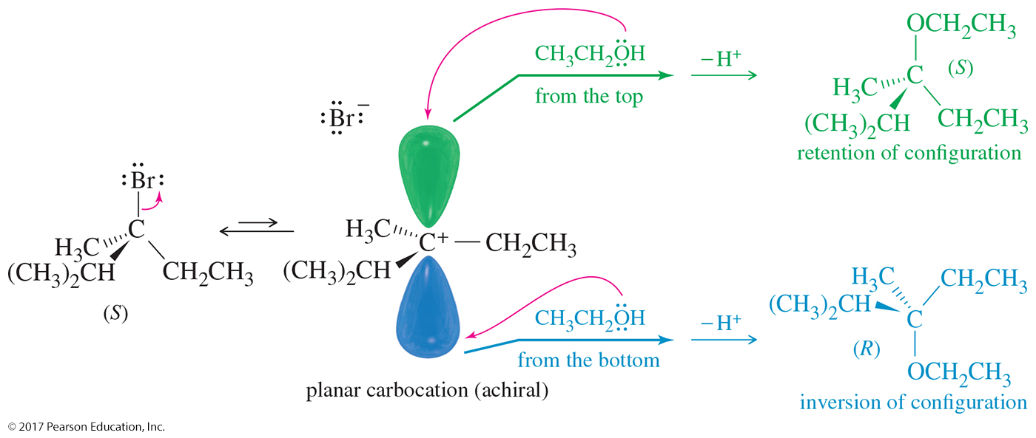
Structure of the Carbocation
Carbocations are sp² hybridized and trigonal planar. The lobes of the empty p orbital are on both sides of the trigonal plane.
Nucleophilic attack can occur from either side, producing mixtures of retention and inversion of configuration if the carbon is chiral.

Slide 50
Carbocation Stability
Carbocations are stabilized by inductive effect and by hyperconjugation.

Slide 51
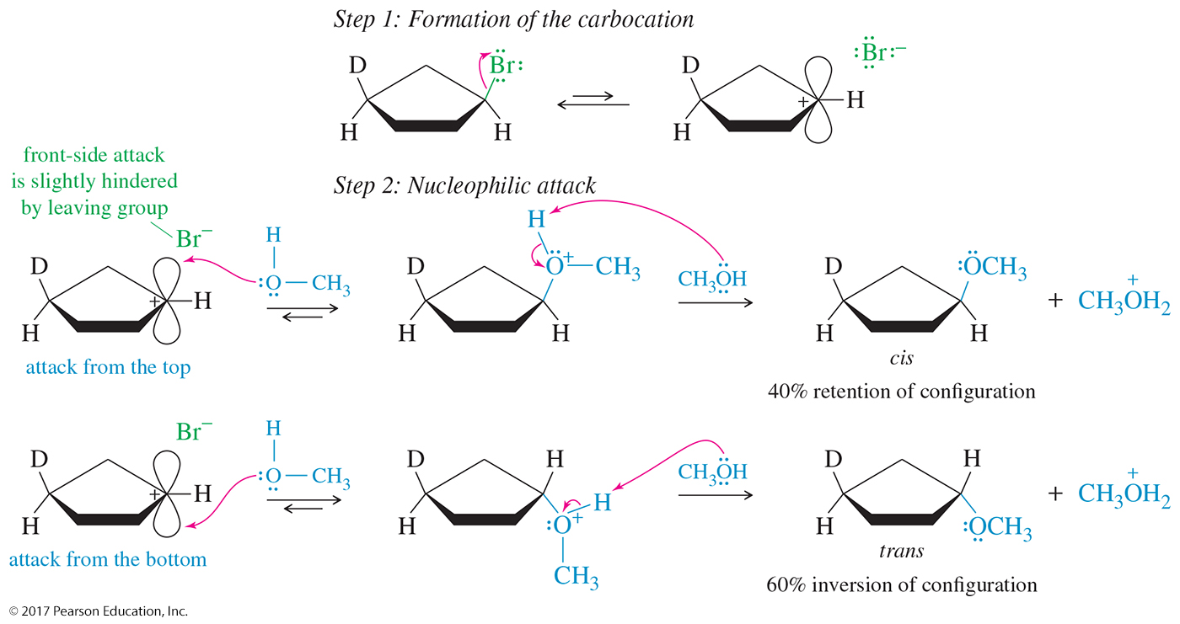
Stereochemistry of S_{N}1
The S_{N}1 reaction produces mixtures of enantiomers. There is usually more inversion than retention of configuration.

Slide 52
Rearrangements
Carbocations can rearrange to form a more stable carbocation.
Move the smallest group on the adjacent carbon:
Hydride shift: H– on adjacent carbon moves.
Methyl shift: CH₃– on adjacent carbon moves.

Slide 53
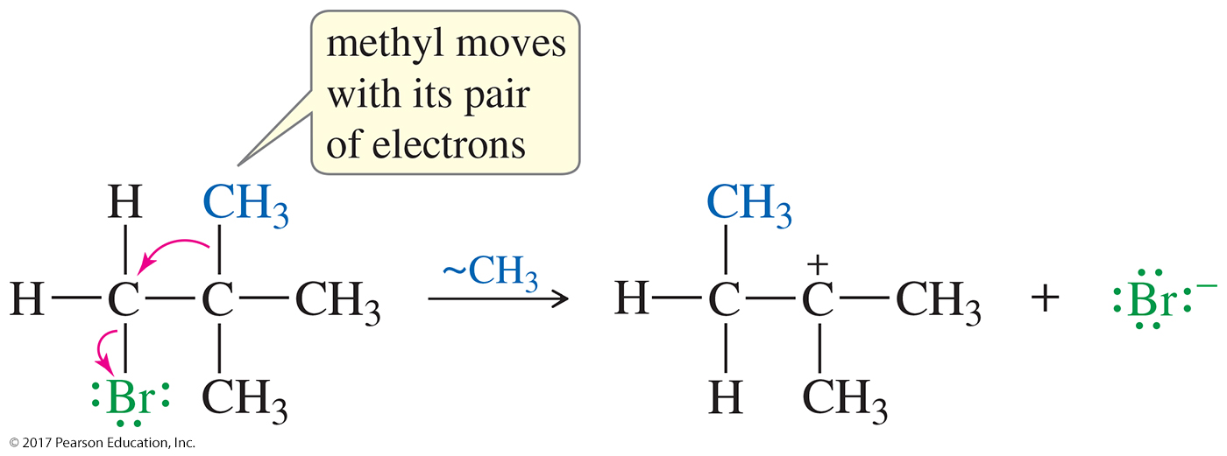
Hydride and Methyl Shifts
Since a primary carbocation cannot form, the methyl group on the adjacent carbon will move (along with both bonding electrons) to the primary carbon, displacing the bromide and forming a tertiary carbocation.
The smallest groups on the adjacent carbon will move: If there is a hydrogen, it will give a hydride shift.

Slide 54
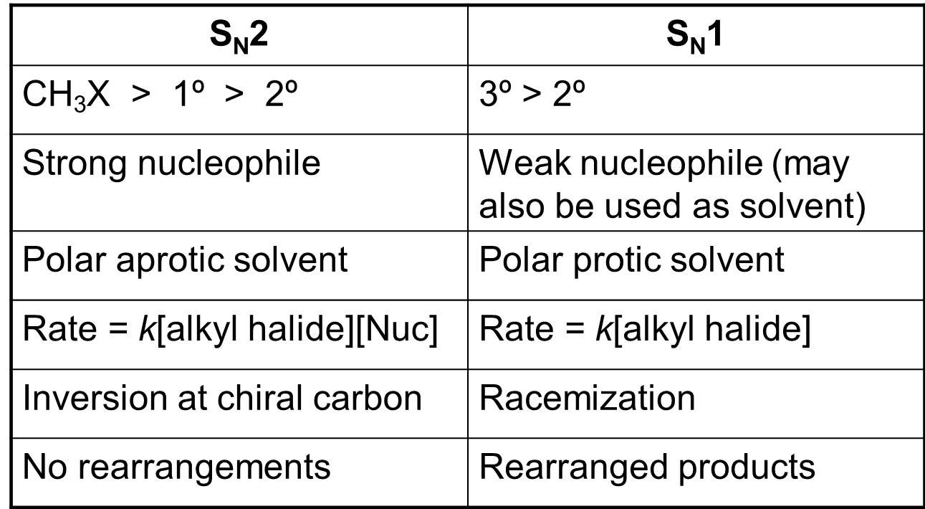
S_{N}1 or S_{N}2 Mechanism?

Slide 55
