Slide 1
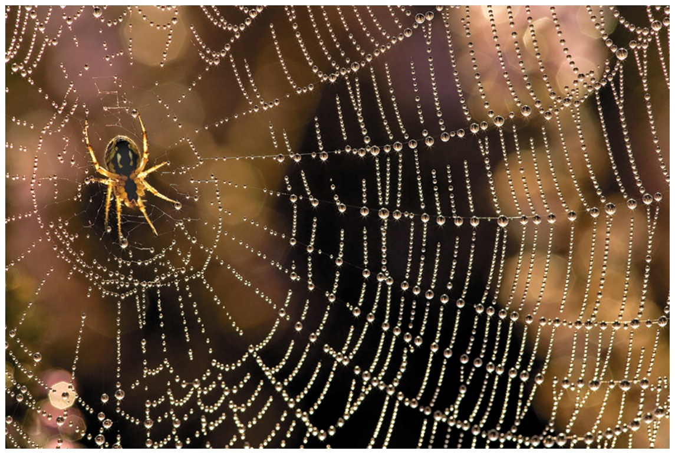
Chapter 24 Lecture
Organic Chemistry, 9th Edition L. G. Wade, Jr.
Amino Acids, Peptides, and Proteins
Chad Snyder, PhD
Grace College
© 2017 Pearson Education, Inc.

Slide 2
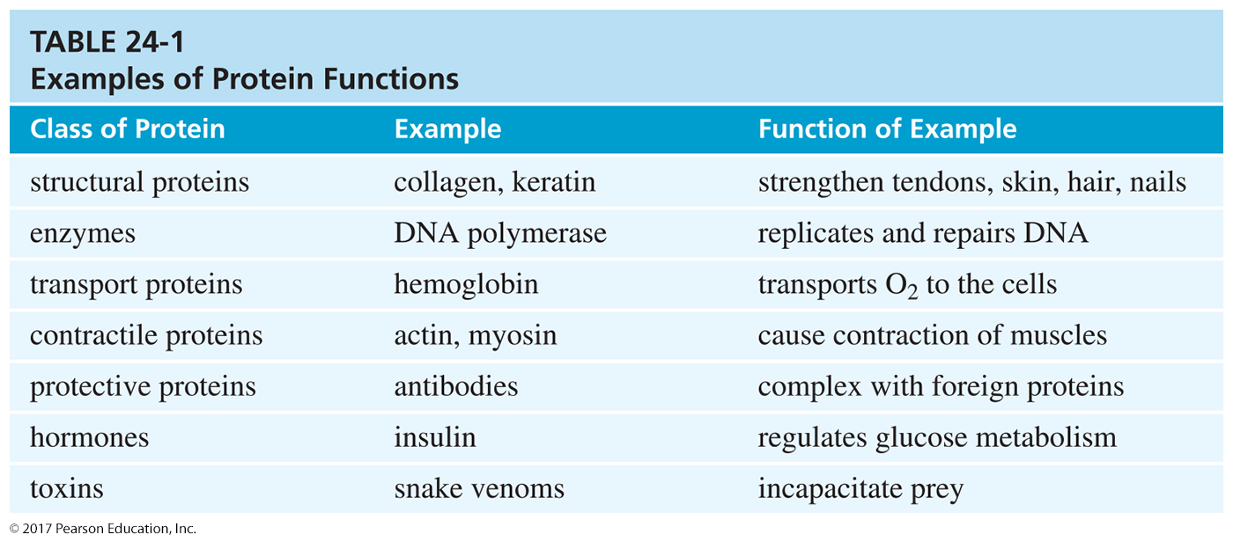
Proteins
Biopolymers of amino acids
Amino acids are joined by peptide bond.
They serve a variety of functions:
Structure
Enzymes
Transport
Protection
Hormones

Slide 3
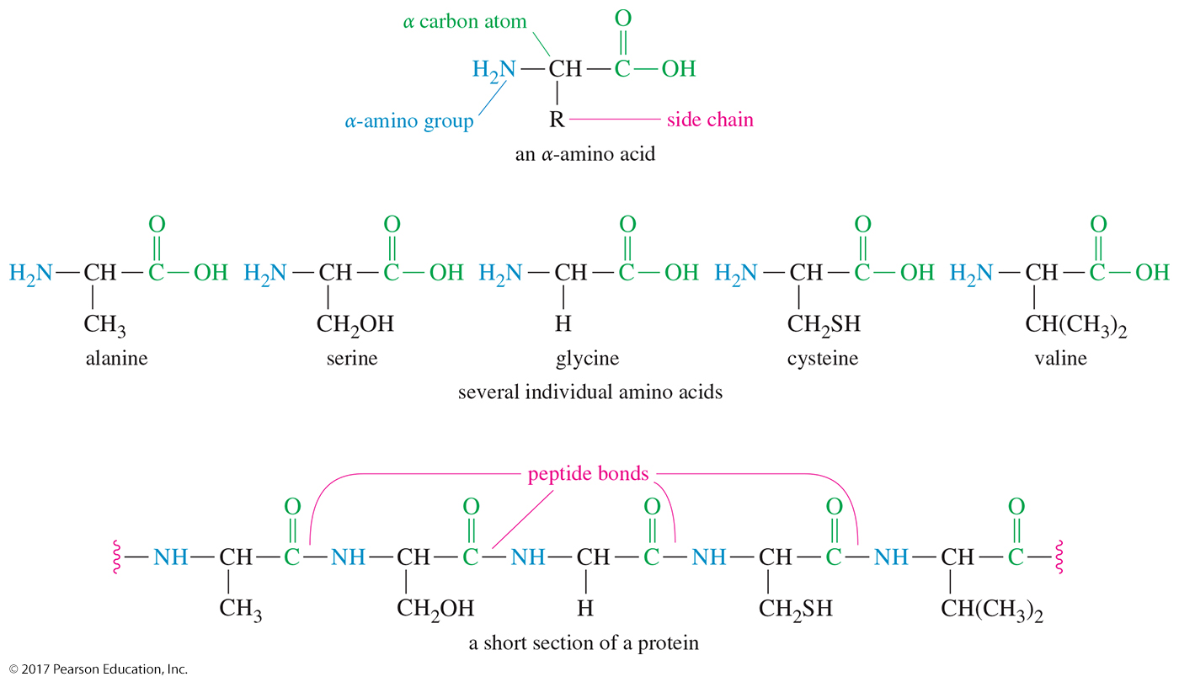
Structure of Proteins

Slide 4
Amino Acids
—NH₂ on the carbon next to —COOH
Glycine, NH₂—CH₂—COOH, is simplest amino acid.
Amino acids with a side chain (—R) are chiral. Almost all the naturally occurring amino acids have the (S) configuration.
They are called L-amino acids because they resemble L-(–)-glyceraldehyde.
Direction of optical rotation, (+) or (–), must be determined experimentally.

Slide 5
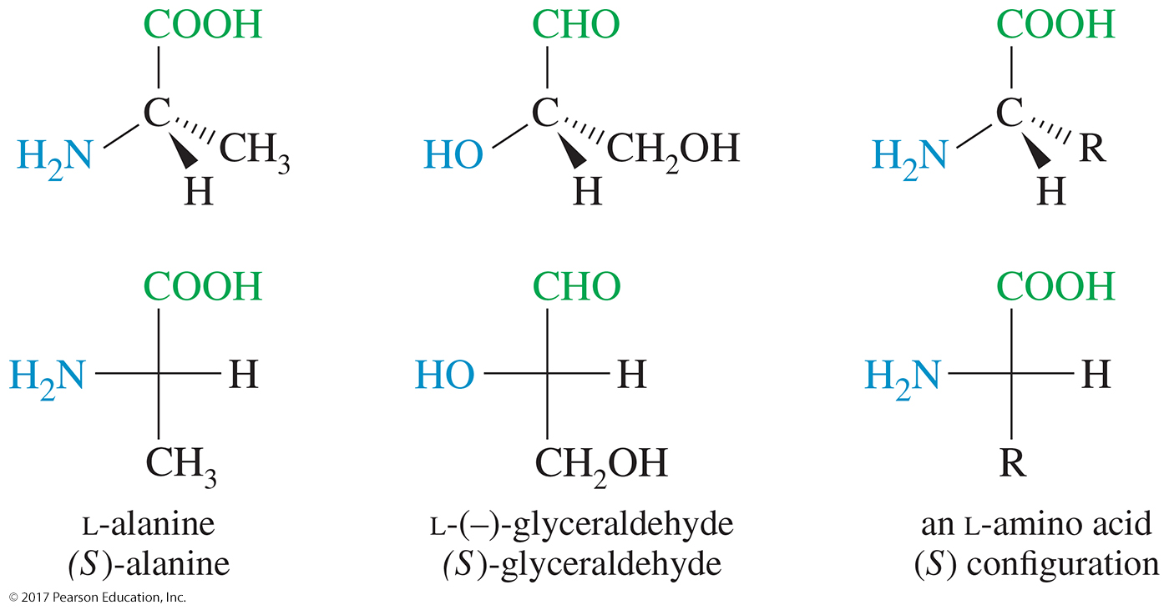
Stereochemistry of α-Amino Acids

Slide 6
Standard Amino Acids
Twenty standard alpha-amino acids
Differ in side-chain characteristics:
—H or alkyl
Contains an —OH
Contains sulfur
Contains a nonbasic nitrogen
Has —COOH
Has a basic nitrogen

Slide 7
Essential Amino Acids
Arginine (Arg)
Threonine (Thr)
Lysine (Lys)
Valine (Val)
Phenylalanine (Phe)
Tryptophan (Trp)
Methionine (Met)
Histidine (His)
Leucine (Leu)
Isoleucine (Ile)

Slide 8
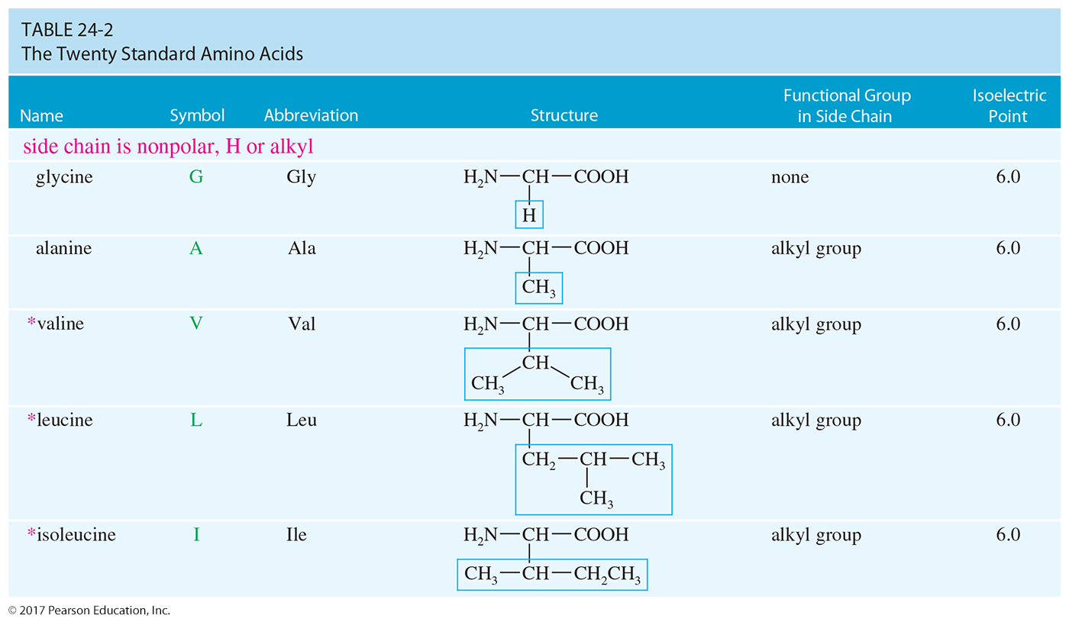
Notes:
Figure: 24_02-02T021.jpg
Title:
Standard Amino Acids
Caption:
There are 20 alpha-amino acids, called the standard amino acids, that are found in nearly all proteins.
Notes:
The standard amino acids differ from each other in the structure of the side chains bonded to their α carbon atoms.

Slide 9
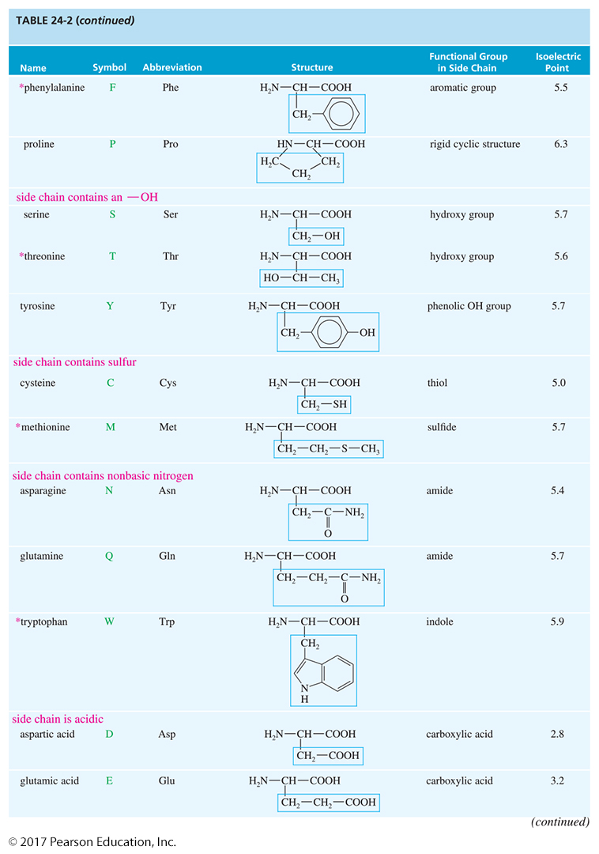

Slide 10
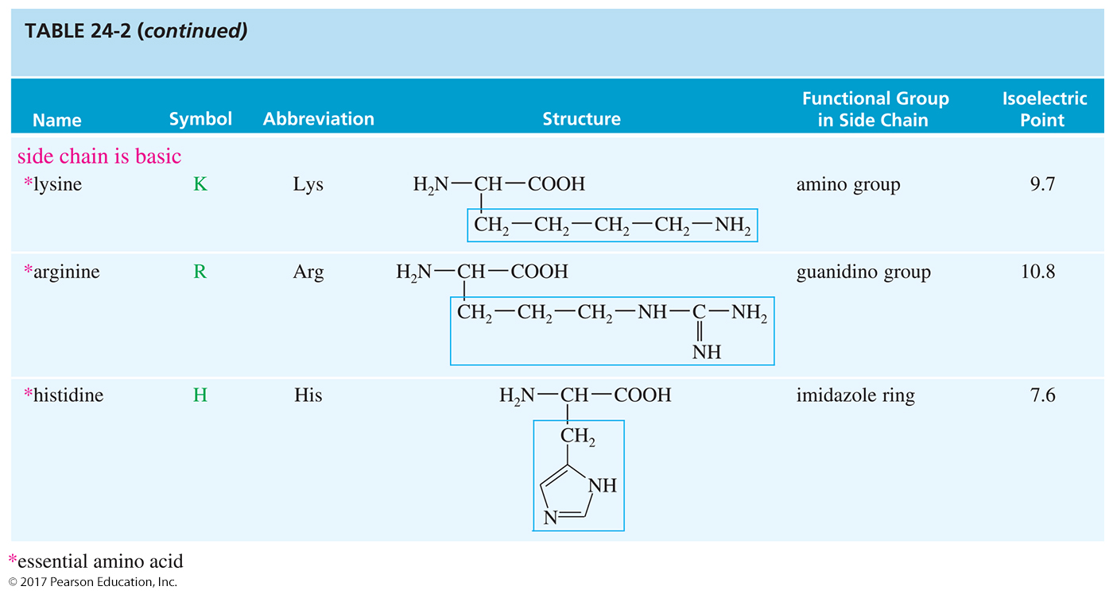

Slide 11
Complete Proteins
Provide all the essential amino acids
Examples: Those found in meat, fish, milk, and eggs
Proteins that are severely deficient in one or more of the essential amino acids are called incomplete proteins. Plant proteins are generally incomplete.
Vegetarians should eat many different kinds of plants or supplement their diets with milk and/or eggs.

Slide 12
Rare Amino Acids
4-Hydroxyproline and 5-hydroxylysine are found in collagen.
D-Glutamic acid is found in cell walls of bacteria.
D-Serine is found in earthworms.
γ-Aminobutyric acid is a neurotransmitter.
β-Alanine is a constituent of the vitamin pantothenic acid.

Slide 13
Properties of Amino Acids
High melting points
More soluble in water than in ether
Larger dipole moments than simple acids or simple amines
Less acidic than most carboxylic acids; less basic than most amines

Slide 14
Zwitterion Formation
Amino acid exists as a dipolar ion.
—COOH loses H⁺; —NH₂ gains H⁺.
Actual structure depends on pH.

Slide 15
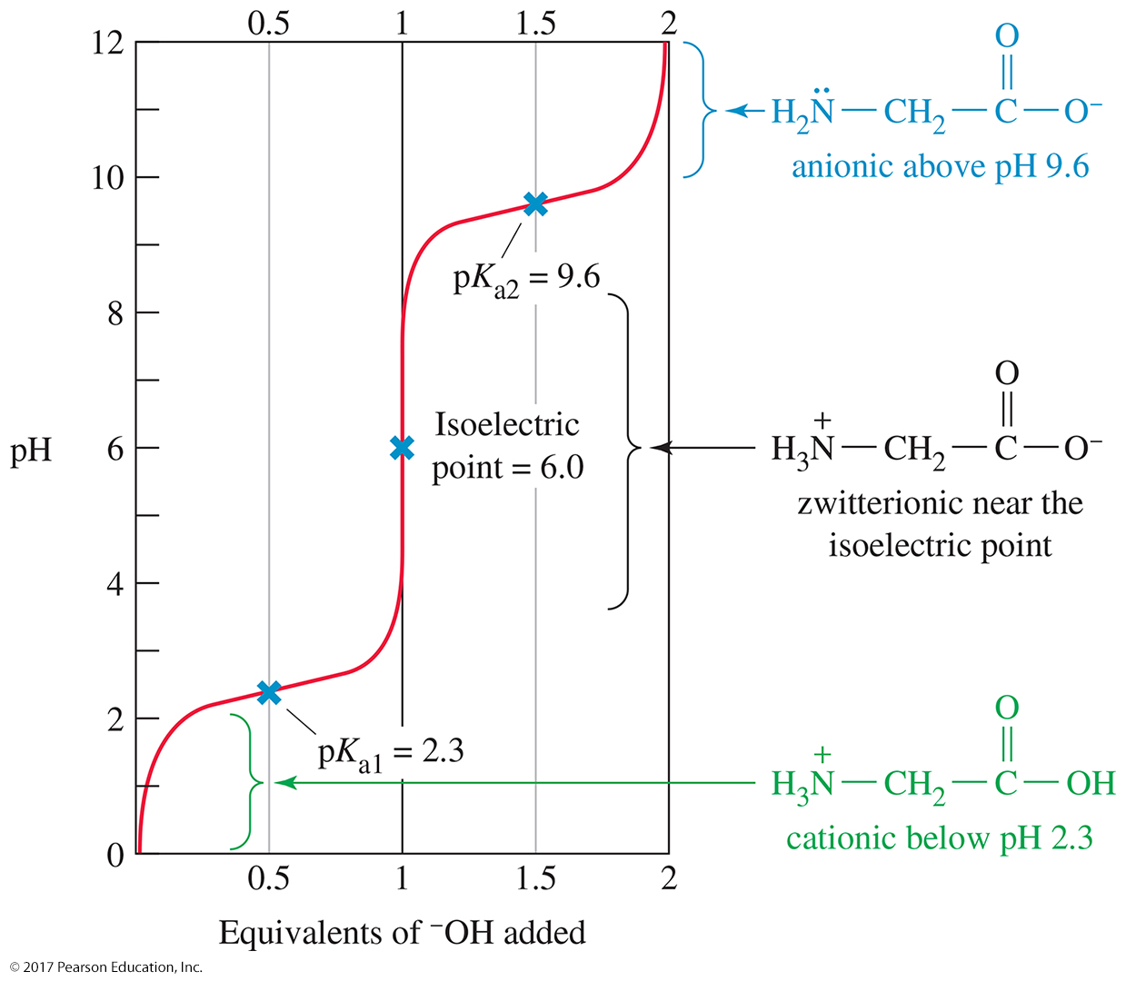
Structure and pH

Slide 16
Isoelectric Point of Amino Acids
Isoelectric point (pI) is defined as the pH at which amino acids exist as the zwitterion (neutral charge).
The pI depends on structure of the side chain of the amino acid.

Slide 17
Isoelectric Points
Acidic amino acids: Isoelectric pH ~3.
Basic amino acids: Isoelectric pH ~9.
Neutral amino acids: Isoelectric pH is slightly acidic, 5–6.

Slide 18
Electrophoresis Separation
Electrophoresis uses differences in isoelectric points to separate mixtures of amino acids.
Positively charged (cationic) amino acids are attracted to the negative electrode (the cathode).
Negatively charged (anionic) amino acids are attracted to the positive electrode (the anode).
An amino acid at its isoelectric point has no net charge, so it does not move.

Slide 19
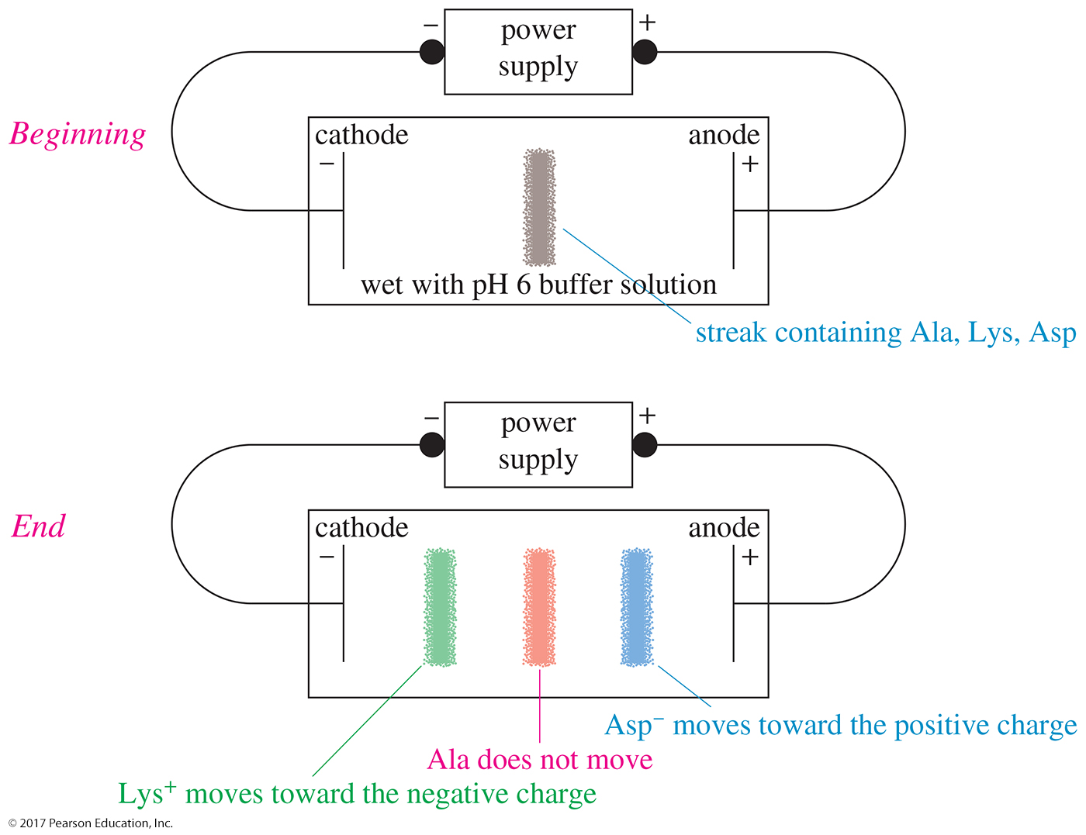
Electrophoresis

Slide 20
Reductive Amination
This method for synthesizing amino acids is biomimetic: it mimics the biological process.
Reaction of an α-ketoacid with ammonia, followed by reduction of the imine with H₂/Pd
A racemic mixture is obtained.

Slide 21
Biosynthesis of Amino Acids
The biosynthesis begins with reductive amination of α-ketoglutaric acid using the ammonium ion as the aminating agent and NADH as the reducing agent.
The product of this enzyme-catalyzed reaction is the pure L-enantiomer of glutamic acid.

Slide 22
Transamination
Biosynthesis of other amino acids uses L-glutamic acid as the source of the amino group.
Such a reaction, moving an amino group from one molecule to another, is called a transamination, and the enzymes that catalyze these reactions are called transaminases.

Slide 23
Amination of α-Halo Acids
Hell–Volhard–Zelinsky reaction places a bromine on the α carbon of a carboxylic acid.
Bromine is then replaced by reaction with excess ammonia.
A racemic mixture is obtained.

Slide 24
Strecker Synthesis
First known synthesis of amino acid occurred in 1850.
Aldehyde reaction with NH₃ yields imine.
Cyanide ion attacks the protonated imine.
The resulting α-amino nitrile is hydrolyzed to a carboxylic acid.

Slide 25
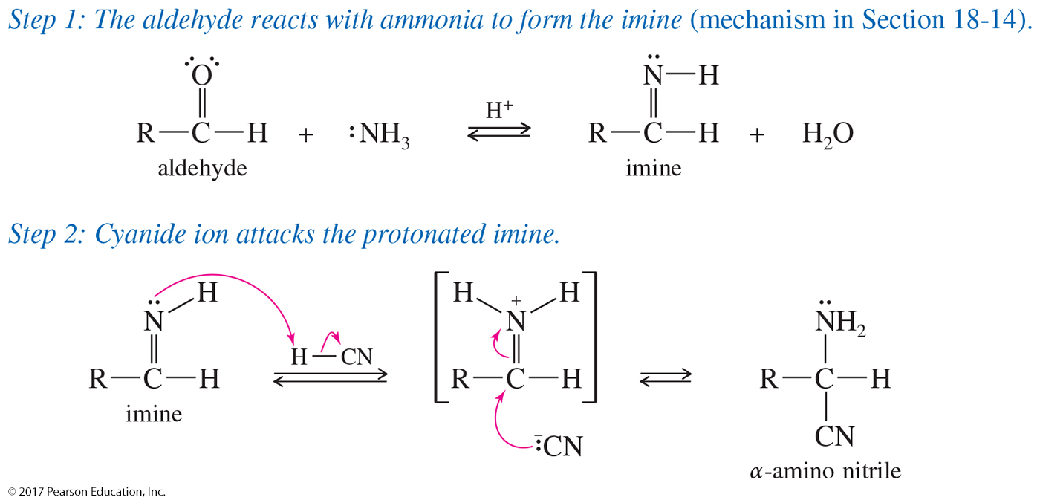
Strecker Mechanism

Slide 26
Solved Problem 1
Show how you would use a Strecker synthesis to make isoleucine.
Solution
Isoleucine has a sec-butyl group for its side chain. Remember that CH₃–CHO undergoes Strecker synthesis to give alanine, with CH₃ as the side chain. Therefore, sec-butyl–CHO should give isoleucine.
Notes:
Copyright © 2006 Pearson Prentice Hall, Inc.

Slide 27
Resolution of Amino Acids
Usually, only the L-enantiomer is biologically active.
Convert the amino acid to a salt, using a chiral acid or base. The result is a mixture of diastereomeric salts that can be separated by chromatography.
Use an enzyme, such as acylase, that will react with only one enantiomer.

Slide 28
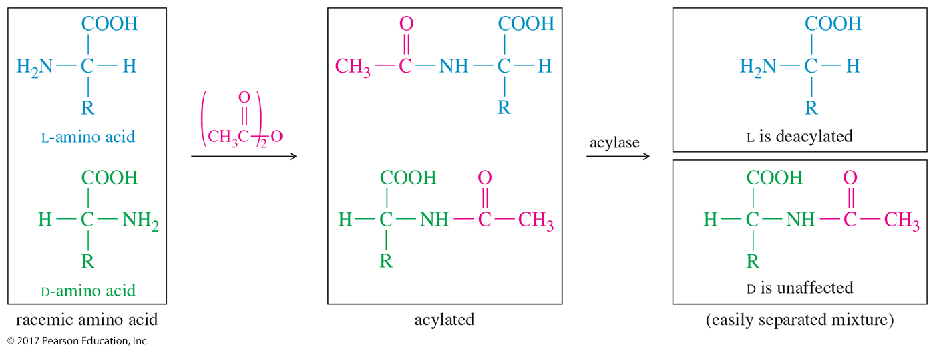
Selective Enzymatic Deacylation

Slide 29
Esterification of the Carboxyl Group
Use a large excess of alcohol and an acidic catalyst.
Esters are often used as protective derivatives.
Aqueous hydrolysis regenerates the acid.

Slide 30
Acylation of the Amino Group
The amino group is converted to an amide.
Acid chlorides and anhydrides are the acylating agents.
Benzyl chloroformate, PhCH₂OCOCl, is commonly used because it is easily removed.

Slide 31
Reaction with Ninhydrin
Used to visualize spots or bands of amino acids separated by chromatography or electrophoresis
Deep purple color formed with traces of any amino acid

Slide 32
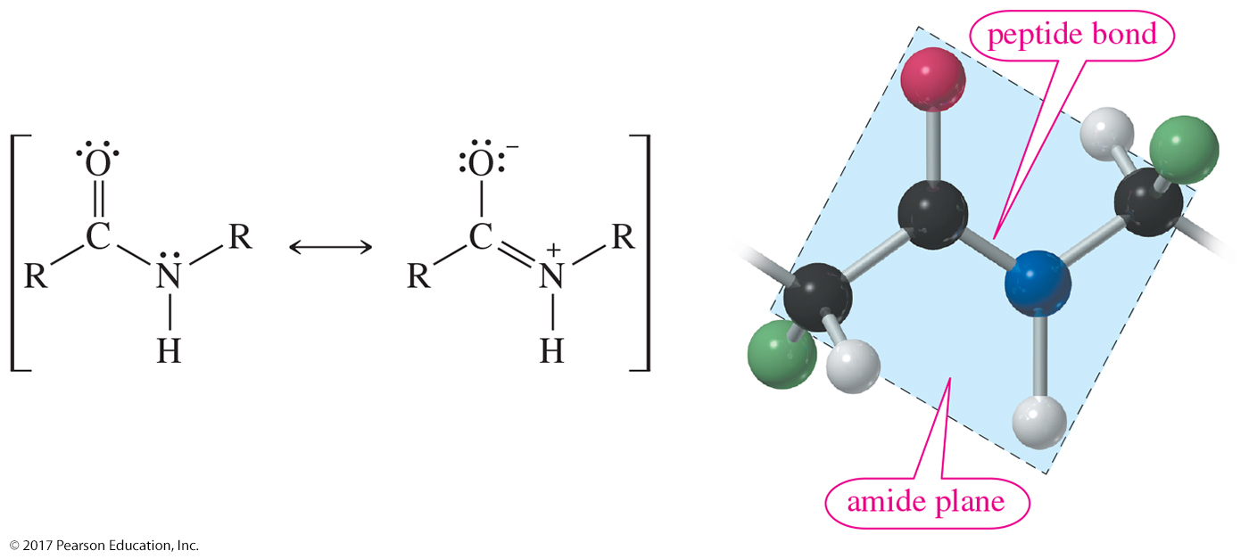
Resonance Stabilization
The peptide bond is an amide bond.
Amides are very stable and neutral.

Slide 33
Peptide Bond Formation
The amino group of one molecule condenses with the acid group of another.
Polypeptides usually have molecular weight less than 5000.
Protein molecular weight is 6000–40,000,000.

Slide 34
Human Hormone Bradykinin
An oligopeptide is made out of four to ten amino acids.
Peptide structures are drawn with the N-terminal end at the left.
Peptides are named from left to right: arginylprolylprolyl…arginine.

Slide 35
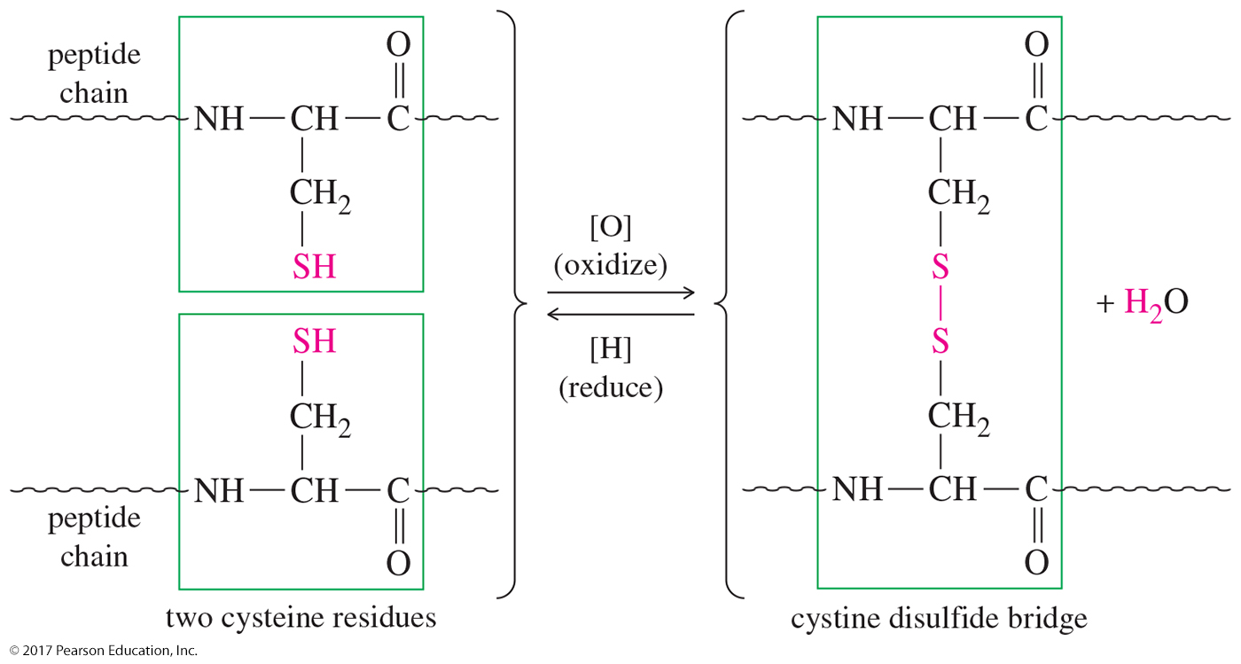
Disulfide Linkages
Cysteine can form disulfide bridges.

Slide 36
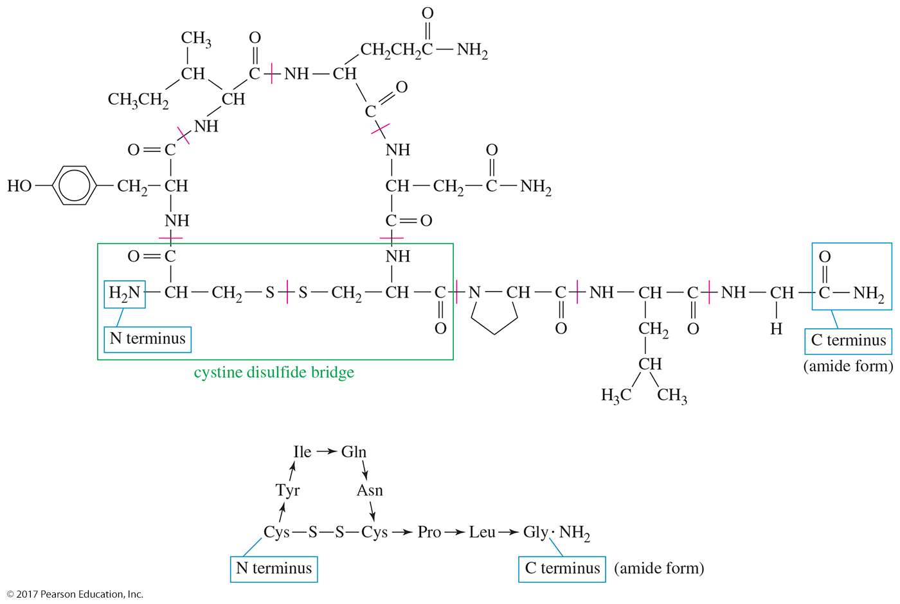
Human Oxytocin
Oxytocin is a nonapeptide with two cysteine residues (at positions 1 and 6) linking part of the molecule in a large ring.

Slide 37
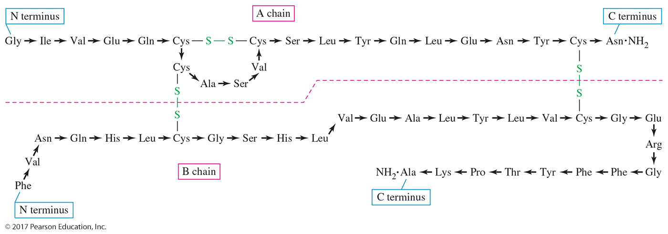
Bovine Insulin
Insulin is composed of two separate peptide chains, the A chain, containing 21 amino acid residues, and the B chain, containing 30.

Slide 38
Peptide Structure Determination
Cleavage of disulfide linkages
Determination of amino acid composition
Sequencing from the N terminus
C-terminal residue analysis
Partial hydrolysis

Slide 39
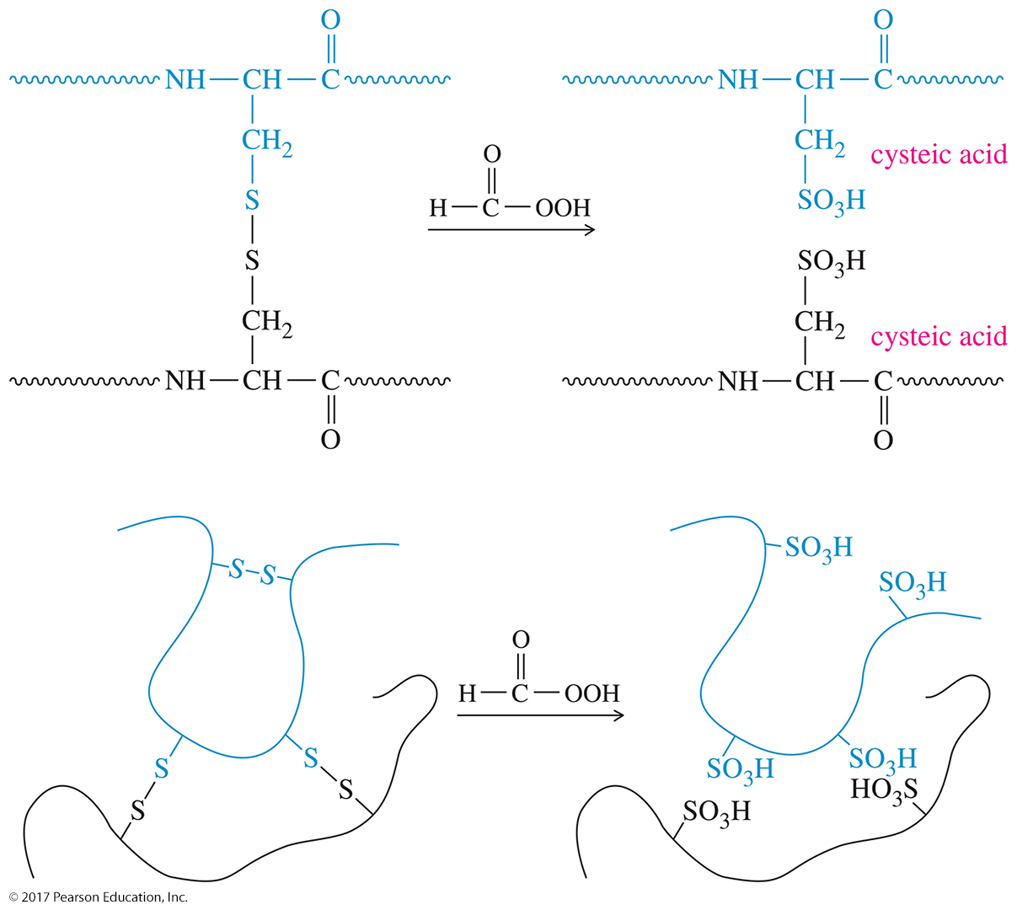
Disulfide Cleavage

Slide 40
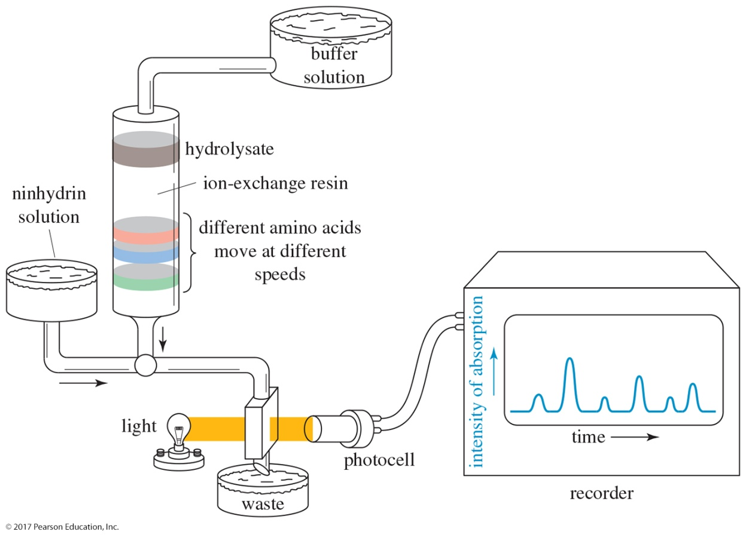
Amino Acid Composition
Separate the individual peptide chains.
Boil with 6 M HCl for 24 hours.
Separate in an amino acid analyzer.

Slide 41
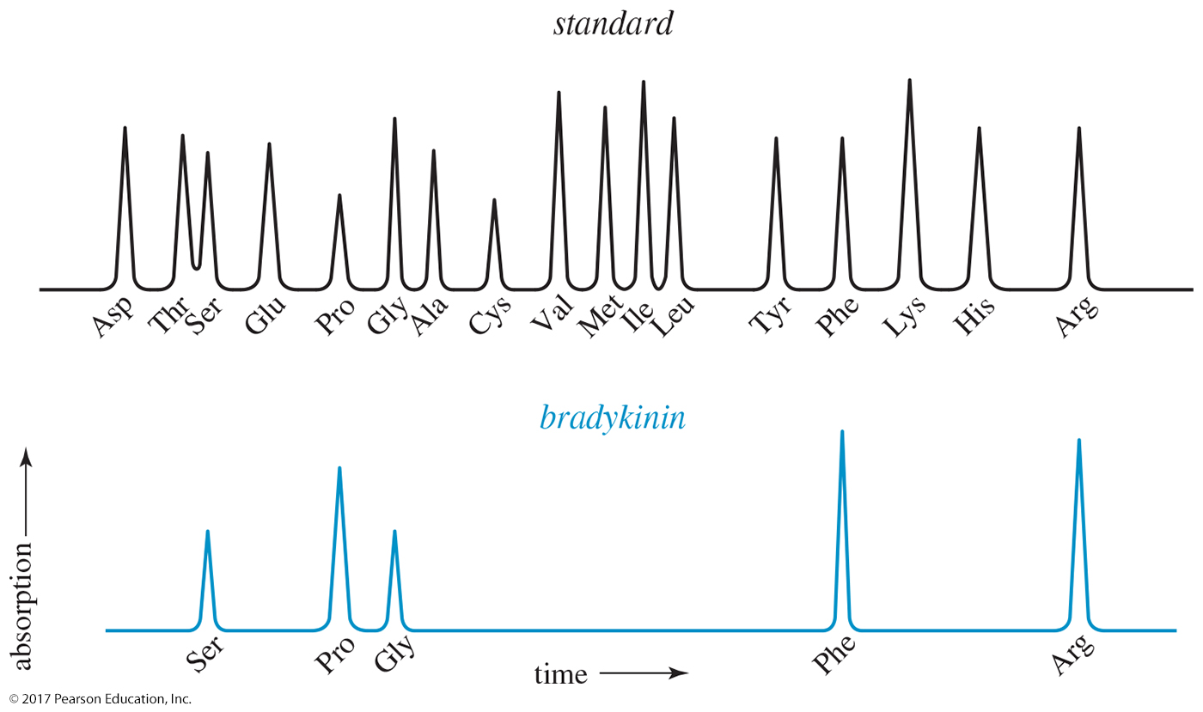
Composition of Human Bradykinin
Use of an amino acid analyzer to determine the composition of human bradykinin

Slide 42
Sequencing from the N Terminus: The Edman Degradation
Edman degradation: The reaction with phenyl isothiocyanate followed by hydrolysis removes the N terminus amino acid.
The phenylthiohydantoin derivative is identified by chromatography.
Use for peptides with < 30 amino acids.

Slide 43
Edman Degradation

Slide 44
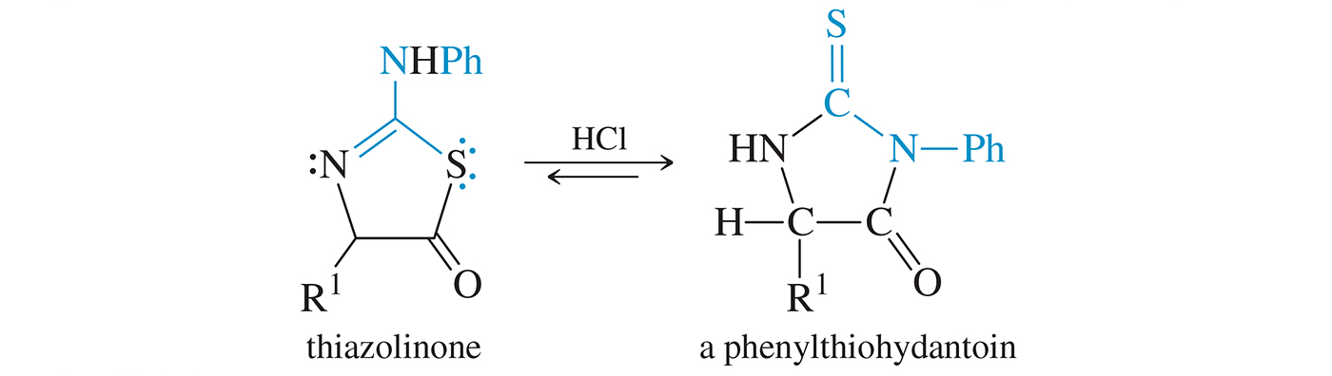
Last Step of the Edman Degradation
In the final step (step 3) the thiazoline isomerizes to the more stable phenylthiohydantoin.

Slide 45
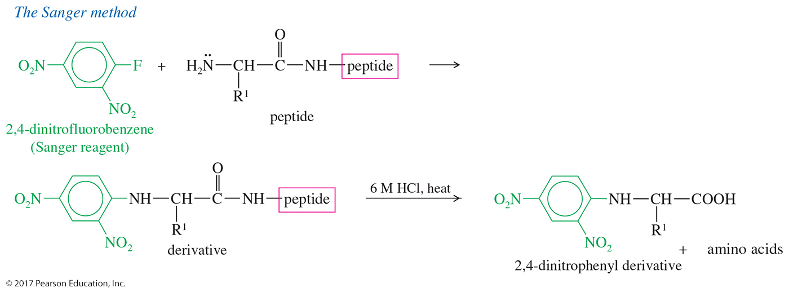
The Sanger Method
The Sanger method for N terminus determination is a less common alternative to the Edman degradation.

Slide 46
Sequencing from the C Terminus
The enzyme carboxypeptidase cleaves the C-terminal peptide bond.
However, since different amino acids react at different rates, it’s difficult to determine more than the original C-terminal amino acid.

Slide 47
C-Terminal Residue Analysis
The C-terminal amino acid can be identified using the enzyme carboxypeptidase, which cleaves the C-terminal peptide bond.
Eventually, the entire peptide is hydrolyzed to its individual amino acids.

Slide 48
Partial Hydrolysis
Break the peptide chain into smaller fragments.
Trypsin cleaves at the carboxyl group of lysine and arginine.
Chymotrypsin cleaves at the carboxyl group of phenylalanine, tyrosine, and tryptophan.
Sequence each fragment, then fit them together like a jigsaw puzzle.

Slide 49
Solution Phase Peptide Synthesis
First, protect the amino group at the N terminus with benzyl chloroformate.
Activate the carboxyl group with ethyl chloroformate to form anhydride of carbonic acid.
Couple the next amino acid.
Repeat activation and coupling until all amino acids needed have been added.
Remove the protecting group.

Slide 50
Solution Phase Peptide Synthesis: Protect, react, then Deprotect

Slide 51
Solid Phase Synthesis
Attaching the growing peptide chains to solid polystyrene beads
Intermediates do not have to be purified.
Excess reagents are washed away with a solvent rinse.
The process can be automated.
Larger peptides can be constructed.

Slide 52
Attaching the Peptide to the Solid Support

Slide 53
Attachment of the C-Terminal Amino Acid
Once the C-terminal amino acid is fixed to the polymer, the chain is built on the amino group of this amino acid.

Slide 54
Protection of the Amino Group as Its Fmoc Derivative

Slide 55
Removal of the Boc Protecting Group
The Fmoc group is easily cleaved by brief treatment with mildly basic conditions.

Slide 56
N,N’-Dicyclohexylcarbodiimide (DCC) Coupling
When a mixture of an amine and an acid is treated with DCC, the amine and the acid couple to form an amide.

Slide 57
DCC-Activated Acyl Derivative
The carboxylate ion adds to the strongly electrophilic carbon of the diimide, giving an activated acyl derivative of the acid.

Slide 58
Coupling with the Amine

Slide 59
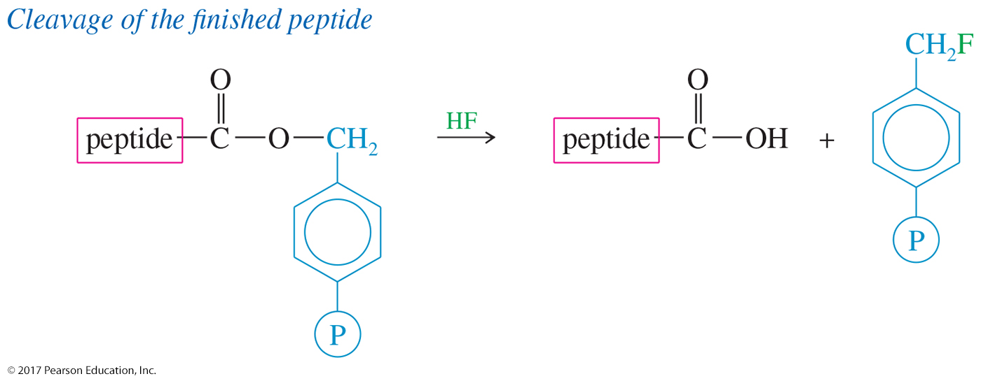
Cleavage of the Finished Peptide
At the completion of the synthesis, the ester bonded to the polymer is cleaved by anhydrous HF.
Because this is an ester bond, it is more easily cleaved than the amide bonds of the peptide.

Slide 60
Classification of Proteins
Simple: Hydrolyzed to amino acids only
Conjugated: Bonded to a nonprotein group, such as sugar, nucleic acid, or lipid
Fibrous: Long, stringy filaments, insoluble in water; function as structure
Globular: Folded into spherical shape; function as enzymes, hormones, or transport proteins

Slide 61
Levels of Protein Structure
Primary: The sequence of the amino acids in the chain and the disulfide links
Secondary: Structure formed by hydrogen bonding. Examples are α helix and pleated sheet.
Tertiary: Complete 3-D conformation
Quaternary: Association of two or more peptide chains to form protein

Slide 62
Secondary Structure: Alpha Helix
Each carbonyl oxygen can hydrogen bond with an N—H hydrogen on the next turn of the coil.

Slide 63
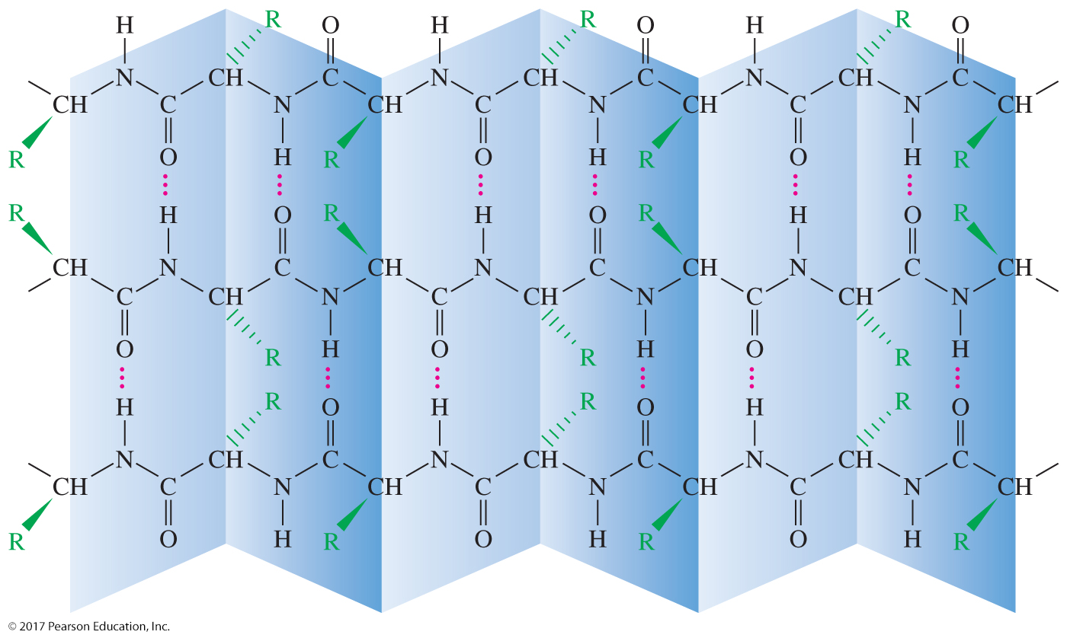
Secondary Structure: Pleated Sheet Arrangement
Each carbonyl oxygen hydrogen bonds with a N—H on an adjacent peptide chain.

Slide 64
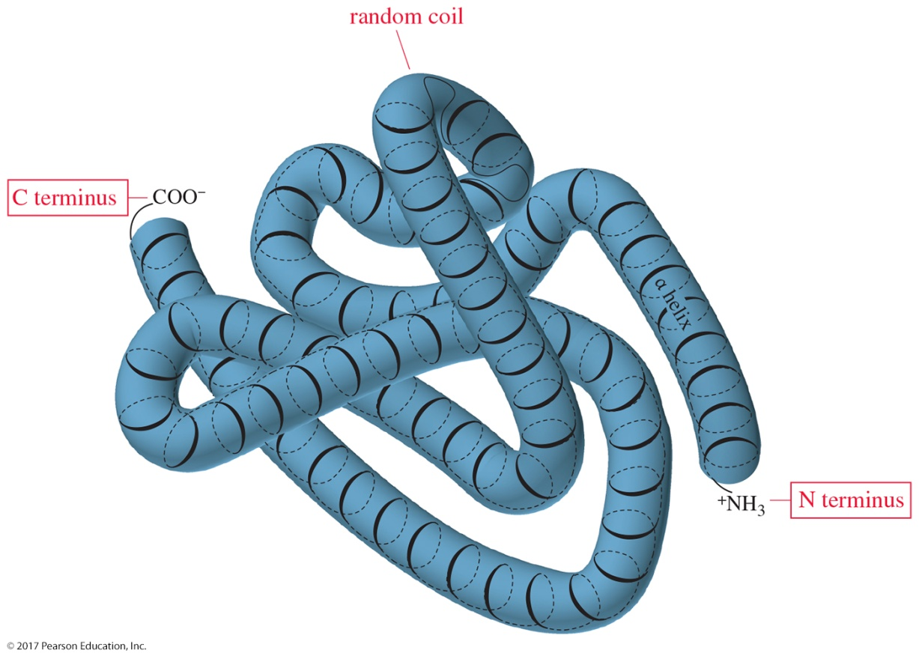
Tertiary Structure of Globular Proteins
The tertiary structure of a typical globular protein includes segments of α helix with segments of random coil at the points where the helix is folded.

Slide 65
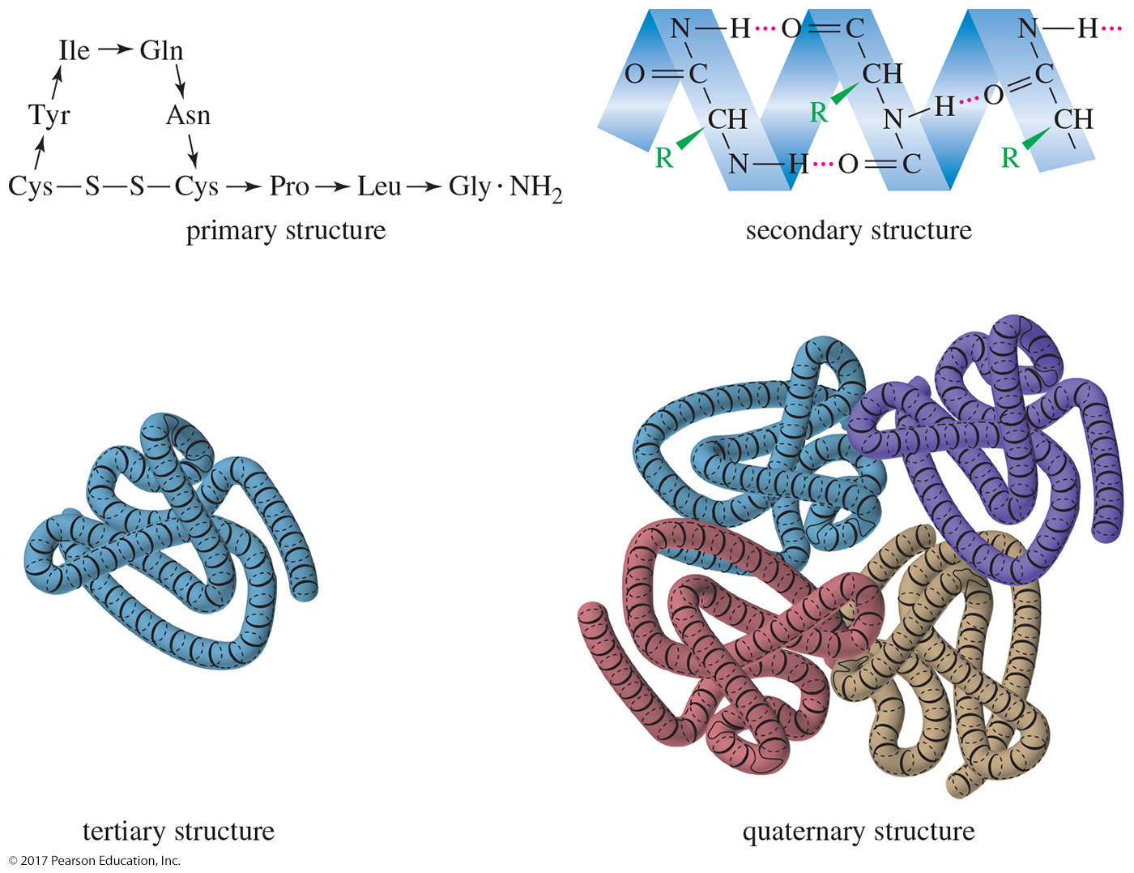
Summary of Structures

Slide 66
Denaturation
Denaturation is defined as the disruption of the normal structure of a protein, such that it loses biological activity.
Usually caused by heat or changes in pH
Usually irreversible.
A cooked egg cannot be “uncooked.”

Slide 67
Prion Diseases
Neurologist Stanley B. Prusiner studied scrapie-infected sheep brains and suggested that it was caused by a protein infectious agent that he called prion protein.
It is believed that prion diseases are caused by misfolded proteins, denatured versions of the normal protein.
They induce normal proteins to misfold.

Slide 68
New-Variant Creutzfeldt–Jakob Disease (vCJD)
Normal
Infected with vCJD

