Slide 1
Biologically Active Amines
The alkaloids are an important group of biologically active amines, mostly synthesized by plants to protect them from being eaten by insects and other animals.
Many drugs of addiction are classified as alkaloids.

Slide 2
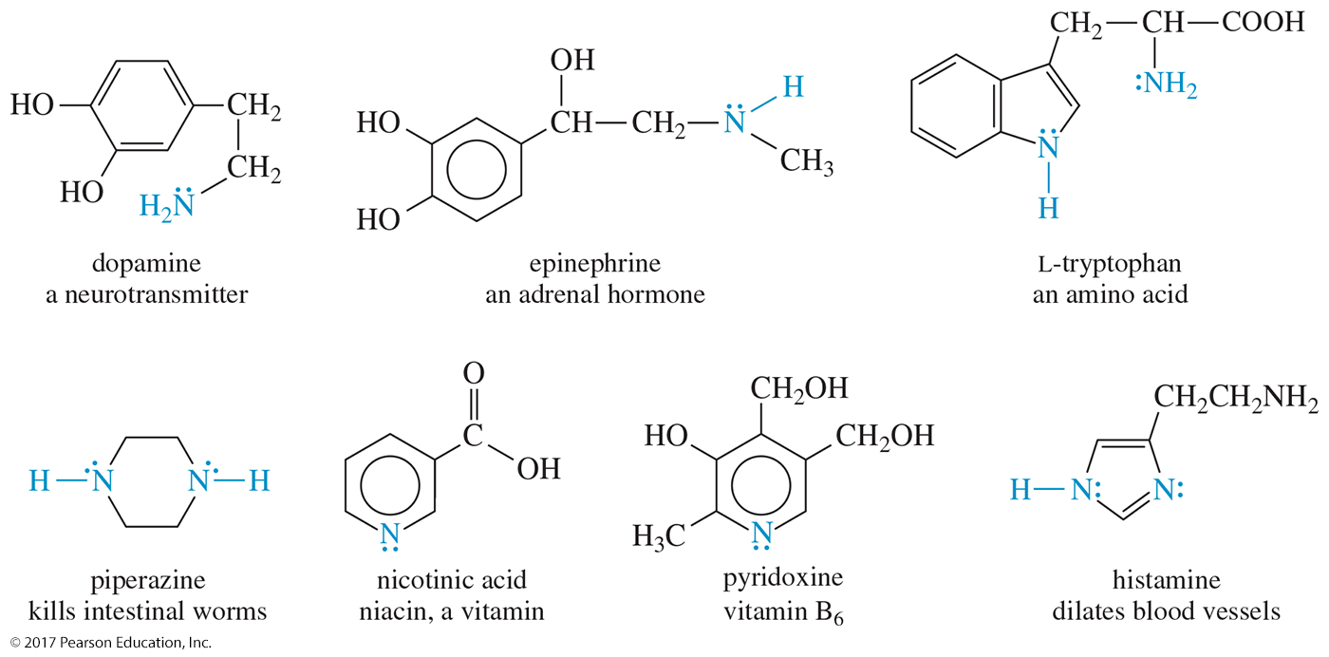
Biological Activity of Amines

Slide 3
Classes of Amines
Primary (1°): Has one alkyl group bonded to the nitrogen (RNH₂)
Secondary (2°): Has two alkyl groups bonded to the nitrogen (R₂NH)
Tertiary (3°): Has three alkyl groups bonded to the nitrogen (R₃N)
Quaternary (4°): Has four alkyl groups bonded to the nitrogen and the nitrogen bears a positive charge (R₄N⁺)

Slide 4
Classification of Amines

Slide 5
Quaternary Ammonium Salts
The nitrogen atom has four alkyl groups attached.
The nitrogen is positively charged.

Slide 6
Common Names
Common names of amines are formed from the names of the alkyl groups bonded to nitrogen, followed by the suffix -amine.

Slide 7
Amine As Substituent
On a molecule with a higher-priority functional group, the amine is named as a substituent.

Slide 8
IUPAC Names
Name is based on longest carbon chain.
The -e of alkane is replaced with -amine.

Slide 9
Aromatic Amines
In aromatic amines, the amino group is bonded to a benzene ring.
The parent compound is called aniline.

Slide 10
Heterocyclic Amines
When naming a cyclic amine, the nitrogen is assigned position number 1.

Slide 11
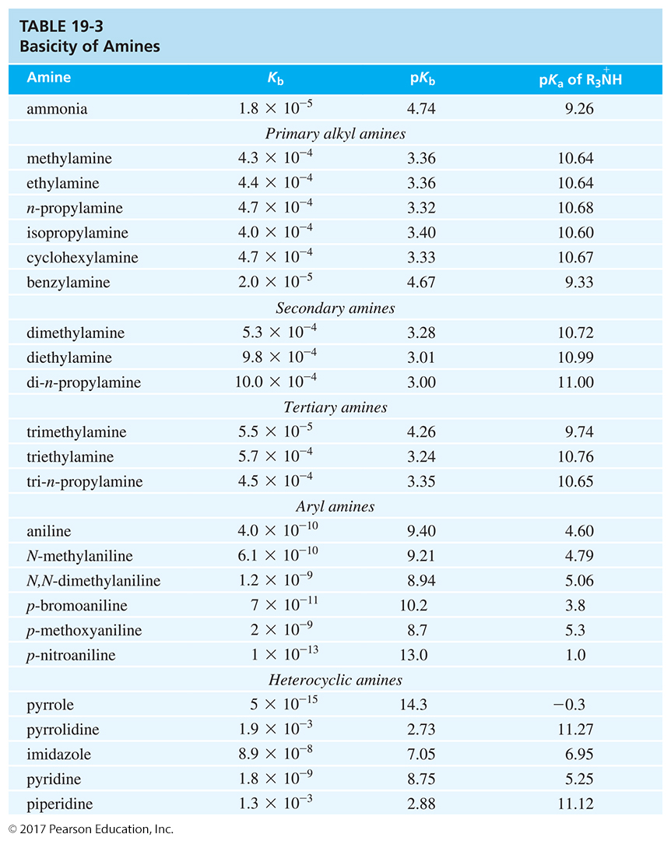
Amine Basicity

Slide 12
Hybridization Effects
Pyridine is less basic than aliphatic amines, but it is more basic than pyrrole because it does not lose its aromaticity on protonation.

Slide 13
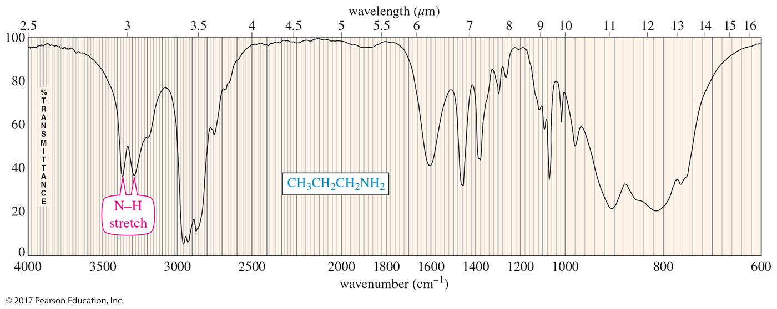
IR Spectroscopy
N—H stretch between 3200 and 3500 cm^{–1}
Two peaks for 1° amine, one for 2°

Slide 14
Arenediazonium Salts
By forming and diazotizing an amine, an activated aromatic position can be converted into a wide variety of functional groups.

Slide 15
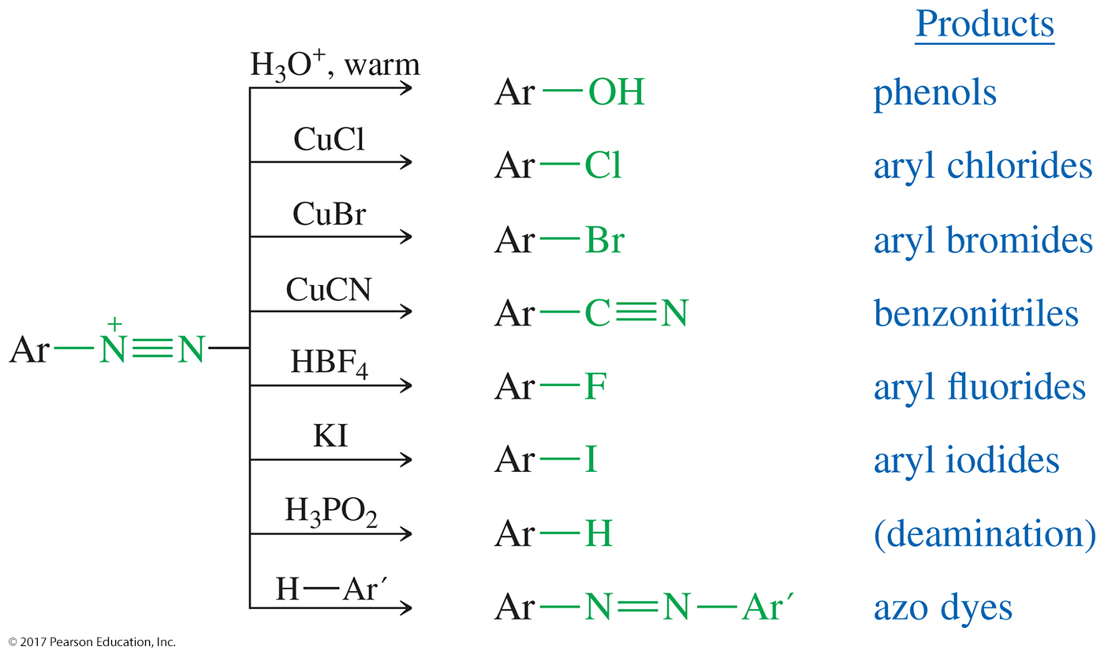
Reactions of Arenediazonium Salts

Slide 16
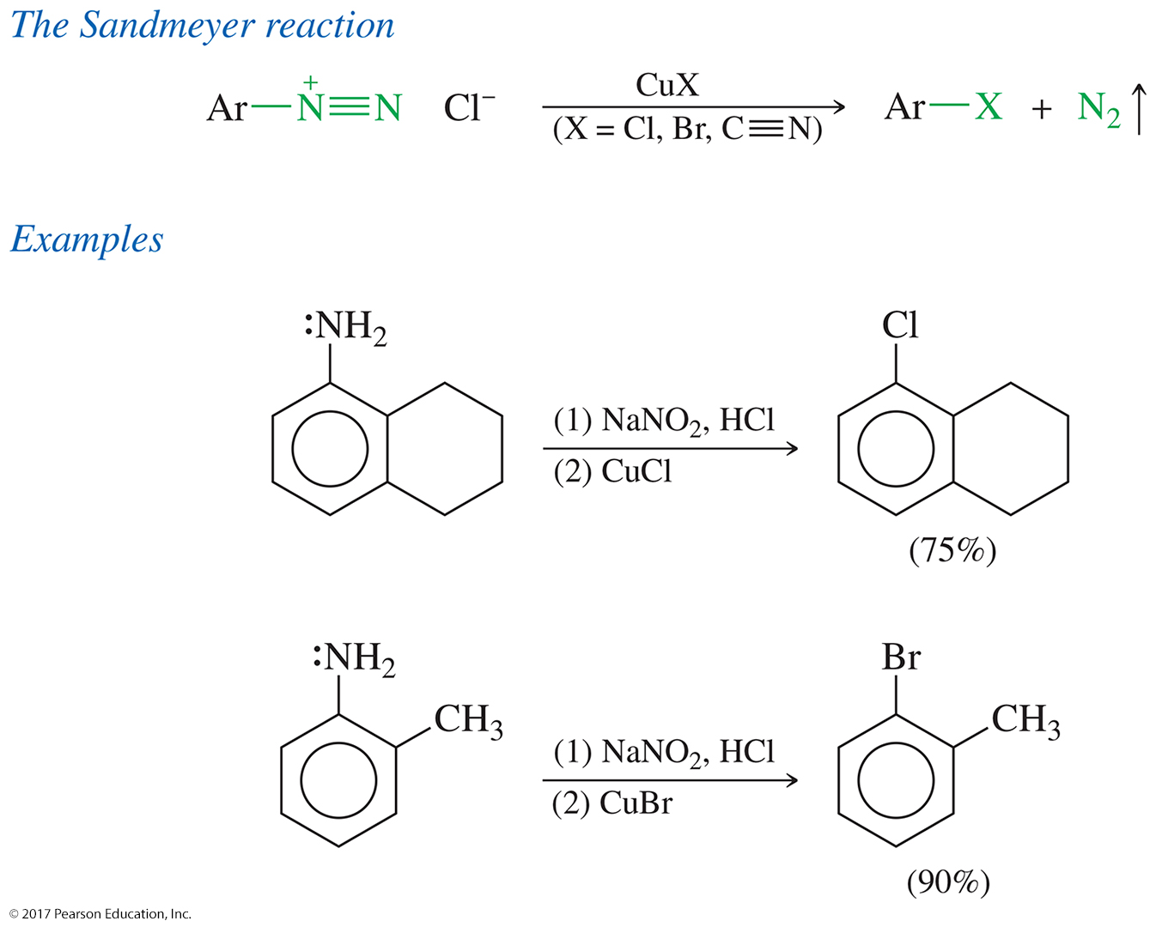
The Sandmeyer Reaction

