Slide 1
Mechanism of Electrophilic Aromatic Substitution
Step 1: Attack on the electrophile forms the sigma complex.
Step 2: Loss of a proton gives the substitution product.

Slide 2
Nitration of Benzene
Sulfuric acid acts as a catalyst, allowing the reaction to be faster and at lower temperatures.
HNO₃ and H₂SO₄ react together to form the electrophile of the reaction: nitronium ion (NO₂⁺).

Slide 3
Reduction of the Nitro Group
Treatment with zinc, tin, or iron in dilute acid will reduce the nitro to an amino group.
This is the best method for adding an amino group to the ring.

Slide 4
Sulfonation of Benzene
Sulfur trioxide (SO₃) is the electrophile in the reaction.
A 7% mixture of SO₃ and H₂SO₄ is commonly referred to as “fuming sulfuric acid.”
The —SO₃H group is called a sulfonic acid.

Slide 5
Nitration of Toluene
Toluene reacts 25 times faster than benzene.
The methyl group is an activator.
The product mix contains mostly ortho- and para-substituted molecules.

Slide 6
Substitution

Slide 7
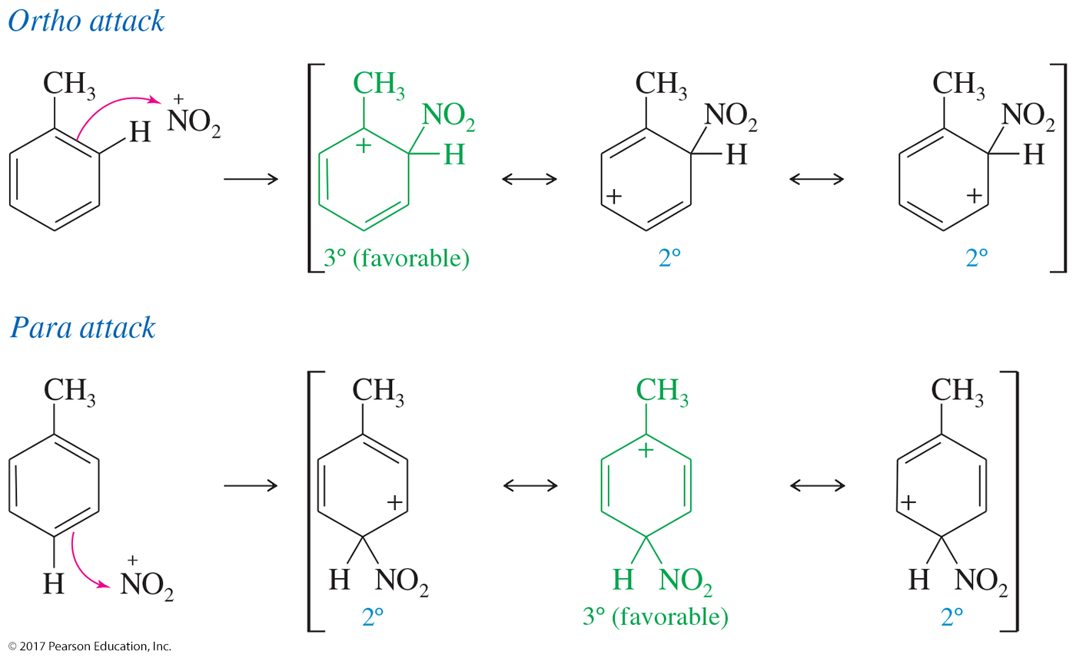
Ortho and Para Substitution
Ortho and para attacks are preferred because their resonance structures include one tertiary carbocation.

Slide 8
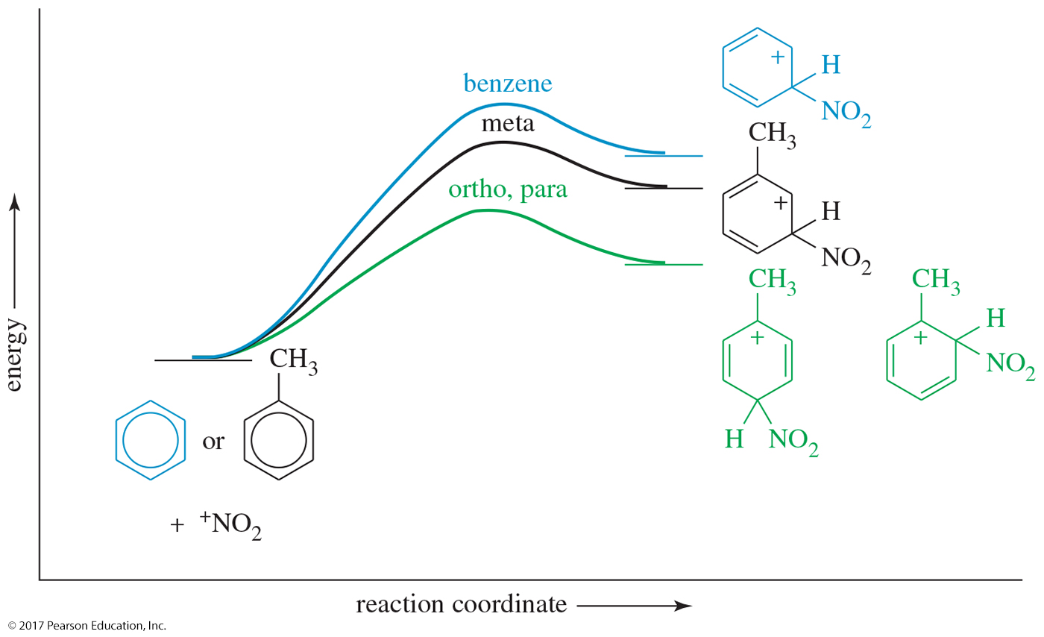
Energy Diagram

Slide 9
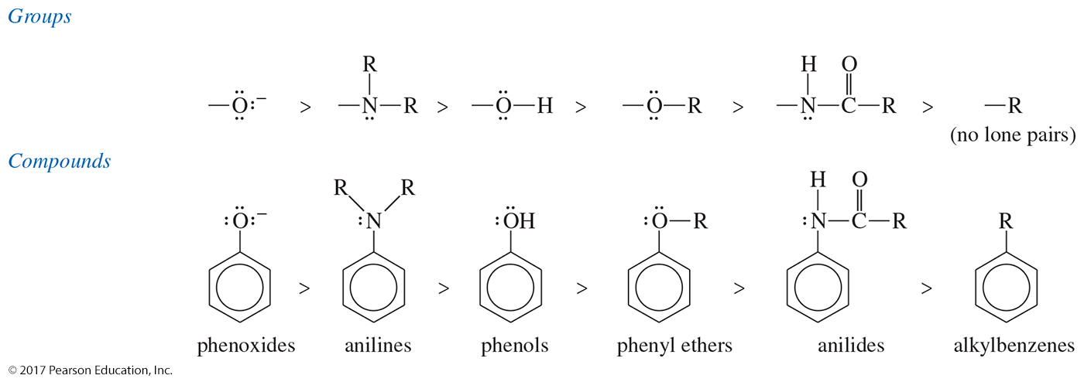
Summary of Activators

Slide 10
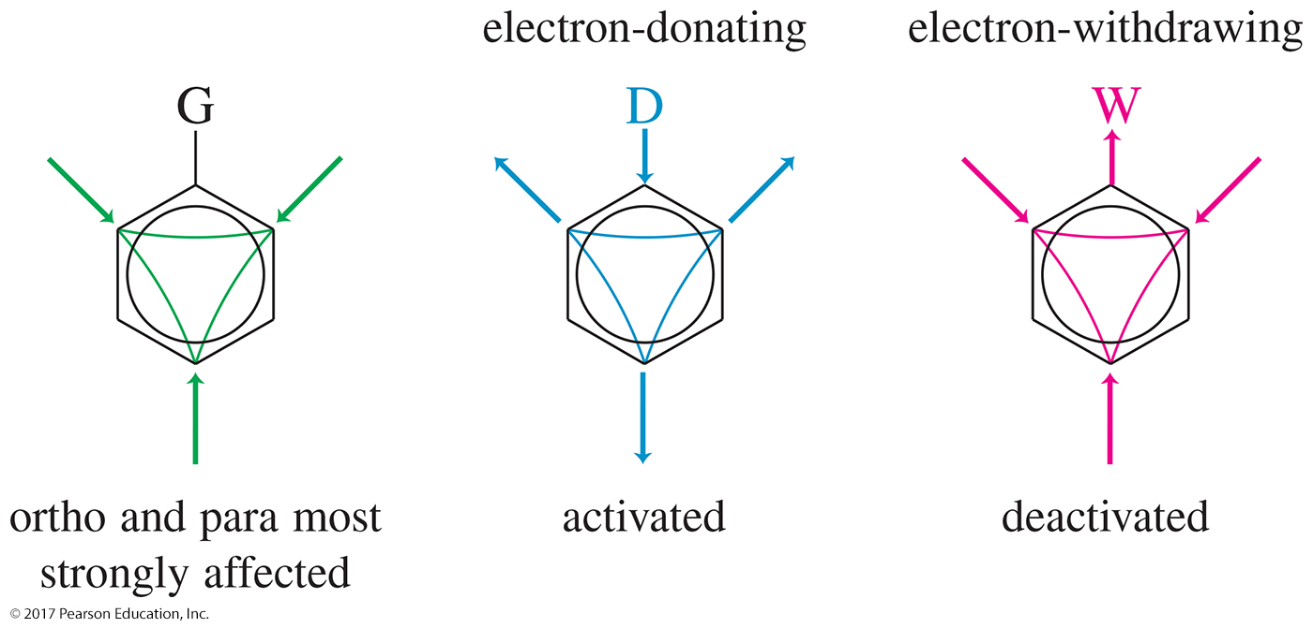
Activators and Deactivators
If the substituent on the ring is electron donating, the ortho and para positions will be activated.
If the group is electron withdrawing, the ortho and para positions will be deactivated.

Slide 11
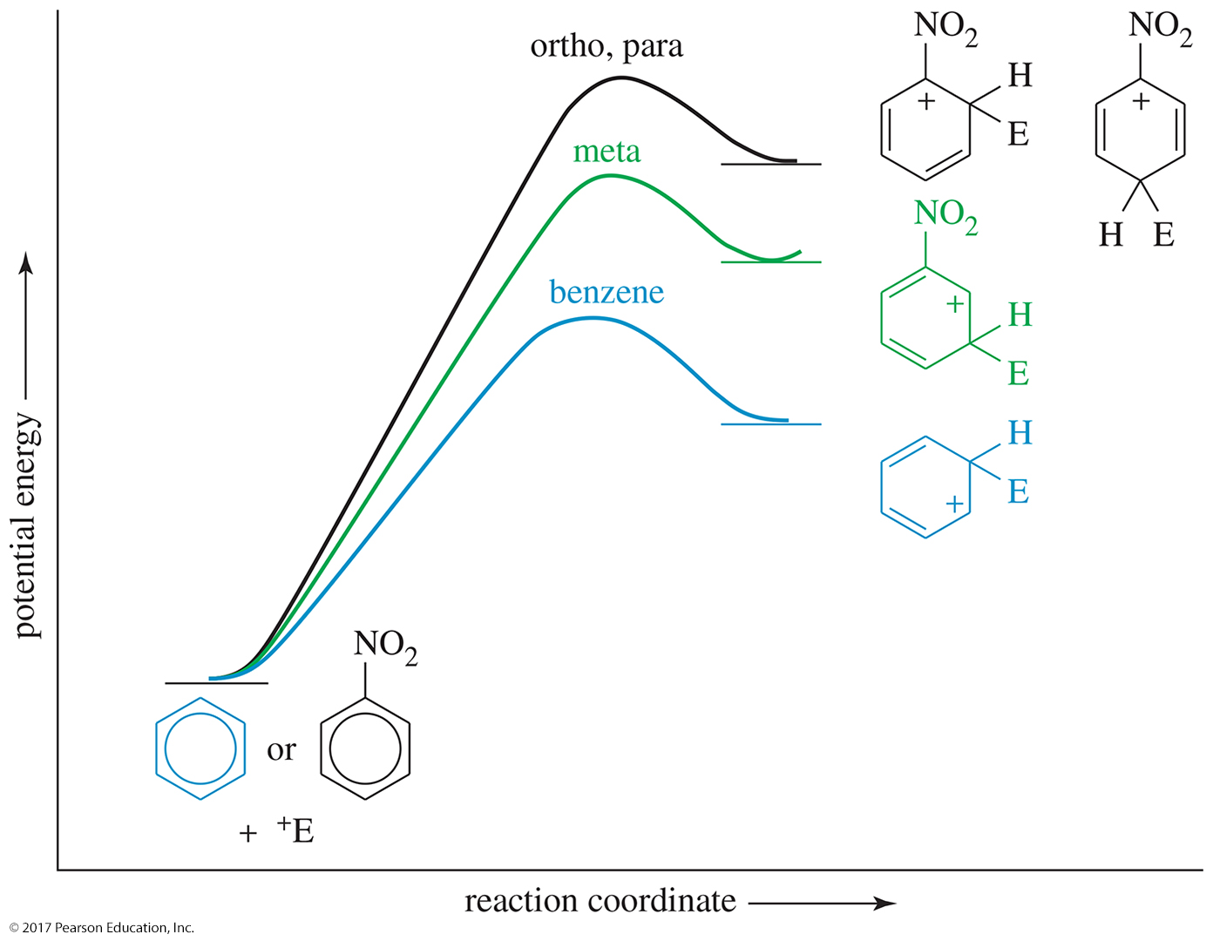
Energy Diagram

Slide 12
Deactivators and Meta-Directors
Most electron-withdrawing groups are deactivators and meta-directors.
The atom attached to the aromatic ring has a positive or partial positive charge.
Electron density is withdrawn inductively along the sigma bond, so the ring has less electron density than benzene, and thus it will be slower to react.

Slide 13
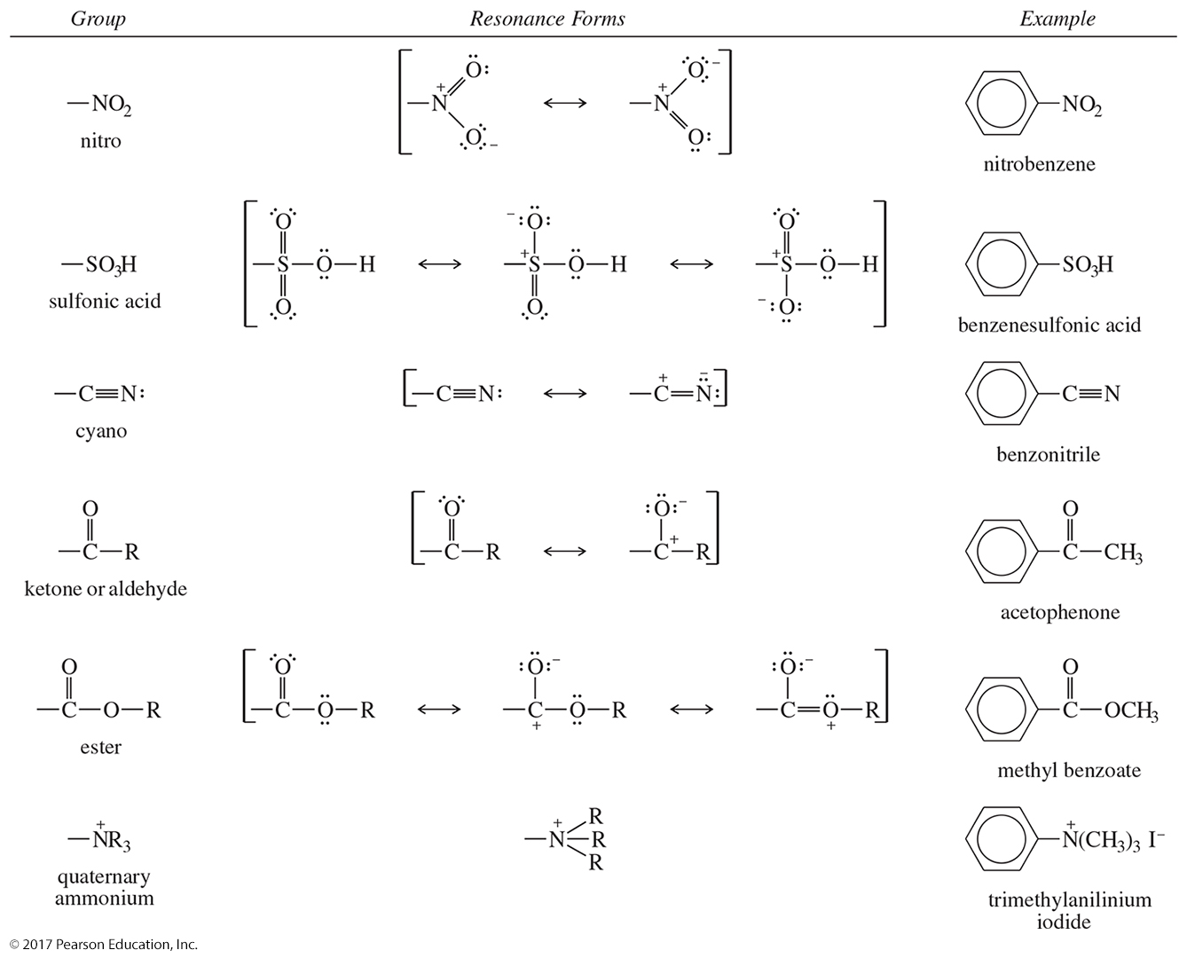
Other Deactivators

Slide 14
Halogens
Halogens are deactivators since they react slower than benzene.
Halogens are ortho, para-directors because the halogen can stabilize the sigma complex.

Slide 15
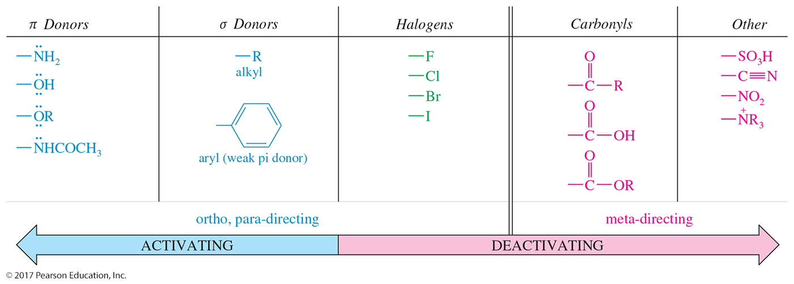
Summary of Directing Effects

Slide 16
Effect of Multiple Substituents
The directing effect of the two (or more) groups may reinforce each other.

Slide 17
Effect of Multiple Substituents (Continued)
The position in between two groups in positions 1 and 3 is hindered for substitution, and it is less reactive.

Slide 18
Effect of Multiple Substituents (Continued)
If directing effects oppose each other, the most powerful activating group has the dominant influence.

Slide 19
Friedel–Crafts Alkylation
Synthesis of alkyl benzenes from alkyl halides and a Lewis acid, usually AlCl₃
Reactions of alkyl halide with Lewis acid produce a carbocation, which is the electrophile.

Slide 20
Limitations of Friedel–Crafts
Reaction fails if benzene has a substituent that is more deactivating than halogens.
Rearrangements are possible.
The alkylbenzene product is more reactive than benzene, so polyalkylation occurs.

Slide 21
Multiple Alkylations

Slide 22
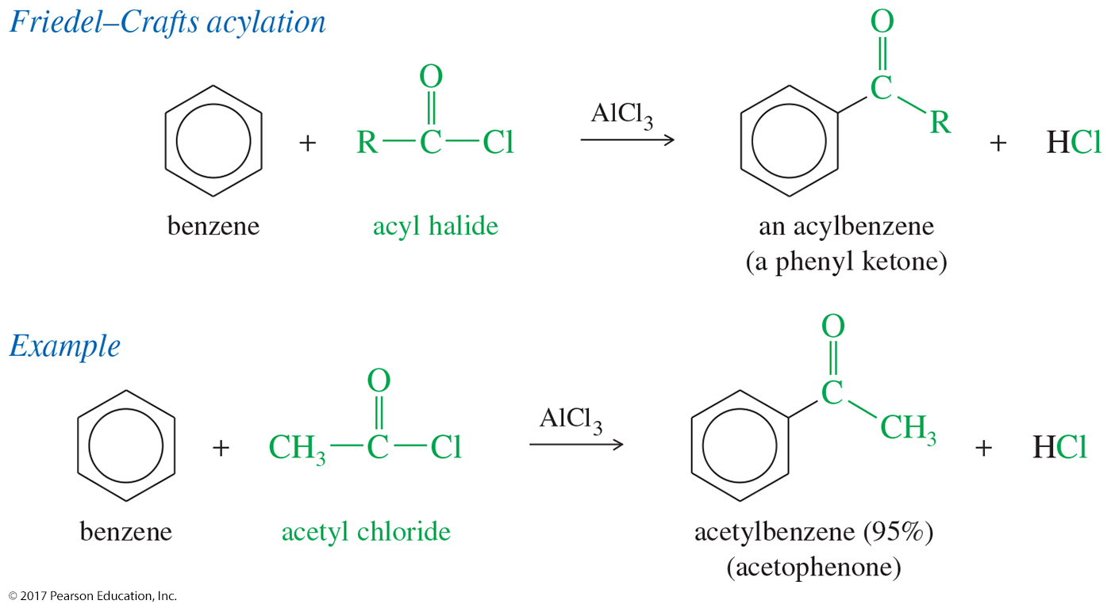
Friedel–Crafts Acylation
Acyl chloride is used in place of alkyl chloride.
The product is a phenyl ketone that is less reactive than benzene.

Slide 23
Clemmensen Reduction
The Clemmensen reduction is a way to convert acylbenzenes to alkylbenzenes by treatment with aqueous HCl and amalgamated zinc.

Slide 24
Side-Chain Oxidation
Alkylbenzenes are oxidized to benzoic acid by heating in basic KMnO₄ or heating in Na₂Cr₂O₇/H₂SO₄.
The benzylic carbon will be oxidized to the carboxylic acid.

