Slide 1
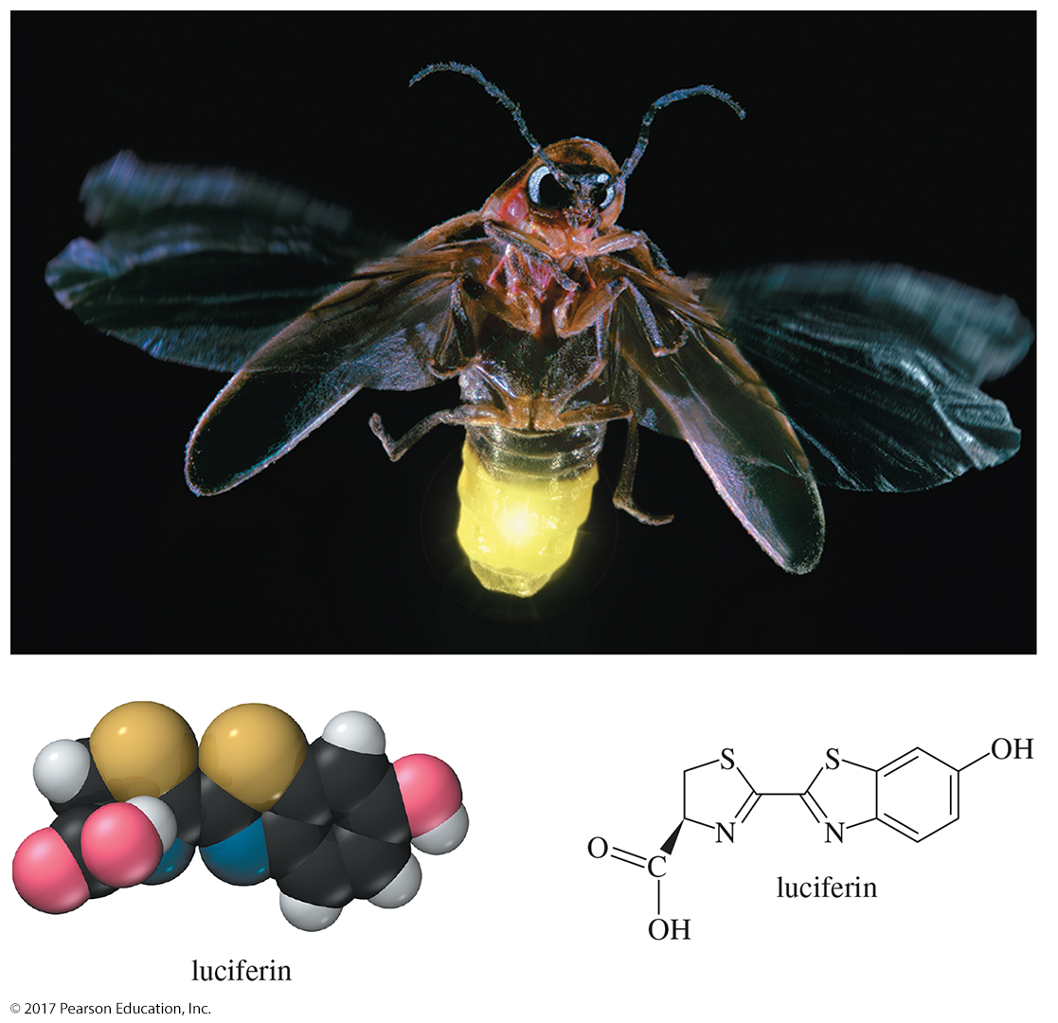
Organic Chemistry,
9th Edition
L. G. Wade, Jr.
Chapter 1
Lecture
Structure and Bonding
Chad Snyder, PhD
Grace College
© 2017 Pearson Education, Inc.

Slide 2
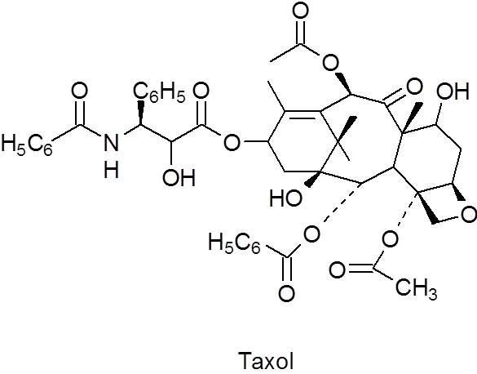
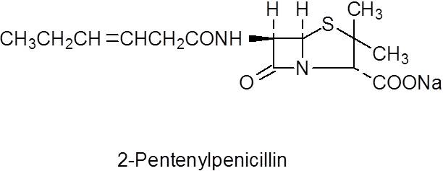
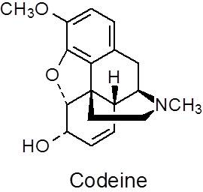
Organic Chemistry
Organic chemistry is the chemistry of carbon compounds.

Slide 3
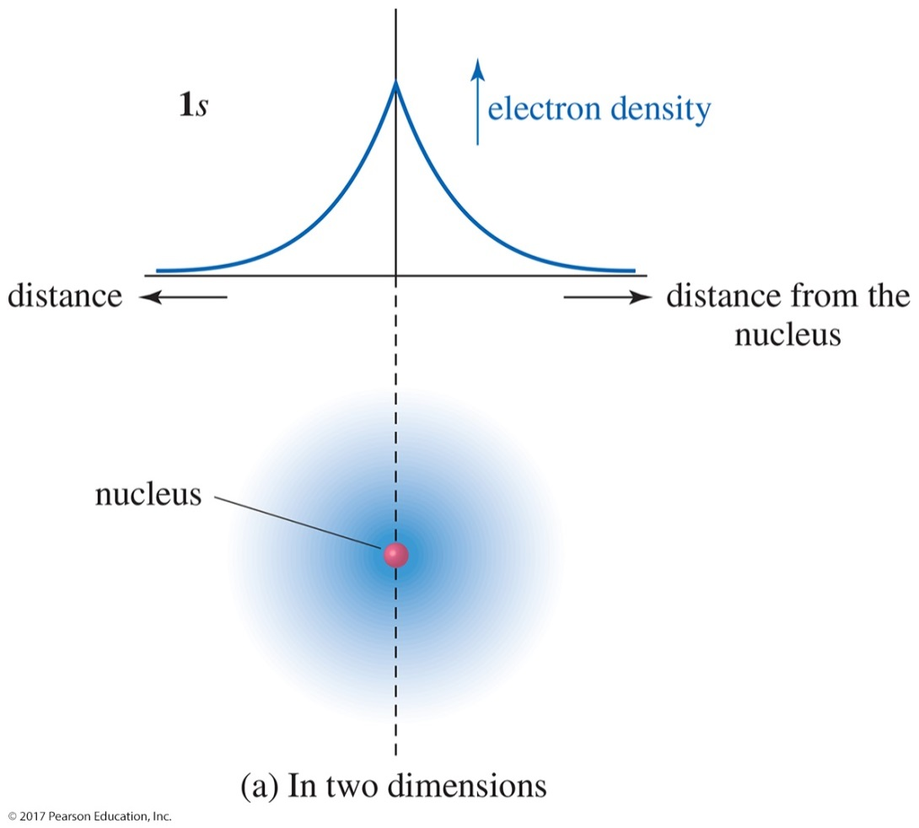
Electronic Structure of the Atom
An atom has a dense, positively charged nucleus surrounded by a cloud of electrons.
The electron density is highest at the nucleus and drops off exponentially with increasing distance from the nucleus in
any direction.

Slide 4
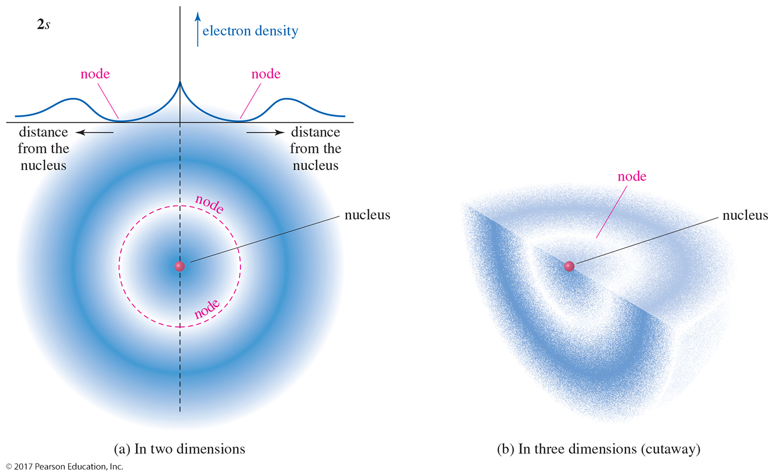
Electronic Structure of the Atom

Slide 5
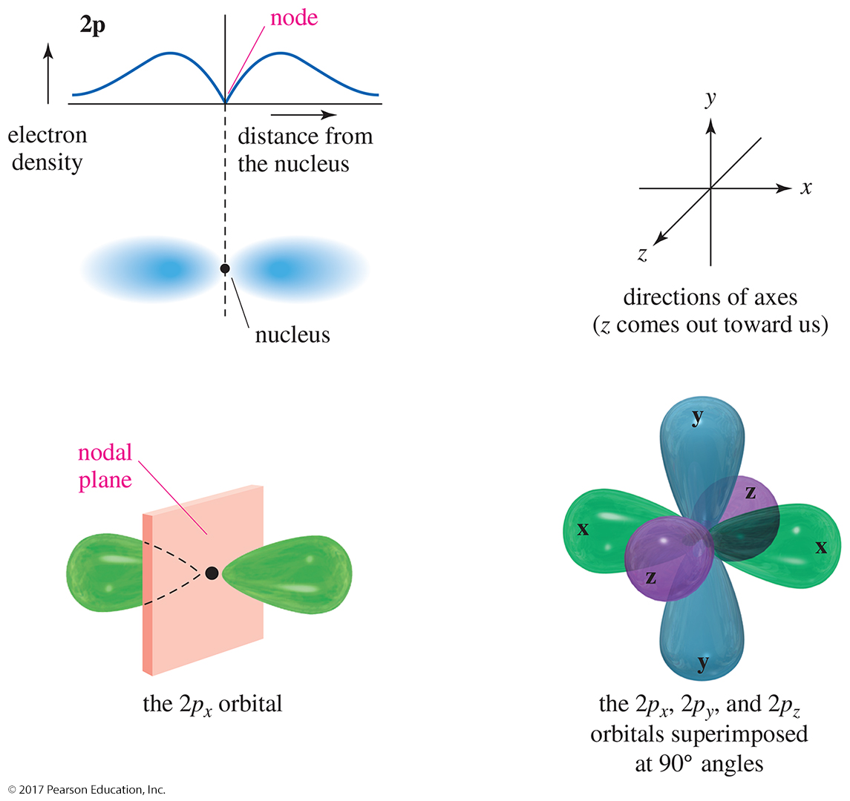
The 2p Orbitals
There are three 2p orbitals oriented at right angles to
each other.
Each p orbital consists of two lobes.
Each is labeled according to its orientation along the x, y, or z axis.

Slide 6
Isotopes
Isotopes are atoms with the same number of protons but a different number of neutrons.
Mass number is the sum of the protons and neutrons in an atom.

Slide 7
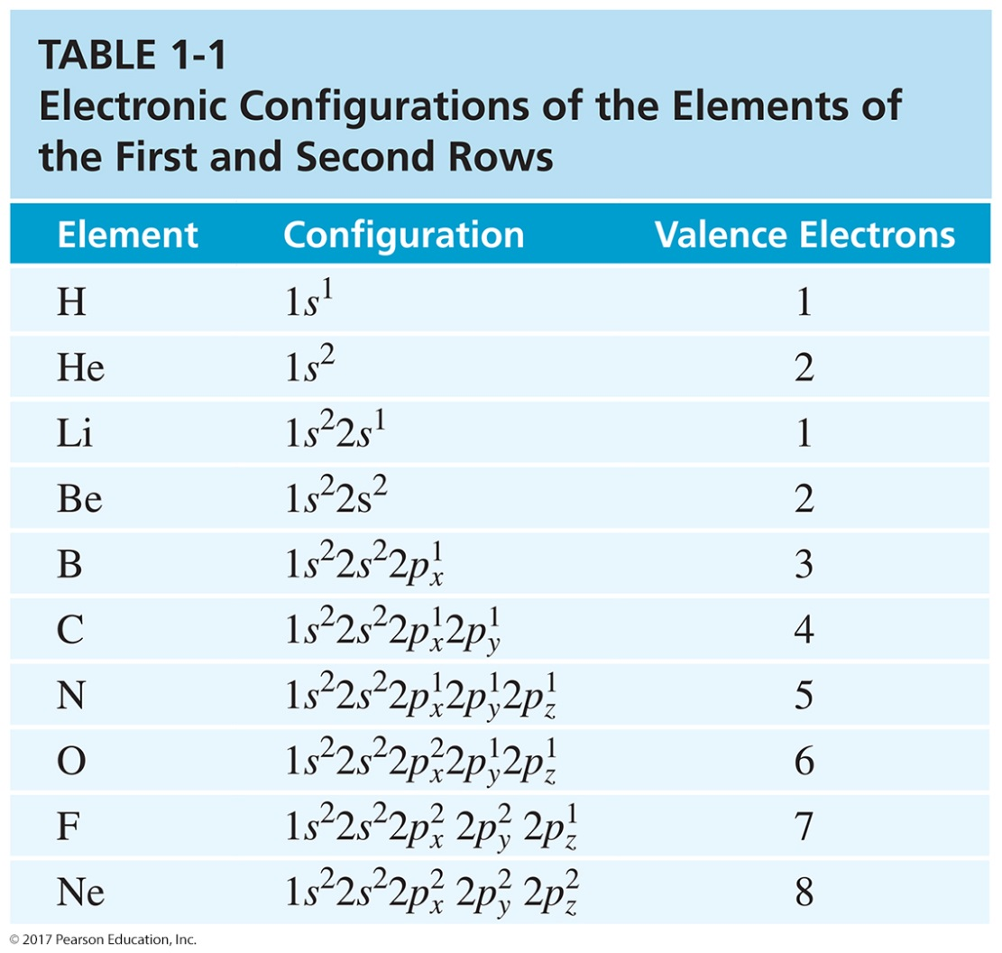
Electronic Configurations of Atoms
Valence electrons are electrons on the outermost shell of the atom.

Slide 8
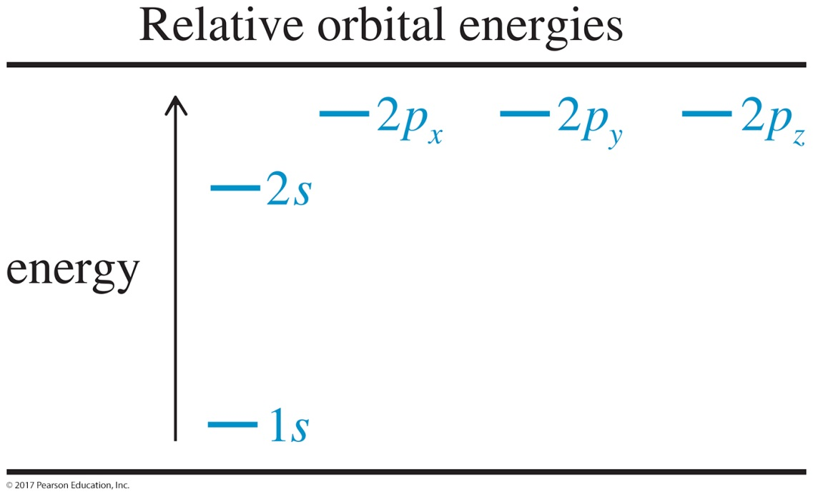
Electronic Configurations
The aufbau principle states we must fill the lowest energy orbitals first.
Hund’s rule states that when there are two or more orbitals of the same energy (degenerate), electrons will go into different orbitals rather than pairing up in the same orbital.

Slide 9
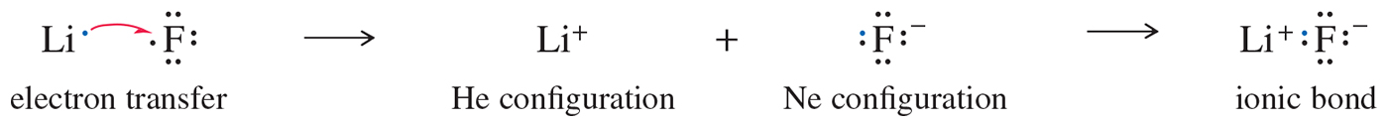
Ionic Bonding
To obtain a noble gas configuration (a full valence shell), atoms may transfer electrons from one atom to another.
The atoms, now bearing opposite charges, attract each other, forming an ionic bond.

Slide 10
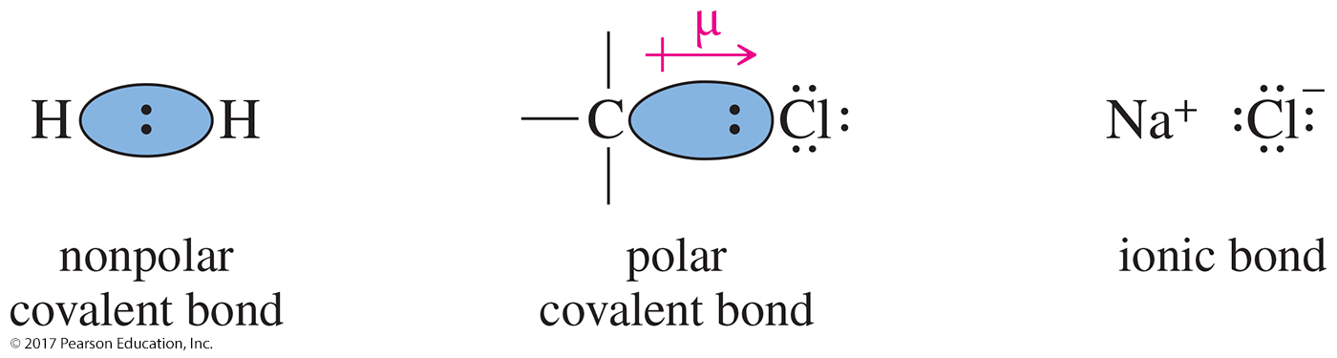
Covalent Bonding
Electrons are shared between the atoms to complete the octet.
When the electrons are shared evenly, the bond is said to be nonpolar covalent, or pure covalent.
When electrons are not shared evenly between the atoms, the resulting bond will be polar covalent.

Slide 11
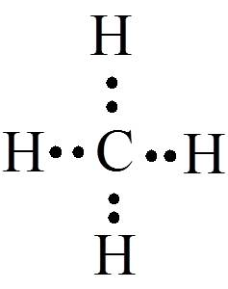
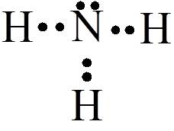


Lewis Structures
CH₄ NH₃
H₂O Cl₂
Carbon: 4 e
4 H@1 e ea: 4 e
8 e
Nitrogen: 5 e
3 H@1 e ea: 3 e
8 e
Oxygen: 6 e
2 H@1 e ea: 2 e
8 e
2 Cl@7 e ea: 14 e

Slide 12
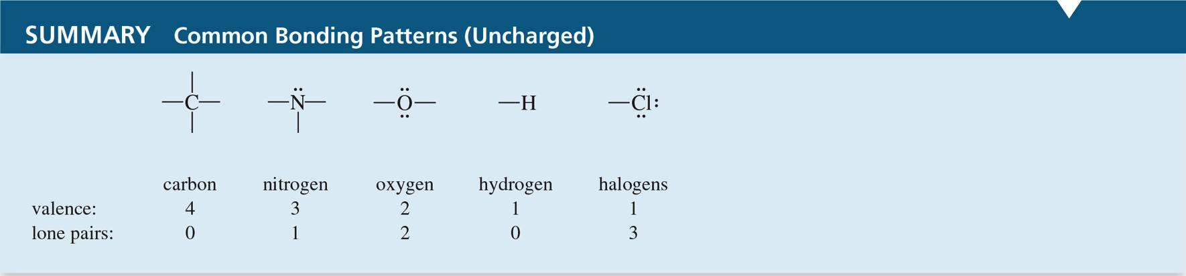
Bonding Patterns

Slide 13
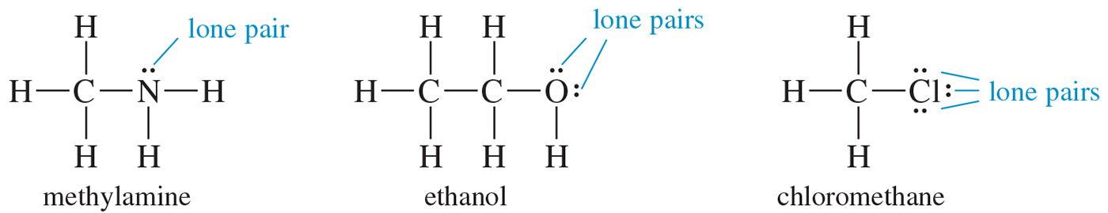
Nonbonding Electrons
Also called lone pairs
Nonbonding electrons are valence-shell electrons that are not shared between atoms.

Slide 14
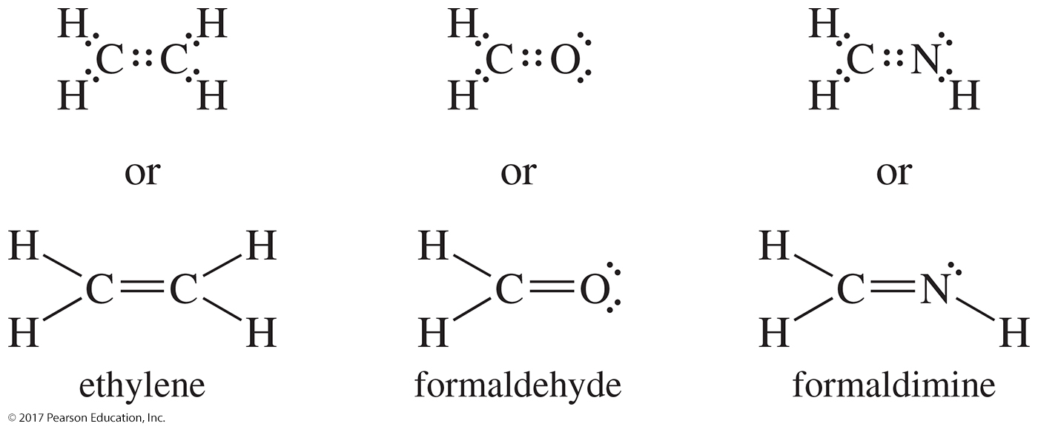
Multiple Bonding
Sharing two pairs of electrons is called a double bond.
Sharing three pairs of electrons is called a triple bond.

Slide 15

Electronegativity and Bond Polarity
A bond with the electrons shared equally between two atoms is called a nonpolar covalent bond. An unequally shared pair of bonding electrons is called a polar covalent bond.

Slide 16
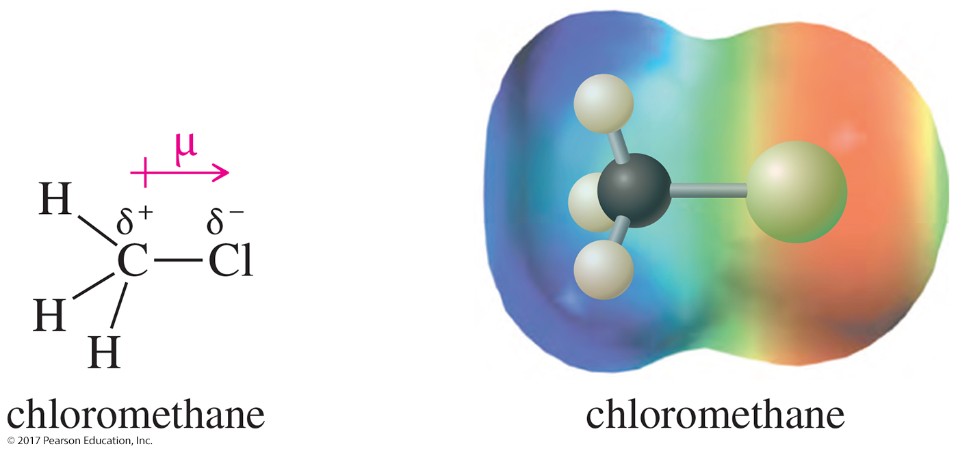
Dipole Moment
Dipole moment is defined to be the amount of charge separation (δ) multiplied by the bond length (μ).
Charge separation is shown by an electrostatic potential map (EPM), where red indicates a partially negative region and blue indicates a partially positive region.

Slide 17
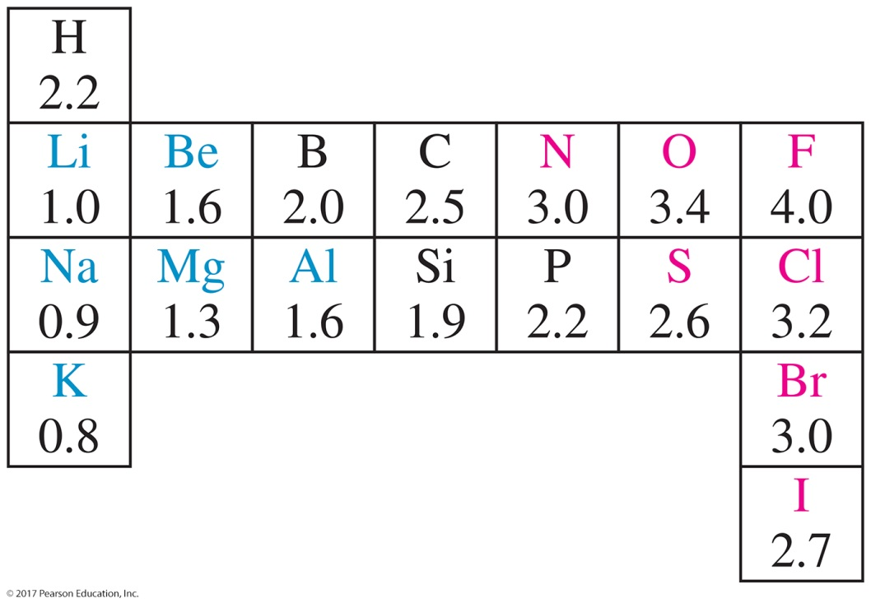
Pauling Electronegativities
Electronegativities can be used to predict whether a bond will be polar and also predict the direction of its dipole moment.
Since the electronegativities of carbon and hydrogen are similar, C—H bonds are considered to be nonpolar.

Slide 18
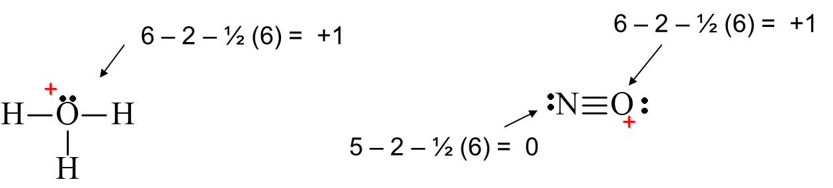
Formal Charges
Formal charge = [group number ] – [nonbonding electrons ] – ½ [shared electrons]
H₃O⁺ NO⁺
Formal charges are a way of keeping track of electrons.
They may or may not correspond to actual charges in the molecule.

Slide 19
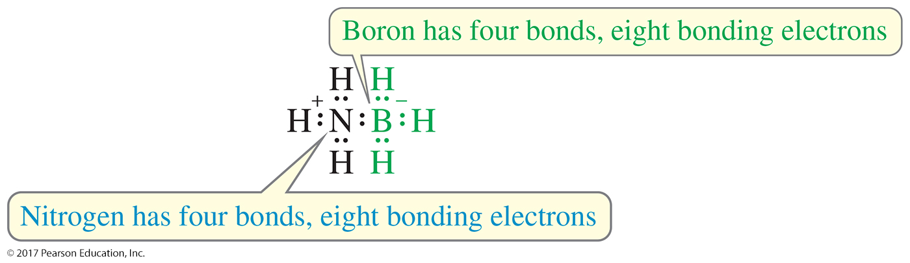
Solved Problem 1
Compute the formal charge (FC) on each atom in H₃N—BH₃.
Solution

Slide 20
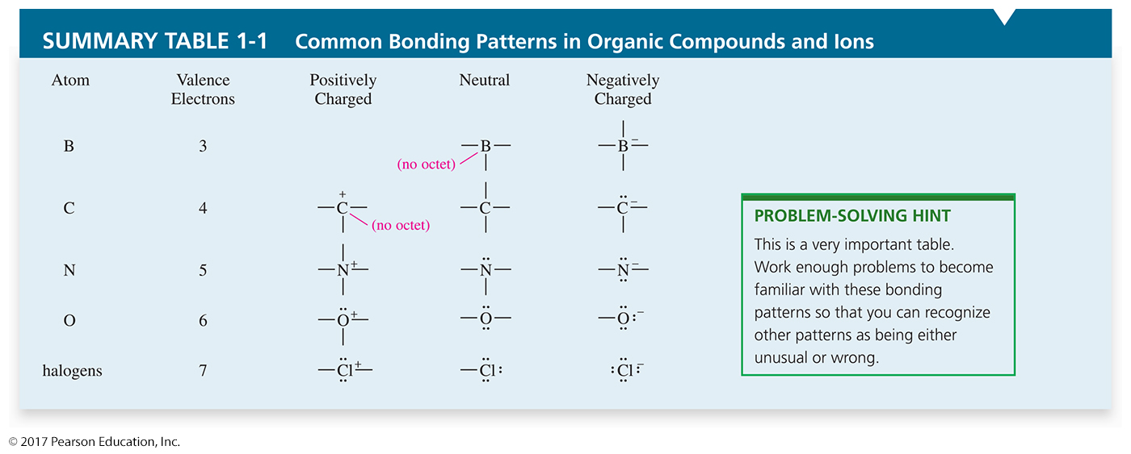
Common Bonding Patterns

Slide 21
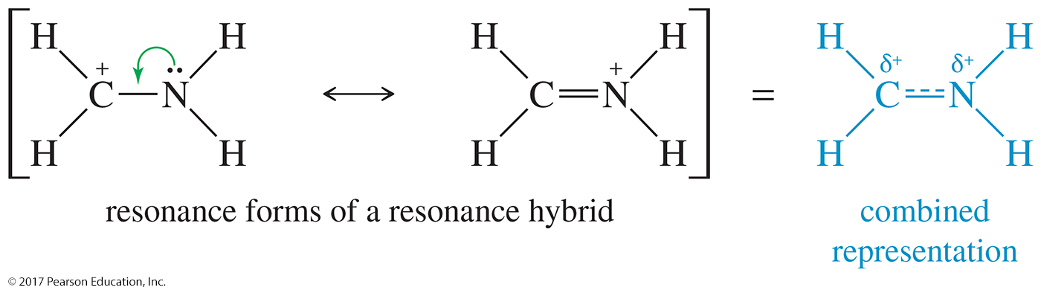
Resonance Forms
The structures of some compounds are not adequately represented by a single Lewis structure.
Resonance forms are Lewis structures that can be interconverted by moving electrons only.
The true structure will be a hybrid between the contributing resonance forms.

Slide 22
Resonance Forms
Resonance forms can be compared using the following criteria, beginning with the most important:
  Has as many octets as possible
  Has as many bonds as possible
  Has the negative charge on the most electronegative atom
  Has as little charge separation as possible

Slide 23
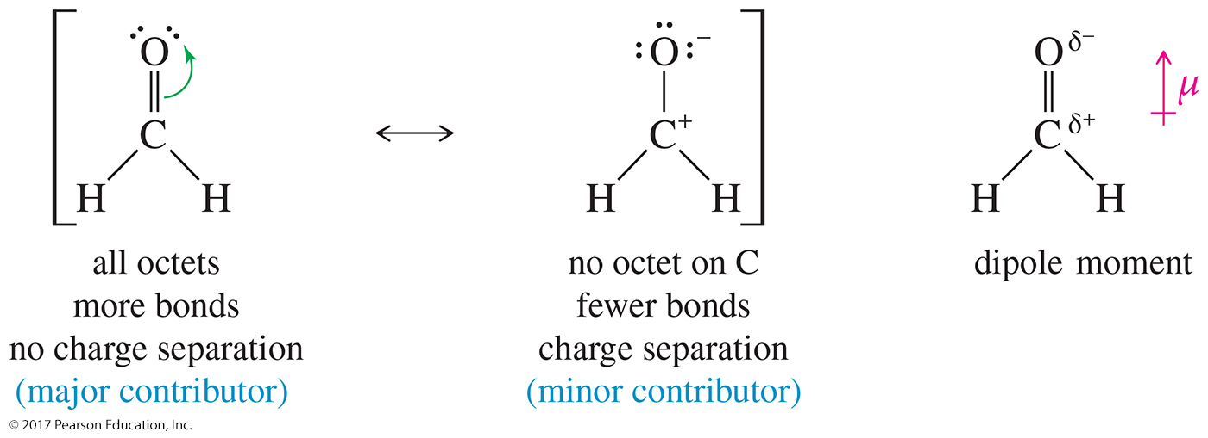
Major and Minor Contributors
The major contributor is the one in which all the atoms have a complete octet of electrons.

Slide 24
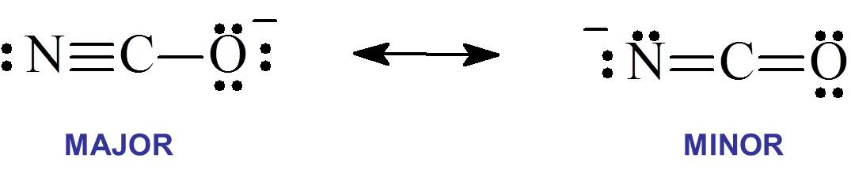
Major and Minor Contributors (Continued)
When both resonance forms obey the octet rule, the major contributor is the one with the negative charge on the most electronegative atom.
The oxygen is more electronegative, so it should have the negative charge.

Slide 25
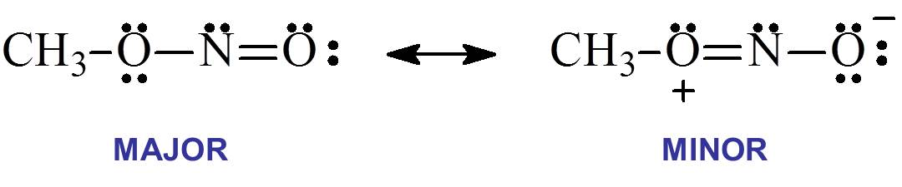
Non-Equivalent Resonance
Opposite charges should be on adjacent atoms.
The most stable one is the one with the smallest separation of oppositely charged atoms.

Slide 26
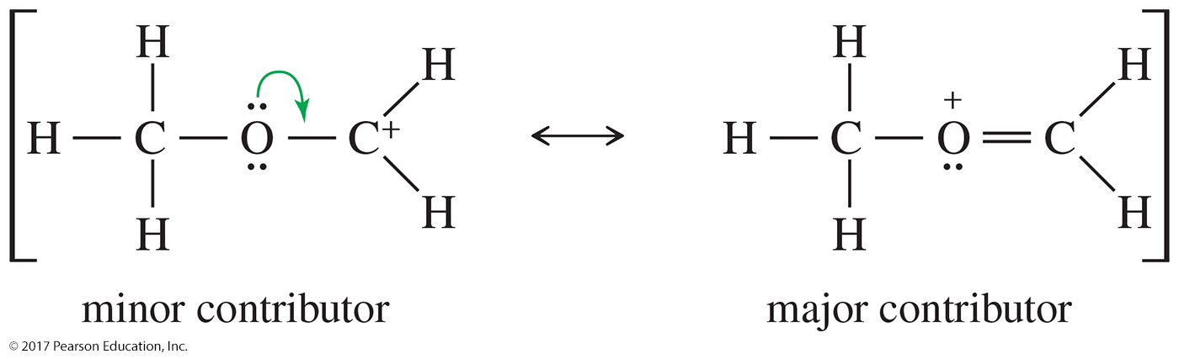
Solved Problem 2
Draw the important resonance forms for [CH₃OCH₂]⁺. Indicate which structure is the major and minor contributor or whether they would have the same energy.
Solution
The first (minor) structure has a carbon atom with only six electrons around it. The second (major) structure has octets on all atoms and an additional bond.

Slide 27
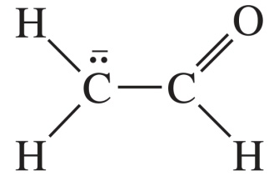
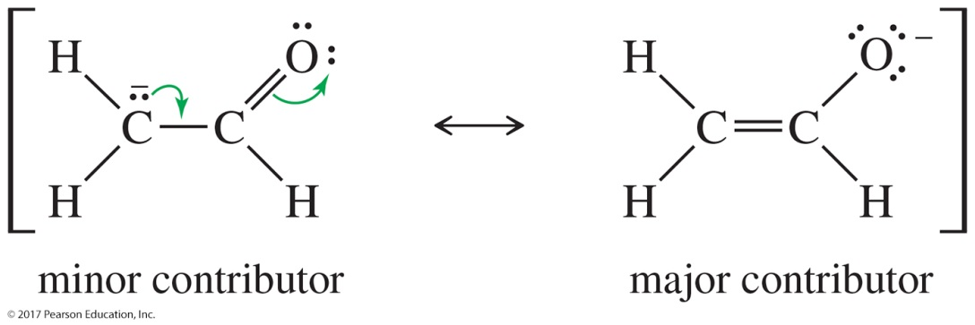
Solved Problem 3
Draw the resonance structures of the compound below. Indicate which structure is the major and minor contributor or whether they would have the same energy.
Solution
Both of these structures have octets on oxygen and both carbon atoms, and they have the same number of bonds. The first structure has the negative charge on carbon, the second on oxygen. Oxygen is the more electronegative element, so the second structure is the major contributor.

Slide 28
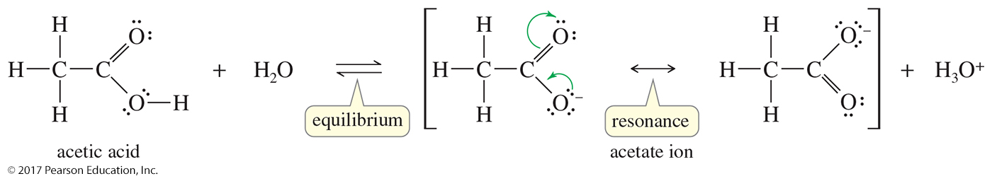
Resonance Forms for the
Acetate Ion
When acetic acid loses a proton, the resulting acetate ion has a negative charge delocalized over both oxygen atoms.
Each oxygen atom bears half of the negative charge, and this delocalization stabilizes the ion.
Each of the carbon–oxygen bonds is halfway between a single bond and a double bond and is said to have a bond order of 1½.

Slide 29
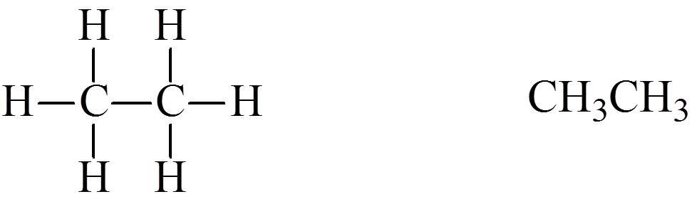
Condensed Structural Formulas
Lewis Condensed
Condensed forms are written without showing all the individual bonds.
Atoms bonded to the central atom are listed after the central atom (CH₃CH₃, not H₃CCH₃).
If there are two or more identical groups, parentheses and a subscript may be used to represent them.
1 2

Slide 30
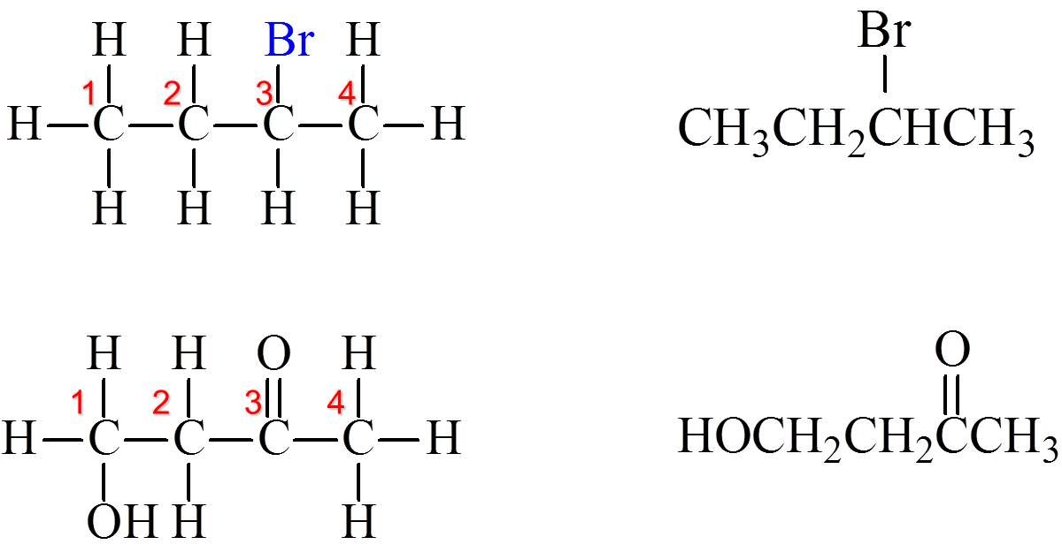
Condensed Structural Formulas
Lewis Condensed

Slide 31
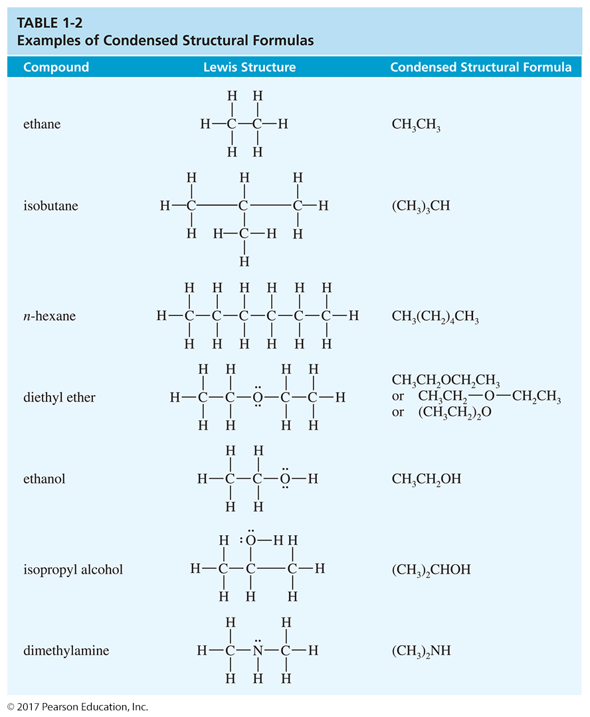
Condensed Structural Formulas (Continued)

Slide 32
Condensed Structural Formulas (Continued)

Slide 33
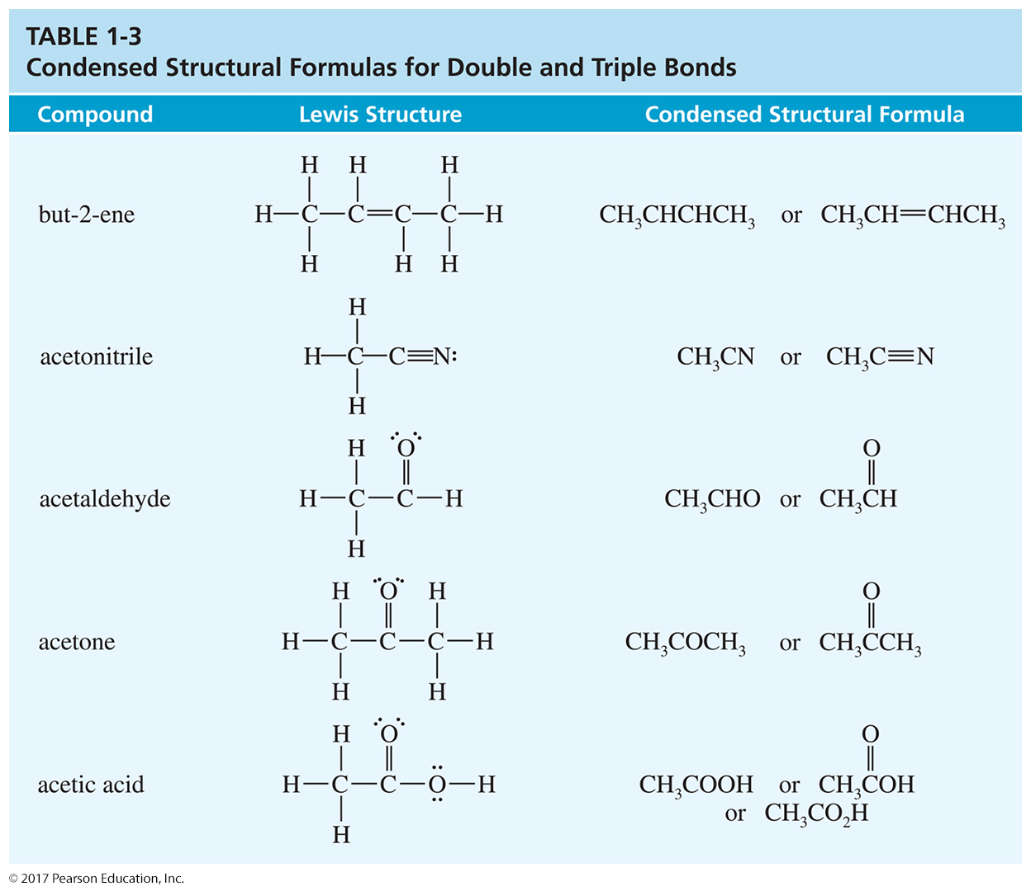
Condensed Structural Formulas (Continued)

Slide 34
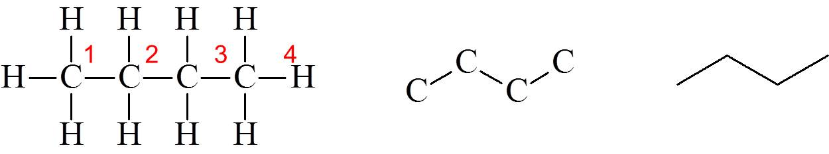
Line-Angle Drawings
Sometimes called skeletal structure or stick figure.
Bonds are represented by lines, and carbons are present where a line begins or ends and where two lines meet.
Hydrogens attached to carbon are not shown.
Nitrogen, oxygen, and halides must be shown.

Slide 35
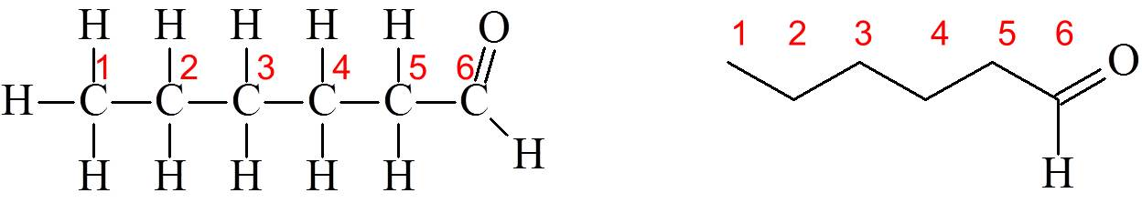
Line–Angle Drawings
Atoms other than carbon must be shown.
Double and triple bonds must also be shown.

Slide 36
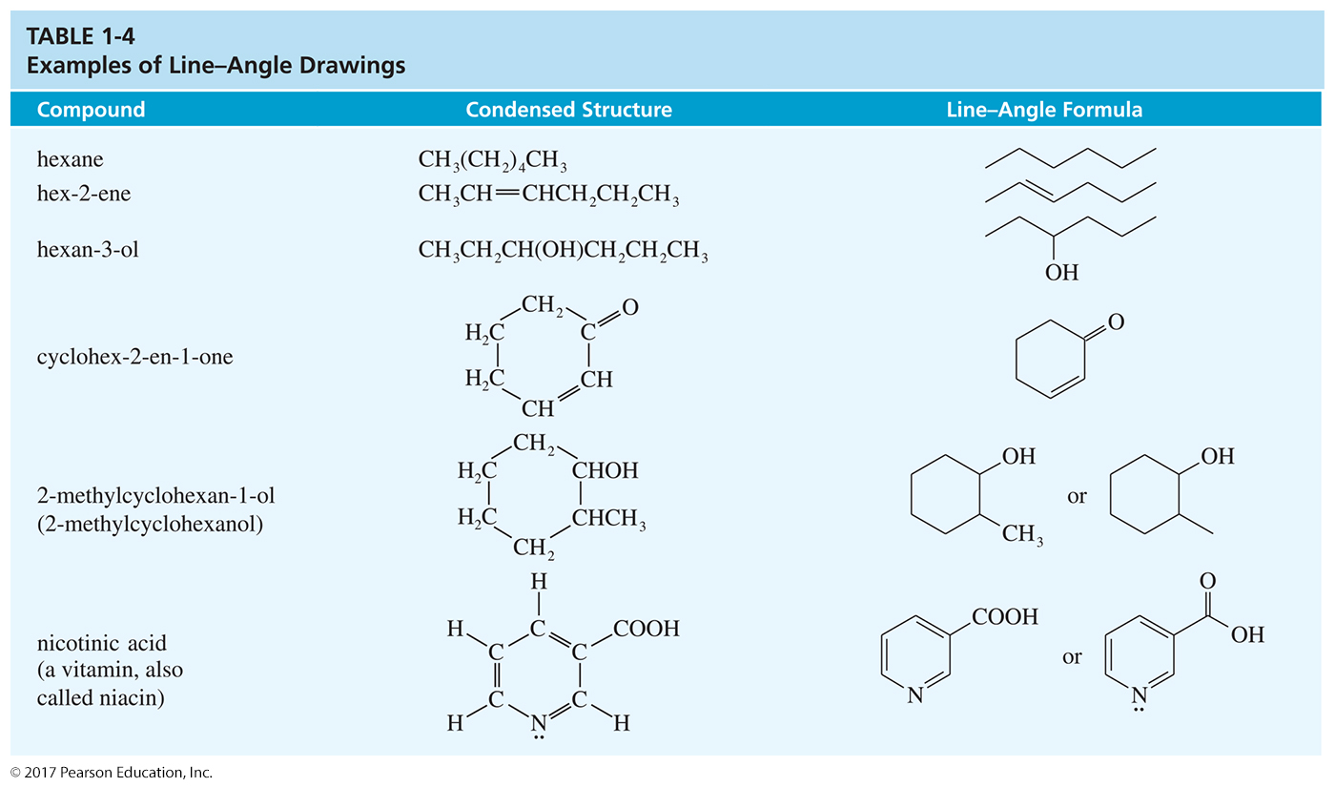
Line–Angle Formulas (Continued)

Slide 37
Effect of Resonance on pK_{a}
The molecular formula gives the number of atoms of each element in one molecule of a compound
CH₃CH₂CH₂CH₂OH
butan-1-ol, molecular formula C₄H₁₀O

Slide 38
Calculating Empirical Formulas
The following are items that need to be considered when calculating empirical formulas:
  Given % composition for each element, assume 100 g.
  Convert the grams of each element to moles.
  Divide by the smallest number of moles to get the ratio.
  The molecular formula may be a multiple of the empirical formula.

Slide 39
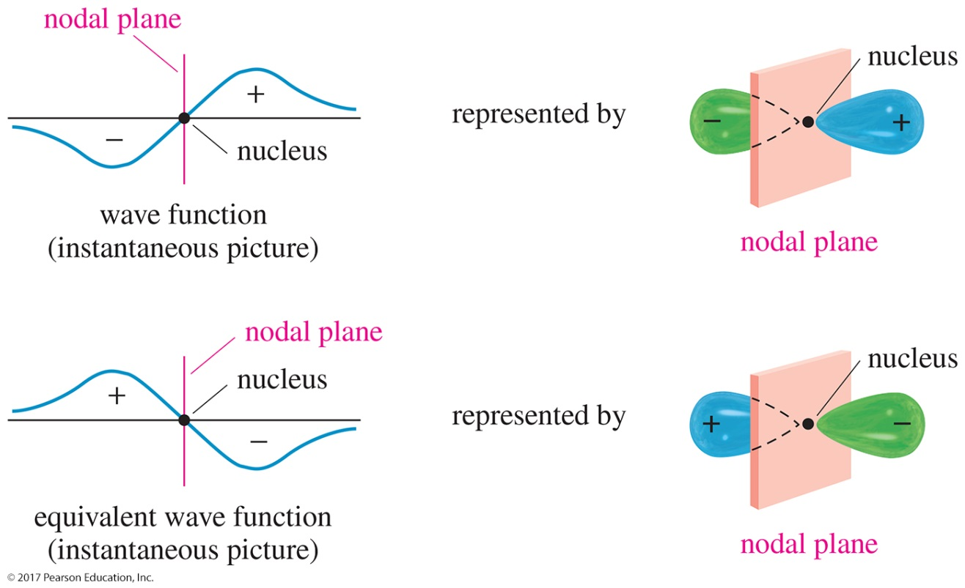
Wave Properties of Electrons
Standing wave vibrates in a fixed location.
Wave function, ψ, is a mathematical description of size, shape, and orientation.
Amplitude may be positive or negative.
Node: Amplitude is zero.

Slide 40
Linear Combination of Atomic Orbitals
Combining orbitals between two different atoms is bond formation.
Combining orbitals on the same atom is hybridization.
Conservation of orbitals
Waves that are in phase add together.
Amplitude increases.
Waves that are out of phase cancel out.

Slide 41
Sigma Bonding
Electron density lies between the nuclei.
A bond may be formed by s—s, p—p, s—p, or hybridized orbital overlaps.
The bonding molecular orbital (MO) is lower in energy than the original atomic orbitals.
The antibonding MO is higher in energy than the atomic orbitals.

Slide 42
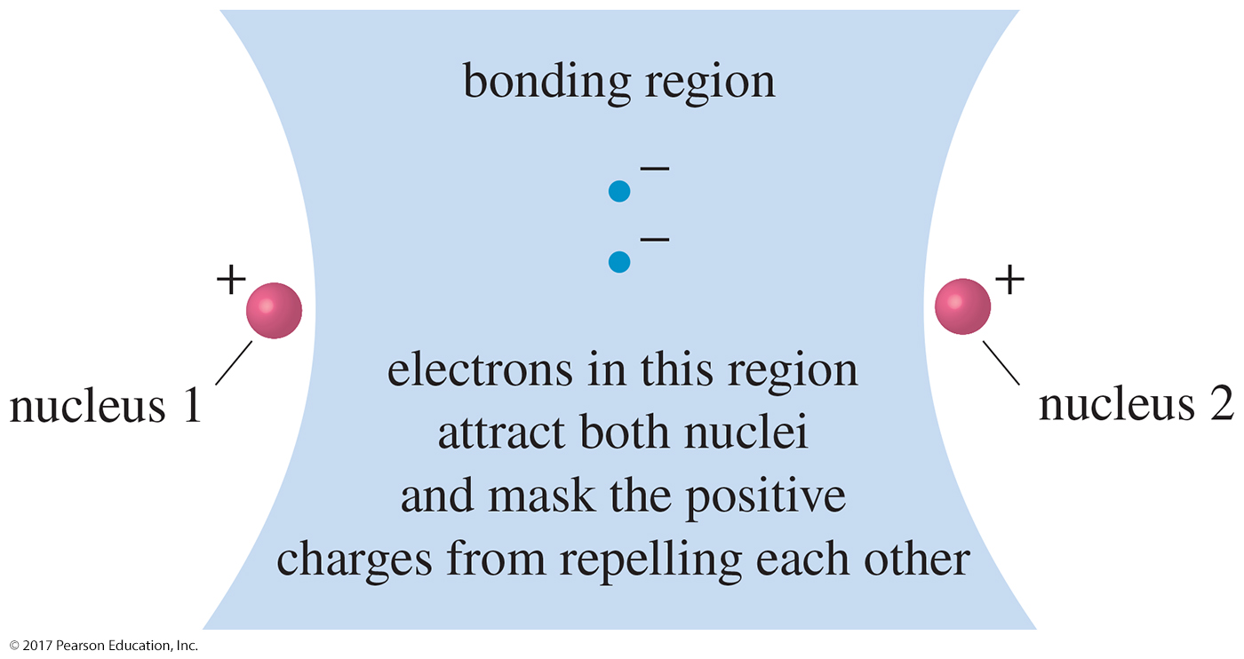
The Bonding Region

Slide 43
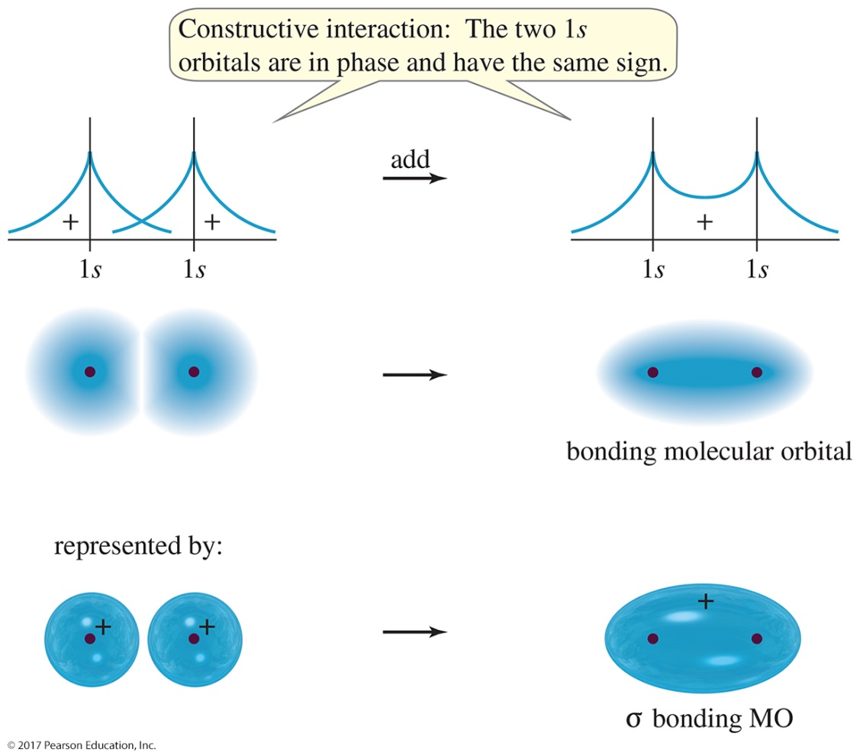
σ-Bonding MO
Formation of a σ-bonding MO: When the 1s orbitals of two hydrogen atoms overlap in phase with each other, they interact constructively to form a bonding MO.

Slide 44
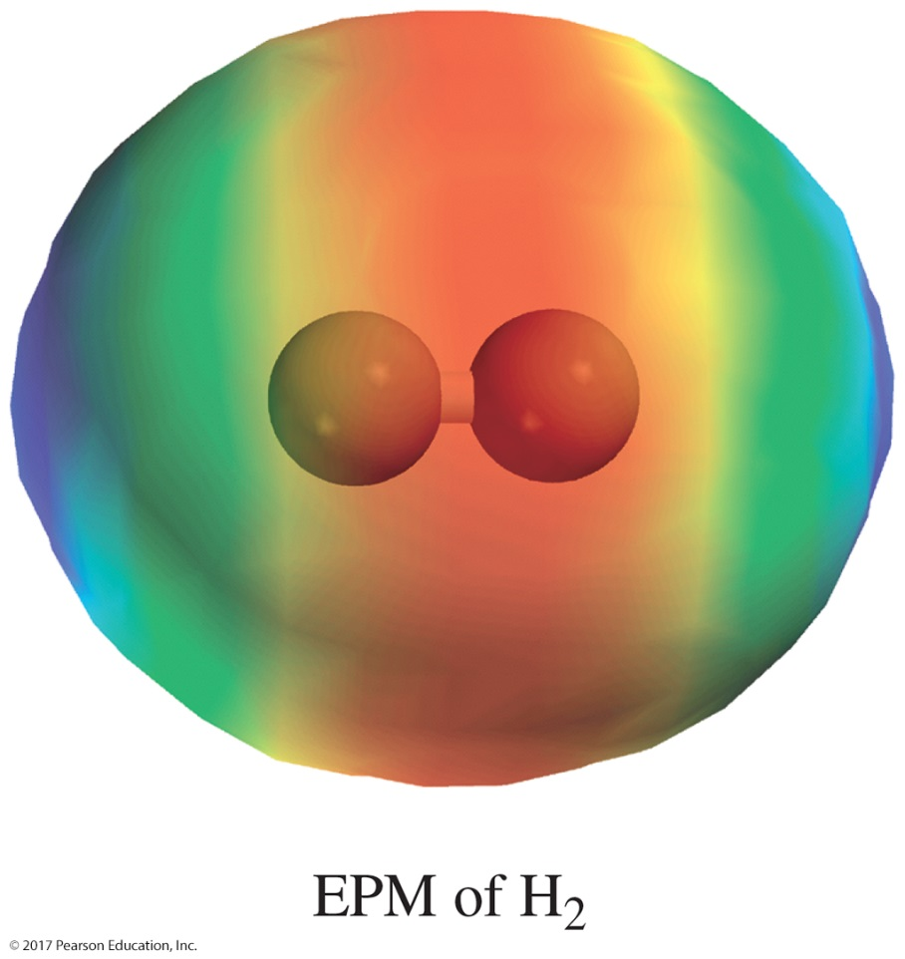
EPM of H₂

Slide 45
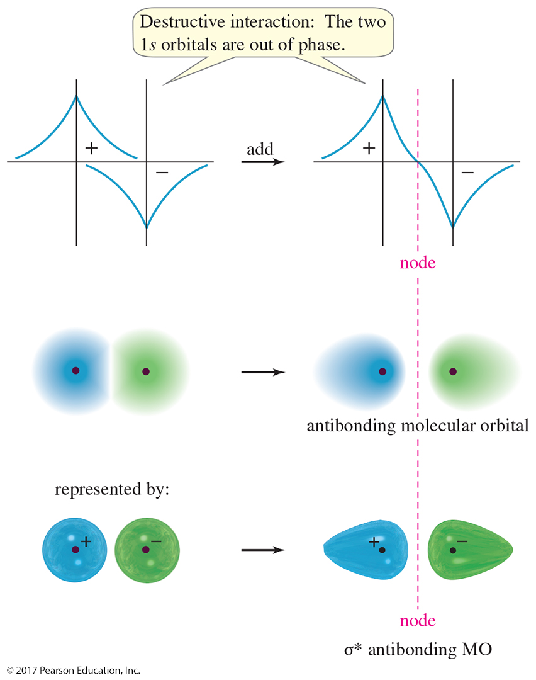
σ∗-Antibonding MO
Formation of a
σ*-antibonding MO: When two 1s orbitals overlap out of phase, they interact destructively to form an antibonding MO.

Slide 46
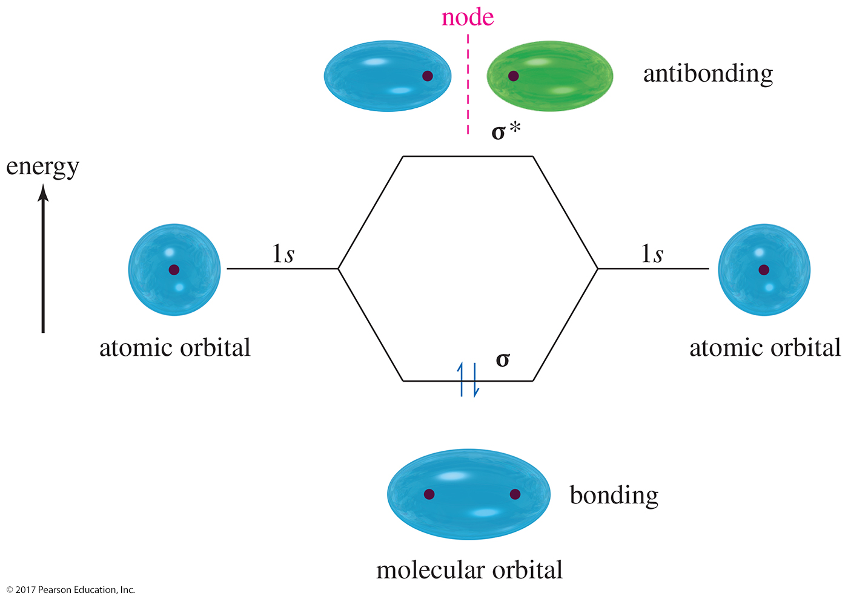
H₂: s—s Overlap

Slide 47
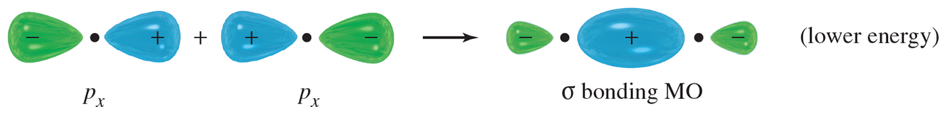
Cl₂: p—p Overlap
When two p orbitals overlap along the line between the nuclei, a bonding orbital and an antibonding orbital result.
Most of the electron density is centered along the line between the nuclei.
This linear overlap is another type of sigma bonding MO.

Slide 48
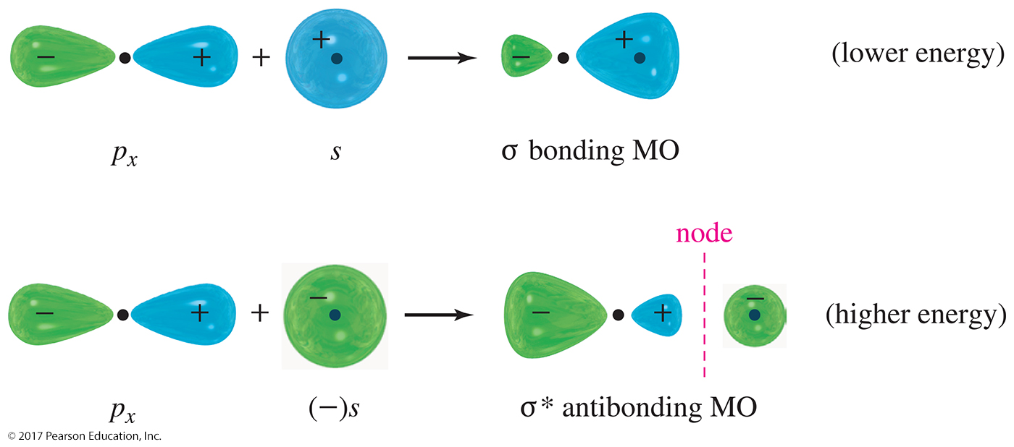
s and p Orbital Overlap
Overlap of an s orbital with a p orbital gives a σ-bonding MO and a σ*-antibonding MO.

Slide 49
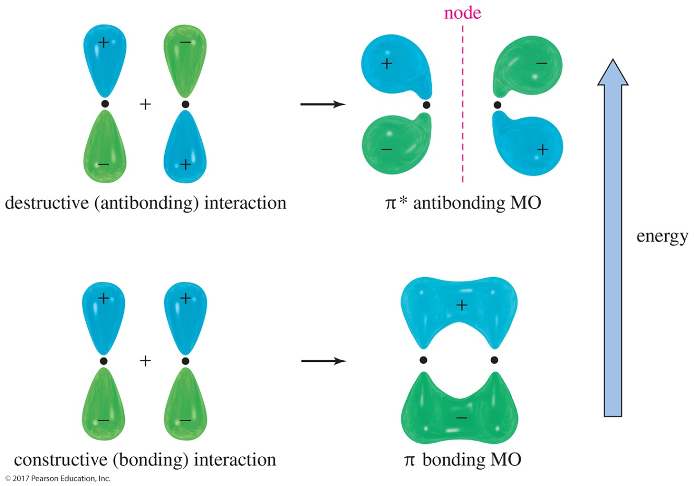
Pi Bonding and Antibonding
The sideways overlap of two parallel p orbitals leads to a
π-bonding MO and a π∗-antibonding MO. A pi (π) bond is not as strong as most sigma bonds.

Slide 50
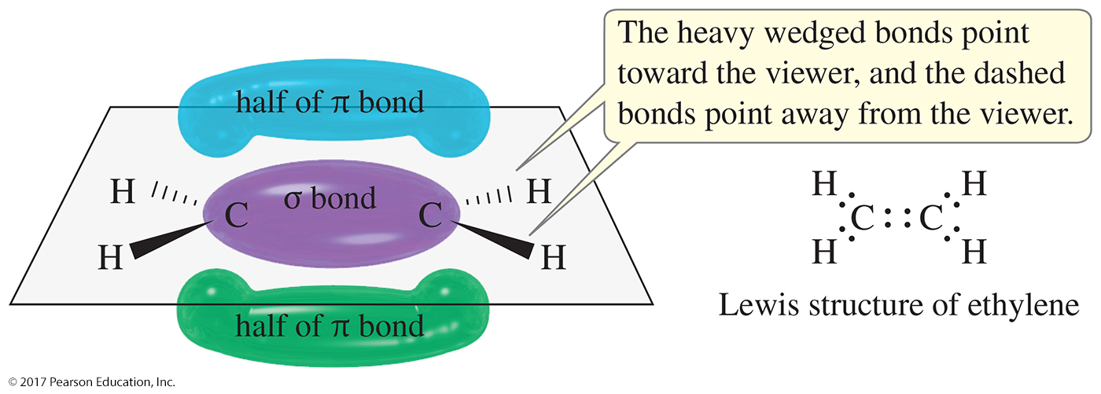
Multiple Bonds
A double bond (two pairs of shared electrons) consists of a sigma bond and a pi bond.
A triple bond (three pairs of shared electrons) consists of a sigma bond and two pi bonds.

Slide 51
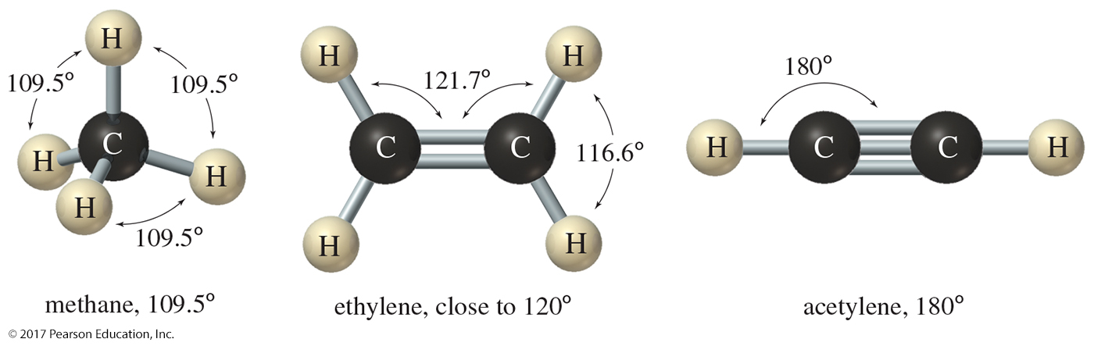
Molecular Shapes
Bond angles cannot be explained with simple s and p orbitals.
Valence-shell electron-pair repulsion theory (VSEPR) is used to explain the molecular shape of molecules.
Hybridized orbitals are lower in energy because electron pairs are farther apart.

Slide 52
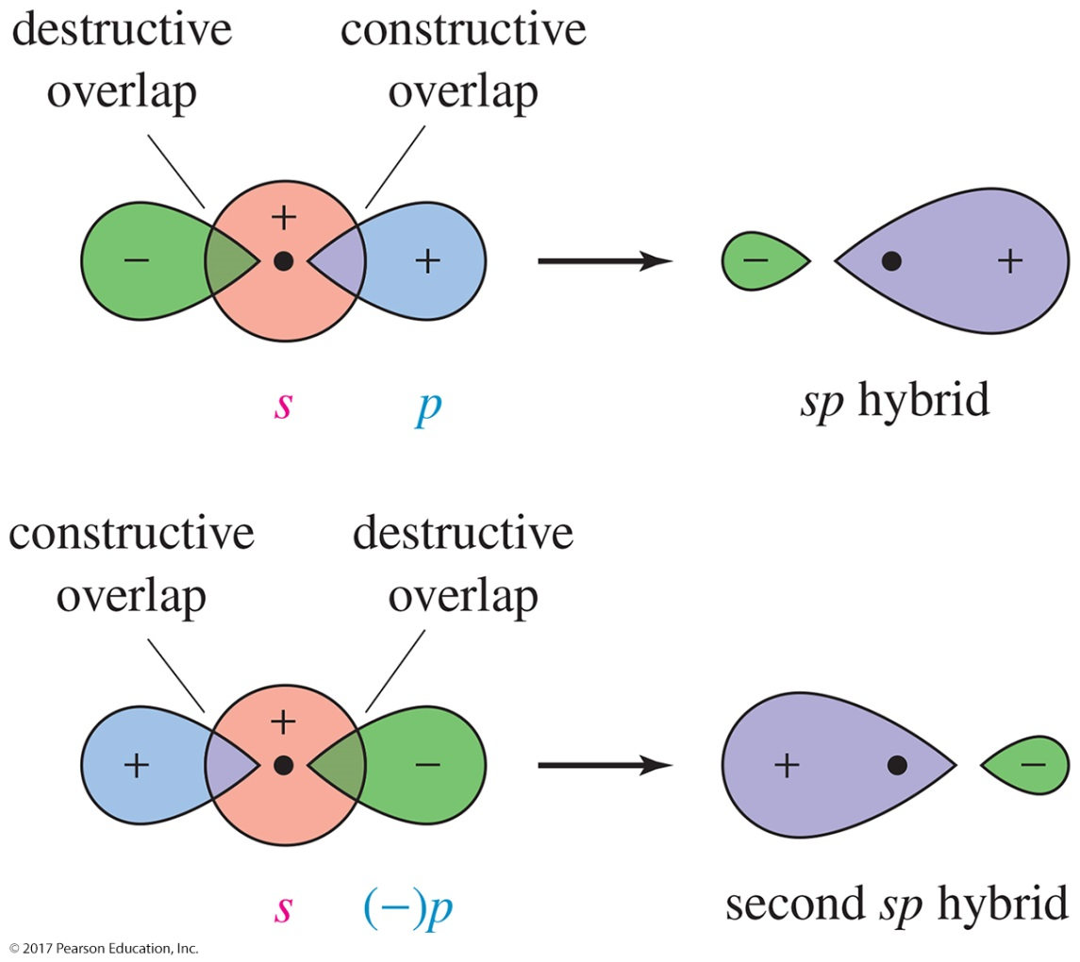
sp Hybrid Orbitals
Hybrid orbitals result when orbitals in the same atom combine.
Two orbitals (s and p) combine to form two
sp orbitals.
Linear electron pair geometry
180° bond angle

Slide 53
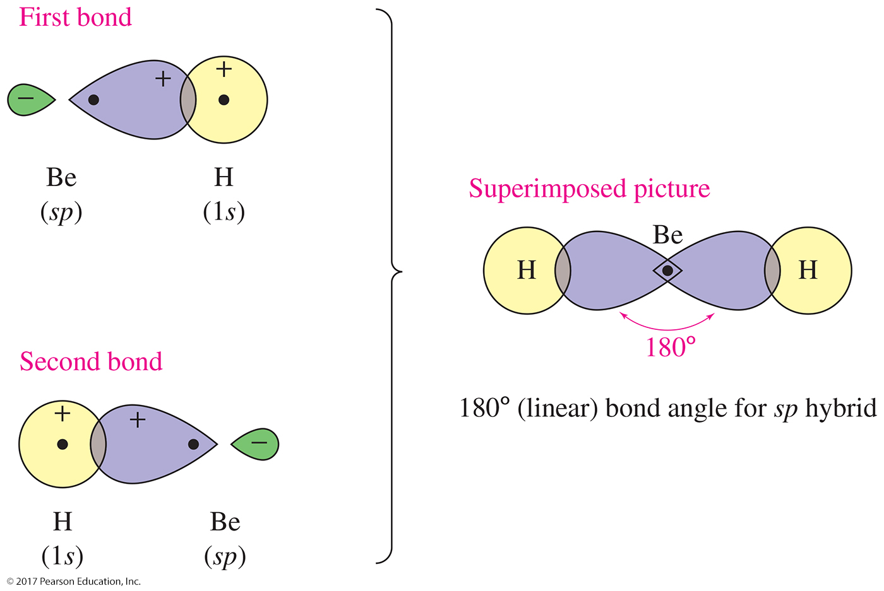
The Bonding of BeH₂
The bond angle in BeH₂ is 180° and the geometry is linear.

Slide 54
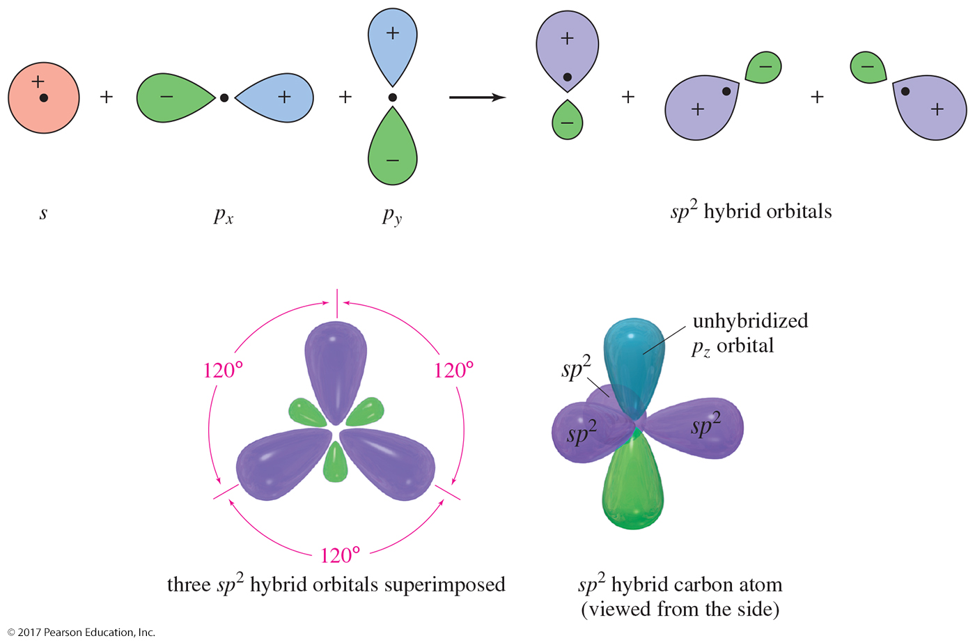
sp² Hybrid Orbitals
Three orbitals (one s and two p) combine to form three sp² orbitals.
Trigonal planar geometry
120° bond angle

Slide 55


Solved Problem 1
Borane (BH₃) is not stable under normal conditions, but it has been detected at low pressure. (a) Draw the Lewis structure for borane. (b) Draw a diagram of the bonding in this molecule, and label the hybridization of each orbital. (c) Predict the H–B–H bond angle.
Solution
There are only six valence electrons in borane. Boron has a single bond to each of the three hydrogen atoms.
The best bonding orbitals are those that provide the greatest electron density in the bonding region while keeping the three pairs of bonding electrons as far apart as possible. Hybridization of an
s orbital with two p orbitals gives three sp² hybrid orbitals directed 120° apart. Overlap of these orbitals with the hydrogen 1s orbitals gives a planar, trigonal molecule. (Note that the small back lobes of the hybrid orbitals have been omitted.)

Slide 56

sp³ Hybrid Orbitals
Four orbitals (one s and three p) combine to form four sp³ orbitals.
The atom has tetrahedral electron-pair geometry.
109.5° bond angle.

Slide 57

Methane

Slide 58

Summary of Hybridization and Geometry

Slide 59


Solved Problem 2
Predict the hybridization of the nitrogen atom in ammonia, NH₃. Draw a picture of the three-dimensional structure of ammonia, and predict the bond angles.
Solution
The hybridization depends on the number of sigma bonds plus lone pairs. A Lewis structure provides this information.
In this structure, there are three sigma bonds and one pair of nonbonding electrons. Four hybrid orbitals are required, implying sp³ hybridization and tetrahedral geometry around the nitrogen atom, with bond angles slightly smaller than 109.5°.

Slide 60

Bonding in Ethylene
Ethylene has three sigma bonds formed by its sp² hybrid orbitals in a trigonal planar geometry.
The unhybridized p orbital of one carbon is perpendicular to its sp² hybrid orbitals, and it is parallel to the unhybridized p orbital of the second carbon.
Overlap of these two p orbitals will produce a pi bond (double bond) that is located above and below the sigma bond.

Slide 61

Bonding in Acetylene

Slide 62

Rotation in Single Bonds
Single bonds are allowed to rotate giving a variety of conformations.

Slide 63

Rotation Around Double Bonds
Double bonds cannot rotate.
Compounds that differ in how their substituents are arranged around the double bond can be isolated and separated.

Slide 64
Isomerism
Molecules that have the same molecular formula but differ in the arrangement of their atoms are called isomers.
Constitutional (or structural) isomers differ in their bonding sequence.
Stereoisomers differ only in the arrangement of the atoms in space.

Slide 65

Constitutional Isomers
Constitutional isomers have the same chemical formula, but the atoms are connected in a different order.
Constitutional isomers have different properties.
The number of isomers increases rapidly as the number of carbon atoms increases.

Slide 66

Geometric Isomers:
Cis and Trans
Stereoisomers are compounds with the atoms bonded in the same order, but their atoms have different orientations in space.
Cis and trans are examples of geometric stereoisomers; they occur when there is a double bond in the compound.
Since there is no free rotation along the carbon–carbon double bond, the groups on these carbons can point to different places in space.

