Slide 1
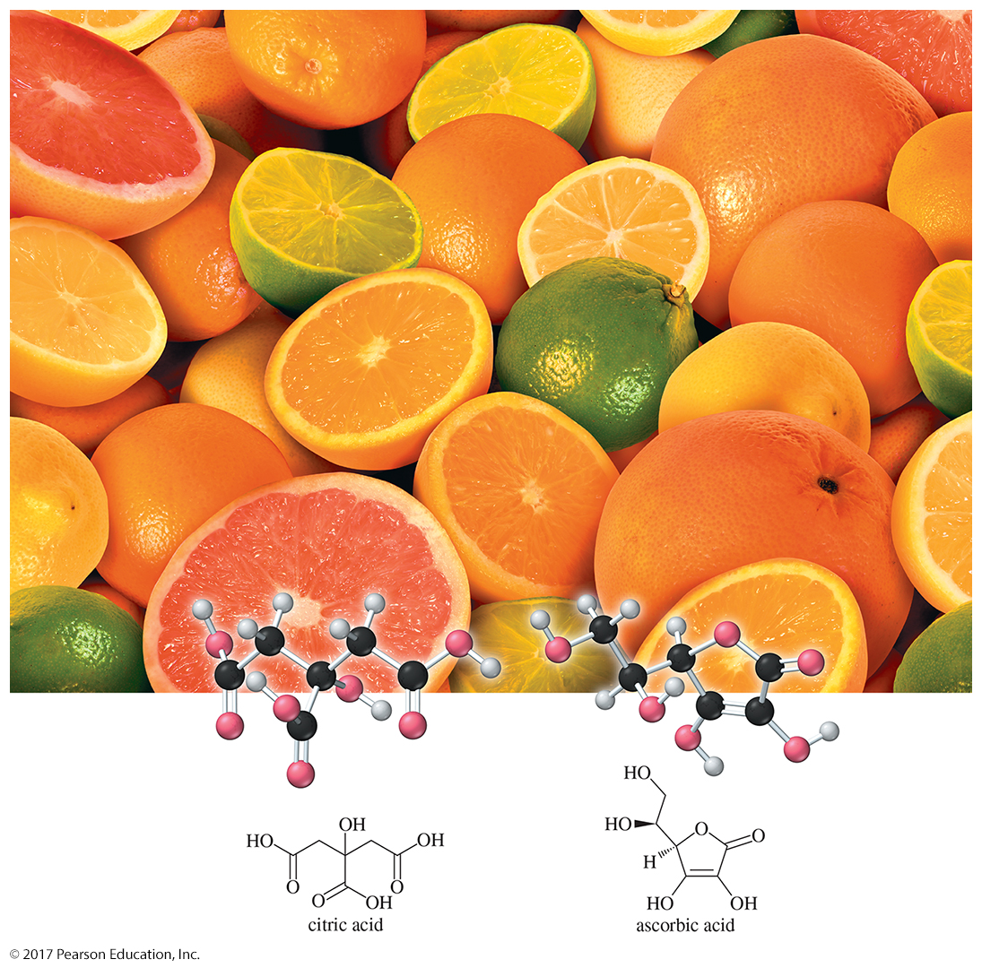
Organic Chemistry,
9th Edition
L. G. Wade, Jr.
Chapter 2
Lecture
Acids and Bases; Functional Groups
Chad Snyder, PhD
Grace College
© 2017 Pearson Education, Inc.

Slide 2
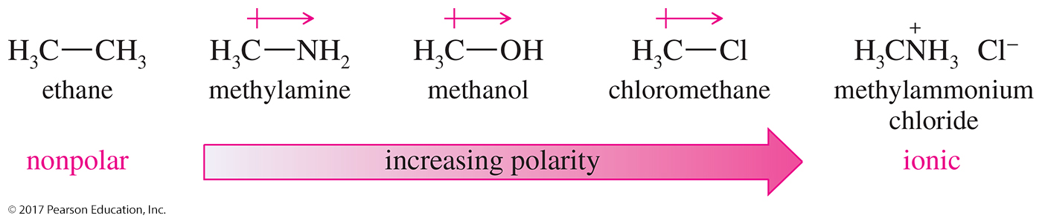
Bond Dipole Moments
Dipole moments are due to differences in electronegativity.
They depend on the amount of charge and distance of separation.
They are measured in debyes (D).

Slide 3
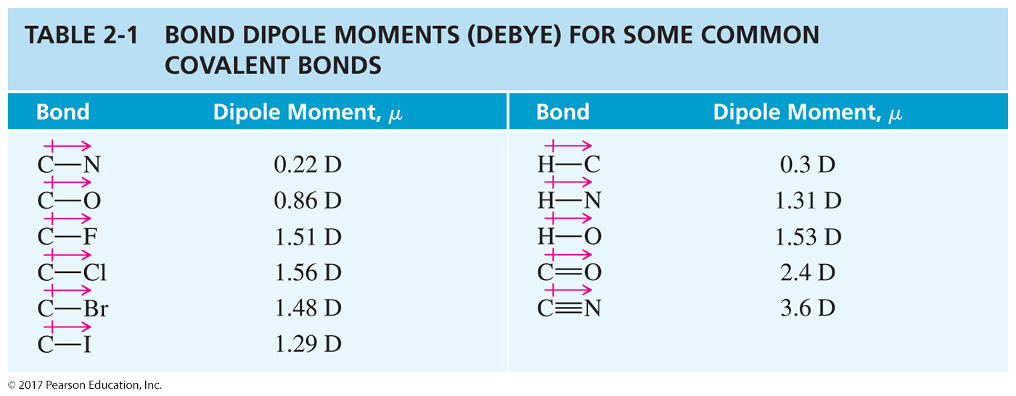

Slide 4
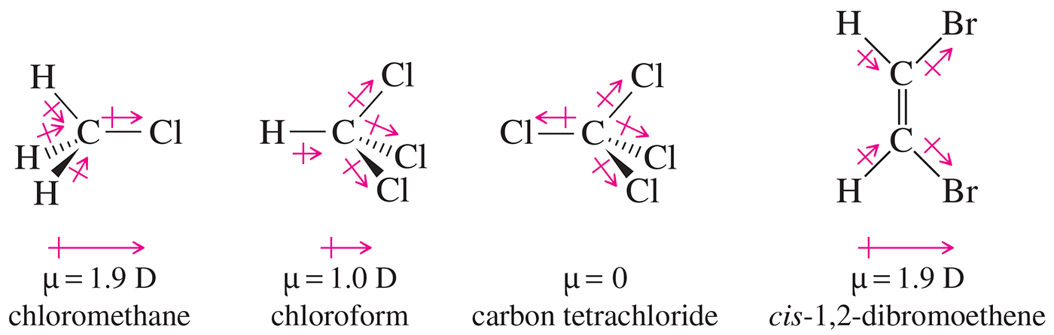
Molecular Dipole Moment
The molecular dipole moment is the vector sum of the bond dipole moments.
It depends on bond polarity and bond angles.
Lone pairs of electrons contribute to the dipole moment.

Slide 5
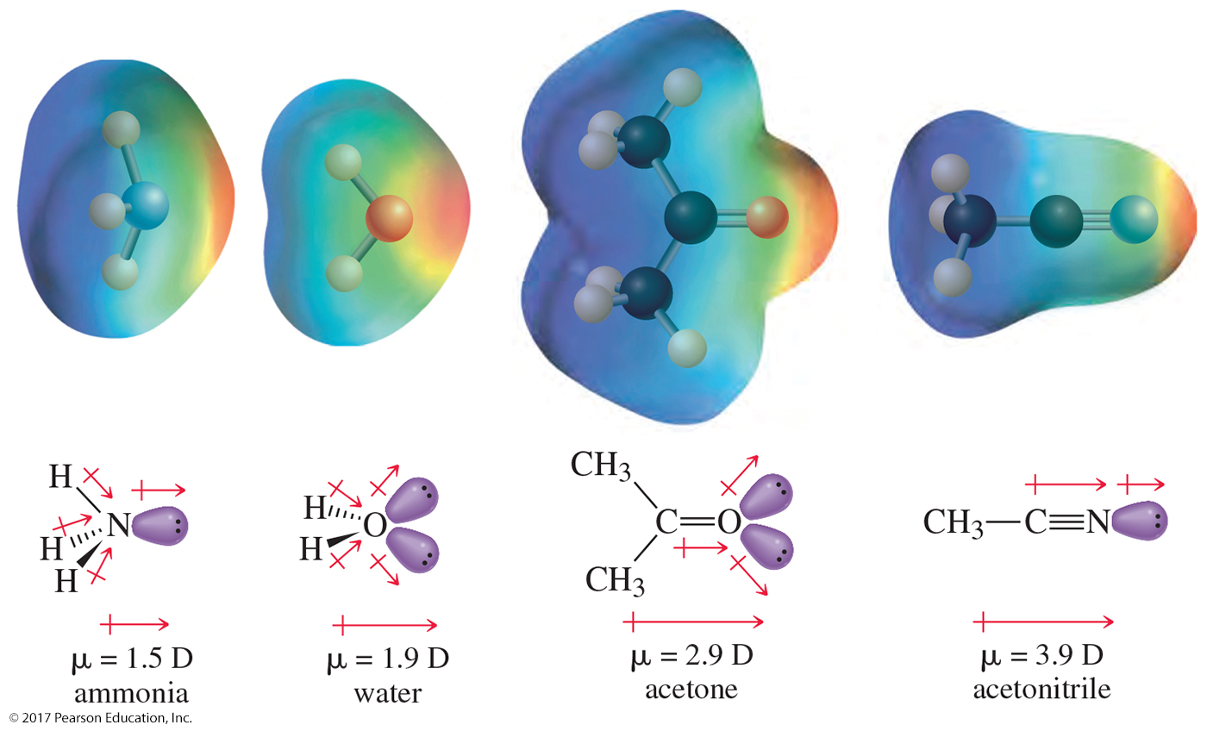
Lone Pairs and Dipole
Moments

Slide 6
Intermolecular Forces
Strength of attractions between molecules influences the melting point (m. p.), boiling point (b. p.), and solubility of compounds.
Classification of attractive forces:
  Dipole–dipole forces
  London dispersions forces
  Hydrogen bonding in molecules with —OH
  or —NH groups

Slide 7
Dipole–Dipole Forces
Dipole–dipole interactions result from the approach of two polar molecules.
If their positive and negative ends approach, the interaction is an attractive one.
If two negative ends or two positive ends approach, the interaction is repulsive.
In a liquid or a solid, the molecules are mostly oriented with the positive and negative ends together, and the net force is attractive.

Slide 8
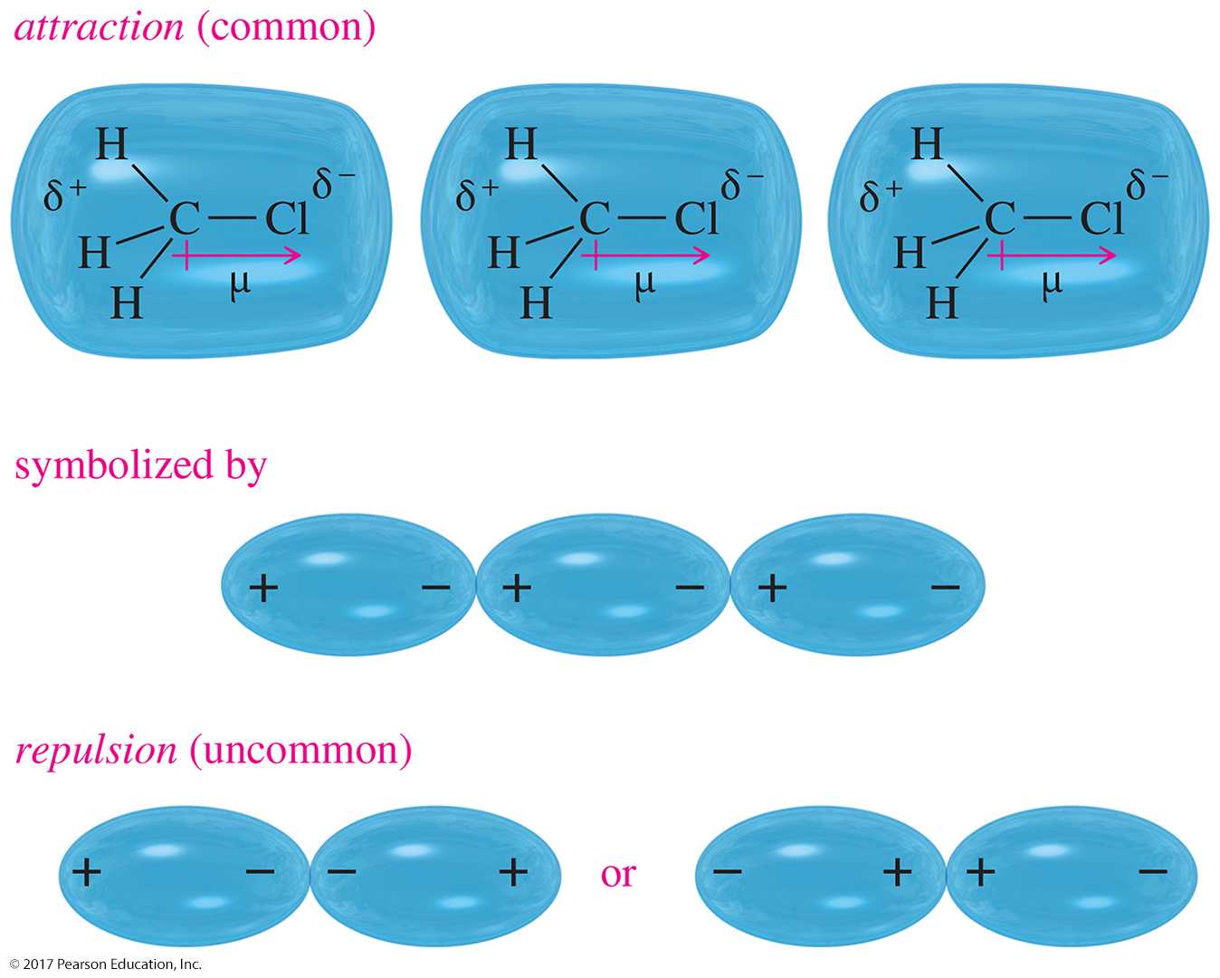
Dipole–Dipole Interaction

Slide 9
London Dispersion Forces
One of the Van der Waal forces
A temporary dipole moment in a molecule can induce a temporary dipole moment in a nearby molecule.
An attractive dipole–dipole interaction results for a fraction of a second.
Main force in nonpolar molecules
Larger atoms are more polarizable.

Slide 10
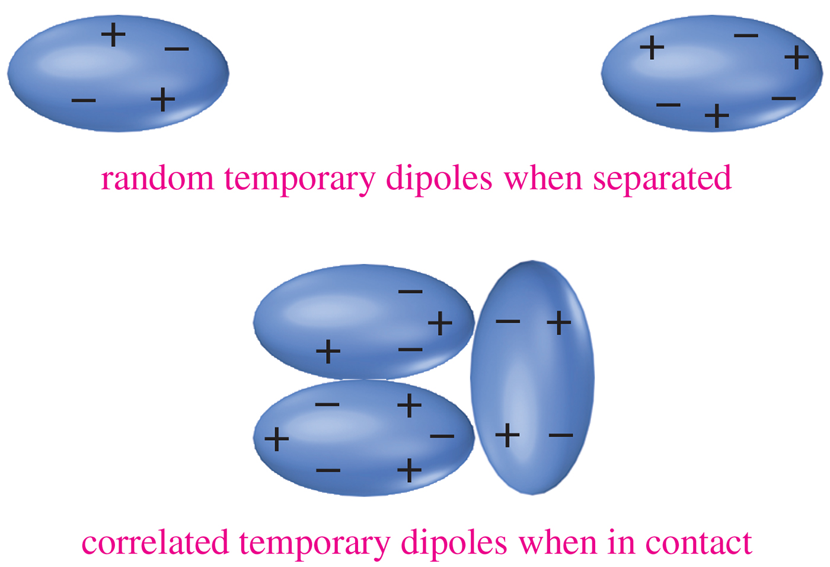
Dispersions

Slide 11
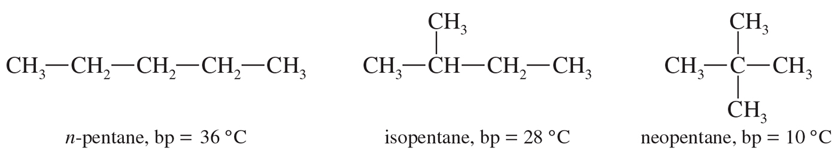
Effect of Branching on
Boiling Point
The long-chain isomer (n-pentane) has the greatest surface area and the highest boiling point.
As the amount of chain branching increases, the molecule becomes more spherical and its surface area decreases.
The most highly branched isomer (neopentane) has the smallest surface area and the lowest boiling point.

Slide 12
Hydrogen Bonding
Strong dipole–dipole attraction
Organic molecules must have N—H or O—H to be able to form a hydrogen bond.
The hydrogen from one molecule is strongly attracted to a lone pair of electrons on the oxygen of another molecule.
O—H is more polar than N—H, so alcohols have stronger hydrogen bonding.

Slide 13
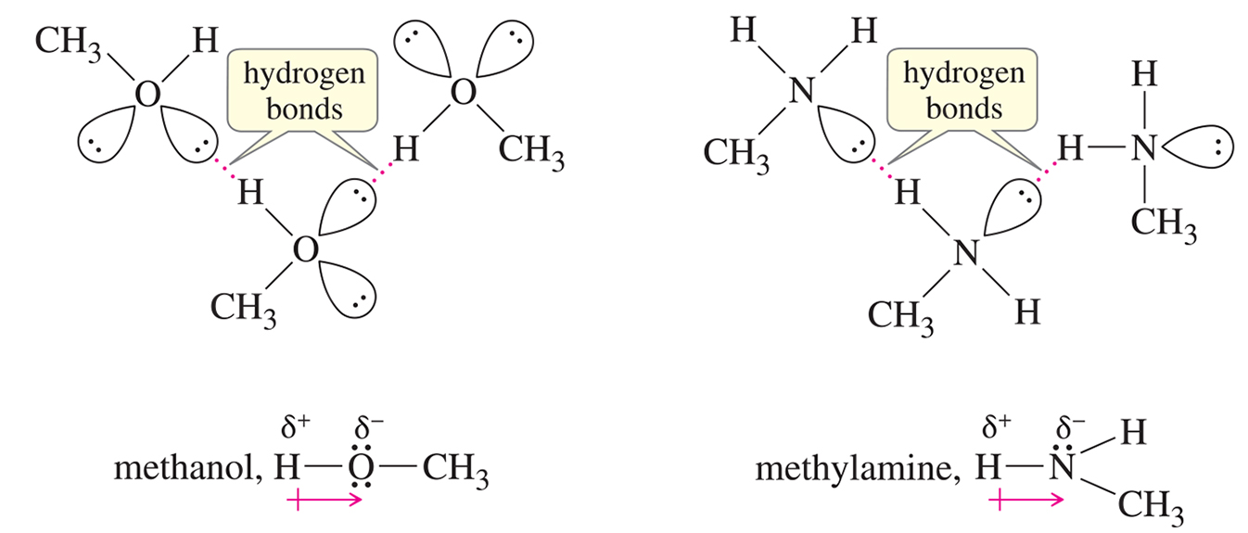
Hydrogen Bonds

Slide 14
Boiling Points and
Intermolecular Forces
C
H
C
H
O
H
C
H
3
O
C
H
3
3
2
ethanol, b. p. = 78 °C
dimethyl ether, b. p. = –25 °C
Hydrogen bonding increases the b. p. of the molecule.
C
H
C
H
O
H
C
H
3
C
H
2
N
H
2
3
2
ethanol, b. p. = 78 °C
ethyl amine, b. p. 17 °C
O—H is more polar than N—H, so alcohols have stronger
hydrogen bonding and, therefore, higher boiling points.

Slide 15
Polarity Effects on Solubility
Like dissolves like.
Polar solutes dissolve in polar solvents.
Nonpolar solutes dissolve in nonpolar solvents.
Molecules with similar intermolecular forces will mix freely.

Slide 16
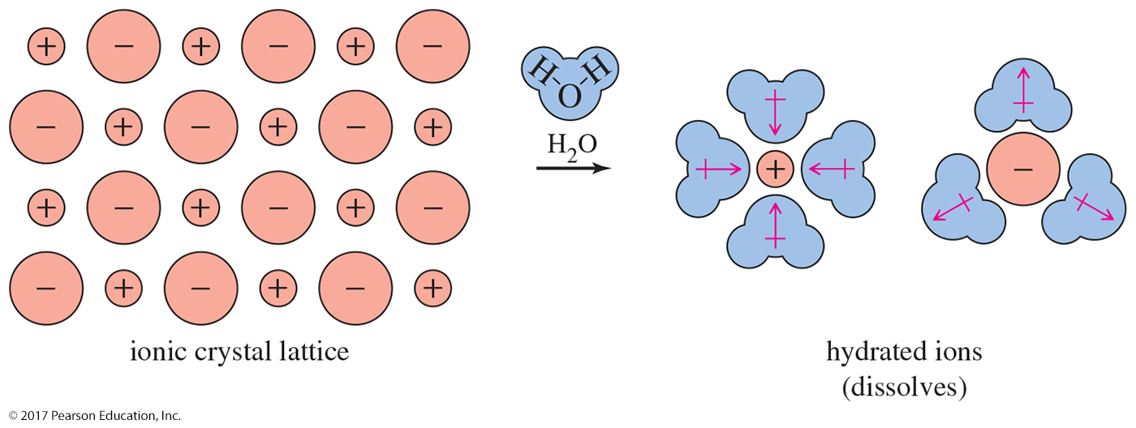
Polar Solute in Polar Solvent
A polar solute dissolves in a polar solvent.
Hydration releases energy; entropy increases.

Slide 17
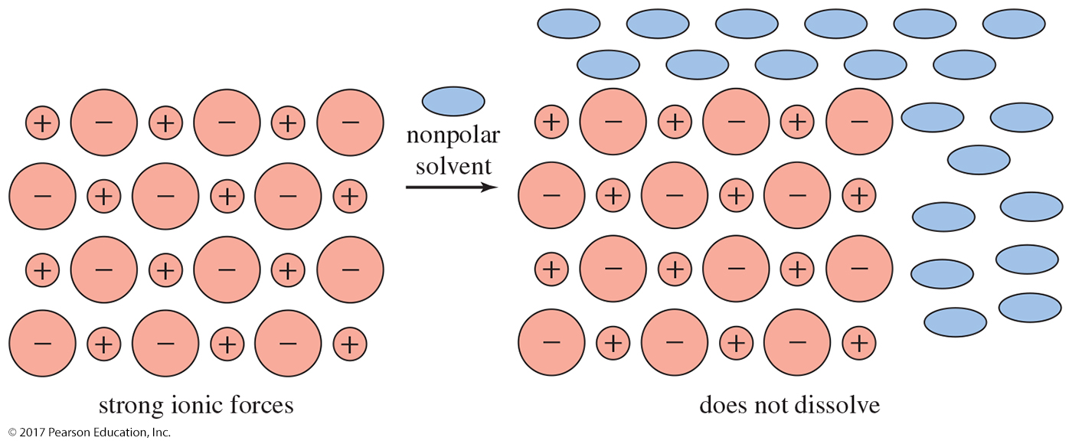
Polar Solute in Nonpolar Solvent
The solvent cannot break apart the intermolecular interaction of the solute, so the polar solid will not dissolve in the nonpolar solvent.

Slide 18
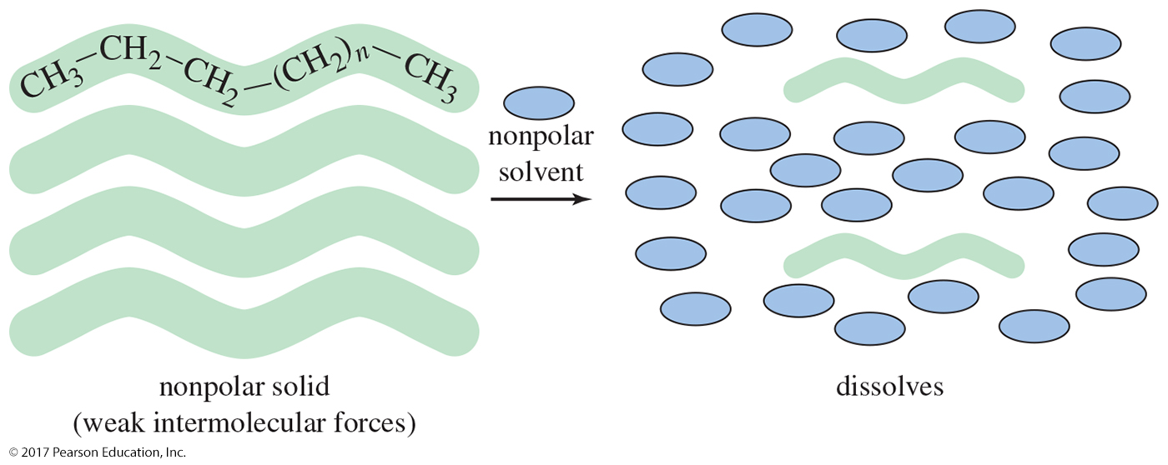
Nonpolar Solute in
Nonpolar Solvent
The weak intermolecular attractions of a nonpolar substance are overcome by the weak attractions for a nonpolar solvent. The nonpolar substance dissolves.

Slide 19
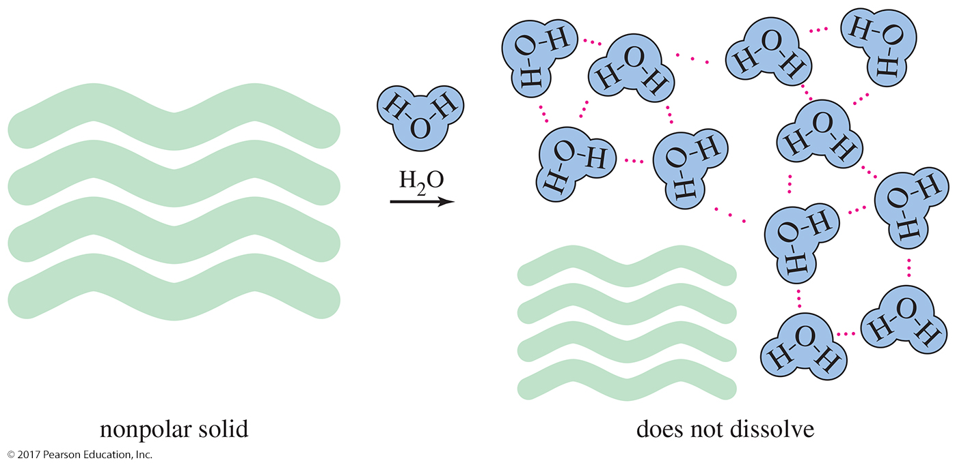
Nonpolar Solute with Polar Solvent
If a nonpolar molecule were to dissolve in water, it would break up the hydrogen bonds between the water molecules. Therefore, nonpolar substances do not dissolve in water.

Slide 20
Classes of Compounds
Classifications are based on
functional group.
Three broad classes:
  Hydrocarbons: Compounds composed of only carbon and hydrogen
  Compounds containing oxygen
  Compounds containing nitrogen

Slide 21
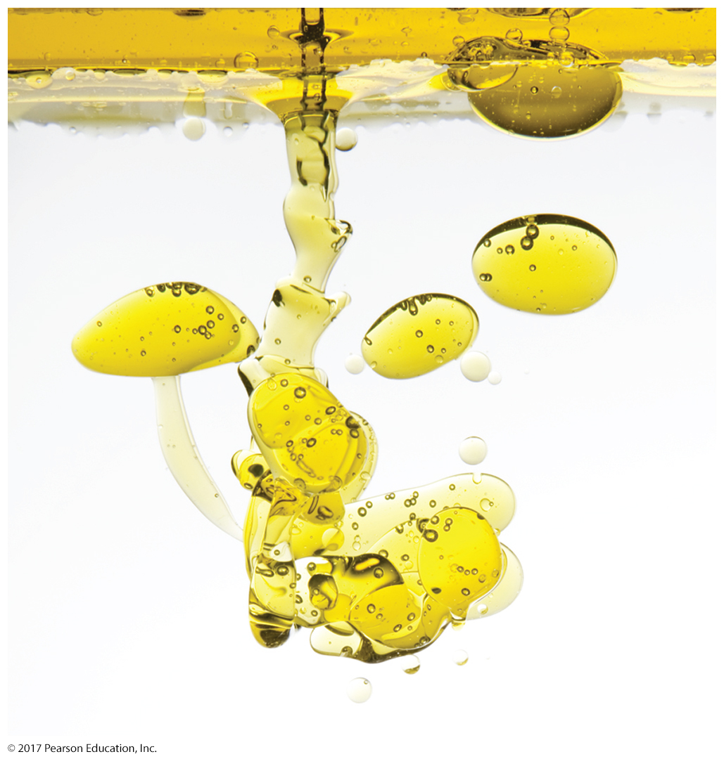
Hydrophobic and Hydrophilic

Slide 22
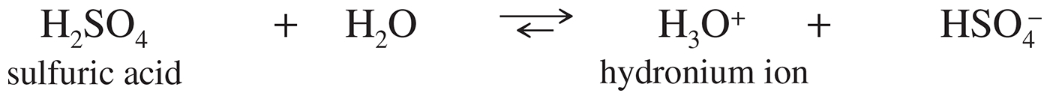
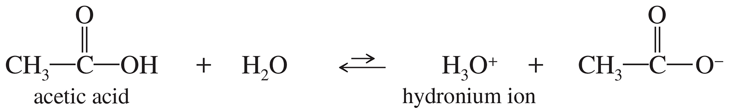
Arrhenius Acids
Arrhenius acids are substances that dissociate in water to give H₃O⁺ ions.
Stronger acids dissociate to a greater
degree than weaker acids.

Slide 23
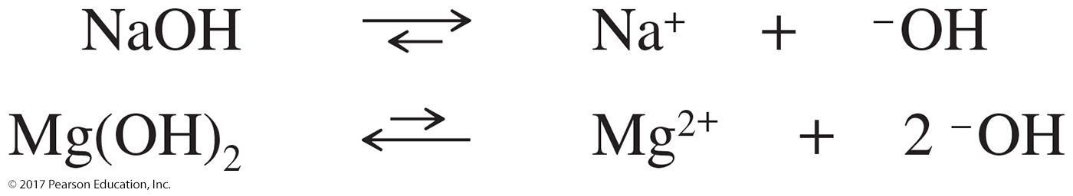
Arrhenius Bases
Arrhenius bases are substances that dissociate in water to give hydroxide ions.
Stronger bases (NaOH) dissociate more than weaker bases (Mg(OH)₂).

Slide 24
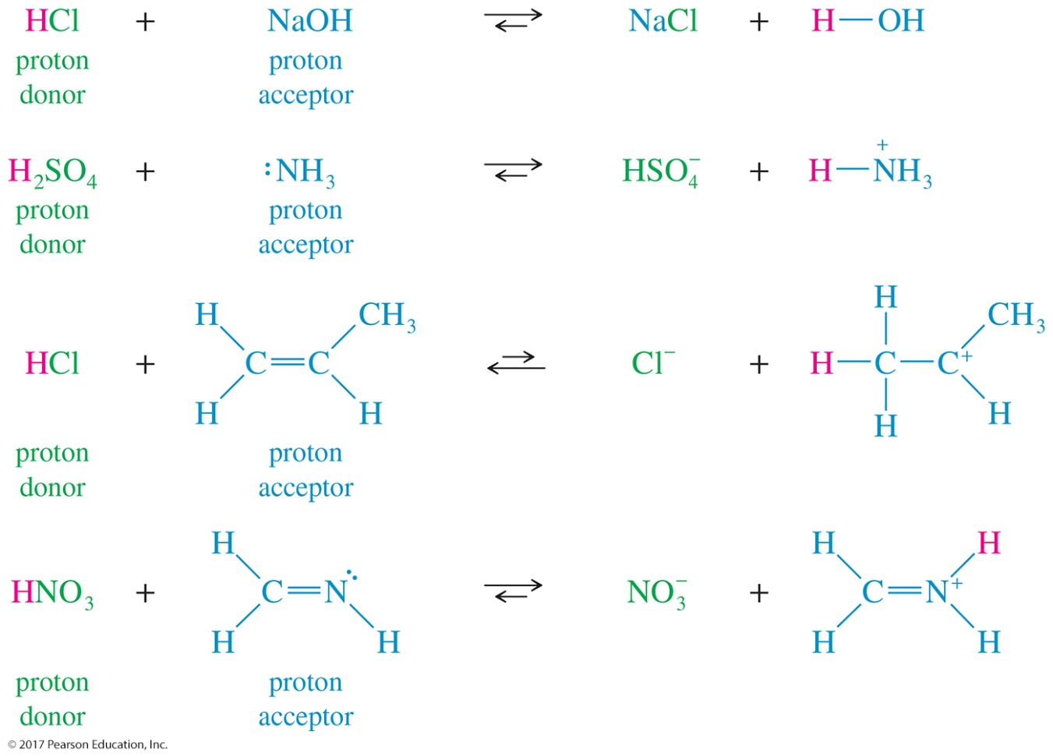
Brønsted–Lowry Acids and Bases
Brønsted–Lowry acids are any species that donate a proton. Brønsted–Lowry bases are any species that can accept a proton.

Slide 25
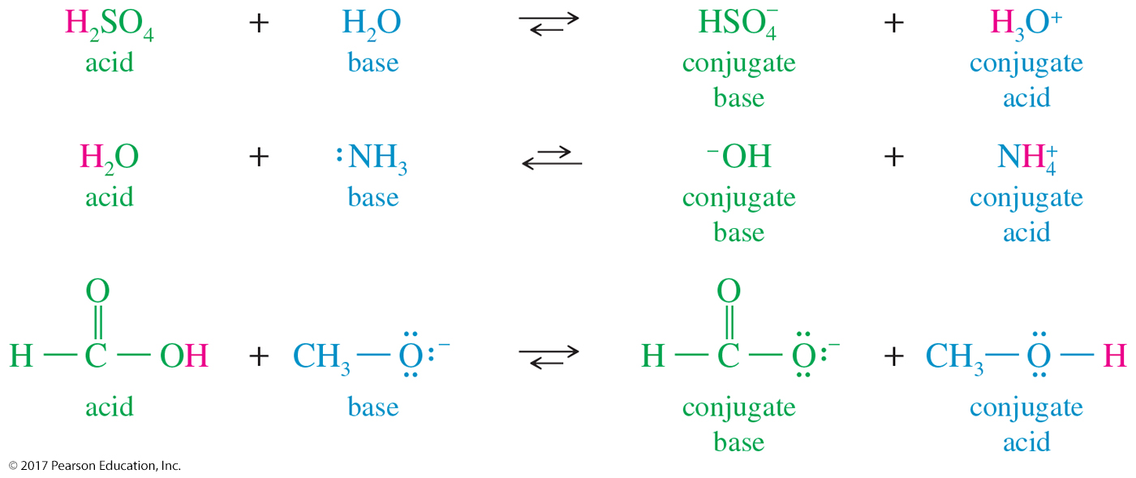
Conjugate Acids and Bases
Conjugate acid: When a base accepts a proton, it becomes an acid capable of returning that proton.
Conjugate base: When an acid donates its proton, it becomes capable of accepting that proton back.

Slide 26
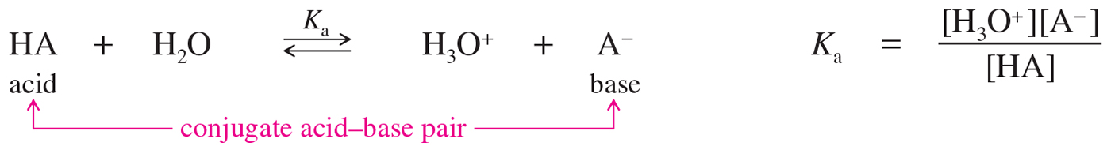
Acid Strength
an acid’s strength is expressed in its extent of ionization in water

Slide 27
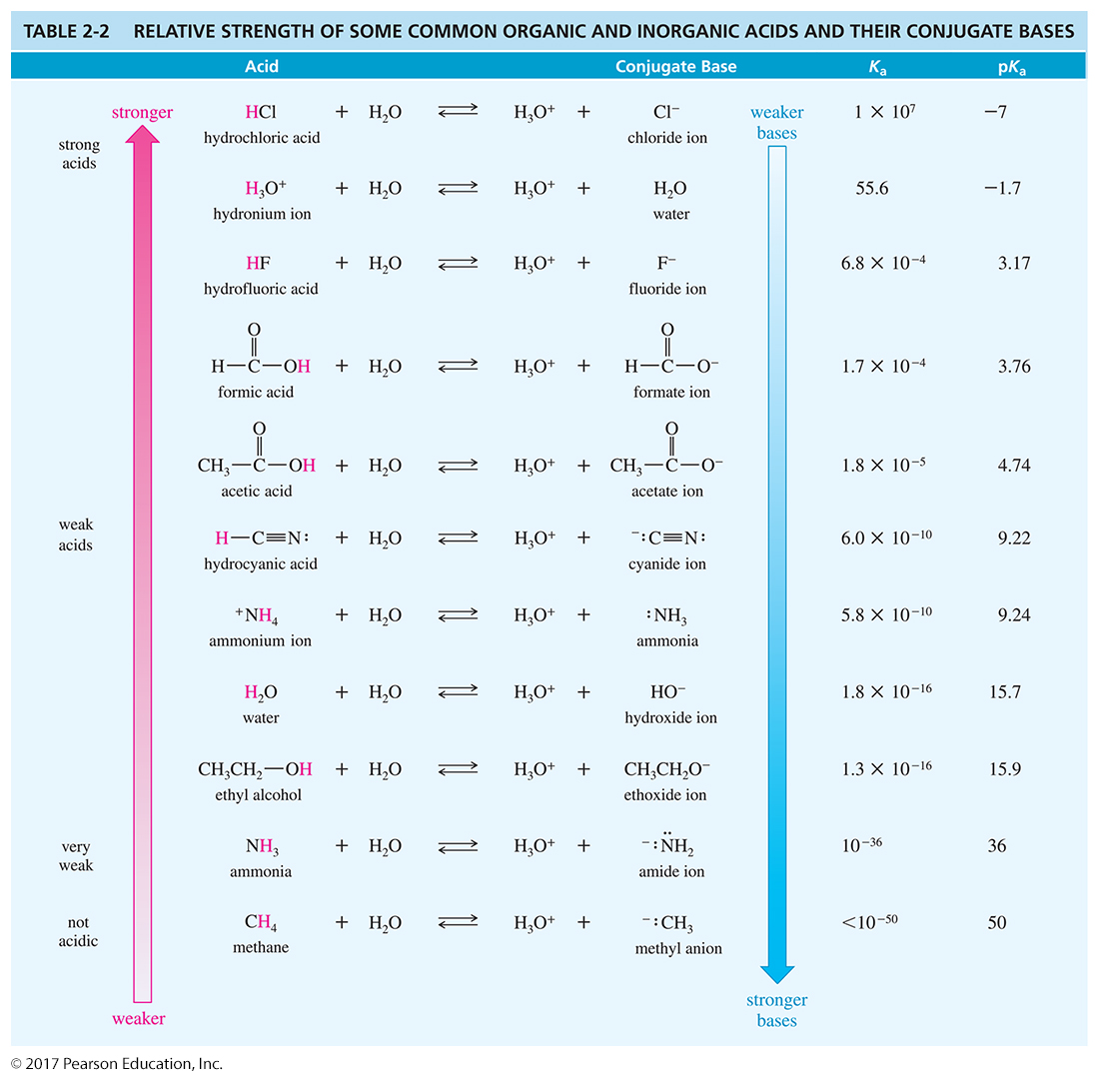

Slide 28
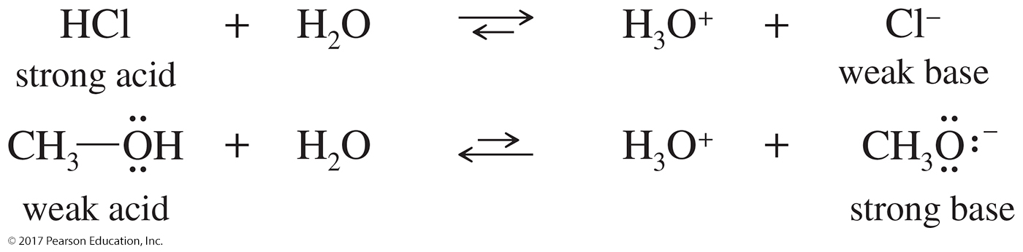
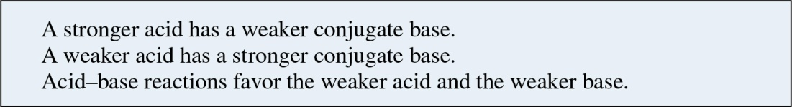
Base Strength
The strength of an acid is inversely related to the strength of its conjugate base.

Slide 29
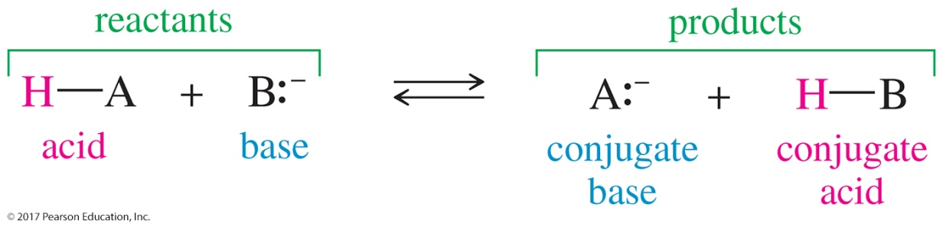
Equilibrium Positions of Acid–Base Reactions
1. The acid–base equilibrium favors formation of the weaker acid and the weaker base.
2. The weaker acid has the larger pK_{a}. The weaker base has the larger pK_{b}.
3. The weaker acid and the weaker base are always on the same side of the equation. Both of them are reactants, or both of them are products.

Slide 30
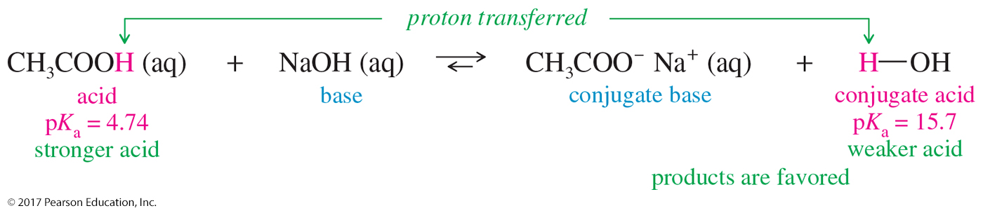
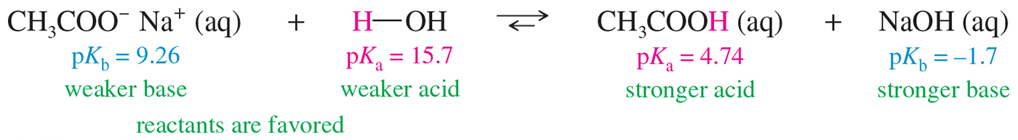
Equilibrium Positions of
Acid–Base Reactions

Slide 31
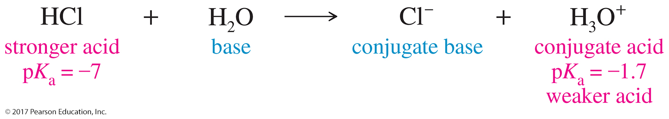
Solvent Effects on Acidity and Basicity
Water is amphoteric; it can react with an acid or a base.
Its conjugate acid is the hydronium ion, and its conjugate base is the hydroxide ion.

Slide 32
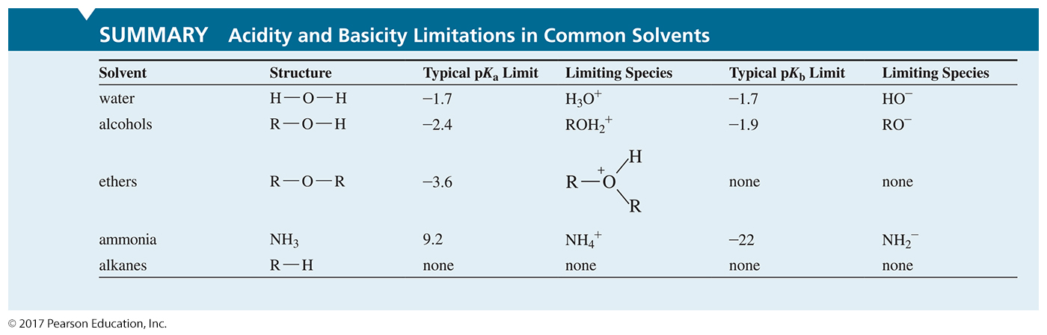

Slide 33
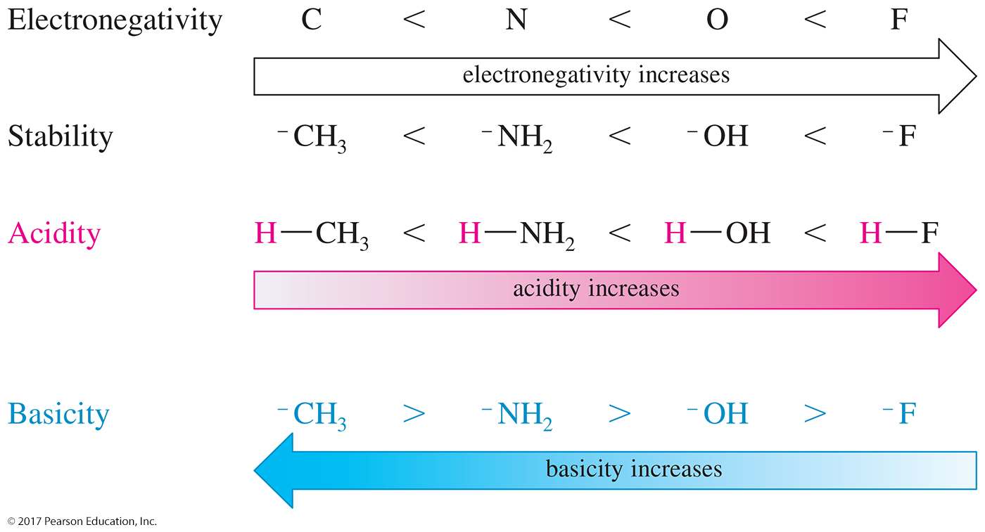
Effect of Electronegativity on pK_{a}
A more electronegative element bears a negative charge more easily, giving a more stable conjugate base and a stronger acid.

Slide 34
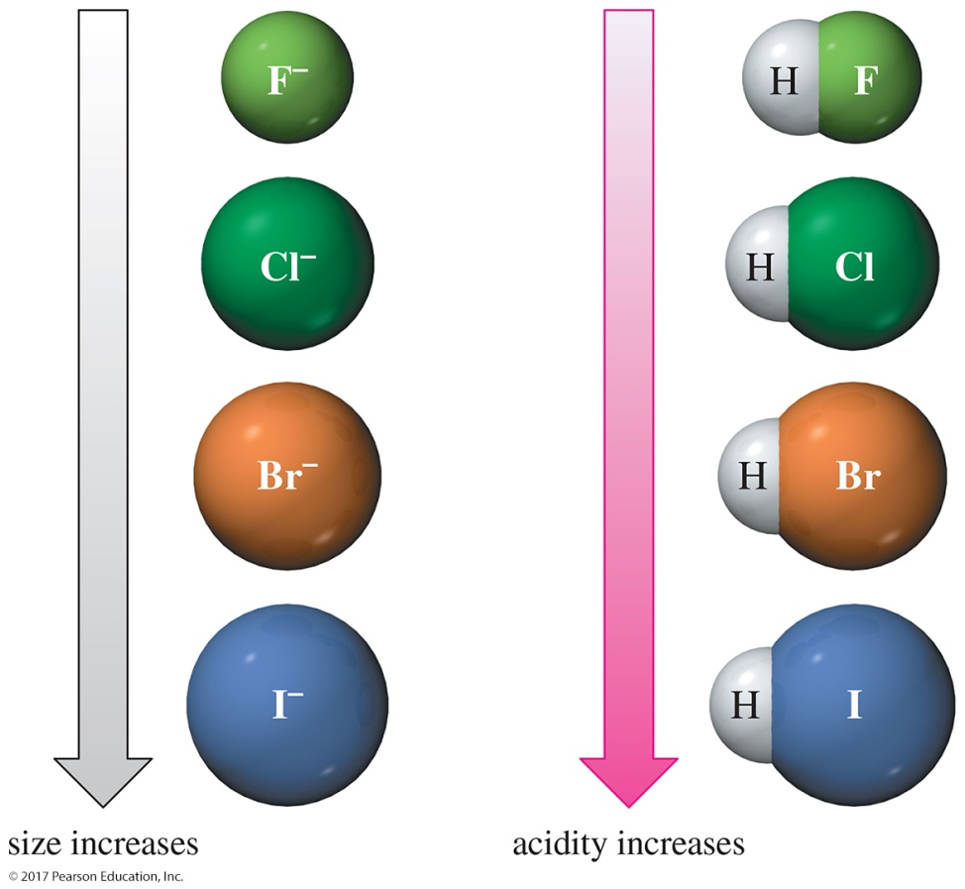
Effect of Size on pK_{a}
The negative charge of an anion is more stable if it is spread over a larger region of space.
Within a column of the periodic table, acidity increases down the column.

Slide 35
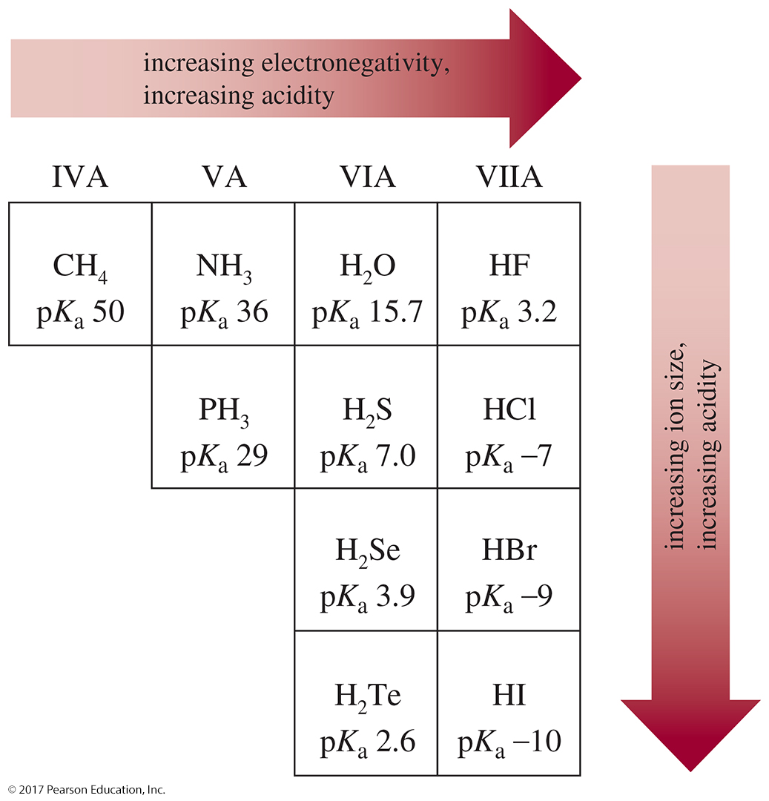

Slide 36
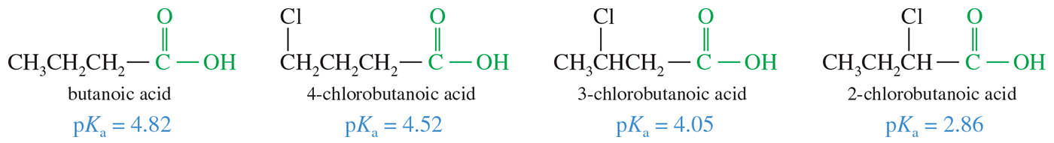
Inductive Effects on Acidity
Electron-withdrawing atoms and groups can stabilize a conjugate base through the sigma bonds of the molecule.
The magnitude of this inductive effect depends on the number of bonds between the electronegative element and the site of the negative charge.

Slide 37
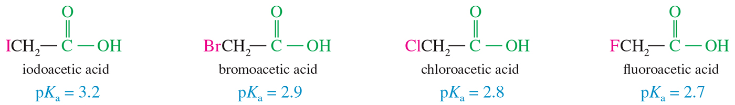
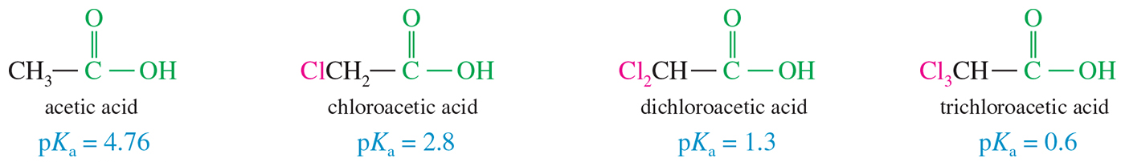
Inductive Effects on Acidity
Stronger electron-withdrawing groups stabilize the anion of the conjugate base more than weaker groups do.
Multiple electron-withdrawing groups stabilize the conjugate base and increase the acidity more than a single group does.

Slide 38
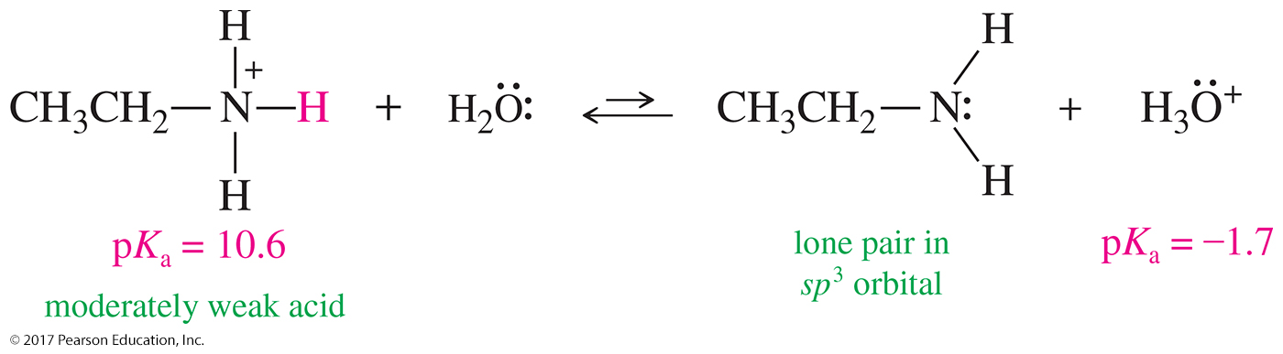
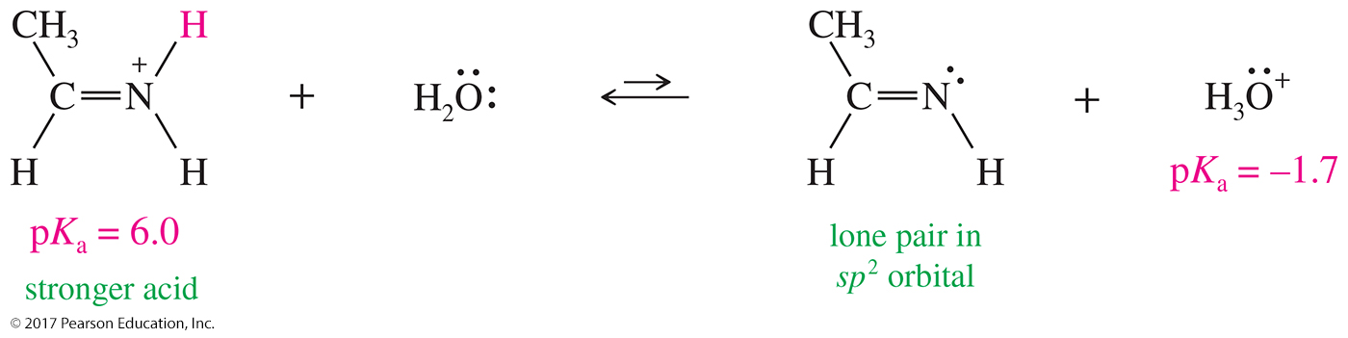
Hybridization Effects on Acidity
The different hybridization states strongly influence acidity.

Slide 39
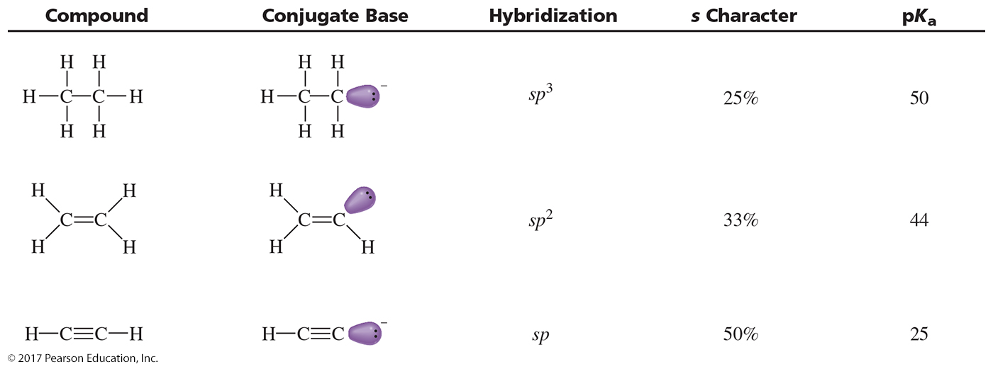
Hybridization Effects on Acidity

Slide 40
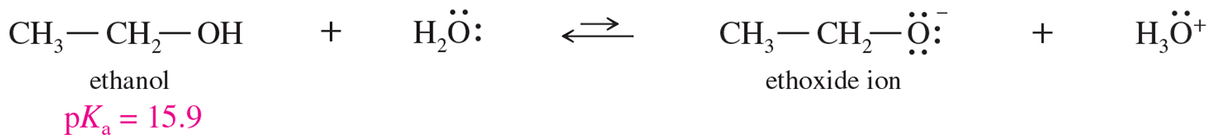
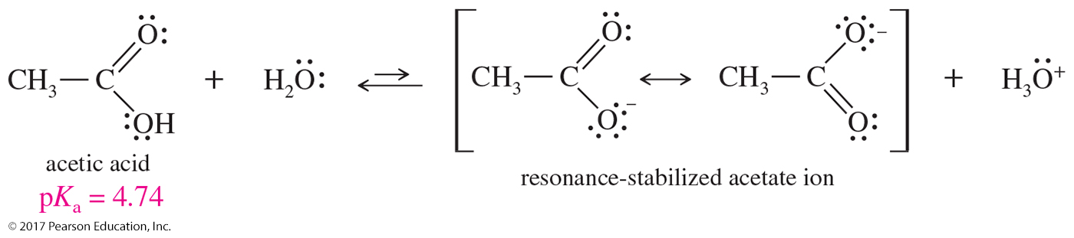
Effect of Resonance on pK_{a}
If the negative charge on an atom can be delocalized over two or more atoms, the acidity of that compound will be greater than when the negative charge cannot be delocalized.
The ethoxide anion is less acidic than the acetate ion simply because the acetate ion can delocalize the negative charge.
Methanesulfonic acid can delocalize the charge in three different resonance forms, making it more acidic than the acetate ion.

Slide 41
Lewis Acids and Lewis Bases
Lewis bases (called nucleophiles) are species with available electrons than can be donated to form a new bond.
Lewis acids are species that can accept these electrons to form new bonds.
Since a Lewis acid accepts a pair of electrons, it is called an electrophile.

Slide 42
Nucleophiles and Electrophiles
Nucleophile: Donates electrons to a nucleus with an empty orbital
Electrophile: Accepts a pair of electrons
When forming a bond, the nucleophile attacks the electrophile, so the arrow goes from negative to positive.
When breaking a bond, the more electronegative atom receives the electrons.

Slide 43
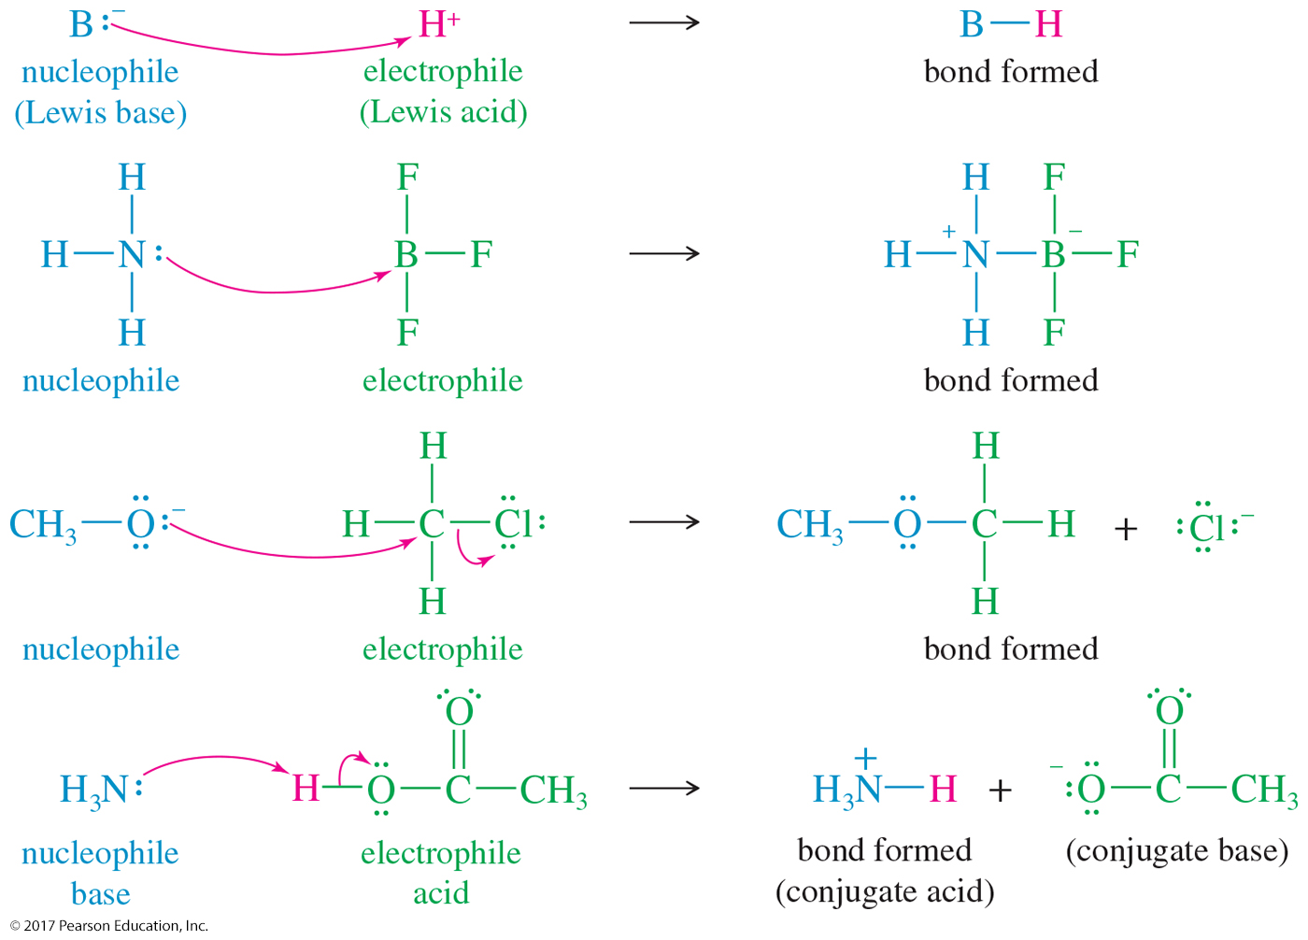

Slide 44
Hydrocarbons
Alkanes: Single bonds between the carbons; all carbons are sp³.
Cycloalkanes: sp³ carbons form a ring.
Alkenes: Double bonds are present in the molecule; sp² carbons.
Cycloalkenes: Double bond in a ring
Alkynes: Triple bonds are present; sp carbons.
Aromatic: Contain a benzene ring

Slide 45
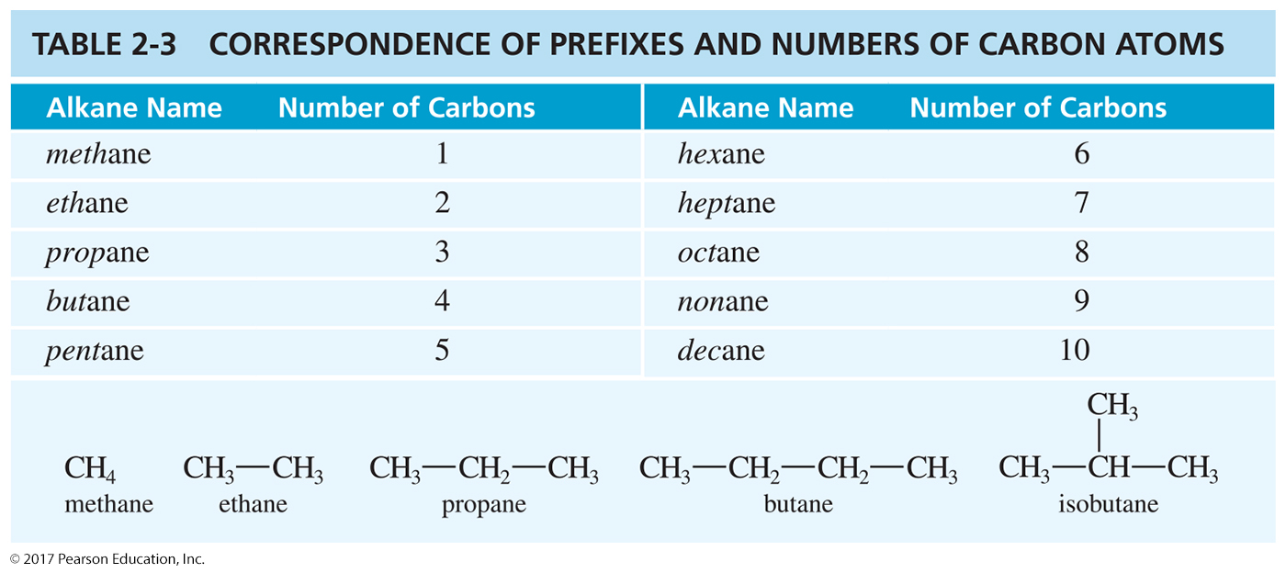
Alkane Naming

Slide 46
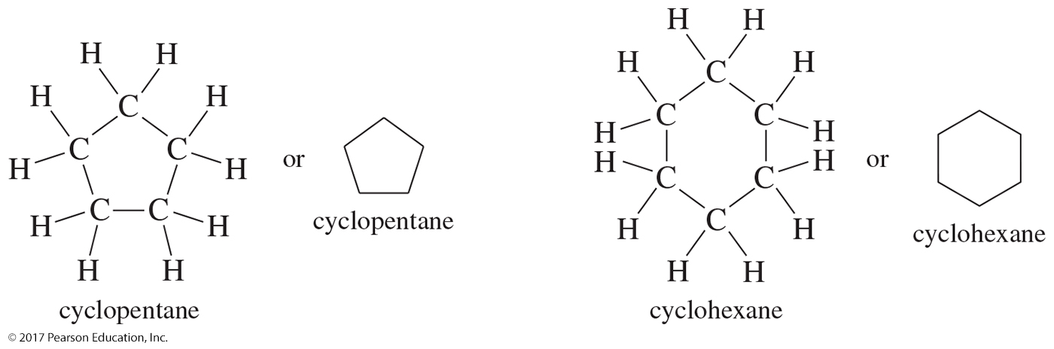
Cycloalkanes
Cycloalkanes are a special class of alkanes in the form of a ring.

Slide 47
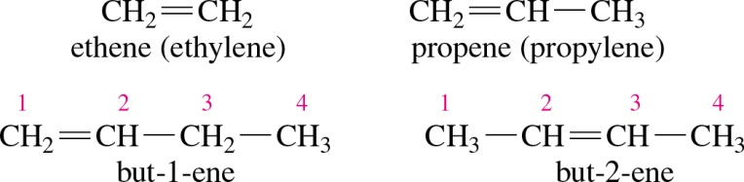
Alkenes
Alkenes are hydrocarbons that contain carbon–carbon double bonds.
Alkene names end in the –ene suffix.
If the double bond might be in more than one position, then the chain is numbered and the lower number of the two double-bonded carbons is added to the name to indicate the position of the double bond.

Slide 48
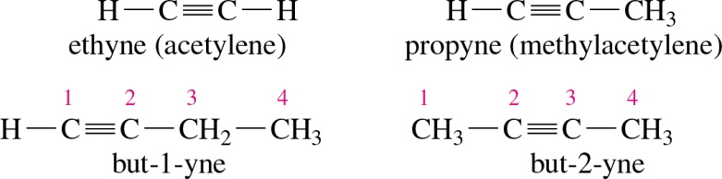
Alkenes
Alkynes are hydrocarbons that contains carbon–carbon triple bonds.
Alkyne names end in the –yne suffix.

Slide 49
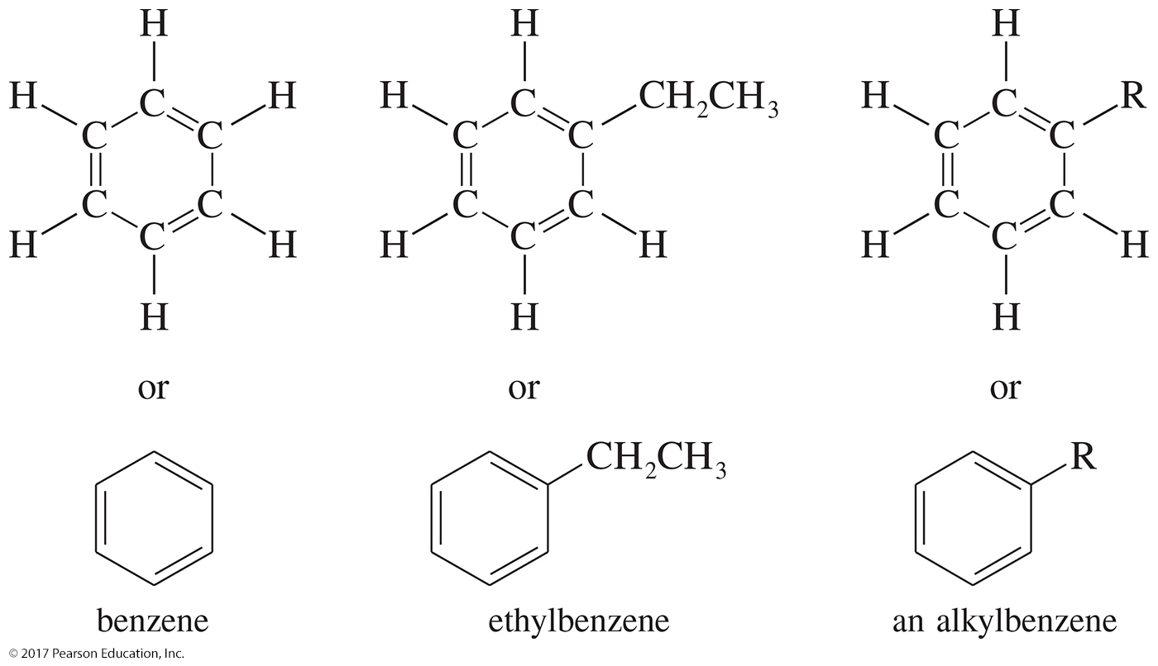
Aromatic Hydrocarbons
Aromatic hydrocarbons (also called arenes) are all derivatives of benzene.

Slide 50
Compounds Containing Oxygen
Alcohols: Contain the hydroxyl group as the main functional group
Ethers: Contain two alkyl groups bonded to an oxygen
Aldehydes and ketones: Contain the carbonyl group, C═O
Carboxylic acids: Contain the carboxyl group, —COOH

Slide 51
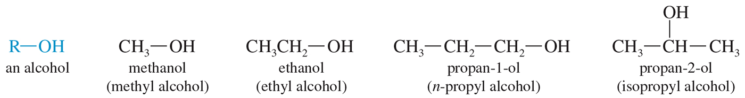
Alcohols
Alcohols are organic compounds that contain the hydroxyl group (—OH).

Slide 52
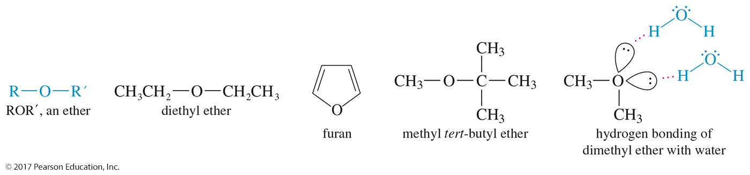
Ethers
Ethers are composed of two alkyl groups bonded to an oxygen atom.

Slide 53
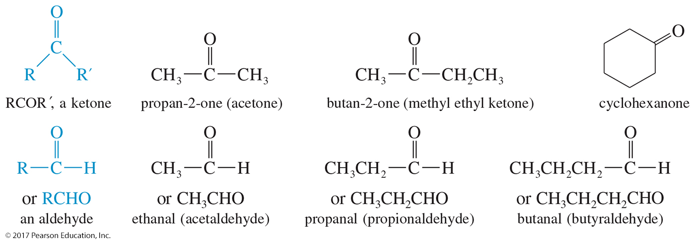
Aldehydes and Ketones
The carbonyl group, C═O, is the functional group for both aldehydes and ketones.
A ketone has two alkyl groups bonded to the carbonyl group; an aldehyde has one alkyl group and a hydrogen atom bonded to the carbonyl group.

Slide 54
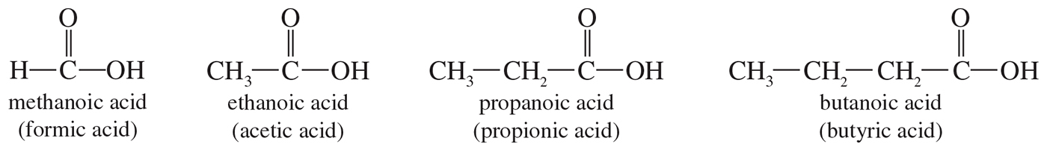
Carboxylic Acids
Carboxylic acids contain the carboxyl group, —COOH, as their functional group.
The carboxyl group is a combination of a carbonyl group and a hydroxyl group.

Slide 55
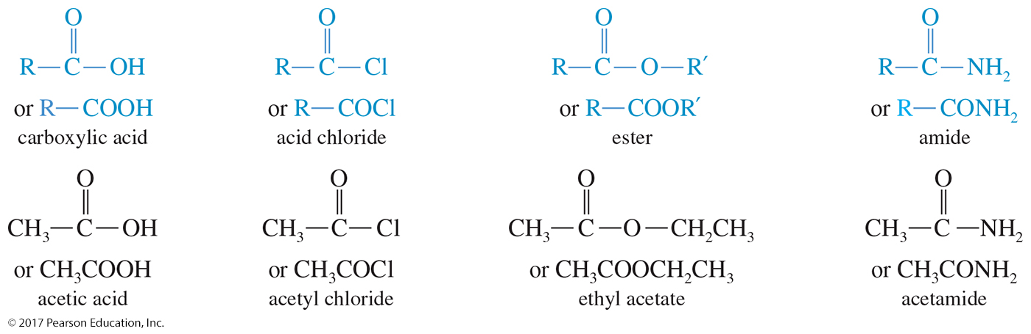
Carboxylic Acid Derivatives
Carboxylic acids are easily converted to a variety of acid derivatives.
Each derivative contains the carbonyl group bonded to an oxygen or another electron-withdrawing element.
These derivatives include acid chlorides, esters, and amides.

Slide 56
Compounds Containing Nitrogen
Amines: Alkylated derivatives of ammonia
Amides: Carboxylic acid derivative with a nitrogen attached to the carbonyl group
Nitriles: Contain the cyano group

Slide 57

Amines
Amines are alkylated derivatives of ammonia.

Slide 58


Amides
Amides are derivatives that result from a combination of an acid with ammonia or an amine.

Slide 59

Nitriles
A nitrile is a compound containing the cyano group.

