Slide 1
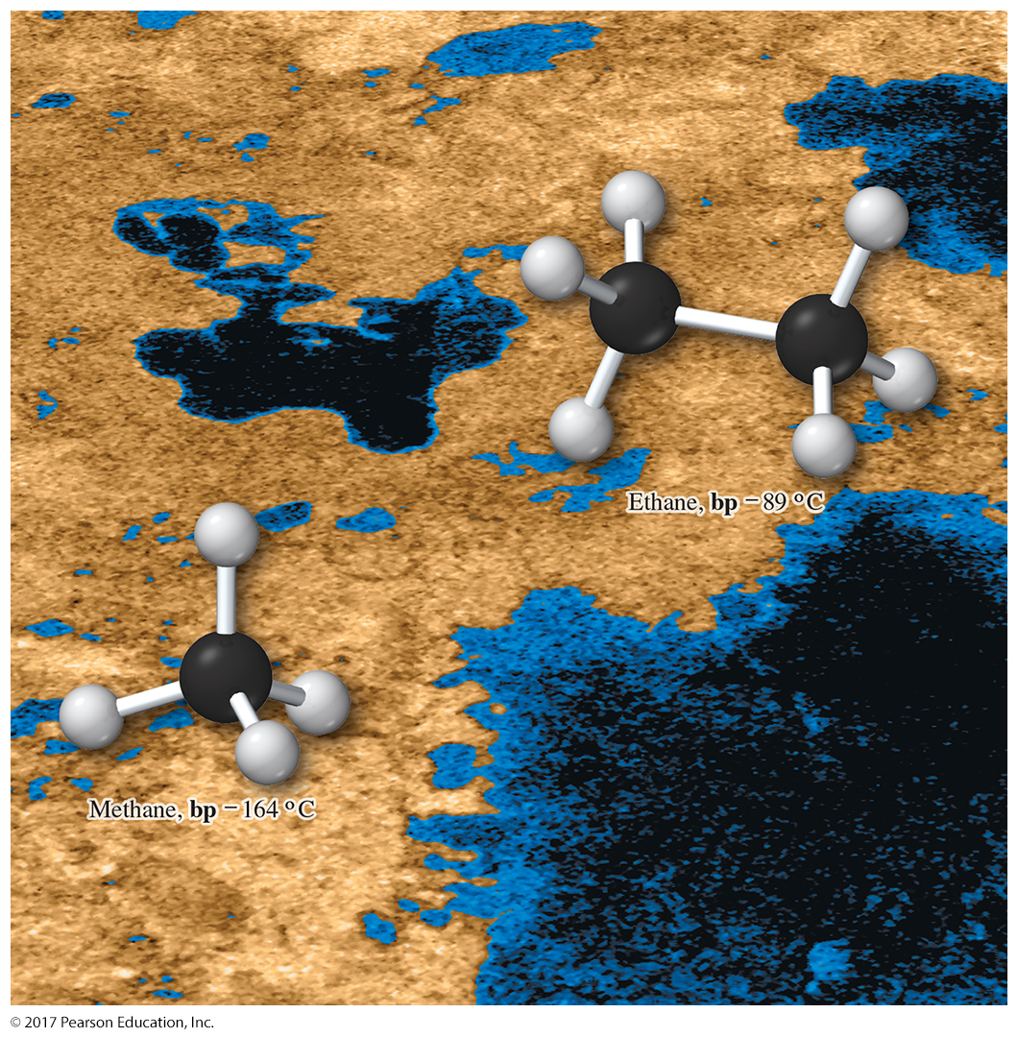
Organic Chemistry,
9th Edition
L. G. Wade, Jr.
Chapter 3
Lecture
Structure and Stereochemistry
of Alkanes
Chad Snyder, PhD
Grace College
© 2017 Pearson Education, Inc.

Slide 2
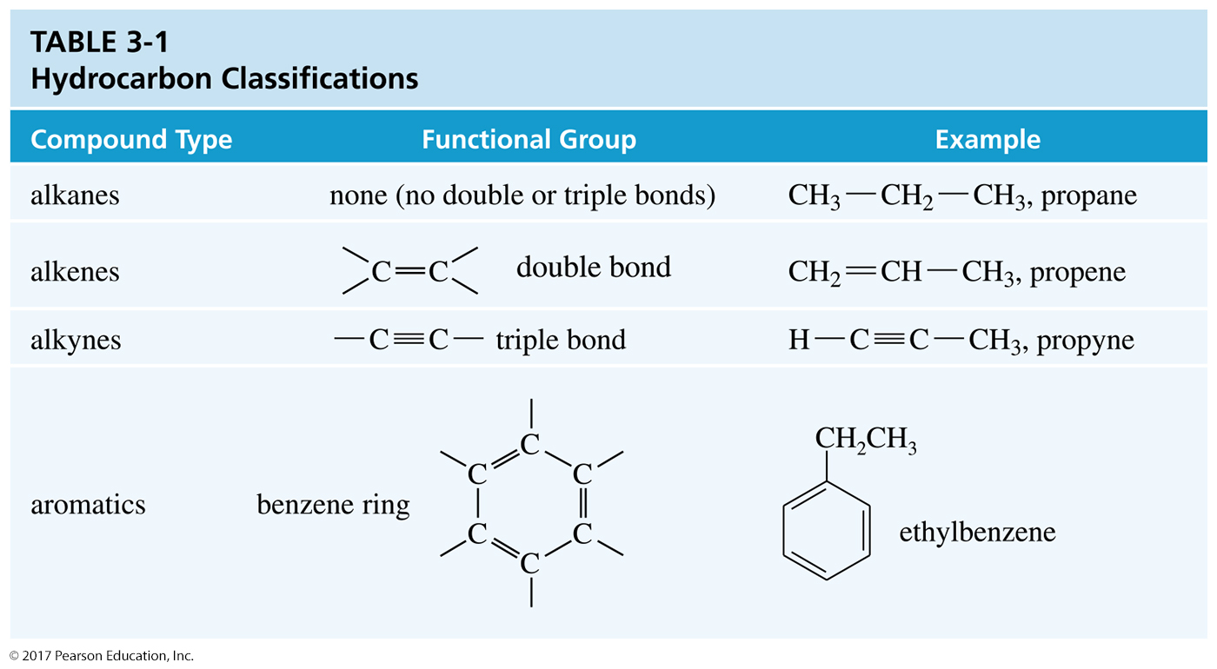
Hydrocarbons
Hydrocarbons are molecules that are made of carbon
and hydrogen only.

Slide 3
Alkanes
General formula: C_{n}H_{2n+2}
These are found in everything from natural gas to petroleum.
The smaller alkanes have very low boiling points (b. p.); therefore, they are gases.
CH₄ C₂H₆ C₃H₈
b. p. –160 °C –89 °C –42 °C

Slide 4
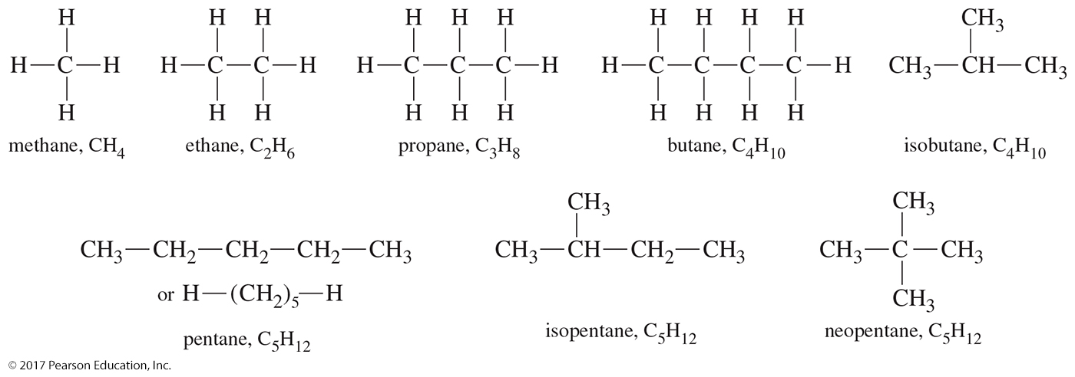
Alkane Examples
The –CH₂– group is called a methylene group.
A series of compounds that differ only in the number of methylene groups is known as a homologous series.

Slide 5
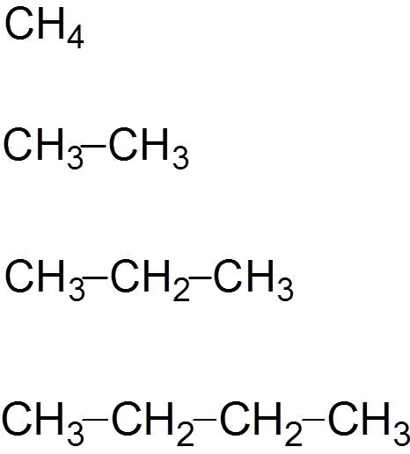
Small Alkanes (C_{n}H_{2n+2})
Methane
Ethane
Propane
Butane

Slide 6
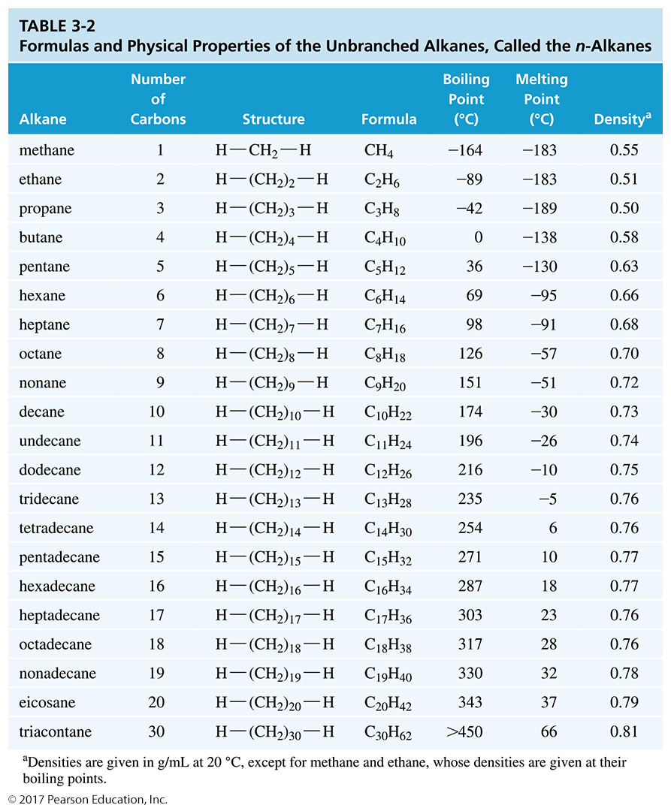
Formulas and Physical Properties of Alkanes

Slide 7
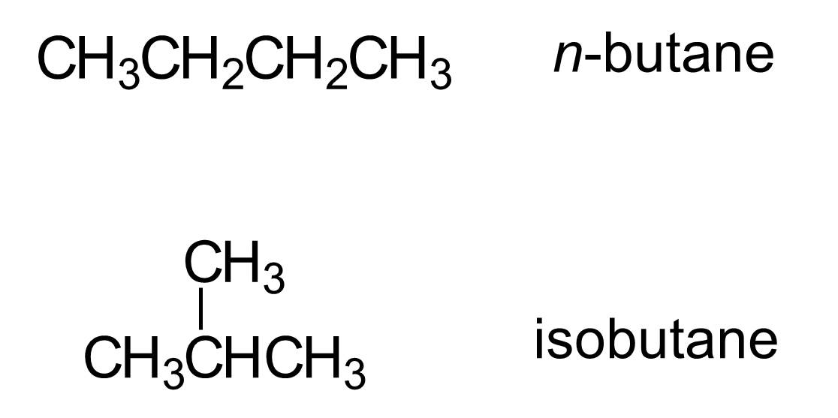
Butane: C₄H₁₀
Constitutional isomers are compounds with the same molecular formula but the carbons are connected differently.

Slide 8
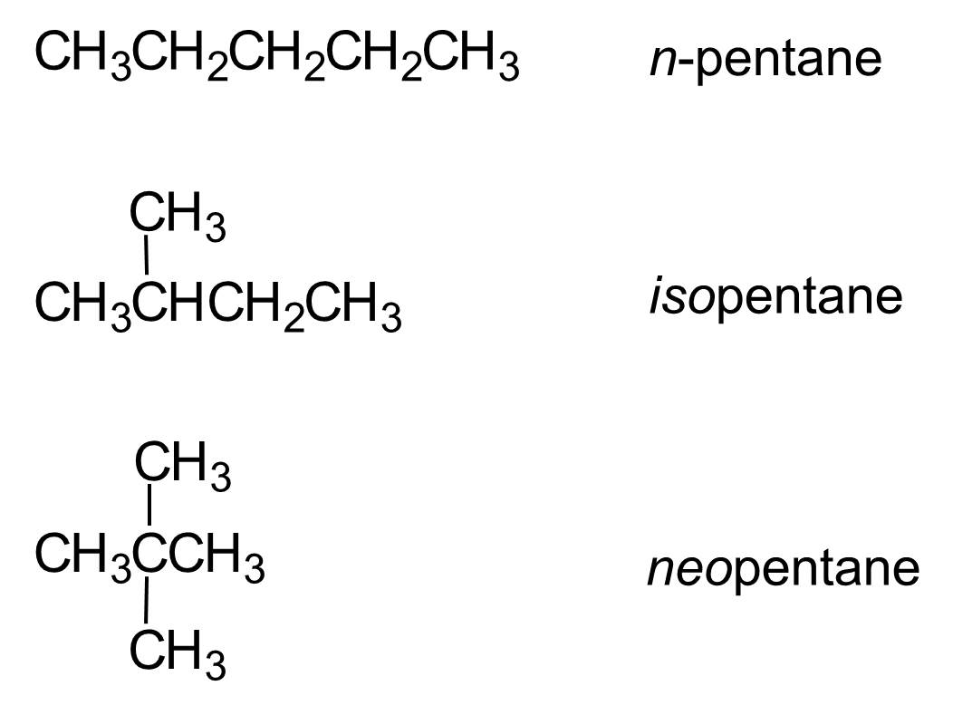
Pentanes: C₅H₁₂

Slide 9
IUPAC or Systematic Names
International Union of Pure and Applied Chemistry
This standard method is used internationally to name compounds.
It uses the longest chain of carbons as the
main chain.
Common names are kept: methane, ethane, propane, and butane.

Slide 10
IUPAC Rules
Rule 1: Find the longest continuous chain of carbon atoms and use the name of this chain as the base name of the compound.
Rule 2: Number the longest chain, beginning with the end of the chain nearest a substituent.
Rule 3: Name the groups attached to the longest chain as alkyl groups. Give the location of each alkyl group by the number of the main-chain carbon atom to which it is attached.
Write the alkyl groups in alphabetical order regardless of their position on the chain.

Slide 11
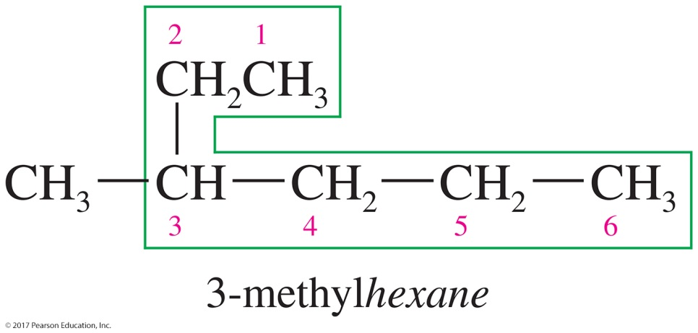
Rule 1: The Main Chain
Find the longest chain of consecutive carbons.
The longest chain is six carbons:
hexane

Slide 12
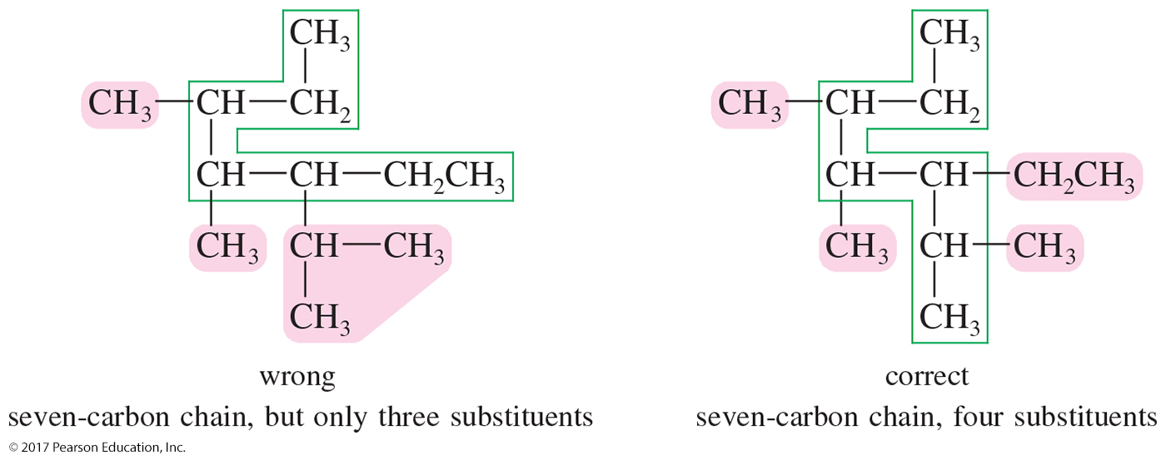
Main Chain
When there are two longest chains of equal length, use the chain with the greatest number of substituents.

Slide 13
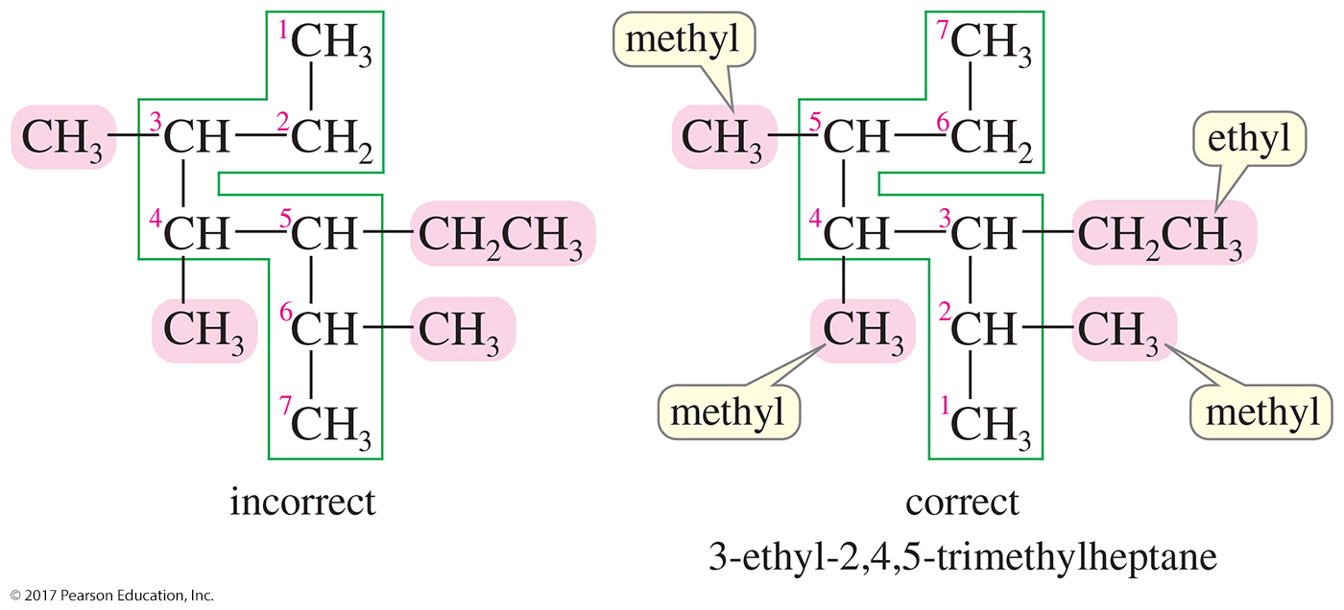
Rule 2: Numbering the
Main Chain
Number the longest chain beginning at the end of the chain nearest a substituent.

Slide 14
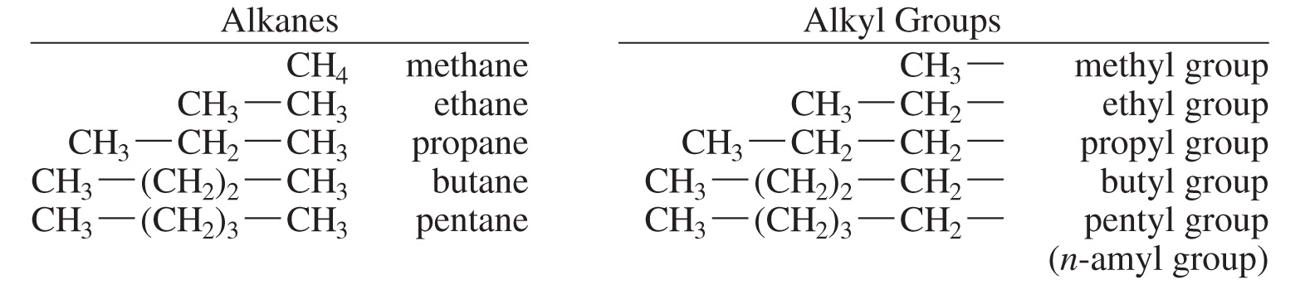
Rule 3: Naming Alkyl Groups

Slide 15
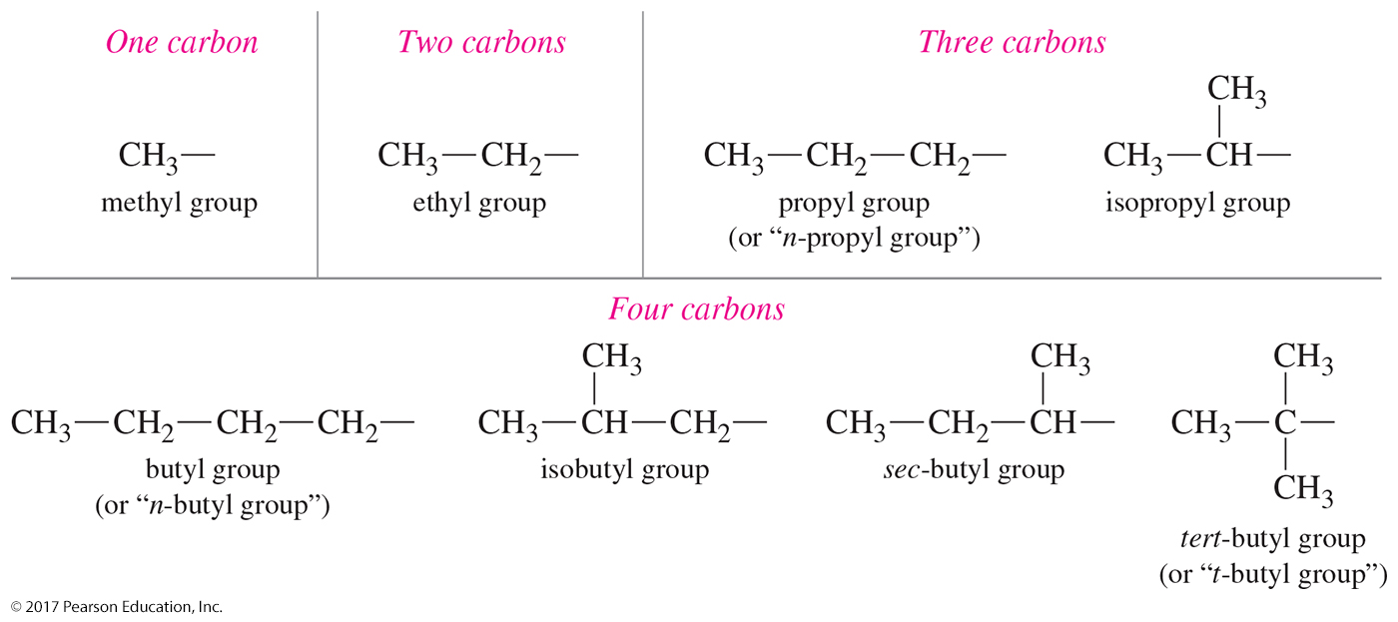
Common Alkyl Groups

Slide 16
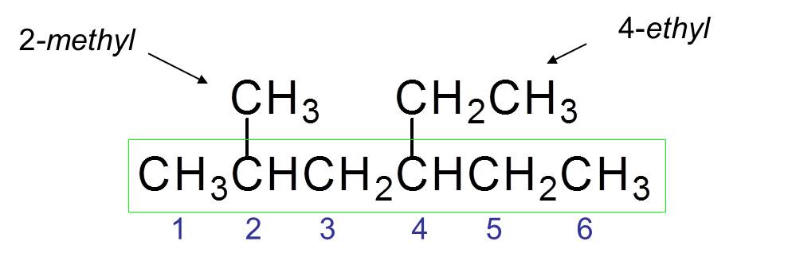
Applying the Naming Rules
Name the groups attached to the longest chain as alkyl groups.
Give the location of each alkyl group by the number of the main-chain carbon atom to which it is attached.
Write the alkyl groups in alphabetical order regardless of their position on the chain.
4-ethyl-2-methylhexane

Slide 17
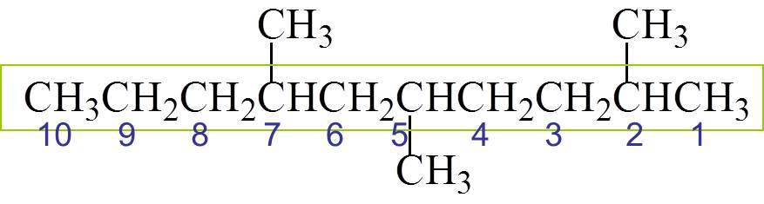
Multiple Groups
When two or more of the same substituents are present, use the prefixes di-, tri-, tetra-, etc. to avoid having to name the alkyl group twice.
Three methyl groups at positions 2, 5, and 7.
2,5,7-trimethyldecane

Slide 18
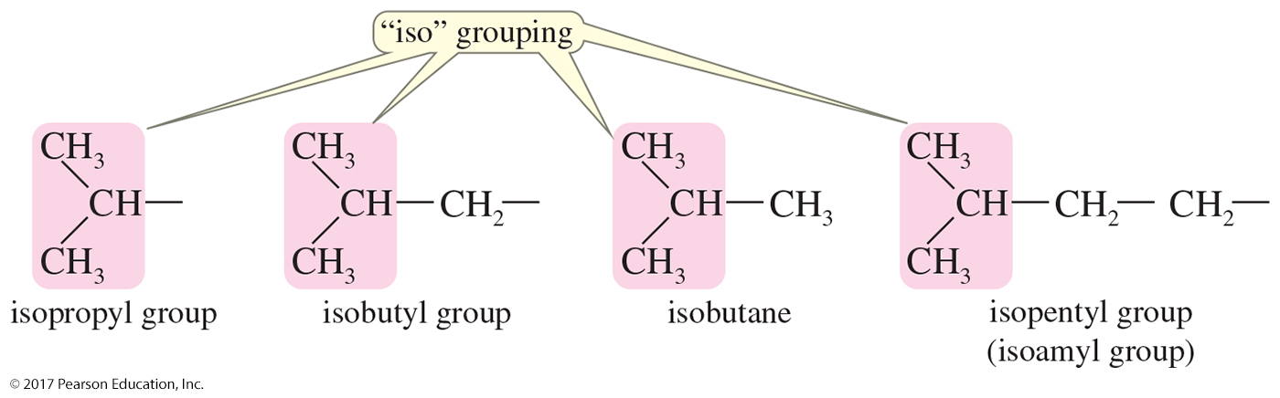
“Iso” Groups

Slide 19
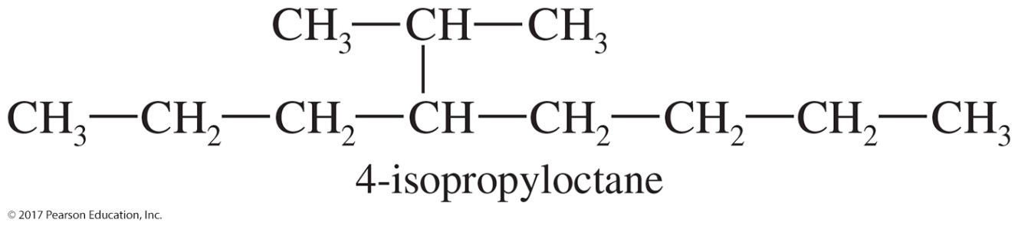
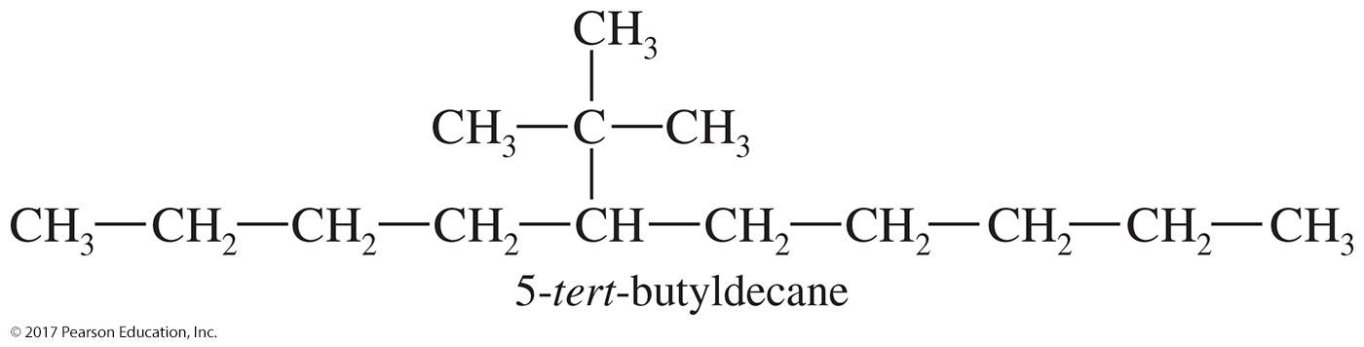
Solved Problem 3-1
Give the structures of 4-isopropyloctane and
5-t-butyldecane.
Solution: 4-Isopropyloctane has a chain of eight carbons, with an isopropyl group on the fourth carbon. 5-t-Butyldecane has a chain of ten carbons, with a t-butyl group on the fifth.

Slide 20
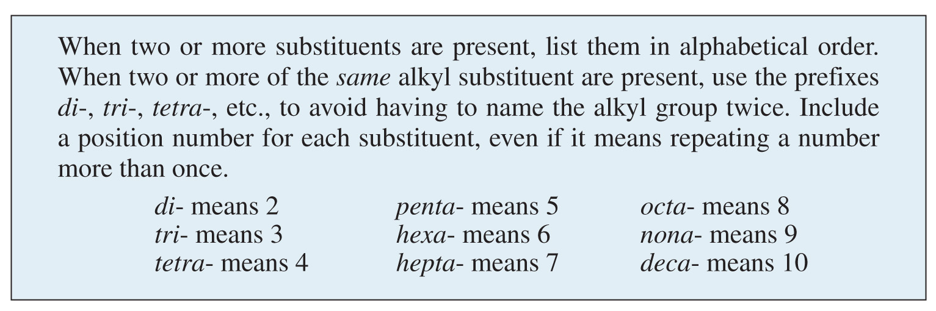
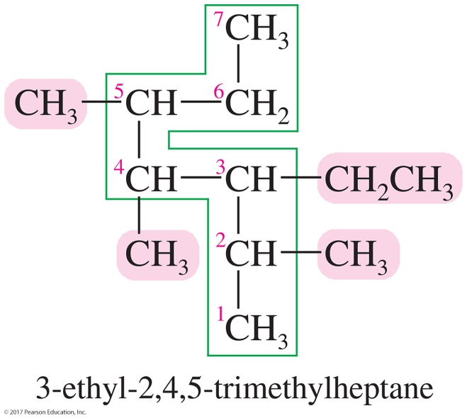
Rule 4: Organizing
Multiple Groups
The final rule deals with naming compounds with more than one substituent.

Slide 21
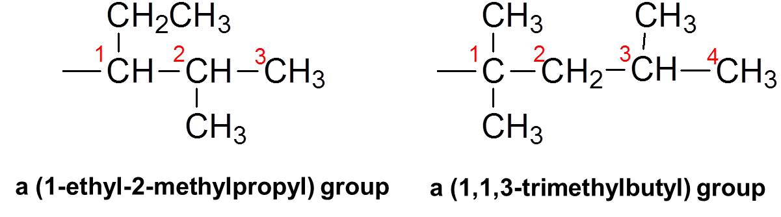
Complex Substituents
Complex alkyl groups are named by using the longest carbon chain.
Carbon number 1 of the alkyl group is the carbon attached to the main chain.

Slide 22
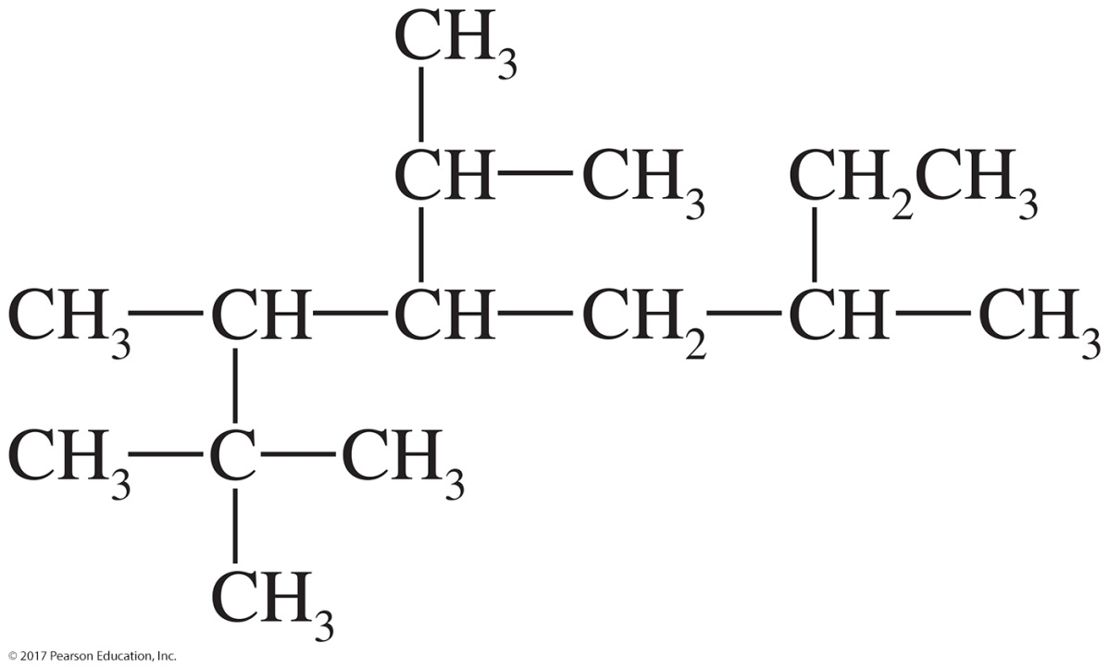
Solved Problem 3-2
Give a systematic (IUPAC) name for the following compound.

Slide 23
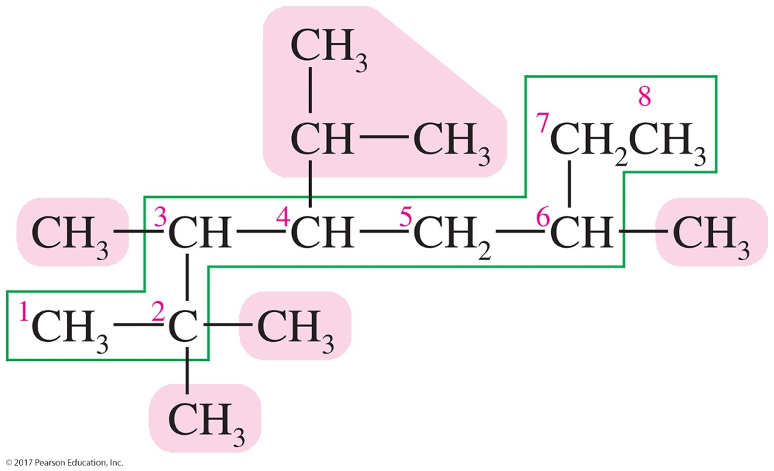
Solved Problem 3-2: Solution
The longest carbon chain contains eight carbon atoms, so this compound is named as an octane. Numbering from left to right gives the first branch on C2; numbering from right to left gives the first branch on C3, so we number from left to right.
4-isopropyl-2,2,3,6-tetramethyloctane

Slide 24
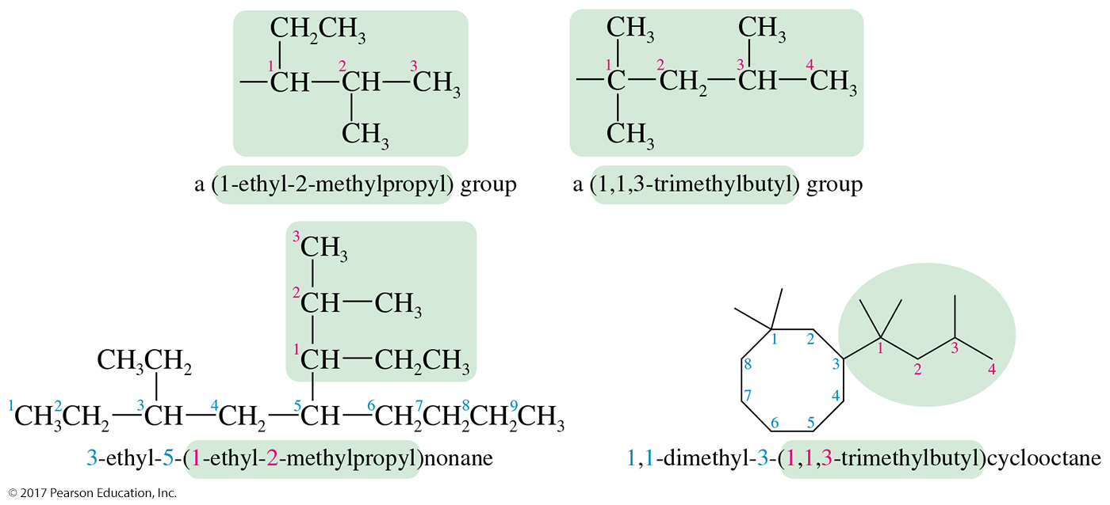
Degree of Alkyl Substitution

Slide 25
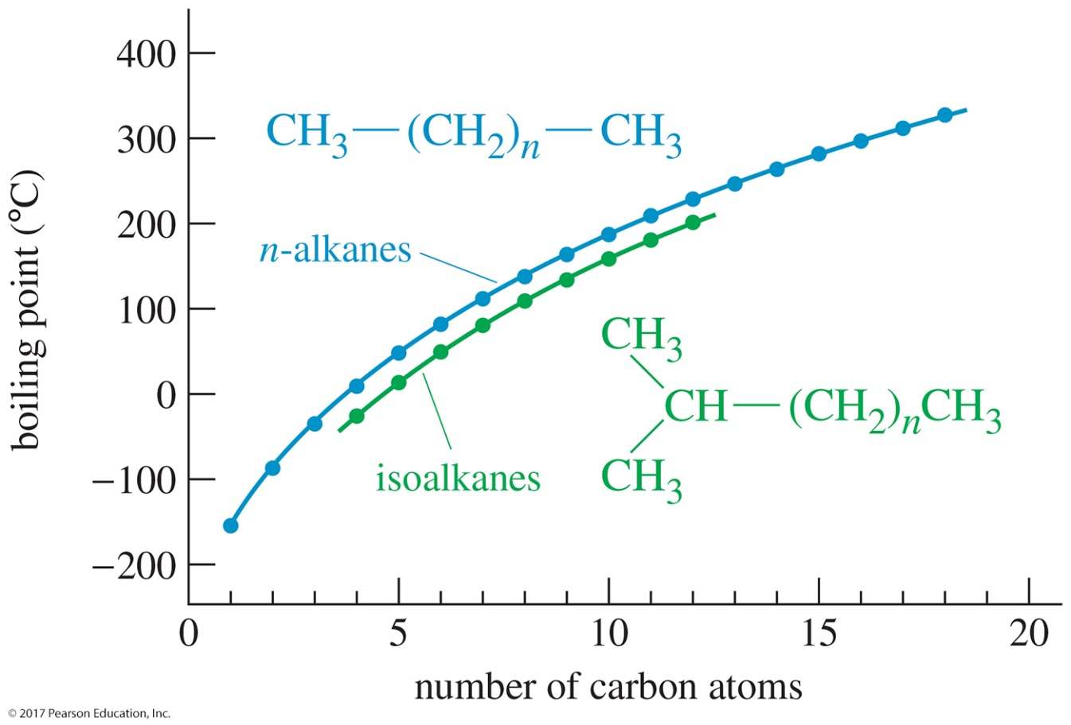
Boiling Points of Alkanes
As the number of carbons in an alkane increases, the boiling point increases due to the larger surface area and the increased van der Waals attractions.

Slide 26
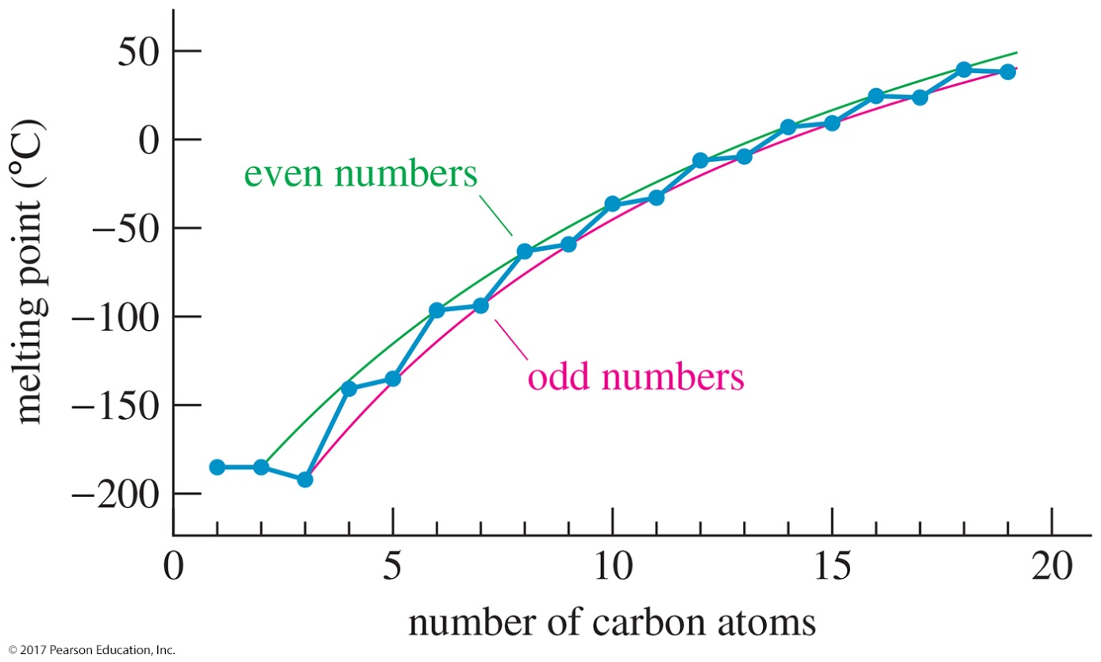
Melting Points of Alkanes
Melting points increase as the carbon chain increases.
Alkanes with an even number of carbons have higher melting points than those with an odd number of carbons.

Slide 27
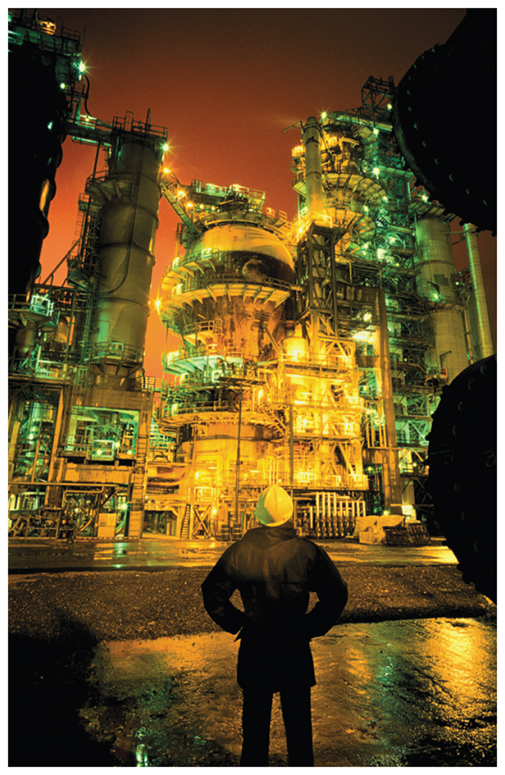
Alkane Sources
Alkanes are obtained from petroleum and petroleum by-products.
Fractional distillation will separate the crude oil into mixtures of alkanes with a range of boiling points.

Slide 28
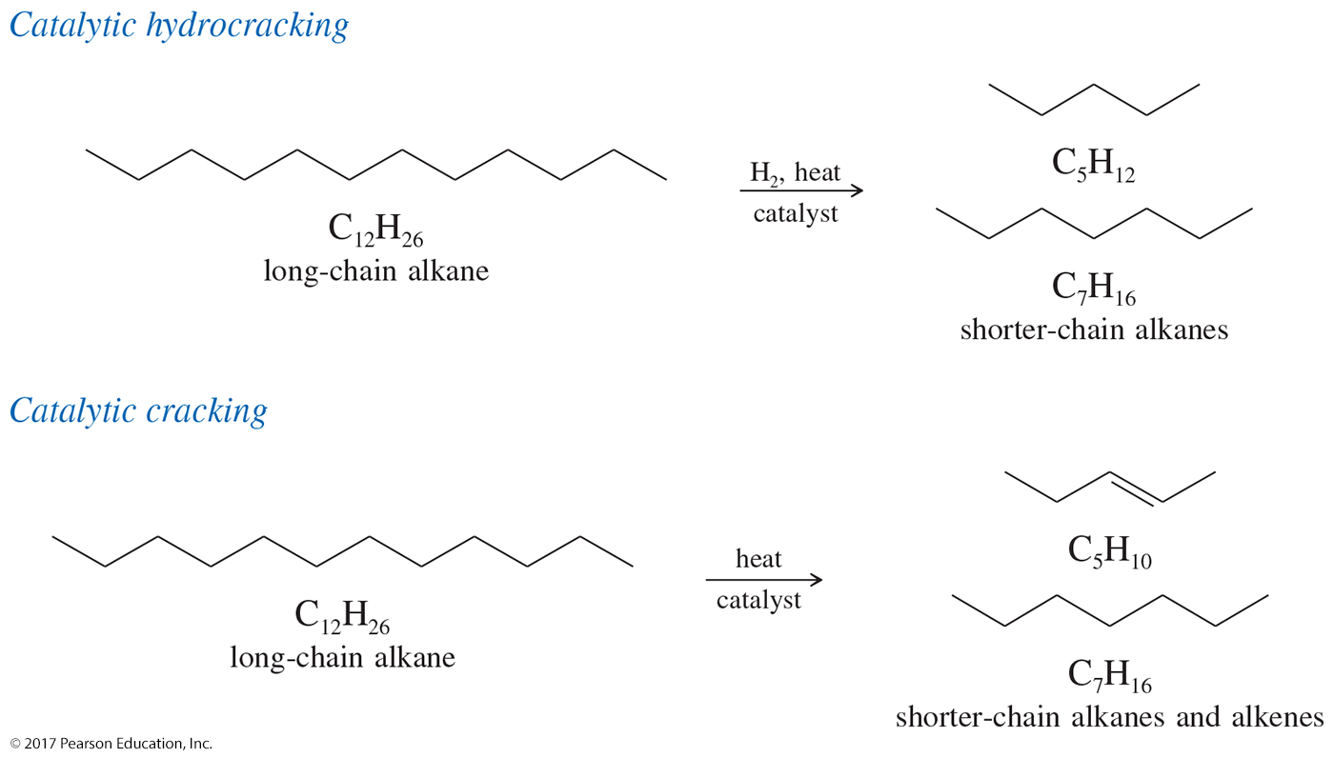
Catalytic Cracking and Hydrocracking

Slide 29
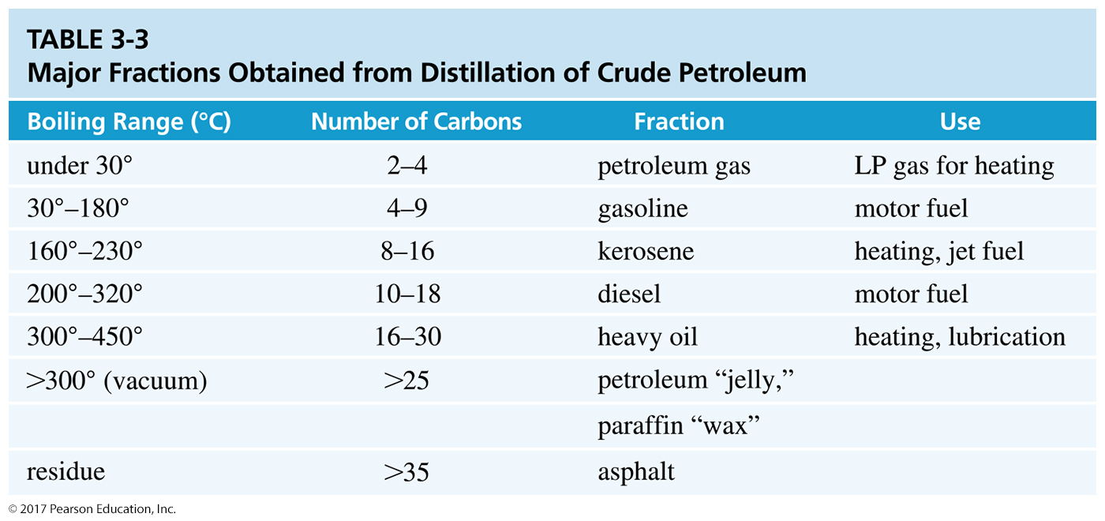

Slide 30
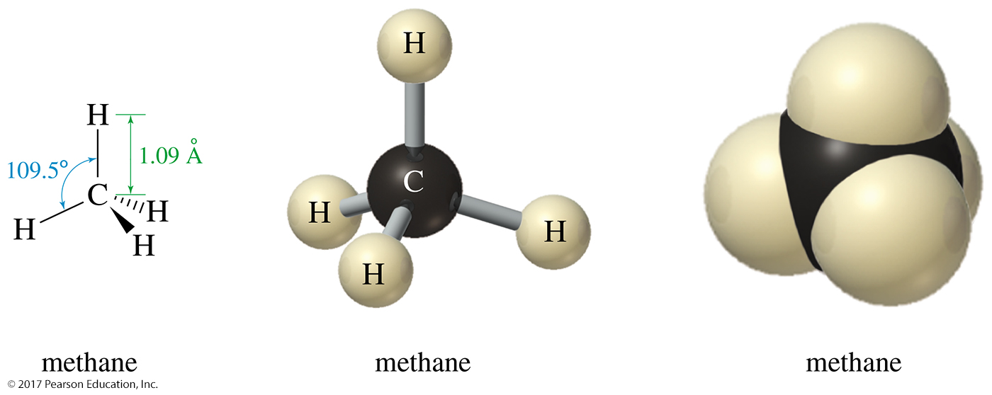
Methane Representations
Tetrahedral
sp³ hybrid carbon with angles of 109.5°

Slide 31
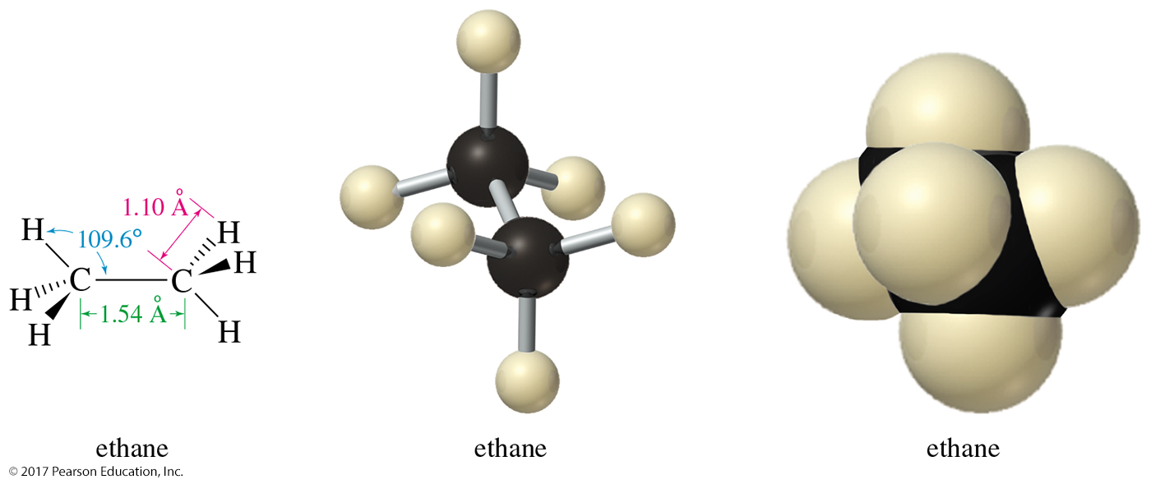
Ethane Representations
Two sp³ hybrid carbons
Rotation about the C—C sigma bond
Conformations are different arrangements of atoms caused by rotation about a single bond.

Slide 32
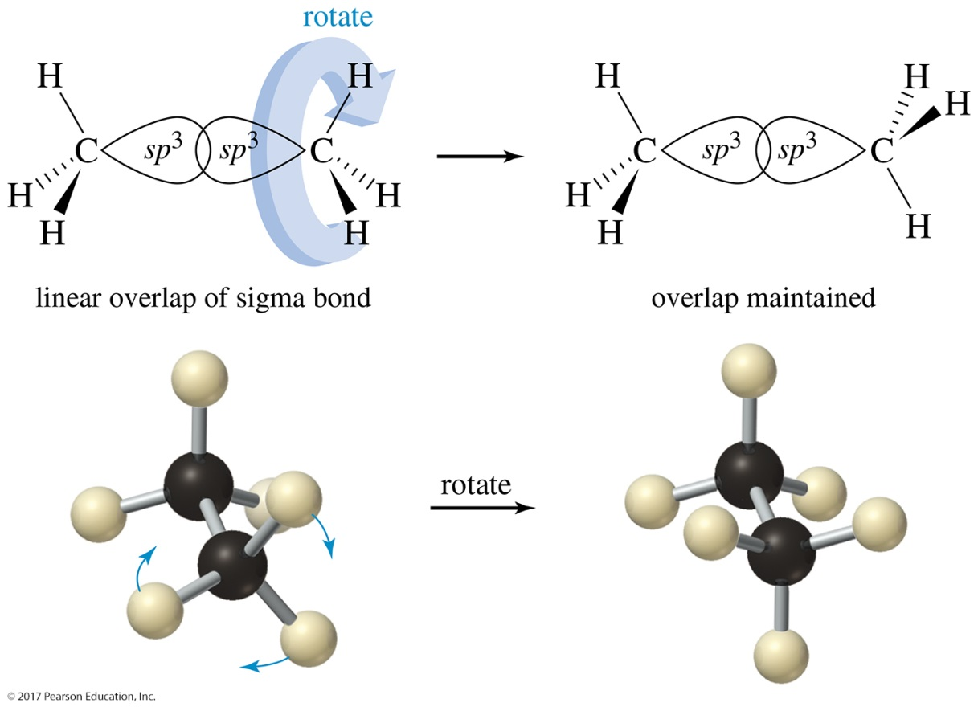
Conformations of Ethane
Pure conformers cannot be isolated in most cases, because the molecules are constantly rotating through all the possible conformations.

Slide 33
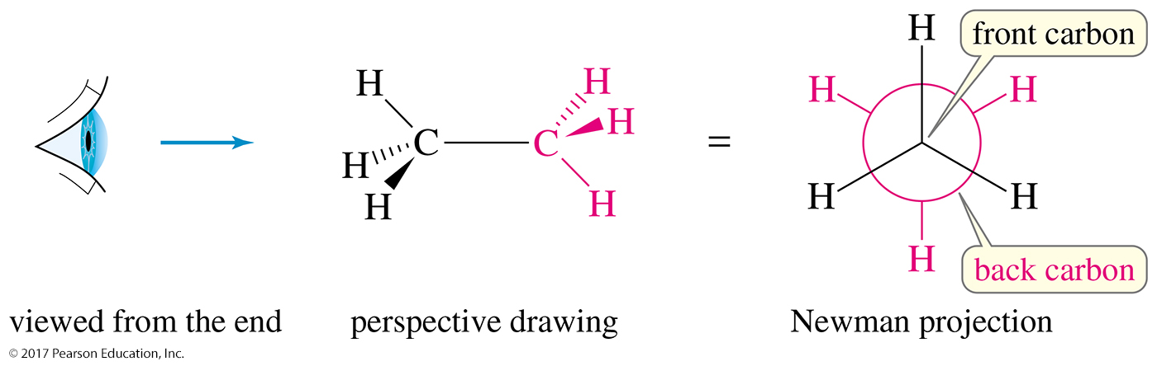
Newman Projections
The Newman projection is the best way to judge the stability of the different conformations of a molecule.

Slide 34
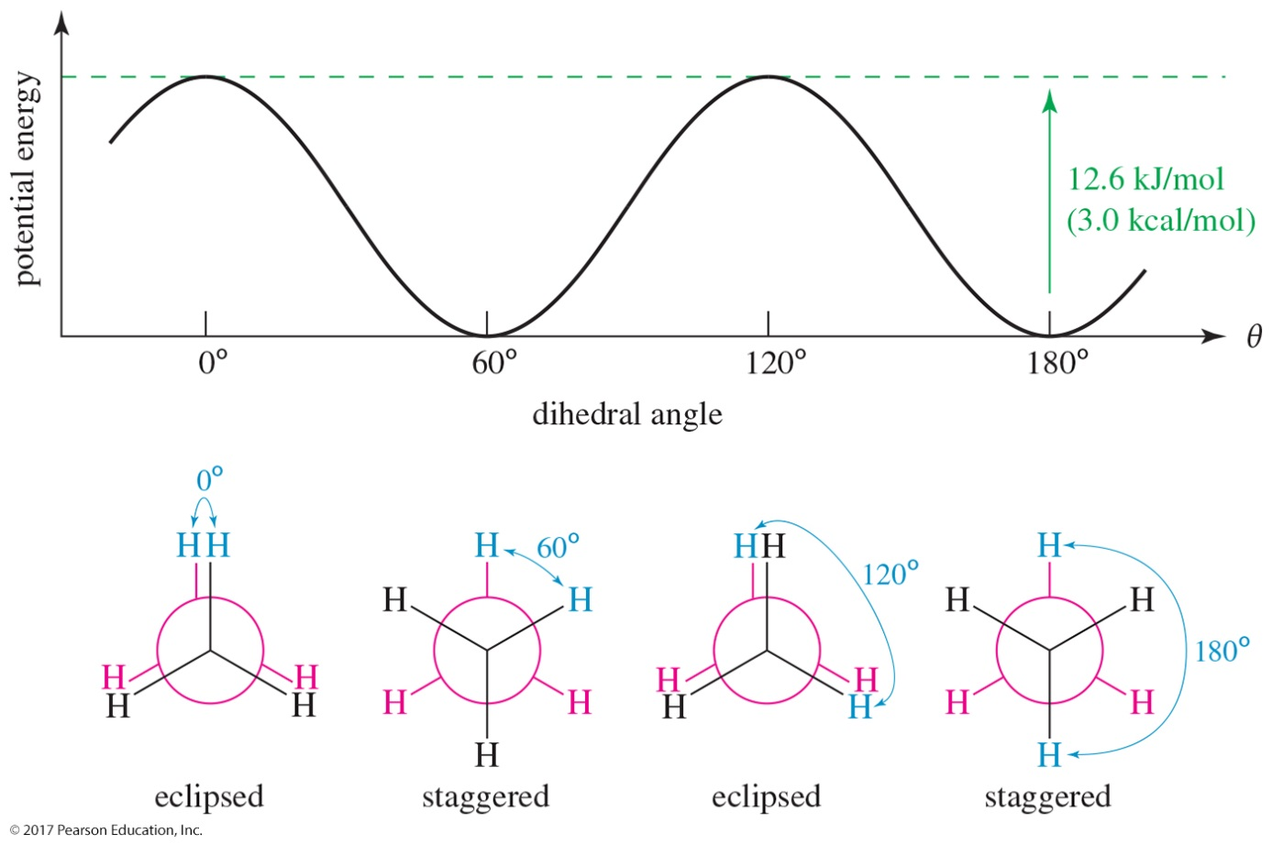
Ethane Conformations
The torsional energy of ethane is lowest in the staggered conformation. The eclipsed conformation is about 3.0 kcal/mol (12.6 kJ/mol) higher in energy. At room temperature, this barrier is easily overcome, and the molecules rotate constantly.

Slide 35
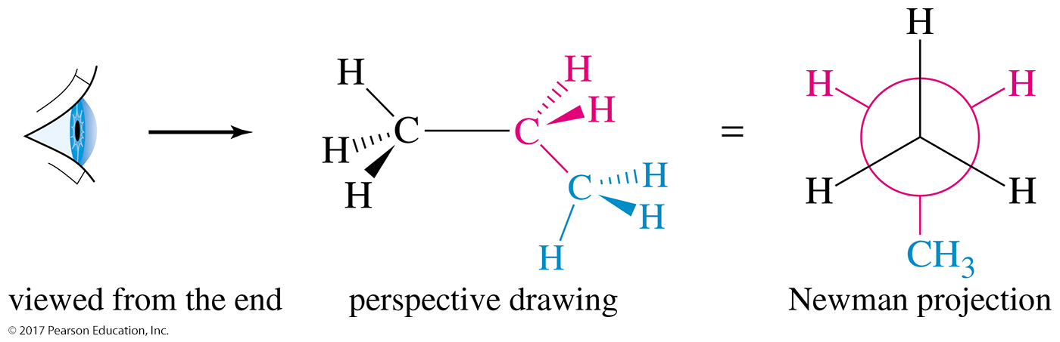
Propane Conformations
Propane is shown here as a perspective drawing and as a Newman projection looking down the C1—C2 bond.

Slide 36
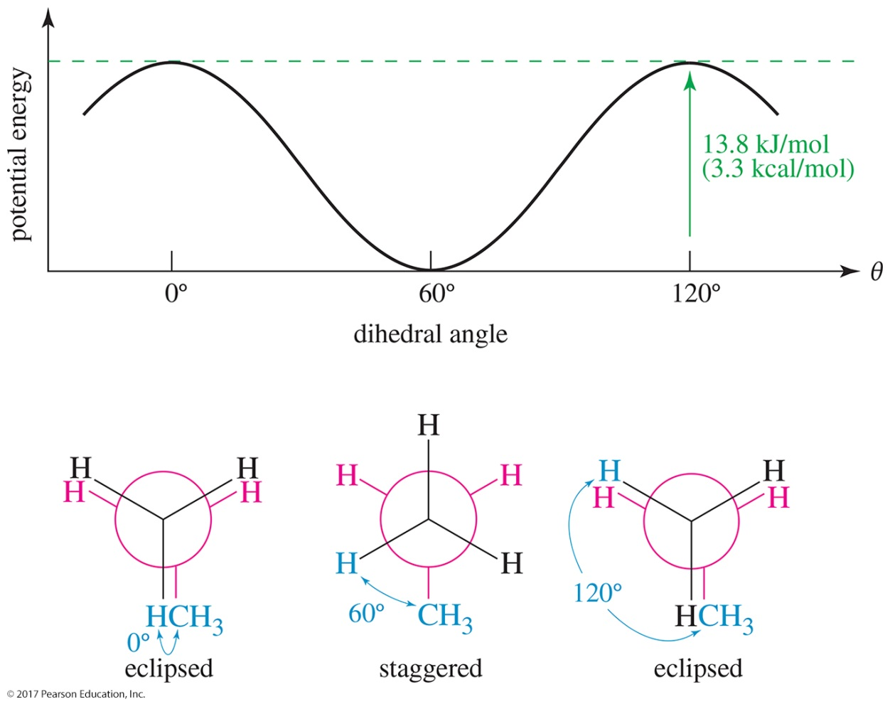
Propane Conformations
The staggered conformations of propane are lower in energy than the eclipsed conformations. Since the methyl group occupies more space than a hydrogen, the torsional strain will be 0.3 kcal/mol higher for propane than for ethane.

Slide 37
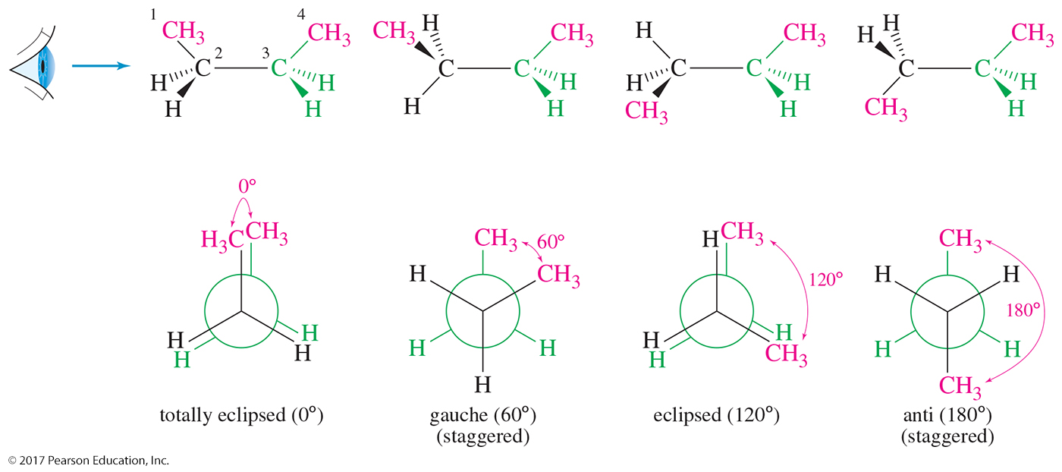
Butane Conformations
Butane has two different staggered conformations: gauche (60° between the methyl groups) and anti (180° between the methyl groups).
The eclipsed conformation where the dihedral angle between the methyl groups is 0° is referred to as totally eclipsed.

Slide 38
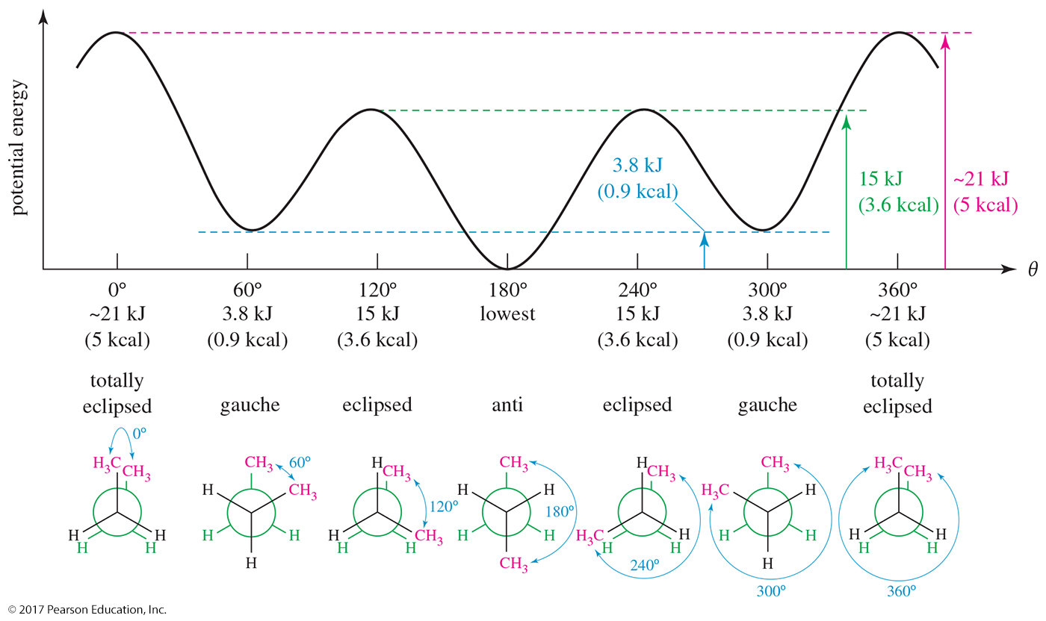
Conformational Analysis of Butane

Slide 39
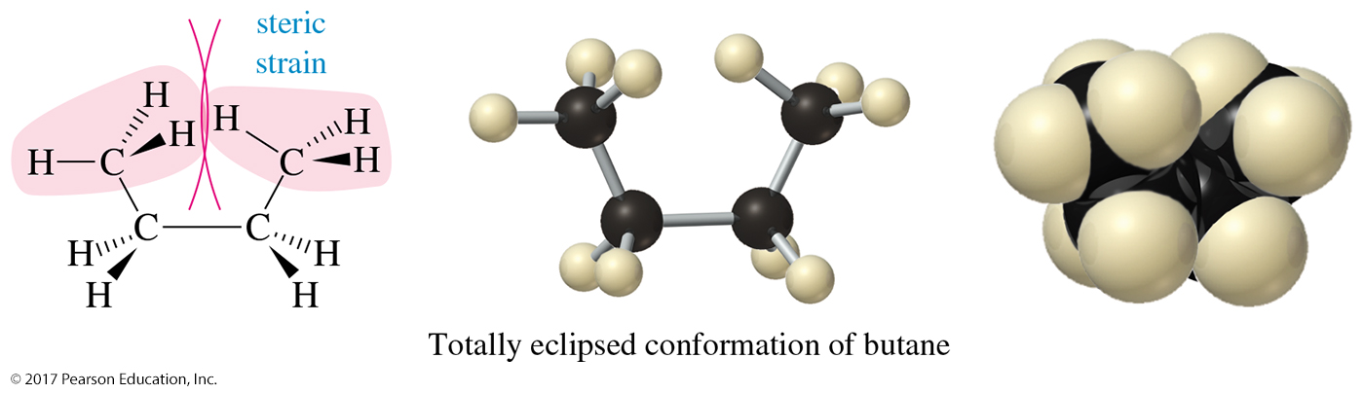
Steric Strain in Butane
The totally eclipsed conformation is higher in energy because it forces the two end methyl groups so close together that their electron clouds experience a strong repulsion.
This kind of interference between two bulky groups is called steric strain or steric hindrance.

Slide 40
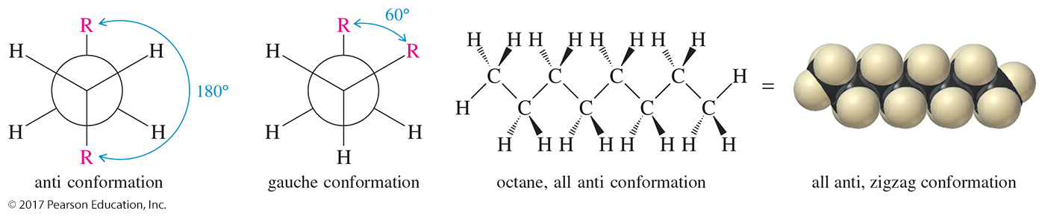
Conformations of Higher Alkanes
The higher alkanes resemble butane in their preference
for anti and gauche conformations about the carbon–carbon bonds.

Slide 41
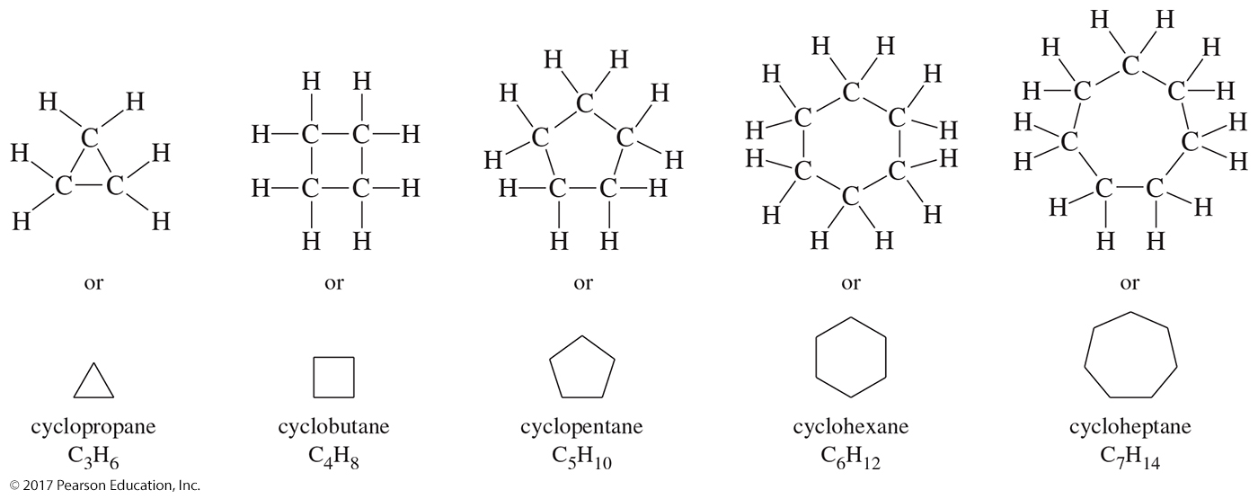
Cycloalkanes: C_{n}H_{2n}
Cycloalkanes contain rings of carbon atoms.

Slide 42
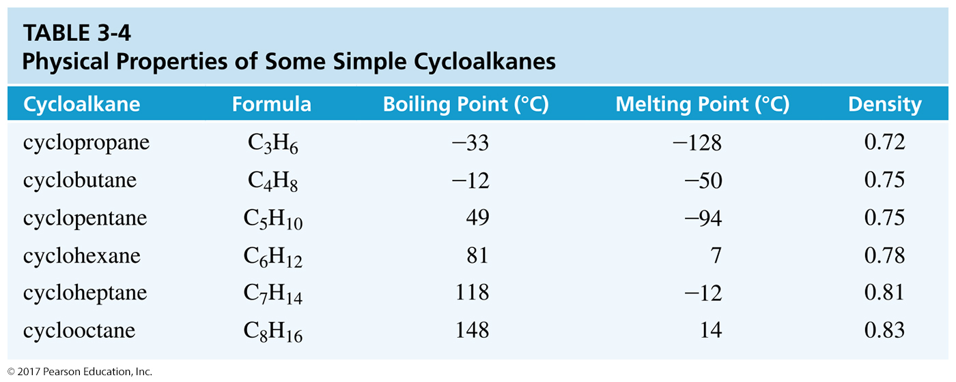
Physical Properties of Alkanes
Nonpolar
Relatively inert
Boiling point and melting point depend on the molecular weight.

Slide 43
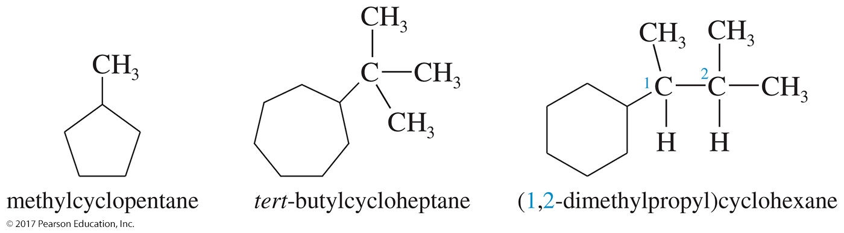
Cycloalkane Nomenclature
Cycloalkane is the main chain; alkyl groups attached to the cycloalkane will be named as alkyl groups.
If only one alkyl group is present, then no number is necessary.

Slide 44
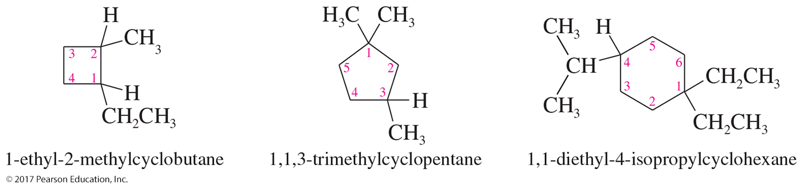
Cycloalkane Nomenclature
If there are two or more substituents, number the
main chain to give all substituents the lowest
possible number.

Slide 45
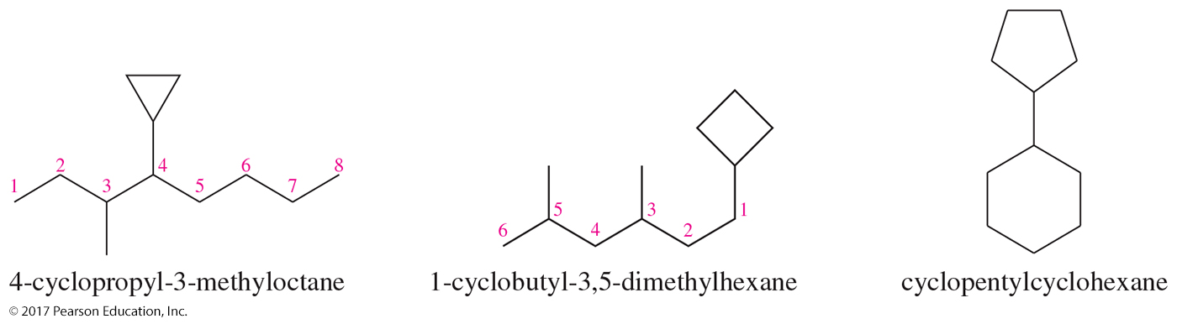
Cycloalkanes As Substituents
The cycloalkane becomes a substituent when the acyclic portion of the molecule contains fewer carbons than the cyclic part or when there is a more important functional group in the molecule.

Slide 46
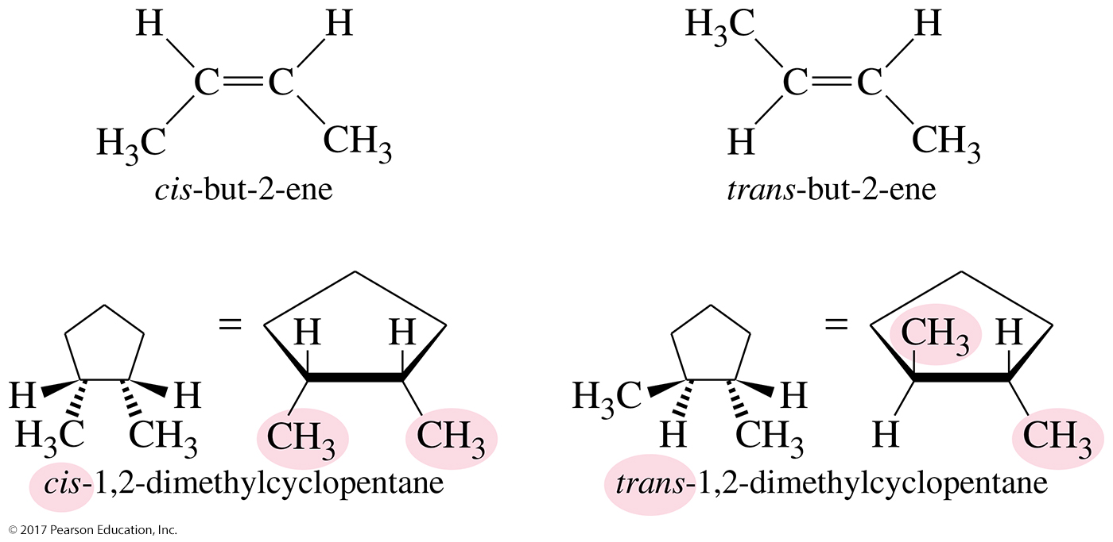
Geometric Isomers

Slide 47
Stabilities of Cycloalkanes
Five- and six-membered rings are the most common in nature.
Carbons of cycloalkanes are sp³ hybridized and thus require an angle of 109.5°.
When a cycloalkane carbon has an angle other than 109.5°, there will not be optimum overlap and the compound will have angle strain.
Angle strain is sometimes called Baeyer strain in honor of Adolf von Baeyer, who first explained this phenomenon.
Torsional strain arises when all the bonds are eclipsed.

Slide 48
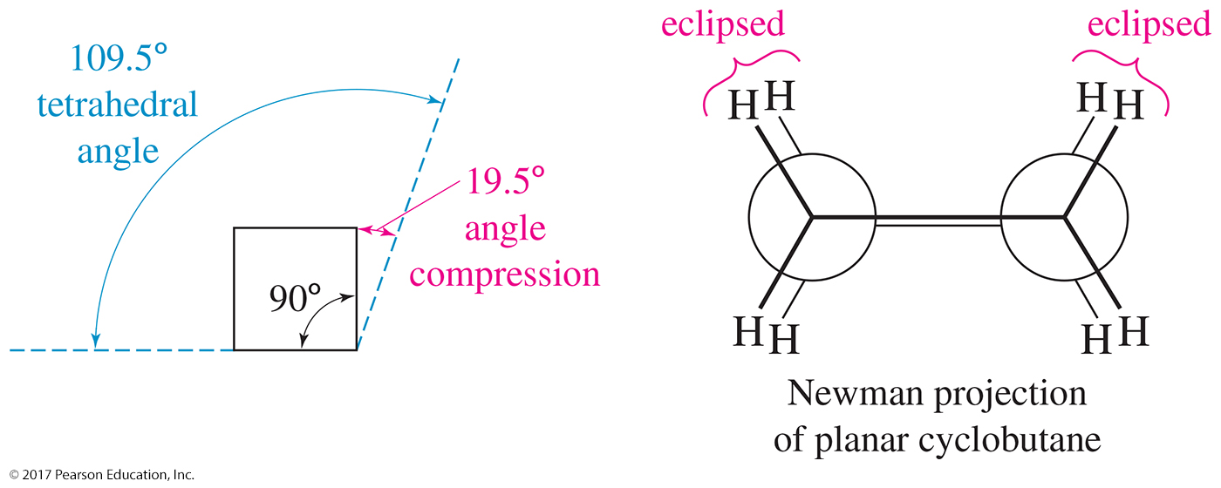
Angle Strain in Cyclobutane
The bond angles are compressed to 90° from the usual 109.5° bond angle of sp³ hybridized carbon atoms.
This severe angle strain leads to nonlinear overlap of the sp³ orbitals and “bent bonds.”

Slide 49
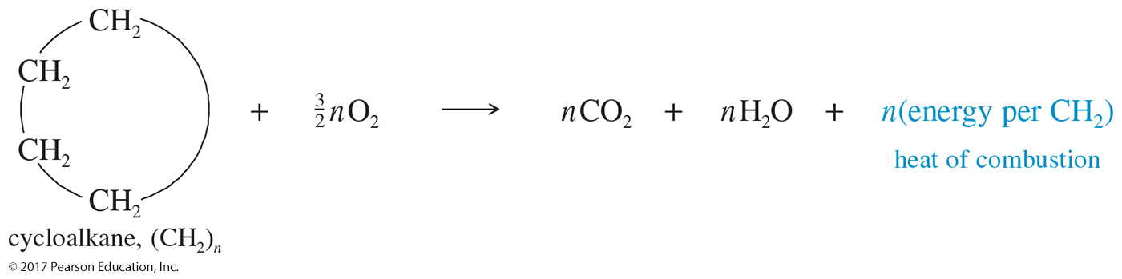
Heats of Combustion
The heat of combustion is the amount of heat released when a compound is burned with an excess of oxygen in a sealed container called a bomb calorimeter.
If the compound has extra energy as a result of ring strain, that extra energy is released in the combustion.

Slide 50
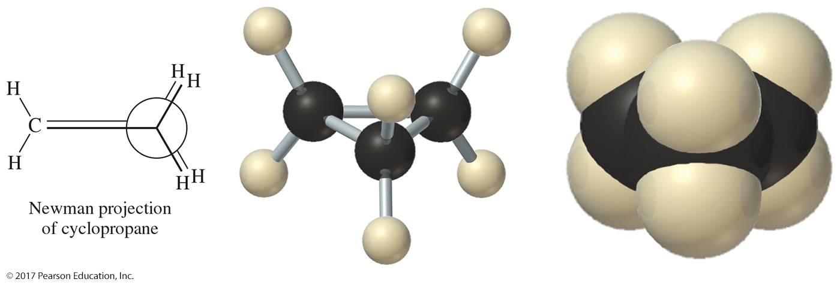
Torsional Strain in Cyclopropane
All the C—C bonds are eclipsed, generating torsional strain that contributes to the total ring strain.

Slide 51
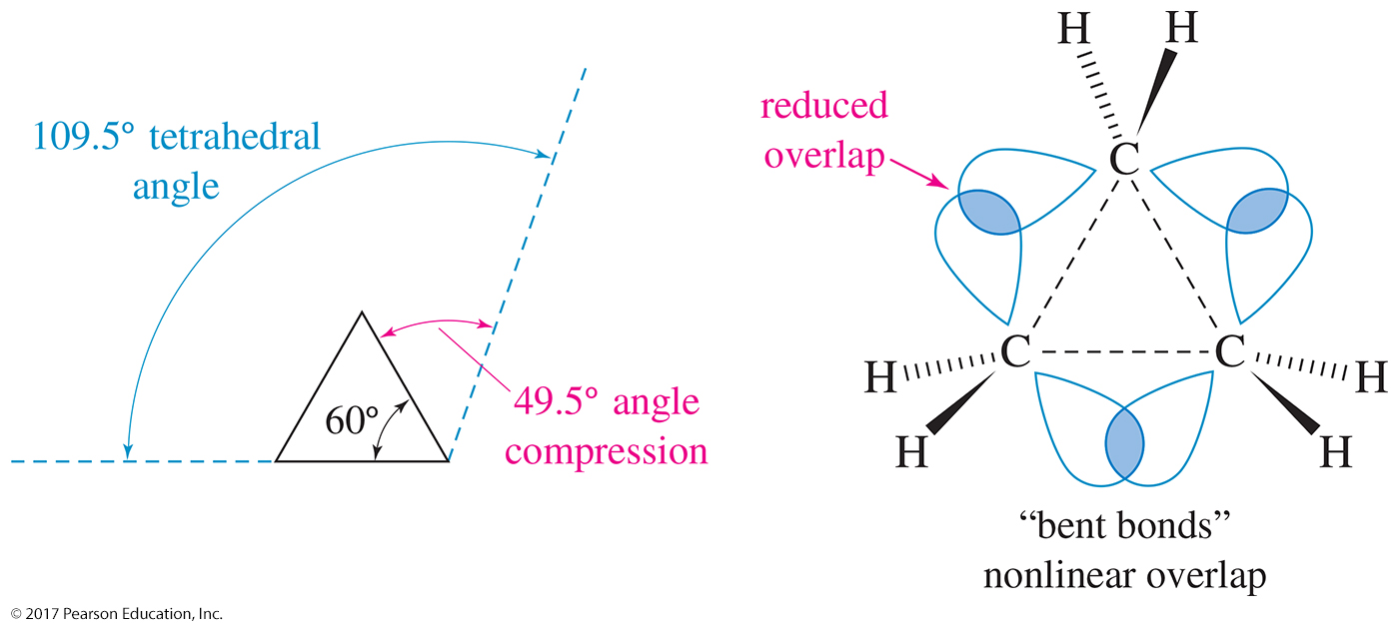
Cyclopropane: C₃H₁₀
The ring strain of a planar cyclopropane results from two factors: angle strain from the compressing of the bond angles to 60° rather than the tetrahedral angle of 109.5° and torsional strain from eclipsing of the bonds.

Slide 52
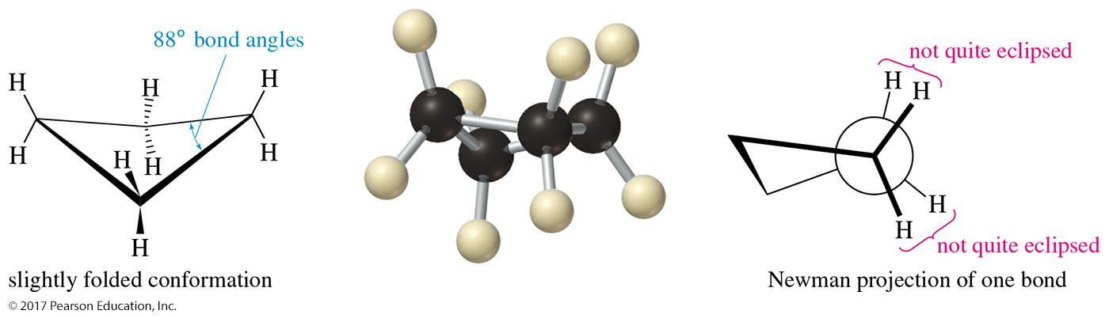
Nonplanar Cyclobutane
Cyclic compounds with four carbons or more adopt nonplanar conformations to relieve ring strain.
Cyclobutane adopts the folded conformation (“envelope”) to decrease the torsional strain caused by eclipsing hydrogens.

Slide 53

Cyclopentane: C₅H₁₀
The conformation of cyclopentane is slightly folded, like the shape of an envelope. This puckered conformation reduces the eclipsing of adjacent methylene (CH₂) groups.

Slide 54

Chair Conformation of Cyclohexane

Slide 55
Chair Conformation
The chair is the most stable conformational isomer of cyclohexane.
The chair has no eclipsing interactions.
Bond angles in the chair conformation are 109.5°.

Slide 56

Boat Conformation of Cyclohexane

Slide 57
Boat and Twisted Boat Conformation
Eclipsing bonds result in torsional strain.
The twisted boat conformation has fewer eclipsing bond interactions and less interference between the flagpole hydrogens.

Slide 58

Conformational Energy Diagram of Cyclohexane

Slide 59

Axial and Equatorial Positions
Axial bonds (red) are directed vertically parallel to the axis of the ring.
Equatorial bonds (green) are directed outward toward the equator of the molecule.

Slide 60

Chair–Chair Interconversion
The most important result in chair conversion is that any substituent that is axial in the original conformation becomes equatorial in the new conformation.

Slide 61

Axial Methyl in Methylcyclohexane

Slide 62

Equatorial Methyl Group

Slide 63

1,3-Diaxial Interaction
The axial substituent interferes with the axial hydrogens on C3 and C5. This interference is called a 1,3-diaxial interaction.

Slide 64

Energy Differences
Substituents are less crowded in the equatorial positions.

Slide 65

Cis-1,3-dimethylcyclohexane
Cis-1,3-dimethylcyclohexane can have both methyl groups in axial positions or both in equatorial positions.
The conformation with both methyl groups being equatorial is more stable.

Slide 66

Trans-1,3-dimethylcyclohexane
Both conformations have one axial and one equatorial methyl group so they have the same energy.

Slide 67

Cis-1,4-di-tert-butylcyclohexane
The most stable conformation of cis-1,4-di-tert-butylcyclohexane is the twist boat. Both chair conformations require one of the bulky
t-butyl groups to occupy an axial position.

Slide 68
Solved Problem 3-3
(a) Draw both chair conformations of
cis-1, 2-dimethylcyclohexane, and determine which conformer is more stable.
(b) Repeat for the trans isomer.
(c) Predict which isomer (cis or trans) is more stable.

Slide 69

Solved Problem 3-3:
Solution (a)
(a) There are two possible chair conformations for the cis isomer, and these two conformations interconvert at room temperature. Each of these conformations places one methyl group axial and one equatorial, giving them the same energy.

Slide 70

Solved Problem 3-3:
Solution (b)
(b) There are two chair conformations of the trans isomer that interconvert at room temperature. Both methyl groups are axial in one, and both are equatorial in the other. The diequatorial conformation is more stable because neither methyl group occupies the more hindered axial position.

Slide 71
Solved Problem 3-3:
Solution (c)
(c) The trans isomer is more stable. The most stable conformation of the trans isomer is diequatorial and therefore about 7.6 kJ/mol (1.8 kcal/mol) lower in energy than either conformation of the cis isomer, each having one methyl axial and one equatorial. Remember that cis and trans are distinct isomers and cannot interconvert.

Slide 72

Solved Problem 3-4
Draw the most stable conformation of
trans-1-ethyl-3-methylcyclohexane.
Solution: First, we draw the two conformations. The ethyl group is bulkier than the methyl group, so the conformation with the ethyl group equatorial is more stable.

Slide 73

Bicyclic Systems
Fused rings share two adjacent carbon atoms and the bond
between them.
Bridged rings share two nonadjacent carbon atoms and one
or more carbon atoms (the bridge) between them.
Spirocyclic compounds are rare; the two rings share only
one carbon.

Slide 74

Nomenclature of Bicyclic Systems
Bicyclo [#.#.#]alkane: where the #s are the numbers of carbons on the bridges (in decreasing order) and the alkane name includes all the carbons in the compound

Slide 75

Decalin
Cis-decalin has a ring fusion where the second ring is attached by two cis bonds. Trans-decalin is fused using two trans bonds. Trans-decalin is more stable because the alkyl groups are equatorial.

