Slide 1
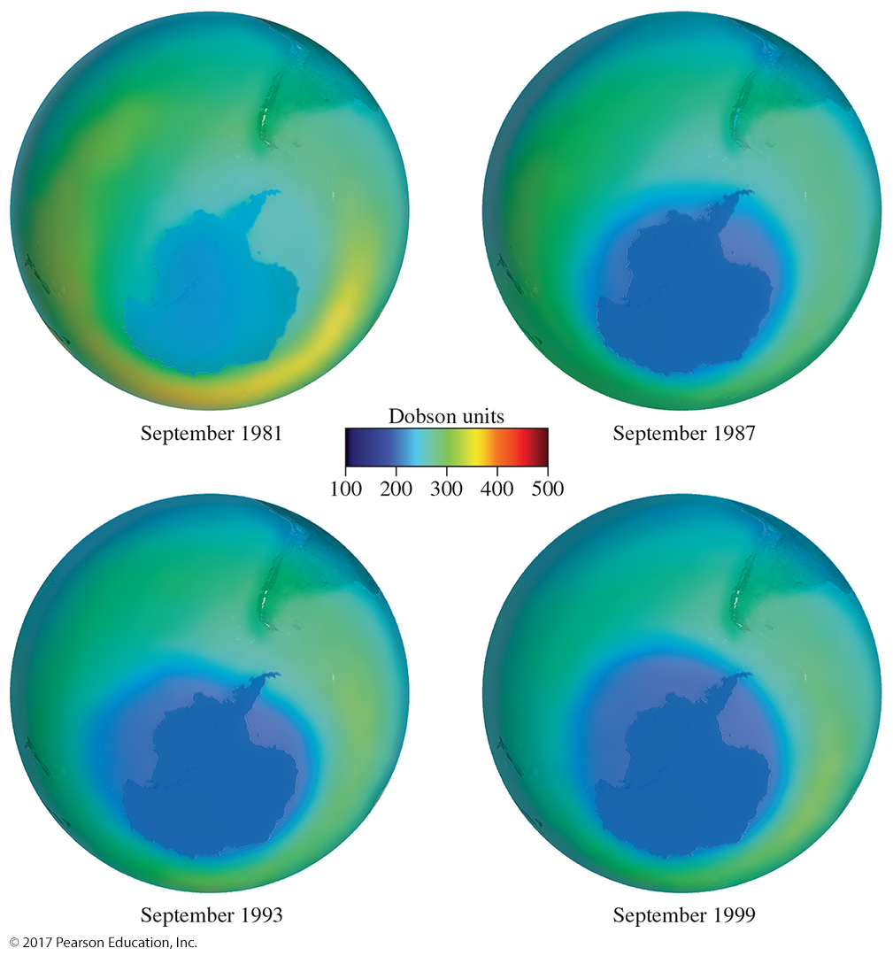
Organic Chemistry,
9th Edition
L. G. Wade, Jr.
Chapter 4
Lecture
The Study of
Chemical Reactions
Chad Snyder, PhD
Grace College
© 2017 Pearson Education, Inc.

Slide 2
Introduction
Overall reaction: reactants → products
To learn more about a reaction:
  Thermodynamics is the study of the energy changes that accompany chemical and physical transformations.
  Kinetics is the study of reaction rates.
Mechanism: step-by-step description of how the reaction happens

Slide 3
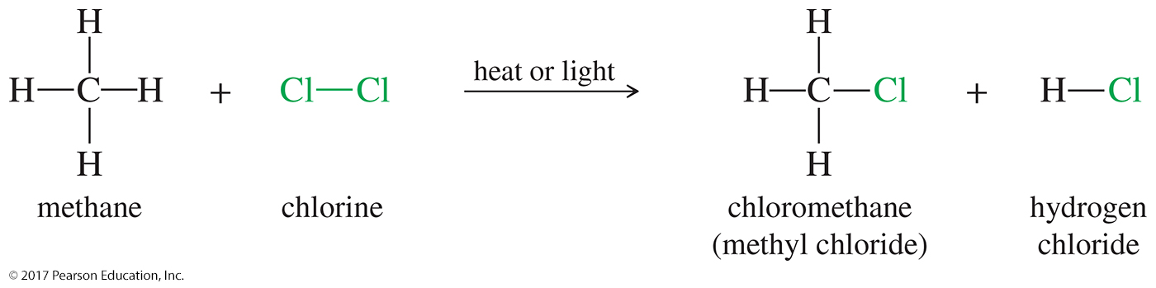
Chlorination of Methane
It requires heat or light for initiation.
The most effective wavelength is blue, which is absorbed by chlorine gas.
Many molecules of product are formed from absorption of only one photon of light (chain reaction).

Slide 4
The Free-Radical Chain Reaction
Initiation generates a radical intermediate.
Propagation: The intermediate reacts with a stable molecule to produce another reactive intermediate (and a product molecule).
Terminations are side reactions that destroy the reactive intermediate.

Slide 5
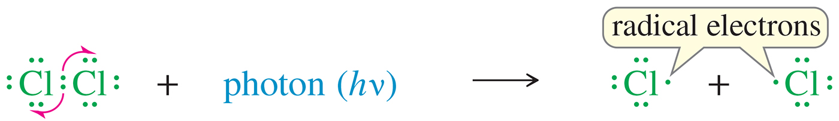
Initiation Step: Formation of Chlorine Atom
A chlorine molecule splits homolytically into chlorine atoms (free radicals).

Slide 6
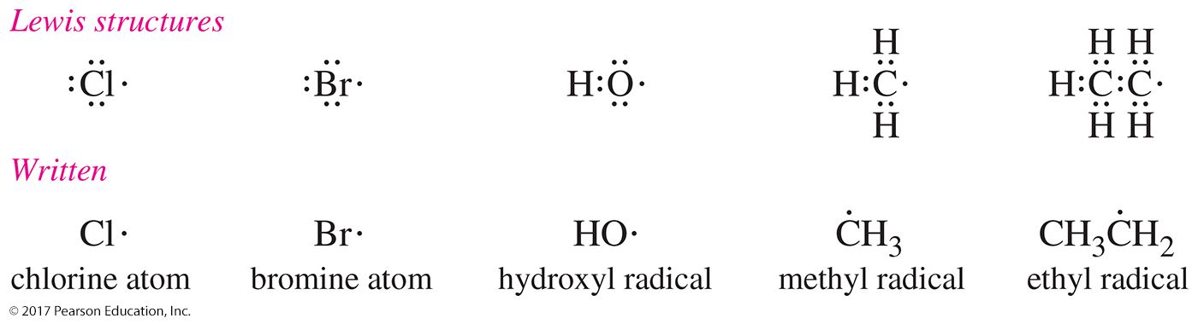
Lewis Structures of Free Radicals
Free radicals are reactive species with odd numbers of electrons.
Halogens have seven valence electrons, so one of them will be unpaired (radical). We refer to the halides as atoms, not radicals.

Slide 7
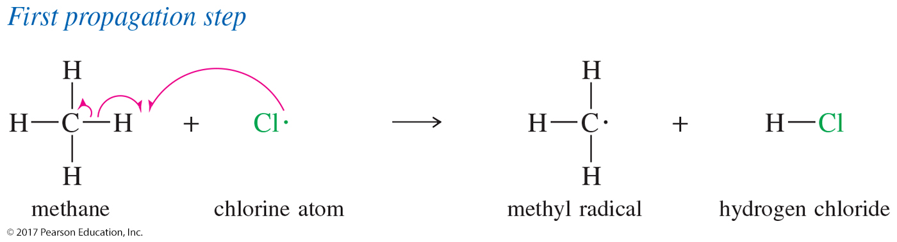
Propagation Step: Carbon Radical
The chlorine atom collides with a methane molecule and abstracts (removes) an H, forming another free radical and one of the products (HCl).

Slide 8
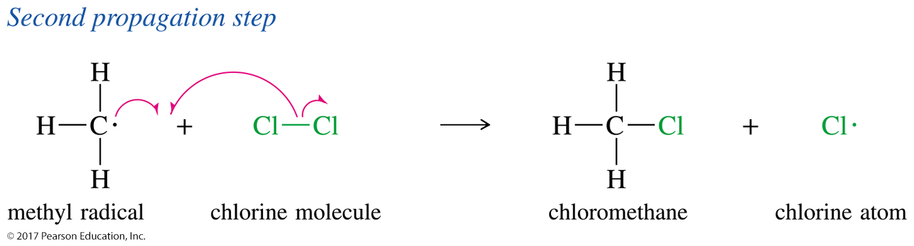
Propagation Step: Product Formation
The methyl free radical collides with another chlorine molecule, producing the organic product (methyl chloride) and regenerating the chlorine radical.

Slide 9
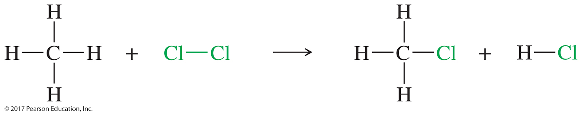
Overall Reaction

Slide 10
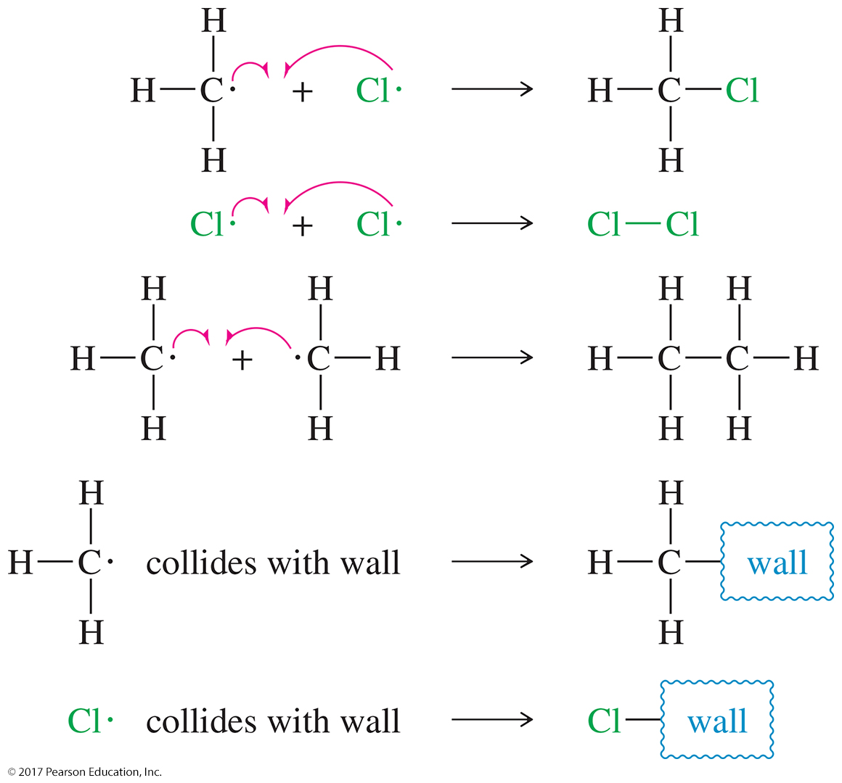
Termination Steps
A reaction is classified as a termination step when any two free radicals join together, producing a nonradical compound.
Combination of a free radical with a contaminant or collision with a wall are also termination steps.

Slide 11
More Termination Steps

Slide 12
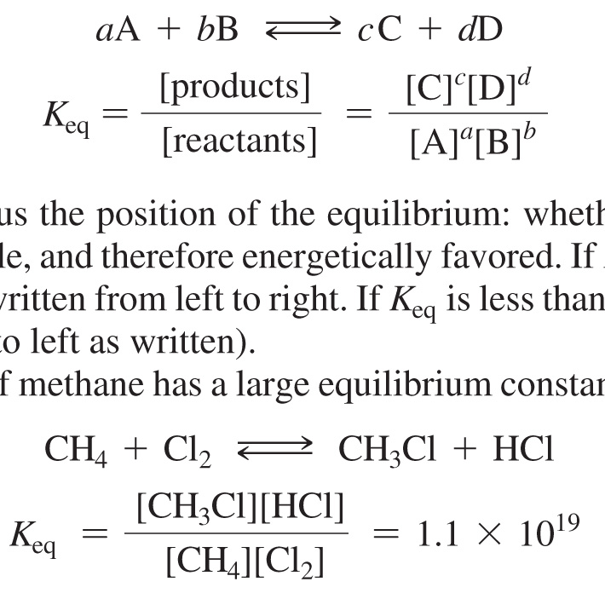
Equilibrium Constant

Slide 13

Free Energy Change
• ΔG = (energy of products) – (energy of reactants)
• ΔG is the amount of energy available to do work.
A reaction with a negative ΔG is favorable and spontaneous.
where R = 8.314 J/K-mol and T = temperature in kelvins.

Slide 14
Factors Determining ΔG°
Free energy change depends on the following:
  • Enthalpy
    ΔH° = (enthalpy of products) – (enthalpy of reactants)
  • Entropy
    ΔS° = (entropy of products) – (entropy of reactants)
ΔG° = ΔH° – TΔS°

Slide 15
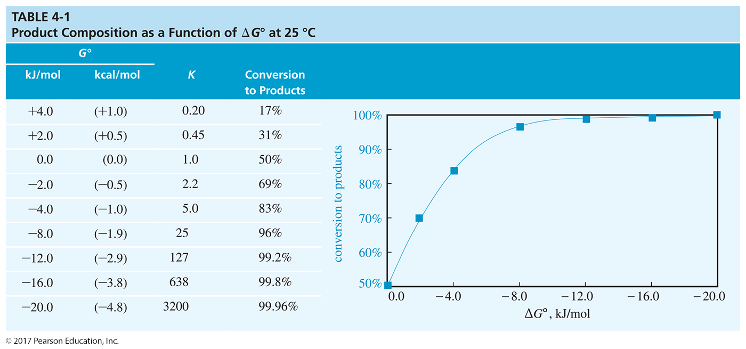

Slide 16
Enthalpy
• ΔH° = heat released or absorbed during a chemical reaction at standard conditions.
Exothermic (–ΔH): Heat is released.
Endothermic (+ΔH): Heat is absorbed.
Reactions favor products with the lowest enthalpy (strongest bonds).

Slide 17
Entropy
• ΔS° = change in randomness, disorder, or freedom of movement.
Increasing heat, volume, or number of particles increases entropy.
Spontaneous reactions maximize disorder and minimize enthalpy.
In the equation ΔG° = ΔH° – TΔS°, the entropy value is often small.

Slide 18
Solved Problem 1
Calculate the value of ΔG° for the chlorination of methane.
Solution
ΔG° = –2.303RT(log K_{eq})
K_{eq} for the chlorination is 1.1 x 10¹⁹, and log K_{eq} = 19.04
At 25 °C (about 298 K), the value of RT is
RT = (8.314 J/kelvin-mol)(298 kelvins) = 2478 J/mol, or 2.48 kJ/mol
Substituting, we have
ΔG° = (–2.303)(2.478 kJ/mol)(19.04) = –108.7 kJ/mol (–25.9 kcal/mol)
This is a large negative value for ΔG°, showing that this chlorination has a large driving force that pushes it toward completion.

Slide 19
Bond-Dissociation Enthalpies (BDE)
Bond dissociation requires energy (+BDE).
Bond formation releases energy (–BDE).
BDE can be used to estimate ΔH for a reaction.
BDE for homolytic cleavage of bonds in a gaseous molecule
    Homolytic cleavage: When the bond breaks, each atom gets one electron.
    Heterolytic cleavage: When the bond breaks, the most electronegative atom gets both electrons.

Slide 20
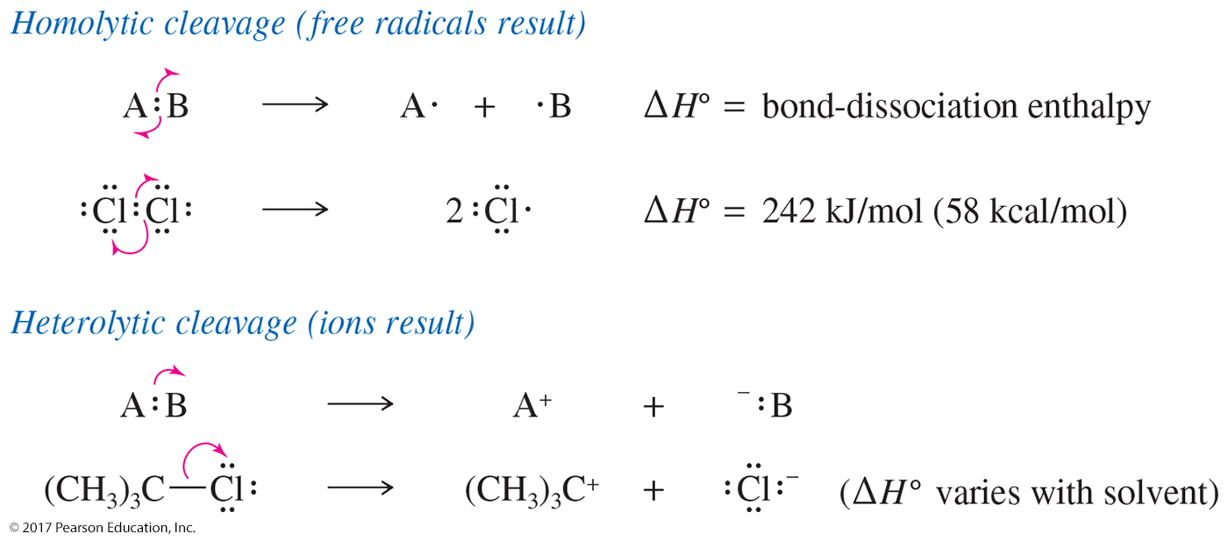
Homolytic and Heterolytic Cleavages

Slide 21
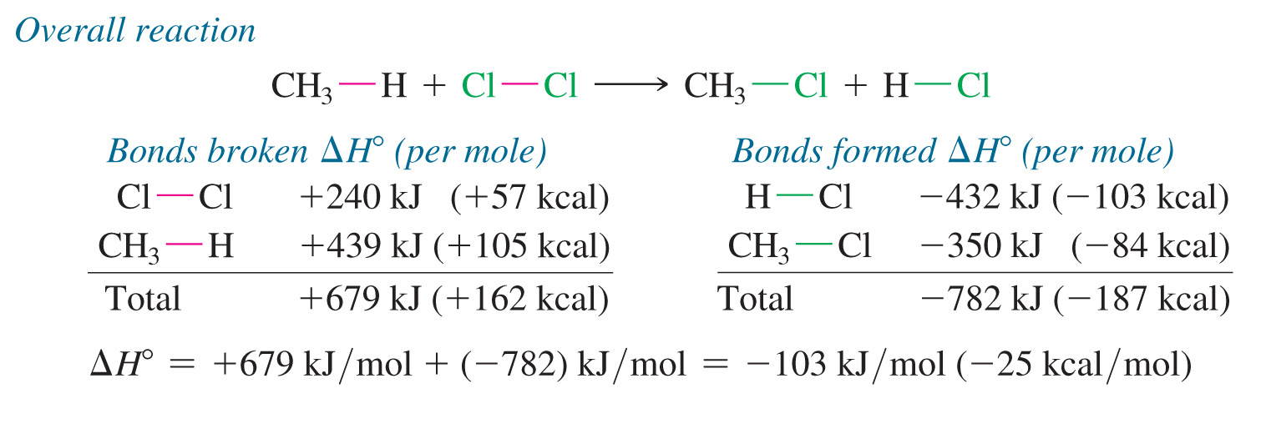
Enthalpy Changes in Chlorination

Slide 22
Kinetics
Kinetics is the study of reaction rates.
Rate of the reaction is a measure of how the concentration of the products increases while the concentration of the starting materials decreases.
A rate equation (also called the rate law) is the relationship between the concentrations
of the reactants and the observed reaction rate.
Rate law is determined experimentally.

Slide 23
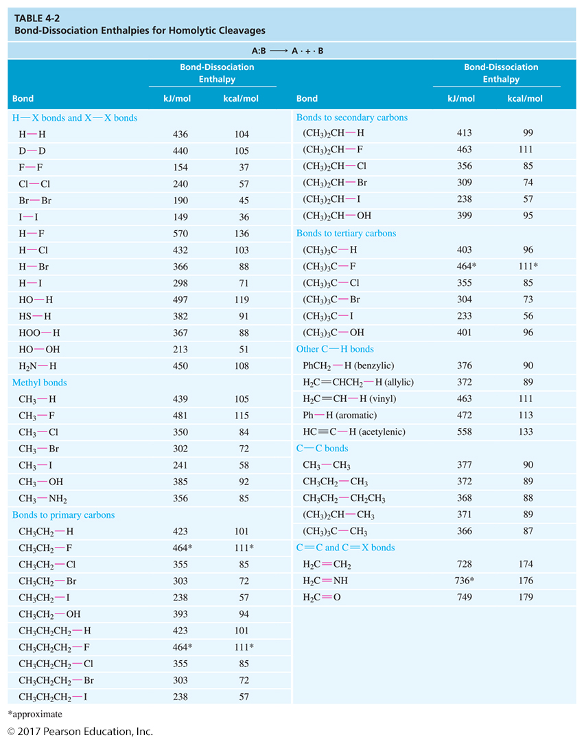

Slide 24
Rate Law
For the reaction A + B → C + D,
rate = k_{r}[A]ª[B]^{b}
      where k_{r} is the rate constant
      a is the order with respect to A
      b is the order with respect to B
      a + b is the overall order
Order is the number of molecules of that reactant which is present in the rate-determining step of the mechanism.

Slide 25
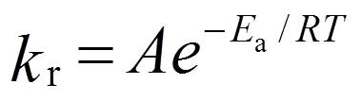
Activation Energy
The rate constant, k_{r}, depends on the conditions of the reaction, especially the temperature:
where A = constant (frequency factor)
E_{a} = activation energy
R = gas constant, 8.314 J/kelvin-mole
T = absolute temperature
E_{a} is the minimum kinetic energy needed to react.

Slide 26
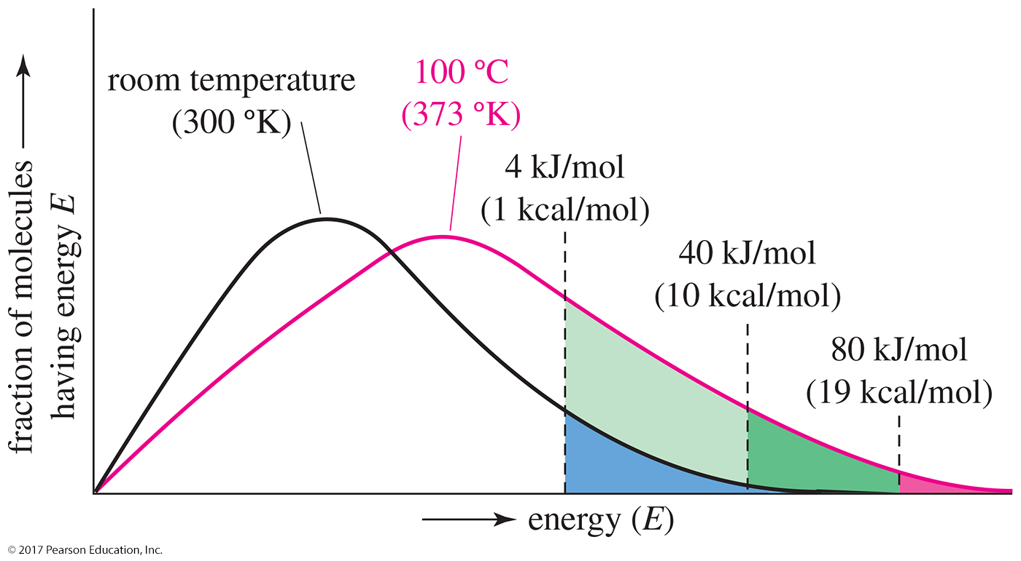
Temperature Dependence of E_{a}
At higher temperatures, more molecules have the required energy to react.

Slide 27
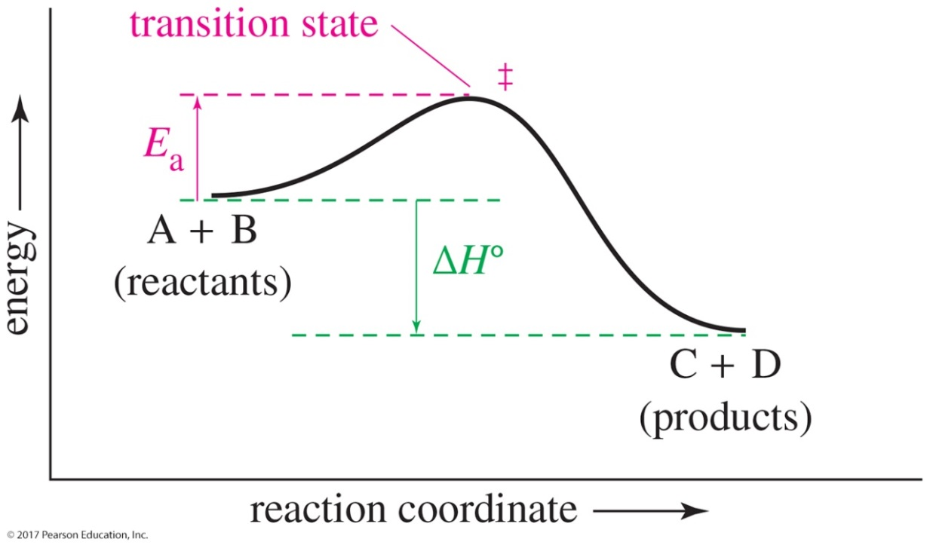
Energy Diagram of an Exothermic Reaction
The vertical axis in this graph represents the potential energy.
The transition state (‡) is the highest point on the graph, and the activation energy (E_{a}) is the energy difference between the reactants and the transition state.

Slide 28
Rates of Multistep Reactions
The highest points in an energy diagram are transition states.
The lowest points in an energy diagram are intermediates.
The reaction step with the highest E_{a} will be the slowest step and will determine the rate at which the reaction proceeds (rate-limiting step).

Slide 29
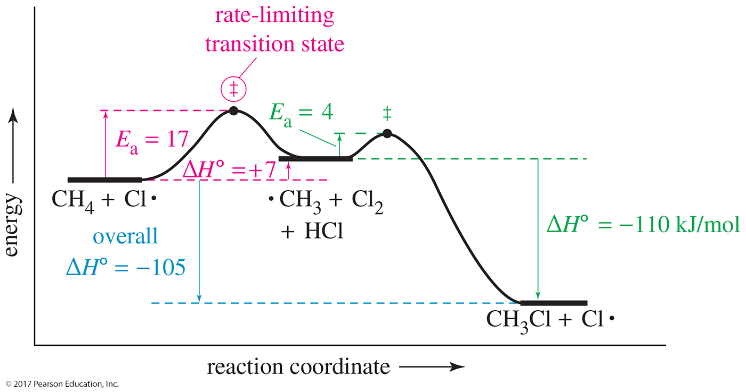
Energy Diagram for the Chlorination of Methane

Slide 30
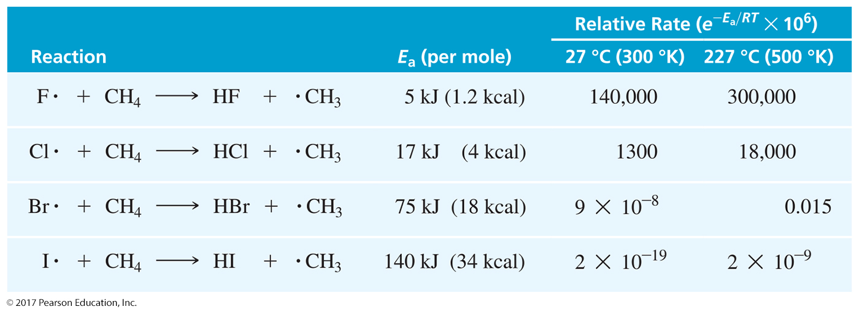
Rate, E_{a}, and Temperature

Slide 31
Conclusions
With increasing E_{a}, rate decreases.
With increasing temperature, rate increases.
Fluorine reacts explosively.
Chlorine reacts at a moderate rate.
Bromine must be heated to react.
Iodine does not react (detectably).

Slide 32

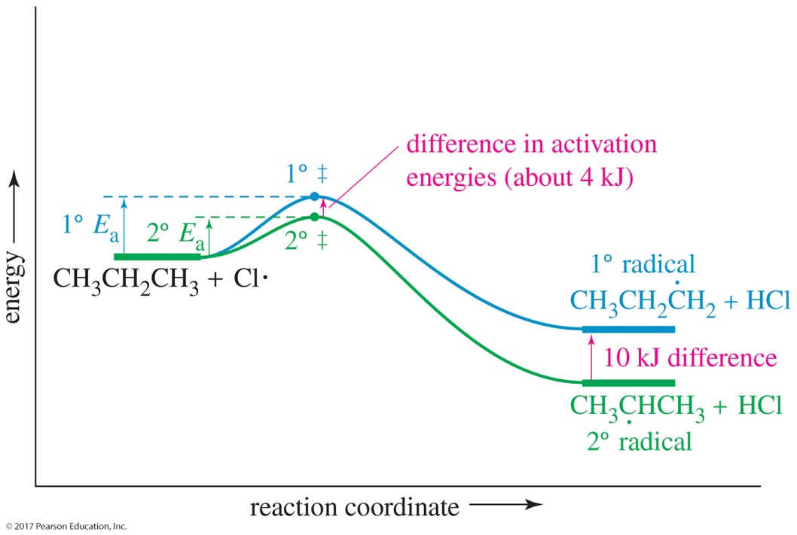
Solved Problem 2
Consider the following reaction:
This reaction has an activation energy (E_{a}) of +17 kJ/mol (+4 kcal/mol) and a ΔH° of +4 kJ/mol (+1 kcal/mol). Draw a reaction-energy diagram for this reaction.
Solution
We draw a diagram that shows the
products to be 4 kJ higher in energy
than the reactants. The barrier is
made to be 17 kJ higher in energy
than the reactants.

Slide 33
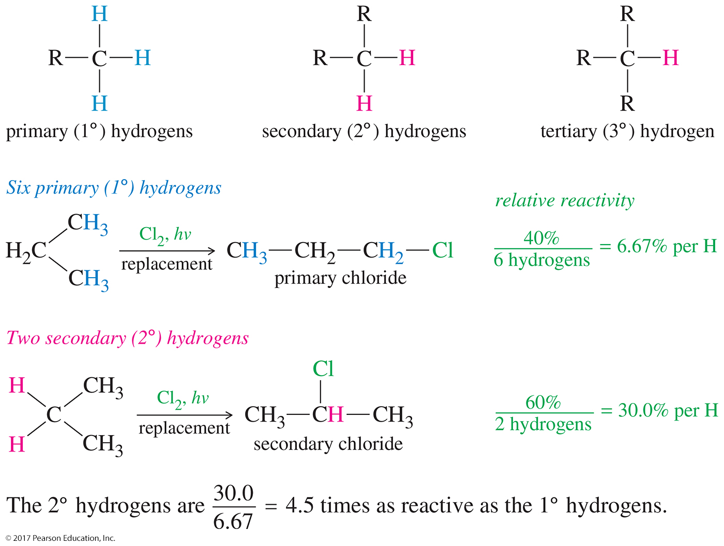
Primary, Secondary, and Tertiary Hydrogens

Slide 34
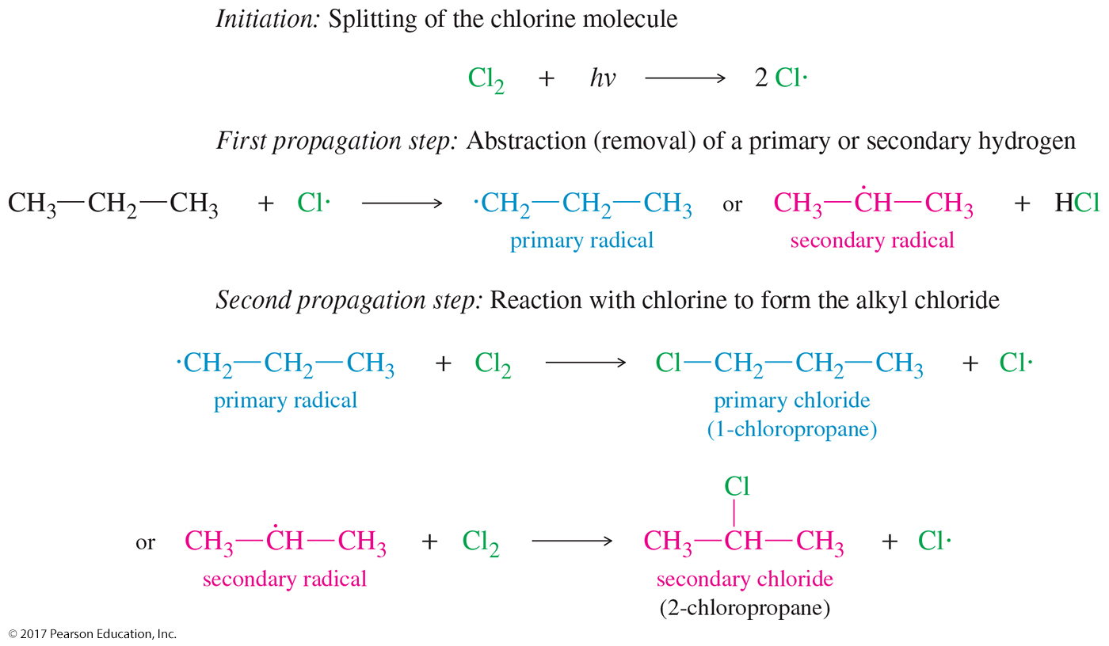
Chlorination Mechanism

Slide 35
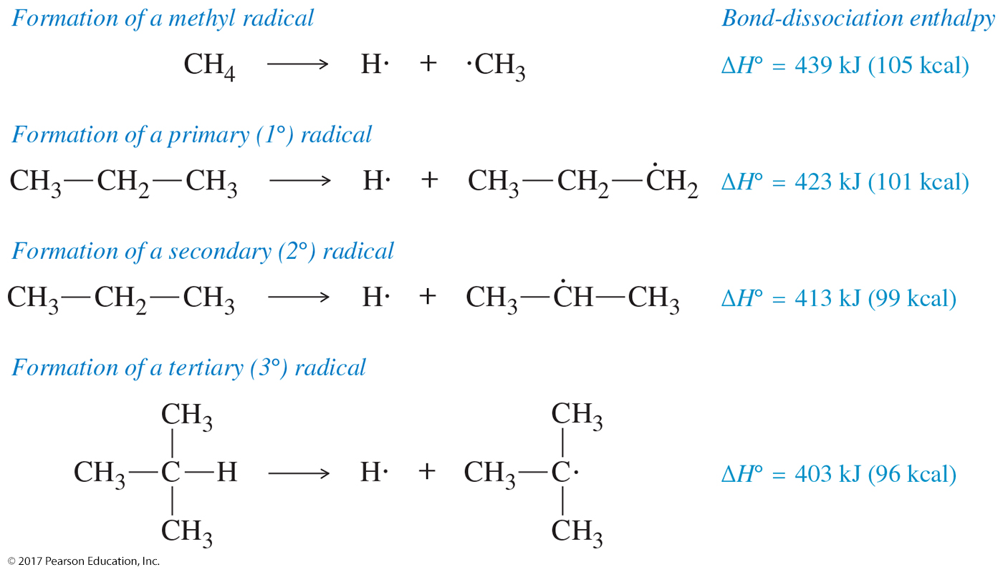
Bond Dissociation Energies for the Formation of Free Radicals

Slide 36
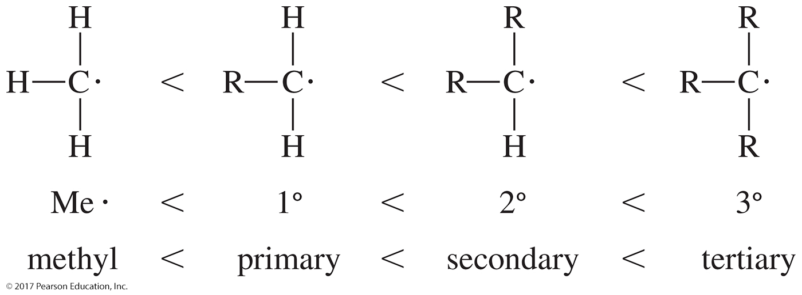
Stability of Free Radicals
Highly substituted free radicals are more stable.

Slide 37

Chlorination Energy Diagram
The lower the E_{a}, the faster the rate, so a more stable intermediate is formed faster.

Slide 38
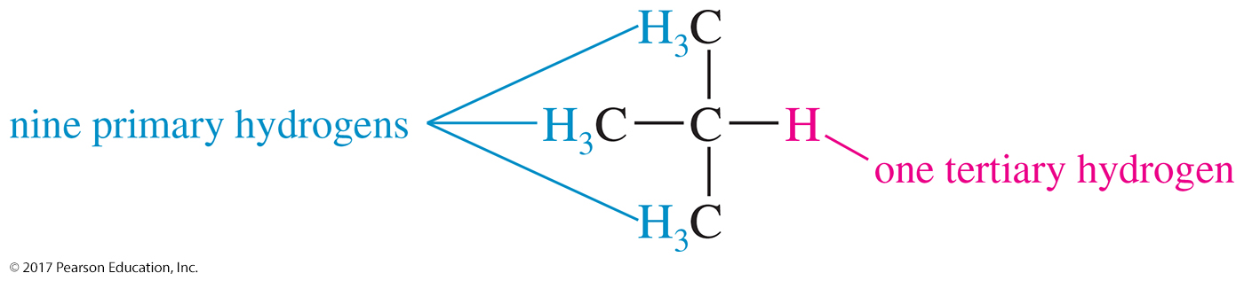
Solved Problem 3
Tertiary hydrogen atoms react with Cl• about 5.5 times as fast as primary ones. Predict the product ratios for chlorination of isobutane.
Solution
There are nine primary hydrogens and one tertiary hydrogen in isobutane.
(9 primary hydrogens) x (reactivity 1.0) = 9.0 relative amount of reaction
(1 tertiary hydrogen) x (reactivity 5.5) = 5.5 relative amount of reaction

Slide 39
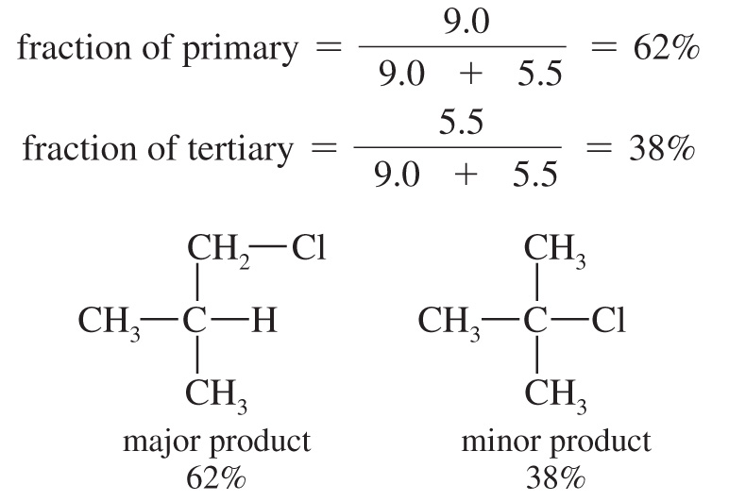
Solved Problem 3 (Continued)
Solution
Even though the primary hydrogens are less reactive, there are so many
of them that the primary product is the major product. The product ratio will be 9.0:5.5, or about 1.6:1.

Slide 40
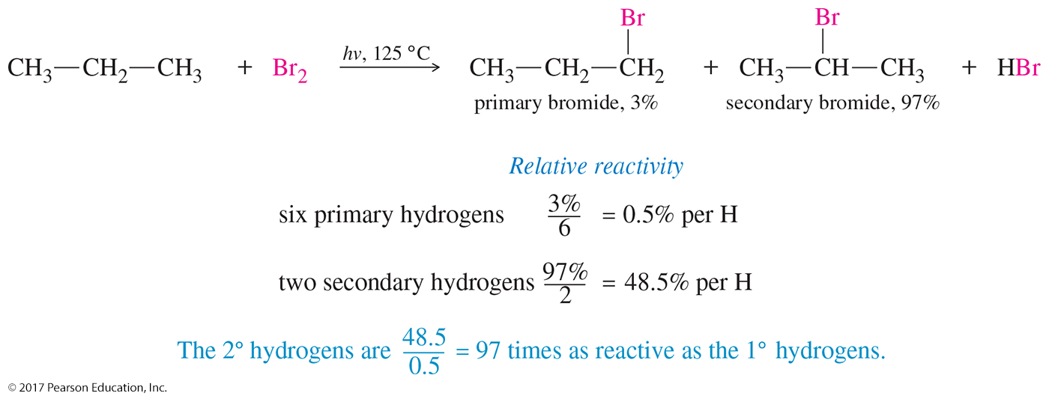
Rate of Substitution in the Bromination of Propane

Slide 41
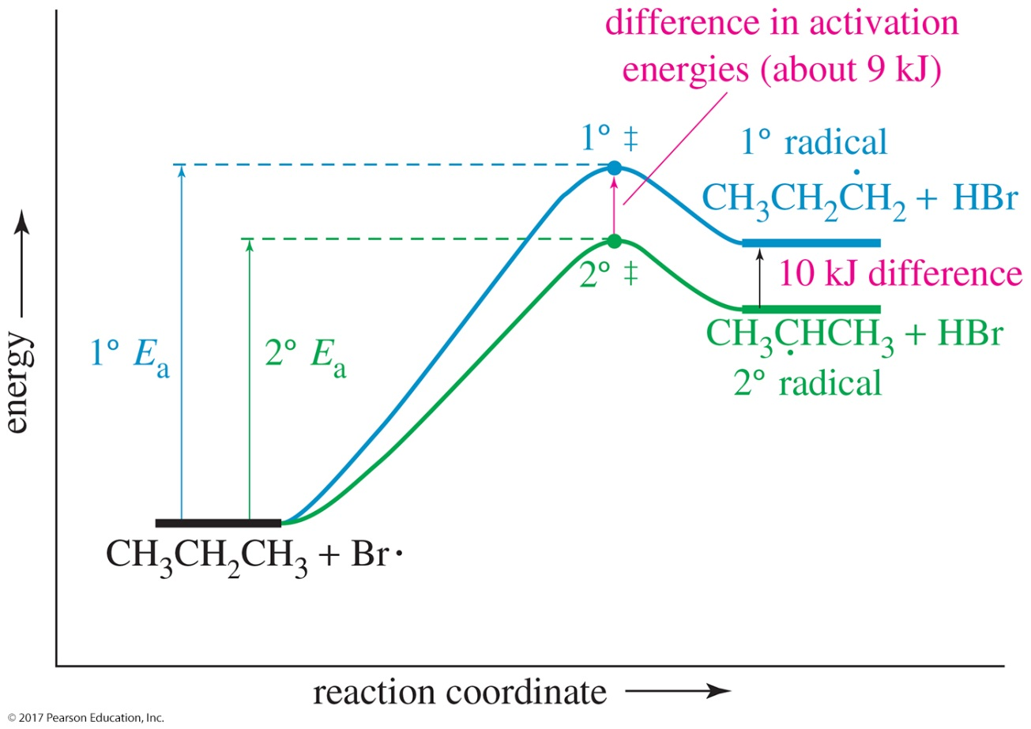
Energy Diagram for the Bromination of Propane

Slide 42
Hammond Postulate
Related species that are similar in energy are also similar in structure.
The structure of the transition state resembles the structure of the closest stable species.
Endothermic reaction: Transition state resembles the product.
Exothermic reaction: Transition state resembles the reactant.

Slide 43
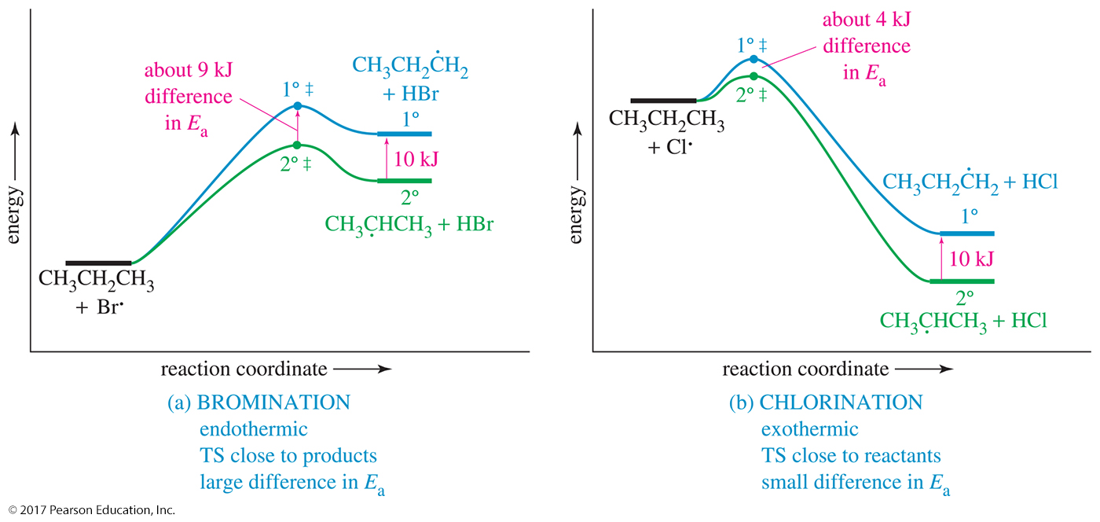
Energy Diagrams: Chlorination Versus Bromination

Slide 44
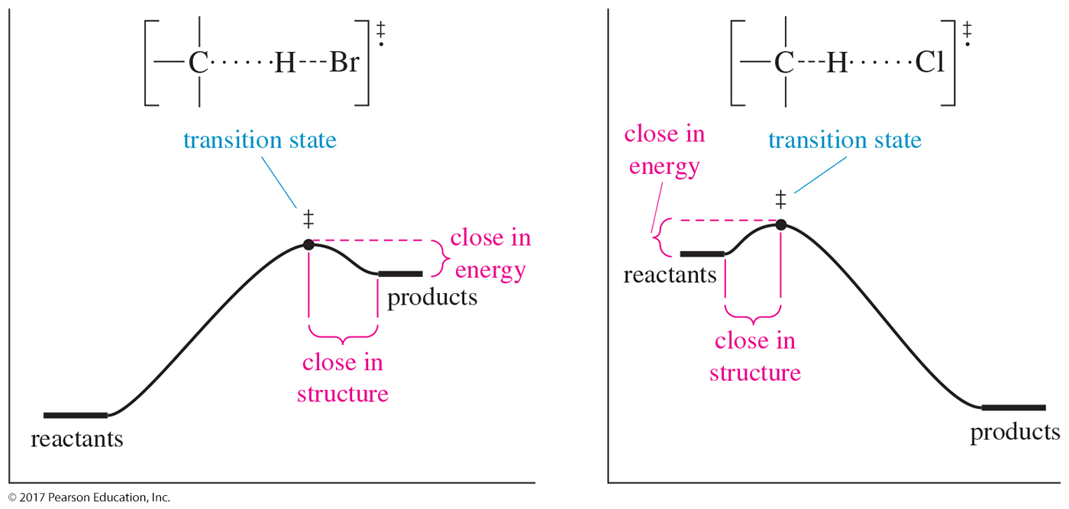
Endothermic and
Exothermic Diagrams

Slide 45
Radical Inhibitors
These are often added to food to retard spoilage by radical chain reactions.
Without an inhibitor, each initiation step will cause a chain reaction so that many molecules will react.
An inhibitor combines with the free radical to form a stable molecule.
Vitamin E and vitamin C are thought to protect living cells from free radicals.

Slide 46
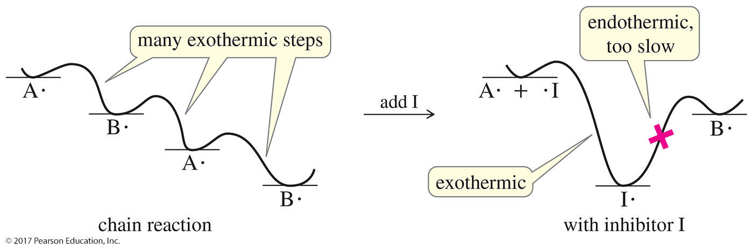
Radical Inhibitors (Continued)
A radical chain reaction is fast and has many exothermic steps that create more reactive radicals.
When an inhibitor reacts with the radical, it creates a stable intermediate, and any further reactions will be endothermic and slow.

Slide 47
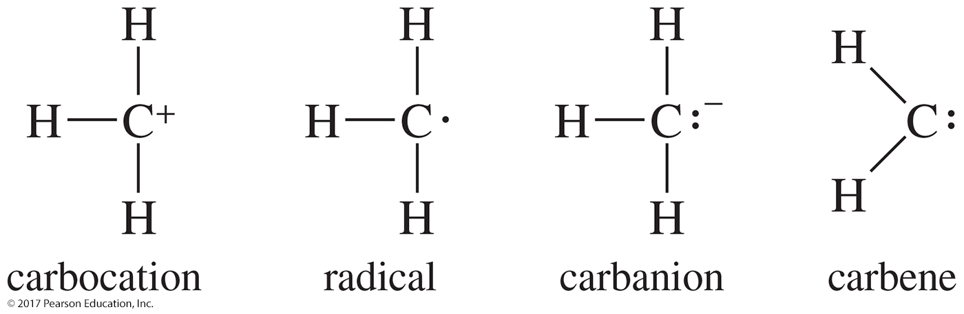
Reactive Intermediates
Reactive intermediates are short-lived species.
They are never present in high concentrations because they react as quickly as they are formed.

Slide 48
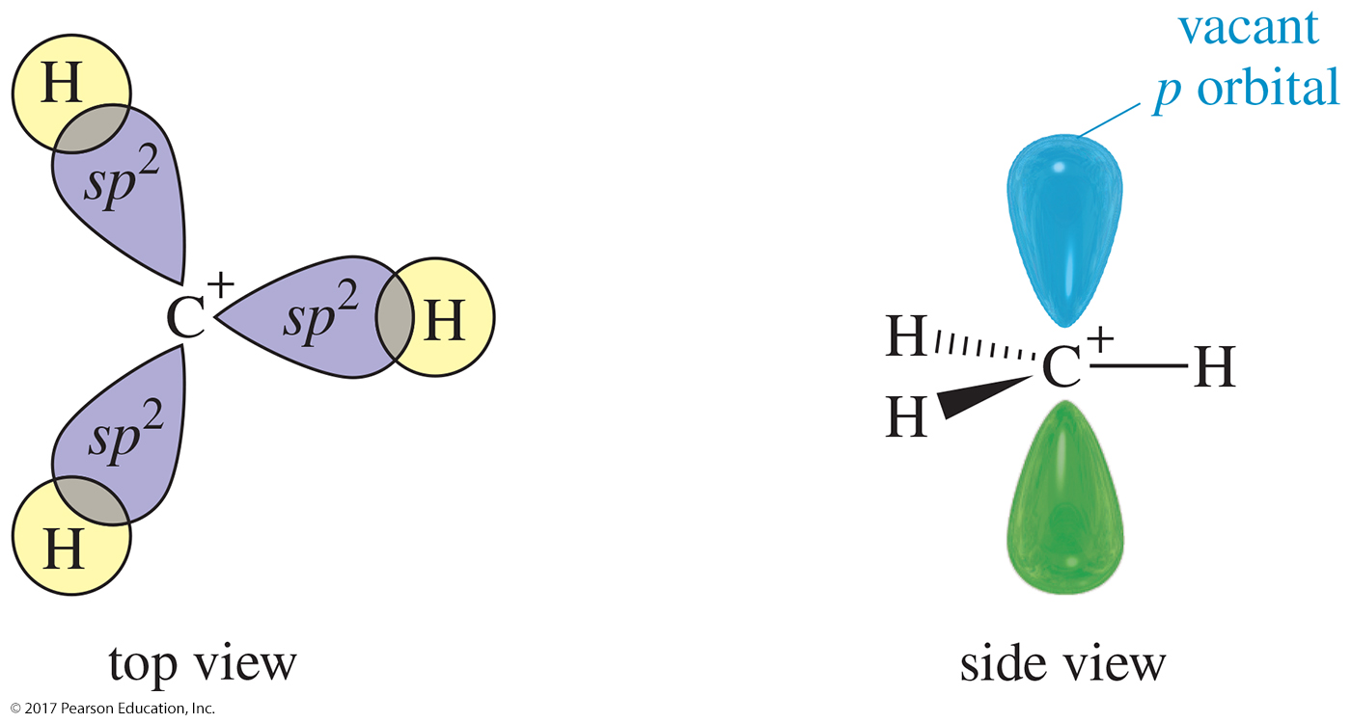
Carbocation Structure
A carbocation (also called a carbonium ion or a carbenium ion) is a positively charged carbon.
Carbon is sp² hybridized with a vacant p orbital.

Slide 49
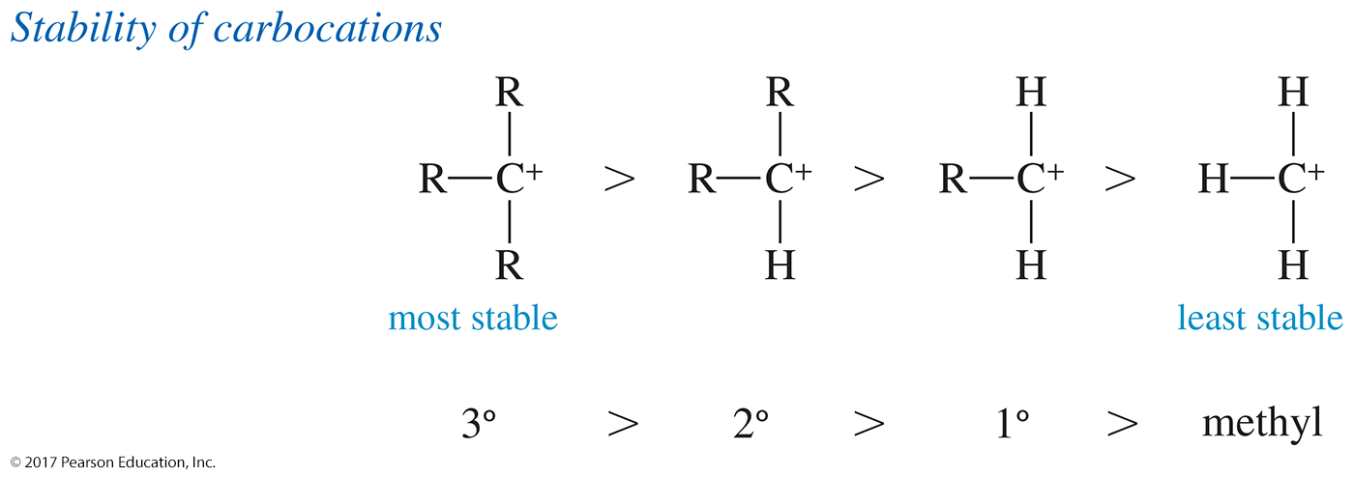
Carbocation Stability
More highly substituted carbocations are more stable.

Slide 50
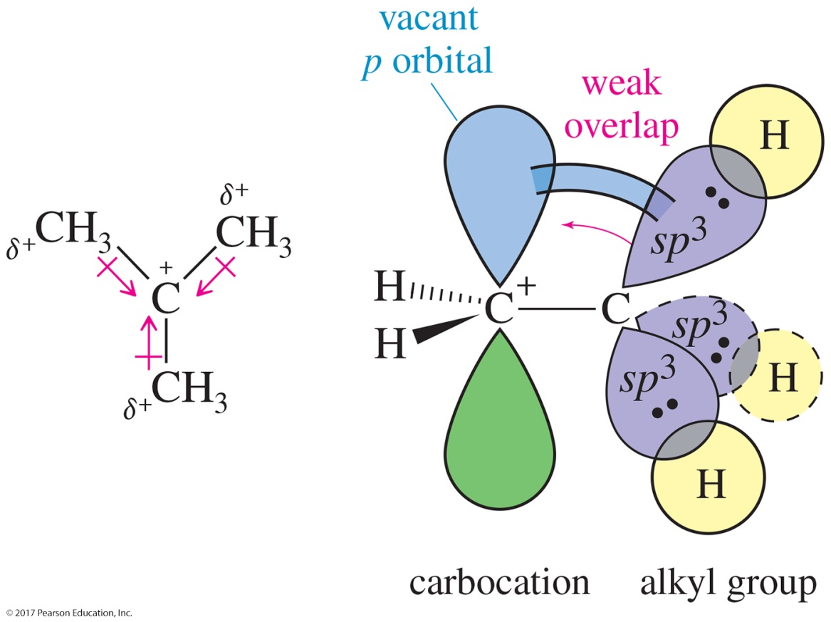
Carbocation Stability (Continued)
Stabilized by alkyl substituents in two ways:
  1. Inductive effect: Donation of electron density along the sigma bonds
  2. Hyperconjugation: Overlap of sigma bonding orbitals with empty p orbital

Slide 51
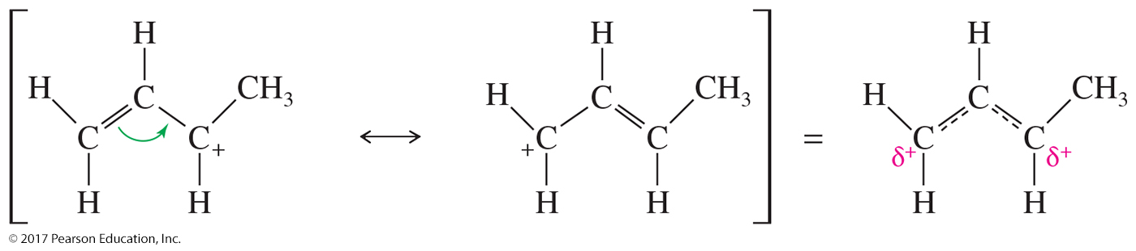
Unsaturated Carbocations
Unsaturated carbocations are also stabilized by resonance stabilization.
If a pi bond is adjacent to a carbocation, the filled p orbitals of the bond will overlap with the empty p orbital of the carbocation.

Slide 52
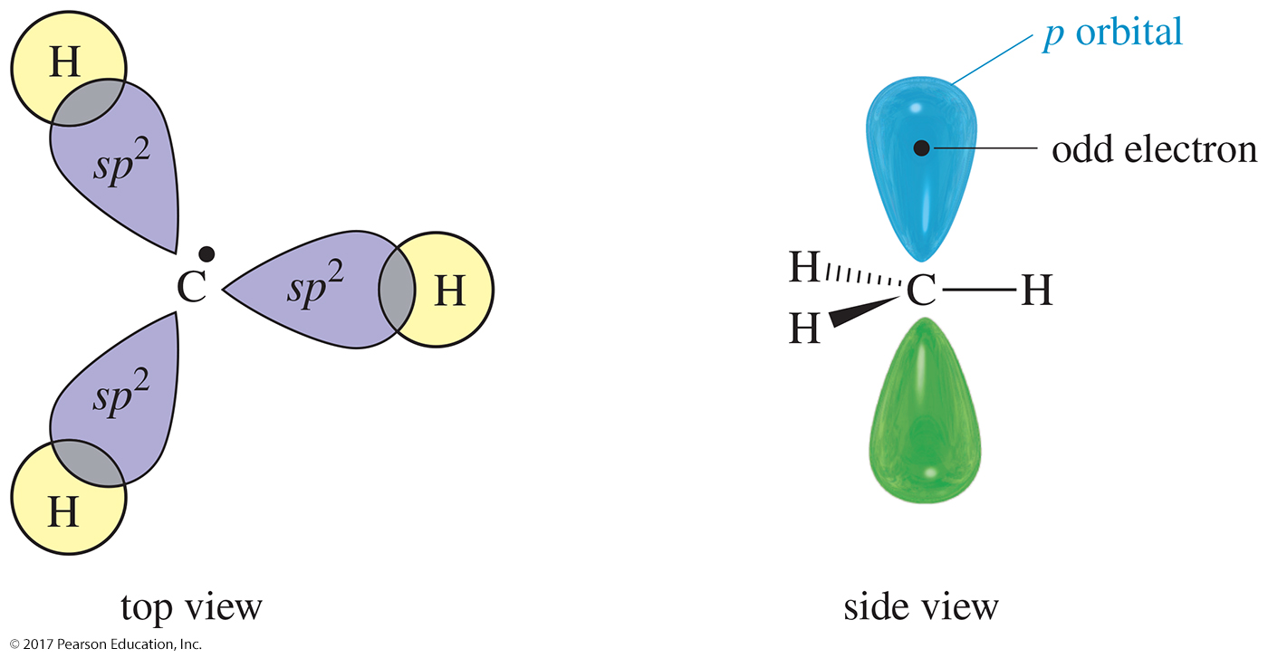
Free Radicals
Carbon is sp² hybridized with one electron in the p orbital.
Stabilized by alkyl substituents
Order of stability: 3° > 2° > 1° > methyl

Slide 53
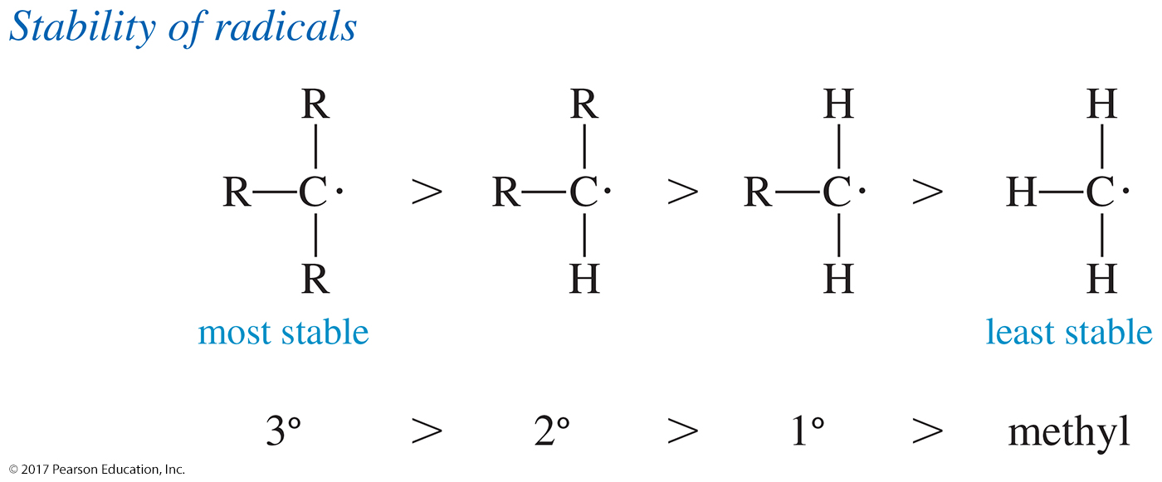
Stability of Carbon Radicals
More highly substituted radicals are more stable.

Slide 54
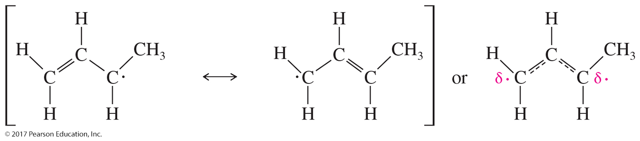
Unsaturated Radicals
Like carbocations, radicals can be stabilized by resonance.
Overlap with the p orbitals of a π bond allows the odd electron to be delocalized over two carbon atoms.
Resonance delocalization is particularly effective in stabilizing a radical.

Slide 55
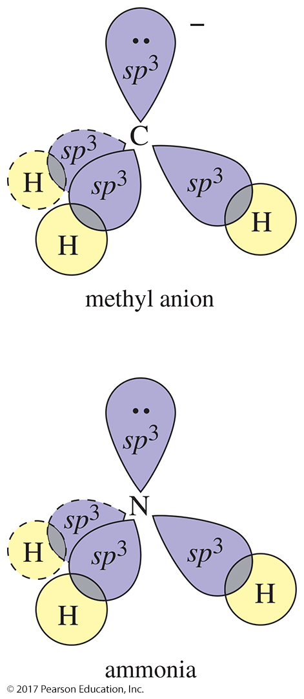
Carbanions
Eight electrons on carbon: six bonding plus one lone pair
Carbon has a negative charge.
Carbanions are nucleophilic and basic.

Slide 56
Stability of Carbanions
Alkyl groups and other electron-donating groups slightly destabilize a carbanion.
The order of stability is usually the opposite of that for carbocations and free radicals.

Slide 57
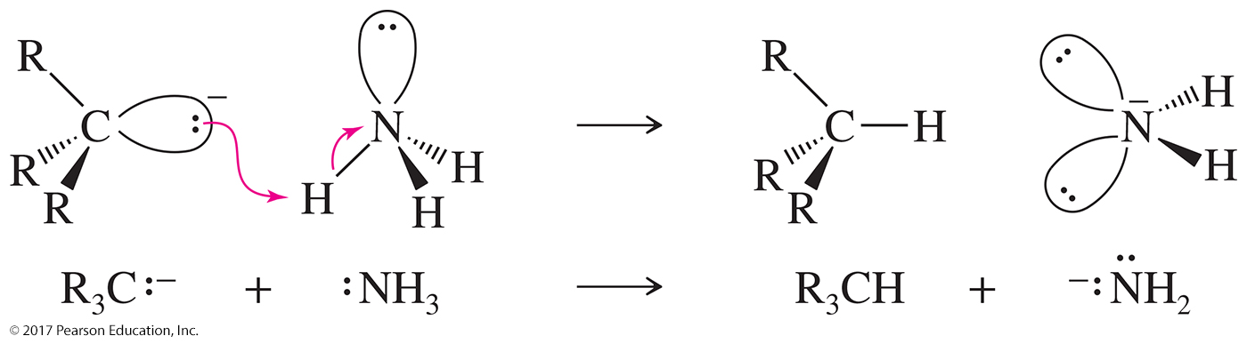
Basicity of Carbanions
A carbanion has a negative charge on its carbon atom, making it a more powerful base and a stronger nucleophile than an amine.
A carbanion is sufficiently basic to remove a proton from ammonia.

Slide 58
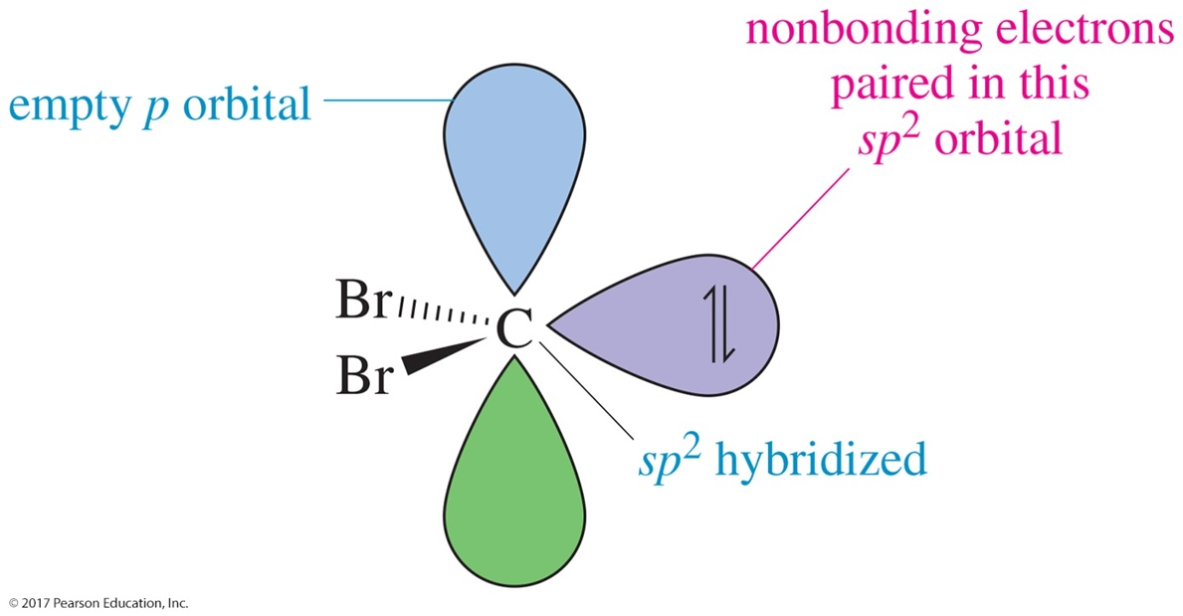
Carbenes
Carbon in carbenes is neutral.
It has a vacant p orbital, so it can react as an electrophile.
It has a lone pair of electrons in the sp² orbital, so it can react as a nucleophile.

Slide 59
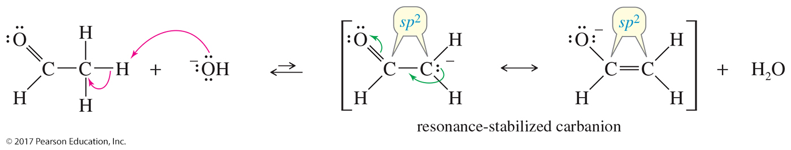
Carbenes as Reaction Intermediates
A strong base can abstract a proton from tribromomethane (CHBr₃) to give an inductively stabilized carbanion.
This carbanion expels bromide ion to give dibromocarbene. The carbon atom is sp² hybridized with trigonal geometry.
A carbene has both a lone pair of electrons and an empty p orbital, so it can react as a nucleophile or as an electrophile.

Slide 60
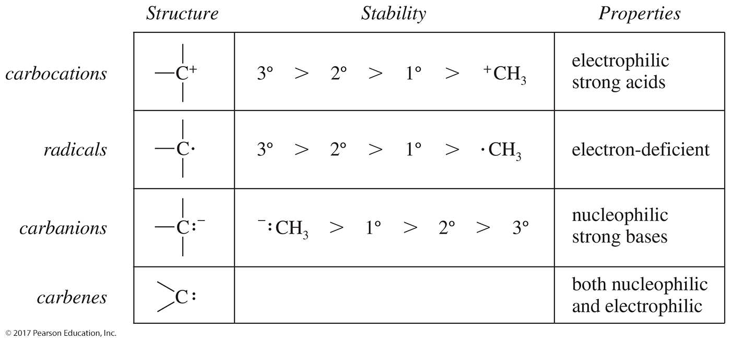
Summary of Reactive Species

