Slide 1
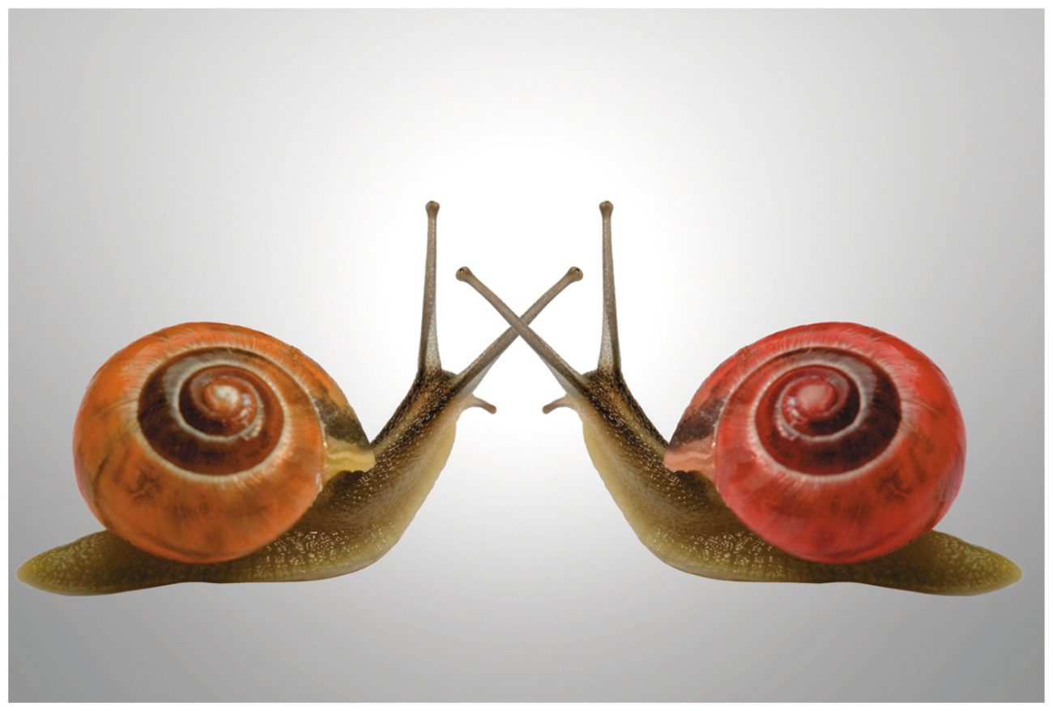
Organic Chemistry,
9th Edition
L. G. Wade, Jr.
Chapter 5
Lecture
Stereochemistry
Chad Snyder, PhD
Grace College
© 2017 Pearson Education, Inc.

Slide 2
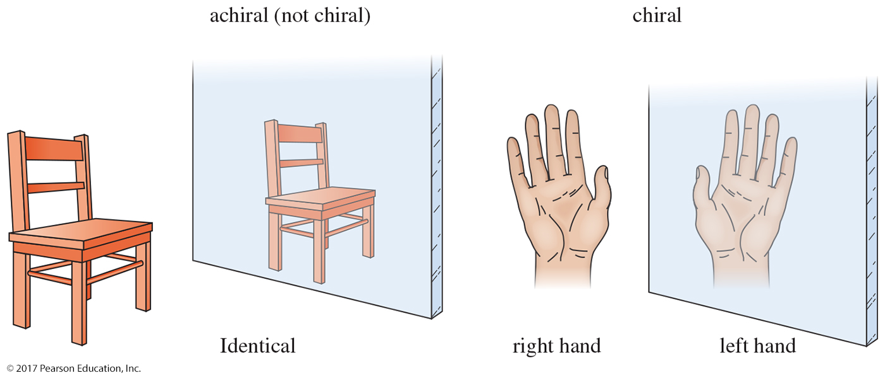
Chirality
“Handedness”: Right-hand glove does not fit the left hand.
An object is chiral if its mirror image is different from the original object.

Slide 3
Achiral
Mirror images that can be superposed are achiral (not chiral).

Slide 4
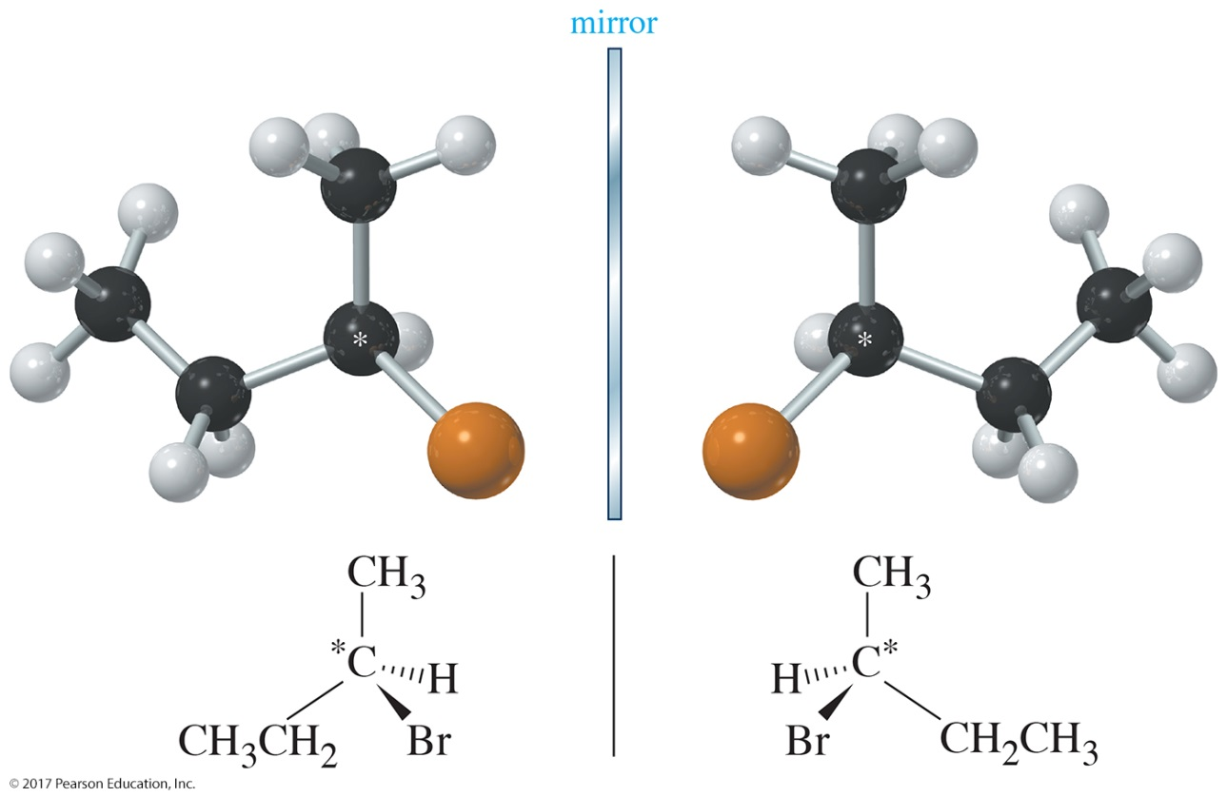
Stereoisomers
Enantiomers are compounds that are nonsuperimposable mirror images. Any molecule that is chiral must have an enantiomer.

Slide 5
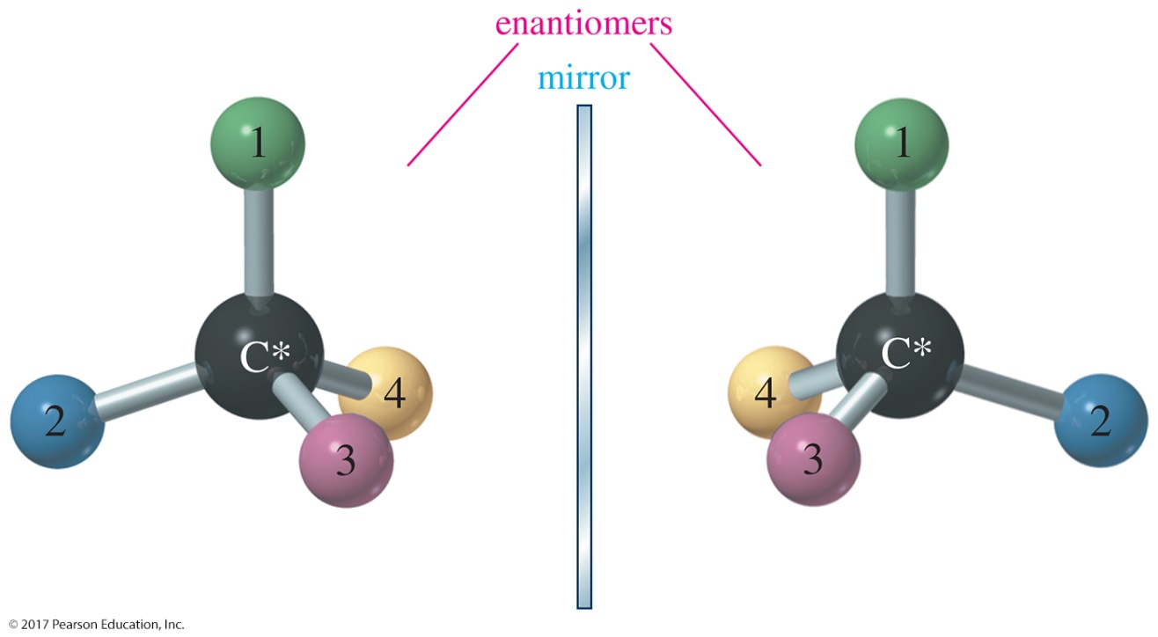
Chiral Carbon Atom
Also called asymmetric carbon atom
A carbon atom that is bonded to four different groups is chiral.
Its mirror image will be a different compound (enantiomer).

Slide 6
Stereocenters
An asymmetric carbon atom is the most common example of a chirality center.
Chirality centers belong to an even broader group called stereocenters. A stereocenter (or stereogenic atom) is any atom at which the interchange of two groups gives a stereoisomer.
Asymmetric carbons and the double-bonded carbon atoms in cis-trans isomers are the most common types of stereocenters.

Slide 7
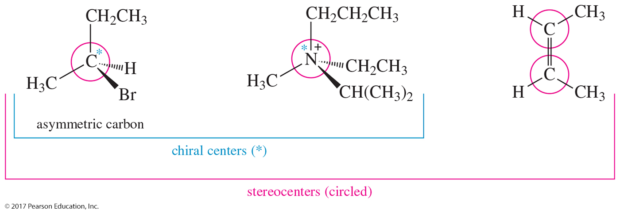
Examples of Chirality Centers
Asymmetric carbon atoms are examples of chirality centers, which are examples of stereocenters.

Slide 8
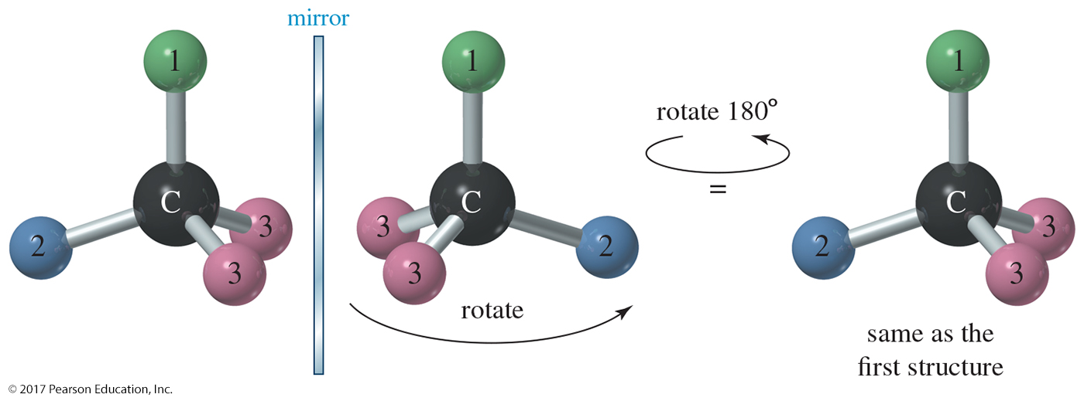
Achiral Compounds
Take this mirror image and try to superimpose it on the one to the left matching all the atoms. Everything will match.
When the images can be superposed, the compound is achiral.

Slide 9
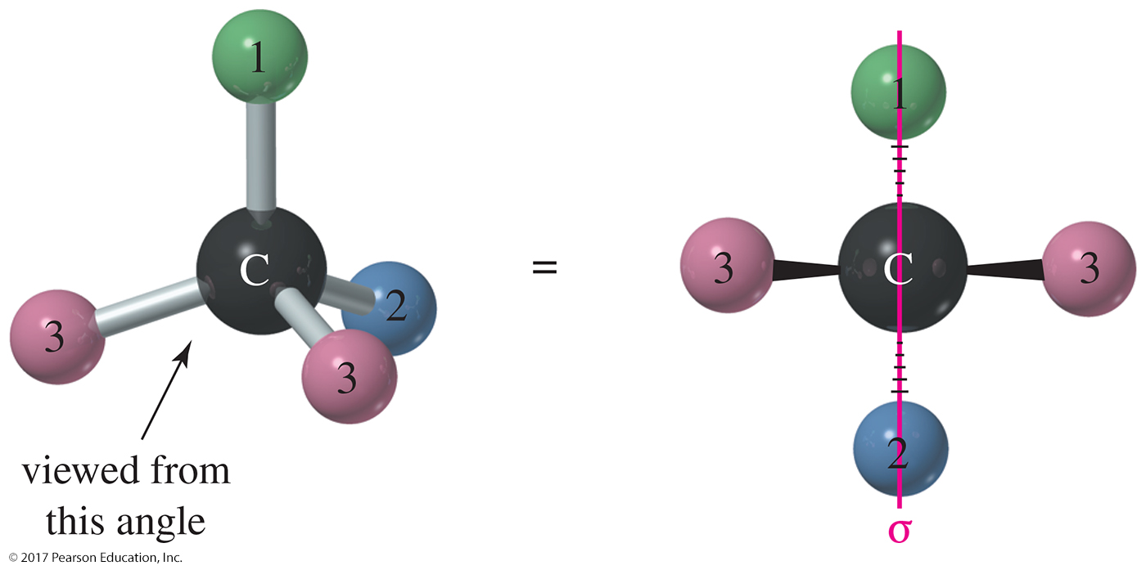
Planes of Symmetry
A molecule that has a plane of symmetry is achiral.

Slide 10
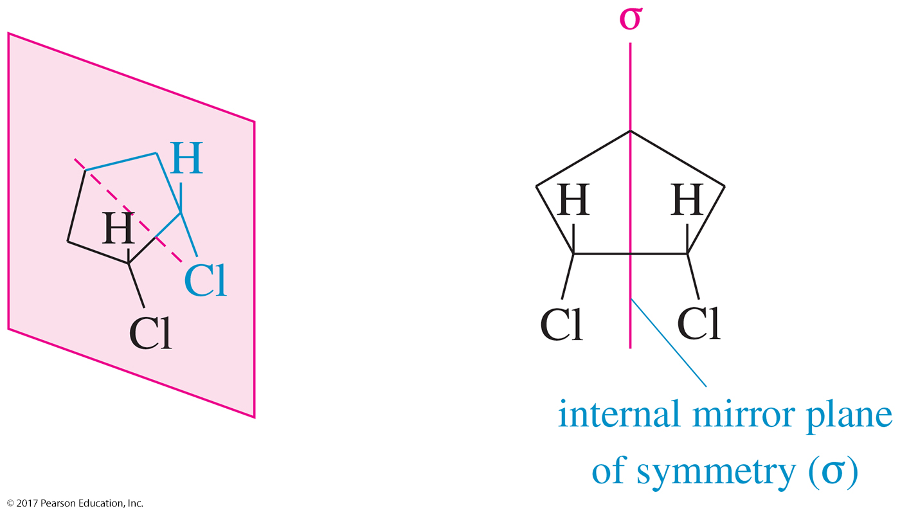
Cis Cyclic Compounds
Cis-1,2-dichlorocyclohexane is achiral because the molecule has an internal plane of symmetry. Both structures above can be superimposed.

Slide 11
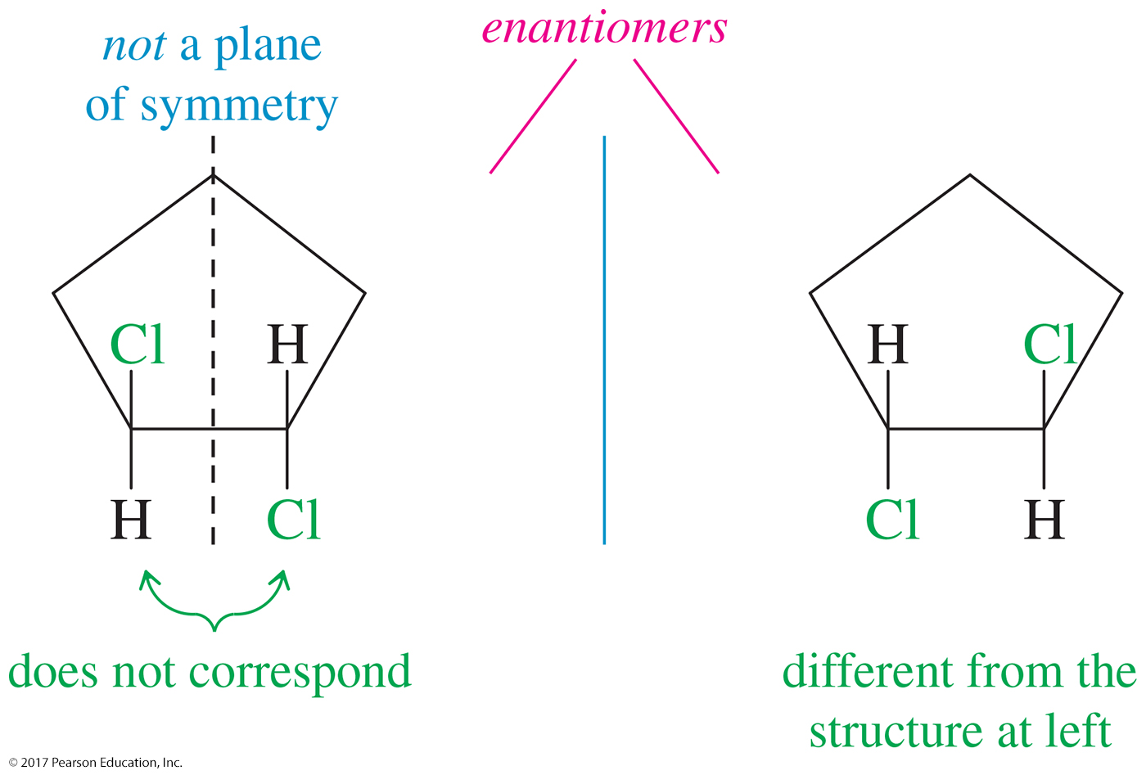
Trans Cyclic Compounds
Trans-1,2-dichlorocyclohexane does not have a plane of symmetry, so the images are nonsuperimposable and the molecule will have two enantiomers.

Slide 12
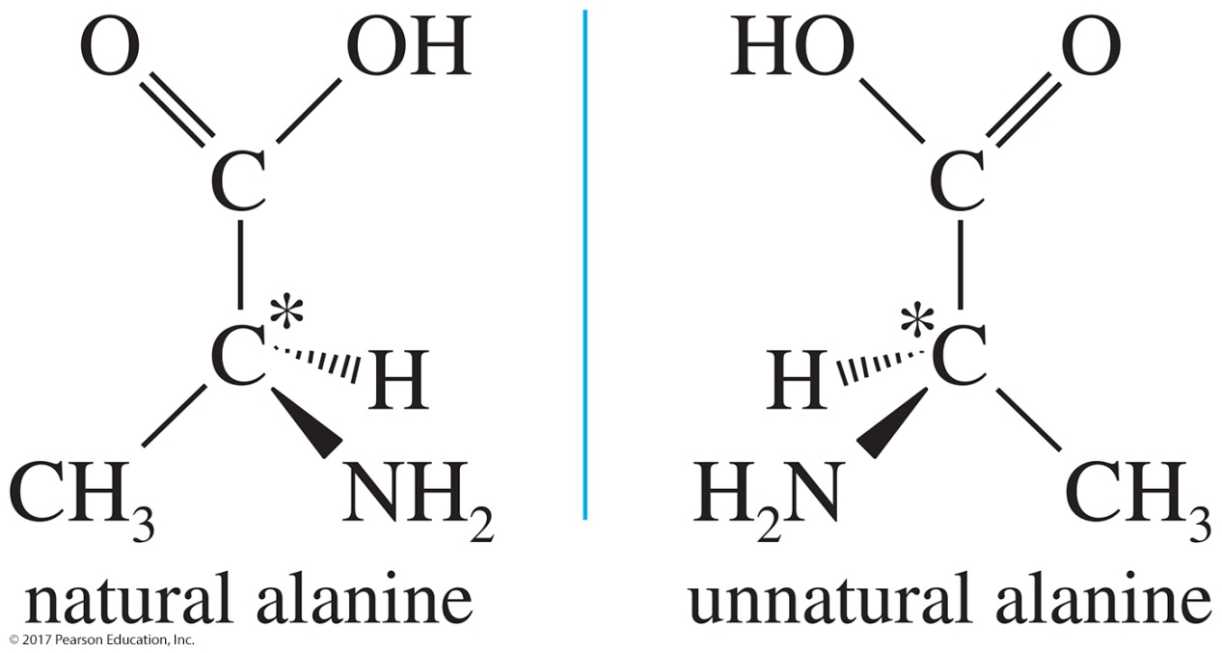
(R) and (S) Configuration
Both enantiomers of alanine receive the same name in the IUPAC system: 2-aminopropanoic acid.
Only one enantiomer is biologically active. In alanine only the left enantiomer can be metabolized by the enzyme.
We need a way to distinguish between them.

Slide 13
Cahn–Ingold–Prelog
Convention
Enantiomers have different spatial arrangements of the four groups attached to the asymmetric carbon.
The two possible spatial arrangements will be called configurations.
Each asymmetric carbon atom is assigned a letter, (R) or (S), based on its three-dimensional configuration.
Cahn–Ingold–Prelog convention is the most widely accepted system for naming the configurations of chirality centers.

Slide 14
(R) and (S) Configuration:
Step 1 Assign Priority
Assign a relative “priority” to each group bonded to the asymmetric carbon. Group 1 would have the highest priority, group 2 second highest, etc.
Atoms with higher atomic numbers receive higher priorities.
I > Br > Cl > S > F > O > N > ¹³C > ¹²C > Li > ²H > ¹H

Slide 15
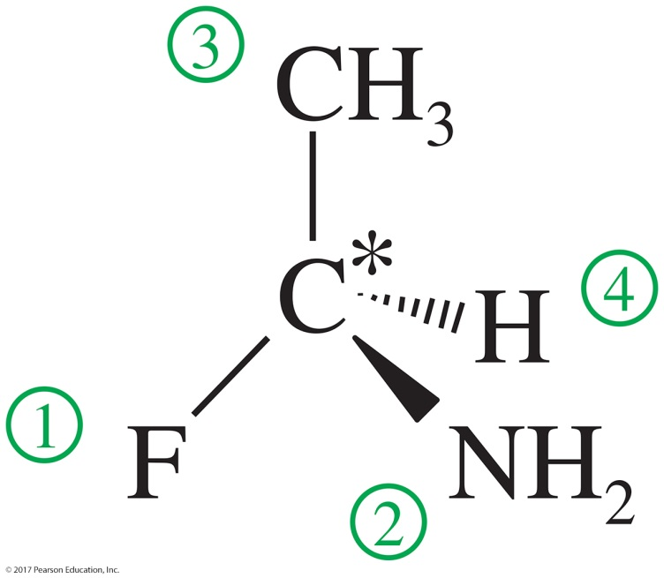
Assign Priorities
Atomic number: F > N > C > H

Slide 16
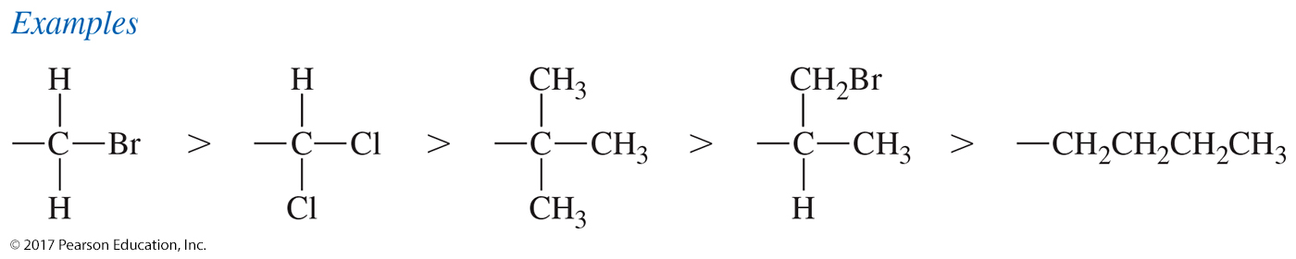
(R) and (S) Configuration: Breaking Ties
In case of ties, use the next atoms along the chain of each
group as tiebreakers.

Slide 17
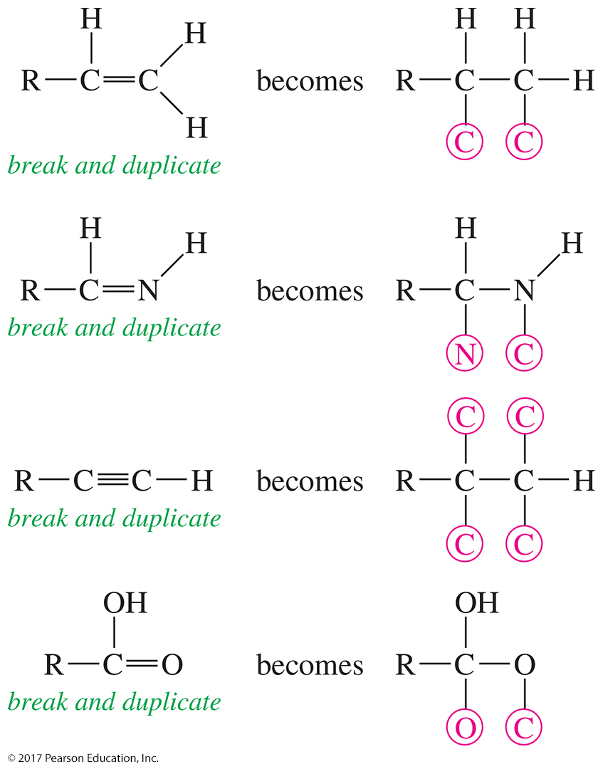
(R) and (S) Configuration: Multiple Bonds
Treat double and triple bonds as if each were a bond to a separate atom.

Slide 18
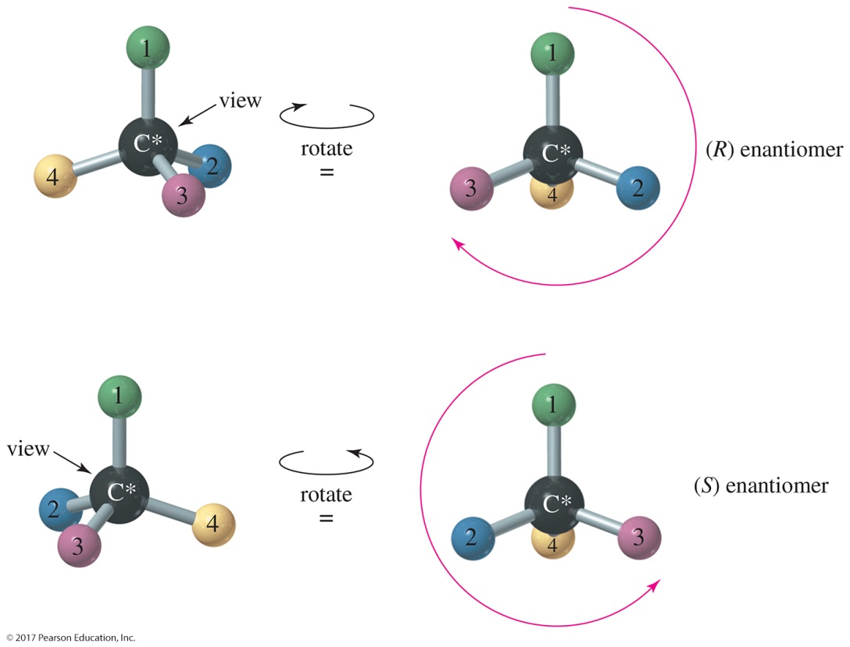
(R) and (S) Configuration:
Step 2
Working in 3-D, rotate the molecule so that the lowest priority group is in back.
Draw an arrow from the highest to lowest priority group.
Clockwise = (R) Counterclockwise = (S)

Slide 19
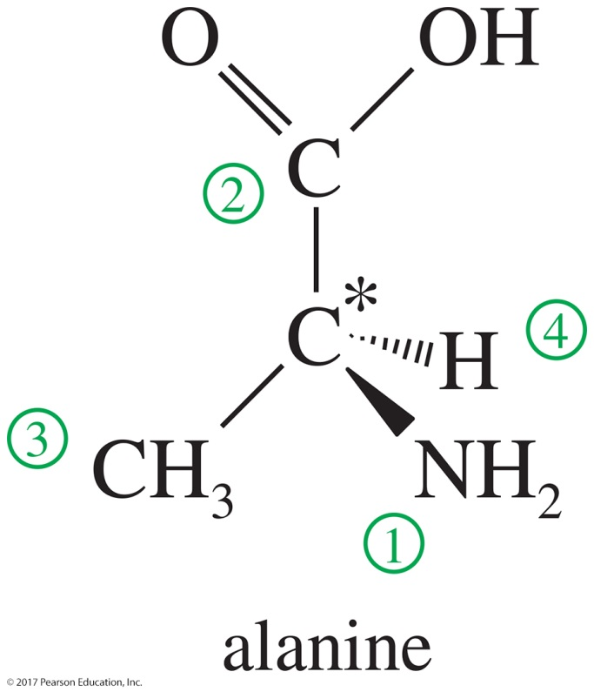
Assign Priorities
Counterclockwise
(S)
Draw an arrow from Group 1 to Group 2 to Group 3 and back to Group 1. Ignore Group 4.
Clockwise = (R) and Counterclockwise = (S)

Slide 20
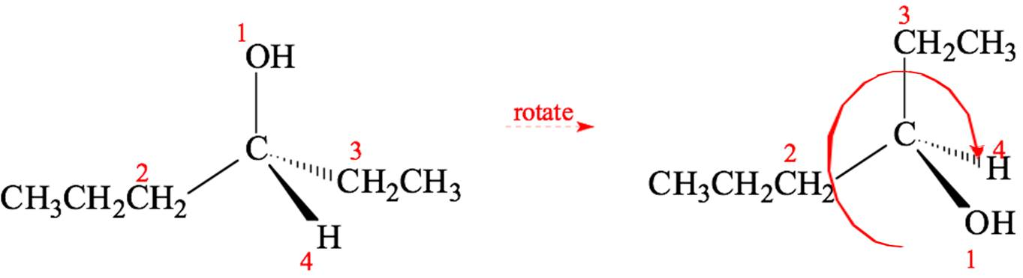
Example
Clockwise
(R)
When rotating to put the lowest priority group in the back, keep one group in place and rotate the other three.

Slide 21
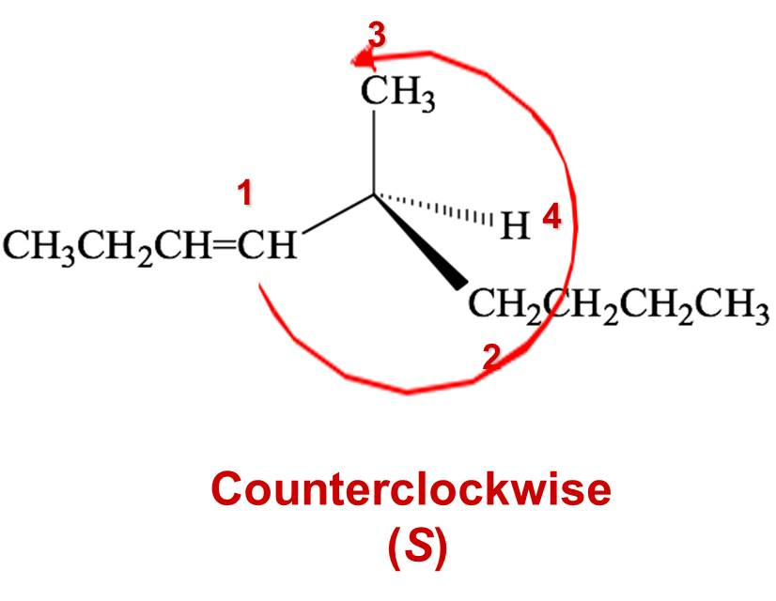
Example (Continued)

Slide 22
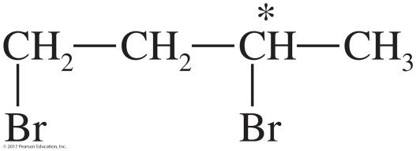
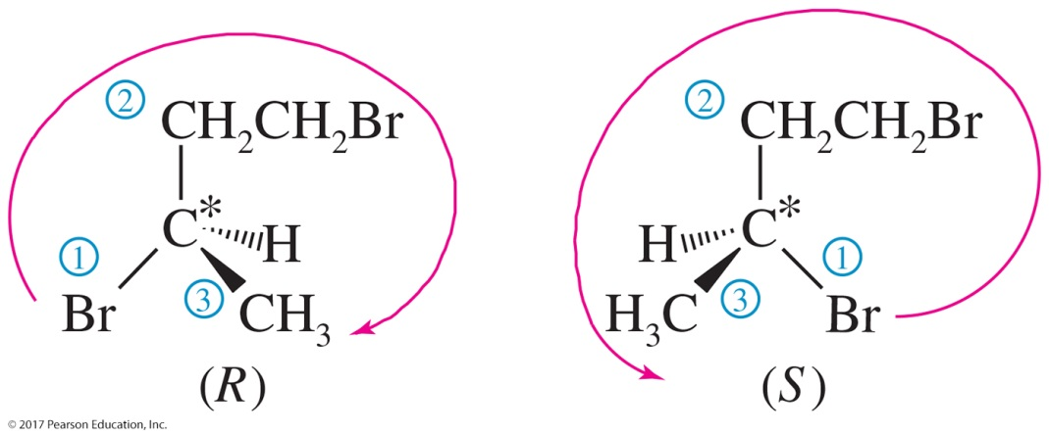
Solved Problem 1
Draw the enantiomers of 1,3-dibromobutane and label them as (R) and (S). (Making a model is particularly helpful for this type of problem.)
Solution
The third carbon atom in 1,3-dibromobutane is asymmetric. The bromine atom receives first priority, the (–CH₂CH₂Br) group second priority, the methyl group third, and the hydrogen fourth. The following mirror images are drawn with the hydrogen atom back, ready to assign (R) or (S) as shown.

Slide 23
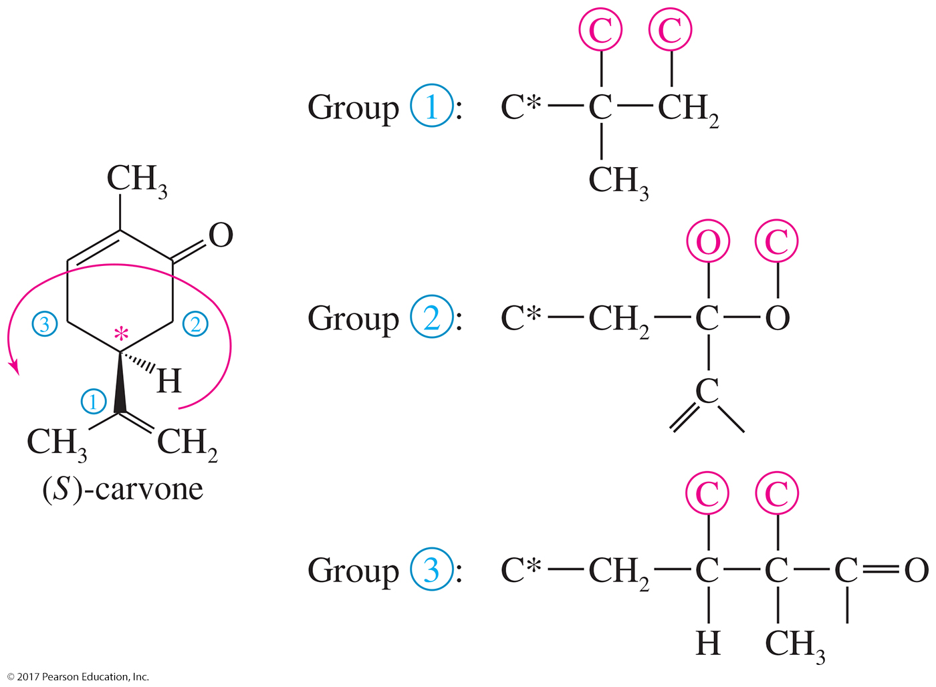
Configuration in Cyclic Compounds

Slide 24
Properties of Enantiomers
Same boiling point, melting point, and density
Same refractive index
Rotate the plane of polarized light in the same magnitude, but in opposite directions.
Different interaction with other chiral molecules
  Active site of enzymes is selective for a specific enantiomer.
  Taste buds and scent receptors are also chiral. Enantiomers may have different smells.

Slide 25
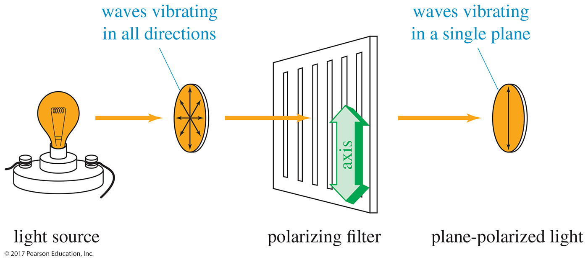
Polarized Light
Plane-polarized light is composed of waves that vibrate in only one plane.

Slide 26
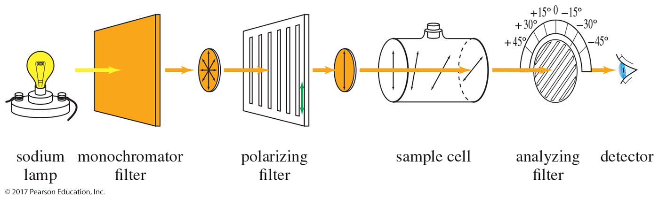
Optical Activity
Enantiomers rotate the plane of polarized light in opposite directions, but in the same number of degrees.

Slide 27
Polarimeter
Clockwise
Dextrorotatory (+)
Counterclockwise
Levorotatory (–)
Not related to (R) and (S)

Slide 28
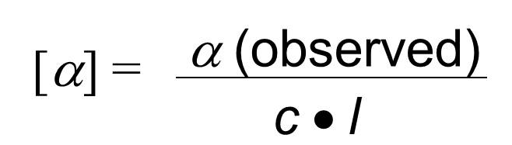
Specific Rotation
Observed rotation depends on the length of the cell and concentration, as well as the strength of optical activity, temperature, and wavelength of light.
where α (observed) is the rotation observed in the polarimeter, c is concentration in g/mL, and l is length of sample cell in decimeters.

Slide 29

Solved Problem 2
When one of the enantiomers of 2-butanol is placed in a polarimeter, the observed rotation
is 4.05° counterclockwise. The solution was made by diluting 6 g of 2-butanol to a total of 40 mL, and the solution was placed into a 200-mm polarimeter tube for the measurement. Determine the specific rotation for this enantiomer of 2-butanol.
Solution
Since it is levorotatory, this must be (–)-2-butanol The concentration is 6 g per 40 mL = 0.15 g/mL, and the path length is 200 mm = 2 dm. The specific rotation is

Slide 30
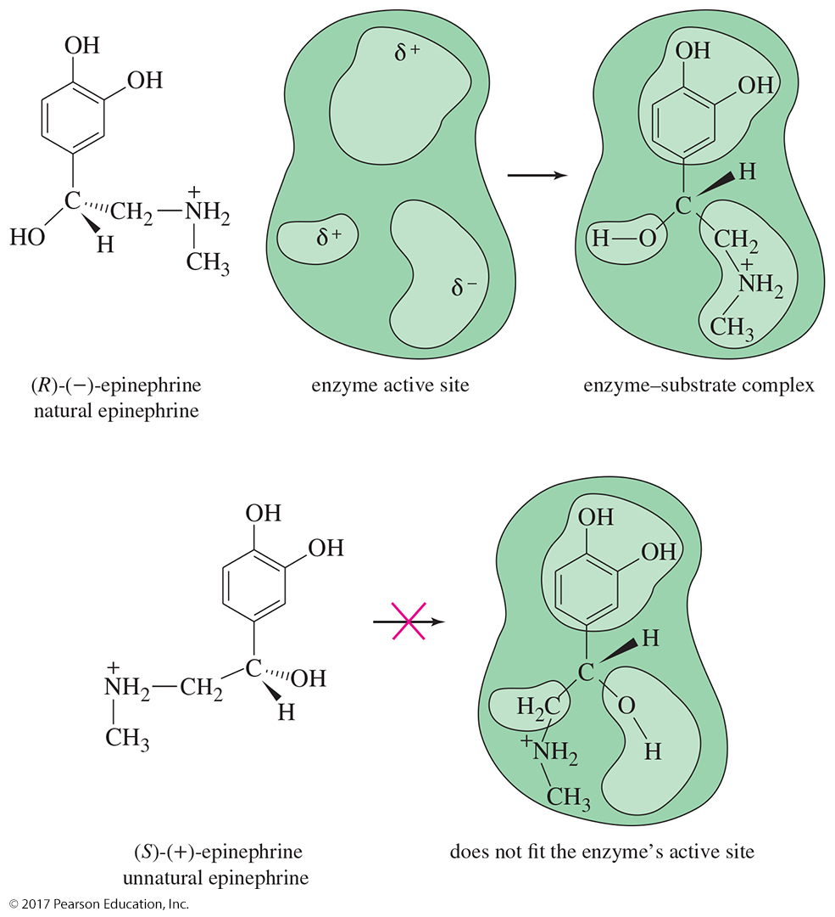
Biological Discrimination

Slide 31
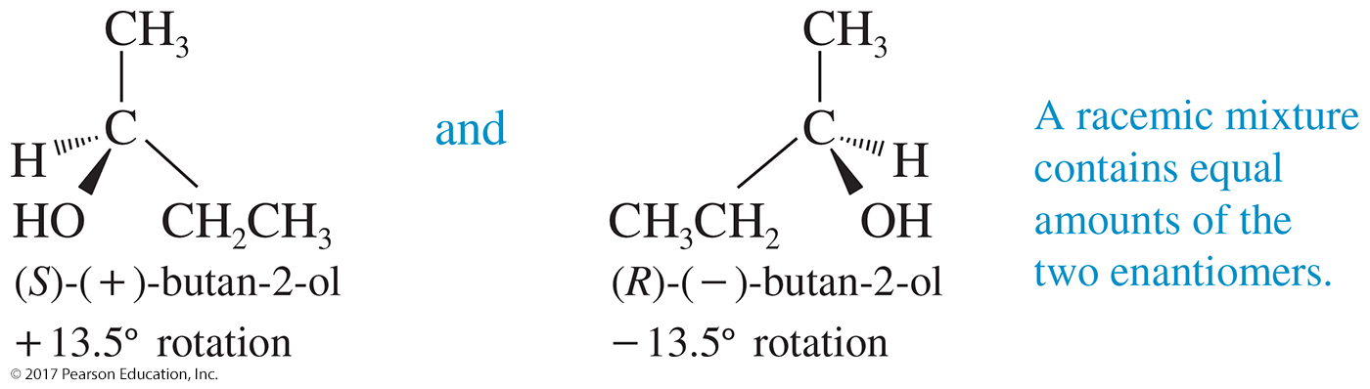
Racemic Mixtures
Equal quantities of d- and l-enantiomers
Notation: (d,l) or (±)
No optical activity
The mixture may have different boiling point (b. p.) and melting point (m. p.) from the enantiomers!

Slide 32
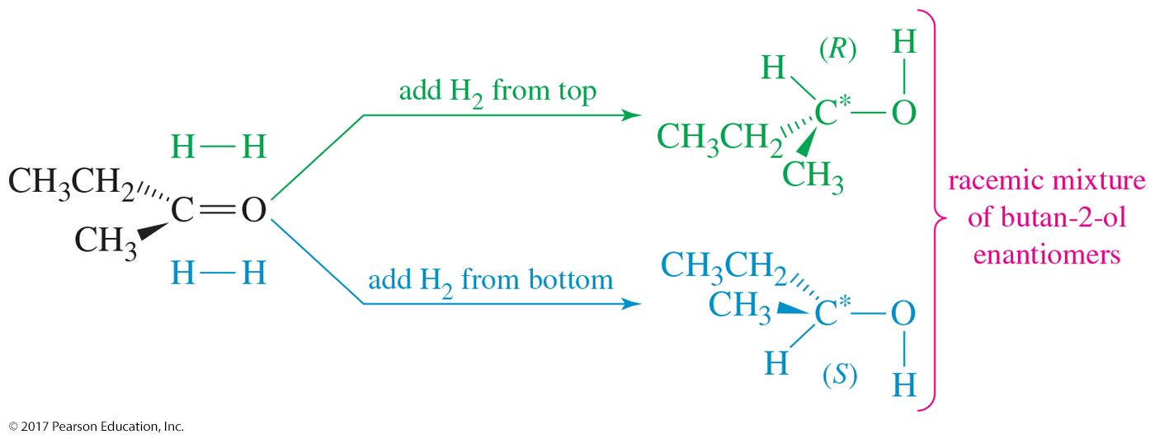
Racemic Products
If optically inactive reagents combine to form a chiral molecule, a racemic mixture is formed.

Slide 33
Optical Purity
Optical purity (o. p.) is sometimes called enantiomeric excess (e. e.).
One enantiomer is present in greater amounts.
observed rotation
rotation of pure enantiomer
o. p. =
× 100

Slide 34
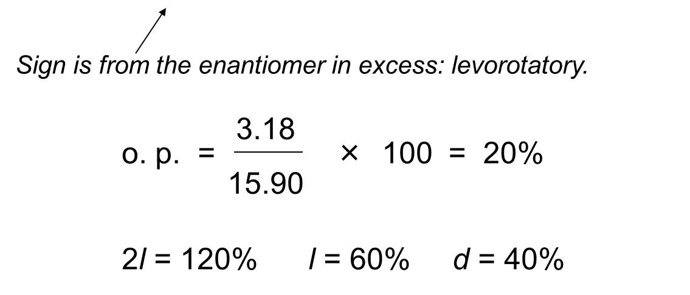
Calculate % Composition
The specific rotation of (S)-2-iodobutane is +15.90°. Determine the % composition of a mixture of (R)- and (S)-2-iodobutane if the specific rotation of the mixture is –3.18°.

Slide 35
Chirality of Conformers
If equilibrium exists between two chiral conformers, the molecule is not chiral.
Judge chirality by looking at the most symmetrical conformer.
Cyclohexane can be considered to be planar, on average.

Slide 36
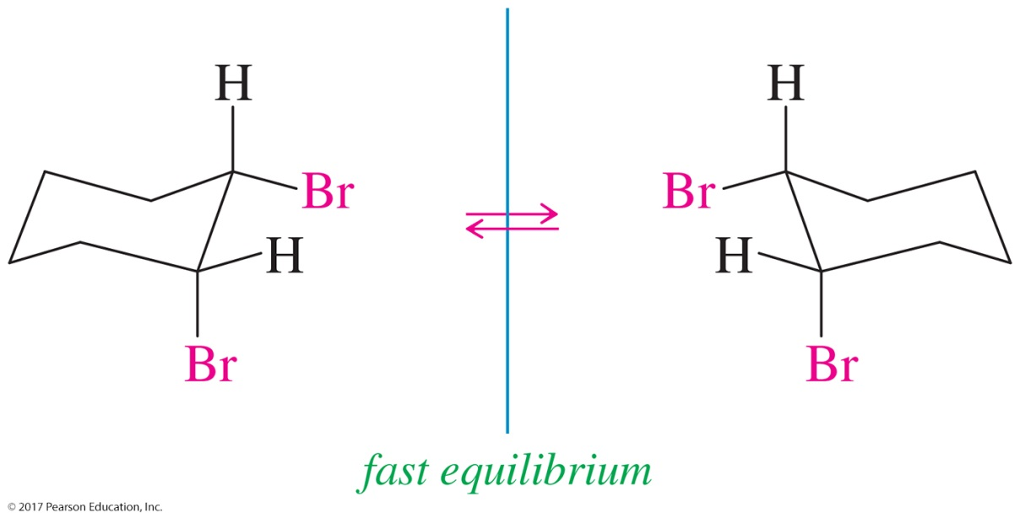
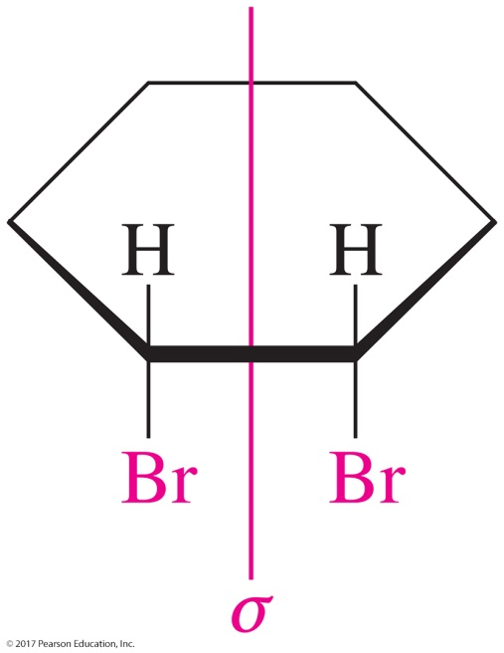
Chirality of Conformational Isomers
The two chair conformations of cis-1,2-dibromocyclohexane are nonsuperimposable, but the interconversion is fast and the molecules are in equilibrium. Any sample would be racemic and, as such, optically inactive.

Slide 37
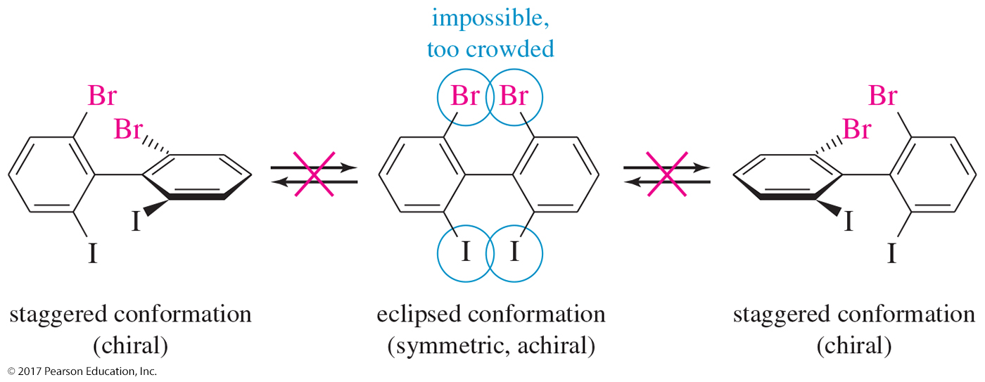
Nonmobile Conformers
The planar conformation of the biphenyl derivative is too sterically crowded. The compound has no rotation around the central C—C bond and, thus, it is conformationally locked.
The staggered conformations are chiral; they are nonsuperimposable mirror images.

Slide 38
Allenes
Some allenes are chiral even though they do not have a chiral carbon.
Central carbon is sp hybridized.
To be chiral, the groups at the end carbons must have different groups.

Slide 39
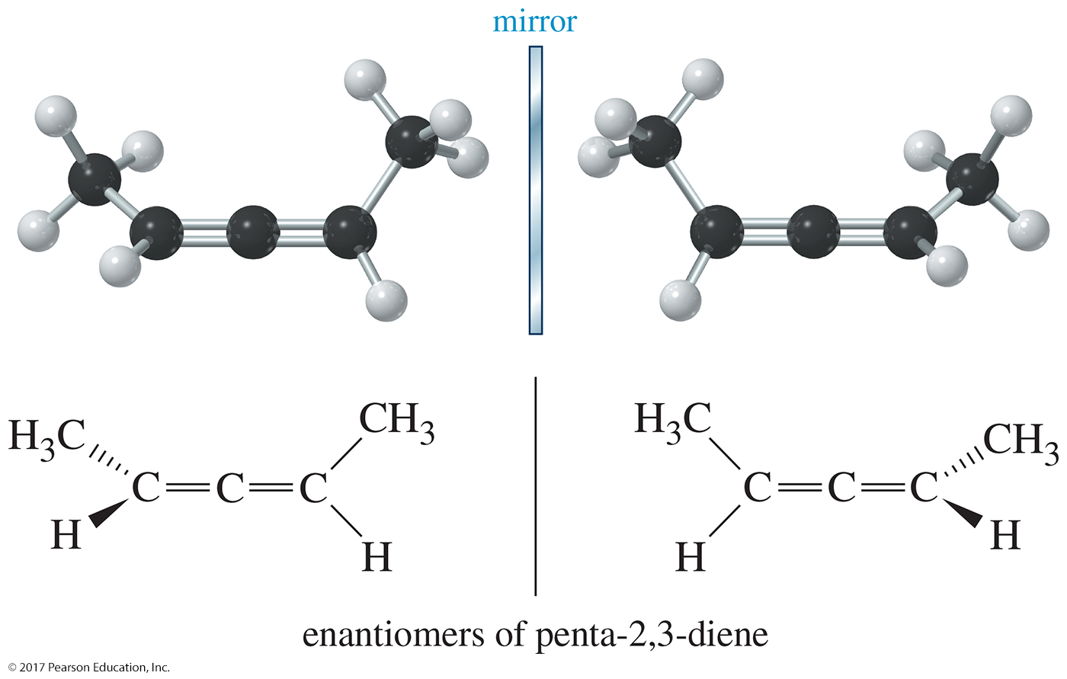
Penta-2,3-diene Is Chiral

Slide 40
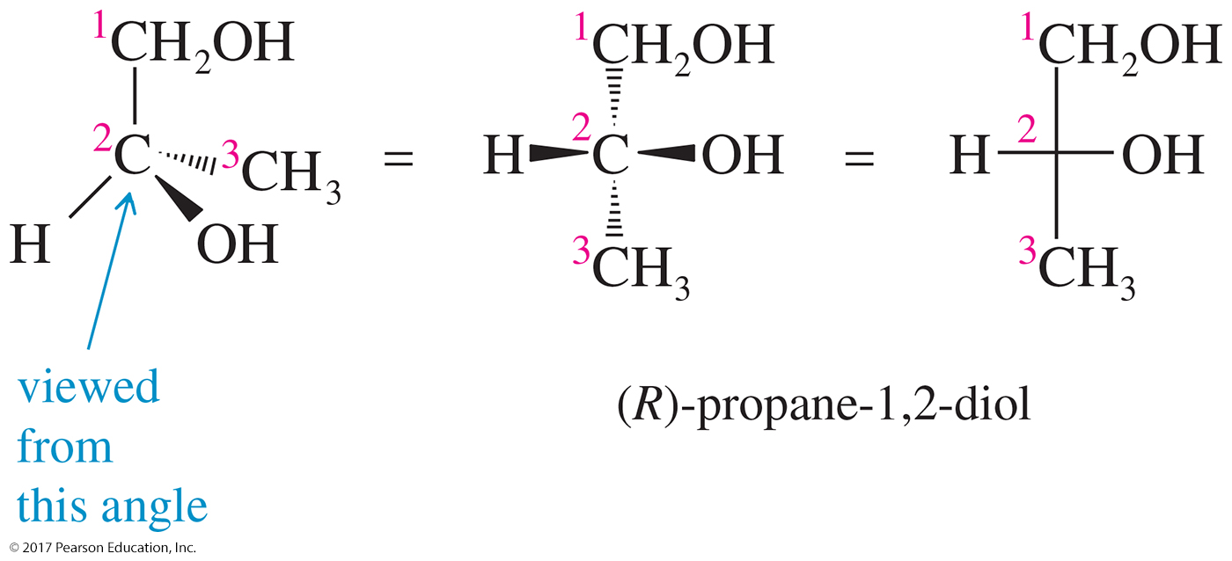
Fischer Projections
Flat representation of a 3-D molecule
A chiral carbon is at the intersection of horizontal and vertical lines.
Horizontal lines are forward, out of plane.
Vertical lines are behind the plane.

Slide 41
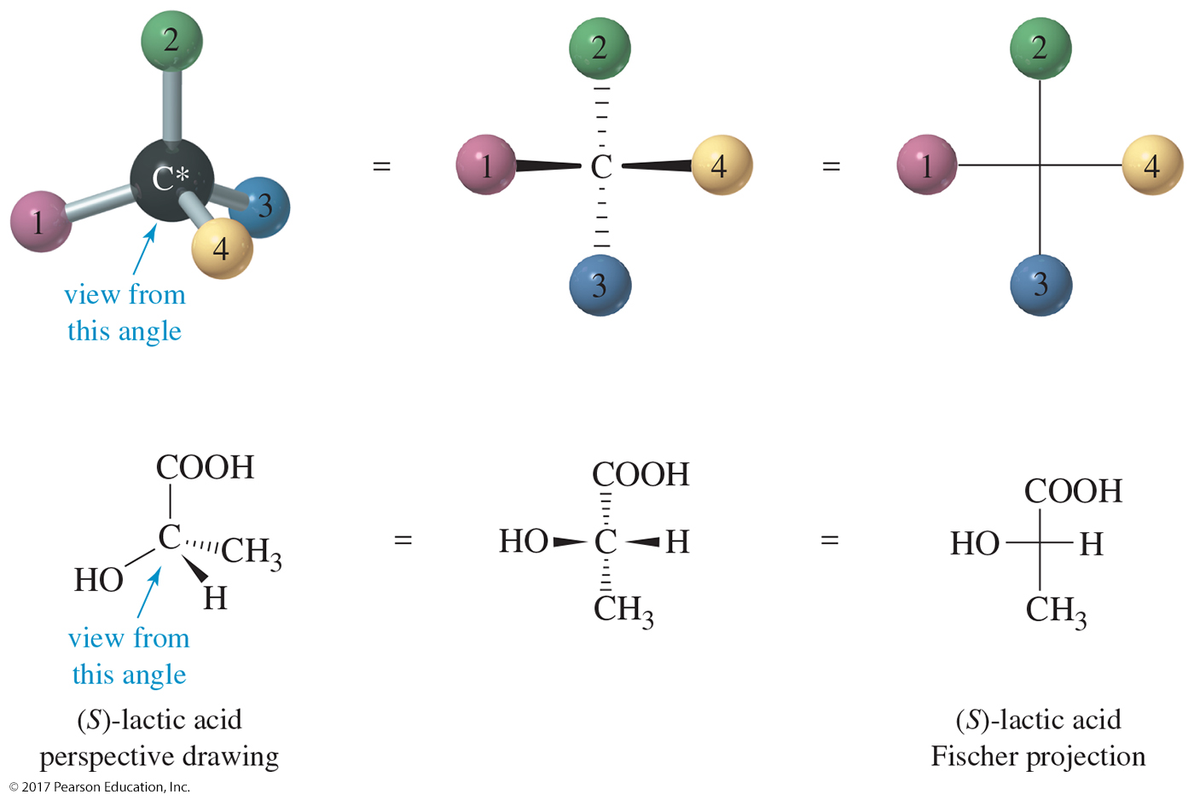
Fischer Projections (Continued)

Slide 42
Fischer Rules
Carbon chain is on the vertical line.
Highest oxidized carbon is at the top.
Rotation of 180° in plane doesn’t change the molecule.
Rotation of 90° is not allowed.

Slide 43
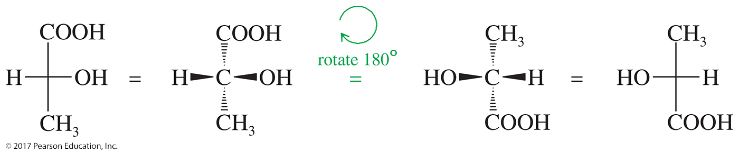
180° Rotation
A rotation of 180° is allowed because it will not change the configuration.

Slide 44
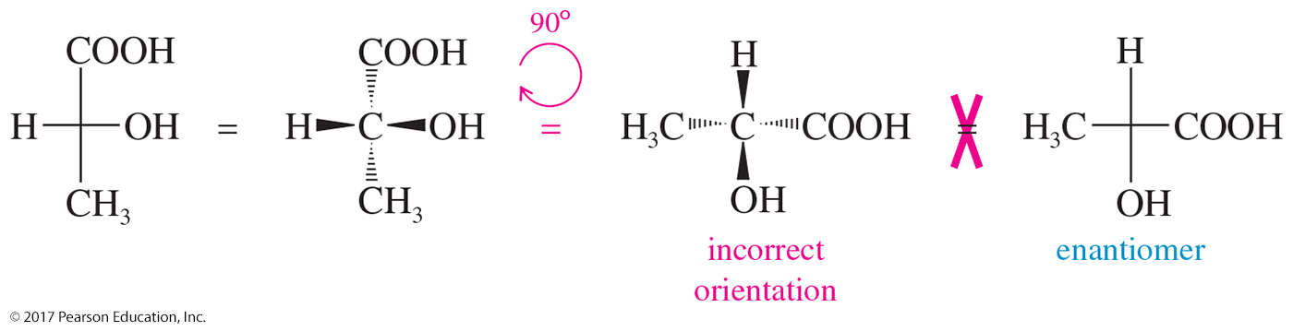
90° Rotation
A 90° rotation will change the orientation of the horizontal and vertical groups.
Do not rotate a Fischer projection 90°.

Slide 45
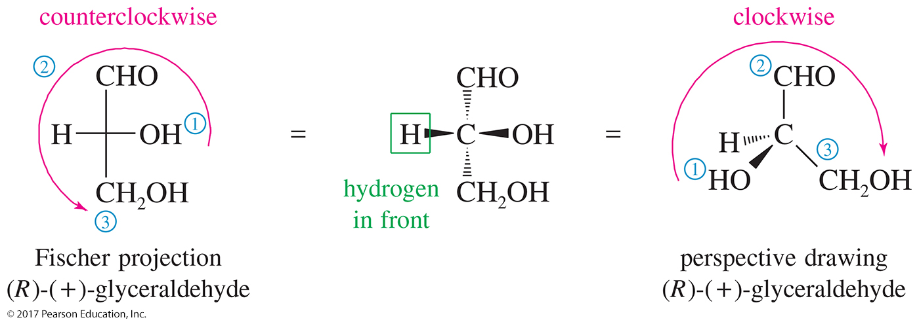
Glyceraldehyde
The arrow from group 1 to group 2 to group 3 appears counterclockwise in the Fischer projection. If the molecule is turned over so the hydrogen is in back, the arrow is clockwise, so this is the (R) enantiomer of glyceraldehyde.

Slide 46
Fischer Mirror Images
Fisher projections are easy to draw and make it easier to find enantiomers and internal mirror planes when the molecule has two or more chiral centers.
C
H
3
H
C
l
C
l
H
C
H
3

Slide 47
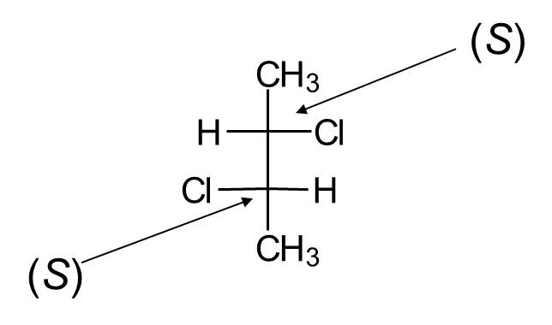
Fischer (R) and (S)
Lowest priority (usually H) comes forward, so assignment rules are backward!
Clockwise 1-2-3 is (S) and counterclockwise 1-2-3 is (R).
Example:

Slide 48
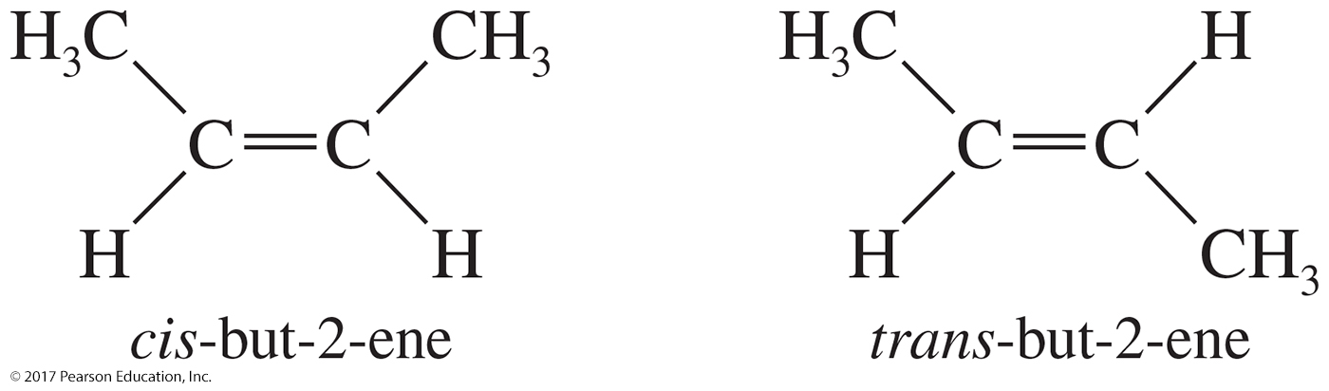
Diastereomers: Cis-Trans Isomerism on Double Bonds
These stereoisomers are not mirror images of each other, so they are not enantiomers. They are diastereomers.

Slide 49
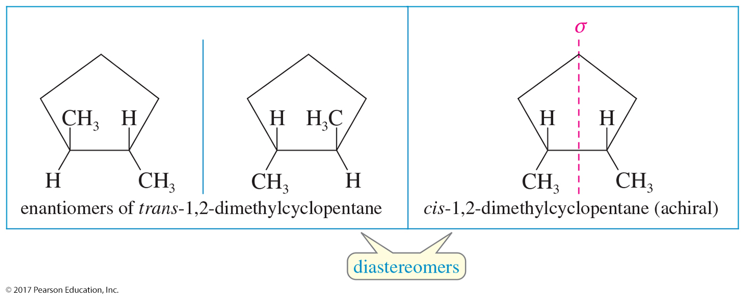
Diastereomers: Cis-Trans Isomerism on Rings
Cis-trans isomers are not mirror images, so these are diastereomers.

Slide 50
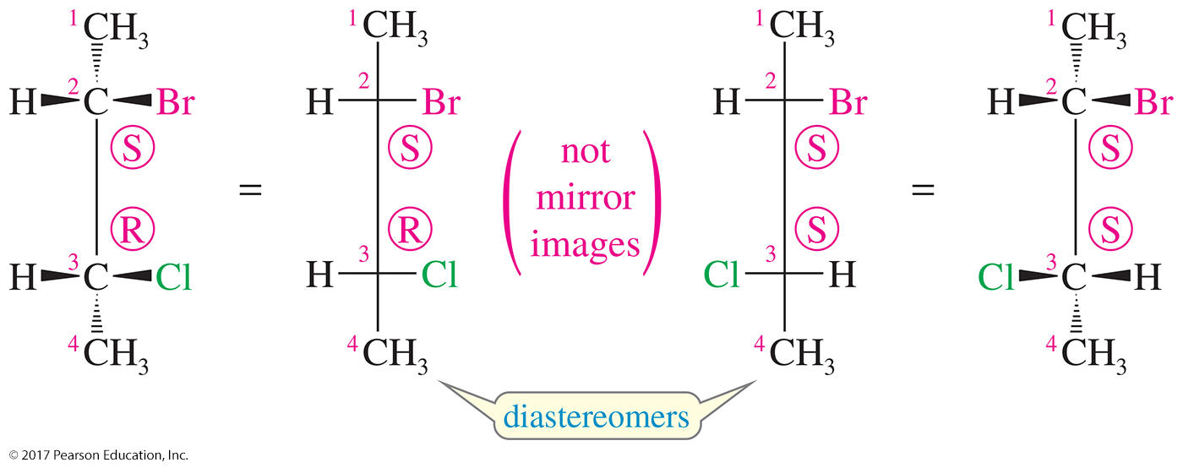
Diastereomers
Molecules with two or more chiral carbons
Stereoisomers that are not mirror images

Slide 51
Two or More Chiral Carbons
When compounds have two or more chiral centers they have enantiomers, diastereomers, or meso isomers.
Enantiomers have opposite configurations at each corresponding chiral carbon.
Diastereomers have some matching and some opposite configurations.
Meso compounds have internal mirror planes.
Maximum number of isomers is 2^{n}, where n = the number of chiral carbons.

Slide 52
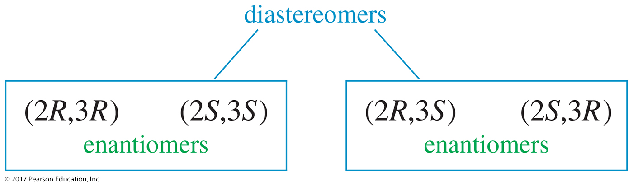

Slide 53
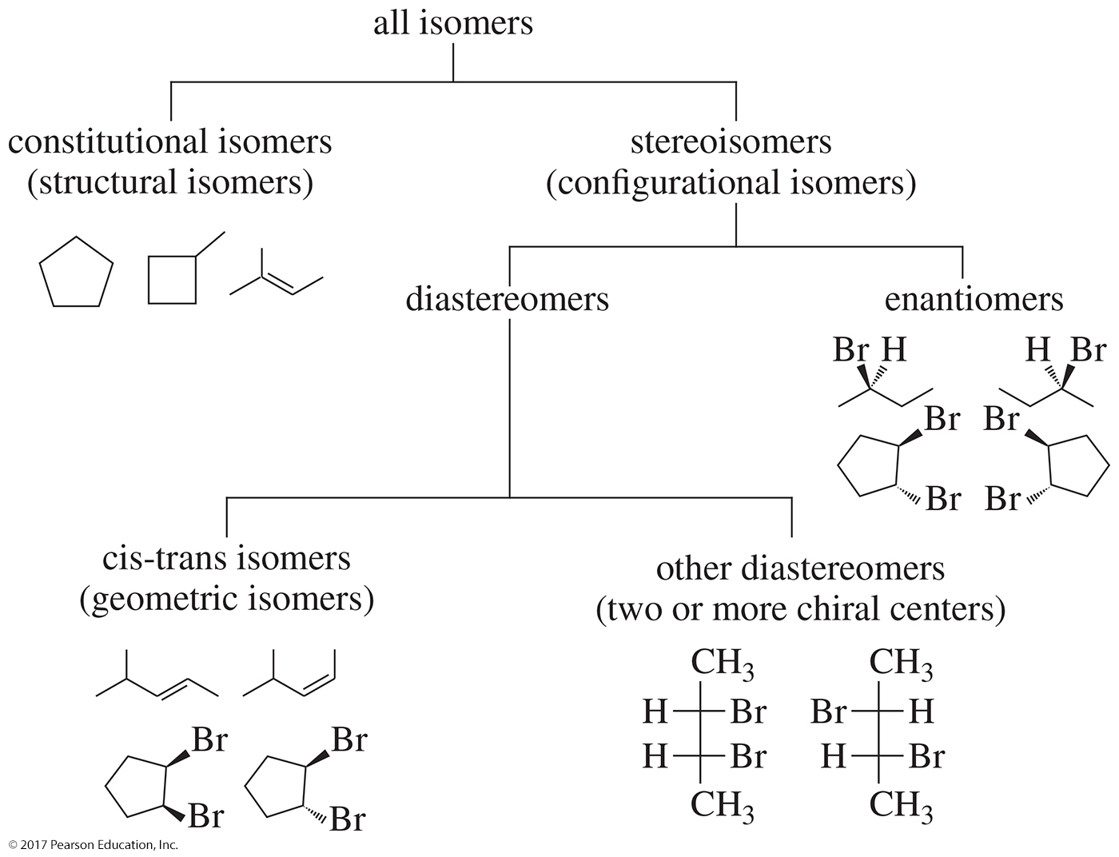
Comparing Structures

Slide 54
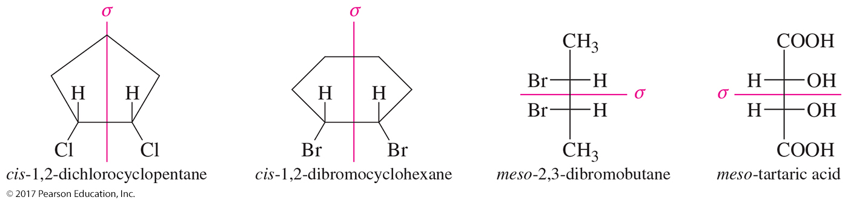
Meso Compounds
Meso compounds have a plane of symmetry.
If one image is rotated 180°, then it can be superimposed on the other image.
Meso compounds are achiral even though they have chiral centers.

Slide 55
Absolute and Relative Configurations
The absolute configuration is the detailed picture of a molecule, including how the atoms are arranged in space.
The relative configuration is the experimentally determined relationship between the configurations of two molecules, even though we may not know the absolute configuration of either.

Slide 56
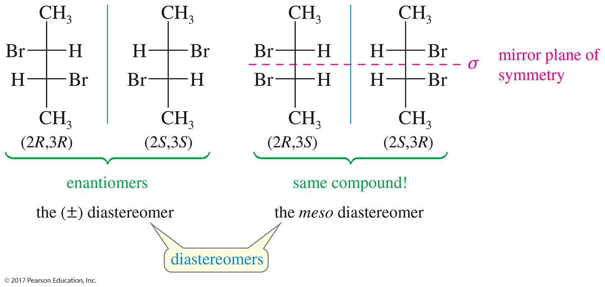
Number of Stereoisomers
The 2^{n} rule will not apply to compounds that may have a plane of symmetry. 2,3-dibromobutane has only three stereoisomers: (±) diastereomer and the meso diastereomer.

Slide 57
Properties of Diastereomers
Diastereomers have different physical properties, so they can be easily separated.
Enantiomers differ only in reaction with other chiral molecules and the direction in which polarized light is rotated.
Enantiomers are difficult to separate.
Convert enantiomers into diastereomers to be able to separate them.

Slide 58
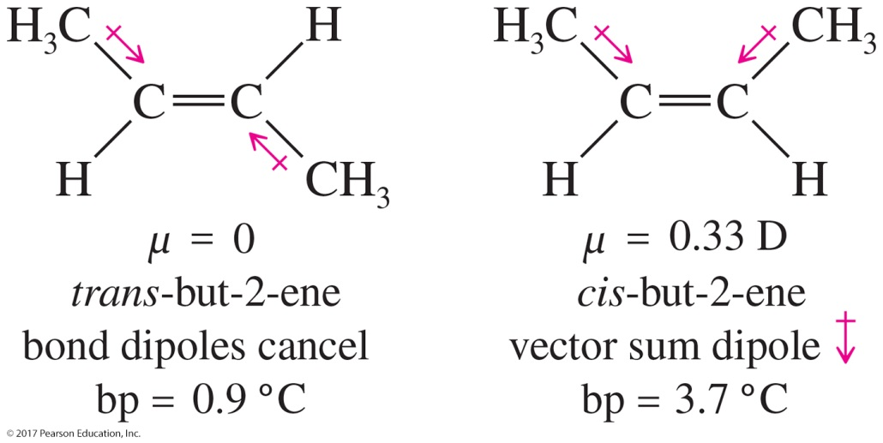
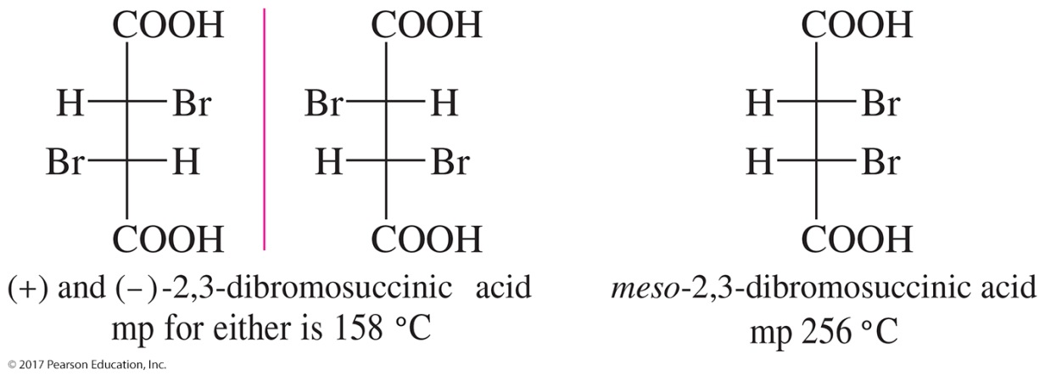
Diastereomers and Their Physical Properties

Slide 59
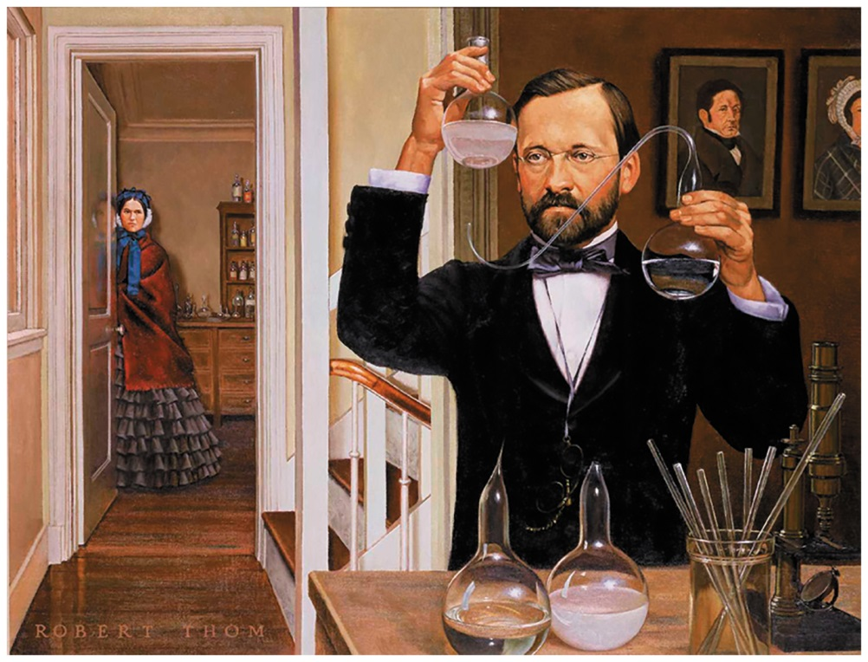
Louis Pasteur
In 1848, Louis Pasteur noticed that a salt of racemic (±)-tartaric acid crystallizes into mirror-image crystals.
Using a microscope and a pair of tweezers, he physically separated the enantiomeric crystals.
Pasteur had accomplished the first artificial resolution of enantiomers.

Slide 60
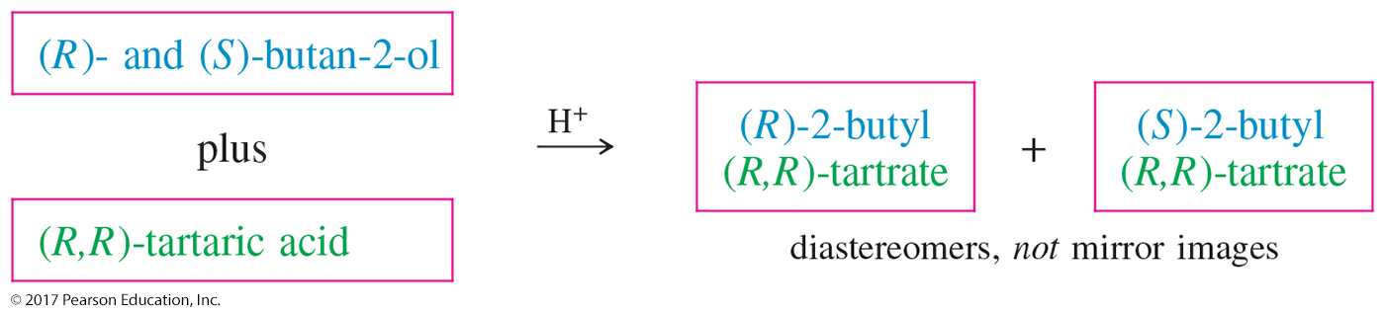
Chemical Resolution of Enantiomers
React the racemic mixture with a pure chiral compound, such as tartaric acid, to form diastereomers, and then separate them.

Slide 61
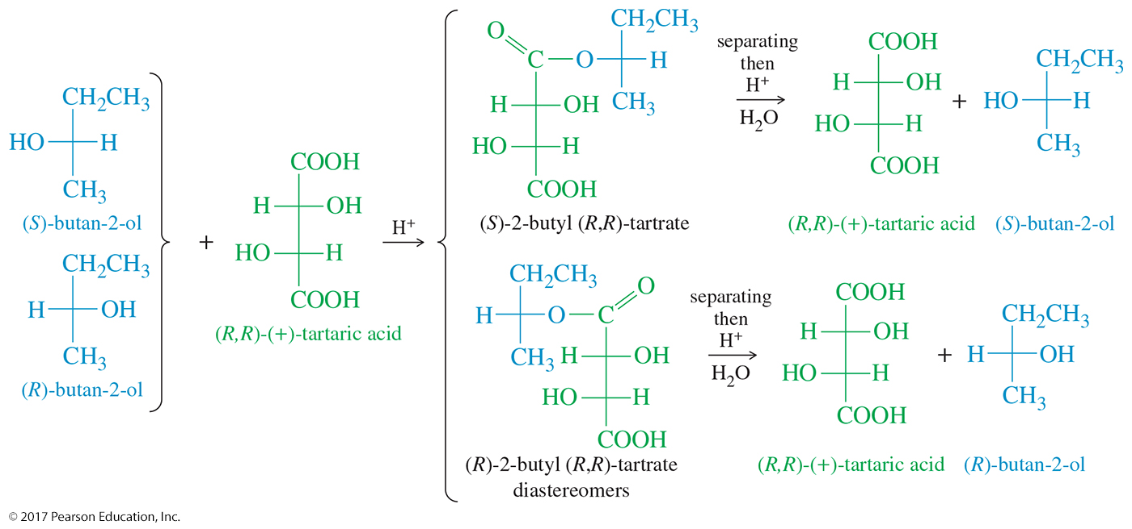
Formation of (R)- and
(S)-2-Butyl Tartrate

Slide 62
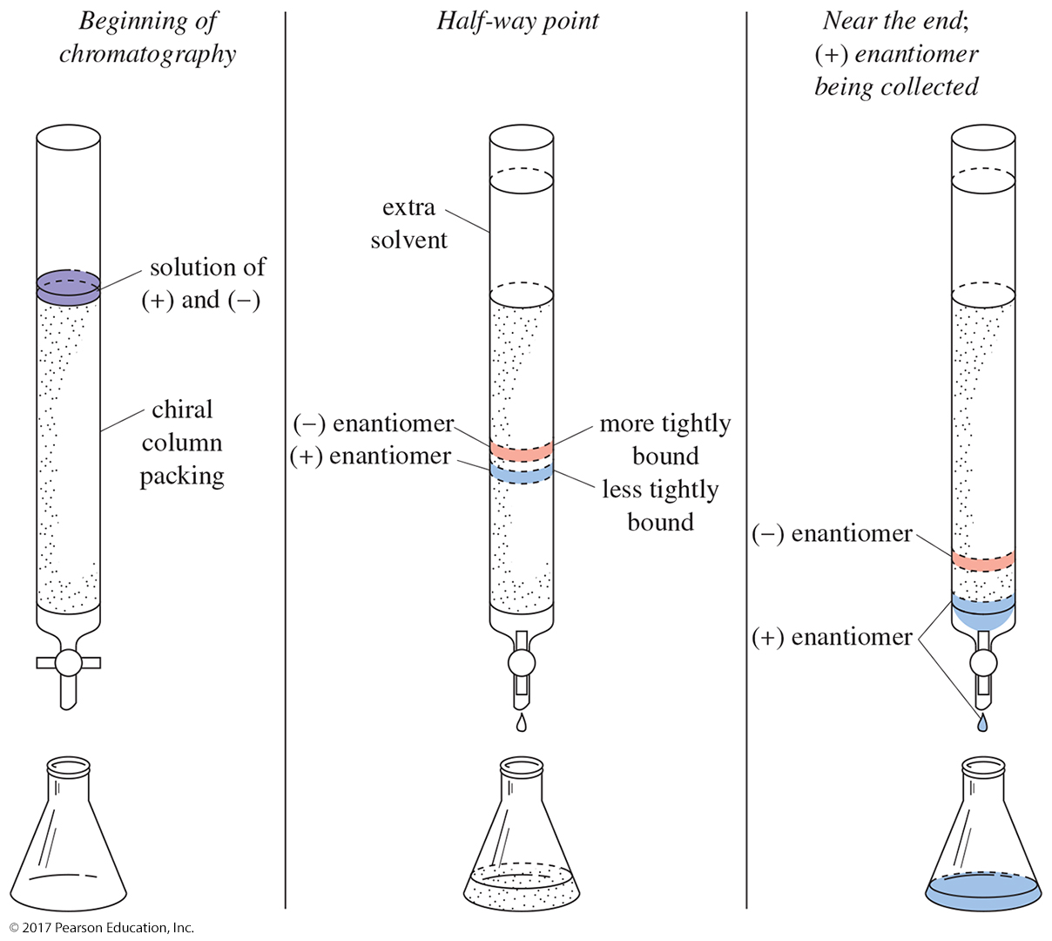
Chromatographic
Resolution of Enantiomers

