Slide 1
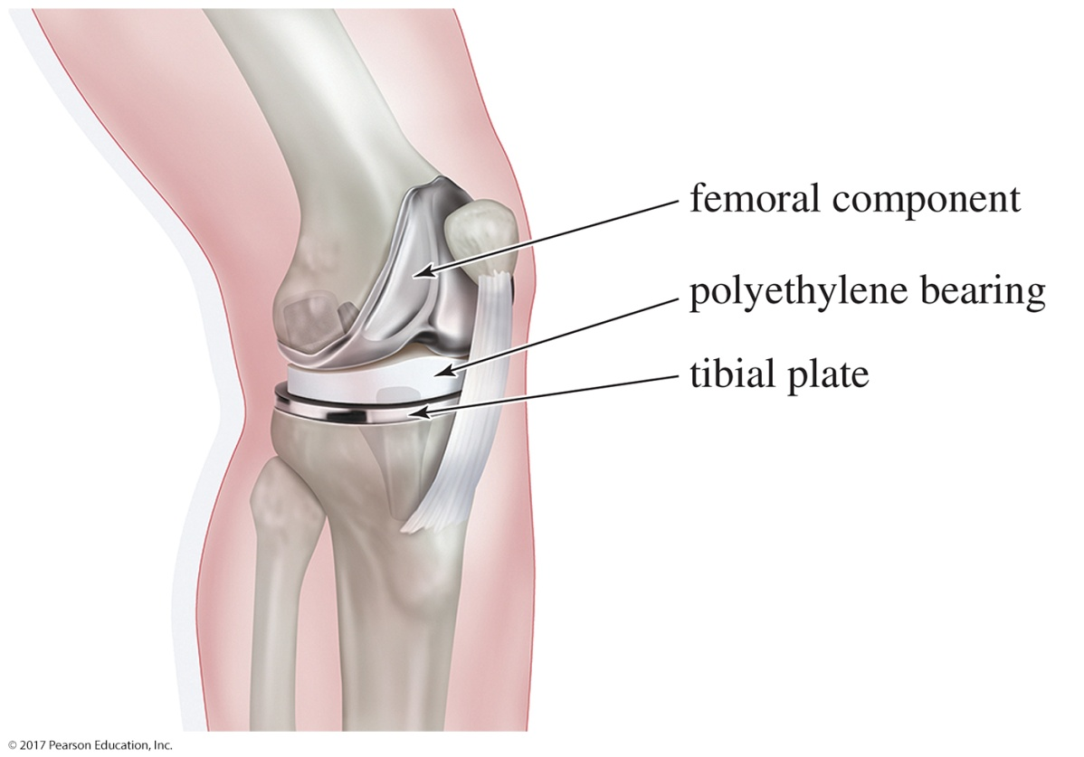
Organic Chemistry,
9th Edition
L. G. Wade, Jr.
Chapter 8
Lecture
Reactions of Alkenes
Chad Snyder, PhD
Grace College
© 2017 Pearson Education, Inc.

Slide 2
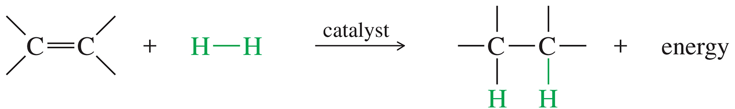
Reactivity of the Carbon–Carbon Double Bond
The most common reactions of double bonds transform the pi bond into a sigma bond.

Slide 3
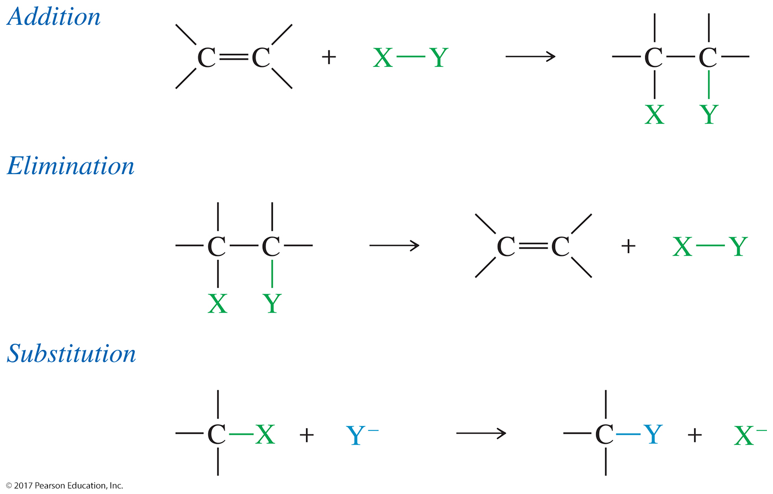
Types of Alkene Reactions

Slide 4
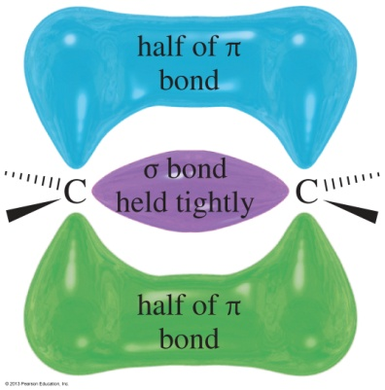
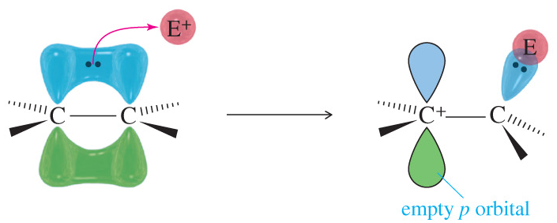
Bonding in Alkenes
Electrons in pi bonds are loosely held.
The double bond acts as a nucleophile attacking electrophilic species.
Carbocations are intermediates in some of these reactions.
These reactions are called electrophilic additions.

Slide 5
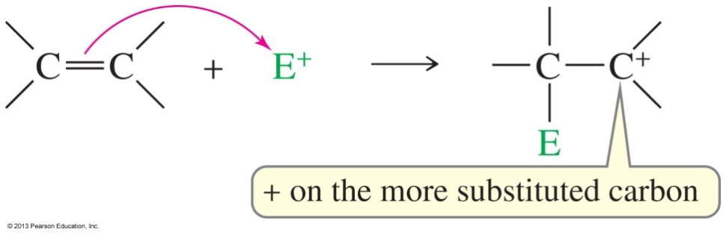
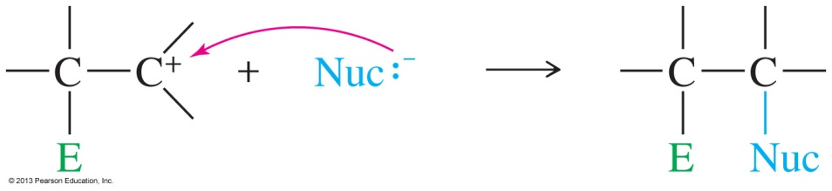
Electrophilic Addition
Step 1: Pi electrons attack the electrophile.
Step 2: Nucleophile attacks the carbocation.

Slide 6
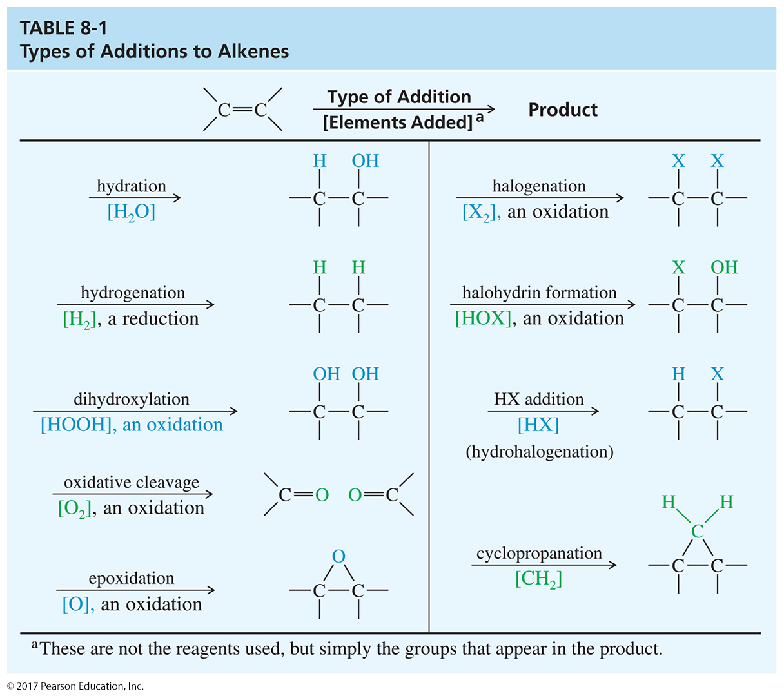
Types of Additions

Slide 7
Addition of HX to Alkenes
Step 1 is the protonation of the double bond.
The protonation step forms the most stable carbocation possible.
In step 2, the nucleophile attacks the carbocation, forming an alkyl halide.
HBr, HCl, and HI can be added through this reaction.

Slide 8
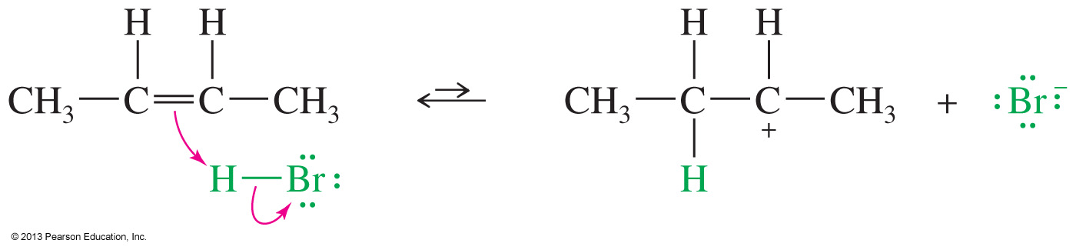
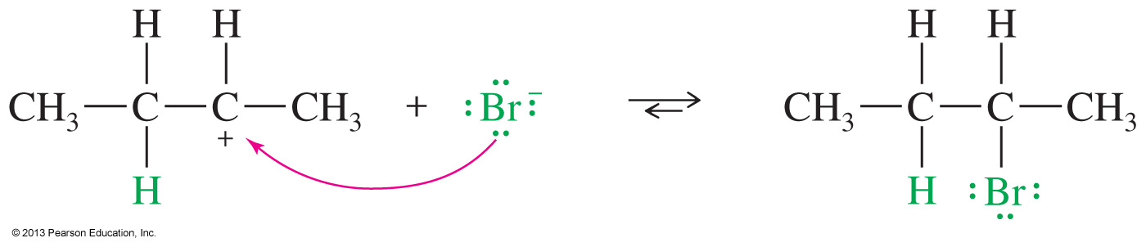
Mechanism of Addition of HX
Step 1: Protonation of the double bond
Step 2: Nucleophilic attack of the halide on the carbocation

Slide 9
Regioselectivity
Markovnikov’s rule: The addition of a proton to the double bond of an alkene results in a product with the acidic proton bonded to the carbon atom that already holds the greater number of hydrogens.
Markovnikov’s rule (extended): In an electrophilic addition to the alkene, the electrophile adds in such a way that it generates the most stable intermediate.

Slide 10
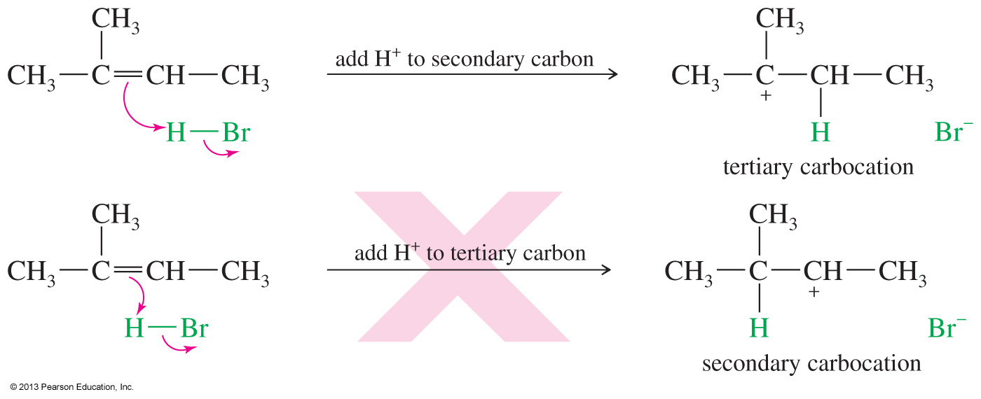
Markovnikov’s Rule
The acid proton will bond to carbon 3 in order to produce the most stable carbocation possible.

Slide 11
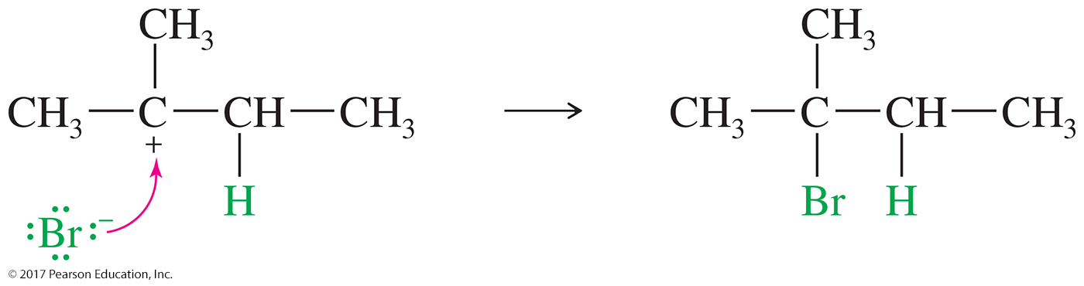
Markovnikov’s Rule (Continued)
The bromide anion then adds to the carbocation.

Slide 12
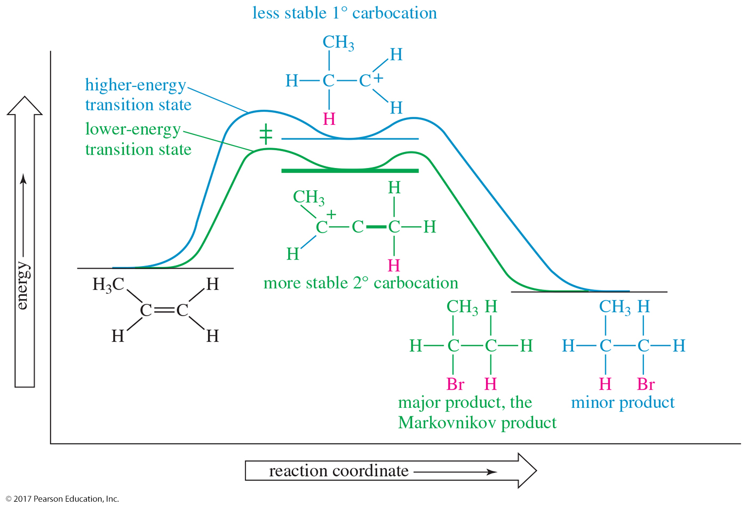
The Reaction-Energy Diagram
The first step is rate-determining in the
electrophilic addition to an alkene.

Slide 13
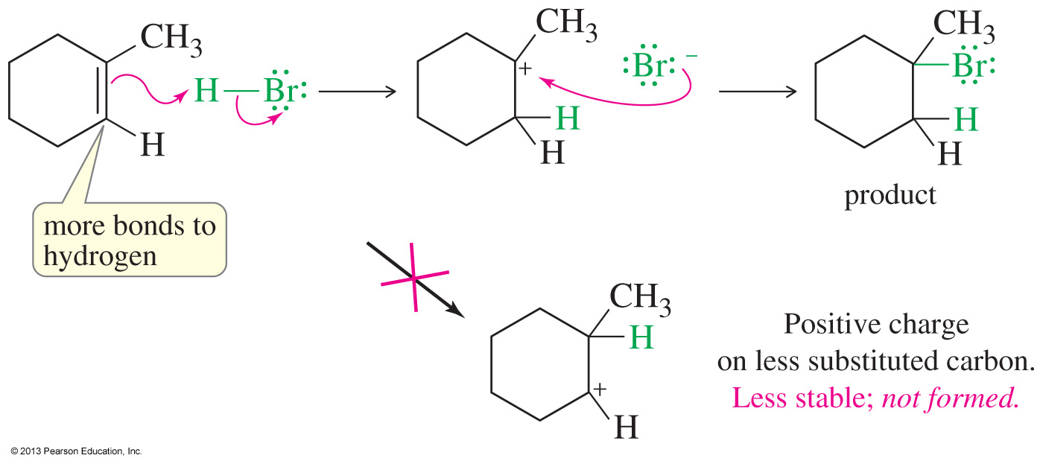
Example

Slide 14
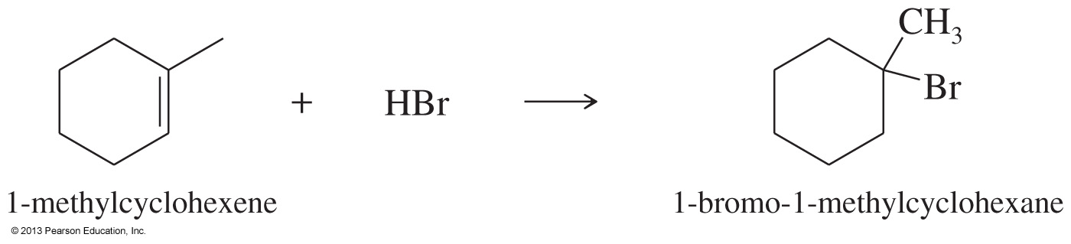
Solved Problem 1
Show how you would accomplish the following synthetic conversions.
(a) Convert 1-methylcyclohexene to 1-bromo-1-methylcyclohexane.
Solution
This synthesis requires the addition of HBr to an alkene with Markovnikov orientation. Ionic addition of HBr gives the correct product.

Slide 15
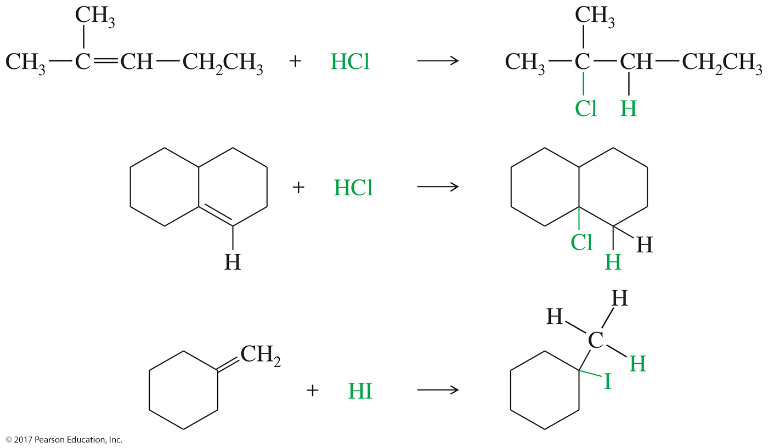
More Examples

Slide 16
Free-Radical Addition of HBr
In the presence of peroxides, HBr adds to an alkene to form the “anti-Markovnikov” product.
Peroxides produce free radicals.
Only HBr has just the right reactivity for each step of the free-radical chain reaction to take place.
The peroxide effect is not seen with HCl or HI because the reaction of an alkyl radical with HCl or HI is strongly endothermic.

Slide 17
Free-Radical Initiation
The peroxide bond breaks homolytically to form the first radical:
Hydrogen is abstracted from HBr.

Slide 18
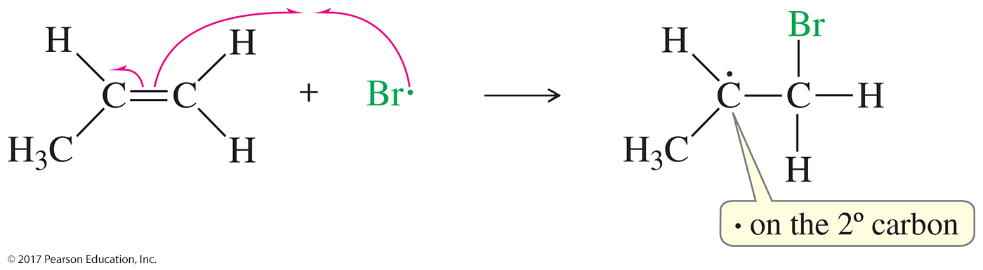
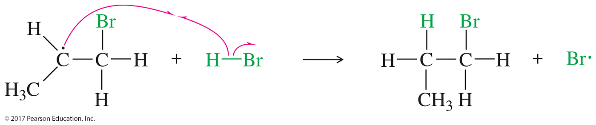
Propagation Steps
Bromine adds to the double bond, forming the most stable radical possible:
Hydrogen is abstracted from HBr:

Slide 19
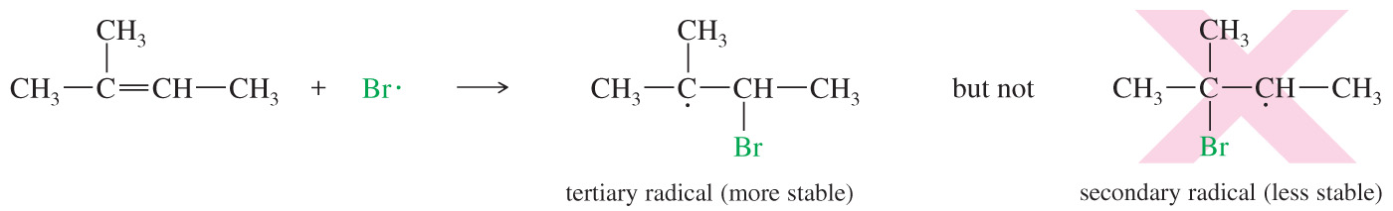
Anti-Markovnikov Stereochemistry
The intermediate tertiary radical forms faster because it is more stable.

Slide 20
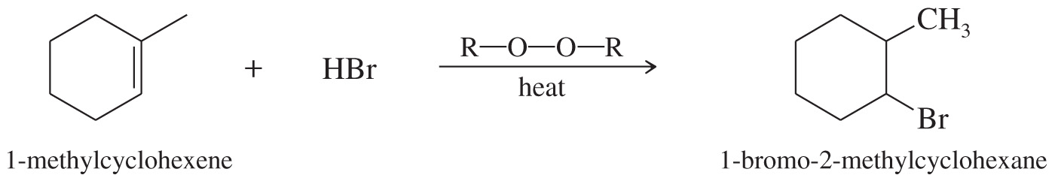
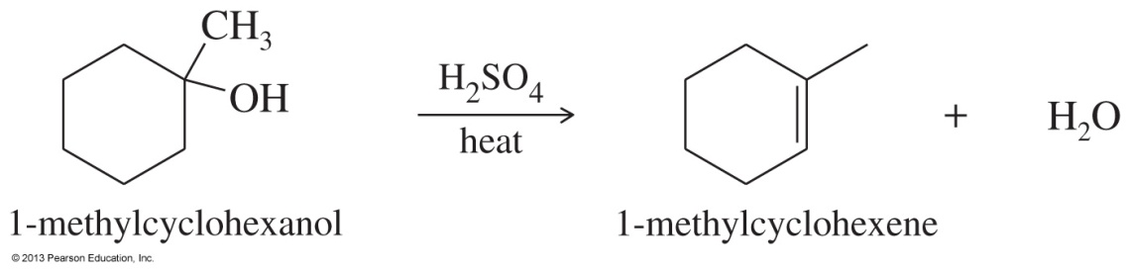
Solved Problem 2
Convert 1-methylcyclohexanol to 1-bromo-2-methylcyclohexane.
Solution
This synthesis requires the conversion of an alcohol to an alkyl bromide with the bromine atom at the neighboring carbon atom. This is the anti-Markovnikov product, which could be formed by the radical-catalyzed addition of HBr to 1-methylcyclohexene.
1-Methylcyclohexene is easily synthesized by the dehydration of 1-methylcyclohexanol. The most substituted alkene is the desired product.

Slide 21
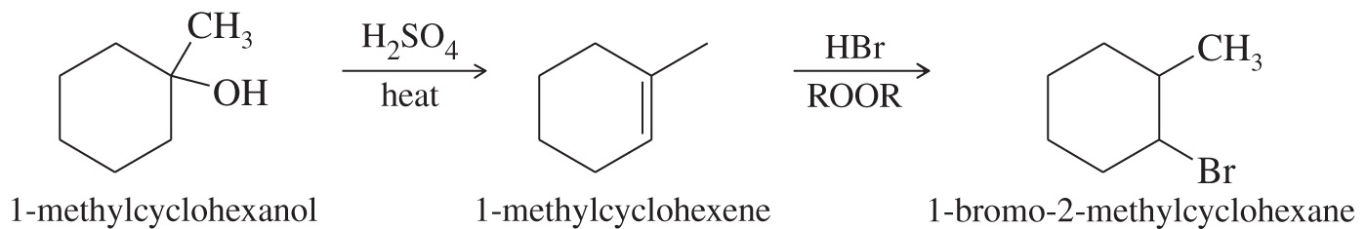
Solved Problem 2 (Continued)
Solution (Continued)
The two-step synthesis is summarized as follows:

Slide 22
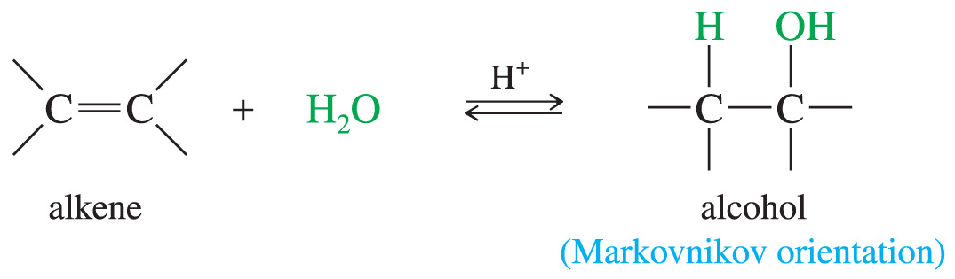
Hydration of Alkenes
Addition of water to the double bond forms an alcohol.
The addition follows Markovnikov’s rule.
This is the reverse of the dehydration of alcohol.
It uses dilute solutions of H₂SO₄ or H₃PO₄ to drive equilibrium toward hydration.

Slide 23
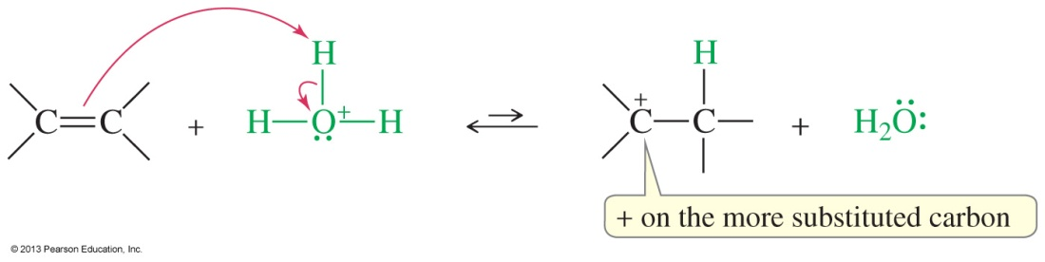
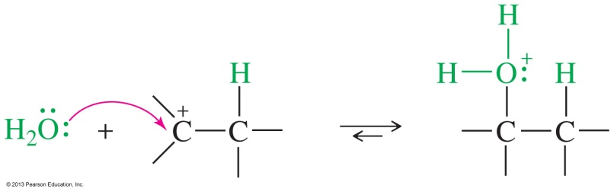
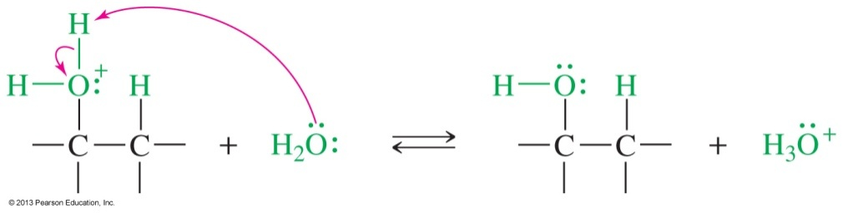
Mechanism for Hydration
Step 1: Protonation of the double bond forms a carbocation.
Step 2: Nucleophilic attack of water
Step 3: Deprotonation of the alcohol

Slide 24
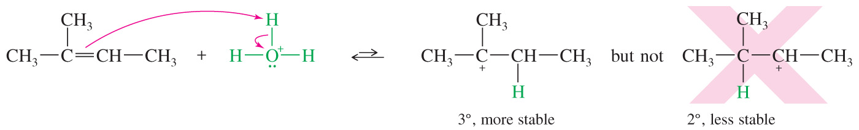
Orientation of Hydration
The protonation follows Markovnikov’s rule: The proton adds to the less substituted end of the double bond, so the positive charge appears at the more substituted end (most stable carbocation).

Slide 25
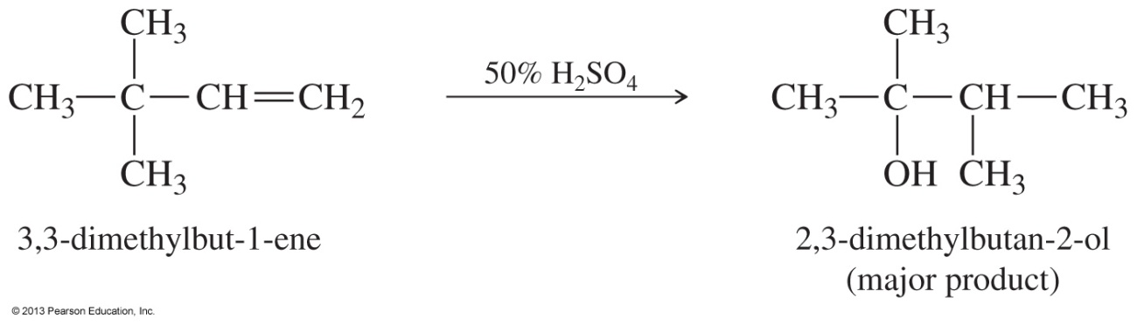
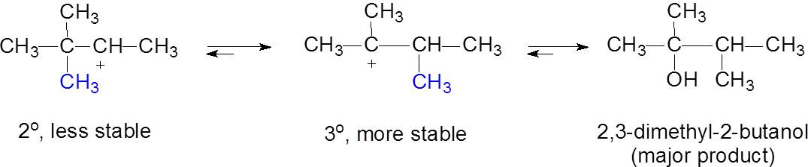
Rearrangements Are Possible
Methyl Shift:
A methyl shift after protonation will produce the more stable tertiary carbocation.

Slide 26
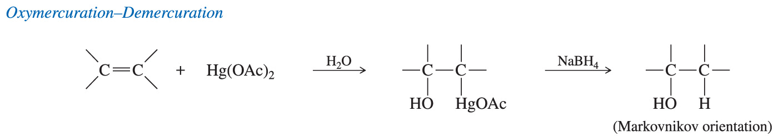
Oxymercuration–Demercuration Reaction
Markovnikov addition of water to the double bond
Milder conditions than direct hydration
No rearrangements or polymerization

Slide 27
Oxymercuration Reaction
The reagent is mercury(II) acetate, which dissociates slightly to form ⁺Hg(OAc).
⁺Hg(OAc) is the electrophile that adds to the
pi bond.
The intermediate is a three-membered ring called the mercurinium ion.
Overall, the addition of water follows Markovnikov’s rule.

Slide 28
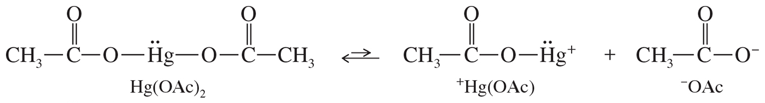
Formation of the Mercury Species +Hg(OAc)

Slide 29
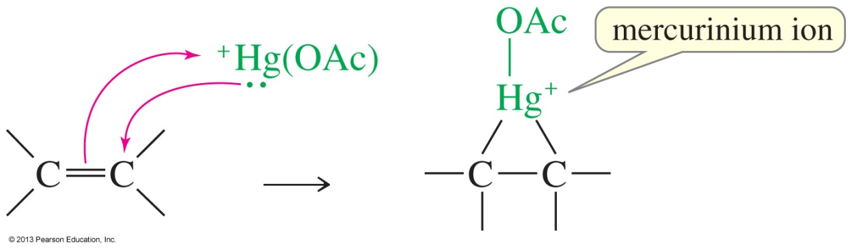
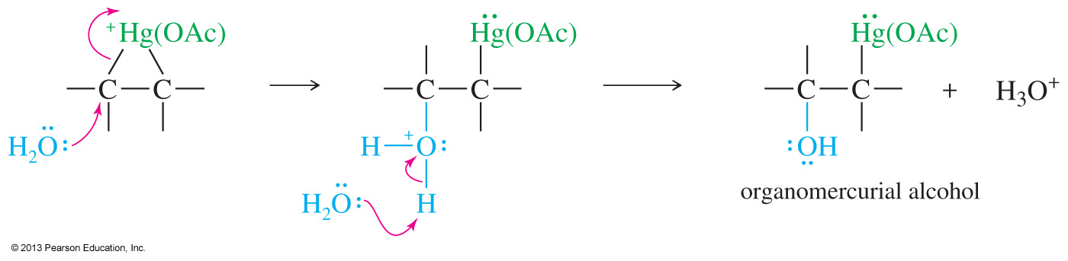
Mechanism of Oxymercuration

Slide 30
Stereochemistry of the Mercurinium Ion Opening
Water adds to the more substituted carbon to form the Markovnikov product.
Water approaches the mercurinium ion from the side opposite the ring (anti addition).

Slide 31
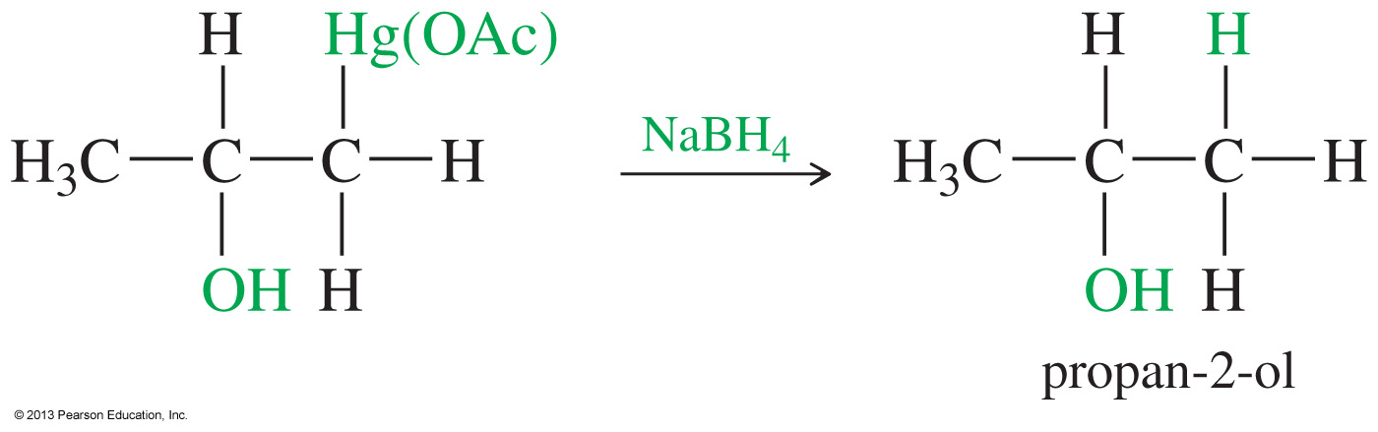
Demercuration Reaction
In the demercuration reaction, a hydride furnished by the sodium borohydride (NaBH₄) replaces the mercuric acetate.
The overall reaction gives the Markovnikov product with the hydroxy group on the most substituted carbon.

Slide 32
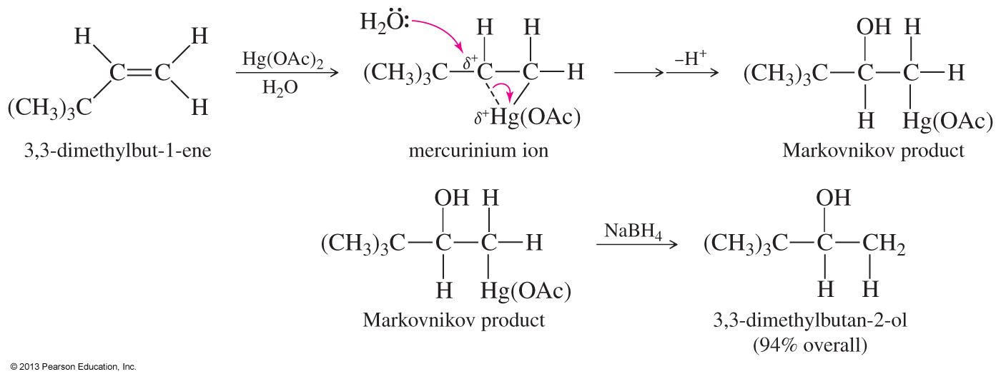
Oxymercuration–Demercuration of 3,3,-Dimethylbut-1-ene
The reaction does not suffer from rearrangements because there is no carbocation intermediate.

Slide 33
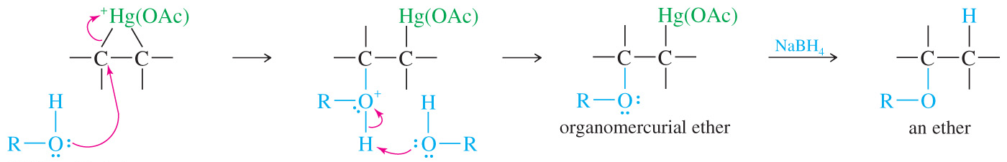
Alkoxymercuration–Demercuration
If the nucleophile is an alcohol (ROH), instead of water, an ether is produced.

Slide 34
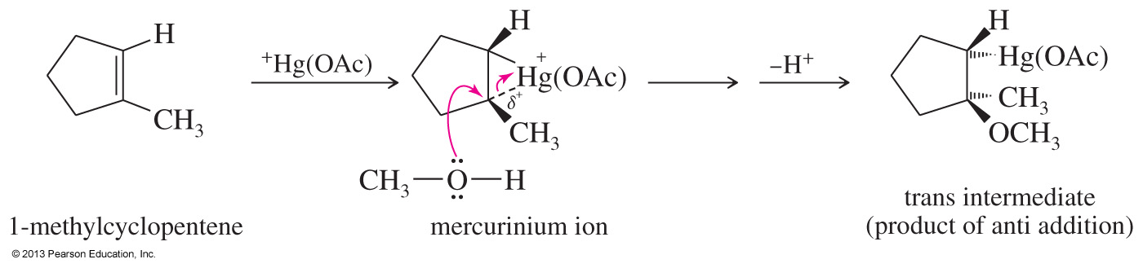
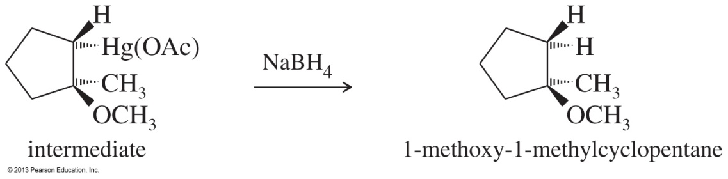
Solved Problem 2
Show the intermediates and products that result from alkoxymercuration–demercuration of
1-methylcyclopentene, using methanol as the solvent.
Solution
Mercuric acetate adds to 1-methylcyclopentene to give the cyclic mercurinium ion. This ion has a considerable amount of positive charge on the more substituted tertiary carbon atom. Methanol attacks this carbon.
Reduction of the intermediate gives the Markovnikov product, 1-methoxy-1-methylcyclopentane.

Slide 35
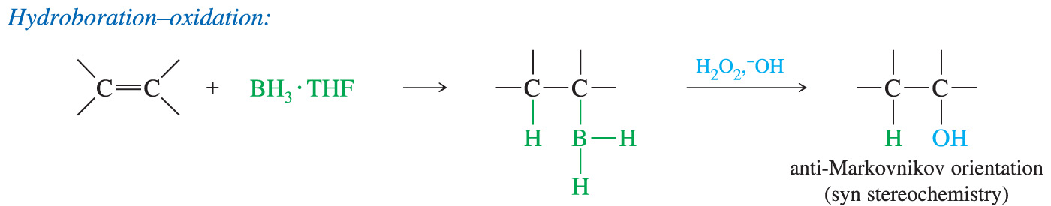
Hydroboration of Alkenes
H. C. Brown of Purdue University discovered that diborane (B₂H₆) adds to alkenes with anti-Markovnikov orientation to form alkylboranes, which, after oxidation, give anti-Markovnikov alcohols.
Brown received the Nobel Prize in Chemistry in 1979 for his work in the field of borane chemistry.

Slide 36
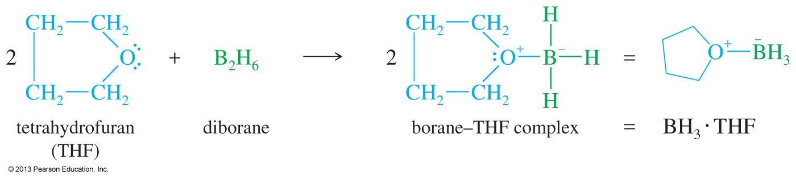
Diborane
Diborane (B₂H₆) is a dimer of borane and is in equilibrium with a small amount of BH₃.
The complex of borane with tetrahydrofuran (BH₃•THF) is the most commonly used form of borane.

Slide 37
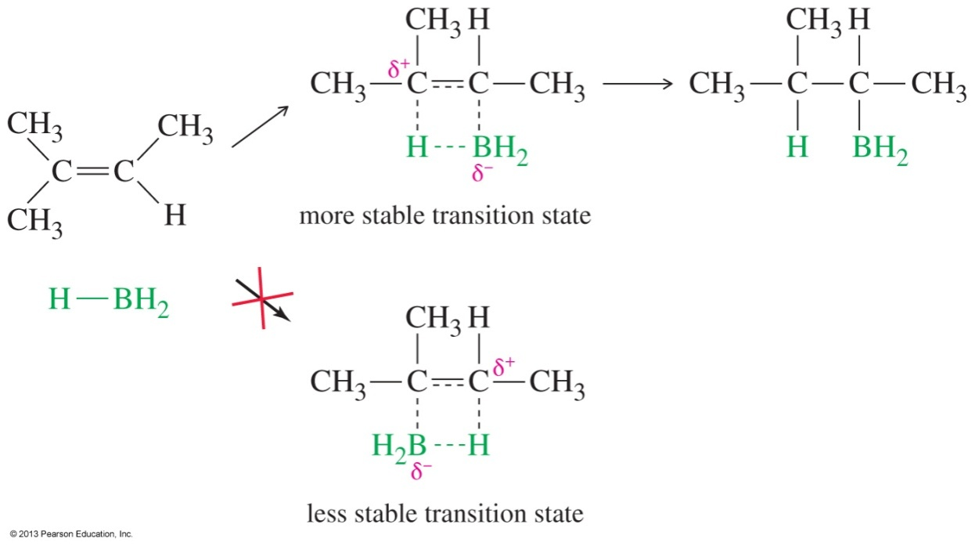
Mechanism of Hydroboration
Borane adds to the double bond in a single step, with boron adding to the less substituted carbon and hydrogen adding to the more highly substituted carbon.
This orientation places the partial positive charge in the transition state on the more highly substituted carbon atom.

Slide 38
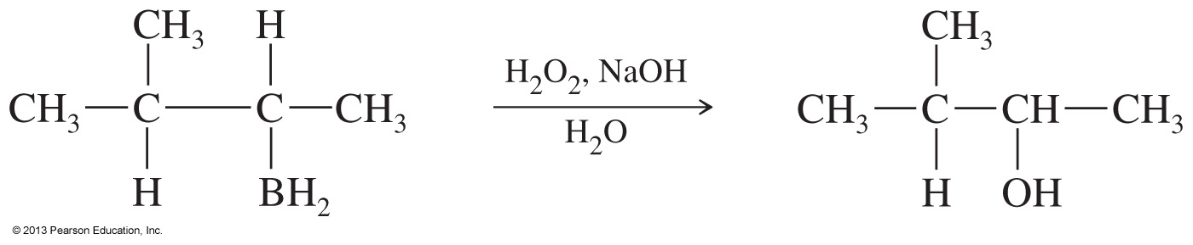
Oxidation to Alcohol
Oxidation of the alkyl borane with basic hydrogen peroxide produces the alcohol.
Orientation is anti-Markovnikov.

Slide 39
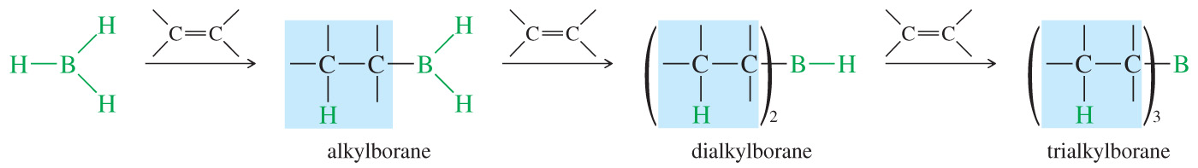
Stoichiometry of Hydroboration
Three moles of alkene can react with each mole of BH₃.

Slide 40
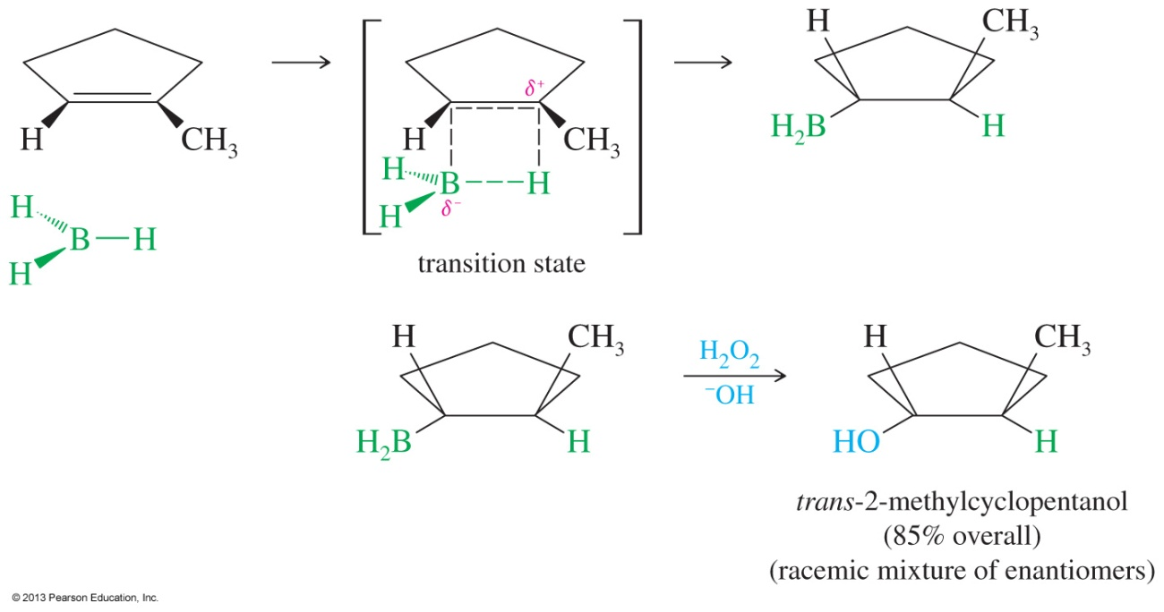
Stereochemistry of Hydroboration
The hydroboration step adds the hydrogen and the boron to the same side of the double bond (syn addition).
When the boron is oxidized, the OH will keep the same stereochemical orientation.

Slide 41
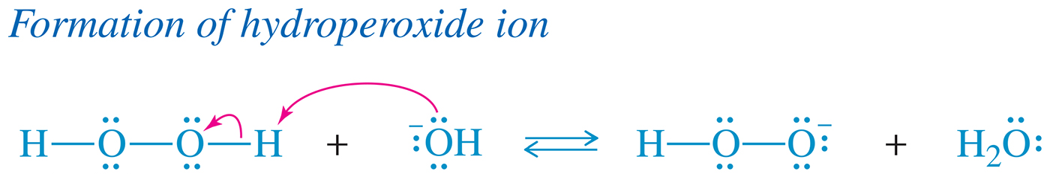
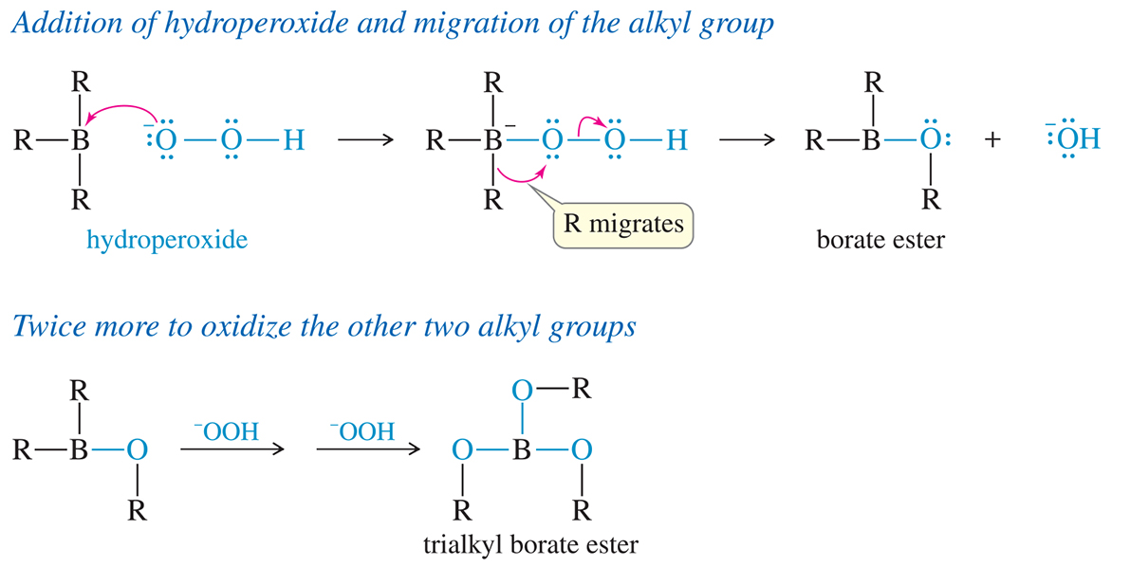
The Role of the
Hydroperoxide Ion

Slide 42
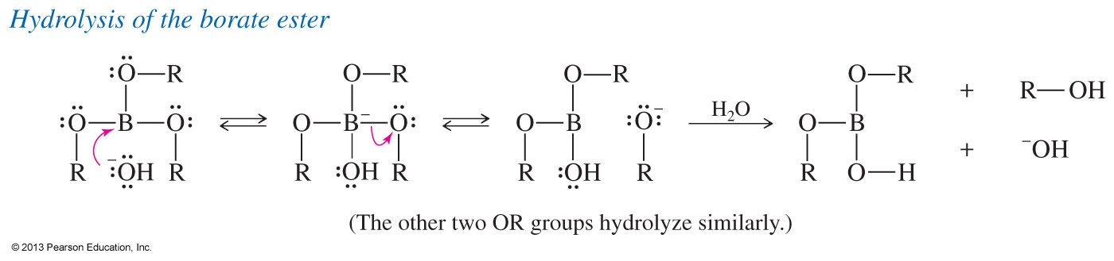
Oxidation of a Trialkylborane

Slide 43
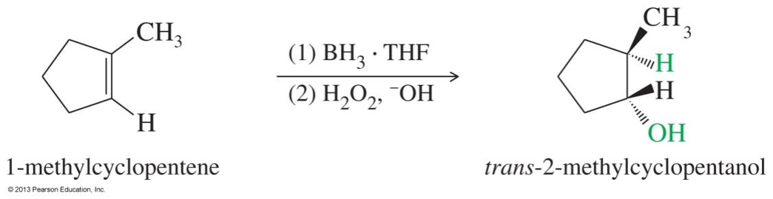
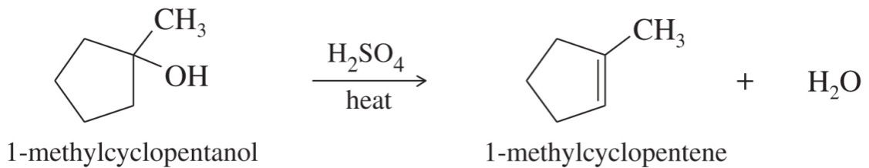
Solved Problem 3
Show how you would convert 1-methylcyclopentanol to 2-methylcyclopentanol.
Solution
Working backward, use hydroboration–oxidation to form 2-methylcyclopentanol from
1-methylcyclopentene. The use of (1) and (2) above and below the reaction arrow indicates individual steps in a two-step sequence.
The 2-methylcyclopentanol that results from this synthesis is the pure trans isomer. This stereochemical result is discussed in Section 8-7C. 1-Methylcyclopentene is the most substituted alkene that results from dehydration of 1-methylcyclopentanol. Dehydration of the alcohol would give the correct alkene.

Slide 44
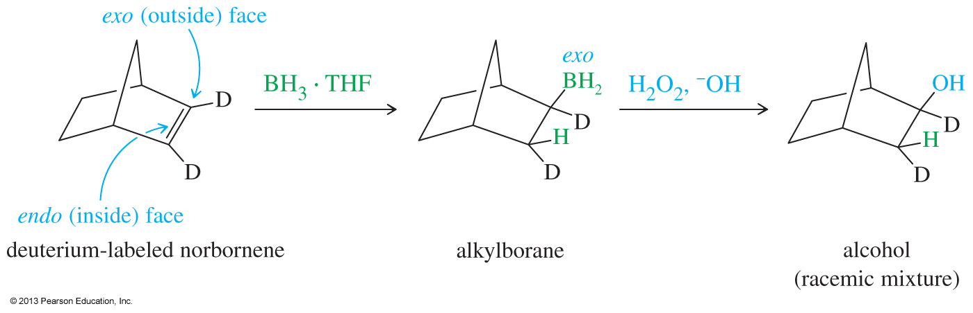
Solved Problem 4
A norbornene molecule labeled with deuterium is subjected to hydroboration–oxidation. Give the structures of the intermediates and products.
Solution
The syn addition of BH₃ across the double bond of norbornene takes place mostly from the more accessible outside (exo) face of the double bond. Oxidation gives a product with both the hydrogen atom and the hydroxyl group in exo positions. (The less accessible inner face of the double bond is called the endo face.)

Slide 45

Addition of Halogens
Cl₂, Br₂, and sometimes I₂ add to a double bond to form a vicinal dihalide.
This is an anti addition of halides.

Slide 46


Mechanism of
Halogen Addition

Slide 47


Mechanism of Halogen Addition to Alkenes continued.
The intermediate is a three-membered ring called the halonium ion.

Slide 48

Stereochemistry of
Halogen Addition
Anti stereochemistry results from the back-side attack of the nucleophile on the bromonium ion.
This back-side attack assures anti stereochemistry of addition.

Slide 49

Examples of Stereospecificity

Slide 50

Bromine Test for Unsaturation
Add Br₂ in CCl₄ (dark, red-brown color) to an alkene.
The color quickly disappears as the bromine adds to the double bond (left-side test tube).
If there is no double bond present, the brown color will remain (right side).
“Decolorizing bromine” is the chemical test for the presence of a double bond.

Slide 51

Formation of Halohydrins
If a halogen is added in the presence of water as solvent, a halohydrin is formed.
Water is the nucleophile.
This is a Markovnikov addition: The bromide (electrophile) will add to the less substituted carbon.

Slide 52


Mechanism of
Halohydrin Formation

Slide 53

Stereochemistry of Halohydrins
Because the mechanism involves a halonium ion, the stereochemistry of addition is anti, as in halogenation.

Slide 54

Orientation of
Halohydrin Formation
The more substituted carbon of the chloronium ion bears more positive charge than the less substituted carbon.
Attack by water occurs on the more substituted carbon to give the Markovnikov product.

Slide 55

Solved Problem 5
Propose a mechanism for the reaction of 1-methylcyclopentene with bromine water.
Solution
1-Methylcyclopentene reacts with bromine to give a bromonium ion. Attack by water could occur at either the secondary carbon or the tertiary carbon of the bromonium ion. Attack actually occurs at the more substituted carbon, which bears more of the positive charge. The product is formed as a racemic mixture.

Slide 56

Solved Problem 6
When cyclohexene is treated with bromine in saturated aqueous sodium chloride, a mixture of trans-2-bromocyclohexanol and trans-1-bromo-2-chlorocyclohexane results. Propose a mechanism to account for these two products.
Solution
Cyclohexene reacts with bromine to give a bromonium ion, which will react with any available nucleophile. The most abundant nucleophiles in saturated aqueous sodium chloride solution are water and chloride ions. Attack by water gives the bromohydrin, and attack by chloride gives the dihalide. Either of these attacks gives anti stereochemistry.

Slide 57

Catalytic Hydrogenation of Alkenes
Hydrogen (H₂) can be added across the double bond in a process known as catalytic hydrogenation.
The reaction only takes place if a catalyst is used.

Slide 58

Mechanism of Catalytic Hydrogenation
The hydrogen and the alkene are adsorbed on the metal surface.
Once adsorbed, the hydrogens insert across the same face of the double bond and the reduced product is released from the metal.
The reaction has a syn stereochemistry since both hydrogens will add to the same side of the double bond.

Slide 59

Wilkinson’s Catalyst
Wilkinson’s catalyst is a soluble homogenous catalyst that catalyzes the hydrogenation of a carbon–carbon double bond.

Slide 60

Syn Stereochemistry in
Catalytic Hydrogenation
A solid heterogeneous catalyst adds two hydrogen atoms to the same face of the pi bond.

Slide 61

The Need for Chiral Catalysts
Only the (–)-enantiomer of dopa can cross the blood–brain barrier and be transformed into dopamine; the other enantiomer is toxic to the patient.

Slide 62

Addition of Carbenes
The insertion of the —CH₂ group into a double bond produces a cyclopropane ring.
There are three methods:
  Diazomethane (CH₃N₂, UV light or heat)
  Simmons–Smith (CH₂I₂ and Zn(Cu))
  Alpha elimination of a haloform (CHX₃, NaOH, H₂O)

Slide 63

Carbenes: Diazomethane Method
Problems with diazomethane:
1. Extremely toxic and explosive
2. The carbene can insert into C—H bonds, too.

Slide 64

Simmons–Smith Reaction
Best method for preparing cyclopropanes.
Preparation of the Simmons–Smith reagent:
CH₂I₂ + Zn(Cu) → ICH₂ZnI
Simmons–Smith
reagent

Slide 65

Alpha Elimination Reaction
In the presence of a base, chloroform or bromoform can be dehydrohalogenated to form a carbene.

Slide 66

Stereospecificity
The cylopropanes will retain the cis or trans stereochemistry of the alkene.

Slide 67


Carbene Examples
Simmons–Smith Reaction
Alpha Elimination Reaction

Slide 68

Epoxidation
An alkene reacts with a peroxyacid to form an epoxide (also called oxirane).
The most common peroxyacid used is meta-chloroperoxybenzoic acid (MCPBA).

Slide 69

Mechanism
The peroxyacid and the alkene react with each other in a one-step reaction to produce the epoxide and a molecule of acid.

Slide 70

Stereochemistry of Epoxidation

Slide 71

Opening the Epoxide Ring
This process is acid-catalyzed.
Water attacks the protonated epoxide on the opposite side of the ring (back-side attack).
Anti-diol is formed.

Slide 72

Reagents for Epoxidation

Slide 73

Syn Hydroxylation of Alkenes
Alkene is converted to a syn-1,2-diol
Two reagents:
  Osmium tetroxide, OsO₄, followed by hydrogen peroxide or
  Cold, dilute solution of KMnO₄ in base

Slide 74

Mechanism with OsO₄
The OsO₄ adds to the double bond of an alkene in a concerted mechanism forming an osmate ester.
The osmate ester can be hydrolyzed to produce a
cis-glycol and regenerate the OsO₄.

Slide 75

Permanganate Dihydroxylation
A cold, dilute solution of KMnO₄ also hydroxylates alkenes with syn stereochemistry.
The basic solution hydrolyzes the manganate ester, liberating the glycol and producing a brown precipitate of manganese dioxide, MnO₂.

Slide 76
Oxidative Cleavage with KMnO₄
If the solution is warm or acidic or too concentrated, oxidative cleavage of the glycol may occur.
Disubstituted carbons become ketones.
Monosubstituted carbons become carboxylic acids.

Slide 77

Permanganate Dihydroxylation
Osmium tetroxide is expensive, highly toxic, and volatile.
A cold, dilute solution of potassium permanganate hydroxylates alkenes with syn stereochemistry.

Slide 78
Oxidative Cleavage of Alkenes
If the potassium permanganate solution is warm or acidic or too concentrated, oxidative cleavage of the glycol may occur.
Aldehydes, if made, are oxidized to carboxylic acids under these conditions.

Slide 79

Examples

Slide 80

Ozonolysis
Ozone will oxidatively cleave (break) the double bond to produce aldehydes and ketones.
Ozonolysis is milder than KMnO₄ and will not oxidize aldehydes further.
A second step of the ozonolysis is the reduction of the intermediate by zinc or dimethyl sulfide.

Slide 81

Mechanism of Ozonolysis
The ozone adds to the double bond, forming a five-membered ring intermediate called molozonide, which rearranges to form the ozonide.

Slide 82

Reduction of the Ozonide
The ozonide is not isolated, but is immediately reduced by a mild reducing agent, such as zinc or dimethyl sulfide, to give the aldehydes and ketones as the main products.
When dimethyl sulfide is used, the sulfur atom gets oxidized, forming dimethyl sulfoxide (DMSO).

Slide 83

Comparison of Permanganate Cleavage and Ozonolysis

Slide 84


Solved Problem 7
Ozonolysis–reduction of an unknown alkene gives an equimolar mixture of cyclohexanecarbaldehyde and butan-2-one. Determine the structure of the original alkene.
Solution
We can reconstruct the alkene by removing the two oxygen atoms of the carbonyl groups (C=O) and connecting the remaining carbon atoms with a double bond. One uncertainty remains, however: The original alkene might be either of two possible geometric isomers.

Slide 85
Polymerization
An alkene (monomer) can add to another molecule like itself to form a chain (polymer).
Three methods:
  Cationic, a carbocation intermediate
  Free radical
  Anionic, a carbanion intermediate (rare)

Slide 86

Cationic Polymerization

Slide 87

Termination Step of Cationic Polymerization
The chain growth ends when a proton is abstracted by the weak base of the acid used to initiate the reaction.
The loss of a hydrogen forms an alkene and ends the chain growth, so this is a termination step.

Slide 88


Cationic Polymerization Using BF₃ as Catalyst

Slide 89

Termination of the
Polymer Chain

Slide 90

Radical Polymerization
In the presence of an initiator such as peroxide, free-radical polymerization occurs.

Slide 91

Anionic Polymerization
For an alkene to gain electrons, strong electron-withdrawing groups such as nitro, cyano, or carbonyl must be attached to the carbons in the double bond.

Slide 92

Olefin Metathesis
We can think of a double bond as two alkylidene groups (=CHR).
Olefin metathesis is any reaction that trades and interchanges alkylidene groups.

Slide 93


Catalysts for Olefin Metathesis

Slide 94

Examples for
Olefin Metathesis

Slide 95
Olefin Metathesis Mechanism
The metal-alkylidene catalyst forms an intermediate four-membered ring with an alkylidene followed by ring opening.

