Slide 1
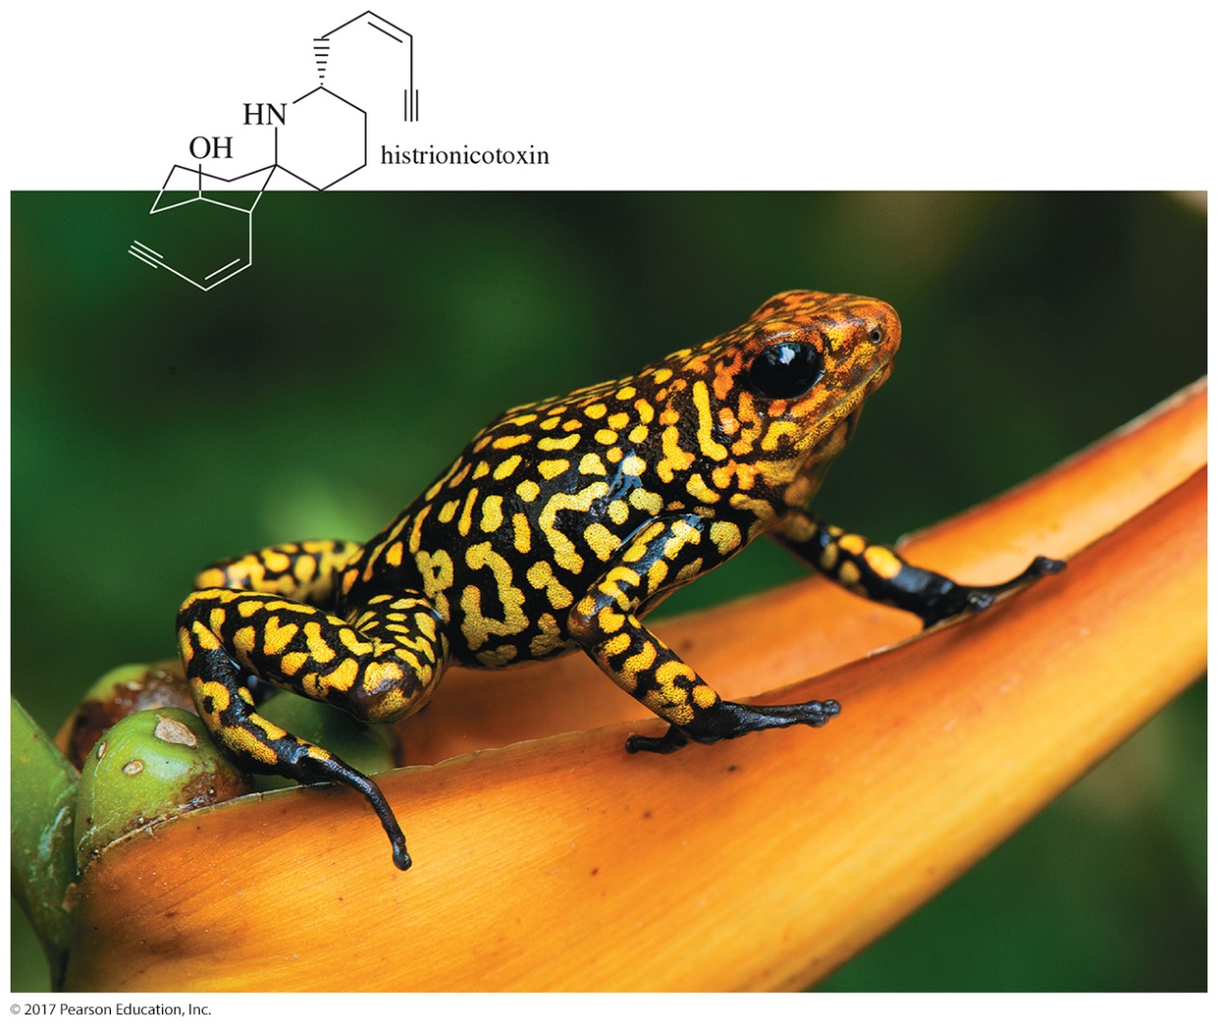
Organic Chemistry,
9th Edition
L. G. Wade, Jr.
Chapter 9
Lecture
Alkynes
Chad Snyder, PhD
Grace College
© 2017 Pearson Education, Inc.

Slide 2
Introduction
Alkynes contain a triple bond.
Their general formula is C_{n}H_{2n–2}.
There are two elements of unsaturation for each triple bond.
Some reactions resemble the reactions of alkenes, like addition and oxidation.
Some reactions are specific to alkynes.

Slide 3
Nomenclature: IUPAC
Find the longest chain containing the triple bond.
Change -ane ending to -yne.
Number the chain, starting at the end closest to the triple bond.
Give branches or other substituents a number to locate their position.

Slide 4
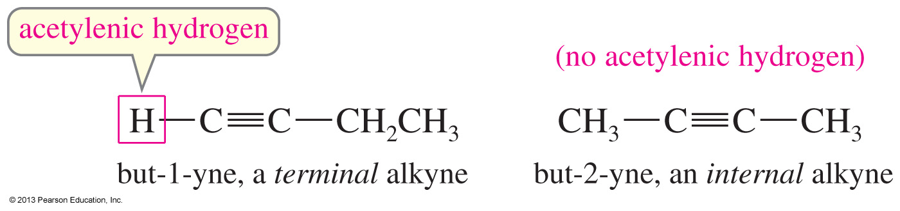
Examples of Nomenclature
All other functional groups, except ethers and halides, have a higher priority than alkynes.

Slide 5
Common Names
Named as substituted acetylene
C
H
C
C
H
3
methylacetylene
(terminal alkyne)
C
H
3
C
H
3
C
H
3
C
H
C
H
2
C
C
C
H
C
H
3
isobutylisopropylacetylene
(internal alkyne)

Slide 6
Physical Properties
Nonpolar, insoluble in water
Soluble in most organic solvents
Their boiling points are similar to an alkane of the same size.
Less dense than water
Up to four carbons, gas at room temperature

Slide 7
Ethyne
Commonly called acetylene
It is used in welding torches.
The oxyacetylene flame reaches temperatures as high as 2800 °C.
It is thermodynamically unstable. When it decomposes to its elements, it releases 234 kJ (56 kcal) of energy per mole.

Slide 8
Synthesis of Acetylene from Coal
CaC₂ + 2 H₂O H—C≡C—H + Ca(OH)₂
Heat coke with lime in an electric furnace to form calcium carbide.
Then drip water on the calcium carbide.

Slide 9

Synthesis of Acetylene from Natural Gas
Methane forms acetylene when it is heated for a very short period of time.

Slide 10
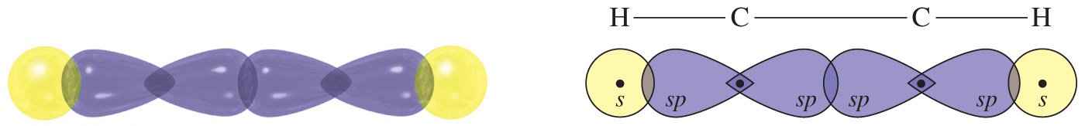
Molecular Structure of Acetylene
Triple-bonded carbons have sp-hybrid orbitals.
A sigma bond is formed between the carbons by overlap of the sp orbitals.
Sigma bonds to the hydrogens are formed by using the second sp orbital.
Since the sp orbitals are linear, acetylene will be a linear molecule.

Slide 11
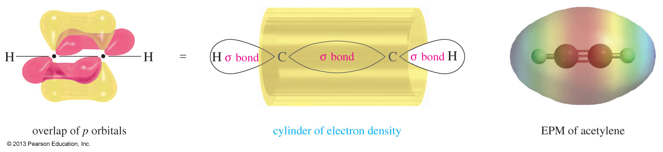
Overlap of the p Orbitals of Acetylene
Each carbon in acetylene has two unhybridized p orbitals with one nonbonded electron. It is the overlap of the parallel p orbitals that forms the triple bond (two pi orbitals).

Slide 12
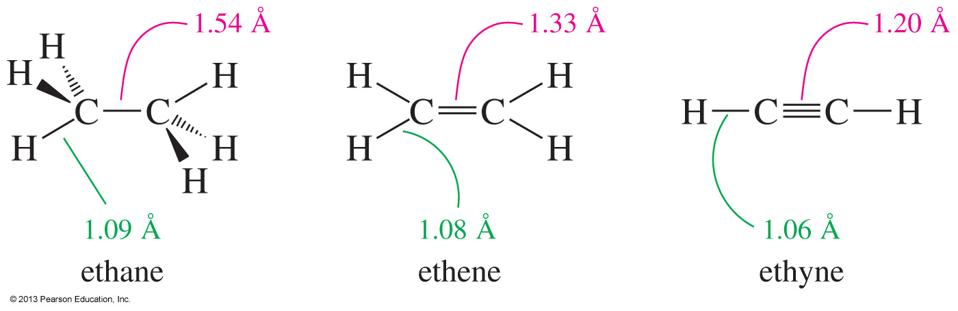
Bond Lengths
Triple bonds are shorter than double or single bonds because of the two pi overlapping orbitals.

Slide 13
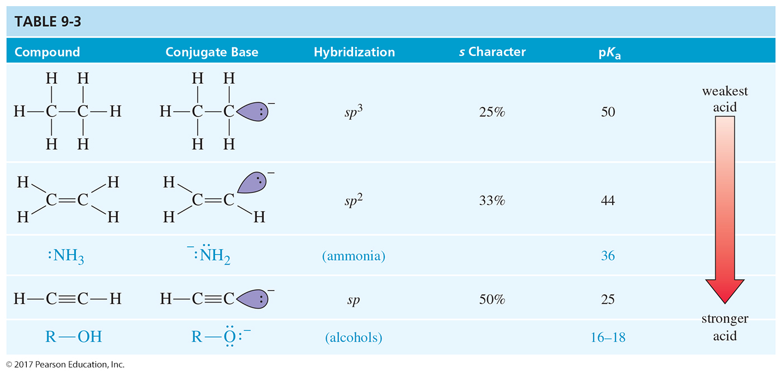
Acidity of Hydrocarbons

Slide 14
Acidity of Alkynes
Terminal alkynes are more acidic than other hydrocarbons due to the higher s character of the sp hybridized carbon.
Terminal alkynes can be deprotonated quantitatively with strong bases such as sodium amide (–NH₂).
Hydroxide (HO–) and alkoxide (RO–) bases are not strong enough to deprotonate the alkyne quantitatively.

Slide 15
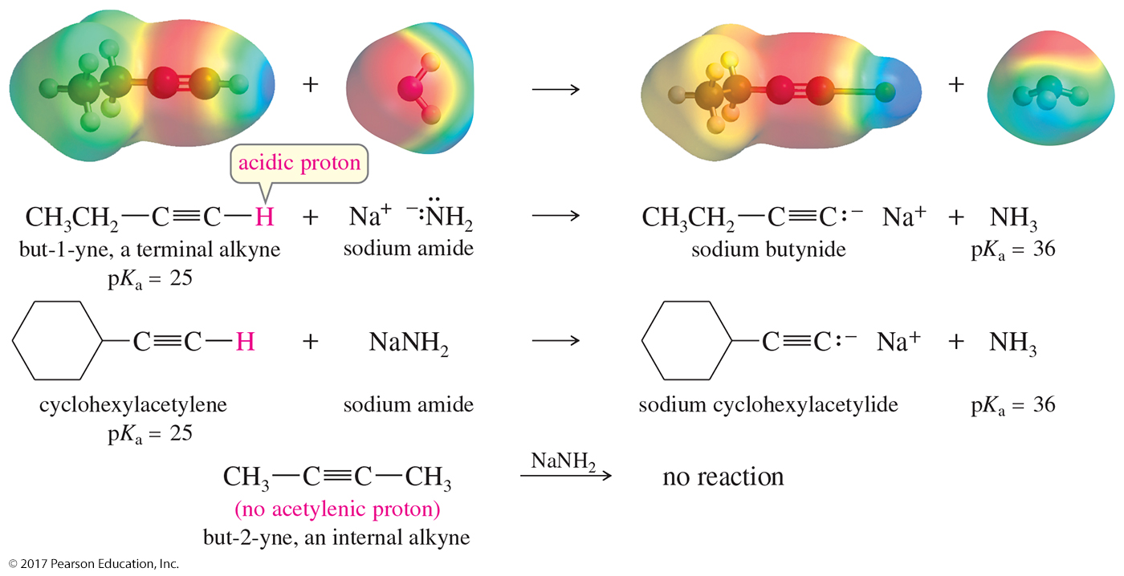

Slide 16
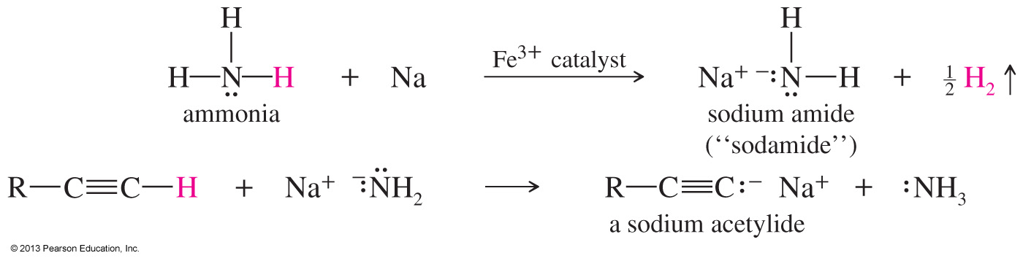
Formation of Acetylide Ions
H⁺ can be removed from a terminal alkyne by sodium amide, NaNH₂.
The acetylide ion is a strong nucleophile that can easily do addition and substitution reactions.

Slide 17
Acetylide Ions in S_{N}2 Reactions
One of the best methods for synthesizing substituted alkynes is a nucleophilic attack by the acetylide ion on an unhindered alkyl halide.
S_{N}2 reactions with 1° alkyl halides lengthen the alkyne chain.
Unhindered alkyl halides work better in an S_{N}2 reaction: CH₃X > 1°.

Slide 18
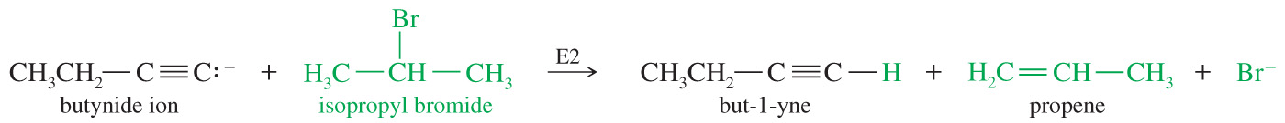
Acetylide Ions as Strong Bases
Acetylide ions are also strong bases. If the S_{N}2 reaction is not possible, then an elimination (E2) will occur.

Slide 19
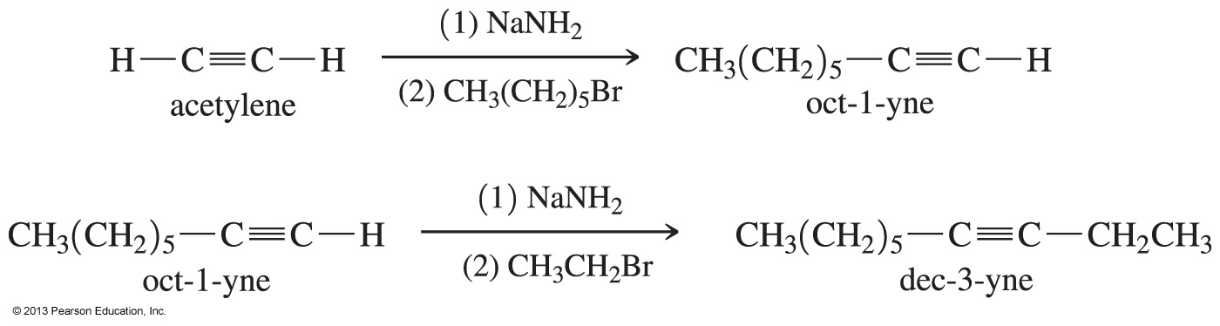
Solved Problem 1
Show how to synthesize 3-decyne from acetylene and any necessary alkyl halides.
Solution
Another name for 3-decyne is ethyl n-hexylacetylene. It can be made by adding an ethyl group and a hexyl group to acetylene. This can be done in either order; we begin by adding the hexyl group.

Slide 20
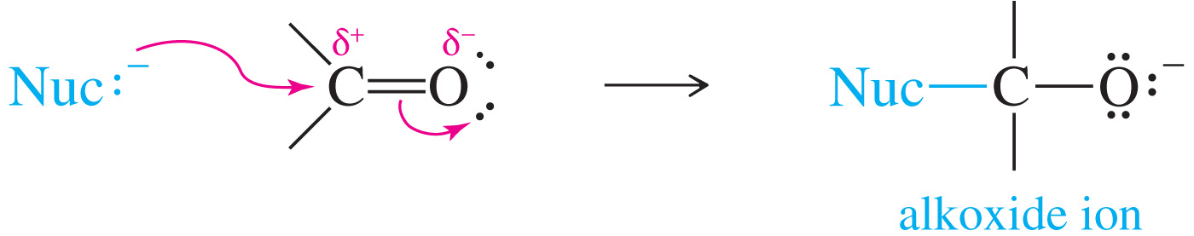
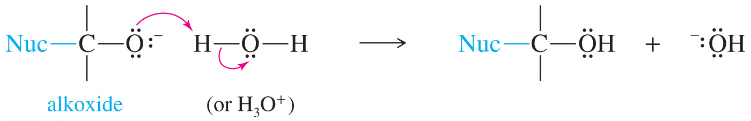
Addition to Carbonyl Compounds
Nucleophiles can attack the carbonyl carbon, forming an alkoxide ion that, on protonation, will form an alcohol.

Slide 21
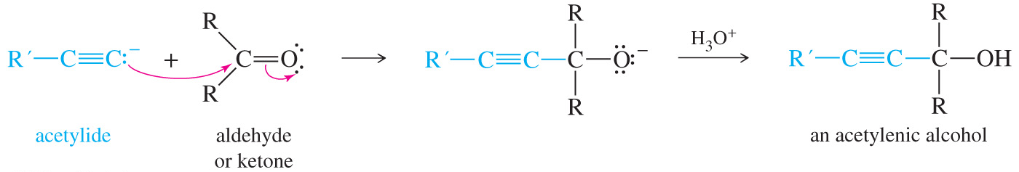
Mechanism of Acetylenic Alcohol Formation

Slide 22
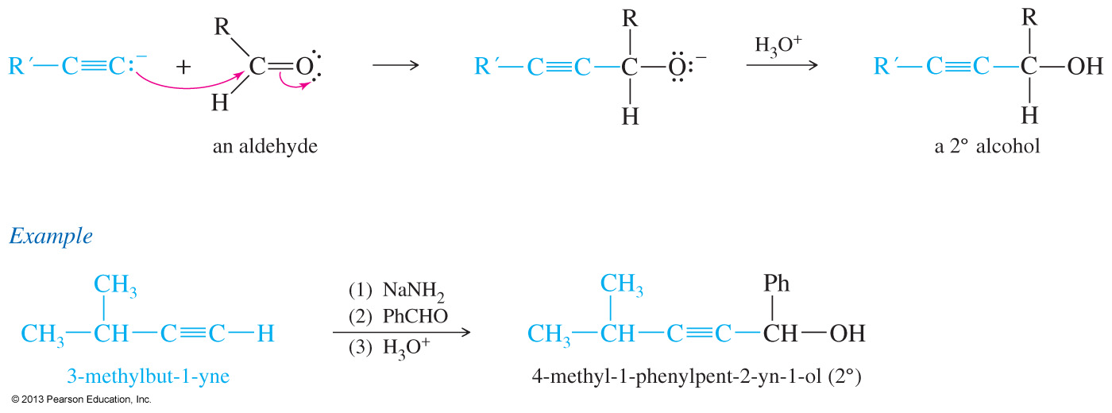
Addition to an Aldehyde
The product is a secondary alcohol with one
R group from the acetylide ion, the other R group from the aldehyde.

Slide 23
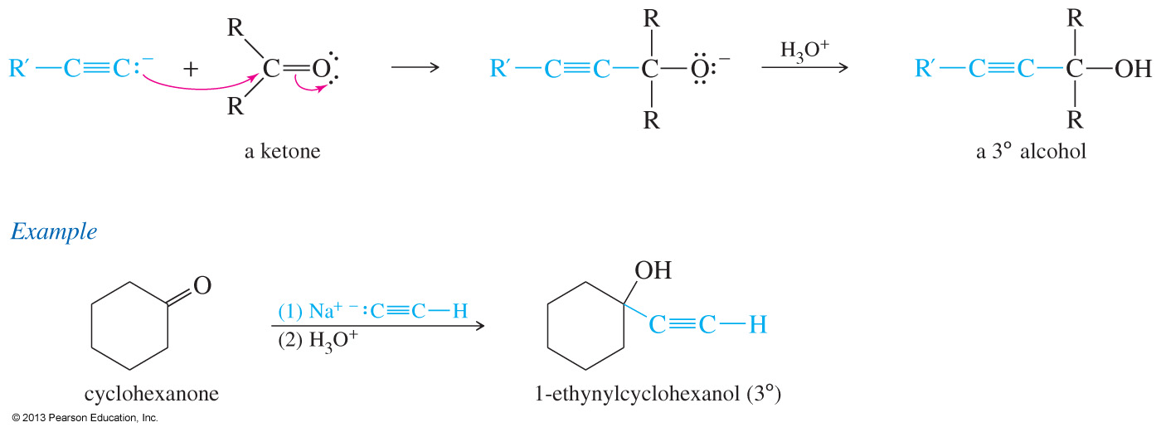
Addition to a Ketone
The product is a tertiary alcohol.

Slide 24
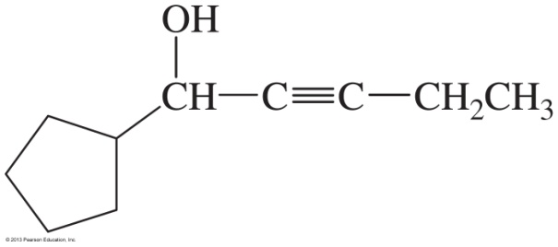
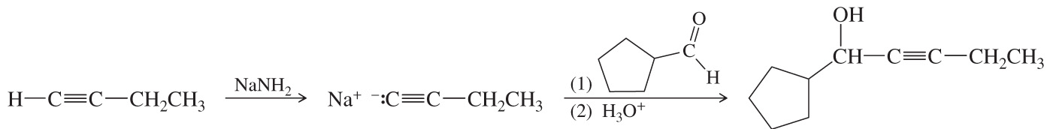
Solved Problem 2
Show how you would synthesize the following compound, beginning with acetylene and any necessary additional reagents.
Solution
We need to add two groups to acetylene: an ethyl group and a six-carbon aldehyde (to form the secondary alcohol). If we formed the alcohol group first, the weakly acidic —OH group would interfere with the alkylation by the ethyl group. Therefore, we should add the less reactive ethyl group first and add the alcohol group later in the synthesis.

Slide 25
Synthesis of Alkynes by Elimination Reactions
Removal of two molecules of HX from a vicinal or geminal dihalide produces an alkyne.
Dehydrohalogenation of a geminal or vicinal dihalide gives a vinyl halide.
Under strongly basic conditions, a second dehydrohalogenation may occur to form an alkyne.

Slide 26
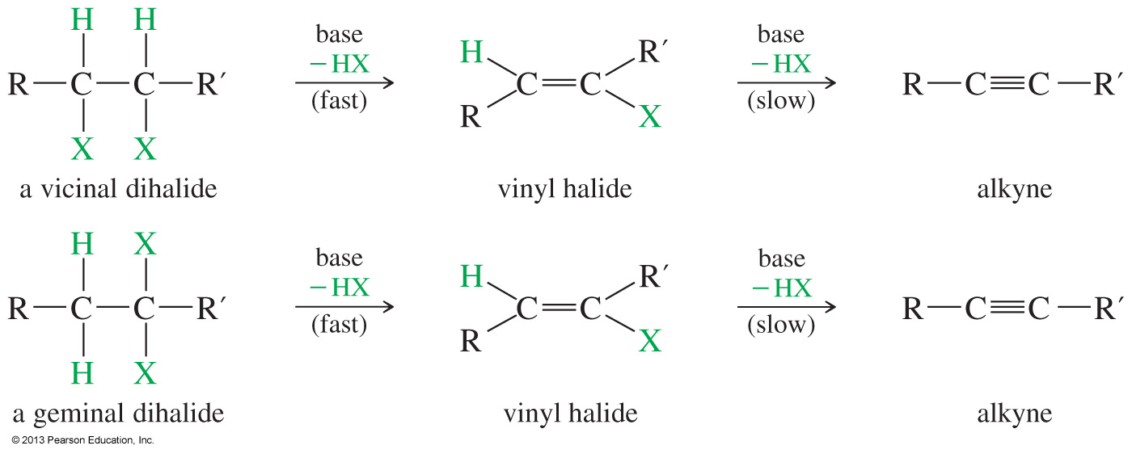
Reagents for Elimination
Molten KOH or alcoholic KOH at 200 °C favors an internal alkyne.
Sodium amide, NaNH₂, at 150 °C, followed by water, favors a terminal alkyne.

Slide 27
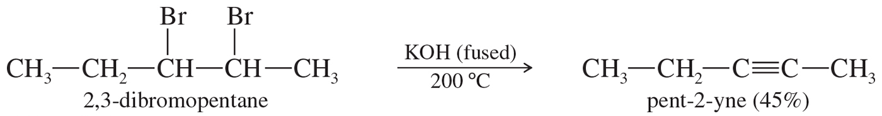
KOH Elimination
The KOH elimination tends to give the most stable,
most highly substituted alkyne.

Slide 28
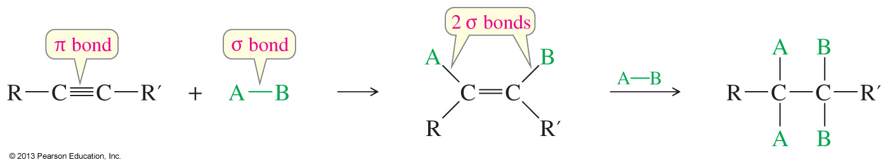
Addition Reactions
Similar to addition to alkenes
The pi bond becomes two sigma bonds.
Usually exothermic
One or two molecules may add.

Slide 29
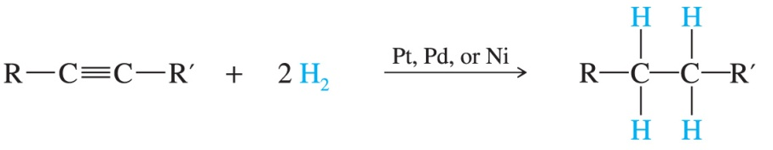
Catalytic Hydrogenation of Alkynes
Two molecules of hydrogen can add across the triple bond to form the corresponding alkane.
A catalyst such as Pd, Pt, or Ni needs to be used for the reaction to occur.
Under these conditions the alkyne will be completely reduced; the alkene intermediate cannot be isolated.

Slide 30
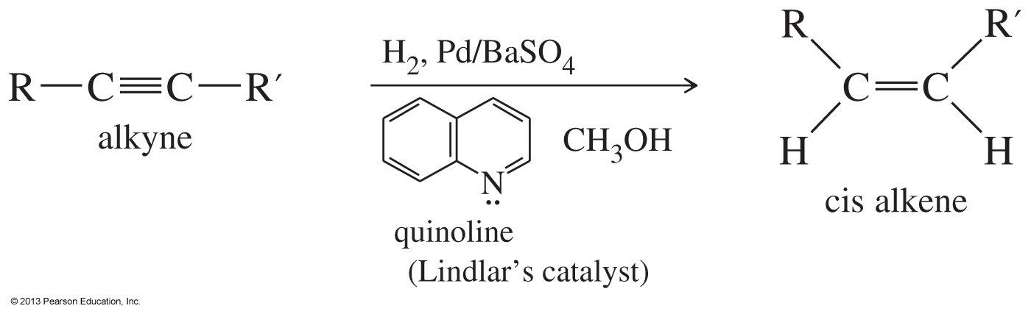
Hydrogenation with
Lindlar’s Catalyst
The catalyst used for the hydrogenation reaction is partially deactivated (poisoned).
The catalyst used is commonly known as Lindlar's catalyst; it is composed of powdered barium sulfate, coated with palladium poisoned with quinoline.
The reaction produces alkenes with cis stereochemistry.

Slide 31
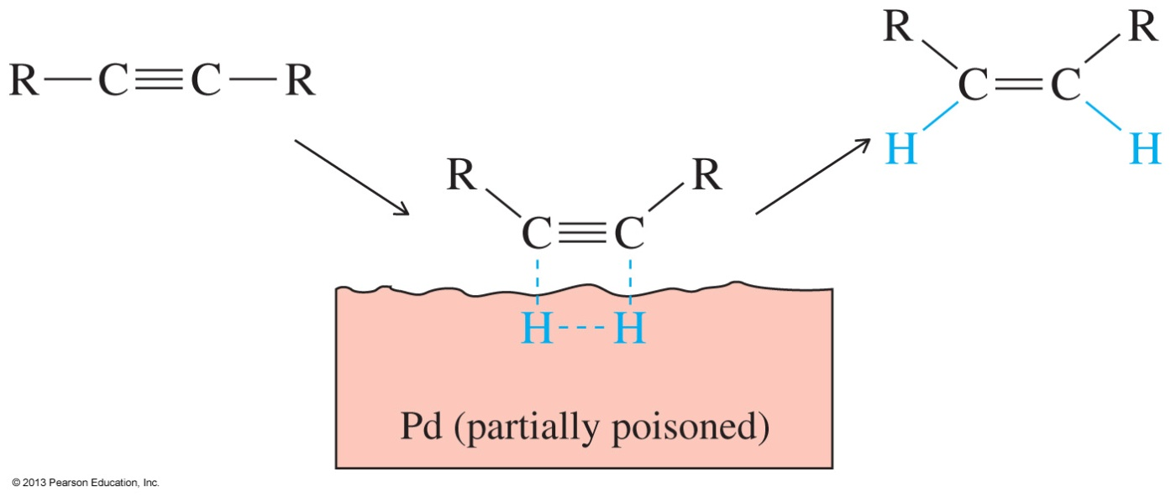
Mechanism
Both substrates, the hydrogen and the alkyne, have to be adsorbed on the catalyst for the reaction to occur.
Once adsorbed, the hydrogens add to the same side of the double bond (syn addition), giving the product a cis stereochemistry.

Slide 32
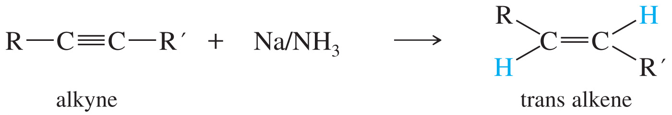
Reduction of Alkynes with
Metal Ammonia
To form a trans alkene, two hydrogens must be added to the alkyne anti stereochemistry, so this reduction is used to convert alkynes to trans alkenes.

Slide 33
Reduction of Alkynes with
Metal Ammonia
Use dry ice to keep ammonia liquid.
As sodium metal dissolves in the ammonia, it loses an electron.
The electron is solvated by the ammonia, creating a deep blue solution.
NH₃ + Na NH₃•e– (deep blue + Na⁺
solution)

Slide 34
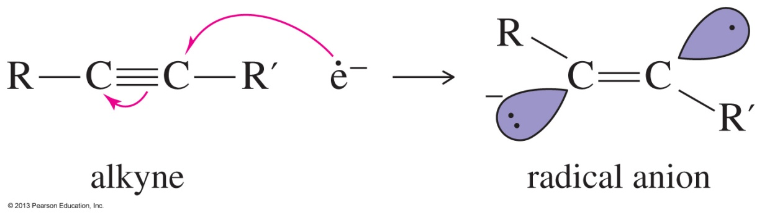
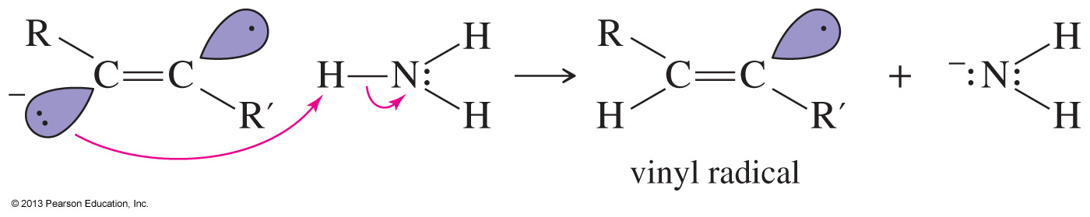
Mechanism of
Metal Reduction
Step 1: An electron adds to the alkyne, forming a radical anion.
Step 2: The radical anion is protonated to give a radical.

Slide 35
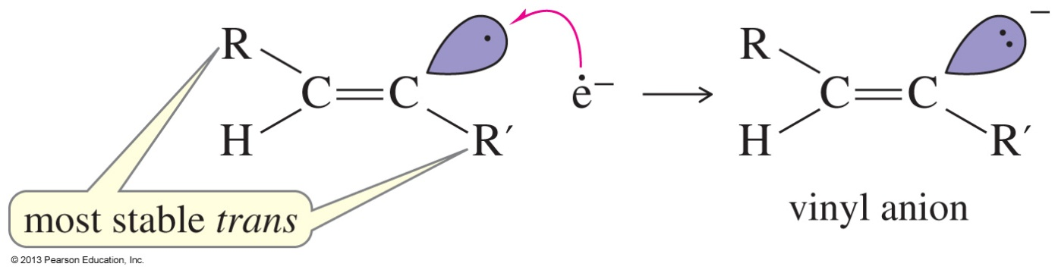
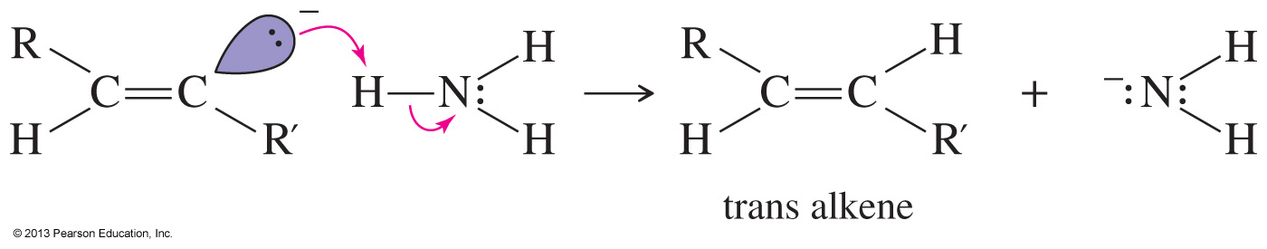
Mechanism of Metal Reduction (Continued)
Step 3: An electron adds to the alkyne, forming an anion.
Step 4: Protonation of the anion gives an alkene.

Slide 36
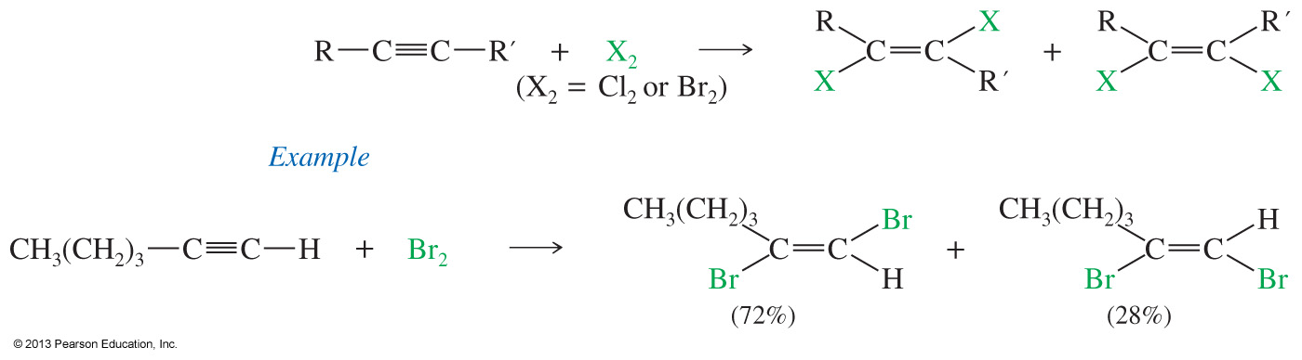
Addition of 1 Mole of Halogen
Cl₂ and Br₂ add to alkynes to form vinyl dihalides.
They may add syn or anti, so the product is a mixture of cis and trans isomers.
It is difficult to stop the reaction at dihalide.

Slide 37
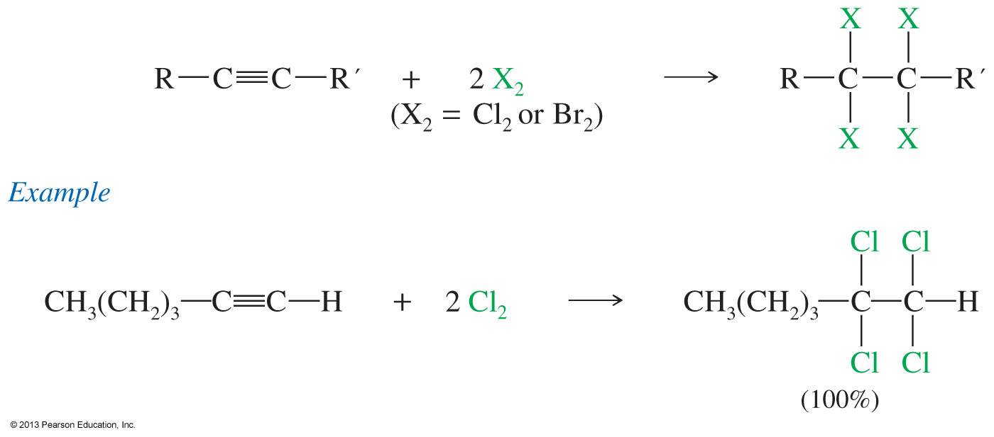
Addition of 2 Moles of Halogen
Two moles of halogen can add to the triple bond, forming a tetrahalide.

Slide 38
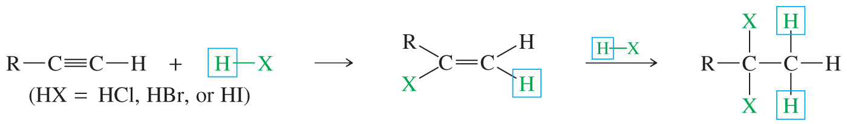
Addition of HX
One mole of HCl, HBr, and HI adds to alkynes to form vinyl halides.
If 2 moles of HX are added, the product is a geminal dihalide.
The addition of HX is Markovnikov and will produce a geminal dihalide.

Slide 39
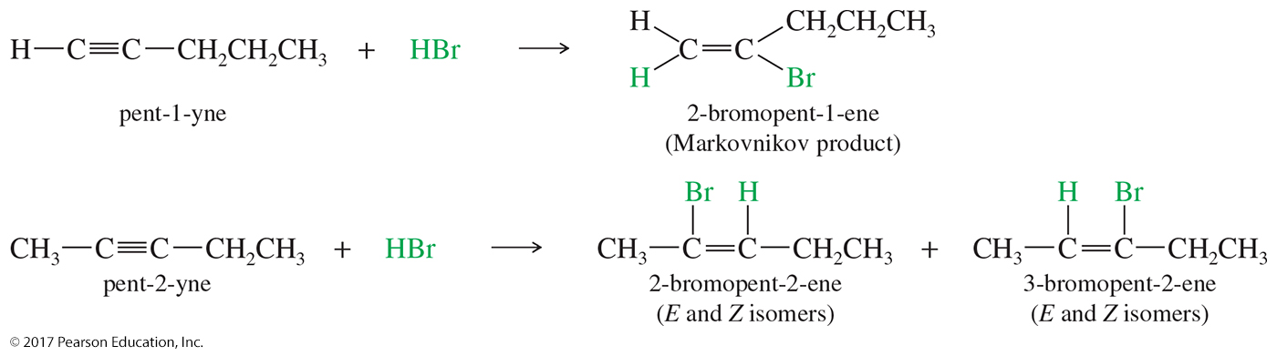
HX Addition Examples

Slide 40
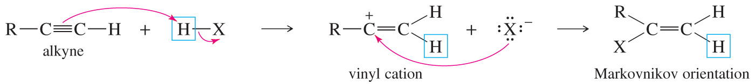
Mechanism of Hydrogen
Halide Addition
The triple bonds abstract a proton from the hydrogen halide, forming a vinyl cation.
The proton adds to the least substituted carbon, forming a vinyl cation.

Slide 41
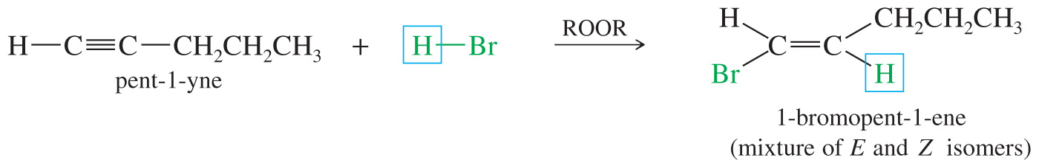
Anti-Markovnikov Addition of Hydrogen Bromide to Alkynes
By using peroxides, hydrogen bromide can be added to a terminal alkyne anti-Markovnikov.
The bromide will attach to the least substituted carbon, giving a mixture of cis and trans isomers.

Slide 42
Hydration of Alkynes
Mercuric sulfate in aqueous sulfuric acid adds H—OH to one pi bond with a Markovnikov orientation, forming a vinyl alcohol (enol) that rearranges to a ketone.
Hydroboration–oxidation adds H—OH with an anti-Markovnikov orientation, and rearranges to an aldehyde.

Slide 43
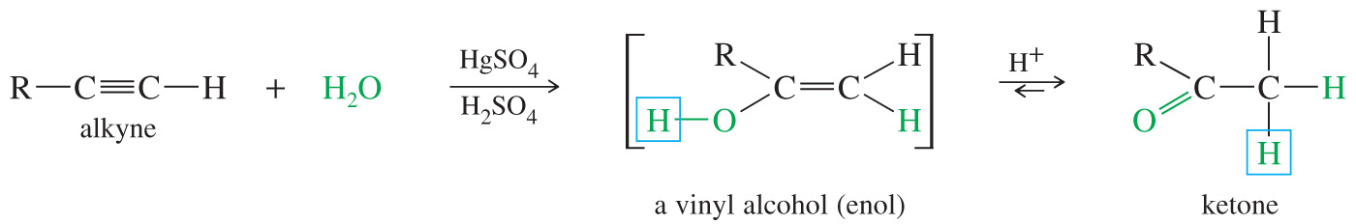
Mercuric Ion-Catalyzed Hydration
Analogous to the oxymercuration–demercuration of alkenes
The hydration is catalyzed by the mercuric ion.
In a typical reaction, a mixture of mercuric acetate in aqueous sulfuric acid is used.
The addition produces an intermediate vinyl alcohol (enol) that quickly tautomerizes to the more stable ketone or aldehyde.

Slide 44
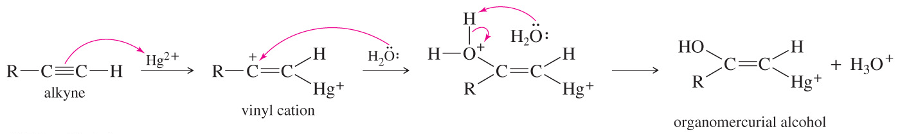
Mechanism of Mercuric Ion-Catalyzed Hydration
The electrophilic addition of mercuric ion (Hg²⁺) creates a vinyl carbocation.
Water attacks the carbocation and, after deprotonation, forms an organomercurial alcohol.
Hydrolysis of the alcohol removes the mercury, forming a vinyl alcohol commonly referred to as enol.

Slide 45
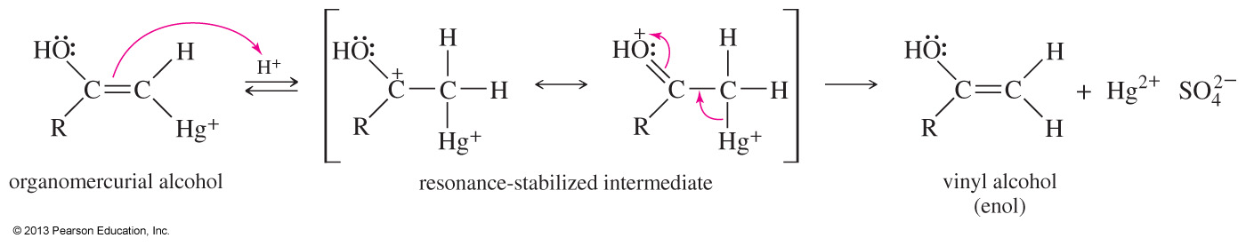
Replacement of the Mercury
Under the acidic reaction conditions, mercury is replaced by hydrogen to give a vinyl alcohol, called an enol.

Slide 46
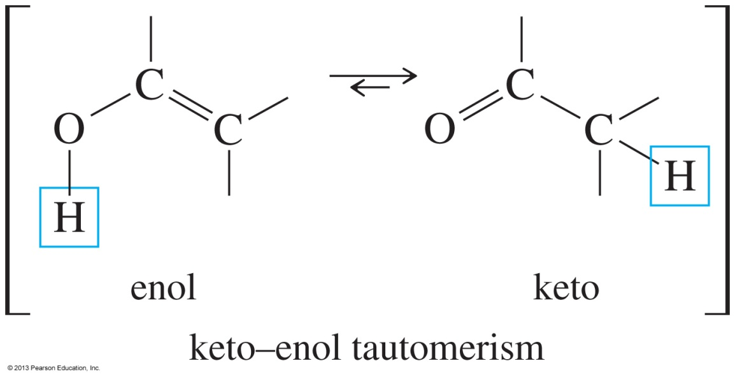
Keto–Enol Tautomerism
Enols are not stable and they isomerize to the corresponding aldehyde or ketone in a process known as keto–enol tautomerism.

Slide 47
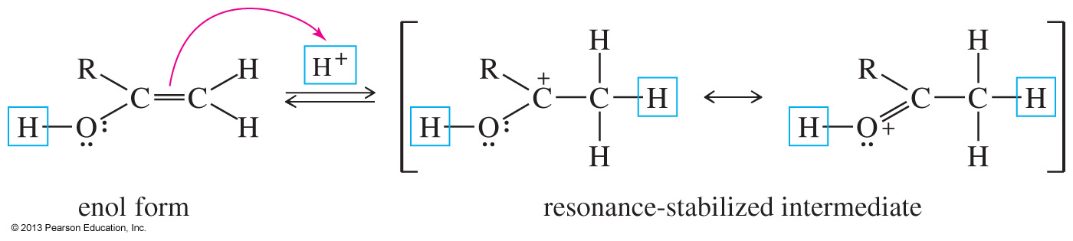
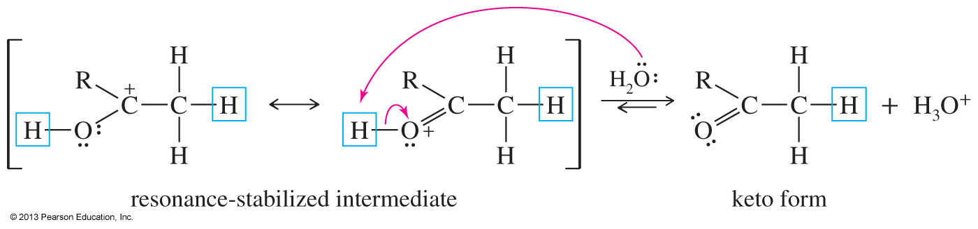
Mechanism of Acid-Catalyzed Tautomerism
Step 1: Addition of a proton at the methylene group
Step 2: Loss of the hydroxyl proton

Slide 48
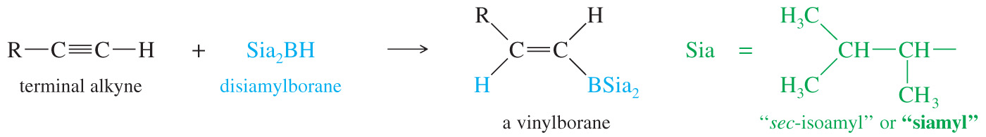
Hydroboration–Oxidation Reaction
Anti-Markovnikov addition of water across the triple bond
A hindered alkyl borane must be used to prevent two molecules of borane from adding to the triple bond. Disiamylborane has two bulky alkyl groups.

Slide 49
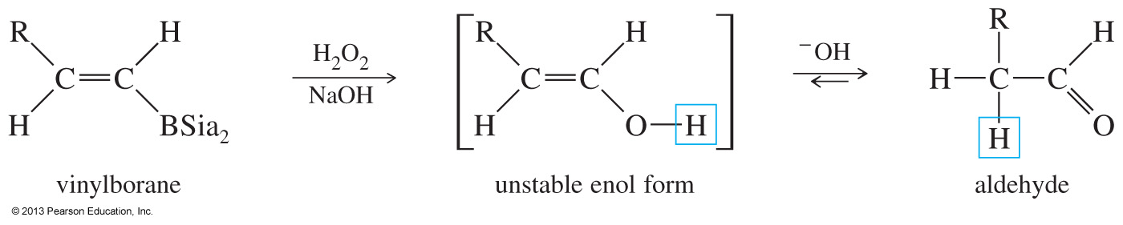
Oxidation of Boranes
In the second step of the hydroboration–oxidation, a basic solution of peroxide is added to the vinyl borane to oxidize the boron and replace it with a hydroxyl group (OH).
Once the enol is formed, it rapidly tautomerizes in base to the more stable aldehyde.

Slide 50
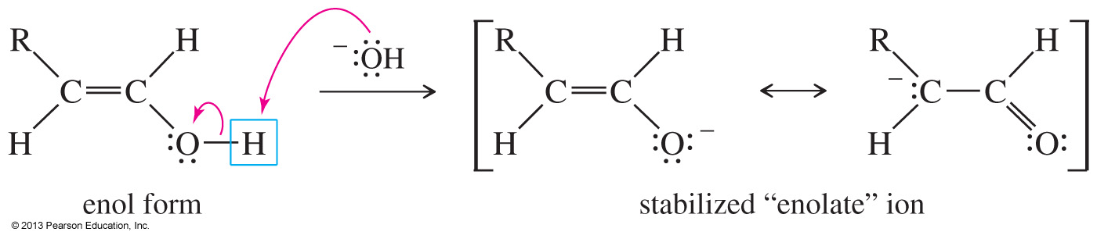
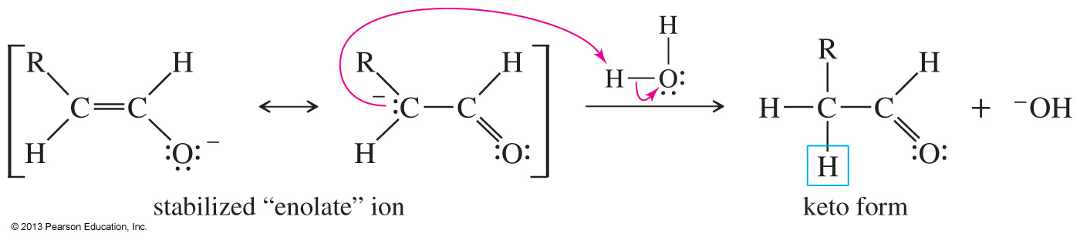
Mechanism of Base-Catalyzed Tautomerism
Step 1: Loss of the hydroxyl proton
Step 2: Reprotonation on the adjacent carbon atom

Slide 51
Oxidation of Alkynes
Similar to oxidation of alkenes
Dilute, neutral solution of KMnO₄ oxidizes alkynes to a diketone.
Warm, basic KMnO₄ cleaves the
triple bond.
Ozonolysis, followed by hydrolysis, cleaves the triple bond.

Slide 52
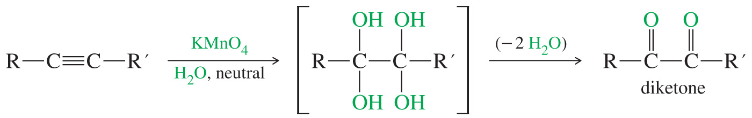
Permanganate Oxidation of Alkynes to Diketones
Under neutral conditions, a dilute potassium permanganate solution can oxidize a triple bond into a diketone.
The reaction uses aqueous KMnO₄ to form a tetrahydroxy intermediate, which loses two water molecules to produce the diketone.

Slide 53
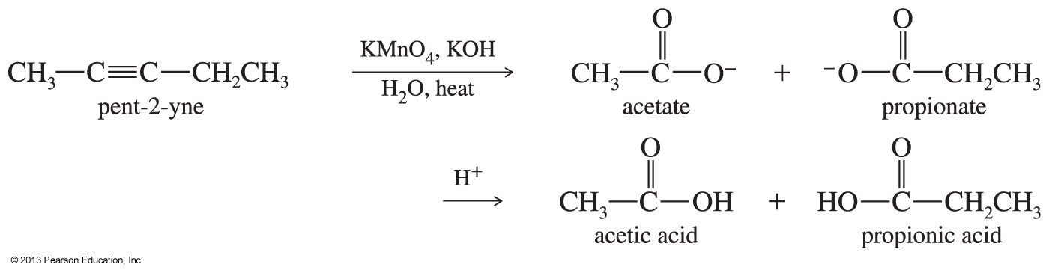
Permanganate Oxidation of Alkynes to Carboxylic Acids
If potassium permanganate is used under basic conditions or if the solution is heated too much, an oxidative cleavage will take place and two molecules of carboxylic acids will be produced.

Slide 54
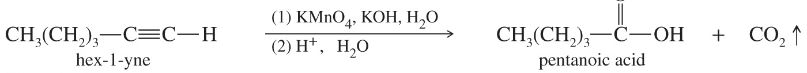
Ozonolysis
Ozonolysis of alkynes produces carboxylic acids (alkenes gave aldehydes and ketones).
Either permanganate cleavage or ozonolysis can be used to determine the position of the triple bond in an unknown alkyne.

