Slide 1
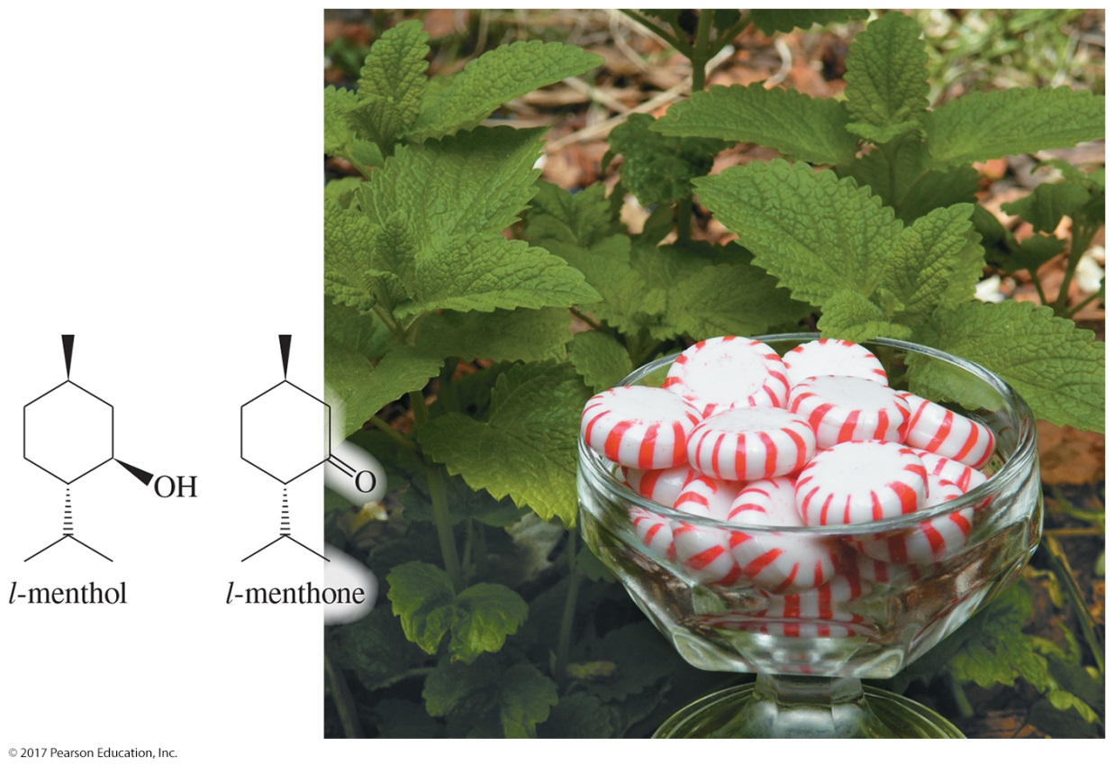
Organic Chemistry,
9th Edition
L. G. Wade, Jr.
Chapter 10
Lecture
Structure and Synthesis
of Alcohols
Chad Snyder, PhD
Grace College
© 2017 Pearson Education, Inc.

Slide 2
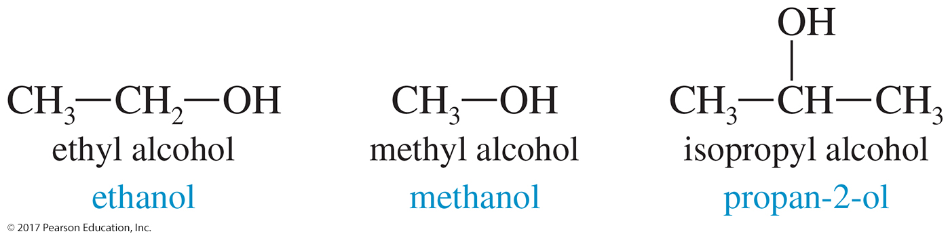
Alcohols
Alcohols are organic compounds containing hydroxyl groups.
They are some of the most useful compounds in nature, industry, and around the house.

Slide 3
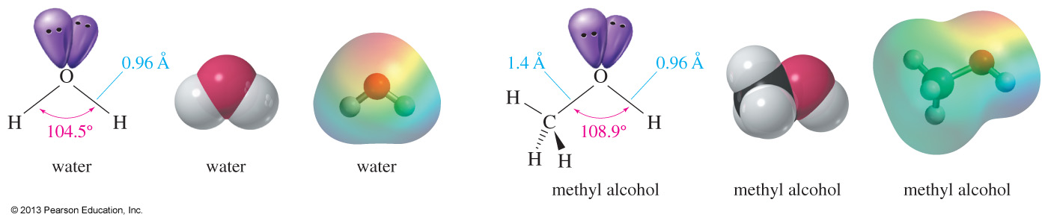
Structure of Water and Methanol
Oxygen is sp³ hybridized and tetrahedral.
The H—O—H angle in water is 104.5°.
The C—O—H angle in methyl alcohol is 108.9°.
The carbinol carbon atom is the carbon bonded to the hydroxyl group.

Slide 4
Classification of Alcohols
Primary: Carbon with —OH is bonded to one other carbon.
Secondary: Carbon with —OH is bonded to two other carbons.
Tertiary: Carbon with —OH is bonded to three other carbons.
Aromatic (phenol): —OH is bonded to a benzene ring.

Slide 5
Examples of Classifications
C
H
3
O
H
C
H
C
H
C
H
O
H
C
H
3
C
H
C
H
2
C
H
3
3
*
2
*
Primary alcohol
Secondary alcohol
C
H
3
*
C
H
3
C
O
H
C
H
3

Slide 6
IUPAC Nomenclature
Find the longest carbon chain containing the carbon with the —OH group.
Drop the -e from the alkane name; add -ol.
Number the chain, giving the —OH group the lowest number possible.
Number and name all substituents and write them in alphabetical order.

Slide 7
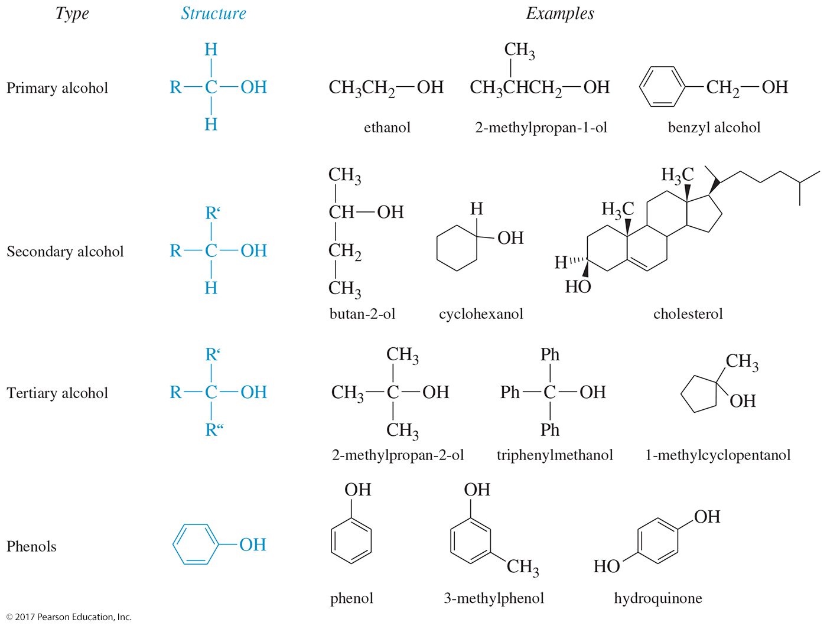
Examples of Nomenclature

Slide 8
Alkenols (Enols)
The hydroxyl group takes precedence. Assign the carbon with the —OH the lowest number.
End the name in -ol, but also specify that there is a double bond by using the ending -ene before –ol.
O
H
C
H
2
C
H
C
H
2
C
H
C
H
3
5 4 3 2 1
Old: 4-penten-2-ol
New: pent-4-ene-2-ol

Slide 9
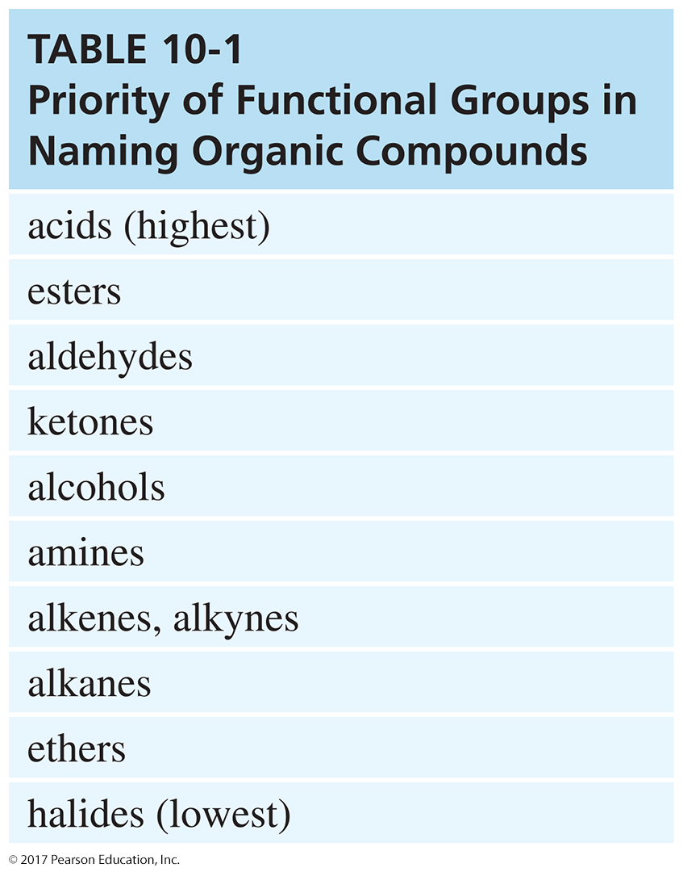
Naming Priority

Slide 10
Hydroxy Substituent
When —OH is part of a higher priority class of compound, it is named as hydroxy.
carboxylic acid
O
H
C
H
2
C
H
2
C
H
2
C
O
O
H
4 3 2 1
4-hydroxybutanoic acid
also known as γ-hydroxybutyric acid (GHB)

Slide 11
Common Names
Alcohol can be named as alkyl alcohol.
Useful only for small alkyl groups
C
H
3
O
H
C
H
C
H
C
H
O
H
C
H
3
C
H
C
H
2
C
H
3
3
2
isobutyl alcohol
IUPAC: 2-methylpropan-1-ol
sec-butyl alcohol
IUPAC: butan-2-ol

Slide 12

Naming Diols
Two numbers are needed to locate the two
—OH groups.
Use -diol as the suffix instead of -ol.
1 2 3 4 5 6
hexane-1,6-diol

Slide 13


Glycols
1,2-diols (vicinal diol) are called glycols.
Common names for glycols use the name of the alkene from which they were made.
IUPAC: ethane-1,2-diol
ethylene glycol
IUPAC: propane-1,2-diol
propylene glycol

Slide 14
Phenol Nomenclature
The —OH group is assumed to be on carbon 1.
For common names of disubstituted phenols, use ortho- for 1,2; meta- for 1,3; and para- for 1,4.
Methyl phenols are cresols.
3-chlorophenol
(meta-chlorophenol)
4-methylphenol
(para-cresol)

Slide 15
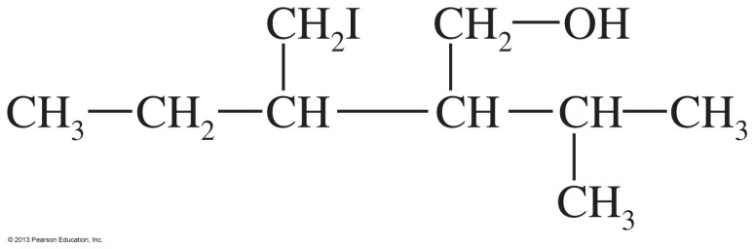
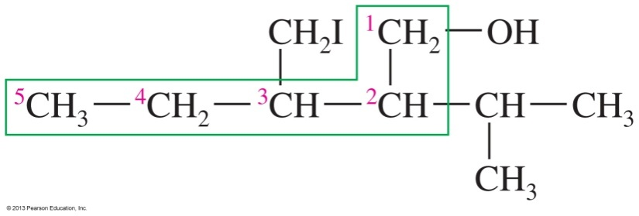
Solved Problem 1
Give the systematic (IUPAC) name for the following alcohol.
Solution
The longest chain contains six carbon atoms, but it does not contain the carbon bonded to the hydroxyl group. The longest chain containing the carbon bonded to the —OH group is the one outlined by the green box, containing five carbon atoms. This chain is numbered from right to left in order to give the hydroxyl-bearing carbon atom the lowest possible number.
The correct name for this compound is 3-(iodomethyl)-2-isopropylpentan-1-ol.

Slide 16
Physical Properties
Alcohols have high boiling points due to hydrogen bonding between molecules.
Small alcohols are miscible in water, but solubility decreases as the size of the alkyl group increases.

Slide 17
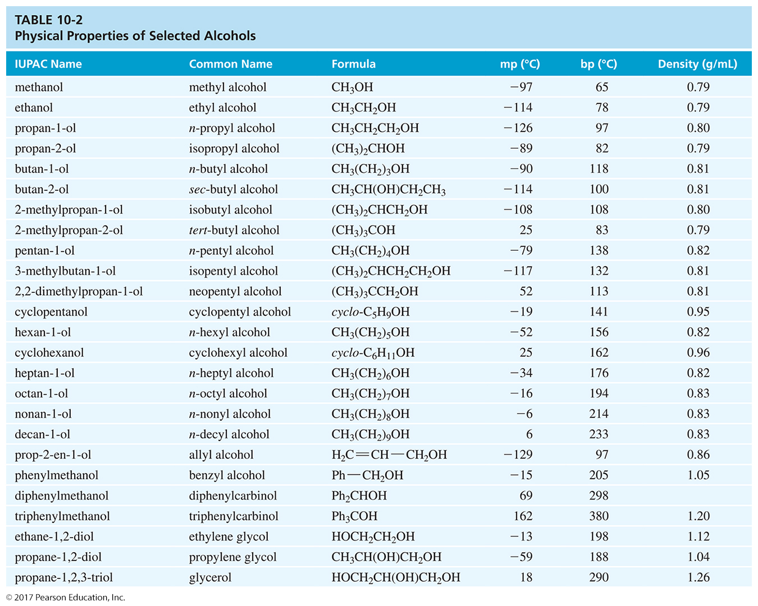
Physical Properties of Alcohols

Slide 18
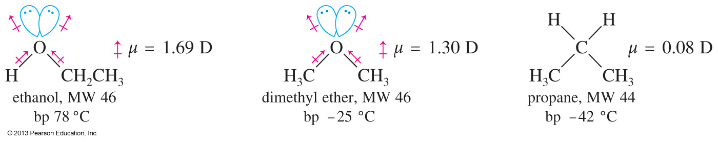
Boiling Points of Alcohols
Alcohols have higher boiling points than ethers and alkanes because alcohols can form hydrogen bonds.
The stronger interaction between alcohol molecules will require more energy to break, resulting in a higher boiling point.

Slide 19
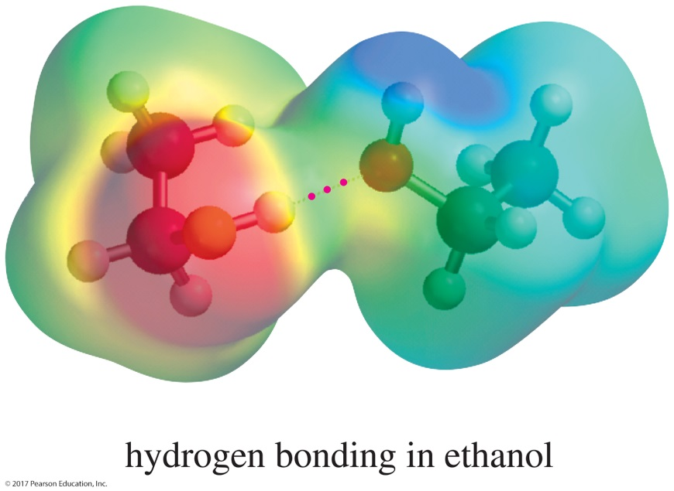
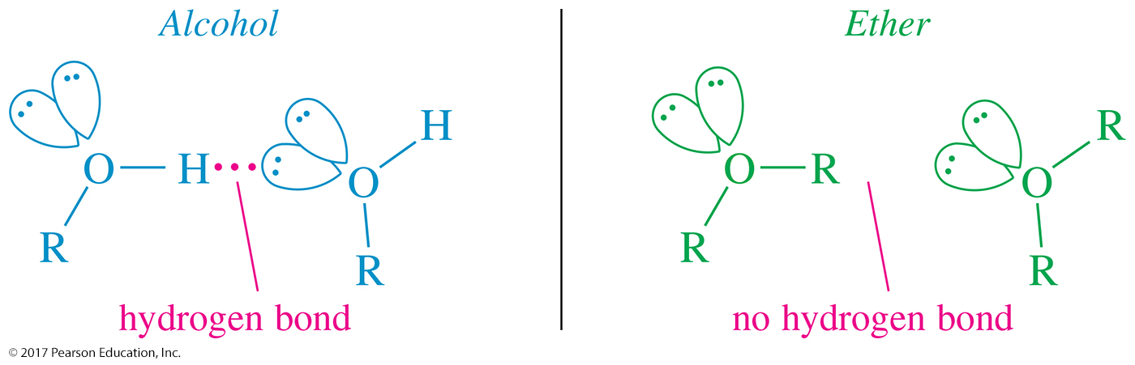
Hydrogen Bonding

Slide 20
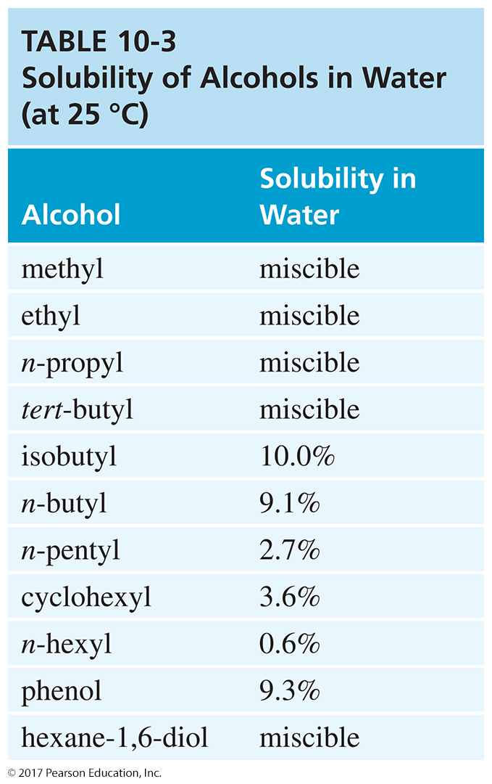
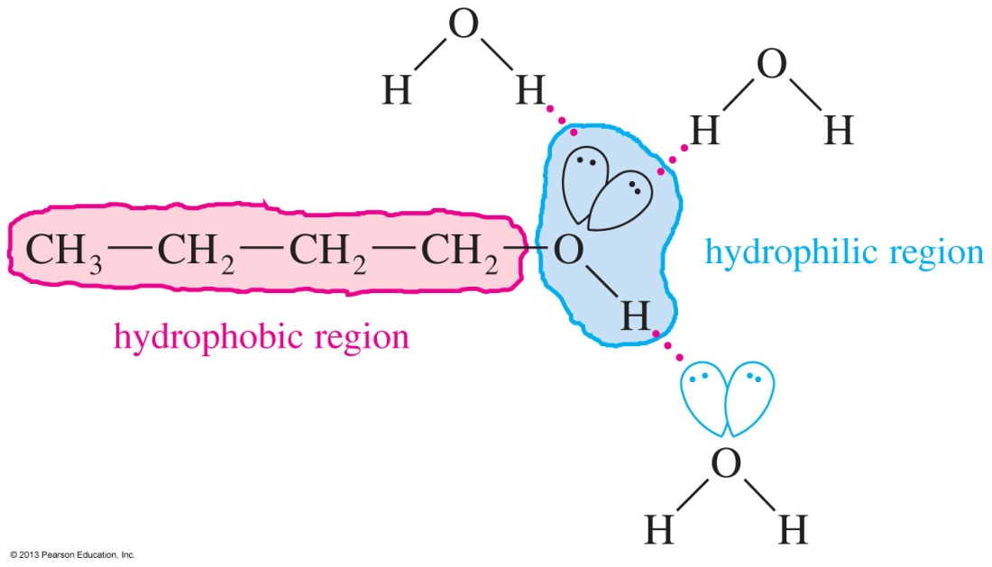
Solubility in Water
Small alcohols are miscible in water, but solubility decreases as the size of the alkyl group increases.

Slide 21
Methanol
“Wood alcohol”
Industrial production from synthesis gas
Common industrial solvent
Toxic dose: 100 mL methanol
Used as fuel at Indianapolis 500
  Fire can be extinguished with water.
  High octane rating
  Low emissions
  Lower energy content
  Invisible flame

Slide 22
Ethanol
Fermentation of sugar and starches in grains
12–15% alcohol, then yeast cells die
Distillation produces “hard” liquors.
Azeotrope: 95% ethanol, constant boiling
Denatured alcohol is used as solvent.
Gasahol: 10% ethanol in gasoline
Toxic dose: 200 mL

Slide 23
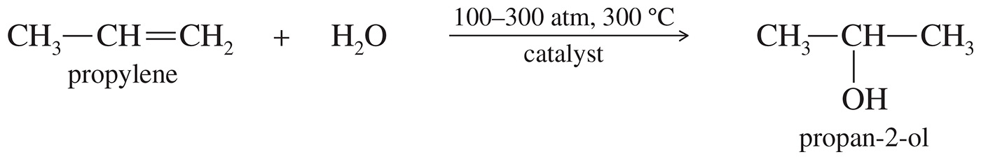
Propan-2-ol
Propan-2-ol is made by the catalytic hydration of propylene.
Isopropyl alcohol is commonly used as rubbing alcohol.

Slide 24
Acidity of Alcohols
pK_{a} range: 15.5–18.0 (water: 15.7)
Acidity decreases as substitution on the alkyl group increases.
Halogens and other electron-withdrawing groups increase the acidity.
Phenol is 100 million times (10⁸) more acidic than cyclohexanol!

Slide 25
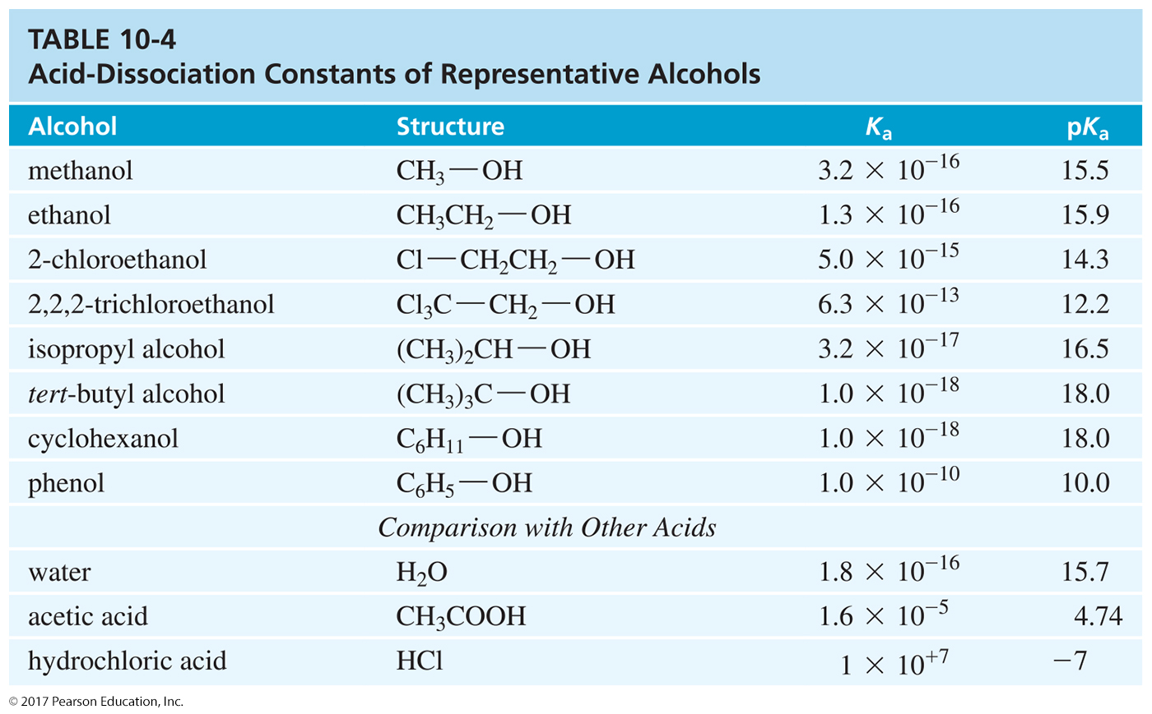
Table of K_{a} Values

Slide 26
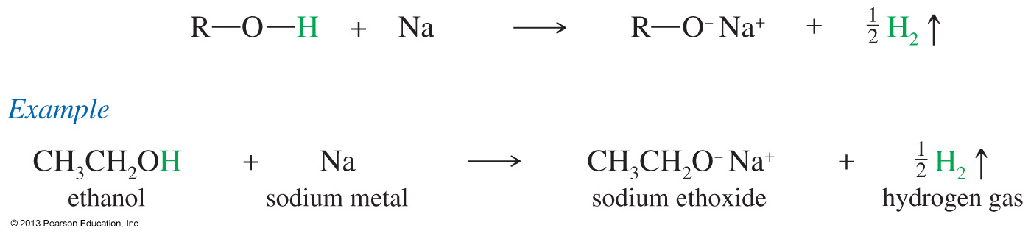
Formation of Alkoxide Ions
Ethanol reacts with sodium metal to form sodium ethoxide (NaOCH₂CH₃), a strong base commonly used for elimination reactions.
More hindered alcohols like 2-propanol or tert-butanol react faster with potassium than with sodium.

Slide 27
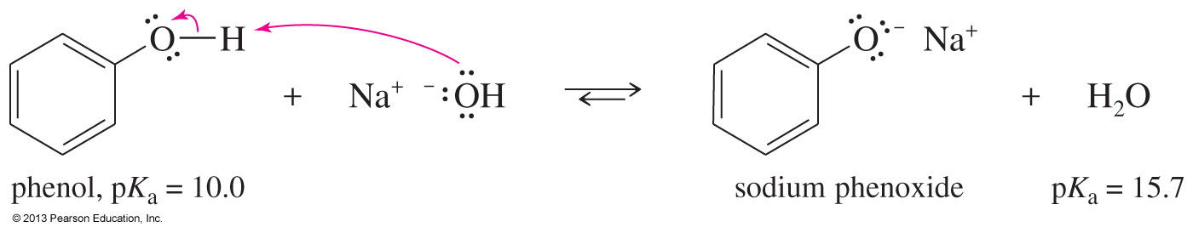
Formation of Phenoxide Ion
The aromatic alcohol phenol is more acidic than aliphatic alcohols due to the ability of aromatic rings to delocalize the negative charge of the oxygen within the carbons of the ring.

Slide 28
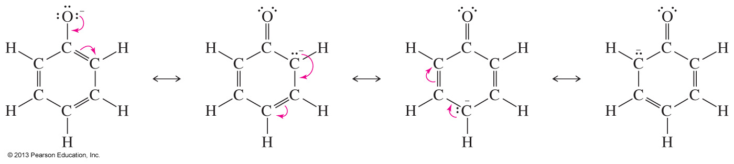
Charge Delocalization on the Phenoxide Ion
The negative charge of the oxygen can be delocalized over four atoms of the phenoxide ion.
The true structure is a hybrid between the four resonance forms.

Slide 29
Synthesis of Alcohols (Review)
Alcohols can be synthesized by nucleophilic substitution (usually S_{N}2) of alkyl halide.
Addition of water to double bonds also produces alcohols:
  Water in acid solution (suffers from rearrangements)
  Oxymercuration–demercuration
  Hydroboration–oxidation

Slide 30
Synthesis of Vicinal Diols (Review)
Vicinal diols can be synthesized by two different methods:
Syn hydroxylation of alkenes
  Osmium tetroxide, hydrogen peroxide
  Cold, dilute, basic potassium permanganate
Anti hydroxylation of alkenes
  Peroxyacids followed by hydrolysis

Slide 31
Organometallic Reagents
Carbon is negatively charged, so it is bonded to a metal (usually Mg or Li).
It will attack a partially positive carbon.
  C—X (alkyl halides)
  C═O (carbonyl)
Good for forming carbon–carbon bonds

Slide 32
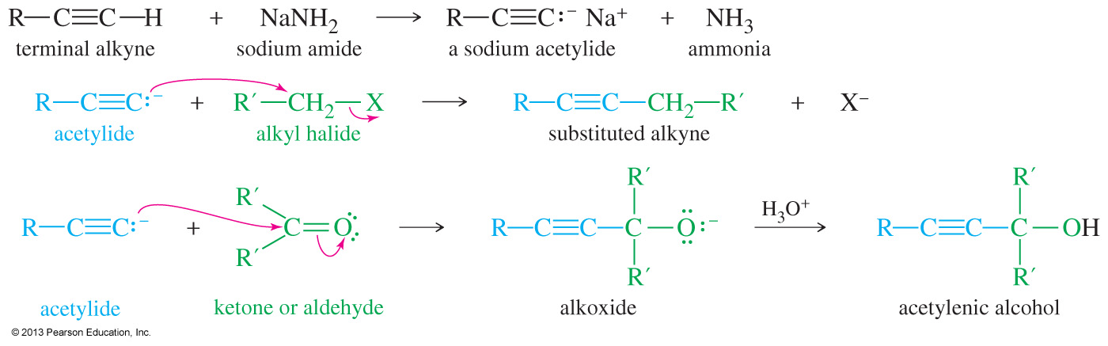
Sodium Acetylides
Terminal alkynes can be converted to sodium acetylides by treatment with an unusually strong base like sodium amide (NaNH₂).
These sodium acetylides are useful nucleophiles, reacting with alkyl halides and carbonyl compounds to form new carbon–carbon bonds.

Slide 33
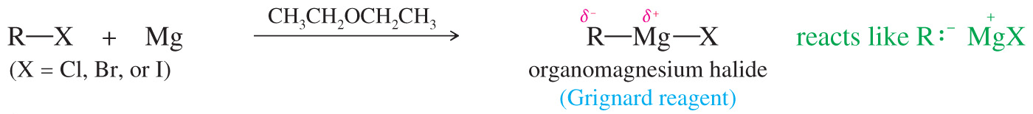
Grignard Reagents
Formula R—Mg—X (reacts like R:– ⁺MgX)
Ethers are used as solvents to stabilize the complex.
Iodides are the most reactive. Fluorides generally do not react.
May be formed from primary, secondary, or tertiary alkyl halides

Slide 34
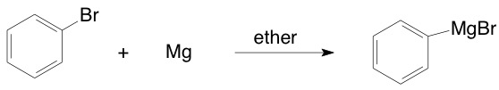

Formation of Grignards

Slide 35
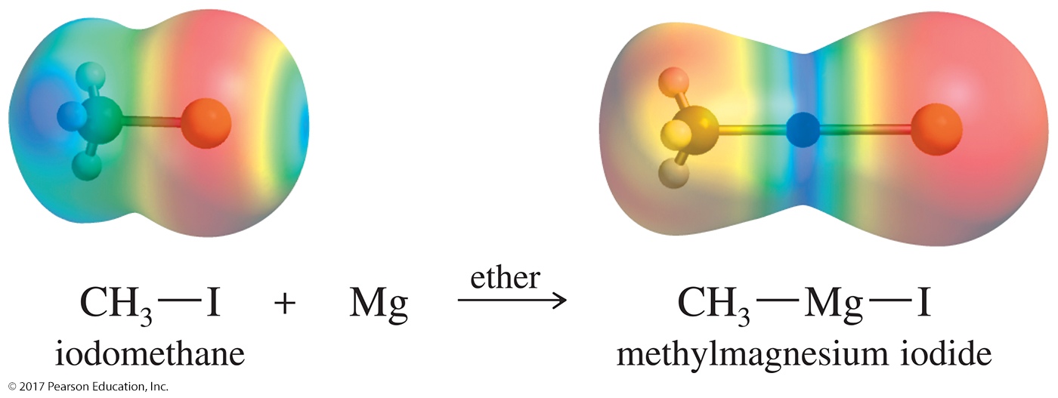
Grignards (Continued)

Slide 36
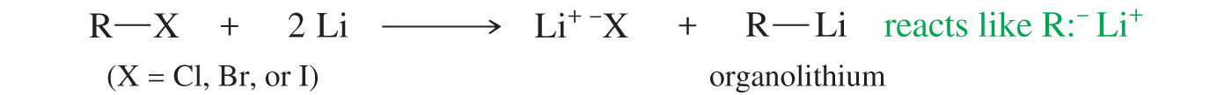
Organolithium Reagents
Reacts the same way as a Grignard
Can be produced from alkyl, vinyl, or aryl halides, just like Grignard reagents
Ether is not necessary; a wide variety of solvents can be used.

Slide 37

Examples of
Organolithium Reagents

Slide 38
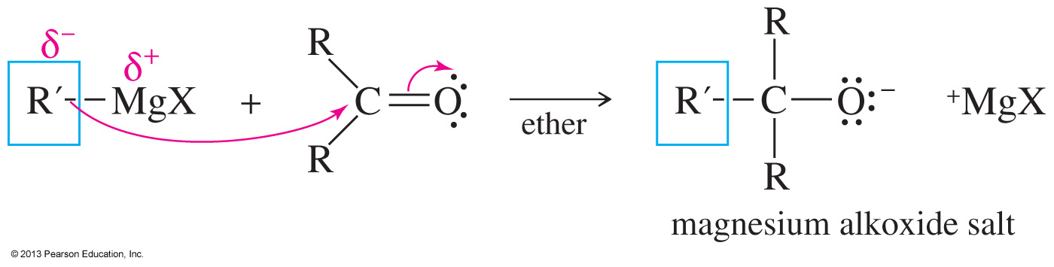
Addition to
Carbonyl Compounds
The carbonyl carbon is partial positive (electrophilic).
Nucleophiles will attack the carbonyl, forming an alkoxide.

Slide 39
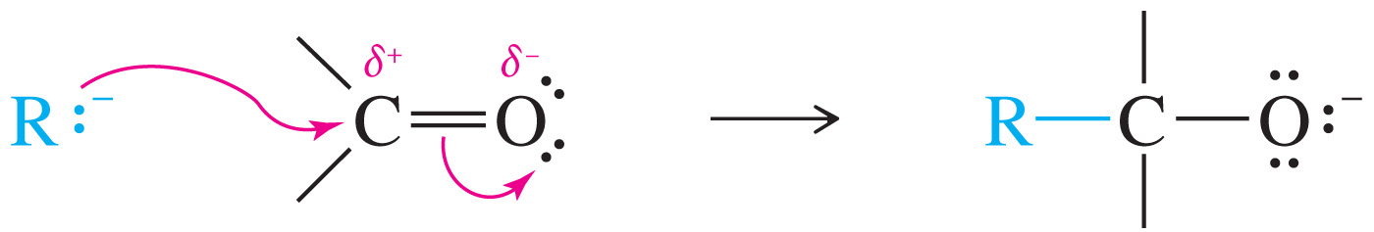
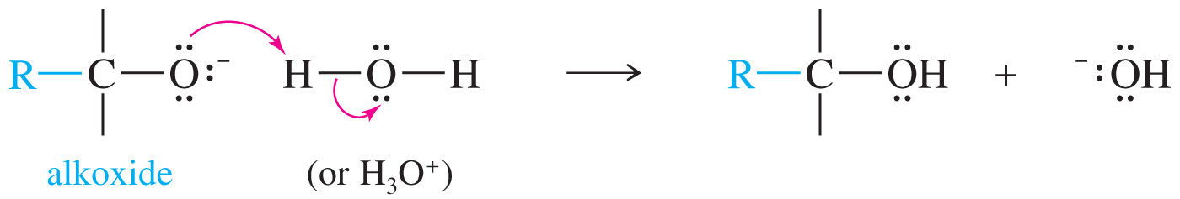
Mechanism of Addition of the Organometallic to the Carbonyl

Slide 40
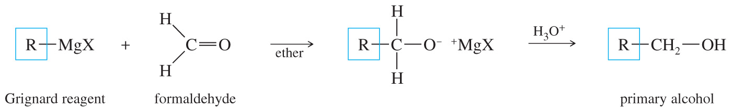
Formation of Primary Alcohols Using Organometallics
Reaction of a Grignard with formaldehyde will produce a primary alcohol after protonation.

Slide 41
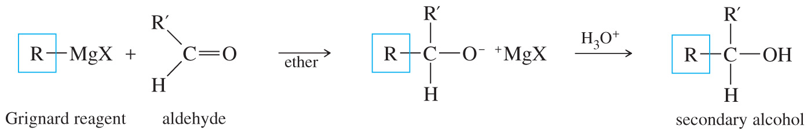
Synthesis of 2° Alcohols
Addition of a Grignard reagent to an aldehyde followed by protonation will produce a secondary alcohol.

Slide 42
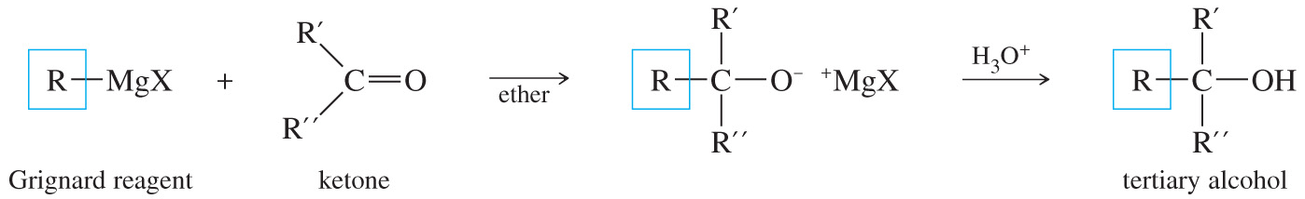
Synthesis of 3° Alcohols
Tertiary alcohols can be easily obtained by addition of a Grignard to a ketone followed by protonation with dilute acid.

Slide 43
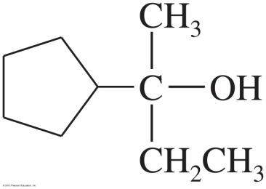
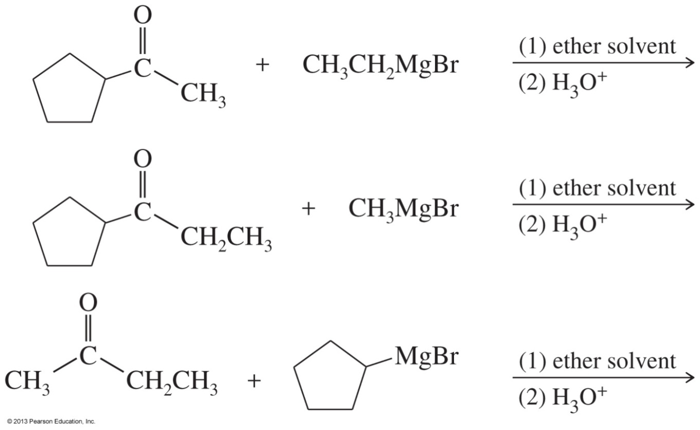
Solved Problem 2
Show how you would synthesize the following alcohol from compounds containing no more than five carbon atoms.
Solution
This is a tertiary alcohol; any one of the three alkyl groups might be added in the form of a Grignard reagent. We can propose three combinations of Grignard reagents with ketones:

Slide 44
Solved Problem 2 (Continued)
Solution (Continued)
Any of these three syntheses would probably work, but only the third begins with fragments containing no more than five carbon atoms. The other two syntheses would require further steps to generate the ketones from compounds containing no more than five carbon atoms.

Slide 45
Grignard Reactions with
Acid Chlorides and Esters
Use two moles of Grignard reagent.
The product is a tertiary alcohol with two identical alkyl groups.
Reaction with one mole of Grignard reagent produces a ketone intermediate, which reacts with the second mole of Grignard reagent.

Slide 46
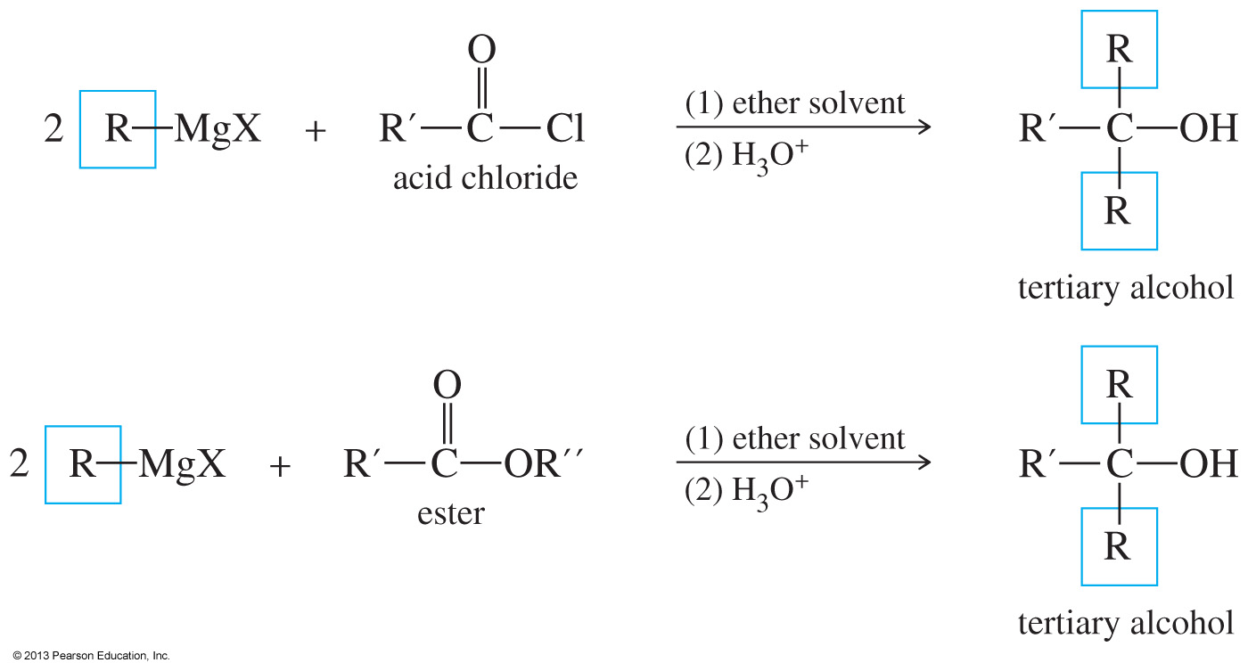
Reaction of Grignards with Carboxylic Acid Derivatives

Slide 47
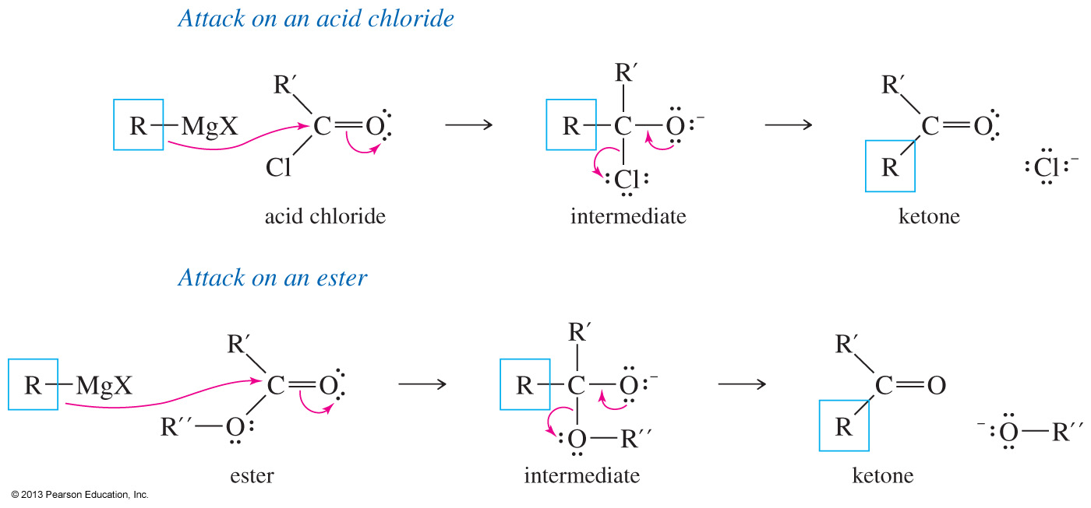
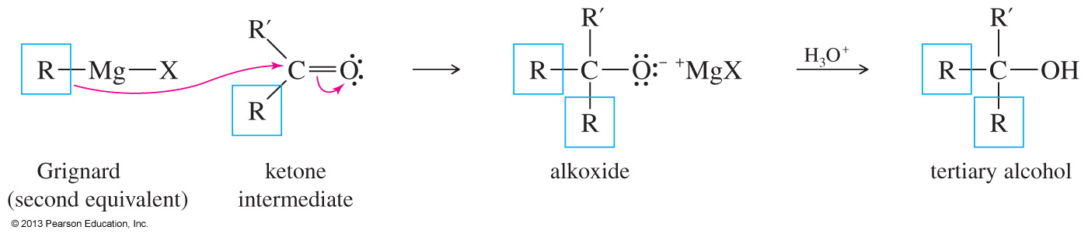
Mechanism with Acid Chloride
The organometallic attacks the carbonyl. The intermediate expels the chloride, forming a ketone.
The ketone reacts with a second equivalent of organometallic and forms a tertiary alkoxide. Protonation of the alkoxide forms the alcohol.

Slide 48
Mechanism with Esters
The organometallic attacks the carbonyl. The intermediate expels the chloride, forming a ketone.
The ketone reacts with a second equivalent of organometallic and forms a tertiary alkoxide. Protonation of the alkoxide forms the alcohol.

Slide 49
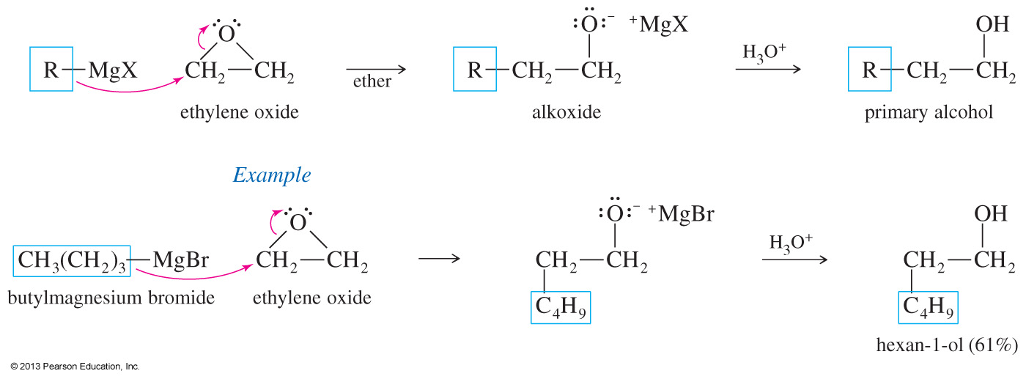
Addition to Ethylene Oxide
Grignard and lithium reagents will attack epoxides (also called oxiranes) and open them to form alcohols.
This reaction is favored because the ring strain present in the epoxide is relieved by the opening.
The reaction is commonly used to extend the length of the carbon chain by two carbons.

Slide 50

Lithium Dialkylcuprates
If you want to couple two groups together efficiently, you can use an organocopper reagent (a lithium dialkylcuprate) to couple an alkyl halide.

Slide 51
Limitations of Organometallics
Grignards and organolithiums are good nucleophiles, but in the presence of acidic protons they will act as strong bases.
  O—H, N—H, S—H, C≡C—H
In the presence of multiple bonds with a strong electronegative element, the organometallics will act as a nucleophile.
  C=O, CN, C≡N, S=O, N=O

Slide 52
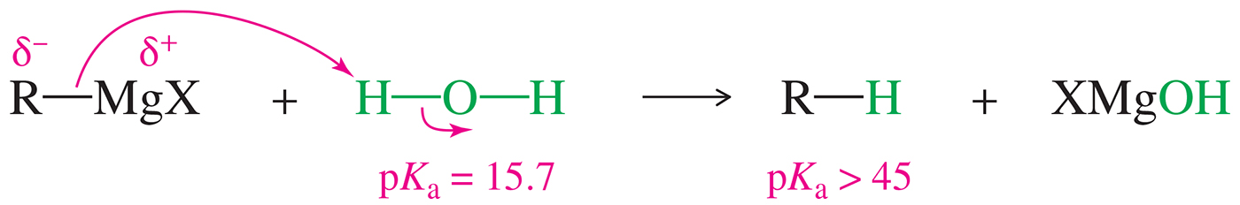
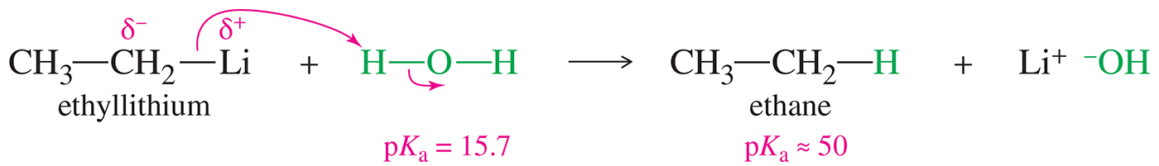
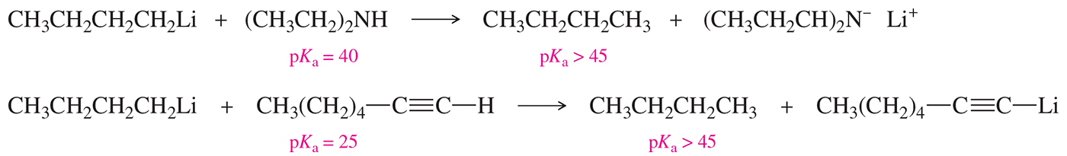
Limitations

Slide 53
Reduction of Carbonyl
Hydride reagents add a hydride ion (H–), reducing the carbonyl group to an alkoxide ion with no additional carbon atoms.
Protonation gives the alcohol.
Reduction of aldehyde yields 1° alcohol.
Reduction of ketone yields 2° alcohol.

Slide 54
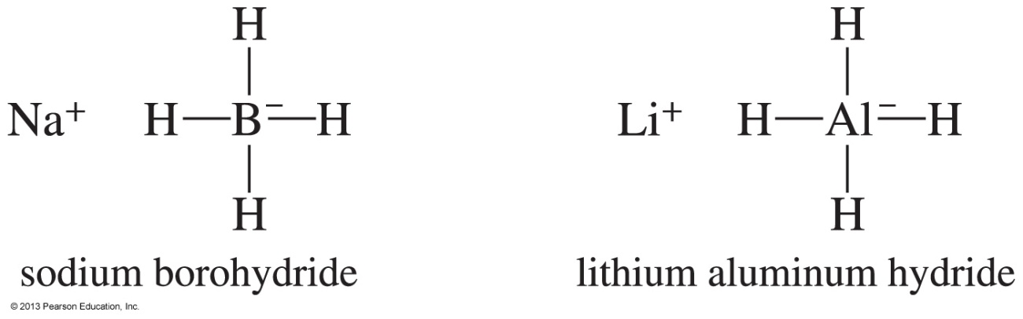
Hydride Reagents
Called complex hydrides because they do not have a simple hydride structure such as Na⁺H– or Li⁺H–
The bonding to the metal makes the hydrides more nucleophilic and less basic.

Slide 55
Sodium Borohydride
NaBH₄ is a source of hydrides (H–).
Hydride attacks the carbonyl carbon, forming an alkoxide ion.
Then the alkoxide ion is protonated by dilute acid.
Only reacts with aldehydes or ketones, not with esters or carboxylic acids.
Can reduce a ketone or an aldehyde in the presence of an acid or an ester

Slide 56
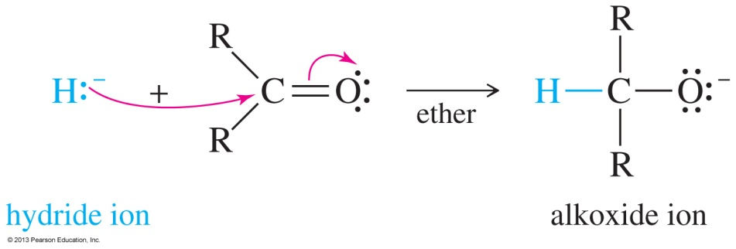
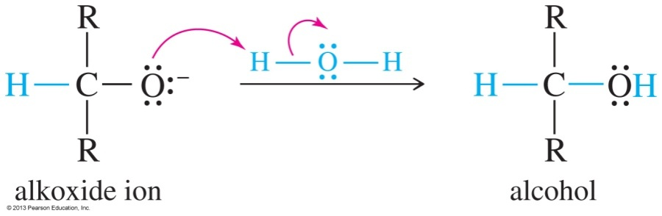
Mechanism of
Hydride Reduction
Reaction 1: The hydride attacks the carbonyl of the aldehyde or the ketone, forming an alkoxide ion.
Reaction 2: Protonation of the intermediate forms the alcohol.

Slide 57
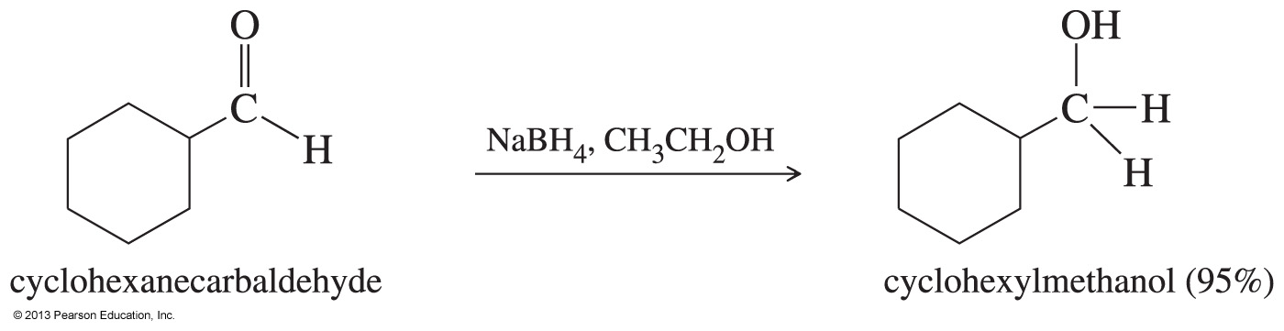
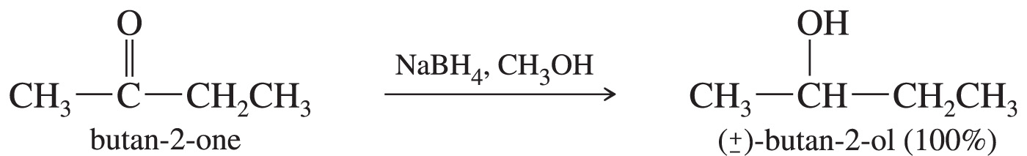
Examples of
NaBH₄ Reduction

Slide 58
Lithium Aluminum Hydride
Stronger reducing agent than sodium borohydride
Dangerous to work with
Reduces ketones and aldehydes into the corresponding alcohol
Converts esters and carboxylic acids to 1° alcohols

Slide 59
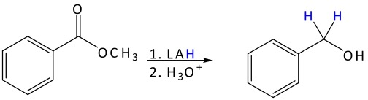
Reduction with LiAlH₄
The LiAlH₄ (or LAH) will add two hydrides to the ester to form the primary alkyl halide.
The mechanism is similar to the attack of Grignards on esters.

Slide 60
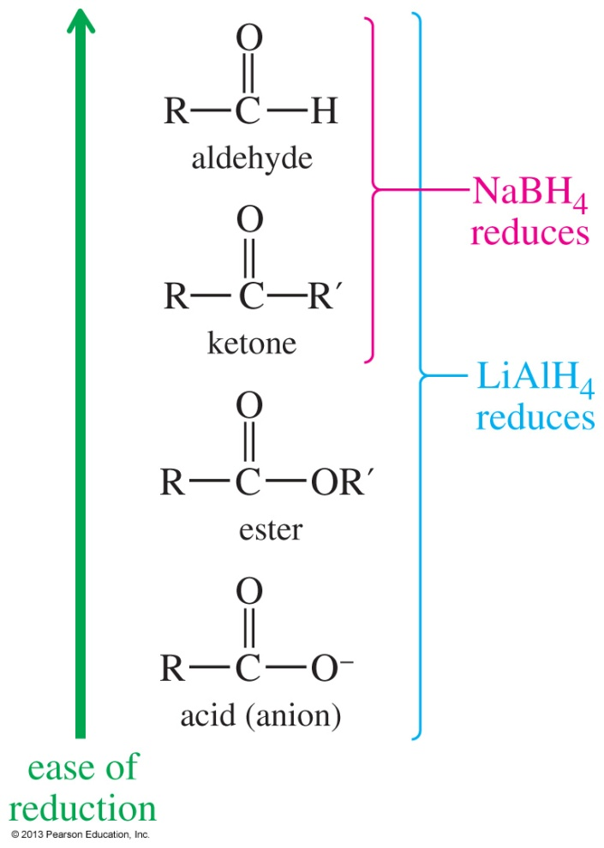
Reducing Agents
NaBH₄ can reduce aldehydes and ketones but not esters and carboxylic acids.
LiAlH₄ is a stronger reducing agent and will reduce all carbonyls.

Slide 61
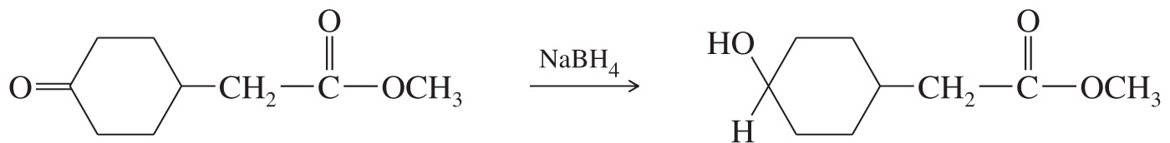
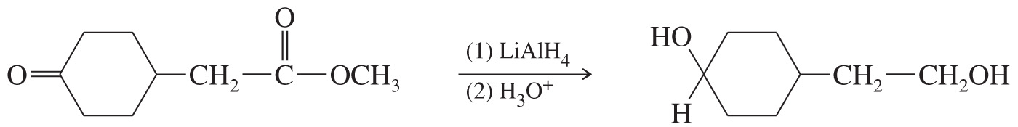
Comparison

Slide 62
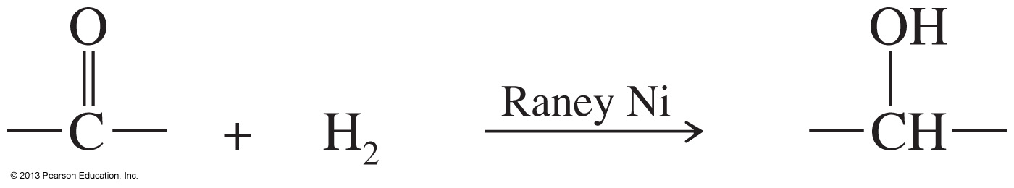
Catalytic Hydrogenation
Raney nickel is a hydrogen-rich nickel powder that is more reactive than Pd or Pt catalysts.
This reaction is not commonly used because it will also reduce double and triple bonds that may be present in the molecule.

Slide 63
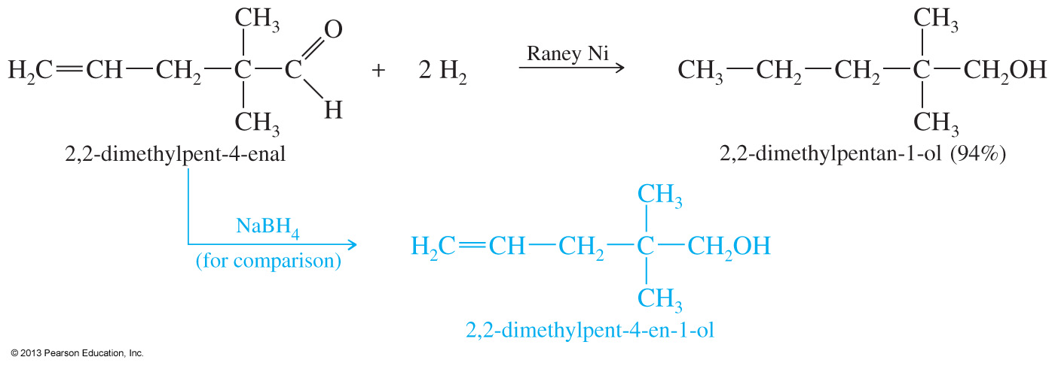
Selective Reductions
Hydride reagents are more selective, so they are used more frequently for carbonyl reductions.

Slide 64
Thiols (Mercaptans)
Sulfur analogues of alcohols are called thiols.
The —SH group is called a mercapto group.
Named by adding the suffix -thiol to the alkane name.

Slide 65
Nomenclature
CH₃—SH CH₃CH₂CH₂CH₂—SH HS—CH₂CH₂—OH
methanethiol
methyl mercaptan
butane-1-thiol
n-butyl mercaptan
2-mercaptoethanol
Common names are formed like those of alcohols, using the name of the alkyl group with the word mercaptan.

Slide 66
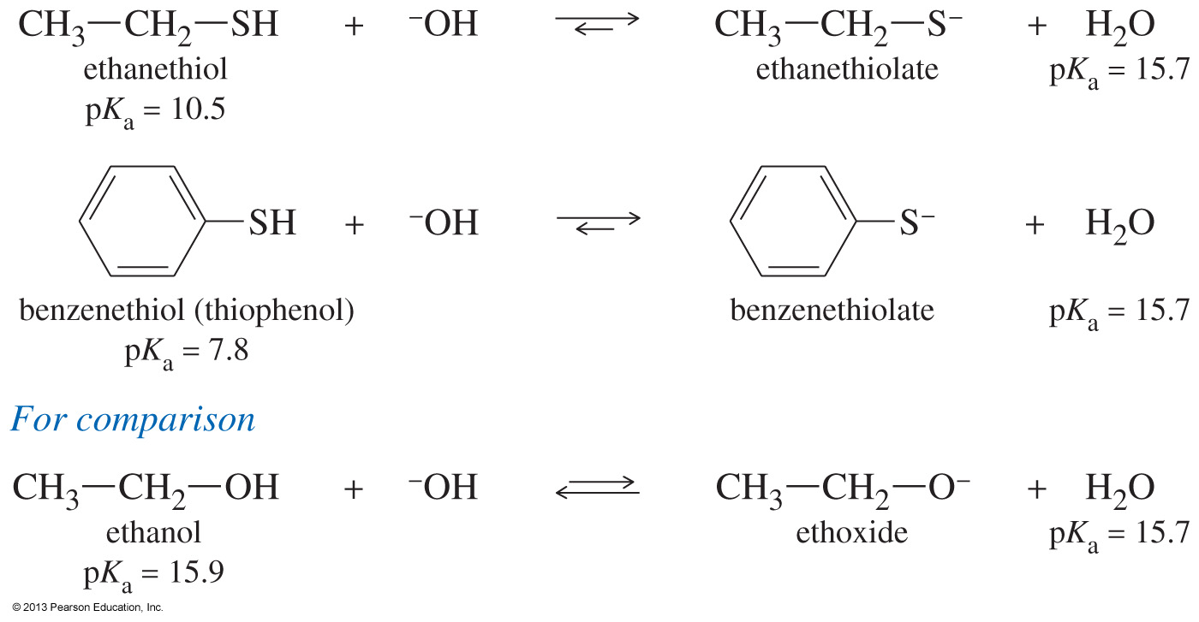
Acidity of Thiols
Thiols are more acidic than alcohols.

Slide 67

Synthesis of Thiols
Thiols are commonly made by an S_{N}2 reaction, so primary alkyl halides work better.
To prevent a second alkylation, use a large excess of sodium hydrosulfide with the alkyl halide.

Slide 68

Thiol Oxidation
Thiols can be oxidized to form disulfides. The disulfide bond can be reduced back to the thiols with a reducing agent.

