Slide 1
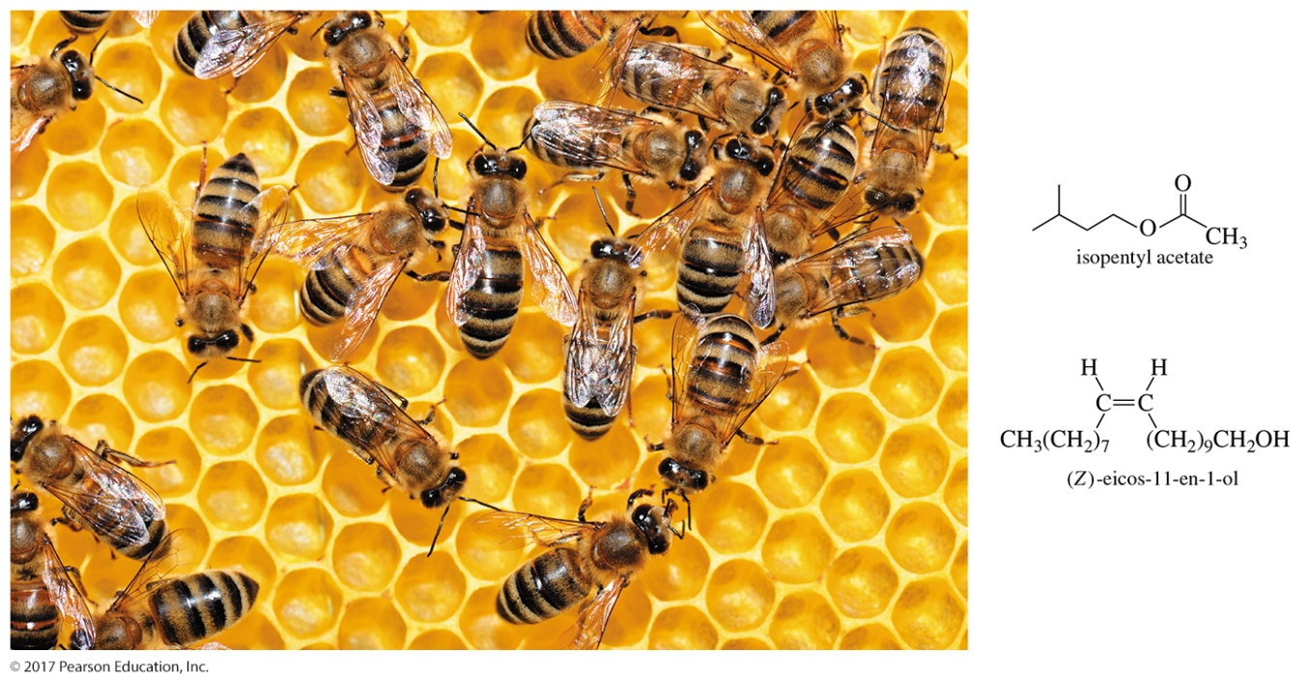
Organic Chemistry,
9th Edition
L. G. Wade, Jr.
Chapter 11
Lecture
Reactions of Alcohols
Chad Snyder, PhD
Grace College
© 2017 Pearson Education, Inc.

Slide 2
Types of Alcohol Reactions
Dehydration to alkene
Oxidation to aldehyde, ketone
Substitution to form alkyl halide
Reduction to alkane
Esterification
Tosylation
Williamson synthesis of ether

Slide 3
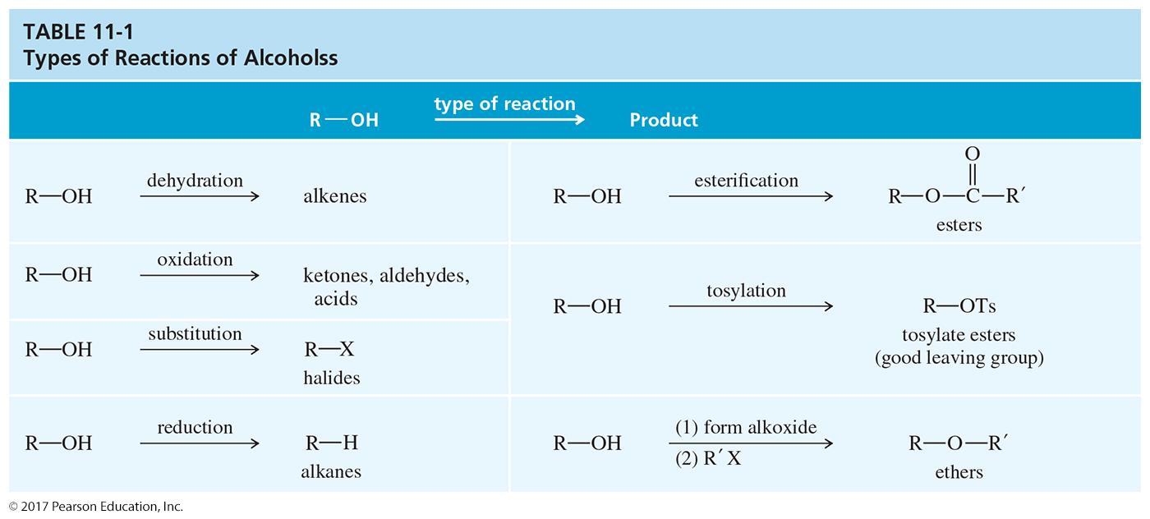
Summary Table

Slide 4
Oxidation States
Inorganic chemistry:
  Oxidation is a loss of electrons.
  Reduction is a gain of electrons.
Organic chemistry
  Oxidation: Gain of O, O₂, or X₂; loss of H₂
  Reduction: Gain of H₂ (or H–); loss of O or O₂; and loss of X₂
  Neither: The gain or loss of H⁺, H₂O, –OH, HX, etc. is neither an oxidation nor a reduction.

Slide 5
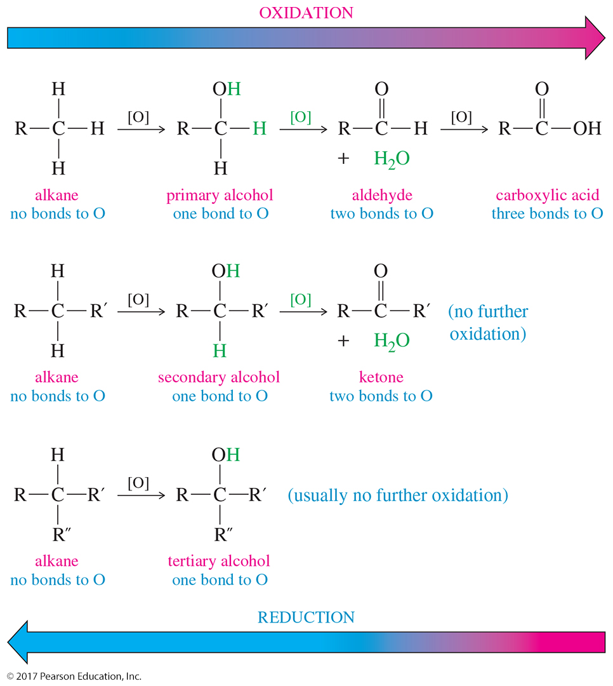
Oxidation States of Carbons

Slide 6
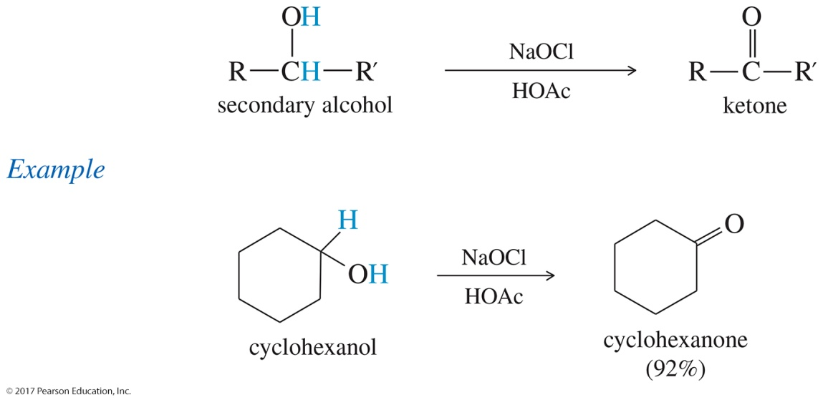
Oxidation of 2° Alcohols
A 2° alcohol becomes a ketone.
Traditional oxidizing agents are chromium- based reagents such as Na₂Cr₂O₇ in H₂SO₄.
Active reagent probably is H₂CrO₄ or HCrO₄–.
Color change is orange to greenish-blue.
Chromium is highly toxic and difficult to dispose of properly.

Slide 7
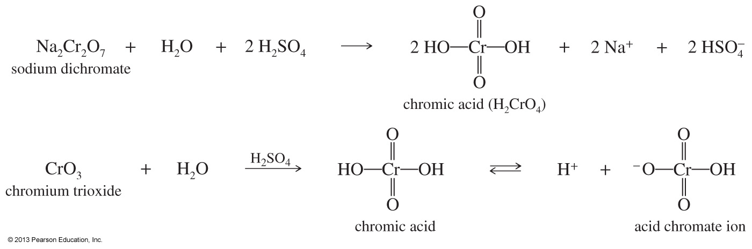
Formation of the Acid
Chromate Ion
CrO₃ will also produce chromic acid in the presence of H₂SO₄ and H₂O.

Slide 8
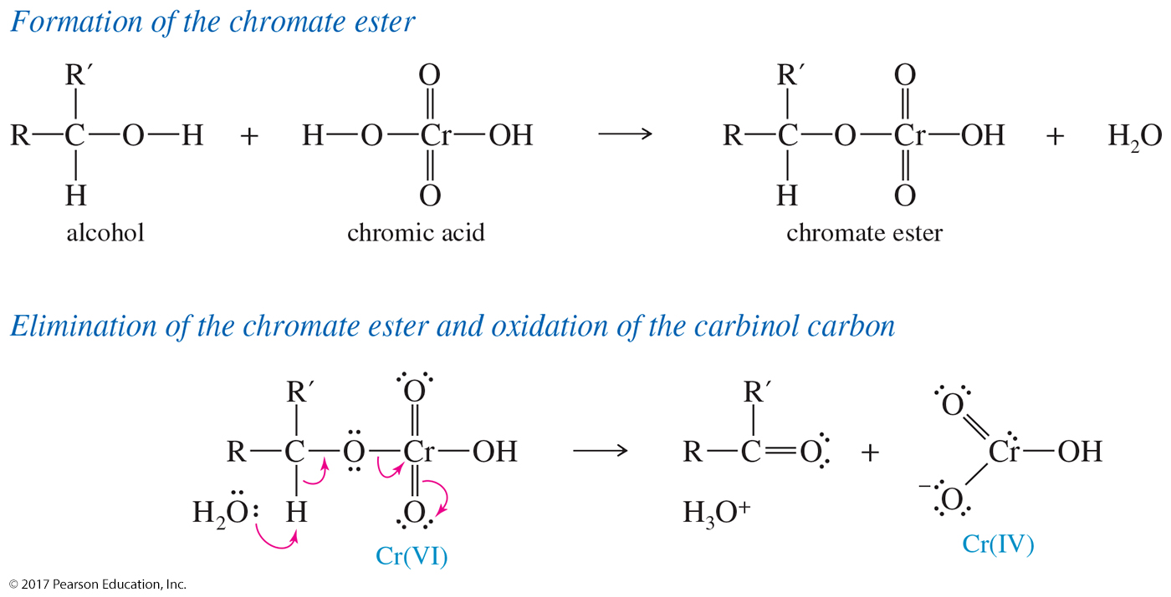
Oxidation Mechanism

Slide 9
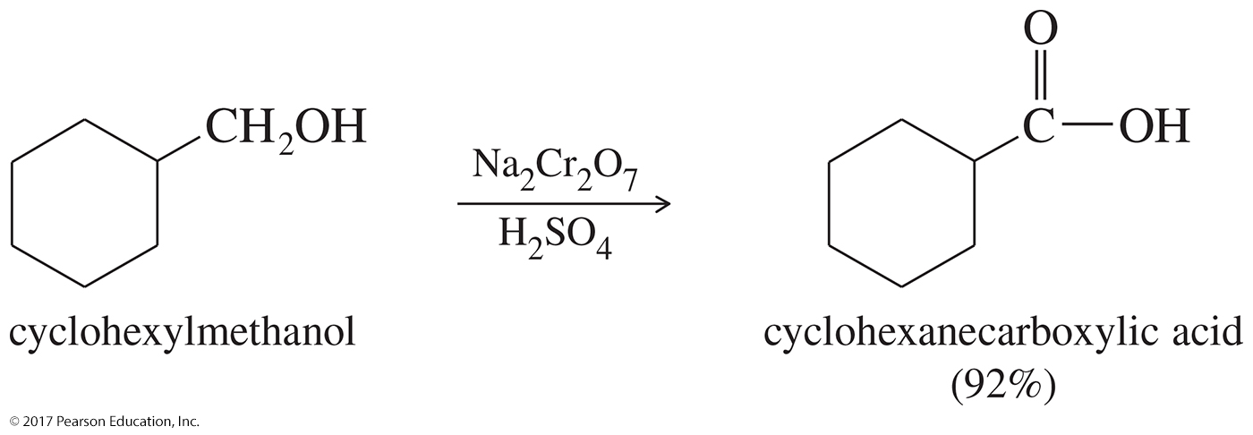
Oxidation of 1° Alcohols to Carboxylic Acids
Chromic acid reagent oxidizes primary alcohols to carboxylic acids.
The oxidizing agent is too strong to stop at the aldehyde.

Slide 10
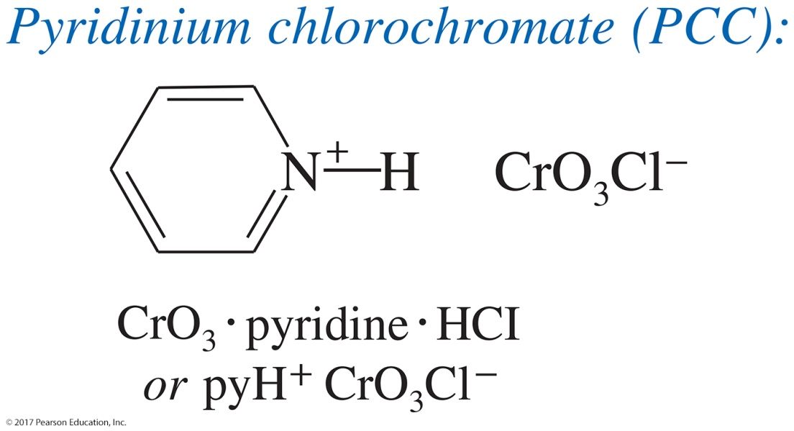
Pyridinium Chlorochromate (PCC)
PCC is a complex of chromium trioxide, pyridine, and HCl.
It oxidizes primary alcohols to aldehydes.
It oxidizes secondary alcohols to ketones.

Slide 11
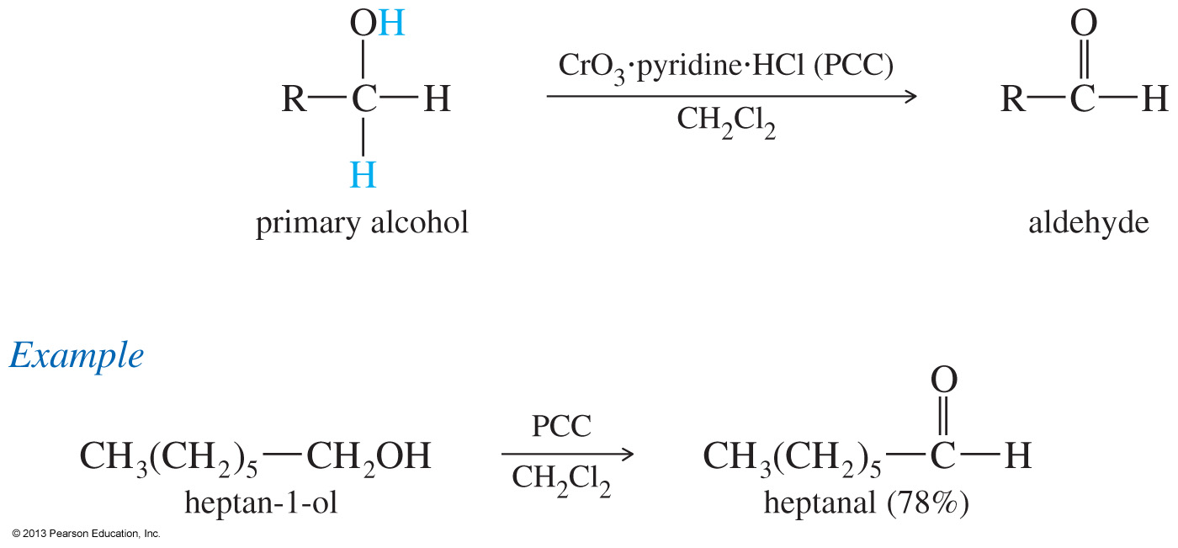
Pyridinium Chlorochromate (PCC)

Slide 12
3° Alcohols Cannot Be Oxidized
Carbon does not have hydrogen, so oxidation is difficult and involves the breakage of a C—C bond.
Chromic acid test is for primary and secondary alcohols because tertiary alcohols do not react.

Slide 13
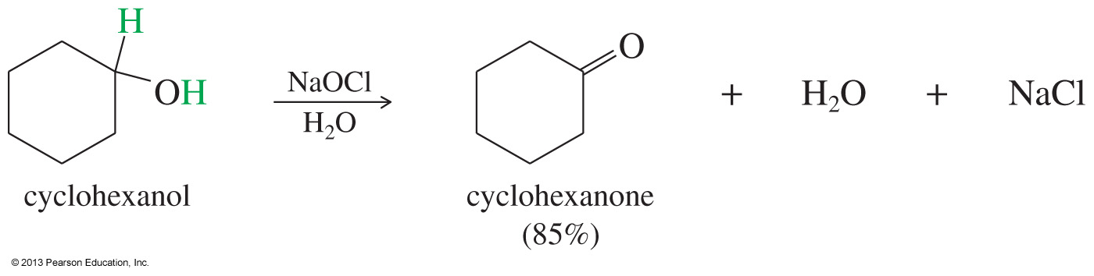
Sodium Hypochlorite (NaOCl)
Sodium hypochlorite (household bleach) can oxidize alcohols without heavy metals or generating hazardous waste.
This is a much better option for acid-sensitive compounds.

Slide 14
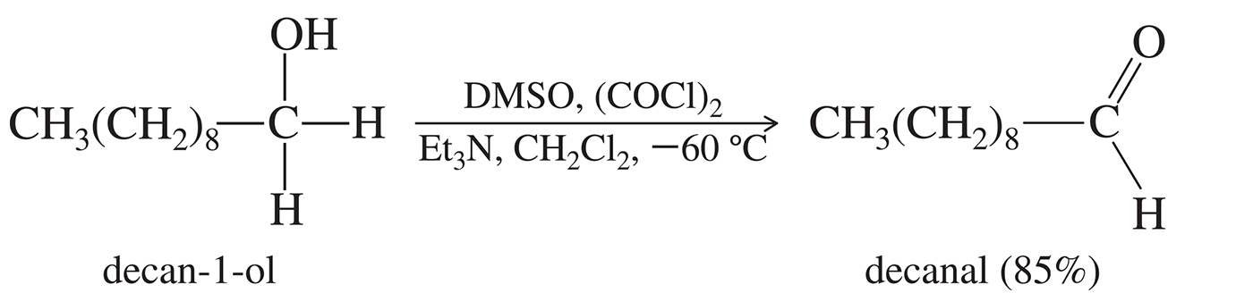
Swern Oxidation
Dimethylsulfoxide (DMSO), with oxalyl chloride and hindered base, oxidizes 2° alcohols to ketones and 1° alcohols to aldehydes.

Slide 15
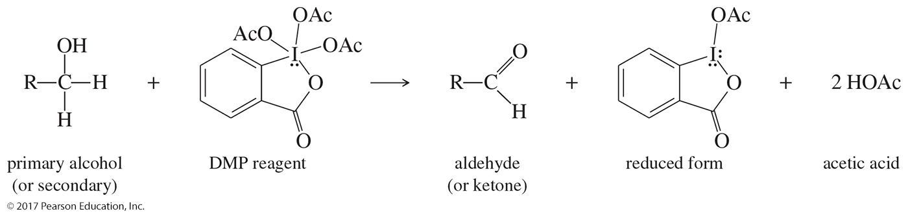
Dess–Martin Periodinane (DMP)
Can oxidize primary alcohols to aldehydes and secondary alcohols to ketones
The reaction with DMP takes place under mild conditions (room temperature, neutral pH) and gives excellent yields.

Slide 16
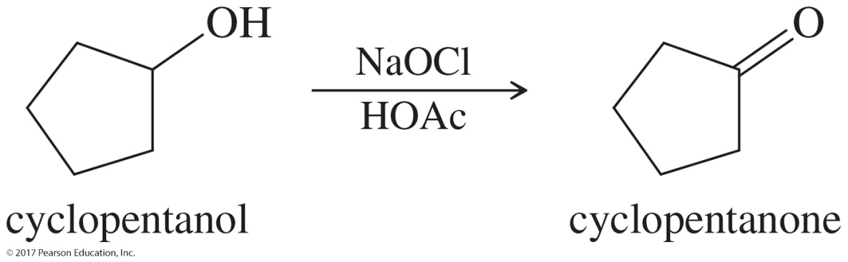
Solved Problem 1
Suggest the most appropriate method for each of the following laboratory syntheses:
(a) cyclopentanol ––––––> cyclopentanone
Solution
Many reagents are available to oxidize a simple secondary alcohol to a ketone. For a laboratory synthesis, however, dehydrogenation is not practical, and cost is not as large a factor as it would be in industry. Most labs would have chromium trioxide or sodium dichromate available, and the chromic acid oxidation would be simple. PCC and the Swern oxidation would also work, although these reagents are more complicated to prepare and use.

Slide 17
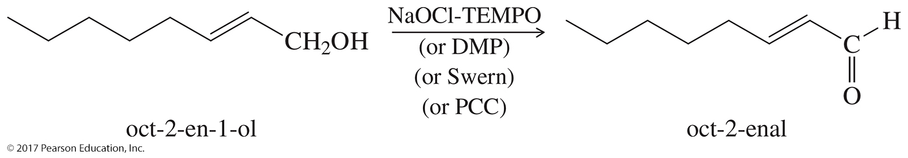
Solved Problem 1 (Continued)
Suggest the most appropriate method for each of the following laboratory syntheses:
(b) 2-octen-l-ol ––––––> 2-octenal (structure below)
Solution
This synthesis requires more finesse. The aldehyde is easily over-oxidized to a carboxylic acid, and the double bond reacts with oxidants such as KMnO₄. Our choices are limited to PCC or the Swern oxidation.

Slide 18
Biological Oxidation
The liver produces alcohol dehydrogenase (ADH), which is an enzyme that catalyzes the oxidation of ethanol.
The oxidizing agent is nicotinamide adenine dinucleotide (NAD⁺).
Ethanol oxidizes to acetaldehyde, then acetic acid, which is a normal metabolite.

Slide 19
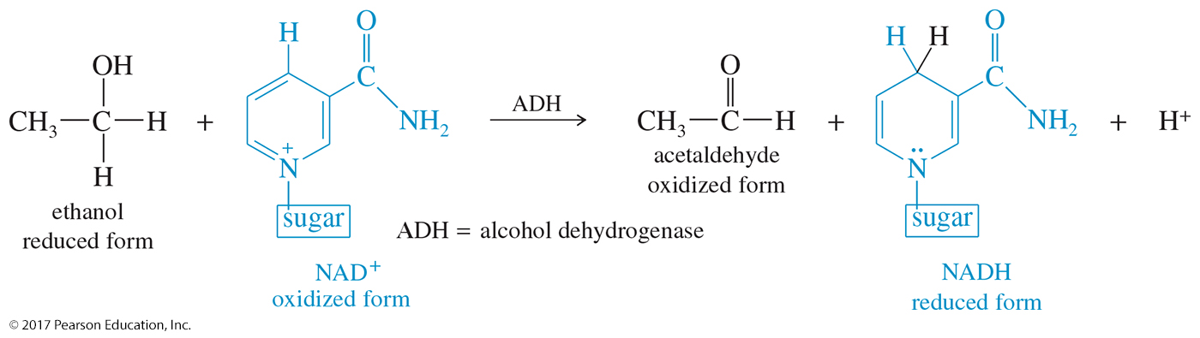
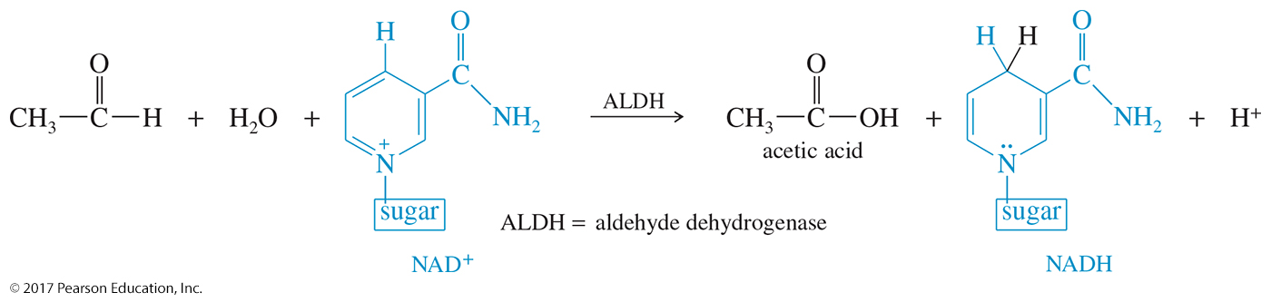
Enzymatic Oxidation of Ethanol
Ethanol oxidizes to acetaldehyde, then acetic acid, which is a normal metabolite.

Slide 20
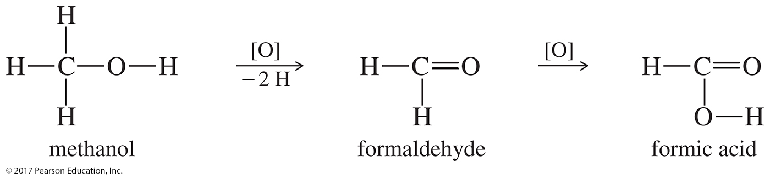
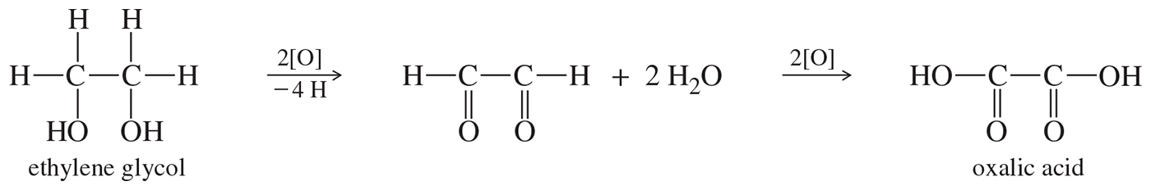
Biological Oxidation of
Methanol and Glycol
Methanol oxidizes to formaldehyde, then formic acid, which is more toxic than methanol.
Ethylene glycol oxidizes to oxalic acid, which is toxic.
Treatment for poisoning is excess ethanol.

Slide 21
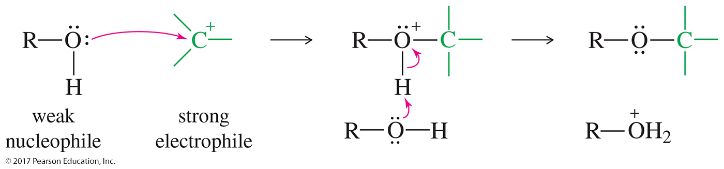
Alcohol As a Nucleophile
Alcohols (ROH) are weak nucleophiles.
Alkoxides (RO–) are strong nucleophiles.
New O—C bond forms; O—H bond breaks.

Slide 22
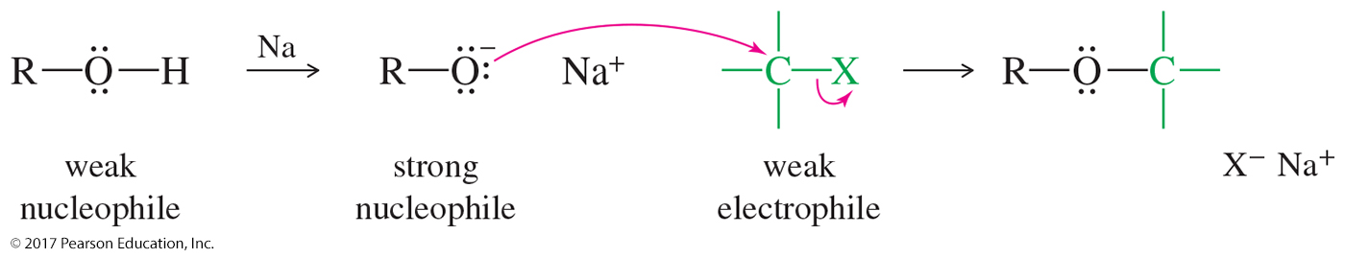
Alcohol As an Electrophile
Alcohols are weak electrophiles because the OH– is not a good leaving group.
Protonation of the hydroxyl group converts it into a good leaving group (H₂O).

Slide 23
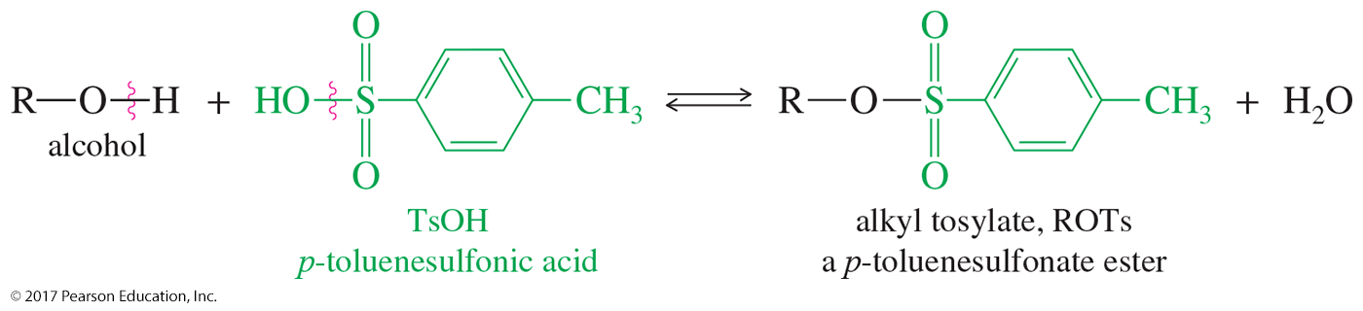
Tosylate Esters
Alcohols can be converted to tosylate esters (ROTs) through a condensation with
p-toluenosulfonic acid.
The tosylate group is an excellent leaving group.

Slide 24
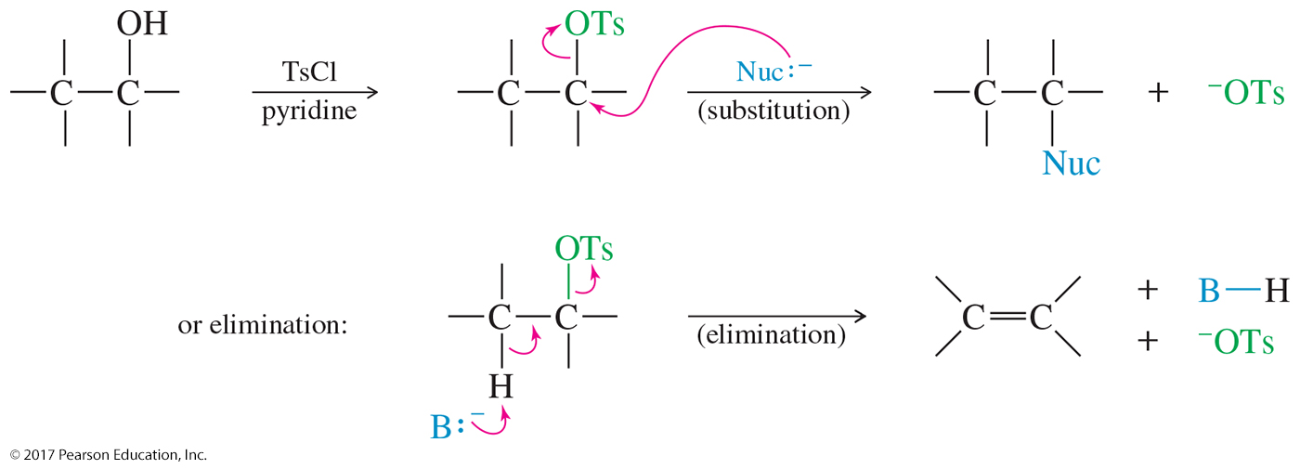
Substitution and Elimination Reactions Using Tosylates

Slide 25
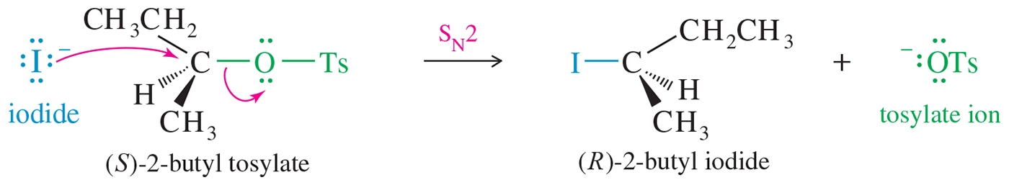
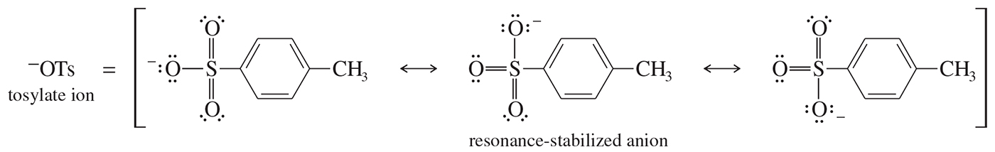
S_{N}2 Reactions with Tosylates
The reaction shows the S_{N}2 displacement of the tosylate ion (–OTs) from (S)-2-butyl tosylate with inversion of configuration.
The tosylate ion is a particularly stable anion, with its negative charge delocalized over three oxygen atoms.

Slide 26
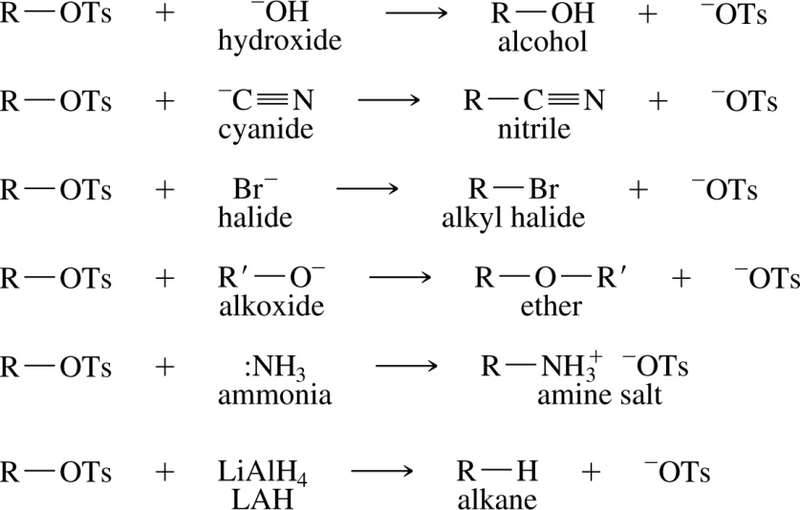
Summary of Tosylate Reactions

Slide 27
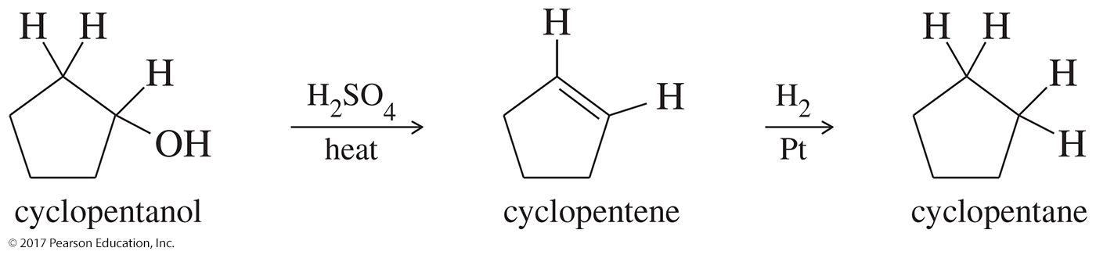
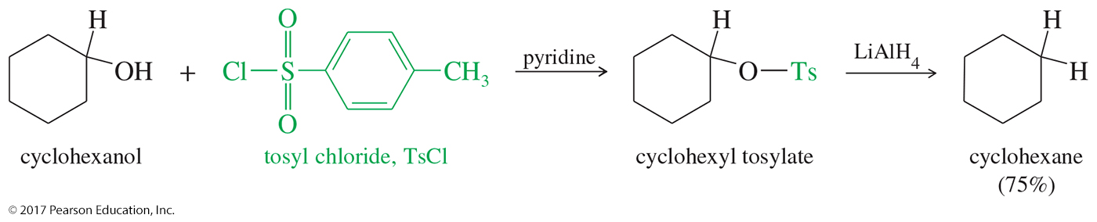
Reduction of Alcohols
Dehydrate with concentrated H₂SO₄, then add H₂.
Make a tosylate, then reduce it with LiAlH₄.

Slide 28
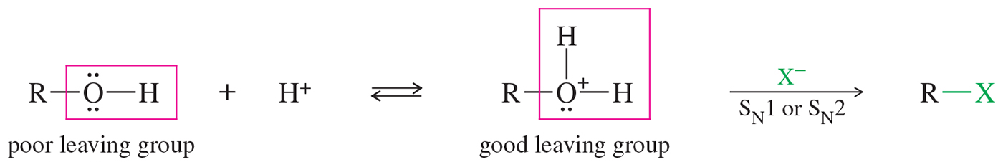
Reaction of Alcohols with Acids
The hydroxyl group is protonated by an acid to convert it into a good leaving group (H₂O).
Once the alcohol is protonated, a substitution or elimination reaction can take place.

Slide 29
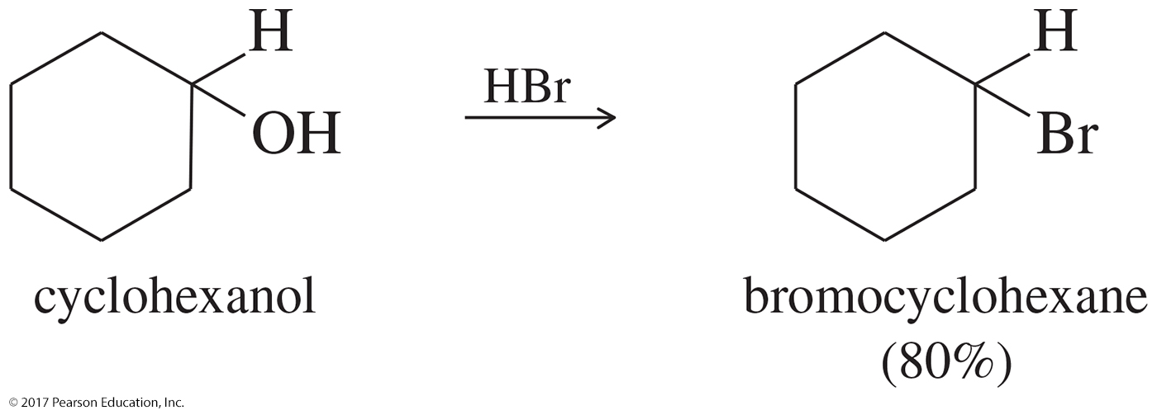
Reaction of Alcohols with HBr
–OH of alcohol is protonated.
–OH₂⁺ is good leaving group.
3° and 2° alcohols react with Br– via S_{N}1.
1° alcohols react via S_{N}2.

Slide 30
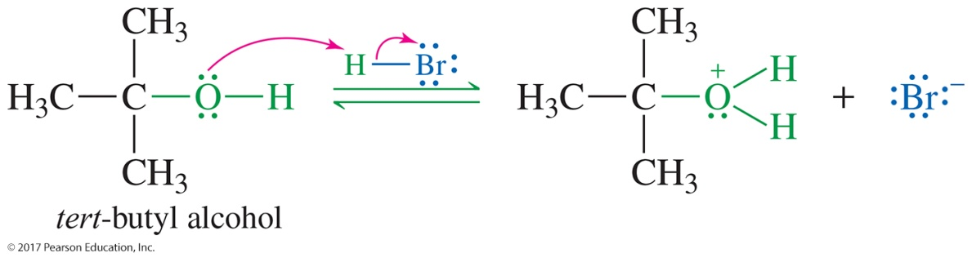
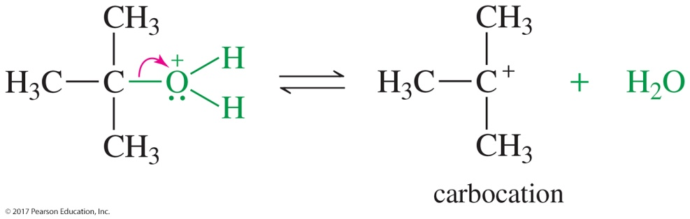
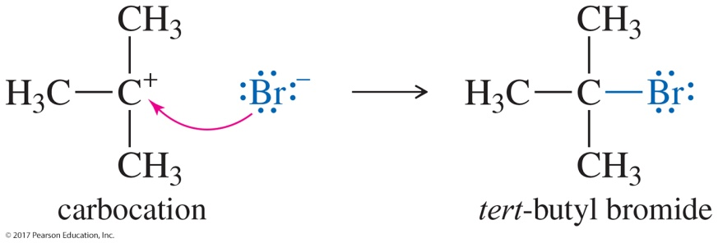
S_{N}1 Mechanism
Step 1: Protonation
Step 2: Formation of the carbocation
Step 3: Bromide attacks the carbocation.

Slide 31
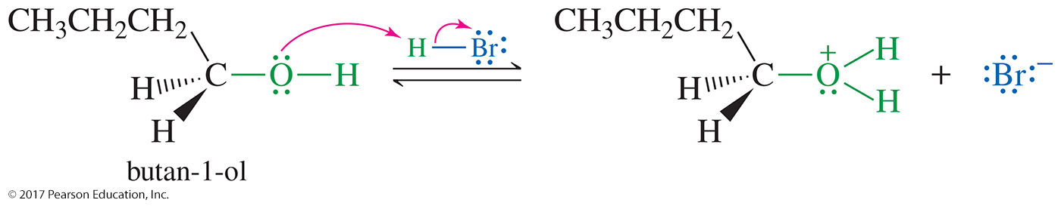
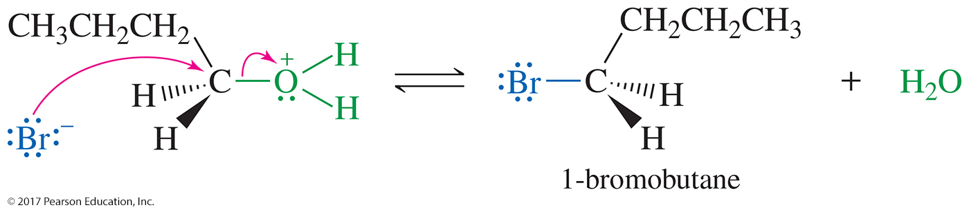
S_{N}2 Mechanism

Slide 32
Reaction with HCl
Chloride is a weaker nucleophile than bromide because it is small and less polarizable.
Addition of ZnCl₂, which bonds strongly with
oxygen of the OH, promotes the reaction.
Lucas test: ZnCl₂ in concentrated HCl
  1° alcohols react slowly or not at all.
  2° alcohols react in 1–5 minutes.
  3° alcohols react in less than 1 minute.

Slide 33
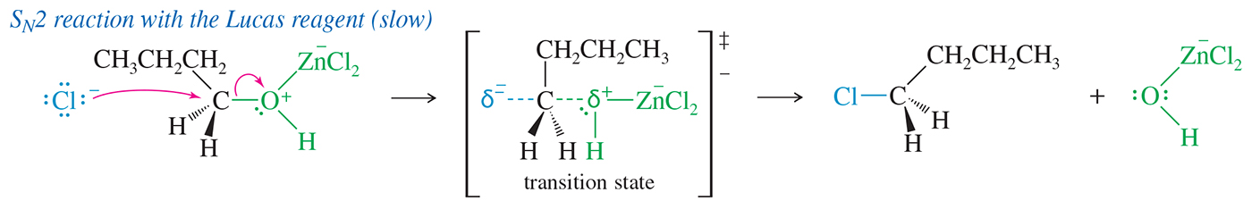
S_{N}2 Reaction with the
Lucas Reagent
Primary alcohols react with the Lucas reagent (HCl and ZnCl₂) by the S_{N}2 mechanism.
Reaction is very slow. The reaction can take from several minutes to several days.

Slide 34
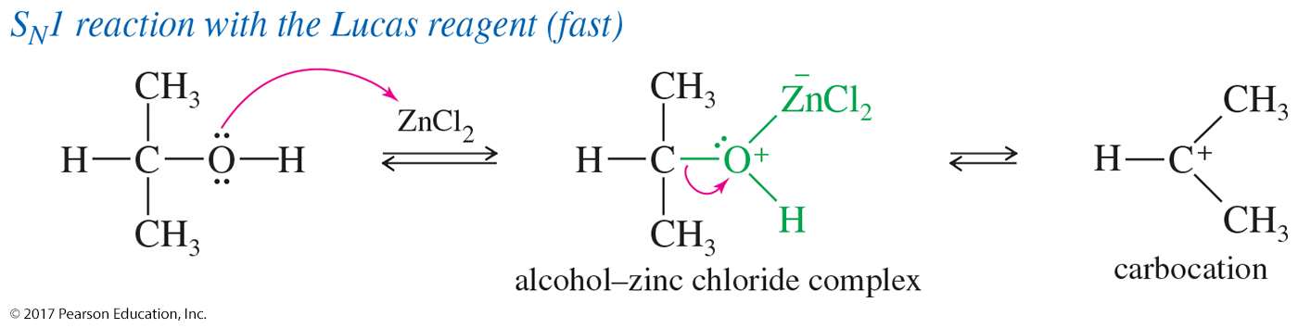
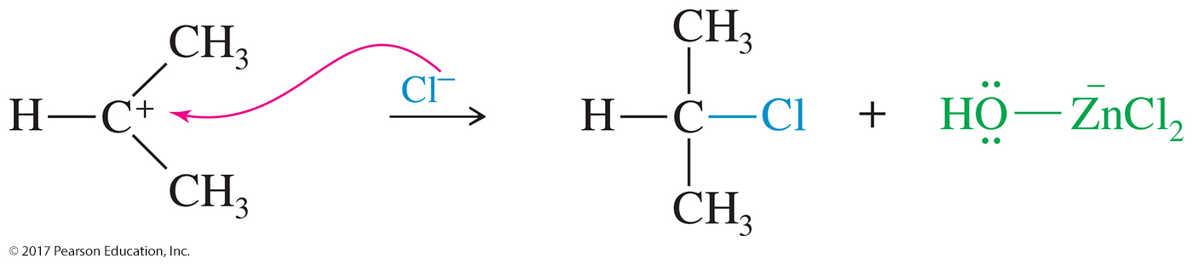
S_{N}1 Reaction with the
Lucas Reagent
Secondary and tertiary alcohols react with the Lucas reagent (HCl and ZnCl₂) by the S_{N}1 mechanism.

Slide 35
Limitations of HX Reactions
Poor yields of alkyl chlorides from primary and secondary alcohols
Elimination competes with substitution.
Carbocation intermediate may undergo a rearrangement.
Limited ability to make alkyl halides

Slide 36
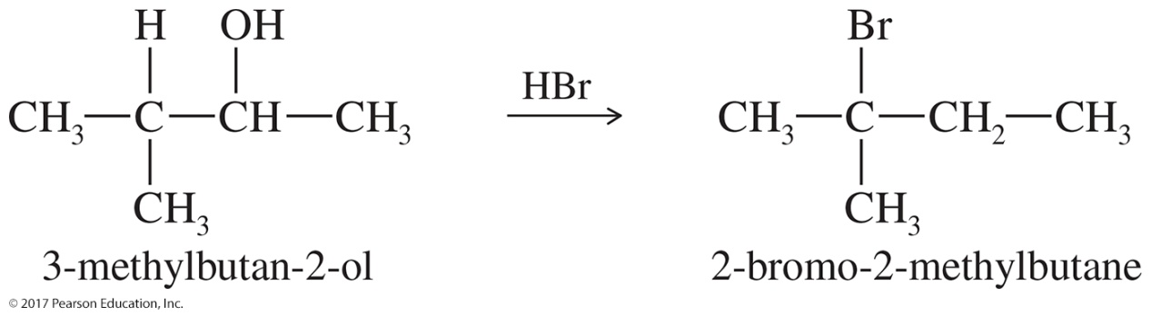
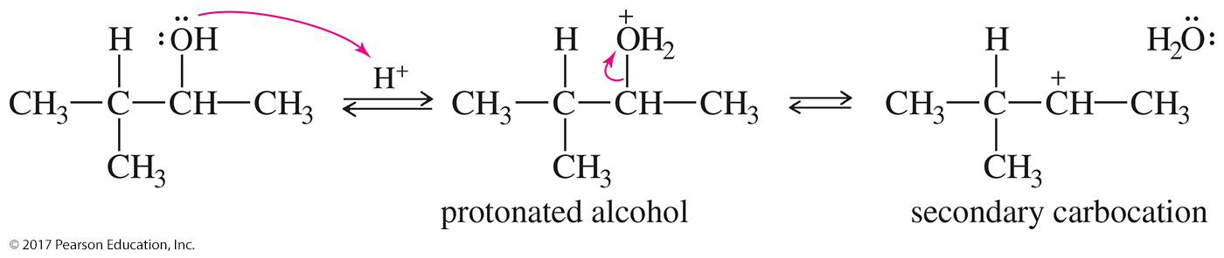
Solved Problem 2
When 3-methyl-2-butanol is treated with concentrated HBr, the major product is 2-bromo-2-methylbutane. Propose a mechanism for the formation of this product.
Solution
The alcohol is protonated by the strong acid. This protonated secondary alcohol loses water to form a secondary carbocation.

Slide 37
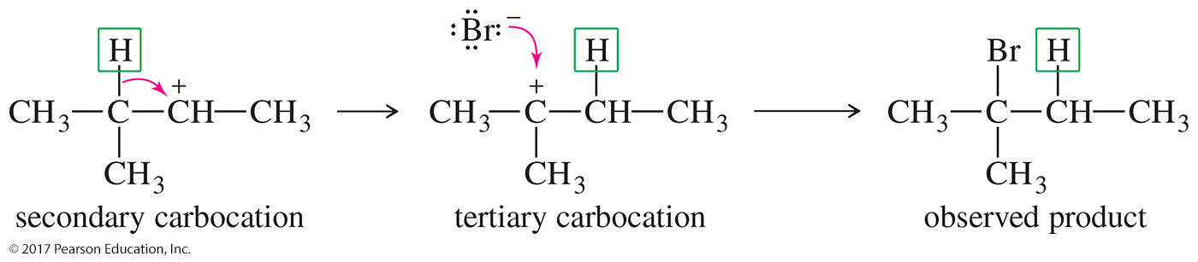
Solved Problem 2 (Continued)
Solution (Continued)
A hydride shift transforms the secondary carbocation into a more stable tertiary cation. Attack by bromide leads to the observed product.

Slide 38
Reactions with
Phosphorus Halides
Good yields with 1° and 2° alcohols
PCl₃ for alkyl chlorides (but SOCl₂ better)
PBr₃ for alkyl bromides
P and I₂ for alkyl iodides (PI₃ not stable)

Slide 39
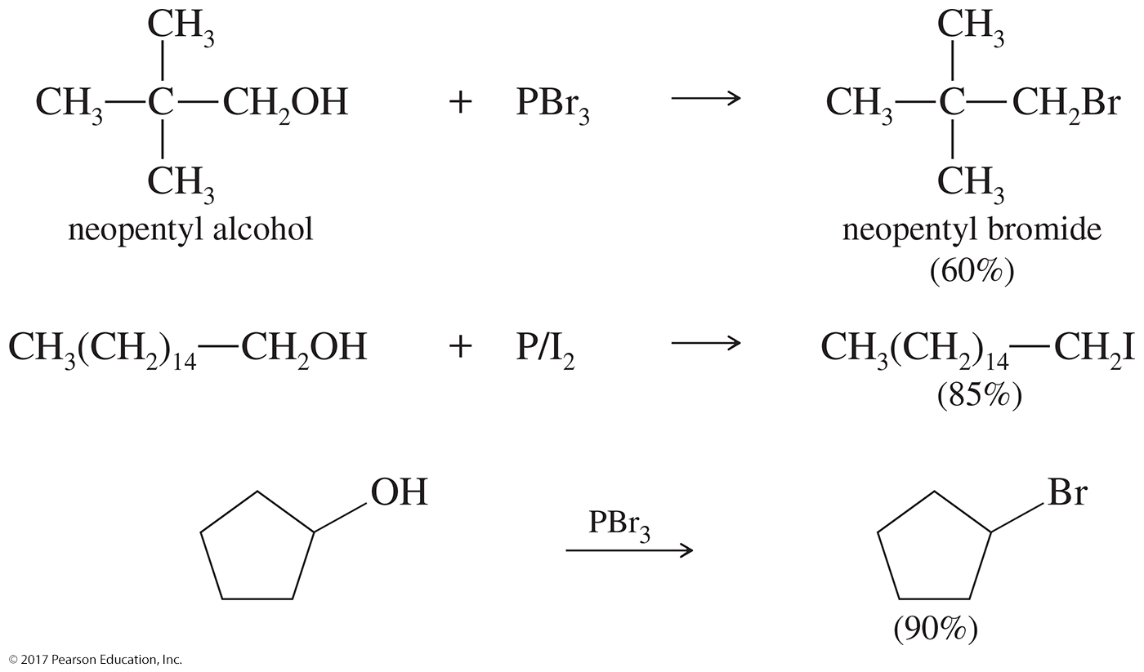
Examples

Slide 40
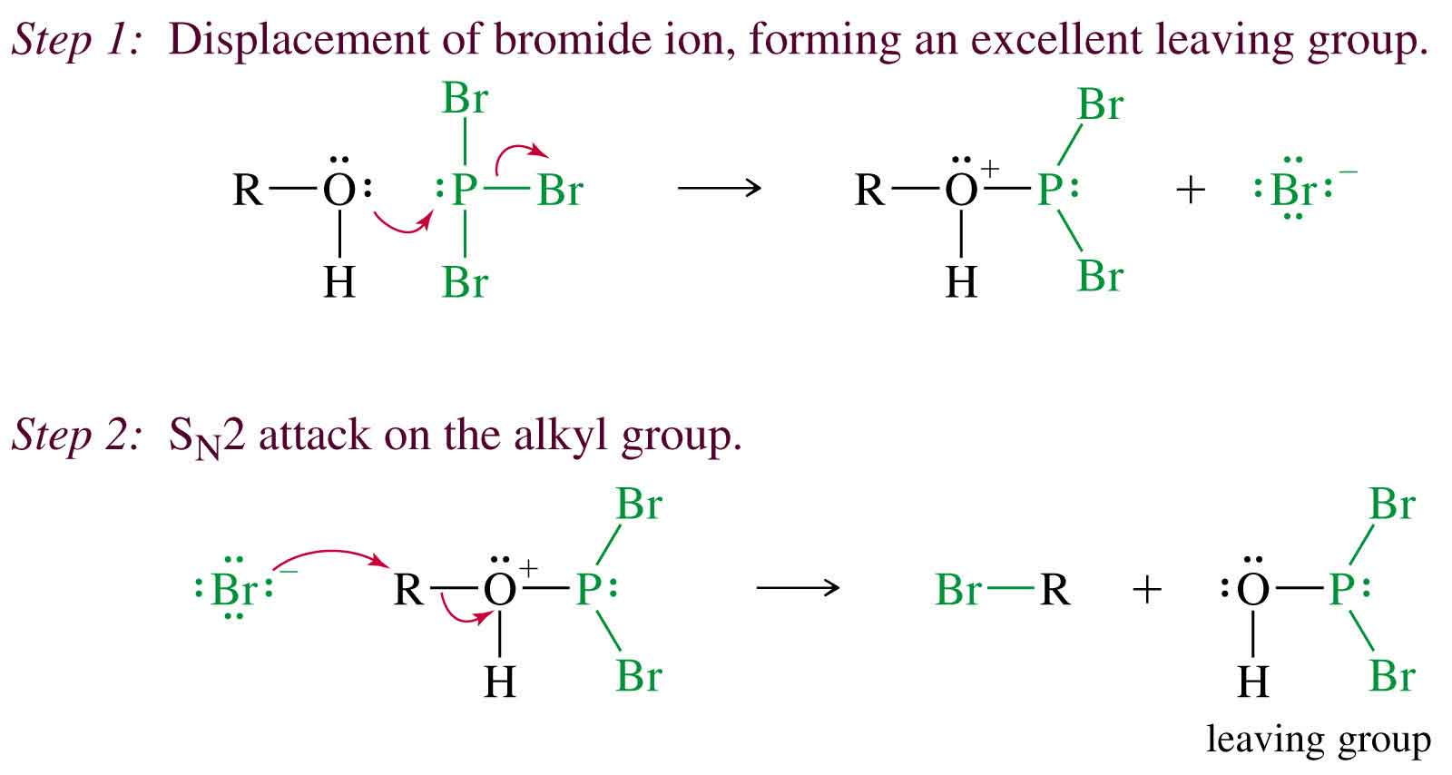
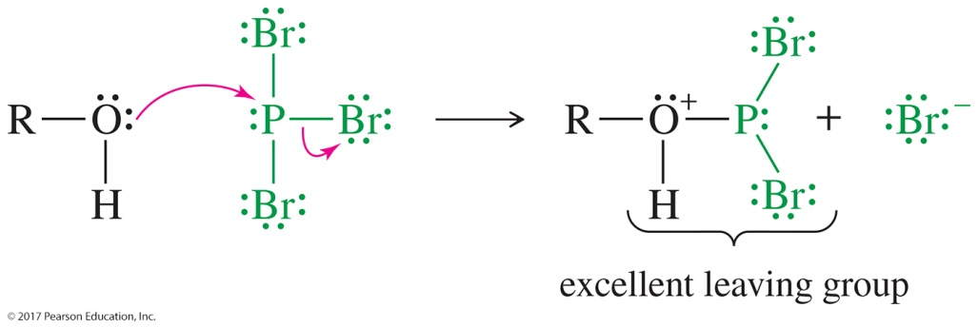
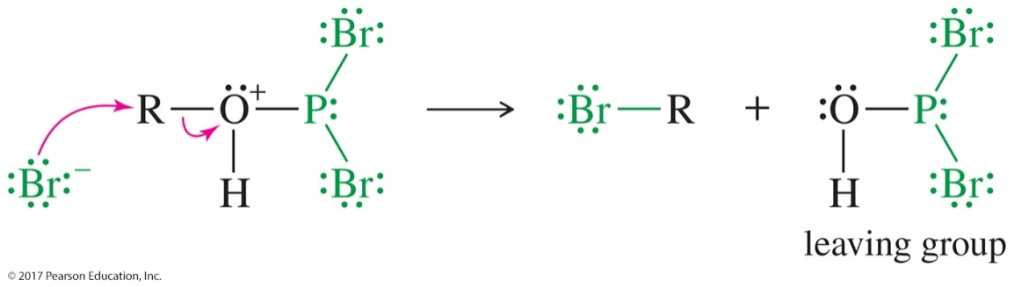
Mechanism with PBr₃
Oxygen attacks the phosphorus, displacing one of the halides.
Br– attacks back-side (S_{N}2).

Slide 41
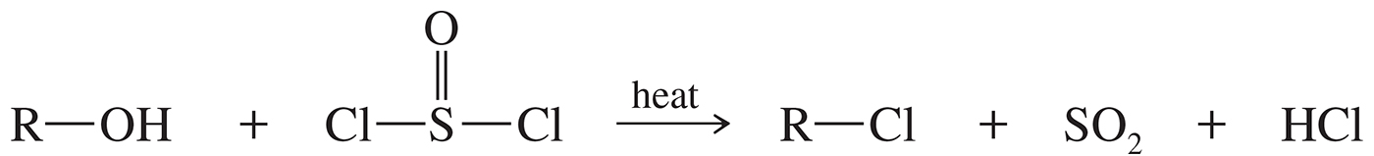
Reaction of Alcohols with Thionyl Chloride
Thionyl chloride (SOCl₂) can be used to convert alcohols into the corresponding alkyl chloride in a simple reaction that produces gaseous HCl and SO₂.

Slide 42
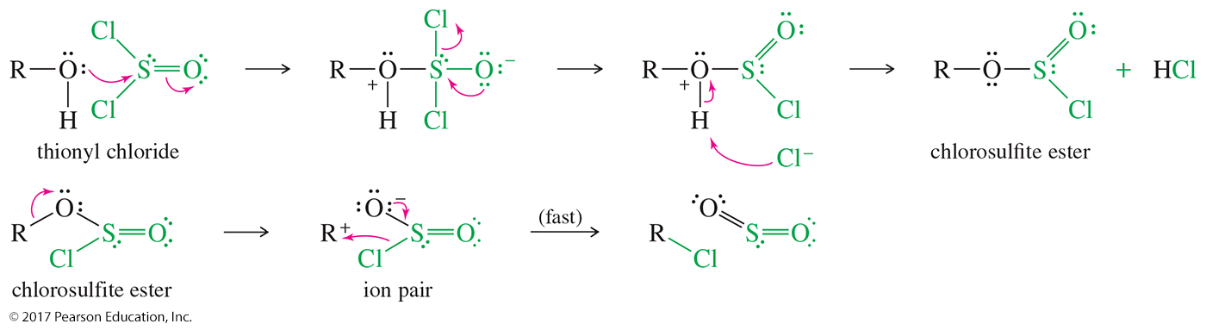
Mechanism of Thionyl
Chloride Reaction

Slide 43
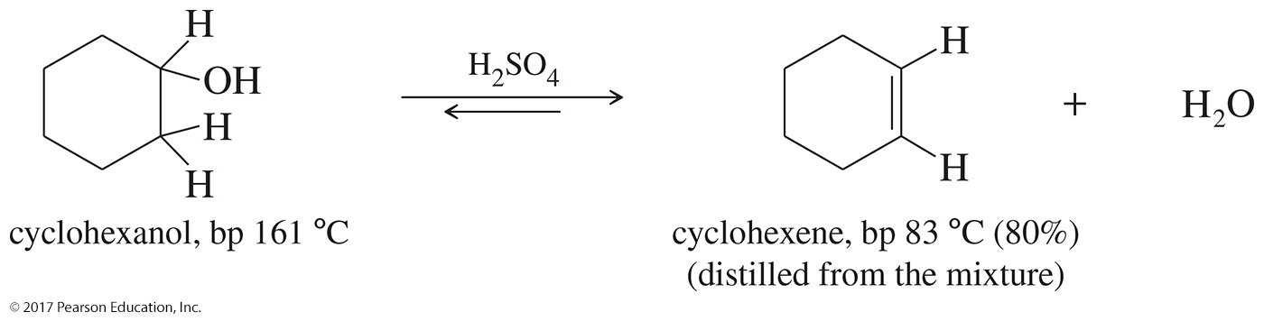
Dehydration Reactions
Concentrated H₂SO₄ produces alkene.
Carbocation intermediate for 2° and 3° alcohols
Zaitsev product
Bimolecular dehydration produces ether.
Low temp, 140 °C and below, favors ether formation.
High temp, 180 °C and above, favors alkene formation.

Slide 44
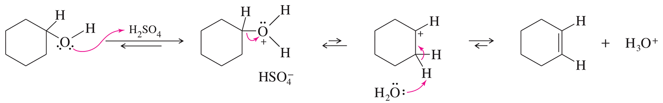
Dehydration of Alcohols
Alcohol dehydration generally takes place through the
E1 mechanism.
Rearrangements are possible.
The rate of the reaction follows the same rate as the ease of formation of carbocations: 3° > 2° > 1°.
Primary alcohols rearrange, so this is not a good reaction for converting 1° alcohols into alkenes.

Slide 45
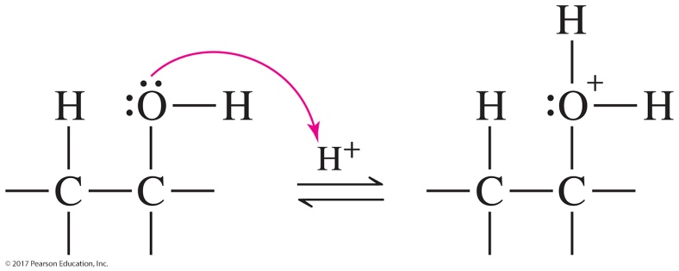
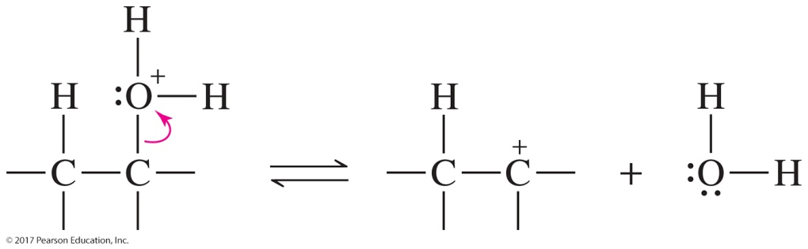

Mechanism of Dehydration: E1
Step 1: Protonation
Step 2: Formation of the carbocation
Step 3: Loss of a proton forms the alkene.

Slide 46

Energy Diagram, E1

Slide 47


Solved Problem 3
Predict the products of sulfuric acid-catalyzed dehydration of 1-methylcyclohexanol.
Solution
1-Methylcyclohexanol reacts to form a tertiary carbocation. A proton may be abstracted from any one of three carbon atoms. The two secondary atoms are equivalent, and abstraction of a proton from one of these carbons leads to the trisubstituted double bond of the major product. Abstraction of a methyl proton leads to the disubstituted double bond of the minor product.

Slide 48

Bimolecular Condensation to Form Ethers (Industrial)
A protonated alcohol may be attacked by another molecule of the alcohol and undergo an S_{N}2 displacement.
The net reaction is a bimolecular dehydration to form an ether.
This is a type of condensation.

Slide 49
Unique Reactions of Diols
Vicinal diols can undergo the following two reactions:
  Pinacol rearrangement
  Periodic acid cleavage

Slide 50

Pinacol Rearrangement
In the pinacol rearrangement, a vicinal diol converts to the ketone (pinacolone) under acidic conditions and heat.
The reaction is classified as a dehydration since a water molecule is eliminated from the starting material.

Slide 51

Mechanism of the Pinacol Rearrangement
Protonation and loss of a water molecule produce a carbocation.

Slide 52


Mechanism of the Pinacol Rearrangement (Continued)
Methyl shift forms a resonance-stabilized carbocation, which, upon deprotonation by water, yields the pinacolone product.

Slide 53

Periodic Acid Cleavage of Glycols
Glycols can be oxidatively cleaved by periodic acid (HIO₄) to form the corresponding ketones and aldehydes.
Useful for determining the structure of sugars.

Slide 54

Mechanism of HIO₄ Cleavage
The cleavage of a glycol probably involves a cyclic periodate intermediate.

Slide 55
Esterification
Fischer: Alcohol + carboxylic acid
Tosylate esters
Sulfate esters
Nitrate esters
Phosphate esters

Slide 56

Fischer Esterification
Reaction of an alcohol and a carboxylic acid produces
an ester.
Sulfuric acid is a catalyst.
The reaction is an equilibrium between starting materials and products, and for this reason the Fischer esterification is seldom used to prepare esters.

Slide 57

Reaction of Alcohols with
Acyl Chlorides
The esterification reaction achieves better results by reacting the alcohol with an acyl chloride.
The reaction is exothermic and produces the corresponding ester in high yields with only HCl as a by-product. Pyridine neutralizes the HCl.

Slide 58

Nitrate Esters
The best-known nitrate ester is nitroglycerine, whose systematic name is glyceryl trinitrate.
Glyceryl trinitrate results from the reaction of glycerol (1,2,3-propanetriol) with three molecules of nitric acid.

Slide 59

Phosphate Esters

Slide 60

Phosphate Esters in DNA

Slide 61

Alkoxide Ions: Williamson
Ether Synthesis
Ethers can be synthesized by the reaction of alkoxide ions with primary alkyl halides in what is known as the Williamson ether synthesis.
This is an S_{N}2 displacement reaction and, as such, works better with primary alkyl halides to facilitate back-side attack.
If a secondary or tertiary alkyl halide is used, the alkoxide will act as a base and an elimination will take place.

