Slide 1
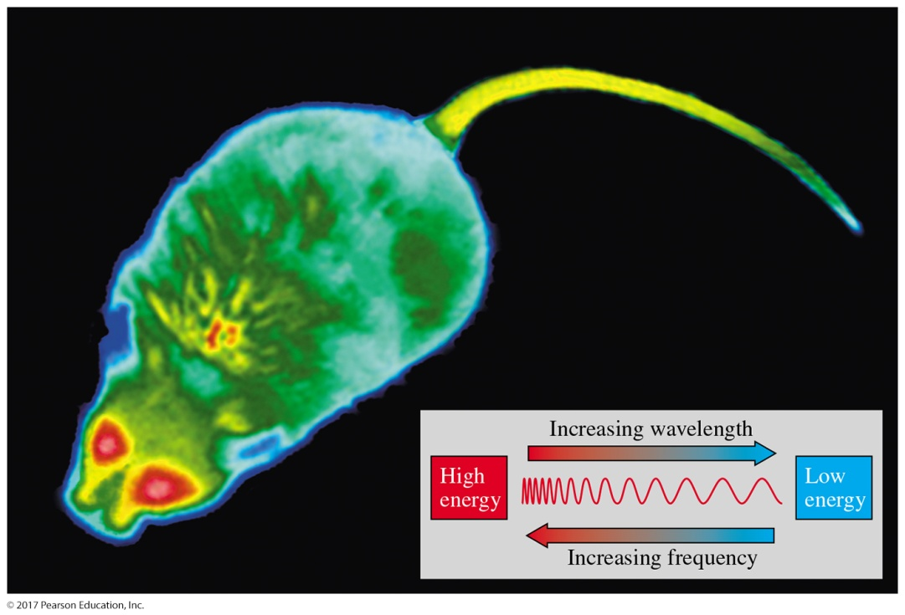
Organic Chemistry,
9th Edition
L. G. Wade, Jr.
Chapter 12
Lecture
Infrared Spectroscopy and
Mass Spectrometry
Chad Snyder, PhD
Grace College
© 2017 Pearson Education, Inc.

Slide 2
Introduction
Spectroscopy is a technique used to determine the structure of a compound.
Most techniques are nondestructive (destroys little or no sample).
Absorption spectroscopy measures the amount of light absorbed by the sample as a function of wavelength.

Slide 3
Types of Spectroscopy
Infrared (IR) spectroscopy measures the bond vibration frequencies in a molecule and is used to determine the functional group.
Mass spectrometry (MS) fragments the molecule and measures the mass. MS can give the molecular weight of the compound and functional groups.
Nuclear magnetic resonance (NMR) spectroscopy analyzes the environment of the hydrogens in a compound. This gives useful clues as to the alkyl and other functional groups present.
Ultraviolet (UV) spectroscopy uses electronic transitions to determine bonding patterns.

Slide 4
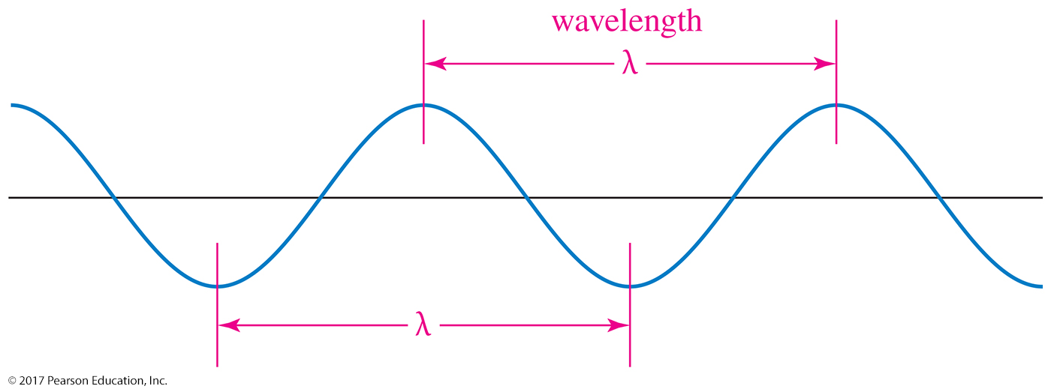
Wavelength and Frequency
The frequency (ν) of a wave is the number of complete wave cycles that pass a fixed point in a second.
Wavelength (λ) is the distance between any two peaks (or any two troughs) of the wave.

Slide 5
Electromagnetic Spectrum
Frequency and wavelength are inversely proportional.
c = λν λ = c/ν
where c is the speed of light (3 × 10¹⁰ cm/sec).
Energy of the photon is given by
E = hν
where h is Planck’s constant (6.62 × 10^{–37} kJ•sec).

Slide 6
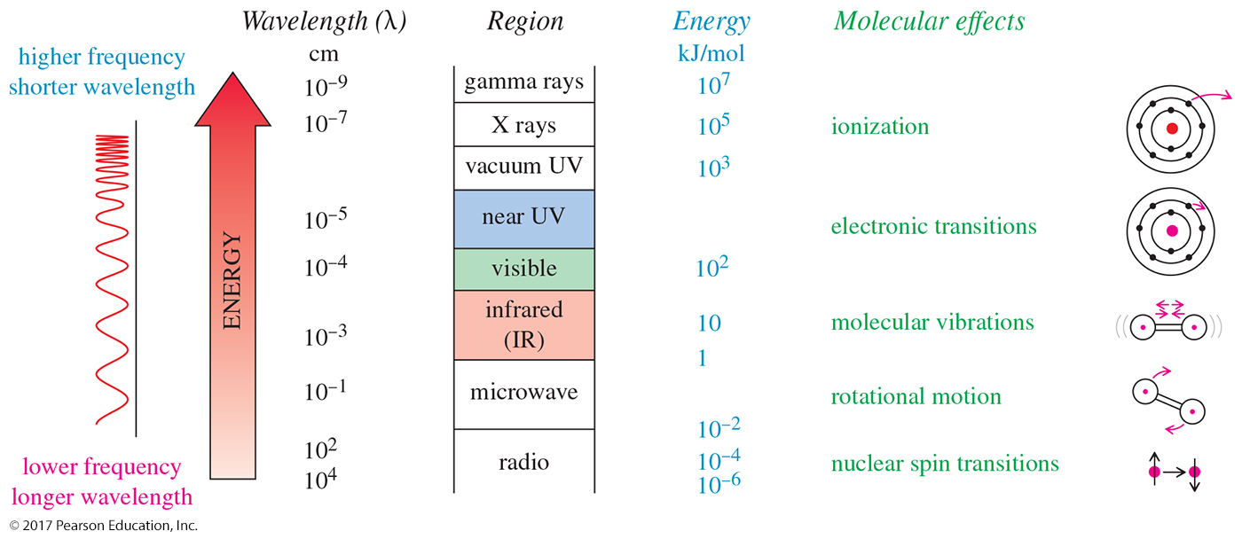
The Electromagnetic Spectrum

Slide 7
The Infrared (IR) Region
From right below the visible region to just above the highest microwave and radar frequencies
Wavelengths are usually 2.5 × 10^{–4} to
25 × 10^{–4} cm.
More common units are wavenumbers, or cm^{–1} (reciprocal centimeters).
Wavenumbers are proportional to frequency and energy.

Slide 8
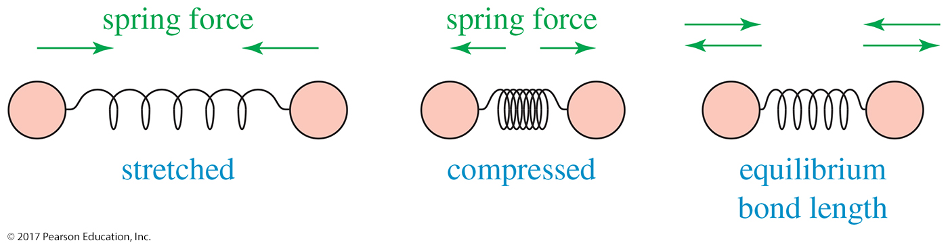
Molecular Vibrations
If the bond is stretched, a restoring force pulls the two atoms together toward their equilibrium bond length.
If the bond is compressed, the restoring force pushes the two atoms apart.
If the bond is stretched or compressed and then released, the atoms vibrate.

Slide 9
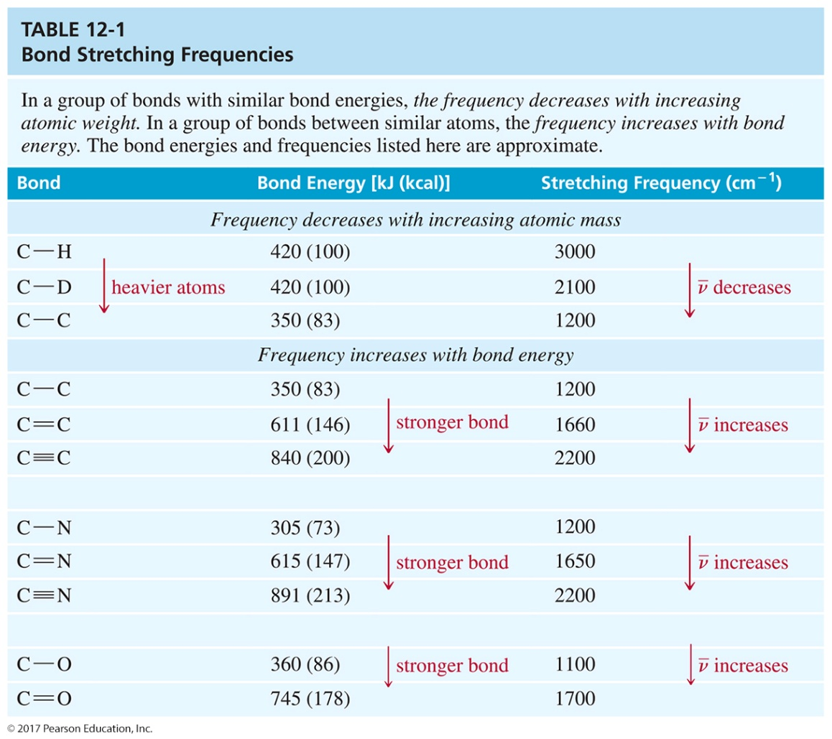
Bond Stretching Frequencies
Frequency decreases with increasing atomic mass.
Frequency increases with increasing bond energy.

Slide 10
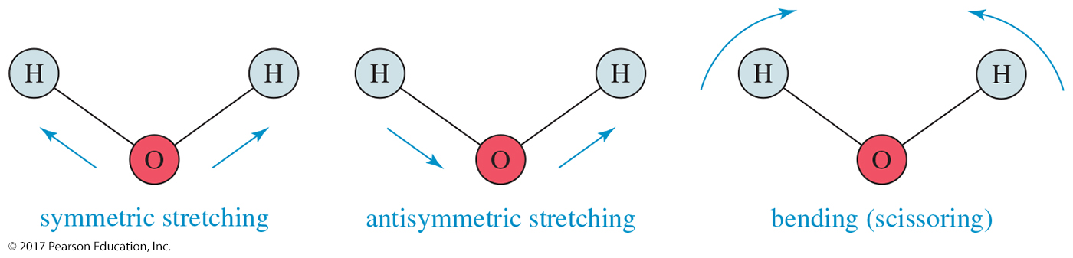
Vibrational Modes
A nonlinear molecule with n atoms has 3n – 6 fundamental vibrational modes.
Water has 3(3) – 6 = 3 modes. Two of these are stretching modes, and one is a bending mode (scissoring).

Slide 11
Fingerprint Region of the Spectrum
No two molecules will give exactly the same IR spectrum (except enantiomers).
Fingerprint region is between 600 and 1400 cm^{–1} and has the most complex vibrations.
The region between 1600 and 3500 cm^{–1} has the most common vibrations, and we can use it to get information about specific functional groups in the molecule.

Slide 12
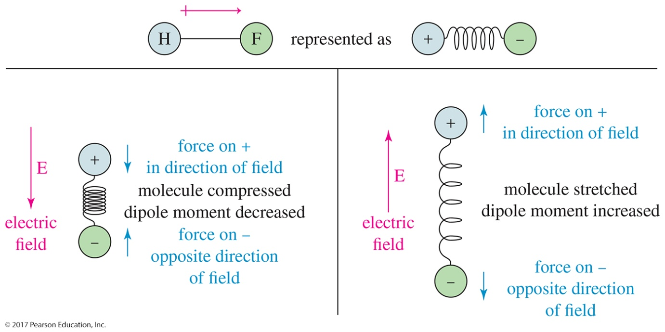
Effect of an Electric Field on a Polar Bond
A bond with a dipole moment (as in HF, for example) is either stretched or compressed by an electric field, depending on the direction of the field.
Notice that the force on the positive charge is in the direction of the electric field (E) and the force on the negative charge is in the opposite direction.

Slide 13
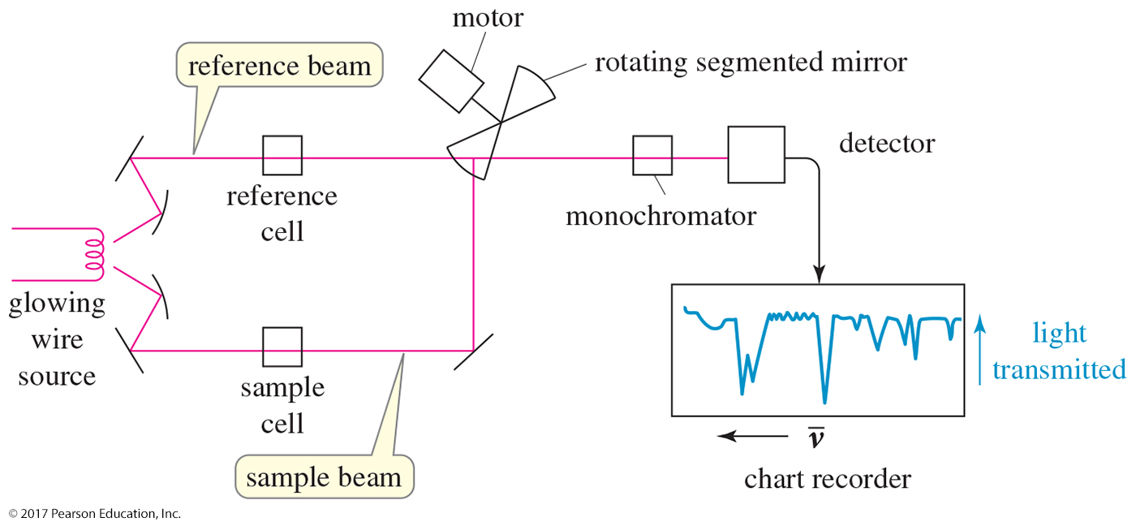
The Infrared Spectrometer

Slide 14
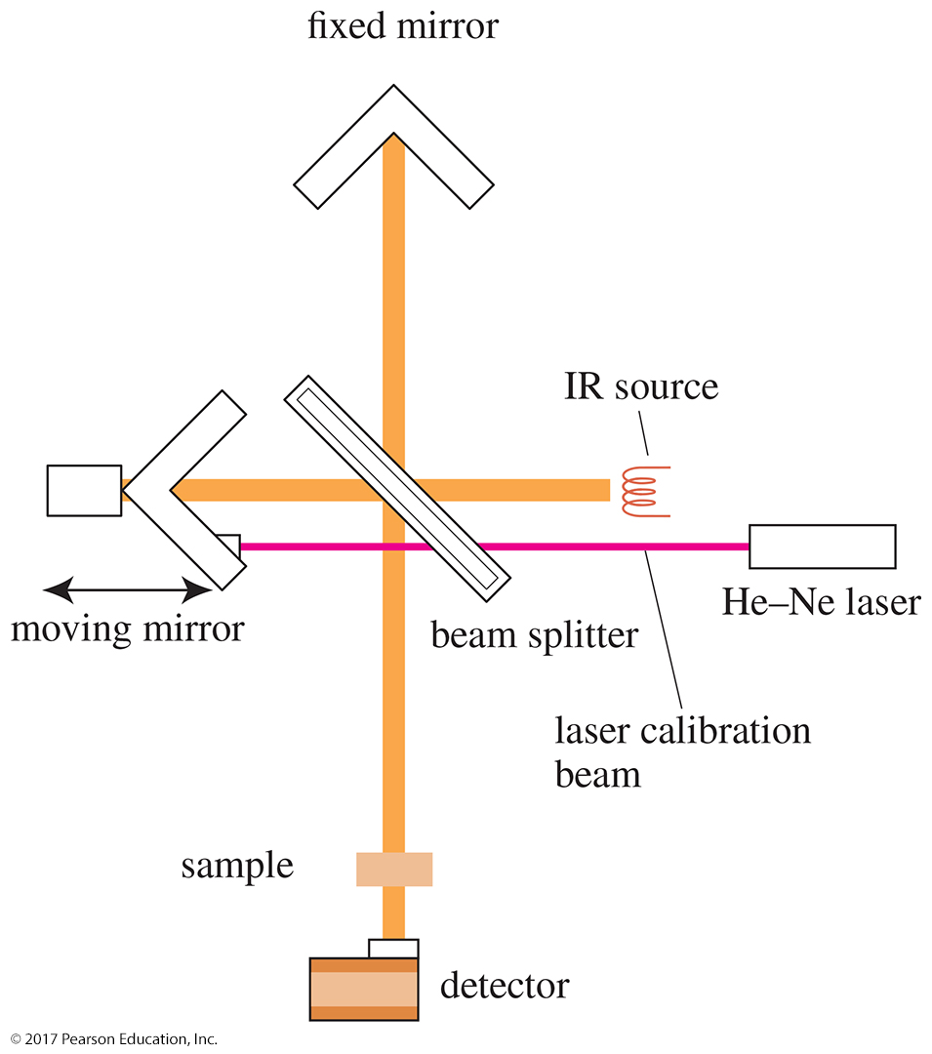
FT–IR Spectrometer
Has better sensitivity
Less energy is needed from the source.
Completes a scan in 1 to 2 seconds
Takes several scans and averages them
Has a laser beam that keeps the instrument accurately calibrated

Slide 15
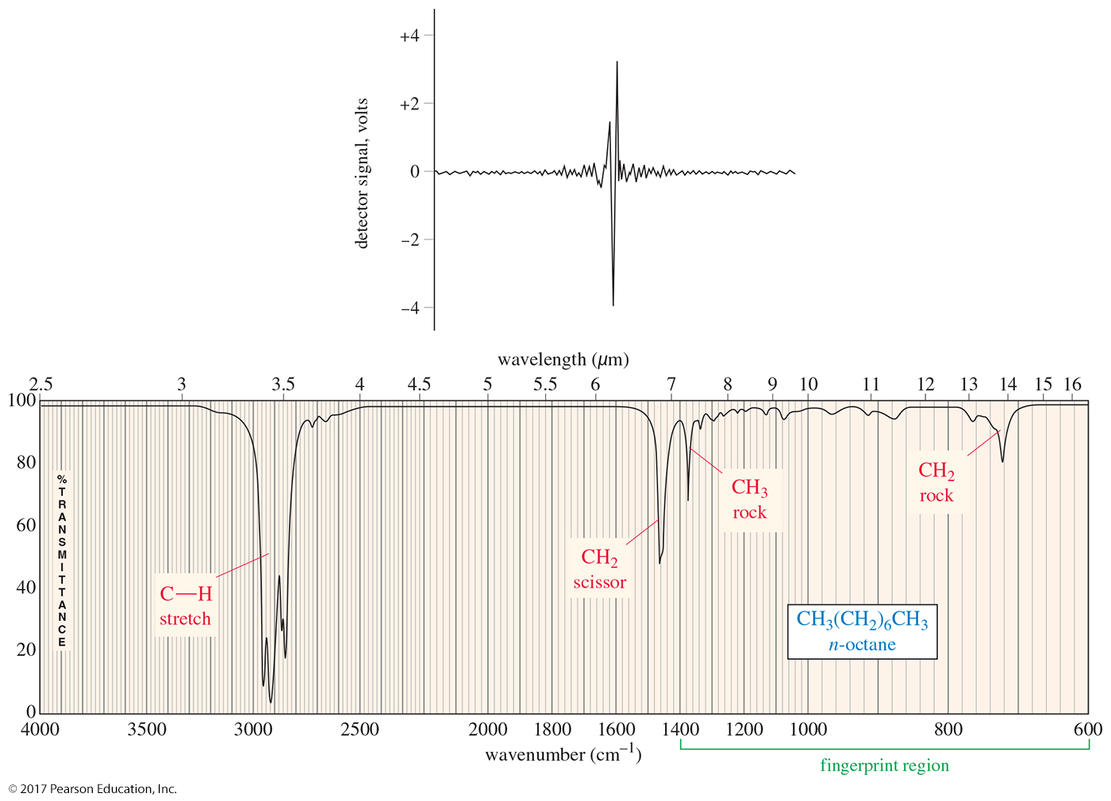
The Interferogram
The interferogram is said to be in the time domain.
A standard computer algorithm (Fourier transform) converts the time domain to the frequency domain.

Slide 16
Carbon–Carbon Bond Stretching
Stronger bonds absorb at higher frequencies because the bond is difficult to stretch:
C—C 1200 cm^{–1}
C=C 1660 cm^{–1}
C≡C <2200 cm^{–1}

Slide 17
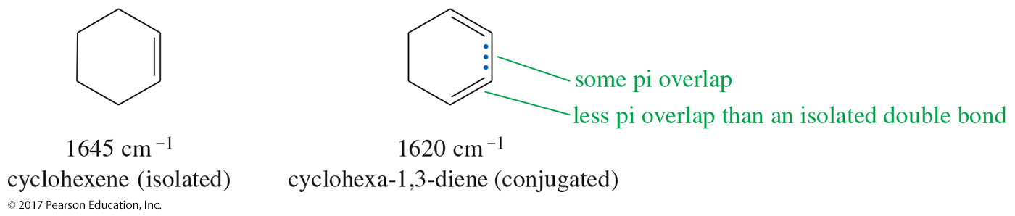
Carbon–Carbon Bond Stretching
Conjugation lowers the frequency:
  isolated C=C 1640–1680 cm^{–1}
  conjugated C=C 1620–1640 cm^{–1}
  aromatic C=C approx. 1600 cm^{–1}

Slide 18
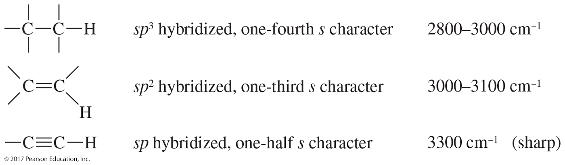
Carbon–Hydrogen Stretching
A greater percent of s character in the hybrid orbitals will make the C—H bond stronger.
The C—H bond of an sp³ carbon will be slightly weaker than the C—H bond of an sp² or an
sp carbon.

Slide 19
IR Spectrum of Alkanes
An alkane will show stretching and bending frequencies for C—H and C—C only.
The C—H stretching is a broad band between 2800 and 3000 cm^{–1}, a band present in virtually all organic compounds.
In this example, the importance lies in what is not seen, i.e., the lack of bands indicates the presence of no other functional group.

Slide 20
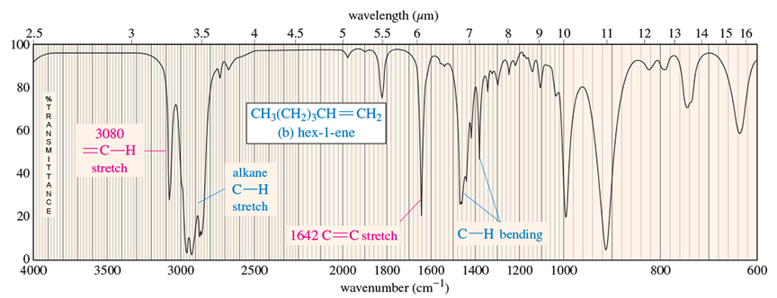
IR Spectrum of Alkenes
The most important absorptions in 1-hexene are the C═C stretch at 1642 cm^{–1} and the unsaturated stretch at 3080 cm^{–1}.
Notice that the bands of the alkane are present in the alkene.

Slide 21
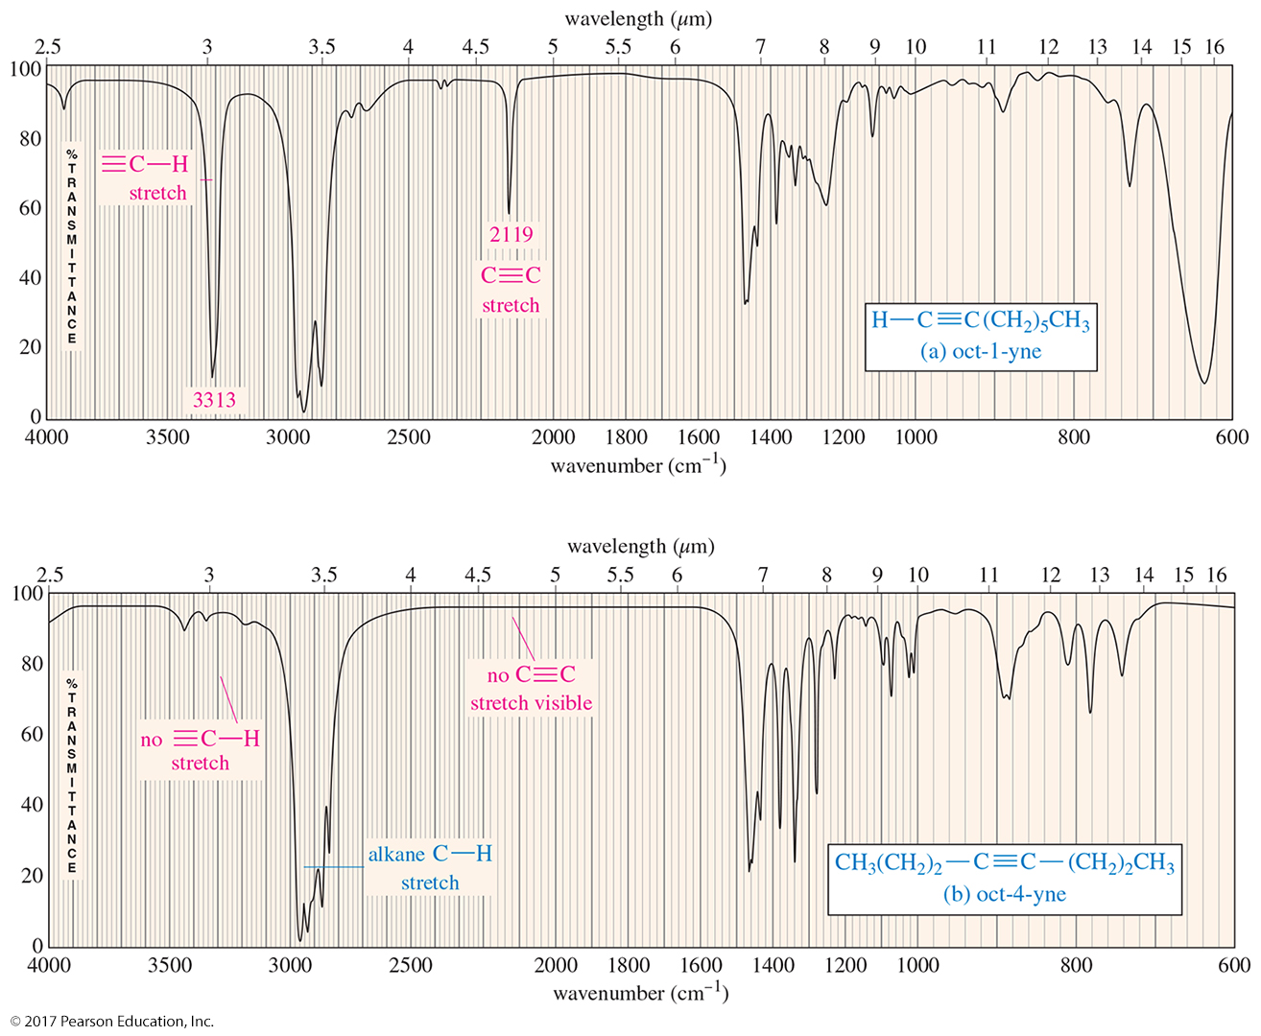
IR Spectra of Alkynes

Slide 22
O—H and N—H Stretching
Both of these occur around 3300 cm^{–1}, but they look different:
  Alcohol O—H is broad with a rounded tip.
  Secondary amine (R₂NH) is broad with one sharp spike.
  Primary amine (RNH₂) is broad with two sharp spikes.
  There is no signal for a tertiary amine (R₃N) because there is no hydrogen.

Slide 23
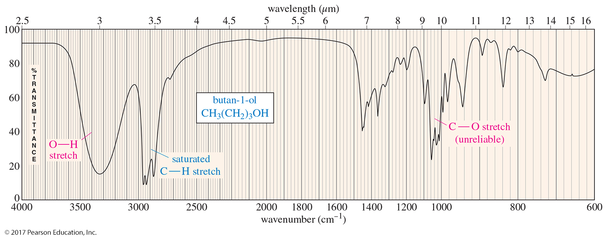
IR Spectrum of Alcohols
The IR spectrum of alcohols will show a broad, intense O—H stretching absorption centered around 3300 cm^{–1}.
The broad shape is due to the diverse nature of the hydrogen bonding interactions of alcohol molecules.

Slide 24
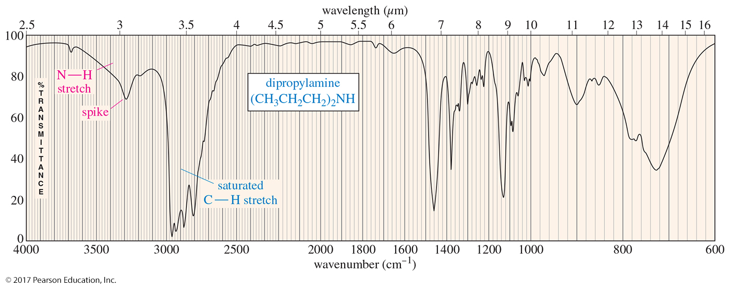
IR Spectrum of Amines
The IR spectrum of amines shows a broad N—H stretching absorption centered around 3300 cm^{–1}.
Dipropylamine has only one hydrogen so it will have only one spike in its spectrum.

Slide 25
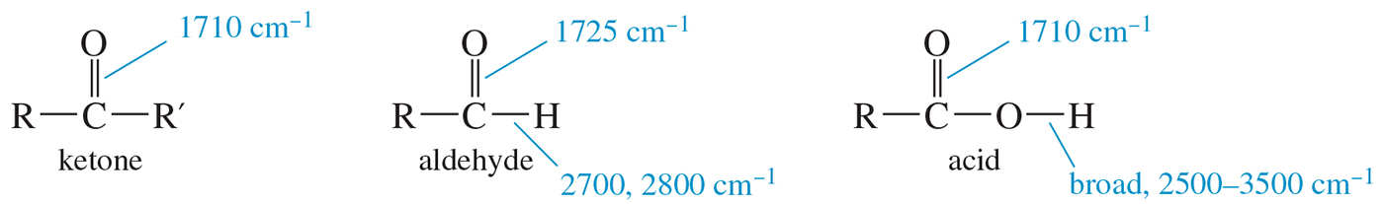
Ketones, Aldehydes, and Acids
The C═O bond of simple ketones, aldehydes, and carboxylic acids absorbs around 1710 cm^{–1}.
Usually the carbonyl is the strongest IR signal.
Carboxylic acids will have O—H, also.
Aldehydes have two C—H signals around 2700 and 2800 cm^{–1}.

Slide 26
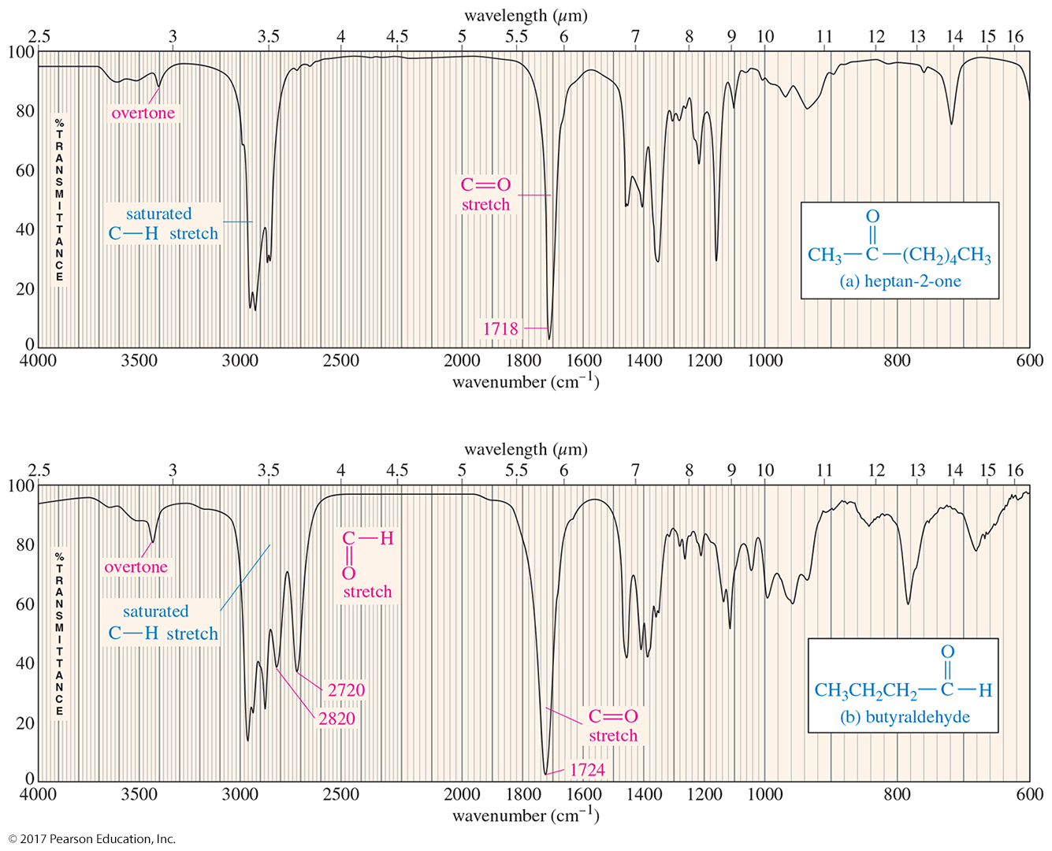
IR Spectrum of Ketones
The spectrum of 2-heptanone shows a strong, sharp absorption at 1718 cm^{–1} due to the C═O stretch.

Slide 27
IR Spectrum of Aldehydes
Aldehydes have the C═O stretch around
1710 cm^{–1}.
They also have two different stretch bands for the C—H bond at 2720 and 2820 cm^{–1}.

Slide 28
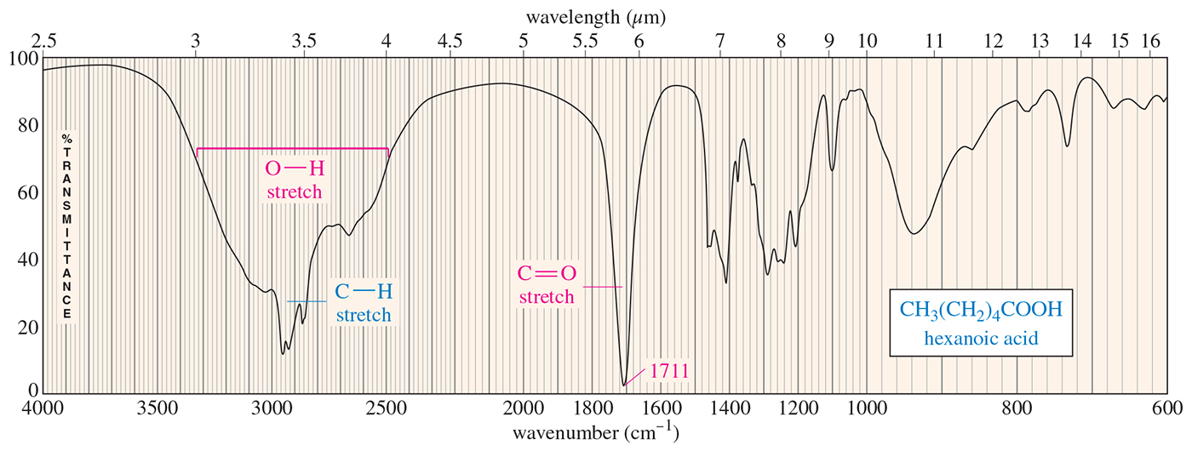
O—H Stretch of
Carboxylic Acids
This O—H absorbs broadly, 2500–3500 cm^{–1}, due to strong hydrogen bonding.
Both peaks need to be present to identify the compound as a carboxylic acid.

Slide 29
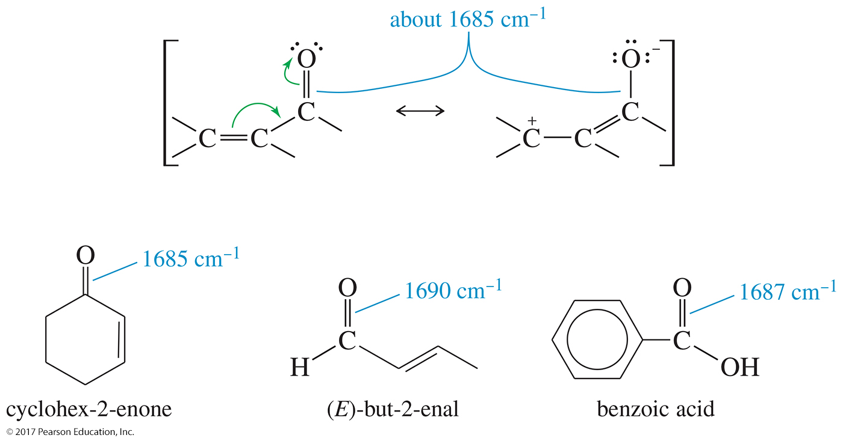
Conjugated Carbonyl Compounds

Slide 30
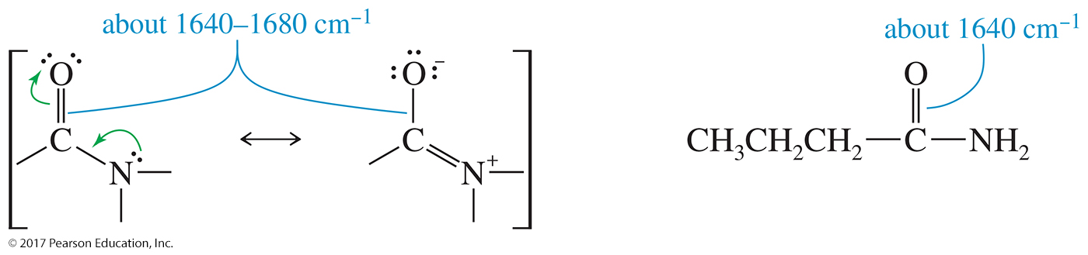
Resonance in Amides
The carbonyl groups of amides absorb at particularly low IR frequencies: about 1640 to 1680 cm^{–1}.

Slide 31
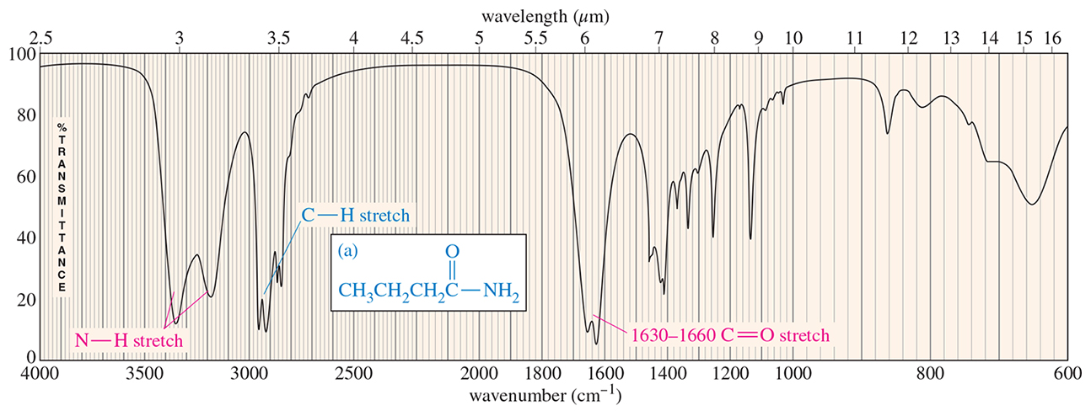
IR Spectrum of Amides
Amides will show a strong absorption for the C═O at 1640–1680 cm^{–1}.
If there are hydrogens attached to the nitrogen of the amide, there will be N—H absorptions around 3300 cm^{–1}.

Slide 32
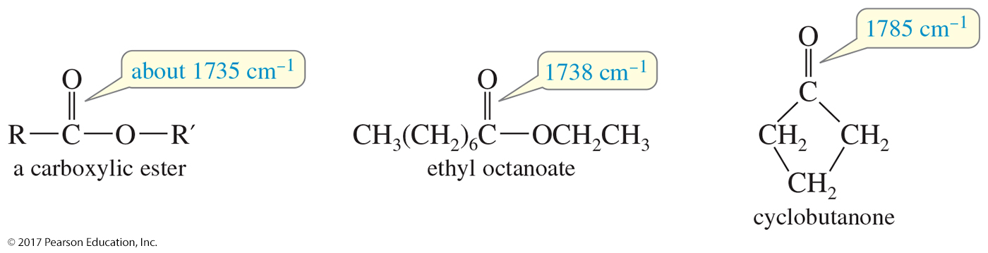
Carbonyl Absorptions Above 1725 cm^{–1}
Esters typically absorb around 1735 cm^{–1}.
Strained cyclic ketones absorb at a higher frequency because the angle strain on the carbonyl results in a stronger, stiffer bond.

Slide 33
Carbon—Nitrogen Stretching
C—N 1200 cm^{–1}
C=N 1660 cm^{–1} usually strong
C≡N >2200 cm¹
C≡C <2200 cm^{–1} (usually moderate or weak)

Slide 34
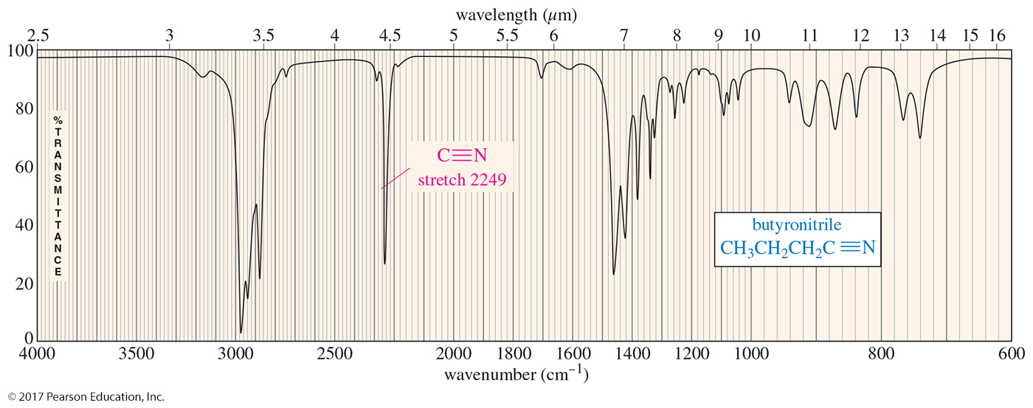
IR Spectrum of Nitriles
A carbon–nitrogen triple bond has an intense and sharp absorption, centered around 2200 to 2300 cm^{–1}.
Nitrile bonds are more polar than carbon–carbon triple bonds, so nitriles produce stronger absorptions than alkynes.

Slide 35
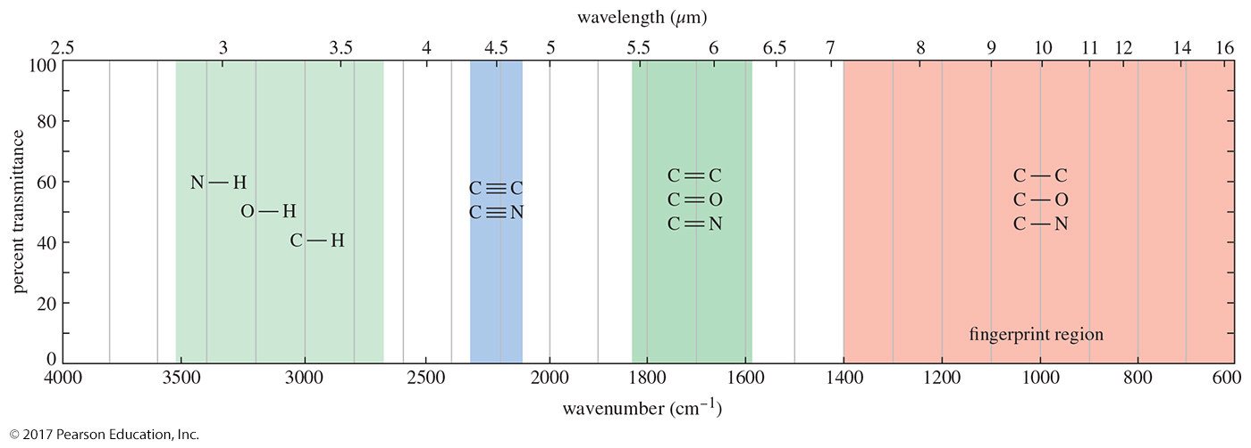
Summary of IR Absorptions

Slide 36
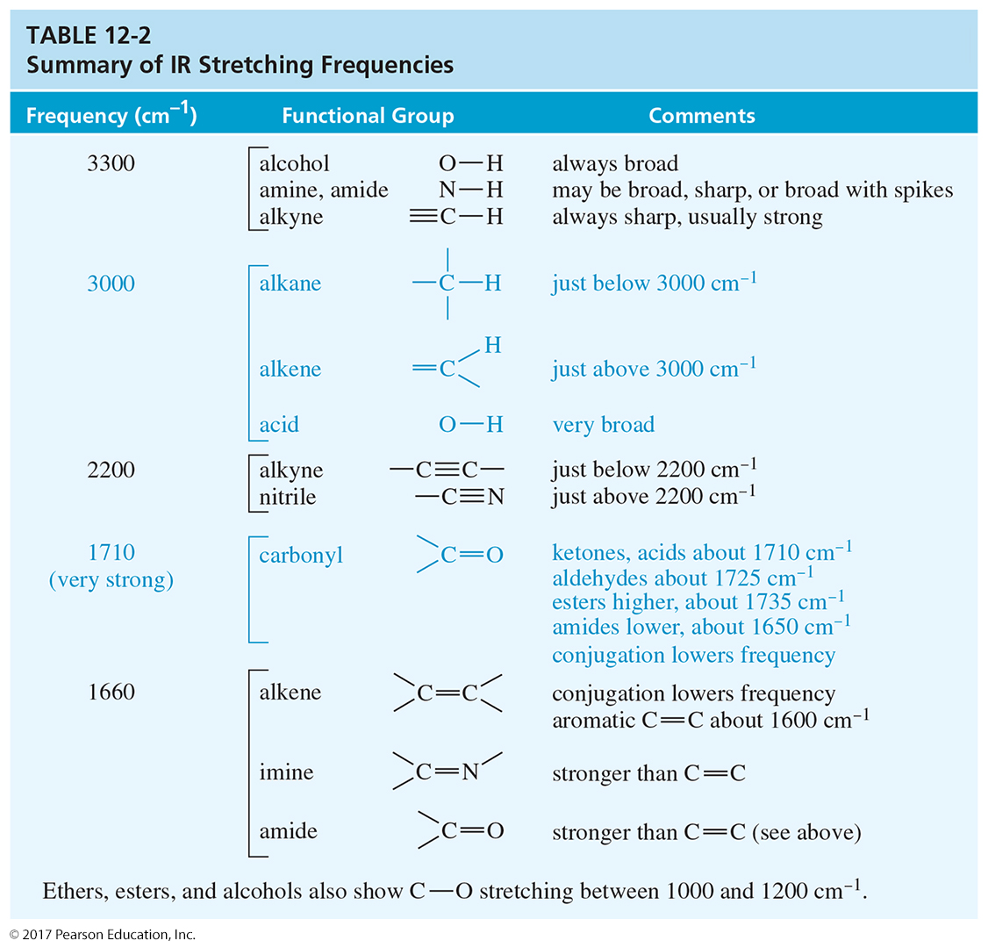

Slide 37
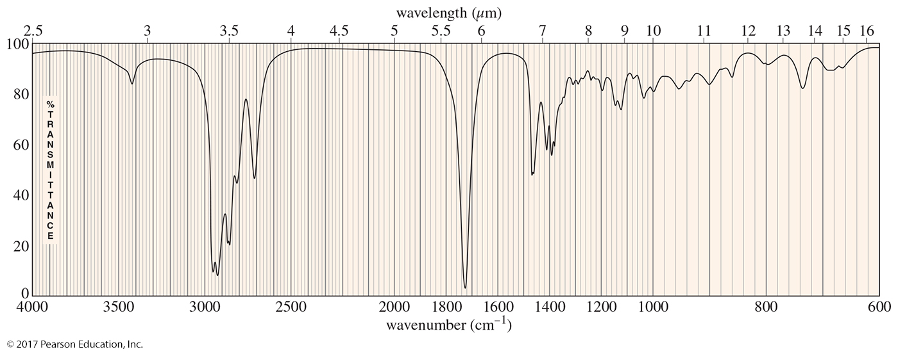
Solved Problem 1
Determine the functional group(s) in the compound whose IR spectrum appears here.

Slide 38
Solved Problem 1 (Continued)
Solution
First, look at the spectrum and see what peaks (outside the fingerprint region) don’t look like alkane peaks: a weak peak around 3400 cm^{–1}, a strong peak about 1720 cm^{–1}, and an unusual C–H stretching region. The C–H region has two additional peaks around 2720 and 2820 cm^{–1}. The strong peak at 1725 cm^{–1} must be a C=O, and the peaks at 2720 and 2820 cm^{–1} suggest an aldehyde. The weak peak around 3400 cm^{–1} might be mistaken for an alcohol O–H. From experience, we know alcohols give much stronger O–H absorptions. This small peak might be from an impurity of water or from a small amount of the hydrate of the aldehyde (see Chapter 18). Many IR spectra show small, unexplained absorptions in the O–H region.

Slide 39
Strengths and Limitations
IR alone cannot determine a structure.
Some signals may be ambiguous.
The functional group is usually indicated.
The absence of a signal is definite proof that the functional group is absent.
Correspondence with a known sample’s IR spectrum confirms the identity of the compound.

Slide 40
Mass Spectrometry (MS)
Molecular weight and molecular formula can be obtained from a very small sample.
Mass spectrometry is fundamentally different from spectroscopy.
Destructive technique: The sample cannot be recovered.

Slide 41
Mass Spectrometry
A beam of high-energy electrons breaks the molecule apart.
The masses of the fragments and their relative abundance reveal information about the structure of the molecule.

Slide 42
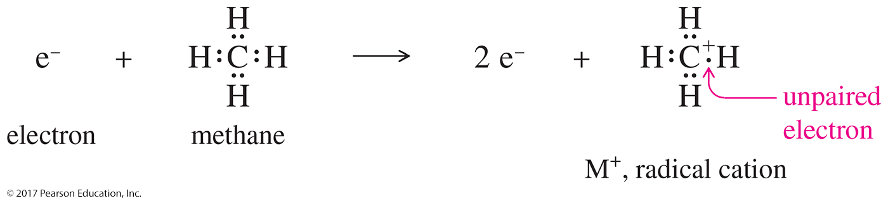
Radical Cation Formation
When a molecule loses one electron, it then has a positive charge and one unpaired electron. This ion is therefore called a radical cation.

Slide 43
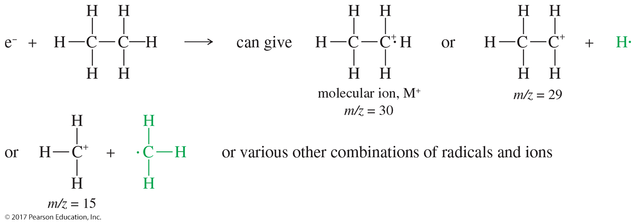
Electron Impact Ionization
Other fragments can be formed when C—C or C—H bonds are broken during ionization. Only the positive fragments can be detected in MS.

Slide 44
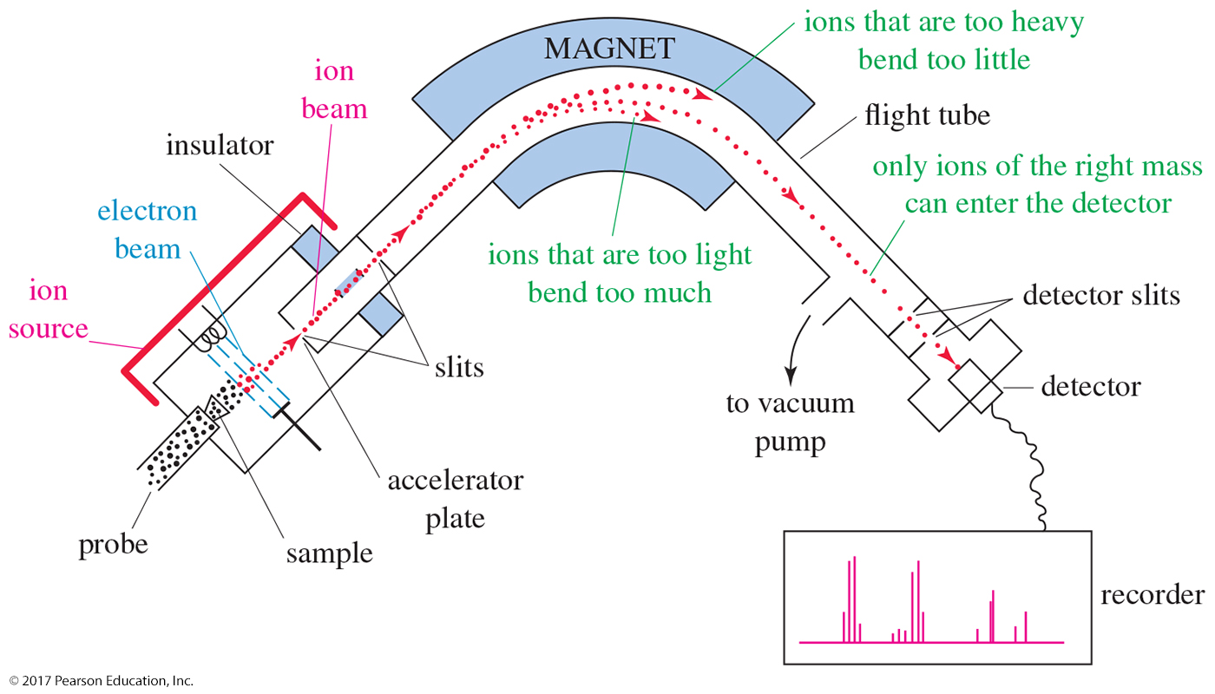
Mass Spectrometer

Slide 45
Separation of Ions
The most common mass spectrometer separates ions by magnetic deflection.
The mixture of ions is accelerated and passes through a magnetic field where the paths of lighter ions are bent more than those of heavier atoms.
By varying the magnetic field, the spectrometer plots the abundance of ions of each mass.
The exact radius of curvature of an ion's path depends on its mass-to-charge ratio, symbolized by m/z. In this expression, m is the mass of the ion (in amu) and z is
its charge.
The vast majority of ions have a +1 charge, so we consider their path to be curved by an amount that depends only on their mass.

Slide 46
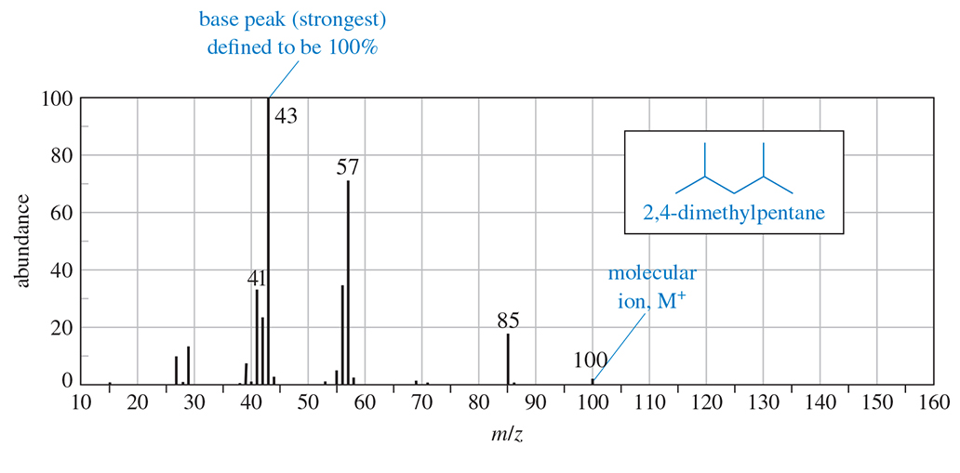
The Mass Spectrum
In the spectrum, the tallest peak is called the base peak and it is assigned an abundance of 100%. The % abundance of all other peaks is given relative to the
base peak.
The molecular ion or parent peak (M⁺) corresponds to the molecular weight of the original molecule.

Slide 47
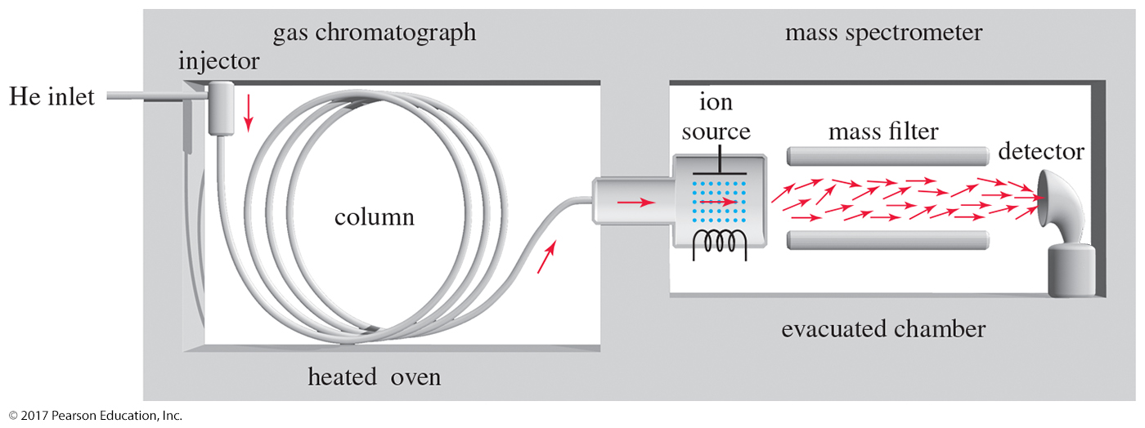
Gas Chromatography–Mass Spectrometry (GC–MS)
The gas chromatograph column separates the mixture into its components.
The mass spectrometer scans mass spectra of the components as they leave the column.

Slide 48
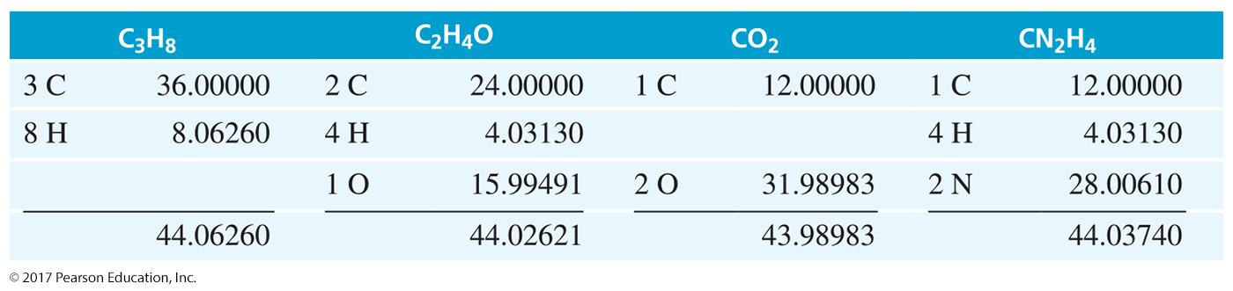
High-Resolution MS
Masses are measured to an accuracy of about 1 part in 20,000.
A molecule with mass of 44 could be C₃H₈, C₂H₄O, CO₂, or CN₂H₄.
Using HRMS, the exact mass can be found and the compound successfully identified.

Slide 49
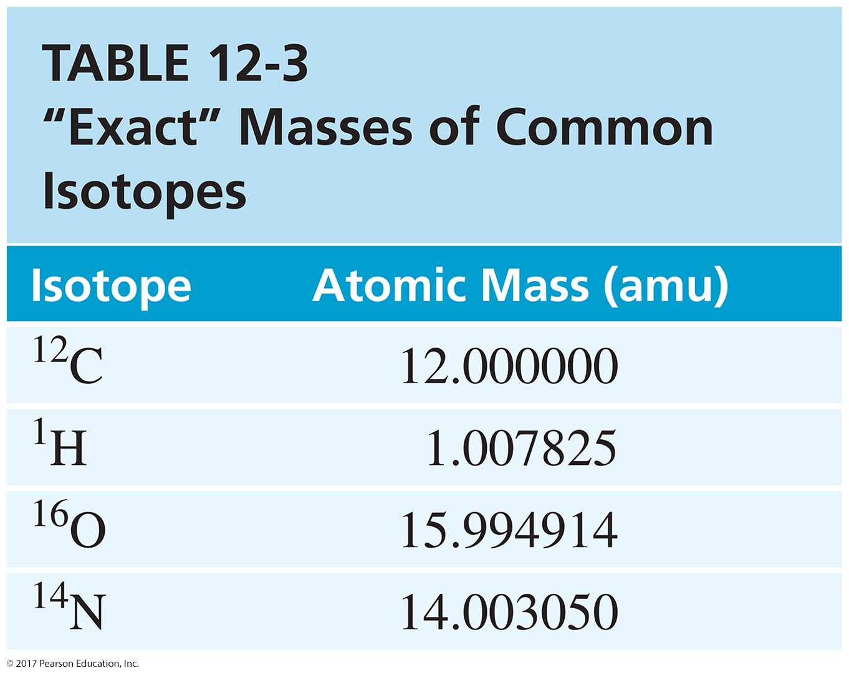
Masses of Common Isotopes

Slide 50
Molecules with Heteroatoms
Isotopes are present in their usual abundance.
Carbon has a ¹³C isotope present in 1.1% abundance. The spectrum will show the normal M⁺ and small M+1 peak.
Bromine has two isotopes: ⁷⁹Br (50.5%) and ⁸¹Br (49.5%). Since the abundances are almost equal, there will be an M⁺ peak and an M+2 peak of equal height.

Slide 51
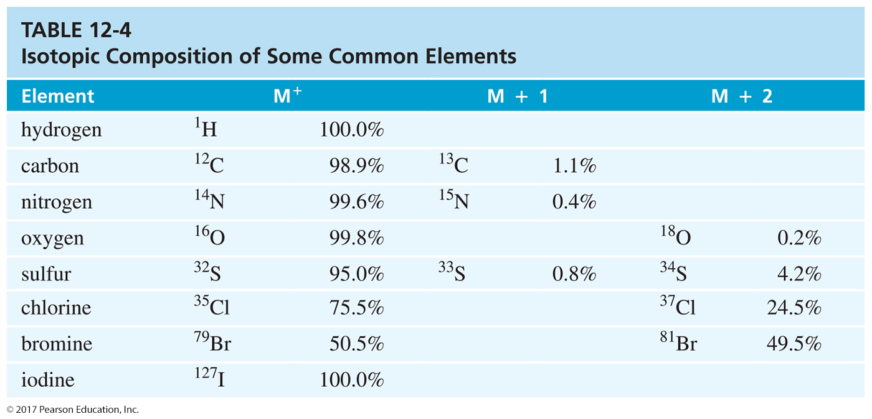
Isotopic Abundance

Slide 52
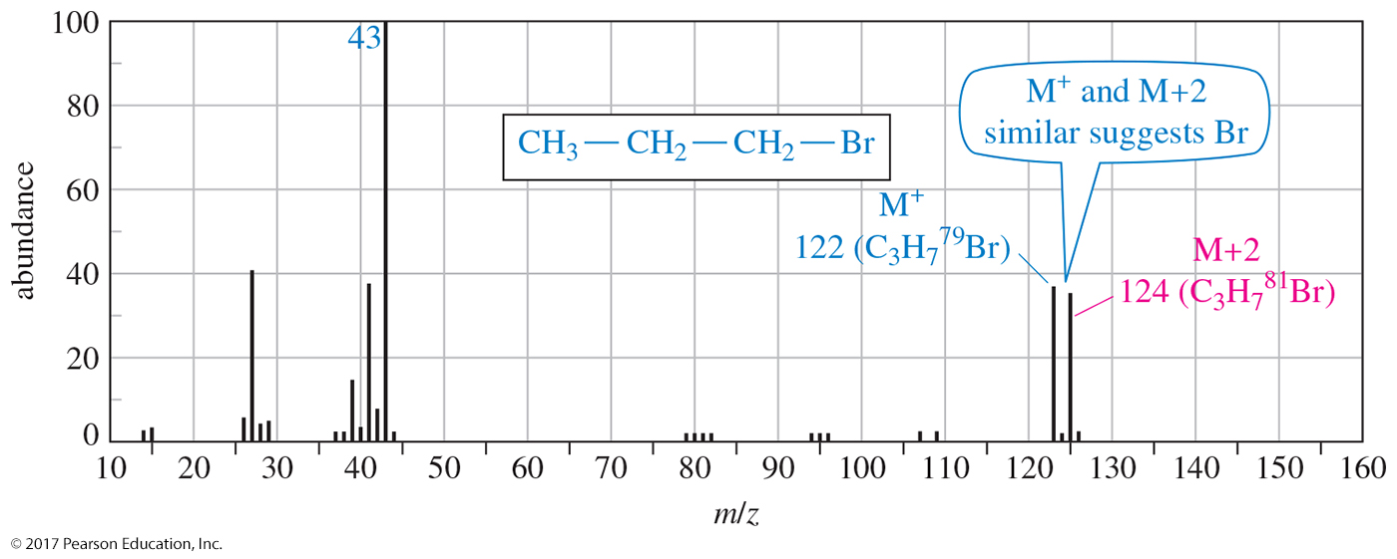
Mass Spectrum with Bromine
Bromine is a mixture of 50.5% ⁷⁹Br and 49.5% ⁸¹Br. The molecular ion peak M⁺ has ⁷⁹Br as tall as the M+2 peak that has ⁸¹Br.

Slide 53
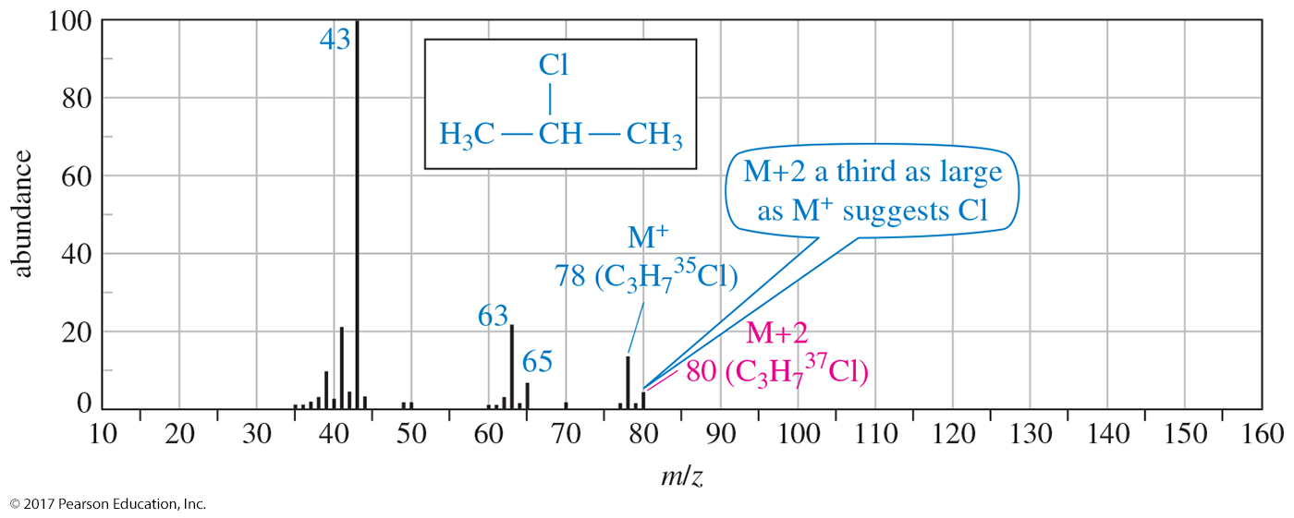
Mass Spectrum with Chlorine
Chlorine is a mixture of 75.5% ³⁵Cl and 24.5% ³⁷Cl. The molecular ion peak M⁺ is three times higher than the M+2 peak.

Slide 54
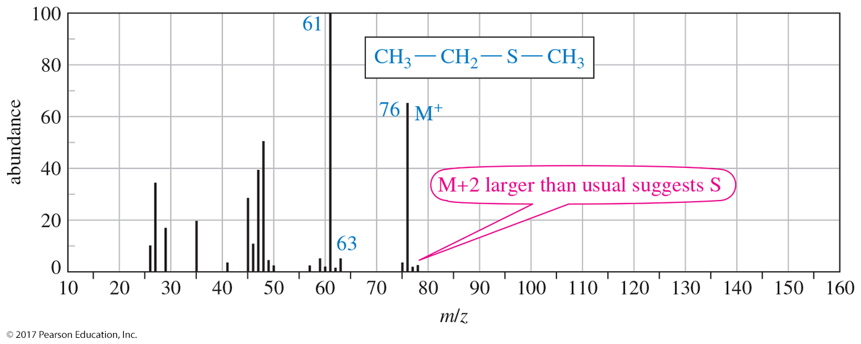
Mass Spectrum with Sulfur
Sulfur has three isotopes: ³²S (95%), ³³S (0.8%), and ³⁴S (4.2%).
The M⁺ peak of ethyl methyl sulfide has an M+2 peak that is larger than usual (about 4% of M⁺).

Slide 55
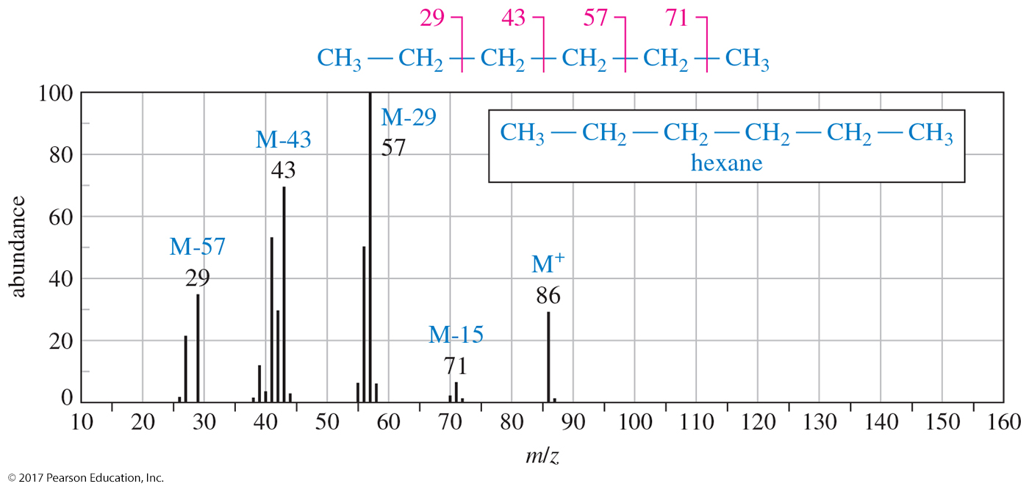
Mass Spectrum of n-Hexane
Groups of ions correspond to loss of one-, two-, three-, and four-carbon fragments.

Slide 56
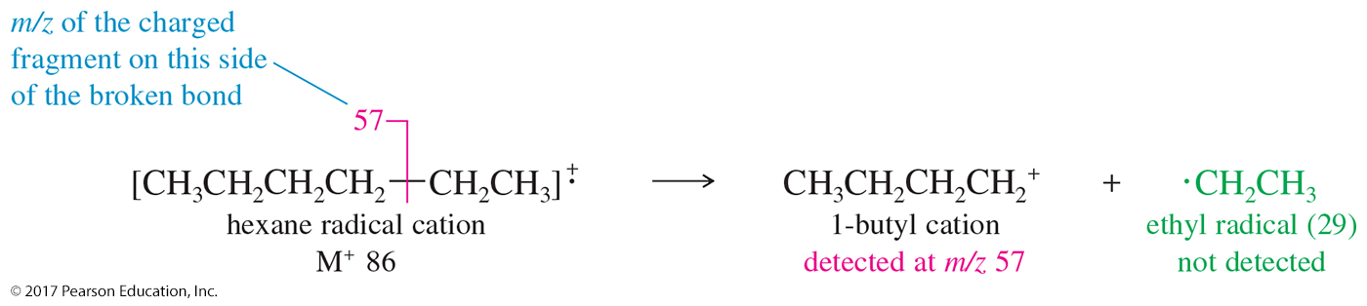
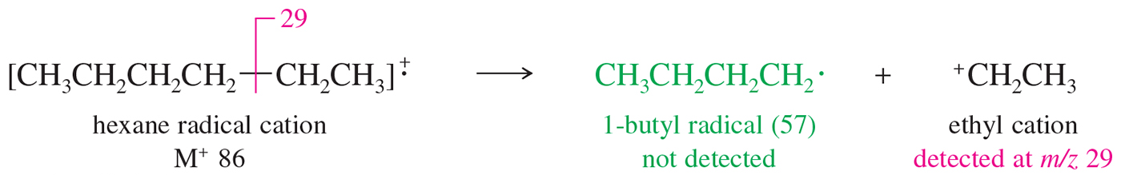
Fragmentation of the Hexane Radical Cation

Slide 57
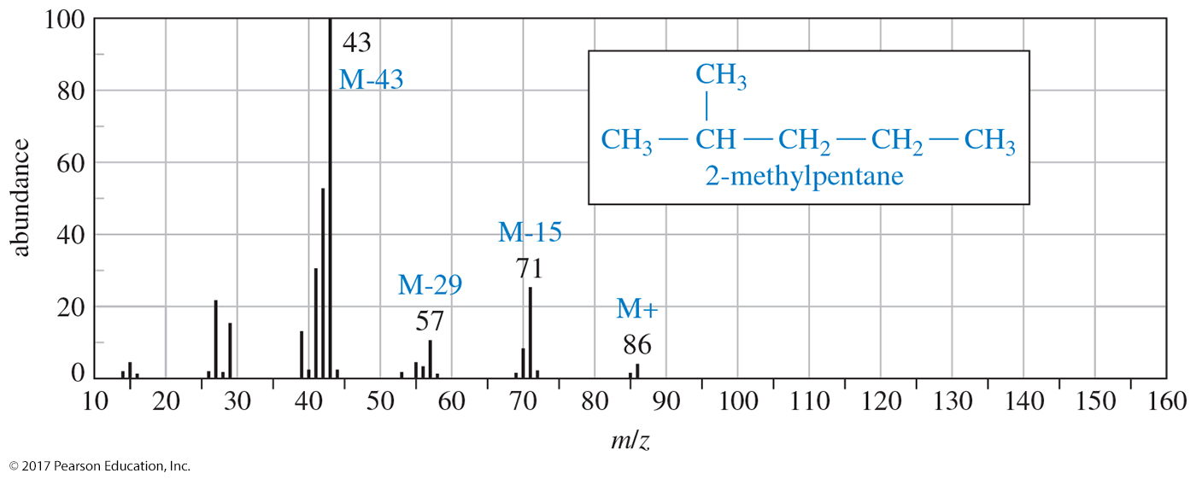
Mass Spectrum of
2-Methylpentane

Slide 58
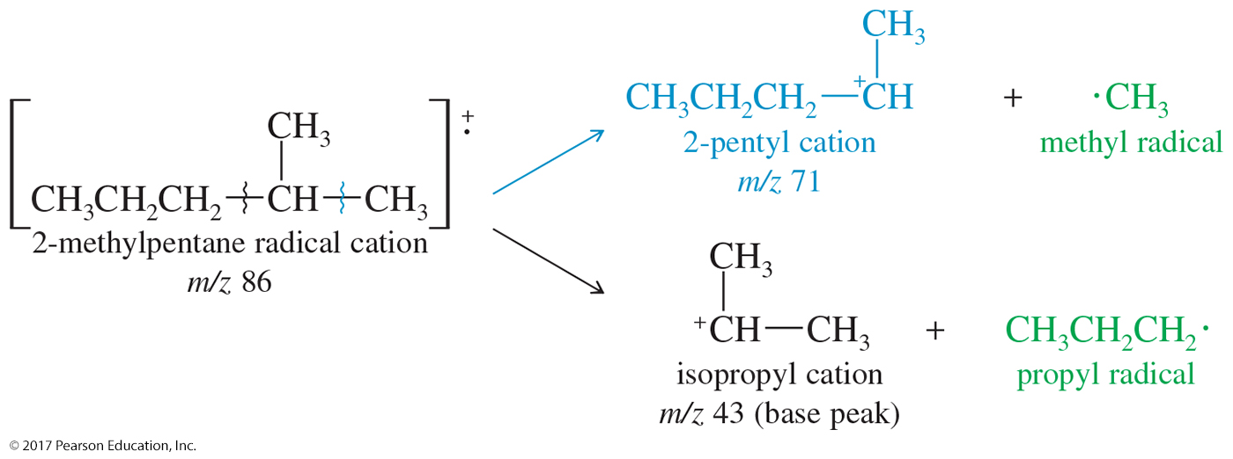
Fragmentation of
Branched Alkanes
The most stable carbocation fragments form in greater
amounts.

Slide 59
Resonance-Stabilized Cations
Fragmentation in the mass spectrometer gives resonance-stabilized cations whenever possible. The most common fragmentation of alkenes is cleavage of an allylic bond to give a resonance-stabilized allylic cation.

Slide 60
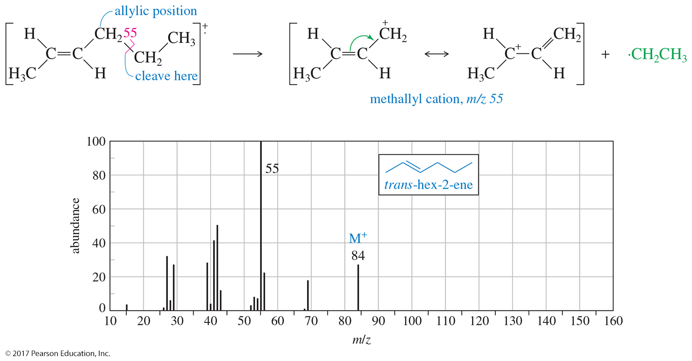
Mass Spectrum of Alkenes
Resonance-stabilized cations are favored.

Slide 61
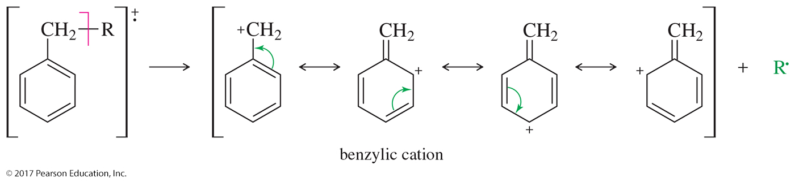
Benzylic Cation
Compounds containing aromatic rings tend to fragment at the carbon next to the aromatic ring.
Such a cleavage forms a resonance-stabilized benzylic cation.

Slide 62
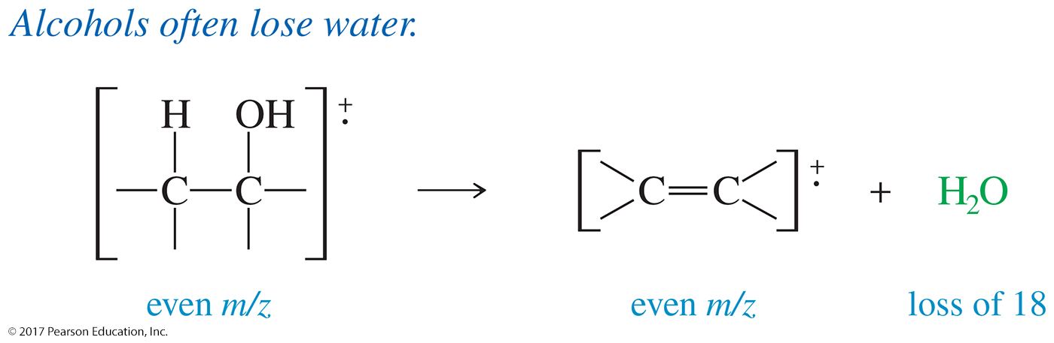
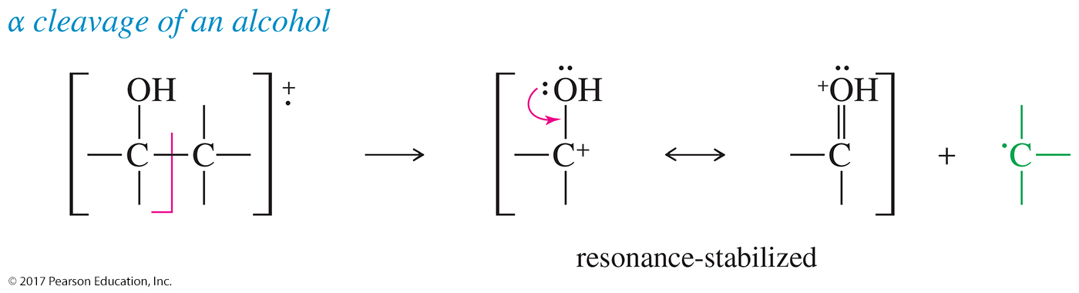
Mass Spectrum of Alcohols

Slide 63
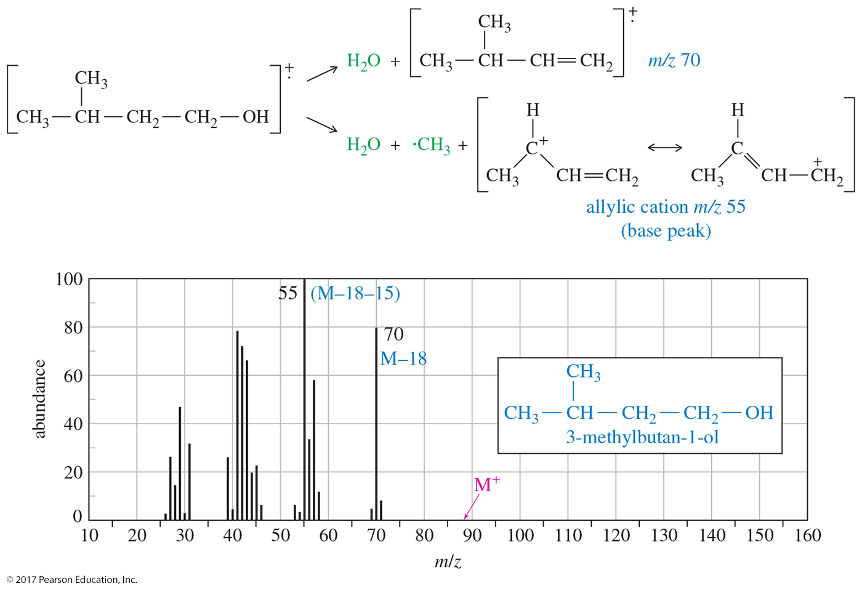
MS of 3-Methylbutan-1-ol

