Slide 1
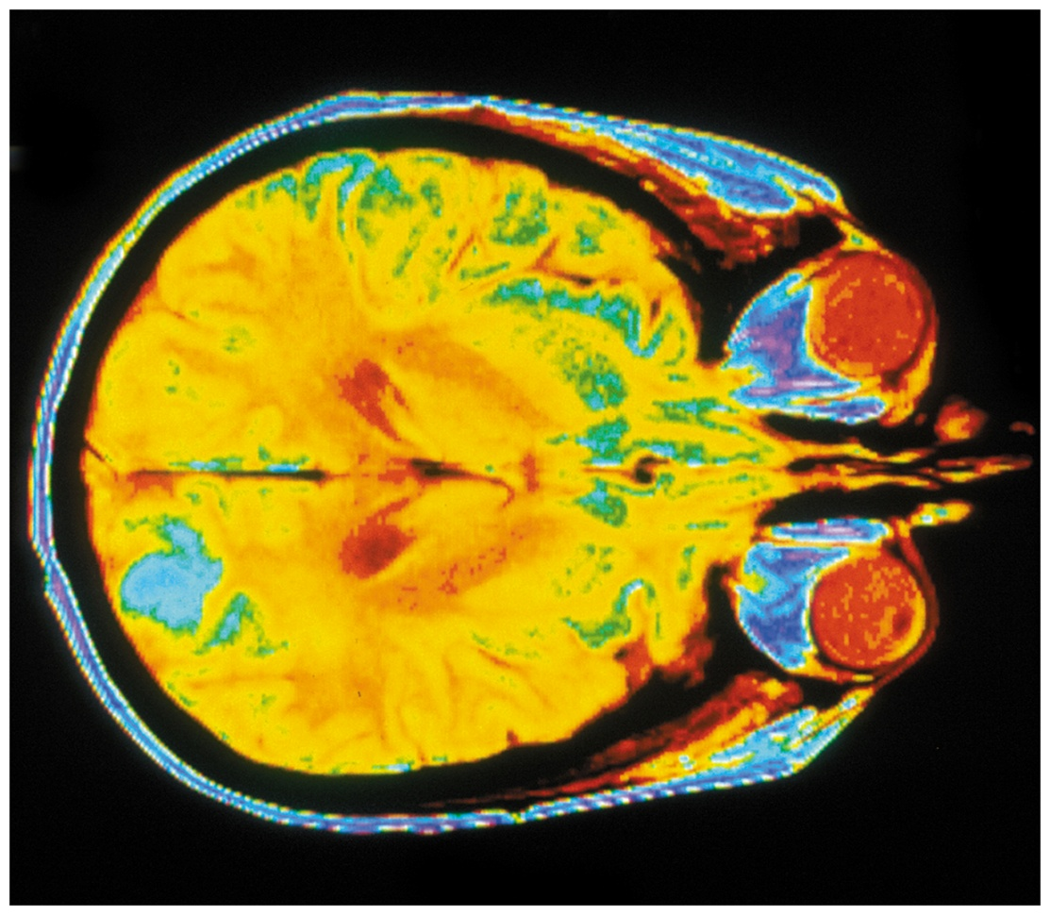
Organic Chemistry,
9th Edition
L. G. Wade, Jr.
Chapter 13
Lecture
Nuclear Magnetic
Resonance Spectroscopy
Chad Snyder, PhD
Grace College
© 2017 Pearson Education, Inc.

Slide 2
Introduction
Nuclear magnetic resonance spectroscopy (NMR) is the most powerful tool available for organic structure determination.
It is used to study a wide variety of nuclei:
  ¹H
  ¹³C
  ¹⁵N
  ¹⁹F
  ³¹P

Slide 3
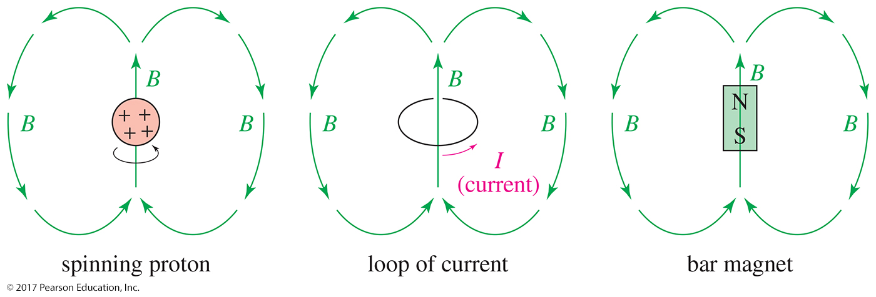
Nuclear Spin
A nucleus with an odd atomic number or an odd mass number has a nuclear spin.
The spinning, charged nucleus generates a magnetic field called magnetic moment.

Slide 4
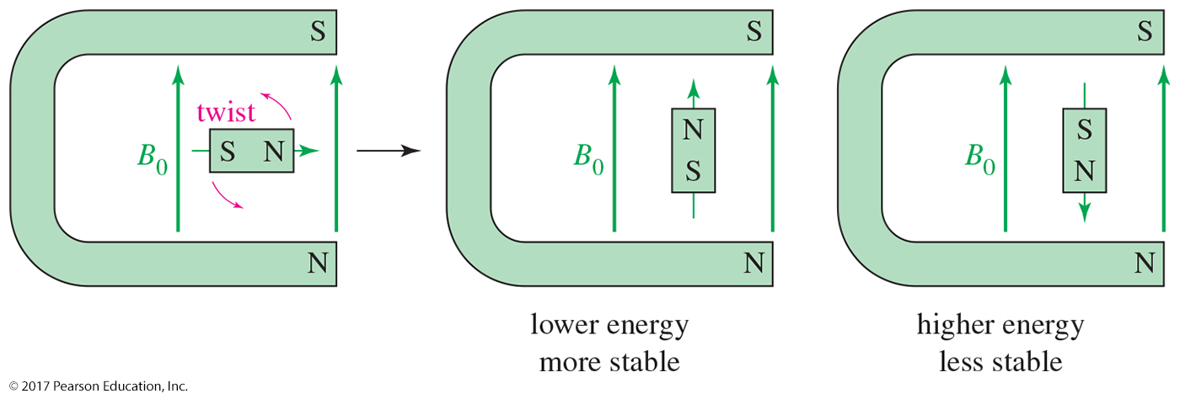
External Magnetic Field
An external magnetic field (B₀) applies a force to a small bar magnet, twisting the bar magnet to align it with the external field.
The arrangement of the bar magnet aligned with the field is lower in energy than the arrangement aligned against the field.

Slide 5
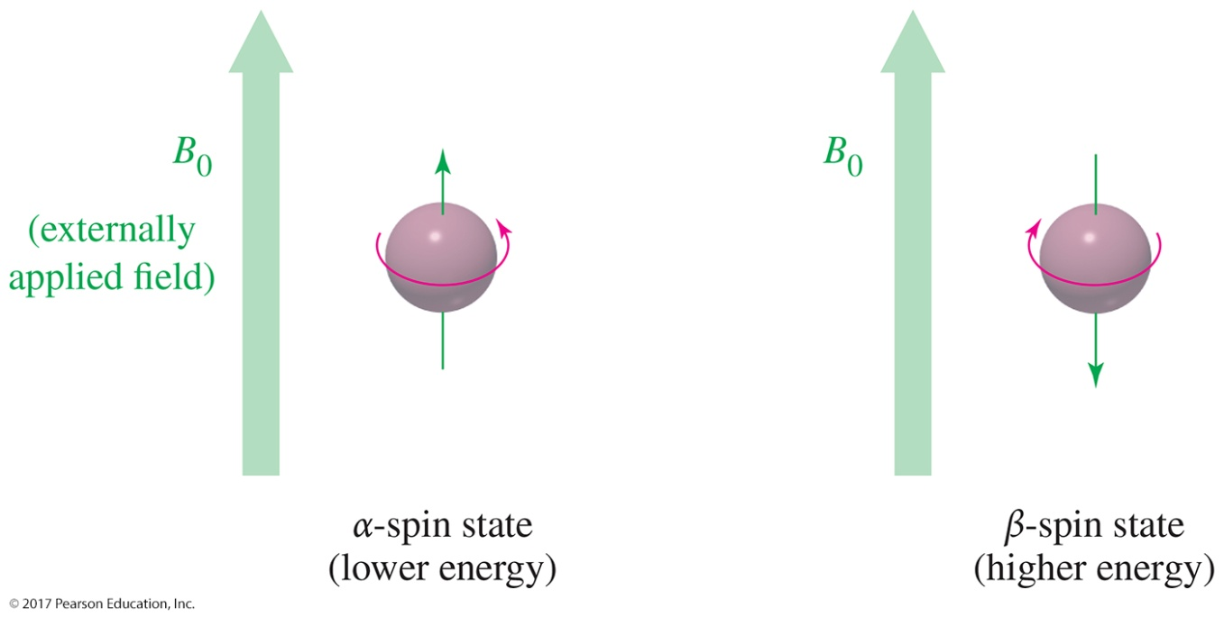
Alpha-Spin State and
Beta-Spin State
The lower energy state with the proton aligned with the field is called the alpha-spin state.
The higher energy state with the proton aligned against the external magnetic field is called the beta-spin state.

Slide 6
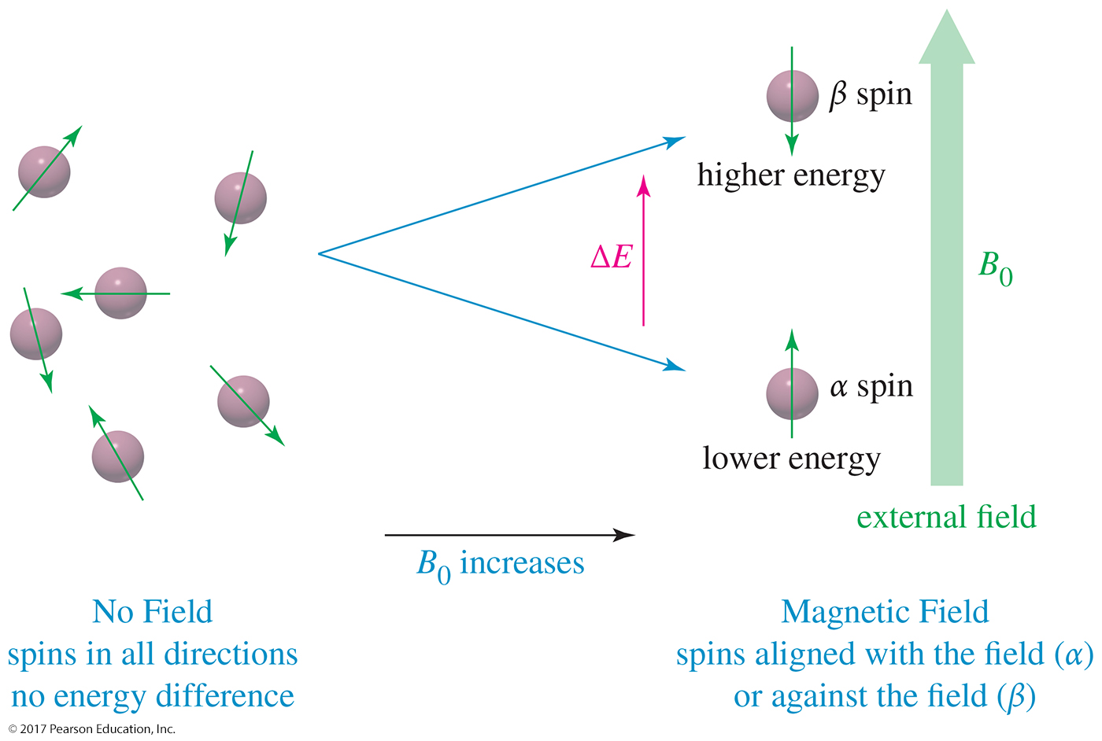
Proton Magnetic Moments

Slide 7
ΔE and Magnet Strength
Energy difference is directly proportional to the magnetic field strength.
ΔE = hν = γ h B₀
2π
Gyromagnetic ratio, γ, is a constant for each nucleus (26,753 sec^{–1}gauss^{–1} for H).
In a 14,092-gauss field, a 60-MHz photon is required to flip a proton.
Low energy, radio frequency

Slide 8
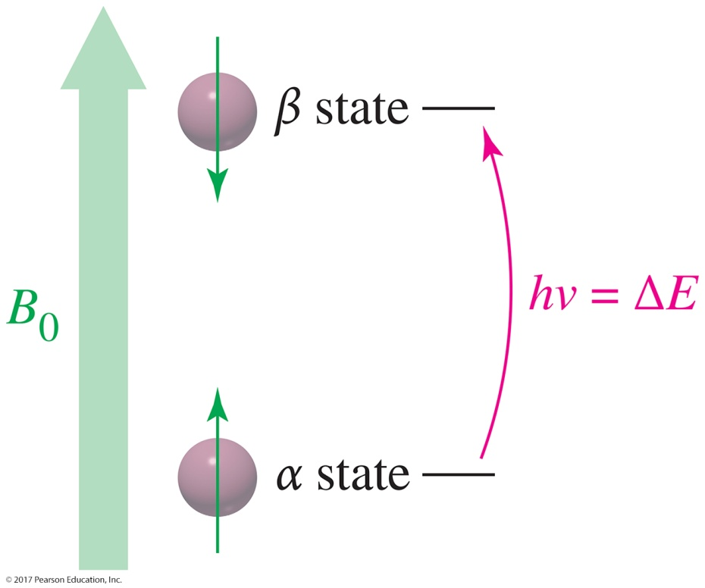
Two Energy States
A nucleus is in resonance when it is irradiated with radio-frequency photons having energy equal to the energy difference between the spin states.
Under these conditions, a proton in the alpha-spin state can absorb a photon and flip to the beta-spin state.

Slide 9
Magnetic Shielding
If all protons absorbed the same amount of energy in a given magnetic field, not much information could be obtained.
But protons are surrounded by electrons that shield them from the external field.
Circulating electrons create an induced magnetic field that opposes the external magnetic field.

Slide 10
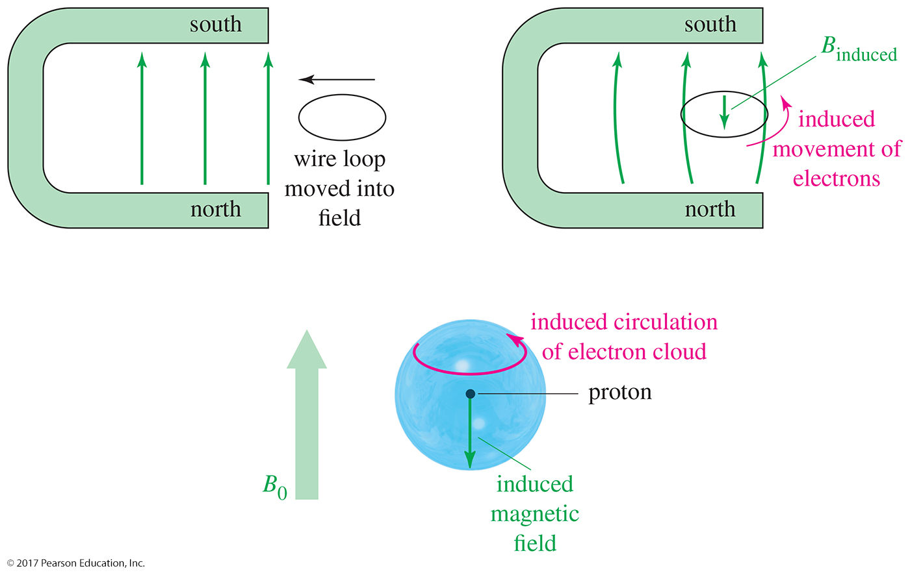
Induced Magnetic Field

Slide 11
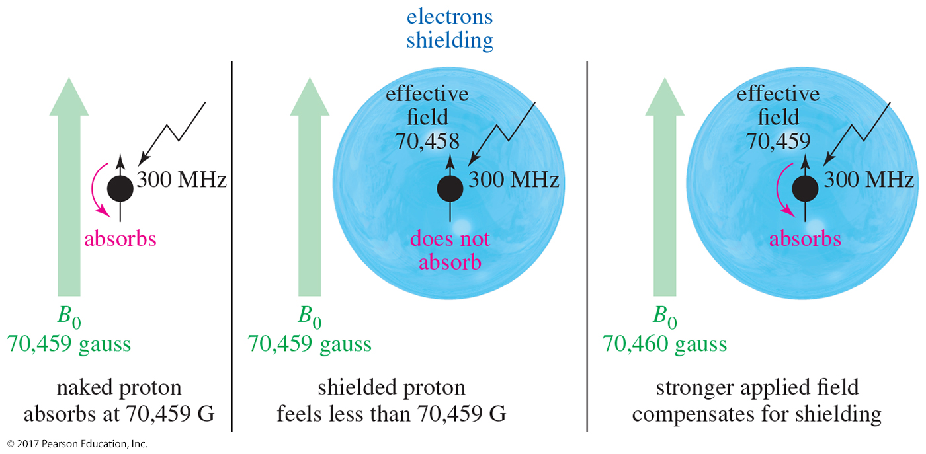
Shielded Protons
A naked proton will absorb at 70,459 gauss.
A shielded proton will not absorb at 70,459 gauss, so the magnetic field must be increased slightly to achieve resonance.

Slide 12
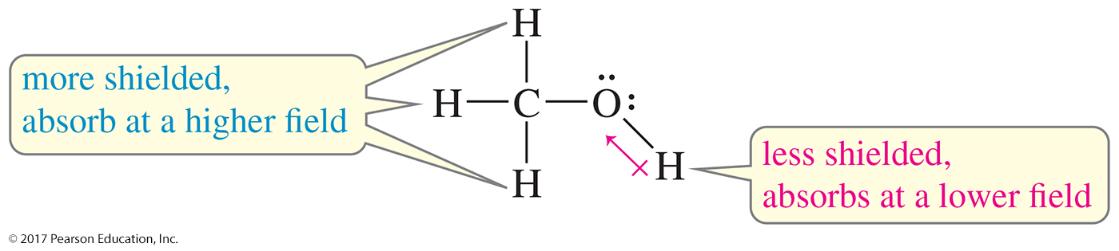
Protons in a Molecule
Protons in different chemical environments are shielded by different amounts.
The hydroxyl proton is not shielded as much as the methyl protons, so the hydroxyl proton absorbs at a lower field than the methyl protons.
We say that the proton is deshielded somewhat by the presence of the electronegative oxygen atom.

Slide 13
NMR Signals
The number of signals shows how many different kinds of protons are present.
The location of the signals shows how shielded or deshielded is the proton.
The intensity of the signal shows the number of protons of that type.
Signal splitting shows the number of protons on adjacent atoms.

Slide 14
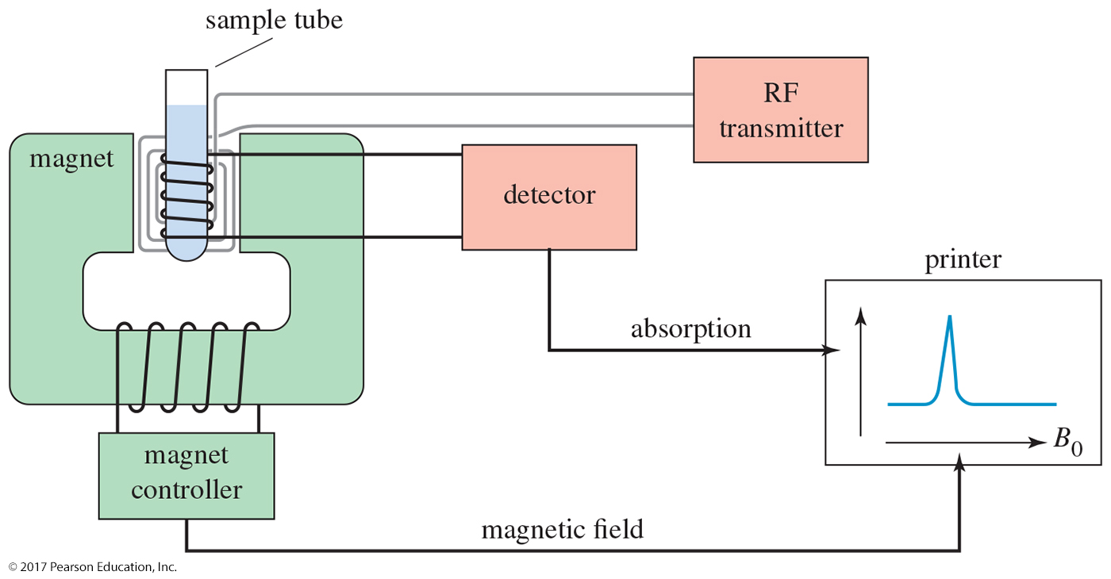
The NMR Spectrometer

Slide 15
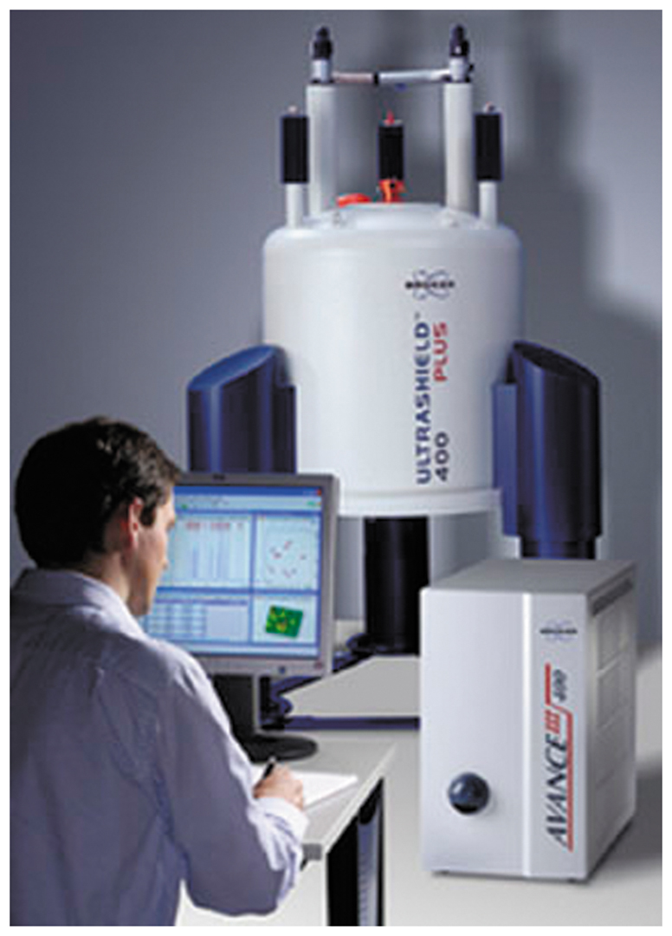
NMR Instrument

Slide 16
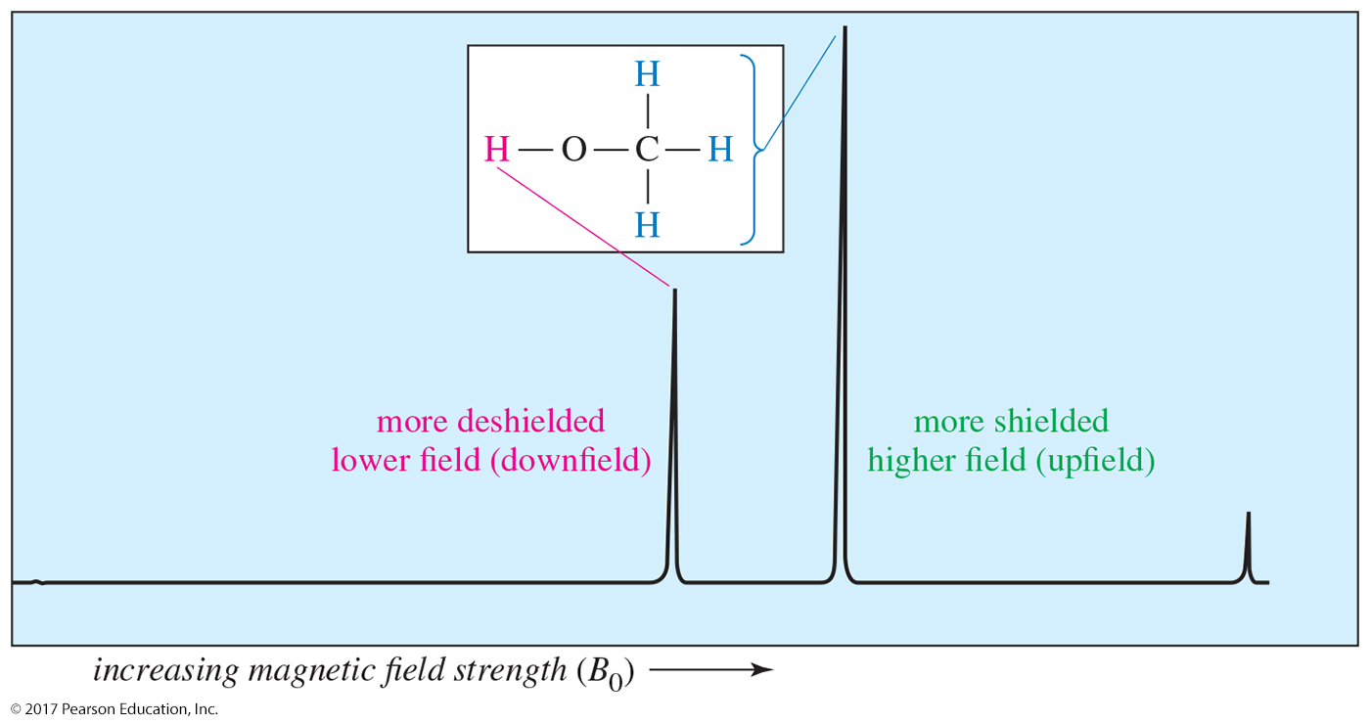
The NMR Graph
downfield
upfield
The more shielded methyl protons appear toward the right of the spectrum (higher field); the less shielded hydroxyl proton appears toward the left (lower field).

Slide 17
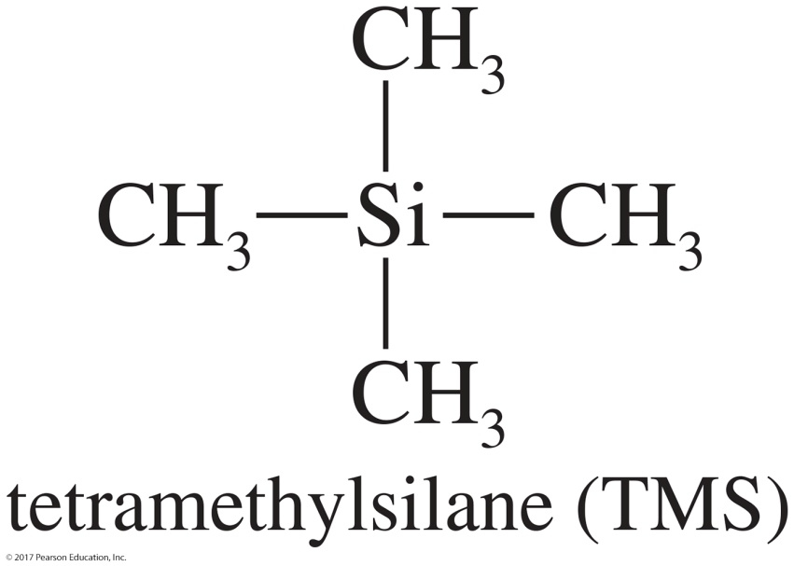
Tetramethylsilane (TMS)
TMS is added to the sample as an internal standard.
Since silicon is less electronegative than carbon, TMS protons are highly shielded.
The TMS signal is defined as 0.00 ppm.
Organic protons absorb downfield (to the left) of the TMS signal.

Slide 18
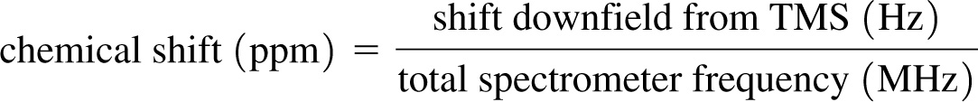
Chemical Shift
The variations in the positions of NMR absorptions, arising from electronic shielding and deshielding, are called chemical shifts.
The chemical shift (in ppm) is independent of the spectrometer used.
Most common scale is the δ (delta) scale.

Slide 19
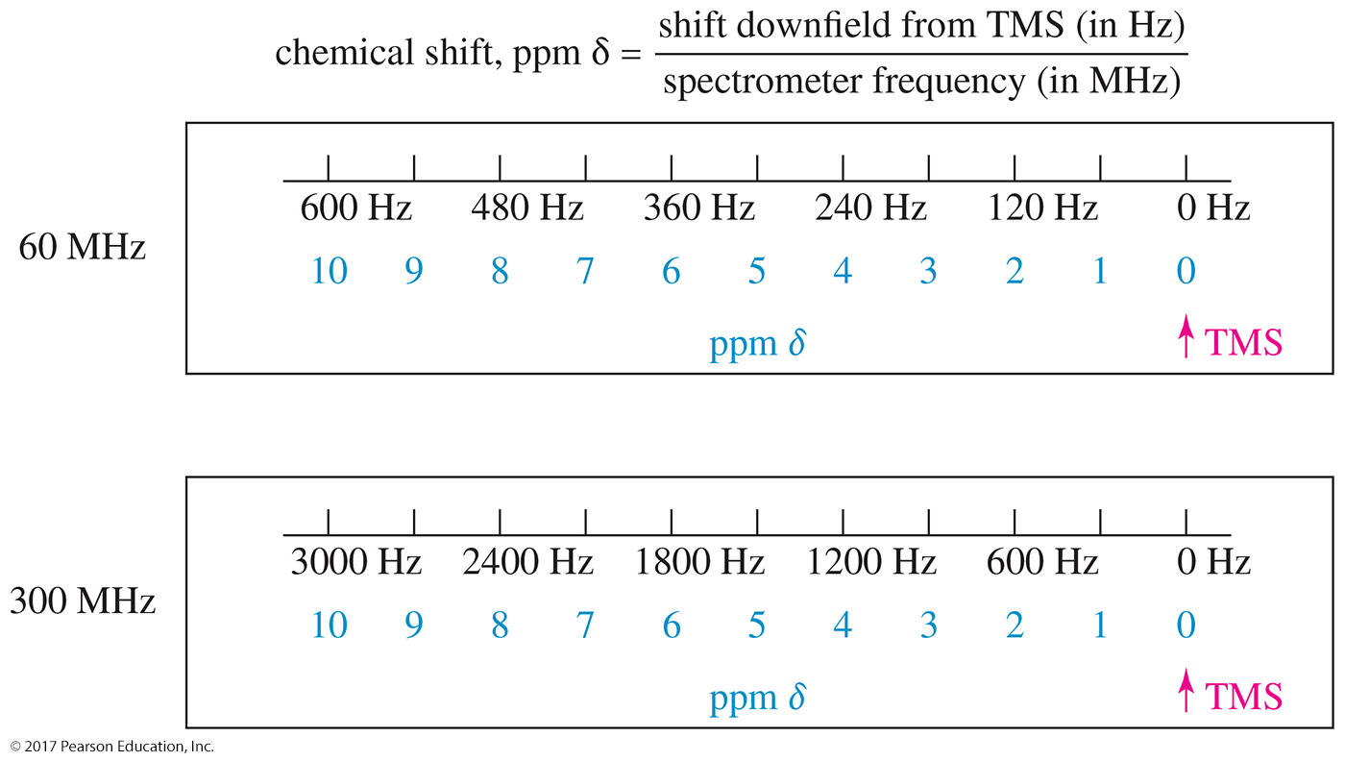
Delta Scale

Slide 20
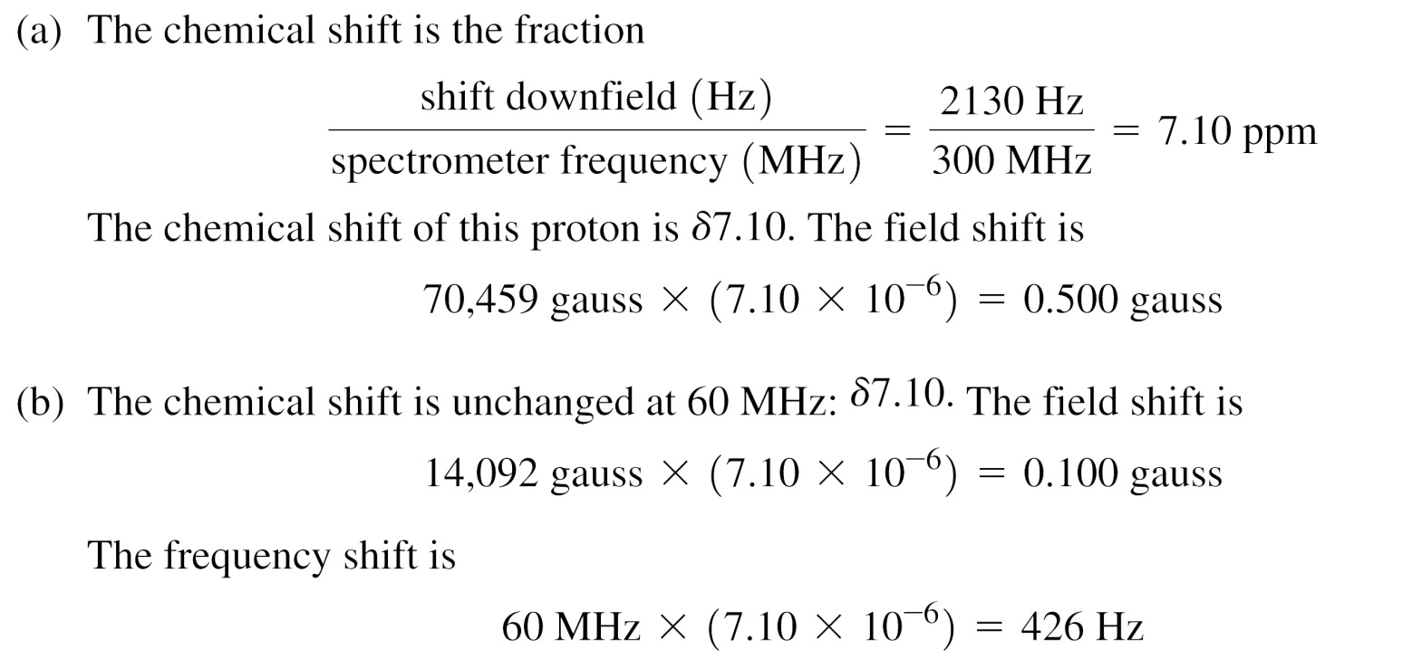
Solved Problem 1
A 300-MHz spectrometer records a proton that absorbs at a frequency 2130 Hz downfield from TMS.
(a) Determine its chemical shift, and express this shift as a magnetic field difference.
(b) Predict this proton’s chemical shift at 60 MHz. In a 60-MHz spectrometer, how far
downfield (in gauss and in hertz) from TMS would this proton absorb?
Solution
We substitute into the equation:

Slide 21
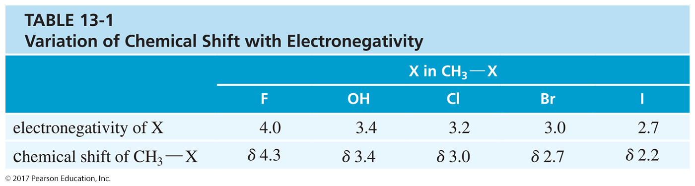
Variation of Chemical Shift

Slide 22
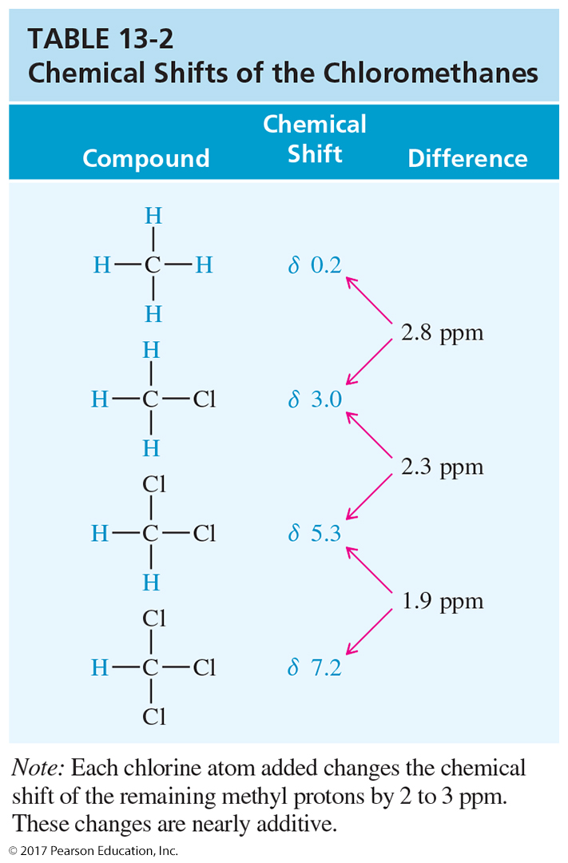
Electronegative Atoms
More electronegative atoms deshield more and give larger shift values.
Additional electronegative atoms cause an increase in chemical shift.

Slide 23
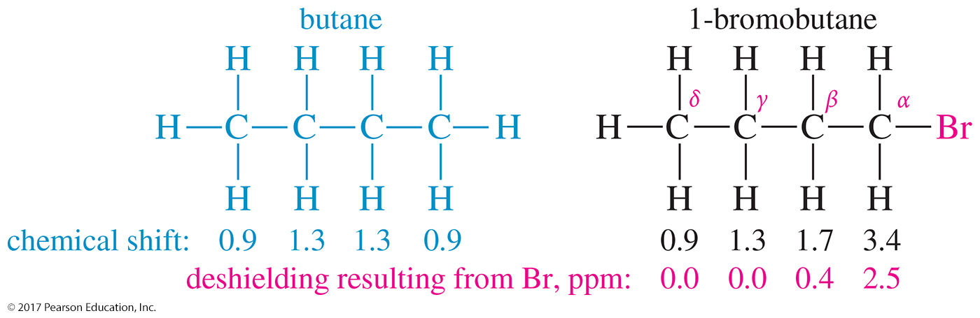
Location of
Electronegative Atoms
The deshielding effect of an electronegative substituent drops off rapidly with distance.

Slide 24
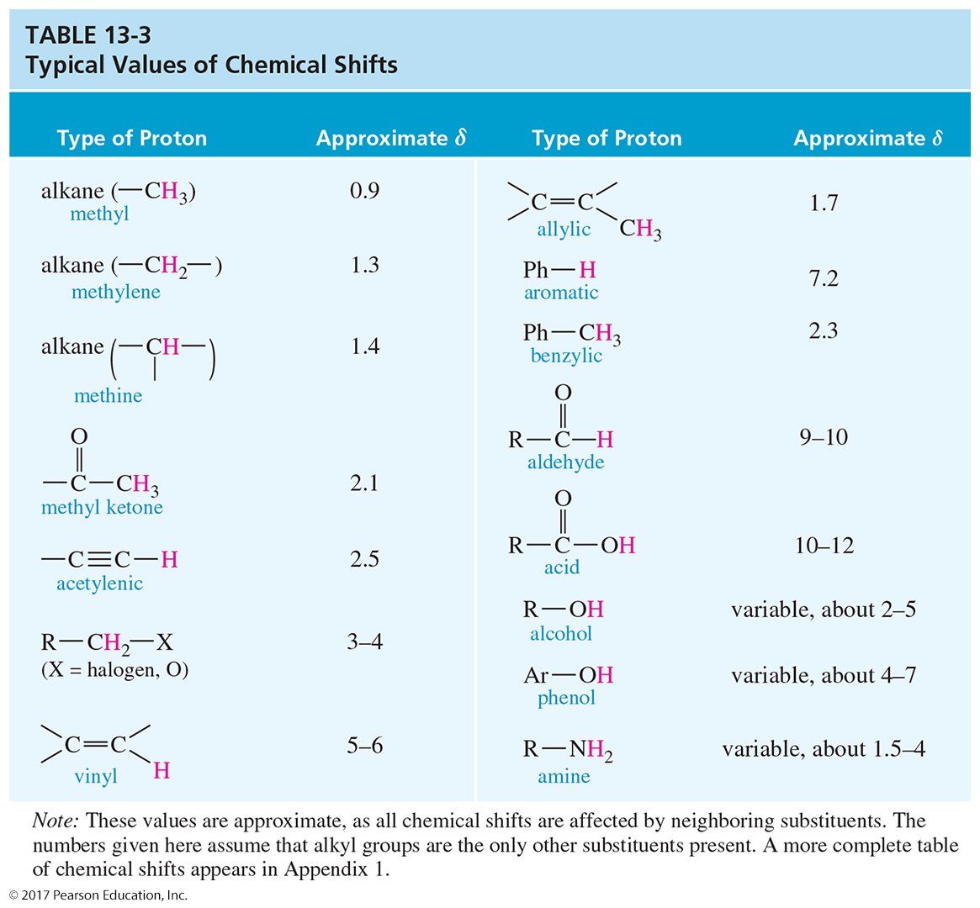
Typical Values

Slide 25
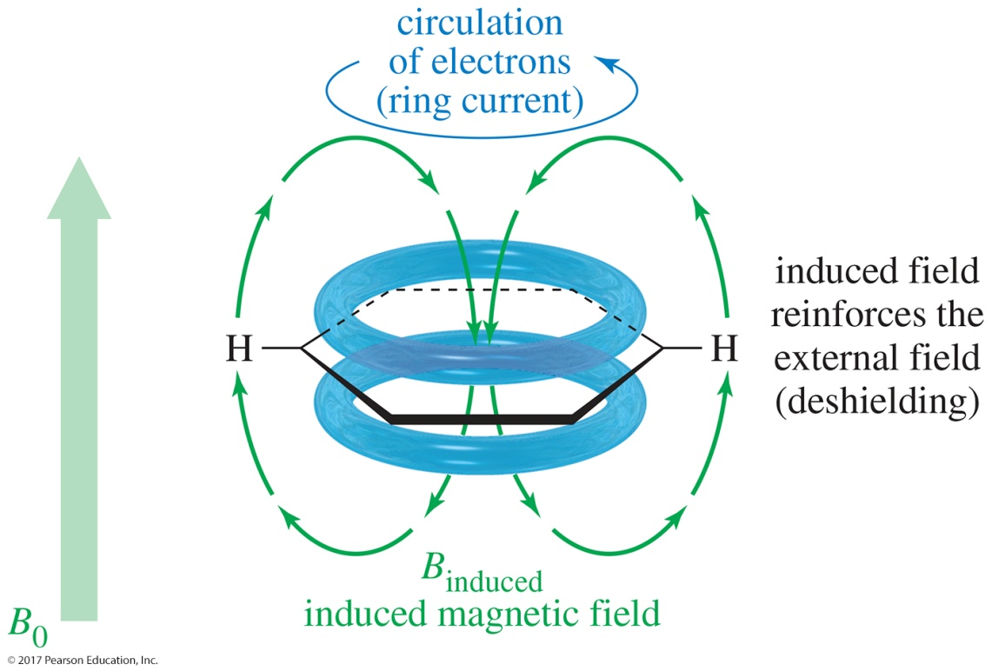
Magnetic Fields in
Aromatic Rings
The induced magnetic field of the circulating aromatic electrons opposes the applied magnetic field along the axis of the ring.
Protons in the region where the induced field reinforces the applied field are deshielded and will appear at lower fields in the spectrum between δ 7–8.

Slide 26
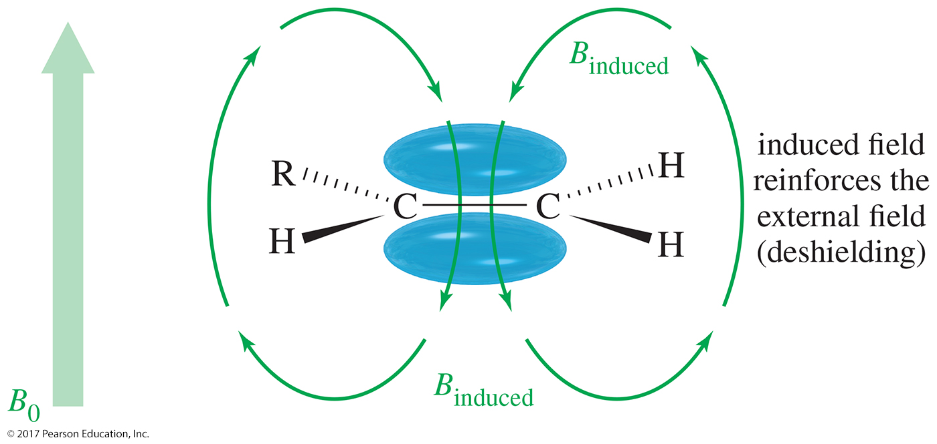
Magnetic Field of Alkenes
The pi electrons of the alkene generate a magnetic field that opposes the applied magnetic field in the middle of the molecule but reinforces the applied field on the outside where the vinylic protons are located.
This reinforcement will deshield the vinylic protons, making them shift downfield in the spectrum to the range of δ 5–6.

Slide 27
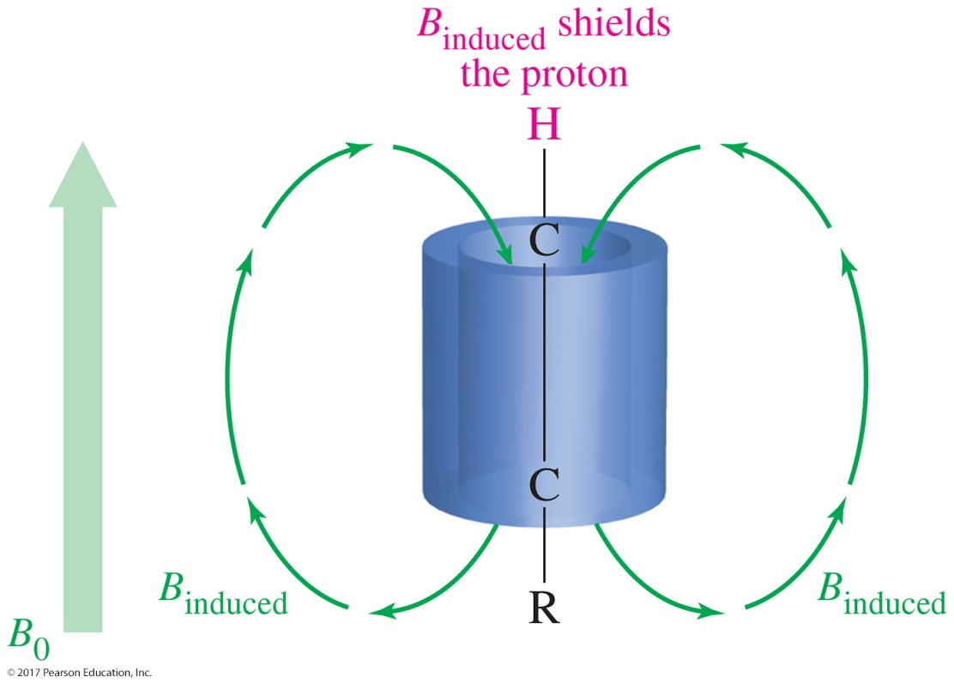
Magnetic Fields of Alkynes
When the terminal triple bond is aligned with the magnetic field, the cylinder of electrons circulates to create an induced magnetic field.
The acetylenic proton lies along the axis of this field, which opposed the external field.
The acetylenic protons are shielded and will be found at δ 2.5.

Slide 28
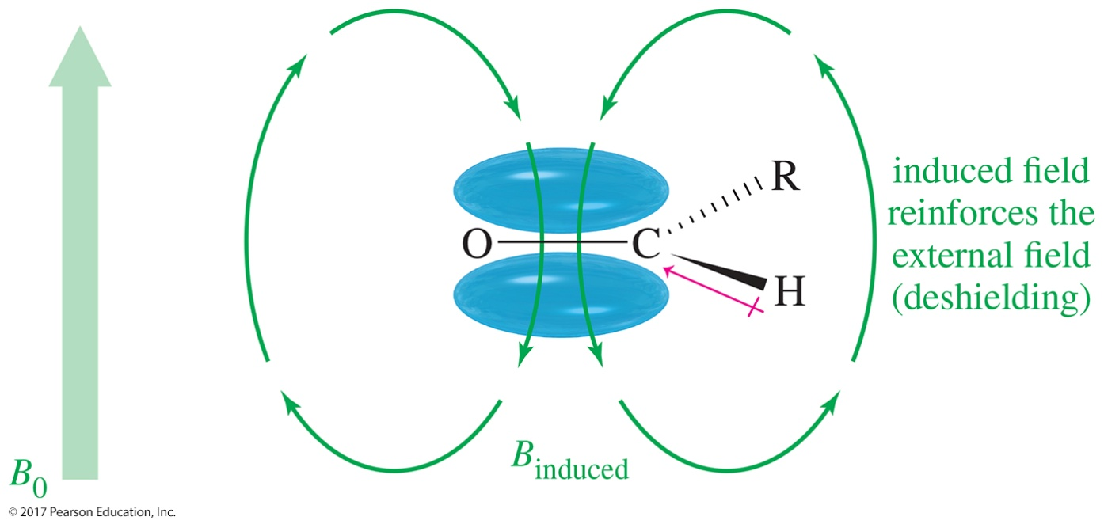
Deshielding of the
Aldehyde Proton
Like a vinyl proton, the aldehyde proton is deshielded by the circulation of electrons in the pi bond.
It is also deshielded by the electron-withdrawing effect of the carbonyl (C═O) group, giving a resonance between
δ 9 and 10.

Slide 29
O—H and N—H Signals
The chemical shift of the acidic protons depends on concentration.
Hydrogen bonding in concentrated solutions deshields the protons, so the signal is around δ 3.5 for N—H and δ 4.5 for O—H.
Proton exchanges between the molecules broaden the peak.

Slide 30
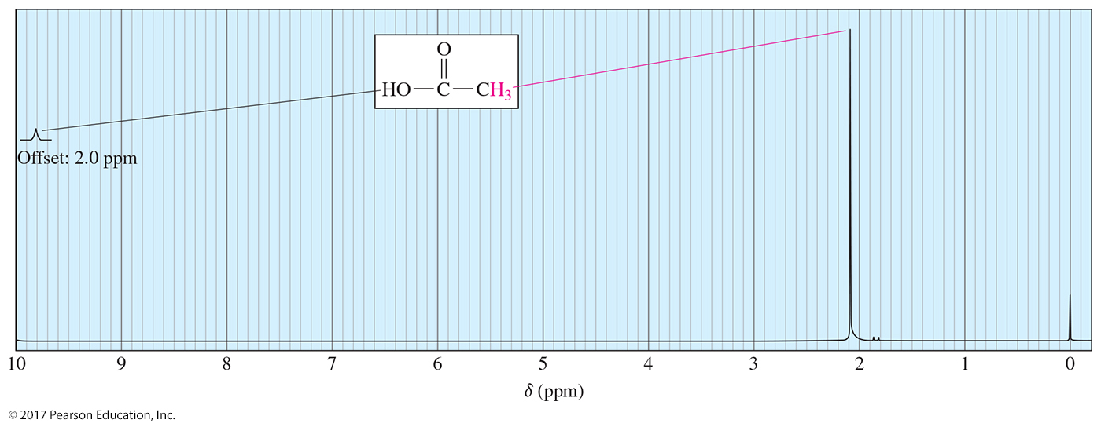
Carboxylic Acid Proton
Because of the high polarity of the carboxylic acid O—H bond, the signal for the acidic proton will be at shifts greater than δ 10.

Slide 31
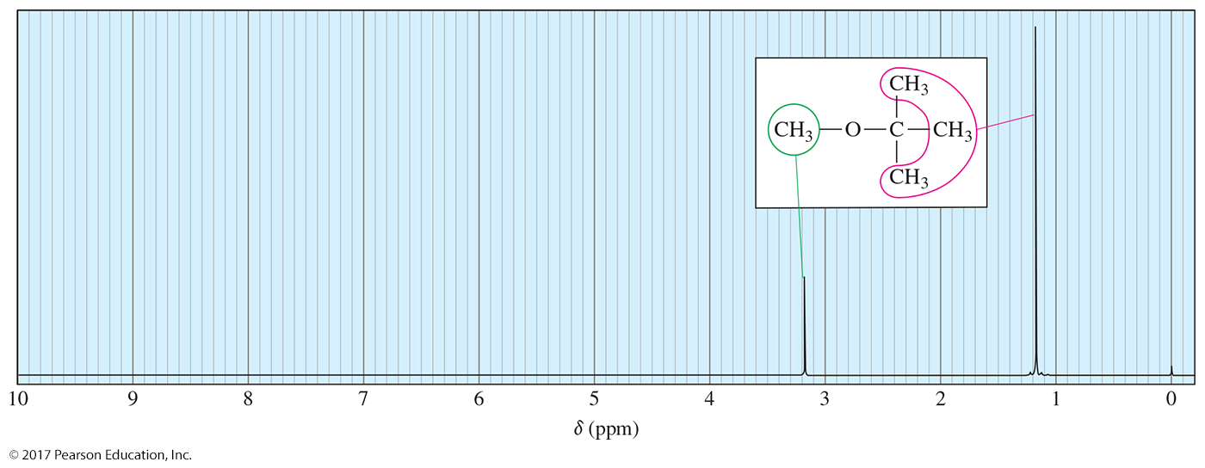
Number of Signals
Methyl tert-butyl ether has two types of protons, giving two NMR signals.
Chemically equivalent hydrogens have the same chemical shift. All the methyl groups of the tert-butyl group are equivalent and they produce only one signal.

Slide 32
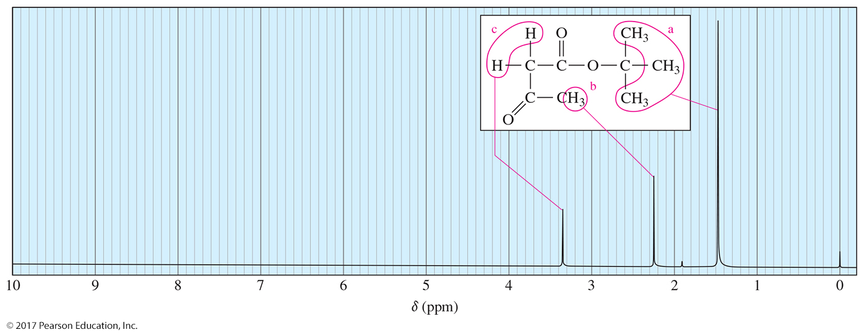
tert-Butyl Acetoacetate
The spectrum of tert-butyl acetoacetate has only three signals. The most shielded protons are the methyl groups of the tert-butyl. The most deshielded signal is the methylene (CH₂) because it is in between two carbonyl groups.

Slide 33
Solved Problem 2
Using Table 13-3, predict the chemical shifts of the protons in the following compounds.
Solution
(a) The methyl group in acetic acid is next to a carbonyl group; Table 13-3 predicts a chemical shift of about δ 2.1. (The experimental value is δ 2.10.) The acid proton (—COOH) should absorb between δ 10 and δ 12. (The experimental value is
δ 11.4, variable.)
(b) Protons a are on the carbon atom bearing the chlorine, and they absorb between δ 3 and δ 4 (experimental: δ 3.7). Protons b are one carbon removed, and they are predicted to absorb about δ 1.7, like the β protons in 1-bromobutane (experimental: δ 1.8). The methyl protons c will be nearly unaffected, absorbing around δ 0.9 ppm (experimental: δ 1.0).
(c) Methyl protons a are expected to absorb around δ 0.9 (experimental: δ 1.0). The vinyl protons b and c are expected to absorb between δ 5 and δ 6 (experimental: δ 5.8 for b and δ 4.9 for c).

Slide 34
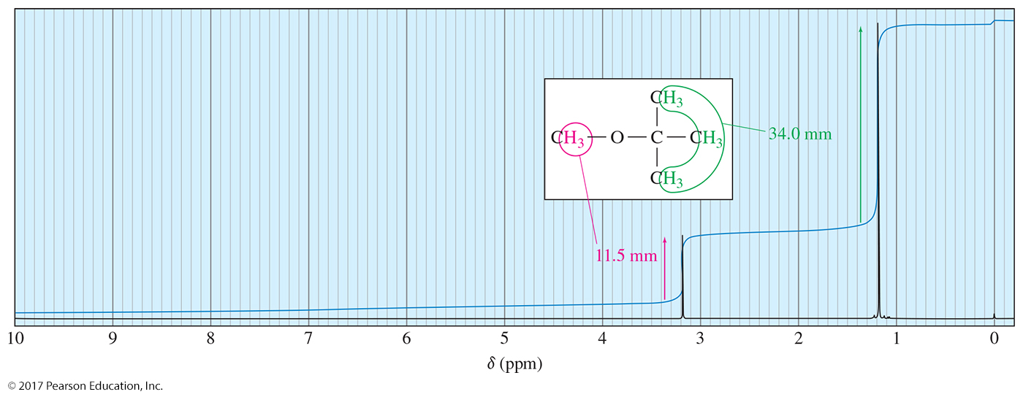
Intensity of Signals: Integration
The amount the integral trace rises is proportional to the area of that peak.
The integration will have a trace for the tert-butyl hydrogens that is three times as large as the trace for the methyl hydrogens. The relative area for methyl and tert-butyl hydrogens is 1:3.

Slide 35
Spin-Spin Splitting
Nonequivalent protons on adjacent carbons have magnetic fields that may align with or oppose the external field.
This magnetic coupling causes the proton to absorb slightly downfield when the external field
is reinforced and slightly upfield when the external field is opposed.
All possibilities exist, so the signal is split.
This splitting of signals into multiplets is called spin-spin splitting.

Slide 36
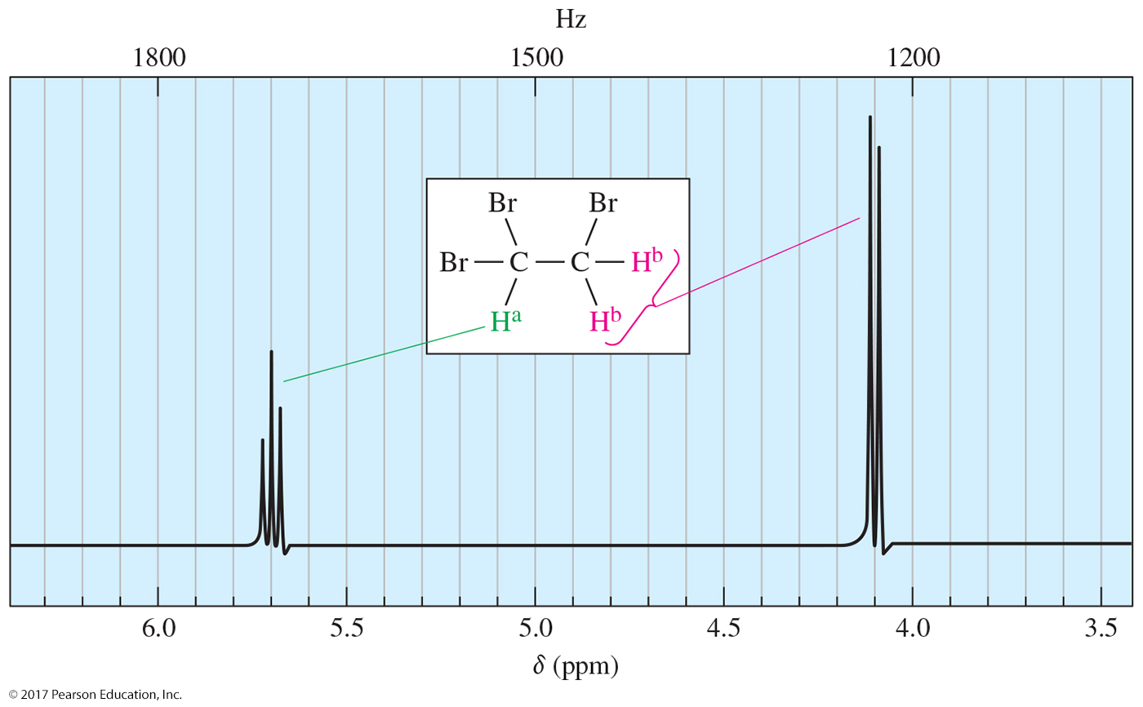
1,1,2-Tribromoethane
Spin-spin splitting is a reciprocal property. If one
proton splits another, the second proton must split
the first.

Slide 37
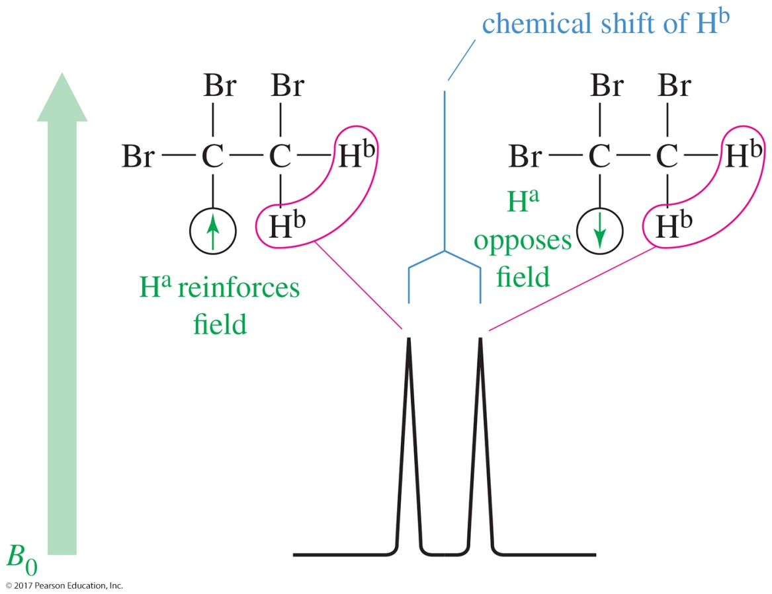
Doublet: One Adjacent Proton
H^{b} can feel the alignment of the adjacent proton Hª.
When Hª is aligned with the magnetic field, H^{b} will be deshielded.
When Hª is aligned against the magnetic field, H^{b} will be shielded.
The signal is split in two and is called a doublet.

Slide 38
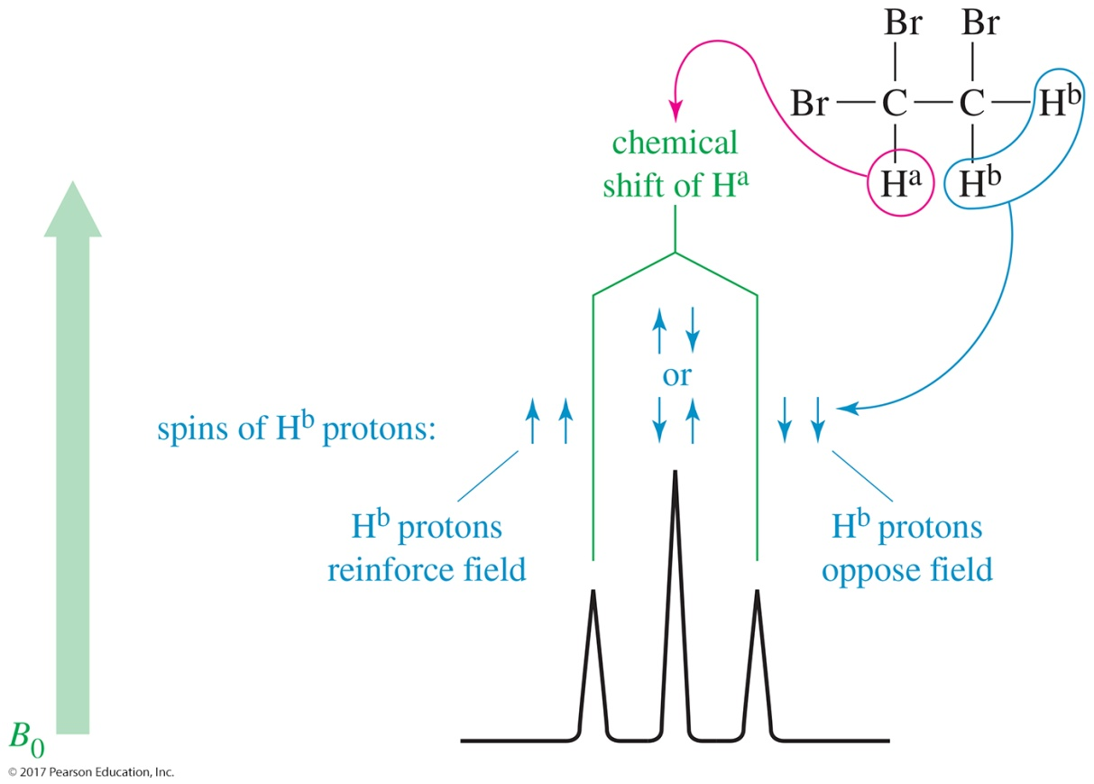
Triplet: Two Adjacent Protons
When both H^{b}s are aligned with the magnetic field, Hª will be deshielded.
When both H^{b}s are aligned against the magnetic field, Hª will be shielded.
It is more likely that one H^{b} will be aligned with the field and the other H^{b} against the field. The signal will be at its normal position.
The signal is split in three and is called a triplet.

Slide 39
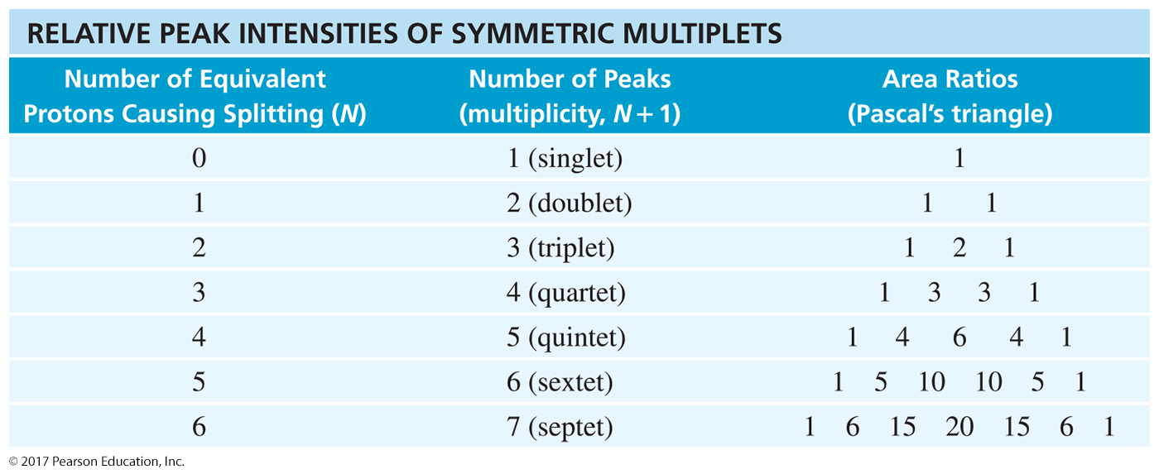
The N + 1 Rule
If a signal is split by N equivalent protons,
it is split into N + 1 peaks.

Slide 40
Spin-Spin Splitting Distance
Equivalent protons do not split each other.
Protons bonded to the same carbon will split each other if they are nonequivalent.
Protons on adjacent carbons normally will split each other.
Protons separated by four or more bonds will not split each other.

Slide 41
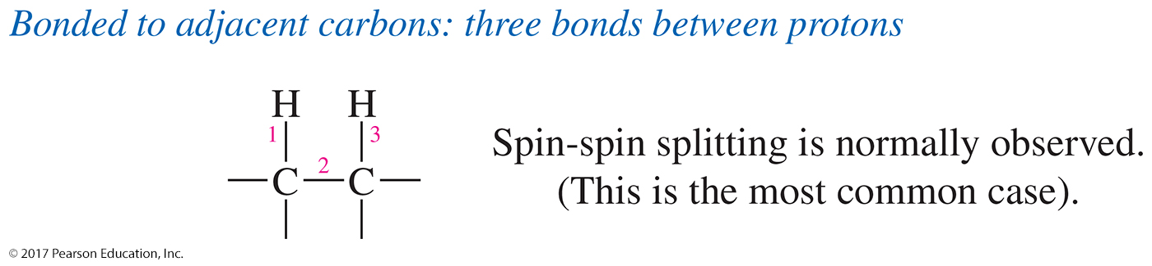
Long-Range Coupling
When the hydrogen atoms are four bonds or more apart, spin-spin splitting is not normally observed. When it actually does occur, it is called long-range coupling.

Slide 42
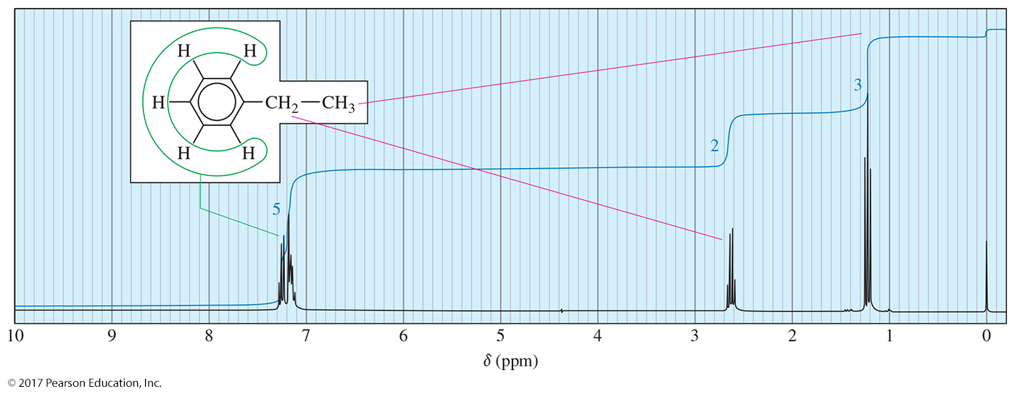
Splitting for Ethyl Groups
The hydrogens on the CH₃ are affected by the two neighboring hydrogens on the adjacent CH₂ group. According to the N + 1 rule, the CH₃ signal will be split into (2 + 1) = 3. This is a triplet.
The hydrogens on the CH₂ group are affected by the three hydrogens on the adjacent CH₃ groups. The N + 1 rule for the CH₂ signal will be split into (3 + 1) = 4. This is called a quartet.

Slide 43
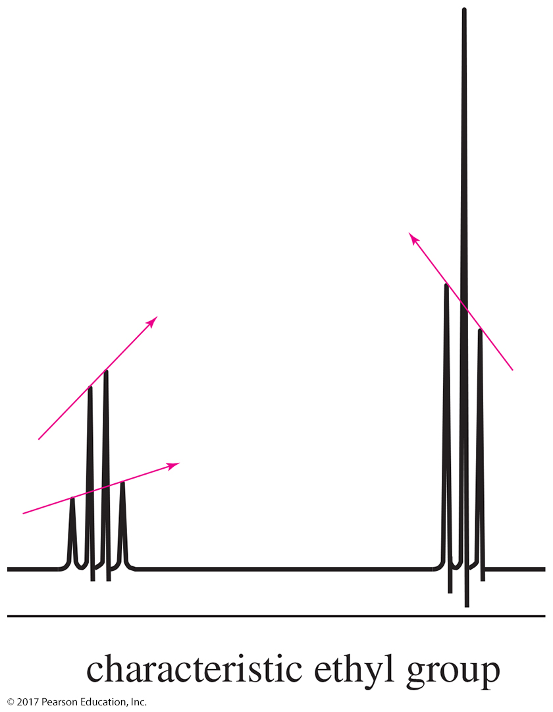
Leaning of a Multiplet

Slide 44
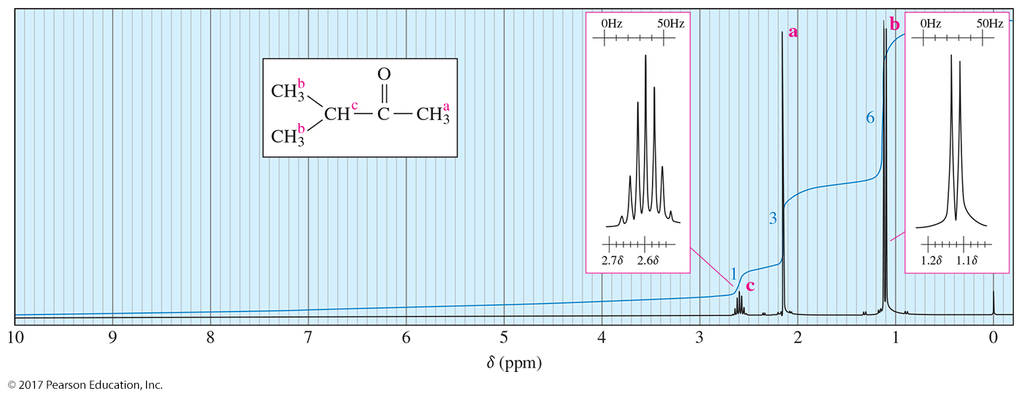
Splitting for Isopropyl Groups
The hydrogen on the CH has six adjacent hydrogens. According to the N + 1 rule, the CH signal will be split into (6 + 1) = 7. This is called a septet.
The two CH₃^{b}s are equivalent, so they give the same signal. They have one adjacent hydrogen (CH), so their signal will be N + 1, 1 + 1 = 2 (doublet).

Slide 45
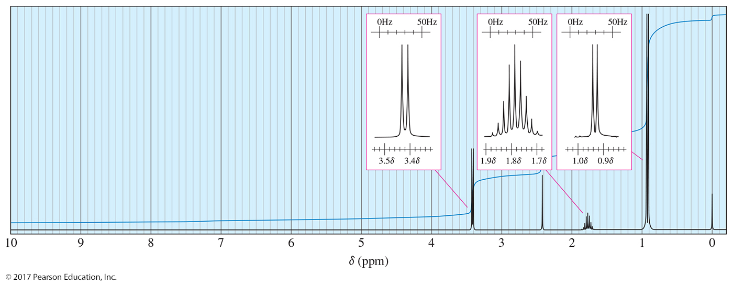
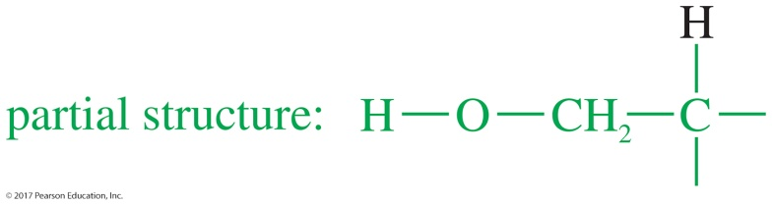
Solved Problem 3
Propose a structure for the compound of molecular formula C₄H₁₀O whose proton NMR spectrum follows.
Solution
The molecular formula C₄H₁₀O indicates no elements of unsaturation. Four types of hydrogens appear in this spectrum, in the ratio 2:1:1:6. The singlet (one proton) at δ 2.4 might be a hydroxy group, and the signal (two protons) at δ 3.4 corresponds to protons on a carbon atom bonded to oxygen. The δ 3.4 signal is a doublet, implying that the adjacent carbon atom bears one hydrogen.

Slide 46
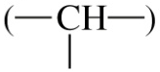
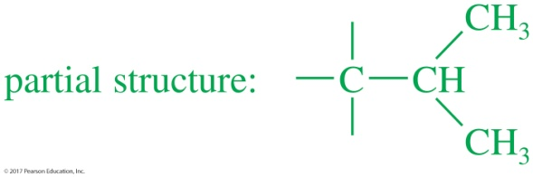
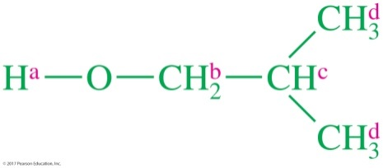
Solved Problem 3 (Continued)
Solution (Continued)
(Since we cannot be certain that the δ 2.4 absorption is actually a hydroxy group, we might consider shaking the sample with D₂O. If the 2.4 ppm absorption represents a hydroxy group, it will shrink or vanish after shaking with D₂O.)
The signals at δ 1.8 and δ 0.9 resemble the pattern for an isopropyl group. The integral ratio of 1:6 supports this assumption. Because the methine proton of the
isopropyl group absorbs at a fairly high field, the isopropyl group must be bonded to a carbon atom rather than an oxygen.
Our two partial structures add to a total of six carbon atoms (compared with the four in the molecular formula) because two of the carbon atoms appear in both partial structures. Drawing the composite of the partial structures, we have isobutyl alcohol:
This structure must be rechecked to make sure that it has the correct molecular formula and that it accounts for all the structural evidence provided by the spectrum (Problem 13-23).

Slide 47
Coupling Constants
The coupling constant is the distance between the peaks of a multiplet (in Hz).
Coupling constants are independent of strength of the external field.
Multiplets with the same coupling constants may come from adjacent groups of protons that split each other.

Slide 48
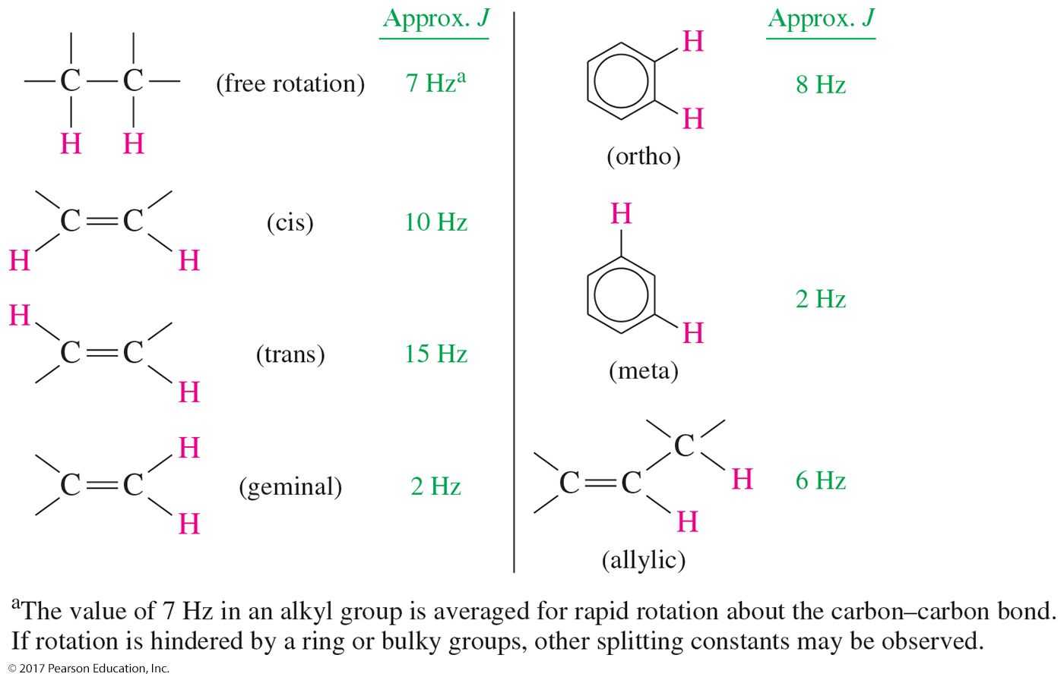
Values for Coupling Constants

Slide 49
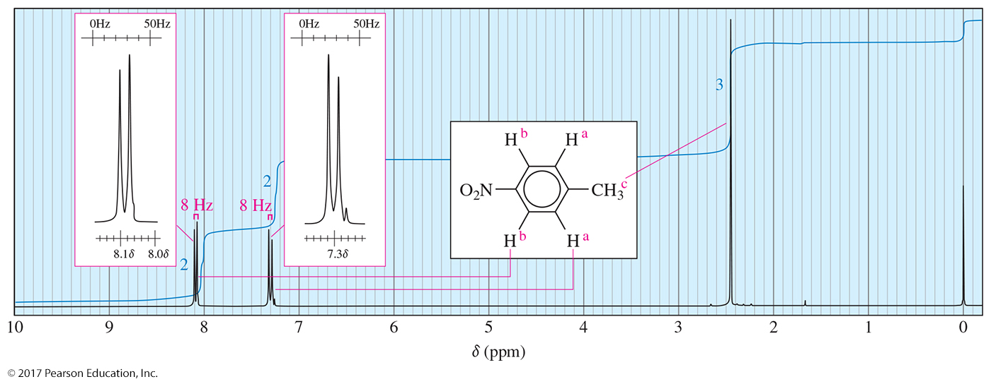
Proton NMR for p-Nitrotoluene
para-Nitrotoluene has two pairs of equivalent aromatic protons a and b. Since the coupling constant for ortho hydrogens is approximately 8 Hz, the peaks of the signal will be separated by around 8 Hz.

Slide 50
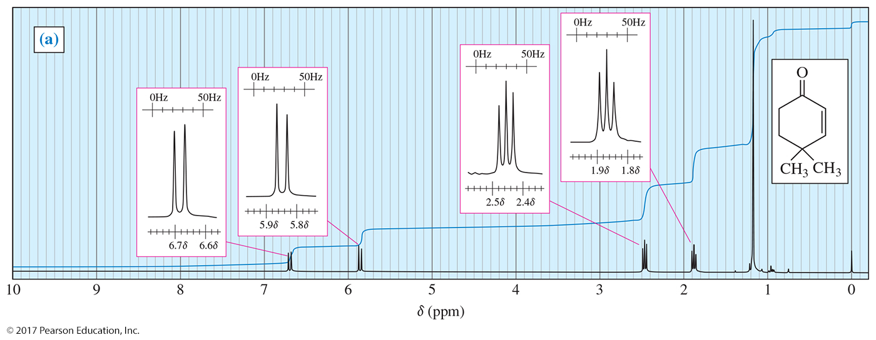
Vinylic Coupling Constants
There are two vinylic protons in 4,4-dimethylcyclohex-2-ene-1-one, and they are cis.
The coupling constant for cis coupling is approximately 10 Hz, so the peaks should be separated by that amount.

Slide 51
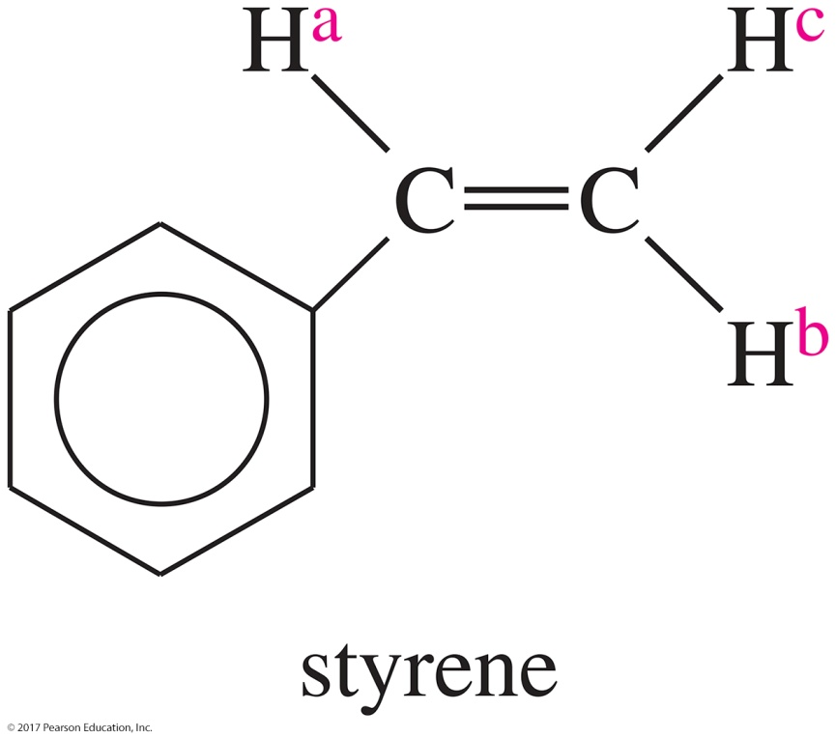
Complex Splitting
Signals may be split by adjacent protons that are different from each other with different coupling constants.
Example: Hª of styrene is split by an adjacent H^{b} trans to it (J = 17 Hz) and an adjacent H^{c} cis to it (J = 11 Hz).

Slide 52
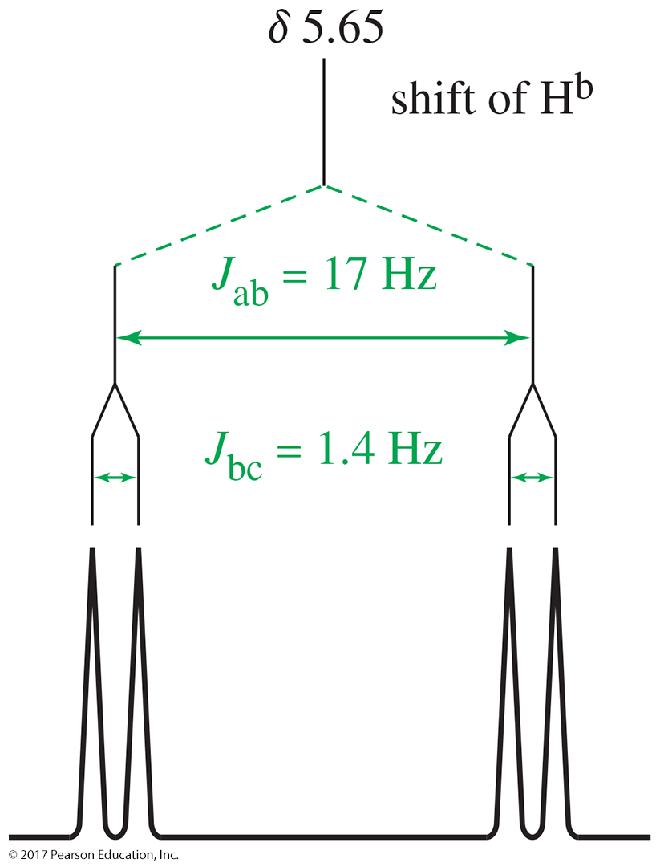
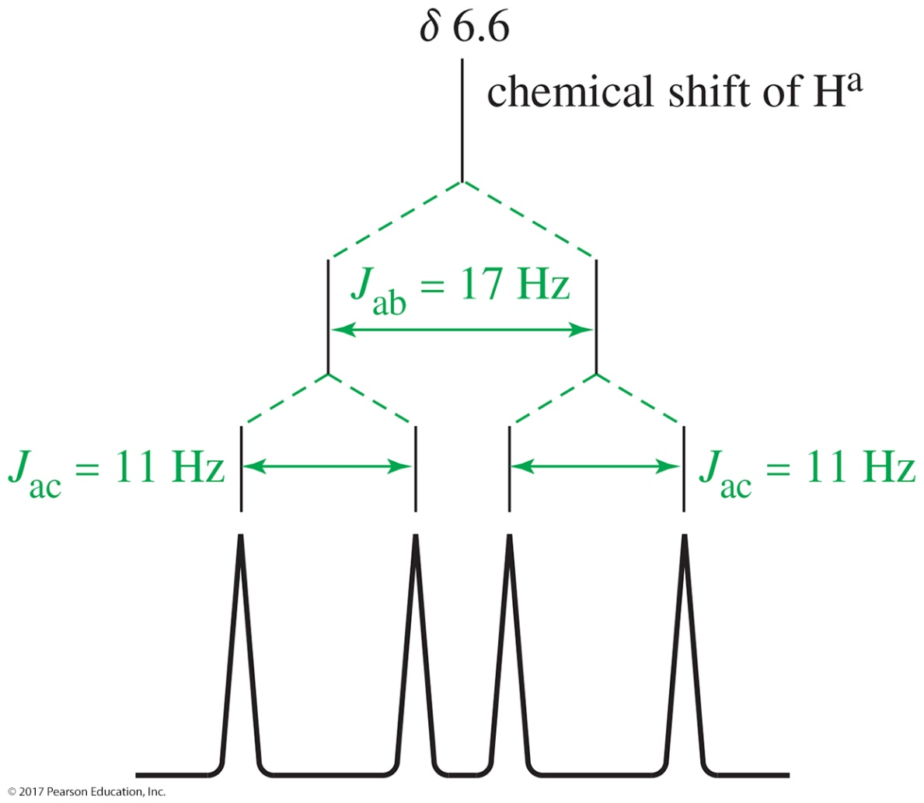
Splitting Tree for Styrene

Slide 53
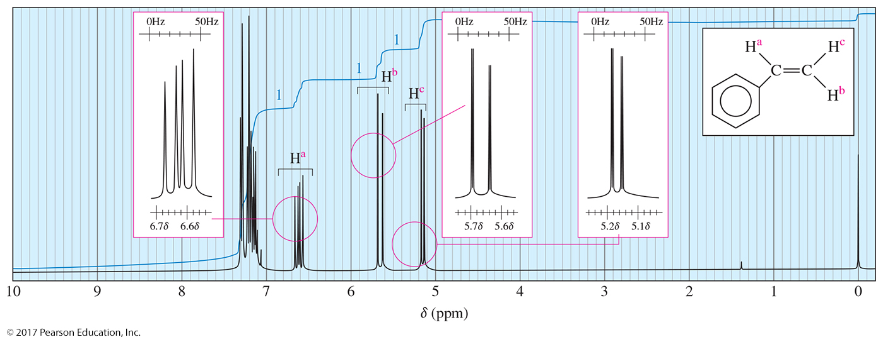
¹H-NMR Spectrum of Styrene

Slide 54
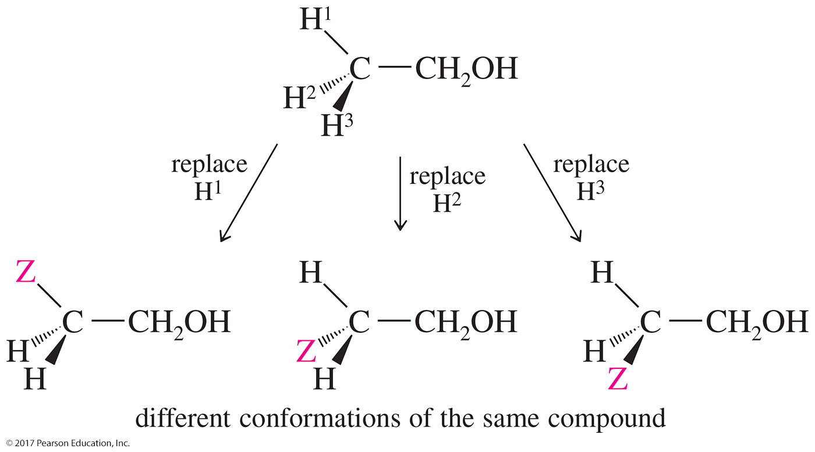
Stereochemical Nonequivalence
If the replacement of each of the protons of a —CH₂ group with an imaginary “Z” gives stereoisomers, then the protons are nonequivalent and will split each other.

Slide 55
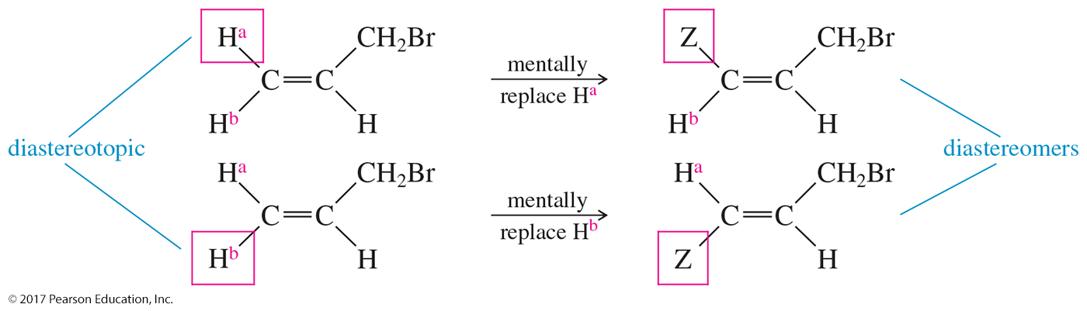
Diastereotopic Vinylic Protons
Replacing the cis hydrogen gives the cis diastereomer, and replacing the trans hydrogen makes the trans diastereomer.
Because the two imaginary products are diastereomers, these protons are called diastereotopic protons.
Diastereotopic hydrogens are capable of splitting each other.

Slide 56

Diastereotopic Protons
The two protons on the —CH₂Cl group are diastereotopic; their imaginary replacements give diastereomers.
Diastereotopic protons are usually vicinal to stereocenters (chiral carbons).

Slide 57

Proton NMR Spectrum of
1,2-Dichloropropane
Proton NMR spectrum of 1,2-dichloropropane shows distinct absorptions for the methylene protons on C1.
These hydrogen atoms are diastereotopic and are chemically nonequivalent.

Slide 58
Time Dependence
Molecules are tumbling relative to the magnetic field, so NMR is an averaged spectrum of all the orientations.
Axial and equatorial protons on cyclohexane interconvert so rapidly that they give a single signal.
Proton transfers for OH and NH may occur so quickly that the proton is not split by adjacent protons in the molecule.

Slide 59

Hydroxyl Proton in a
Pure Sample
Ultrapure samples of ethanol show splitting.

Slide 60

Hydroxyl Proton in an
Impure Sample
Ethanol with a small amount of acidic or basic impurities will not show splitting.

Slide 61

N—H Proton
The acidic proton on the nitrogen has a moderate rate of exchange.
The peak may be broad.

Slide 62
Identifying the O—H or N—H Peak
Chemical shift will depend on concentration and solvent.
To verify that a particular peak is due to O—H or N—H, shake the sample with D₂O to exchange the H for a D.
The deuterium is invisible in the proton NMR, so the original signal for the OH will disappear.
R—O—H + D—O—D R—O—D + D—O—H
R—NH₂ + 2 D—O—D R—ND₂ + 2 D—O—H

Slide 63
Carbon-13 NMR
Carbon-12 (¹²C) has no magnetic spin.
Carbon-13 (¹³C) has a magnetic spin, but is only 1% of the carbon in a sample.
The gyromagnetic ratio of ¹³C is one-fourth of that of ¹H.
For carbon, a technique called Fourier transform spectroscopy is used.

Slide 64

Fourier Transform NMR
A radio-frequency pulse is given.
Nuclei absorb energy and precess (spin) like
little tops.
A complex signal is produced and then decays as the nuclei lose energy.
Free induction decay (FID) is converted to a spectrum.

Slide 65

Carbon Chemical Shifts
Table of approximate chemical shifts values for ¹³C-NMR: Most of these values for a carbon atom are about 15–20 times the chemical shift of a proton if it were bonded to the carbon atom.

Slide 66

Combined ¹³C and ¹H Spectra

Slide 67
Differences Between ¹H and
¹³C Technique
Resonance frequency is about one-fourth that of hydrogen, 15.1 MHz instead of
60 MHz.
Peak areas are not proportional to the number of carbons.
Carbon atoms with more hydrogens absorb more strongly.

Slide 68
Spin-Spin Splitting
It is unlikely that a ¹³C would be adjacent to another ¹³C, so splitting by carbon is negligible.
¹³C will magnetically couple with attached protons and adjacent protons.
These complex splitting patterns are difficult to interpret.

Slide 69
Proton Spin Decoupling
To simplify the spectrum, protons are continuously irradiated with broadband “noise,” so they are rapidly flipping.
The carbon nuclei see an average of all the possible proton spin states.
Thus, each different kind of carbon gives a single, unsplit peak because carbon–hydrogen splitting was eliminated.

Slide 70

¹H and ¹³C-NMR of
1,2,2-Trichloropropane

Slide 71

Off-Resonance Decoupling
¹³C-NMR of 1,2,2-Trichloropropane
¹³C nuclei are split only by the protons attached directly to them.
The N + 1 rule applies: A carbon with N number of protons gives a signal with N + 1 peaks.

Slide 72
Interpreting ¹³C NMR
The number of different signals indicates the number of different kinds of carbon.
The location (chemical shift) indicates the type of functional group.
The splitting pattern of an off-resonance, decoupled spectrum indicates the number of protons attached to the carbon.

Slide 73

Two ¹³C NMR Spectra

Slide 74
DEPT ¹³C NMR
DEPT (Distortionless Enhanced Polarization Transfer) provides the same information as off-resonance decoupling.
Easier to run with Fourier-transform spectrometers
Each ¹³C nucleus is magnetically coupled to the protons bonded to it.

Slide 75

Information from ¹³C DEPT

Slide 76

Interpreting Carbon NMR Spectra
Interpreting ¹³C NMR spectra uses the same principles as interpreting ¹H NMR spectra.

Slide 77
Magnetic Resonance
Imaging (MRI)
Nuclear magnetic resonance imaging is a noninvasive diagnostic tool.
“Nuclear” is omitted because of the public’s fear that it would be radioactive.
A computer puts together “slices” to get
3-D images.
Tumors are readily detected.

Slide 78

MRI Scan of a Human Brain
MRI scan of a human brain showing a metastatic tumor in one hemisphere

Slide 79

MRI Image of the Pelvic Region

