Slide 1
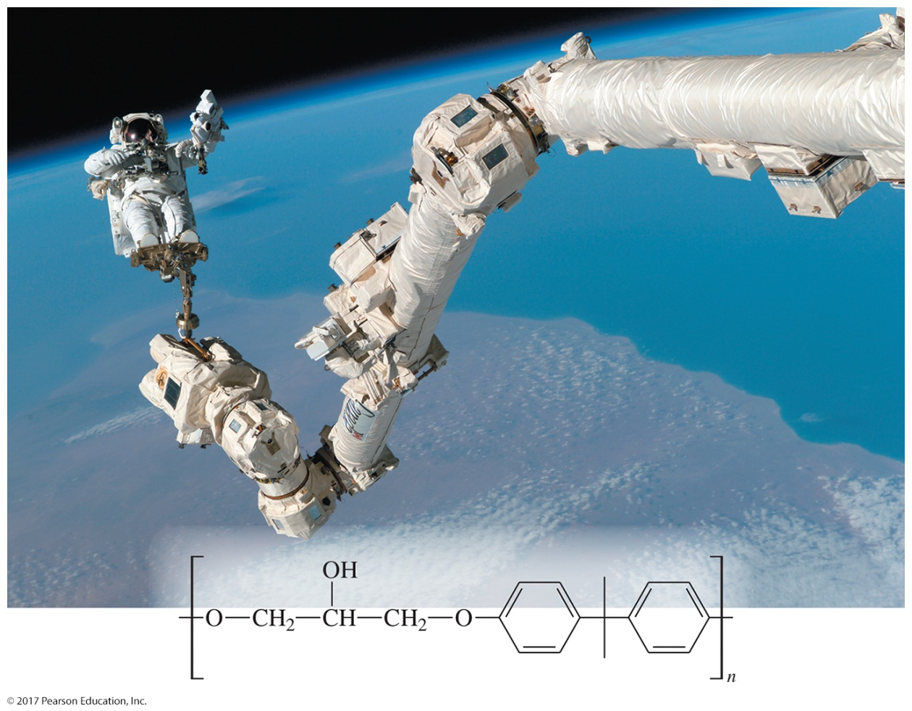
Organic Chemistry,
9th Edition
L. G. Wade, Jr.
Chapter 14
Lecture
Ethers, Epoxides, and Thioethers
Chad Snyder, PhD
Grace College
© 2017 Pearson Education, Inc.

Slide 2
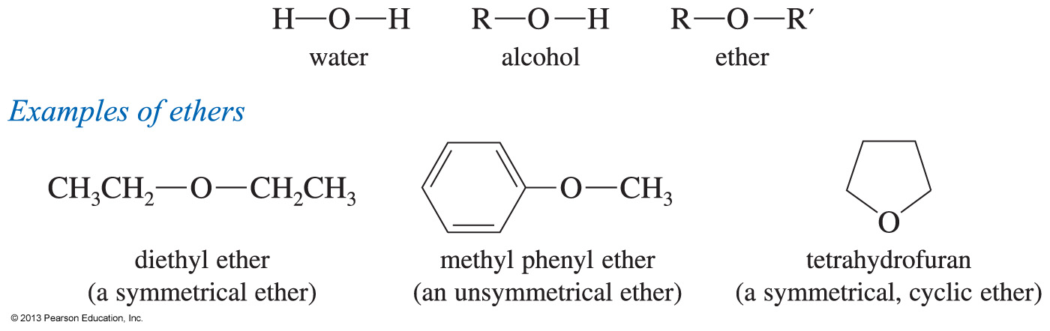
Ethers
The formula is R—O—R′, where R and R′ are alkyl or aryl.
Symmetrical or unsymmetrical

Slide 3
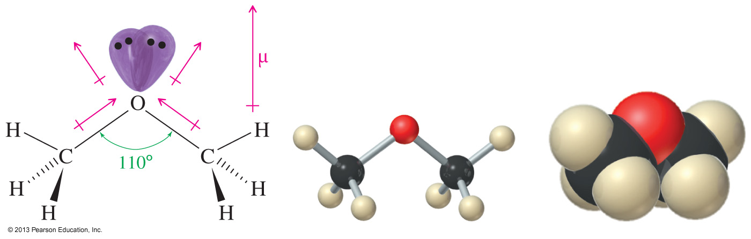
Structure and Polarity
Oxygen is sp³ hybridized.
Bent molecular geometry
Tetrahedral C—O—C angle is 110°.
Polar C—O bonds

Slide 4
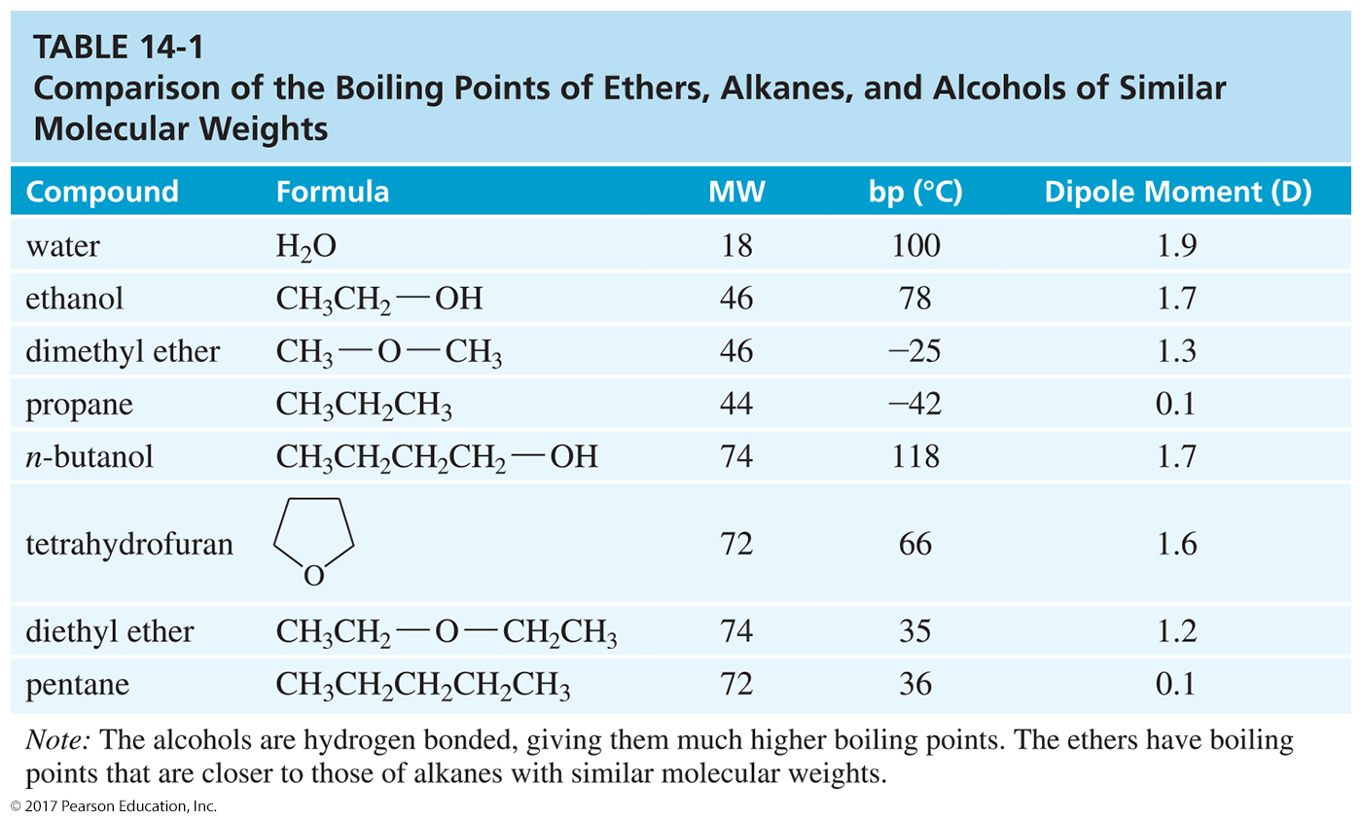
Boiling Points
Similar to alkanes of comparable molecular weight

Slide 5
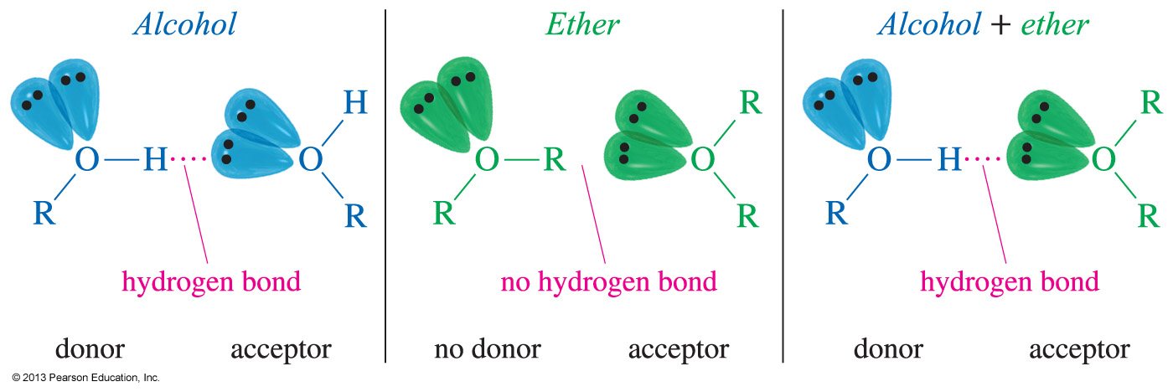
Hydrogen Bond Acceptor
Ethers cannot hydrogen bond with other ether molecules, so they have a lower boiling point than alcohols.
Ether molecules can hydrogen bond with water and alcohol molecules.
They are hydrogen bond acceptors.

Slide 6
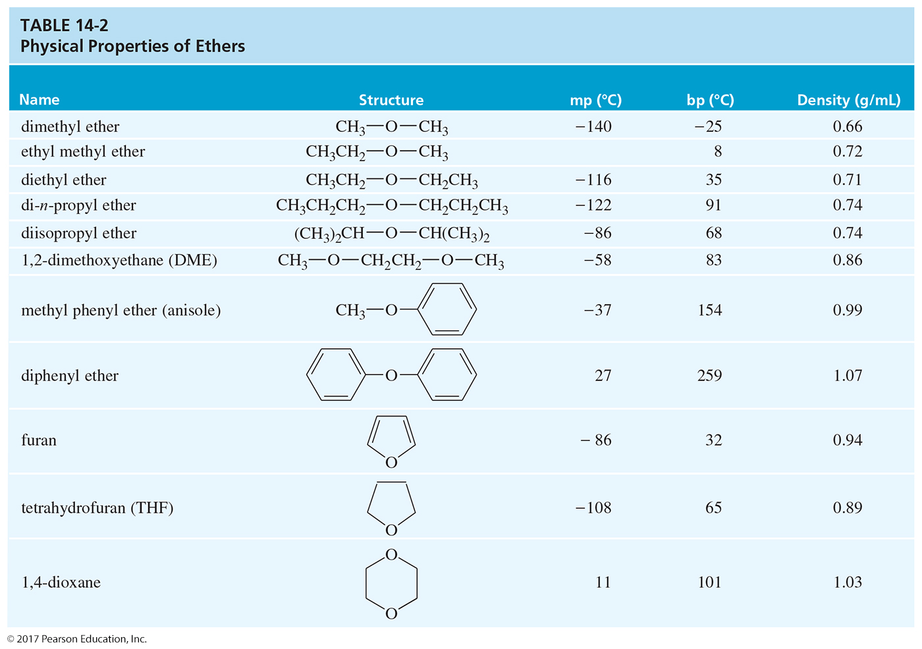

Slide 7
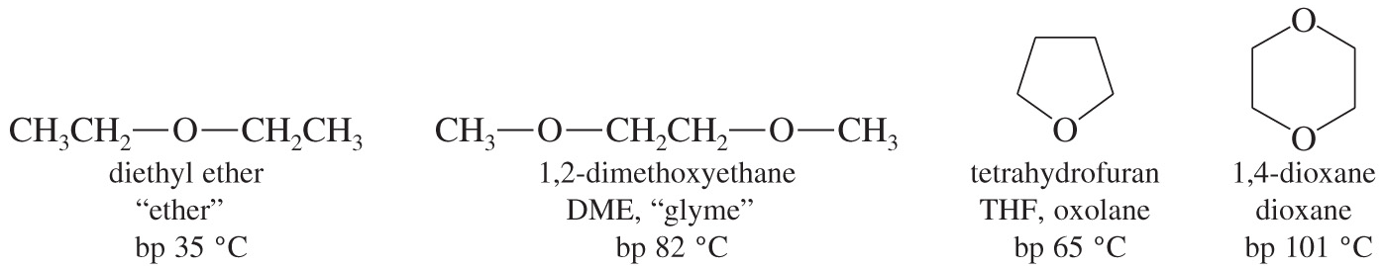
Ethers As Solvents
Ethers are widely used as solvents because
  they can dissolve nonpolar and polar substances.
  they are unreactive toward strong bases.

Slide 8
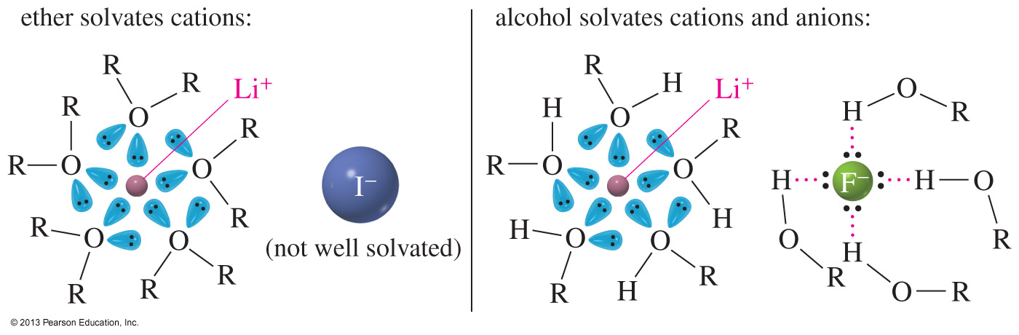
Solvation of Ions with Ether
An ionic substance such as lithium iodide is moderately soluble in ethers because the small lithium cation is strongly solvated by the ether’s lone pairs of electrons.
Unlike alcohols, ethers cannot serve as hydrogen bond donors, so they do not solvate small anions well.

Slide 9
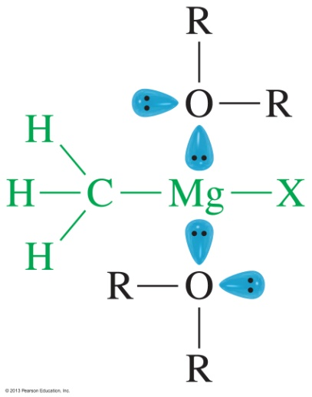
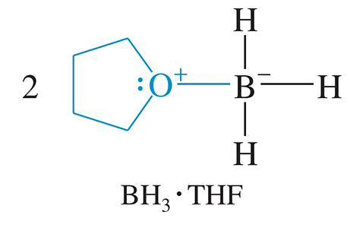
Ether Complexes
Grignard reagents: Complexation of an ether with a Grignard reagent stabilizes the reagent and helps keep it in solution.
Electrophiles: The ether’s nonbonding electrons stabilize the borane (BH₃).

Slide 10
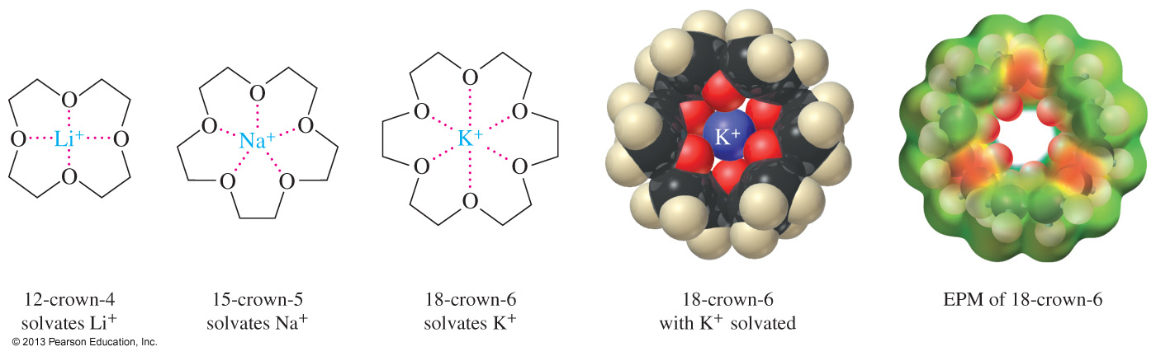
Crown Ether Complexes
Crown ethers can complex metal cations in the center of the ring.
The size of the ether ring will determine which cation it can solvate better.
Complexation by crown ethers often allows polar inorganic salts to dissolve in nonpolar organic solvents.

Slide 11
Common Names of Ethers
Name the two alkyl groups attached to the oxygen and add the word ether.
Name the groups in alphabetical order.
Symmetrical: Use dialkyl or just alkyl.
C
H
3
C
H
3
C
H
2
O
C
H
2
C
H
3
C
H
3
O
C
C
H
3
C
H
3
diethyl ether or
ethyl ether
t-butyl methyl ether or
methyl t-butyl ether

Slide 12
IUPAC Names: Alkoxy Alkane Names
The more complex alkyl group is the alkane name. The small group (with the oxygen) becomes an “alkoxy” group.
C
H
3
O
C
H
3
C
H
3
O
C
C
H
3
C
H
3
2-Methyl-2-methoxypropane
Methoxycyclohexane

Slide 13
Cyclic Ethers (Heterocycles)
Heterocyclic: Oxygen is part of the ring.
Epoxides (oxiranes)
Oxetanes
Furans (oxolanes )
Pyrans (oxanes )
Dioxanes

Slide 14
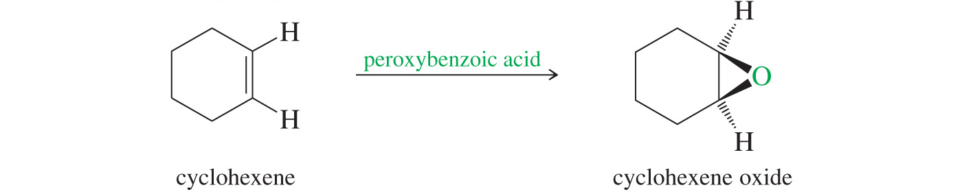
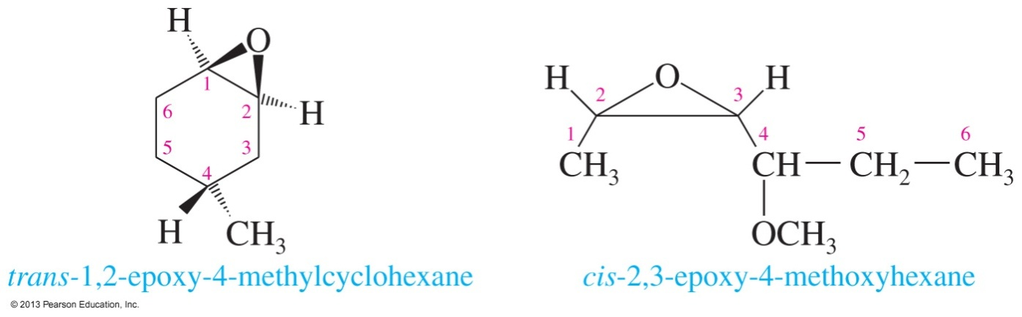
Epoxide Nomenclature
Name the starting alkene and add oxide.
The oxygen can be treated as a substituent (epoxy) on the compound. Use numbers to specify position.

Slide 15
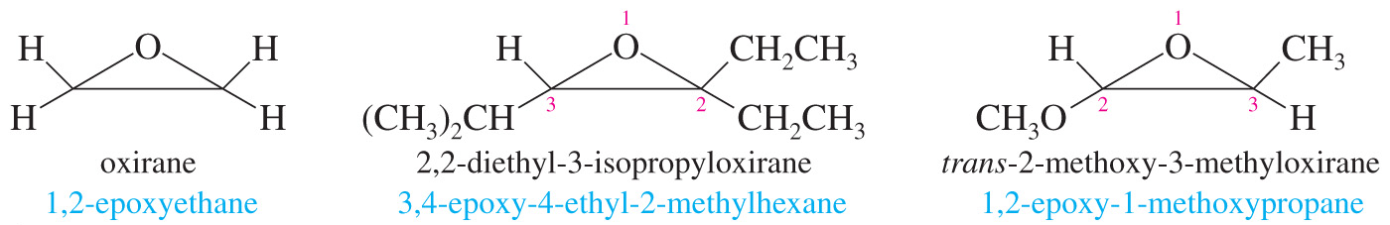
Epoxide Nomenclature (Continued)
The three-membered oxirane ring is the parent. (Oxygen is 1; the carbons are 2 and 3.) Substituents are named in alphabetical order.

Slide 16
IR Spectroscopy of Ethers
IR: The C—O stretch is in the fingerprint region around 1000–1200 cm^{–1}.
Many compounds have the C—O stretch.
If the IR spectrum has the C—O stretch but does not have a C═O or an OH stretch, then the compound is most likely an ether.

Slide 17
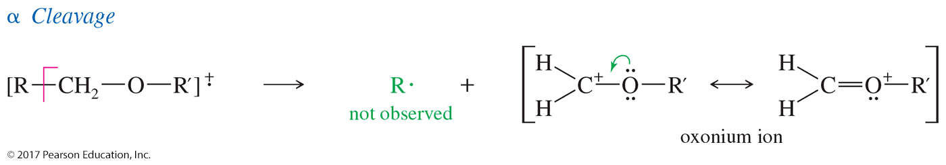
MS Spectrometry of Ethers
Main fragmentation is the α cleavage to form the resonance-stabilized oxonium ion.
Either alkyl group can be cleaved this way.

Slide 18
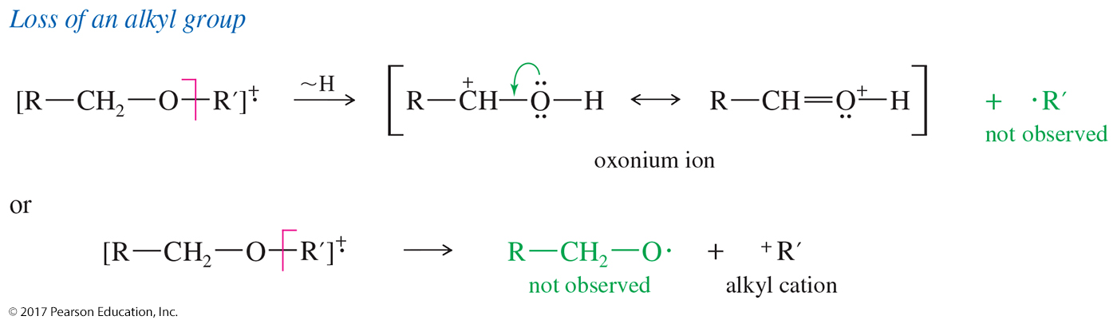
Loss of an Alkyl Group
The C—O bond can be cleaved to produce a carbocation.

Slide 19
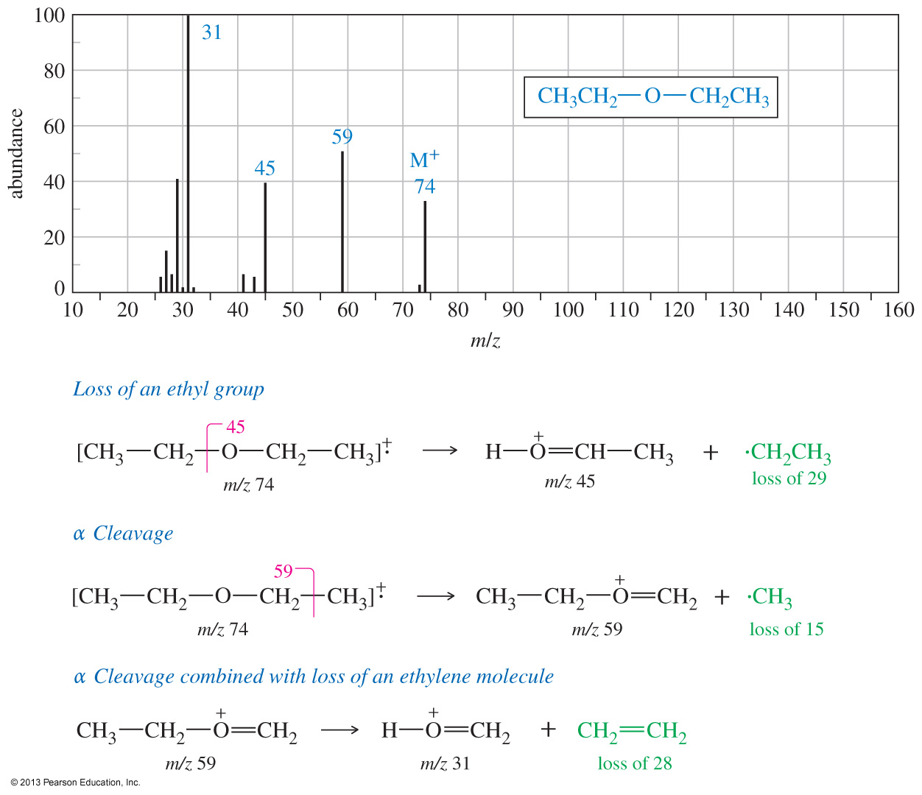
MS Spectra of Diethyl Ether

Slide 20
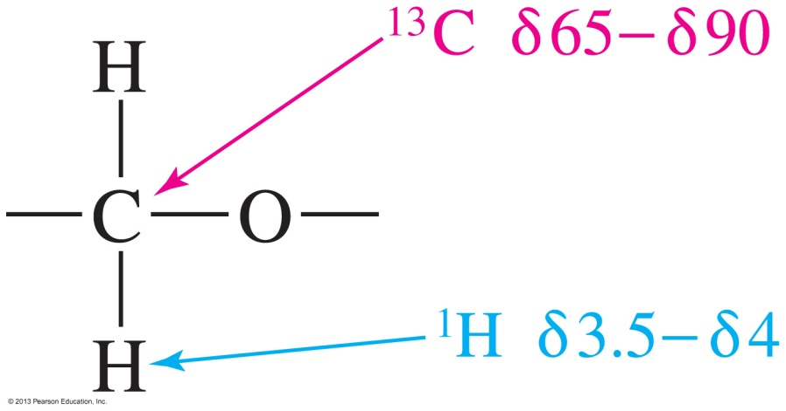
NMR Spectroscopy of Ethers
The typical chemical shifts for ethers in NMR are
¹³C—O signal between δ 65 and 90.
¹H—C—O signal between δ 3.5 and 4.

Slide 21
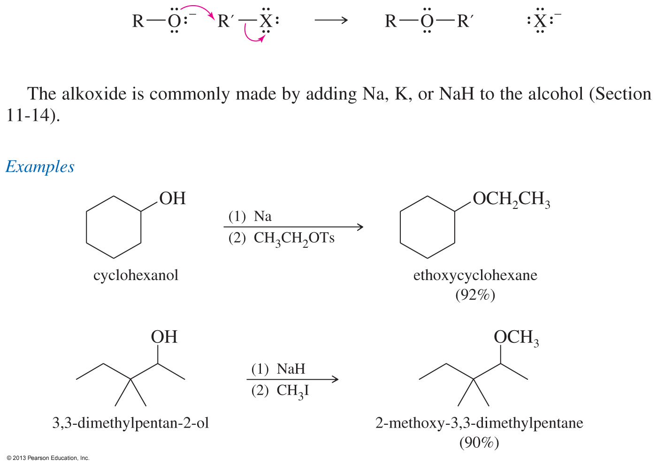
Williamson Ether Synthesis
This method involves an S_{N}2 attack of the alkoxide on an unhindered primary halide or tosylate.
The alkoxide is commonly made by adding Na, K, or NaH to the alcohol.

Slide 22
Examples of the
Williamson Synthesis

Slide 23
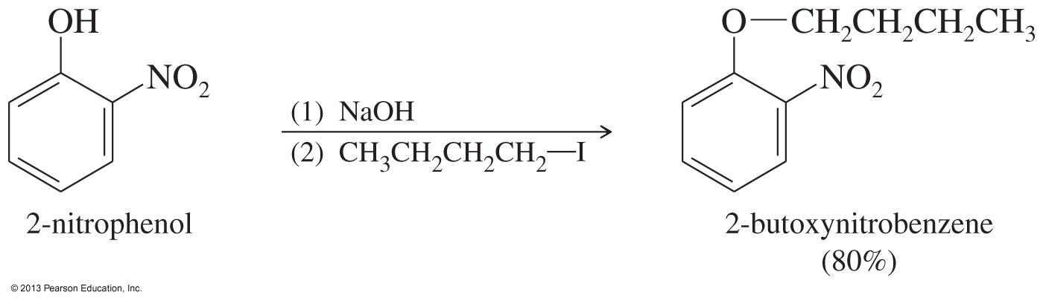
Phenyl Ethers
Phenoxide ions are easily produced because the alcohol proton is acidic.
Phenyl halides or tosylates cannot be used in this synthesis method.

Slide 24
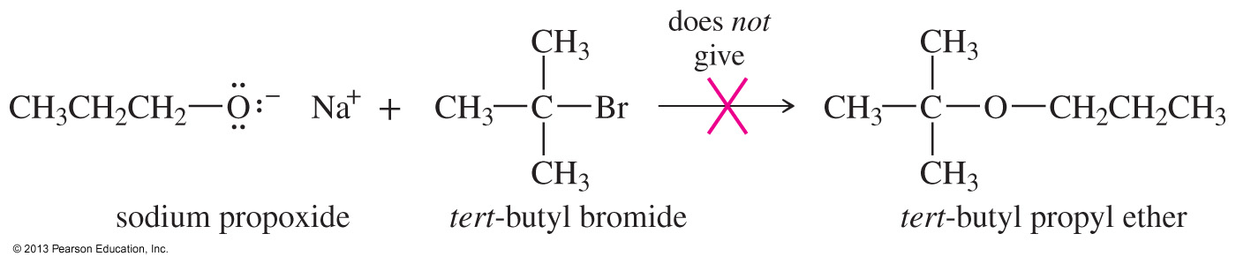
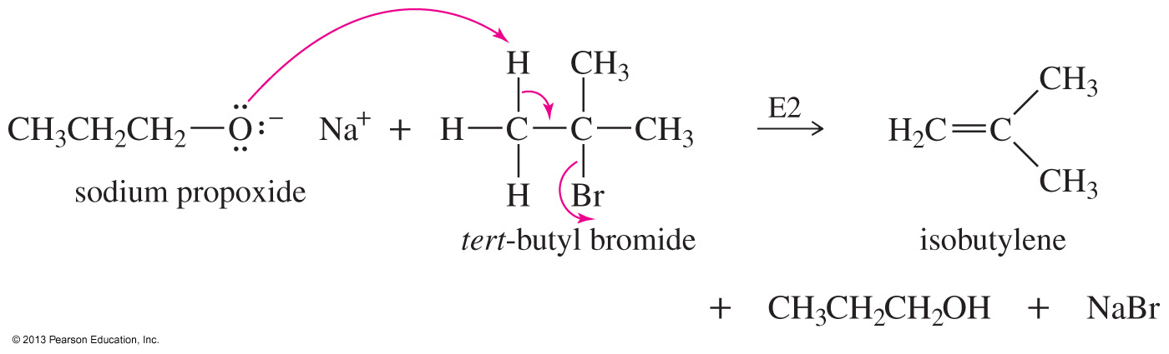
Solved Problem 1
Why is the following reaction a poor method for the synthesis of t-butyl propyl ether?
What would be the major product from this reaction?
Propose a better synthesis of t-butyl propyl ether.
Solution
The desired S_{N}2 reaction cannot occur on the tertiary alkyl halide.
The alkoxide ion is a strong base as well as a nucleophile, and elimination prevails.

Slide 25
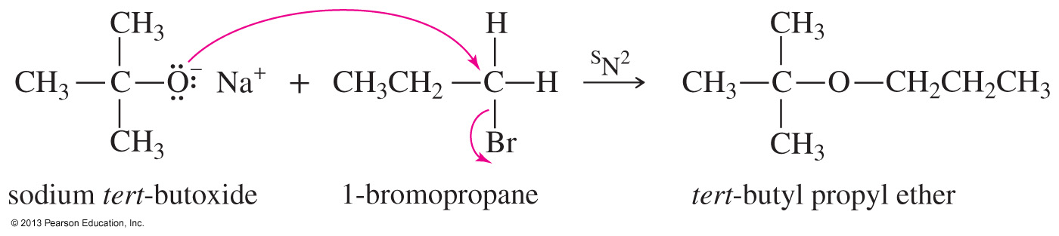
Solved Problem 1 (Continued)
Solution (Continued)
(c) A better synthesis would use the less hindered alkyl group as the S_{N}2 substrate and the alkoxide of the more hindered alkyl group.

Slide 26
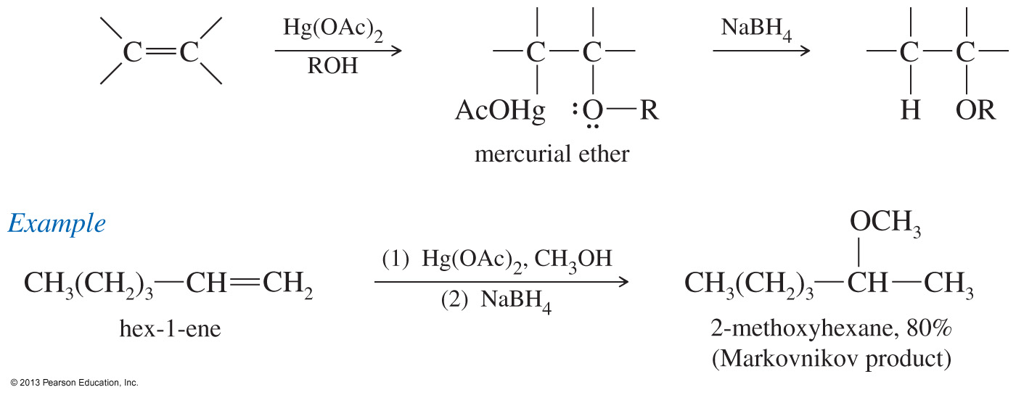
Alkoxymercuration–Demercuration Reaction
Use mercuric acetate with an alcohol. The alcohol will react with the intermediate mercurinium ion by attacking the more substituted carbon.

Slide 27
Industrial Synthesis of Ethers
Bimolecular condensation of alcohols
Industrial method, not good lab synthesis
If temperature is too high, alkene forms.
H
2
S
O
4
C
H
3
C
H
2
O
H
+
H
O
C
H
2
C
H
3
C
H
C
H
O
C
H
C
H
3
2
2
3
140 °C

Slide 28
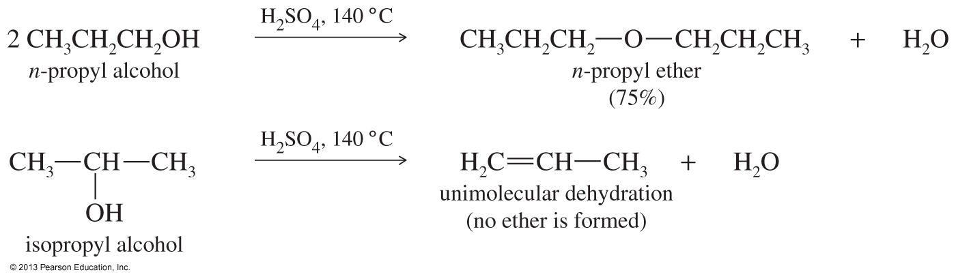
Examples of Industrial Synthesis of Ethers

Slide 29
Cleavage of Ethers by
HBr and HI
Ethers are unreactive, which makes them ideal solvents for a lot of different reactions.
They can be cleaved by heating with concentrated HBr and HI.
Reactivity: HI > HBr

Slide 30
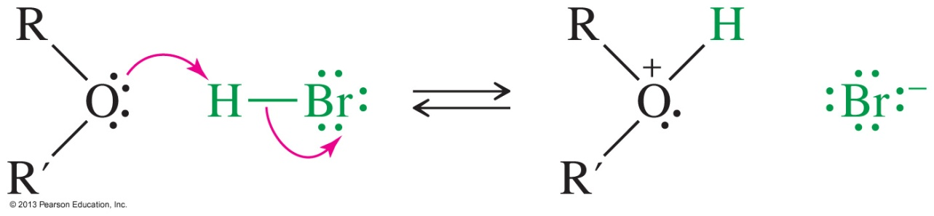
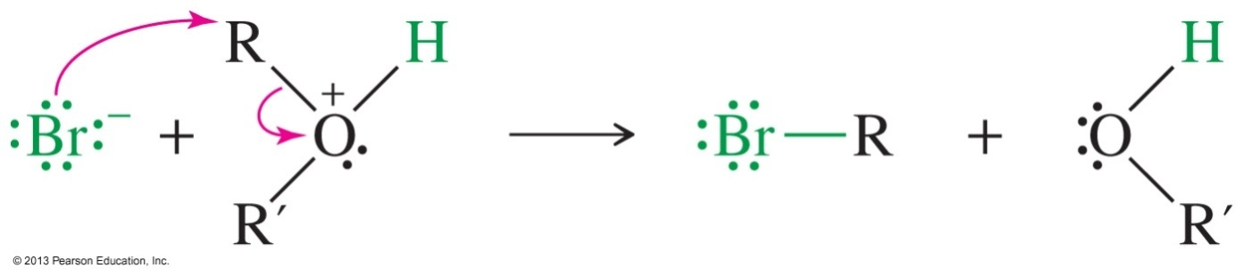
Mechanism of
Ether Cleavage
Step 1: Protonation of the oxygen
Step 2: The halide will attack the carbon and displace the alcohol (S_{N}2).

Slide 31
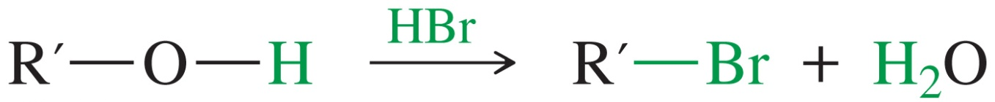
Mechanism of
Ether Cleavage
Step 3: The alcohol reacts further with the acid to produce another mole of alkyl halide.
This does not occur with aromatic alcohols (phenols).

Slide 32
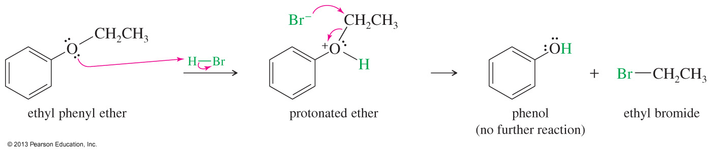
Phenyl Ether Cleavage
Phenol cannot react further to become a halide because an S_{N}2 reaction cannot occur on an sp² carbon.

Slide 33
Autoxidation of Ethers
In the presence of atmospheric oxygen, ethers slowly oxidize to hydroperoxides and dialkyl peroxides.
Both are highly explosive.
Precautions:
  Do not distill to dryness.
  Store in full bottles with tight caps.

Slide 34
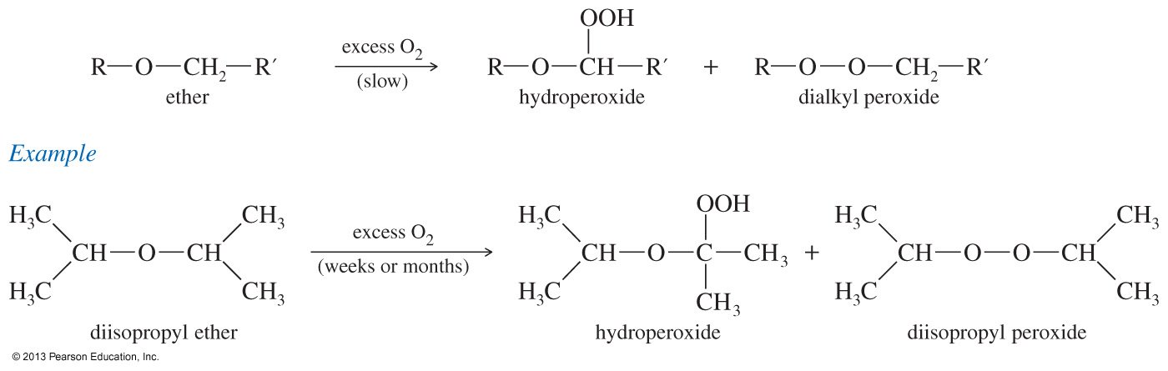
Mechanism of Autoxidation

Slide 35
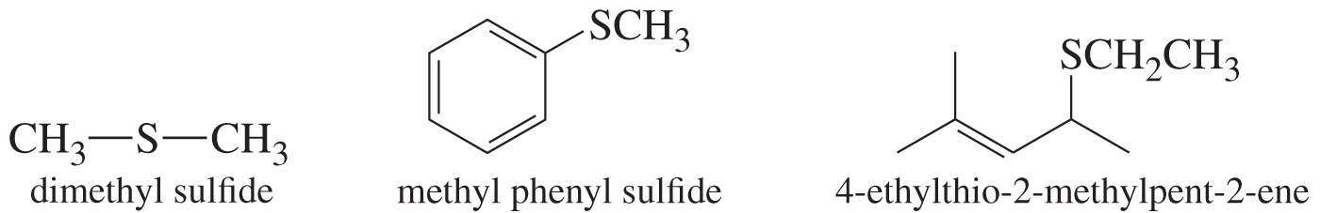
Thioethers
R—S—R′, analog of ether
Name sulfides like ethers, replacing sulfide for ether in the common name, or alkylthio for alkoxy in the IUPAC system.

Slide 36
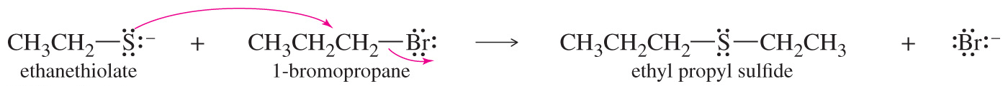
Thiols and Thiolates
Thioethers are easily synthesized by the Williamson ether synthesis using a thiolate ion as the nucleophile.

Slide 37
Sulfide Reactions
Sulfides are easily oxidized to sulfoxides and sulfones.
O
O
H
2
O
2
H
2
O
2
C
H
3
S
C
H
3
C
H
S
C
H
C
H
3
S
C
H
3
C
H
C
O
O
H
3
3
C
H
C
O
O
H
3
3
O
Sulfides react with unhindered alkyl halides to give sulfonium salts.
+
_
C
H
3
S
C
H
3
+
C
H
3
I
C
H
S
C
H
I
3
3
C
H
3

Slide 38
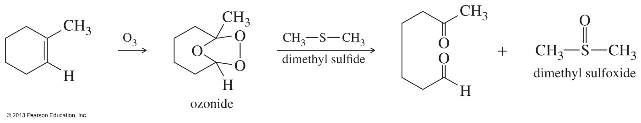
Thioethers as
Reducing Agents
Because sulfides are easily oxidized, they are often used as mild reducing agents.

Slide 39
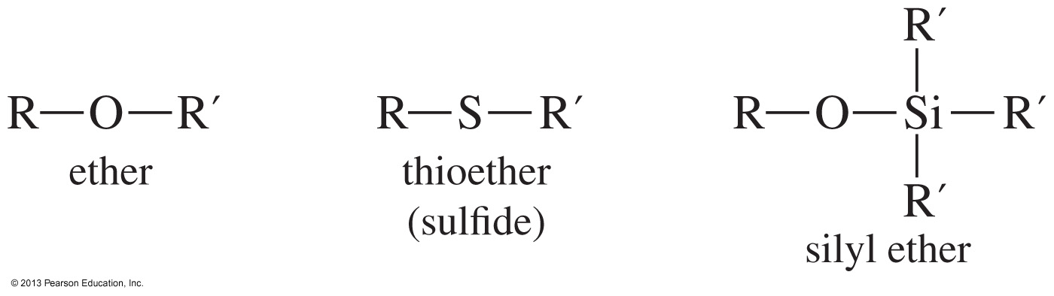
Silyl Ethers
Resistant to some acids, bases, and oxidizing agents
More easily formed and more easily hydrolyzed
Used as protecting groups for alcohols

Slide 40
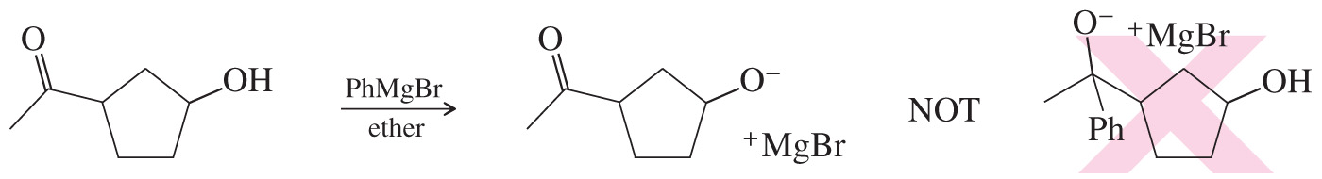
Alcohol-Protecting Groups
If the molecule has more than one functional group, sometimes their reactivity can interfere with the desired reaction.

Slide 41
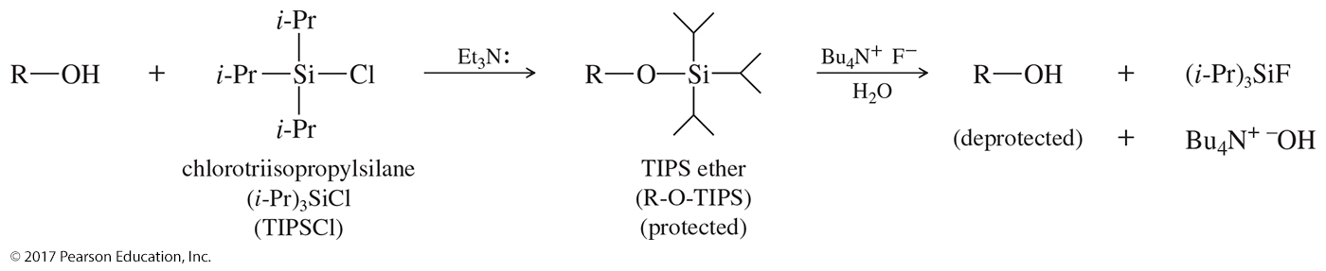
Silyl Ethers as
Protecting Groups
Protecting the alcohol as a silyl ether will ensure the Grignard will react with the carbonyl.
The silyl ether group can be removed in aqueous or organic solvents.

Slide 42
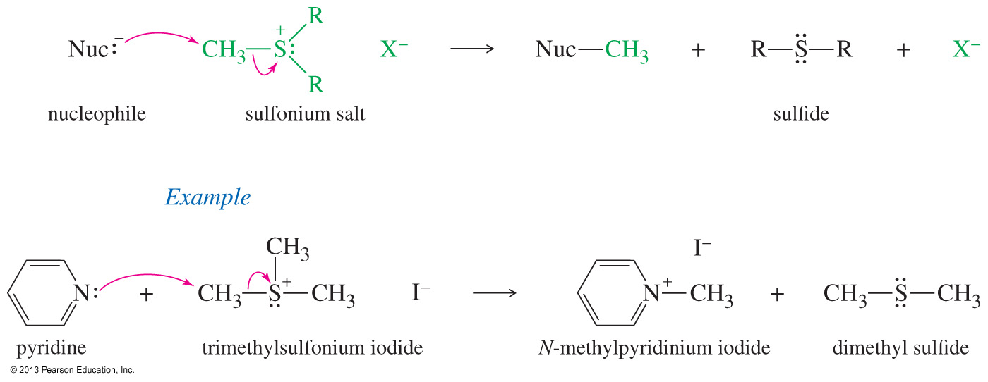
Sulfonium Salts as
Alkylating Agents
Used as alkylating agents because the leaving group that forms is neutral

Slide 43
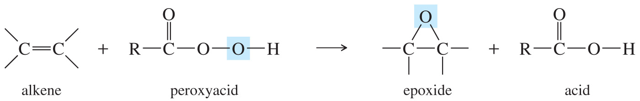
Synthesis of Epoxides
Peroxyacids are used to convert alkenes to epoxides.
Most commonly used peroxyacid is meta-chloroperoxybenzoic acid (MCPBA).
The reaction is carried out in an aprotic acid to prevent the opening of the epoxide.

Slide 44
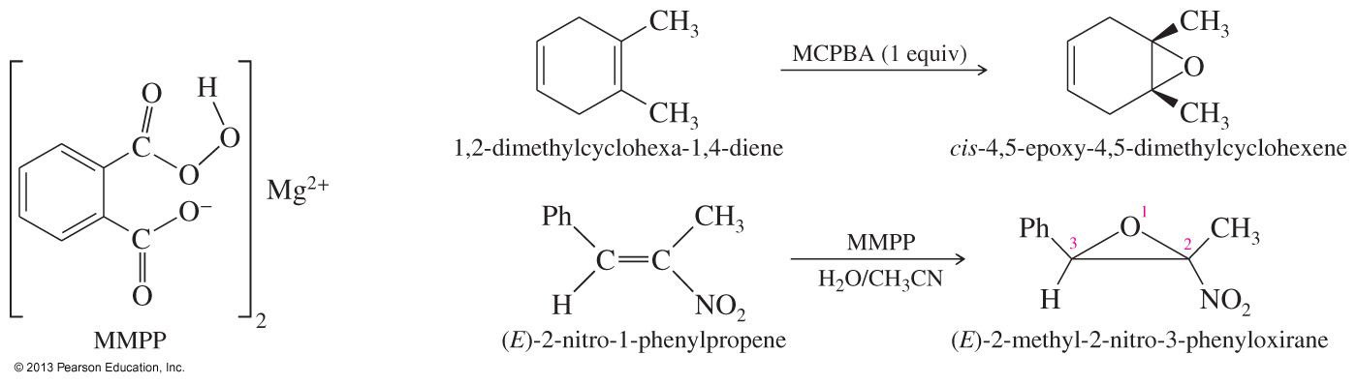
Selectivity of Epoxidation
The most electron-rich double bond reacts faster, making selective epoxidation possible.

Slide 45
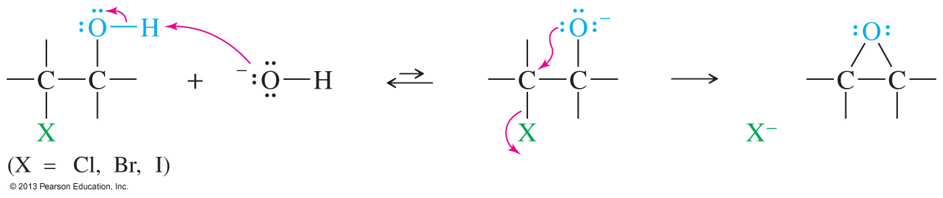
Halohydrin Cyclization
If an alkoxide and a halogen are located in the same molecule, the alkoxide may displace a halide ion and form a ring.
Treatment of a halohydrin with a base leads to an epoxide through this internal S_{N}2 attack.

Slide 46
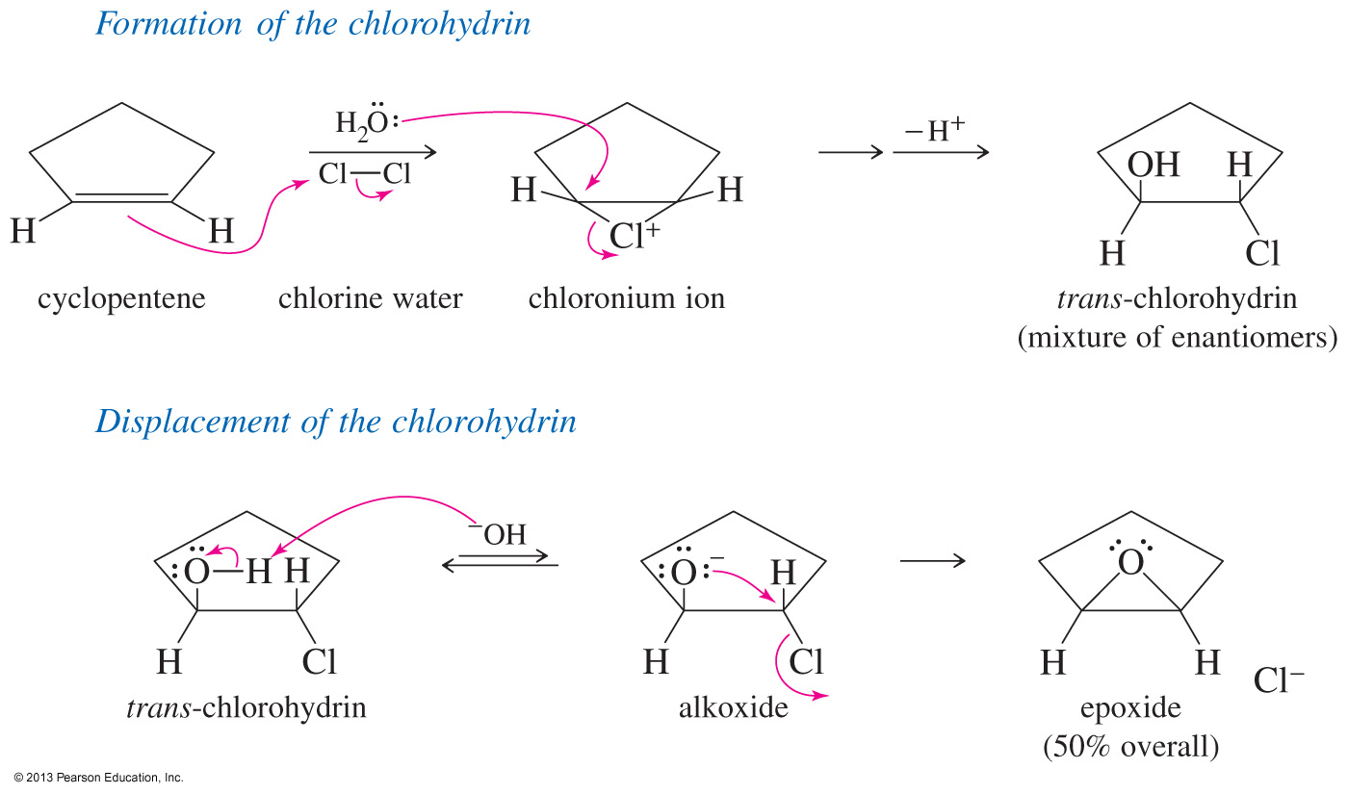
Epoxides via Halohydrins

Slide 47
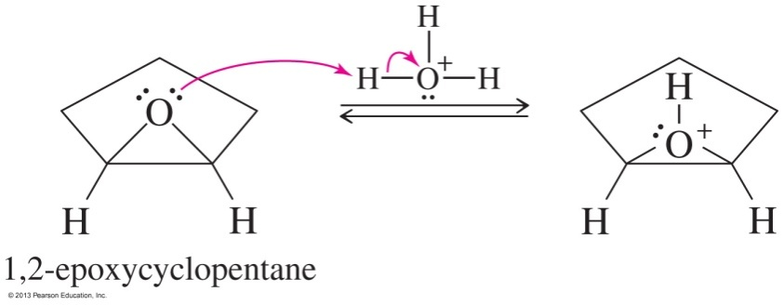
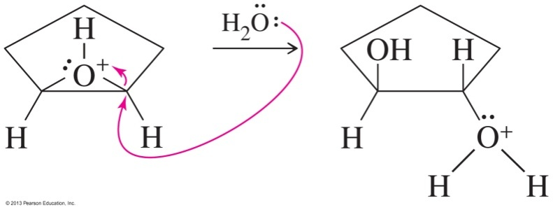
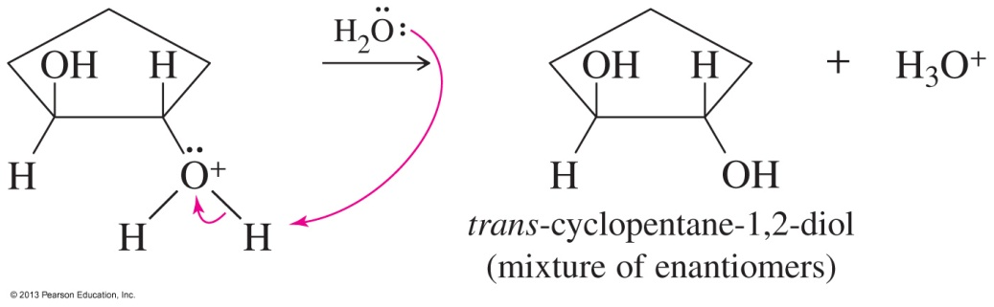
Acid-Catalyzed Opening of Epoxides
Step1: Protonation of the oxygen
Step 2: Water attacks the protonated epoxide.
Step 3: Deprotonation of the trans-1,2-diol

Slide 48
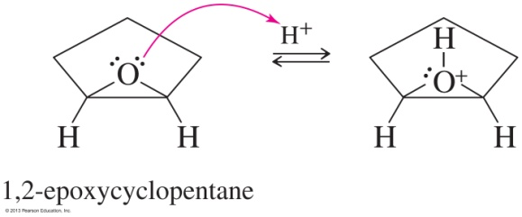
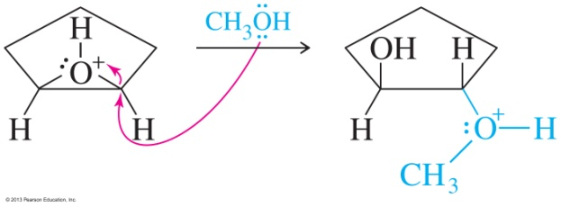
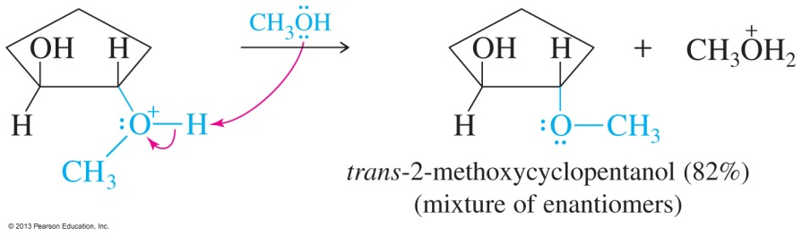
Acid-Catalyzed Opening of Epoxides in Alcohol Solution
A molecule of alcohol acts as the nucleophile and attacks and opens the epoxide.
This reaction produces an alkoxy alcohol with anti stereochemistry.

Slide 49
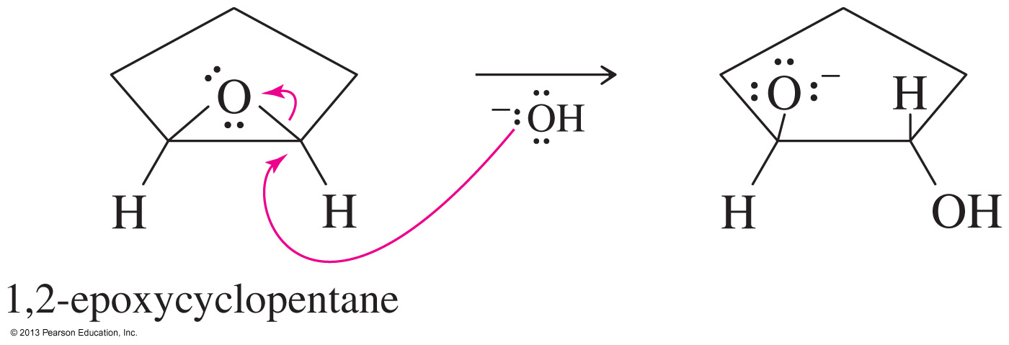
Base-Catalyzed Opening of Epoxides
The hydroxide ion attacks and opens the ring.
The diol is obtained after protonation of the alkoxide with water.

Slide 50
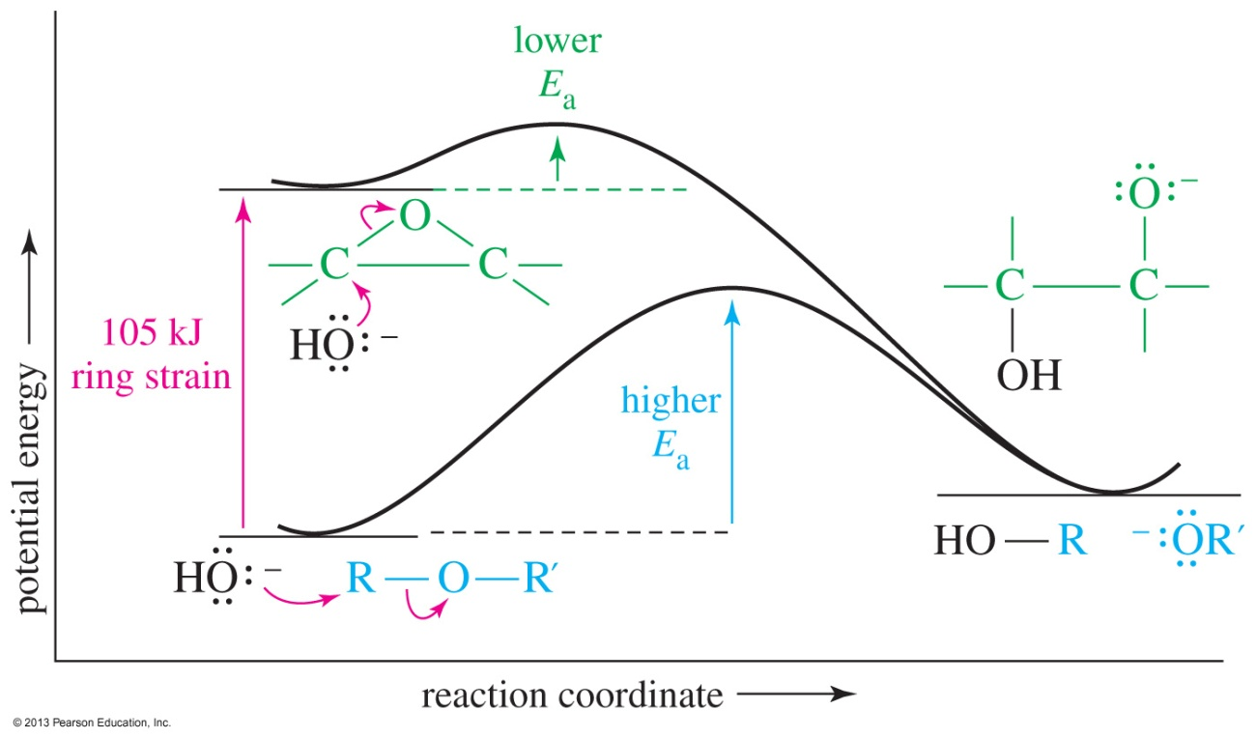
Ring Opening in Base
An epoxide is higher in energy than an acyclic ether by about 25 kcal/mol ring strain.
Release of the ring strain makes the opening of an epoxide thermodynamically favored.

Slide 51
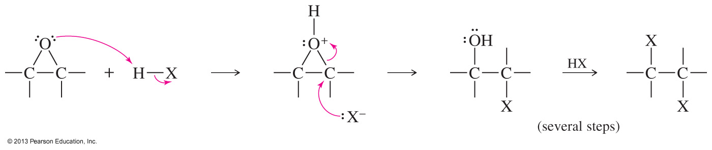
Ring Opening with Hydrohalic Acids
After protonation the halide ion attacks the protonated epoxide.
The halohydrin initially formed reacts further with HX to give a 1,2-dihalide.

Slide 52

Regioselectivity of Epoxidation

Slide 53


Solved Problem 2
Predict the major products for the reaction of 1-methyl-1,2-epoxycyclopentane with
(a) sodium ethoxide in ethanol.
(b) H₂SO₄ in ethanol.
Solution
Sodium ethoxide attacks the less hindered secondary carbon to give (E)-2-ethoxy-1 methylcyclopentanol.
(b) Under acidic conditions, the alcohol attacks the more electrophilic tertiary carbon atom of the protonated epoxide. The product is (E)-2-ethoxy-2-methylcyclopentanol.

Slide 54

Biosynthesis of Steroids

Slide 55

Reaction of Epoxides with
Grignard and Organolithiums
Strong bases, such as Grignards and organolithiums, open the epoxide ring by attacking the less hindered carbon.

Slide 56


Epoxy Resins
The earliest glues were made by carbohydrates and proteins.
Epoxies polymerize in place, so they match the shape of the joint perfectly.

Slide 57

The Second Epoxide

