Slide 1
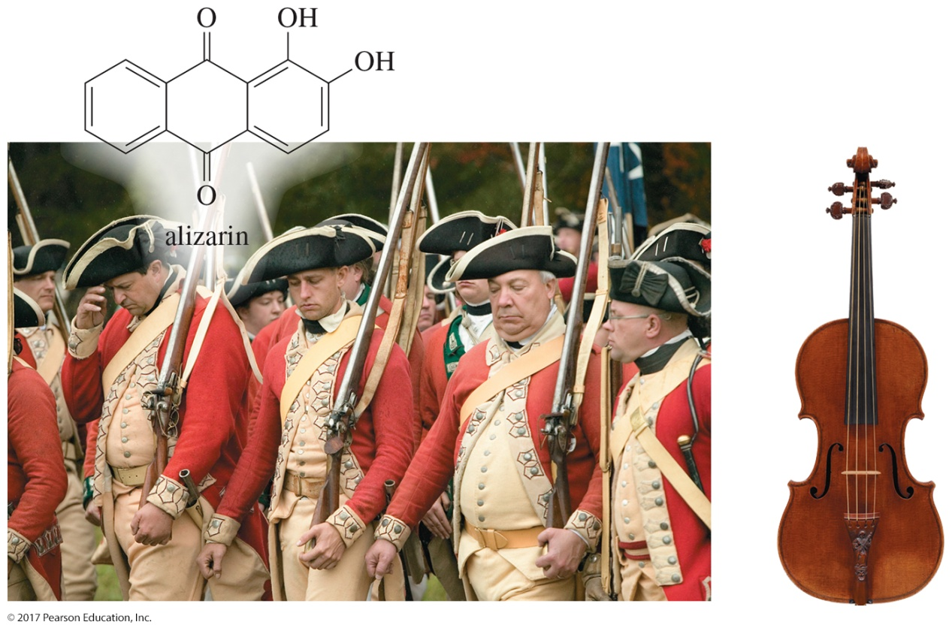
Organic Chemistry,
9th Edition
L. G. Wade, Jr.
Chapter 15
Lecture
Conjugated Systems, Orbital Symmetry, and Ultraviolet Spectroscopy
Chad Snyder, PhD
Grace College
© 2017 Pearson Education, Inc.

Slide 2
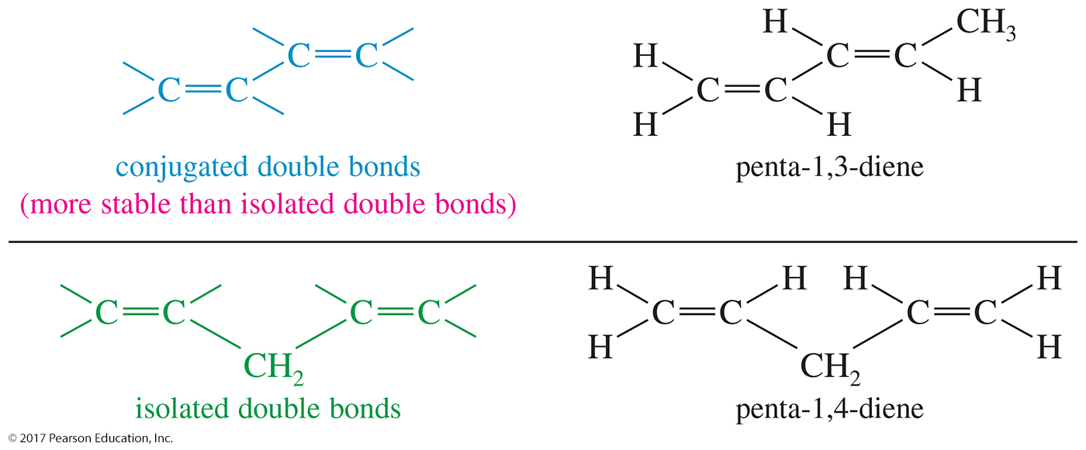
Conjugated Systems
Conjugated double bonds are separated by one single bond.
Isolated double bonds are separated by two or more single bonds.
Conjugated double bonds are more stable than isolated ones.

Slide 3
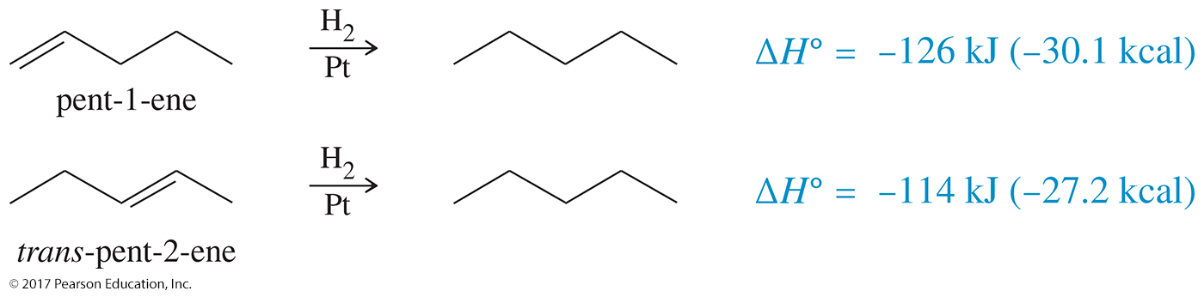
Diene Stability
Heats of hydrogenation are used to compare the relative stabilities of alkenes.

Slide 4
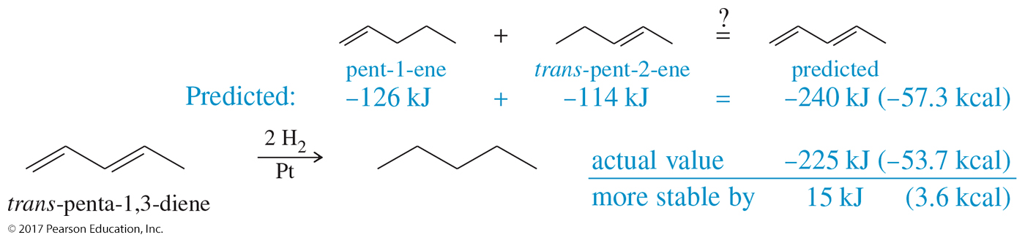
Heat of Hydrogenation of Conjugated Bonds
For conjugated double bonds, the heat of hydrogenation is less than the sum for the individual double bonds.
The more stable the compound, the less heat released during hydrogenation.
Conjugated double bonds have extra stability.

Slide 5
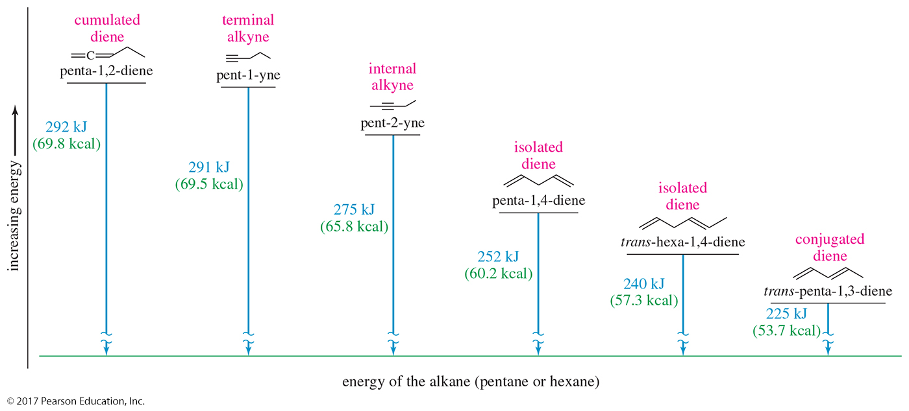
Relative Stabilities

Slide 6
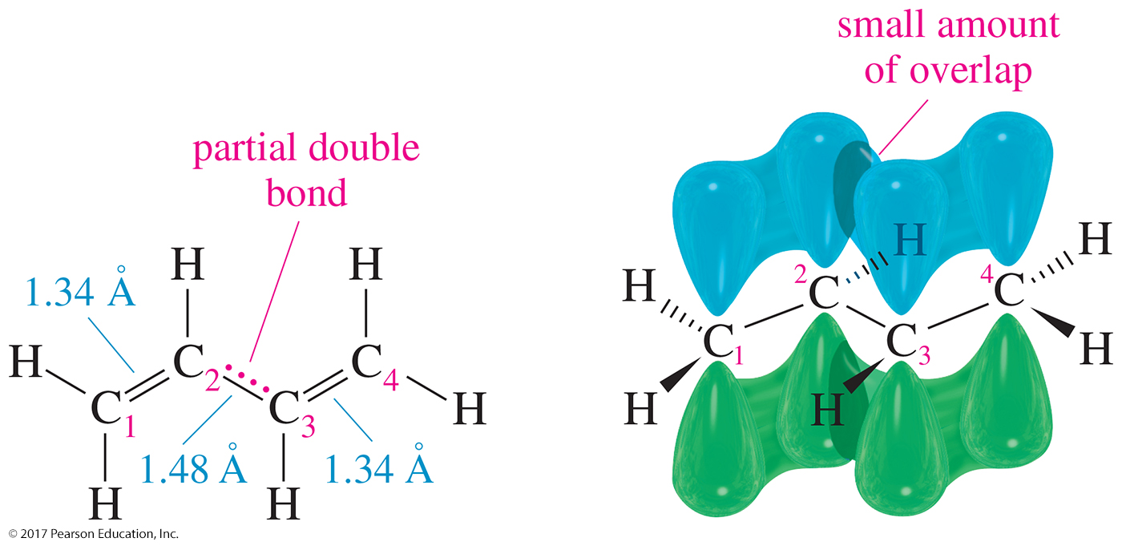
Structure of Buta-1,3-diene
The C2—C3 single bond is shorter than 1.54 Å.
Electrons are delocalized over the molecule.
There is a small amount of overlap across the central C2—C3 bond, giving it a partial double bond character.

Slide 7
Molecular Orbitals (MOs)
All atoms of buta-1,3-diene are sp² hybridized with overlapping p orbitals.
Each p orbital has two lobes with the wave function indicated by plus (+) and minus (–) signs (not electrical charges).
When lobes overlap constructively (+ and +, or – and –), a pi bonding (π) MO is formed.
When lobes overlap destructively (+ and –), a pi antibonding (π∗) MO is formed.

Slide 8
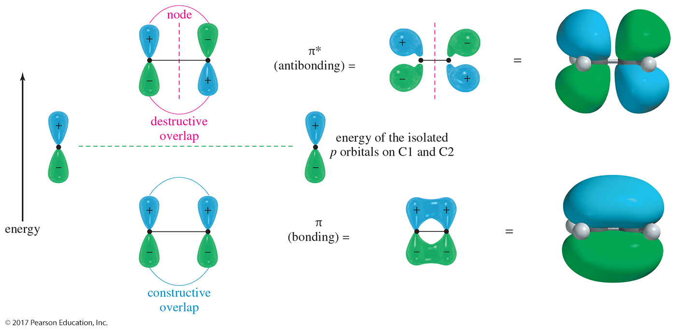
Ethylene Pi MOs
The combination of two p orbitals must give two molecular orbitals.
Constructive overlap is a pi bonding (π) MO.
Destructive overlap is an antibonding (π∗) MO.

Slide 9
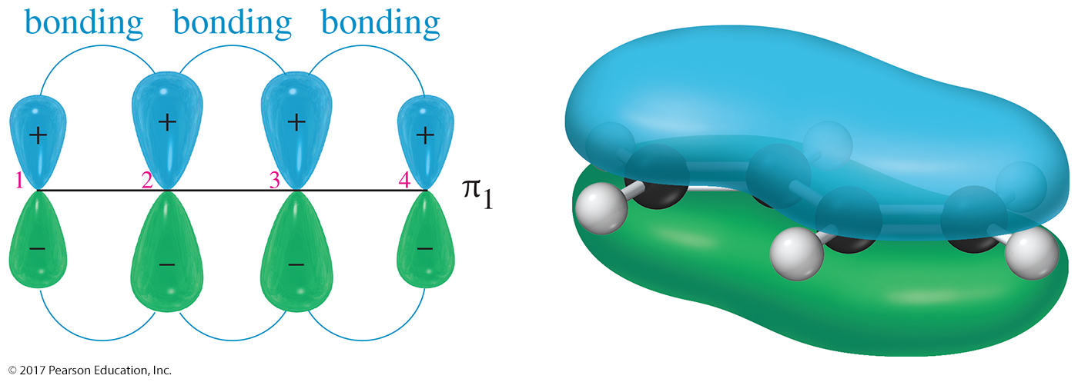
π₁ MO for Buta-1,3-diene
Lowest energy
All bonding interactions
Electrons are delocalized over four nuclei.

Slide 10
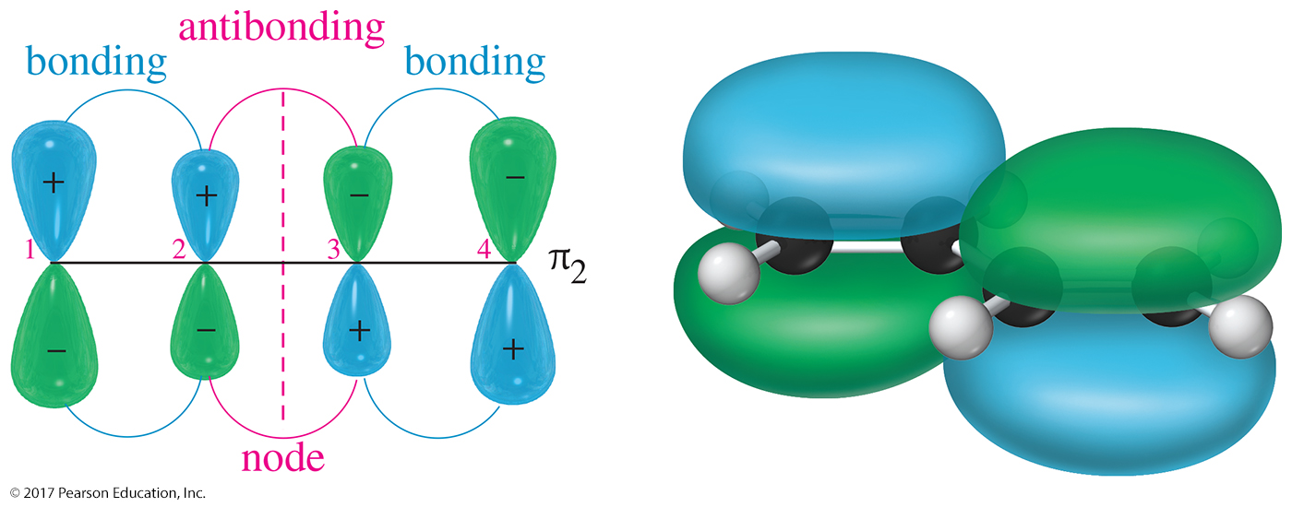
π₂ MO for Buta-1,3-diene
Two bonding interactions
One antibonding interaction
This is a bonding MO.
Higher energy than π₁ MO and not as strong

Slide 11
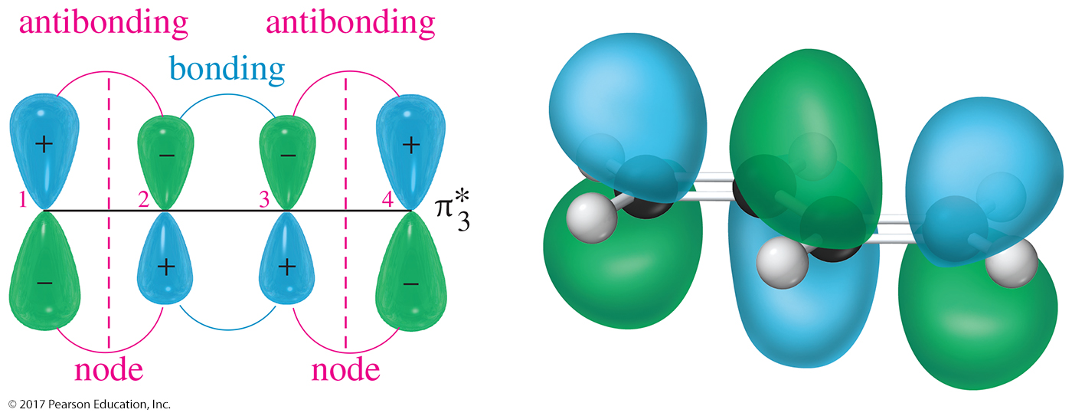
π₃* MO for Buta-1,3-diene
Two antibonding and one bonding interaction
Two nodes
Vacant in the ground state

Slide 12
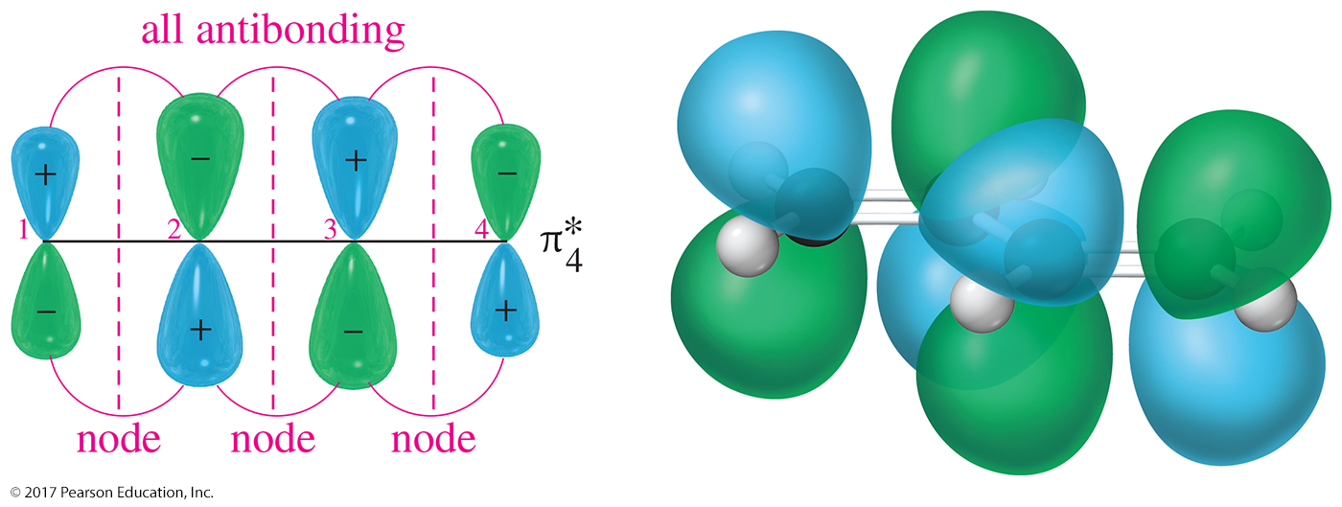
π₄* MO for Buta-1,3-diene
Three nodes
Strongly antibonding
Highest energy MO
Vacant at ground state

Slide 13
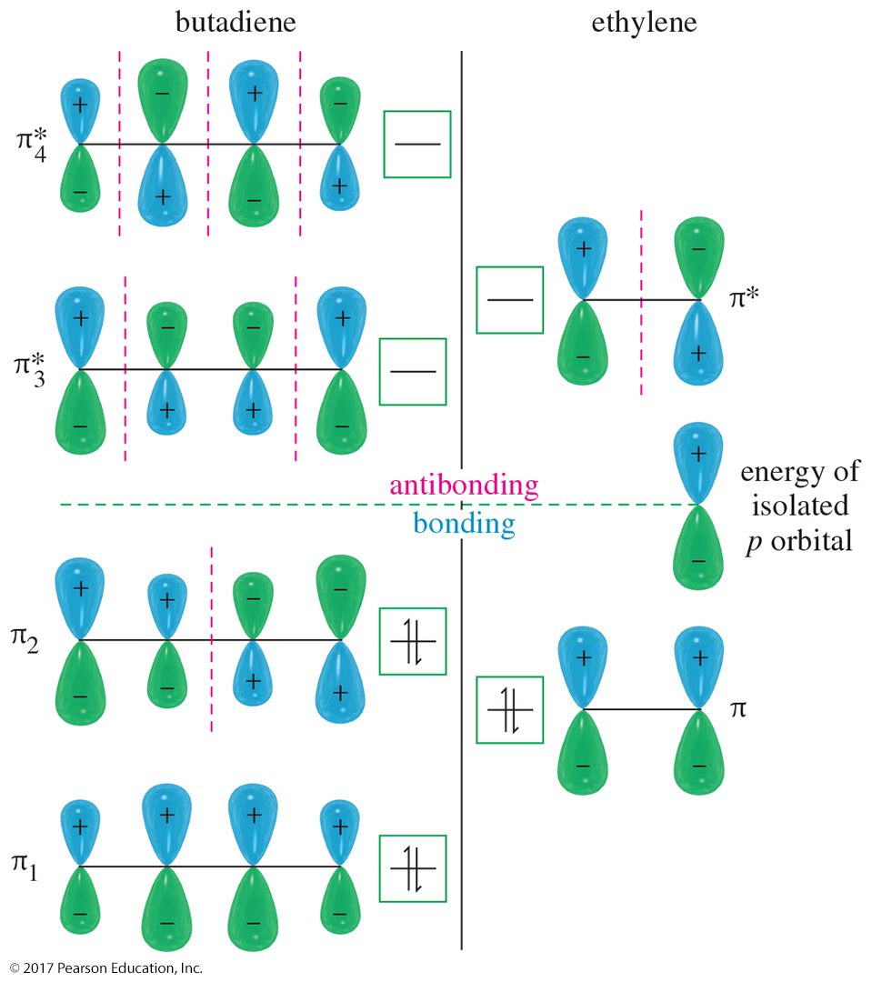
MO for Buta-1,3-diene and Ethylene
The bonding MOs of both buta-1,3-diene and ethylene are filled and the antibonding MOs are empty.
Buta-1,3-diene has lower energy than ethylene.
This lower energy is the resonance stabilization of the conjugated diene.

Slide 14
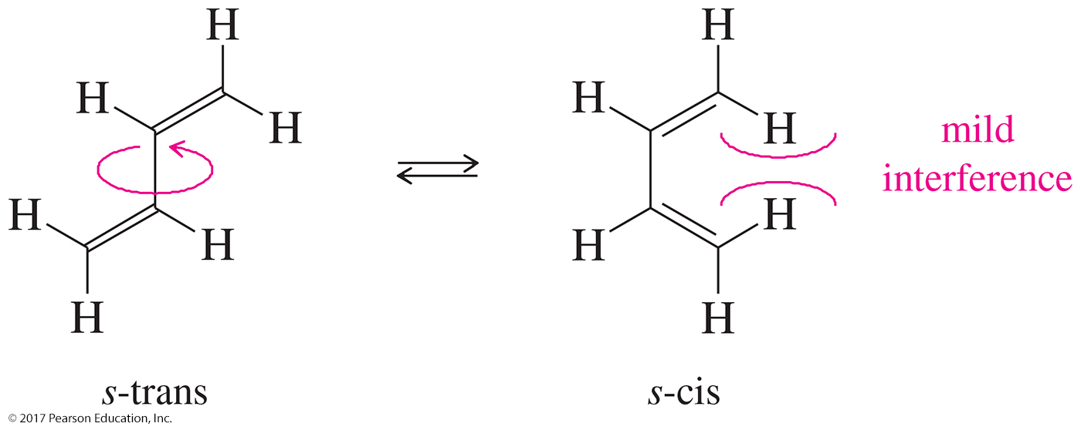
Conformations of
Buta-1,3-diene
The s-trans conformer is more stable than the s-cis by 12 kJ/mol (2.8 kcal/mol).
Easily interconvert at room temperature.

Slide 15
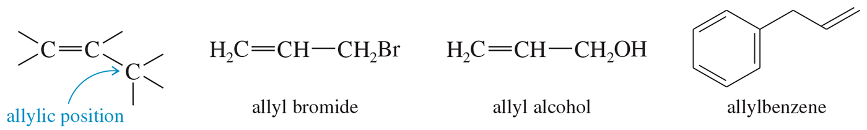
The Allylic Position
The allylic carbon is the one directly attached to an sp² carbon.
Allylic cations are stabilized by resonance.

Slide 16
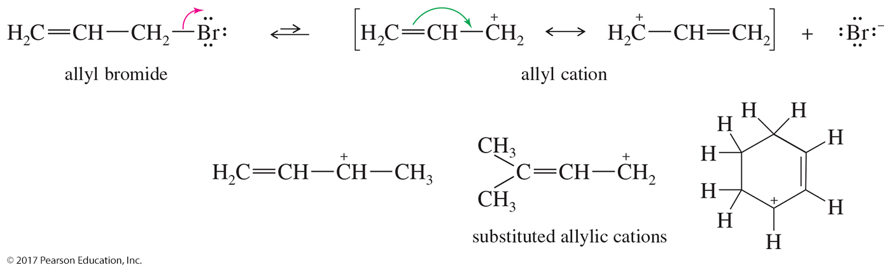
Allylic Cations
The positive charge is delocalized over two carbons by resonance, giving the allyl cation more stability than nonconjugated cations.

Slide 17
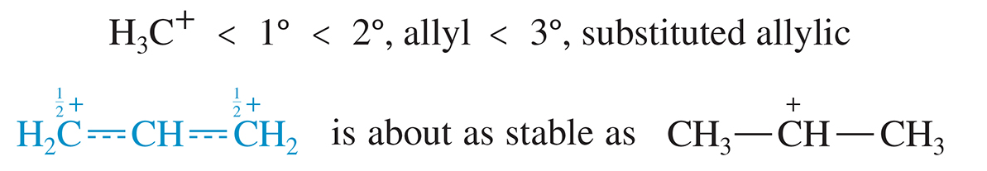
Stability of Carbocations
Stability of 1° allylic ≈ 2° carbocation.
Stability of 2° allylic ≈ 3° carbocation.

Slide 18
1,2- and 1,4-Addition to Conjugated Dienes
Electrophilic addition to the double bond produces the most stable intermediate.
For conjugated dienes, the intermediate is a resonance-stabilized allylic cation.
Nucleophile adds to either carbon 2 or 4, both of which have the delocalized positive charge.

Slide 19
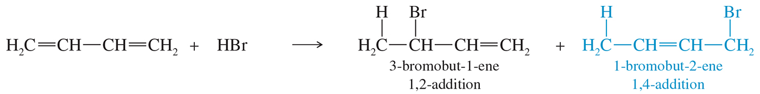
1,2- and 1,4-Addition to Dienes
Addition of HBr to buta-1,3-diene produces
3-bromobut-1-ene (1,2-addition) and
1-bromobut-2-ene (1,4-addition).

Slide 20
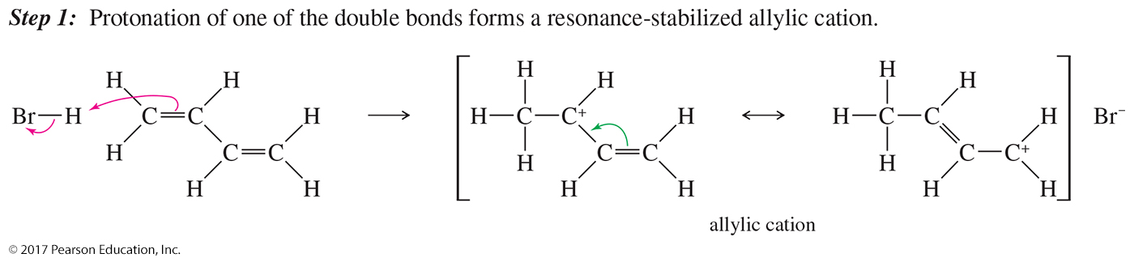
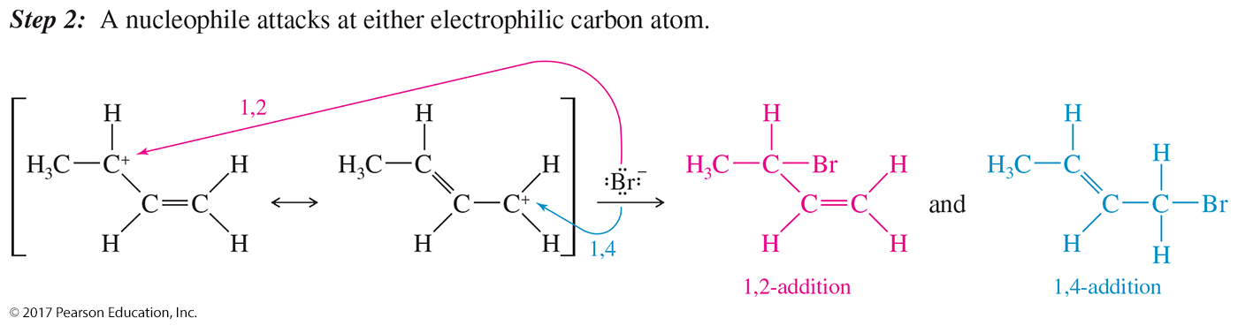
Mechanism of 1,2- and 1,4-Addition

Slide 21
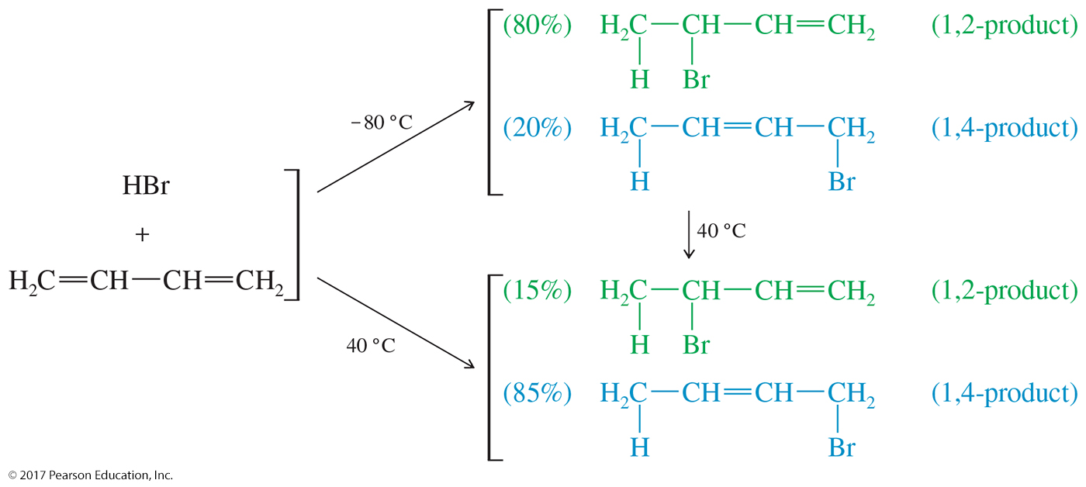
Kinetic Versus Thermodynamic
Control

Slide 22
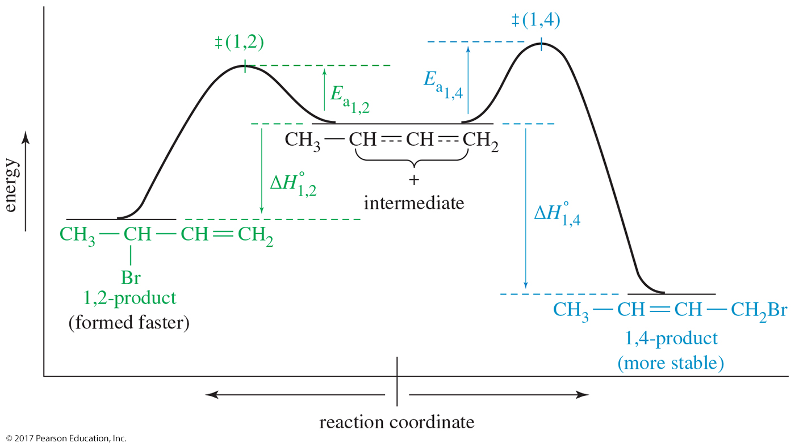
Kinetic Versus Thermodynamic
Control (Continued)

Slide 23
Kinetic Control at –80 °C
Transition state for the 1,2-addition has a lower E_{a} because it is a more stable secondary carbocation.
The 1,2-addition will be the faster addition at any temperature.
The nucleophilic attack of the bromide on the C2 allylic carbocation is irreversible at this low temperature.
The product that forms faster predominates (kinetic product).
Because the kinetics of the reaction determines the product, the reaction is said to be under kinetic control.

Slide 24
Thermodynamic Control at 40 °C
The 1,2-addition is still the faster addition, but at 40 °C, the bromide attack is reversible.
The 1,2-product ionizes back to the allylic cation.
At 40 °C an equilibrium is established, which favors the most stable product.
The 1,4-addition is the most stable product (thermodynamic product) because it has a more substituted double bond.
Because the thermodynamics of the reaction determines the product, the reaction is said to be under thermodynamic control.

Slide 25
Allylic Radicals
Stabilized by resonance.
Radical stabilities: 1° < 2° < 3° < 1° allylic
Substitution at the allylic position competes with addition to double bond.
To encourage substitution, use a low concentration of reagent with light, heat, or peroxides to initiate free radical formation.

Slide 26
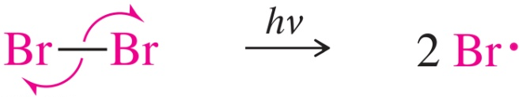
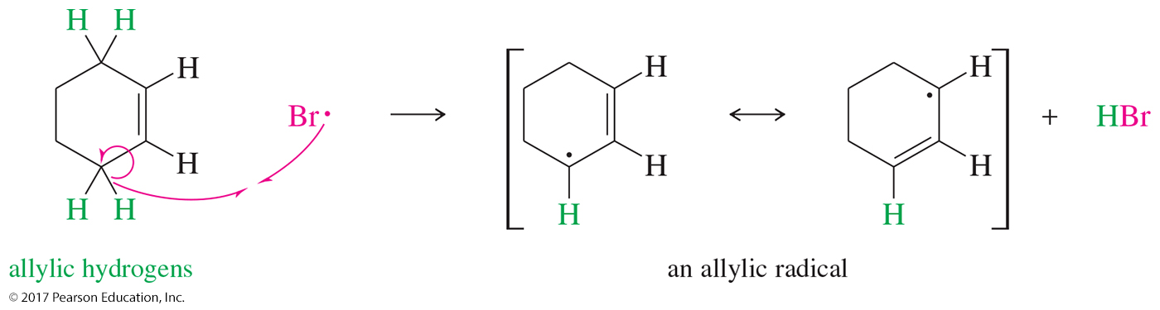
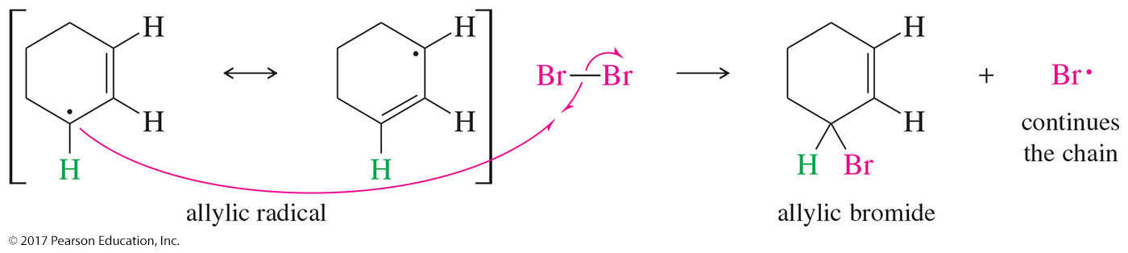
Mechanism of Allylic Bromination
Initiation step:
Propagation steps:

Slide 27
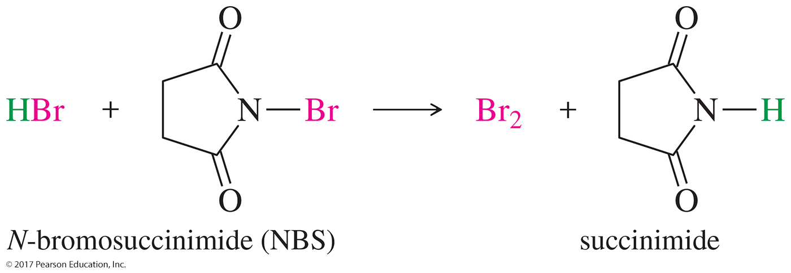
Bromination Using
N-Bromosuccinimide (NBS)
NBS provides a low, constant concentration of Br₂.
NBS reacts with the HBr by-product to produce Br₂ and to prevent HBr addition across the double bond.

Slide 28
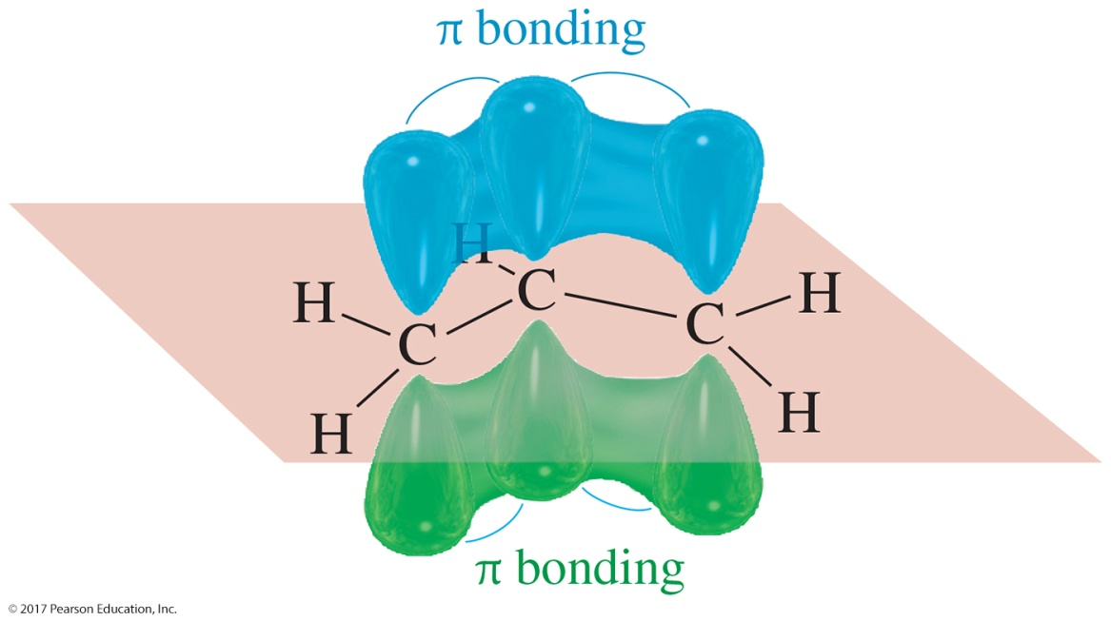
Allyl System
Geometric structure of the allyl cation, allyl radical, and allyl anion
The three p orbitals of the allyl system are parallel to each other, allowing for the extended overlap between C1–C2 and C2–C3.

Slide 29
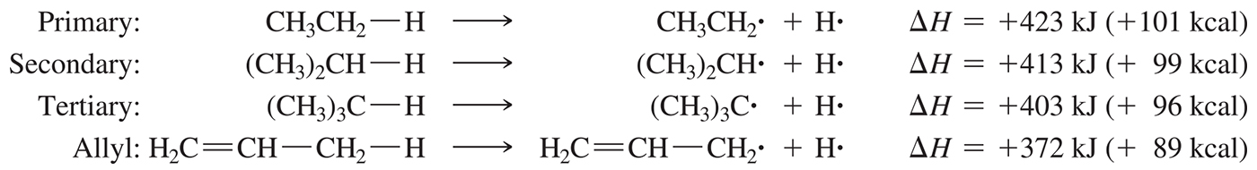
Stability of Allyic Radicals

Slide 30
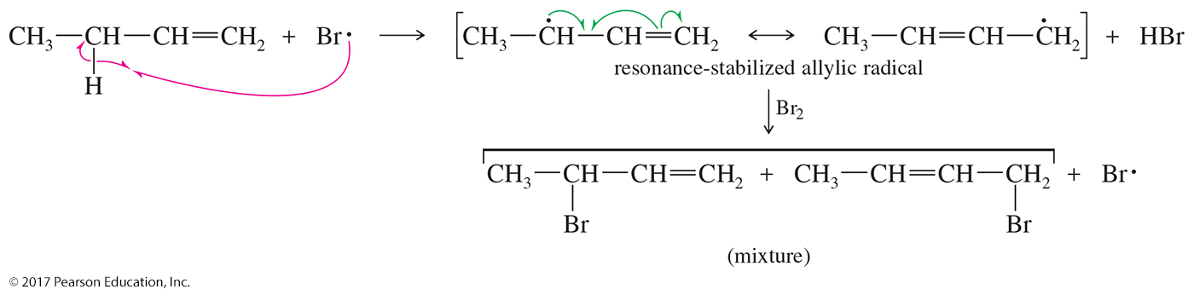
Resonance Stabilization
During propagation an allylic radical is formed that is stabilized by resonance.
Either radical can form the final product.

Slide 31
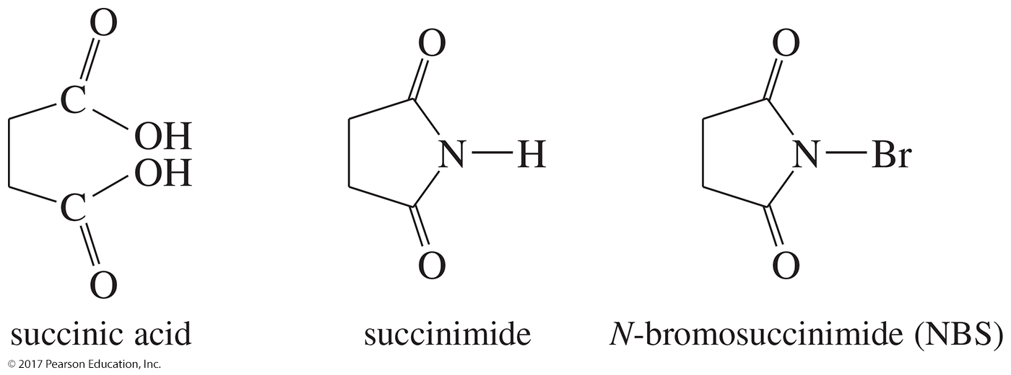
Bromination Using NBS
A convenient bromine source for allyic bromination is N-bromosuccinimide (NBS), a brominated derivative of succinimide.

Slide 32
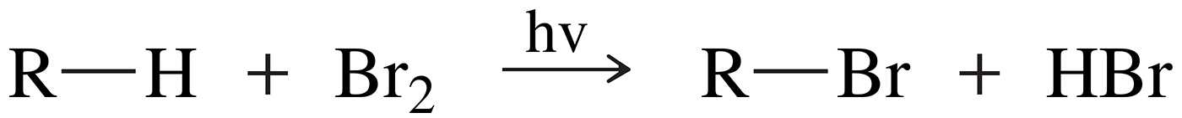
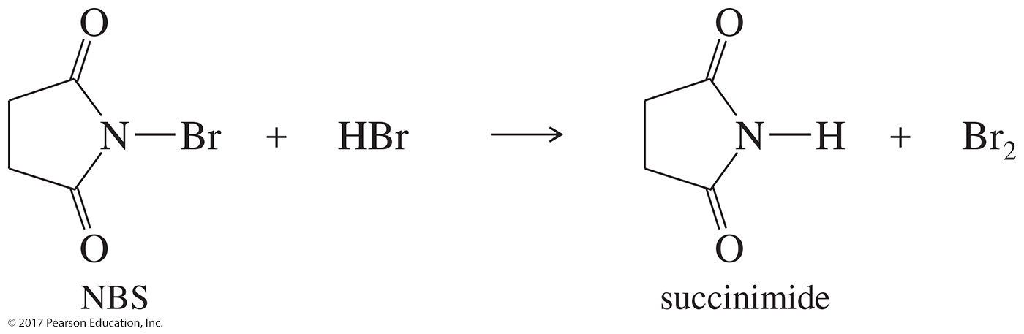
NBS

Slide 33
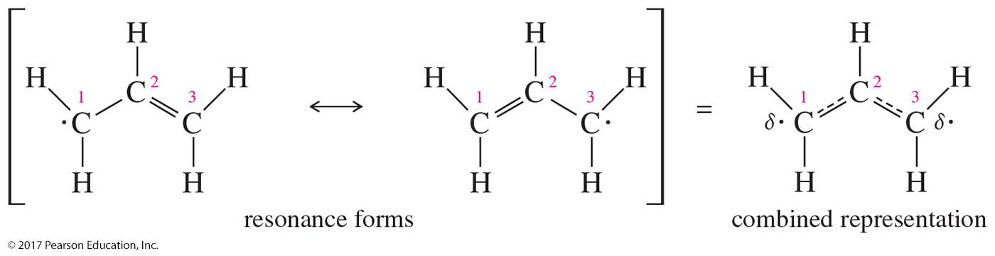
Molecular Orbitals of the
Allylic System
One resonance form shows the radical electron on C1, with a pi bond between C2 and C3.
The other resonance form shows the radical electron on C3 and a pi bond between C1 and C2.

Slide 34

Molecular Orbitals of the Allylic System
No resonance form has an independent existence.

Slide 35
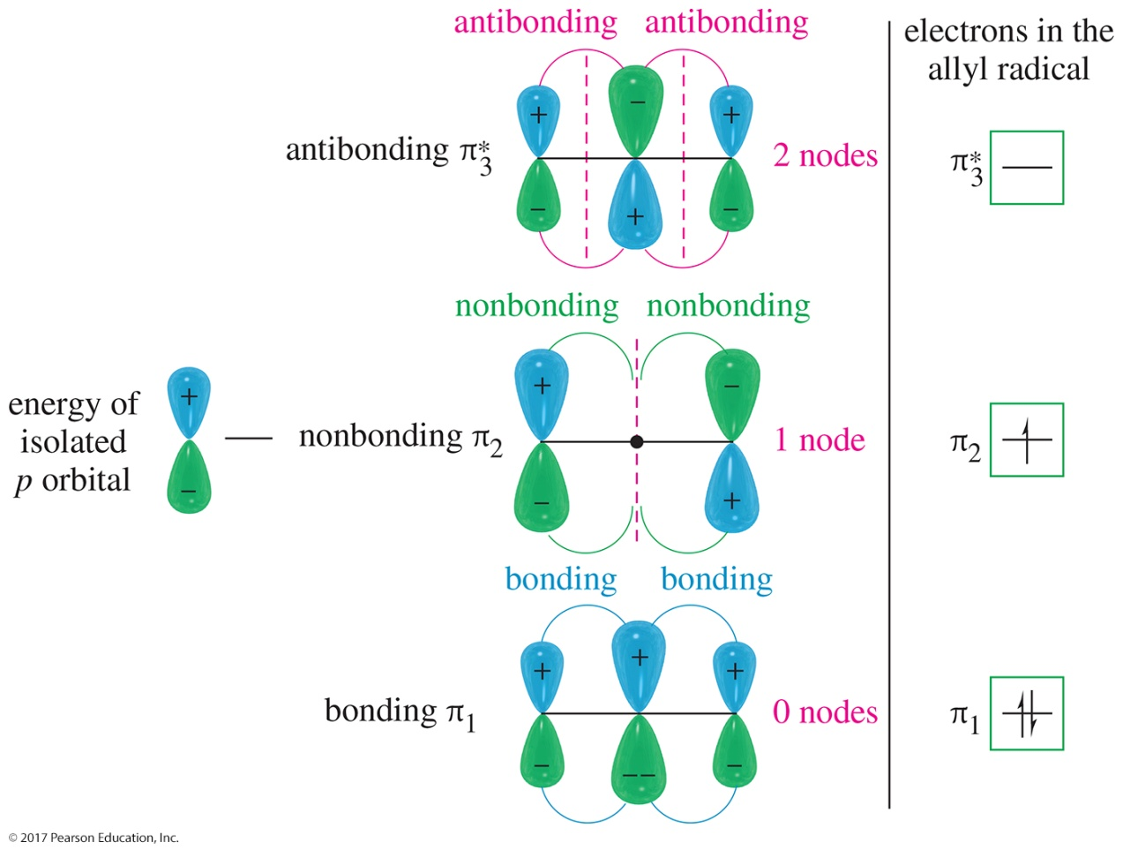
Molecular Orbitals of the
Allyl Radical
The radical electron occupies the nonbonding molecular orbital.

Slide 36
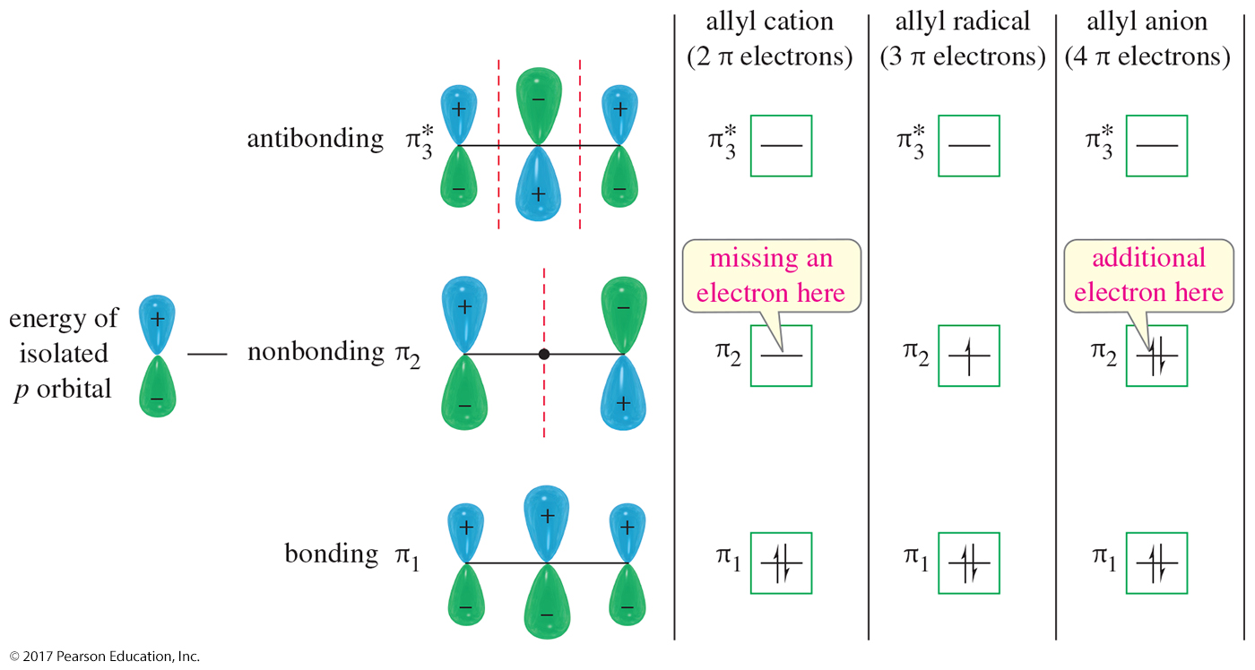
MOs for the Allylic Species

Slide 37
S_{N}2 Reactions of Allylic Halides and Tosylates
Allylic halides and tosylates react quickly by the S_{N}2 mechanism.
The transition state of the S_{N}2 mechanism is stabilized through conjugation with the p orbitals of the pi bond.
This transition state has a lower activation energy and explains the enhanced reactivity of these allylic species.

Slide 38
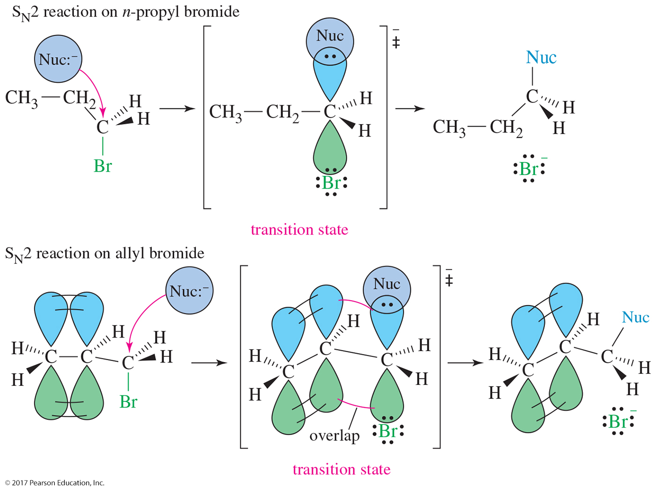
S_{N}2 Reactions of Allylic Halides

Slide 39
S_{N}2 Reactions with Organometallics
Allylic halides and tosylates react with Grignards and organolithiums:
H₂C═CHCH₂Br + CH₃Li → H₂C═CHCH₂CH₃ + LiBr

Slide 40
Diels–Alder Reaction
Named after Otto Diels and Kurt Alder. They received the Nobel prize in 1950.
The reaction is between a diene and an electron-deficient alkene (dienophile).
Produces a cyclohexene ring.
The Diels–Alder is also called a [4 + 2] cycloaddition because a ring is formed by the interaction of four pi electrons of the alkene with two pi electrons of the alkene or alkyne.

Slide 41
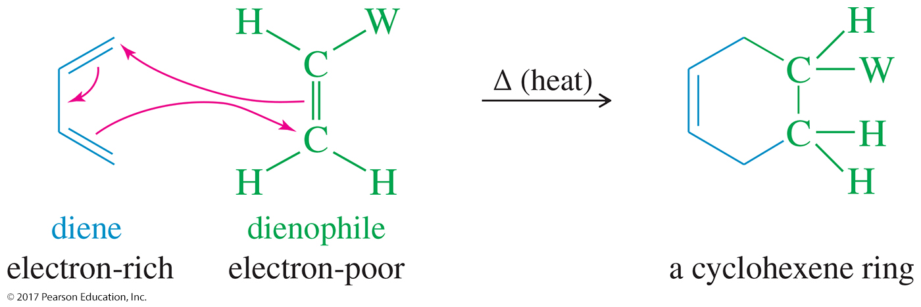
Mechanism of the
Diels–Alder Reaction
One-step, concerted mechanism
A diene reacts with an electron-poor alkene (dienophile) to give cyclohexene or cyclohexadiene rings.

Slide 42
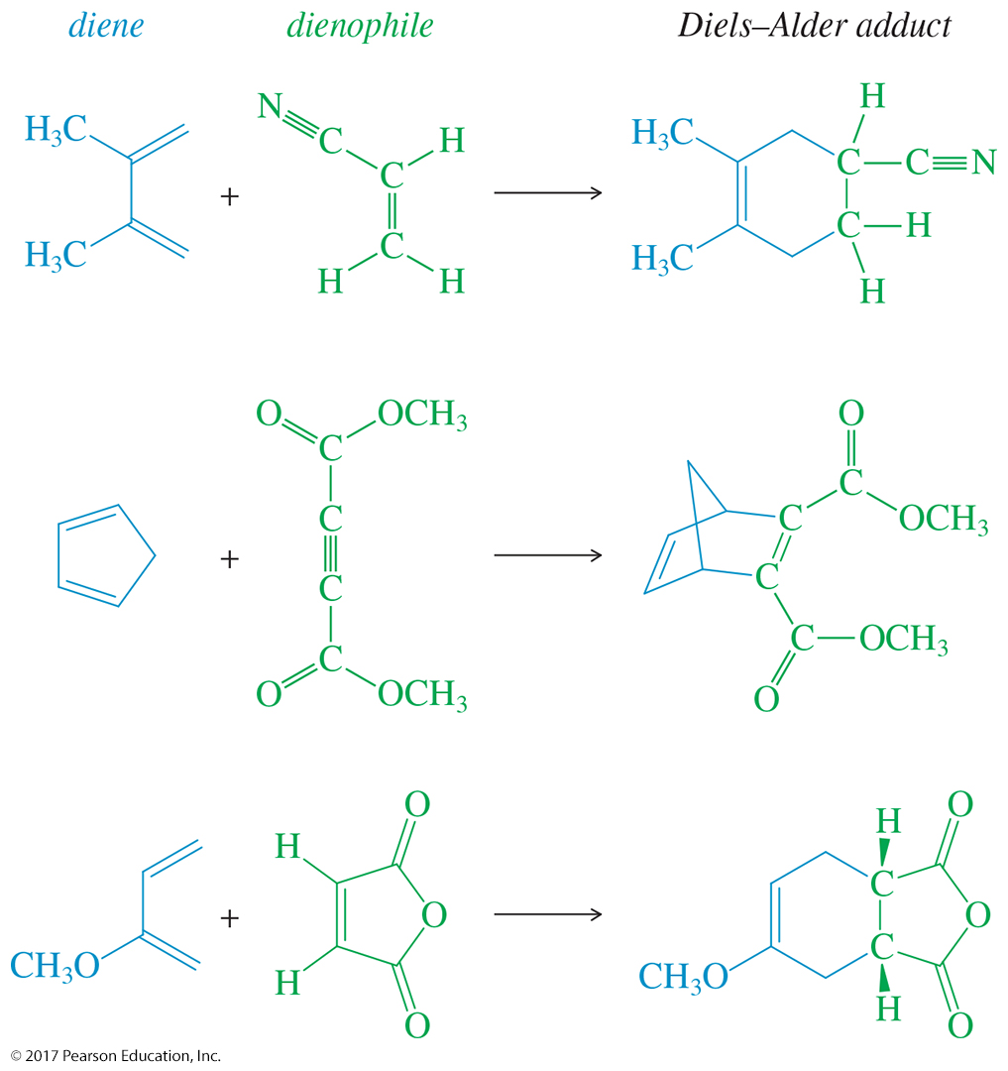
Examples of Diels–Alder Reactions

Slide 43
Stereochemical Requirements
The diene must be in s-cis conformation.
Diene’s C1 and C4 p orbitals must overlap with dienophile’s p orbitals to form new sigma bonds.
Both sigma bonds are on same face of the diene: syn stereochemistry.

Slide 44
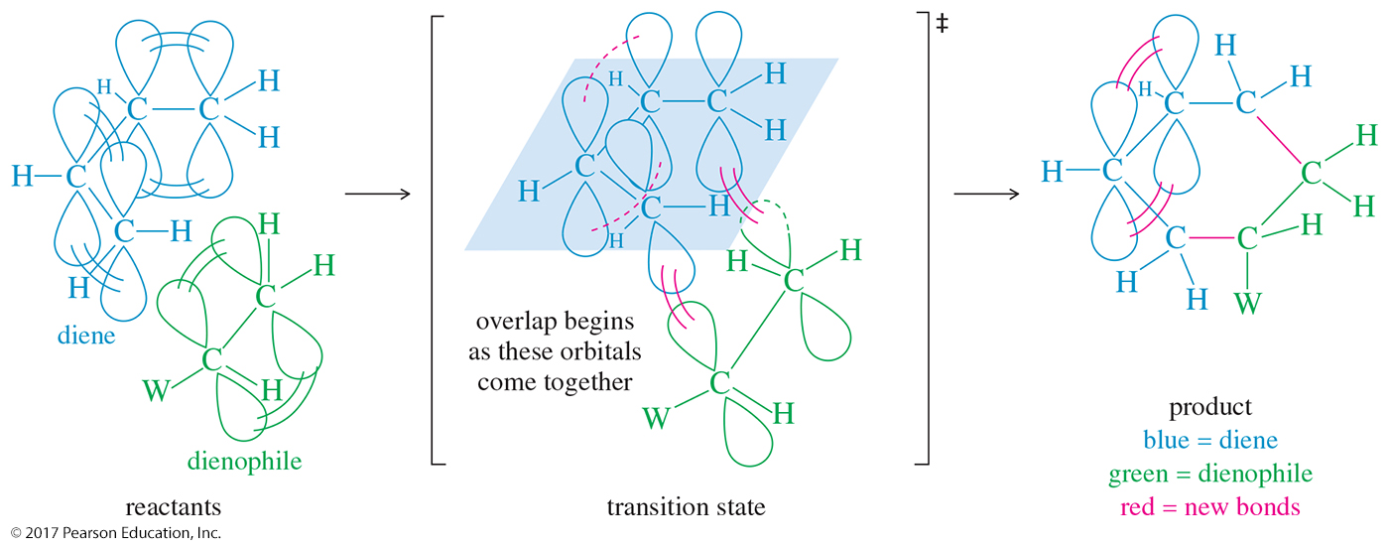
Orbital Overlap of the
Diels–Alder Reaction

Slide 45
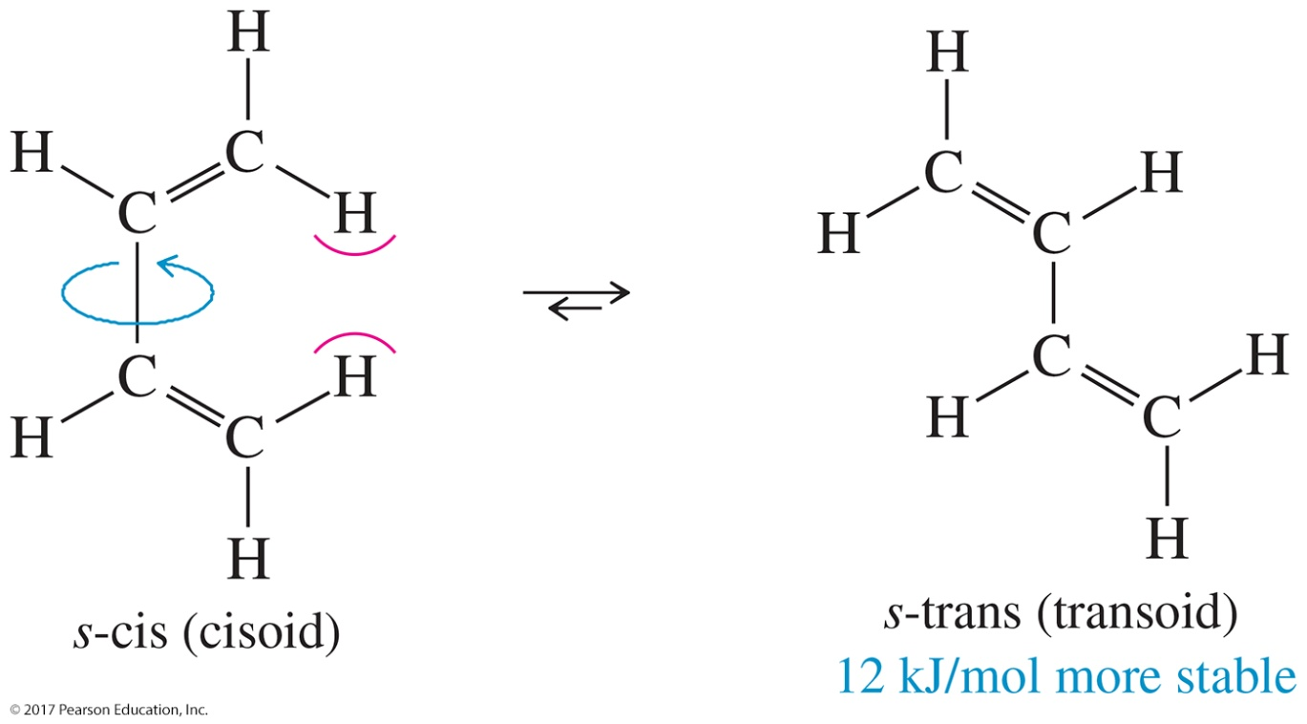
s-Cis Conformation of the Diene
The s-cis conformation can rotate around the C—C single bond to get the more stable s-trans conformation.
The s-trans conformation is 12 kJ/mol more stable than the s-cis.

Slide 46
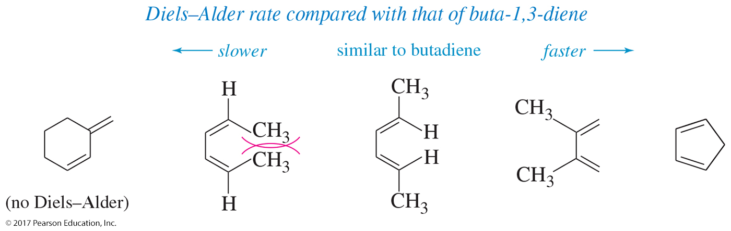
Diels–Alder Rate for Dienes
Cyclopentadiene undergoes the Diels–Alder reaction readily because of its fixed s-cis conformation.
When the diene is sterically hindered, the reaction slows down even though the conformation can be s-cis.
s-trans dienes cannot undergo the Diels–Alder reaction.

Slide 47
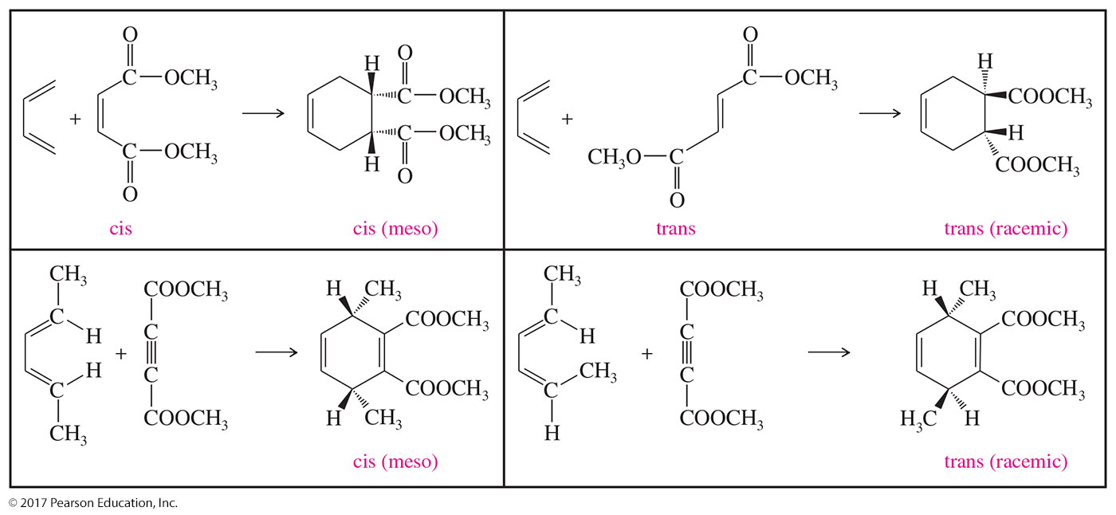
Stereochemistry of the
Diels–Alder Reaction

Slide 48
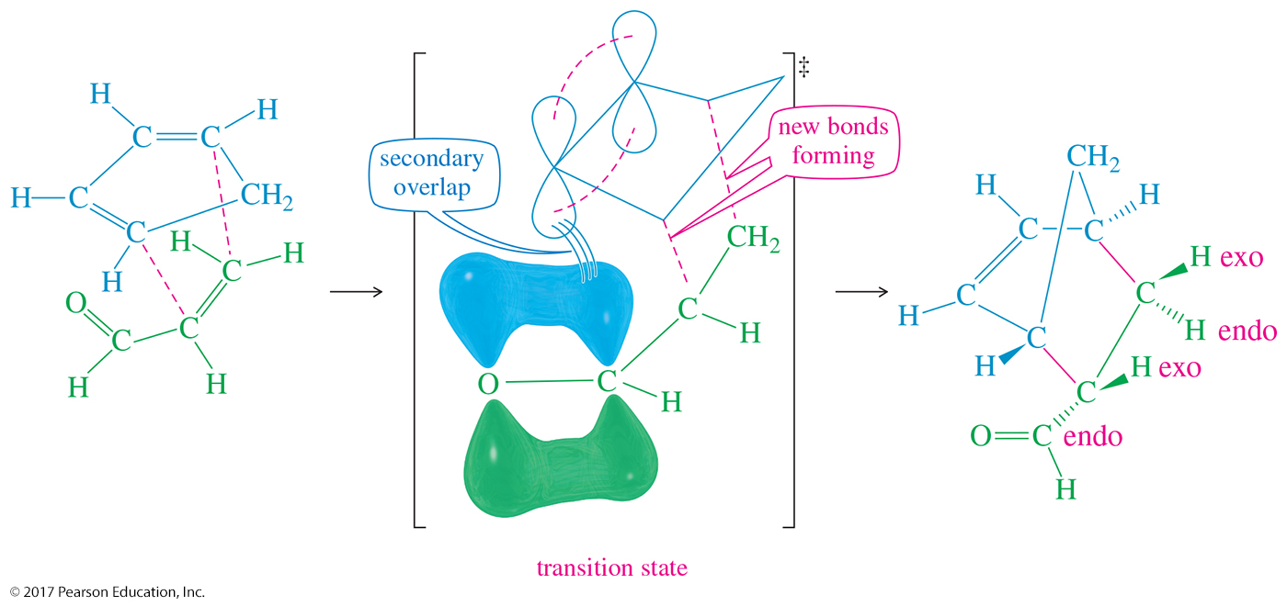
Endo Rule
The p orbitals of the electron-withdrawing groups on the dienophile have a secondary overlap with the p orbitals of C2 and C3 in the diene.

Slide 49
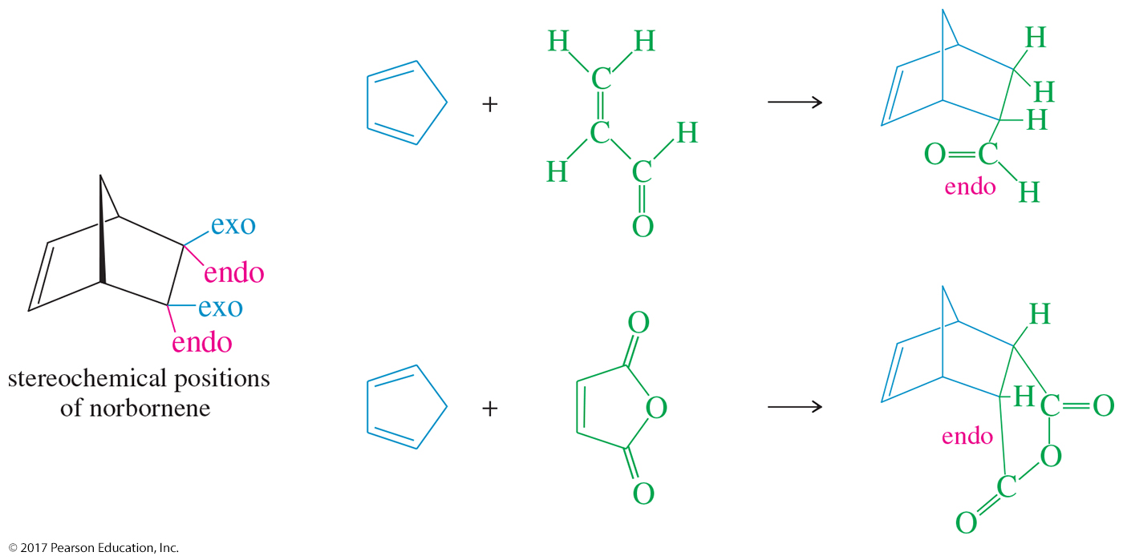
Examples of Endo Rule

Slide 50
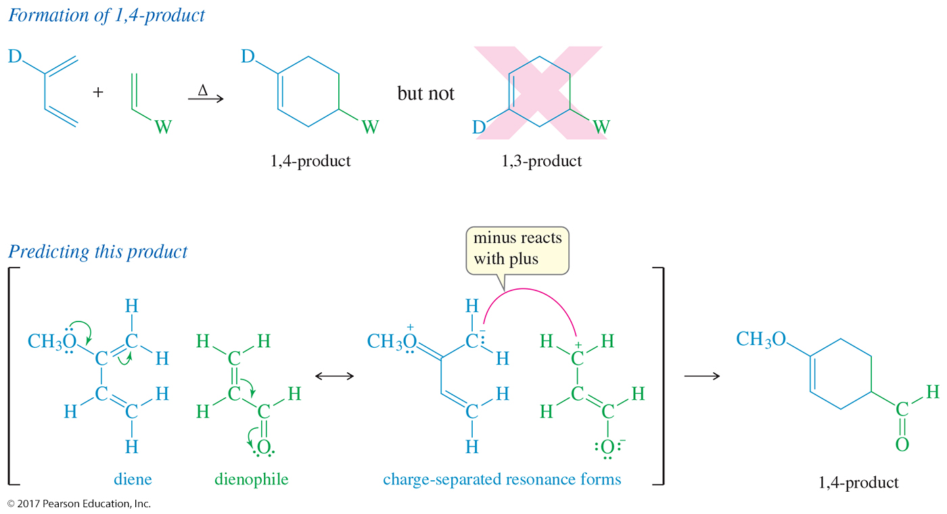
Unsymmetrical Reagents:
1,4-Product

Slide 51
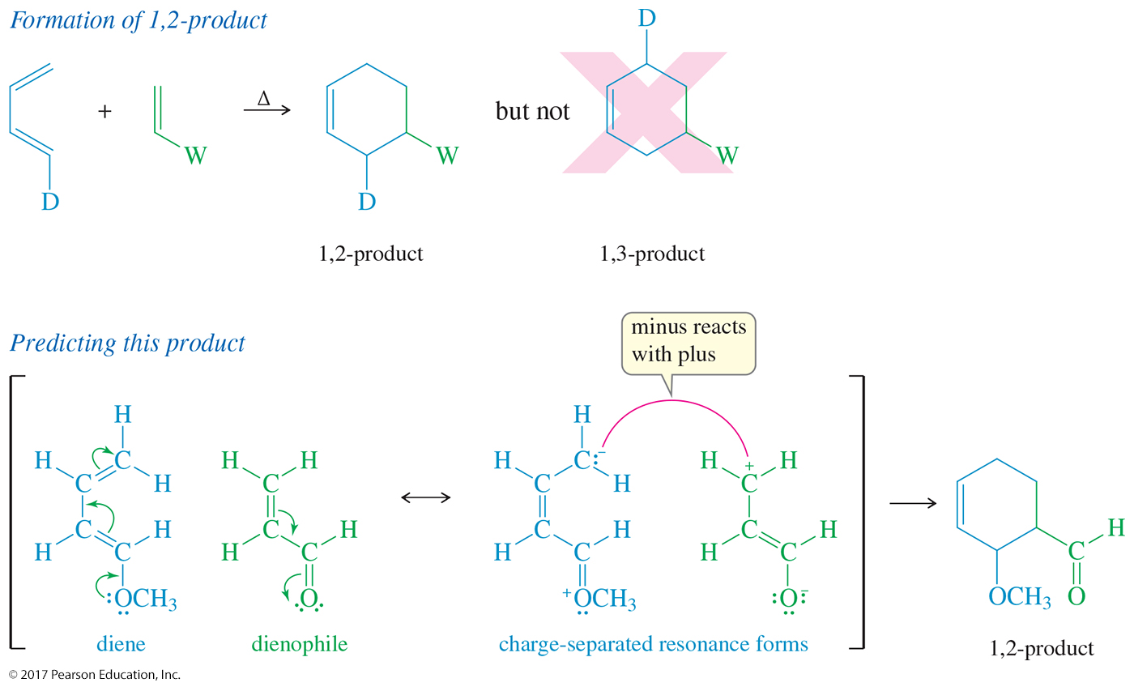
Unsymmetrical Reagents:
1,2-Product

Slide 52
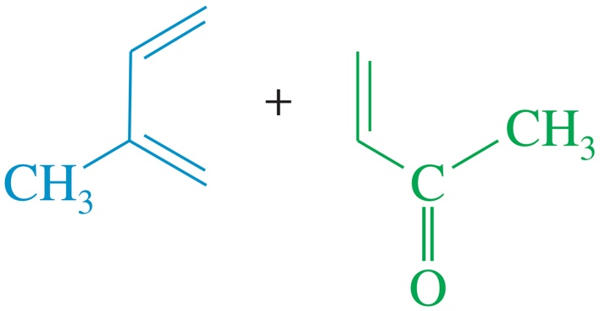
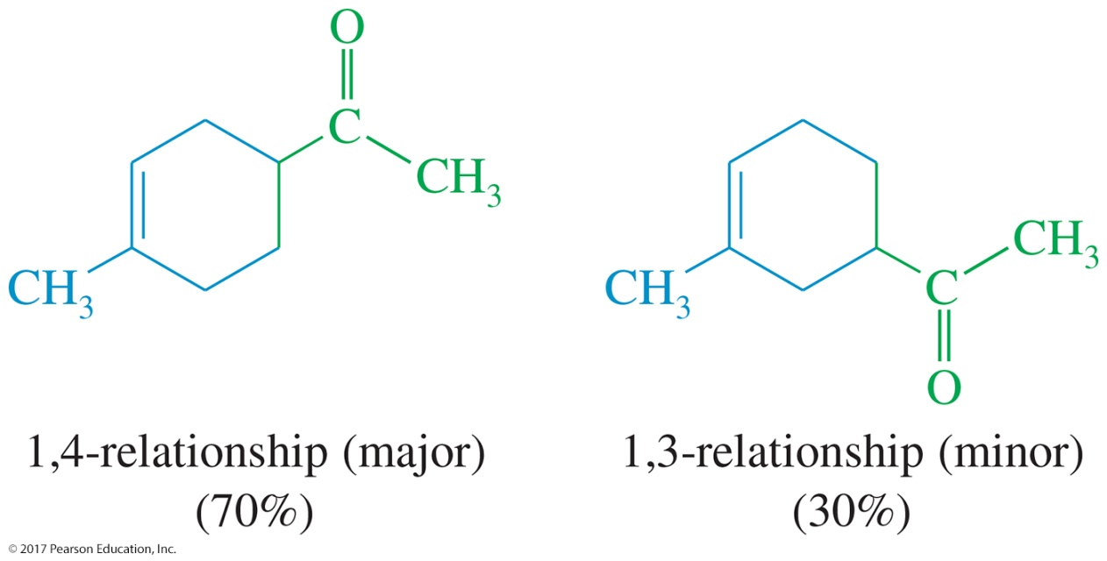
Solved Problem 1
Predict the products of the following proposed Diels–Alder reactions.
Solution

Slide 53
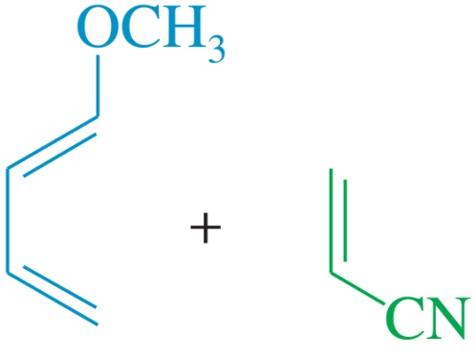
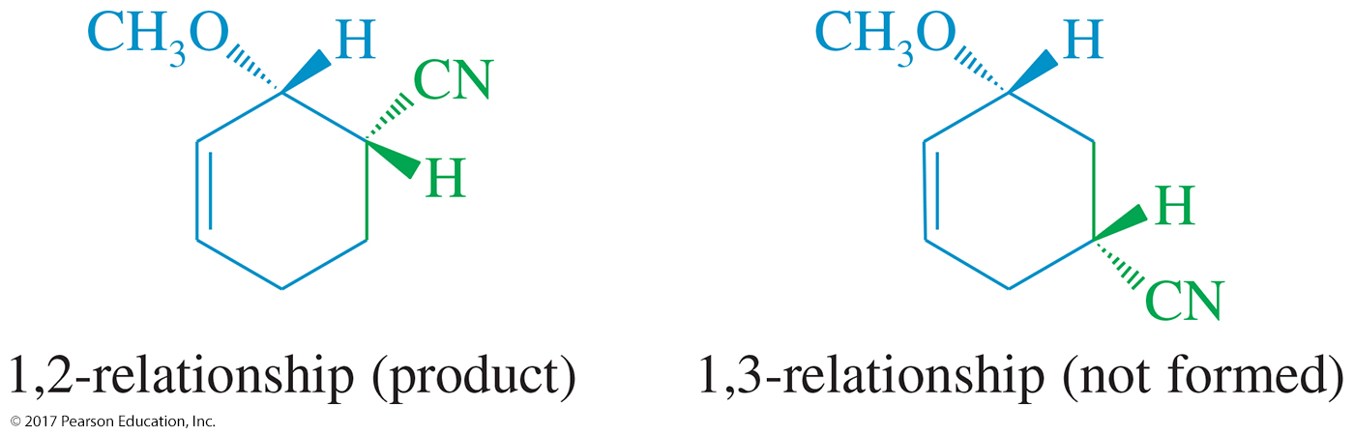
Solved Problem 1 (Continued)
Predict the products of the following proposed Diels–Alder reactions.
Solution (Continued)

Slide 54
Pericyclic Reactions
The Diels–Alder reaction is an example of a pericyclic reaction.
Woodward and Hoffmann predicted reaction products using their theory of conservation of orbital symmetry.
MOs must overlap constructively to stabilize the transition state.

Slide 55
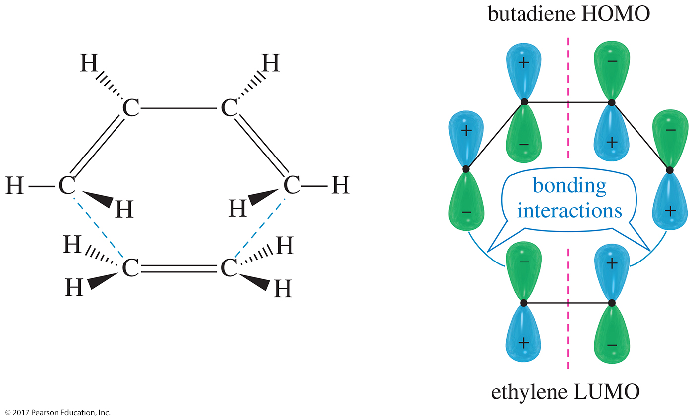
Symmetry-Allowed Reaction
Diene contributes electrons from its highest energy occupied orbital (HOMO).
Dienophile receives electrons in its lowest energy unoccupied orbital (LUMO).

Slide 56

“Forbidden” Cycloaddition
[2 + 2] cycloaddition of two ethylenes to form cyclobutene has antibonding overlap of HOMO and LUMO.

Slide 57

Photochemical Induction
Absorption of correct energy photon will promote an electron to an energy level that was previously unoccupied.

Slide 58

[2 + 2] Cycloaddition
Photochemically allowed, but thermally forbidden.

Slide 59
Ultraviolet Spectroscopy
200- to 400-nm photons excite electrons from a π bonding orbital to a π* antibonding orbital.
Conjugated dienes have MOs that are closer in energy.
A compound that has a longer chain of conjugated double bonds absorbs light at a longer wavelength.

Slide 60

Comparison of IR and
UV Wavelengths

Slide 61

π → π* for Ethylene and Butadiene

Slide 62

Obtaining a UV Spectrum
The spectrometer measures the intensity of a reference beam through solvent only (I_{r}) and the intensity of a beam through a solution of the sample (I_{s}).
Absorbance is the log of the ratio I_{r}/I_{s}.

Slide 63
The UV Spectrum
Usually shows broad peaks
Read λ_{max} from the graph.
Absorbance, A, follows Beer’s law:
A = εcl
where ε is the molar absorptivity, c is the sample concentration in moles per liter, and l is the length of the light path in centimeters.

Slide 64

UV Spectrum of Isoprene

Slide 65

Sample UV Absorptions

Slide 66

Solved Problem 2
Rank the following dienes in order of increasing values of λ_{max}. (Their actual absorption maxima are 185 nm, 235 nm, 273 nm, and 300 nm.)
These compounds are an isolated diene, two conjugated dienes, and a conjugated triene. The isolated diene will have the shortest value of λ_{max} (185 nm), close to that of cyclohexene (182 nm).
The second compound looks like 3-methylenecyclohexene (232 nm) with an additional alkyl substituent (circled). Its absorption maximum should be around (232 + 5) nm, and
235 nm must be the correct value.
The third compound looks like cyclohexa-1,3-diene (256 nm), but with an additional alkyl substituent (circled) raising the value of λ_{max} so 273 nm must be the correct value.
The fourth compound looks like cyclohexa-1,3-diene (256 nm), but with an additional conjugated double bond (circled) and another alkyl group (circled). We predict a value of λ_{max} about 35 nm longer than for cyclohexa-1,3-diene, so 300 nm must be the correct value.

Slide 67


Colored Organic Compounds

Slide 68

Colored Natural Products

Slide 69

UV-Visible Analysis in
Biology and Medicine
UV-visible spectroscopy is nondestructive and exceptionally sensitive.
Can measure small concentrations of highly conjugated metabolites.

