Slide 1
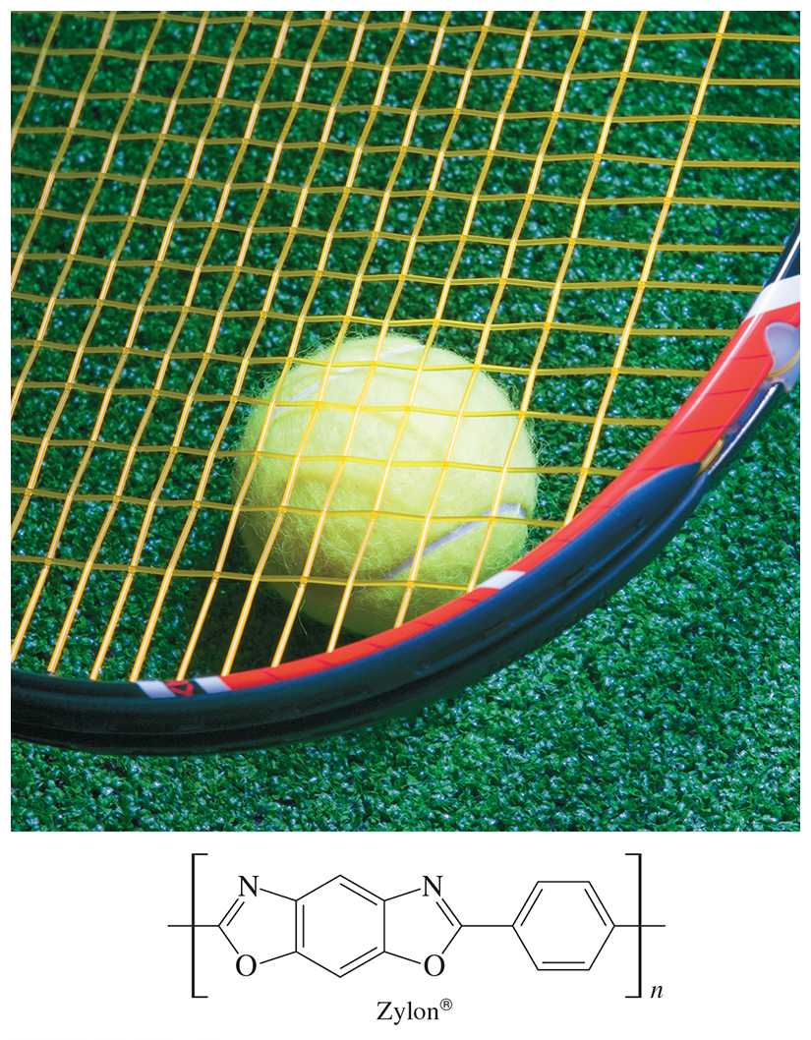
Organic Chemistry,
9th Edition
L. G. Wade, Jr.
Chapter 16
Lecture
Aromatic Compounds
Chad Snyder, PhD
Grace College
© 2017 Pearson Education, Inc.

Slide 2
Discovery of Benzene
Benzene was isolated in 1825 by Michael Faraday, who determined C:H ratio to be 1:1. He named it “bicarburet of hydrogen.”
It was synthesized in 1834 by Eilhard Mitscherlich, who determined its molecular formula to be C₆H₆. He named it benzin.
Other related compounds with low C:H ratios had a pleasant smell, so they were classified as aromatic

Slide 3
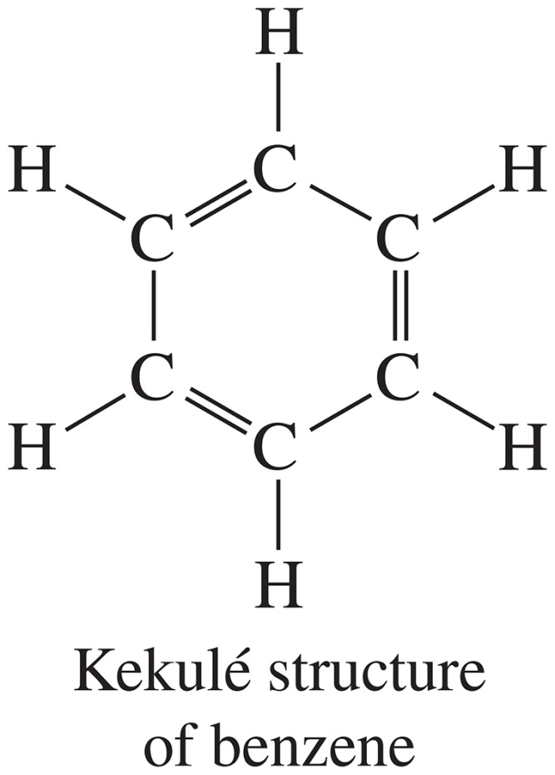
Kekulé Structure
This structure was proposed in 1866 by Friedrich Kekulé, shortly after multiple bonds were suggested.
It failed to explain
the existence of
only one isomer of
1,2-dichlorobenzene.

Slide 4
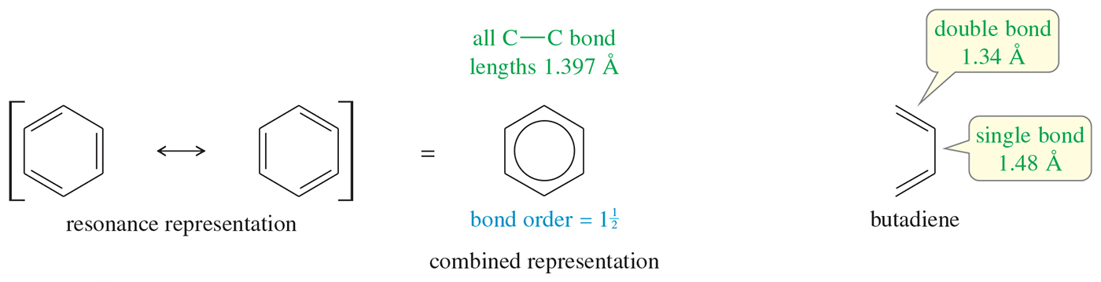
Resonance Structures of Benzene
Benzene is actually a resonance hybrid between the two Kekulé structures.
The C—C bond lengths in benzene are shorter than typical single-bond lengths, yet longer than typical double-bond lengths (bond order 1.5).
Benzene’s resonance can be represented by drawing a circle inside the six-membered ring as a combined representation.

Slide 5
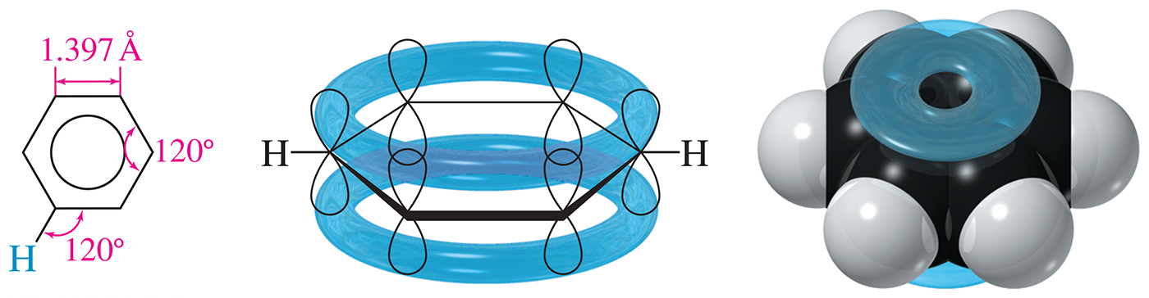
Structure of Benzene
Each sp² hybridized C in the ring has an unhybridized
p orbital perpendicular to the ring that overlaps around the ring.
The six pi electrons are delocalized over the six carbons.

Slide 6
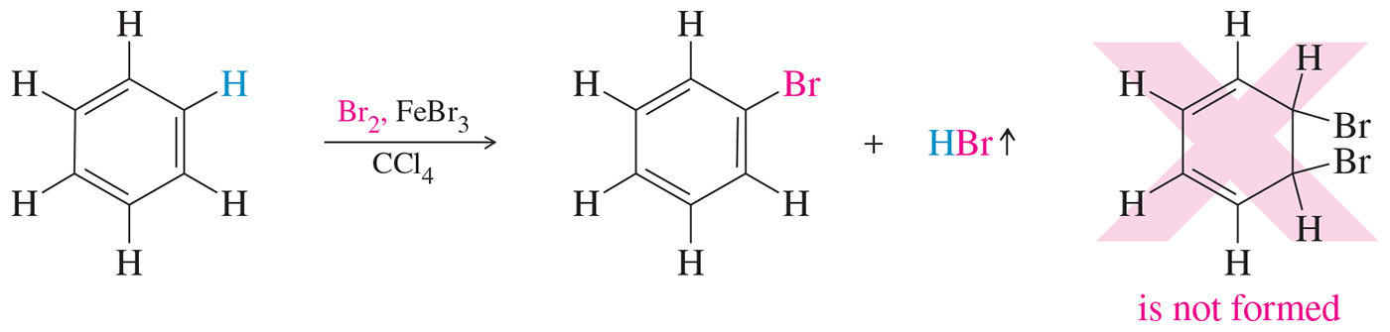
Unusual Addition of Bromine to Benzene
When bromine adds to benzene, a catalyst such as FeBr₃ is needed.
The reaction that occurs is the substitution of a hydrogen atom by a bromine.
Addition of Br₂ to the double bond is not observed.

Slide 7
Resonance Energy
Benzene does not have the predicted heat of hydrogenation of –359 kJ/mol.
The observed heat of hydrogenation is
–208 kJ/mol, a difference of 151 kJ.
This difference between the predicted and the observed value is called the resonance energy.

Slide 8
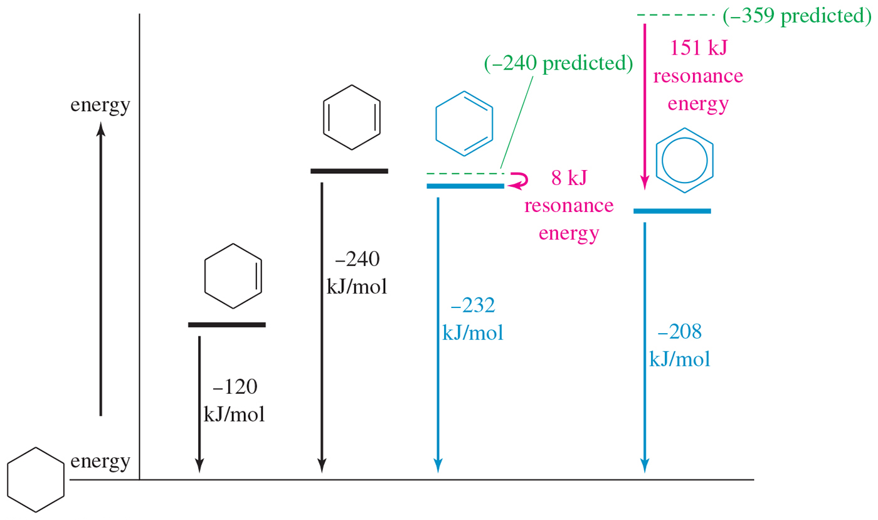
Molar Heats of Hydrogenation

Slide 9
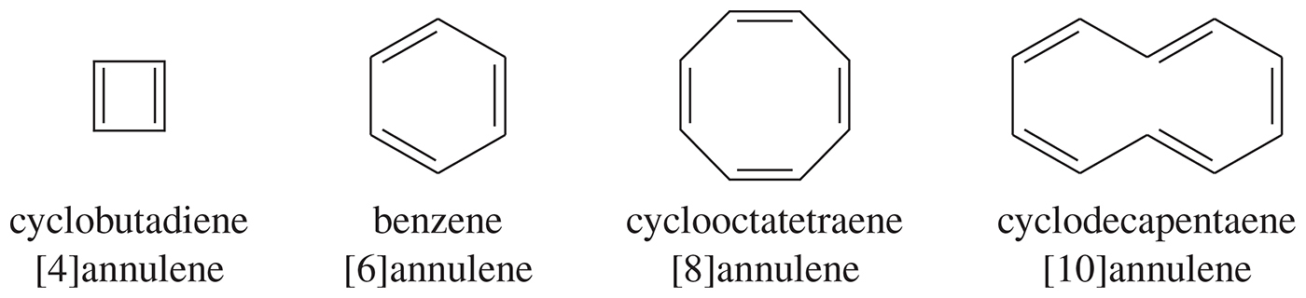
Annulenes
Annulenes are hydrocarbons with alternating single and double bonds.
Benzene is a six-membered annulene, so it can be named [6]-annulene. Cylobutadiene is [4]-annulene; cyclooctatetraene is [8]-annulene.

Slide 10
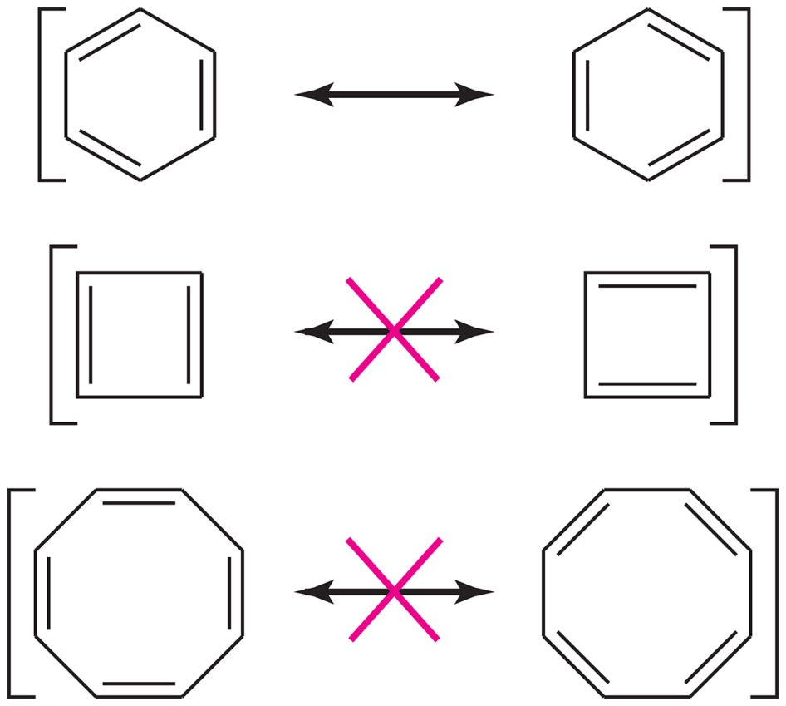
Failures of the Resonance Picture
All cyclic conjugated hydrocarbons were proposed to be aromatic.
However, cyclobutadiene is so reactive that it dimerizes before it can be isolated.
Cyclooctatetraene adds Br₂ readily to the double bonds.

Slide 11
MO Rules for Benzene
Six overlapping p orbitals must form six molecular orbitals (MOs).
Three will be bonding, three antibonding.
The lowest-energy MO will have all bonding interactions and no nodes.
As the energy of the MO increases, the number of nodes increases.

Slide 12
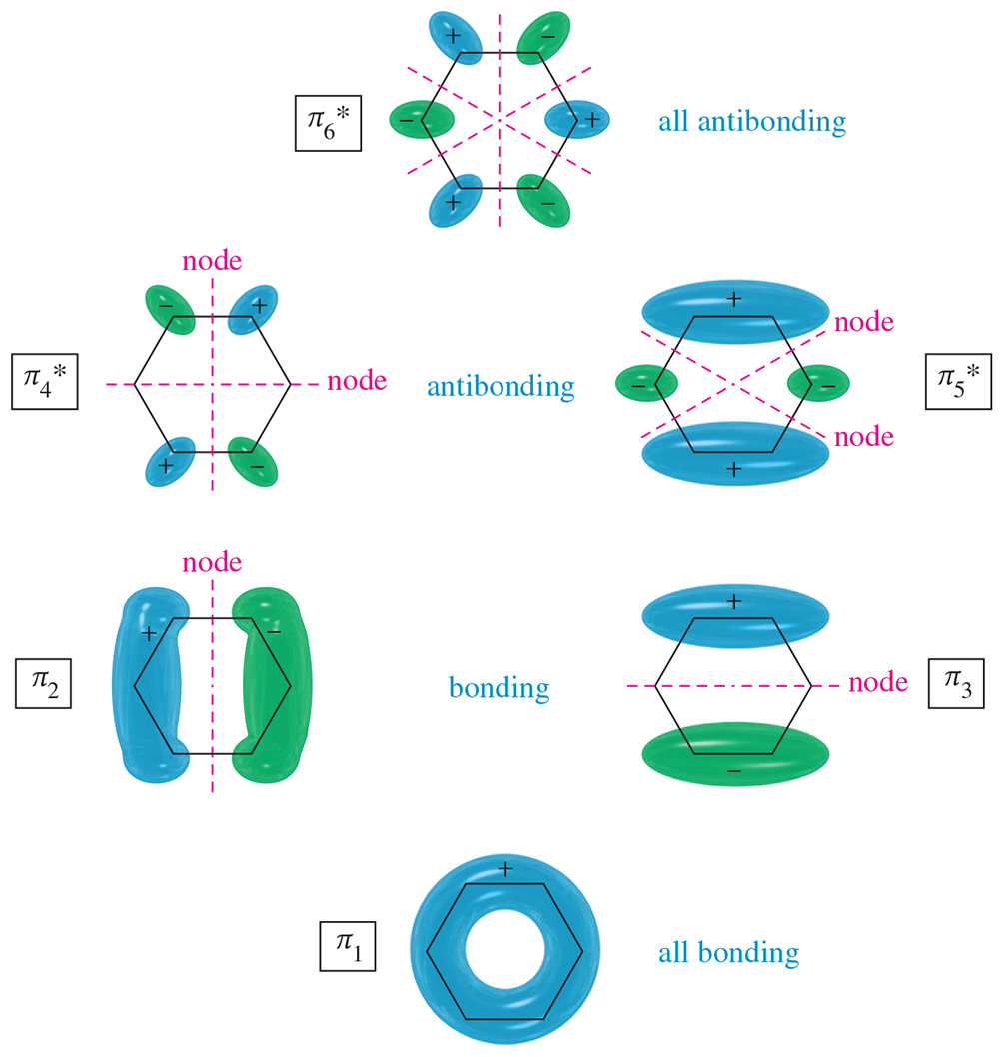
MOs for Benzene

Slide 13
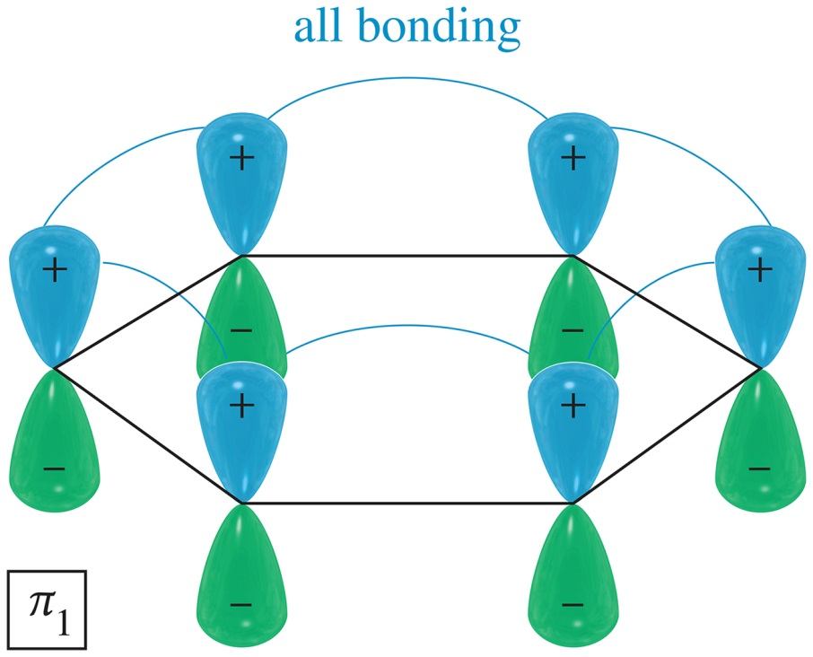
First MO of Benzene
The first MO of benzene is entirely bonding with no nodes.
It has very low energy because it has six bonding interactions and the electrons are delocalized over all six carbon atoms.

Slide 14
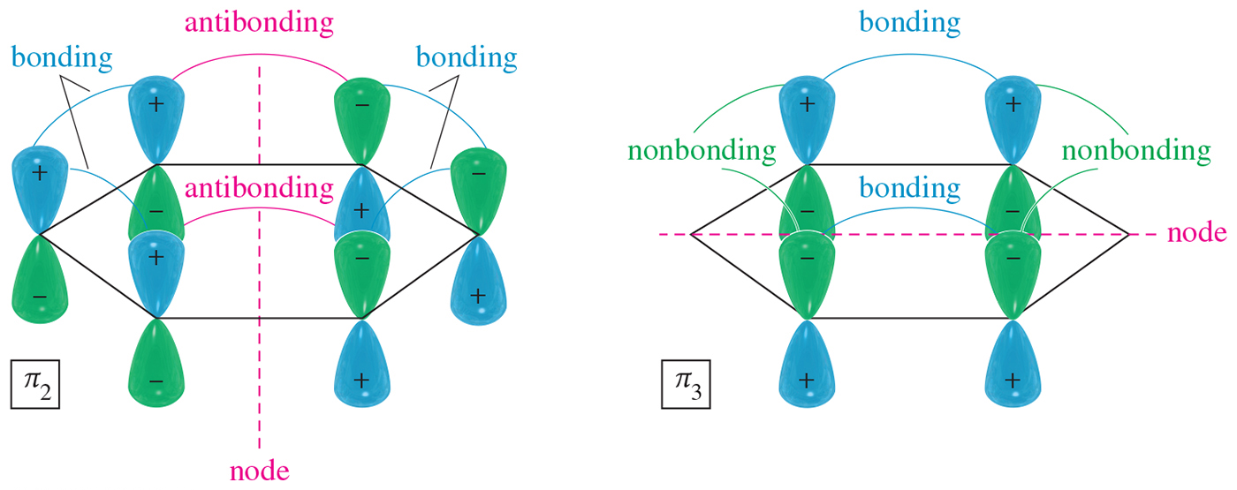
Intermediate MO of Benzene
The intermediate levels are degenerate (equal in energy) with two orbitals at each energy level.
Both π₂ and π₃ have one nodal plane.

Slide 15
All-Antibonding MOs of Benzene
The all-antibonding π₆* has three nodal planes.
Each pair of adjacent
p orbitals is out of phase and interacts destructively.

Slide 16
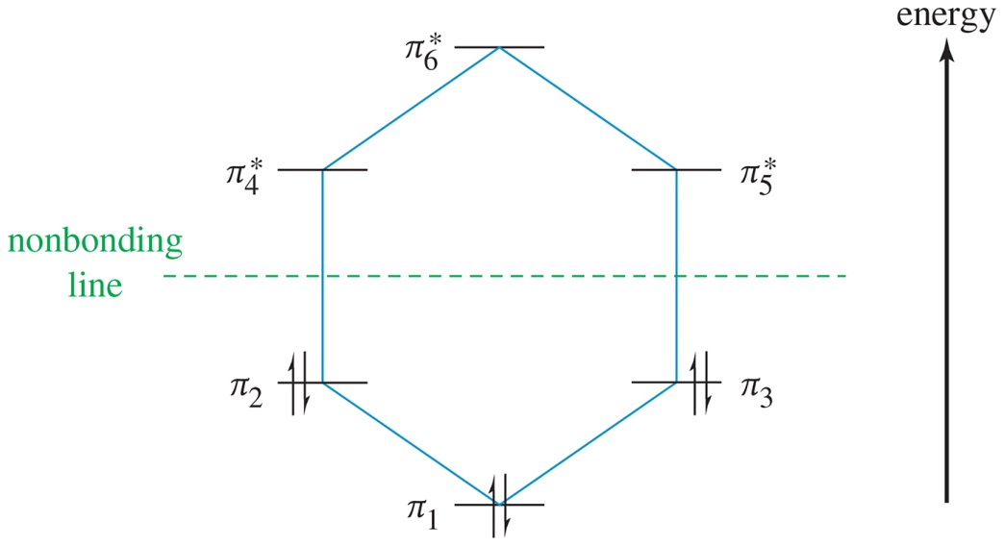
Energy Diagram for
Benzene
The six π electrons fill the three bonding pi orbitals.
All bonding orbitals are filled (“closed shell”), an extremely stable arrangement.

Slide 17
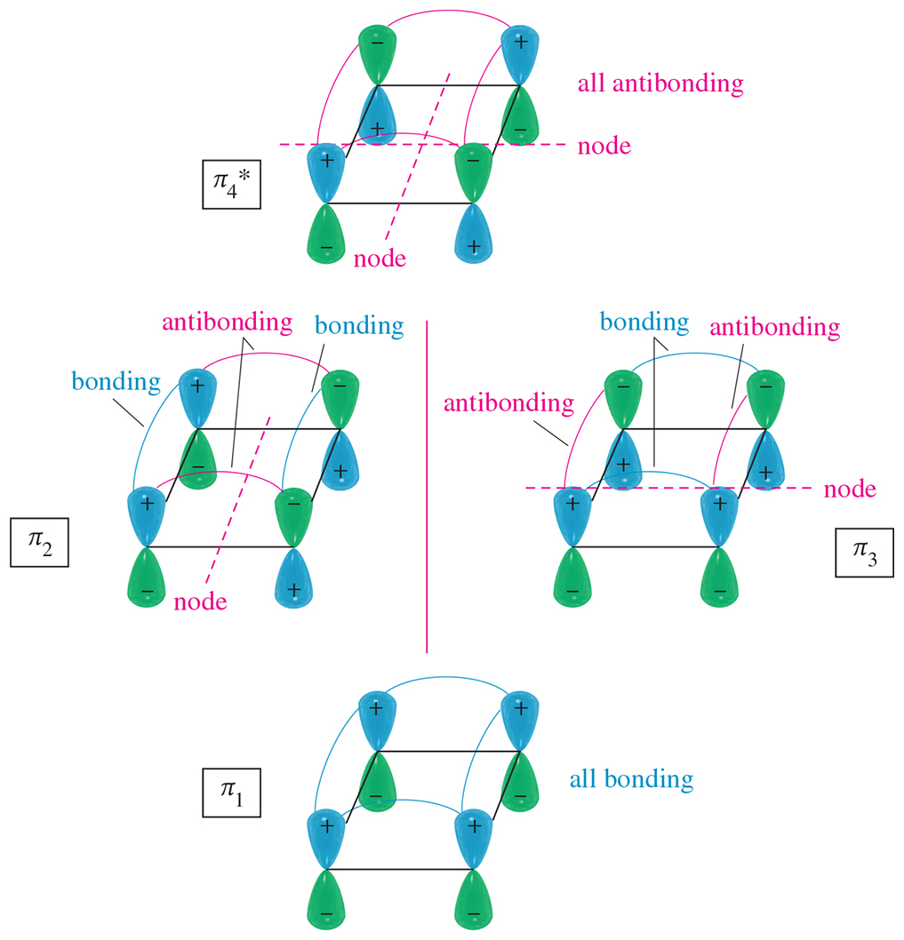
MOs for Cyclobutadiene

Slide 18
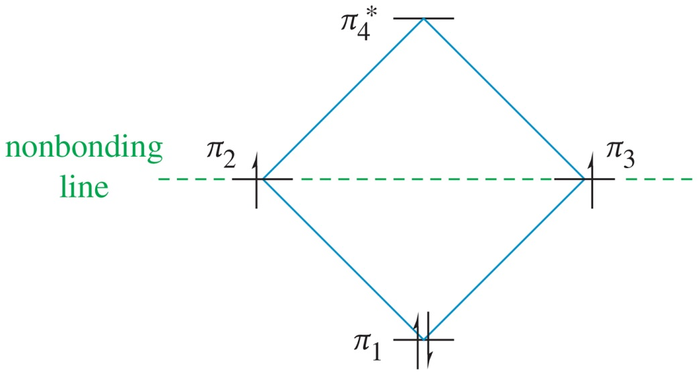
Electronic Energy Diagram for
Cyclobutadiene
Following Hund’s rule, two electrons are in separate, nonbonding molecular orbitals.
This diradical would be very reactive.

Slide 19
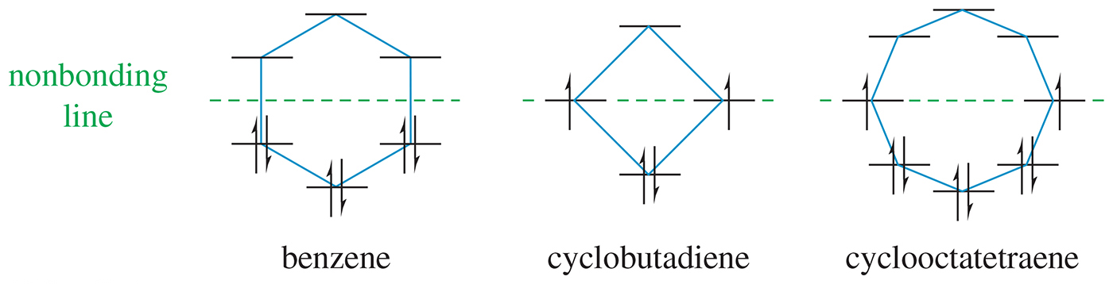
Polygon Rule
The energy diagram for an annulene has the same shape as the cyclic compound with one vertex at the bottom.

Slide 20
Aromatic Requirements
The structure must be cyclic with conjugated
pi bonds.
Each atom in the ring must have an unhybridized p orbital (sp² or sp).
The p orbitals must overlap continuously around the ring. The structure must be planar (or close to planar) for effective overlap to occur.
Delocalization of the pi electrons over the ring must lower the electronic energy.

Slide 21
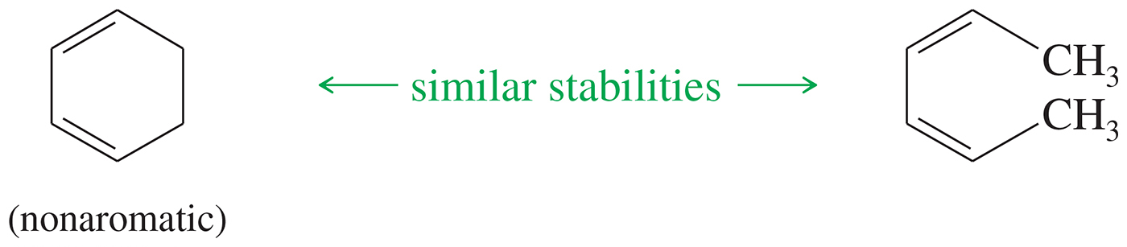
Nonaromatic Compounds
Nonaromatic compounds do not have a continuous ring of overlapping p orbitals and may be nonplanar.

Slide 22
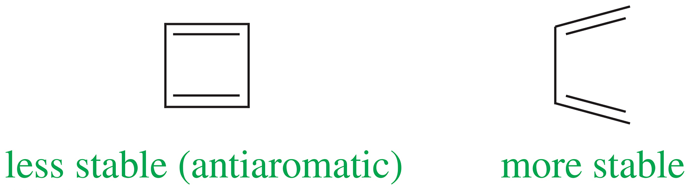
Antiaromatic Compounds
Antiaromatic compounds are cyclic and conjugated with overlapping p orbitals around the ring, but electron delocalization increases its electronic energy.

Slide 23
Hückel’s Rule
Once the aromatic criteria are met, Hückel’s rule applies.
If the number of pi electrons is (4N + 2), the system is aromatic (where N is an integer).
If the number of pi electrons is (4N), the system is antiaromatic.

Slide 24
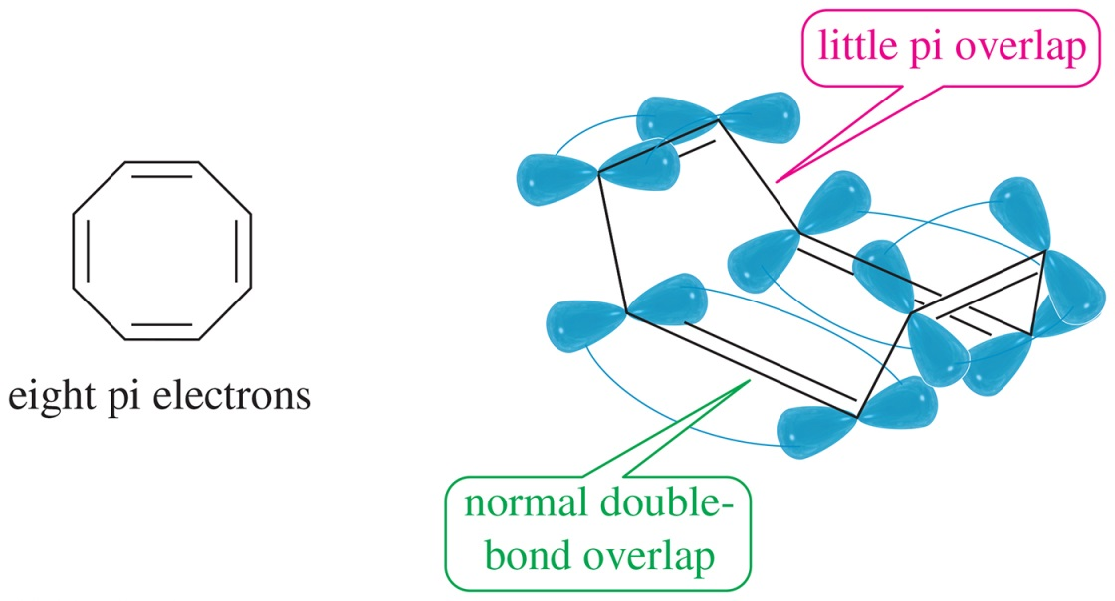
Orbital Overlap of Cyclooctatetraene
Cyclooctatetraene assumes a nonplanar tub conformation that avoids most of the overlap between the adjacent pi bonds. Hückel's rule simply does not apply.

Slide 25
Annulenes
[4]Annulene (cyclobutadiene) is antiaromatic.
[8]Annulene (cyclooctatetraene) would be antiaromatic, but it’s not planar, so it’s nonaromatic.
[10]Annulene is aromatic except for the isomers that are nonplanar.
Larger 4N annulenes are not antiaromatic because they are flexible enough to become nonplanar.

Slide 26
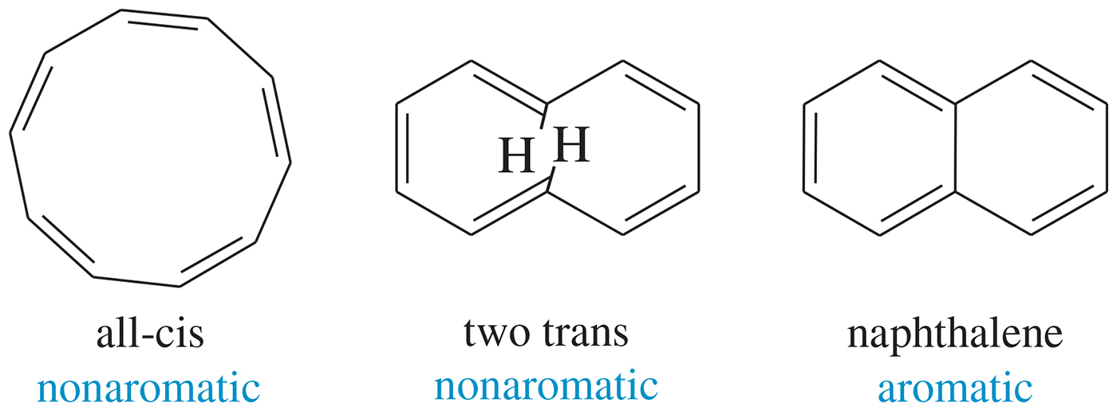
[10]Annulene
In the all-cis [10]annulene, the planar conformation requires an excessive amount of angle strain.
The [10]annulene isomer with two trans double bonds cannot adopt a planar conformation either because two hydrogen atoms interfere with each other.

Slide 27
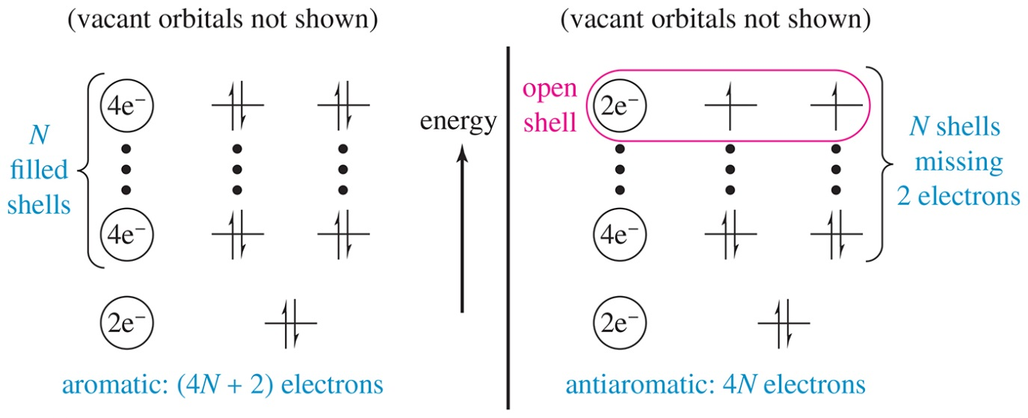
MO Derivation of
Hückel’s Rule
Aromatic compounds have (4N + 2) electrons and the orbitals are filled.
Antiaromatic compounds have only 4N electrons and have unpaired electrons in two degenerate orbitals.

Slide 28
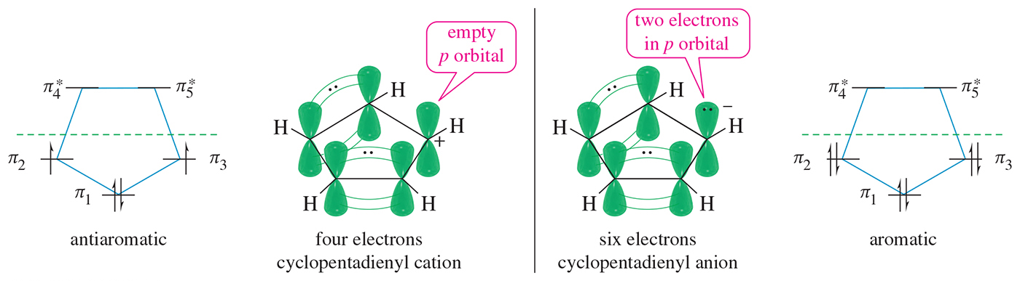
Cyclopentadienyl Ions
The cation has an empty p orbital and four pi electrons, so it is antiaromatic.
The anion has a nonbonding pair of electrons in a p orbital for a total of six pi electrons, so it is aromatic.

Slide 29
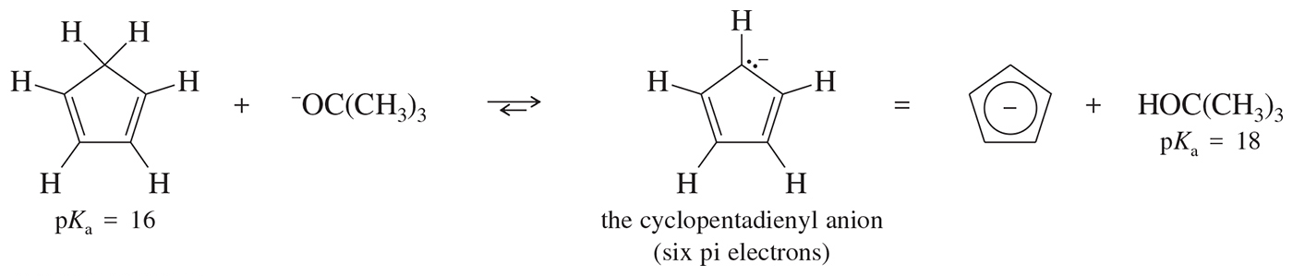
Deprotonation of Cyclopentadiene
By deprotonating the sp³ carbon of cyclopentadiene, there will be a pair of electrons in one of the sp³ orbitals.
This sp³ orbital can rehybridize to a p orbital.
The six electrons in the p orbitals can be delocalized over all five carbon atoms and the compound would be aromatic.

Slide 30
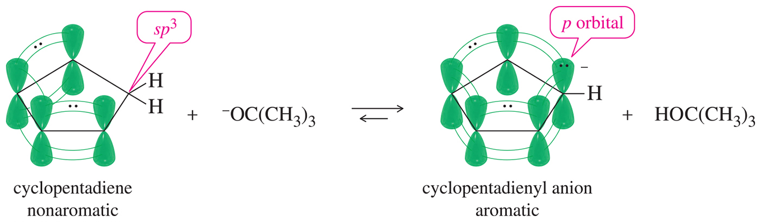
Orbital View of the Deprotonation of Cyclopentadiene
Deprotonation will allow the overlap of all the
p orbitals in the molecule.
Cyclopentadiene is not necessarily as stable as benzene and it reacts readily with electrophiles.

Slide 31
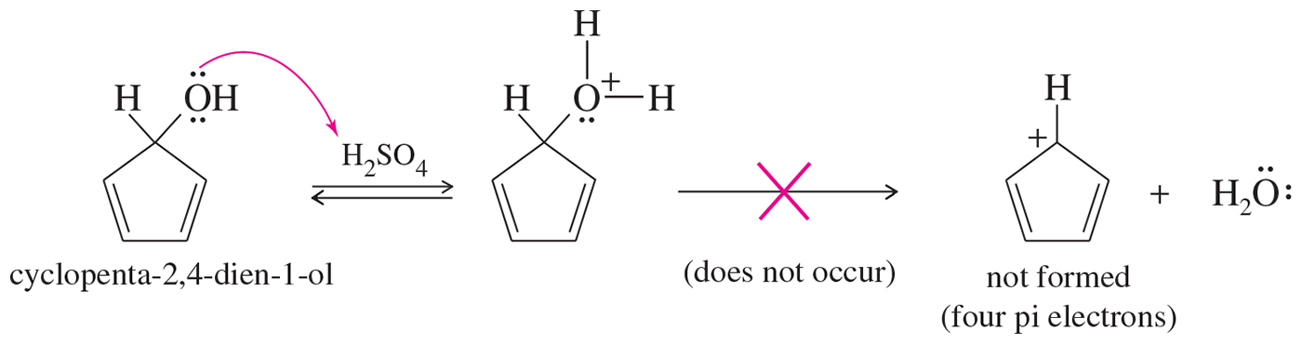
Cyclopentadienyl Cation
Hückel’s rule predicts that the cyclopentadienyl cation, with four pi electrons, is antiaromatic.
In agreement with this prediction, the cyclopentadienyl cation is not easily formed.

Slide 32
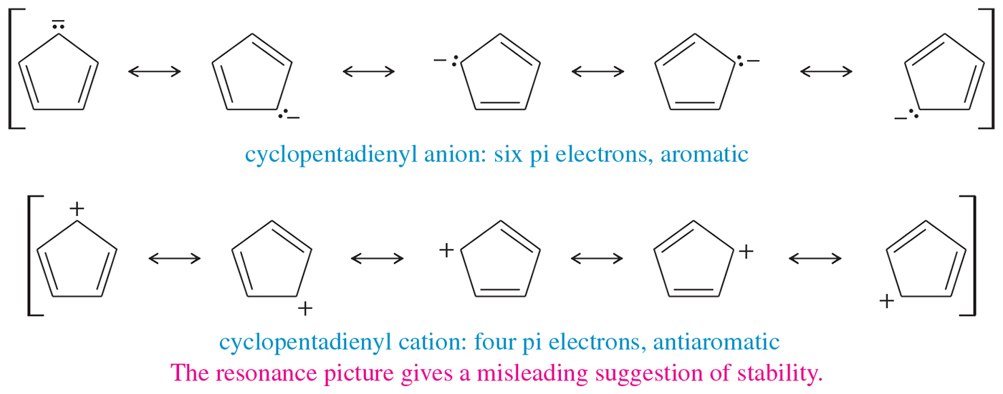
Resonance Forms of Cyclopentadienyl Ions

Slide 33
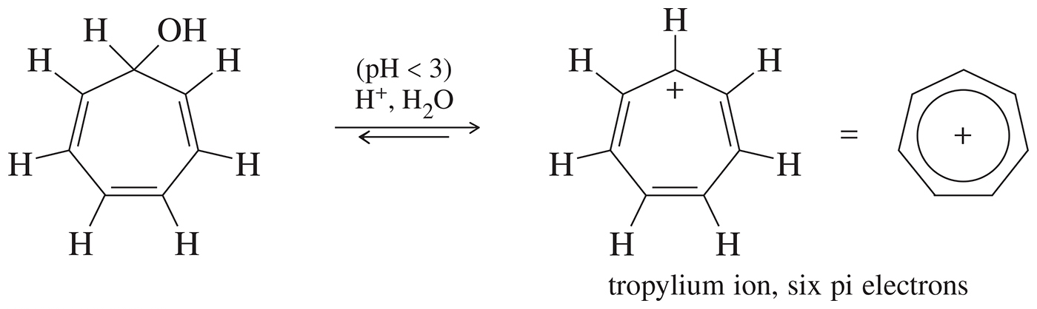
Cycloheptatrienyl Cation
The cycloheptatrienyl cation has six pi electrons and an empty p orbital.
The cycloheptatrienyl cation is easily formed by treating the corresponding alcohol with dilute (0.01N) aqueous sulfuric acid.
The cycloheptatrienyl cation is commonly known as the tropylium ion.

Slide 34
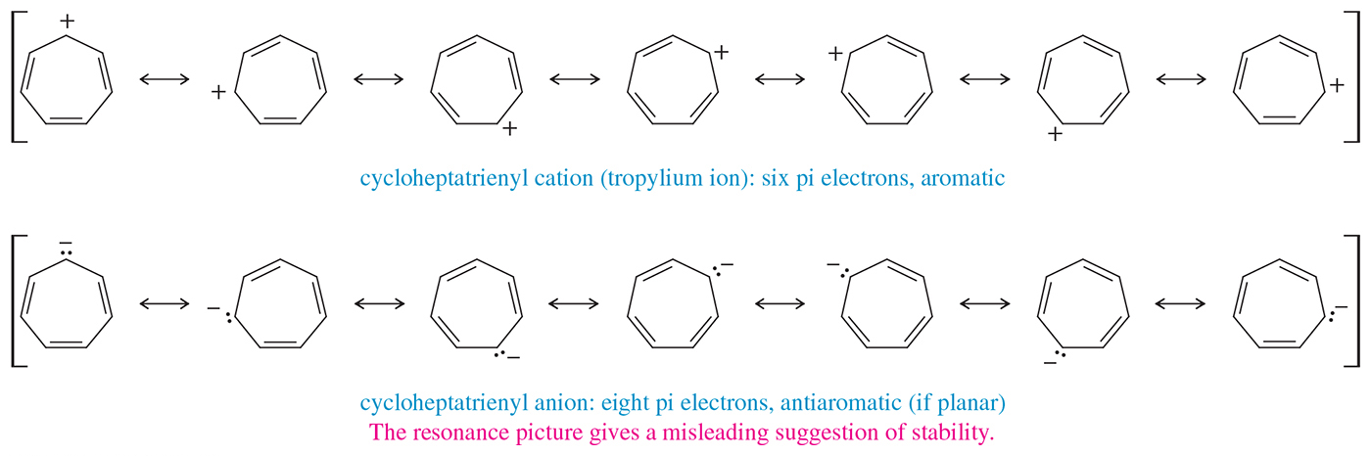
Cycloheptatrienyl Ions

Slide 35
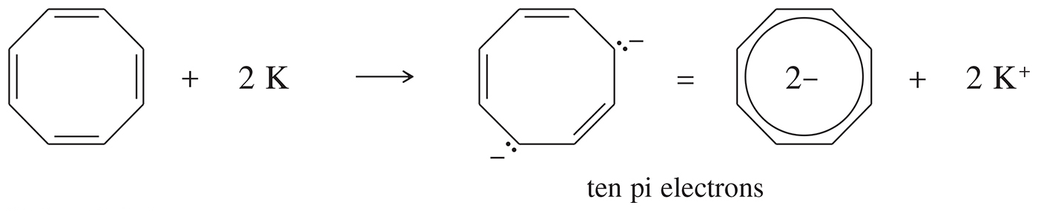
Cyclooctatetraene Dianion
Cyclooctatetraene reacts with potassium metal to form an aromatic dianion.
The dianion has ten pi electrons and is aromatic.

Slide 36

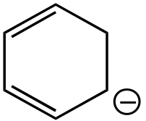
Which of the following is an aromatic compound?
Nonaromatic
Aromatic
There is an sp³ carbon in the ring, so delocalization will not be complete.
All carbons are sp³ hybridized and it obeys Hückel’s rule.

Slide 37
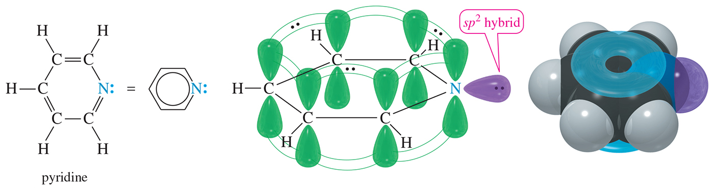
Pyridine Pi System
Pyridine has six delocalized electrons in its pi system.
The two nonbonding electrons on nitrogen are in an sp² orbital, and they do not interact with the pi electrons of the ring.

Slide 38
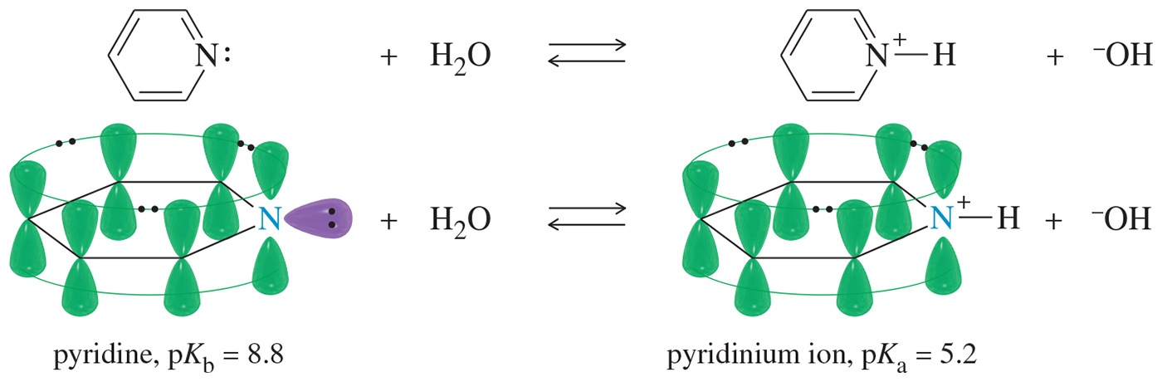
Pyridine
Pyridine is basic, with a pair of nonbonding electrons available to abstract a proton.
The protonated pyridine (the pyridinium ion) is still aromatic.

Slide 39
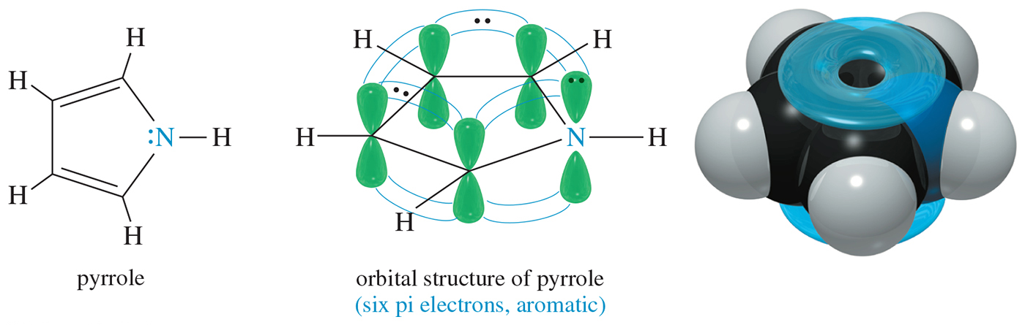
Pyrrole Pi System
The pyrrole nitrogen atom is sp² hybridized with a lone pair of electrons in the p orbital. This p orbital overlaps with the p orbitals of the carbon atoms to form a continuous ring.
Pyrrole is aromatic because it has six pi electrons (N = 1).

Slide 40
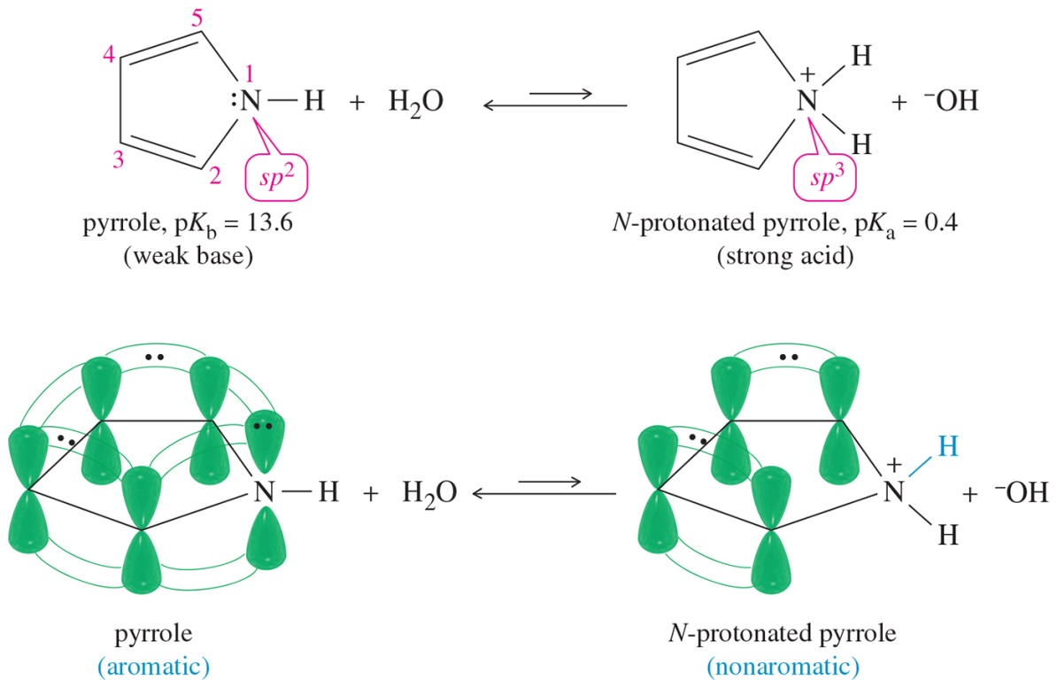
Pyrrole
Pyrrole is aromatic because the lone pair on nitrogen is delocalized.
N-protonated pyrrole is nonaromatic because the nitrogen is sp³.

Slide 41
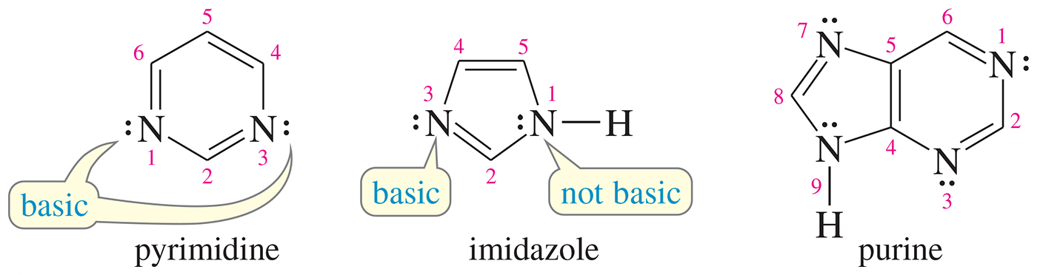
Basic or Nonbasic?
Pyrimidine has two basic nitrogens.
Imidazole has one basic nitrogen and
one nonbasic.
Only one of purine’s nitrogens is not basic.

Slide 42
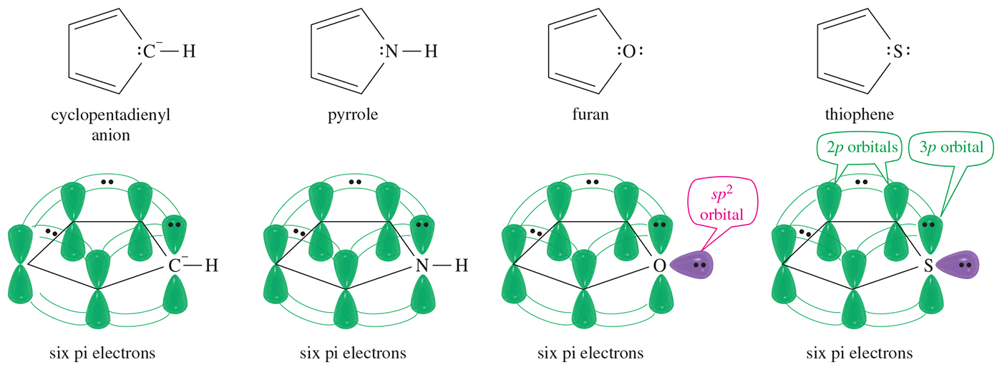
Other Heterocyclics

Slide 43
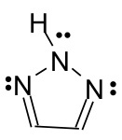
Is the molecule below aromatic, antiaromatic, or nonaromatic?
Aromatic

Slide 44
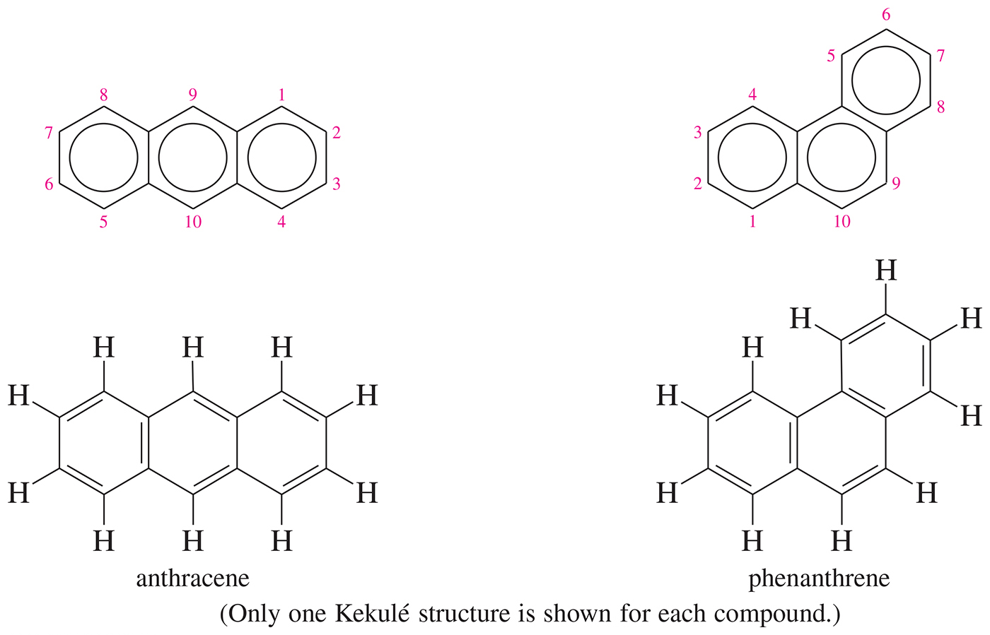
Polynuclear Aromatic Hydrocarbons

Slide 45
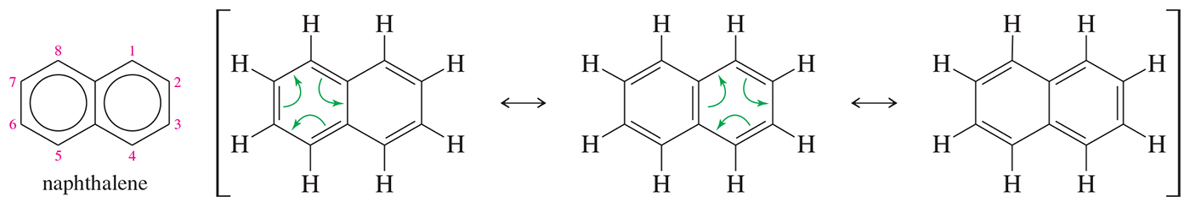
Naphthalene
Fused rings share two atoms and the bond between them.
Naphthalene is the simplest fused aromatic hydrocarbon.

Slide 46
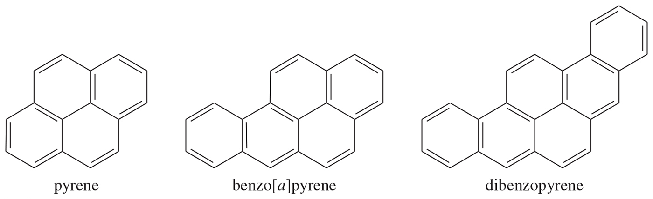
Larger Polynuclear
Aromatic Hydrocarbons
Formed in combustion (tobacco smoke)
Many are carcinogenic.
Epoxides form and combine with DNA base.

Slide 47
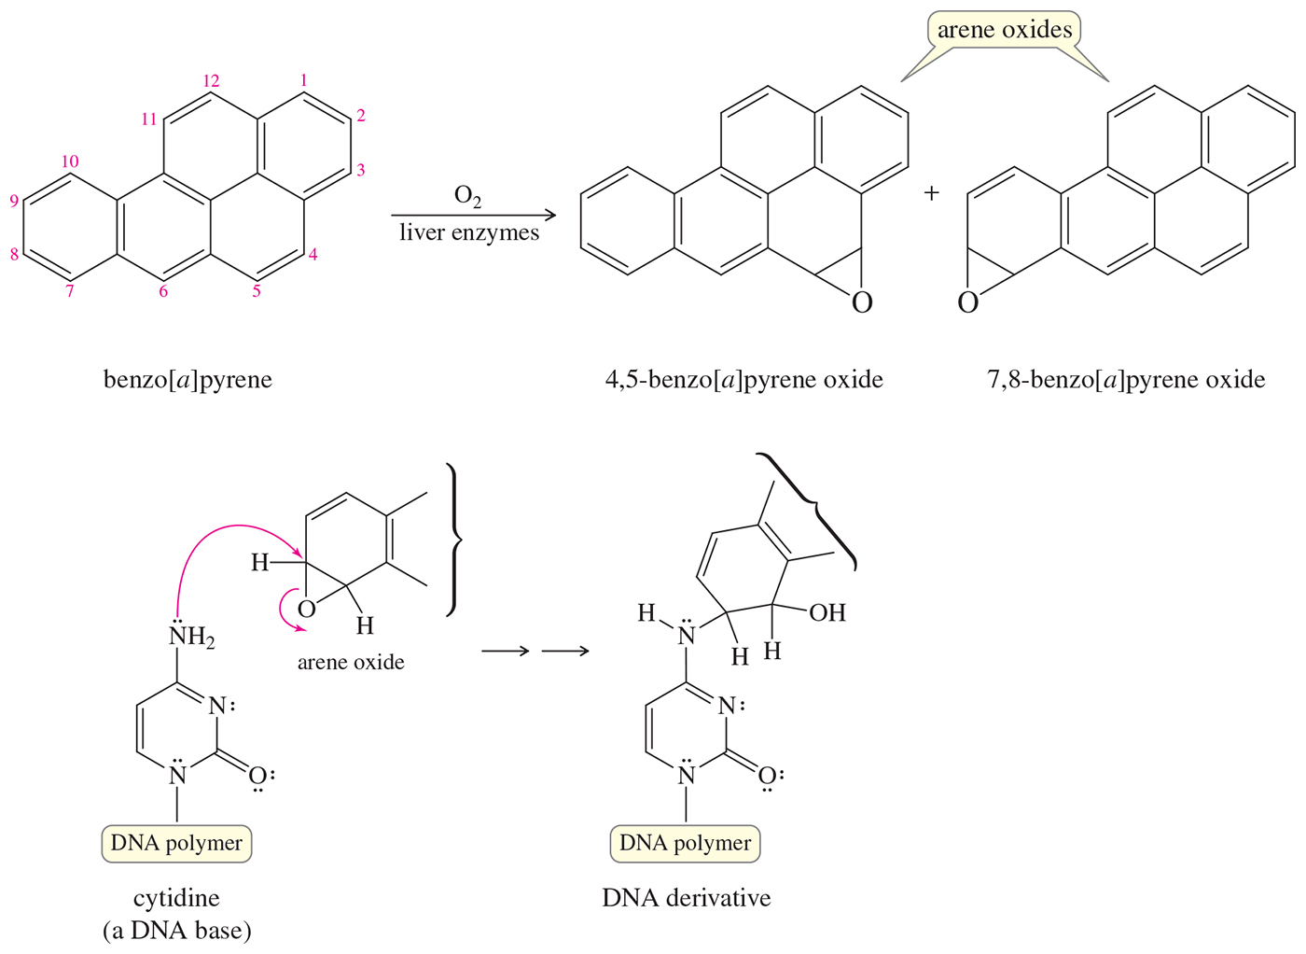
Mutations

Slide 48
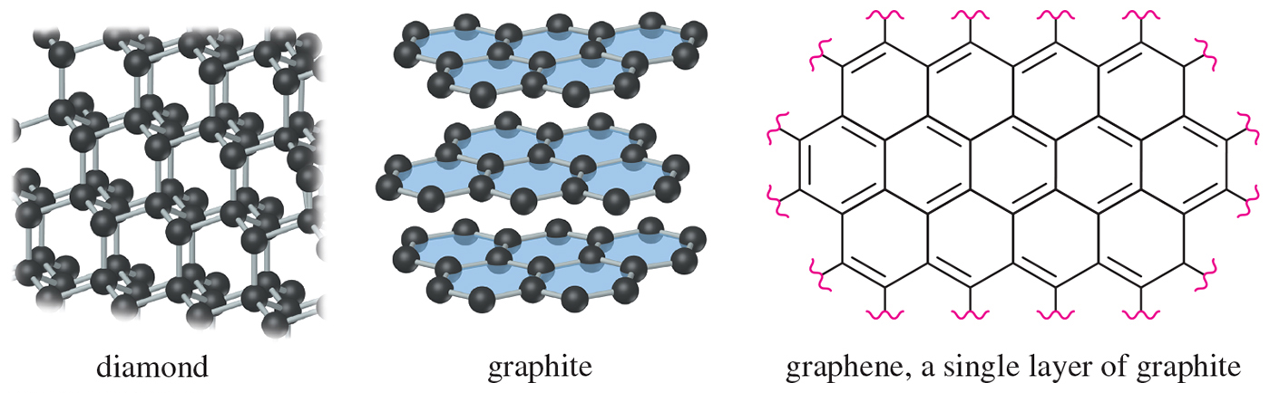
Allotropes of Carbon
Amorphous: Small particles of graphite; charcoal, soot, coal, carbon black
Diamond: A lattice of tetrahedral carbon atoms
Graphite: Layers of fused aromatic rings

Slide 49
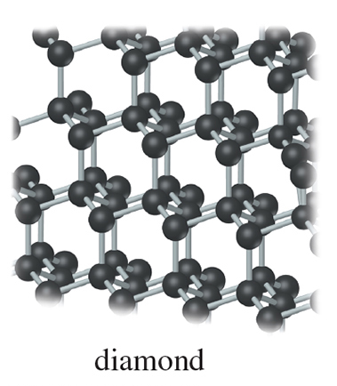
Diamond
One giant molecule
Tetrahedral carbon.
Sigma bonds, 1.54 Å
Electrical insulator

Slide 50
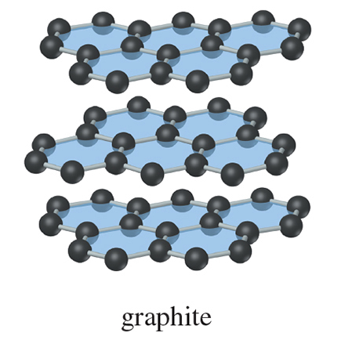
Graphite
Planar layered structure
Layer of fused benzene rings, bonds: 1.415 Å
Only van der Waals forces between layers
Conducts electrical current parallel to layers

Slide 51
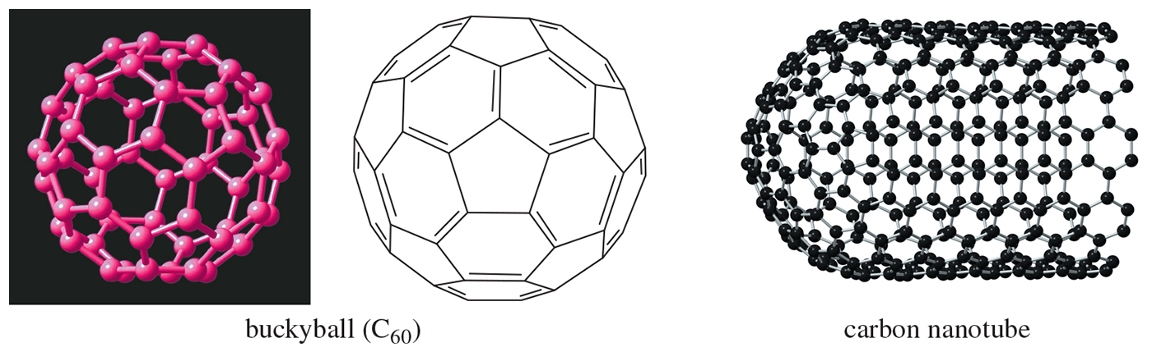
Some New Allotropes
Fullerenes: Five- and six-membered rings arranged to form a “soccer ball” structure
Nanotubes: Half of a C₆₀ sphere fused to a cylinder of fused aromatic rings

Slide 52
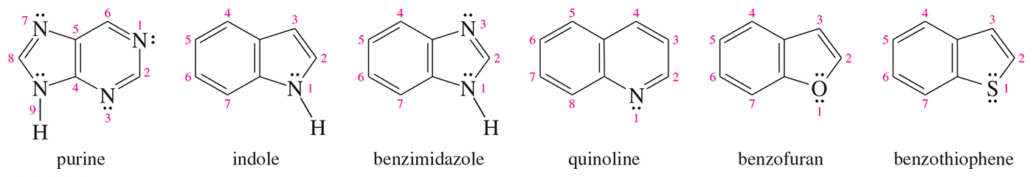
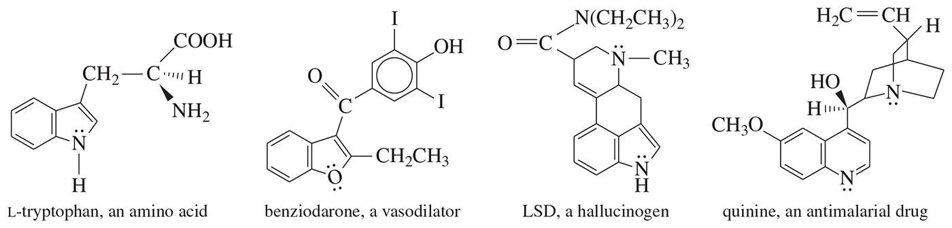
Fused Heterocyclic Compounds
Common in nature; synthesized for drugs

Slide 53
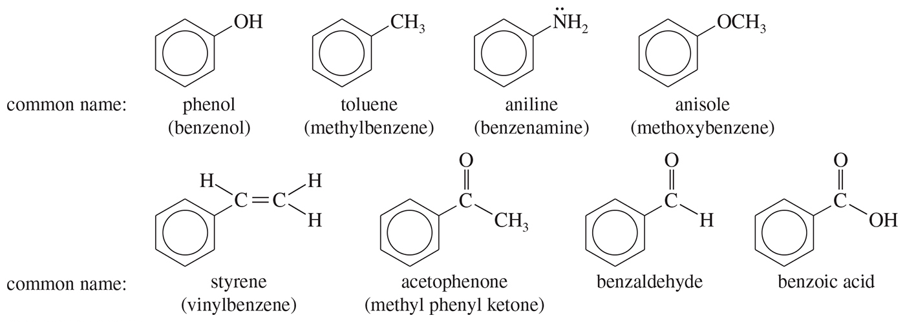
Common Names of
Benzene Derivatives

Slide 54
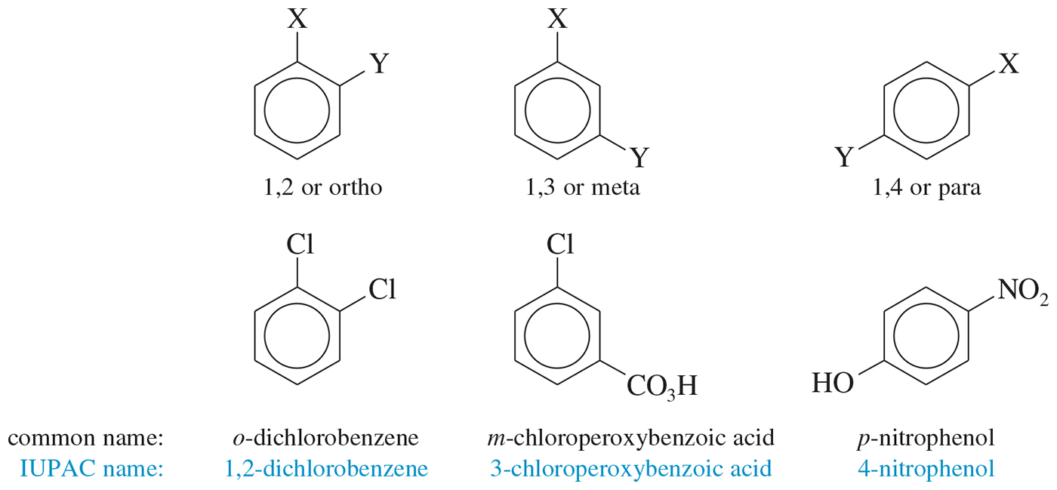
Disubstituted Benzenes
Numbers can also be used to identify the relationship between the groups; ortho- is 1,2-disubstituted, meta- is 1,3, and para- is 1,4.

Slide 55
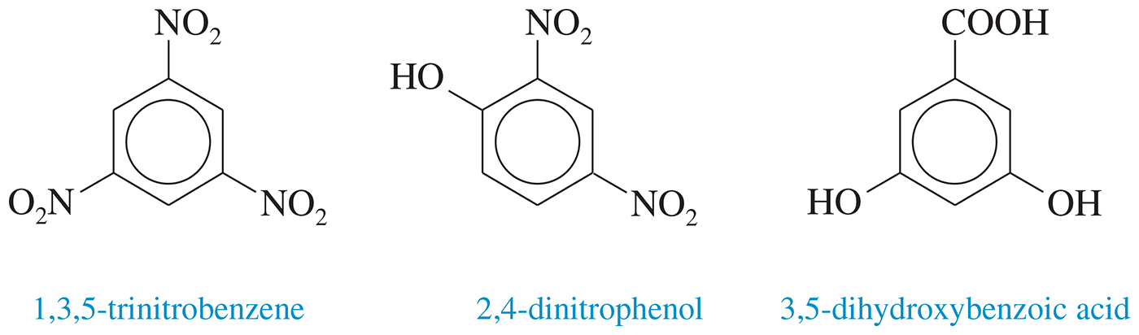
Three or More Substituents
Use the smallest possible numbers, but
the carbon with a functional group is number 1.

Slide 56
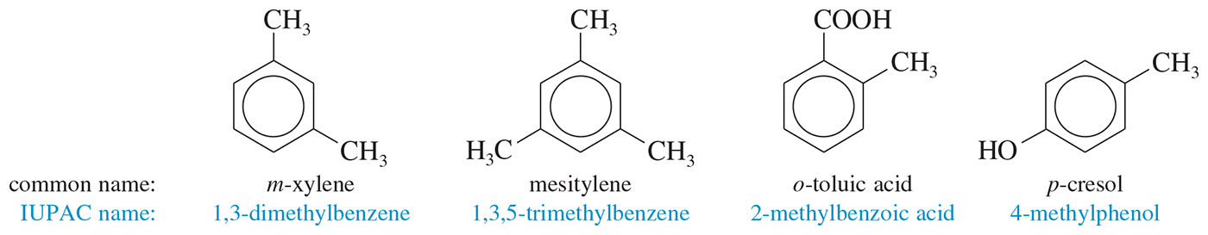
Common Names for
Disubstituted Benzenes

Slide 57

Phenyl and Benzyl
Phenyl indicates the benzene ring attachment. The benzyl group has an additional carbon.

Slide 58
Physical Properties of Aromatic Compounds
Melting points: More symmetrical than corresponding alkane, pack better into crystals, so higher melting points
Boiling points: Dependent on dipole moment, so ortho > meta > para for disubstituted benzenes
Density: More dense than nonaromatics, less dense than water
Solubility: Generally insoluble in water

Slide 59

Physical Properties of Aromatic Compounds

Slide 60

IR and NMR Spectroscopy
C═C stretch absorption at 1600 cm^{–1}
sp² C—H stretch just above 3000 cm^{–1}
¹H NMR at δ 7–δ 8 for H’s on aromatic ring
¹³C NMR at δ 120–δ 150, similar to alkene carbons

Slide 61

Mass Spectrometry

Slide 62

UV Spectroscopy

Slide 63


