Slide 1
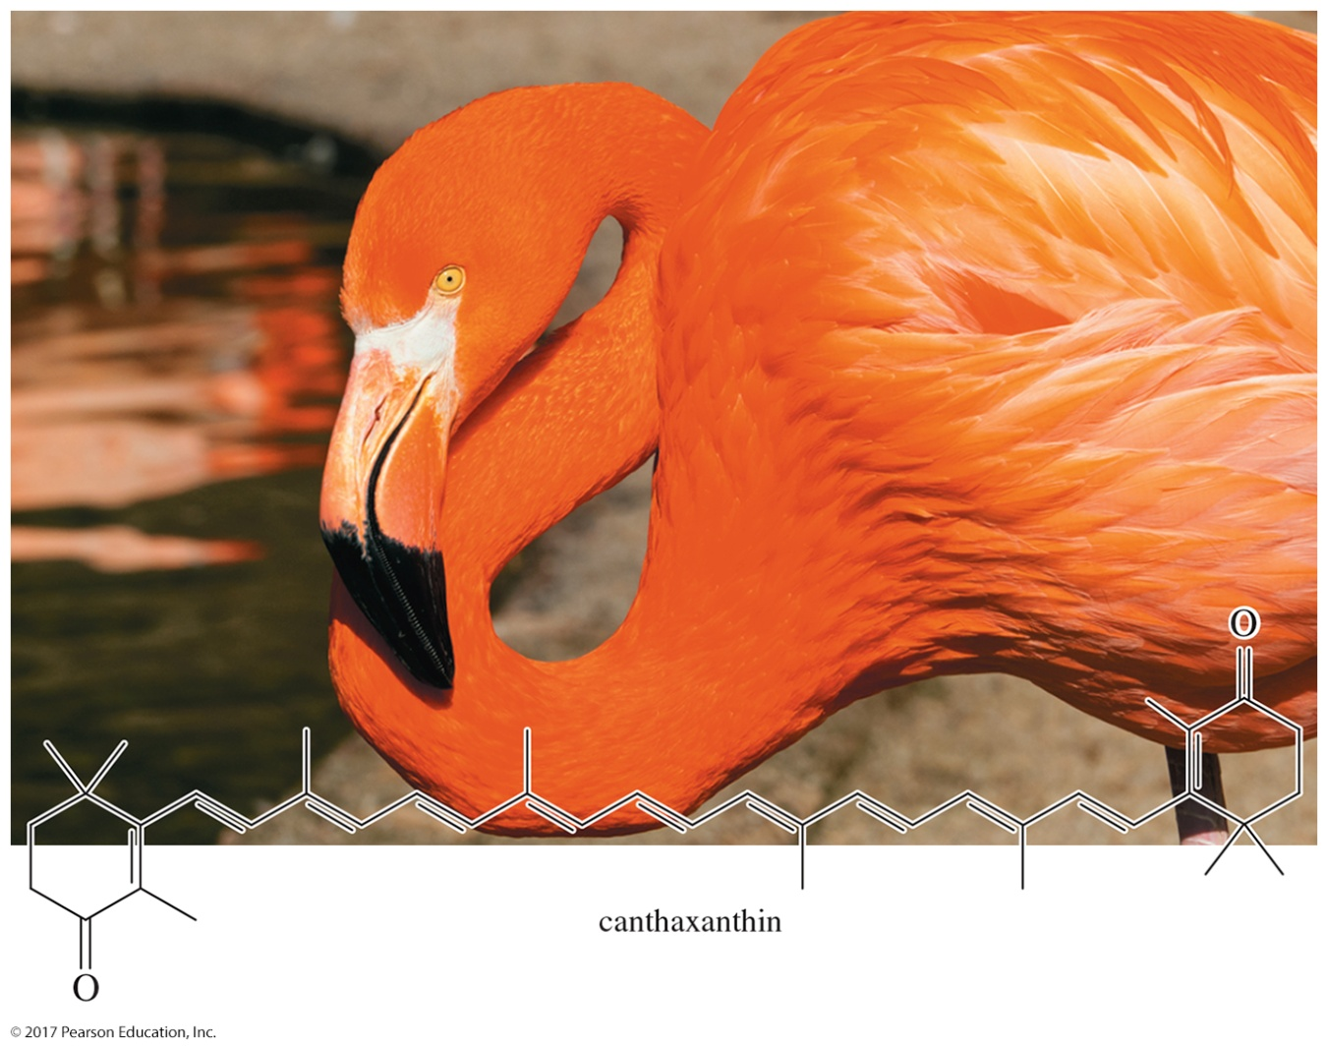
Organic Chemistry,
9th Edition
L. G. Wade, Jr.
Chapter 18
Lecture
Ketones and Aldehydes
Chad Snyder, PhD
Grace College
© 2017 Pearson Education, Inc.

Slide 2
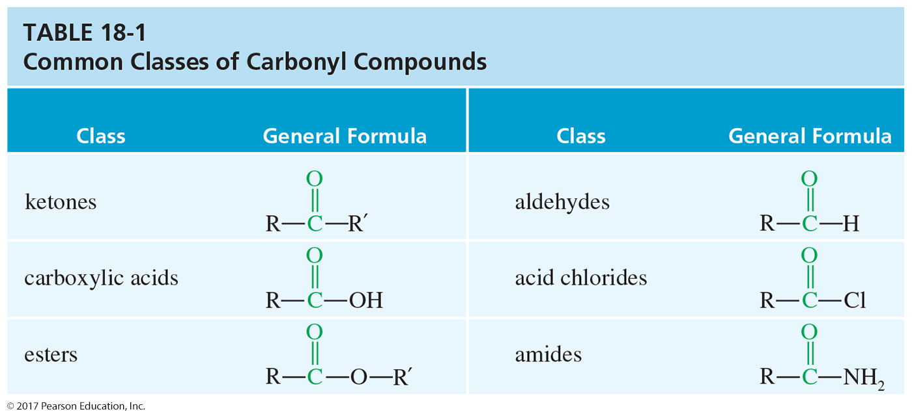
Classes of Carbonyl Compounds

Slide 3
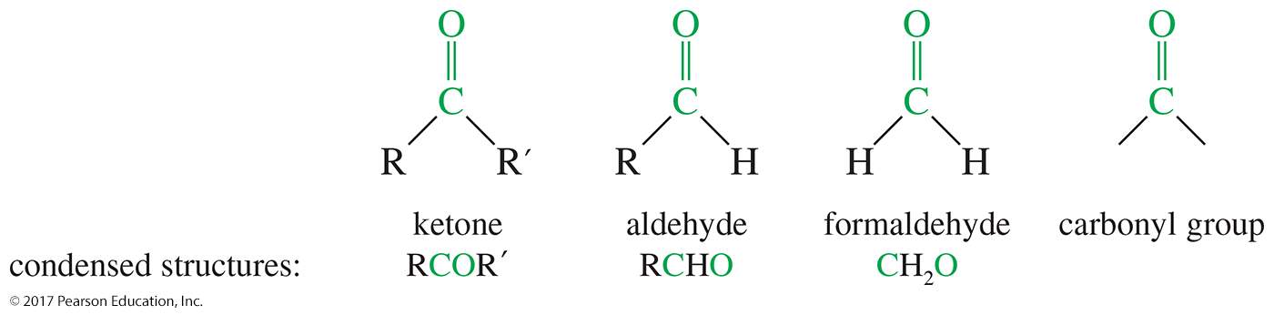
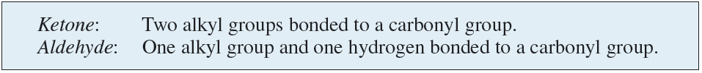
Structure of the Carbonyl Group

Slide 4
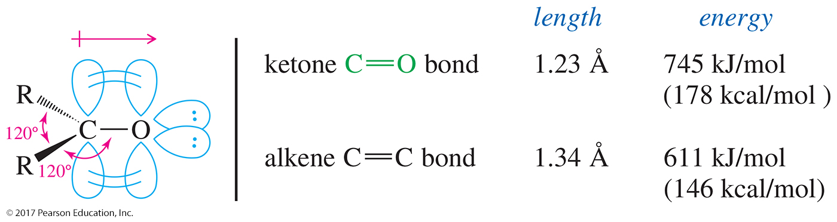
Structure of the Carbonyl Group (Continued)
Carbon is sp² hybridized.
The C═O bond is shorter, stronger, and more polar than the C═C bond in alkenes.

Slide 5
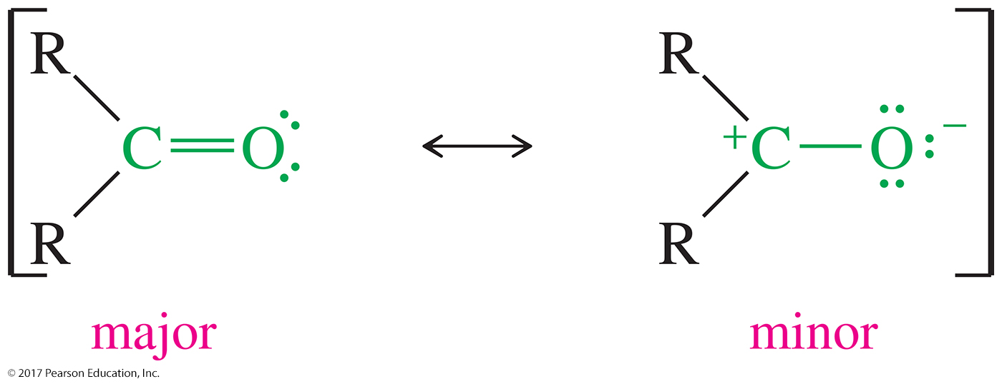
Resonance
The first resonance is better because all atoms complete the octet and there are no charges.
The carbonyl carbon has a partial positive and will react as an electrophile.

Slide 6
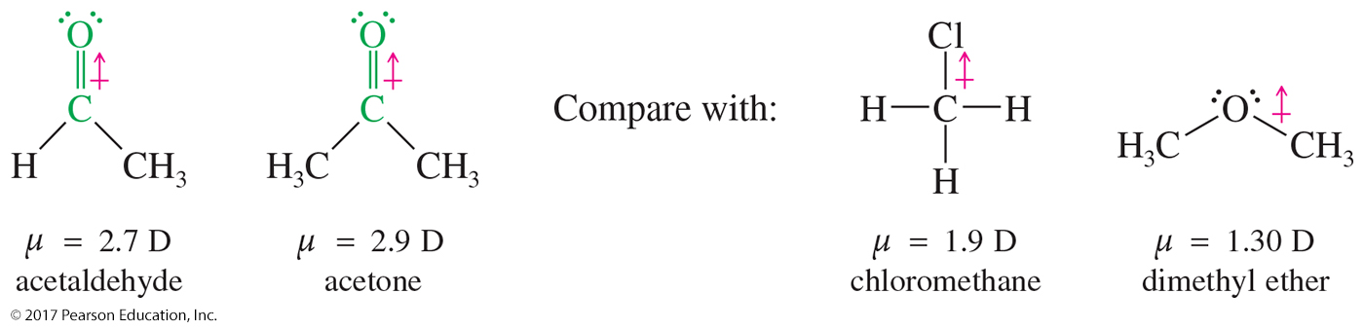
Dipole Moments

Slide 7
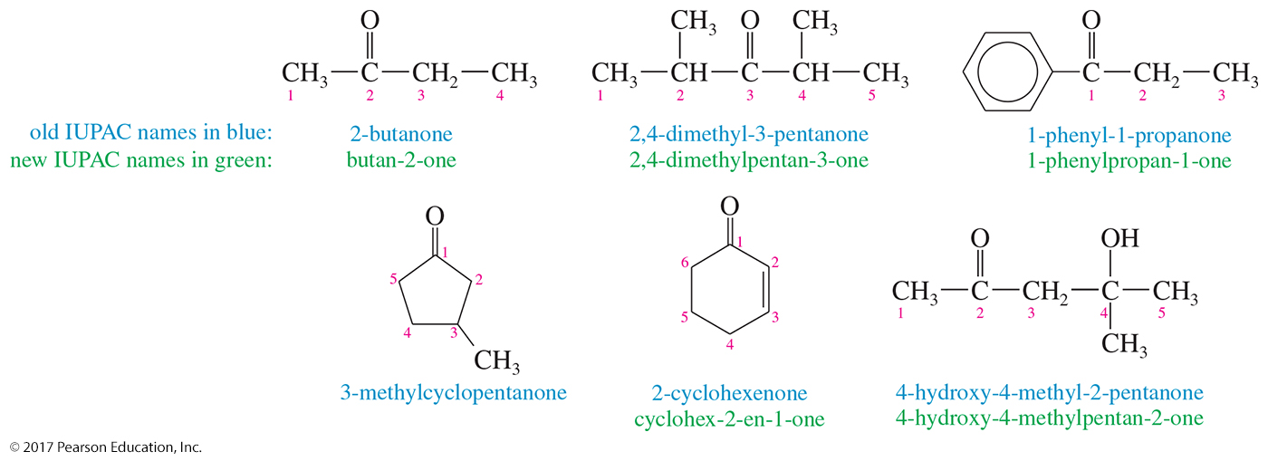
Ketone Nomenclature
Number the chain so that the carbonyl carbon has the lowest number.
Replace the alkane -e with -one.

Slide 8
Cyclic Ketone Nomenclature
For cyclic ketones, the carbonyl carbon is assigned the number 1.
When the compound has a carbonyl and a double bond, the carbonyl takes precedence.

Slide 9
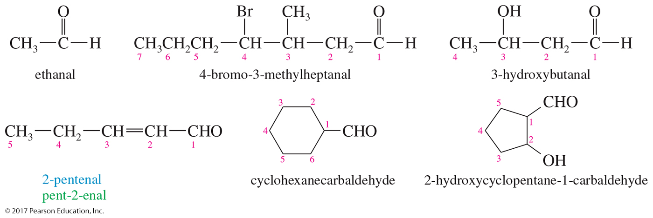
Aldehydes Nomenclature
The aldehyde carbon is number 1.
IUPAC: Replace -e with -al.
If the aldehyde group is attached to a ring, the suffix -carbaldehyde is used.

Slide 10
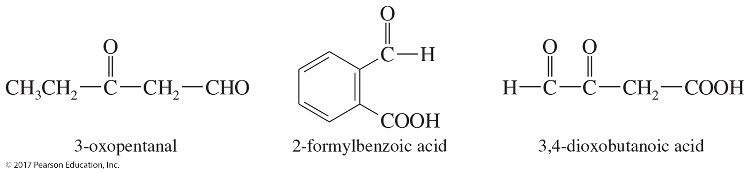
Carbonyl as Substituent
On a molecule with a higher-priority functional group, a ketone is an oxo and an aldehyde is a formyl group.
Aldehydes have a higher priority than ketones.

Slide 11
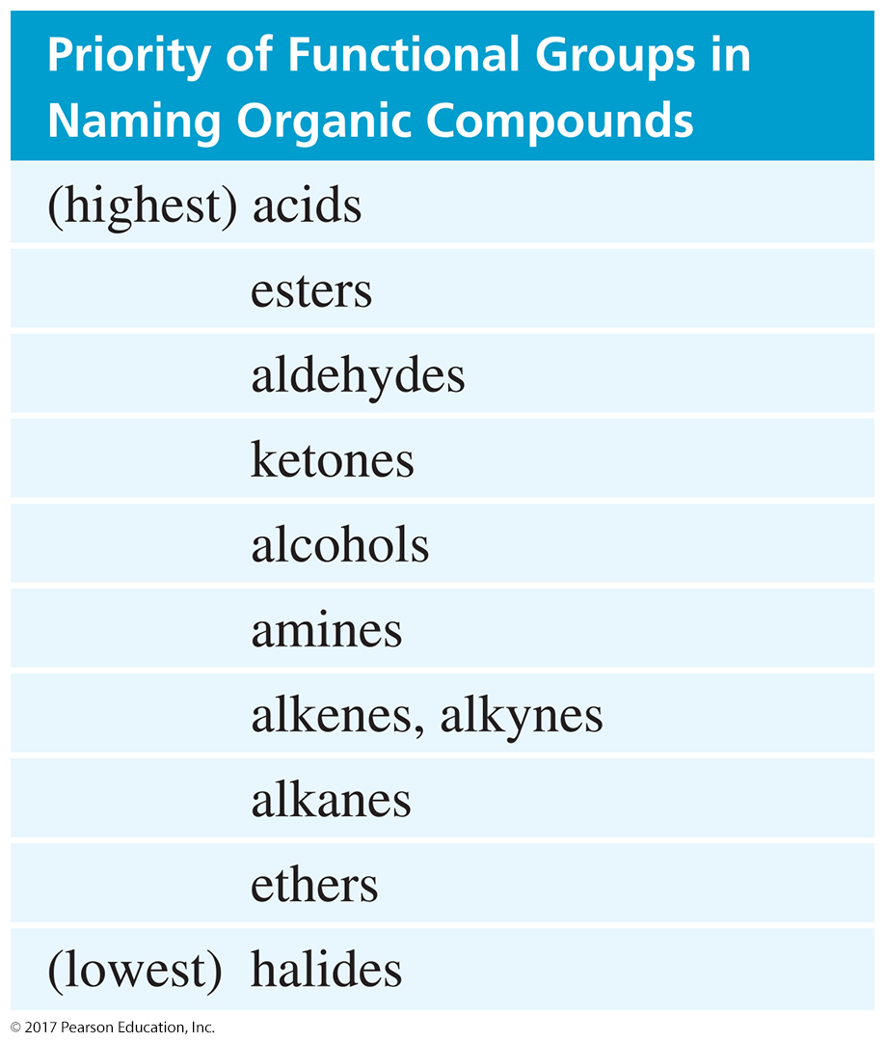
Functional Group Priority

Slide 12
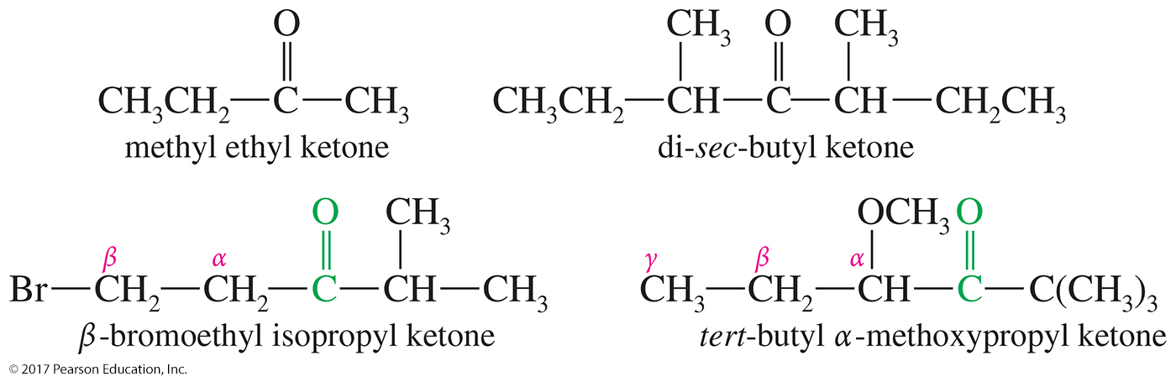
Common Names for Ketones
Named as alkyl attachments to —C═O
Use Greek letters instead of numbers.

Slide 13
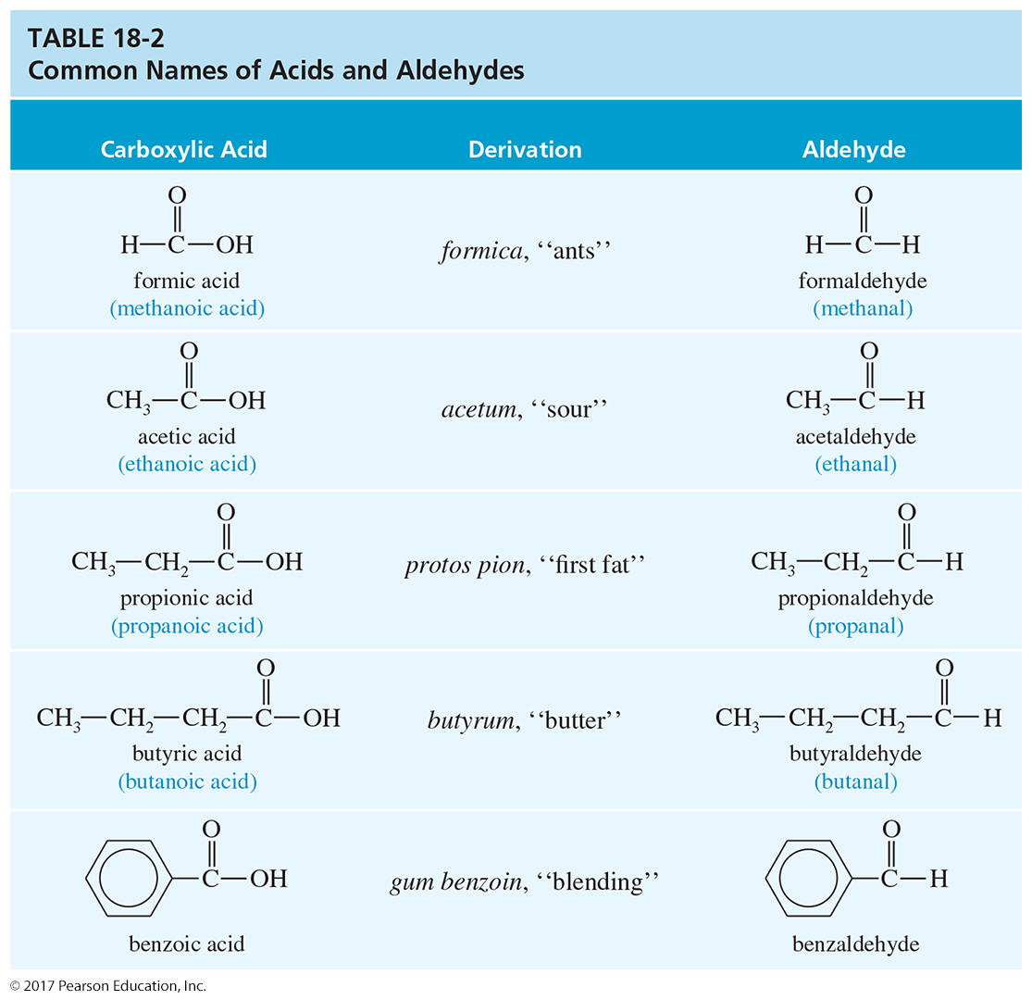
Common Names of Acids and Aldehydes

Slide 14
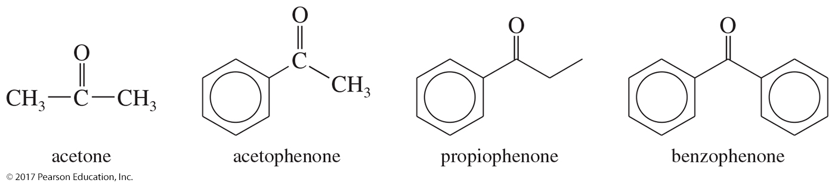
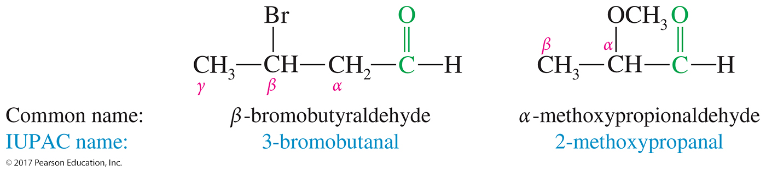
Historical Common Names

Slide 15
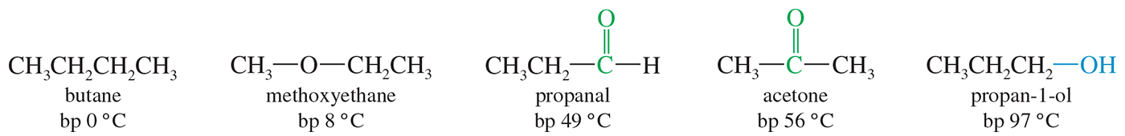
Boiling Points
Ketones and aldehydes are more polar, so they have a higher boiling point than comparable alkanes or ethers.
They cannot hydrogen-bond to each other, so their boiling point is lower than the comparable alcohol.

Slide 16
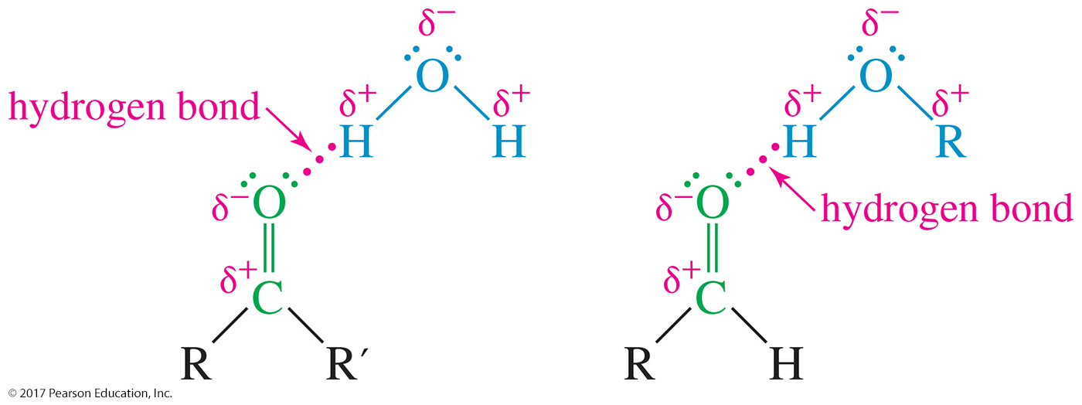
Solubility of Ketones and Aldehydes
Good solvent for alcohols
Lone pair of electrons on oxygen of carbonyl can accept a hydrogen bond from O—H or N—H.
Acetone and acetaldehyde are miscible in water.

Slide 17
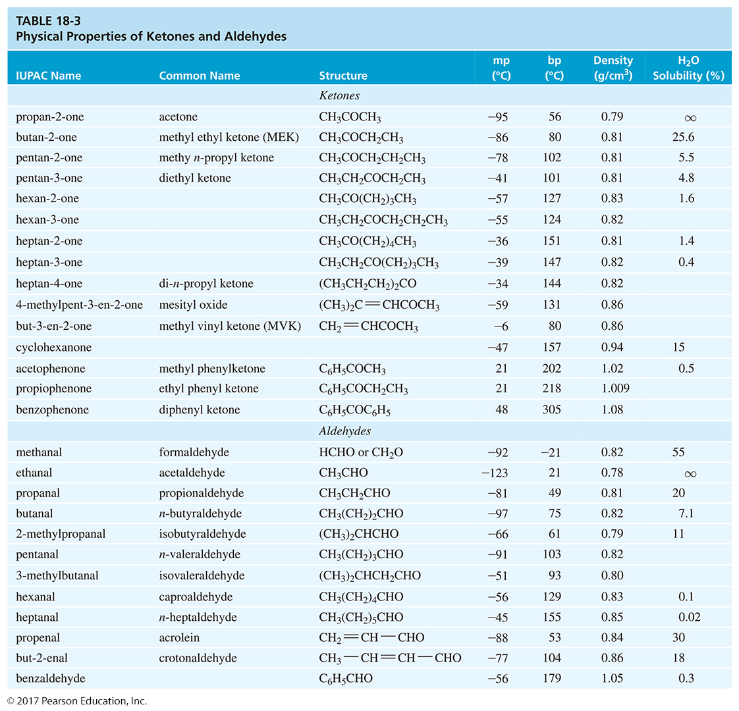

Slide 18
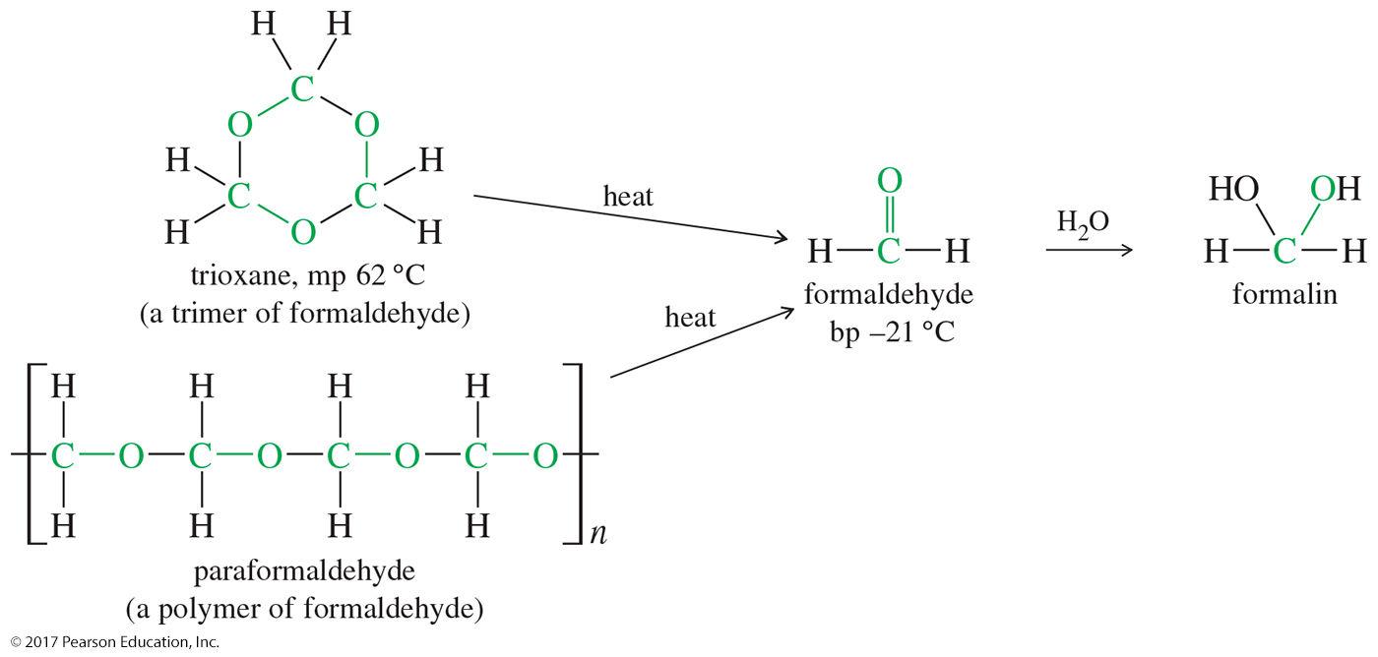
Formaldehyde
Gas at room temperature
Formalin is a 40% aqueous solution.
Trioxane is a cyclic trimer of formaldehyde.
When trioxane is heated, it generates formaldehyde.

Slide 19
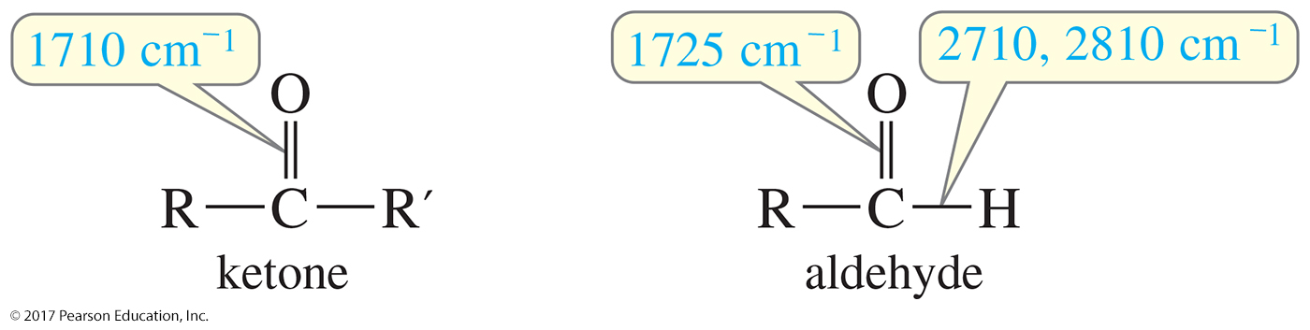
Infrared (IR) Spectroscopy
Very strong C═O stretch around 1710 cm^{–1} for ketones and 1725 cm^{–1} for simple aldehydes
Additional C—H stretches for aldehyde: Two absorptions at 2710 cm^{–1} and 2810 cm^{–1}

Slide 20
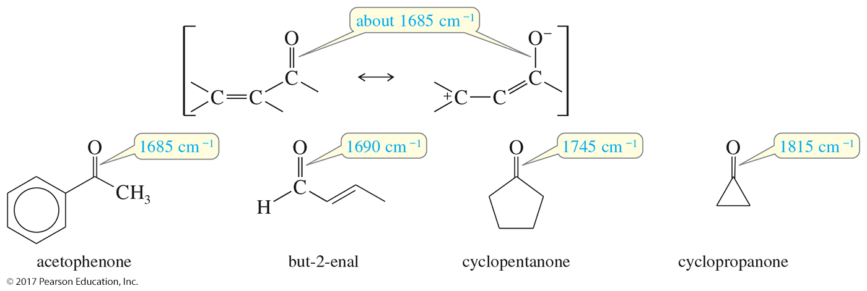
IR Spectra
Conjugation lowers the carbonyl stretching frequencies to about 1685 cm^{–1}.
Rings that have ring strain have higher C═O frequencies.

Slide 21
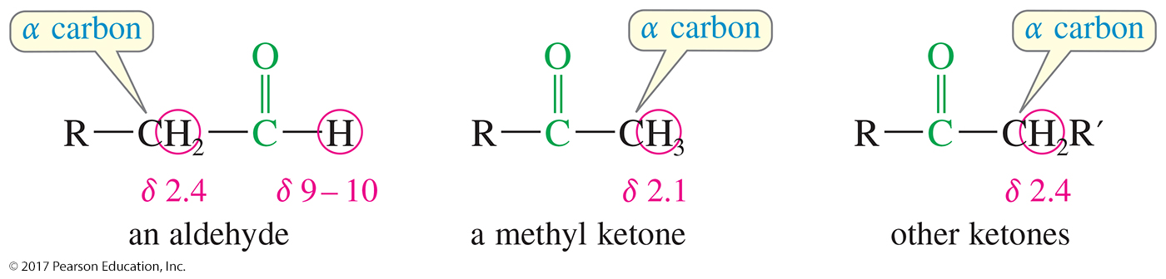
Proton NMR Spectra
Aldehyde protons normally absorb between
δ 9 and δ 10.
Protons of the α carbon usually absorb between δ 2.1 and δ 2.4 if there are no other electron-withdrawing groups nearby.

Slide 22
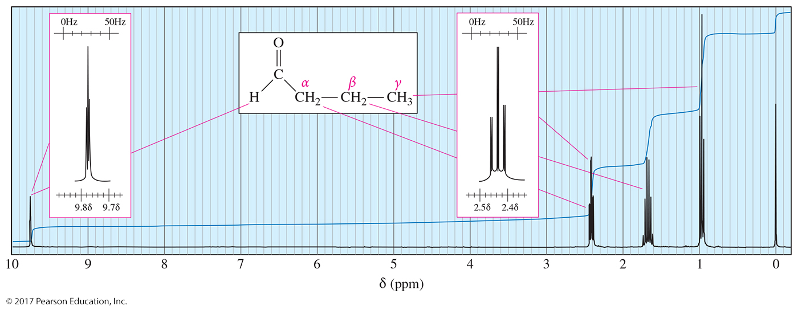
¹H NMR Spectroscopy
Protons closer to the carbonyl group are more deshielded.
The α, β, and γ protons appear at values of δ that decrease with increasing distance from the carbonyl group.

Slide 23
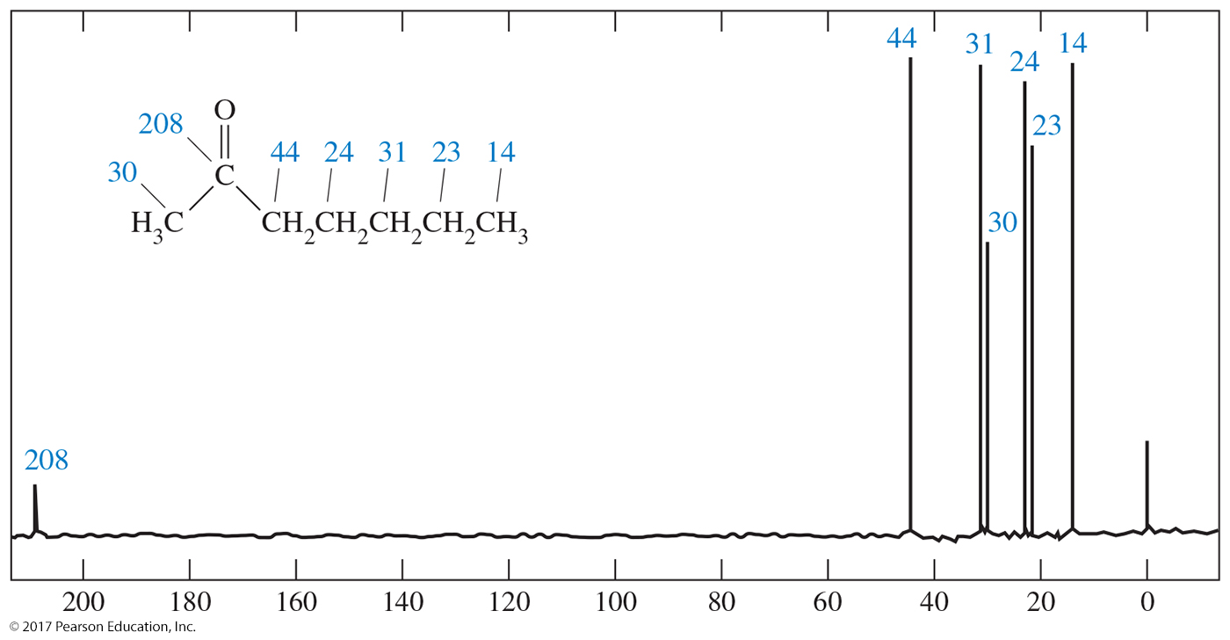
Carbon NMR Spectra of Ketones
The spin-decoupled carbon NMR spectrum of 2-heptanone shows the carbonyl carbon at 208 ppm and the α carbon at 30 ppm (methyl) and 44 ppm (methylene).

Slide 24
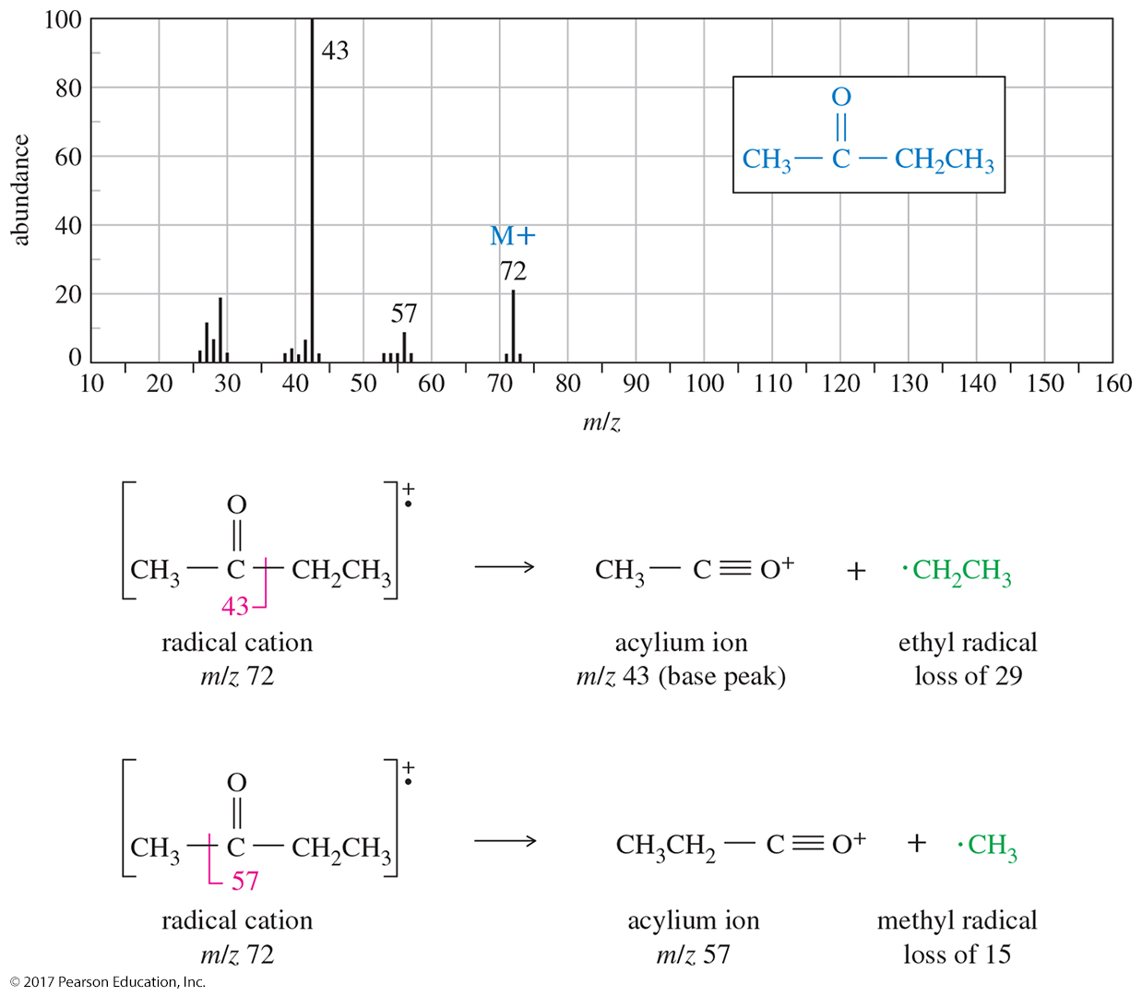
Mass Spectrometry (MS)

Slide 25
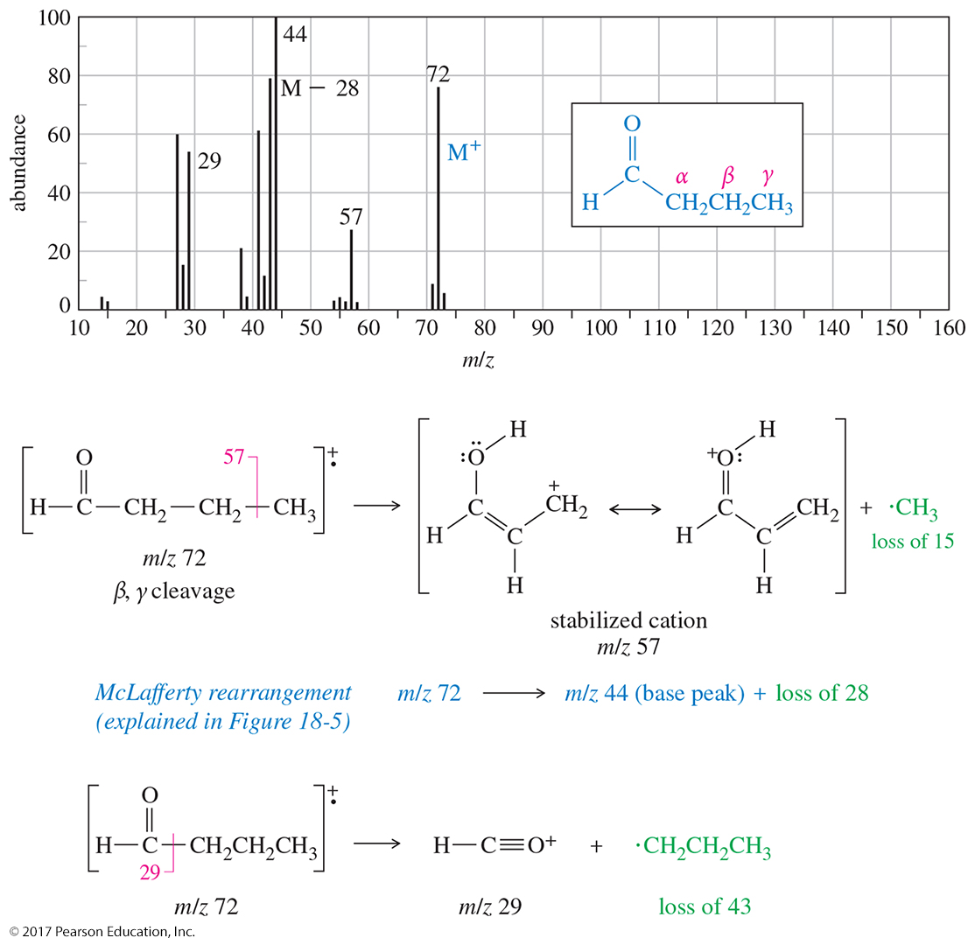
MS for Butyraldehyde

Slide 26
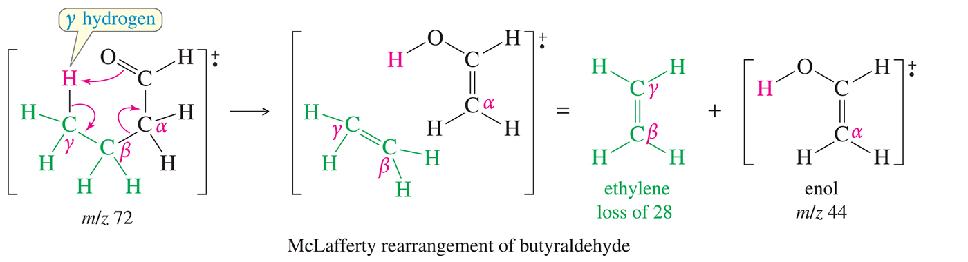
McLafferty Rearrangement
The net result of this rearrangement is the breaking of the α, β bond and the transfer of a proton from the γ carbon to the oxygen.
An alkene is formed as a product of this rearrangement through the tautomerization of the enol.

Slide 27
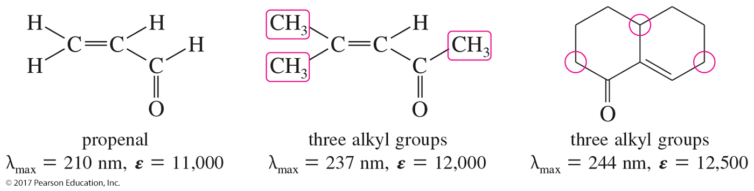
Ultraviolet Spectra of Conjugated Carbonyl Compounds
Conjugated carbonyl compounds have characteristic
π → π * absorption in the UV spectrum.
An additional conjugated C═C increases λ_{max} about 30 nm; an additional alkyl group increases it about 10 nm.

Slide 28
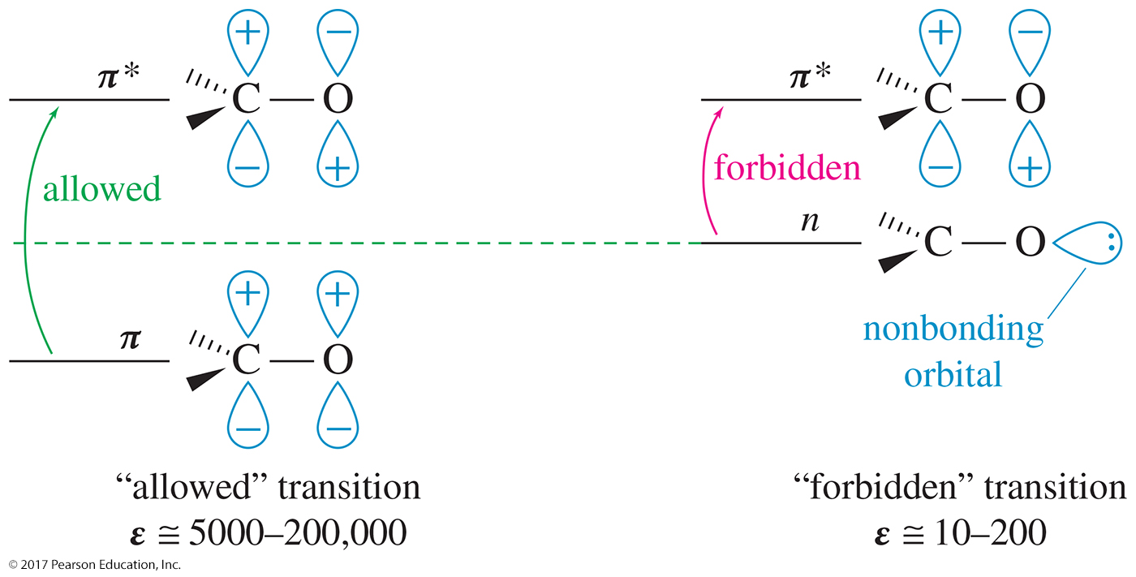
Electronic Transitions of the C═O
Small molar absorptivity
“Forbidden” transition occurs less frequently.

Slide 29
Industrial Importance
Acetone and methyl ethyl ketone are common industrial solvents.
Formaldehyde is used in polymers like Bakelite® and many other polymeric products.
Also used as flavorings and additives for food

Slide 30
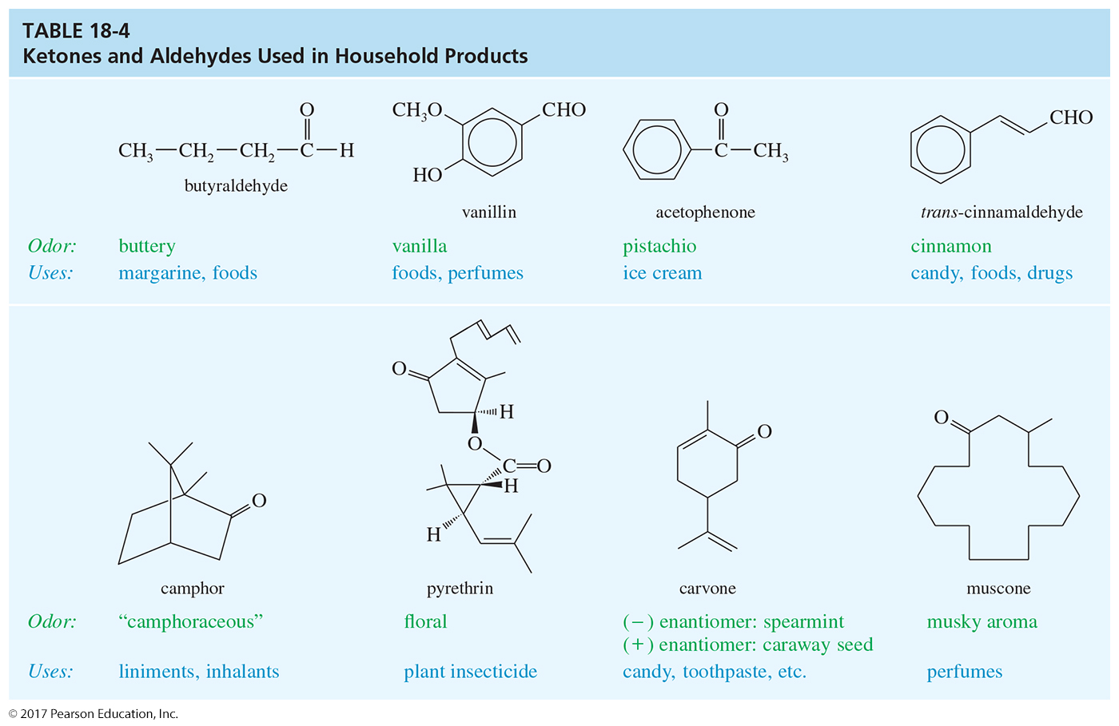

Slide 31
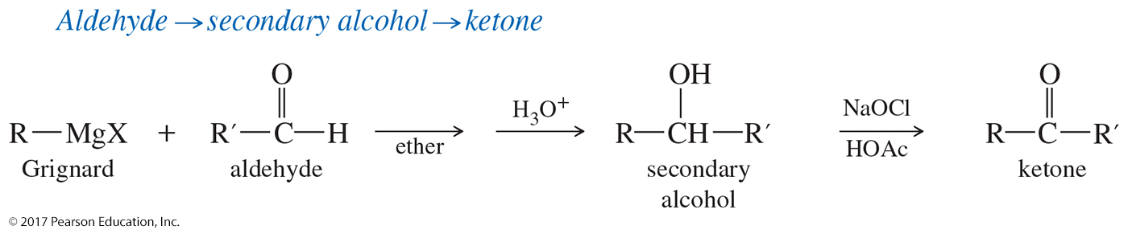
Grignards As a Source for
Ketones and Aldehydes
A Grignard reagent can be used to make an alcohol, and then the alcohol can be easily oxidized.

Slide 32
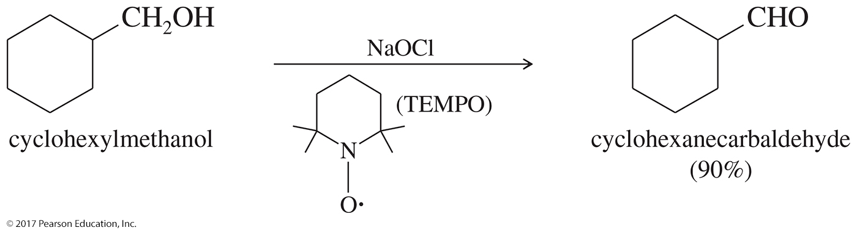
Oxidation of Primary
Alcohols to Aldehydes
Pyridinium chlorochromate (PCC) is selectively used to oxidize primary alcohols to aldehydes.
The Swern oxidation could also be used.

Slide 33
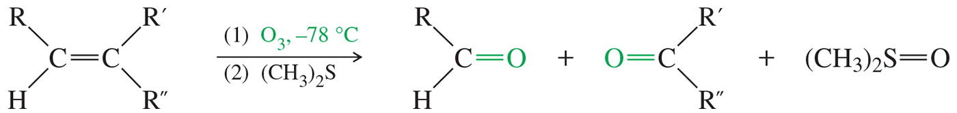
Ozonolysis of Alkenes
The double bond is oxidatively cleaved by ozone, followed by reduction.
Ketones and aldehydes can be isolated as products under these conditions.

Slide 34
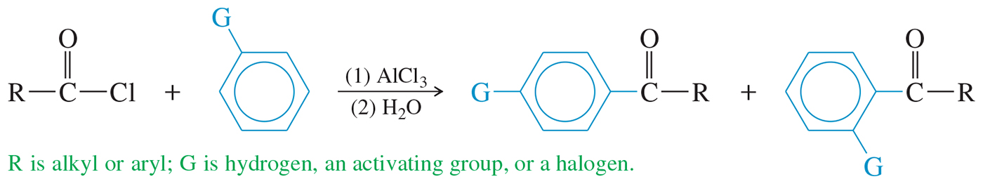
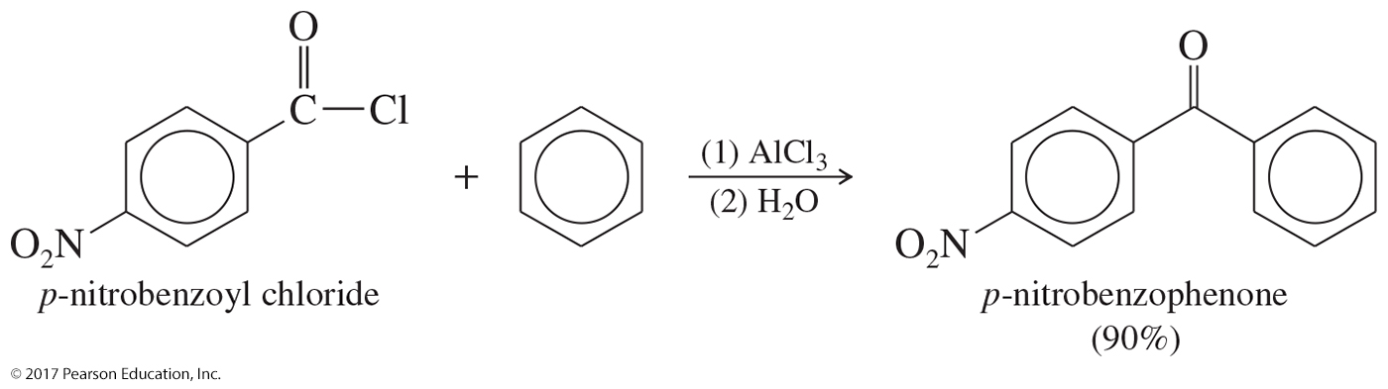
Friedel–Crafts Reaction
Reaction between an acyl halide and an aromatic ring will produce a ketone.

Slide 35
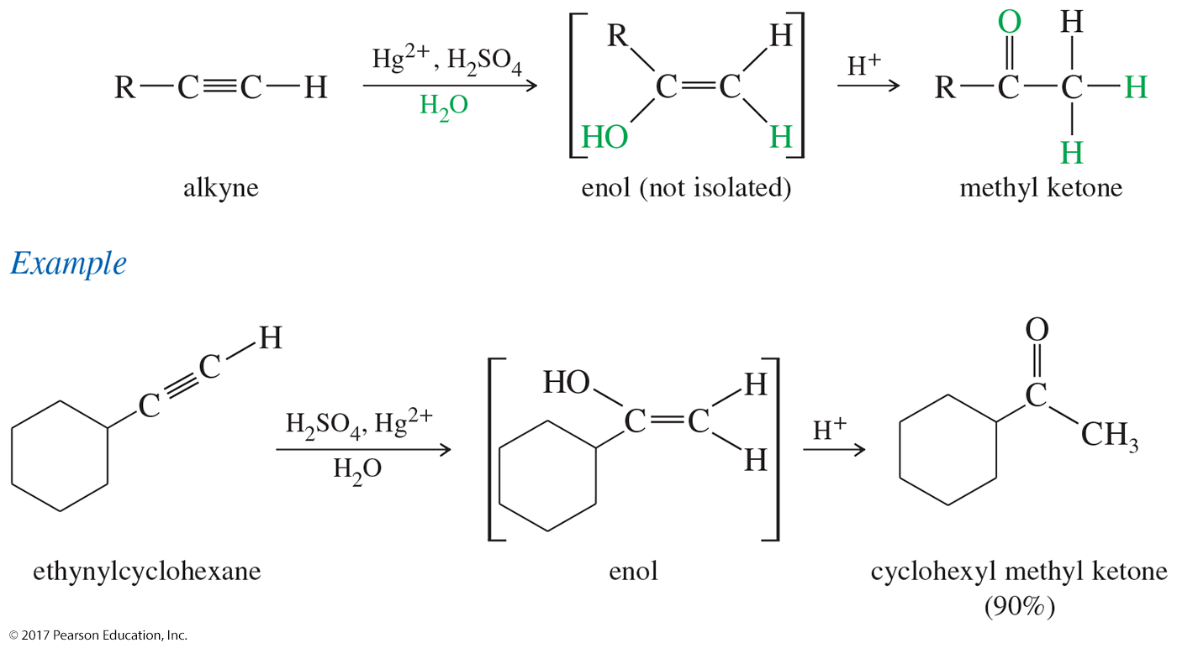
Hydration of Alkynes
The initial product of Markovnikov hydration is an enol, which quickly tautomerizes to its keto form.
Internal alkynes can be hydrated, but mixtures of ketones often result.

Slide 36
Hydroboration–Oxidation of Alkynes
Hydroboration–oxidation of an alkyne gives anti-Markovnikov addition of water across the triple bond.

Slide 37
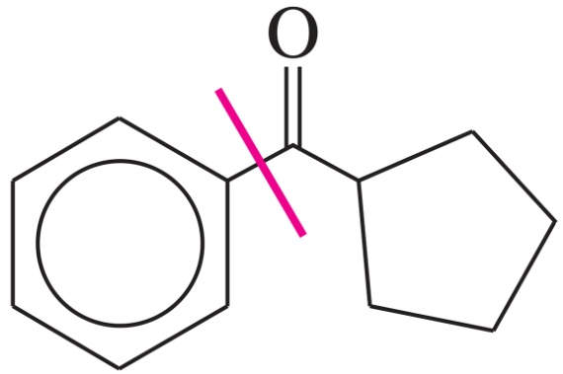
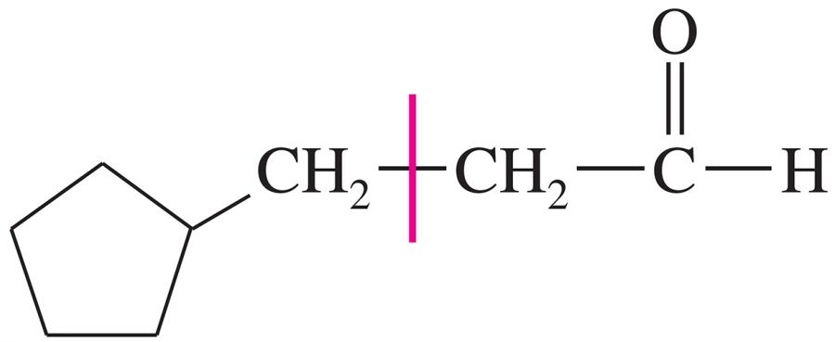
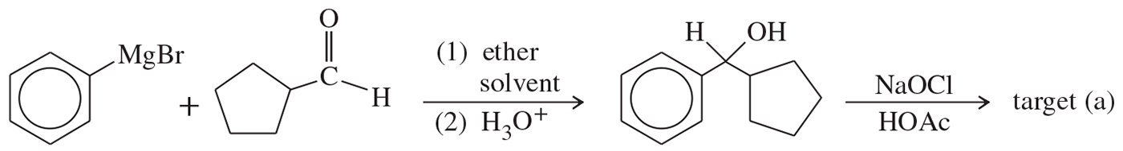
Solved Problem 1
Show how you would synthesize each compound from starting materials containing no more than six carbon atoms.
(a)
(b)
Solution
(a) This compound is a ketone with 12 carbon atoms. The carbon skeleton might be assembled from two six-carbon fragments using a Grignard reaction, which gives an alcohol that is easily oxidized to the target compound.

Slide 38
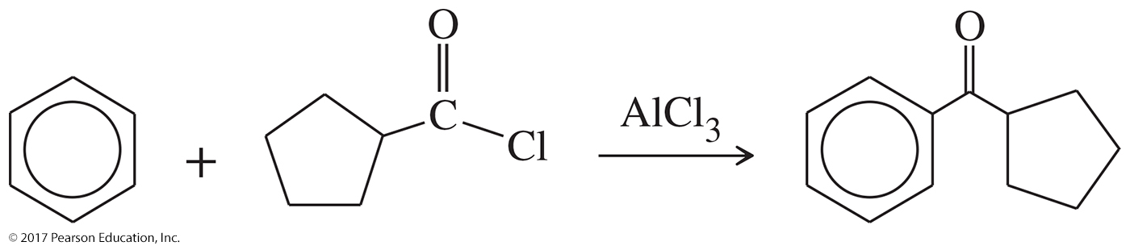
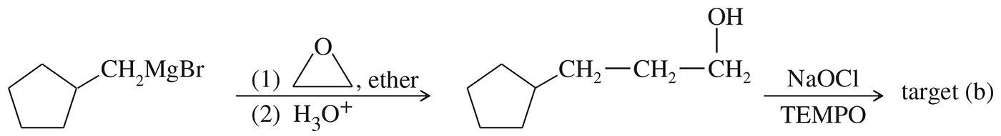
Solved Problem 1 (Continued)
Solution (Continued)
An alternative route to the target compound involves Friedel–Crafts acylation.
(b) This compound is an aldehyde with eight carbon atoms. An aldehyde might come from oxidation of an alcohol (possibly a Grignard product) or hydroboration of an alkyne. If we use a Grignard, the restriction to six-carbon starting materials means we need to add two carbons to a methylcyclopentyl fragment, ending in a primary alcohol. Grignard addition to an epoxide does this.

Slide 39
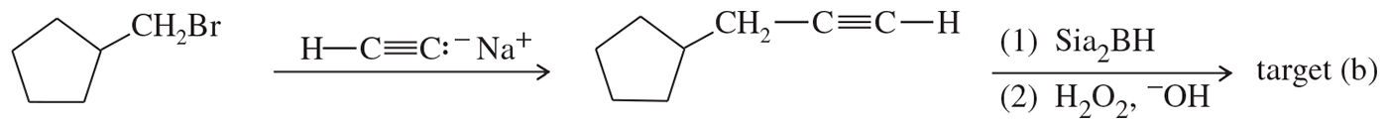
Solved Problem 1 (Continued)
Solution (Continued)
Alternatively, we could construct the carbon skeleton using acetylene as the two-carbon fragment. The resulting terminal alkyne undergoes hydroboration to the correct aldehyde.

Slide 40
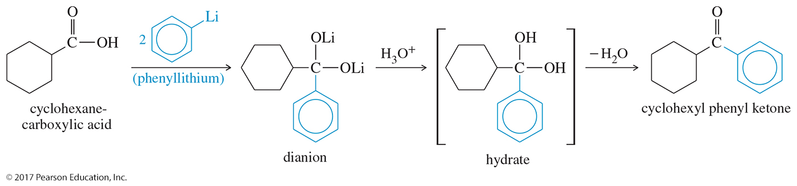
Synthesis of Ketones from Carboxylic Acids
Organolithiums will attack the lithium salts of carboxylate anions to give dianions.
Protonation of the dianion forms the hydrate of a ketone, which quickly loses water to give the ketone.

Slide 41
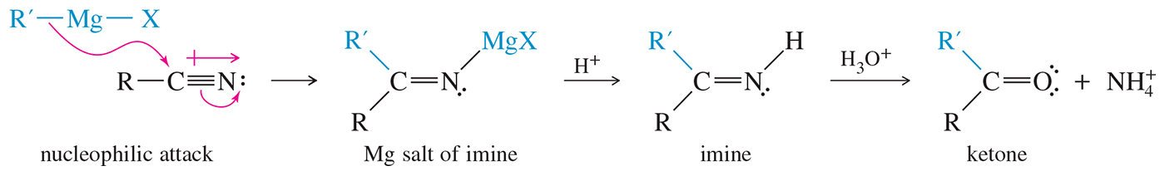
Ketones and Aldehydes from Nitriles
A Grignard or organolithium reagent can attack the carbon of the nitrile.
The imine is then hydrolyzed to form a ketone.

Slide 42
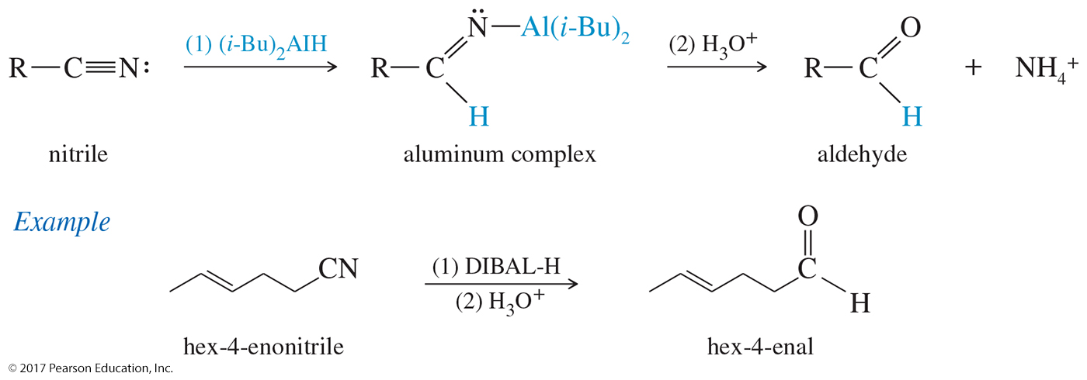
Reduction of Nitriles to Aldehydes
Aluminum hydrides can reduce nitriles to aldehydes.
Diisobutylaluminum hydride, abbreviated (i-Bu)₂AlH or DIBAL-H, is commonly used for the reduction of nitriles.

Slide 43
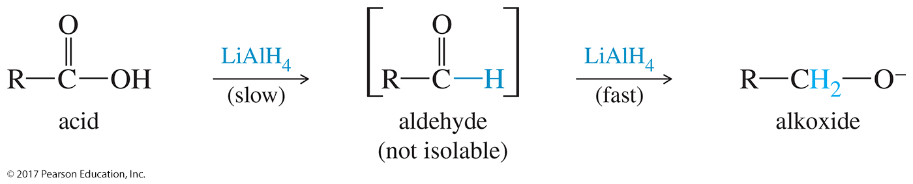
Aldehydes to Alkoxides
Aldehydes are easily oxidized to acids.

Slide 44
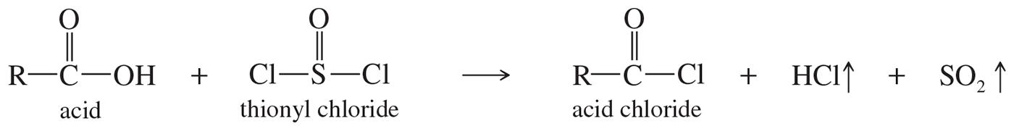
Acids to Acid Chlorides

Slide 45
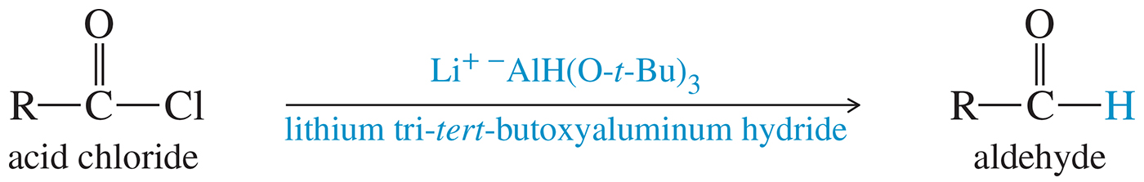
Aldehydes from
Acid Chlorides
Lithium aluminum tri(t-butoxy)hydride is a milder reducing agent that reacts faster with acid chlorides than with aldehydes.

Slide 46
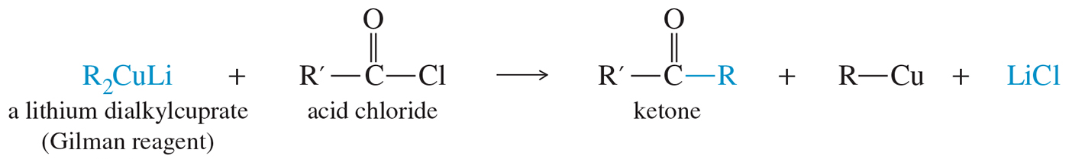
Lithium Dialkyl
Cuprate Reagents
A lithium dialkylcuprate will transfer one of its alkyl groups to the acid chloride.
Grignards and organolithiums cannot do this reaction.

Slide 47
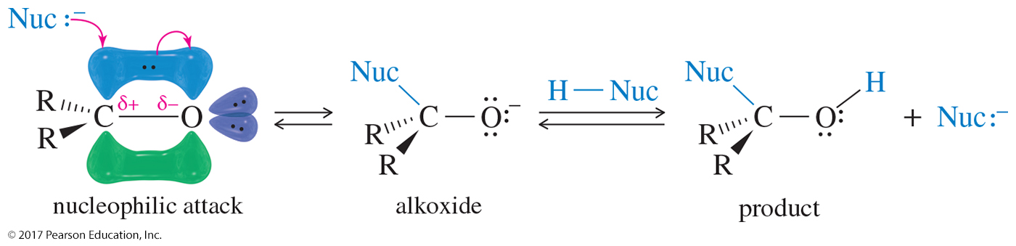
Nucleophilic Addition
A strong nucleophile attacks the carbonyl carbon, forming an alkoxide ion that is then protonated.
Aldehydes are more reactive than ketones.

Slide 48

Reaction with a
Grignard Reagent
A strong nucleophile attacks the carbonyl carbon, forming an alkoxide ion that is then protonated.

Slide 49

Reaction with a Hydride
The hydride anion adds to the carbonyl carbon; the alkoxide is protonated to form an alcohol.

Slide 50

Electrophilic Strength

Slide 51

Hydration of Ketones and Aldehydes
In an aqueous solution, a ketone or an aldehyde is in equilibrium with its hydrate, a geminal diol.
With ketones, the equilibrium favors the unhydrated keto form (carbonyl).

Slide 52

Acid-Catalyzed Hydration of Carbonyls
Hydration occurs through the nucleophilic addition mechanism, with water (in acid) or hydroxide (in base) serving as the nucleophile.

Slide 53

Base-Catalyzed Hydration of Carbonyls
The hydroxide ion attacks the carbonyl group.
Protonation of the intermediate gives the hydrate.

Slide 54

Cyanohydrin Formation
The mechanism is a base-catalyzed nucleophilic addition: attack by cyanide ion on the carbonyl group, followed by protonation of the intermediate.
HCN is highly toxic.

Slide 55



Cyanohydrin Reactions

Slide 56

Formation of Imines
Ammonia or a primary amine reacts with a ketone or an aldehyde to form an imine.
Imines are nitrogen analogues of ketones and aldehydes with a C═N bond in place of the carbonyl group.
Optimum pH is around 4.5.

Slide 57


Mechanism of Imine Formation
Acid-catalyzed addition of the amine to the carbonyl
compound group
Acid-catalyzed dehydration

Slide 58

Imine Reactions

Slide 59

Other Condensations with Amines

Slide 60

Formation of Acetals

Slide 61

Mechanism for
Hemiacetal Formation
Must be acid-catalyzed
Adding H⁺ to carbonyl makes it more reactive with the weak nucleophile, ROH.

Slide 62


Acetal Formation

Slide 63

Hydrolysis of Acetals
Acetals can be hydrolyzed by addition of
dilute acid.
The excess of water drives the equilibrium toward the formation of the ketone or aldehyde.

Slide 64

Cyclic Acetals
Addition of a diol produces a cyclic acetal.
The reaction is reversible.
This reaction is used in synthesis to protect carbonyls from reaction.

Slide 65

Carbohydrates

Slide 66

Acetals As Protecting Groups
The aldehyde requires protection.

Slide 67

Synthesis

Slide 68

The Wittig Reaction
The Wittig reaction converts the carbonyl group into a new C═C double bond where no bond existed before.
A phosphorus ylide is used as the nucleophile in the reaction.

Slide 69

Preparation of Phosphorus Ylides
Prepared from triphenylphosphine and an unhindered alkyl halide
Butyllithium then abstracts a hydrogen from the carbon attached to phosphorus.

Slide 70


Mechanism of the Wittig Reaction
Betaine formation
Oxaphosphetane formation

Slide 71

Mechanism for Wittig
The oxaphosphetane will collapse, forming a carbonyl (ketone or aldehyde) and a molecule of triphenyl phosphine oxide.

Slide 72

Solved Problem 2
Show how you would use a Wittig reaction to synthesize 1-phenyl-1,3-butadiene.

Slide 73

Solved Problem 2 (Continued)
Solution (Continued)
This molecule has two double bonds that might be formed by Wittig reactions. The central double bond could be formed in either of two ways. Both of these syntheses will probably work, and both will produce a mixture of cis and trans isomers.
You should complete this solution by drawing out the syntheses indicated by this analysis
(Problem 18-16).

Slide 74


Oxidation of Aldehydes
Aldehydes are easily oxidized to carboxylic acids.

Slide 75

The Tollens Test
The Tollens test involves adding a solution of silver–ammonia complex (the Tollens reagent) to the unknown compound.
If an aldehyde is present, its oxidation reduces silver ion to metallic silver.

Slide 76
Reduction Reagents
Sodium borohydride, NaBH₄, can reduce ketones to secondary alcohols and aldehydes to primary alcohols.
Lithium aluminum hydride, LiAlH₄, is a powerful reducing agent, so it can also reduce carboxylic acids and their derivatives.
Hydrogenation with a catalyst can reduce the carbonyl, but it will also reduce any double or triple bonds present in the molecule.

Slide 77


Sodium Borohydride
NaBH₄ can reduce ketones and aldehydes, but not esters, carboxylic acids, acyl chlorides, or amides.

Slide 78

Lithium Aluminum Hydride
LiAlH₄ can reduce any carbonyl because it is a very strong reducing agent.
Difficult to handle

Slide 79

Catalytic Hydrogenation
Widely used in industry
Raney nickel is finely divided Ni powder saturated with hydrogen gas.
It will attack the alkene first, then the carbonyl.

Slide 80

Deoxygenation of Ketones and Aldehydes
The Clemmensen reduction or the Wolff–Kishner reduction can be used to deoxygenate ketones and aldehydes.

Slide 81


Clemmensen Reduction

Slide 82

Wolff–Kishner Reduction
Form hydrazone, then heat with strong base like KOH or potassium tert-butoxide.
Use a high-boiling solvent: ethylene glycol, diethylene glycol, or DMSO.
A molecule of nitrogen is lost in the last steps of the reaction.

Slide 83


Wolff–Kishner Mechanism

