Slide 1
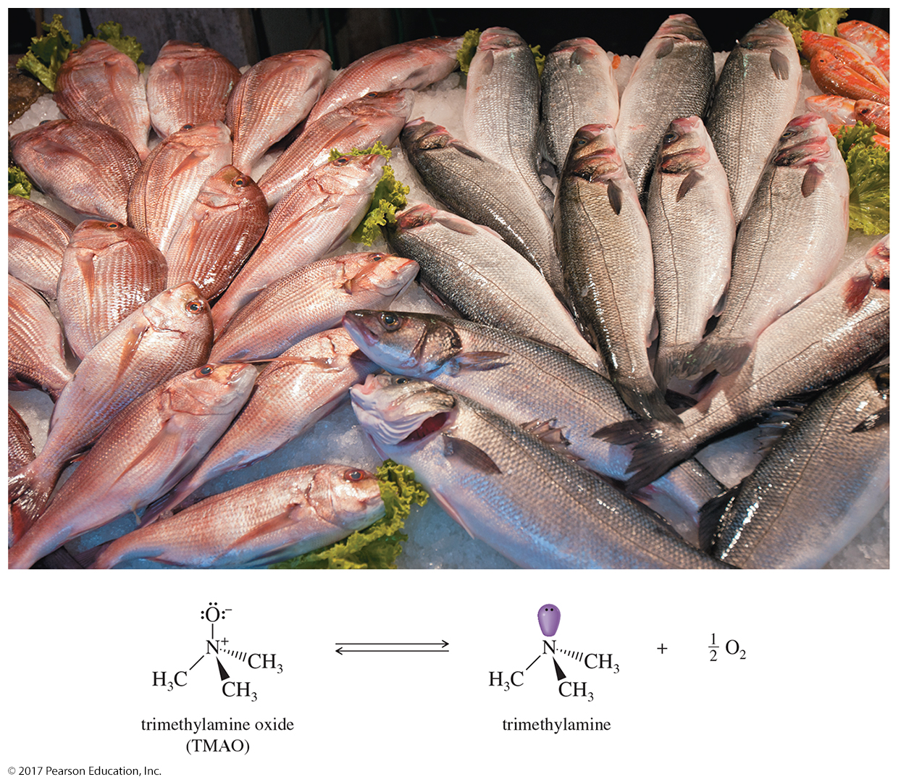
Organic Chemistry,
9th Edition
L. G. Wade, Jr.
Chapter 19
Lecture
Amines
Chad Snyder, PhD
Grace College
© 2017 Pearson Education, Inc.

Slide 2
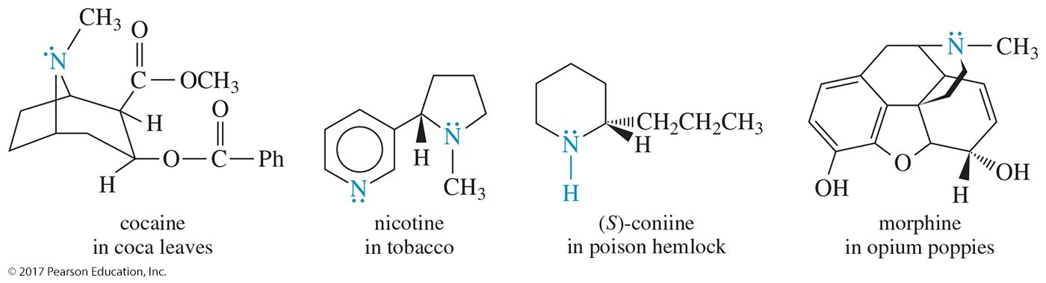
Biologically Active Amines
The alkaloids are an important group of biologically active amines, mostly synthesized by plants to protect them from being eaten by insects and other animals.
Many drugs of addiction are classified as alkaloids.

Slide 3
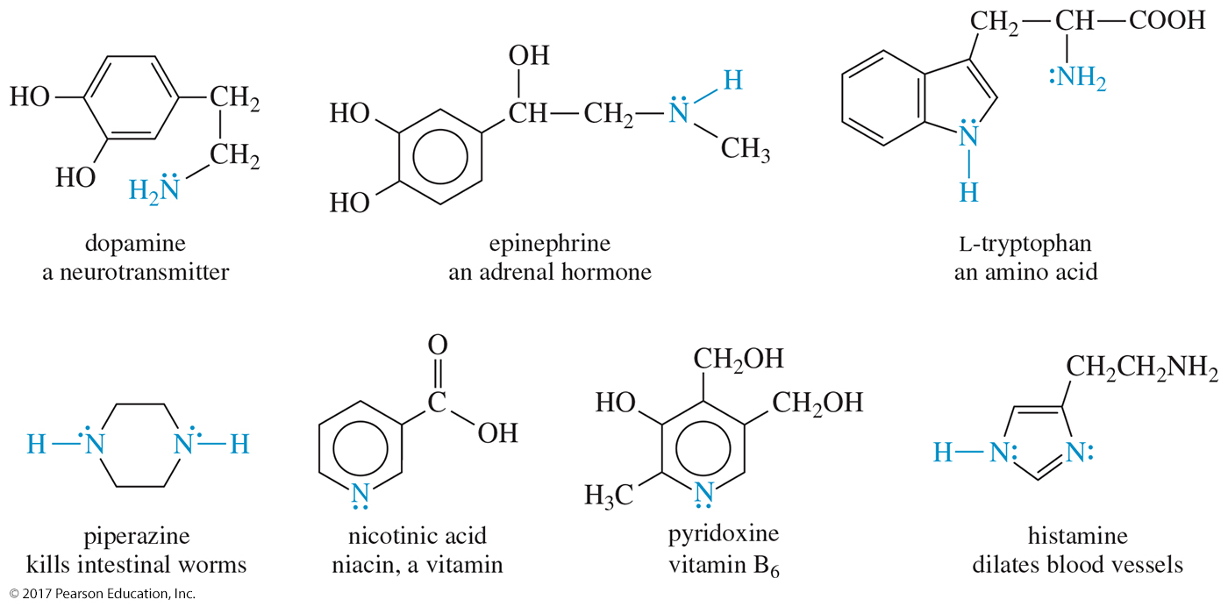
Biological Activity of Amines

Slide 4
Classes of Amines
Primary (1°): Has one alkyl group bonded to the nitrogen (RNH₂)
Secondary (2°): Has two alkyl groups bonded to the nitrogen (R₂NH)
Tertiary (3°): Has three alkyl groups bonded to the nitrogen (R₃N)
Quaternary (4°): Has four alkyl groups bonded to the nitrogen and the nitrogen bears a positive charge (R₄N⁺)

Slide 5
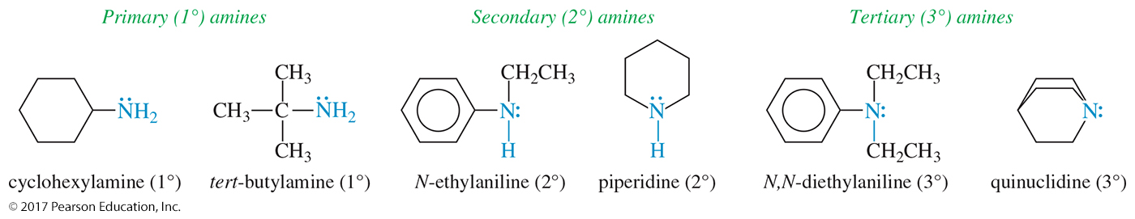
Classification of Amines

Slide 6
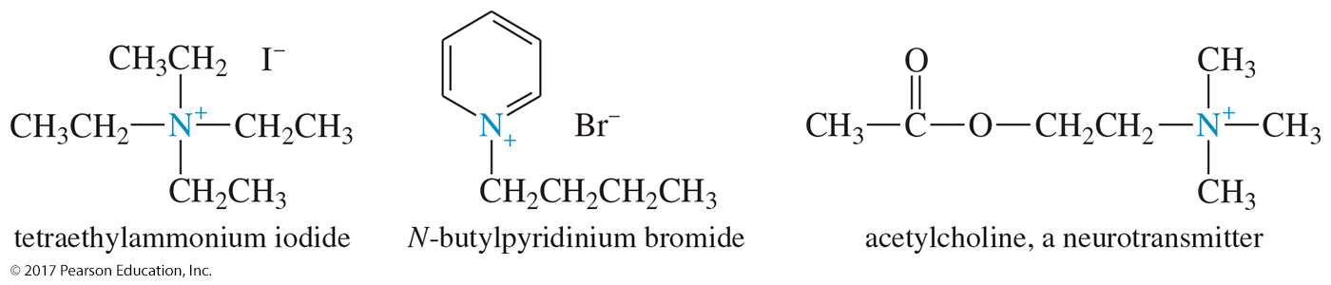
Quaternary Ammonium Salts
The nitrogen atom has four alkyl groups attached.
The nitrogen is positively charged.

Slide 7
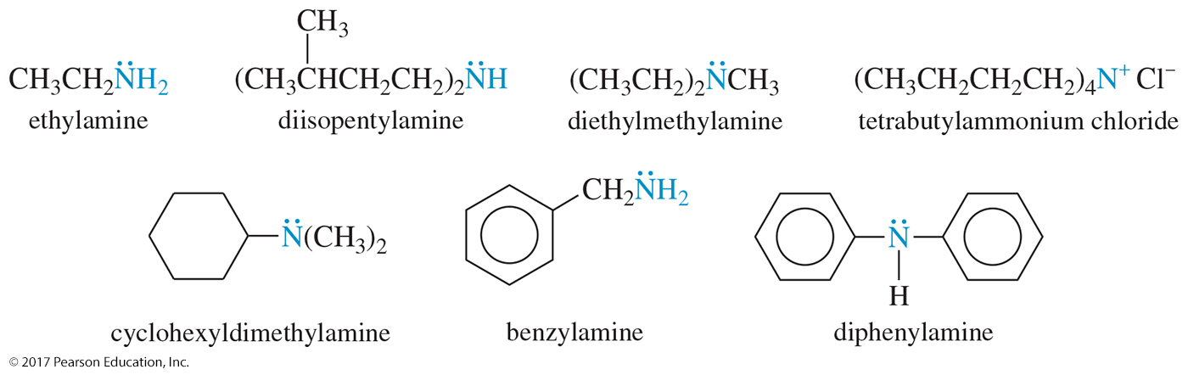
Common Names
Common names of amines are formed from the names of the alkyl groups bonded to nitrogen, followed by the suffix -amine.

Slide 8
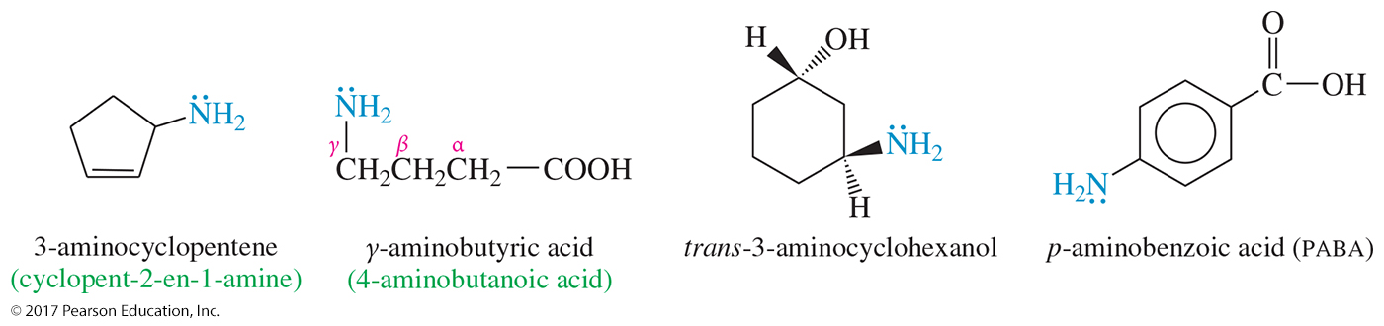
Amine As Substituent
On a molecule with a higher-priority functional group, the amine is named as a substituent.

Slide 9
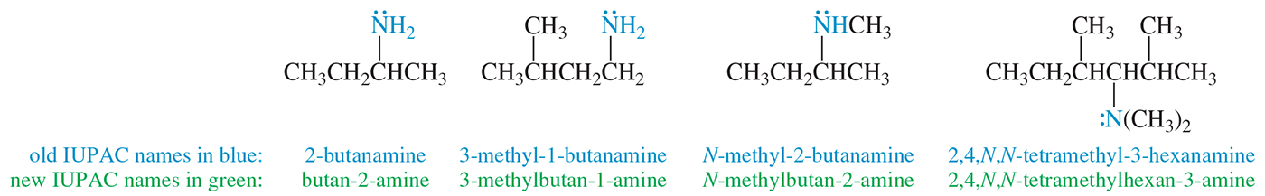
IUPAC Names
Name is based on longest carbon chain.
The -e of alkane is replaced with -amine.

Slide 10
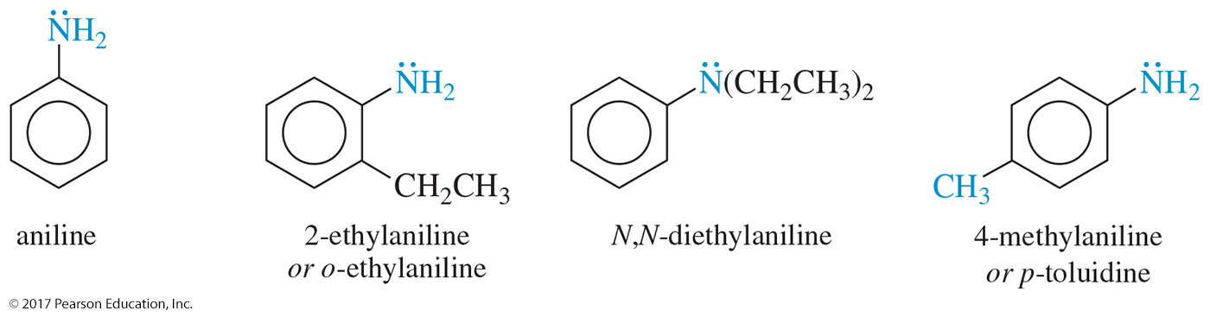
Aromatic Amines
In aromatic amines, the amino group is bonded to a benzene ring.
The parent compound is called aniline.

Slide 11
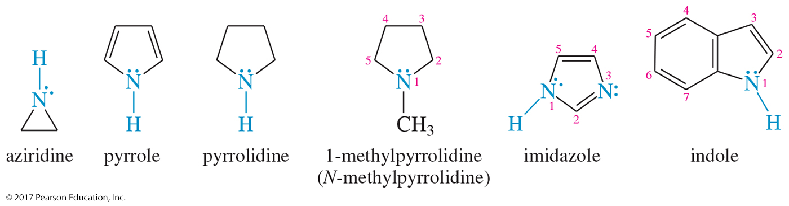
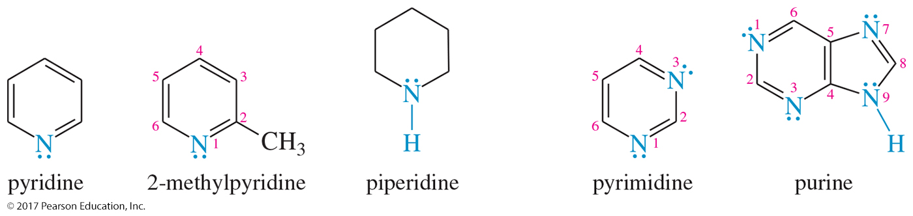
Heterocyclic Amines
When naming a cyclic amine, the nitrogen is assigned position number 1.

Slide 12
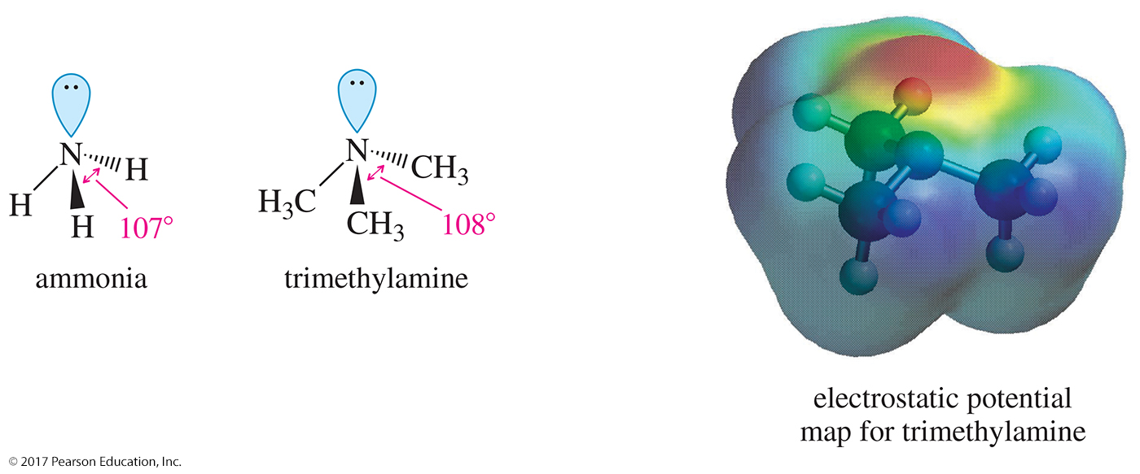
Structure of Amines
Nitrogen is sp³ hybridized with a lone pair of electrons.
The angle is less than 109.5°.

Slide 13
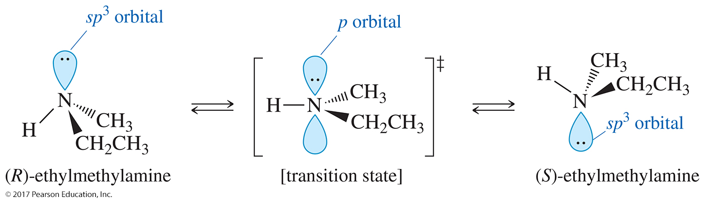
Interconversion of
Chiral Amines
Nitrogen may have three different groups and a lone pair, but enantiomers cannot be isolated due to inversion around N.

Slide 14
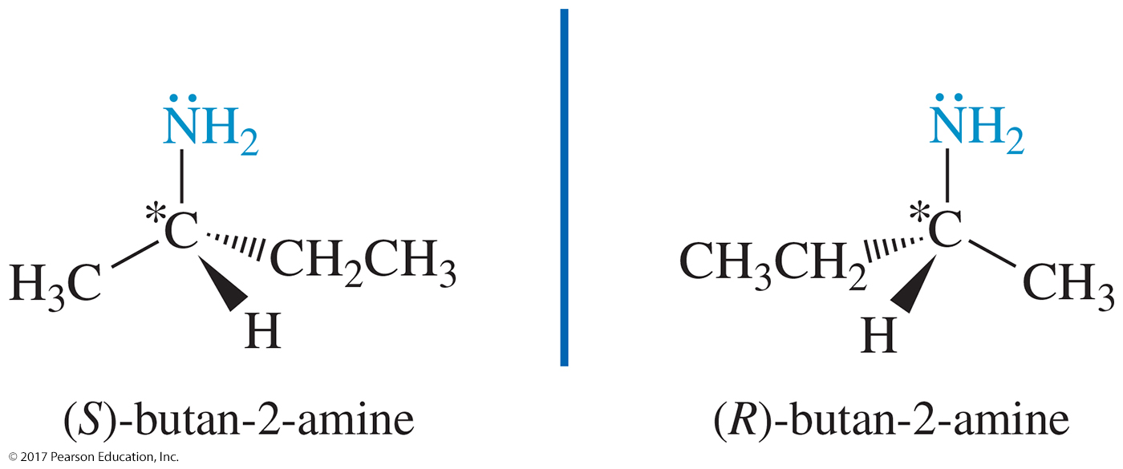
Chiral Amines
Amines whose chirality stems from the presence of chiral carbon atoms
Inversion of the nitrogen is not relevant because it will not affect the chiral carbon.

Slide 15
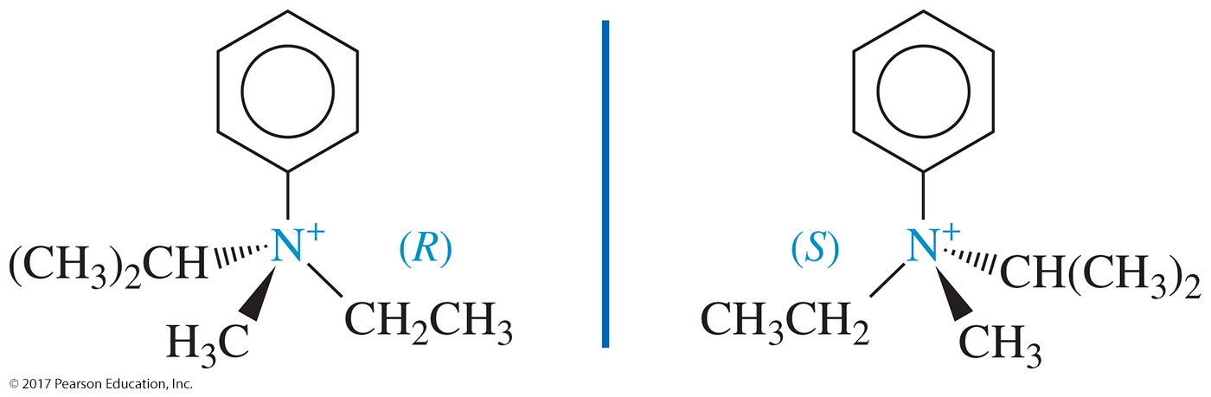
Chiral Quaternary
Ammonium Salts
Quaternary ammonium salts may have a chiral nitrogen atom if the four substituents are different.
Inversion of configuration is not possible because there is no lone pair to undergo nitrogen inversion.

Slide 16
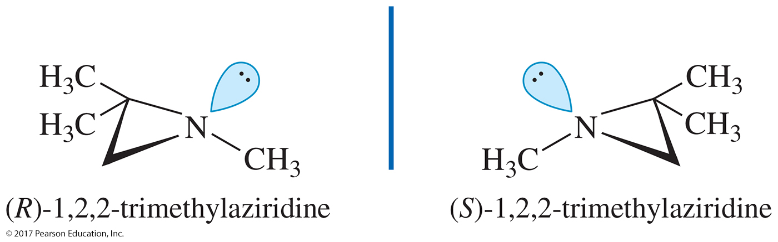
Chiral Cyclic Amines
If the nitrogen atom is contained in a small ring, for example, it is prevented from attaining the 120° bond
angle that facilitates inversion.
Such a compound has a higher activation energy for inversion, the inversion is slow, and the enantiomers may be resolved.

Slide 17
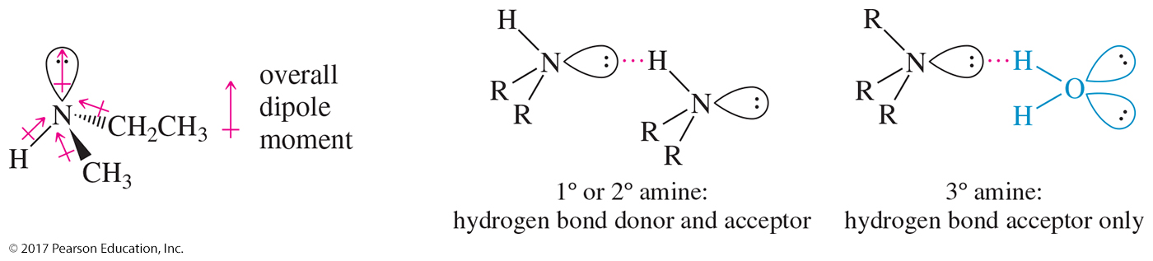
Boiling Points
N—H is less polar than O—H.
Weaker hydrogen bonds, so amines will have a lower boiling point than the corresponding alcohol
Tertiary amines cannot hydrogen-bond, so they have lower boiling points than primary and secondary amines.

Slide 18
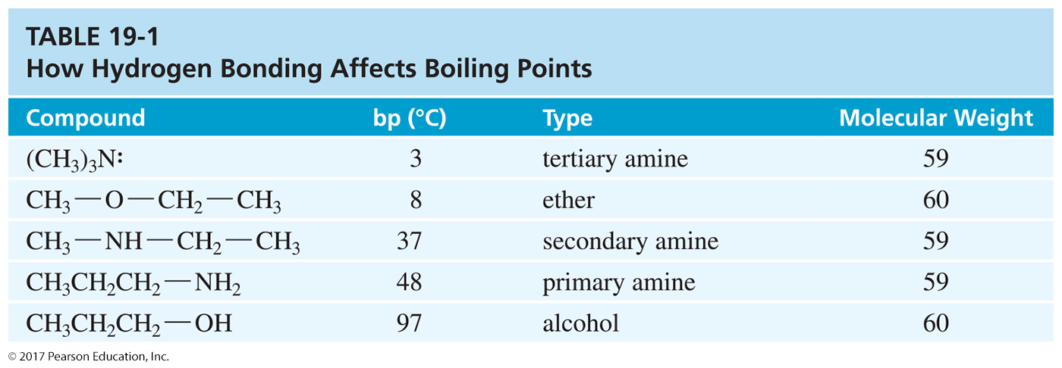
Hydrogen Bonding and
Boiling Points

Slide 19
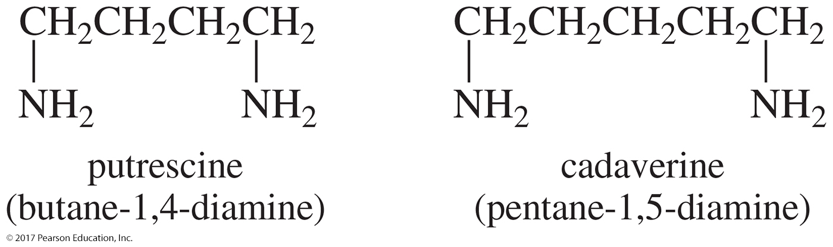
Solubility and Odor
Small amines (< six Cs) are soluble in water.
All amines accept hydrogen bonds from water and alcohol.
Branching increases solubility.
Most amines smell like rotting fish.

Slide 20
Basicity of Amines
Lone pair of electrons on nitrogen can accept a proton from an acid.
Aqueous solutions are basic to litmus.
Ammonia pK_{b} = 4.74.
Alkyl amines are usually stronger bases than ammonia.
Increasing the number of alkyl groups decreases solvation of ion, so 2° and 3° amines are similar to 1° amines in basicity.

Slide 21
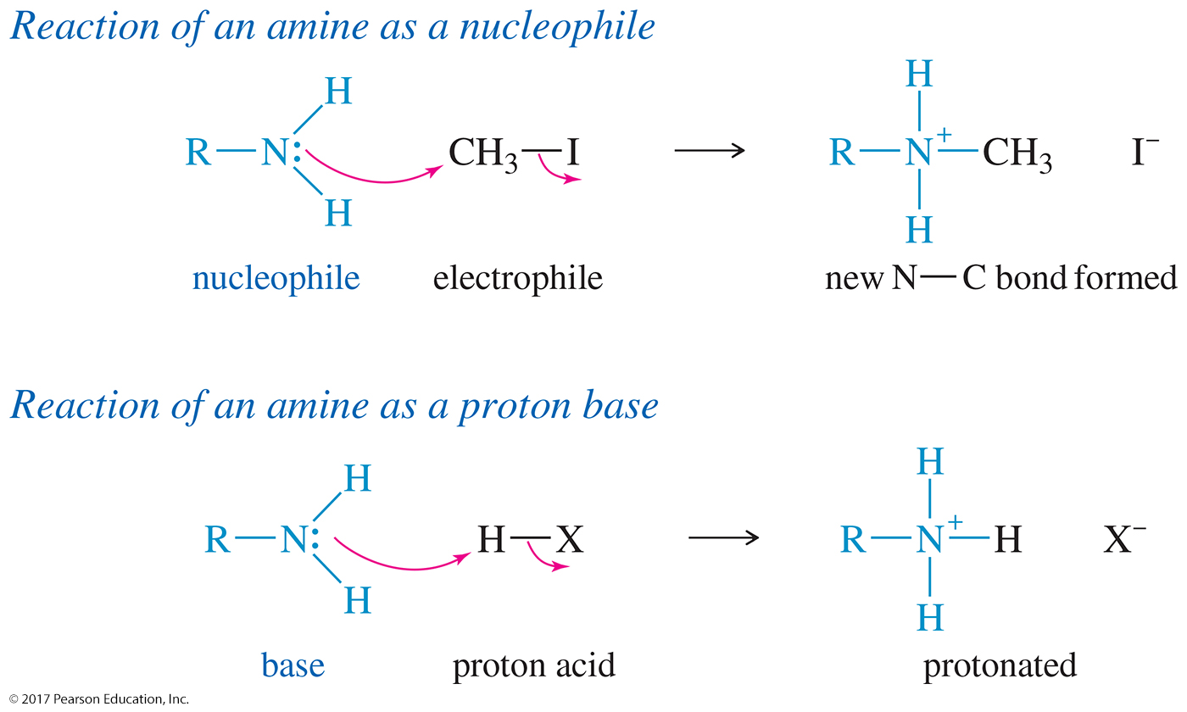
Reactivity of Amines

Slide 22
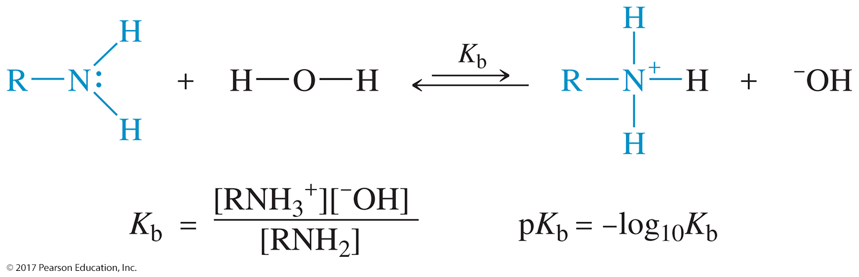
Base-Dissociation Constant of Amines
Amines are strongly basic and as such they can abstract a proton from water, giving an ammonium ion and a hydroxide ion.
The equilibrium constant for this reaction is called the base-dissociation constant for the amine, symbolized
by K_{b}.

Slide 23
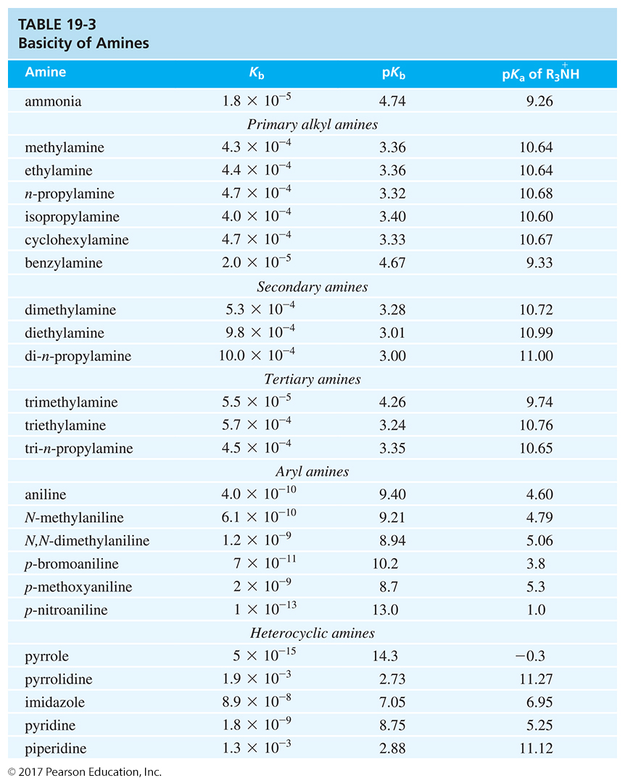
Amine Basicity

Slide 24
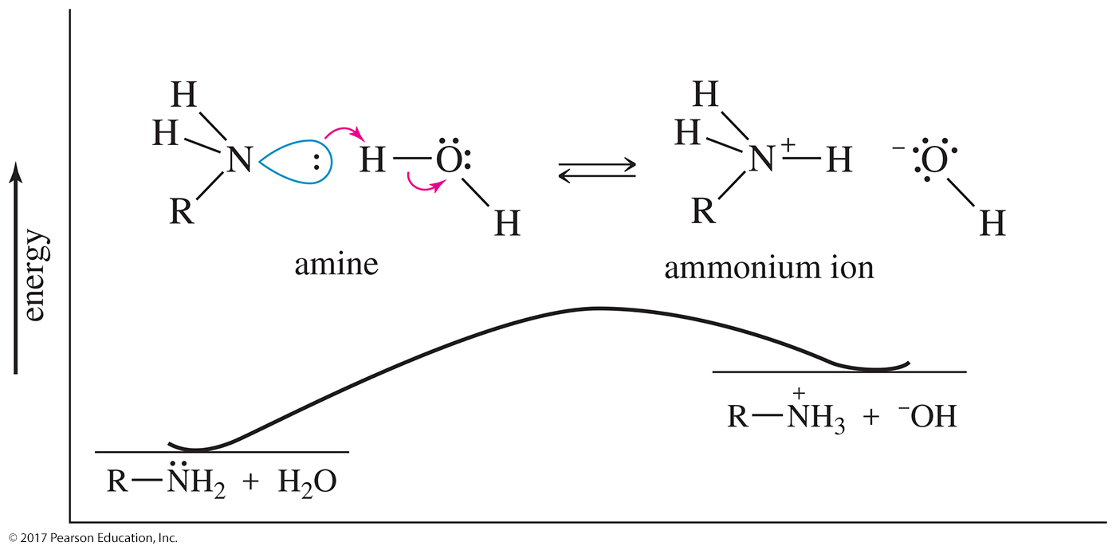
Base Dissociation of an Amine
Alkyl groups stabilize the ammonium ion, making the amine a stronger base.

Slide 25
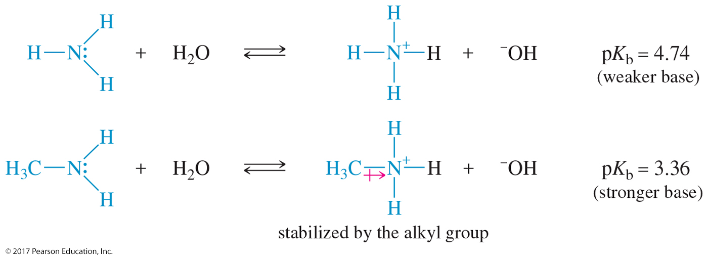
Alkyl Group Stabilization of Amines
Alkyl groups make the nitrogen a stronger base than ammonia.

Slide 26
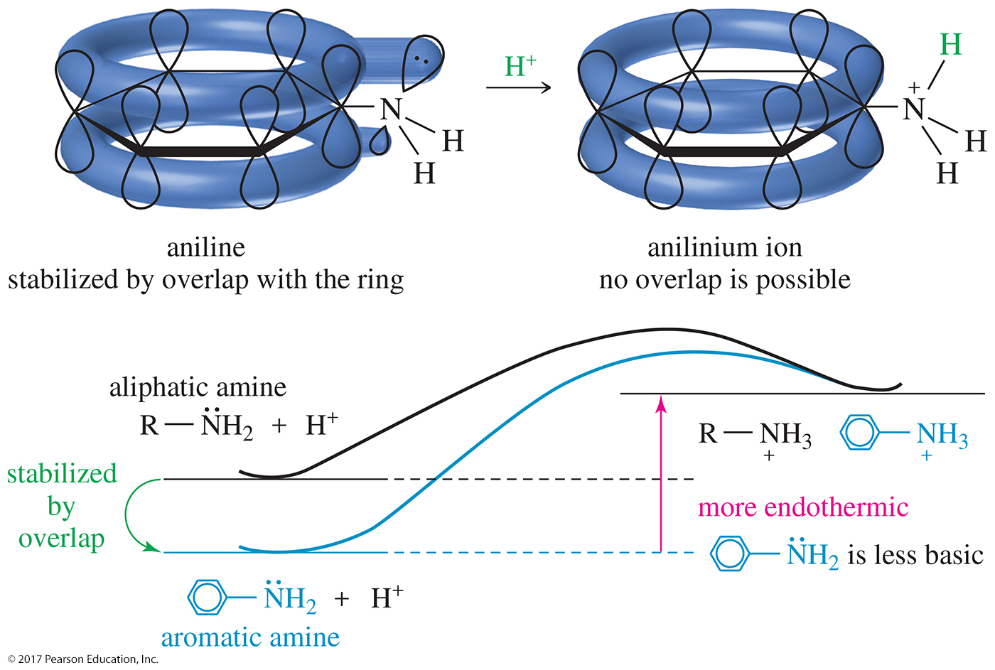
Resonance Effects
Any delocalization of the electron pair weakens the base.

Slide 27
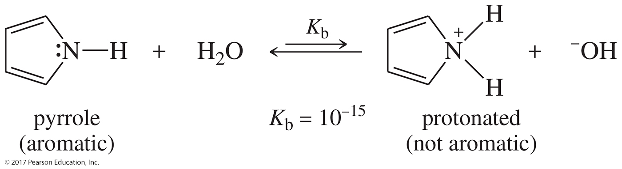
Protonation of Pyrrole
When the pyrrole nitrogen is protonated, pyrrole loses its aromatic stabilization.
Therefore, protonation on nitrogen is unfavorable and pyrrole is a very weak base.

Slide 28
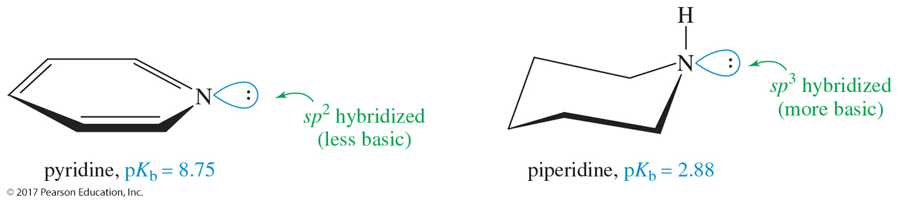
Hybridization Effects
Pyridine is less basic than aliphatic amines, but it is more basic than pyrrole because it does not lose its aromaticity on protonation.

Slide 29
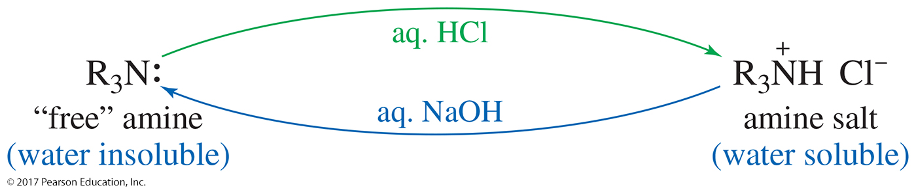
Ammonium Salts
Ionic solids with high melting points
Soluble in water
No fishy odor

Slide 30
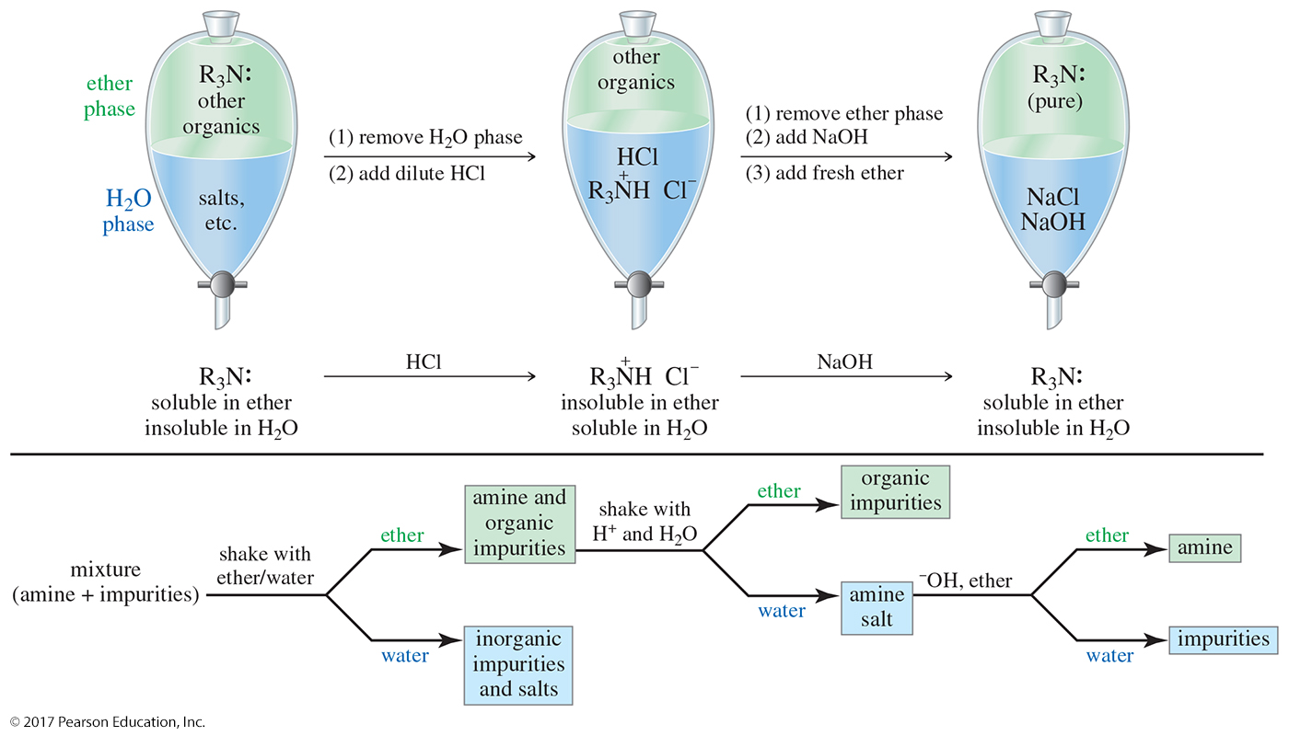
Purifying an Amine

Slide 31
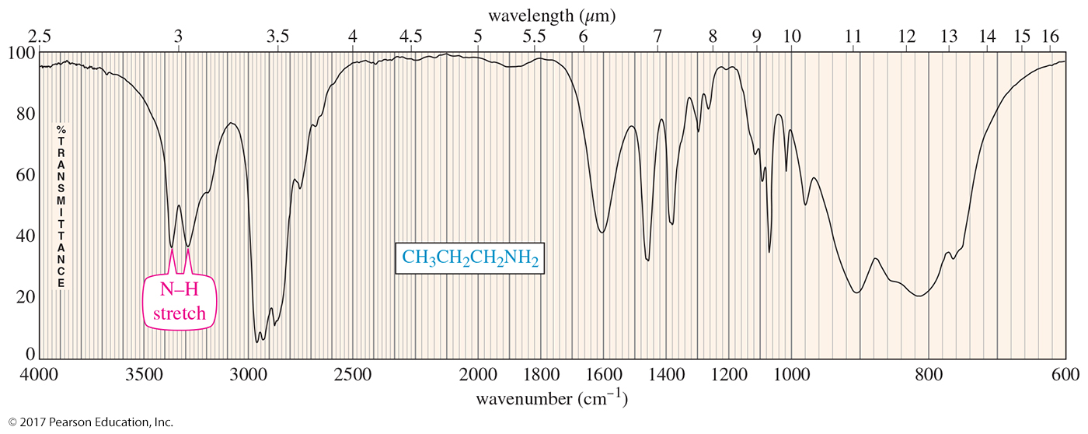
IR Spectroscopy
N—H stretch between 3200 and 3500 cm^{–1}
Two peaks for 1° amine, one for 2°

Slide 32
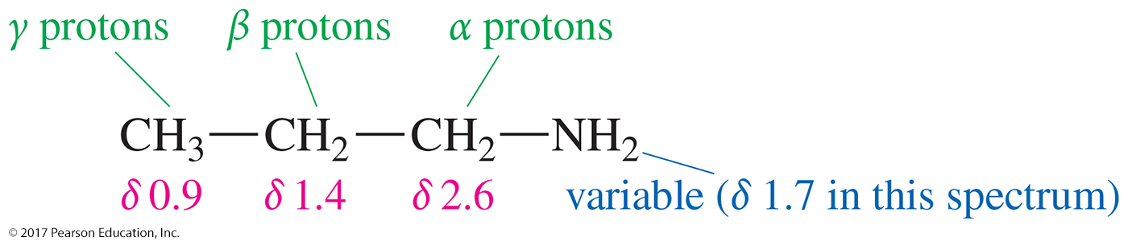
NMR Spectroscopy of Amines
Nitrogen is not as electronegative as oxygen, so the protons on the α carbon atoms of amines are not as strongly deshielded.

Slide 33
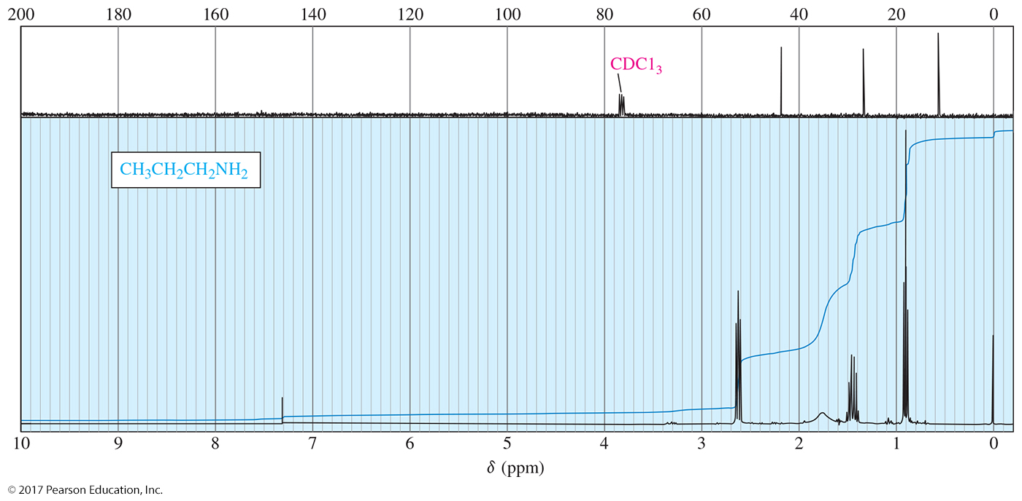
NMR Spectrum

Slide 34
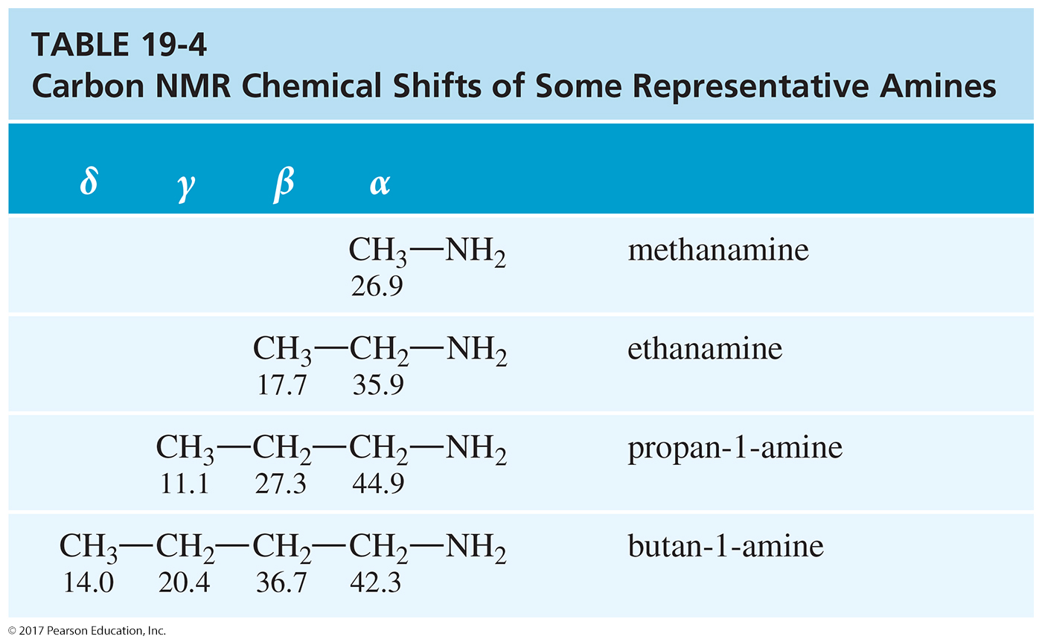
Carbon NMR Chemical Shifts

Slide 35
Mass Spectroscopy of Amines
Nitrogen has an odd valence and an even mass number.
When a nitrogen atom is present in a stable molecule, the molecular weight is odd.
Whenever an odd number of nitrogen atoms are present in a molecule, the molecular ion has an odd mass number.

Slide 36
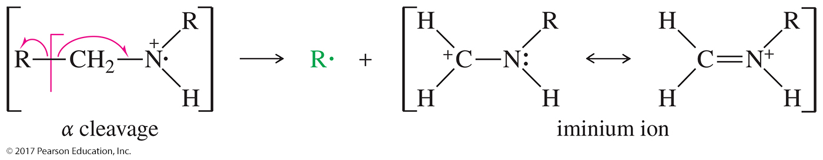
Alpha Cleavage of Amines
The most common fragmentation of amines is α cleavage to give a resonance-stabilized cation—an iminium ion.

Slide 37
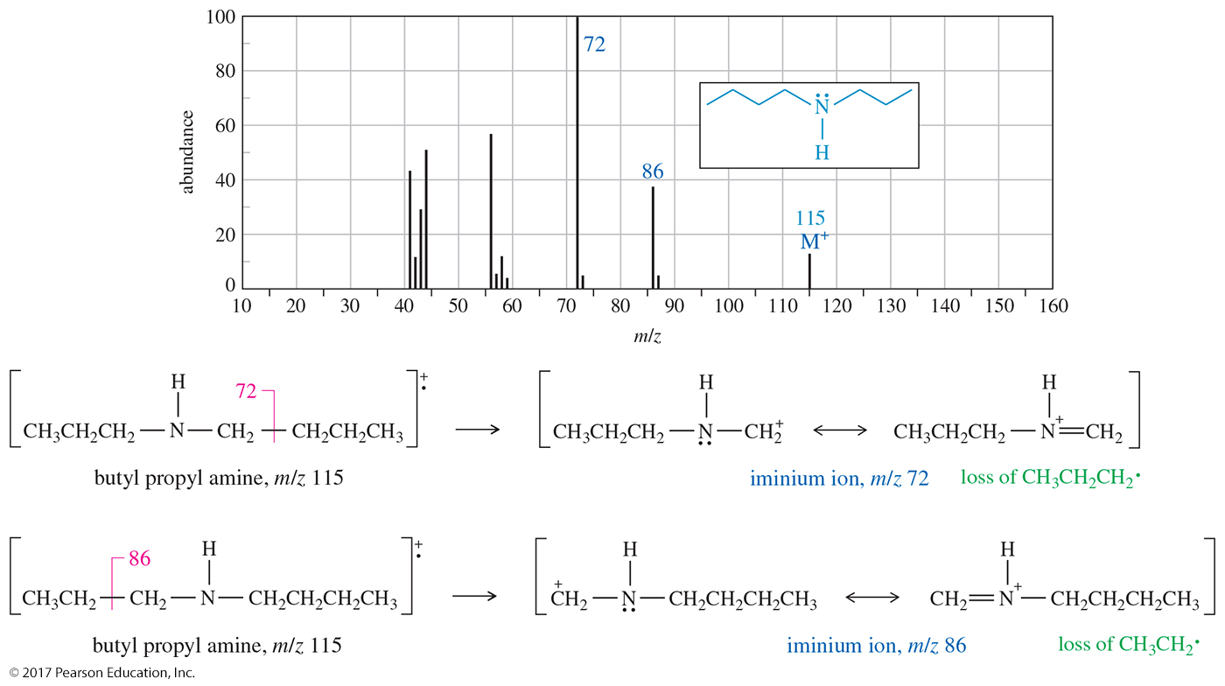
MS of Butyl Propyl Amine

Slide 38
Fragmentation of
Butyl Propyl Amine

Slide 39
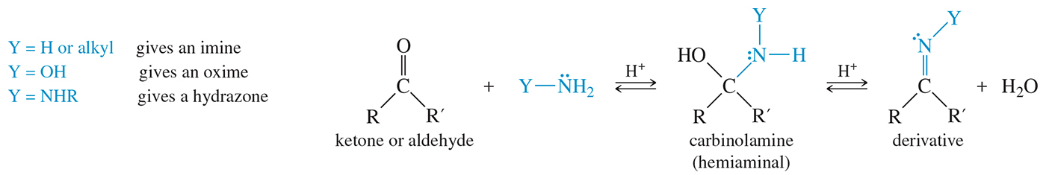
Reaction of Amines with Ketones and Aldehydes

Slide 40
Aromatic Substitution of Arylamines
—NH₂ is a strong activator and an ortho-, para-director.
Multiple substitution is a problem.
Protonation of the amine under acidic conditions converts the group into a strong deactivator (—NH₃⁺).

Slide 41
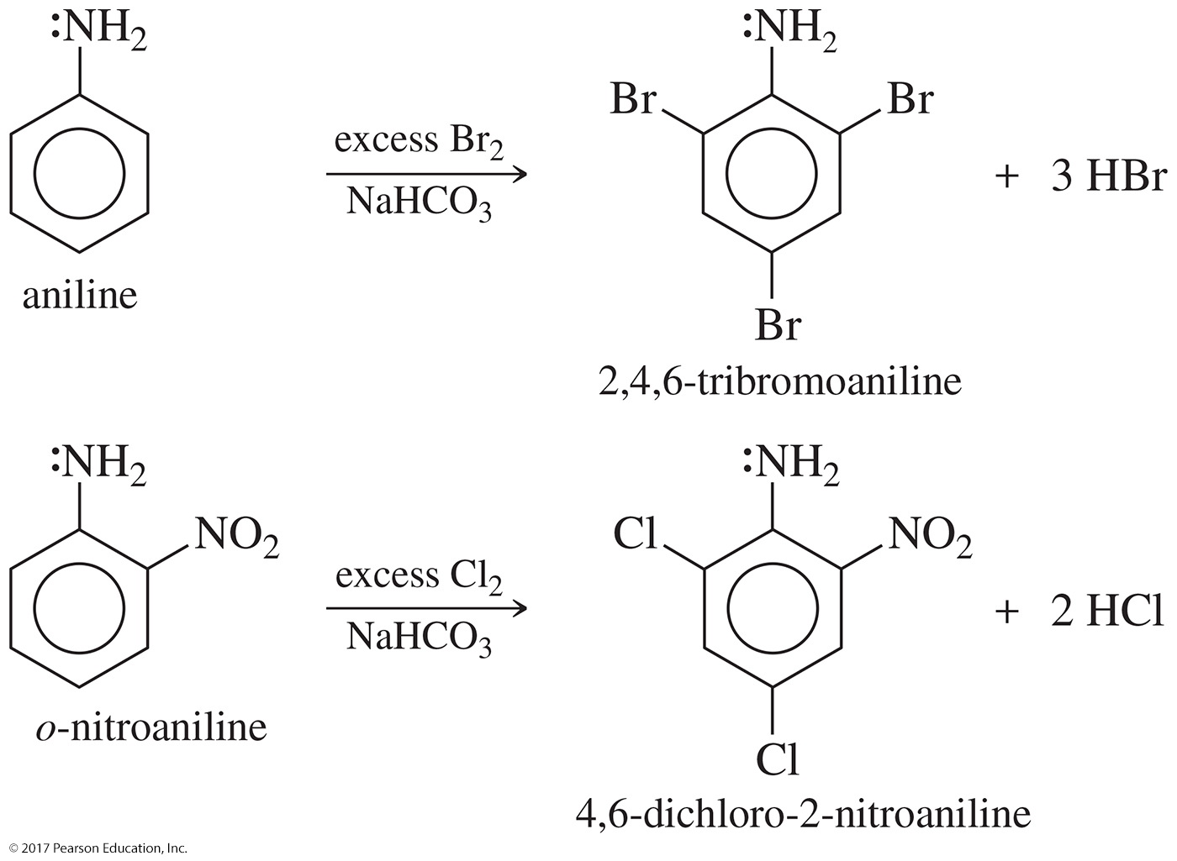
Multiple Substitutions

Slide 42
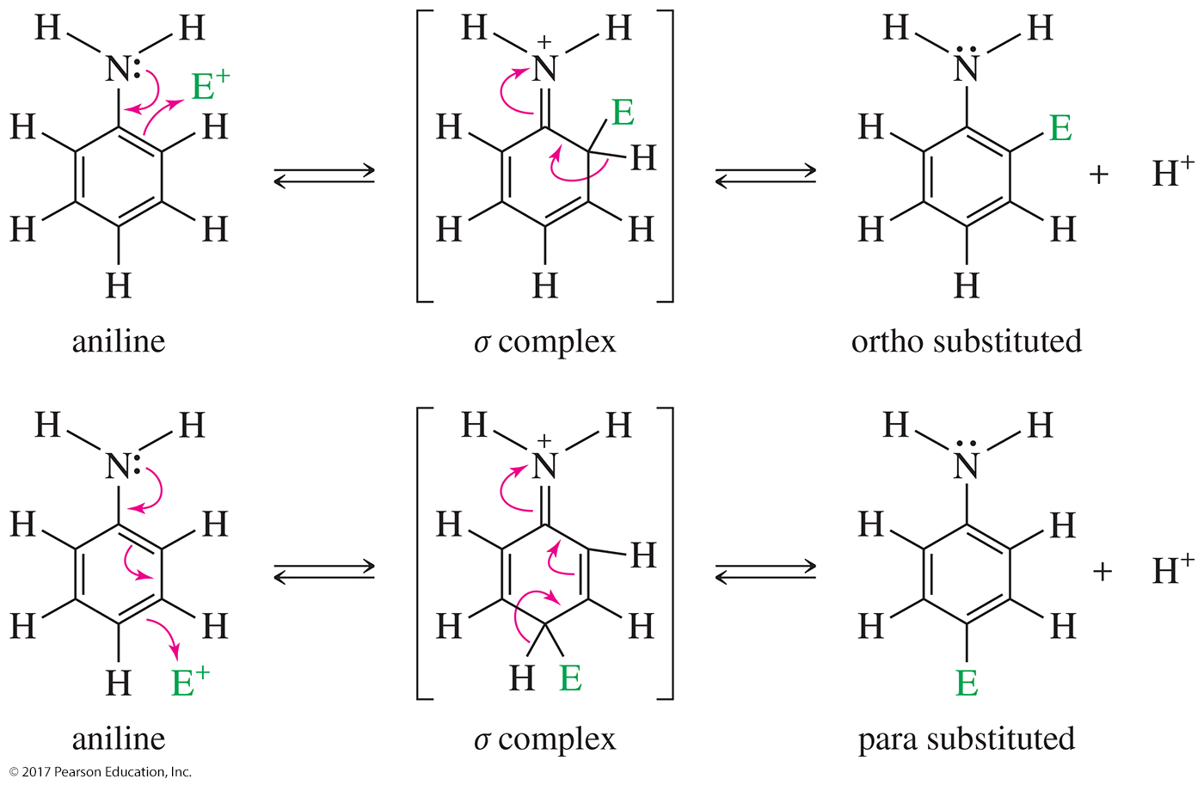
Ortho and Para
Substitution of Aniline

Slide 43
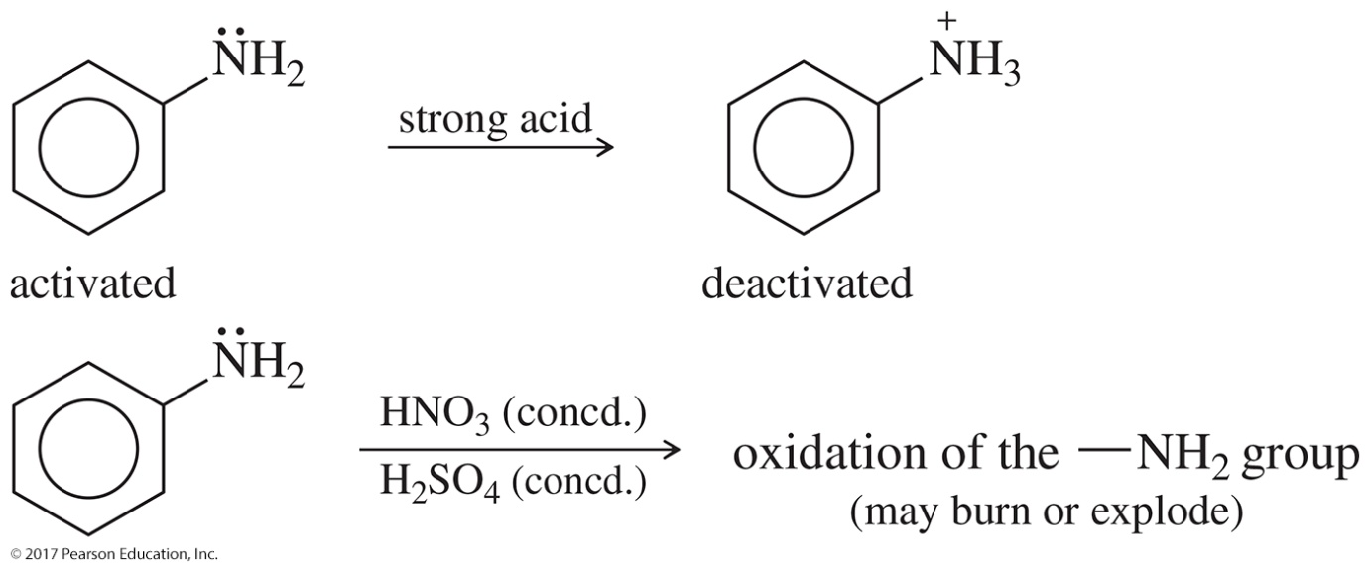
Protonation of Aniline in Substitution Reactions
Strongly acidic reagents protonate the amino group, producing an ammonium salt.
The —NH₃⁺ group is strongly deactivating (and
meta-allowing).
Therefore, strongly acidic reagents are unsuitable for substitution of anilines.

Slide 44
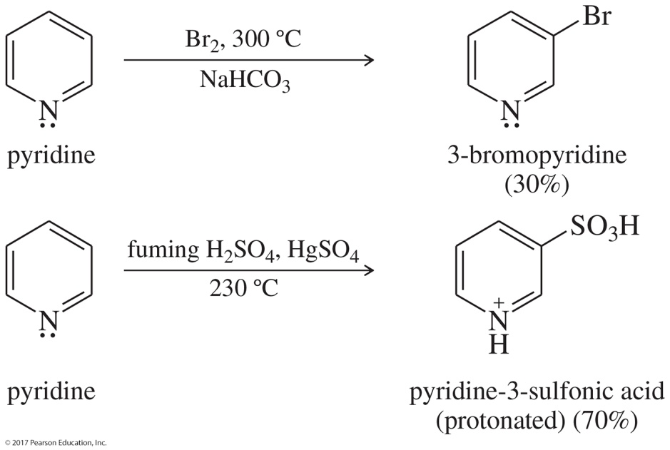
Aromatic Substitution of Pyridine
Strongly deactivated toward electrophilic attack by the electronegative nitrogen atom
Substitutes in the 3-position in a manner analogous to the meta substitution
Electrons on N may react with the electrophile.

Slide 45
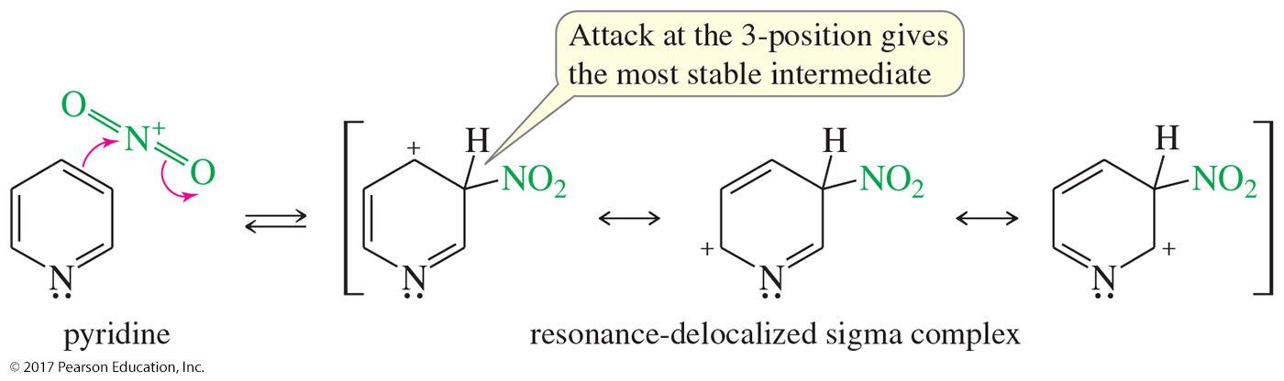
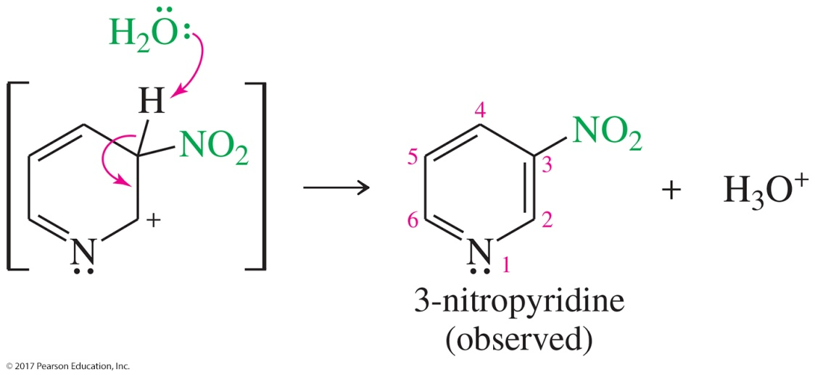
Electrophilic Aromatic Substitution of Pyridine

Slide 46
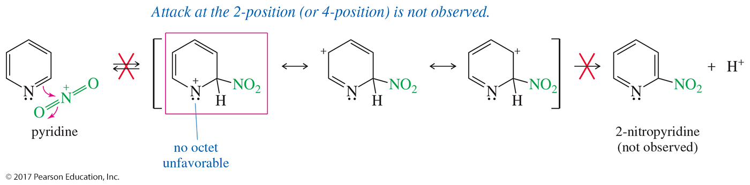
Attack on 2-Position
Attack at the 2-position would have an unfavorable resonance structure in which the positive charge is localized on the nitrogen.
Substitution at the 2-position is not observed.

Slide 47
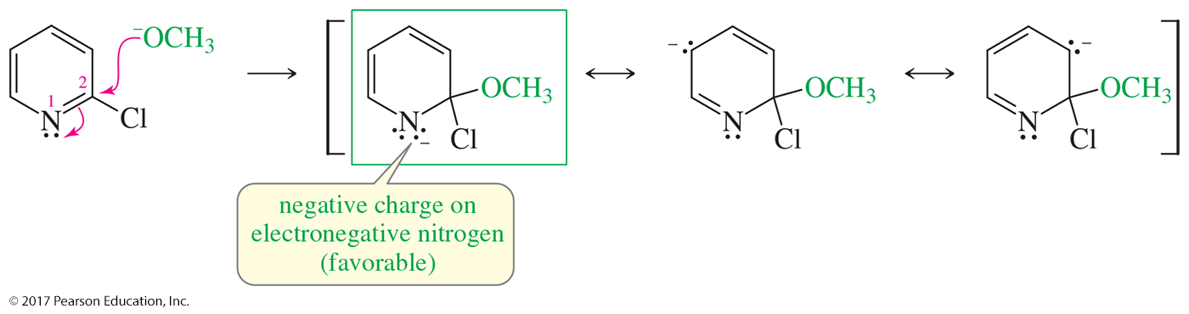
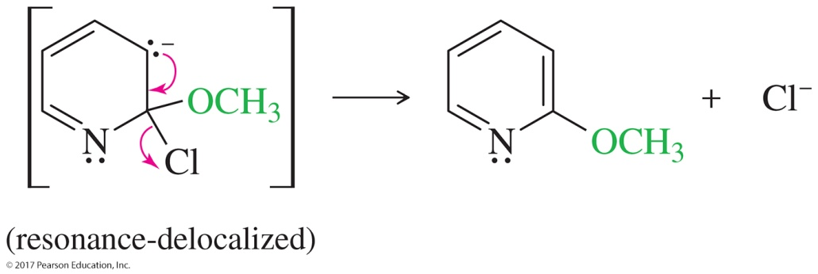
Nucleophilic Substitution of Pyridine
Activated toward nucleophilic aromatic substitution
Nucleophile will replace a good leaving group in the 2- or 4-position.

Slide 48
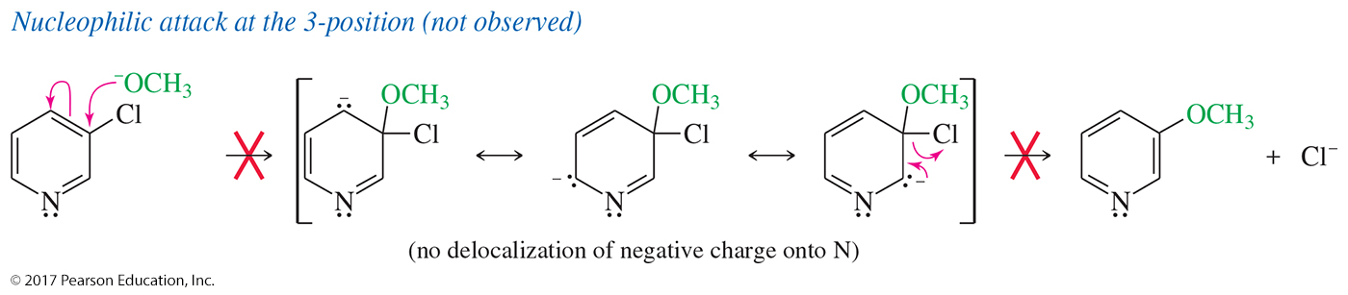
Nucleophilic Attack on 3-Position
Attack at the 3-position does not place the negative charge on the nitrogen.
Substitution at the 3-position is not observed.

Slide 49
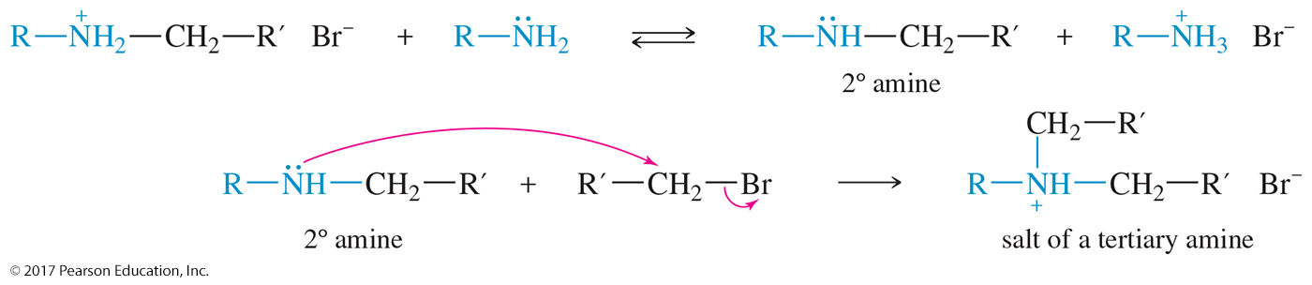
Alkylation of Amines by Alkyl Halides
Proceeds by the S_{N}2 mechanism
Secondary alkyl halides will give elimination products.
Multiple alkylations are a major problem. Complex mixtures are obtained.

Slide 50
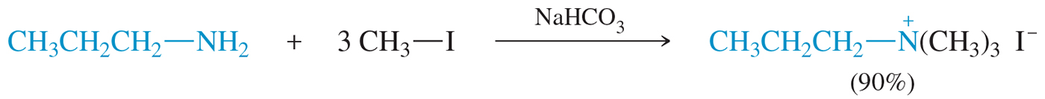
Exhaustive Alkylation
Exhaustive alkylation forms the tetraalkylammonium salt.
Mild basic conditions (NaHCO₃) are used to deprotonate the intermediates and neutralize the acid formed.

Slide 51
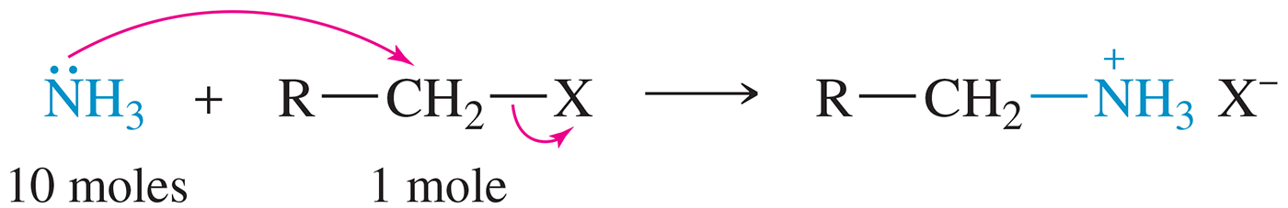
Alkylations with
Excess Ammonia
Reaction with large excess of NH₃ to form the primary amine in good yields
Excess ammonia is allowed to evaporate after reaction.

Slide 52
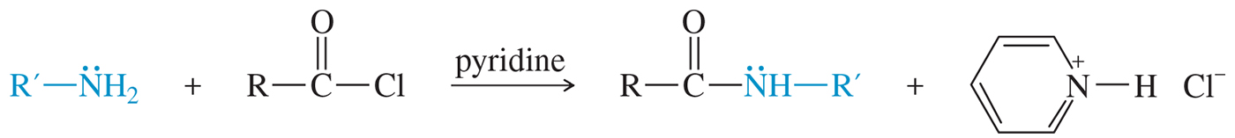
Acylation of Amines
Primary and secondary amines react with acid halides to form amides.
This reaction is a nucleophilic acyl substitution.

Slide 53



Mechanism of Acyl Substitution
Step 1: Nucleophile attacks the carbonyl carbon, forming the tetrahedral intermediate.
Step 2: Expulsion of the chloride ion
Step 3: Loss of a proton gives
the amide.

Slide 54

Acylation of Aromatic Amines
The resulting amide is still activating and ortho,
para-directing.
The acyl group can be removed later by acidic or basic hydrolysis.

Slide 55


Solved Problem 1
Show how you would accomplish the following synthetic conversion in good yield.
Solution
An attempted Friedel–Crafts acylation on aniline would likely meet with disaster. The free amino group would attack both the acid chloride and the Lewis acid catalyst.

Slide 56

Solved Problem 1 (Continued)
Solution (Continued)
We can control the nucleophilicity of aniline’s amino group by converting it to an amide, which is still activating and ortho, para-directing for the Friedel–Crafts reaction. Acylation, followed by hydrolysis of the amide, gives the desired product.

Slide 57

Formation of Sulfonamides
Sulfonyl chlorides are the acid chlorides of sulfonic acids.
Sulfonyl chlorides are strongly electrophilic.

Slide 58

Formation of Sulfonamides
Primary or secondary amines react with sulfonyl chloride to produce an amide.
Amides of sulfonic acid are called sulfonamides.

Slide 59

Synthesis of Sulfanilamide
The sulfa drugs are a class of sulfonamides used as antibacterial agents.
In 1936, sulfanilamide was found to be effective against streptococcal infections.

Slide 60

Biological Activity of Sulfanilamide
Sulfanilamide is an analogue of p-aminobenzoic acid.
Streptococci use p-aminobenzoic acid to synthesize folic acid, an essential compound for growth and reproduction. Sulfanilamide cannot be used to make folic acid.
Bacteria cannot distinguish between sulfanilamide and
p-aminobenzoic acid, so it will inhibit their growth and reproduction.

Slide 61
Amines As Leaving Groups
Amines can undergo elimination reactions to form alkenes.
The –NH₂ or –NHR groups are not good leaving groups because they are very
strong bases.
Exhaustive methylation can convert the amino group into a quaternary ammonium salt, which can leave as the neutral amine.

Slide 62

Hofmann Elimination
A quaternary ammonium salt has a good leaving group—a neutral amine.
Heating the hydroxide salt produces the least substituted alkene.

Slide 63

Exhaustive Methylation of Amines
Methyl iodide is usually used as a methylating agent.
The leaving group is the neutral amine.

Slide 64

Conversion to the
Hydroxide Salt
The iodide salt is converted to the hydroxide salt by treatment with silver oxide and water.
The hydroxide will serve as the base in the elimination step.

Slide 65

Mechanism of the
Hofmann Elimination
The Hofmann elimination is a one-step, concerted E2 reaction in which the amine is the leaving group.

Slide 66

Regioselectivity of the
Hofmann Elimination
The least substituted product is the major product of the reaction (Hofmann product).

Slide 67

E2 Mechanism

Slide 68


Solved Problem 2
Predict the major product(s) formed when the following amine is treated with excess iodomethane, followed by heating with silver oxide.
Solution
Solving this type of problem requires finding every possible elimination of the methylated salt. In this case, the salt has the following structure:

Slide 69

Solved Problem 2 (Continued)
Solution (Continued)
The green, blue, and red arrows show the three possible elimination routes. The corresponding products are as follows:
The first (green) alkene has a disubstituted double bond. The second (blue) alkene is monosubstituted, and the red alkene (ethylene) has an unsubstituted double bond. We predict that the red products will be favored.

Slide 70

Oxidation of Amines
Amines are easily oxidized, even in air.
Common oxidizing agents: H₂O_{2 ,} MCPBA
2° amines oxidize to hydroxylamine (—NOH).
3° amines oxidize to amine oxide (R₃N⁺—O–).

Slide 71

Preparation of Amine Oxides
Tertiary amines are oxidized to amine oxides, often in
good yields.
Either H₂O₂ or peroxyacid may be used for this oxidation.
The N-oxide can undergo elimination to form alkenes in a reaction analogous to the Hofmann elimination.

Slide 72

Cope Rearrangement
E2 mechanism
The amine oxide acts as its own base through a cyclic transition state, so a strong base is not needed.

Slide 73


Solved Problem 3
Predict the products expected when the following compound is treated with H₂O₂ and heated.
Solution
Oxidation converts the tertiary amine to an amine oxide. Cope elimination can give either of two alkenes. We expect the less hindered elimination to be favored, giving the Hofmann product.

Slide 74


Formation of Diazonium Salts
Primary amines react with nitrous acid (HNO₂) to form dialkyldiazonium salts.
The diazonium salts are unstable and decompose into carbocations and nitrogen.

Slide 75


Diazotization of an Amine
Step 1: The amine attacks the nitrosonium ion and forms
N-nitrosoamine.
Step 2: A proton transfer (a tautomerism) from nitrogen to oxygen forms a hydroxyl group and a second N—N bond.

Slide 76

Diazotization of an Amine (Continued)
Step 3: Protonation of the hydroxyl group, followed by the loss of water, gives the diazonium ion.

Slide 77

Arenediazonium Salts
By forming and diazotizing an amine, an activated aromatic position can be converted into a wide variety of functional groups.

Slide 78

Reactions of
Arenediazonium Salts

Slide 79

The Sandmeyer Reaction

Slide 80


Replacement of the Diazonium Group by Fluoride and Iodide

Slide 81

Reduction of Diazonium Group to Hydrogen: Deamination of Anilines

Slide 82

Diazonium Salts as Electrophiles: Diazo Coupling

Slide 83


Synthesis of Amines by Reductive Amination
The most common amine synthesis begins with ammonia or an amine and addition of another alkyl group.
Reductive amination is the most general synthesis, capable of adding a primary or secondary alkyl group to an amine.

Slide 84

Reductive Amination: 1° Amines
Primary amines result from the condensation of hydroxylamine (zero alkyl groups) with a ketone or an aldehyde, followed by reduction of the oxime.
LiAlH₄ or NaBH₃CN can be used to reduce the oxime.

Slide 85

Reductive Amination: 2° Amines
Condensation of a ketone or an aldehyde with a primary amine forms an N-substituted imine (a Schiff base).
Reduction of the N-substituted imine gives a
secondary amine.

Slide 86

Reductive Amination: 3° Amines
Condensation of a ketone or an aldehyde with a secondary amine gives an iminium salt.
Iminium salts are frequently unstable, so they are rarely isolated.
A reducing agent in the solution reduces the iminium salt to a tertiary amine.

Slide 87


Solved Problem 3
Show how to synthesize the following amines from the indicated starting materials.
(a) N-cyclopentylaniline from aniline (b) N-ethylpyrrolidine from pyrrolidine
Solution
(a) This synthesis requires adding a cyclopentyl group to aniline (primary) to make a secondary amine. Cyclopentanone is the carbonyl compound.
(b) This synthesis requires adding an ethyl group to a secondary amine to make a tertiary amine. The carbonyl compound is acetaldehyde. Formation of a tertiary amine by Na(AcO)₃BH reductive amination involves an iminium intermediate, which is reduced by sodium triacetoxyborohydride.

Slide 88

Synthesis of 1° Amines by Acylation–Reduction
Acylation of the starting amine by an acid chloride gives an amide with no tendency toward overacylation.
Reduction of the amide by LiAlH₄ gives the corresponding amine.

Slide 89

Synthesis of 2° Amines by Acylation–Reduction
Acylation–reduction converts a primary amine to a secondary amine.
LiAlH₄, followed by hydrolysis, can easily reduce the intermediate amide to the amine.

Slide 90

Synthesis of 3° Amines by Acylation–Reduction
Acylation–reduction converts a secondary amine to a tertiary amine.
Reduction of the intermediate amide is accomplished with LiAlH₄.

Slide 91

Solved Problem 4
Show how to synthesize N-ethylpyrrolidine from pyrrolidine using acylation–reduction.
Solution
This synthesis requires adding an ethyl group to pyrrolidine to make a tertiary amine. The acid chloride needed will be acetyl chloride (ethanoyl chloride). Reduction of the amide gives N-ethylpyrrolidine.
Compare this synthesis with Solved Problem 19-5(b) to show how reductive amination and acylation–reduction can accomplish the same result.

Slide 92

The Gabriel Synthesis
The phthalimide ion is a strong nucleophile, displacing the halide or tosylate ion from the alkyl halide (S_{N}2).
Heating the N-alkyl phthalimide with hydrazine displaces the primary amine and the very stable hydrazide of phthalimide.

Slide 93
The Gabriel Synthesis

Slide 94

Reduction of Azides
Azide ion, –N₃, is a good nucleophile.
React azide with unhindered 1° or 2° halide or tosylate (S_{N}2).
Alkyl azides are explosive, so reduction is carried out without purifying the azide.

Slide 95

Reduction of Nitriles
Nitrile (C≡N) is a good S_{N}2 nucleophile.
Reduction with H₂ or LiAlH₄ converts the nitrile into a primary amine.

Slide 96

Reduction of Nitro Compounds
The nitro group can be reduced to the amine by catalytic hydrogenation or by an active metal
and H⁺.
Commonly used to synthesize anilines

