Slide 1
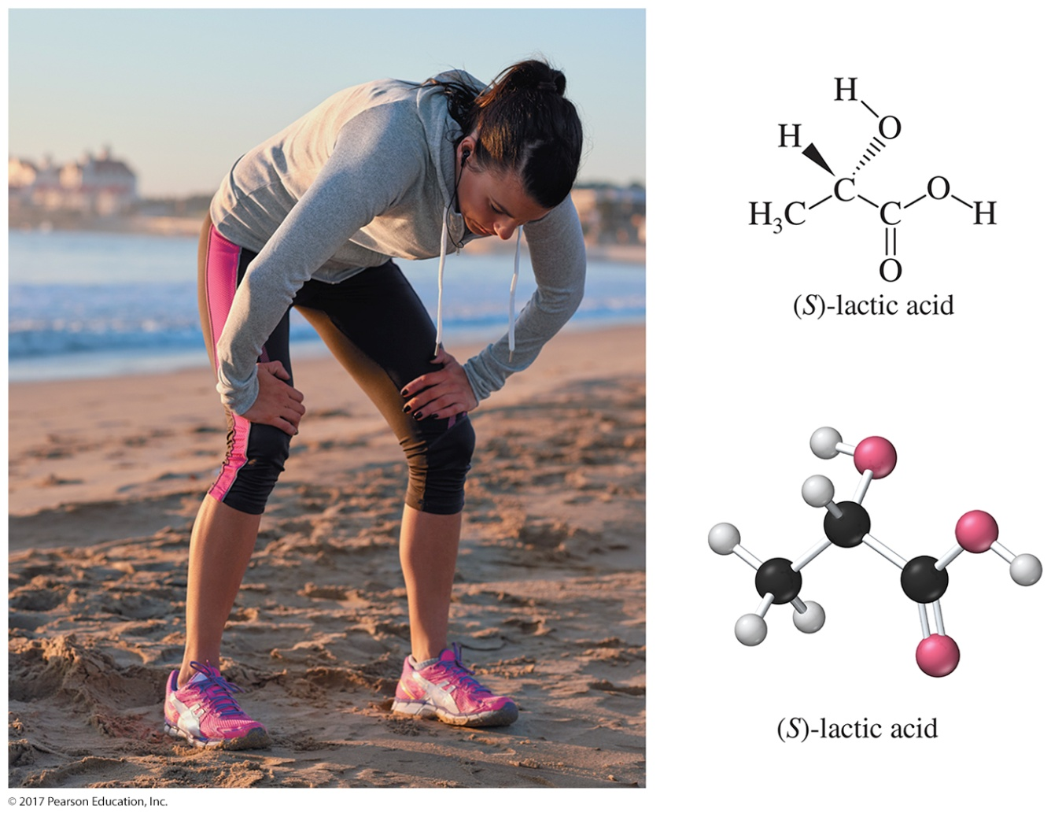
Organic Chemistry,
9th Edition
L. G. Wade, Jr.
Chapter 20
Lecture
Carboxylic Acids
Chad Snyder, PhD
Grace College
© 2017 Pearson Education, Inc.

Slide 2
Introduction
The functional group of carboxylic acids consists of a C═O with —OH bonded to the same carbon.
The carboxyl group is usually written
—COOH.
Aliphatic acids have an alkyl group bonded to —COOH.
Aromatic acids have an aryl group.
Fatty acids are long-chain aliphatic acids.

Slide 3
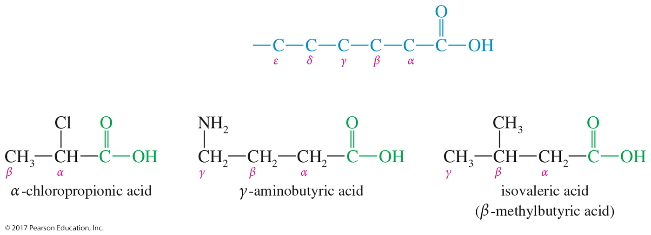
Common Names
Many aliphatic acids have historical names.
Positions of substituents on the chain are labeled with Greek letters starting at the carbon attached to the carboxylic carbon.

Slide 4
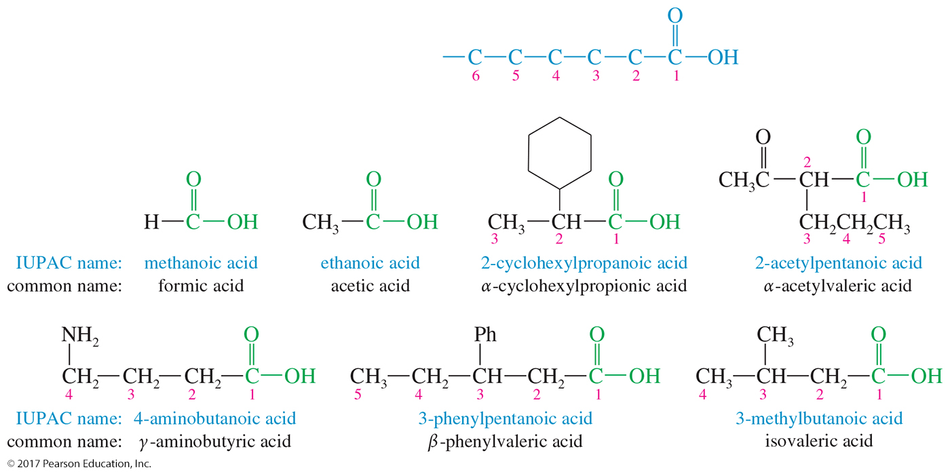
IUPAC Names
Remove the final -e from the alkane name, and add the ending -oic acid.
The carbon of the carboxyl group is number 1.

Slide 5
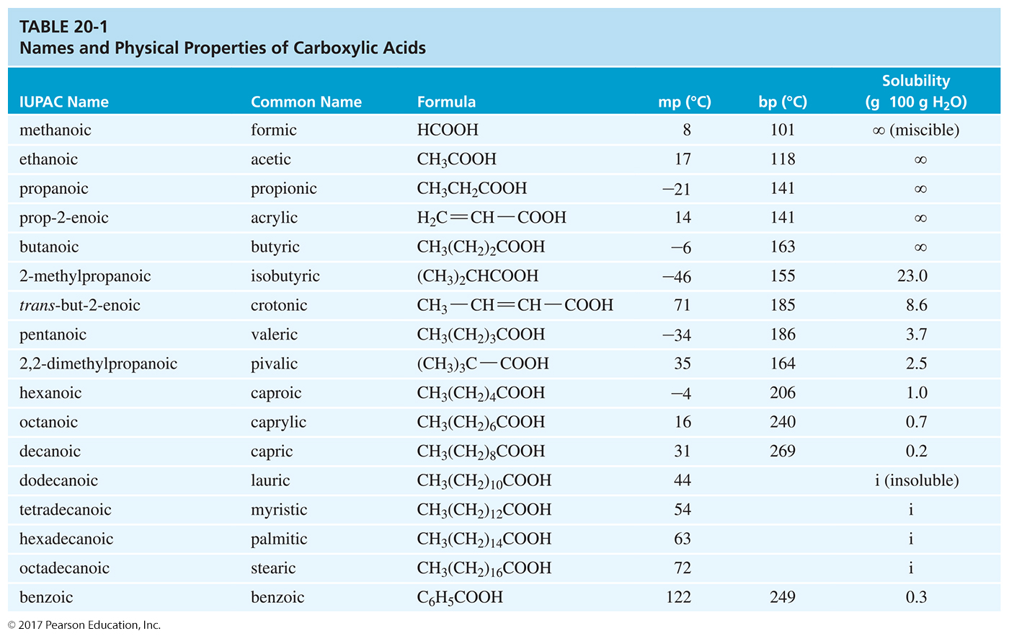

Slide 6
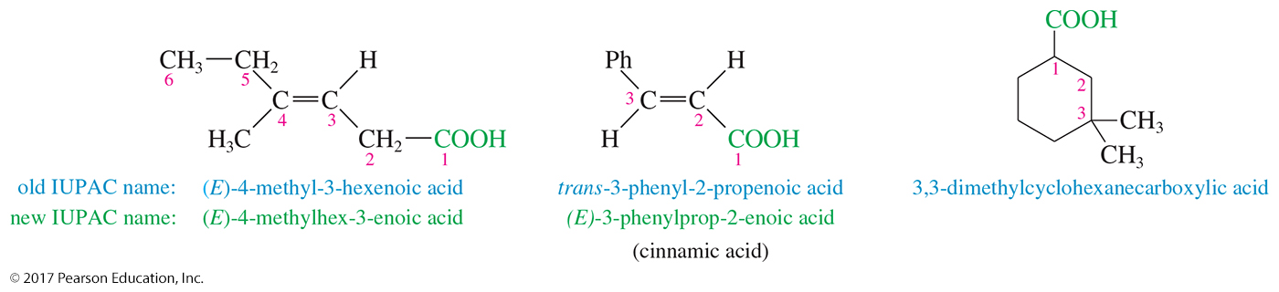
Unsaturated Acids
Remove the final -e from the alkene name, and add the ending -oic acid.
Start numbering at the carboxyl group and the location of the double bond is given.
Stereochemistry is specified (E or Z).

Slide 7
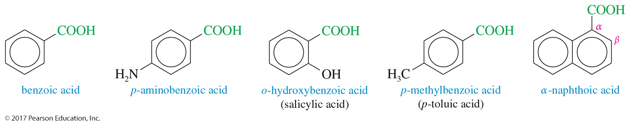
Aromatic Acids
Aromatic acids are named as derivatives of benzoic acid.
Ortho-, meta-, and para- prefixes are used to specify the location of a second substituent.
Numbers are used to specify locations when more than two substituents are present.

Slide 8
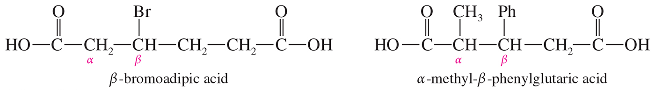
Dicarboxylic Acids
Aliphatic diacids are usually called by their common names using Greek letters beginning with the carbon next to the carboxyl group.
For the IUPAC name, number the chain from the end closest to a substituent.

Slide 9
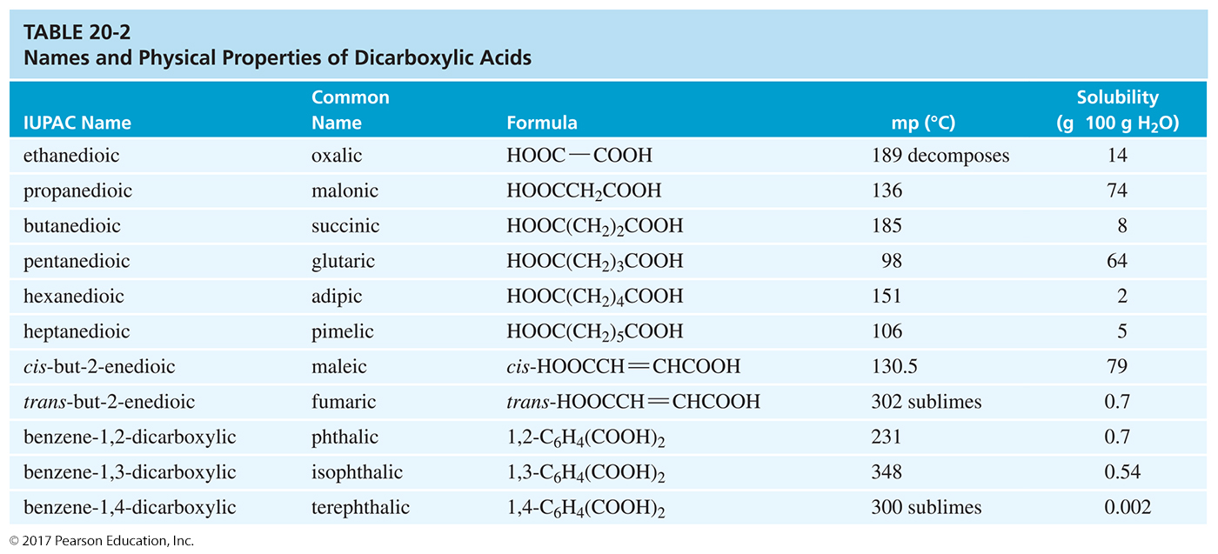

Slide 10
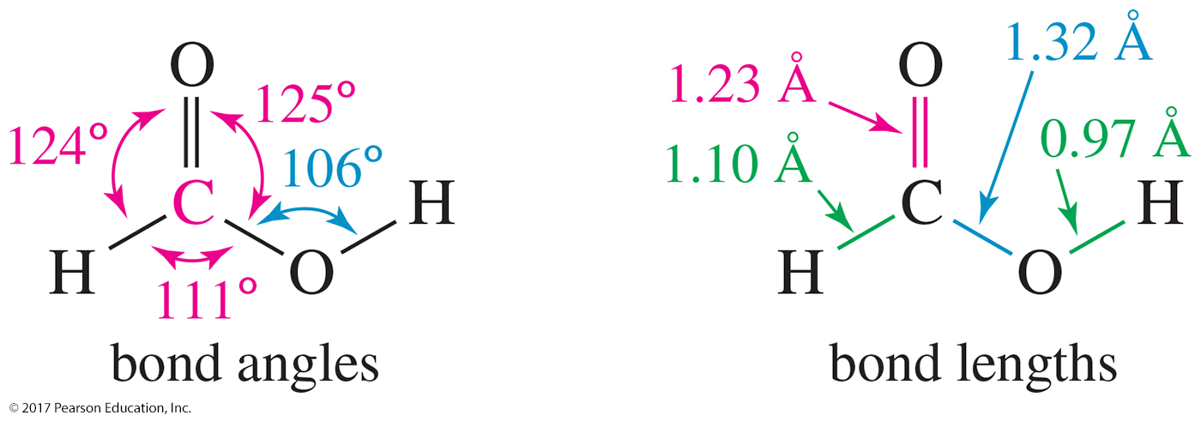
Structure of the Carboxyl Group
The sp² hybrid carbonyl carbon atom is planar, with nearly trigonal bond angles.
The O—H bond also lies in this plane, eclipsed with the C═O bond.
The sp³ oxygen has a C—O—H angle of 106°.

Slide 11
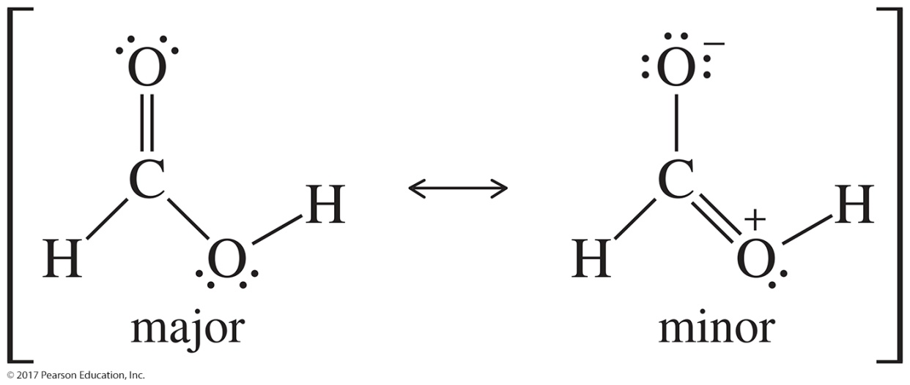
Resonance Structures of Formic Acid
One of the unshared electron pairs on the hydroxyl oxygen atom is delocalized into the electrophilic pi system of the carbonyl group, O—H eclipsed with C═O, to get an overlap of the π orbital with an orbital of a lone pair on oxygen.

Slide 12
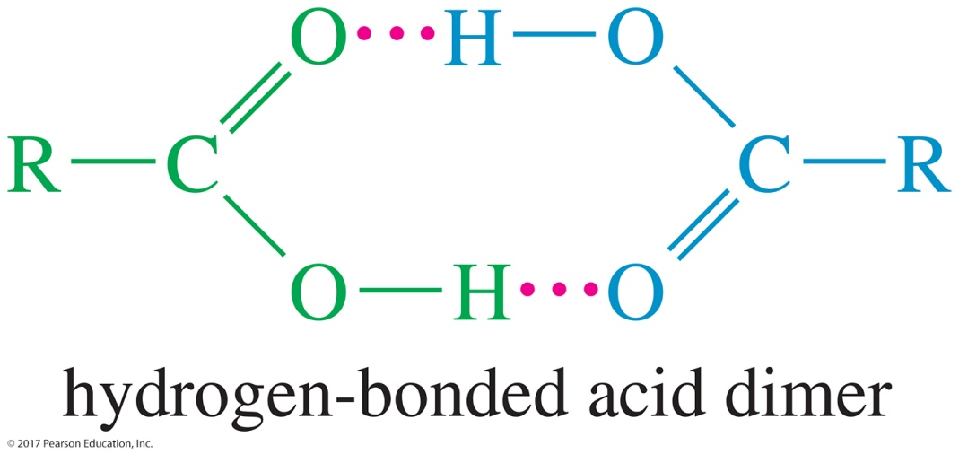
Boiling Points
Carboxylic acids boil at considerably higher temperatures than do alcohols, ketones, or aldehydes of similar molecular weights.
The high boiling points of carboxylic acids result from formation of a stable, hydrogen-bonded dimer.

Slide 13
Melting Points
Aliphatic acids with more than eight carbons are solids at room temperature.
Double bonds (especially cis) lower the melting point. The following acids all have 18 carbons:
  Stearic acid (saturated): 72 °C
  Oleic acid (one cis double bond): 16 °C
  Linoleic acid (two cis double bonds): –5 °C

Slide 14
Solubility
Water solubility decreases with the length of the carbon chain.
Acids with more than 10 carbon atoms are nearly insoluble in water.
They are very soluble in alcohols.
They are also soluble in relatively nonpolar solvents like chloroform because the hydrogen bonds of the dimer are not disrupted by the nonpolar solvent.

Slide 15
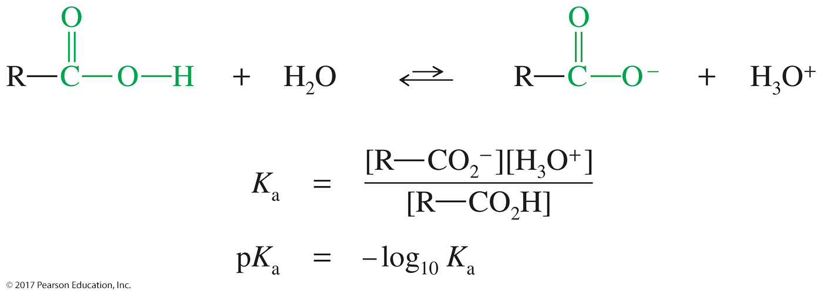
Acidity of Carboxylic Acids
A carboxylic acid may dissociate in water to give a proton and a carboxylate ion.
The equilibrium constant K_{a} for this reaction is called the acid-dissociation constant.
The acid will be mostly dissociated if the pH of the solution is higher than the pK_{a} of the acid.

Slide 16
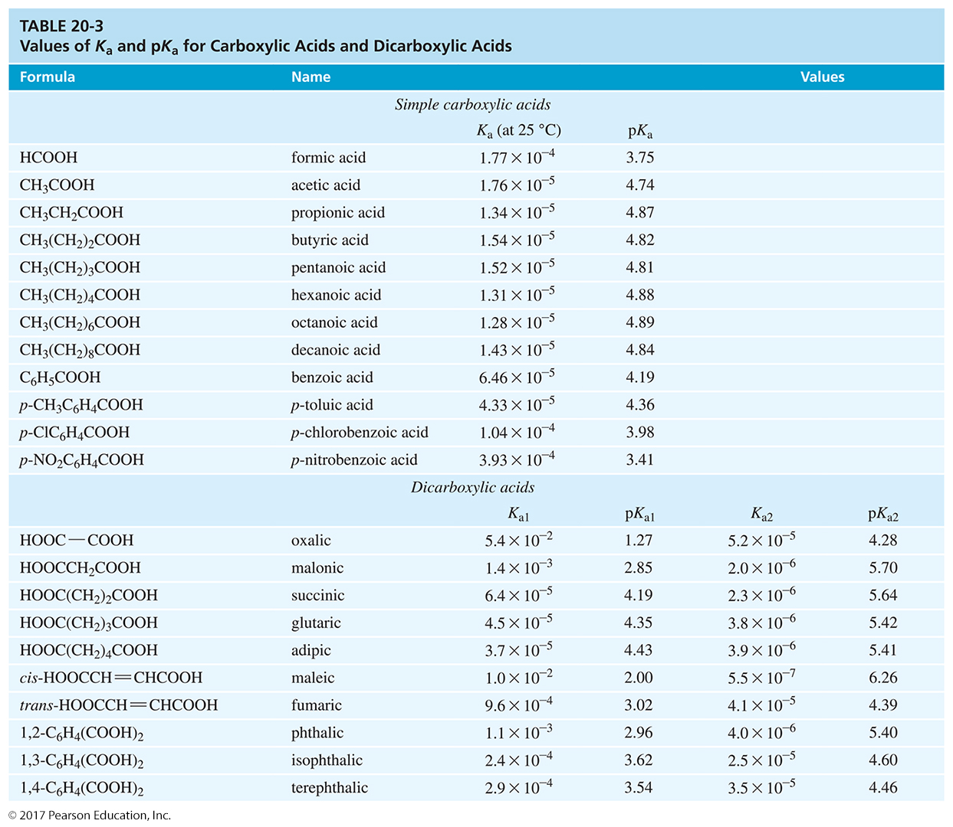

Slide 17
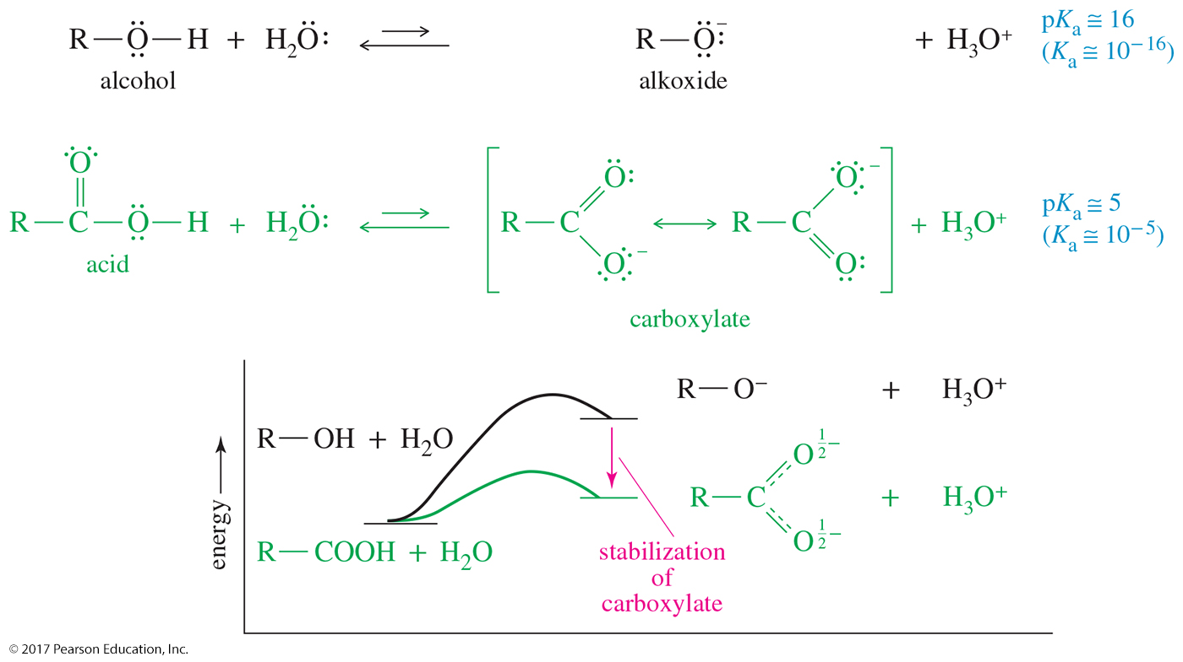
Energy Diagram of Carboxylic Acids and Alcohols

Slide 18
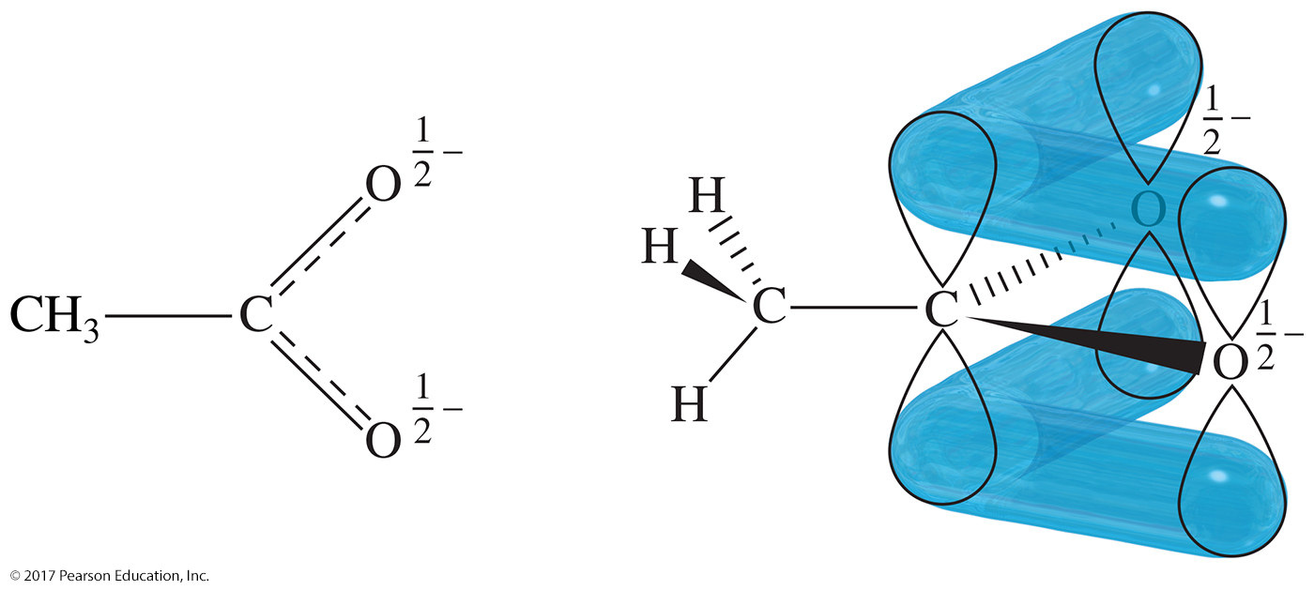
Acetate Ion Structure
Each oxygen atom bears half of the negative charge.
The delocalization of the negative charge over the two oxygens makes the acetate ion more stable than an alkoxide ion.

Slide 19
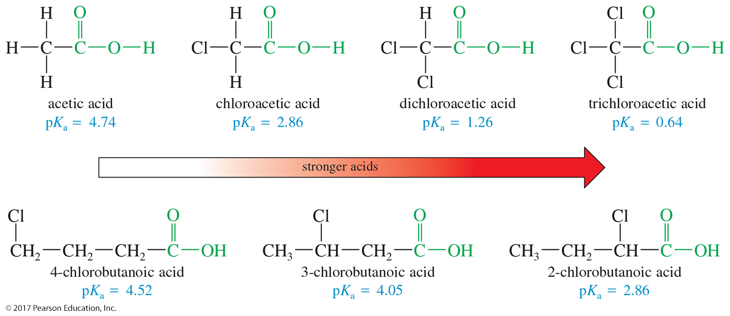
Substituent Effects on Acidity
The magnitude of a substituent effect depends on its distance from the carboxyl group.

Slide 20
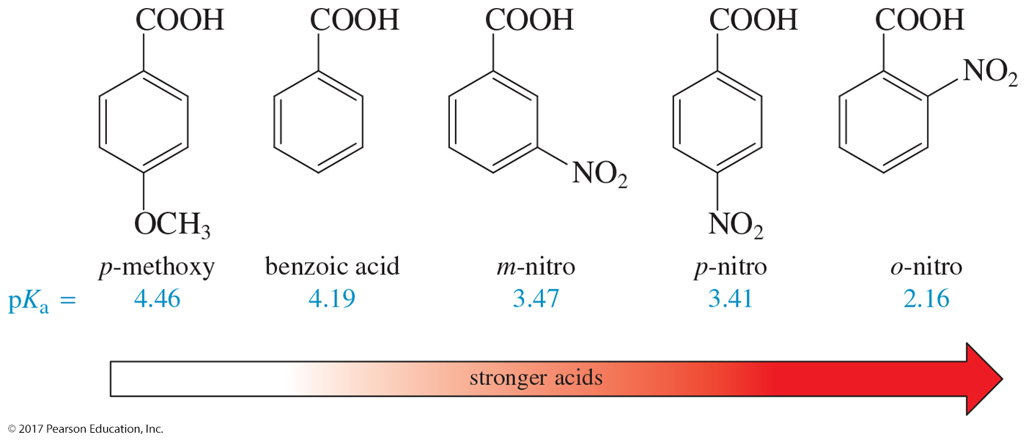
Aromatic Carboxylic Acids
Electron-withdrawing groups enhance the acid strength, and electron-donating groups decrease the acid strength.
Effects are strongest for substituents in the ortho and para positions.

Slide 21
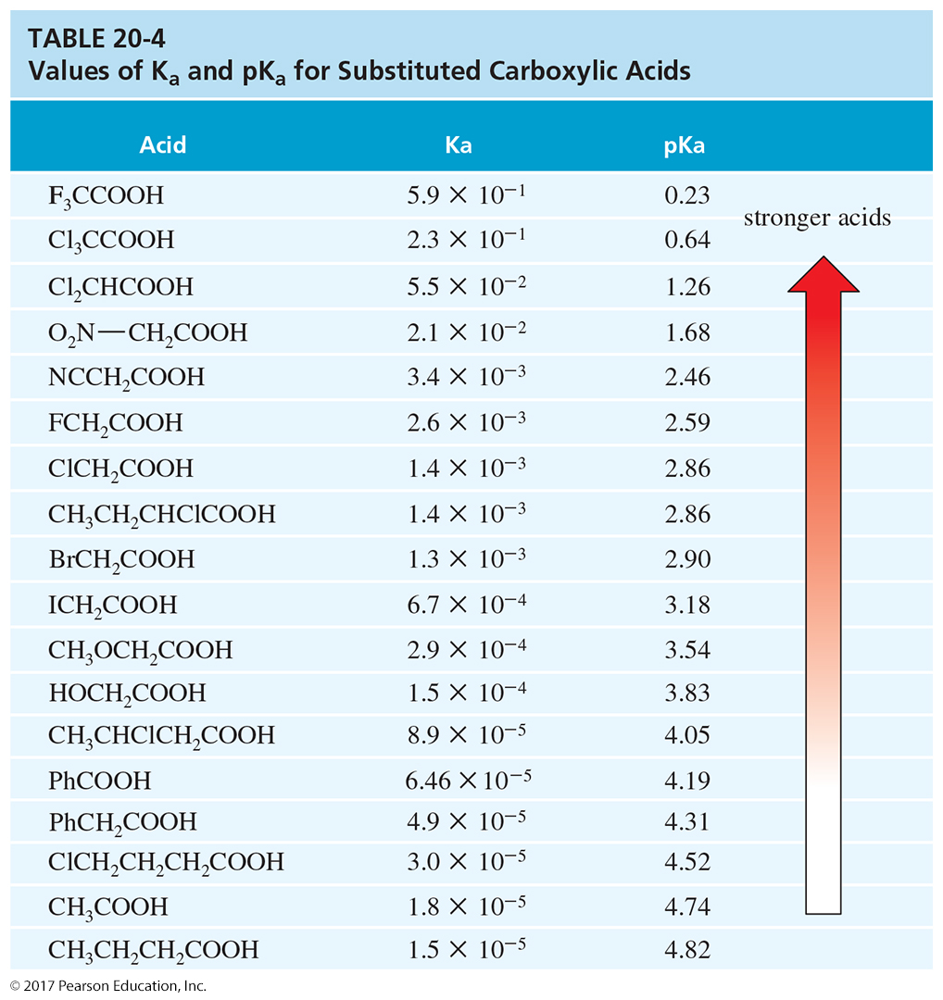

Slide 22
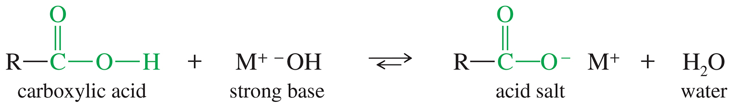
Deprotonation of
Carboxylic Acids
The hydroxide ion completely deprotonates the acid to form the carboxylate salt.

Slide 23
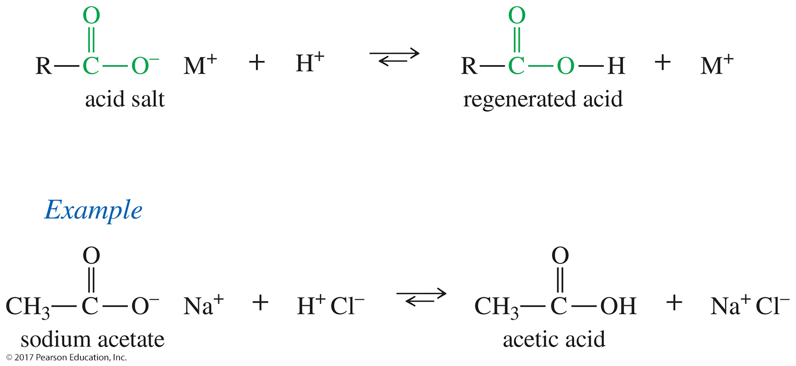
Protonation of Carboxylic Acids
Adding a strong acid, like HCl, regenerates the carboxylic acid.

Slide 24
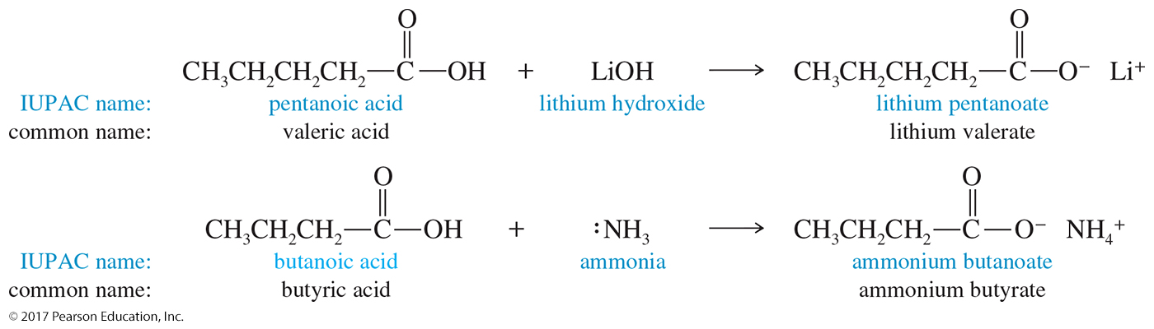
Naming Carboxylic Acid Salts
First name the cation.
Then name the anion by replacing the
-ic acid with -ate.

Slide 25
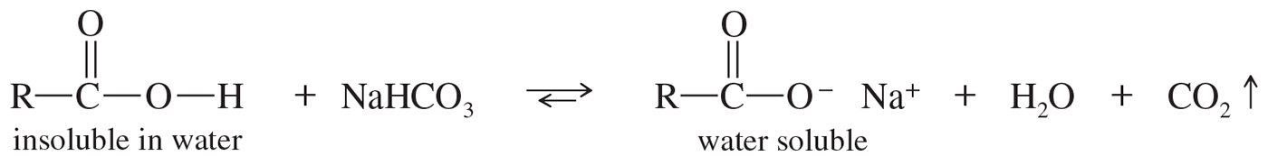
Properties of Acid Salts
Usually solids with no odor
Carboxylate salts of Na⁺, K⁺, Li⁺, and NH₄⁺ are soluble in water.
Soap is the soluble sodium salt of a long-chain fatty acid.
Salts can be formed by the reaction of an acid with NaHCO₃, releasing CO₂.

Slide 26
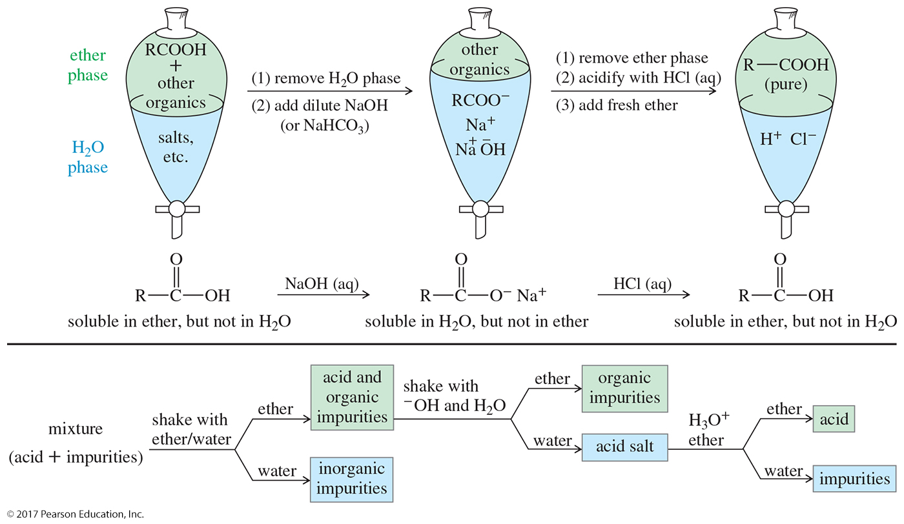
Extraction of Carboxylic Acids
A carboxylic acid is more soluble in the organic phase, but its salt is more soluble in the aqueous phase.
Acid–base extractions can move the acid from the ether phase into the aqueous phase and back into the ether phase, leaving impurities behind.

Slide 27
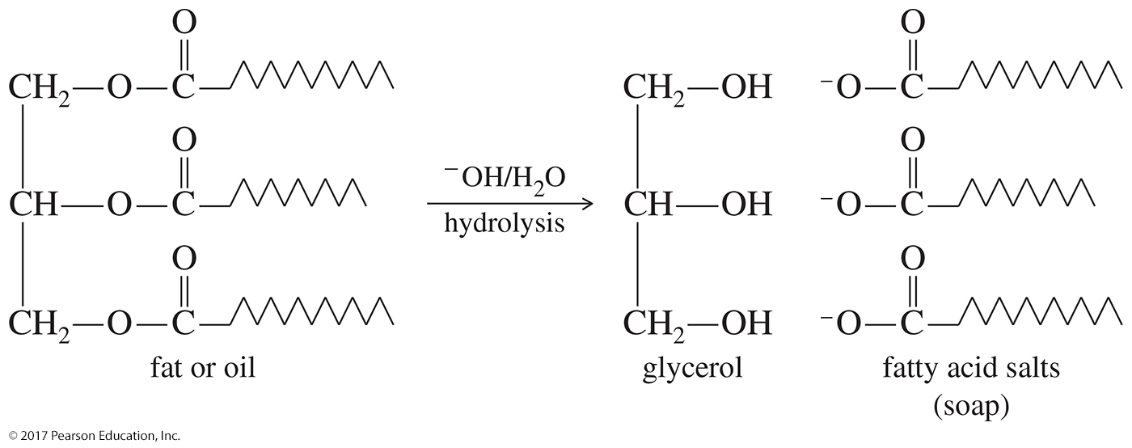
Basic Hydrolysis of
Fats and Oils
The basic hydrolysis of fats and oils produces soap (this reaction is known as saponification).

Slide 28
Some Important Acids
Acetic acid is in vinegar and other foods, and is used industrially as a solvent, catalyst, and reagent for synthesis.
Fatty acids are from fats and oils.
Benzoic acid is found in drugs and preservatives.
Adipic acid is used to make nylon 66.
Phthalic acid is used to make polyesters.

Slide 29
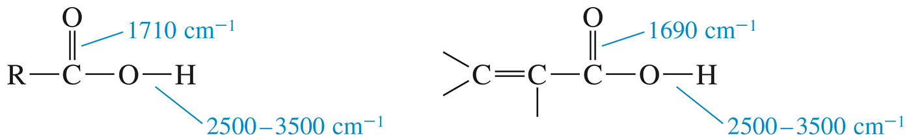
IR Bands of Carboxylic Acids
There will be two features in the IR spectrum of a carboxylic acid: the intense carbonyl stretching absorption (1710 cm^{–1}) and the OH absorption (2500–3500 cm^{–1}).
Conjugation lowers the frequency of the C═O band.

Slide 30
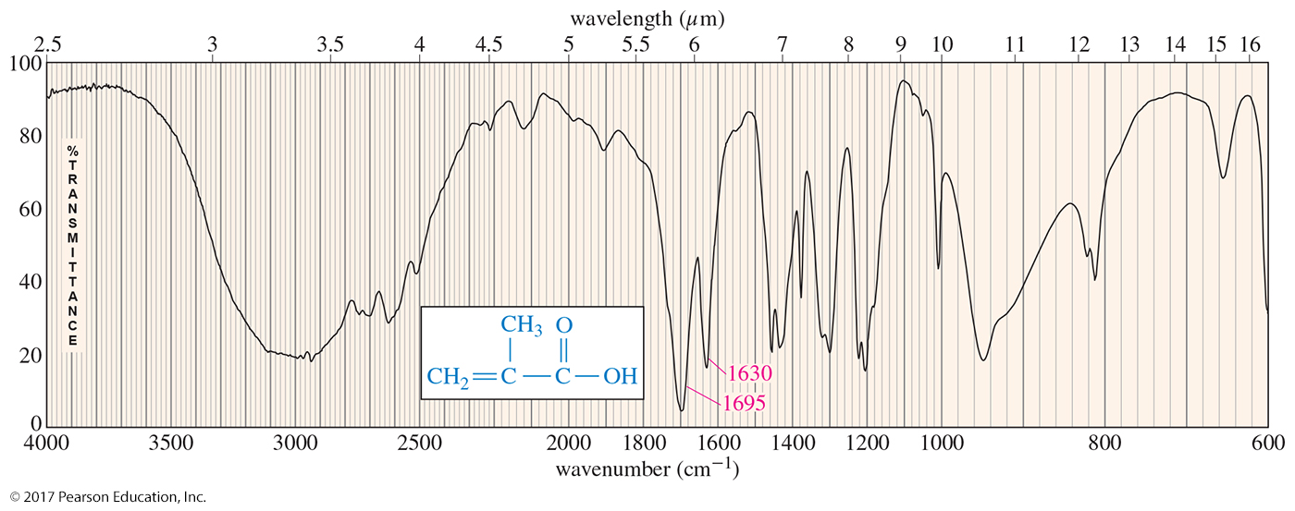
IR Spectroscopy

Slide 31
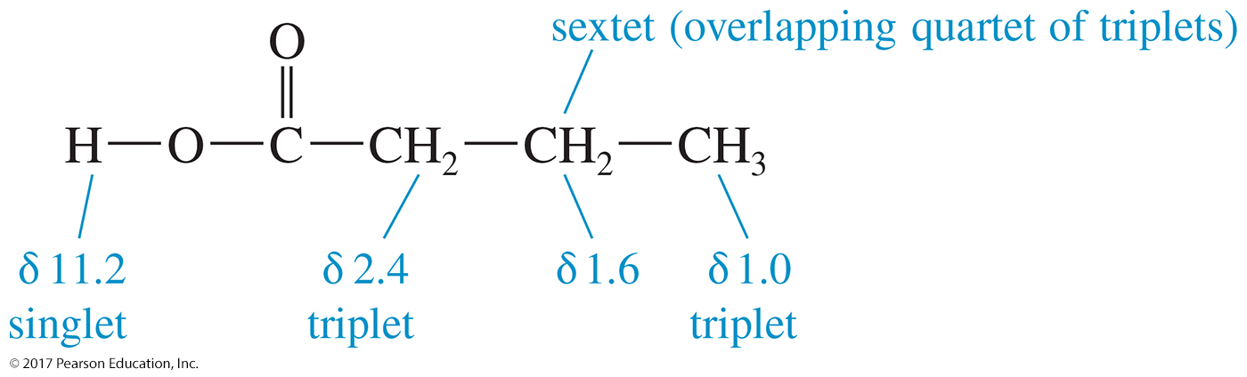
NMR of Carboxylic Acids
Carboxylic acid protons are the most deshielded protons we have encountered, absorbing between δ 10 and δ 13.
The protons on the α carbon atom absorb between
δ 2.0 and δ 2.5.

Slide 32
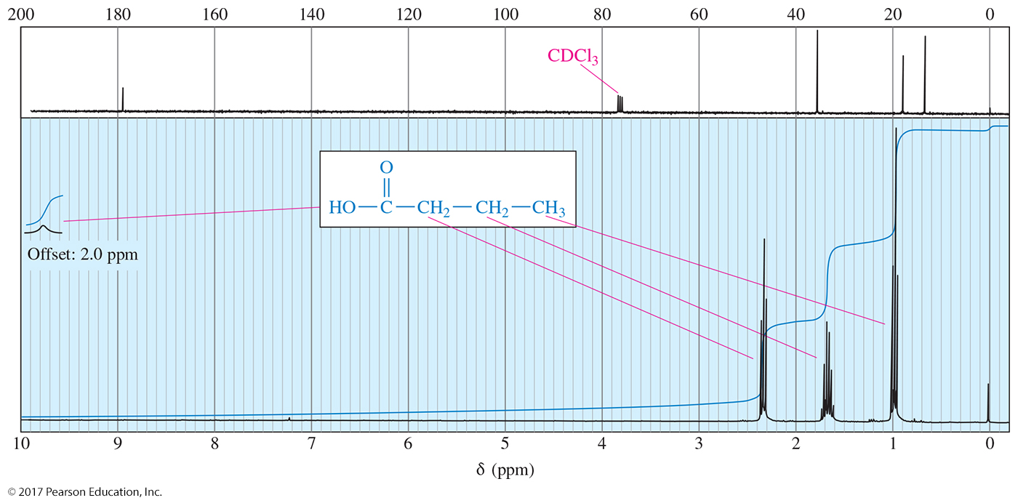
NMR Spectroscopy

Slide 33
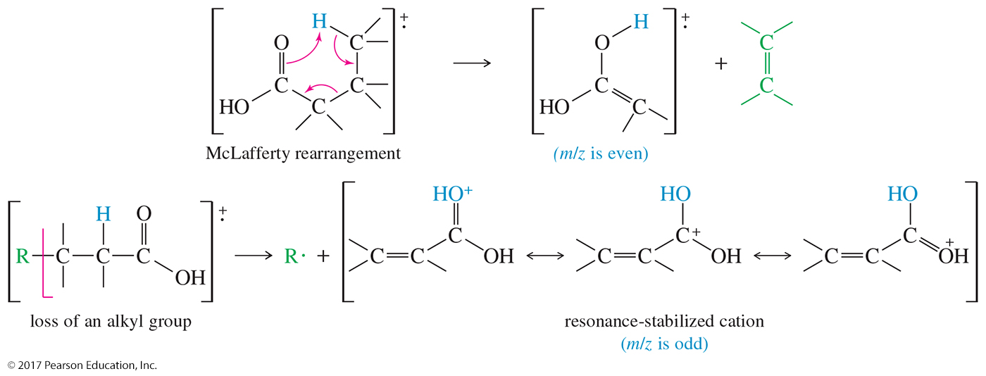
MS of Carboxylic Acids
The most common fragmentation is the loss of an alkene through the McLafferty rearrangement.
Another common fragmentation is cleavage of the
β—γ bond to form an alkyl radical and a resonance-stabilized cation.

Slide 34
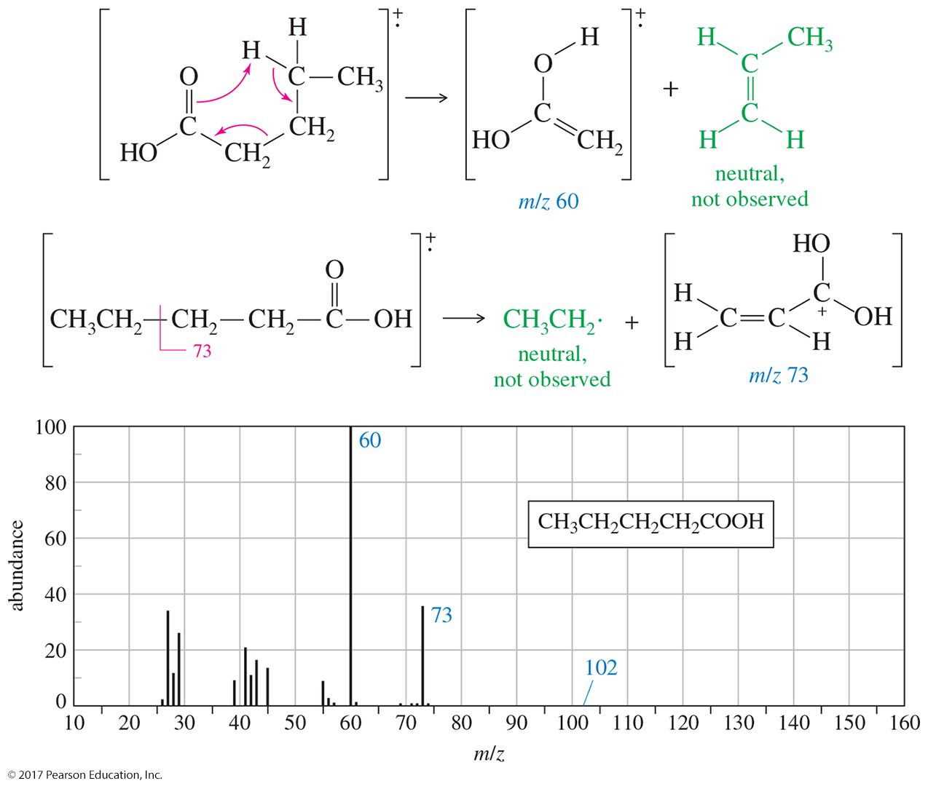
Mass Spectrometry

Slide 35
Synthesis Review
Oxidation of primary alcohols and aldehydes with chromic acid
Cleavage of an alkene with hot KMnO₄ produces a carboxylic acid if there is a vinylic hydrogen present.
Ozonolysis of an alkyne
Alkyl benzenes are oxidized to benzoic acid by hot KMnO₄ or hot chromic acid.

Slide 36
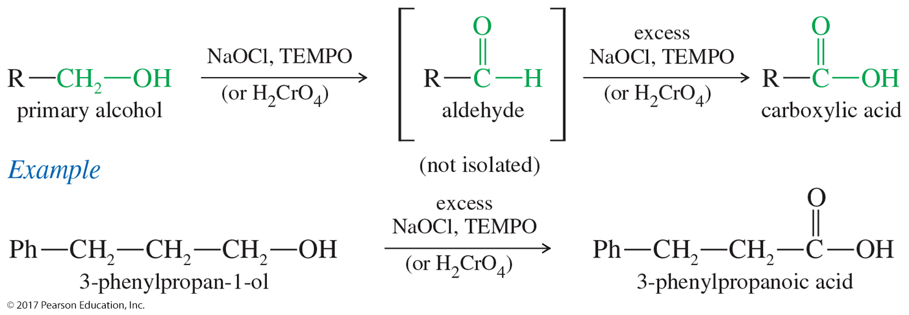
Oxidation of Primary Alcohol to Carboxylic Acids
Primary alcohols and aldehydes are commonly oxidized to acids by chromic acid (H₂CrO₄ formed from Na₂Cr₂O₇ and H₂SO₄).
Potassium permanganate is occasionally used, but the yields are often lower.

Slide 37
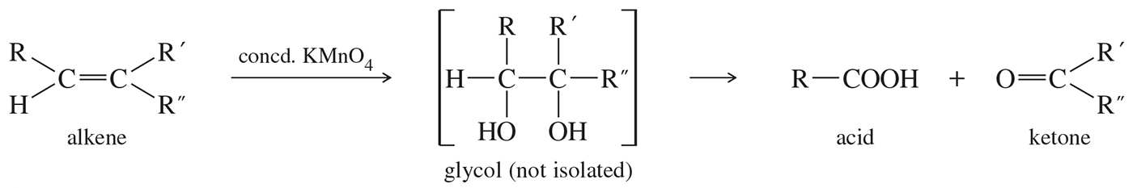
Cleavage of Alkenes
Using KMnO₄
Warm, concentrated permanganate solutions oxidize the glycols, cleaving the central C═C bond.
Depending on the substitution of the original double bond, ketones or acids may result.

Slide 38
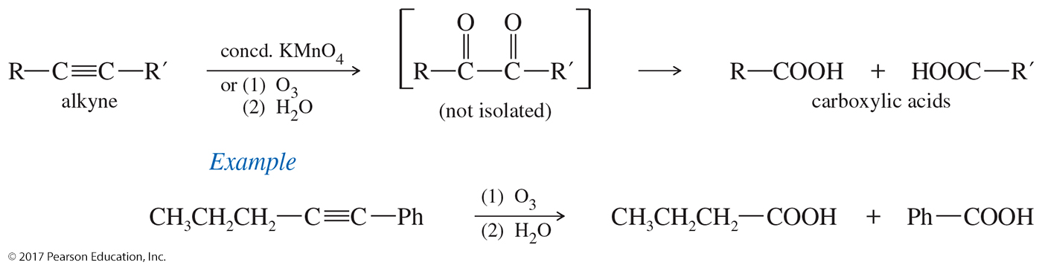
Alkyne Cleavage Using
Ozone or KMnO₄
With alkynes, either ozonolysis or a vigorous permanganate oxidation cleaves the triple bond to give carboxylic acids.

Slide 39
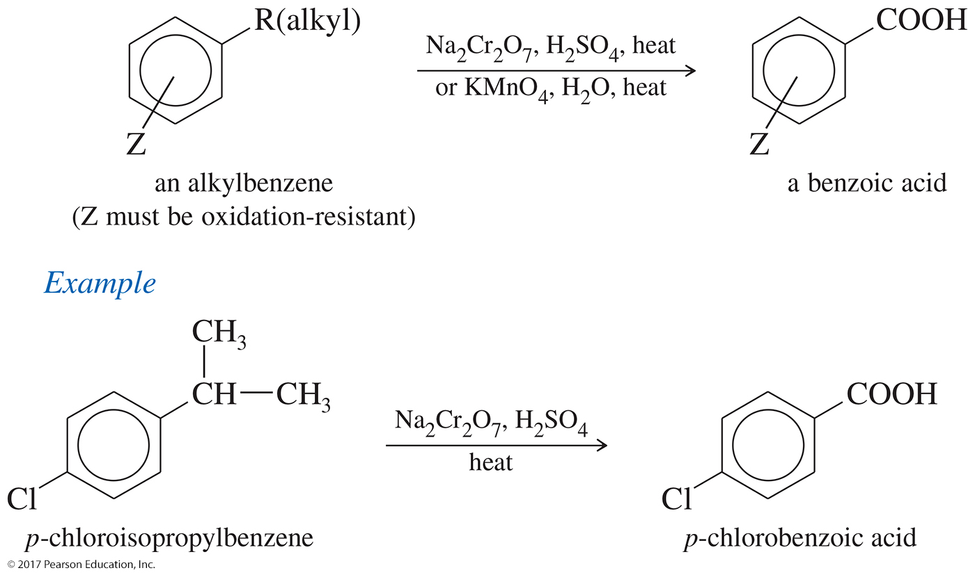
Side-Chain Oxidation of Alkylbenzenes

Slide 40
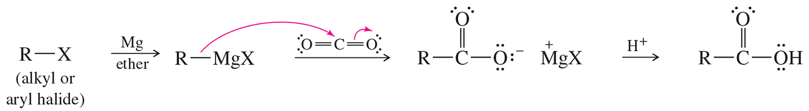
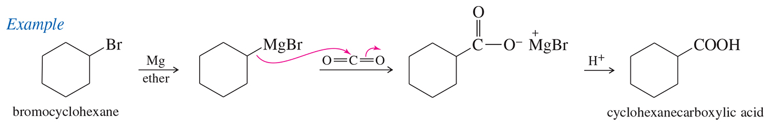
Carboxylation of
Grignard Reagents
Grignard reagents react with CO₂ to produce, after protonation, a carboxylic acid.
This reaction is sometimes called “CO₂ insertion,” and it increases the number of carbons in the molecule by one.

Slide 41
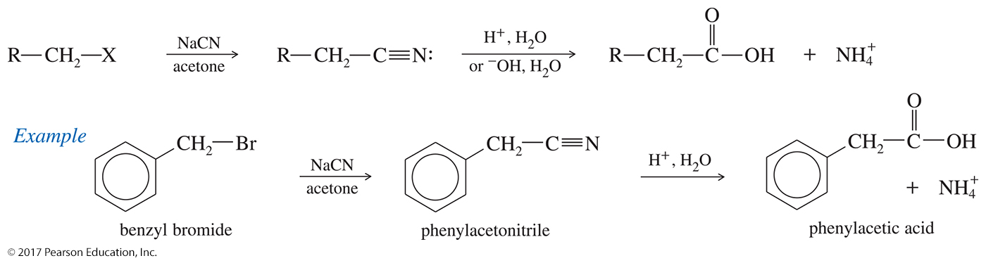
Hydrolysis of Nitriles
Basic or acidic hydrolysis of a nitrile (—CN) produces a carboxylic acid.
The overall reaction, starting from the alkyl halide, adds an extra carbon to the molecule.

Slide 42
Acid Derivatives
The group bonded to the acyl carbon determines the class of compound:
  —OH, carboxylic acid
  —Cl, acid chloride
  —OR′, ester
  —NH₂, amide
These interconvert via nucleophilic acyl substitution.

Slide 43
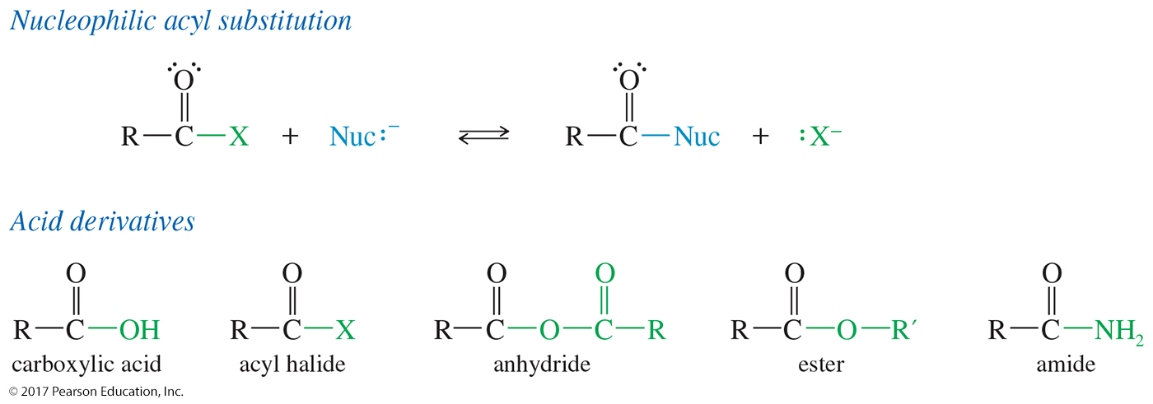
Nucleophilic Acyl Substitution
Carboxylic acids react by nucleophilic acyl substitution, where one nucleophile replaces another on the acyl (C═O) carbon atom.

Slide 44
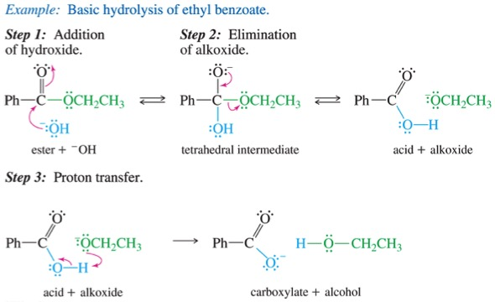
Basic Hydrolysis of an Ester

Slide 45
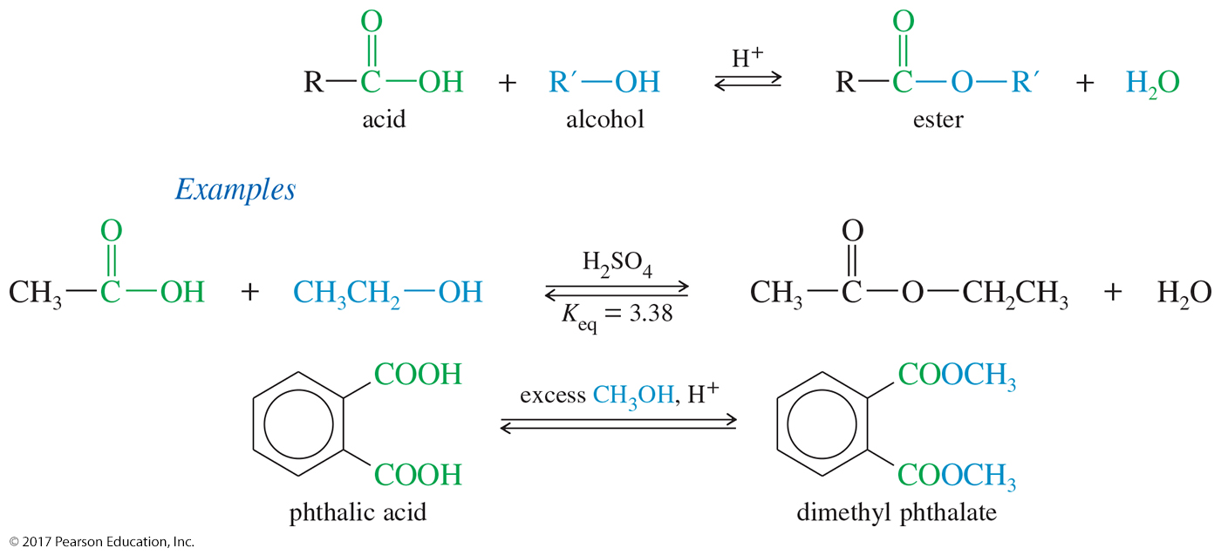
Fischer Esterification
Reaction of a carboxylic acid with an alcohol under acidic conditions produces an ester.
Reaction is an equilibrium; the yield of ester is not high.
To drive the equilibrium toward the formation of products, use a large excess of alcohol.

Slide 46
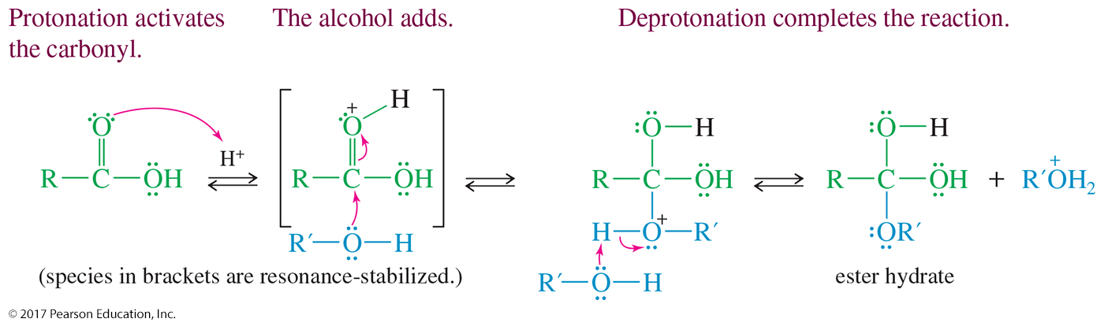
Mechanism of the Fischer Esterification
Step 1:
  The carbonyl oxygen is protonated to activate the carbon toward nucleophilic attack.
  The alcohol attacks the carbonyl carbon.
  Deprotonation of the intermediate produces the ester hydrate.

Slide 47
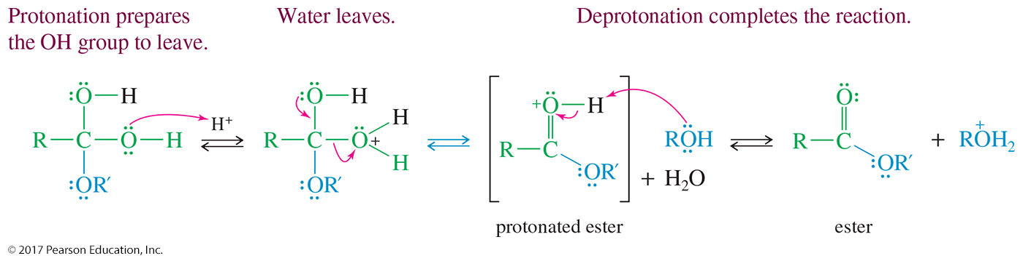
Mechanism of the Fischer Esterification (Continued)
Step 2:
  Protonation of one of the hydroxide groups creates a good leaving group.
  Water leaves.
  Deprotonation of the intermediate produces the ester.

Slide 48
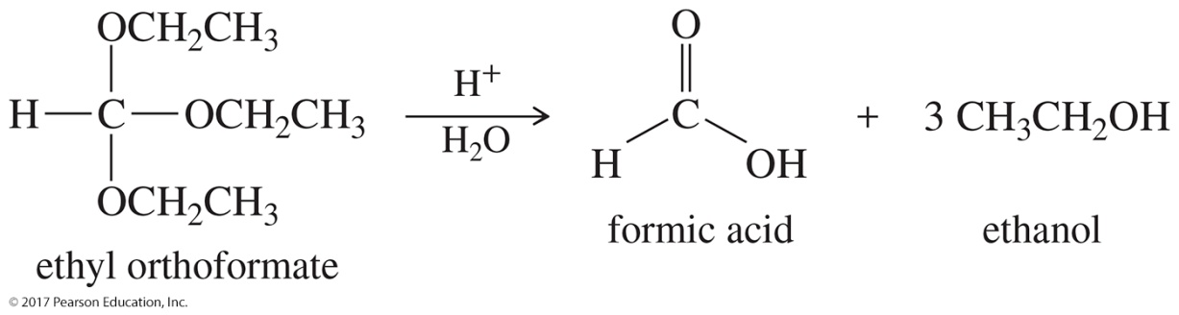
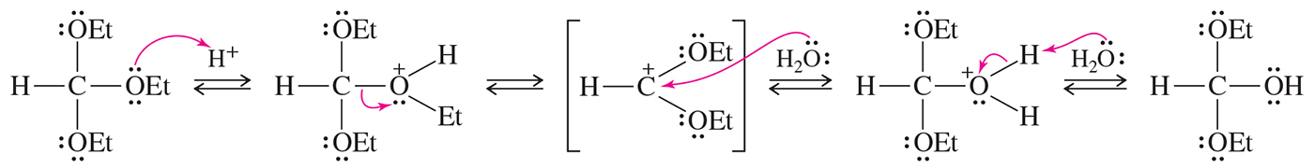
Solved Problem 1
Ethyl orthoformate hydrolyzes easily in dilute acid to give formic acid and three equivalents of ethanol. Propose a mechanism for the hydrolysis of ethyl orthoformate.
Solution
Ethyl orthoformate resembles an acetal with an extra alkoxy group, so this mechanism should resemble the hydrolysis of an acetal (Section 18-18). There are three equivalent basic sites: the three oxygen atoms. Protonation of one of these sites allows ethanol to leave, giving a resonance-stabilized cation. Attack by water gives an intermediate that resembles a hemiacetal with an extra alkoxy group.

Slide 49
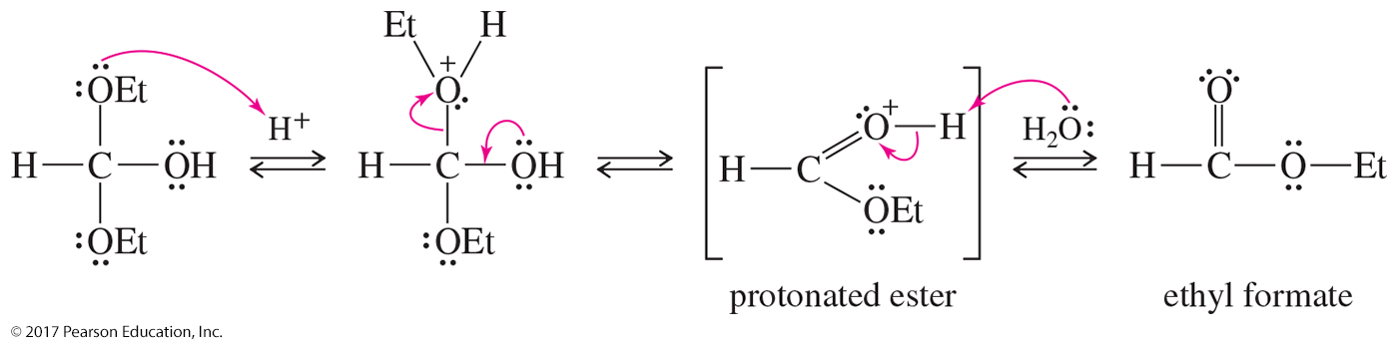
Solved Problem 1 (Continued)
Solution (Continued)
Protonation and loss of a second ethoxyl group give an intermediate that is simply a protonated ester.
Hydrolysis of ethyl formate follows the reverse path of the Fischer esterification. This part of the mechanism is left to you as an exercise.

Slide 50
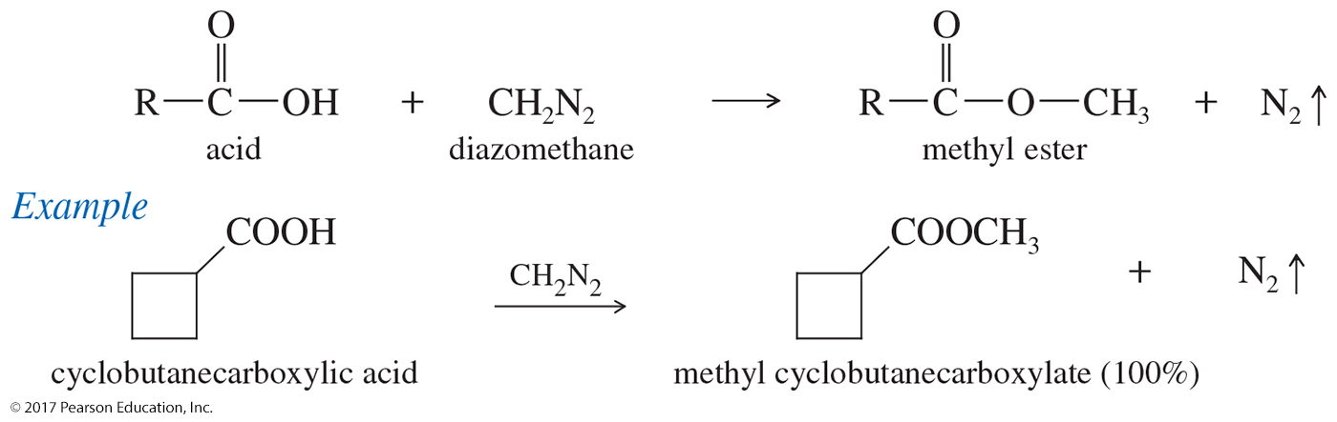
Esterification Using Diazomethane
Carboxylic acids are converted to their methyl esters very simply by adding an ether solution of diazomethane.
The reaction usually produces quantitative yields of ester.
Diazomethane is a very toxic, explosive, yellow gas.

Slide 51
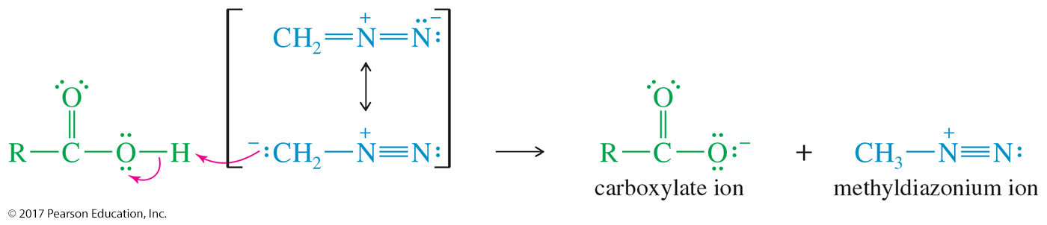
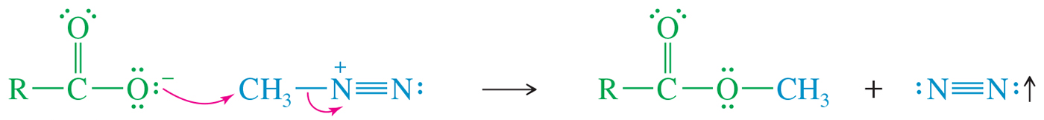
Mechanism of Diazomethane Esterification
Step 1: Proton transfer, forming a carboxylate ion and a methyldiazonium ion.
Step 2: Nucleophilic attack on the methyl group displaces nitrogen.

Slide 52
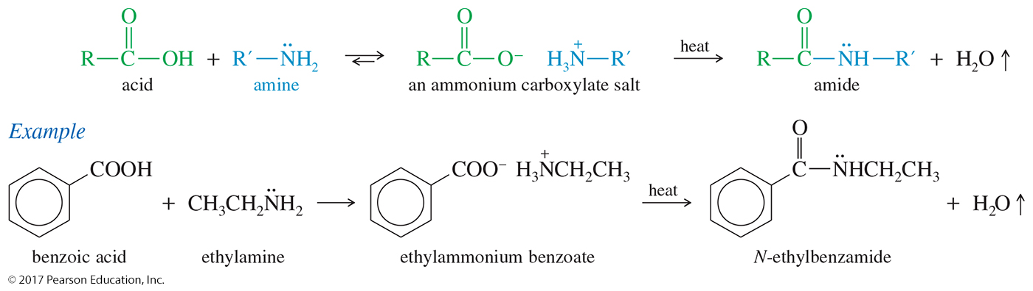
Synthesis of Amides
The initial reaction of a carboxylic acid with an amine gives an ammonium carboxylate salt.
Heating this salt to well above 100 °C drives off steam and forms an amide.

Slide 53
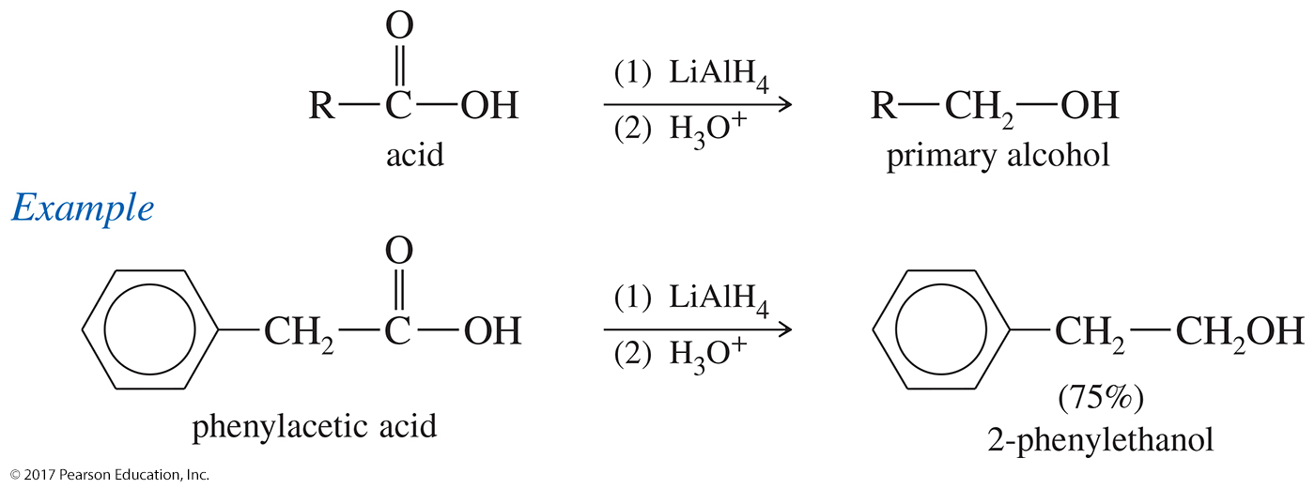
LiAlH₄ or BH₃ Reduction of Carboxylic Acids
LiAlH₄ reduces carboxylic acids to primary alcohols.
The intermediate aldehyde reacts faster with the reducing agent than the carboxylic acid.
Borane can also reduce the carboxylic acid to the alcohol.

Slide 54

Reduction of Acid Chlorides to Aldehydes
Lithium aluminum tri(tert-butoxy)hydride is a weaker reducing agent than lithium aluminum hydride.
It reduces acid chlorides because they are strongly activated toward nucleophilic addition of a hydride ion.
Under these conditions, the aldehyde reduces more slowly, and it is easily isolated.

Slide 55

Conversion of Carboxylic
Acids to Ketones
A general method of making ketones involves the reaction of a carboxylic acid with two equivalents of an organolithium reagent.

Slide 56

Mechanism of Ketone Formation
The first equivalent of organolithium acts as a base, deprotonating the carboxylic acid.
The second equivalent adds to the carbonyl.
Hydrolysis forms the hydrate of the ketone, which converts to the ketone.

Slide 57

Synthesis of Acid Chlorides
The best reagents for converting carboxylic acids to acid chlorides are thionyl chloride (SOCl₂) and oxalyl chloride (COCl₂).
They form gaseous by-products that do not contaminate the product.

Slide 58


Mechanism of Acid
Chloride Formation
Step 1:
Step 2:
Step 3:

Slide 59

Effective Esterification of a Carboxylic Acid
Esterification of an acyl chloride is more efficient than the Fischer esterification.

Slide 60

Amide Synthesis
Ammonia and amines react with acid chlorides to give amides
NaOH, pyridine, or a second equivalent of amine is used to neutralize the HCl produced in order to prevent protonation of the amine.

