Slide 1
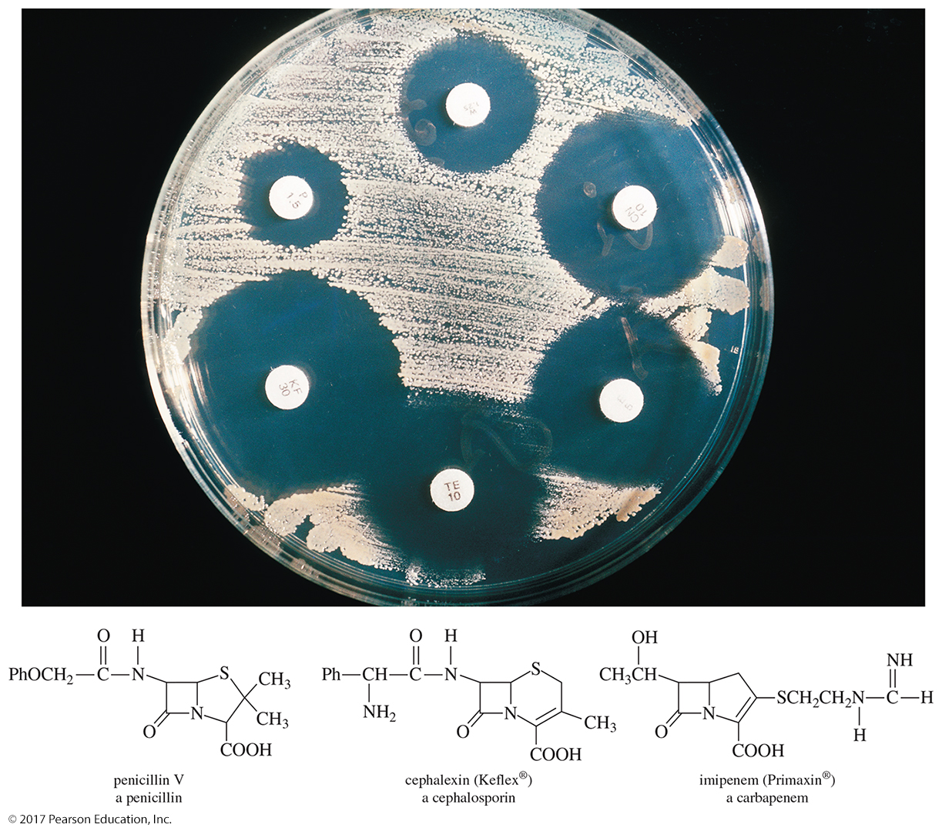
Organic Chemistry,
9th Edition
L. G. Wade, Jr.
Chapter 21
Lecture
Carboxylic Acid Derivatives
Chad Snyder, PhD
Grace College
© 2017 Pearson Education, Inc.

Slide 2
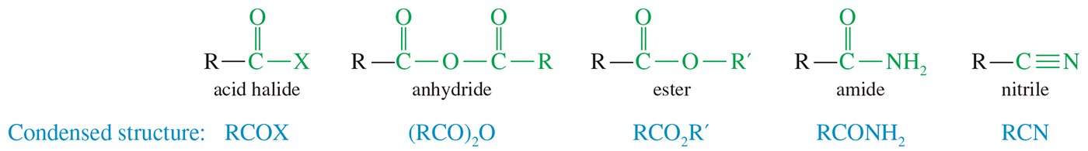
Carboxylic Acid Derivatives
Carboxylic acid derivatives are defined as compounds with functional groups that can be converted to carboxylic acids by a simple acidic or basic hydrolysis.

Slide 3
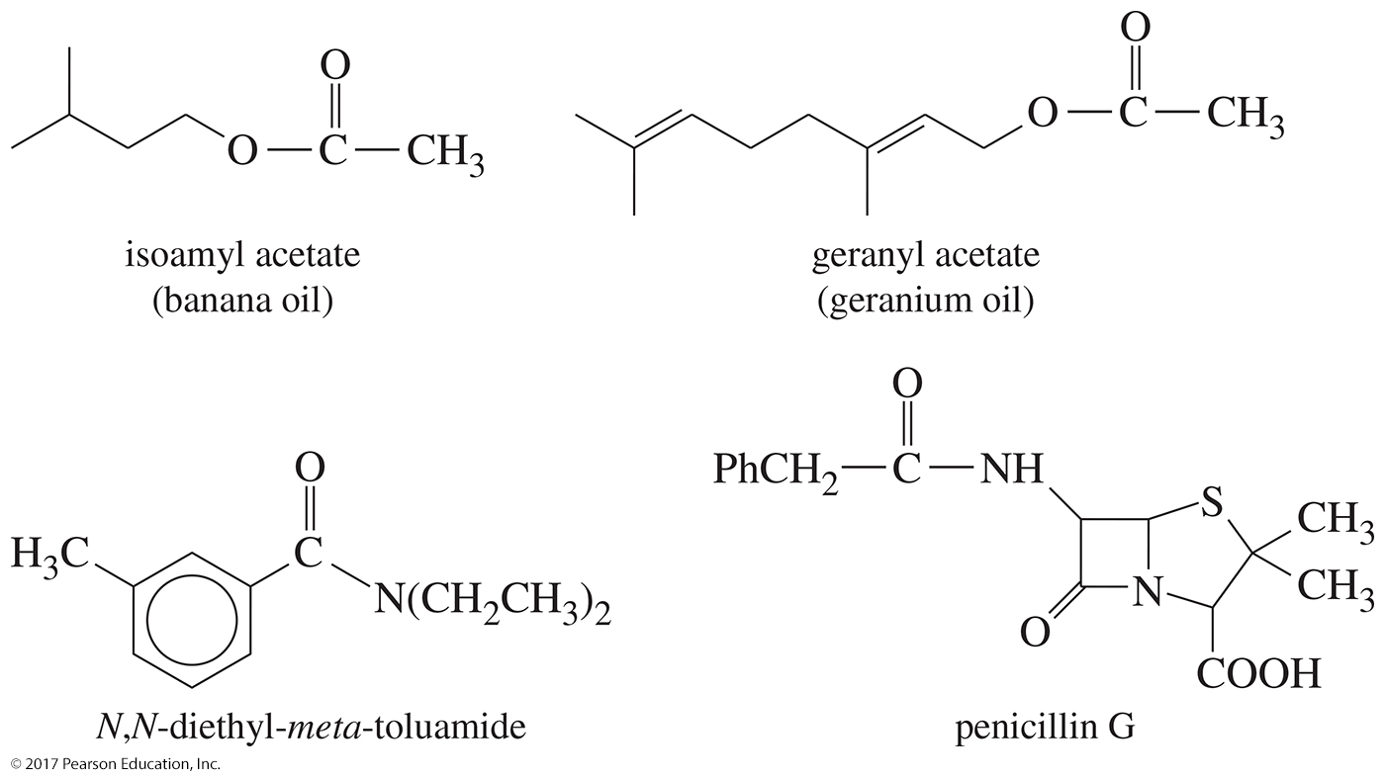
Some Naturally Occurring Esters and Amides

Slide 4
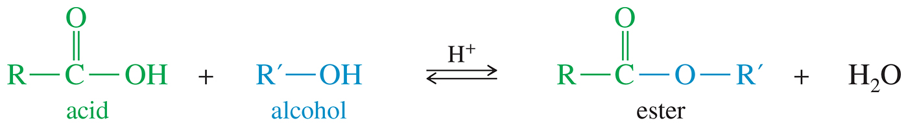
Structures and Nomenclature of Acid Derivatives
Esters are carboxylic acid derivatives in which the hydroxy group (—OH) is replaced by an alkoxy
(—OR).

Slide 5
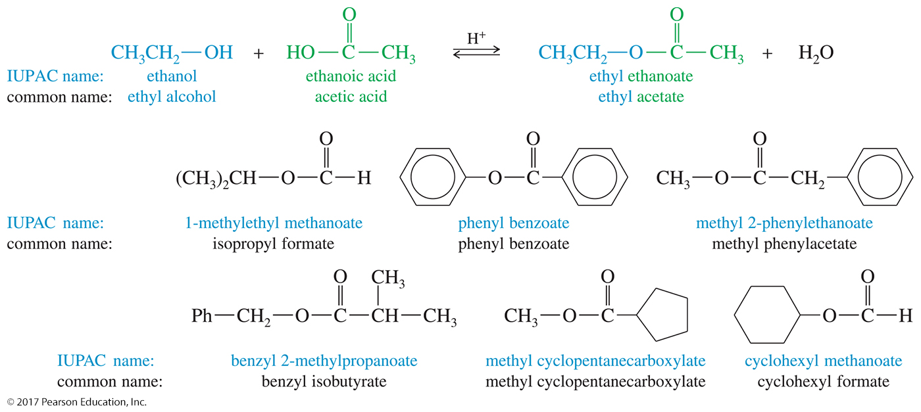
Common and Systematic Names for Some Acids, Alcohols, and Esters

Slide 6
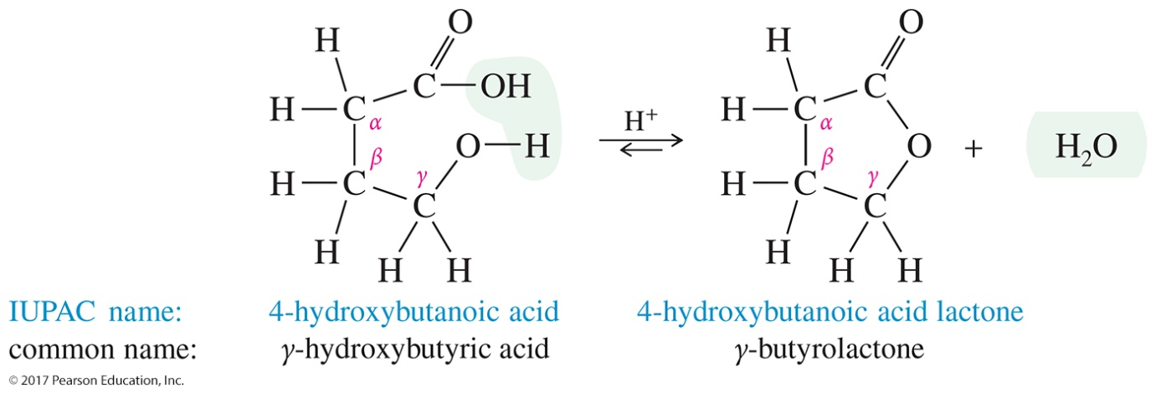
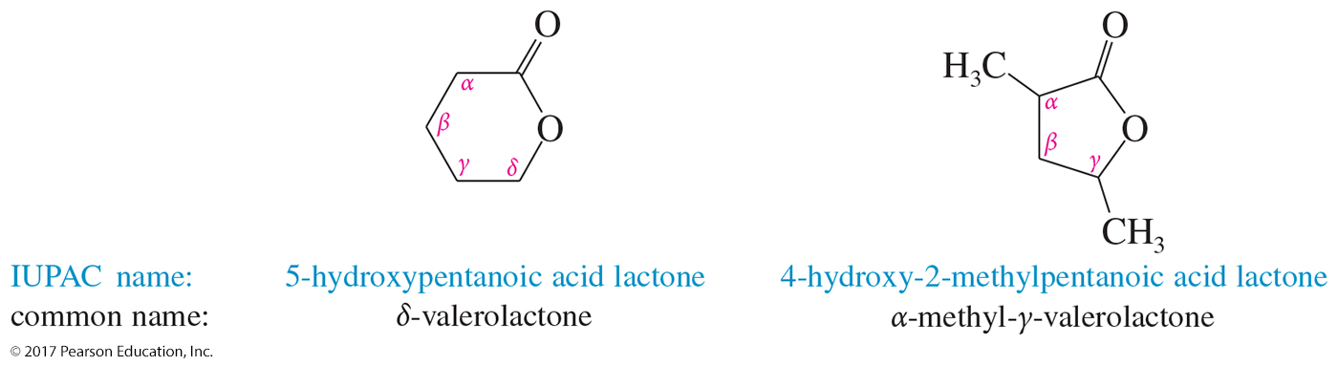
Lactones
Cyclic esters are called lactones.
The IUPAC names of lactones are derived by adding the term lactone at the end of the parent acid.

Slide 7
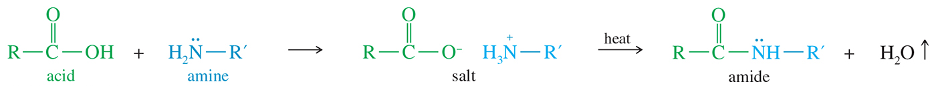
Amides
An amide is a composite of a carboxylic acid and ammonia or an amine.
Ammonium salts are converted to amides at high temperatures.

Slide 8
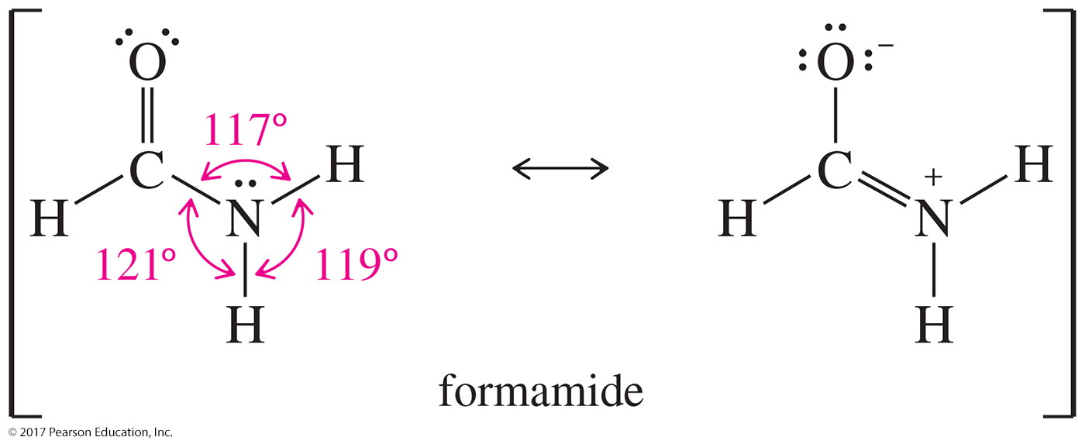
Resonance Representation of Amides

Slide 9
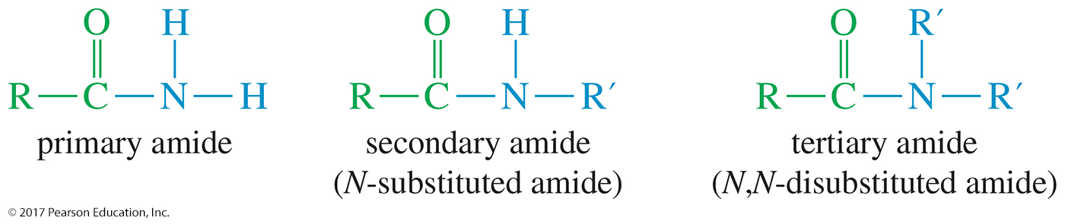
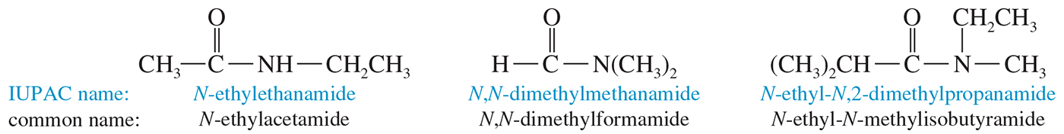
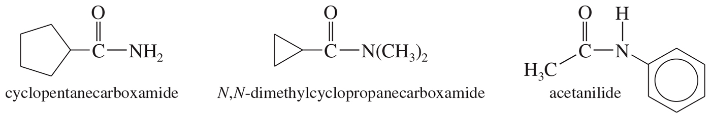
Amide Substitution and Naming

Slide 10
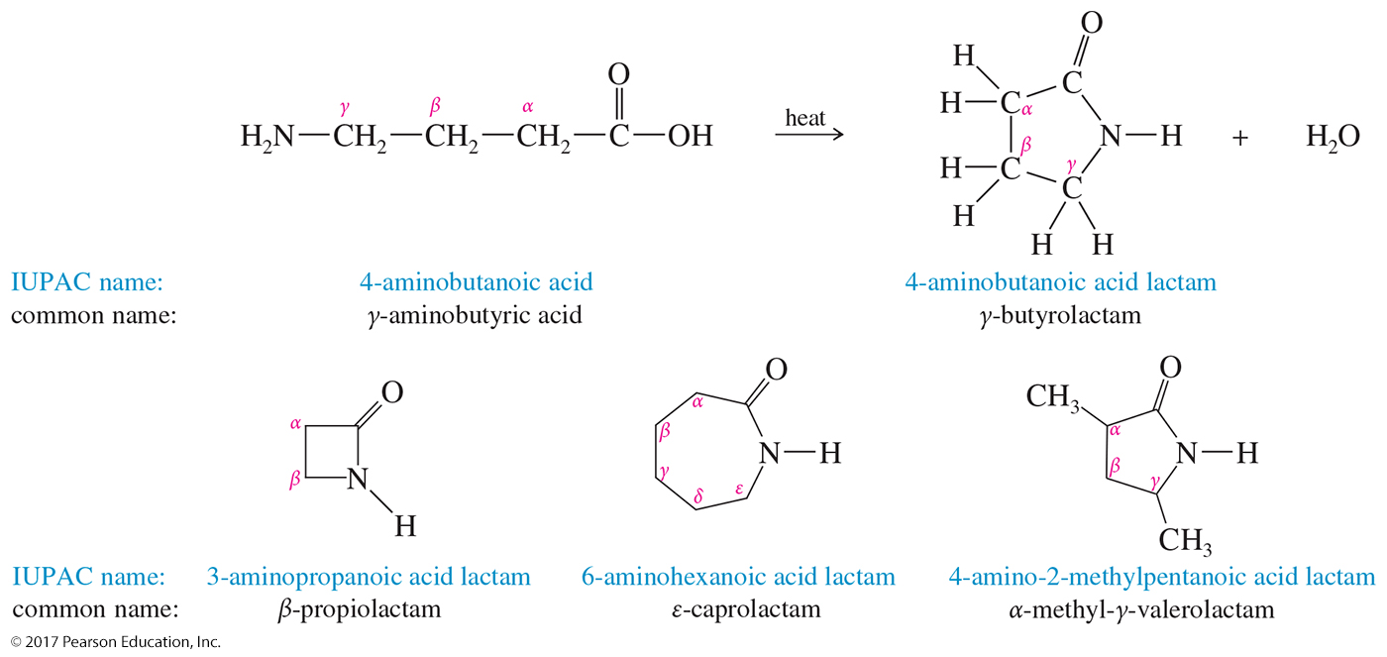
Lactams
Cyclic amides are called lactams.
Lactams are named by adding the term lactam at the end of the IUPAC name of the parent acid.

Slide 11
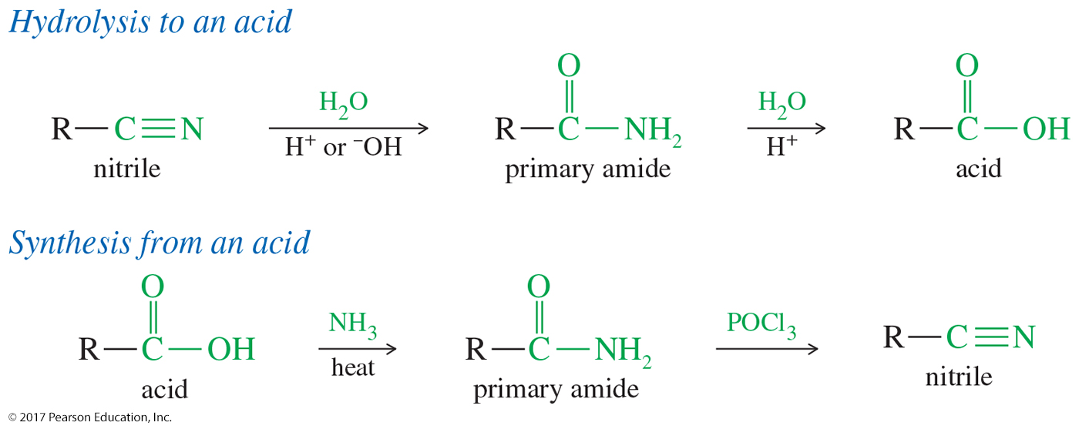
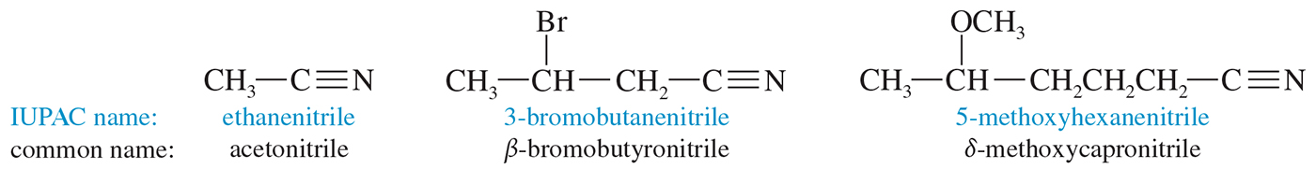
Nitriles
Nitriles contain the cyano group.

Slide 12
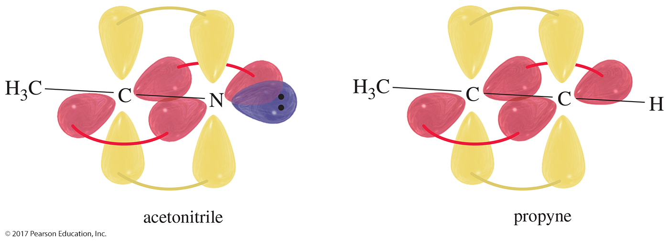
Electronic Structure of Nitriles
The atoms at the ends of the triple bonds are sp hybridized, and the bond angle is 180°.

Slide 13
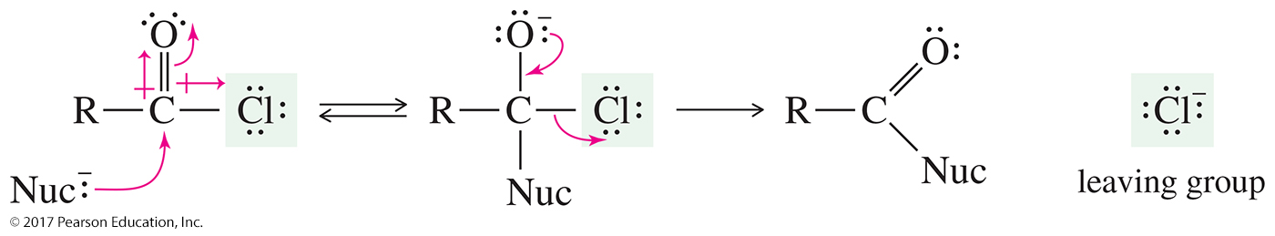
Acid Halides
Acid halides are also called acyl halides.
Acid halides are activated derivatives used in the synthesis of other acyl compounds such as an ester.

Slide 14
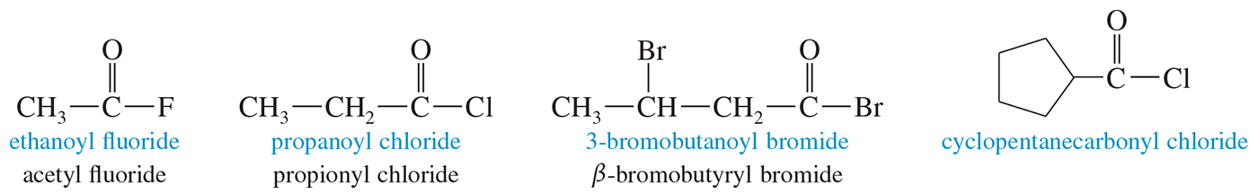
Acid Halides
Acid halides are named by replacing the -ic acid suffix name with -yl and the halide name.

Slide 15
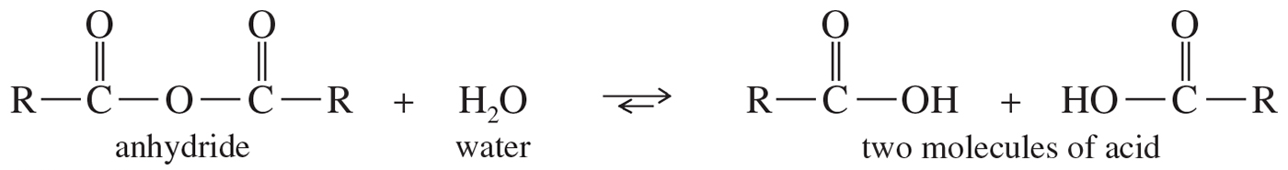
Acid Anhydrides
The word anhydride means “without water.”
An acid anhydride contains two molecules of acid, with loss of a molecule of water.

Slide 16
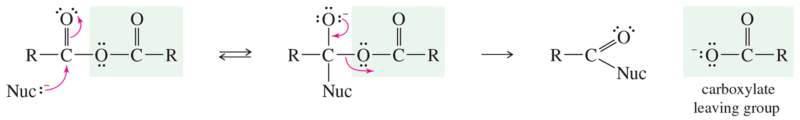
Acid Anhydrides
Acid anhydrides are activated derivatives of carboxylic acids.

Slide 17
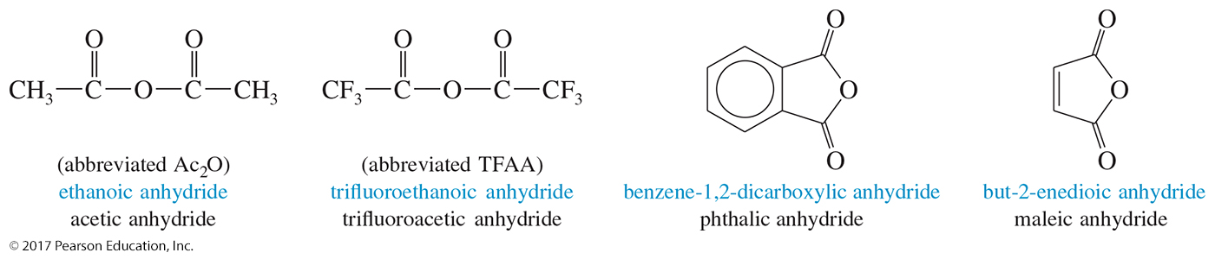
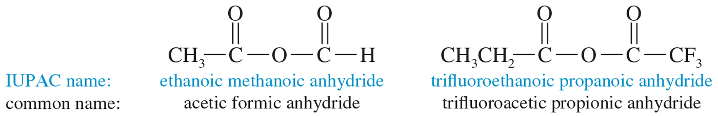
Naming Acid Anhydrides
Acid anhydrides are named by replacing the word acid with anhydride.

Slide 18
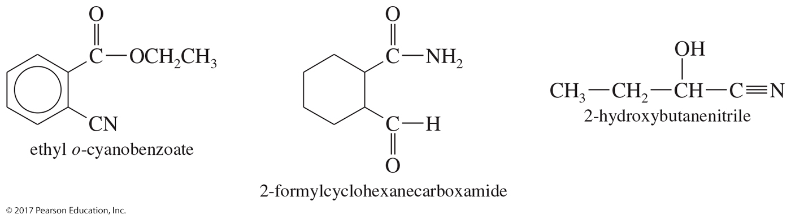
Nomenclature of
Multifunctional Compounds
acid > ester > amide > nitrile > aldehyde > ketone > alcohol > amine > alkene, alkyne

Slide 19
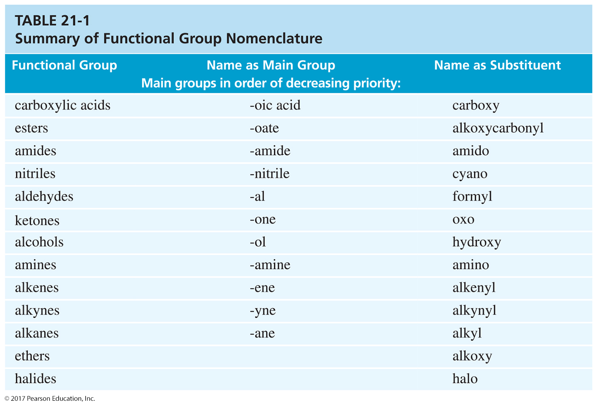

Slide 20
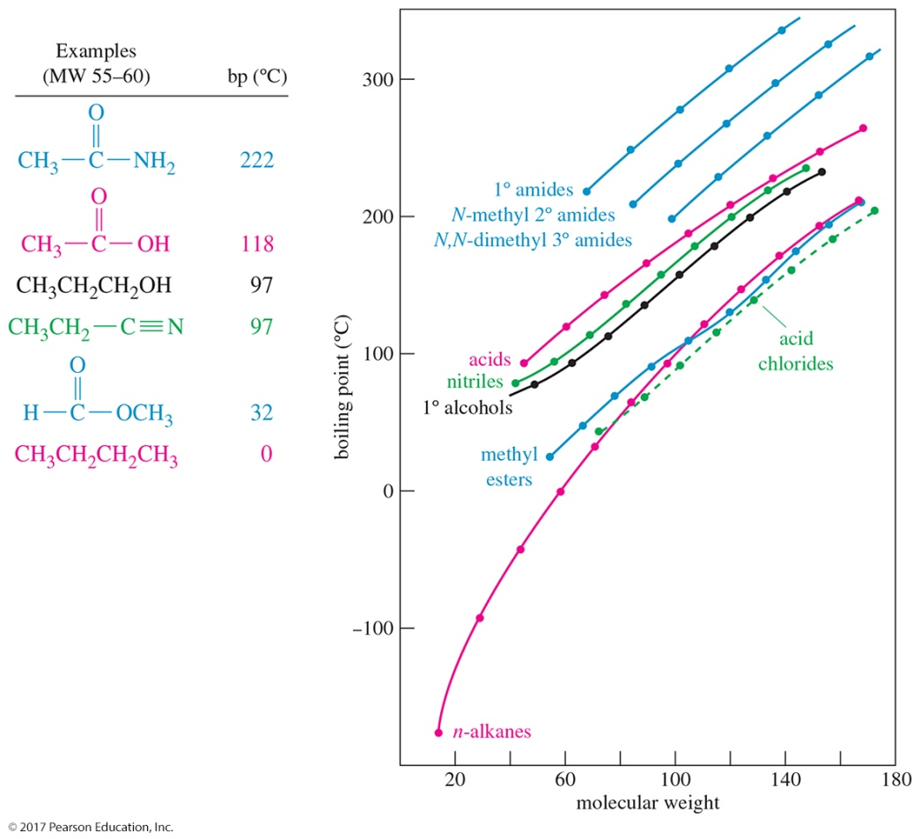
Physical Properties of Carboxylic Acid Derivatives
The physical properties of acid derivatives largely depend on their polarity and their hydrogen-bonding properties.

Slide 21
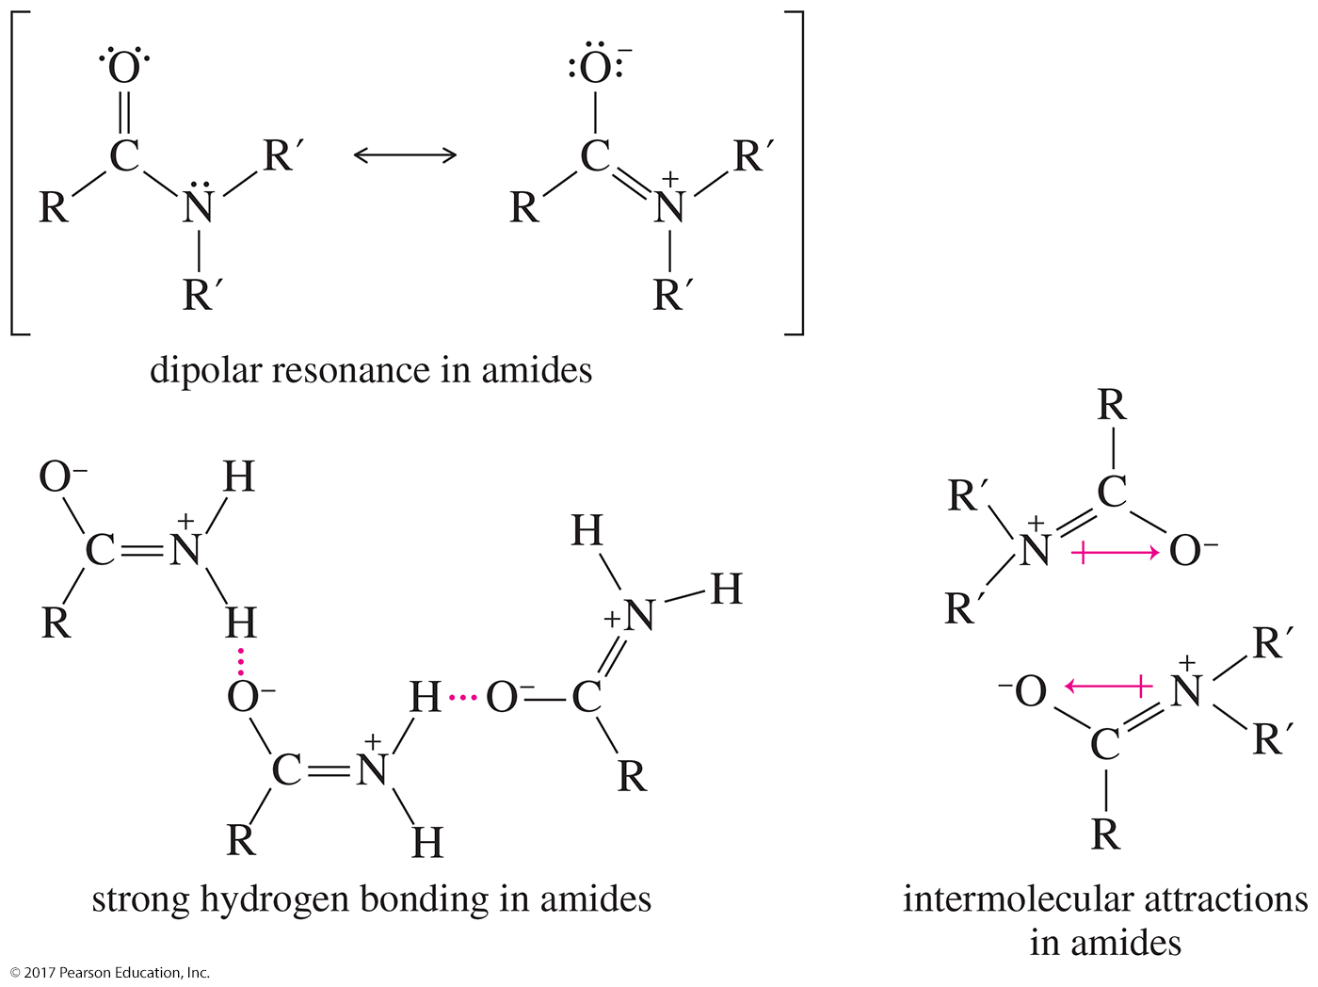
Resonance
The resonance picture of an amide shows its strongly polar nature.

Slide 22
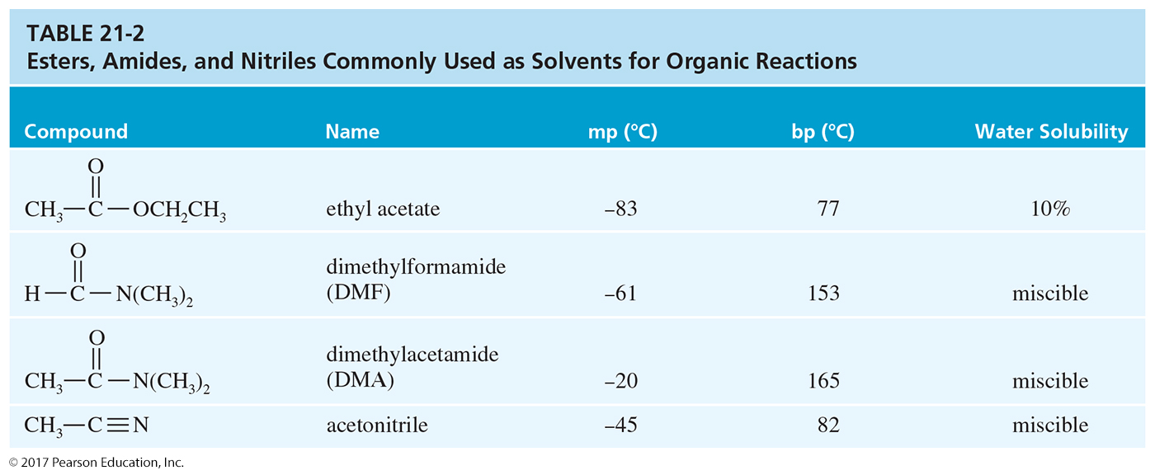
Solubility of Carboxylic
Acid Derivatives
Acid derivatives (esters, acid chlorides, anhydrides, nitriles, and amides) are soluble in common organic solvents.

Slide 23
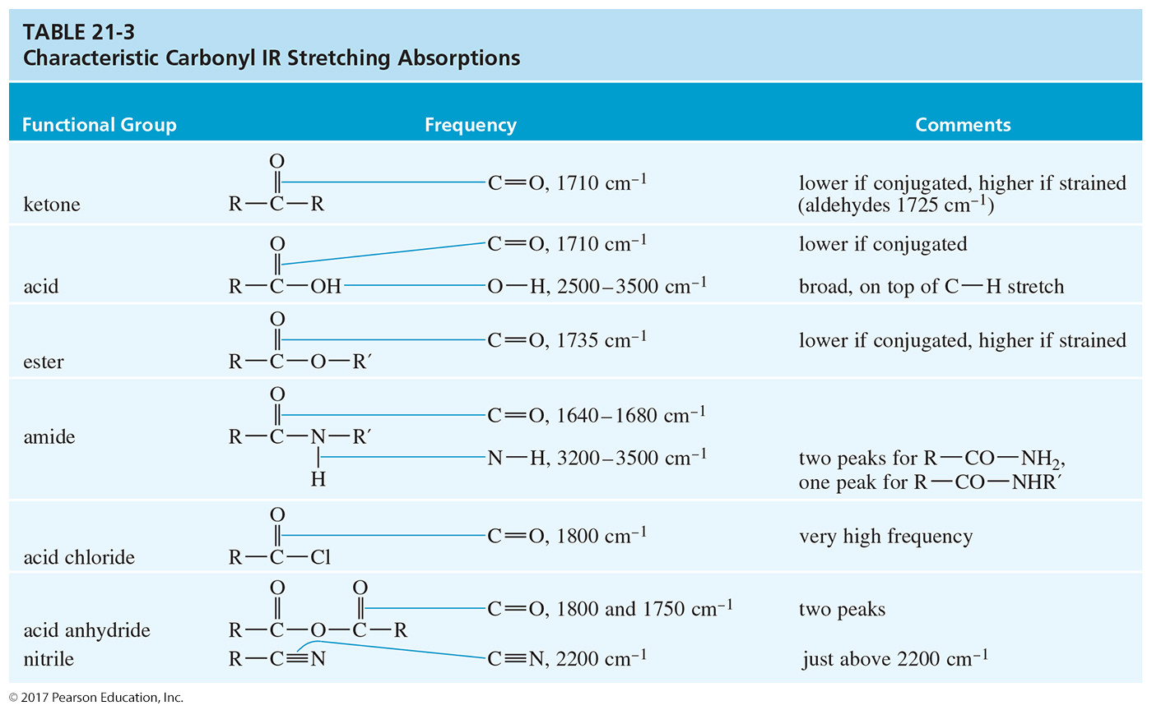
Spectroscopy of Carboxylic
Acid Derivatives

Slide 24
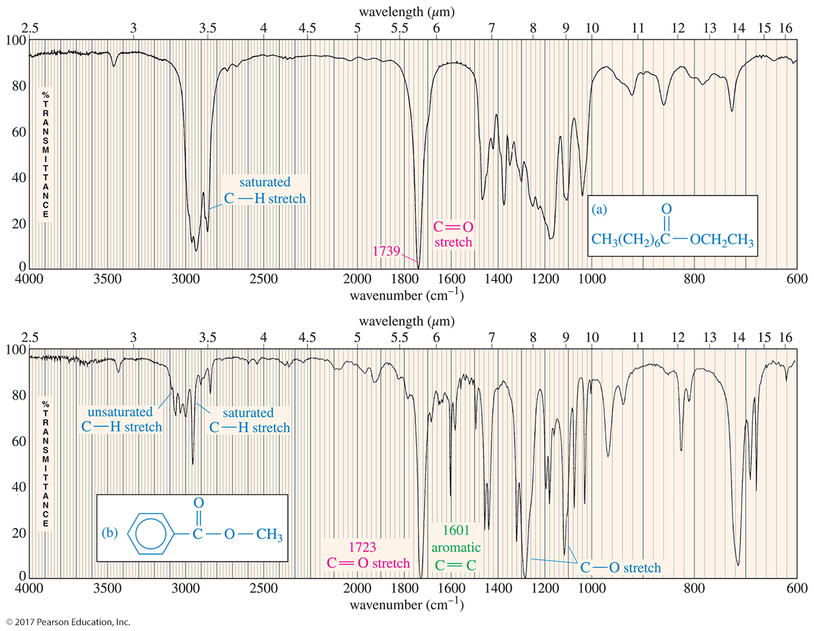

Slide 25
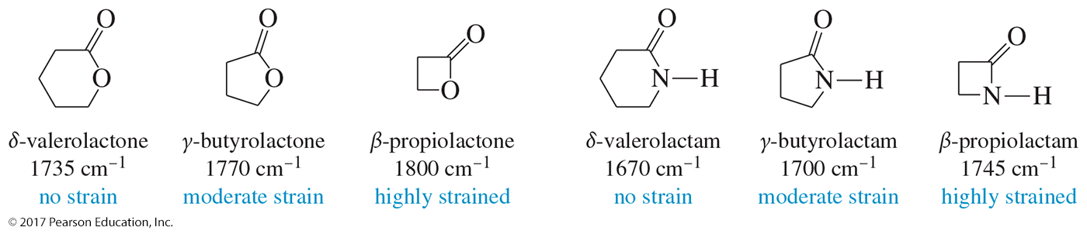
Amides, Lactones, Lactams, Nitriles, Acid Halides, and Anhydrides
Most acid derivatives have C═O stretches between 1700 cm^{–1} and 1800 cm^{–1}.

Slide 26
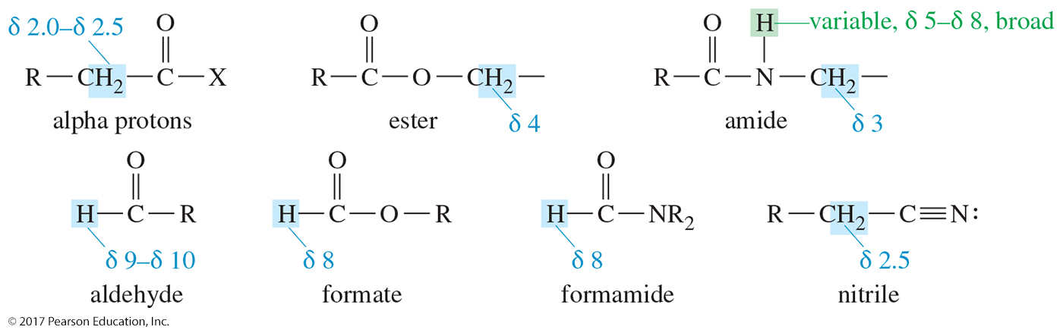
NMR Spectroscopy: ¹H NMR
The proton chemical shifts found in acid derivatives are close to those of similar protons in ketones, aldehydes, alcohols, and amines.

Slide 27
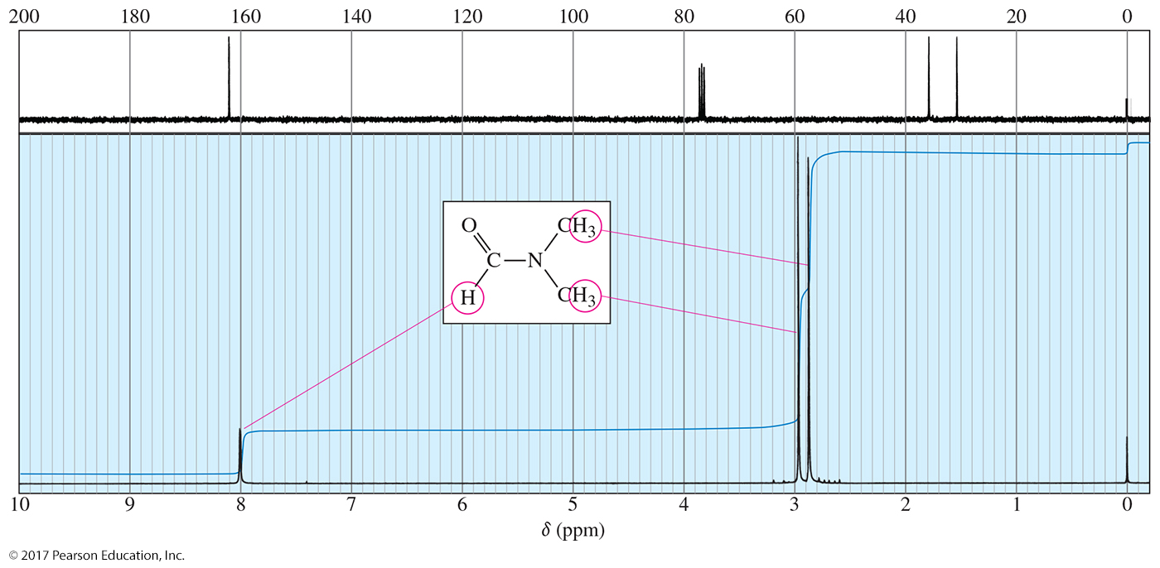
DMF ¹H NMR

Slide 28
Nucleophilic Acyl Substitution
Interconversion of acid derivatives occurs by nucleophilic acyl substitution.
The nucleophile adds to the carbonyl, forming a tetrahedral intermediate.
Elimination of the leaving group regenerates the carbonyl.
This is an addition–elimination mechanism.
Nucleophilic acyl substitutions are also called acyl transfer reactions because they transfer the acyl group to the attacking nucleophile.

Slide 29
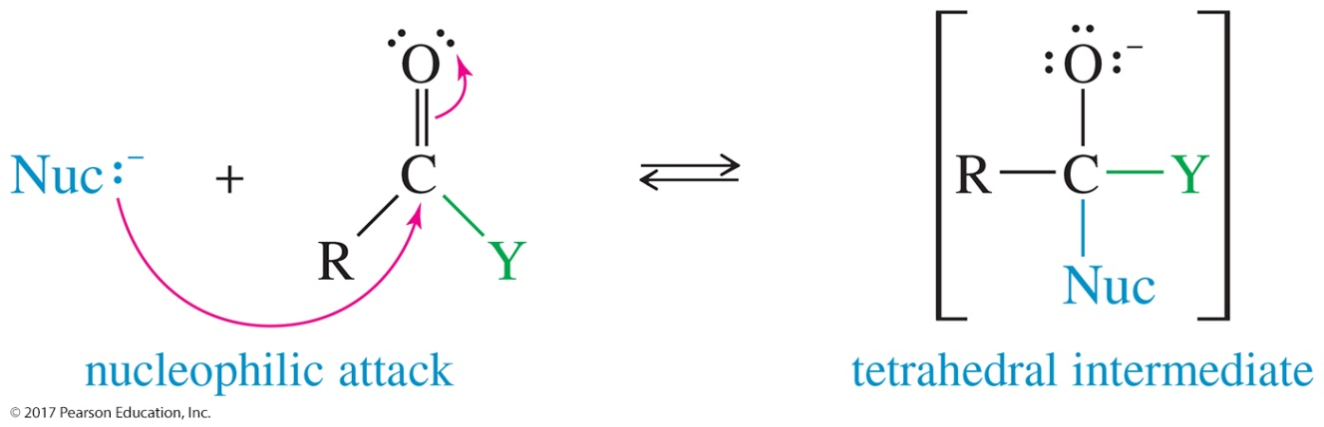
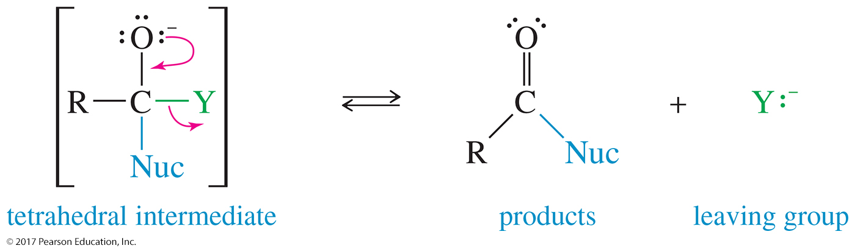
Mechanism of Acyl Substitution
Step 1: Addition of the nucleophile forms the tetrahedral intermediate.
Step 2: Elimination of the leaving group regenerates the carbonyl group.

Slide 30
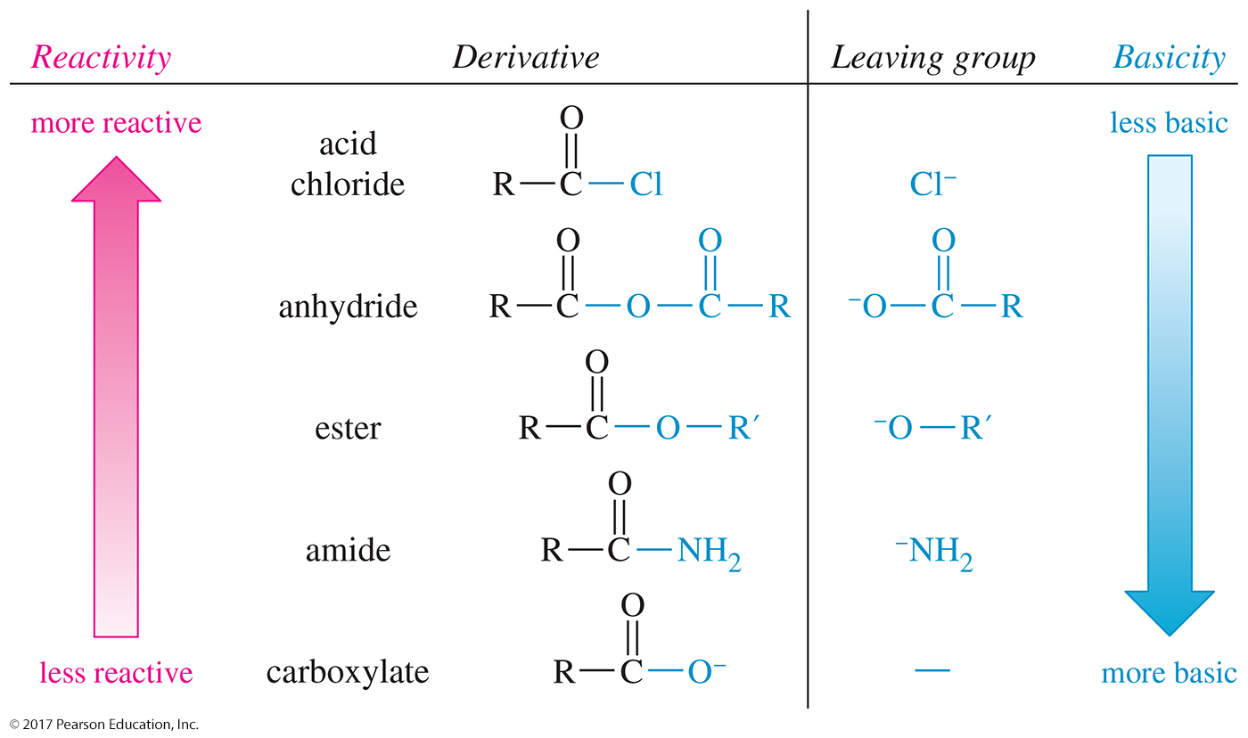
Reactivity of Acid Derivatives

Slide 31
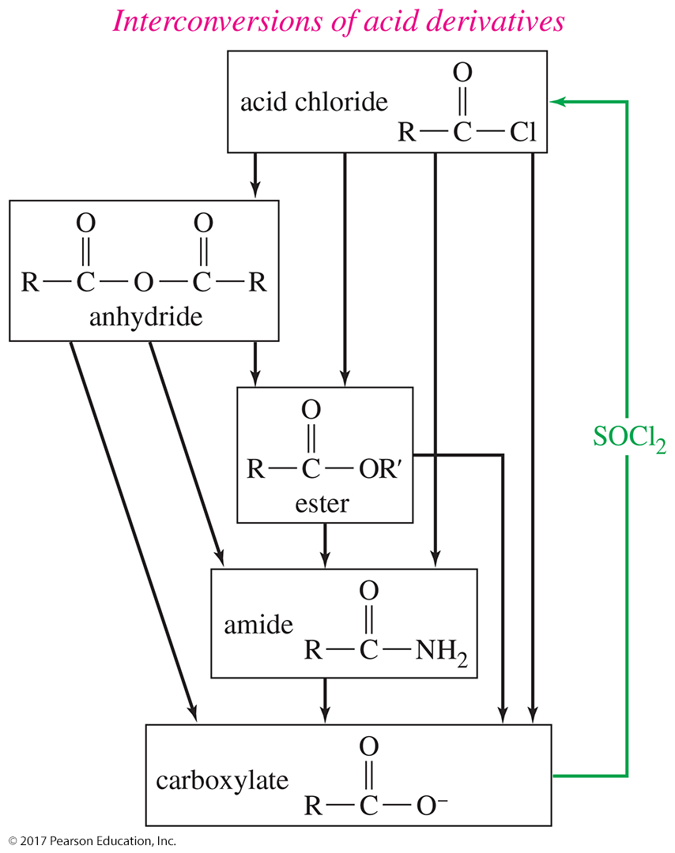
Interconversion of Derivatives
More reactive derivatives can be converted to less reactive derivatives.

Slide 32
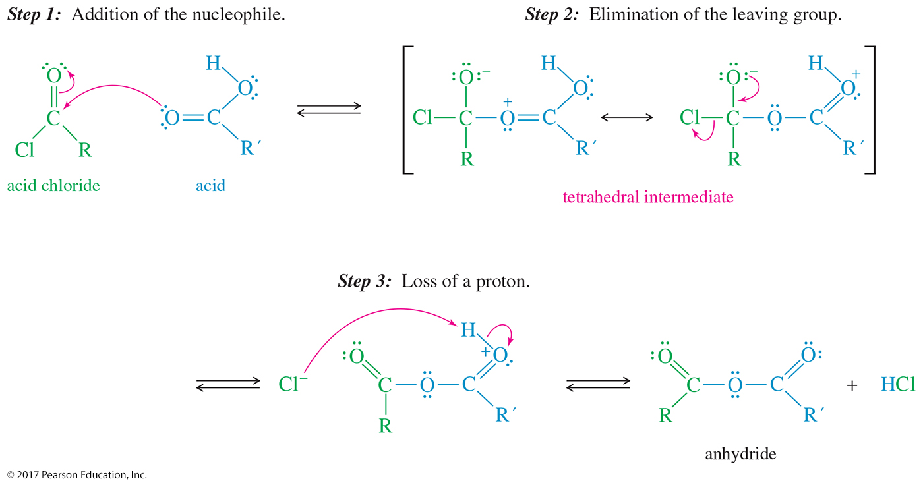
Acid Chloride to Anhydride
The carboxylic acid attacks the acyl chloride, forming the tetrahedral intermediate.
Chloride ion leaves, restoring the carbonyl.
Deprotonation produces the anhydride.

Slide 33
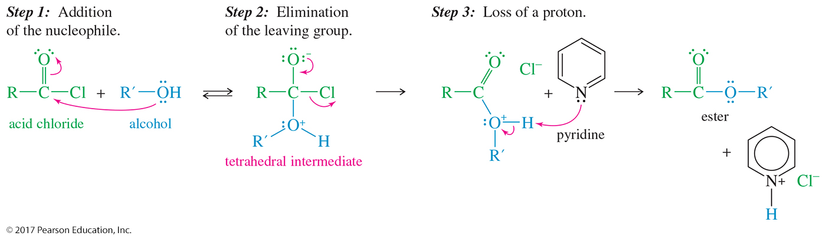
Acid Chloride to Ester
The alcohol attacks the acyl chloride, forming the tetrahedral intermediate.
Chloride ion leaves, restoring the carbonyl.
Deprotonation produces the ester.

Slide 34
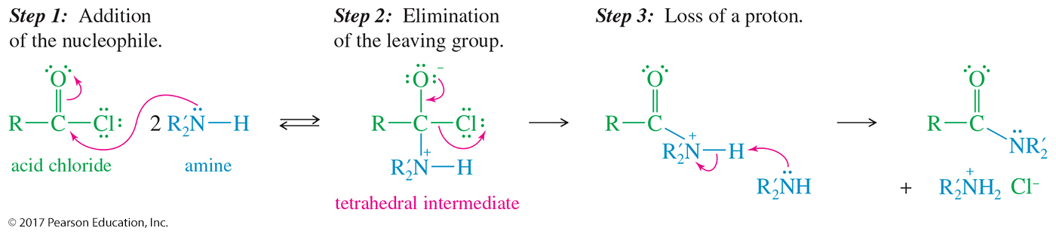
Acid Chloride to Amide
Ammonia yields a 1° amide.
A 1° amine yields a 2° amide.
A 2° amine yields a 3° amide.

Slide 35
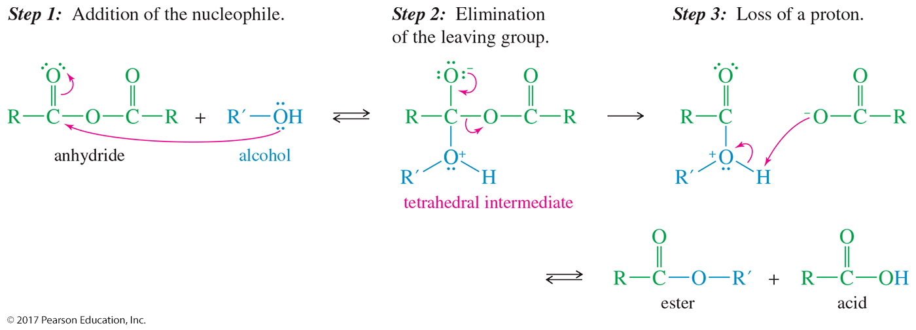
Anhydride to Ester
Alcohol attacks one of the carbonyl groups of the anhydride, forming the tetrahedral intermediate.
The other acid unit is eliminated as the leaving group.

Slide 36
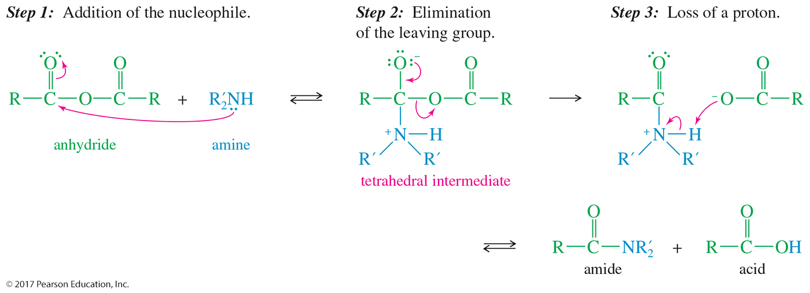
Anhydride to Amide
Ammonia yields a 1° amide; a 1° amine yields a 2° amide; and a 2° amine yields a 3° amide.

Slide 37
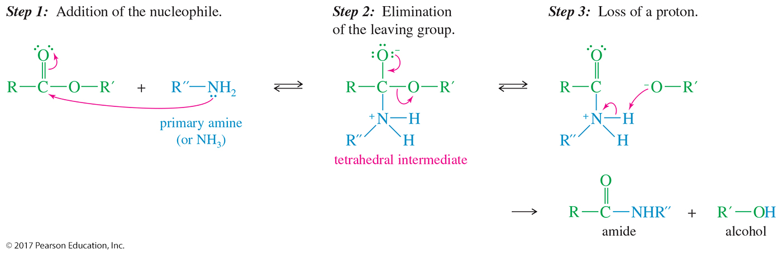
Ester to Amide: Ammonolysis
The nucleophile must be NH₃ or 1° amine.
Prolonged heating is required.

Slide 38
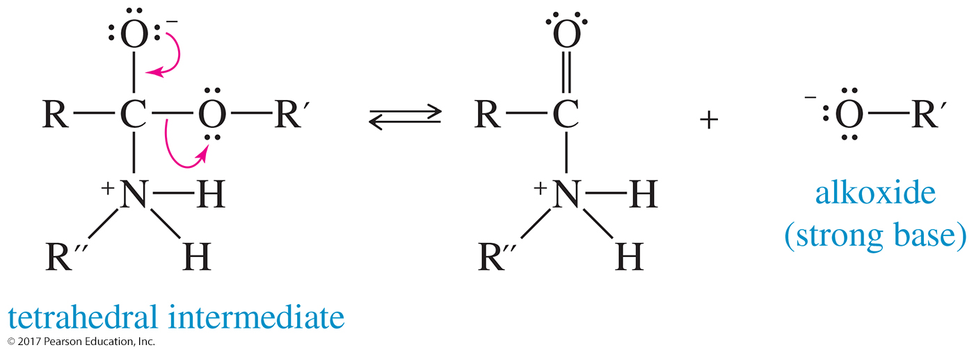
Leaving Groups in Nucleophilic Acyl Substitution
A strong base, such as an alkoxide (–OR), is not usually a leaving group, except in an exothermic step.

Slide 39
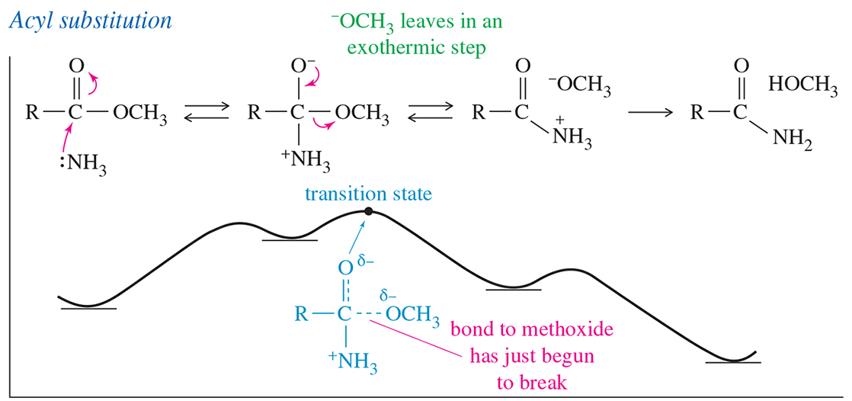
Energy Diagram
In the nucleophilic acyl substitution, the elimination
of the alkoxide is highly exothermic, converting the tetrahedral intermediate into a stable molecule.

Slide 40
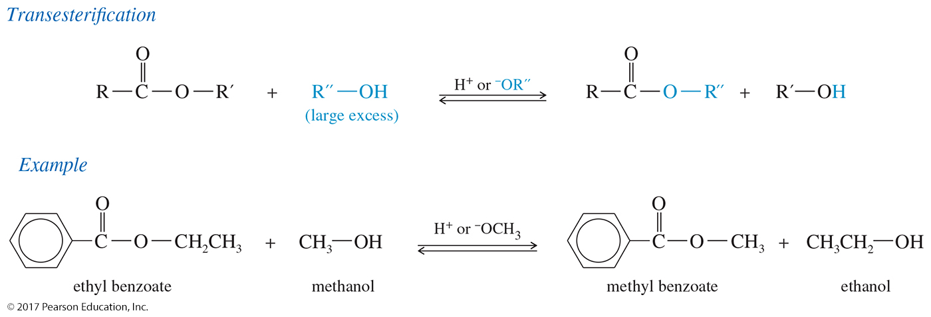
Transesterification
One alkoxy group can be replaced by another with acid or base catalyst.
Use large excess of desired alcohol.

Slide 41
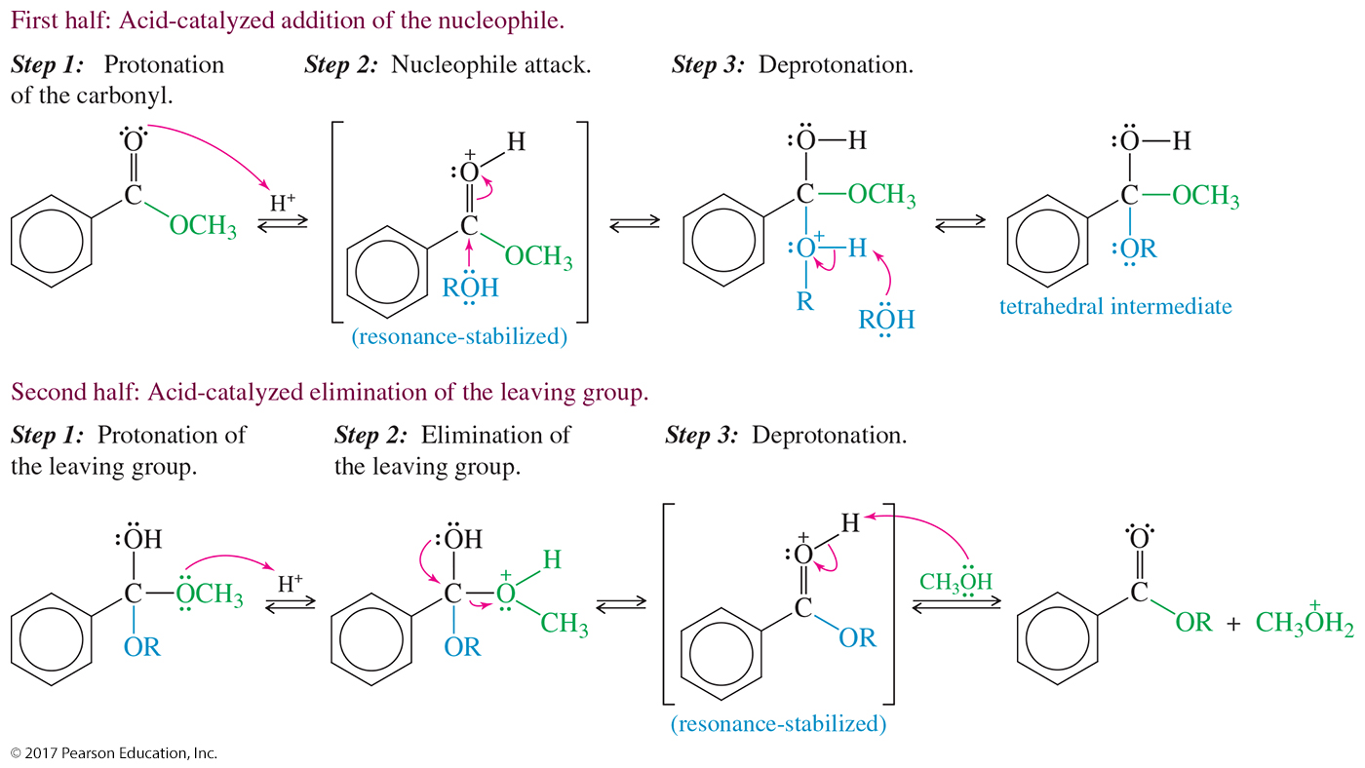
Acid-Catalyzed Transesterification Mechanism

Slide 42
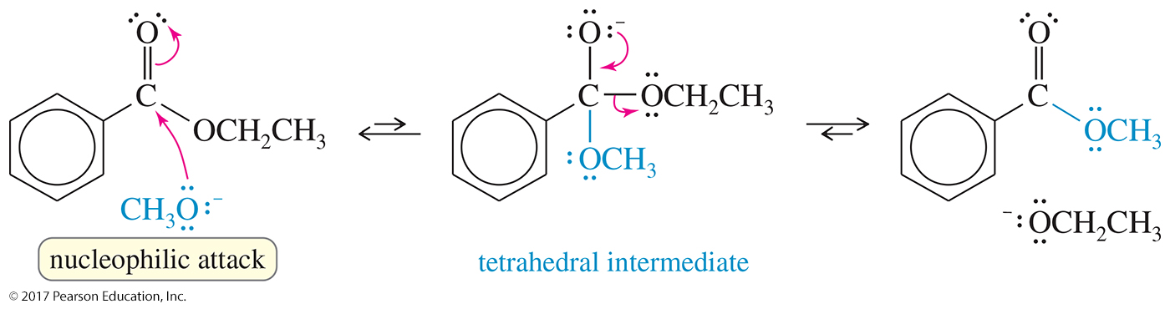
Base-Catalyzed Transesterification Mechanism

Slide 43
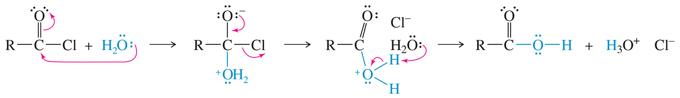
Hydrolysis of Acid
Chlorides and Anhydrides
Hydrolysis occurs quickly, even in moist air with no acid or base catalyst.
Reagents must be protected from moisture.

Slide 44
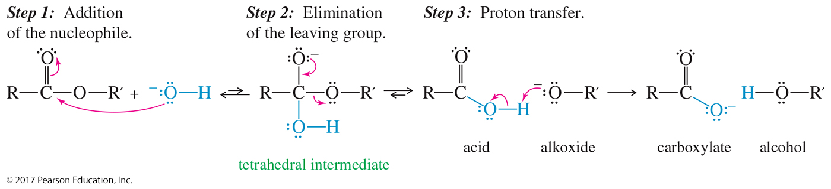
Hydrolysis of Esters: Saponification
The base-catalyzed hydrolysis of ester is known as saponification.
Saponification means “soap-making.”

Slide 45
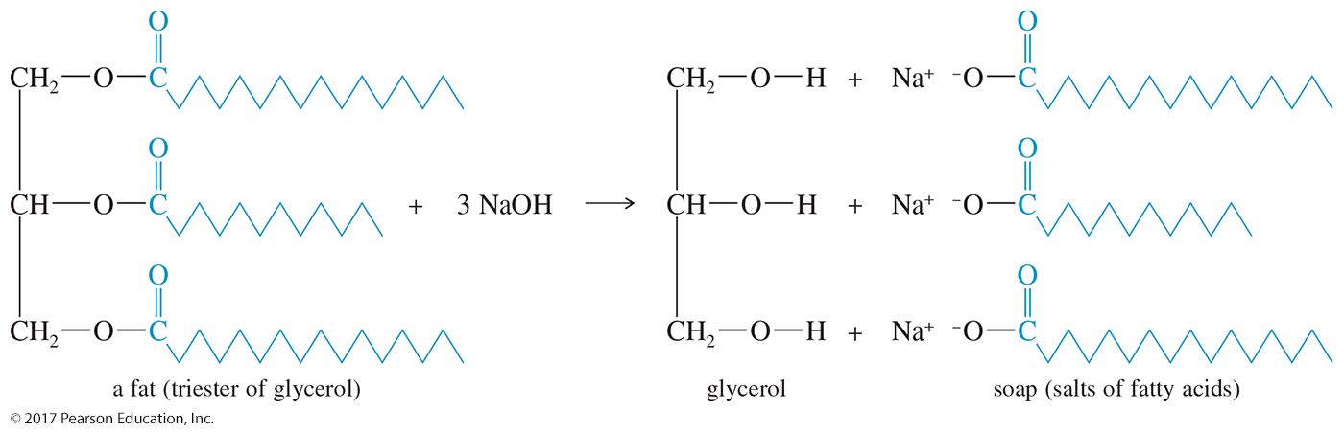
Saponification
Soaps are made by heating NaOH with a fat (triester of glycerol) to produce the sodium salt of a fatty acid—a soap.

Slide 46

Hydrolysis of Amides
Amides are hydrolyzed to the carboxylic acid under acidic or basic conditions.

Slide 47

Basic Hydrolysis of Amides
Similar to the hydrolysis of an ester.
The hydroxide ion attacks the carbonyl, forming a tetrahedral intermediate.
The amino group is eliminated and a proton is transferred to the nitrogen to give the carboxylate salt.

Slide 48

Acid Hydrolysis of Amides

Slide 49

Hydrolysis of Nitriles
Heating with aqueous acid or base will hydrolyze a nitrile to a carboxylic acid.

Slide 50

Base-Catalyzed Hydrolysis of a Nitrile

Slide 51

Reduction of Esters to Alcohols
Lithium aluminum hydride (LiAlH₄) reduces esters, acids, and acyl chlorides to primary alcohols.

Slide 52

Mechanism of Reduction of Esters

Slide 53

Reduction of Acyl Halides to Aldehydes
Lithium tri-tert-butoxyaluminum hydride is a milder reducing agent.
Reacts faster with acyl chlorides than with aldehydes.

Slide 54

Reduction to Aldehydes with DIBAL
Di-isobutylaluminum hydride, commonly called DIBAL or DIBAL-H, is another mild reducing agent that can reduce esters to aldehydes.

Slide 55

Reduction of an Amide to an Amine
Amides will be reduced to the corresponding amine by LiAlH₄.

Slide 56

Reduction of an Amide

Slide 57

Reduction of Nitriles to Primary Amines
Nitriles are reduced to primary amines by catalytic hydrogenation or by lithium aluminum hydride reduction.

Slide 58

Organometallic Reagents
Grignard and organolithium reagents add twice to acid chlorides and esters to give alcohols after protonation.

Slide 59


Mechanism of Grignard Addition
Esters react with two moles of Grignards or organolithium reagents to produce an alcohol.
The ketone intermediate will react with a second mole of organometallic to produce the alcohol.

Slide 60

Dialkylcuprate Reagents
Acid chlorides react just once with dialkylcuprates (Gilman reagents) to give ketones.

Slide 61

Reaction of Nitriles with Grignards
A Grignard reagent or organolithium reagent attacks the cyano group to form an imine, which is hydrolyzed to a ketone.

Slide 62

Synthesis of Acid Chlorides
Thionyl chloride (SOCl₂) and oxalyl chloride (COCl₂) are the most convenient reagents because they produce only gaseous side products.

Slide 63

Acid Chloride Reactions (1)

Slide 64

Acid Chloride Reactions (2)

Slide 65

Friedel–Crafts Acylation

Slide 66

General Anhydride Synthesis
The most generalized method for making anhydrides is the reaction of an acid chloride with a carboxylic acid or a carboxylate salt.
Pyridine is sometimes used to deprotonate the acid and form the carboxylate.

Slide 67

Reaction of Anhydrides

Slide 68

Friedel–Crafts Acylation
Using Anhydrides
Using a cyclic anhydride allows for only one of the acid groups to react, leaving the second acid group free to undergo further reactions.

Slide 69

Acetic Formic Anhydride
Acetic formic anhydride, made from sodium formate and acetyl chloride, reacts primarily at the formyl group.
The formyl group is more electrophilic because of the lack of alkyl groups.

Slide 70

Synthesis of Esters

Slide 71

Reactions of Esters

Slide 72


Formation of Lactones
Formation is favored for five- and six-membered rings.
For larger rings, remove water to shift equilibrium toward products.

Slide 73

Reactions of Amides

Slide 74

Dehydration of Amides to Nitriles
Strong dehydrating agents can eliminate the elements of water from a primary amide to give a nitrile.
Phosphorus oxychloride (POCl₃) or phosphorus pentoxide (P₂O₅) can be used as dehydrating agents.

Slide 75

Formation of Lactams
Five-membered lactams (γ-lactams) and six-membered lactams (δ -lactams) often form on heating or adding a dehydrating agent to the appropriate γ -amino acid or
δ -amino acid.

Slide 76

β-Lactams
Unusually reactive, four-membered ring amides are capable of acylating a variety of nucleophiles.
They are found in three important classes of antibiotics: penicillins, cephalosporins, and carbapenems.

Slide 77

Mechanism of β-Lactam Acylation
The nucleophile attacks the carbonyl of the four-membered ring amide, forming a tetrahedral intermediate.
The nitrogen is eliminated and the carbonyl reformed.
Protonation of the nitrogen is the last step of the reaction.

Slide 78

Action of β-Lactam Antibiotics
The β-lactams work by interfering with the synthesis of bacterial cell walls.
The acylated enzyme is inactive for synthesis of the cell wall protein.

Slide 79

Synthesis of Nitriles

Slide 80

Reactions of Nitriles

Slide 81

Thioesters
A thioester is formed from a carboxylic acid and a thiol.
Thioesters are also called thiol esters to emphasize that they are derivatives of thiols.

Slide 82

Resonance Overlap in
Esters and Thioesters
The resonance overlap in a thioester is not as effective as that in an ester.
Thioesters are more reactive toward nucleophilic acyl substitution than are normal esters.

Slide 83

Structure of Coenzyme A (CoA)
Coenzyme A (CoA) is a thiol whose thioesters serve as a biochemical acyl transfer reagents.

Slide 84
Mechanism of Action of Acetyl CoA
Acetyl CoA transfers an acetyl group to a nucleophile, with coenzyme A serving as the leaving group.
Thioesters are not so prone to hydrolysis, yet they are excellent selective acylating reagents; therefore, thioesters are common acylating agents in living systems.

Slide 85

Synthesis of Carbamate Esters from Isocyanates

Slide 86

Polycarbonate Synthesis
Polycarbonates are polymers bonded to the carbonate ester linkage.
The diol used to make Lexan® is a phenol called
bisphenol A, a common intermediate in polyester and polyurethane synthesis.

Slide 87

Synthesis of Polyurethanes
Reaction of toluene diisocyanate with ethylene glycol produces one of the most common forms of polyurethanes.

