Slide 1
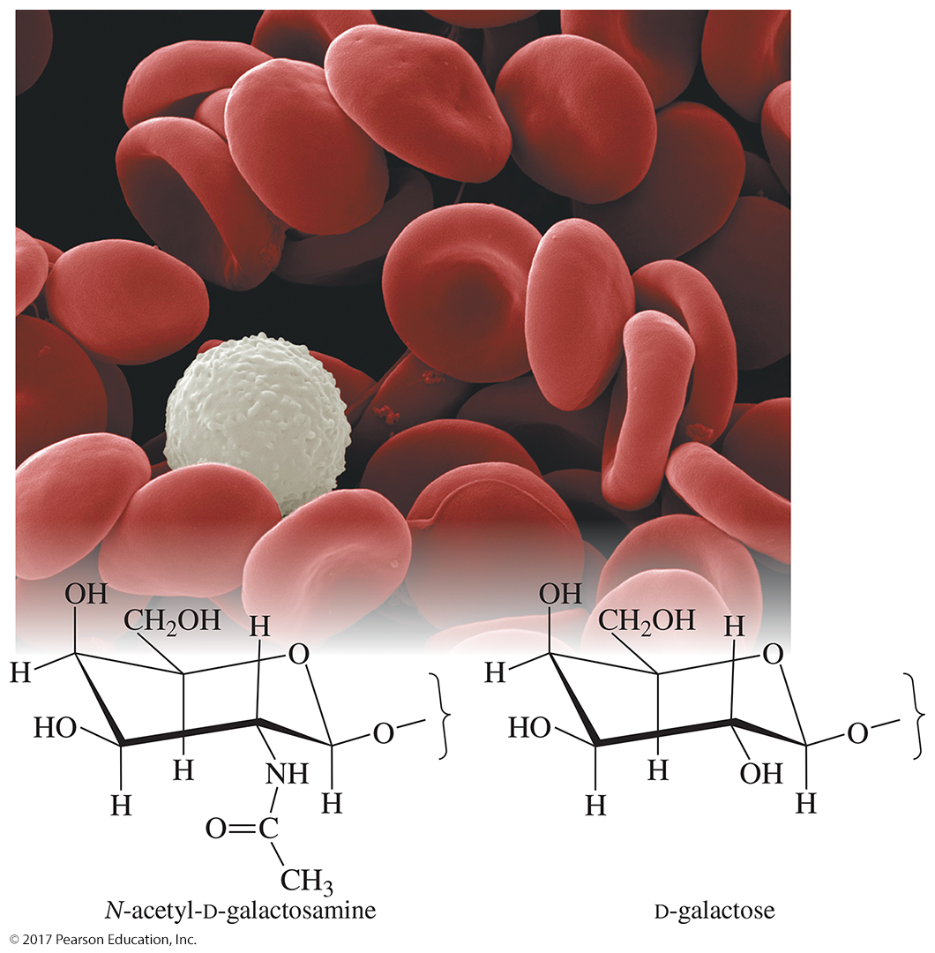
Chapter 23
Lecture
Organic Chemistry,
9th Edition
L. G. Wade, Jr.
Carbohydrates and Nucleic Acids
Chad Snyder, PhD
Grace College
© 2017 Pearson Education, Inc.

Slide 2
Carbohydrates
Synthesized by plants using sunlight to convert CO₂ and H₂O to glucose and O₂
Polymers include starch and cellulose.
Starch is a storage unit for solar energy.
Most sugars have formula C_{n}(H₂O)_{m}, “hydrate
of carbon.”

Slide 3
Classification of Carbohydrates
Monosaccharides or simple sugars:
  Polyhydroxyaldehydes or aldoses
  Polyhydroxyketones or ketoses
Disaccharides can be hydrolyzed to two monosaccharides.
Polysaccharides hydrolyze to many monosaccharide units. For example, starch and cellulose have
> 1000 glucose units.

Slide 4
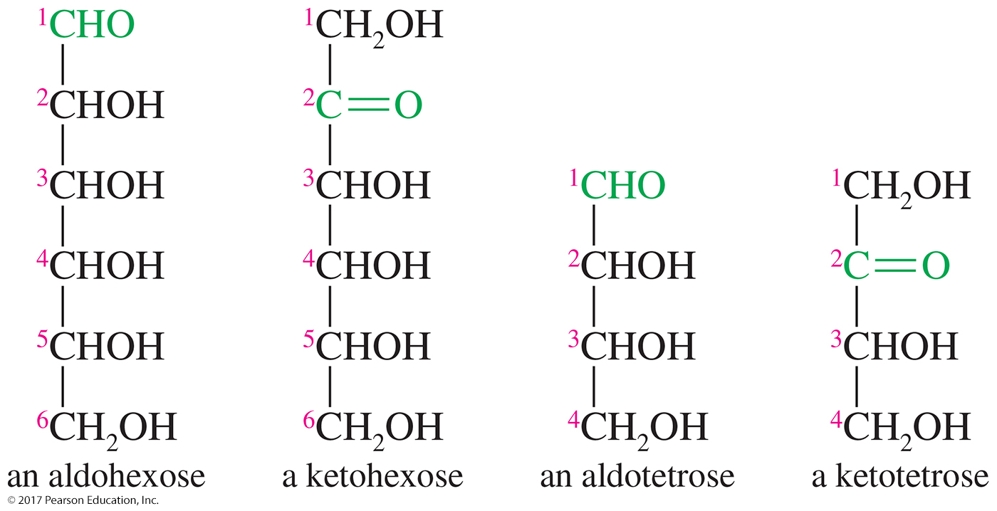
Monosaccharide Classification
Classified using three criteria:
  If it contains a ketone or an aldehyde group
  Number of carbons in the chain
  Configuration of the asymmetric carbon farthest from the carbonyl group

Slide 5
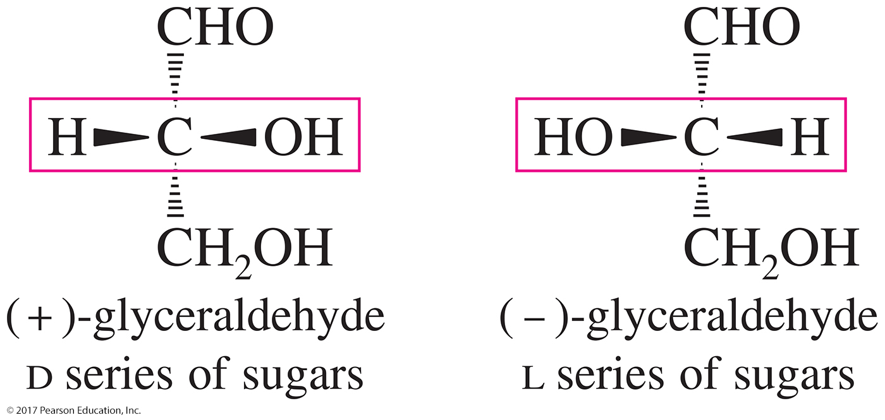
(+) and (–)-Glyceraldehydes
The (+) enantiomer of glyceraldehyde has its OH group on the right of the Fischer projection.
The (–) enantiomer of glyceraldehyde has its OH group on the left of the Fischer projection.

Slide 6
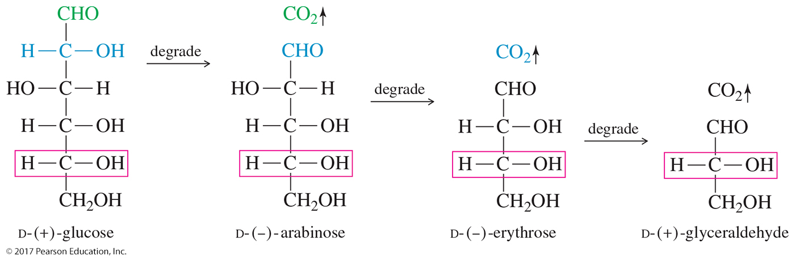
Degradation of d and l Sugars
Fischer–Rosanoff convention.
d sugars can be degraded to the dextrorotatory (+) form of glyceraldehyde.
l sugars can be degraded to the levorotatory (–) form of glyceraldehyde.

Slide 7
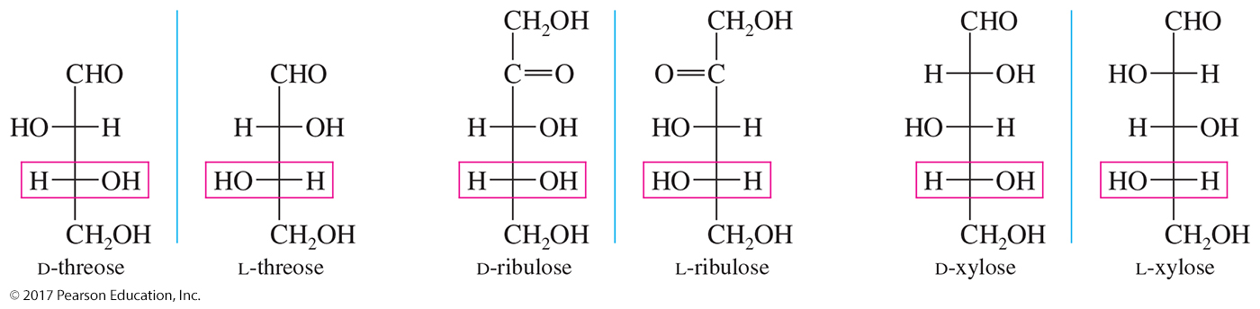
d and l Series of Sugars
Sugars of the d series have the OH group of the bottom asymmetric carbon on the right in the Fischer projection.
Sugars of the l series, in contrast, have the OH group of the bottom asymmetric carbon on the left.

Slide 8
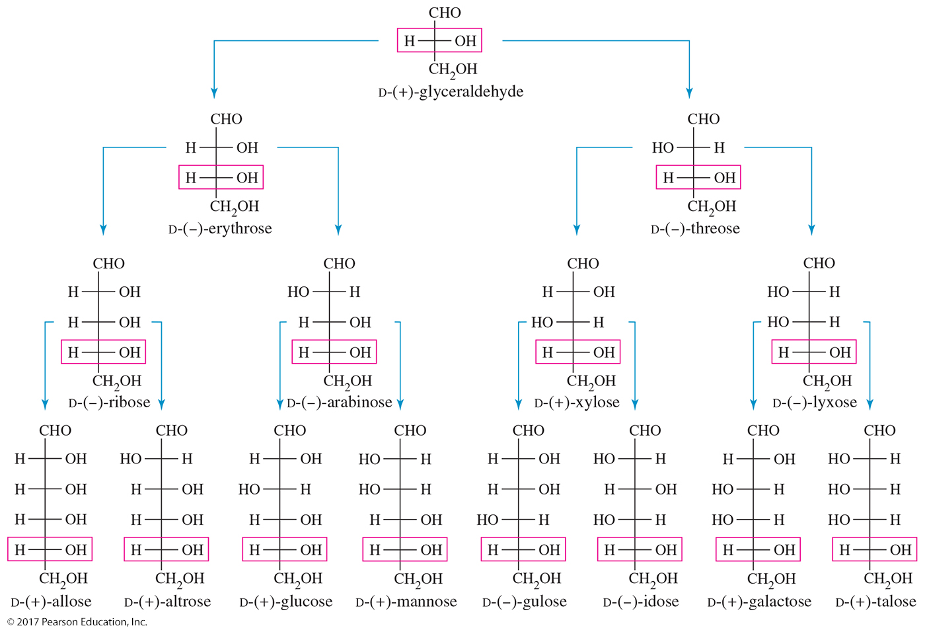
The d Aldose Family

Slide 9
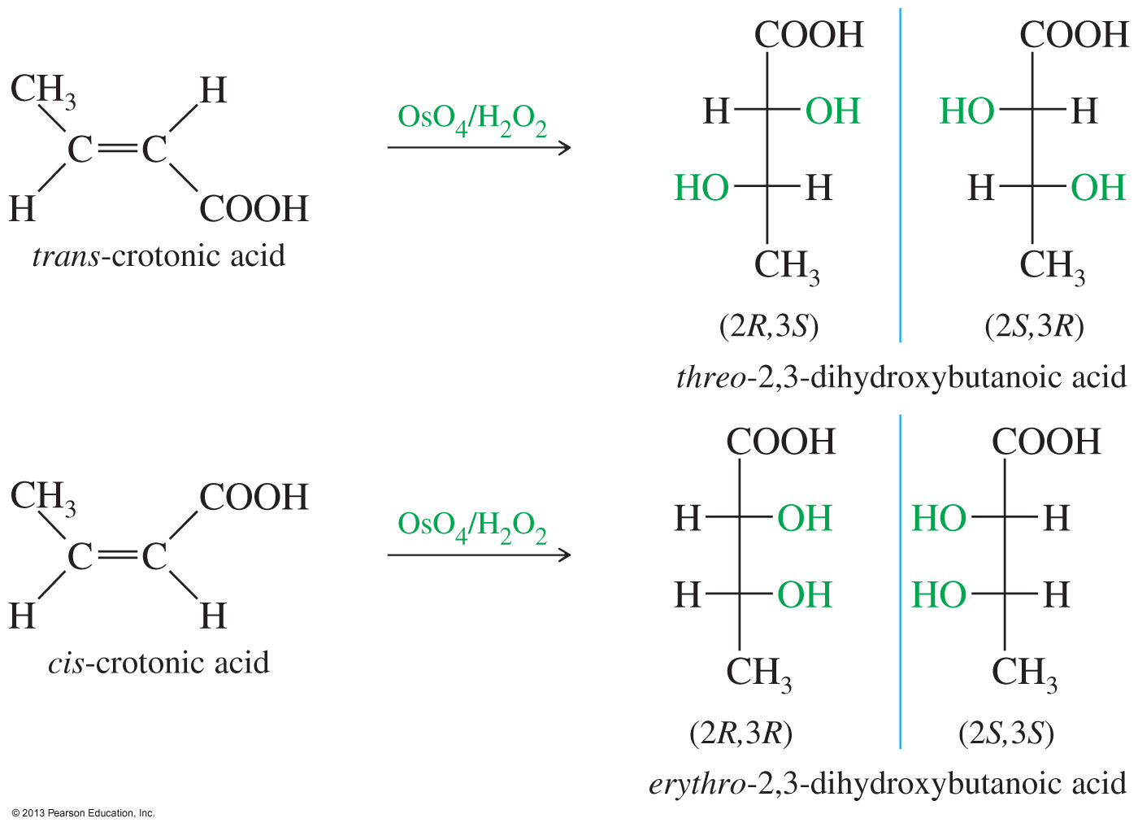
Erythro and Threo Diastereomers
File Name: AAALDDT0

Slide 10
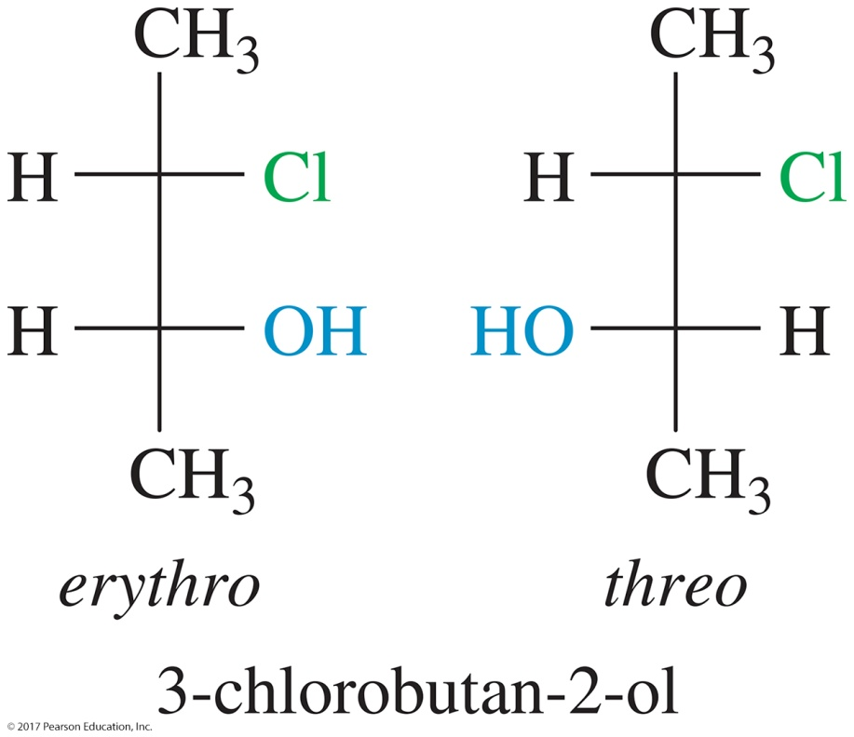
Erythro and Threo Nomenclature
Erythro diastereomers have similar groups on the same side of the Fischer projection.
Threo diastereomers have similar groups on opposite sides of the Fischer projection.

Slide 11
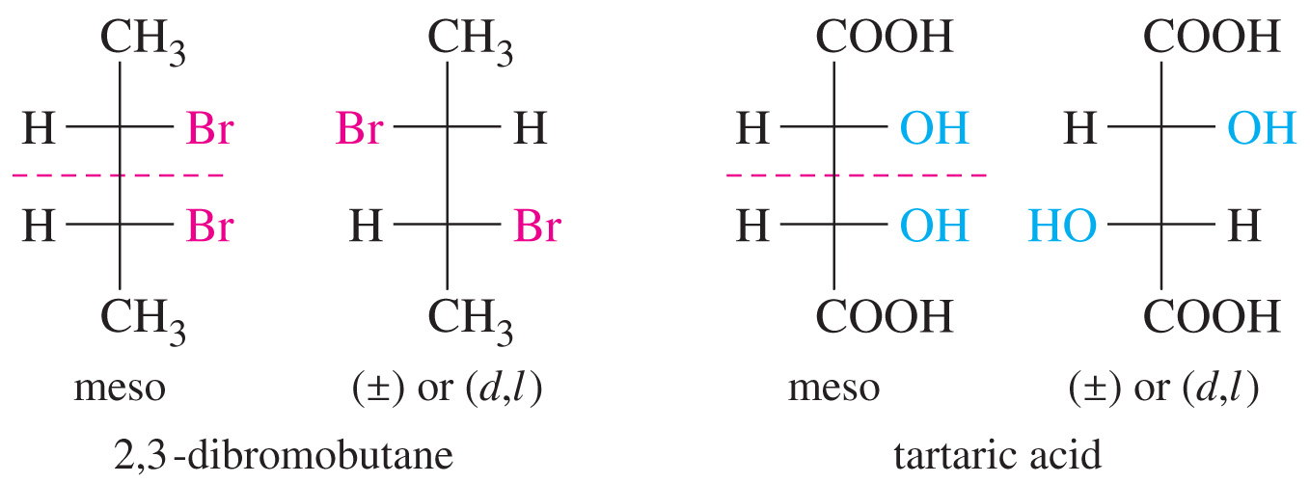
Symmetric Molecules
File Name: AAALDDU0
Bottom figures only (meso) please.
Erythro and threo are not used on molecules with similar ends.
For symmetric molecules, the terms meso and (d,l) are used.

Slide 12
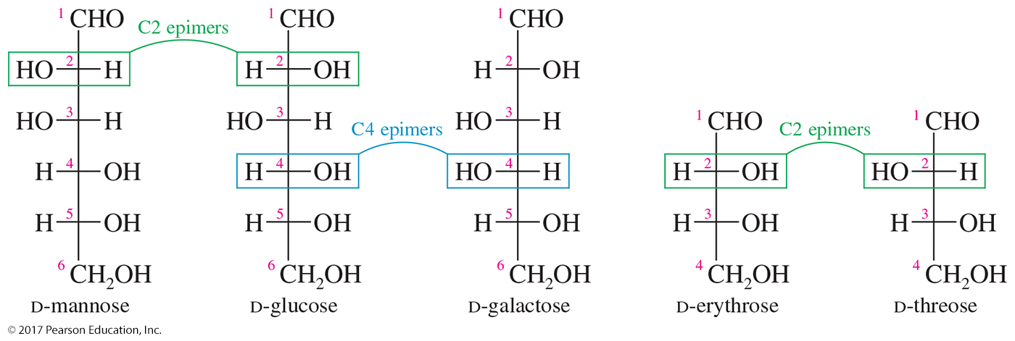
Epimers
Sugars that differ only in their stereochemistry at a single carbon
The carbon at which the stereochemistry differs is usually specified.

Slide 13
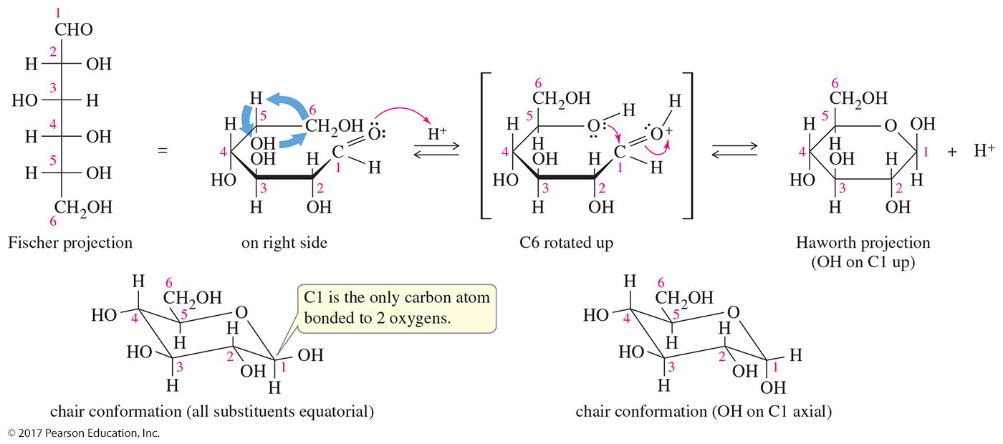
Cyclic Structure for Glucose
Glucose exists almost entirely as its cyclic
hemiacetal form.
Five- or six-membered ring hemiacetals are more stable than their open-chain forms.
The Haworth projection, although widely used, may give the impression of the ring being flat.

Slide 14
Chair Conformation for Glucose
The chair conformations give a more accurate representation of glucose.
Glucose exists almost entirely as its cyclic
hemiacetal form.

Slide 15
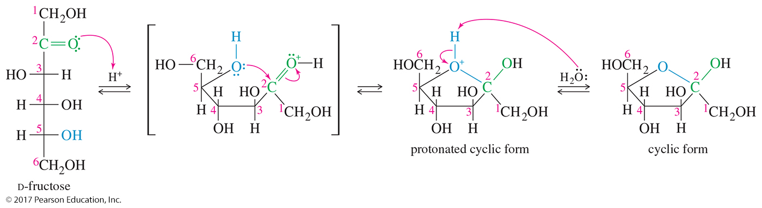
Cyclic Hemiacetal Form of Fructose
Cyclic hemiacetal formed by reaction of C═O at C2 with
—OH at C5
Since five-membered rings are not puckered as much as six-membered rings, they are usually depicted as flat Haworth projections.

Slide 16
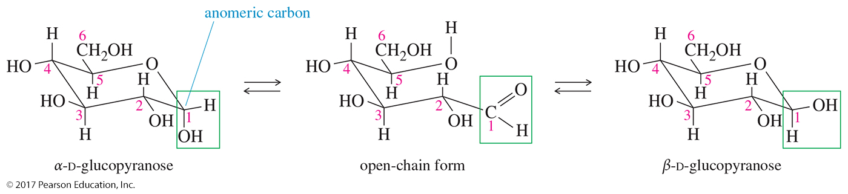
Anomers of Glucose
The hydroxyl group on the anomeric (hemiacetal) carbon is down (axial) in the α anomer and up (equatorial) in the
β anomer.
The β anomer of glucose has all its substituents in equatorial positions.
The hemiacetal carbon is easily identified as the only carbon atom bonded to two oxygens.

Slide 17
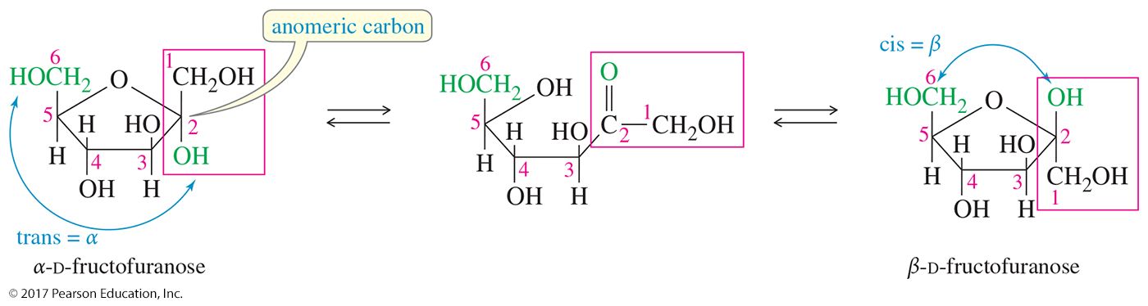
Anomers of Fructose
The α anomer of fructose has the anomeric —OH group down, trans to the terminal —CH₂OH group.
The β anomer has the anomeric —OH group up, cis to the terminal —CH₂OH.

Slide 18
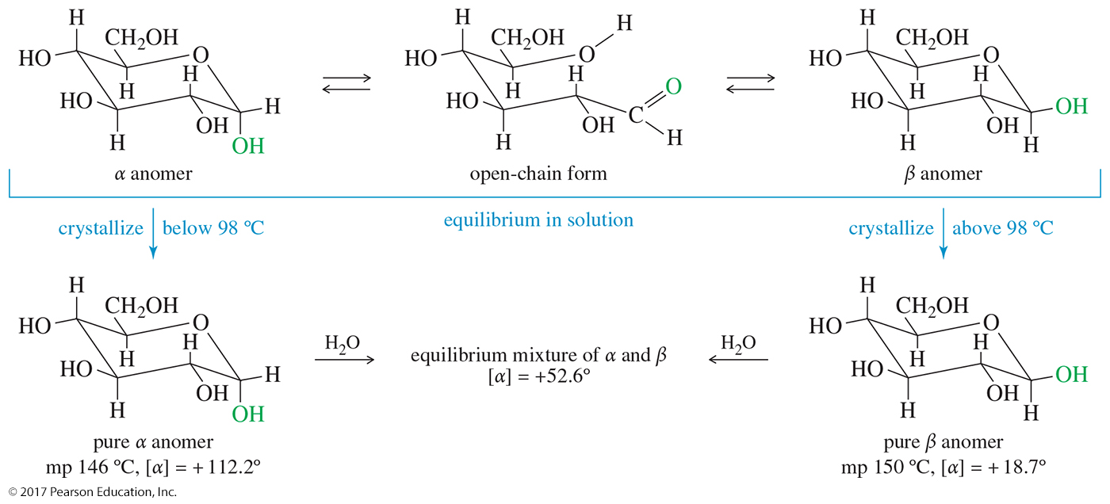
Mutarotation
An aqueous solution of D-glucose contains an equilibrium mixture of
α -D-glucopyranose, β -D-glycopyranose, and the intermediate open-chain form.
Crystallization below 98 °C gives the α anomer, and crystallization above 98 °C gives the β anomer.

Slide 19
Reduction of Simple Sugars
Aldoses and ketoses can be reduced to the corresponding polyalcohols, called sugar alcohols or alditols.
The most common reagents are NaBH₄ or H₂/Ni.
Alditols are named by adding the suffix -itol to the root name of the sugar.

Slide 20
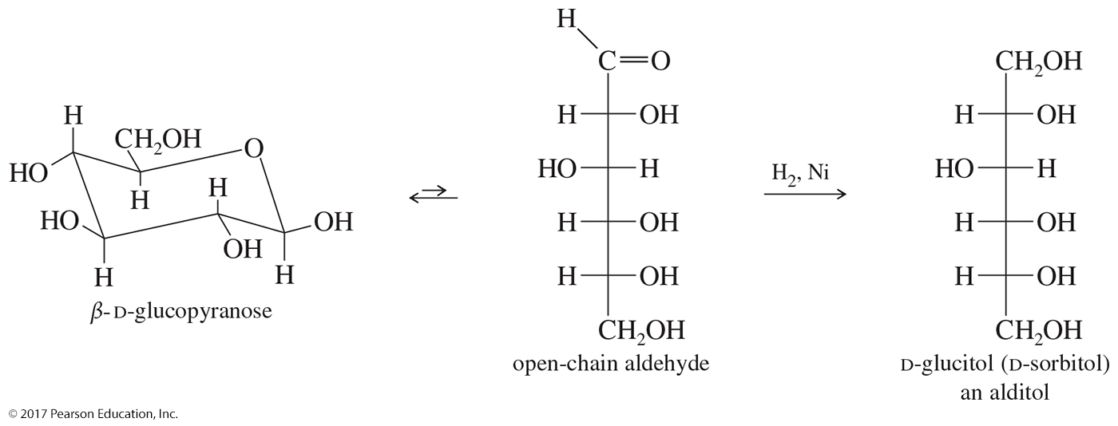
Reduction of β-D-Glucopyranose

Slide 21
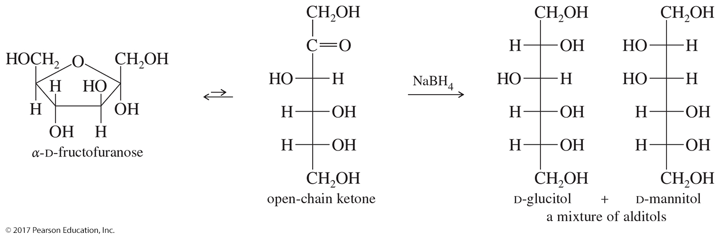
Reduction of Fructose
Reduction of fructose creates a new asymmetric carbon atom, which can have either configuration.
The products are a mixture of glucitol and mannitol.

Slide 22
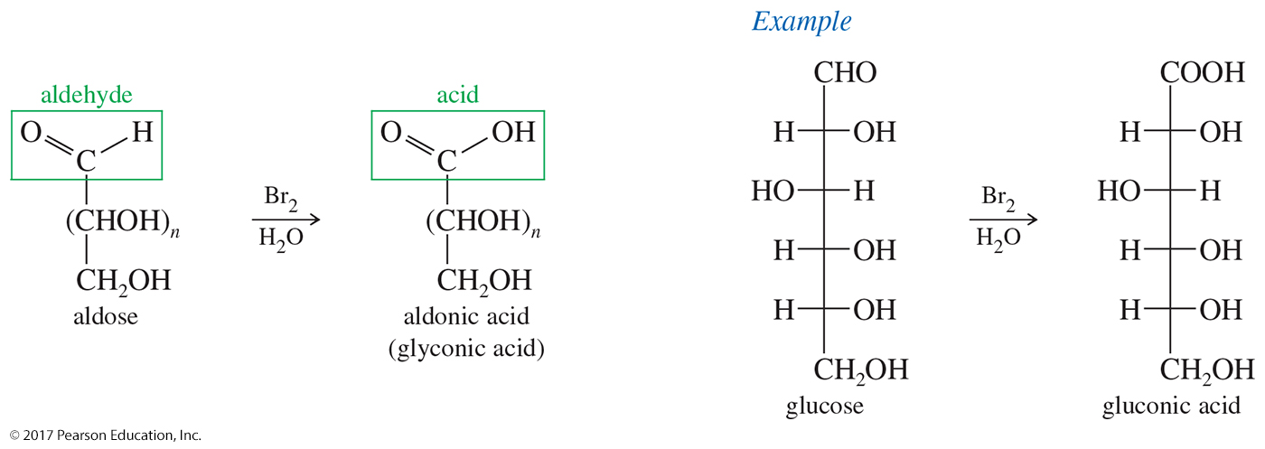
Oxidation By Bromine
Bromine water oxidizes the aldehyde group of an aldose to a carboxylic acid.
Bromine in water is used for this oxidation because it does not oxidize the alcohol groups of the sugar and it does not oxidize ketoses.

Slide 23
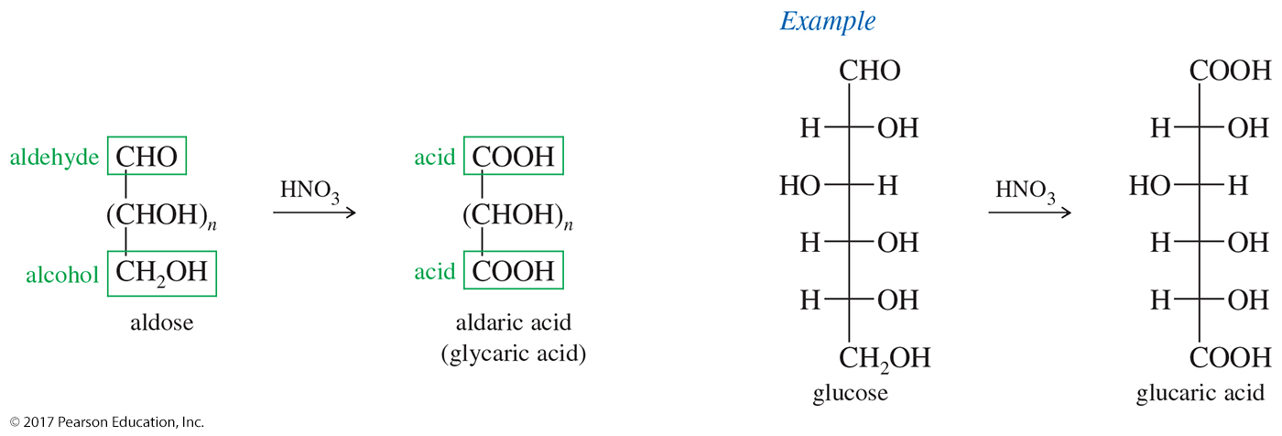
Nitric Acid Oxidation
Nitric acid is a stronger oxidizing agent than bromine, oxidizing both the aldehyde group and the terminal
—CH₂OH group of an aldose to a carboxylic acid.

Slide 24
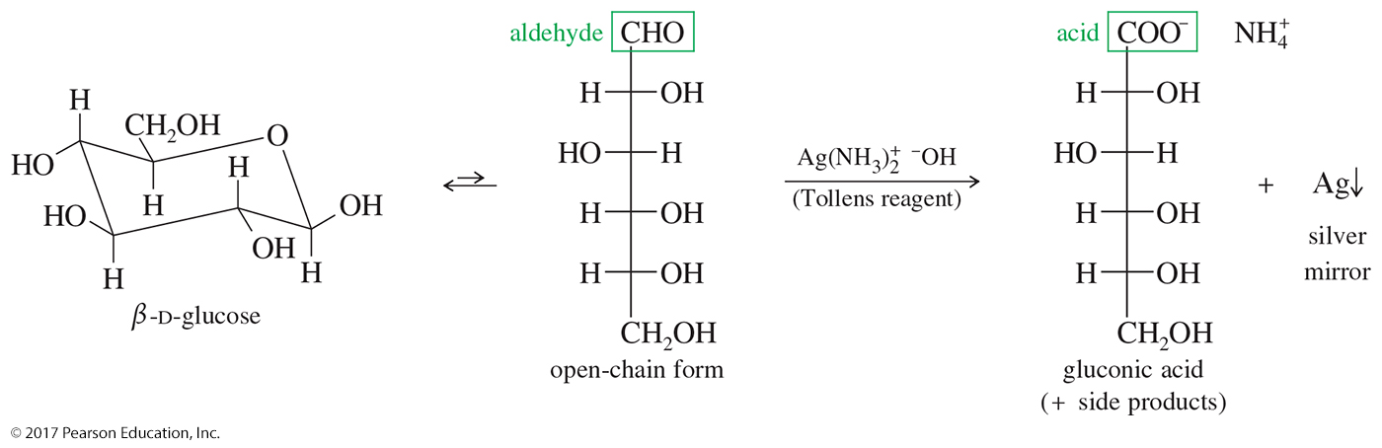
Oxidation By Tollens Reagent
Aldoses have an aldehyde group, which reacts with Tollens reagent to give an aldonic acid and a silver mirror.
Sugars that reduce Tollens reagent to give a silver mirror are called reducing sugars.
The Tollens test is used as a qualitative test for the identification of aldehydes.

Slide 25
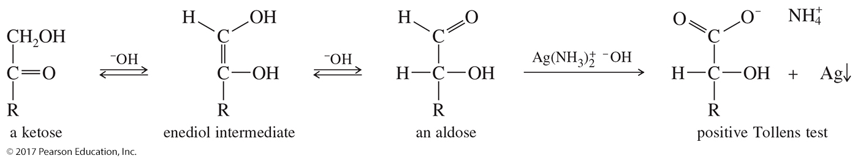
Tollens Reagent and Ketoses
The Tollens test cannot distinguish between aldoses and ketoses because the basic Tollens reagent promotes enediol rearrangements.
Under basic conditions, the open-chain form of a ketose can isomerize to an aldose, which reacts to give a positive Tollens test.

Slide 26
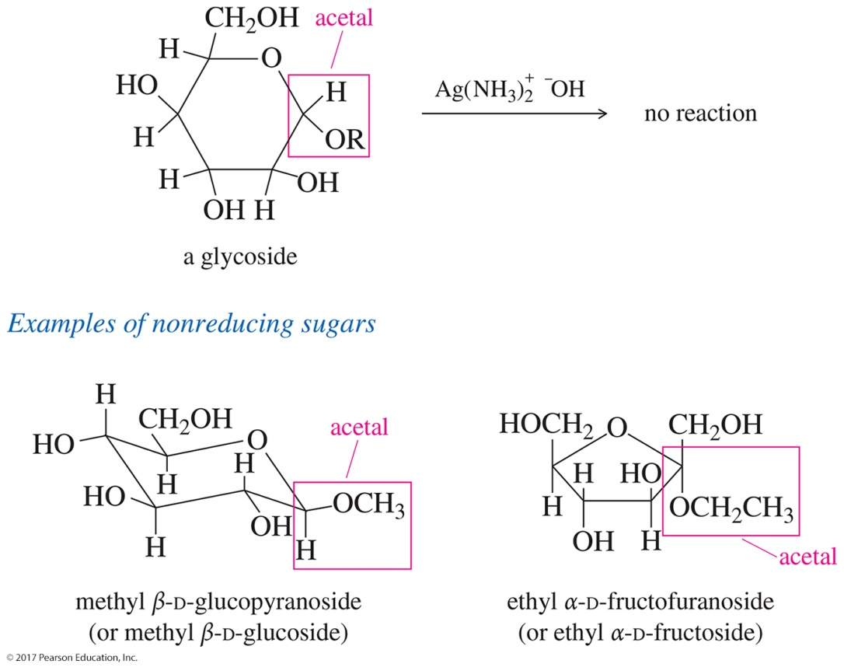
Nonreducing Sugars
Glycosides are acetals, stable in base, so they do not react with Tollens reagent.
Disaccharides and polysaccharides are also acetals, nonreducing sugars.

Slide 27
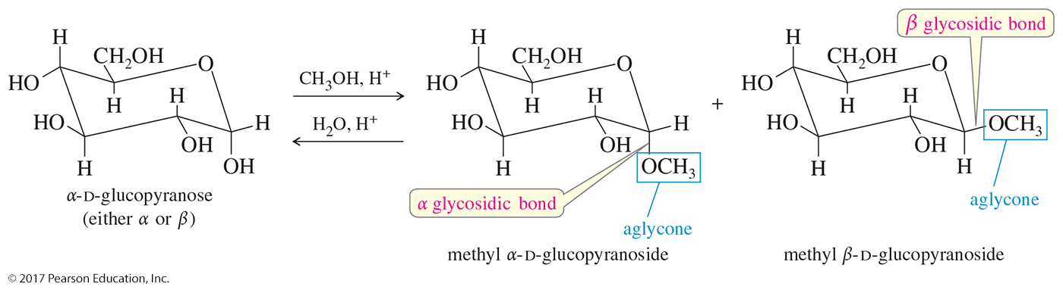
Formation of Glycosides
Acetals can be made by reacting sugar with alcohol and a trace of acid.
Since the open-chain sugar is in equilibrium with its α- and β-hemiacetal, both anomers of the acetal are formed.

Slide 28
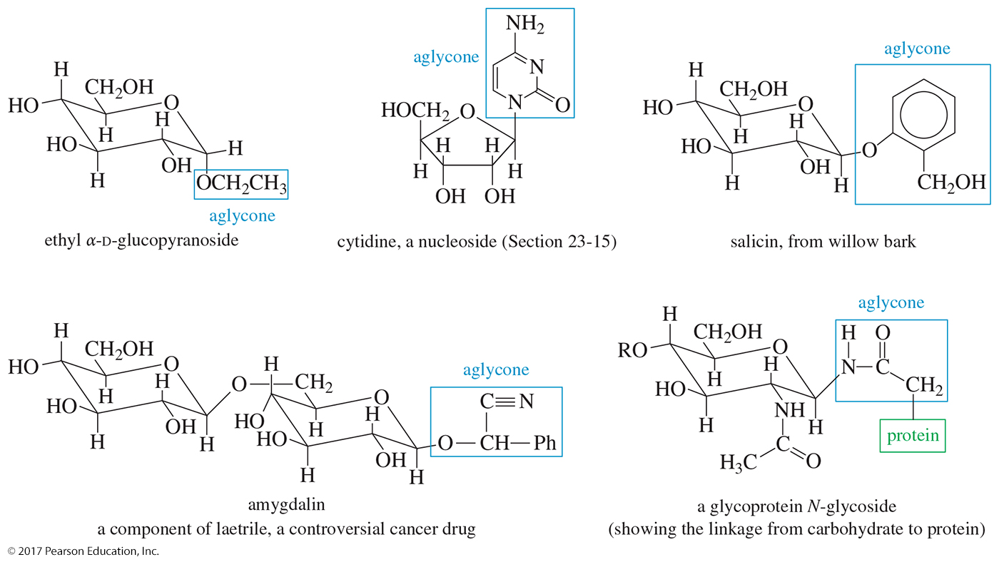
Aglycones
The group bonded to the anomeric carbon of a glycoside is called an aglycone.
Some aglycones are bonded through an oxygen atom (a true acetal), and others are bonded through other atoms such as nitrogen.

Slide 29
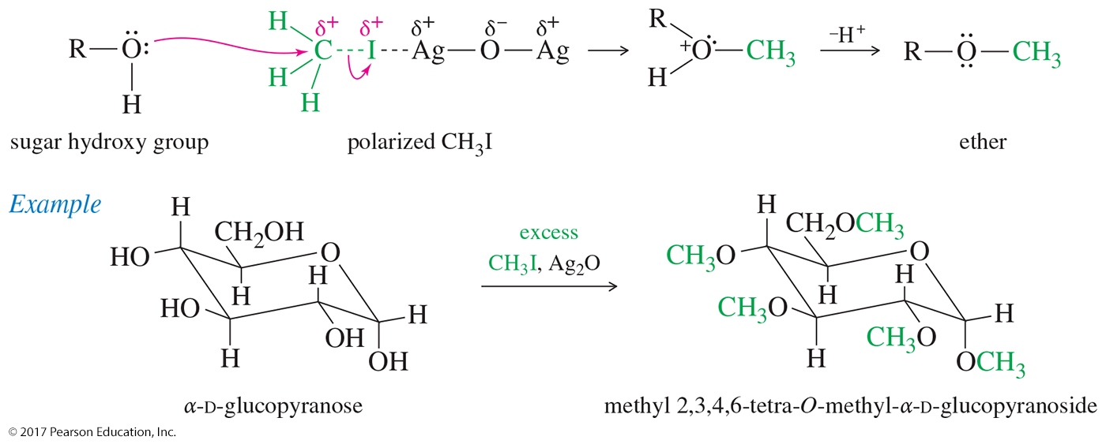
Formation of Methyl Ethers
Reaction of the sugar with methyl iodide and silver oxide will convert the hydroxides to methyl ethers.
The methylated sugar is stable in base.

Slide 30
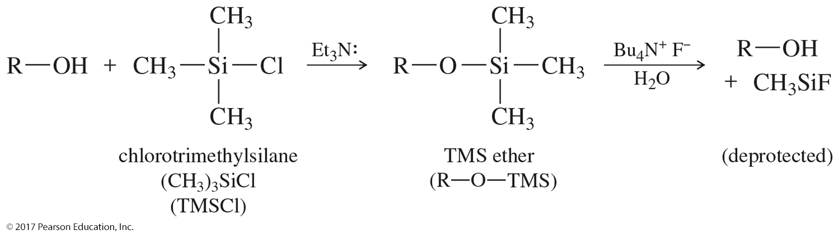
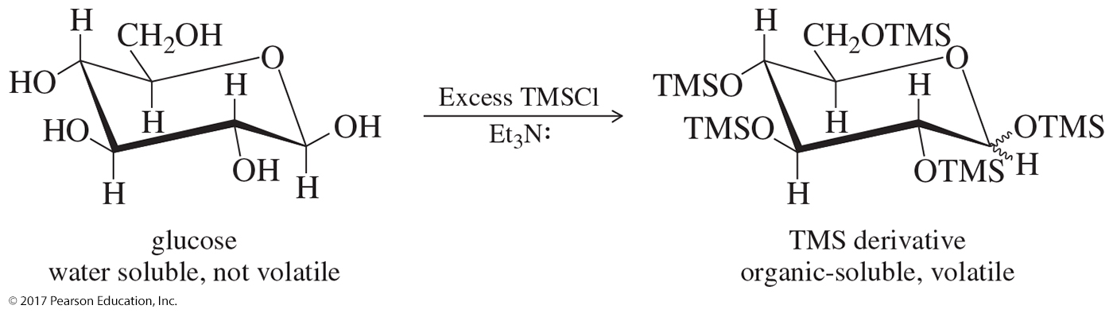
Silyl Ethers
Sugars are most commonly converted to their silyl ethers to make them easier to handle and sufficiently volatile for gas chromatography (GC) and mass spectrometry (MS).

Slide 31
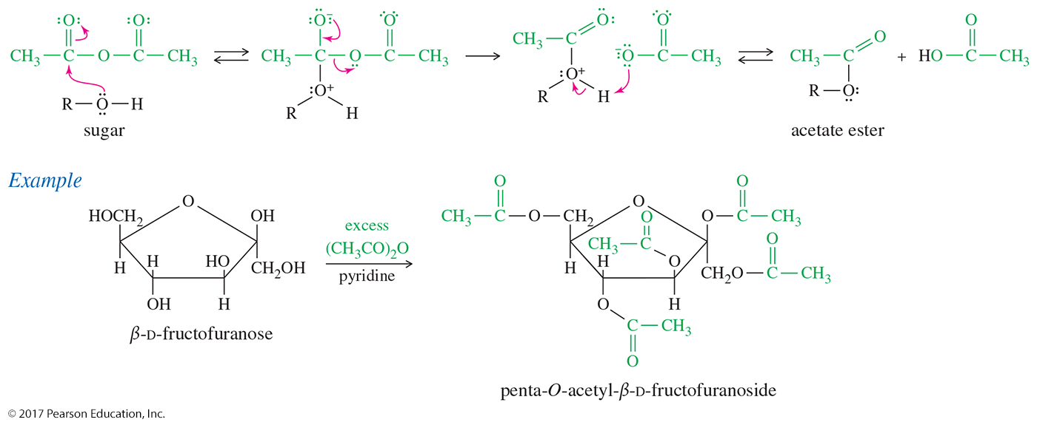
Acetate Ester Formation
Acetic anhydride with pyridine catalyst converts all the oxygens to acetate esters.
Esters are readily crystallized and purified.

Slide 32
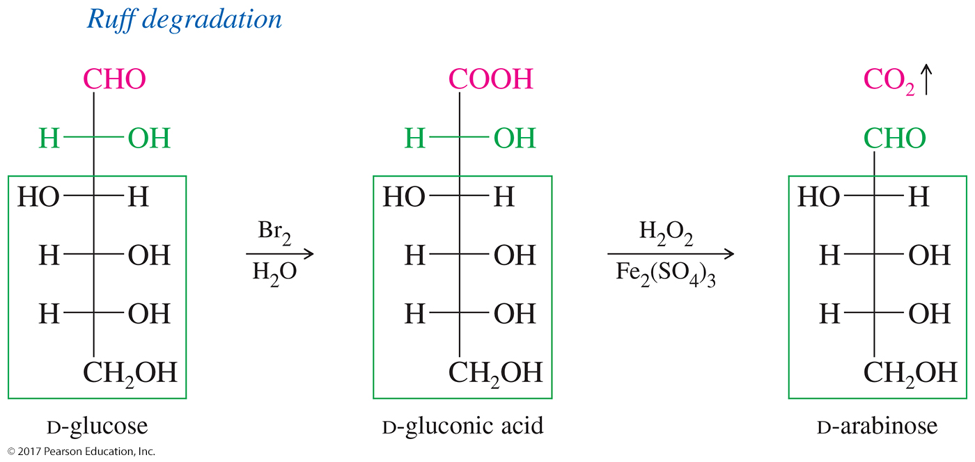
The Ruff Degradation
The Ruff degradation is a two-step process that begins with the bromine water oxidation of the aldose to its aldonic acid.
Treatment of the aldonic acid with hydrogen peroxide and ferric sulfate oxidizes the carboxyl group to CO₂ and gives an aldose with one less carbon atom.

Slide 33
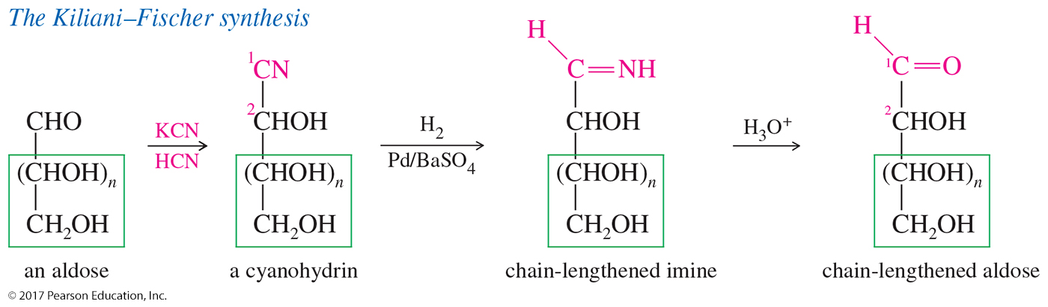
Kiliani–Fischer Synthesis
The Kiliani–Fischer synthesis lengthens an aldose carbon chain by adding one carbon atom to the aldehyde end of the aldose.
This synthesis is useful both for determining the structure of existing sugars and for synthesizing new sugars.

Slide 34
Disaccharides
Three naturally occurring glycosidic linkages:
  1-4′ link: The anomeric carbon is bonded to oxygen on C4 of second sugar.
  1-6′ link: The anomeric carbon is bonded to oxygen on C6 of second sugar.
  1-1′ link: The anomeric carbons of the two sugars are bonded through an oxygen.

Slide 35
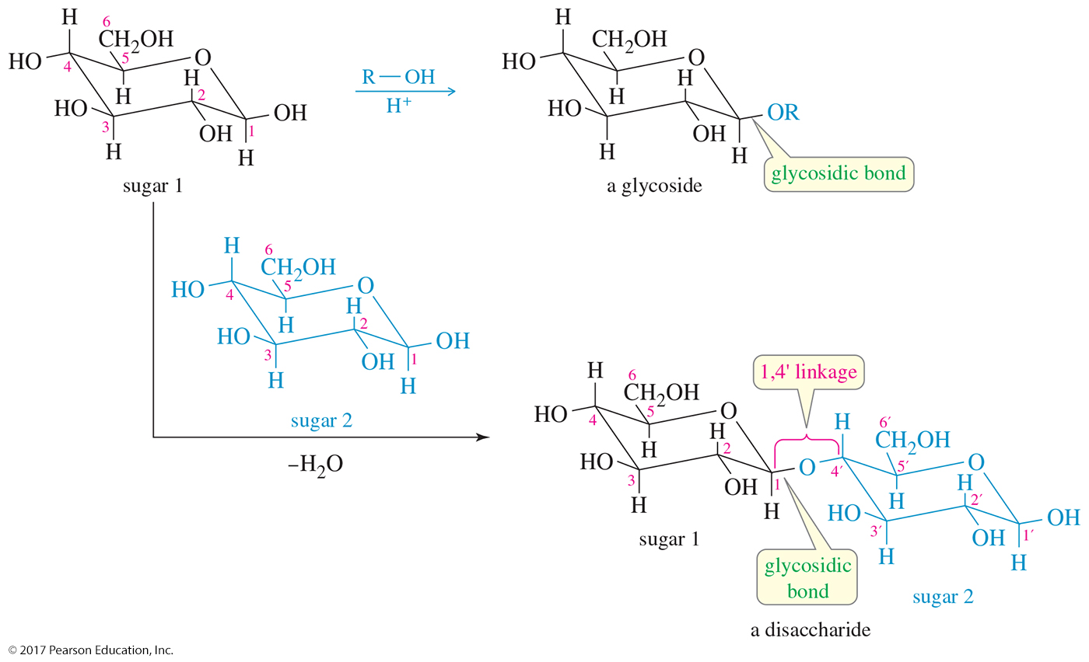
Disaccharides (Continued)

Slide 36
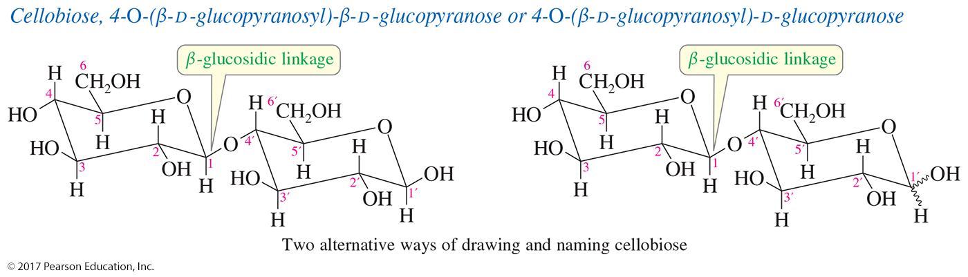
Cellobiose:
A β-1-4′ Glucosidic Linkage
In cellobiose, the anomeric carbon of one glucose unit is linked through an equatorial (β) carbon–oxygen bond to C4 of another glucose unit.
This is called a β-1-4′ glucosidic linkage.

Slide 37
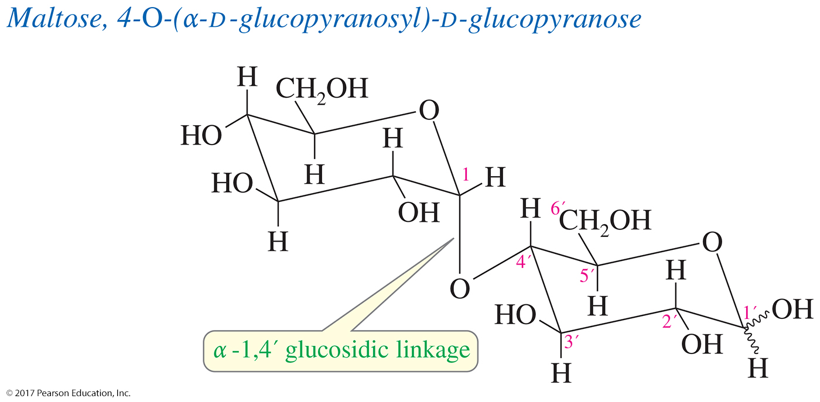
Maltose:
An α-1,4′ Glucosidic Linkage
Maltose contains an α-1,4′ glucosidic linkage between the two glucose units.
The monosaccharides in maltose are joined together by the axial position of C1 and the equatorial position of C4′.

Slide 38
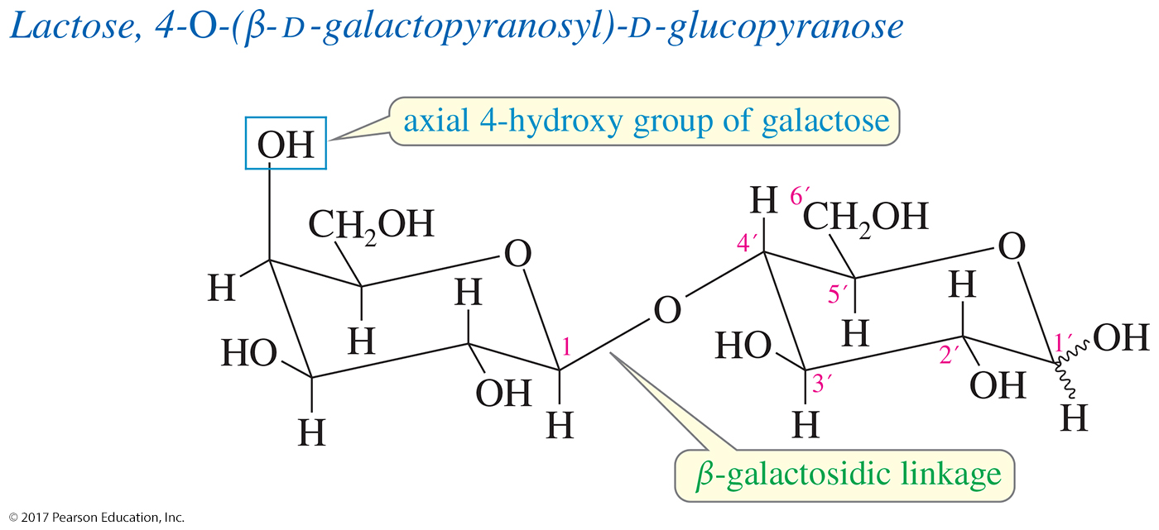
Lactose:
A β-1,4′ Galactosidic Linkage
Lactose is composed of one galactose unit and one glucose unit.
The two rings are linked by a β-glycosidic bond of the galactose acetal to the 4-position on the glucose ring: a β-1,4′ galactosidic linkage.

Slide 39
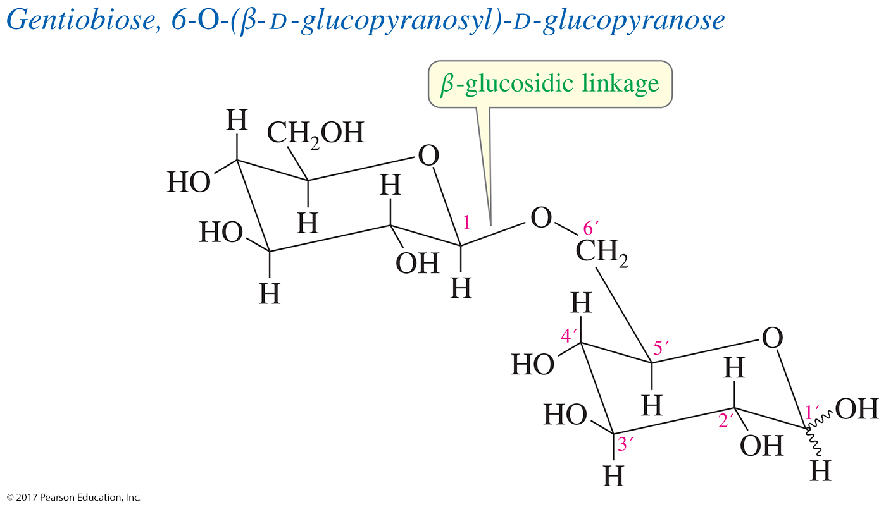
Gentiobiose: The 1,6′ Linkage
Two glucose units linked 1,6′
Rare for disaccharides, but commonly seen as branch point in carbohydrates

Slide 40
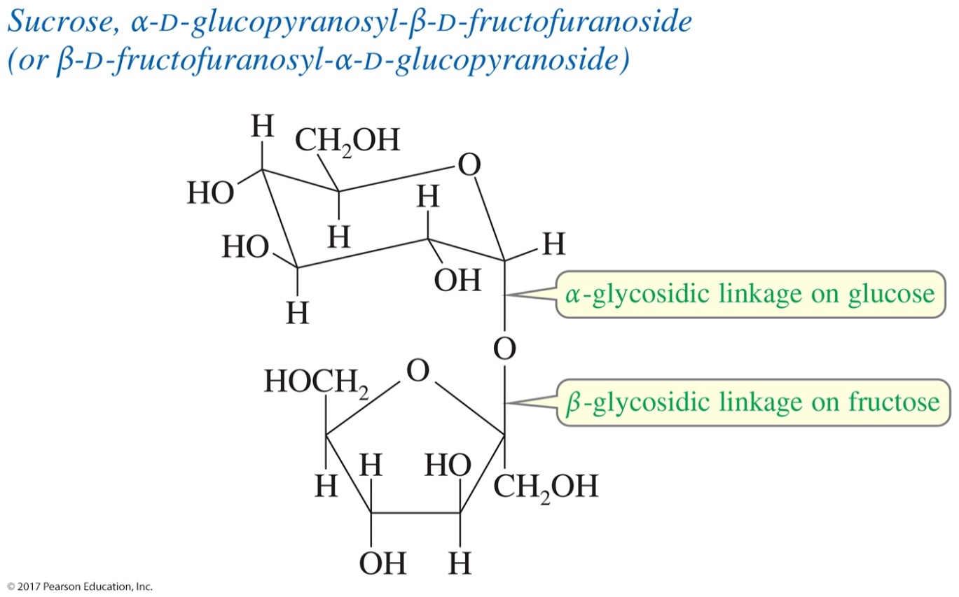
Sucrose: Linkage of Two Anomeric Carbons
Some sugars are joined by a direct glycosidic linkage between their anomeric carbon atoms: a 1,1′ linkage.

Slide 41
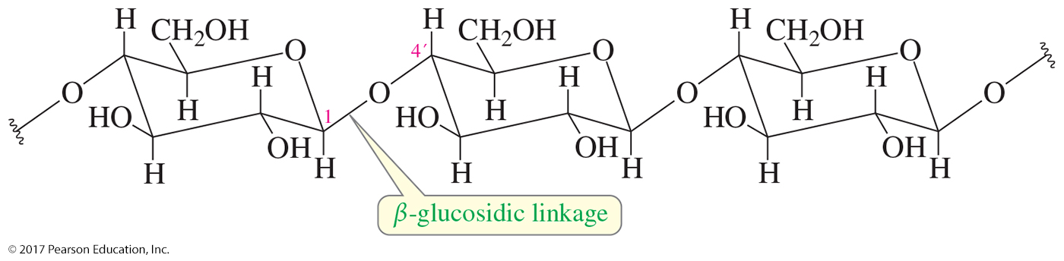
Cellulose
Cellulose is a β-1,4′ polymer of D-glucose, systematically named poly(1,4′-O-β-D-glucopyranoside).
Cellulose is the most abundant organic material.
It is synthesized by plants as a structural material to support the weight of the plant.

Slide 42
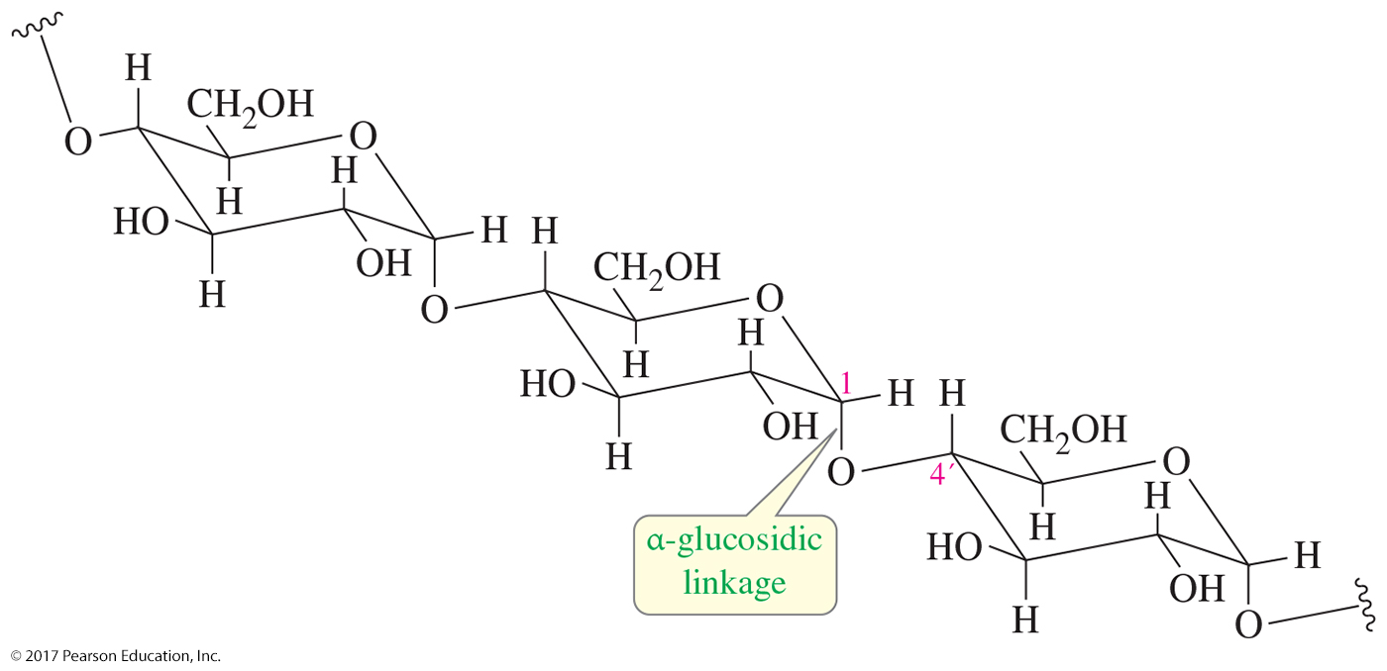
Starches: Amylose, Amylopectin, and Glycogen
Amylose is an α-1,4′ polymer of glucose, systematically named poly(1,4′-O-α-D-glucopyranoside).

Slide 43
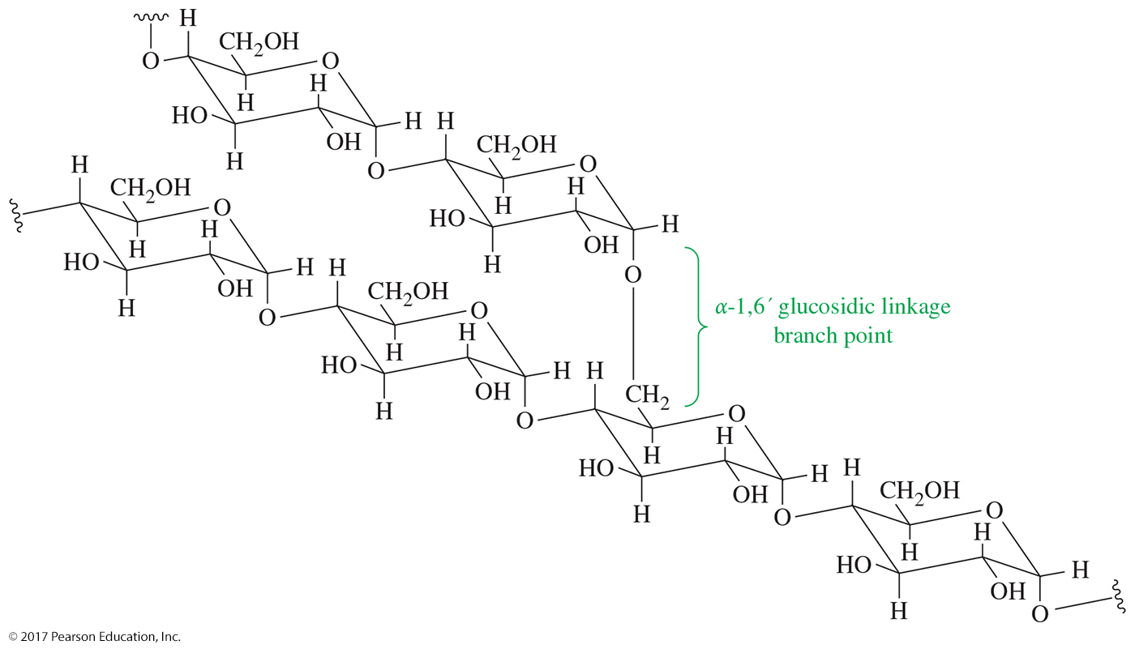
Amylopectin
Amylopectin is a branched α-1,6′ polymer of glucose.

Slide 44
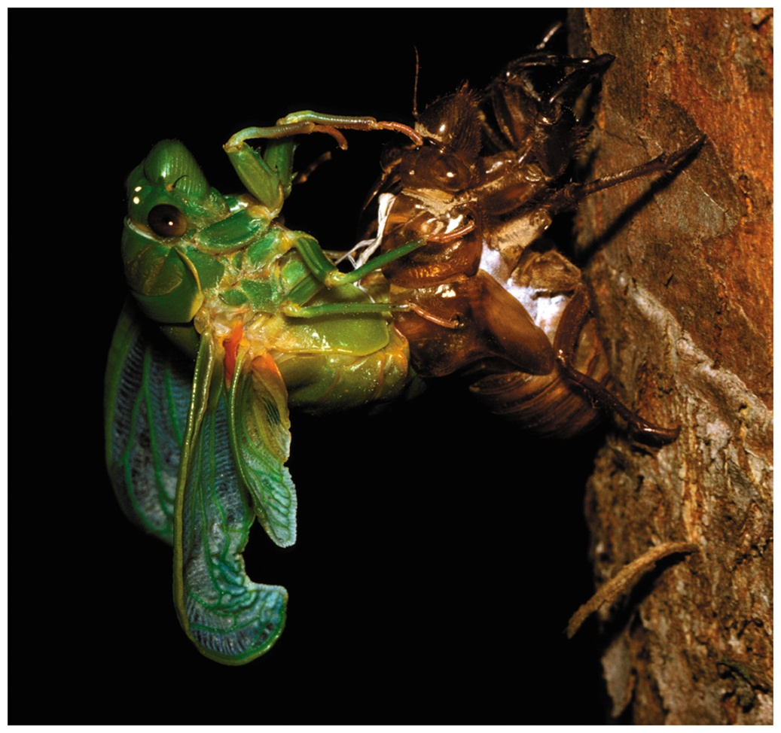
Chitin
Chitin is a polymer of
N-acetylglucosamine.
It forms the exoskeletons
of insects.
Like other amides,
N-acetylglucosamine forms exceptionally strong hydrogen bonds between the amide carbonyl groups and protons.

Slide 45
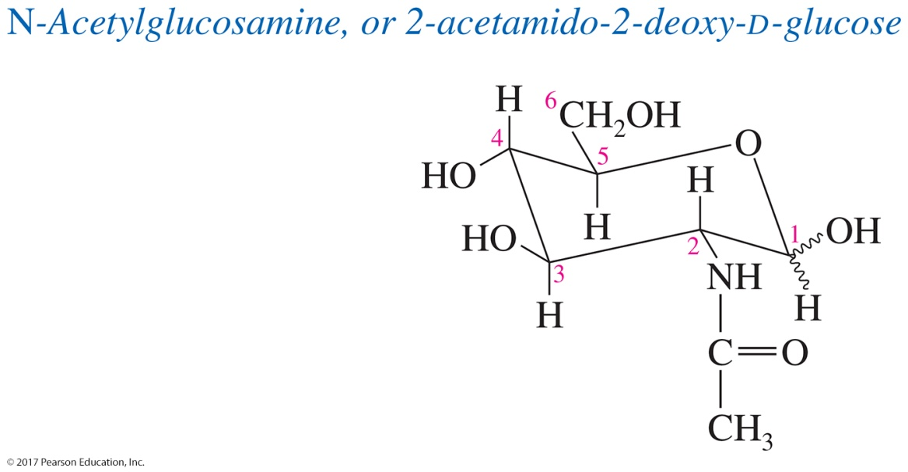
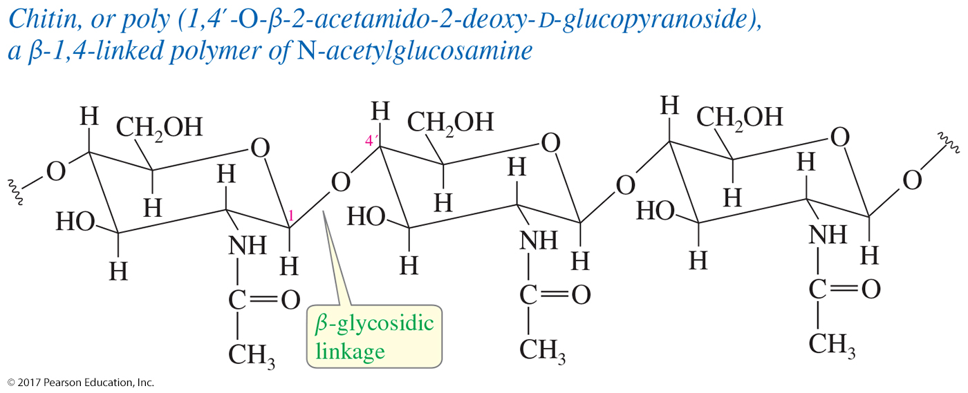
Chitin

Slide 46
Nucleic Acids
Polymer of ribofuranoside rings linked by phosphate ester groups
Each ribose is bonded to a base.
Ribonucleic acid (RNA)
Deoxyribonucleic acid (DNA)

Slide 47
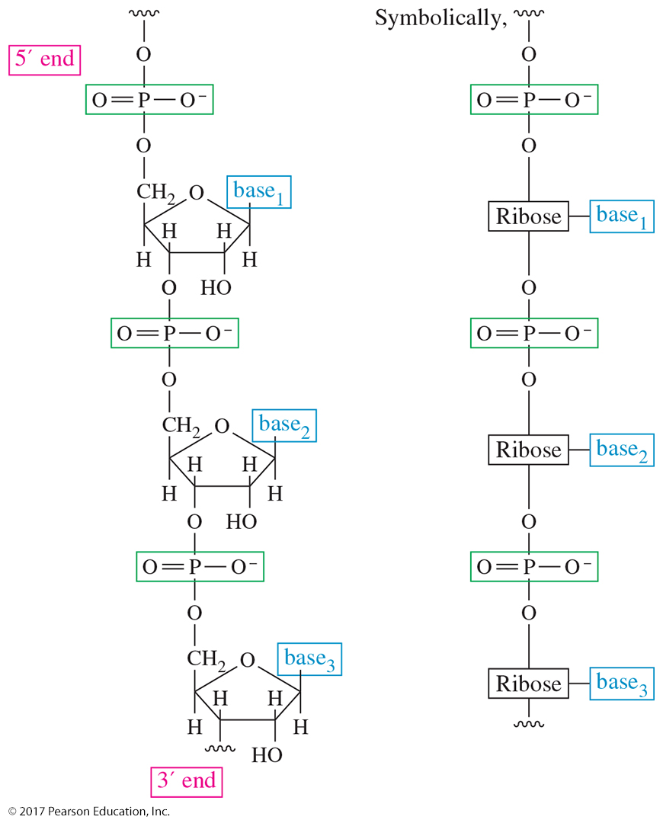
RNA Polymer
Nucleic acids are assembled on a backbone made up of ribofuranoside units linked by phosphate esters.

Slide 48
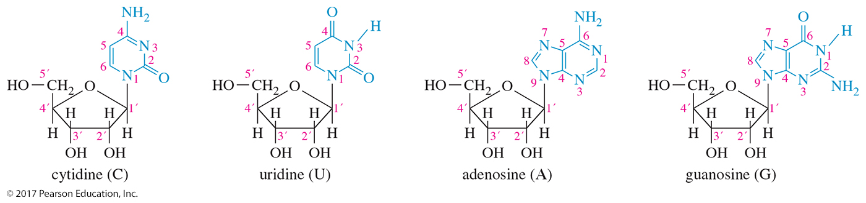
Cytidine, Uridine, Adenosine, and Guanosine
Ribonucleosides are components of RNA based on glycosides of the furanose form of d-ribose.

Slide 49
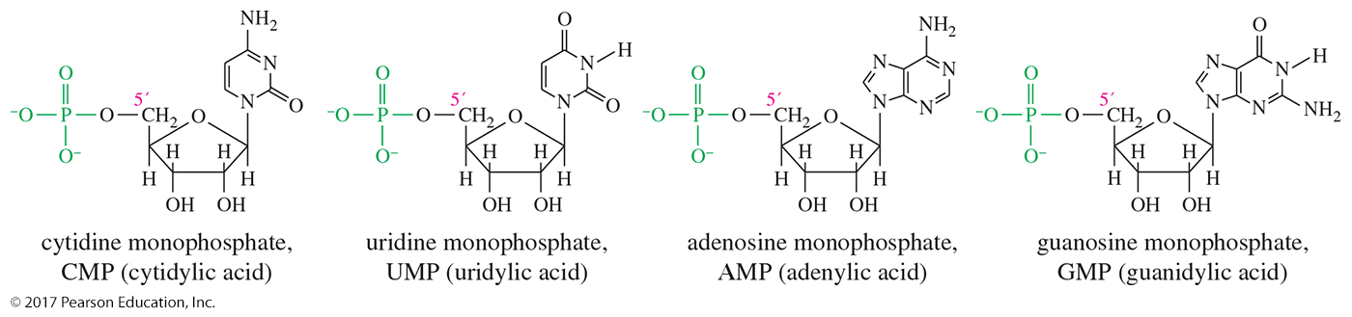
Common Ribonucleotides
Ribonucleosides are esterified by phosphoric acid at their
5′ position, the —CH₂OH at the end of the ribose chain.
Ribonucleosides are joined together by phosphate ester linkages.

Slide 50
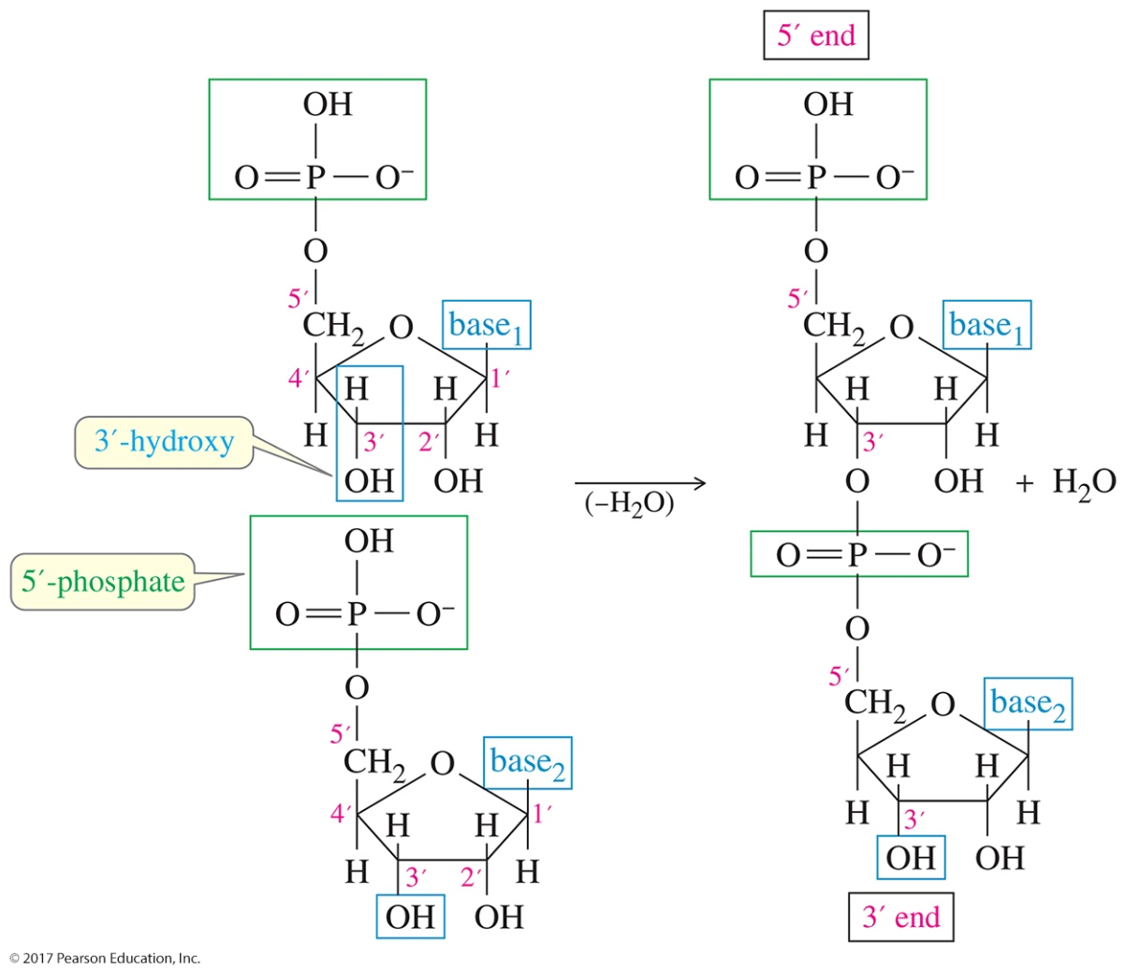
Phosphate Linkages
A molecule of RNA always has two ends (unless it is in the form of a large ring); one end has a free 3′ group, and the other end has a free 5′ group.

Slide 51
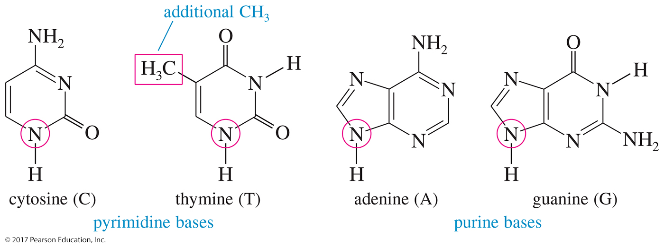
DNA Bases
The four common bases of DNA are cytosine, thymine, adenine, and guanine.

Slide 52
The Double Helix of DNA
Heterocyclic bases are cytosine, thymine (instead of uracil), adenine, and guanine.
They are linked by phosphate ester groups to form the primary structure.

Slide 53
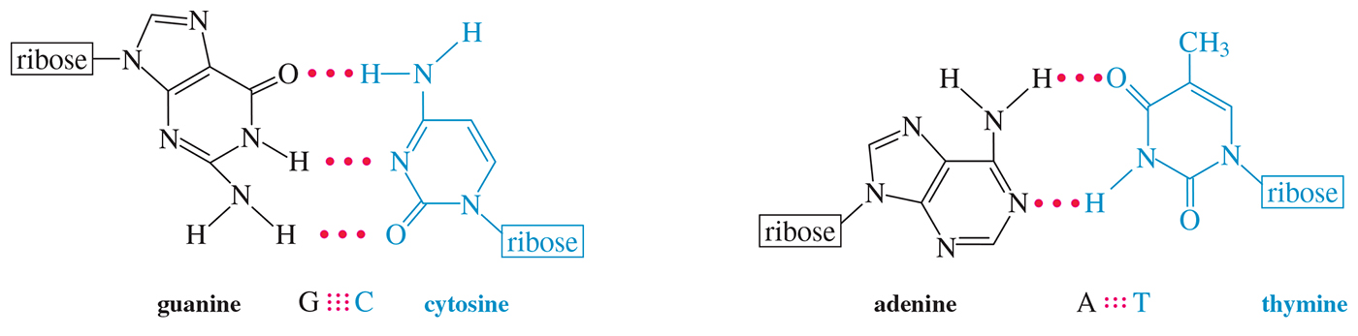
Base Pairing in DNA and RNA
Each purine forms a stable hydrogen-bonded pair with a specific pyrimidine base.
Guanine hydrogen-bonds to cytosine in three places; adenine hydrogen-bonds to thymine in two places.

Slide 54
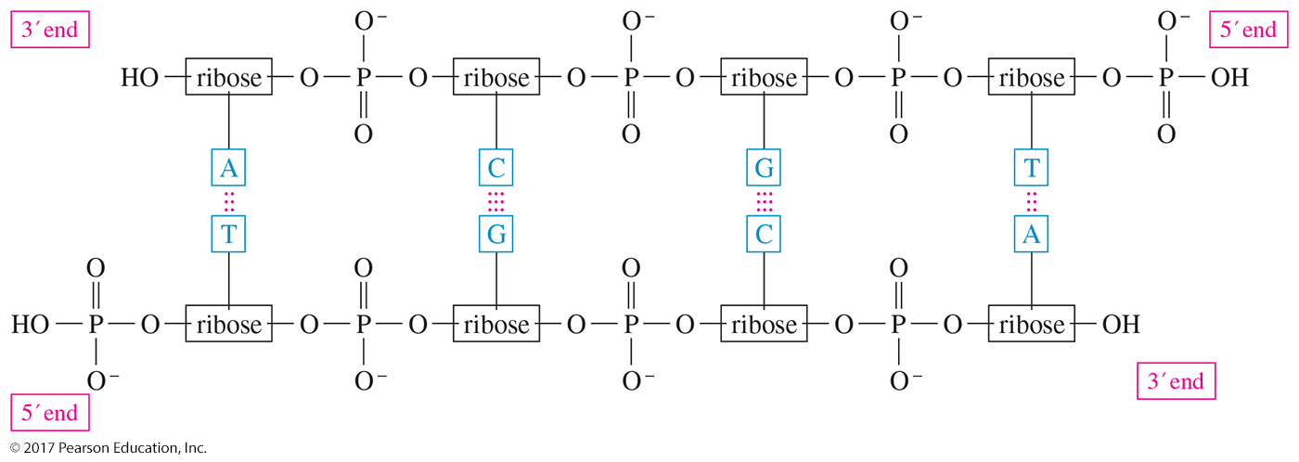
Antiparallel Strands of DNA
DNA usually consists of two complementary strands, with all the base pairs hydrogen-bonded together.
The two strands are antiparallel, running in opposite directions.

Slide 55
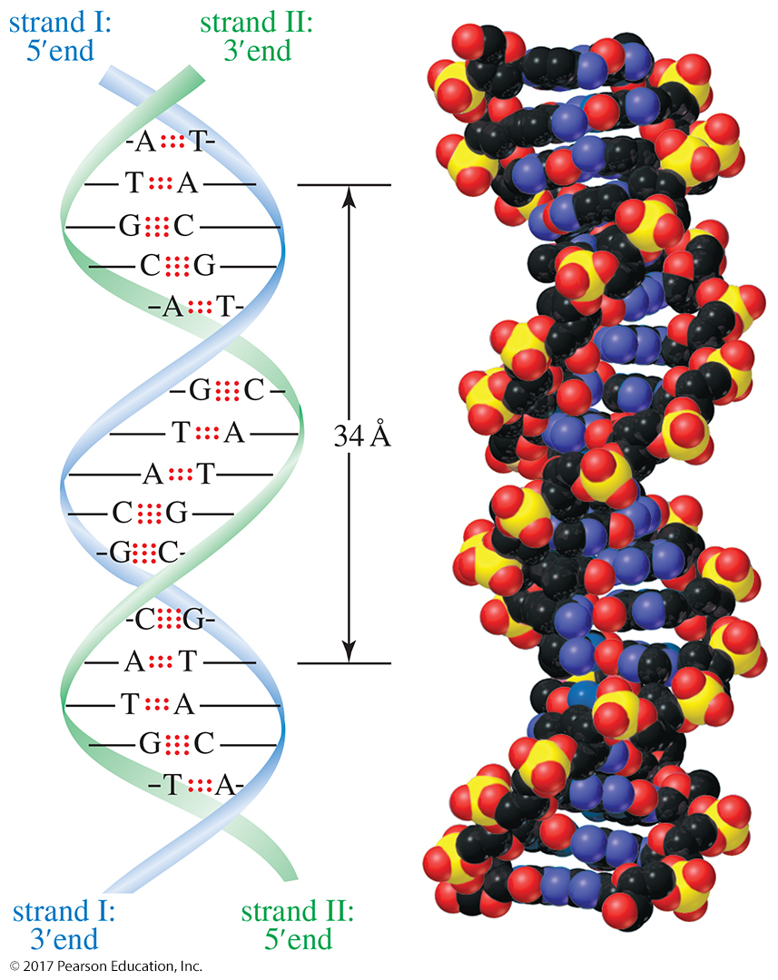
The Double Helix
Two complementary strands are joined by hydrogen bonds between the base pairs.
This double strand coils into a helical arrangement described by Watson and Crick in 1953.

Slide 56

Replication

Slide 57
Additional Nucleotides
Adenosine monophosphate (AMP), a regulatory hormone
Nicotinamide adenine dinucleotide (NAD), a coenzyme
Adenosine triphosphate (ATP), an energy source

Slide 58

AMP and Cyclic AMP

Slide 59

NAD

