Slide 1
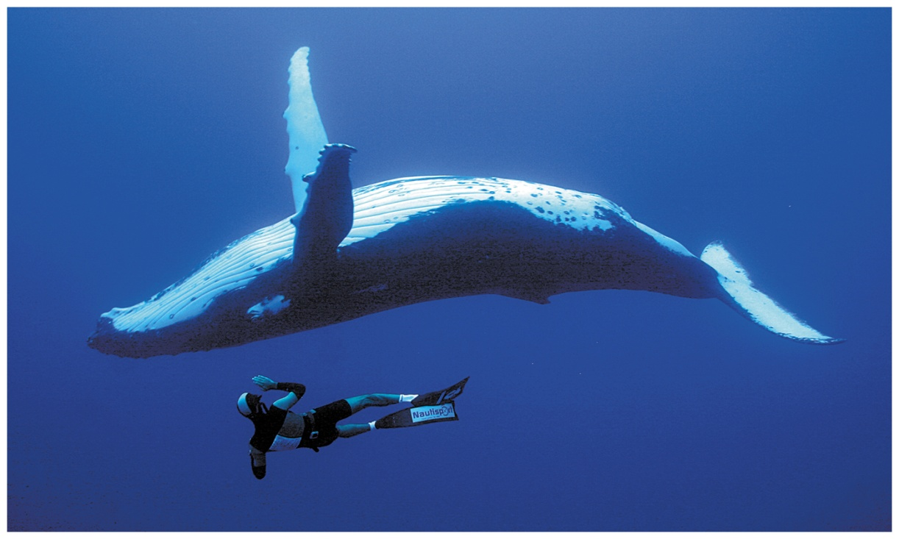


Chapter 25
Lecture
Organic Chemistry,
9th Edition
L. G. Wade, Jr.
Lipids
Chad Snyder, PhD
Grace College
© 2017 Pearson Education, Inc.

Slide 2
Introduction
Lipids are compounds that can be extracted from cells by nonpolar organic solvents.
Complex lipids are easily hydrolyzed.
    Long-chain esters are called fatty acids.
Simple lipids are not easily hydrolyzed in acid or base.
    Steroids
    Prostaglandins
    Terpenes

Slide 3
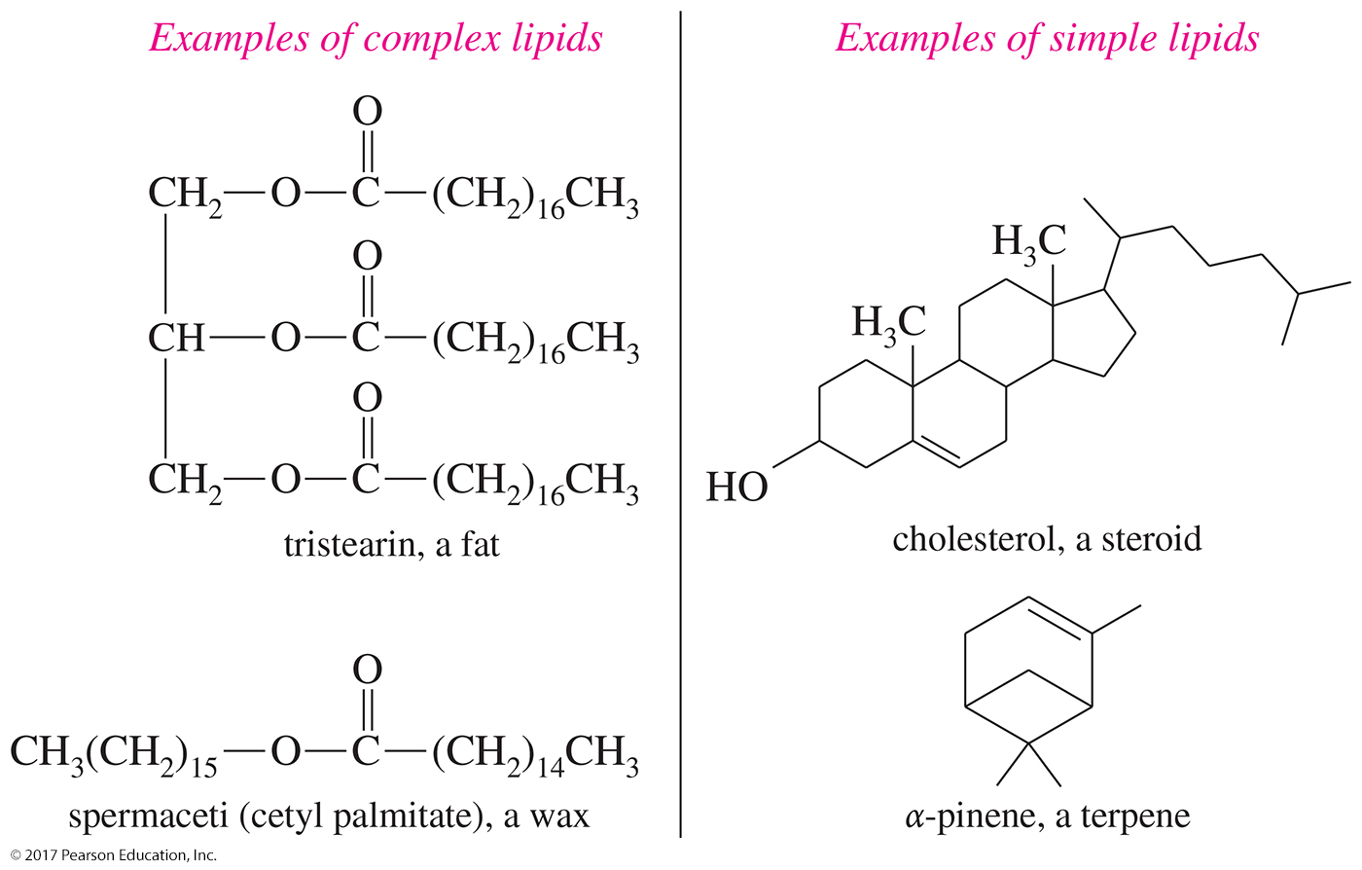
Examples of Lipids

Slide 4
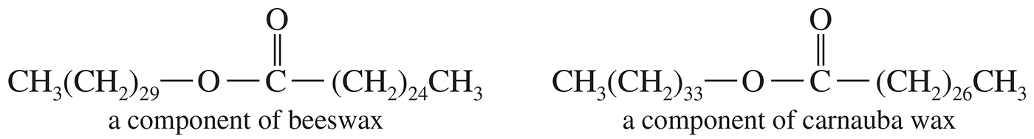
Waxes
Esters of long-chain fatty acids with long-chain alcohols
Commonly found in nature
      Spermaceti is found in the head of the sperm whale.
      Beeswax is a mixture of waxes, hydrocarbons, and alcohols that bees use to make their honeycomb.
      Carnauba wax is a mixture of waxes of high molecular weights.

Slide 5
Fatty Acids
Unbranched carboxylic acids with 12–20 carbons
Most contain an even number of carbons because they are built from acetic acid units.
Melting points increase with increasing molecular weights.
Unsaturation greatly lowers the melting point.

Slide 6
Glycerides
Fatty acid esters of the triol glycerol
Triglycerides are the most common glycerides, and they are used for long-term energy storage in plants and animals.
    Fats
        Solid at room temperature
        Most are derived from mammals.
    Oils
        Liquid at room temperature
        Most are derived from plants or cold-blooded animals.

Slide 7
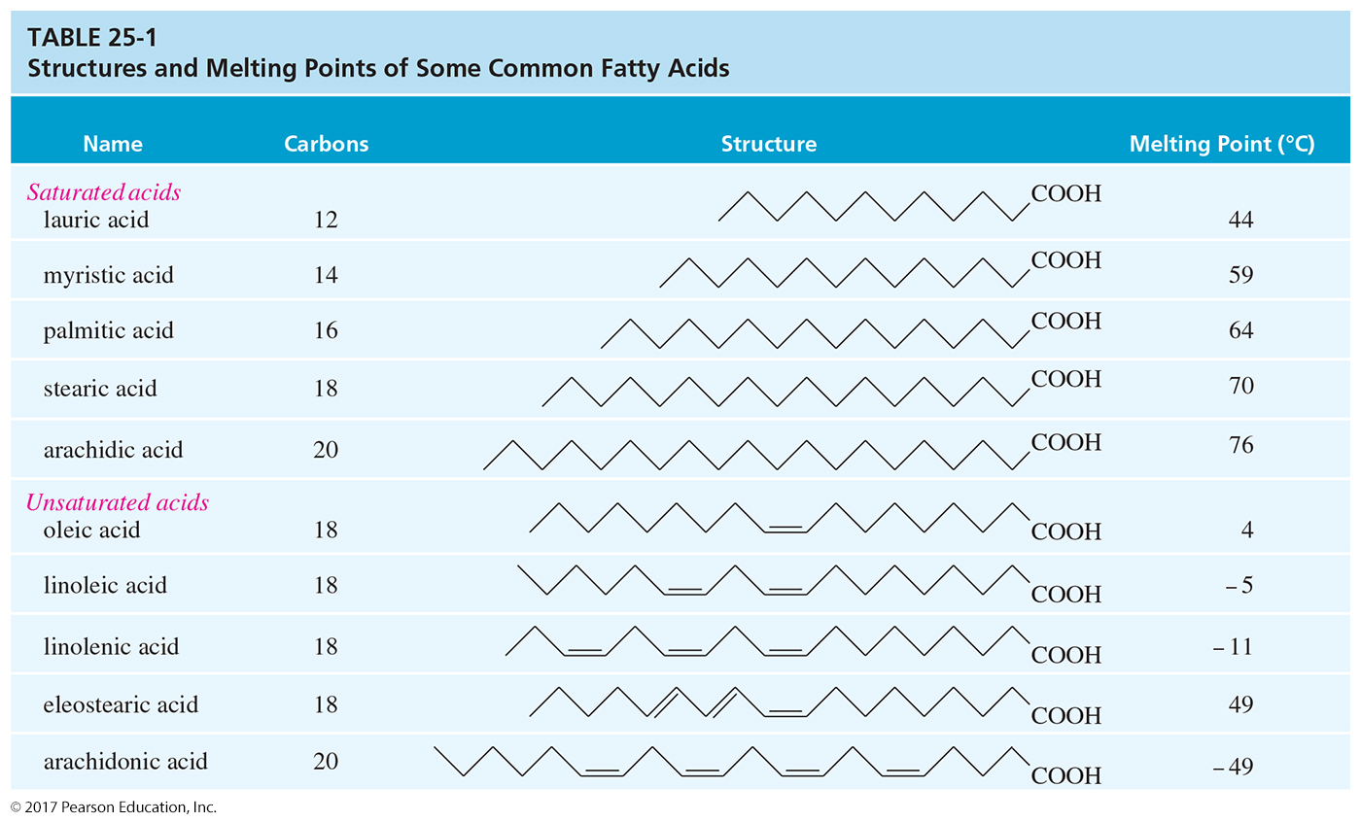
Melting Points of Fatty Acids
Notes:
Figure: 25_01-03T01.jpg
Title:
Structures and Melting Points of Some Common Fatty Acids
Caption:
Saturated fatty acids have melting points that increase gradually with their molecular weight.
Notes:
The presence of cis double bonds lowers the melting point.

Slide 8
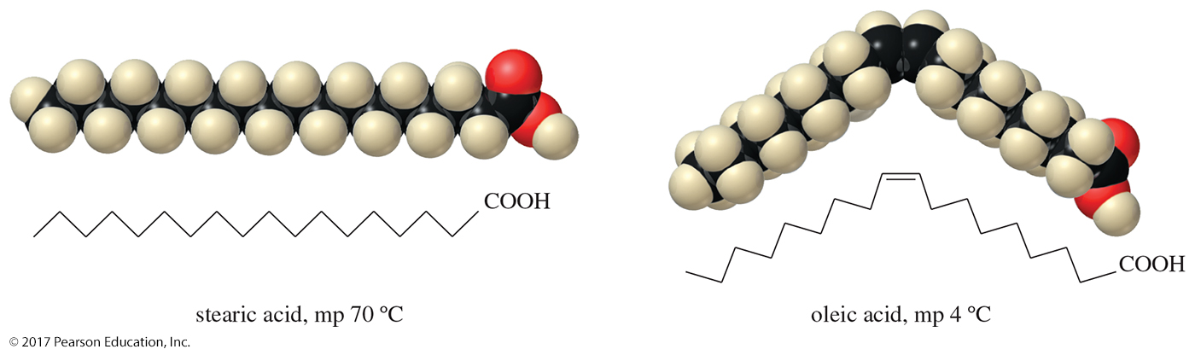
Melting Points
The cis double bond in oleic acid lowers the melting point by 66 °C.
A cis double bond bends the molecule, so it cannot pack efficiently.
A trans double bond has less effect.

Slide 9
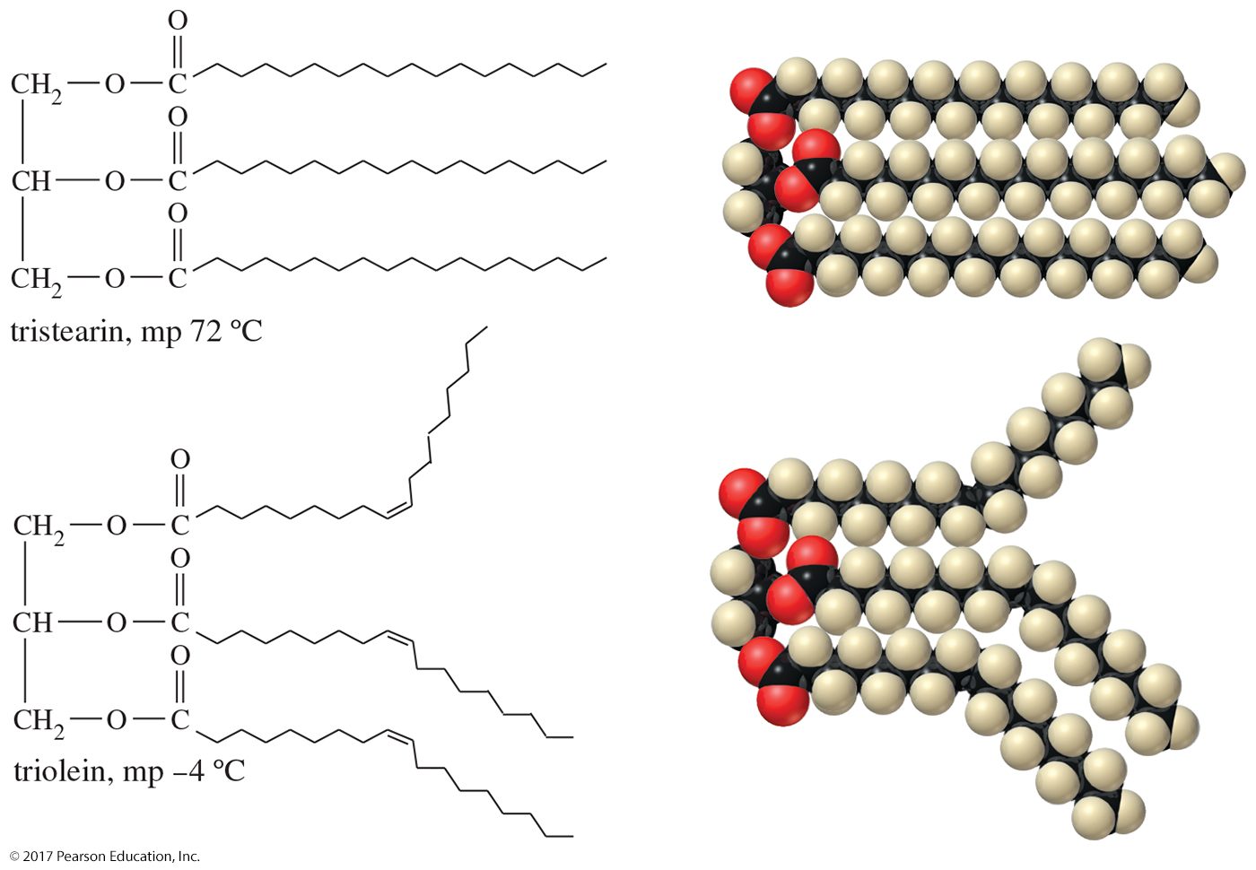
Fats and Oils
Unsaturated triglycerides have lower melting points because their unsaturated fatty acids do not pack as well in a solid lattice.

Slide 10
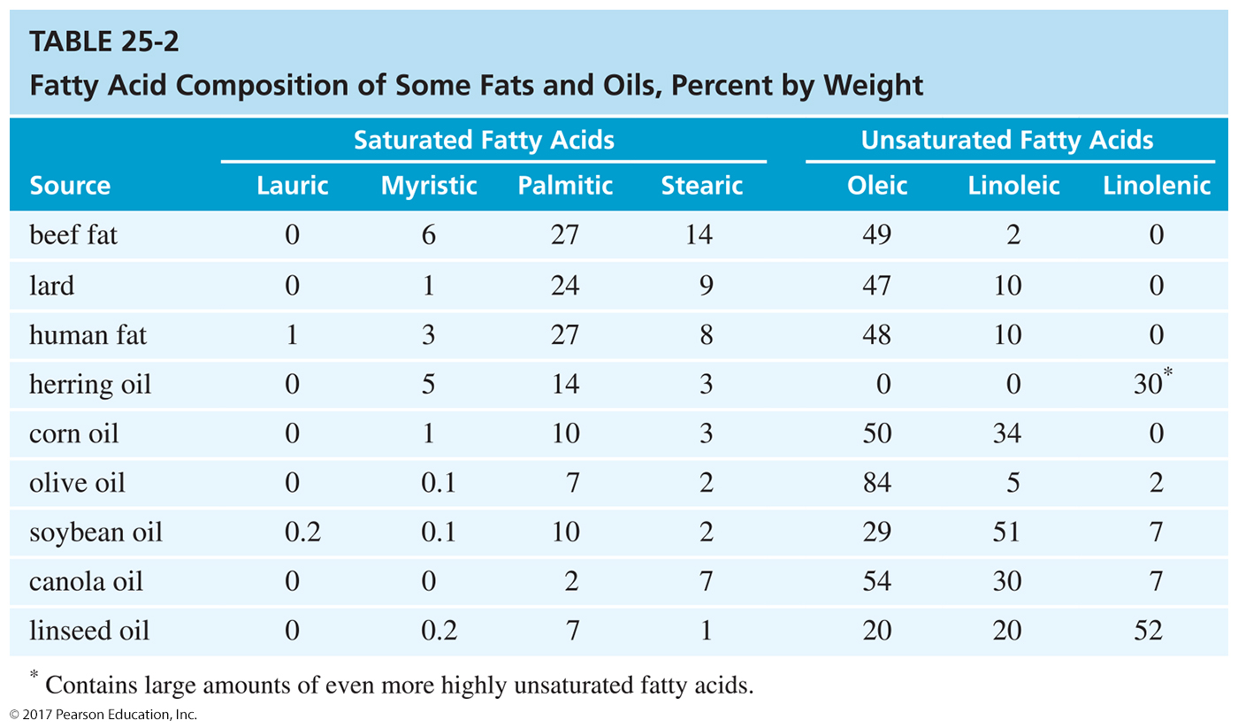

Slide 11
Trans Fats
Consumers are concerned with the presence of unnatural trans fatty acids in “partially hydrogenated vegetable oil.”
The hydrogenation process can produce trans fats, which are associated with an increase in coronary heart disease.

Slide 12
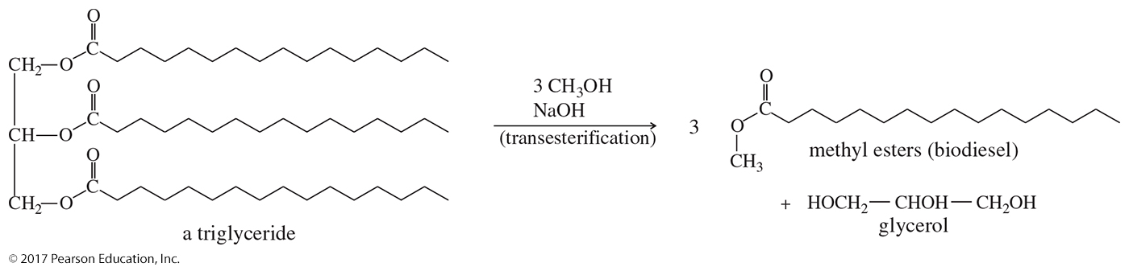
Biodiesel
Most diesel engines can run on cooking oil once they are warm, but cooking oil is not sufficiently volatile to start a cold diesel engine.

Slide 13
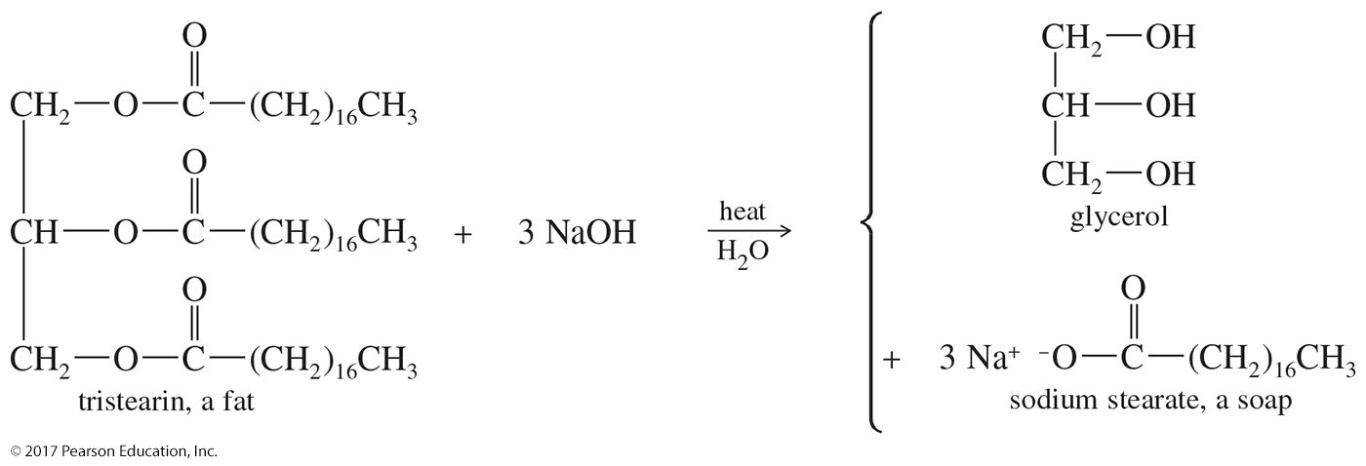
Saponification
Base-catalyzed hydrolysis of ester linkages in fats and oils
Long-chain carboxylate salts are known as soap.

Slide 14
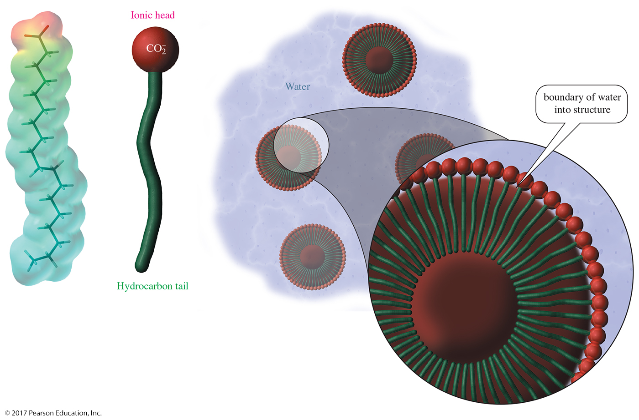
Soap Structure: Micelles

Slide 15
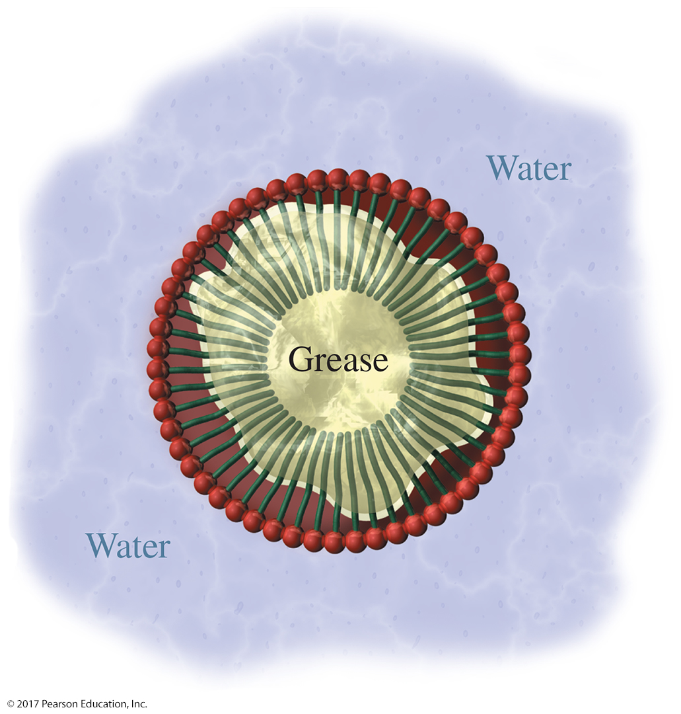
Grease in Soap Solution
In water, soap forms a cloudy solution of micelles, with the hydrophilic heads in contact with water and the hydrophobic tails clustered in the interior.
The Na⁺ ions (not shown) are dissolved in the water surrounding the micelle.

Slide 16
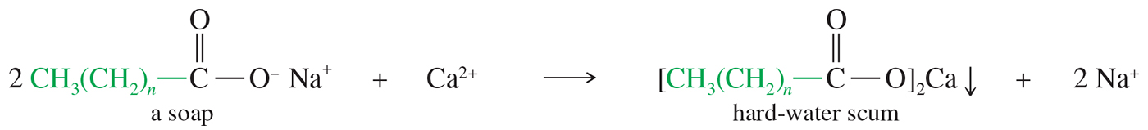
Hard Water and Acid Scum
Hard water is water that is acidic or that contains ions of calcium, magnesium, or iron.
Although these mineral-rich waters can be healthful for drinking, the ions react with soaps to form insoluble salts called hard-water scum.

Slide 17
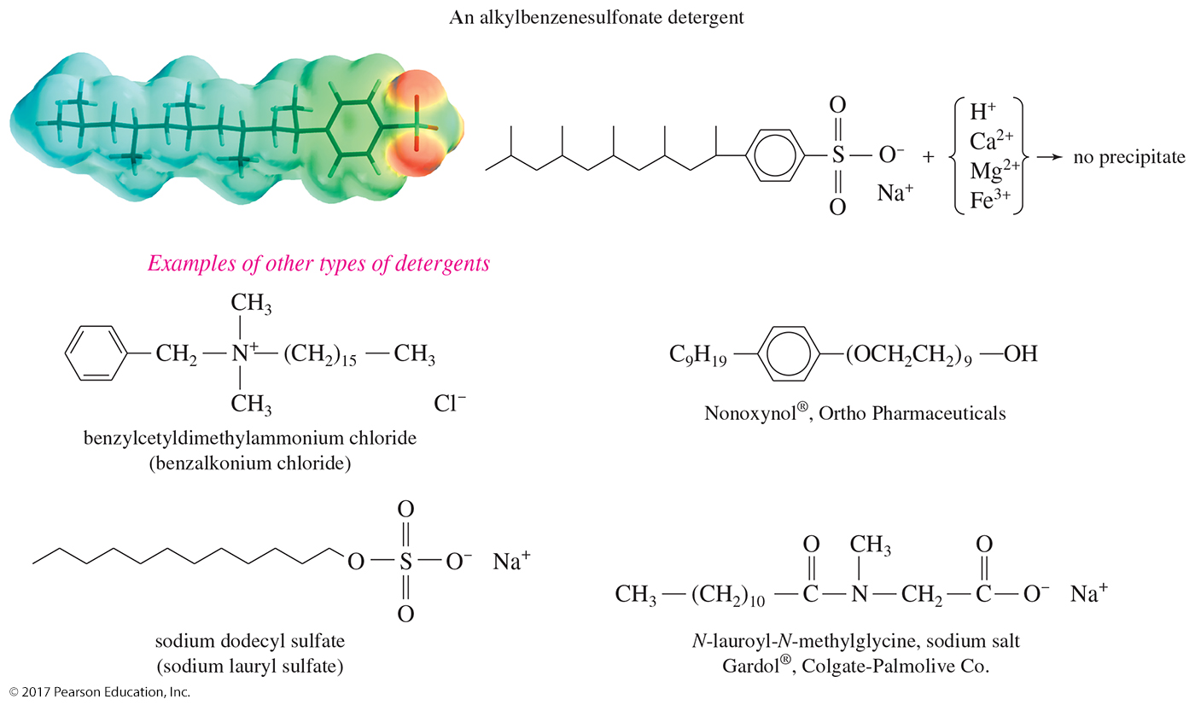
Synthetic Detergents
Synthetic detergents may have anionic, cationic, or nonionic hydrophilic functional groups.

Slide 18
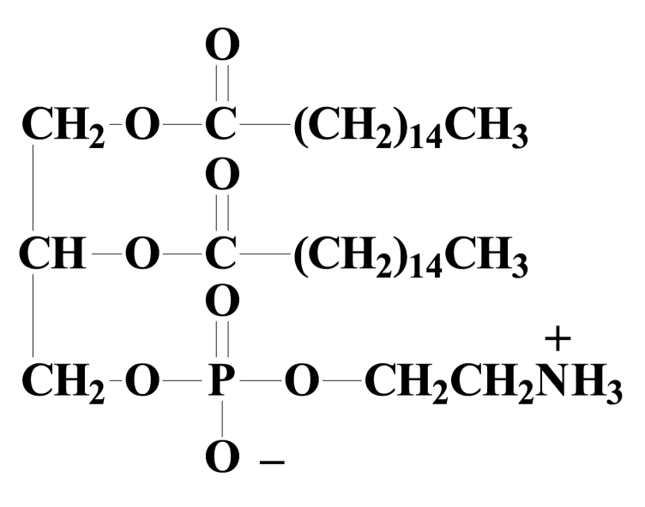
Phospholipids
Phospholipids are lipids that contain groups derived from phosphoric acid.
Phosphoglycerides usually have one phosphoric acid group and two fatty acids.
The phosphate may have an additional alcohol attached by an ester linkage.

Slide 19
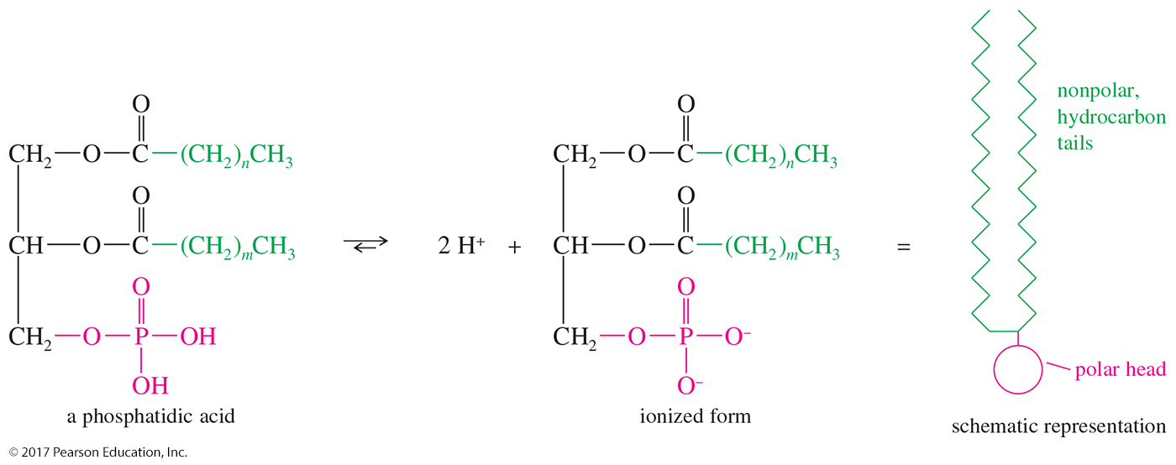
Phosphatidic Acids
Although it is often drawn in its acid form, a phosphatidic acid is actually deprotonated at neutral pH.

Slide 20
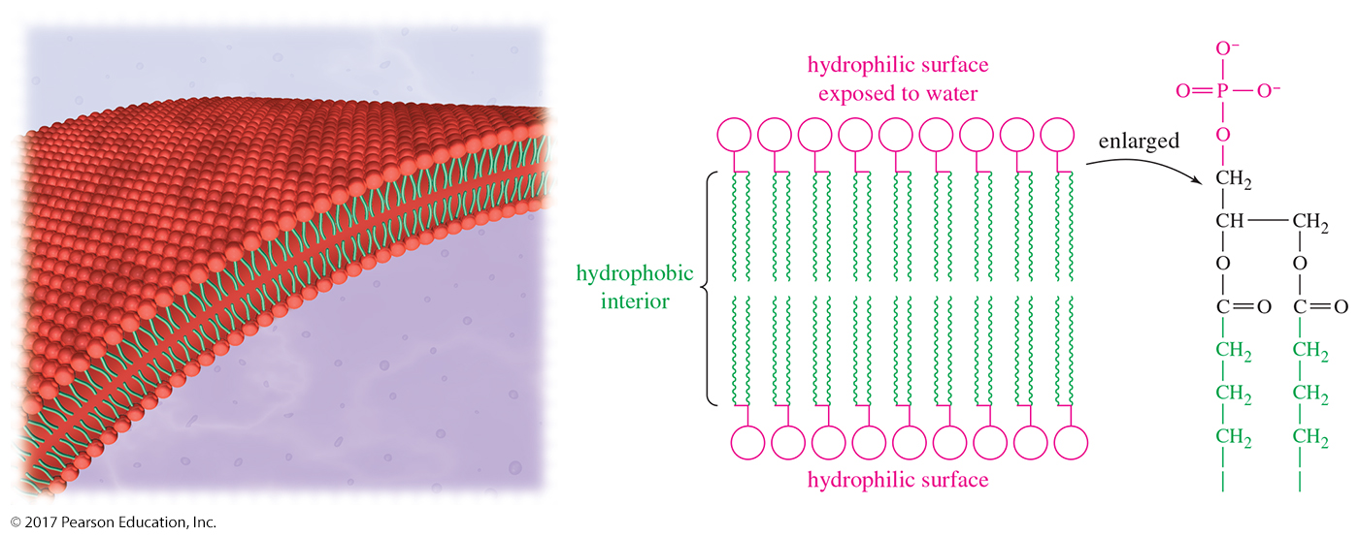
Lipid Bilayer
Phosphoglycerides can aggregate into a bilayer membrane with their polar heads exposed to the aqueous solution and the hydrocarbon tails protected within.
This lipid bilayer is an important part of the cell membrane. It restricts the flow of water and dissolved substances.

Slide 21
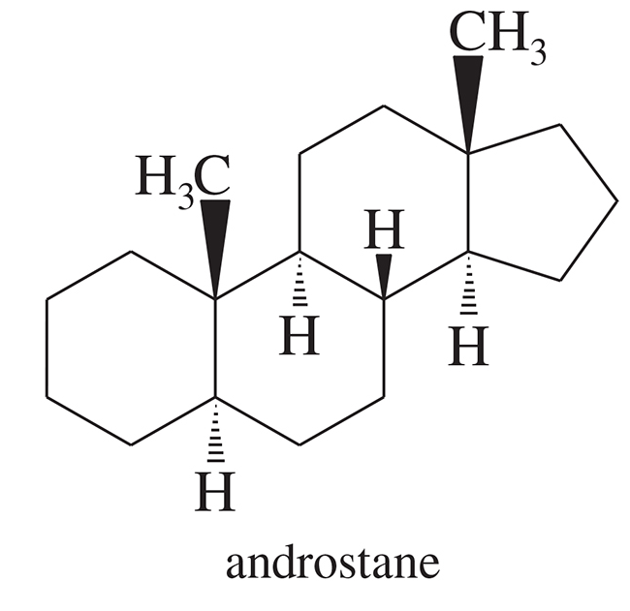
Steroids
Steroids are classified as simple lipids because they do not undergo hydrolysis.
Common structural features:
    ═O or —OH at C3
    Side chain at C17
    May also have a double bond from C5 to either C4 or C6

Slide 22
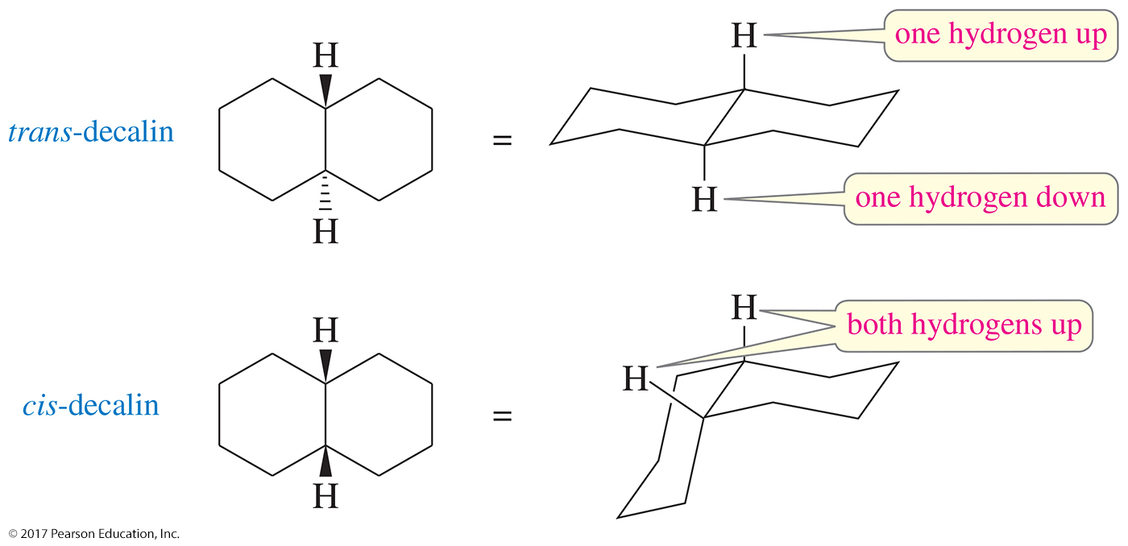
Cis- and Trans-Decalins
In trans-decalin, the two bonds to the second ring are trans to one another, and the hydrogens on the junction are also trans.
In cis-decalin, the bonds to the second ring are cis, and the junction hydrogens are also cis.

Slide 23
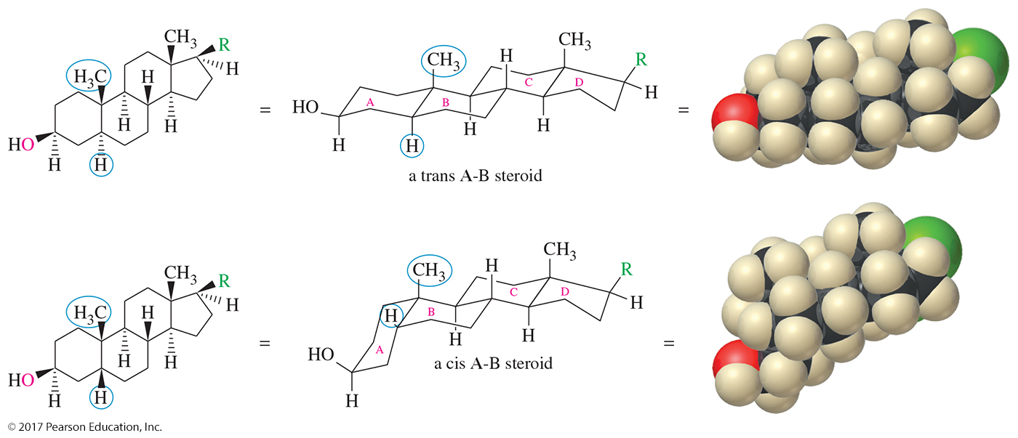
Cis and Trans Steroids
Common steroids may have either a cis or a trans A-B ring junction. The other junctions are normally trans.

Slide 24
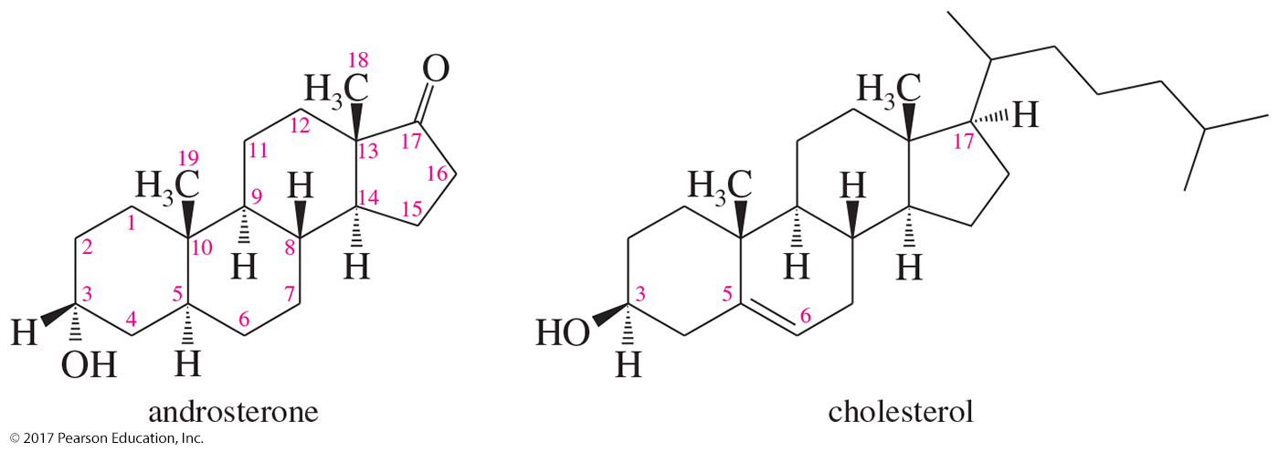
Cholesterol
Common biological intermediate
Probably a precursor to other steroids
Side chain at C17 and double bond at C5–C6

Slide 25
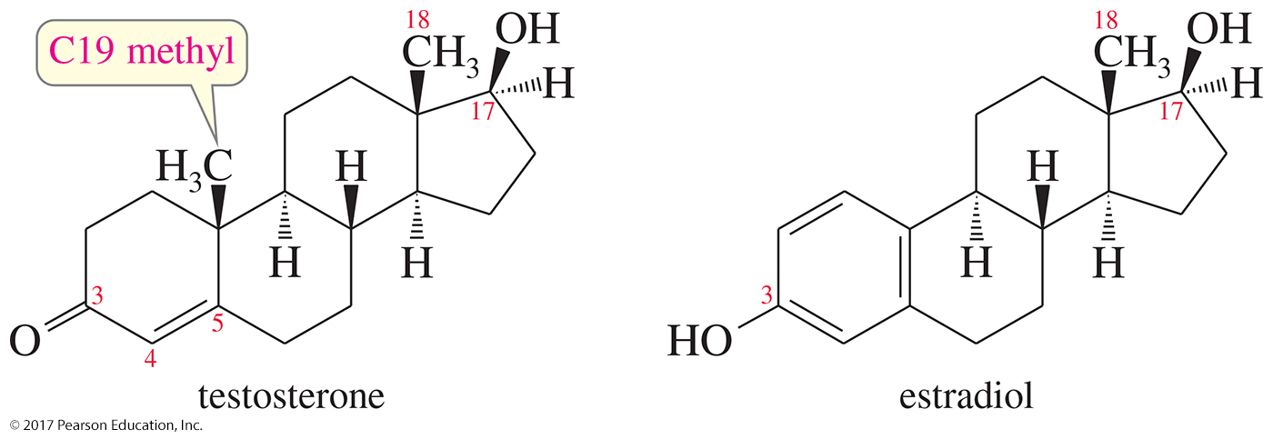
Sex Hormones
Testosterone is the most potent of the natural male sex hormones, and estradiol is the most potent natural female hormone.
Notice that the female sex hormone differs from the male hormone by its aromatic A ring.

Slide 26
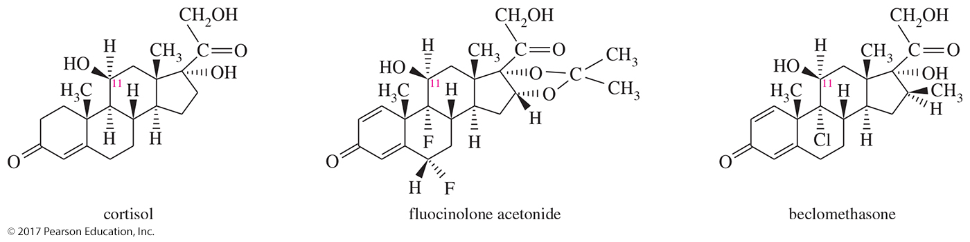
Examples of Steroids
Cortisol is the major natural hormone of the adrenal cortex.
Fluocinolone acetonide is more potent for treating skin inflammation.
Beclomethasone is more potent for treating asthma.

Slide 27
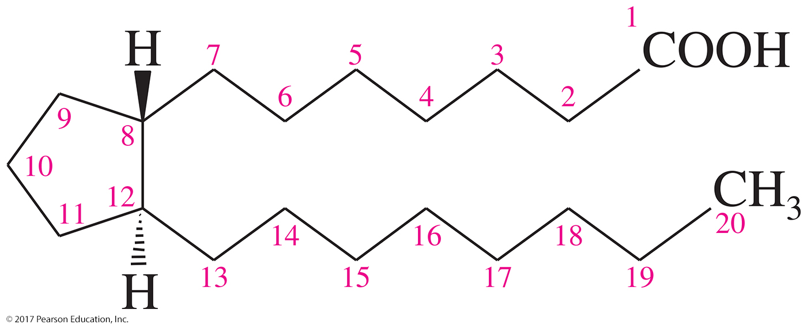
Prostaglandins
Biochemical regulators more powerful than steroids
Cyclopentane ring with two long side chains trans to each other
Most have 20 carbon atoms.
Derived from arachidonic acid

Slide 28
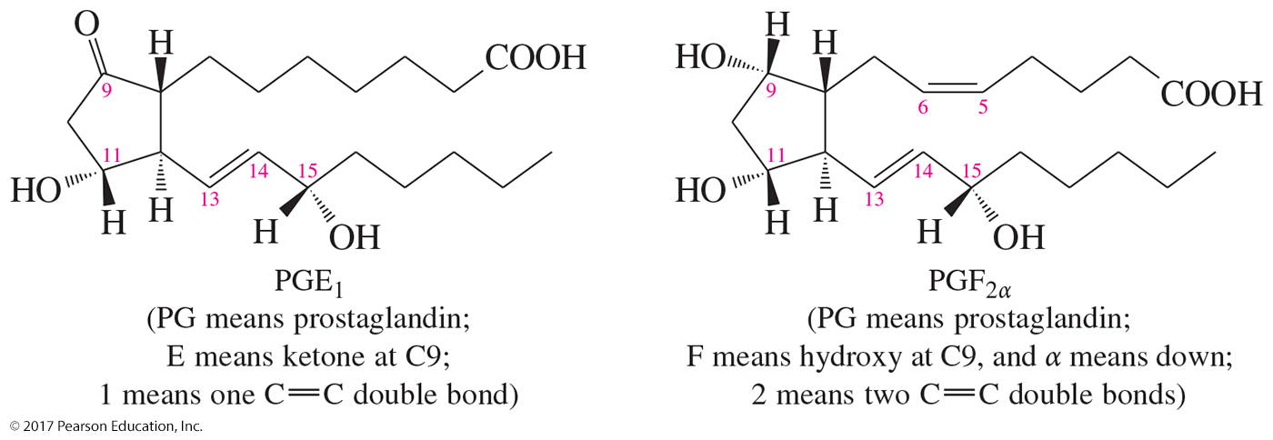
Biosynthesis of Prostaglandins
Biosynthesis of prostaglandins begins with
an enzyme-catalyzed oxidative cyclization of arachidonic acid.

Slide 29
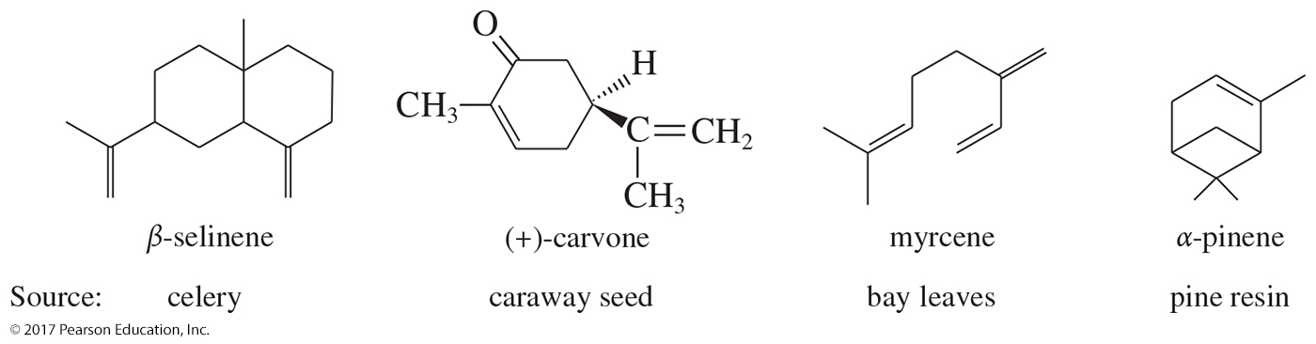
Terpenes
Composed of five carbon isopentyl (isoprene) groups
Isolated from the essential oils of plants
Pleasant taste or fragrant aroma and used as flavorings

Slide 30
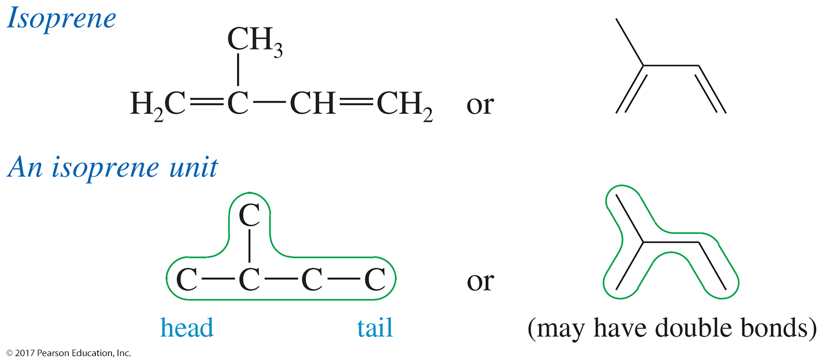
Terpenes
Terpenes are composed of two or more isoprene units.
The isoprene units will maintain their isopentyl, usually with modification of the isoprene double bonds.

Slide 31
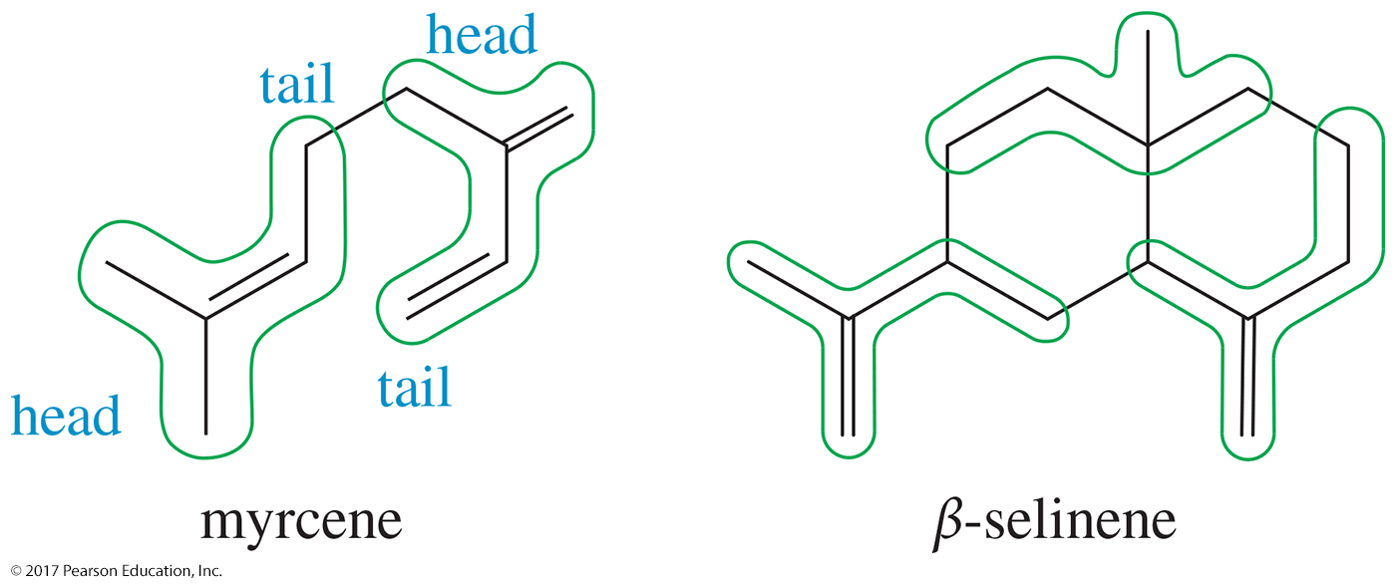
Structure of Terpenes
The isoprene molecule and the isoprene unit are said to have a “head” (the branched end) and a “tail” (the unbranched ethyl group).

Slide 32
Classification
Terpenes are classified by the number of carbons they contain in groups of 10.
    A monoterpene has 10 carbons and 2 isoprene units.
    A sesquiterpene has 15 carbons and 3 isoprene units.
    A diterpene has 20 carbons and 4 isoprene units.

Slide 33
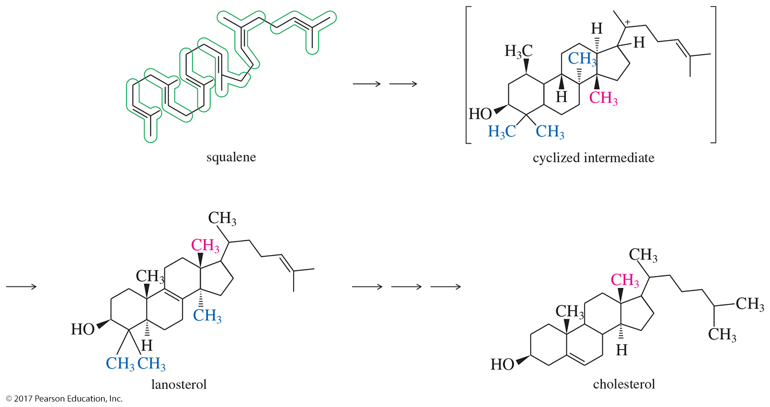
Cholesterol

Slide 34
Terpenoids
Many natural products are derived from terpenes, even though they do not have carbon skeletons composed exclusively of C5 isoprene units.
These terpene-like compounds are called terpenoids.
Terpenoids may have been altered through rearrangements, loss of carbon atoms, or introduction of carbon atoms (example: cholesterol).

