Slide 1
Oxidation States
Inorganic chemistry:
  Oxidation is a loss of electrons.
  Reduction is a gain of electrons.
Organic chemistry
  Oxidation: Gain of O, O₂, or X₂; loss of H₂
  Reduction: Gain of H₂ (or H–); loss of O or O₂; and loss of X₂
  Neither: The gain or loss of H⁺, H₂O, –OH, HX, etc. is neither an oxidation nor a reduction.

Slide 2
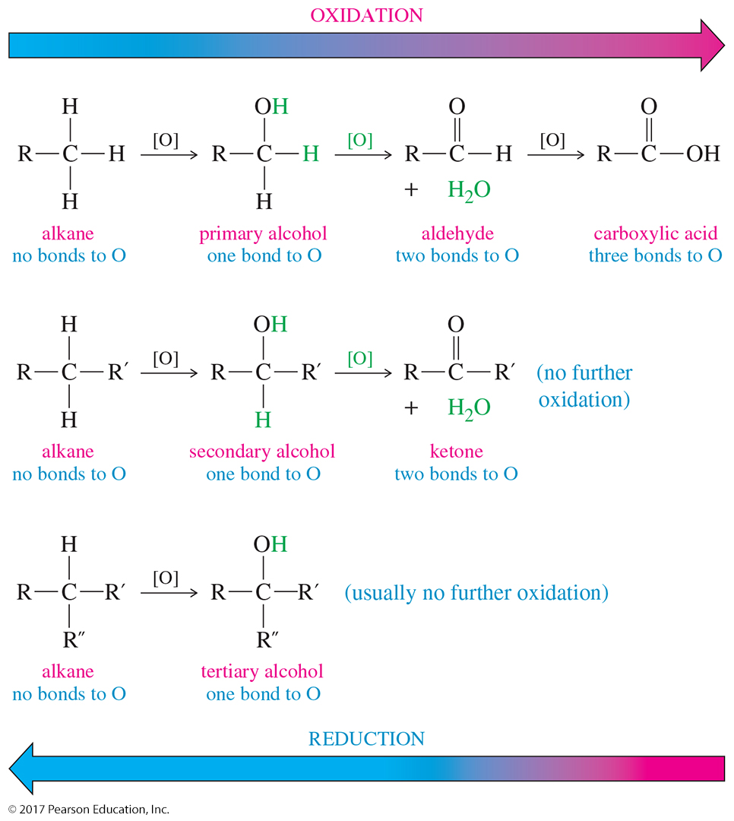
Oxidation States of Carbons

Slide 3
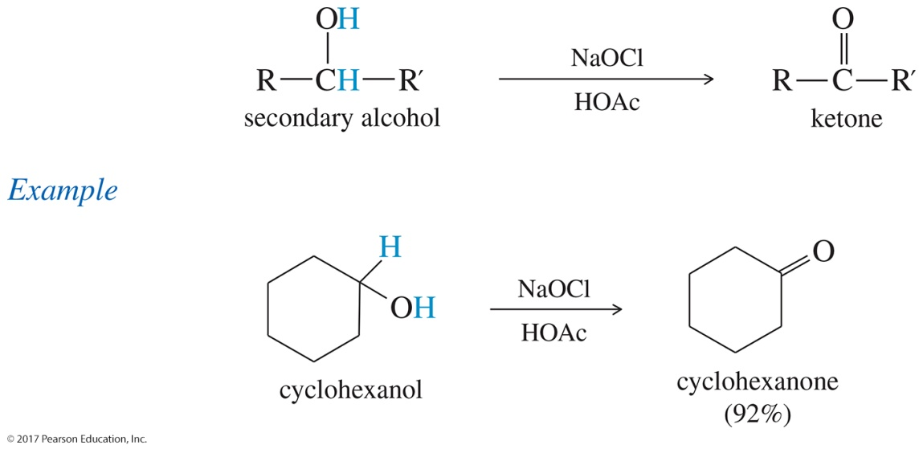
Oxidation of 2° Alcohols
A 2° alcohol becomes a ketone.
Traditional oxidizing agents are chromium- based reagents such as Na₂Cr₂O₇ in H₂SO₄.
Active reagent probably is H₂CrO₄ or HCrO₄–.
Color change is orange to greenish-blue.
Chromium is highly toxic and difficult to dispose of properly.

Slide 4
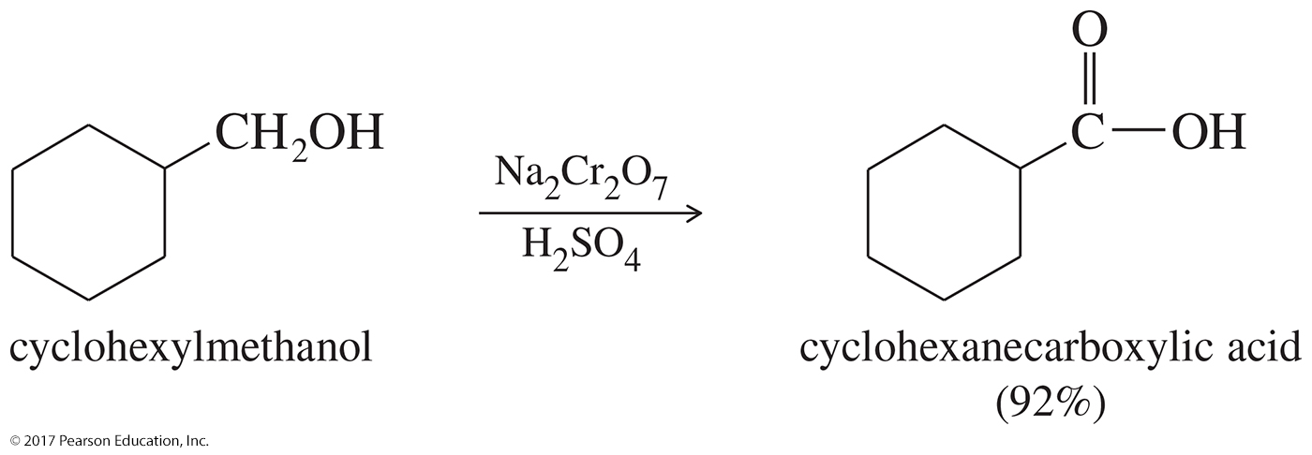
Oxidation of 1° Alcohols to Carboxylic Acids
Chromic acid reagent oxidizes primary alcohols to carboxylic acids.
The oxidizing agent is too strong to stop at the aldehyde.

Slide 5
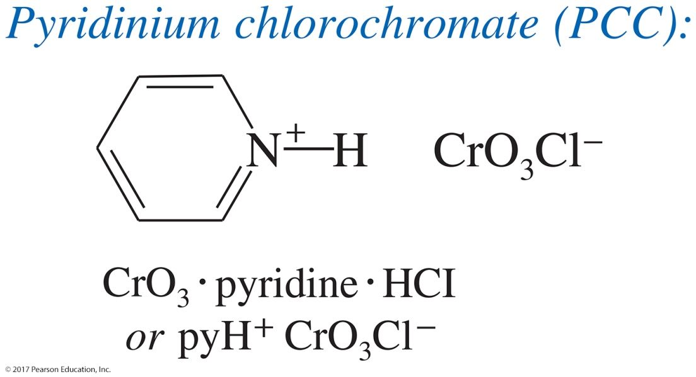
Pyridinium Chlorochromate (PCC)
PCC is a complex of chromium trioxide, pyridine, and HCl.
It oxidizes primary alcohols to aldehydes.
It oxidizes secondary alcohols to ketones.

Slide 6
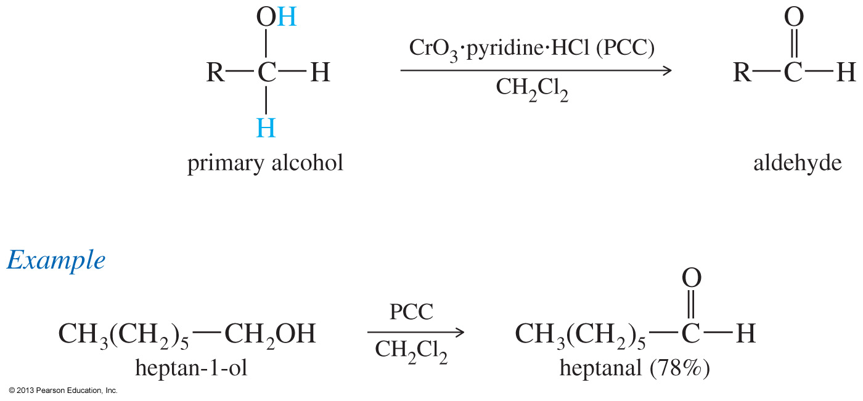
Pyridinium Chlorochromate (PCC)

Slide 7
3° Alcohols Cannot Be Oxidized
Carbon does not have hydrogen, so oxidation is difficult and involves the breakage of a C—C bond.
Chromic acid test is for primary and secondary alcohols because tertiary alcohols do not react.

Slide 8
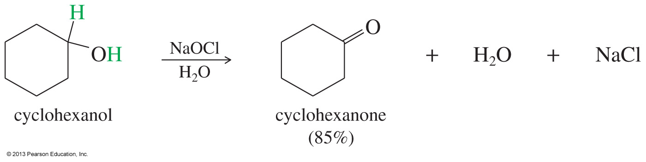
Sodium Hypochlorite (NaOCl)
Sodium hypochlorite (household bleach) can oxidize alcohols without heavy metals or generating hazardous waste.
This is a much better option for acid-sensitive compounds.

Slide 9
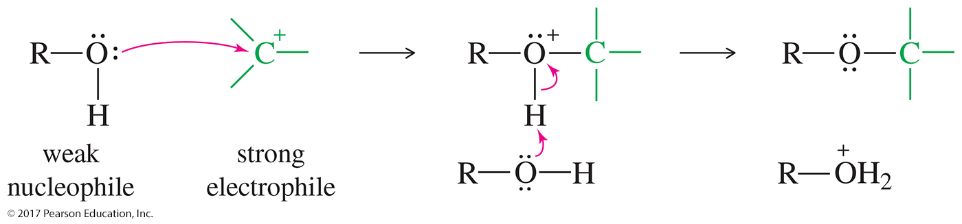
Alcohol As a Nucleophile
Alcohols (ROH) are weak nucleophiles.
Alkoxides (RO–) are strong nucleophiles.
New O—C bond forms; O—H bond breaks.

Slide 10
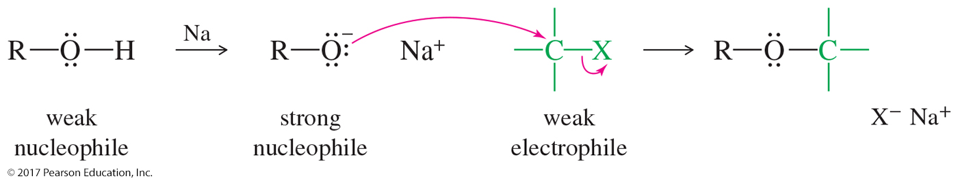
Alcohol As an Electrophile
Alcohols are weak electrophiles because the OH– is not a good leaving group.
Protonation of the hydroxyl group converts it into a good leaving group (H₂O).

Slide 11
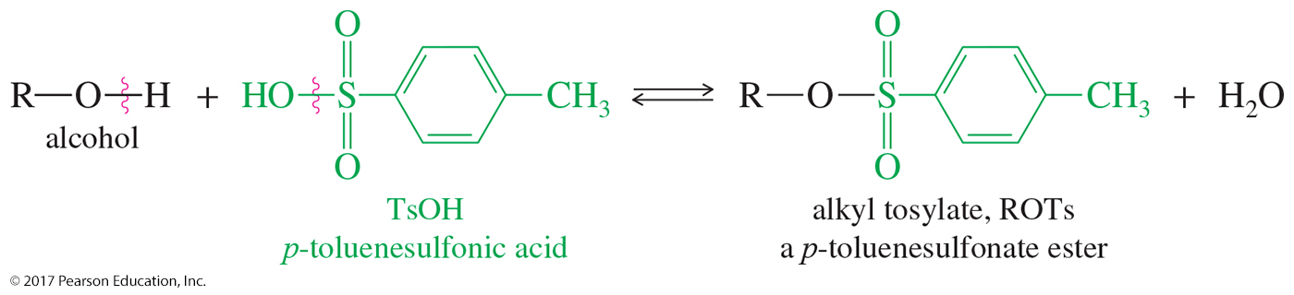
Tosylate Esters
Alcohols can be converted to tosylate esters (ROTs) through a condensation with
p-toluenosulfonic acid.
The tosylate group is an excellent leaving group.

Slide 12
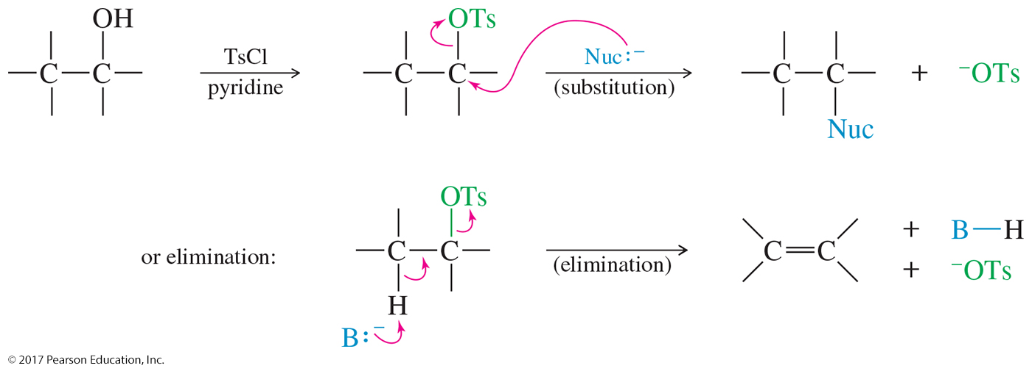
Substitution and Elimination Reactions Using Tosylates

Slide 13
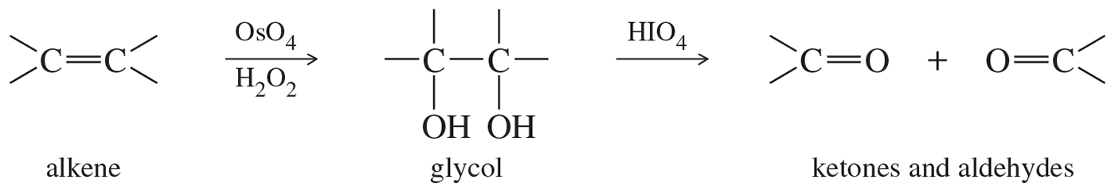
Periodic Acid Cleavage of Glycols
Glycols can be oxidatively cleaved by periodic acid (HIO₄) to form the corresponding ketones and aldehydes.
Useful for determining the structure of sugars.

