Slide 1
Introduction
Nuclear magnetic resonance spectroscopy (NMR) is the most powerful tool available for organic structure determination.
It is used to study a wide variety of nuclei:
  ¹H
  ¹³C
  ¹⁵N
  ¹⁹F
  ³¹P

Slide 2
NMR Signals
The number of signals shows how many different kinds of protons are present.
The location of the signals shows how shielded or deshielded is the proton.
The intensity of the signal shows the number of protons of that type.
Signal splitting shows the number of protons on adjacent atoms.

Slide 3
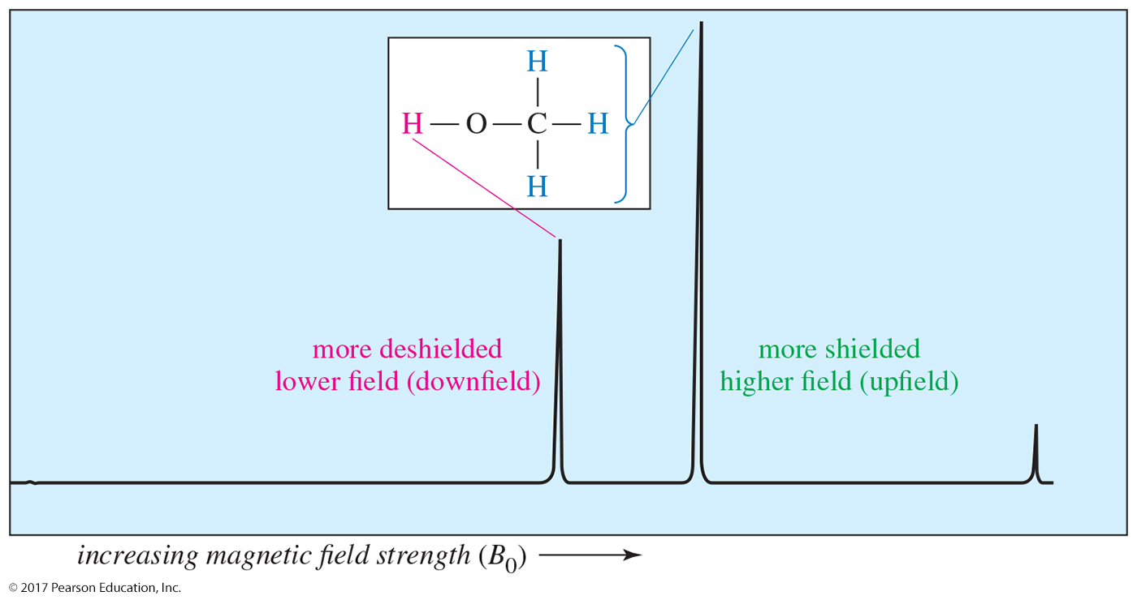
The NMR Graph
downfield
upfield
The more shielded methyl protons appear toward the right of the spectrum (higher field); the less shielded hydroxyl proton appears toward the left (lower field).

Slide 4
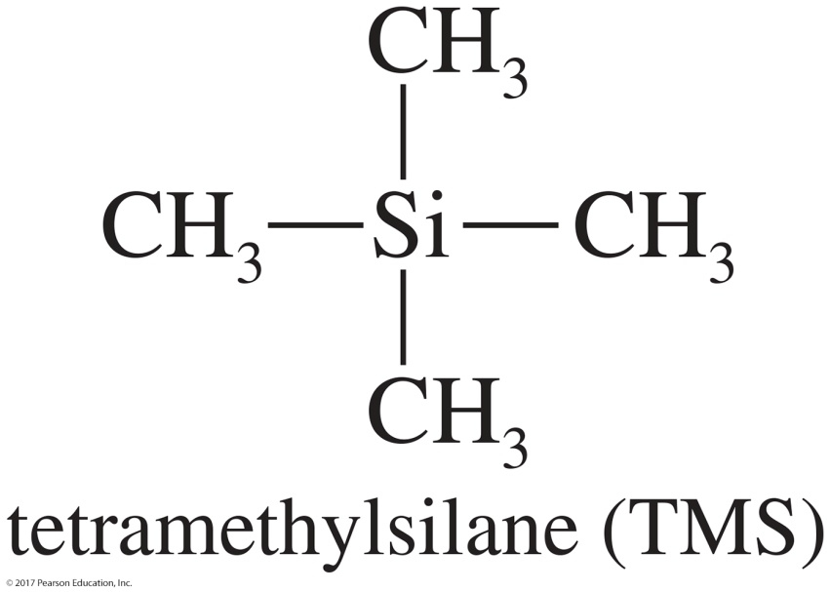
Tetramethylsilane (TMS)
TMS is added to the sample as an internal standard.
Since silicon is less electronegative than carbon, TMS protons are highly shielded.
The TMS signal is defined as 0.00 ppm.
Organic protons absorb downfield (to the left) of the TMS signal.

Slide 5
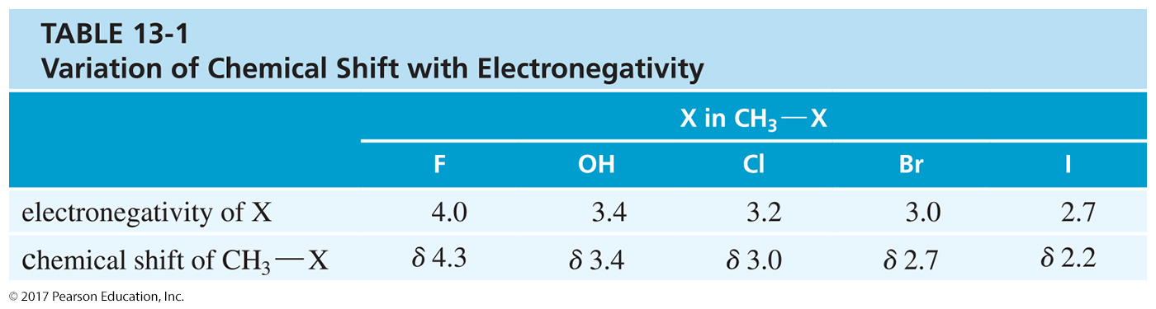
Variation of Chemical Shift

Slide 6
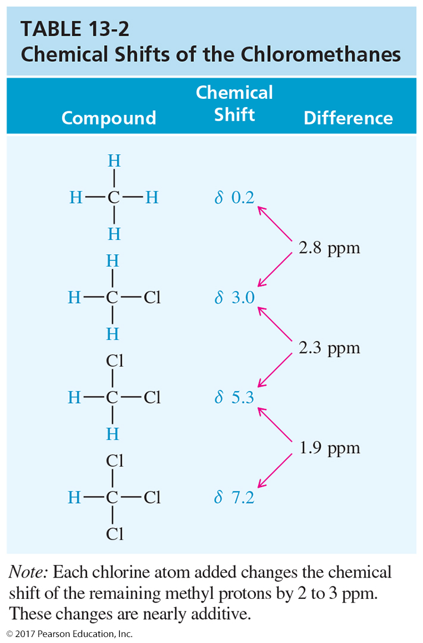
Electronegative Atoms
More electronegative atoms deshield more and give larger shift values.
Additional electronegative atoms cause an increase in chemical shift.

Slide 7
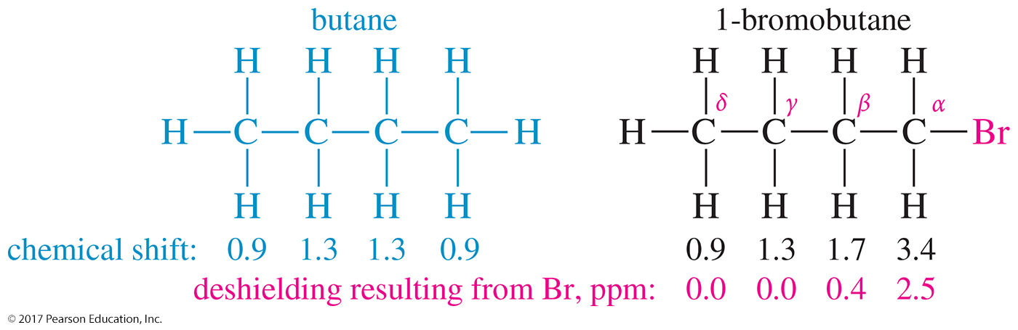
Location of
Electronegative Atoms
The deshielding effect of an electronegative substituent drops off rapidly with distance.

Slide 8
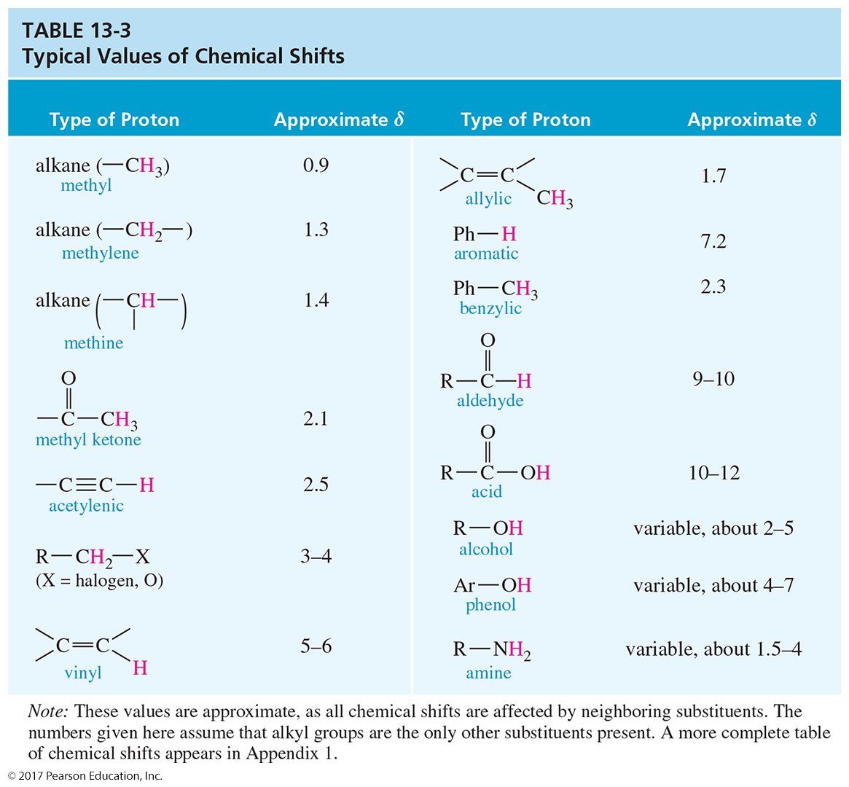
Typical Values

Slide 9
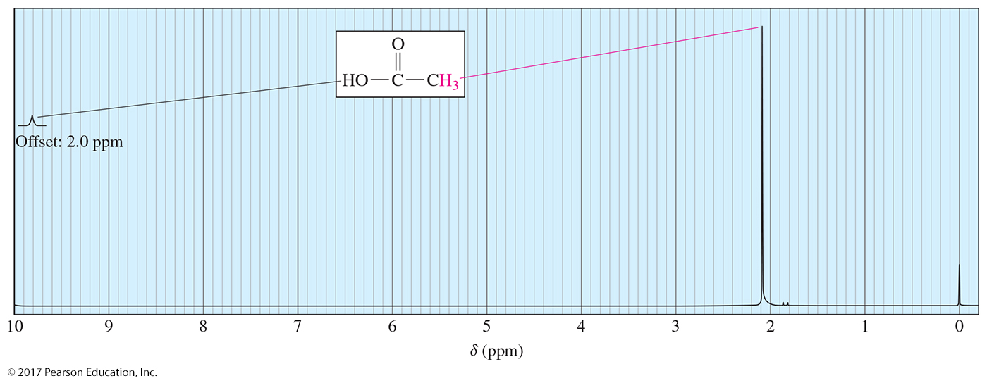
Carboxylic Acid Proton
Because of the high polarity of the carboxylic acid O—H bond, the signal for the acidic proton will be at shifts greater than δ 10.

Slide 10
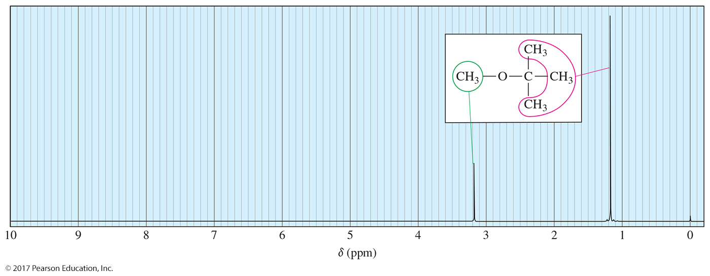
Number of Signals
Methyl tert-butyl ether has two types of protons, giving two NMR signals.
Chemically equivalent hydrogens have the same chemical shift. All the methyl groups of the tert-butyl group are equivalent and they produce only one signal.

Slide 11
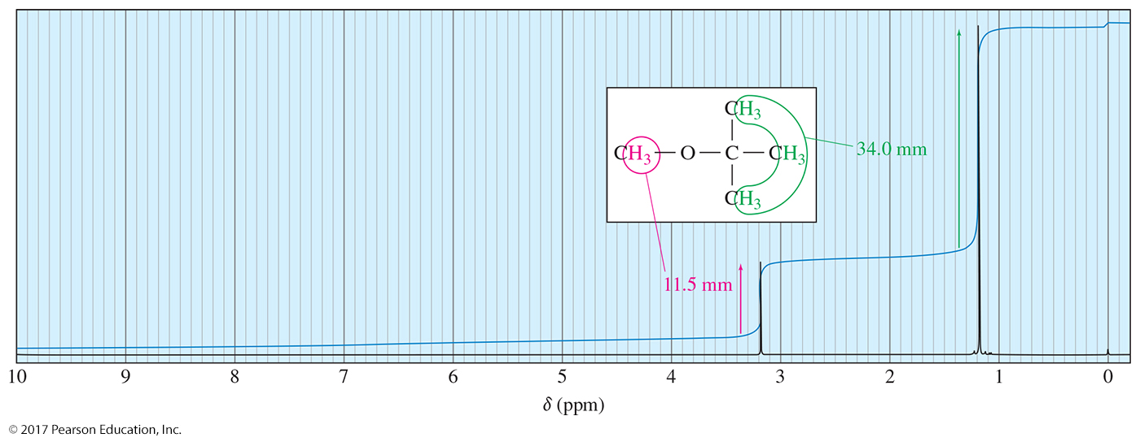
Intensity of Signals: Integration
The amount the integral trace rises is proportional to the area of that peak.
The integration will have a trace for the tert-butyl hydrogens that is three times as large as the trace for the methyl hydrogens. The relative area for methyl and tert-butyl hydrogens is 1:3.

Slide 12
Spin-Spin Splitting
Nonequivalent protons on adjacent carbons have magnetic fields that may align with or oppose the external field.
This magnetic coupling causes the proton to absorb slightly downfield when the external field
is reinforced and slightly upfield when the external field is opposed.
All possibilities exist, so the signal is split.
This splitting of signals into multiplets is called spin-spin splitting.

Slide 13
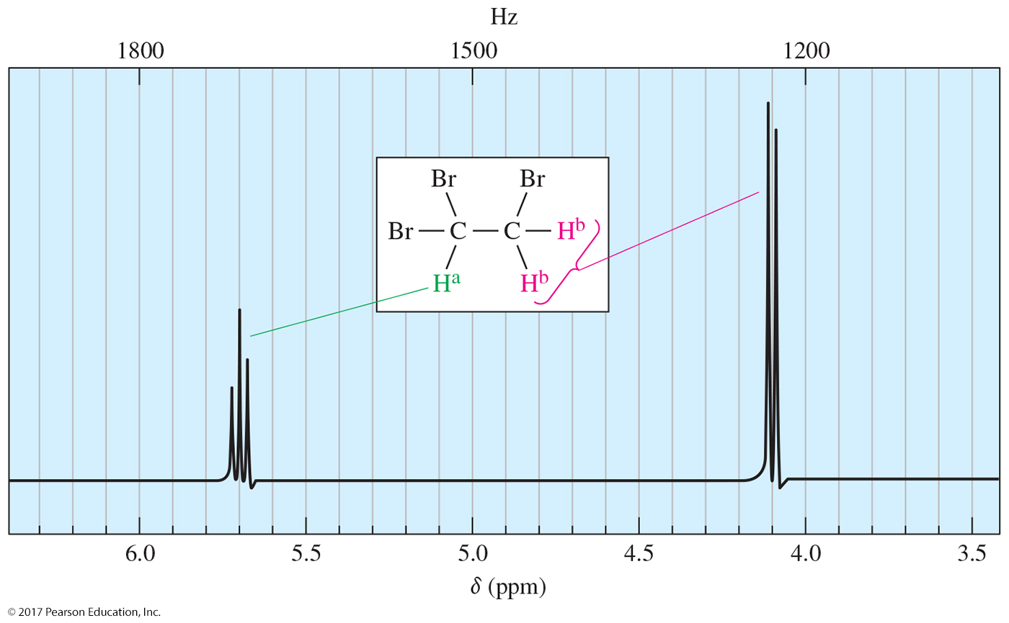
1,1,2-Tribromoethane
Spin-spin splitting is a reciprocal property. If one
proton splits another, the second proton must split
the first.

Slide 14
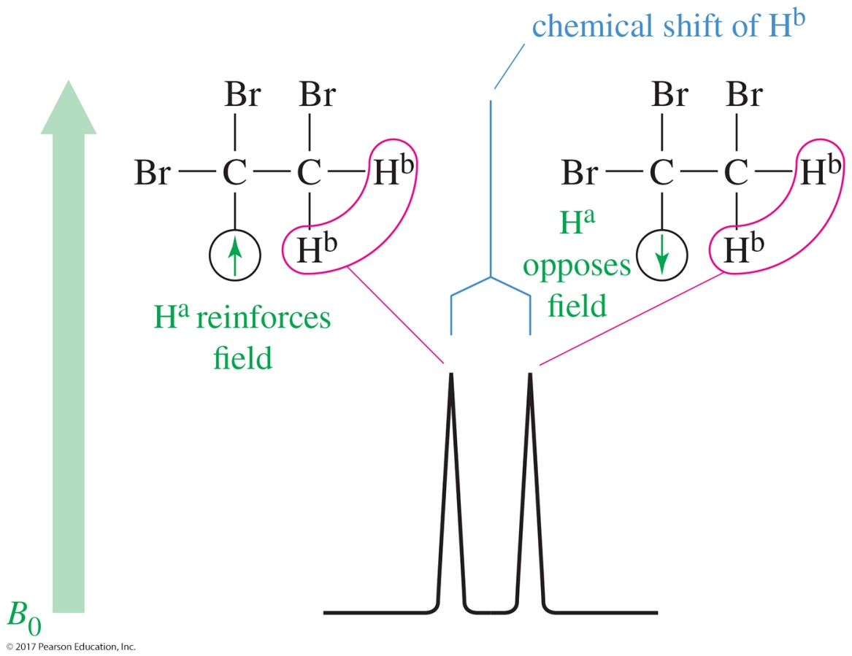
Doublet: One Adjacent Proton
H^{b} can feel the alignment of the adjacent proton Hª.
When Hª is aligned with the magnetic field, H^{b} will be deshielded.
When Hª is aligned against the magnetic field, H^{b} will be shielded.
The signal is split in two and is called a doublet.

Slide 15
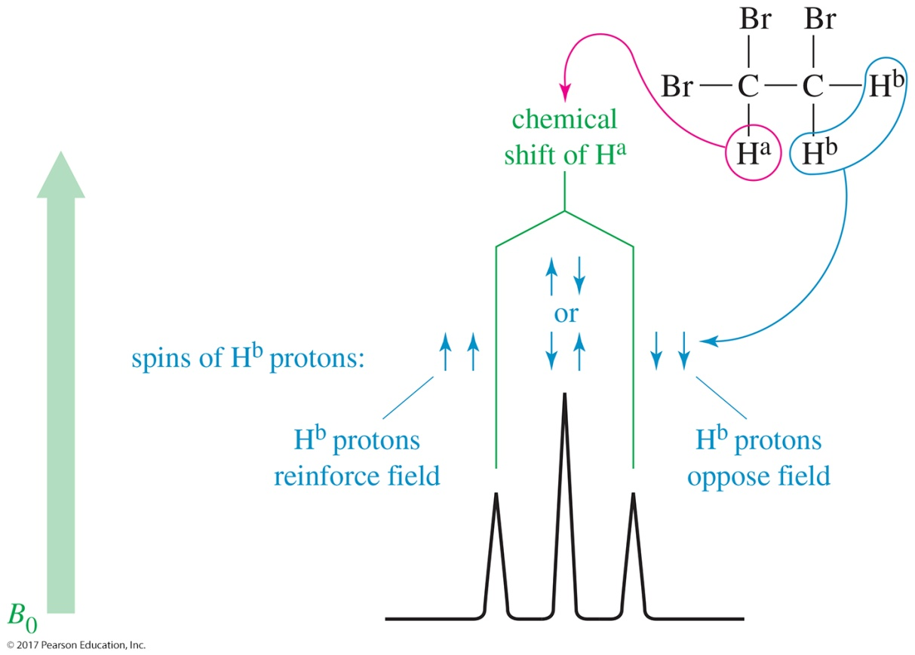
Triplet: Two Adjacent Protons
When both H^{b}s are aligned with the magnetic field, Hª will be deshielded.
When both H^{b}s are aligned against the magnetic field, Hª will be shielded.
It is more likely that one H^{b} will be aligned with the field and the other H^{b} against the field. The signal will be at its normal position.
The signal is split in three and is called a triplet.

Slide 16
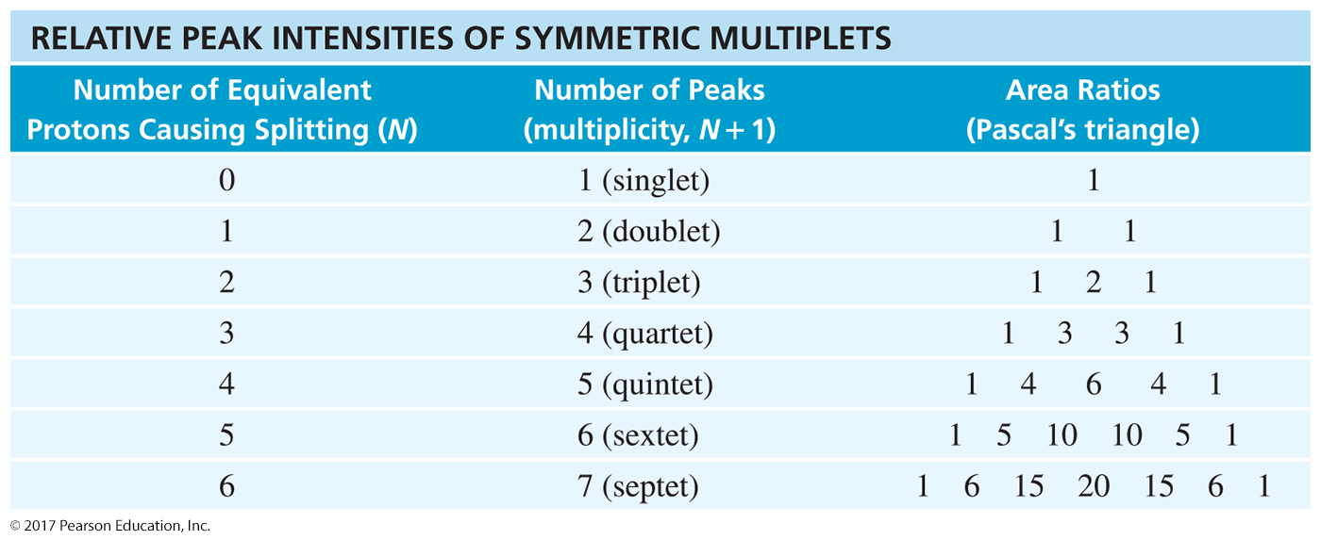
The N + 1 Rule
If a signal is split by N equivalent protons,
it is split into N + 1 peaks.

Slide 17
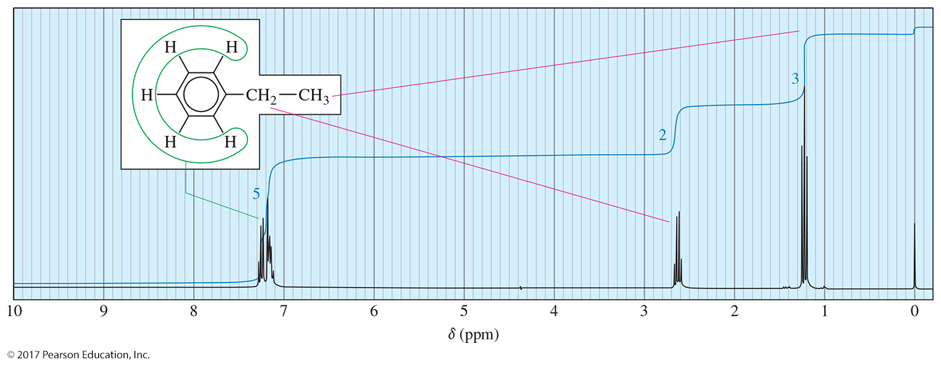
Splitting for Ethyl Groups
The hydrogens on the CH₃ are affected by the two neighboring hydrogens on the adjacent CH₂ group. According to the N + 1 rule, the CH₃ signal will be split into (2 + 1) = 3. This is a triplet.
The hydrogens on the CH₂ group are affected by the three hydrogens on the adjacent CH₃ groups. The N + 1 rule for the CH₂ signal will be split into (3 + 1) = 4. This is called a quartet.

Slide 18
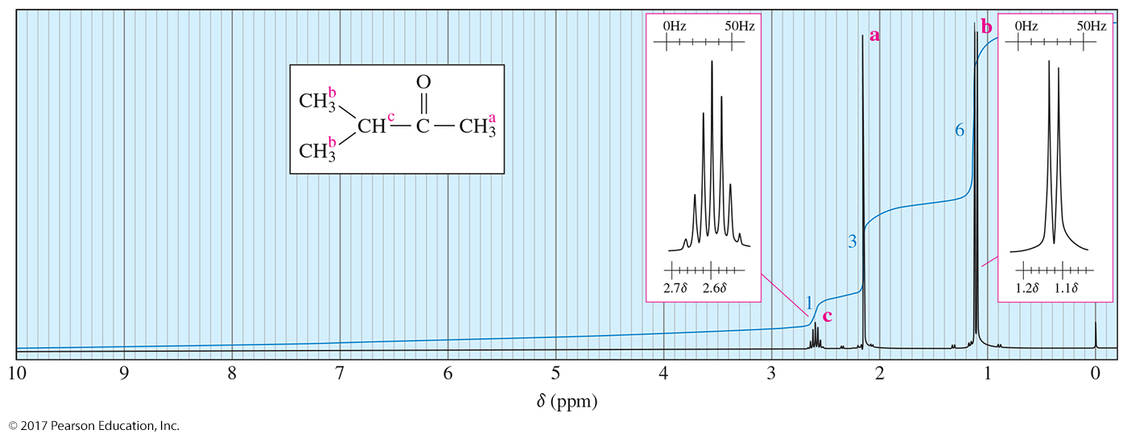
Splitting for Isopropyl Groups
The hydrogen on the CH has six adjacent hydrogens. According to the N + 1 rule, the CH signal will be split into (6 + 1) = 7. This is called a septet.
The two CH₃^{b}s are equivalent, so they give the same signal. They have one adjacent hydrogen (CH), so their signal will be N + 1, 1 + 1 = 2 (doublet).

Slide 19
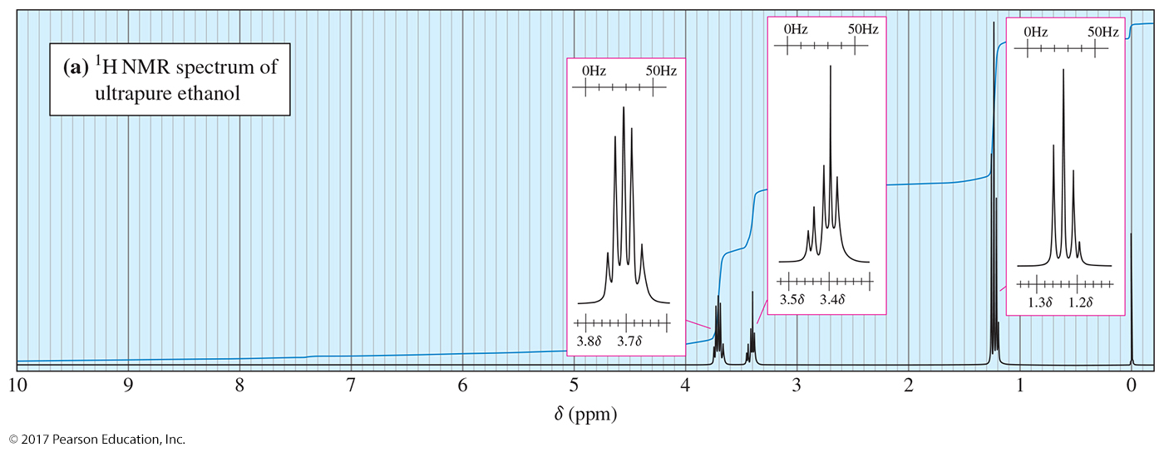
Hydroxyl Proton in a
Pure Sample
Ultrapure samples of ethanol show splitting.

Slide 20
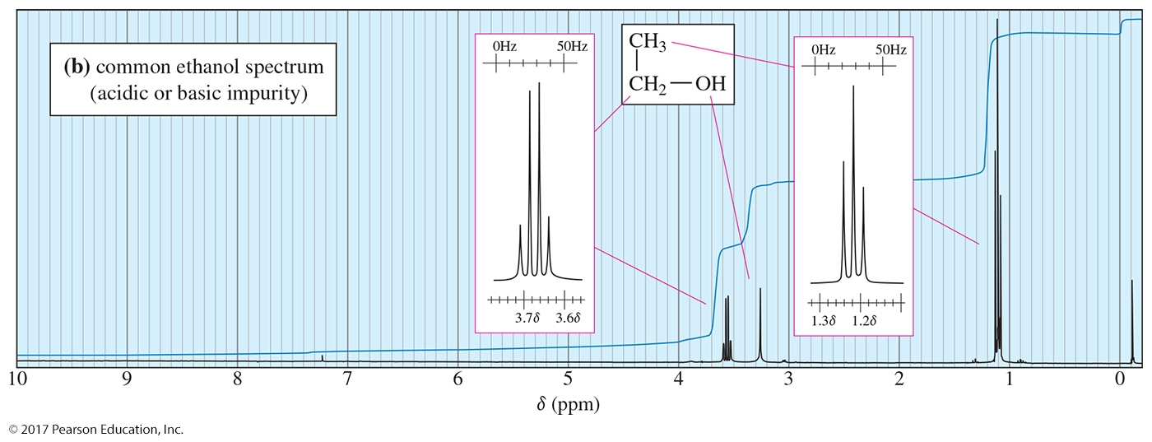
Hydroxyl Proton in an
Impure Sample
Ethanol with a small amount of acidic or basic impurities will not show splitting.

Slide 21
Carbon-13 NMR
Carbon-12 (¹²C) has no magnetic spin.
Carbon-13 (¹³C) has a magnetic spin, but is only 1% of the carbon in a sample.
The gyromagnetic ratio of ¹³C is one-fourth of that of ¹H.
For carbon, a technique called Fourier transform spectroscopy is used.

Slide 22
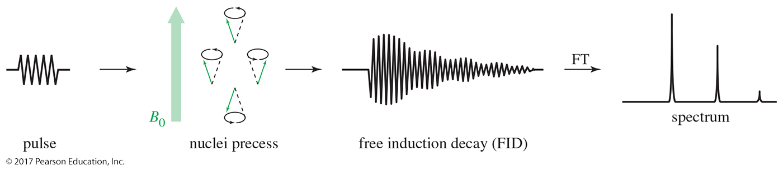
Fourier Transform NMR
A radio-frequency pulse is given.
Nuclei absorb energy and precess (spin) like
little tops.
A complex signal is produced and then decays as the nuclei lose energy.
Free induction decay (FID) is converted to a spectrum.

Slide 23
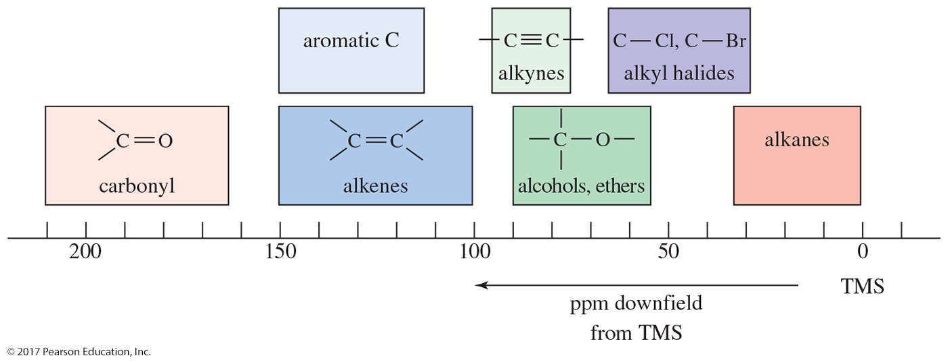
Carbon Chemical Shifts
Table of approximate chemical shifts values for ¹³C-NMR: Most of these values for a carbon atom are about 15–20 times the chemical shift of a proton if it were bonded to the carbon atom.

Slide 24
Spin-Spin Splitting
It is unlikely that a ¹³C would be adjacent to another ¹³C, so splitting by carbon is negligible.
¹³C will magnetically couple with attached protons and adjacent protons.
These complex splitting patterns are difficult to interpret.

Slide 25
Proton Spin Decoupling
To simplify the spectrum, protons are continuously irradiated with broadband “noise,” so they are rapidly flipping.
The carbon nuclei see an average of all the possible proton spin states.
Thus, each different kind of carbon gives a single, unsplit peak because carbon–hydrogen splitting was eliminated.

Slide 26
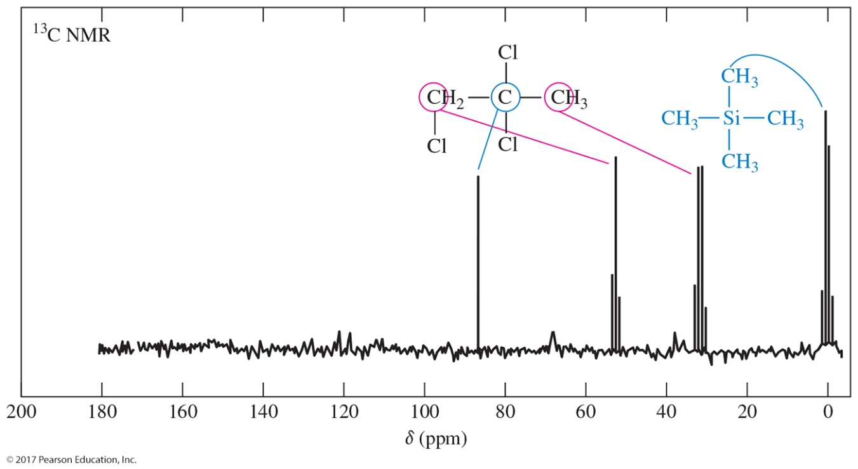
Off-Resonance Decoupling
¹³C-NMR of 1,2,2-Trichloropropane
¹³C nuclei are split only by the protons attached directly to them.
The N + 1 rule applies: A carbon with N number of protons gives a signal with N + 1 peaks.

Slide 27
Interpreting ¹³C NMR
The number of different signals indicates the number of different kinds of carbon.
The location (chemical shift) indicates the type of functional group.
The splitting pattern of an off-resonance, decoupled spectrum indicates the number of protons attached to the carbon.

Slide 28
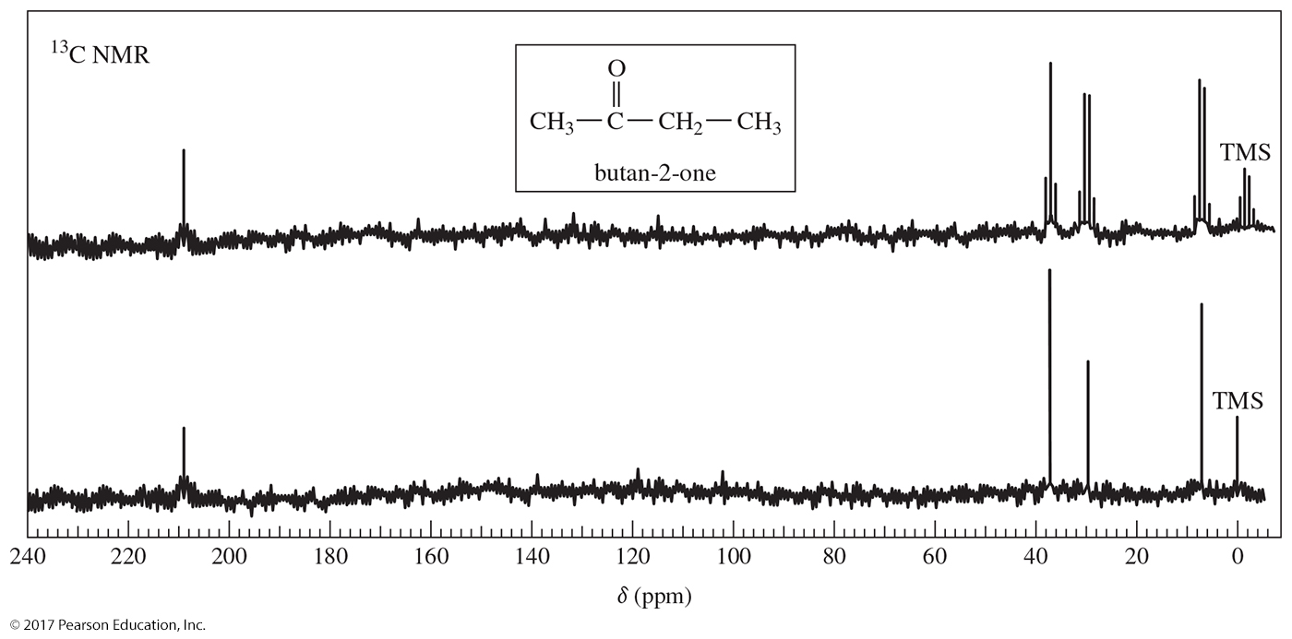
Two ¹³C NMR Spectra

Slide 29
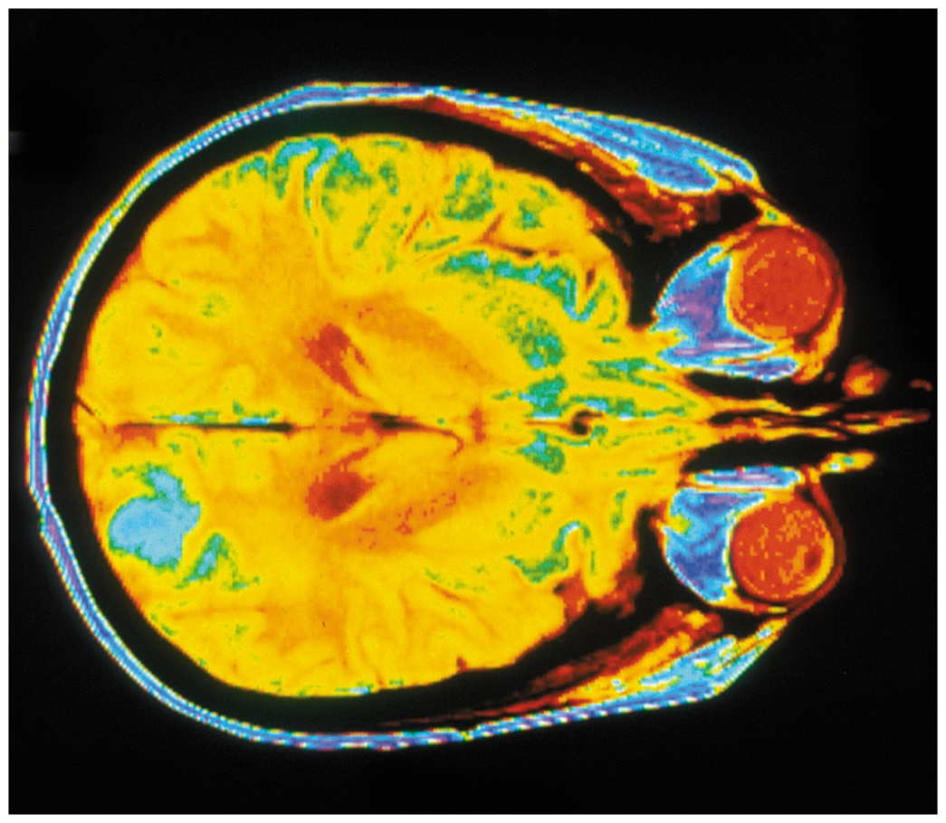
MRI Scan of a Human Brain
MRI scan of a human brain showing a metastatic tumor in one hemisphere

