Slide 1
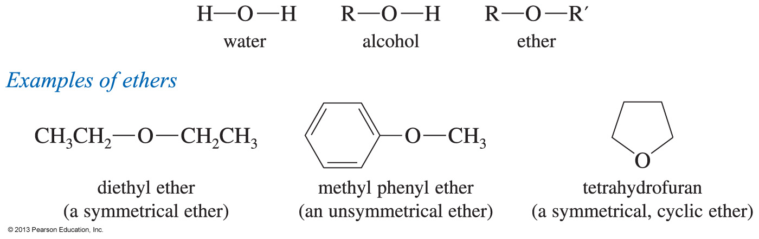
Ethers
The formula is R—O—R′, where R and R′ are alkyl or aryl.
Symmetrical or unsymmetrical

Slide 2
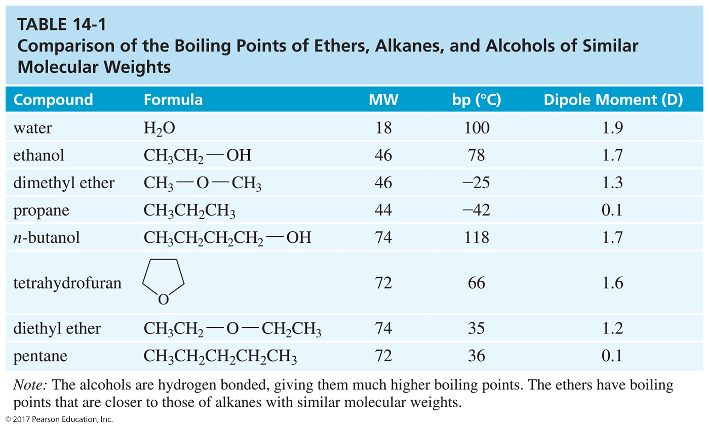
Boiling Points
Similar to alkanes of comparable molecular weight

Slide 3
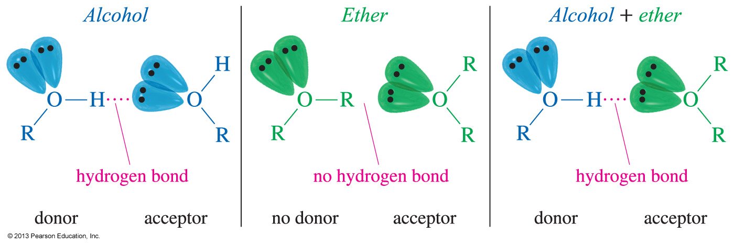
Hydrogen Bond Acceptor
Ethers cannot hydrogen bond with other ether molecules, so they have a lower boiling point than alcohols.
Ether molecules can hydrogen bond with water and alcohol molecules.
They are hydrogen bond acceptors.

Slide 4
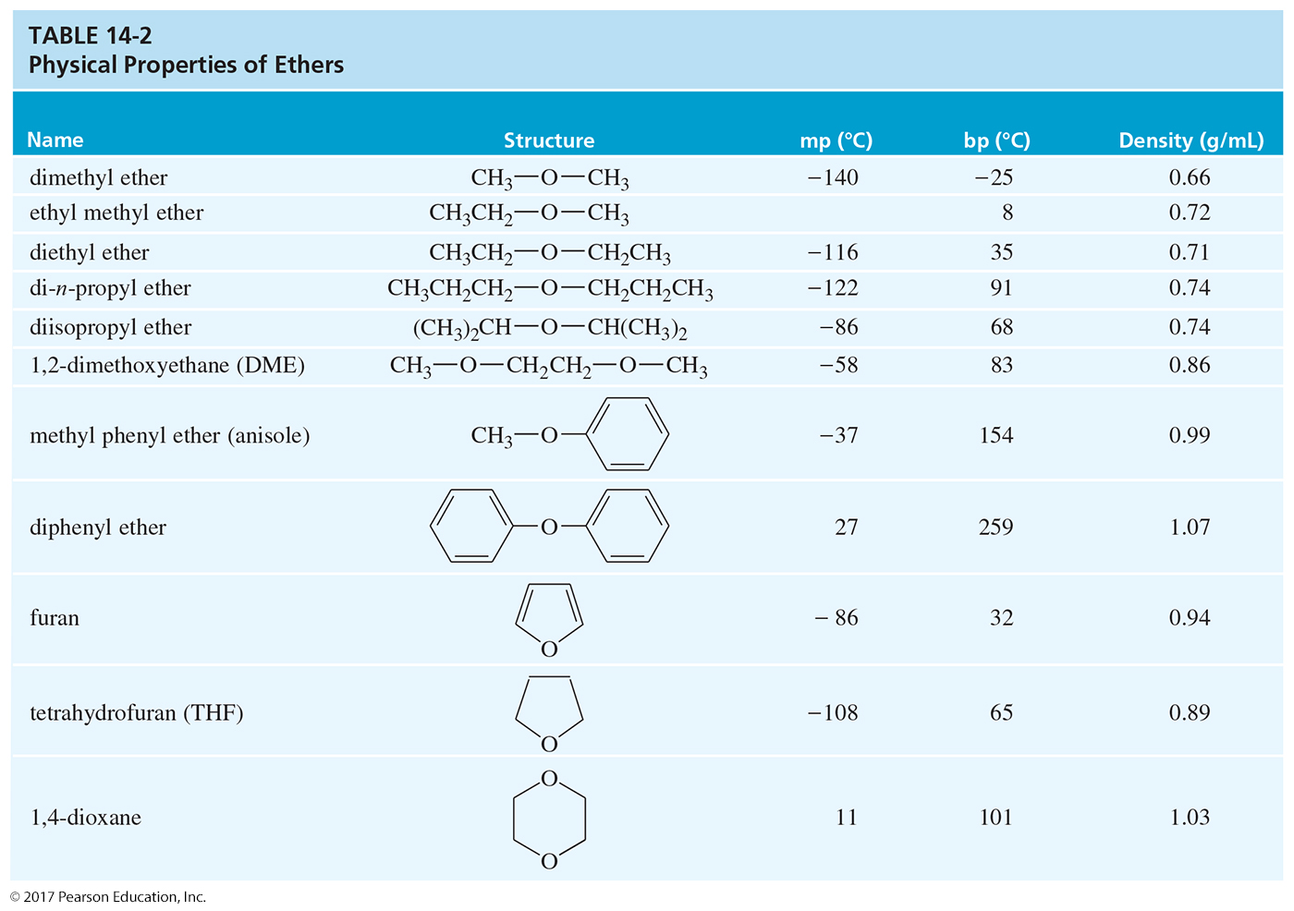

Slide 5
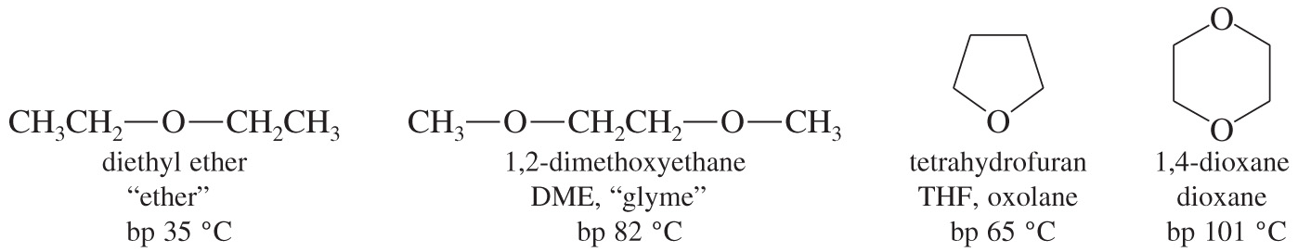
Ethers As Solvents
Ethers are widely used as solvents because
  they can dissolve nonpolar and polar substances.
  they are unreactive toward strong bases.

Slide 6
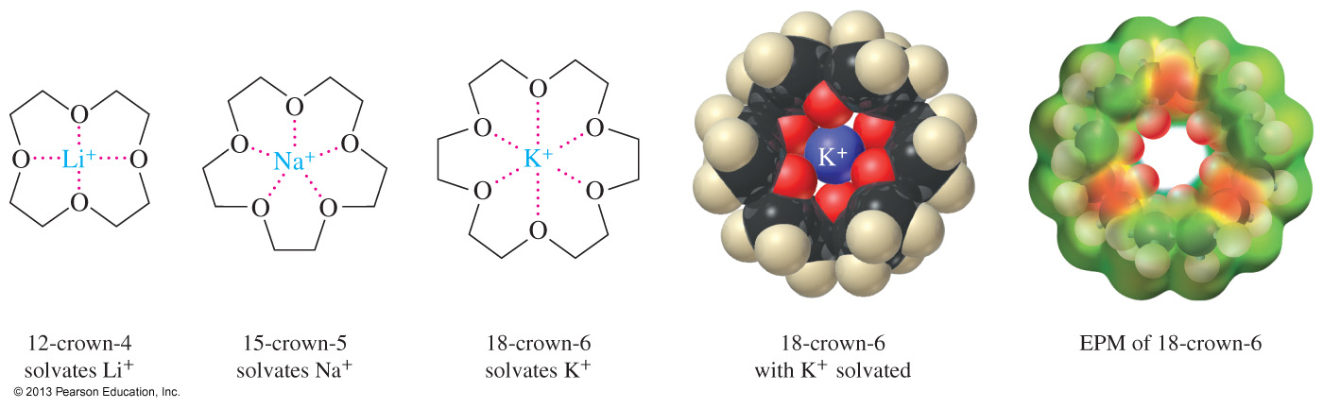
Crown Ether Complexes
Crown ethers can complex metal cations in the center of the ring.
The size of the ether ring will determine which cation it can solvate better.
Complexation by crown ethers often allows polar inorganic salts to dissolve in nonpolar organic solvents.

Slide 7
Common Names of Ethers
Name the two alkyl groups attached to the oxygen and add the word ether.
Name the groups in alphabetical order.
Symmetrical: Use dialkyl or just alkyl.
C
H
3
C
H
3
C
H
2
O
C
H
2
C
H
3
C
H
3
O
C
C
H
3
C
H
3
diethyl ether or
ethyl ether
t-butyl methyl ether or
methyl t-butyl ether

Slide 8
IUPAC Names: Alkoxy Alkane Names
The more complex alkyl group is the alkane name. The small group (with the oxygen) becomes an “alkoxy” group.
C
H
3
O
C
H
3
C
H
3
O
C
C
H
3
C
H
3
2-Methyl-2-methoxypropane
Methoxycyclohexane

Slide 9
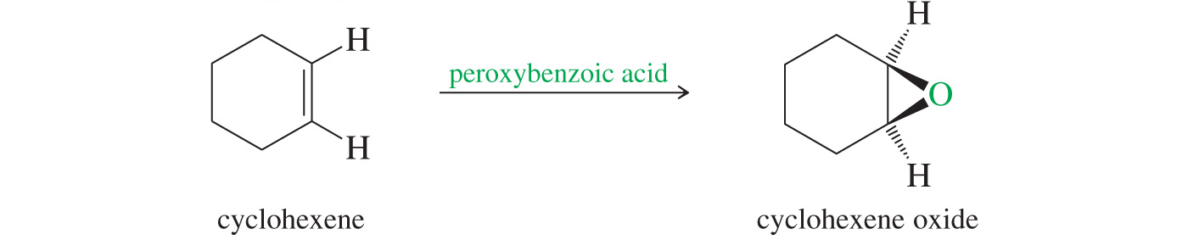
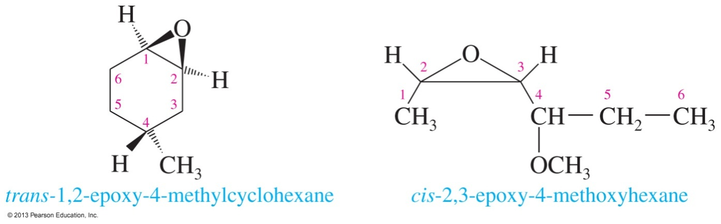
Epoxide Nomenclature
Name the starting alkene and add oxide.
The oxygen can be treated as a substituent (epoxy) on the compound. Use numbers to specify position.

Slide 10
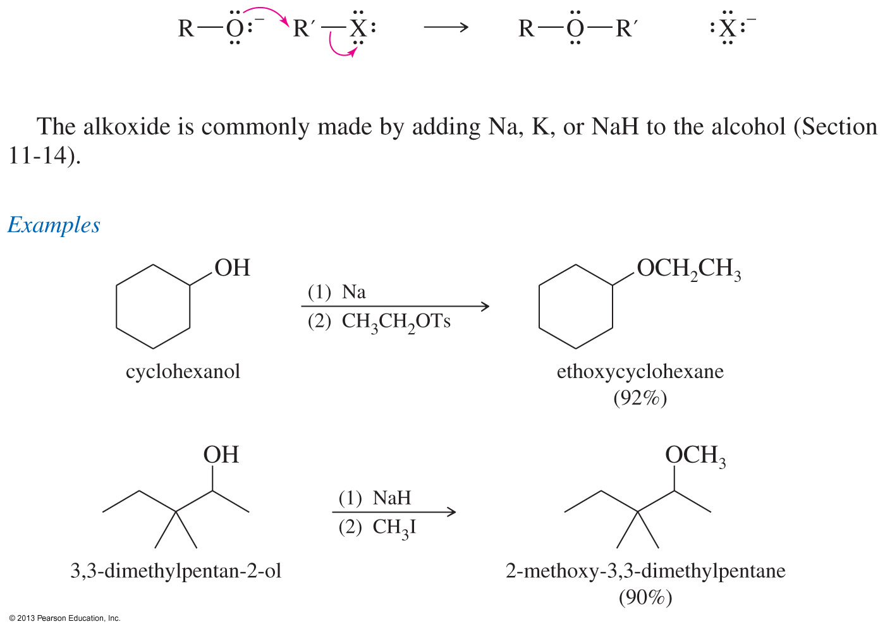
Williamson Ether Synthesis
This method involves an S_{N}2 attack of the alkoxide on an unhindered primary halide or tosylate.
The alkoxide is commonly made by adding Na, K, or NaH to the alcohol.

Slide 11
Examples of the
Williamson Synthesis

Slide 12
Autoxidation of Ethers
In the presence of atmospheric oxygen, ethers slowly oxidize to hydroperoxides and dialkyl peroxides.
Both are highly explosive.
Precautions:
  Do not distill to dryness.
  Store in full bottles with tight caps.

Slide 13
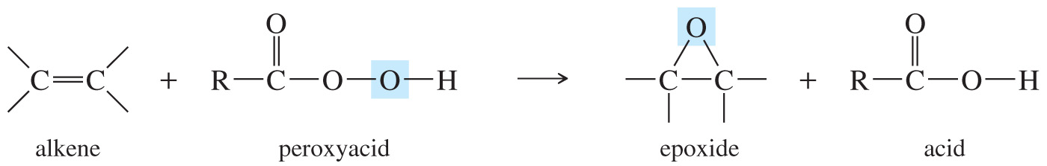
Synthesis of Epoxides
Peroxyacids are used to convert alkenes to epoxides.
Most commonly used peroxyacid is meta-chloroperoxybenzoic acid (MCPBA).
The reaction is carried out in an aprotic acid to prevent the opening of the epoxide.

