Slide 1
UNIT 8 KEY SKILLS
Chapters 20/21 carboxylic acids and derivatives
nomenclature 1
Synthesis 1
Physical/chemical properties 1
NAS mechanism 1
NAS reactions 2
Chapter 24/25
Protein structure 1
Triglyceride structure 1
Polymer structure 1
Steroid structure 1

Slide 2
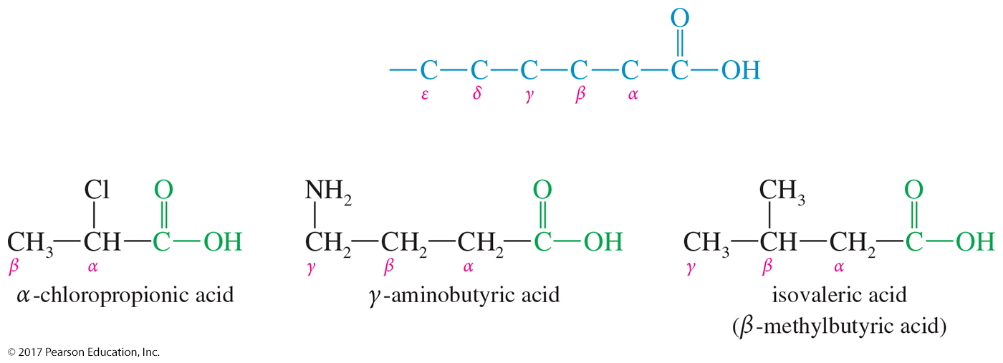
Common Names
Many aliphatic acids have historical names.
Positions of substituents on the chain are labeled with Greek letters starting at the carbon attached to the carboxylic carbon.

Slide 3
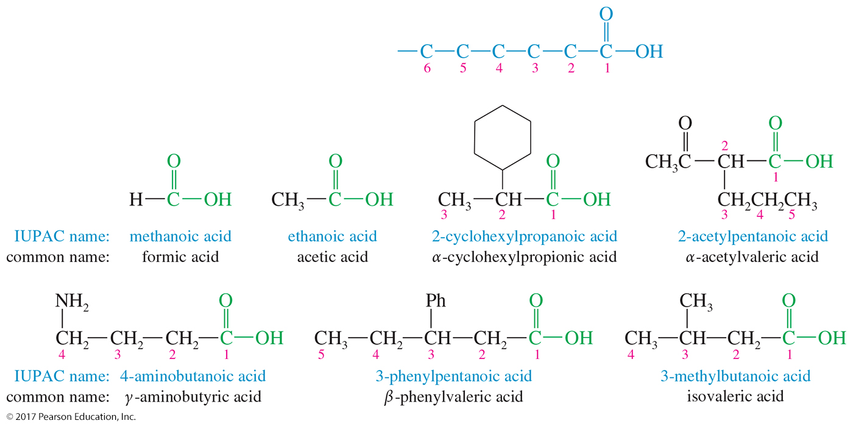
IUPAC Names
Remove the final -e from the alkane name, and add the ending -oic acid.
The carbon of the carboxyl group is number 1.

Slide 4
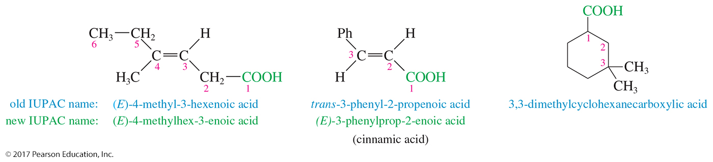
Unsaturated Acids
Remove the final -e from the alkene name, and add the ending -oic acid.
Start numbering at the carboxyl group and the location of the double bond is given.
Stereochemistry is specified (E or Z).

Slide 5
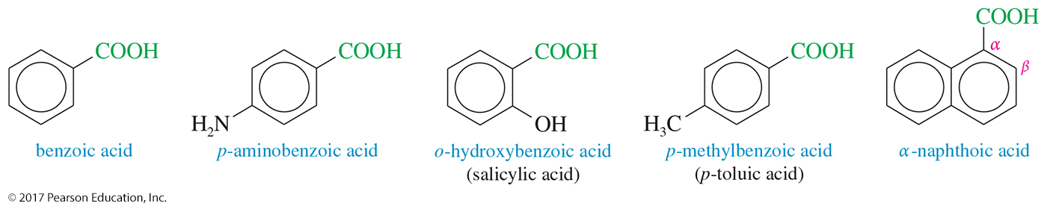
Aromatic Acids
Aromatic acids are named as derivatives of benzoic acid.
Ortho-, meta-, and para- prefixes are used to specify the location of a second substituent.
Numbers are used to specify locations when more than two substituents are present.

Slide 6
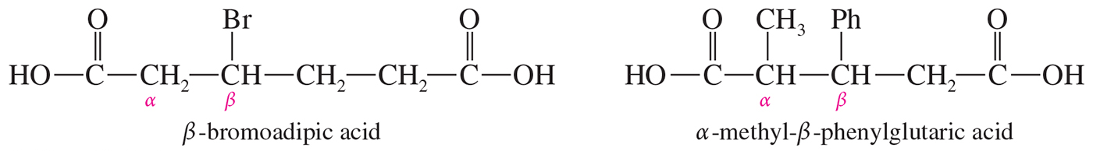
Dicarboxylic Acids
Aliphatic diacids are usually called by their common names using Greek letters beginning with the carbon next to the carboxyl group.
For the IUPAC name, number the chain from the end closest to a substituent.

Slide 7
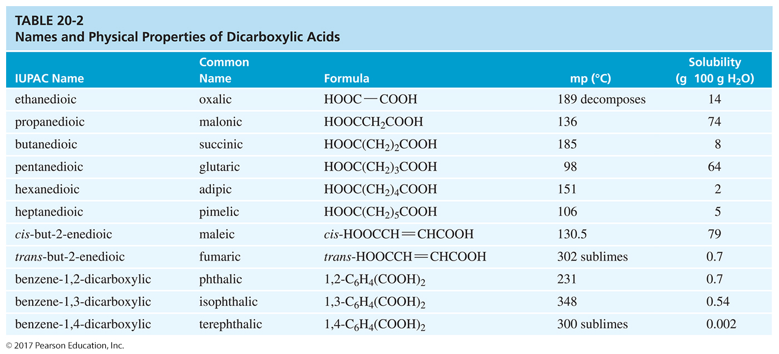

Slide 8
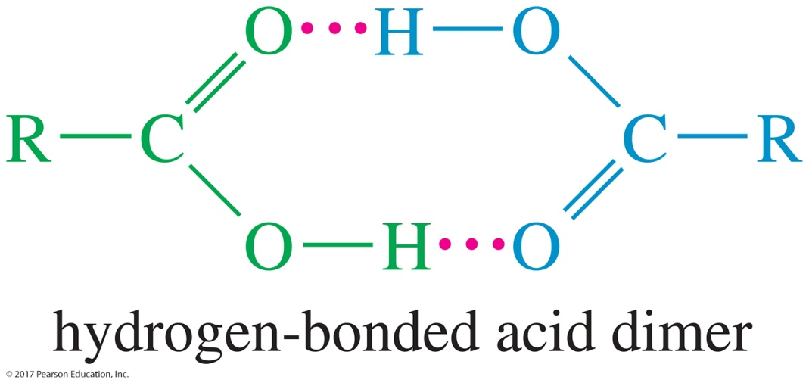
Boiling Points
Carboxylic acids boil at considerably higher temperatures than do alcohols, ketones, or aldehydes of similar molecular weights.
The high boiling points of carboxylic acids result from formation of a stable, hydrogen-bonded dimer.

Slide 9
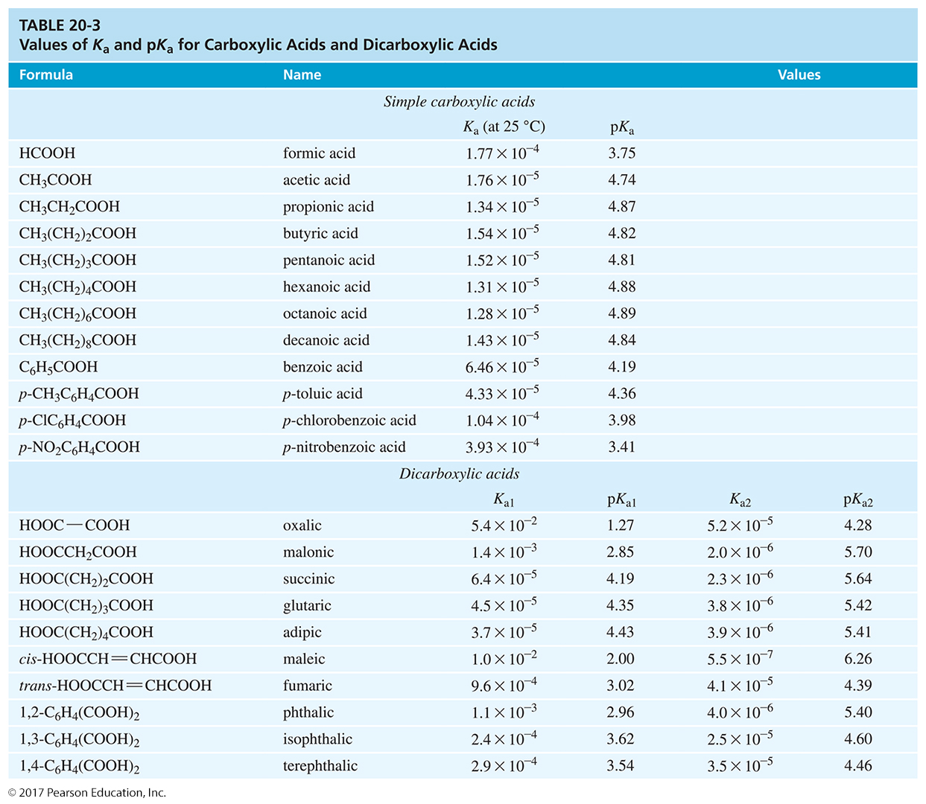

Slide 10
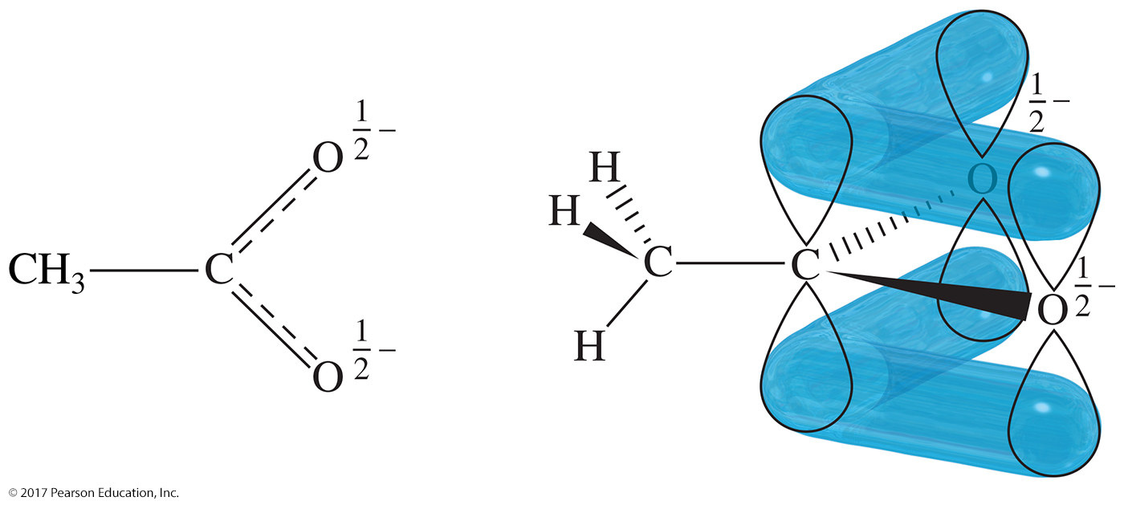
Acetate Ion Structure
Each oxygen atom bears half of the negative charge.
The delocalization of the negative charge over the two oxygens makes the acetate ion more stable than an alkoxide ion.

Slide 11
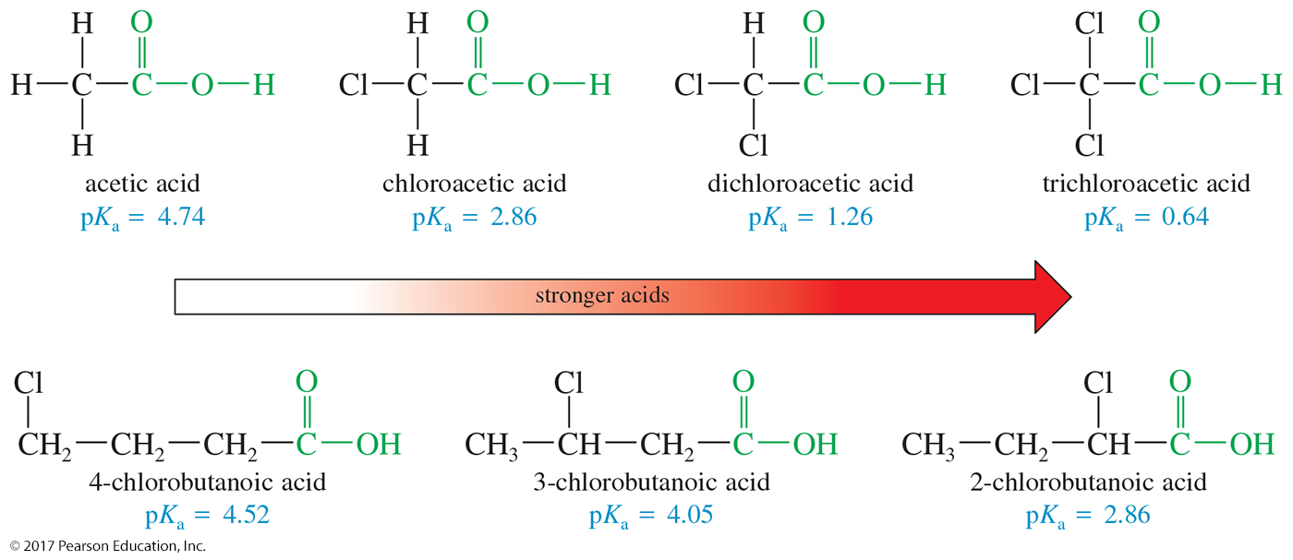
Substituent Effects on Acidity
The magnitude of a substituent effect depends on its distance from the carboxyl group.

Slide 12
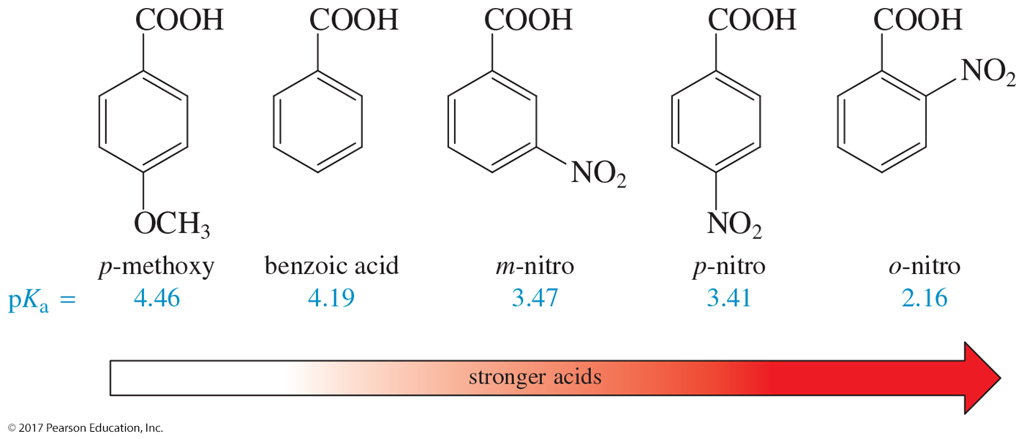
Aromatic Carboxylic Acids
Electron-withdrawing groups enhance the acid strength, and electron-donating groups decrease the acid strength.
Effects are strongest for substituents in the ortho and para positions.

Slide 13
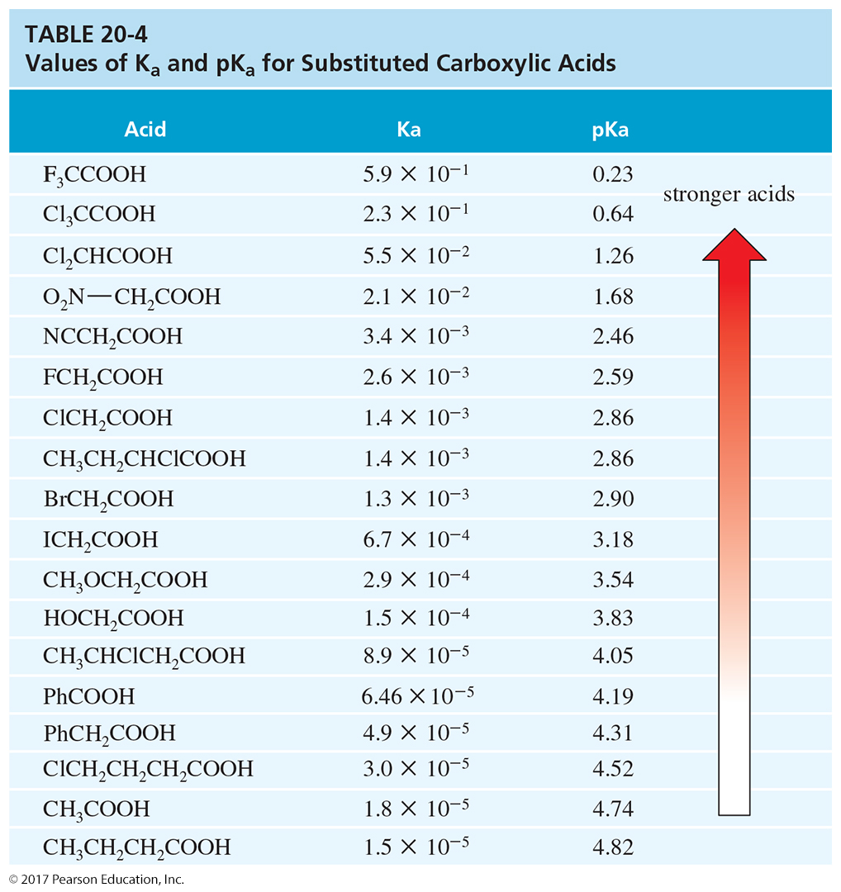

Slide 14
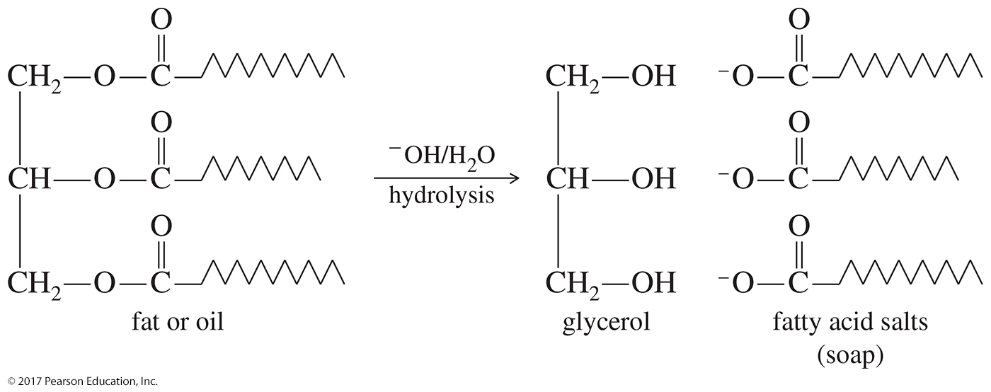
Basic Hydrolysis of
Fats and Oils
The basic hydrolysis of fats and oils produces soap (this reaction is known as saponification).

Slide 15
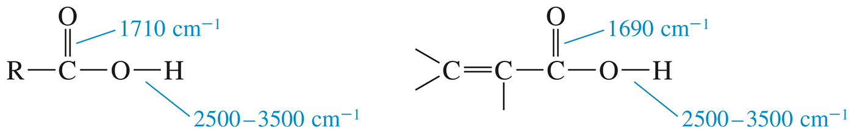
IR Bands of Carboxylic Acids
There will be two features in the IR spectrum of a carboxylic acid: the intense carbonyl stretching absorption (1710 cm^{–1}) and the OH absorption (2500–3500 cm^{–1}).
Conjugation lowers the frequency of the C═O band.

Slide 16
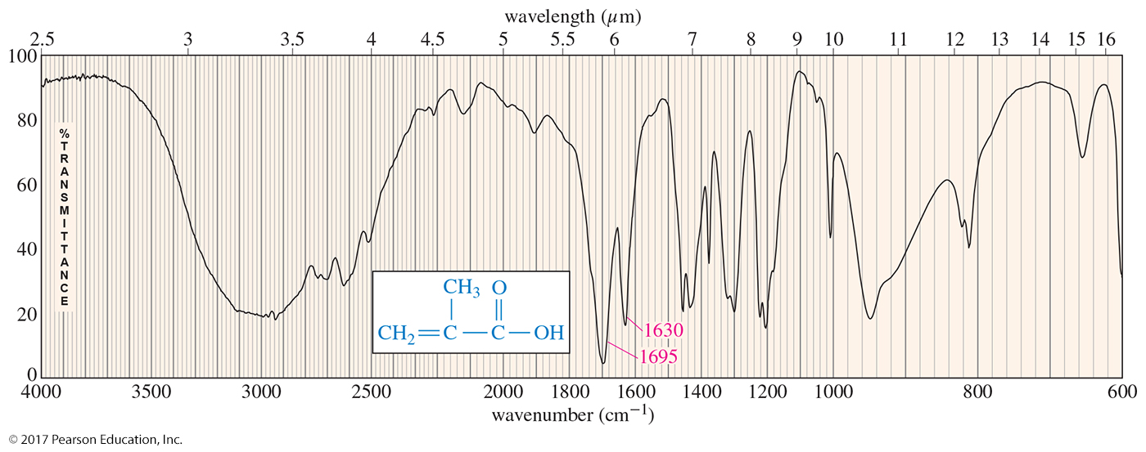
IR Spectroscopy

Slide 17
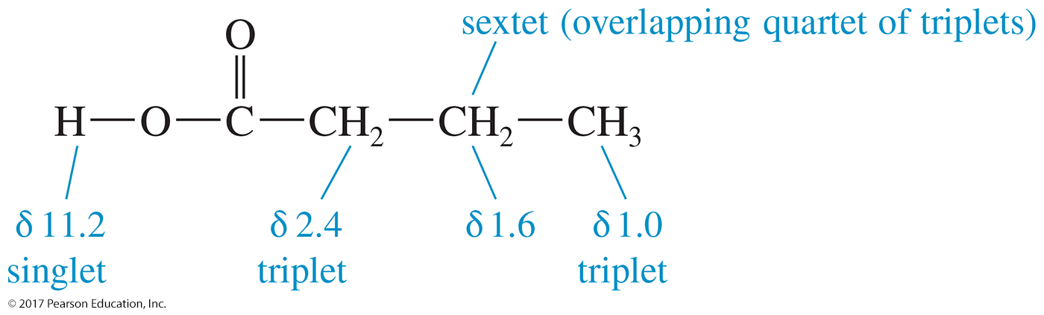
NMR of Carboxylic Acids
Carboxylic acid protons are the most deshielded protons we have encountered, absorbing between δ 10 and δ 13.
The protons on the α carbon atom absorb between
δ 2.0 and δ 2.5.

Slide 18
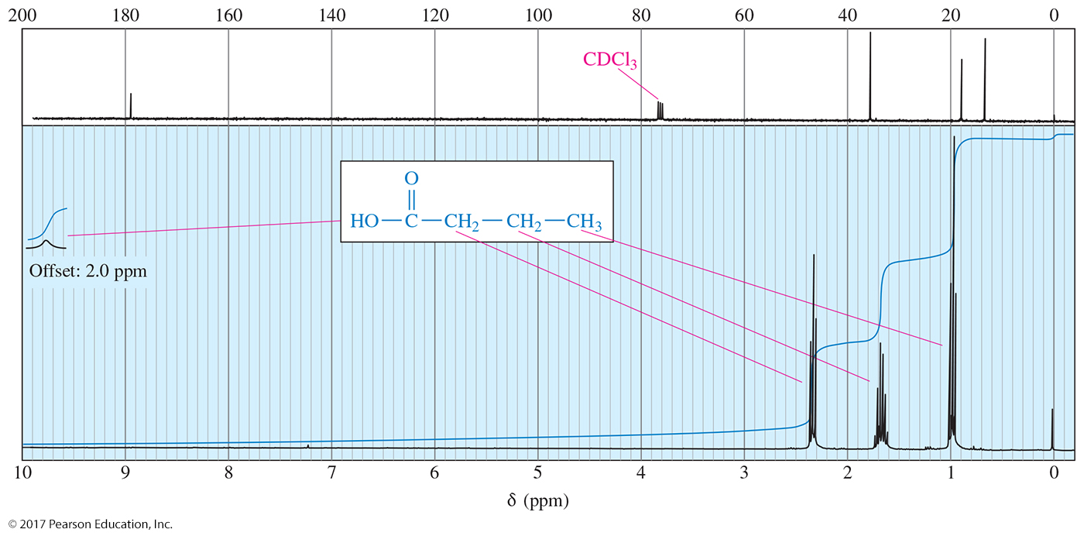
NMR Spectroscopy

Slide 19
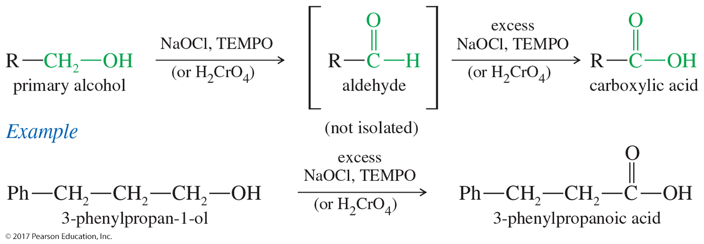
Oxidation of Primary Alcohol to Carboxylic Acids
Primary alcohols and aldehydes are commonly oxidized to acids by chromic acid (H₂CrO₄ formed from Na₂Cr₂O₇ and H₂SO₄).
Potassium permanganate is occasionally used, but the yields are often lower.

Slide 20
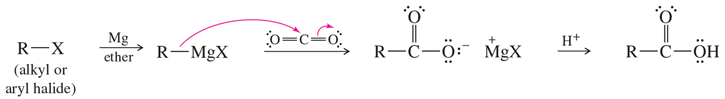
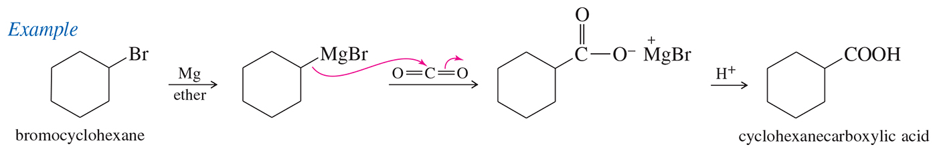
Carboxylation of
Grignard Reagents
Grignard reagents react with CO₂ to produce, after protonation, a carboxylic acid.
This reaction is sometimes called “CO₂ insertion,” and it increases the number of carbons in the molecule by one.

Slide 21
Acid Derivatives
The group bonded to the acyl carbon determines the class of compound:
  —OH, carboxylic acid
  —Cl, acid chloride
  —OR′, ester
  —NH₂, amide
These interconvert via nucleophilic acyl substitution.

Slide 22
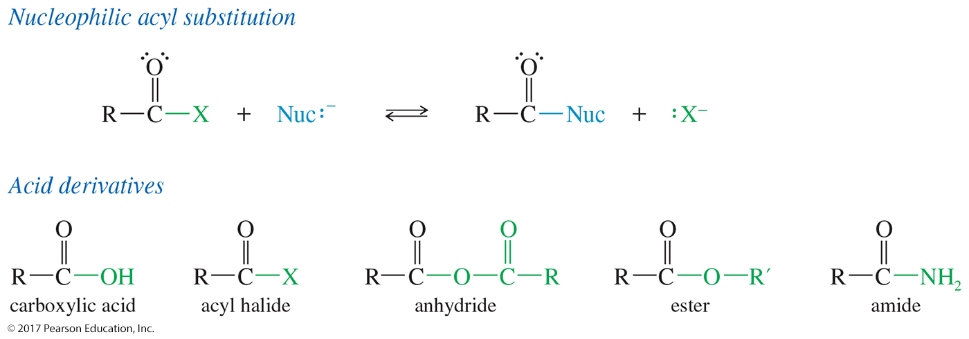
Nucleophilic Acyl Substitution
Carboxylic acids react by nucleophilic acyl substitution, where one nucleophile replaces another on the acyl (C═O) carbon atom.

