Slide 1
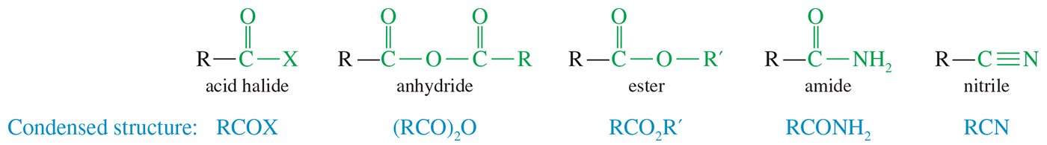
Carboxylic Acid Derivatives
Carboxylic acid derivatives are defined as compounds with functional groups that can be converted to carboxylic acids by a simple acidic or basic hydrolysis.

Slide 2
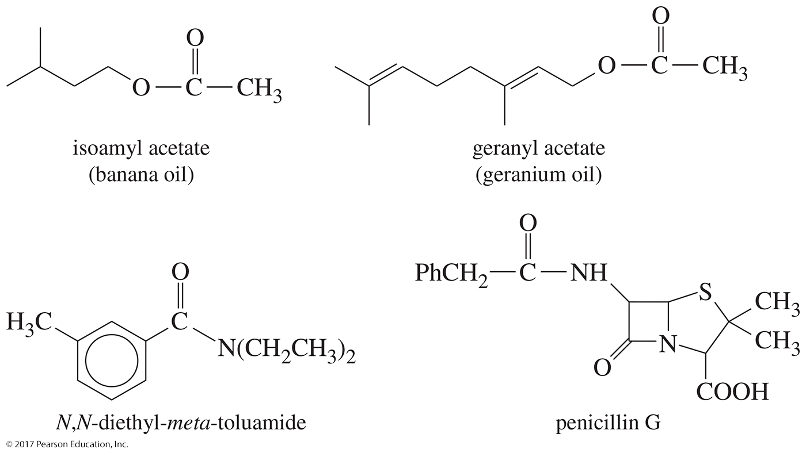
Some Naturally Occurring Esters and Amides

Slide 3
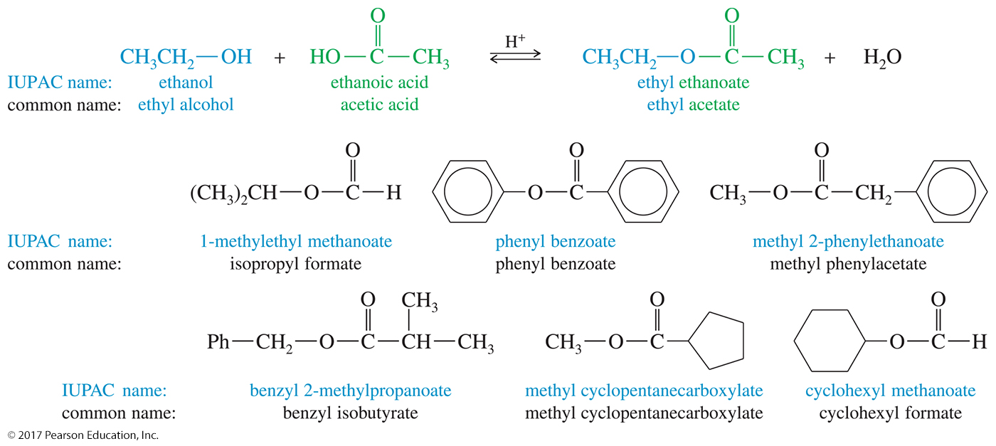
Common and Systematic Names for Some Acids, Alcohols, and Esters

Slide 4
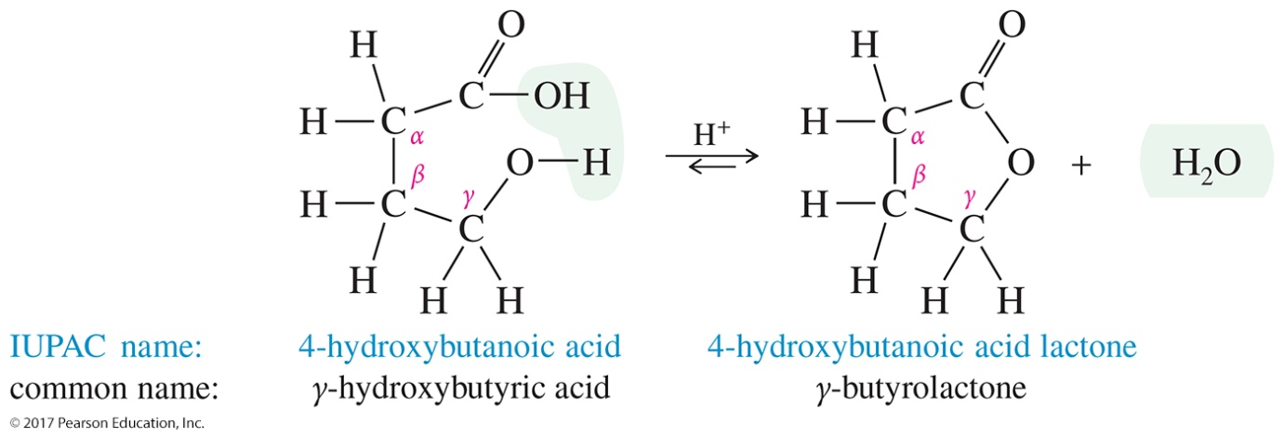
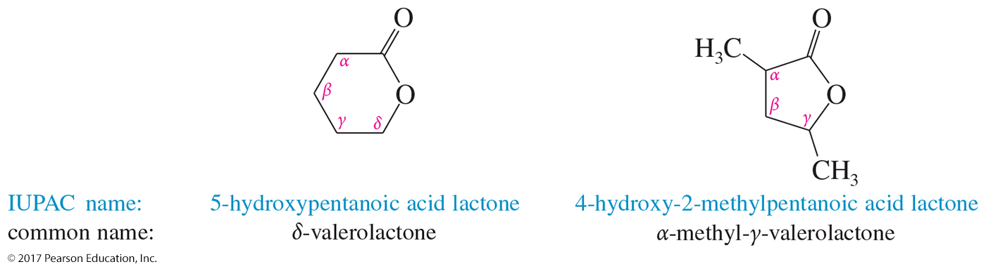
Lactones
Cyclic esters are called lactones.
The IUPAC names of lactones are derived by adding the term lactone at the end of the parent acid.

Slide 5
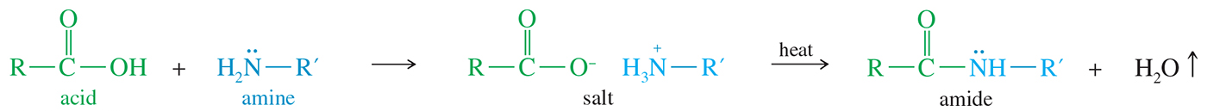
Amides
An amide is a composite of a carboxylic acid and ammonia or an amine.
Ammonium salts are converted to amides at high temperatures.

Slide 6
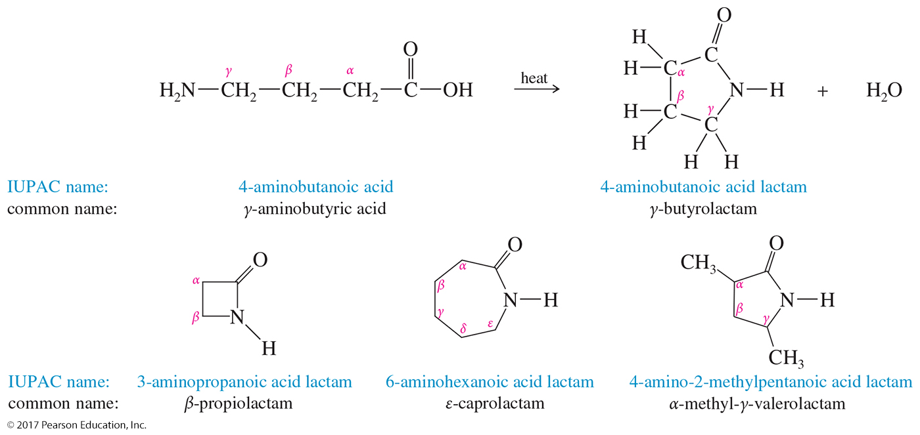
Lactams
Cyclic amides are called lactams.
Lactams are named by adding the term lactam at the end of the IUPAC name of the parent acid.

Slide 7
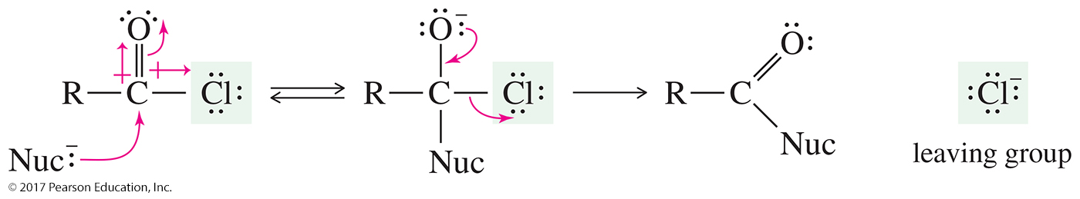
Acid Halides
Acid halides are also called acyl halides.
Acid halides are activated derivatives used in the synthesis of other acyl compounds such as an ester.

Slide 8
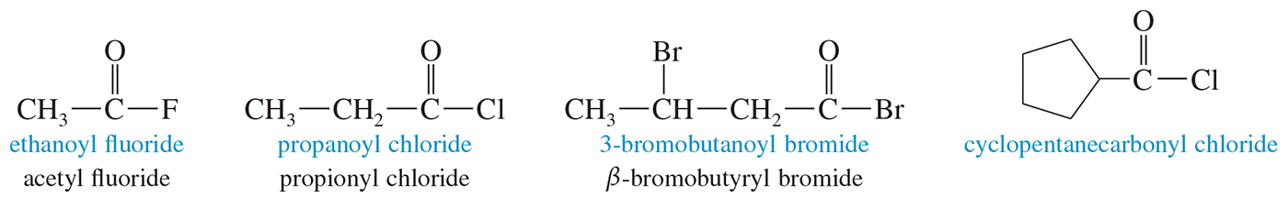
Acid Halides
Acid halides are named by replacing the -ic acid suffix name with -yl and the halide name.

Slide 9
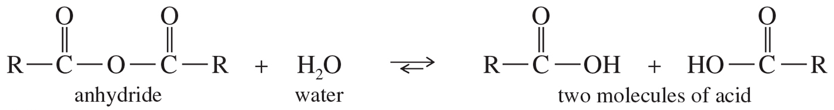
Acid Anhydrides
The word anhydride means “without water.”
An acid anhydride contains two molecules of acid, with loss of a molecule of water.

Slide 10
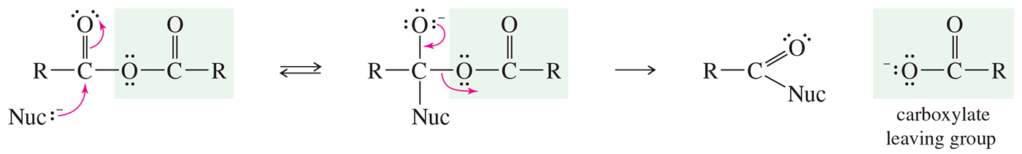
Acid Anhydrides
Acid anhydrides are activated derivatives of carboxylic acids.

Slide 11
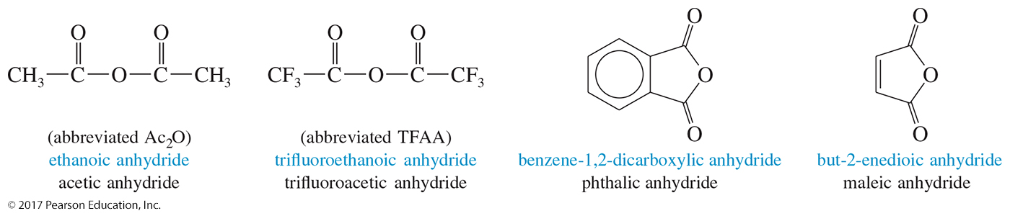
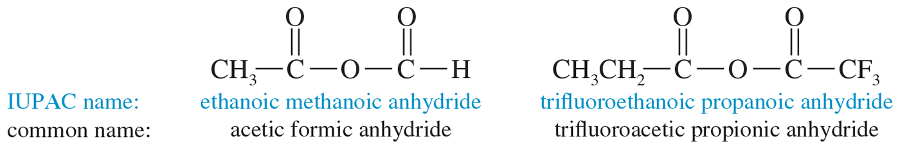
Naming Acid Anhydrides
Acid anhydrides are named by replacing the word acid with anhydride.

Slide 12
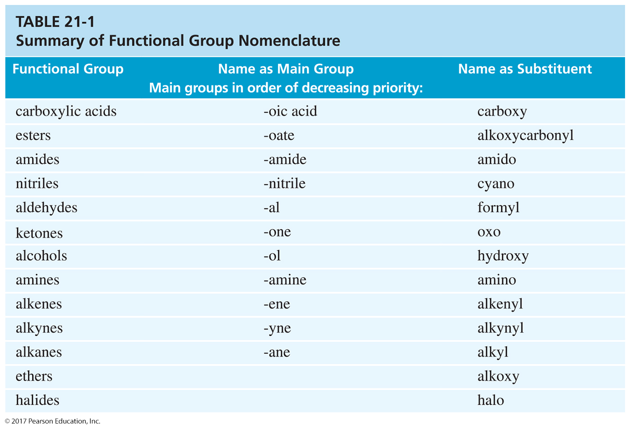

Slide 13
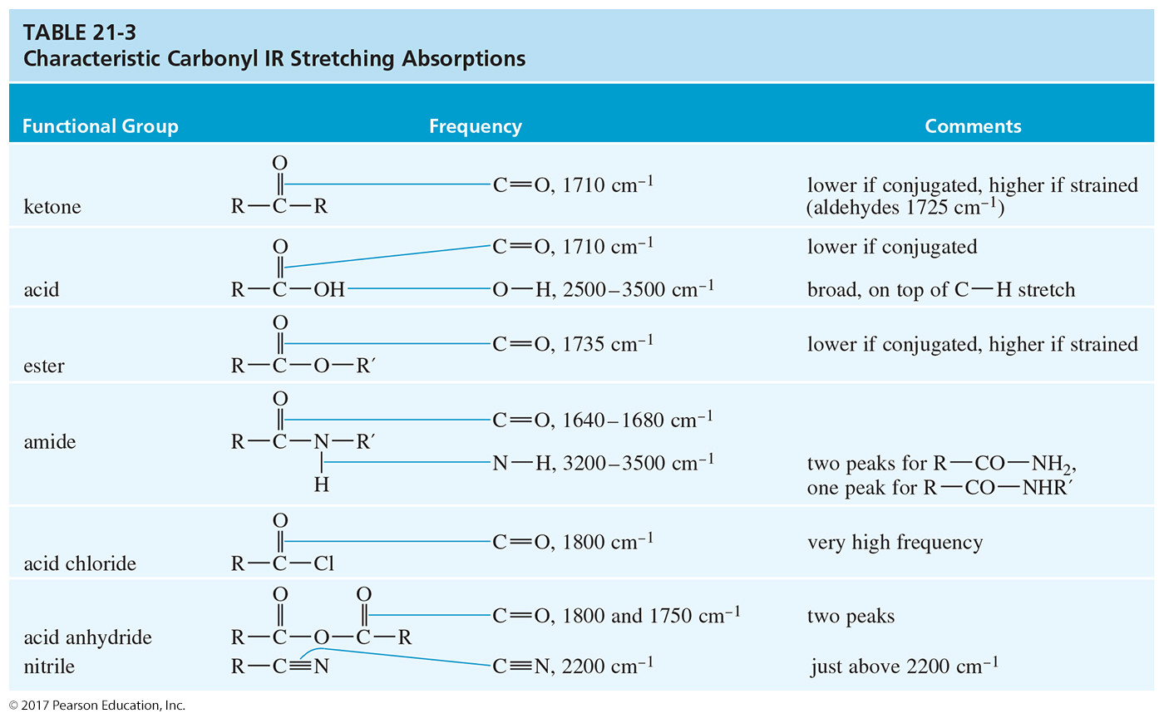
Spectroscopy of Carboxylic
Acid Derivatives

Slide 14
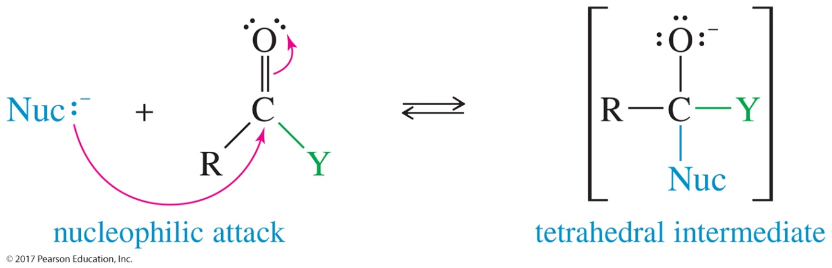
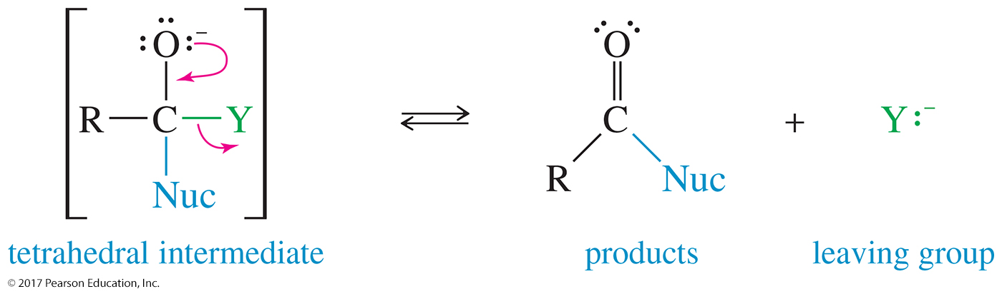
Mechanism of Acyl Substitution
Step 1: Addition of the nucleophile forms the tetrahedral intermediate.
Step 2: Elimination of the leaving group regenerates the carbonyl group.

Slide 15
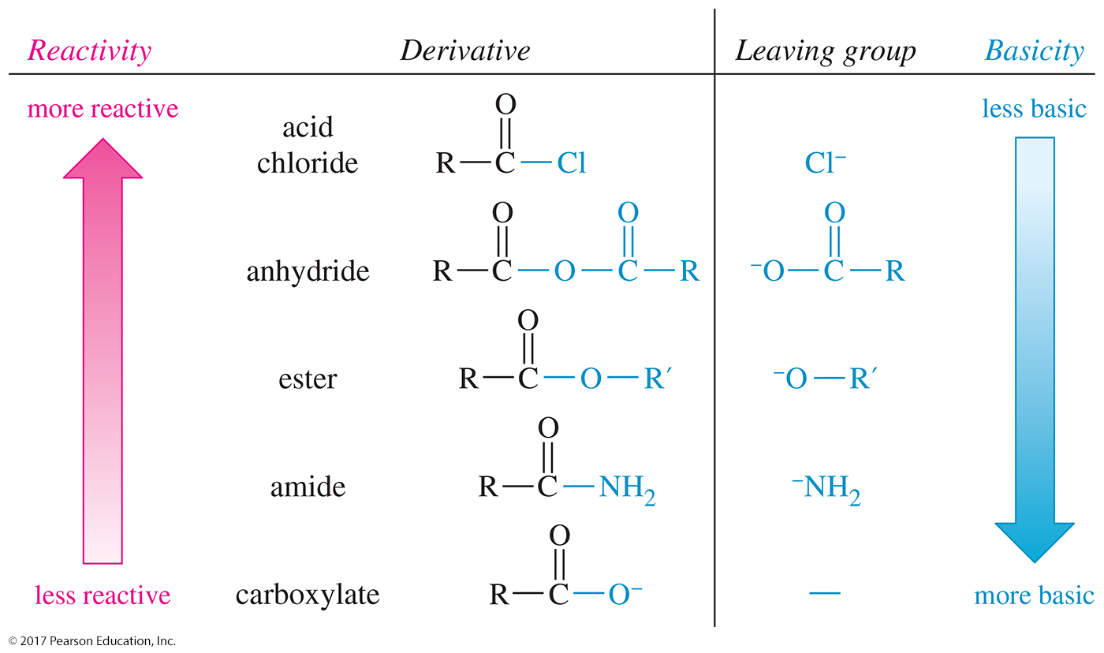
Reactivity of Acid Derivatives

Slide 16
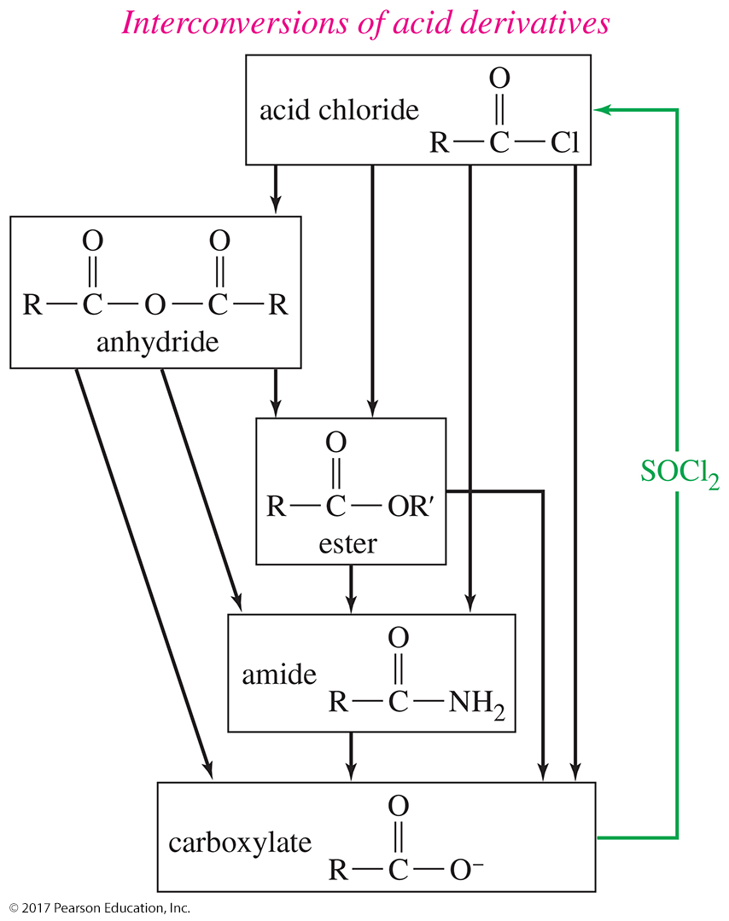
Interconversion of Derivatives
More reactive derivatives can be converted to less reactive derivatives.

Slide 17
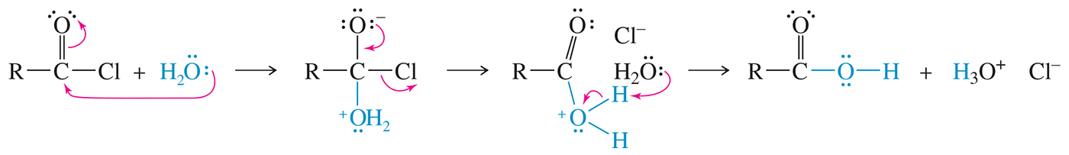
Hydrolysis of Acid
Chlorides and Anhydrides
Hydrolysis occurs quickly, even in moist air with no acid or base catalyst.
Reagents must be protected from moisture.

Slide 18
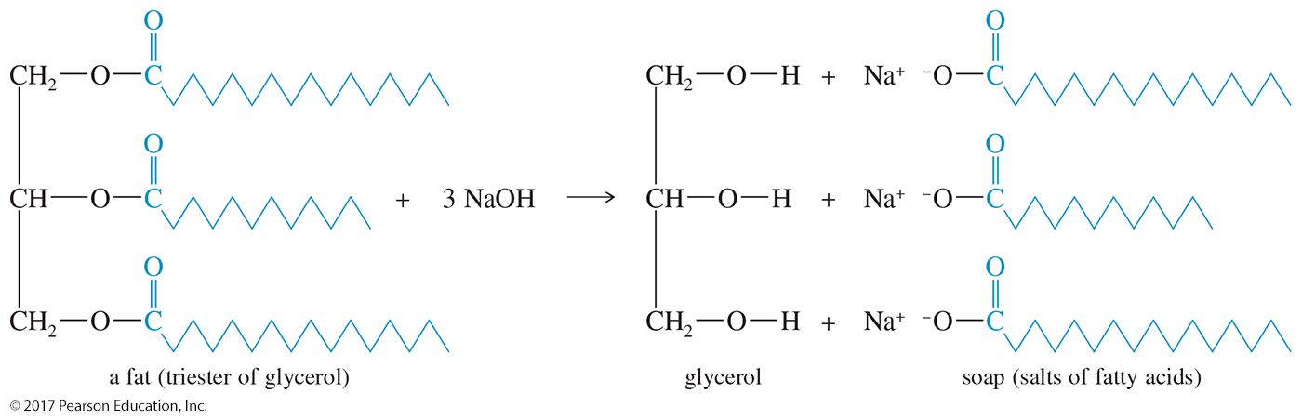
Saponification
Soaps are made by heating NaOH with a fat (triester of glycerol) to produce the sodium salt of a fatty acid—a soap.

Slide 19
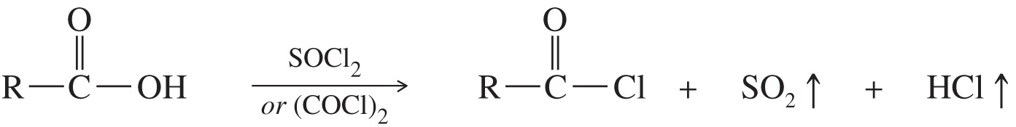
Synthesis of Acid Chlorides
Thionyl chloride (SOCl₂) and oxalyl chloride (COCl₂) are the most convenient reagents because they produce only gaseous side products.

Slide 20
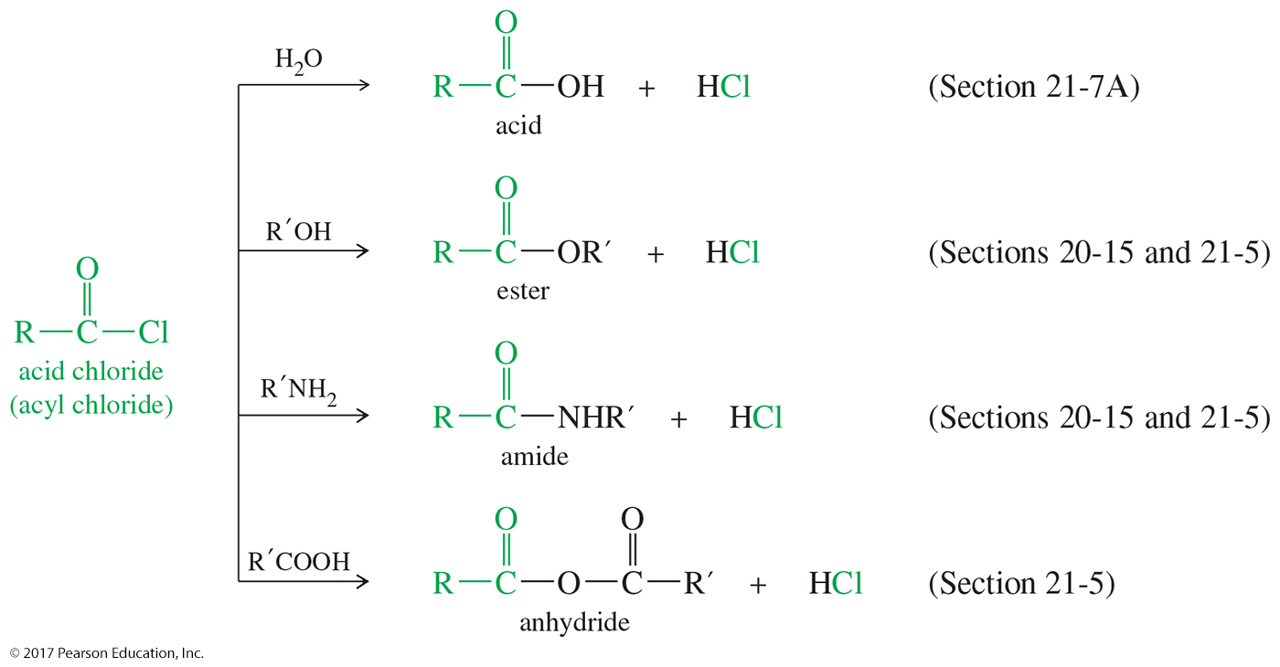
Acid Chloride Reactions (1)

Slide 21
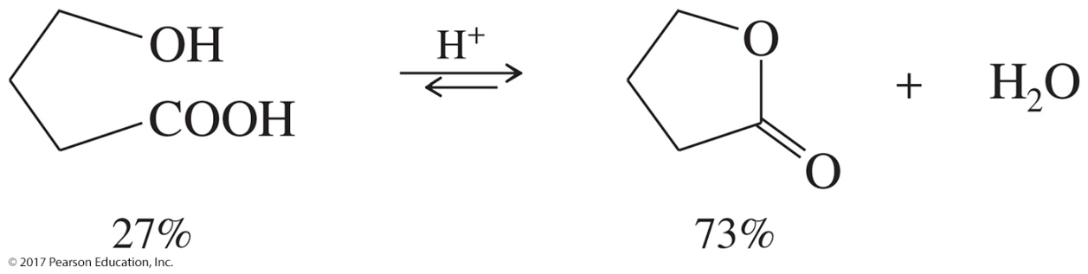
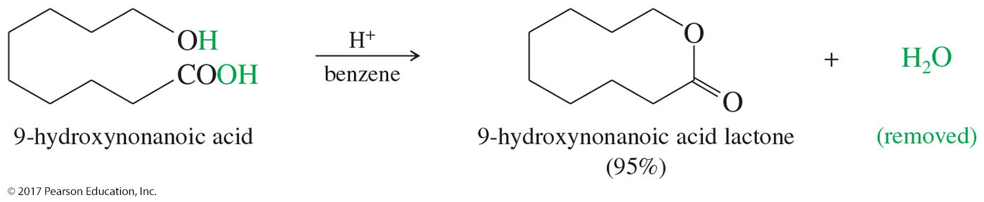
Formation of Lactones
Formation is favored for five- and six-membered rings.
For larger rings, remove water to shift equilibrium toward products.

Slide 22
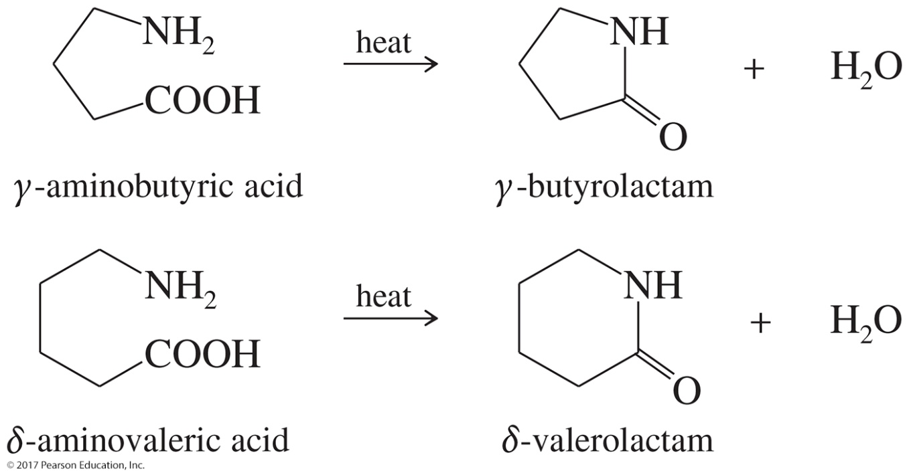
Formation of Lactams
Five-membered lactams (γ-lactams) and six-membered lactams (δ -lactams) often form on heating or adding a dehydrating agent to the appropriate γ -amino acid or
δ -amino acid.

Slide 23
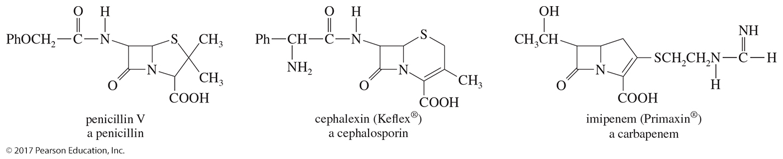
β-Lactams
Unusually reactive, four-membered ring amides are capable of acylating a variety of nucleophiles.
They are found in three important classes of antibiotics: penicillins, cephalosporins, and carbapenems.

Slide 24
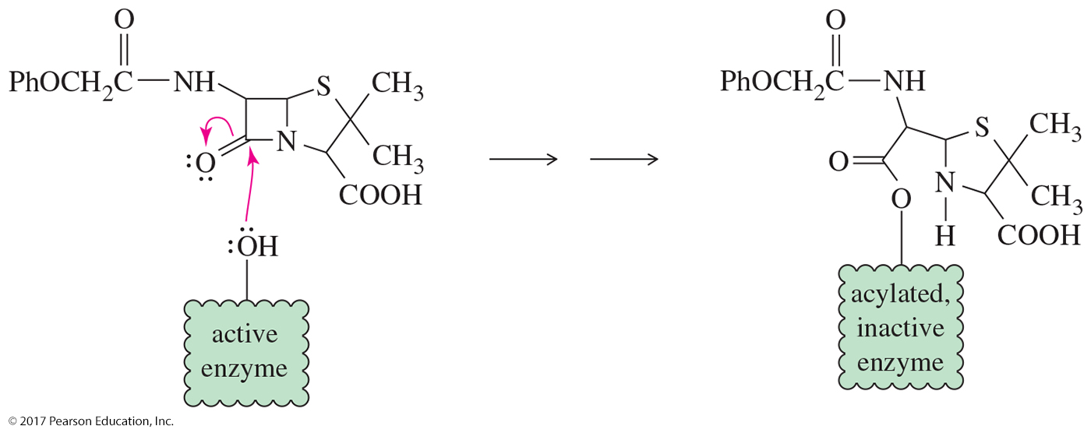
Action of β-Lactam Antibiotics
The β-lactams work by interfering with the synthesis of bacterial cell walls.
The acylated enzyme is inactive for synthesis of the cell wall protein.

Slide 25
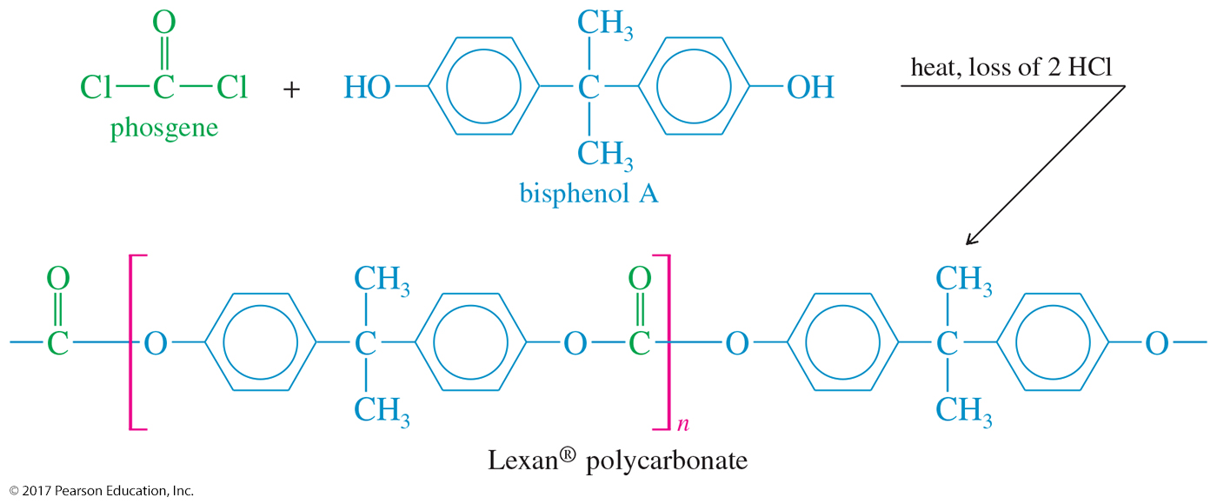
Polycarbonate Synthesis
Polycarbonates are polymers bonded to the carbonate ester linkage.
The diol used to make Lexan® is a phenol called
bisphenol A, a common intermediate in polyester and polyurethane synthesis.

Slide 26
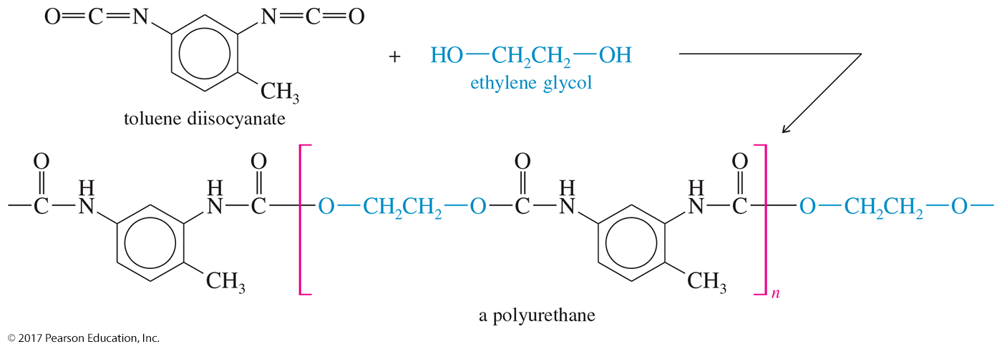
Synthesis of Polyurethanes
Reaction of toluene diisocyanate with ethylene glycol produces one of the most common forms of polyurethanes.

