Slide 1
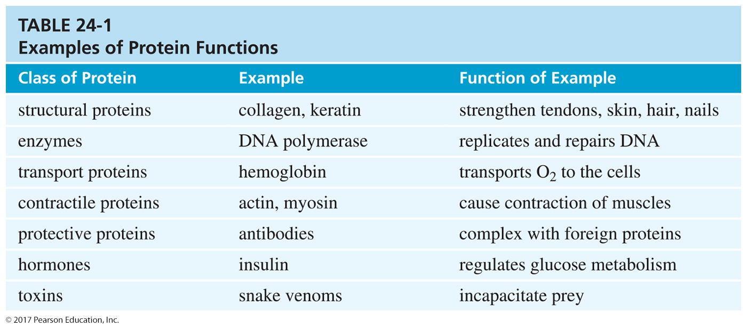
Proteins
Biopolymers of amino acids
Amino acids are joined by peptide bond.
They serve a variety of functions:
  Structure
  Enzymes
  Transport
  Protection
  Hormones

Slide 2
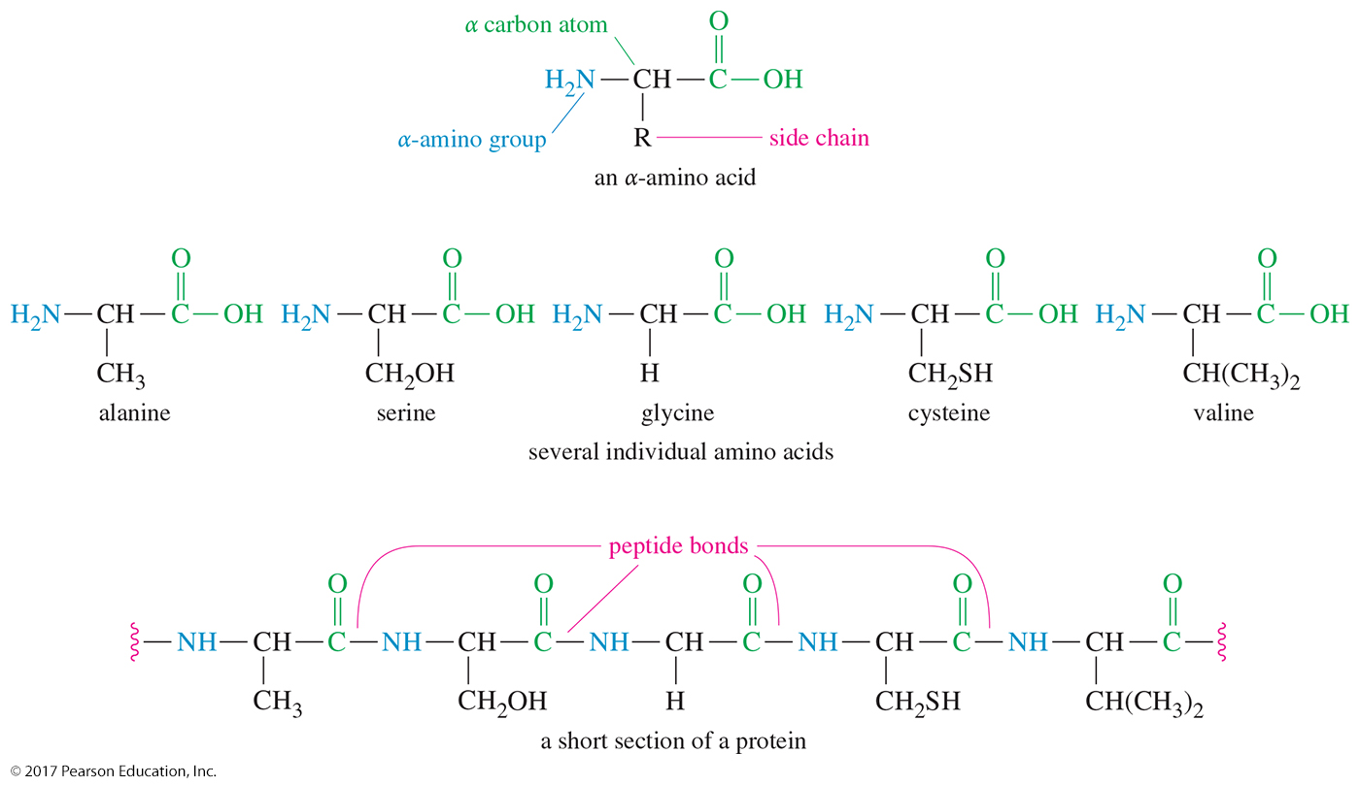
Structure of Proteins

Slide 3
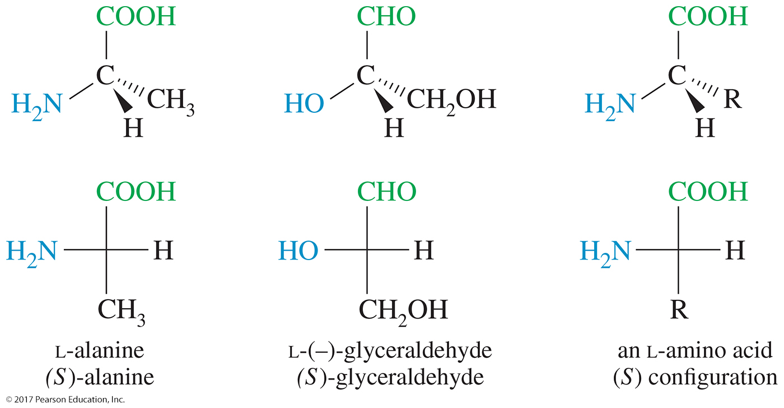
Stereochemistry of α-Amino Acids

Slide 4
Standard Amino Acids
Twenty standard alpha-amino acids
Differ in side-chain characteristics:
  —H or alkyl
  Contains an —OH
  Contains sulfur
  Contains a nonbasic nitrogen
  Has —COOH
  Has a basic nitrogen

Slide 5
Essential Amino Acids
Arginine (Arg)
Threonine (Thr)
Lysine (Lys)
Valine (Val)
Phenylalanine (Phe)
Tryptophan (Trp)
Methionine (Met)
Histidine (His)
Leucine (Leu)
Isoleucine (Ile)

Slide 6
Complete Proteins
Provide all the essential amino acids
Examples: Those found in meat, fish, milk,
and eggs
Proteins that are severely deficient in one or more of the essential amino acids are called incomplete proteins. Plant proteins are generally incomplete.
Vegetarians should eat many different kinds
of plants or supplement their diets with milk
and/or eggs.

Slide 7
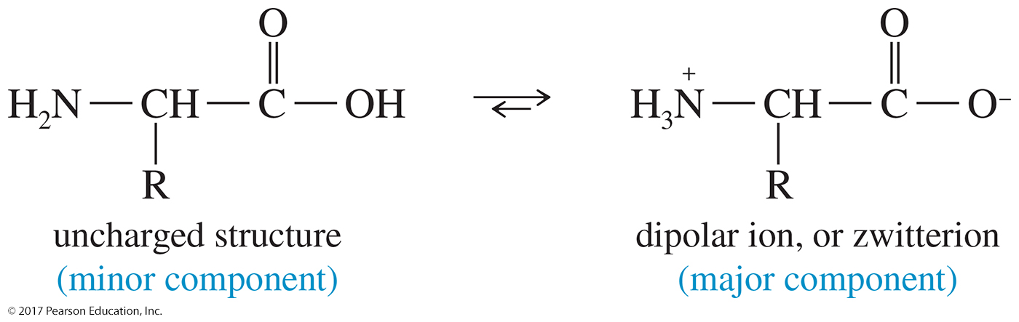
Zwitterion Formation
Amino acid exists as a dipolar ion.
—COOH loses H⁺; —NH₂ gains H⁺.
Actual structure depends on pH.

Slide 8
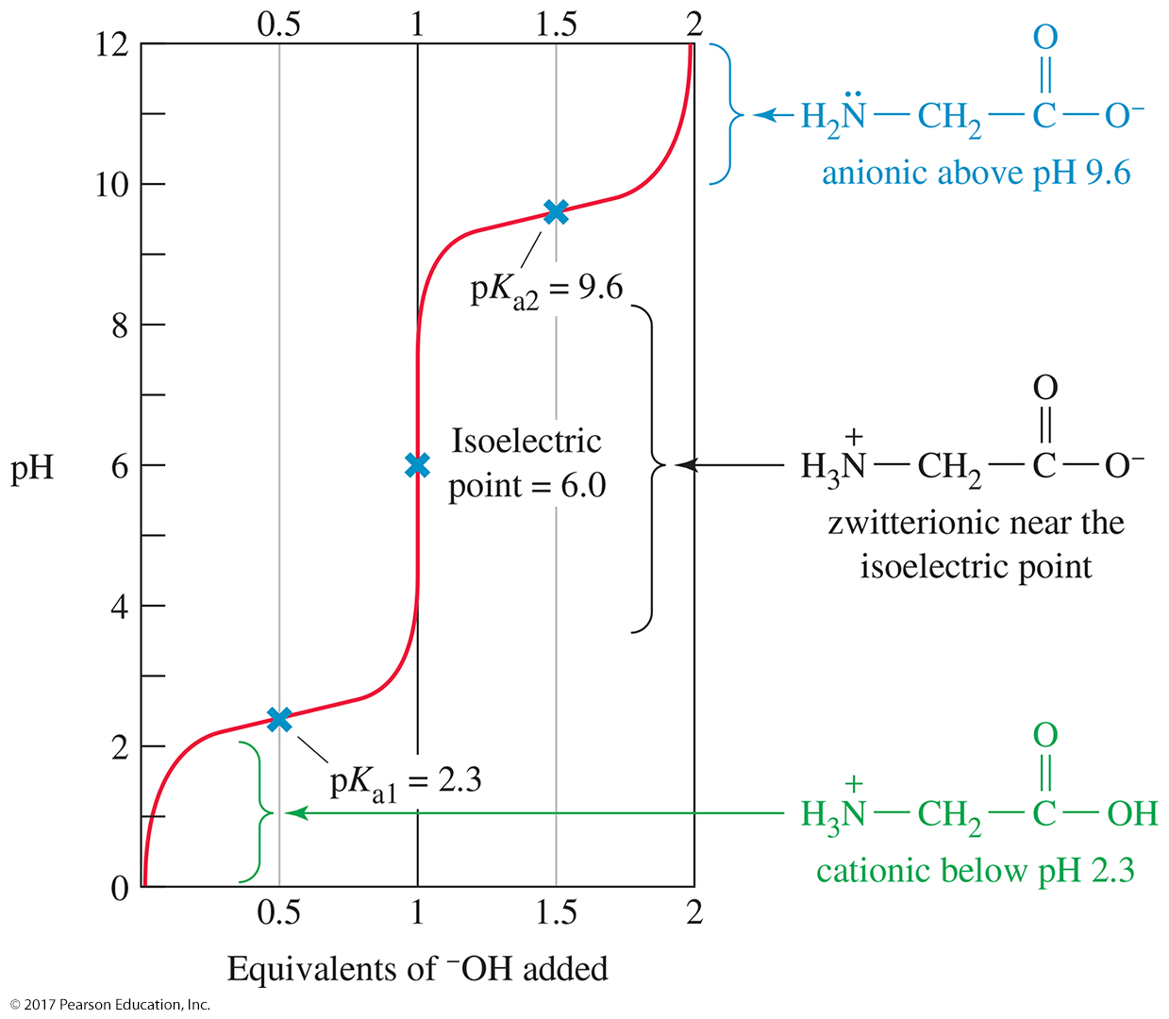
Structure and pH

Slide 9
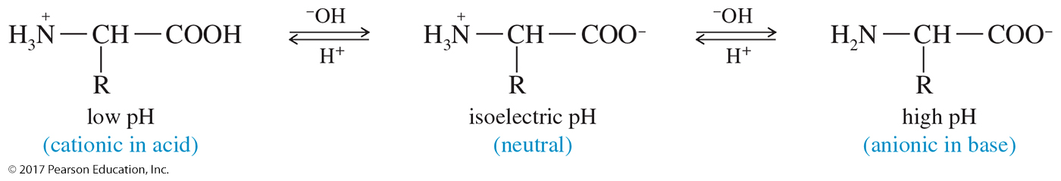
Isoelectric Point of Amino Acids
Isoelectric point (pI) is defined as the pH at which amino acids exist as the zwitterion (neutral charge).
The pI depends on structure of the side chain of the amino acid.

Slide 10
Isoelectric Points
Acidic amino acids: Isoelectric pH ~3.
Basic amino acids: Isoelectric pH ~9.
Neutral amino acids: Isoelectric pH is slightly acidic, 5–6.

Slide 11
Electrophoresis Separation
Electrophoresis uses differences in isoelectric points to separate mixtures of amino acids.
Positively charged (cationic) amino acids are attracted to the negative electrode (the cathode).
Negatively charged (anionic) amino acids are attracted to the positive electrode (the anode).
An amino acid at its isoelectric point has no net charge, so it does not move.

Slide 12
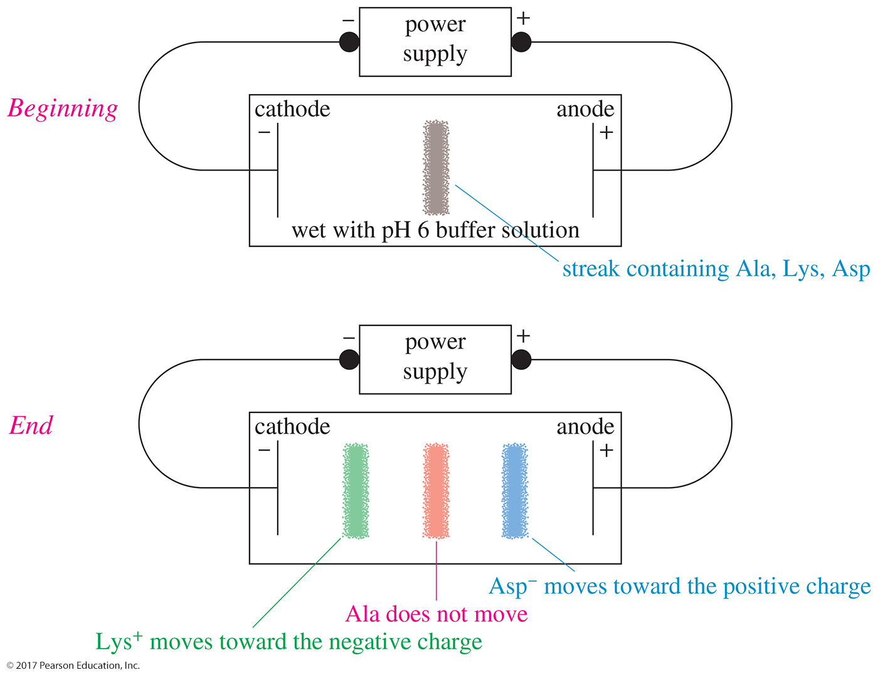
Electrophoresis

Slide 13
Resolution of Amino Acids
Usually, only the L-enantiomer is biologically active.
Convert the amino acid to a salt, using a chiral acid or base. The result is a mixture of diastereomeric salts that can be separated by chromatography.
Use an enzyme, such as acylase, that will react with only one enantiomer.

Slide 14
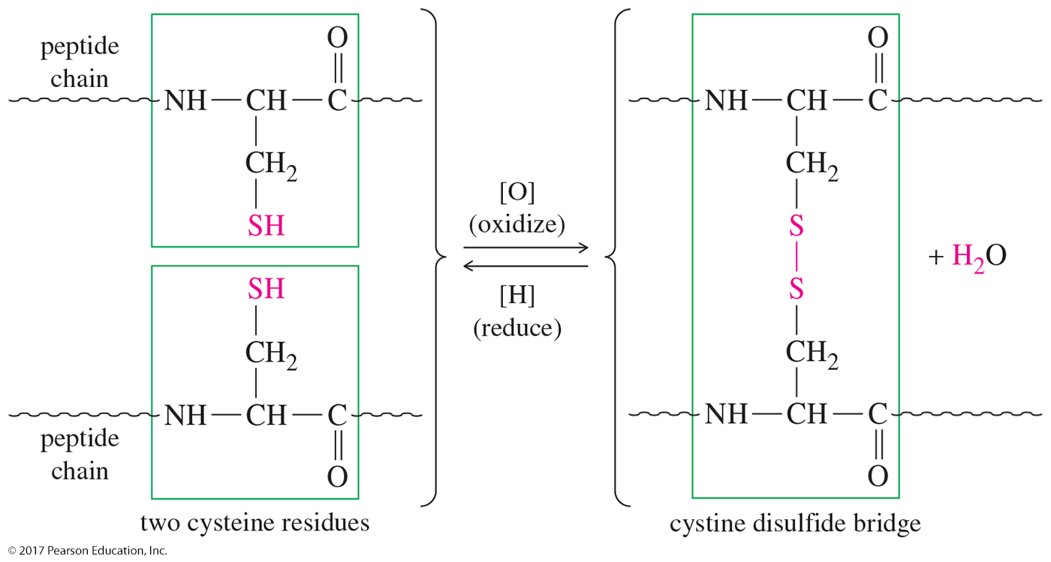
Disulfide Linkages
Cysteine can form disulfide bridges.

Slide 15
Classification of Proteins
Simple: Hydrolyzed to amino acids only
Conjugated: Bonded to a nonprotein group, such as sugar, nucleic acid, or lipid
Fibrous: Long, stringy filaments, insoluble in water; function as structure
Globular: Folded into spherical shape; function as enzymes, hormones, or transport proteins

Slide 16
Levels of Protein Structure
Primary: The sequence of the amino acids in the chain and the disulfide links
Secondary: Structure formed by hydrogen bonding. Examples are α helix and pleated sheet.
Tertiary: Complete 3-D conformation
Quaternary: Association of two or more peptide chains to form protein

Slide 17
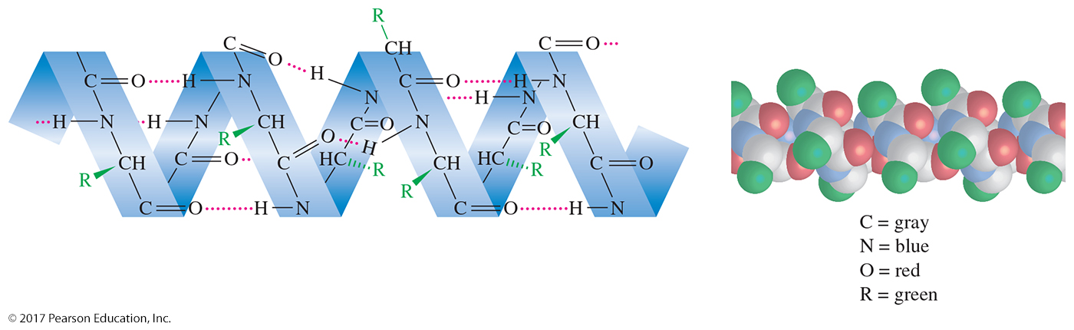
Secondary Structure:
Alpha Helix
Each carbonyl oxygen can hydrogen bond with an N—H hydrogen on the next turn of the coil.

Slide 18
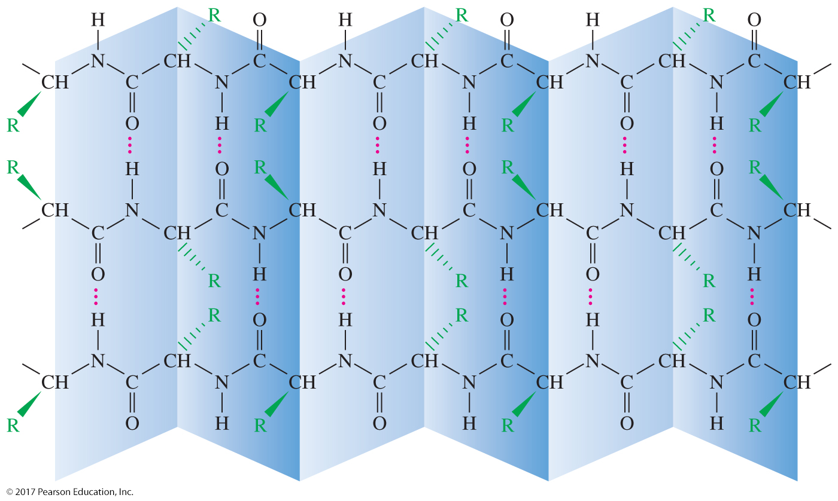
Secondary Structure:
Pleated Sheet Arrangement
Each carbonyl oxygen hydrogen bonds with a N—H on an adjacent peptide chain.

Slide 19
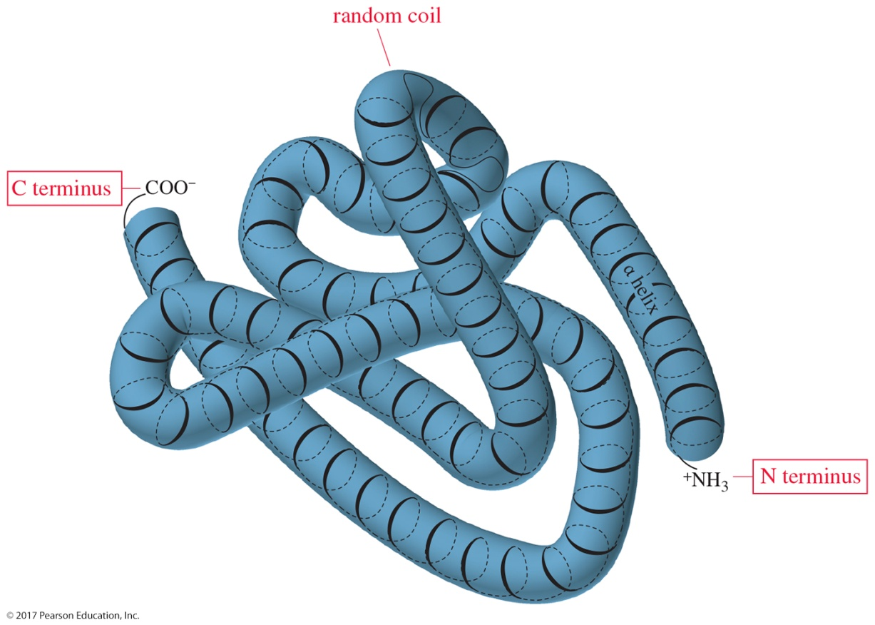
Tertiary Structure of
Globular Proteins
The tertiary structure of a typical globular protein includes segments of α helix with segments of random coil at the points where the helix is folded.

Slide 20
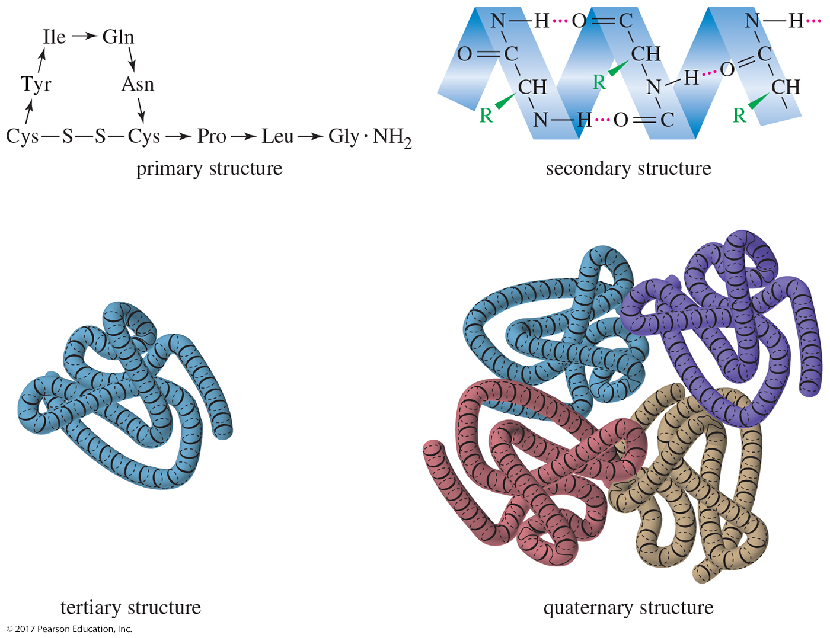
Summary of Structures

