Slide 1
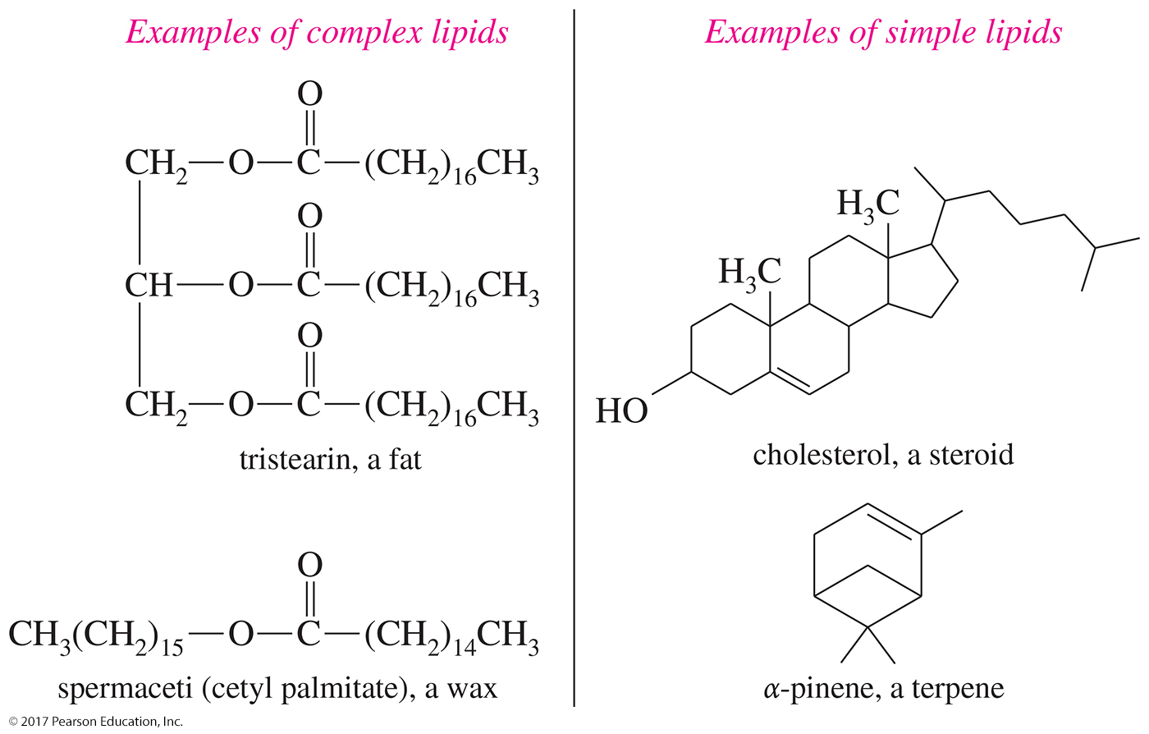
Examples of Lipids

Slide 2
Fatty Acids
Unbranched carboxylic acids with 12–20 carbons
Most contain an even number of carbons because they are built from acetic acid units.
Melting points increase with increasing molecular weights.
Unsaturation greatly lowers the melting point.

Slide 3
Glycerides
Fatty acid esters of the triol glycerol
Triglycerides are the most common glycerides, and they are used for long-term energy storage in plants and animals.
    Fats
        Solid at room temperature
        Most are derived from mammals.
    Oils
        Liquid at room temperature
        Most are derived from plants or cold-blooded animals.

Slide 4
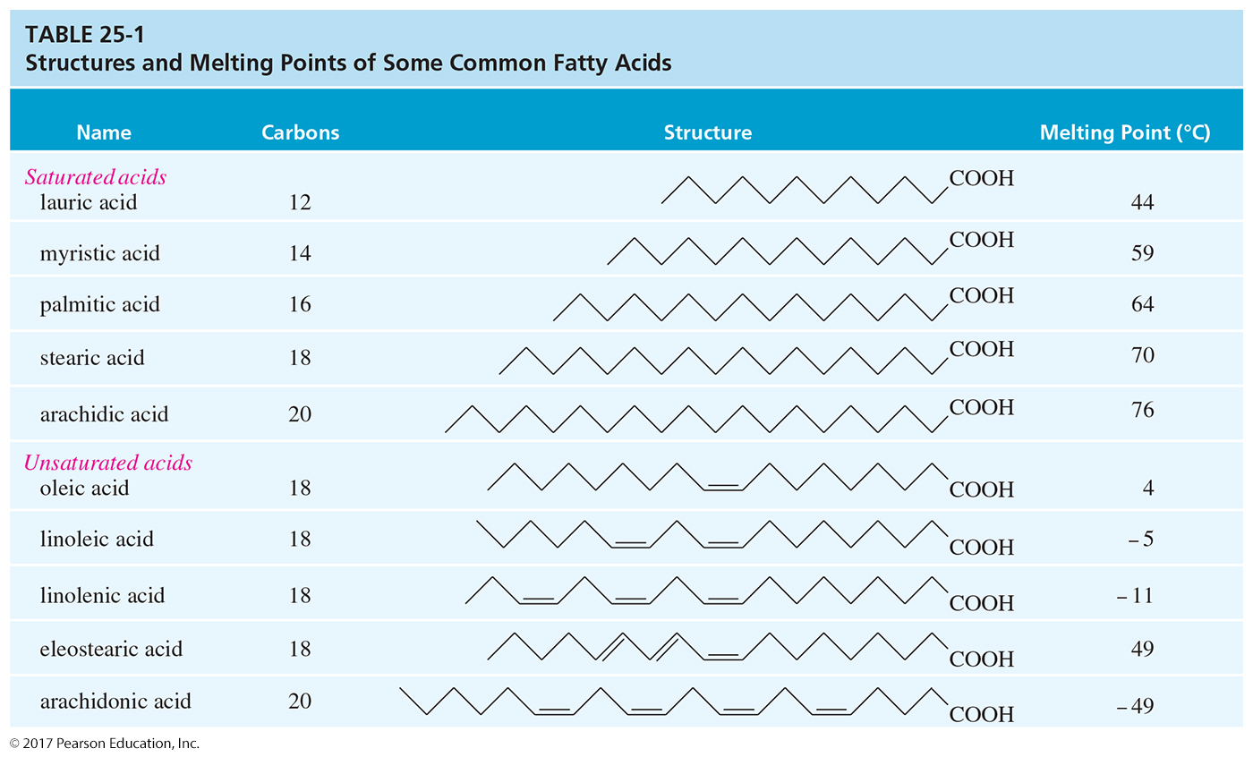
Melting Points of Fatty Acids
Notes:
Figure: 25_01-03T01.jpg
Title:
Structures and Melting Points of Some Common Fatty Acids
Caption:
Saturated fatty acids have melting points that increase gradually with their molecular weight.
Notes:
The presence of cis double bonds lowers the melting point.

Slide 5
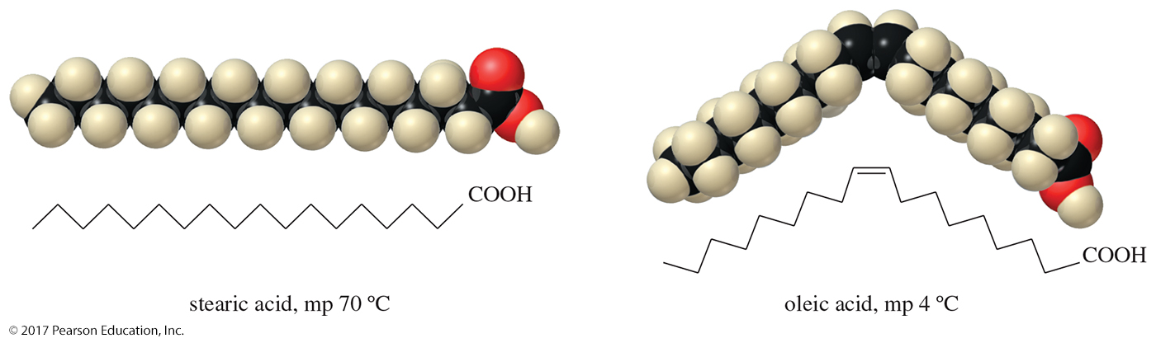
Melting Points
The cis double bond in oleic acid lowers the melting point by 66 °C.
A cis double bond bends the molecule, so it cannot pack efficiently.
A trans double bond has less effect.

Slide 6
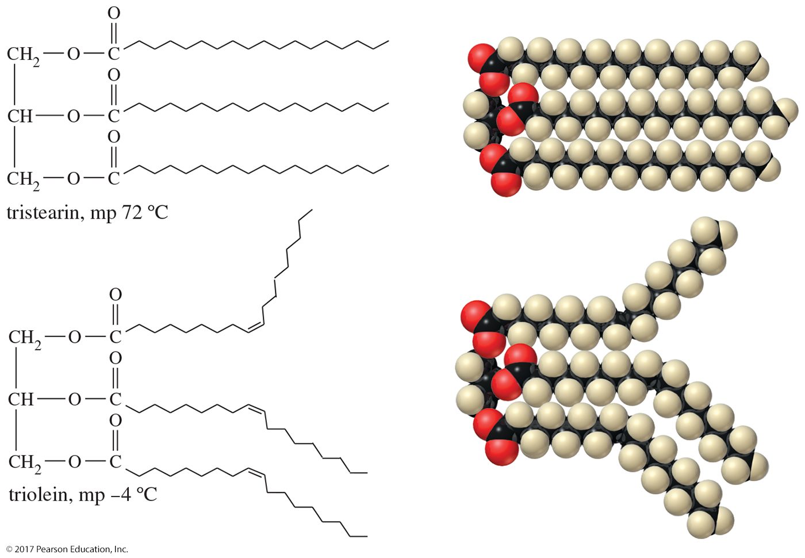
Fats and Oils
Unsaturated triglycerides have lower melting points because their unsaturated fatty acids do not pack as well in a solid lattice.

Slide 7
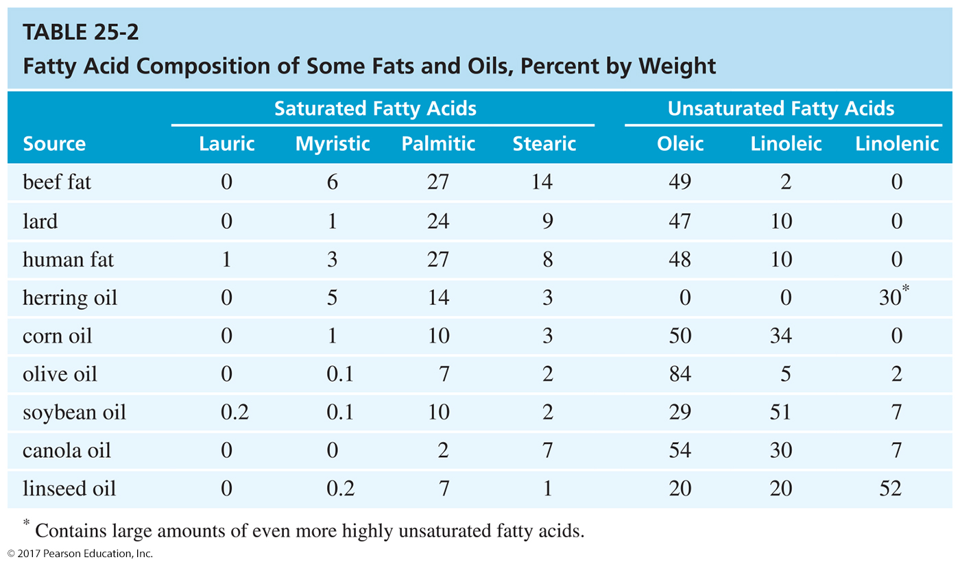

Slide 8
Trans Fats
Consumers are concerned with the presence of unnatural trans fatty acids in “partially hydrogenated vegetable oil.”
The hydrogenation process can produce trans fats, which are associated with an increase in coronary heart disease.

Slide 9
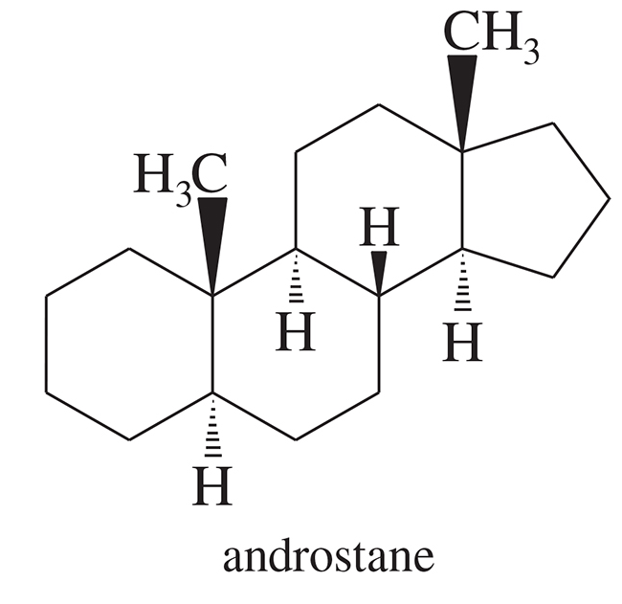
Steroids
Steroids are classified as simple lipids because they do not undergo hydrolysis.
Common structural features:
    ═O or —OH at C3
    Side chain at C17
    May also have a double bond from C5 to either C4 or C6

Slide 10
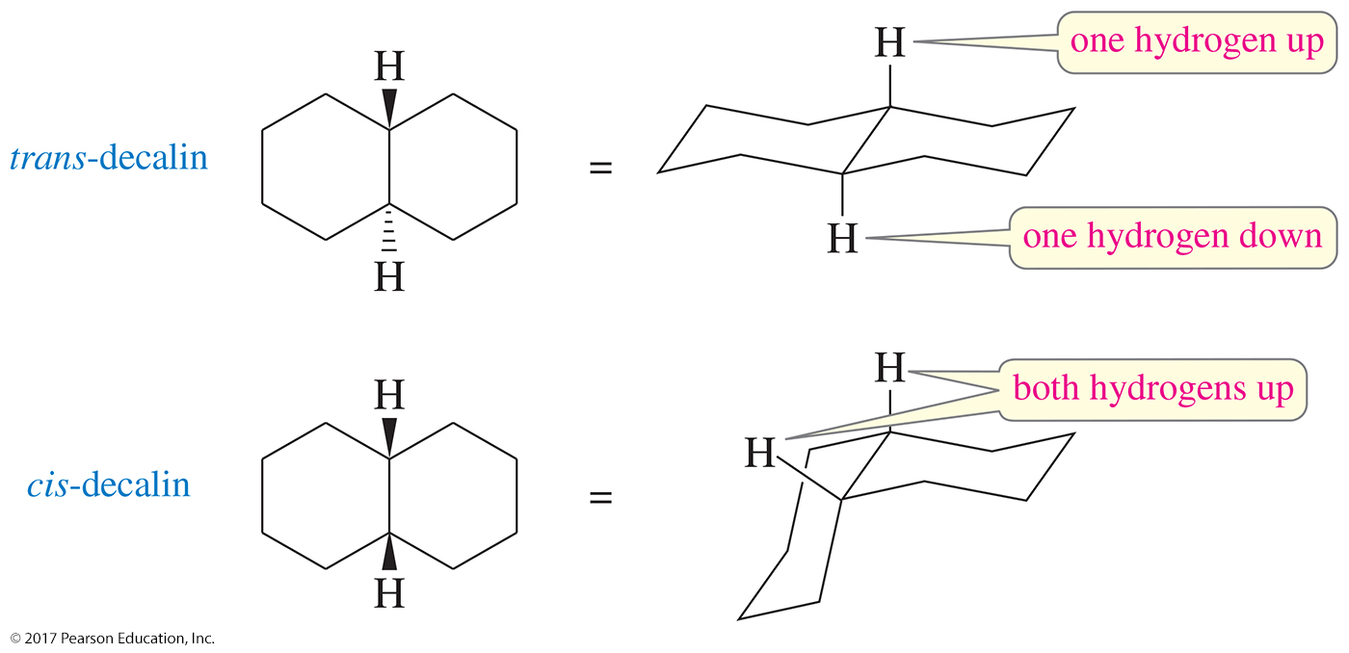
Cis- and Trans-Decalins
In trans-decalin, the two bonds to the second ring are trans to one another, and the hydrogens on the junction are also trans.
In cis-decalin, the bonds to the second ring are cis, and the junction hydrogens are also cis.

Slide 11
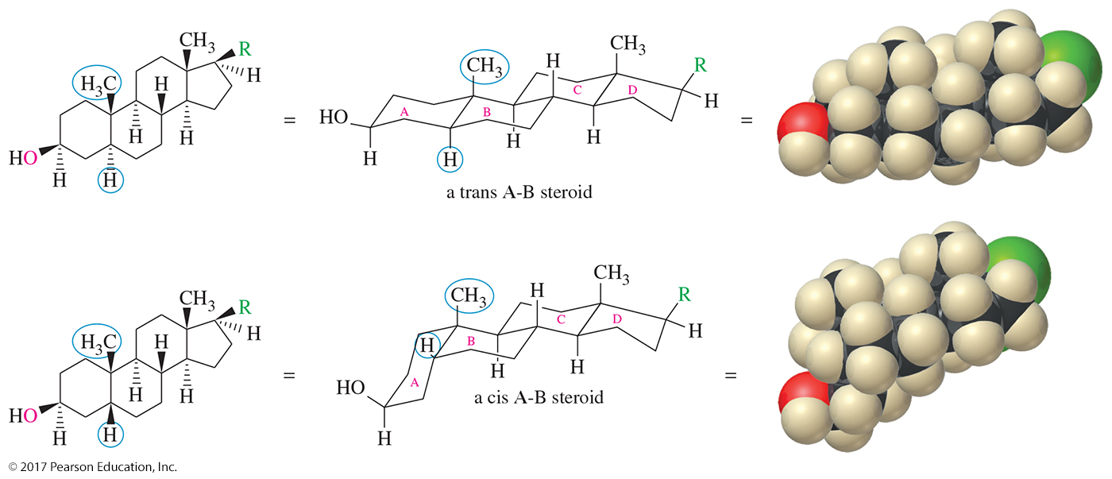
Cis and Trans Steroids
Common steroids may have either a cis or a trans A-B ring junction. The other junctions are normally trans.

Slide 12
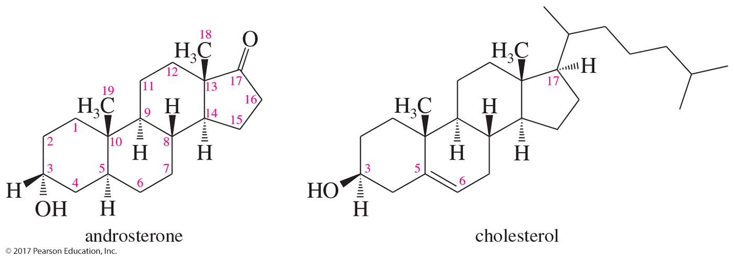
Cholesterol
Common biological intermediate
Probably a precursor to other steroids
Side chain at C17 and double bond at C5–C6

Slide 13
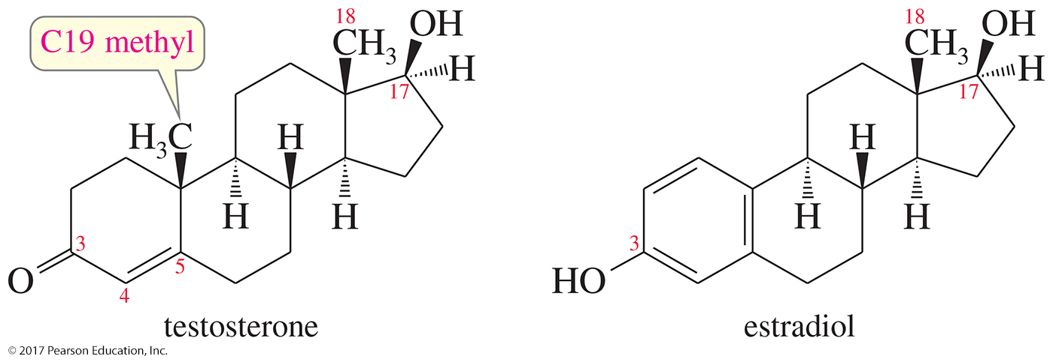
Sex Hormones
Testosterone is the most potent of the natural male sex hormones, and estradiol is the most potent natural female hormone.
Notice that the female sex hormone differs from the male hormone by its aromatic A ring.

Slide 14
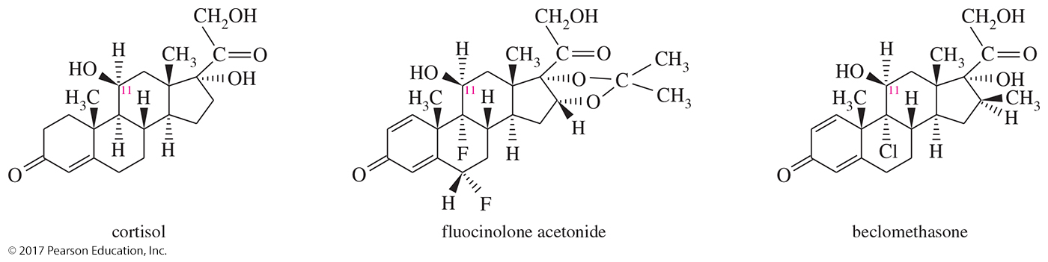
Examples of Steroids
Cortisol is the major natural hormone of the adrenal cortex.
Fluocinolone acetonide is more potent for treating skin inflammation.
Beclomethasone is more potent for treating asthma.

Slide 15
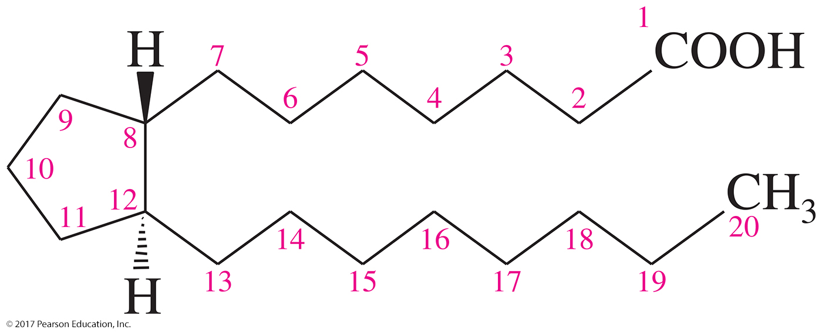
Prostaglandins
Biochemical regulators more powerful than steroids
Cyclopentane ring with two long side chains trans to each other
Most have 20 carbon atoms.
Derived from arachidonic acid

Slide 16
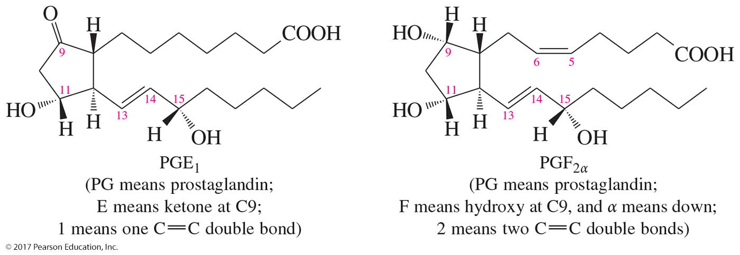
Biosynthesis of Prostaglandins
Biosynthesis of prostaglandins begins with
an enzyme-catalyzed oxidative cyclization of arachidonic acid.

