Slide 1
UNIT SEVEN KEY TOPICS
CHAPTER 18
Rxns with aldehydes/ketones as products ozonolysis or oxidation 1
Rxns with aldehydes/ketones as reactant Wittig or aldol (ch22) 1
IR signatures of aldehydes and ketones
1
CHAPTER 19
Amines as bases 1
Amines as nucleophile in NAS 1
Sandmeyer reaction 1
Relative amine basicity 1
IR signature of amines 1
CHAPTER 23
Relative structures of ribonucleotides/ribonucleotides 1
Haworth structures of monosaccharides 1

Slide 2
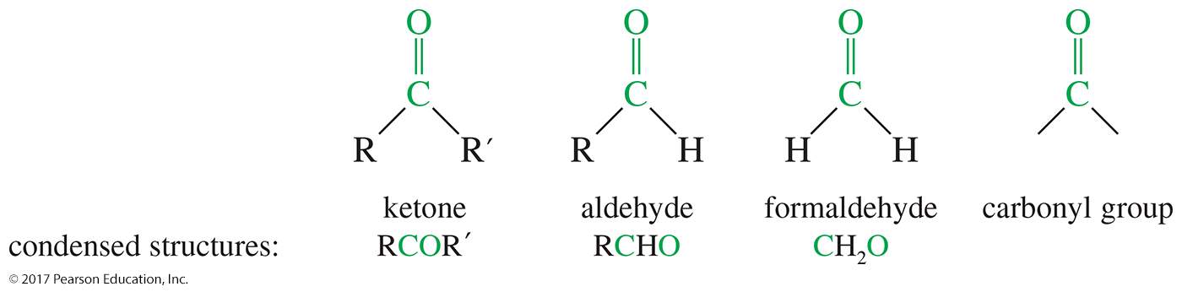
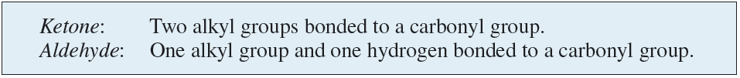
Structure of the Carbonyl Group

Slide 3
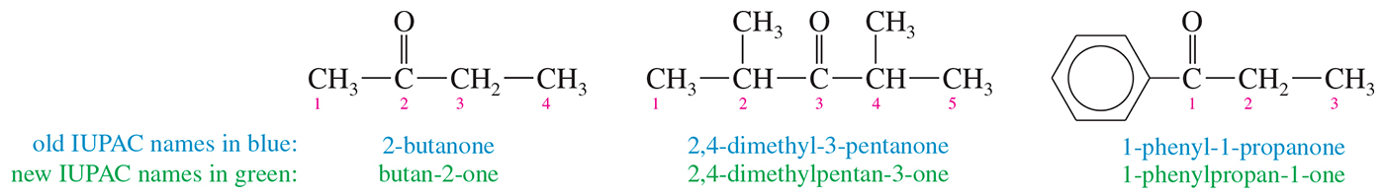
Ketone Nomenclature
Number the chain so that the carbonyl carbon has the lowest number.
Replace the alkane -e with -one.

Slide 4
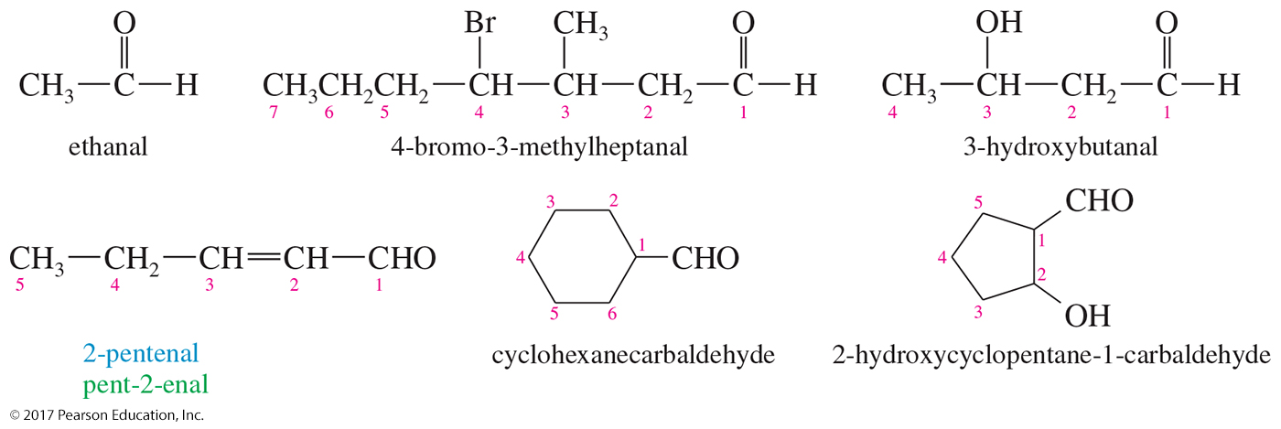
Aldehydes Nomenclature
The aldehyde carbon is number 1.
IUPAC: Replace -e with -al.
If the aldehyde group is attached to a ring, the suffix -carbaldehyde is used.

Slide 5
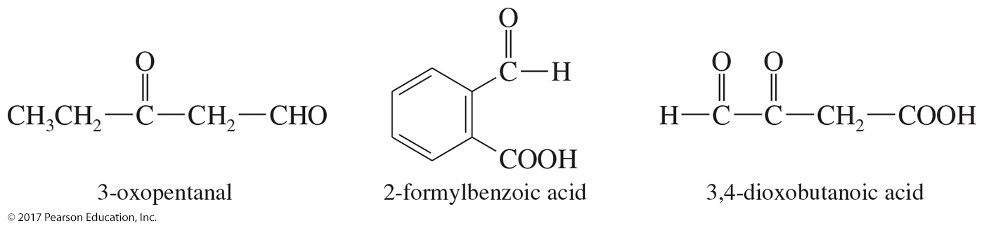
Carbonyl as Substituent
On a molecule with a higher-priority functional group, a ketone is an oxo and an aldehyde is a formyl group.
Aldehydes have a higher priority than ketones.

Slide 6
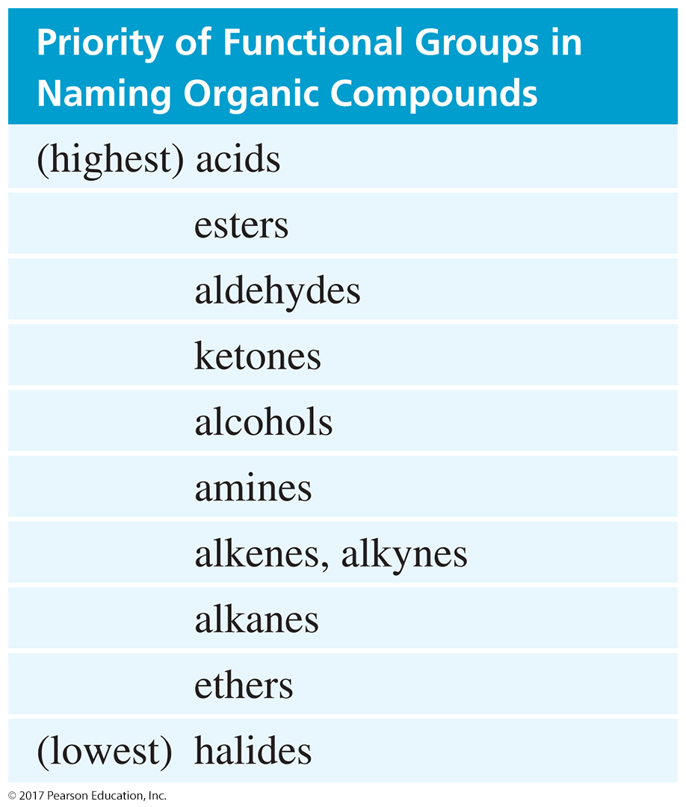
Functional Group Priority

Slide 7
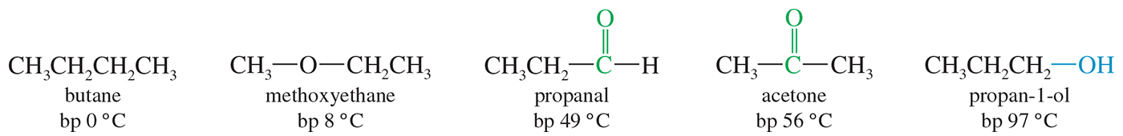
Boiling Points
Ketones and aldehydes are more polar, so they have a higher boiling point than comparable alkanes or ethers.
They cannot hydrogen-bond to each other, so their boiling point is lower than the comparable alcohol.

Slide 8
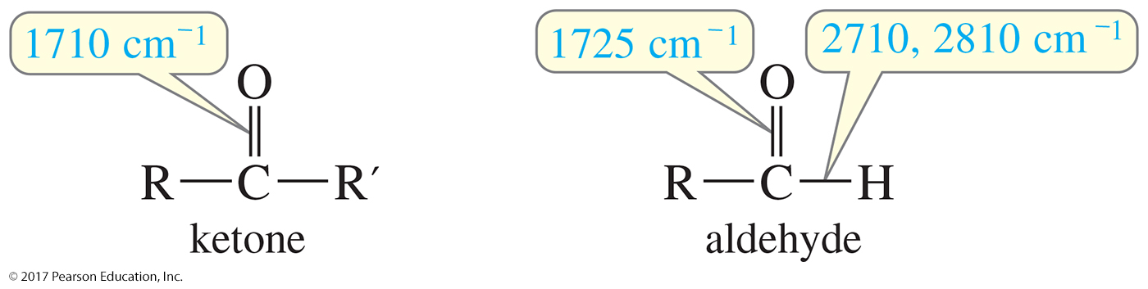
Infrared (IR) Spectroscopy
Very strong C═O stretch around 1710 cm^{–1} for ketones and 1725 cm^{–1} for simple aldehydes
Additional C—H stretches for aldehyde: Two absorptions at 2710 cm^{–1} and 2810 cm^{–1}

Slide 9
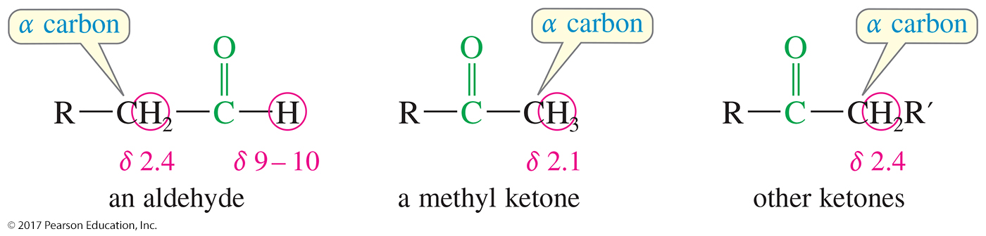
Proton NMR Spectra
Aldehyde protons normally absorb between
δ 9 and δ 10.
Protons of the α carbon usually absorb between δ 2.1 and δ 2.4 if there are no other electron-withdrawing groups nearby.

Slide 10
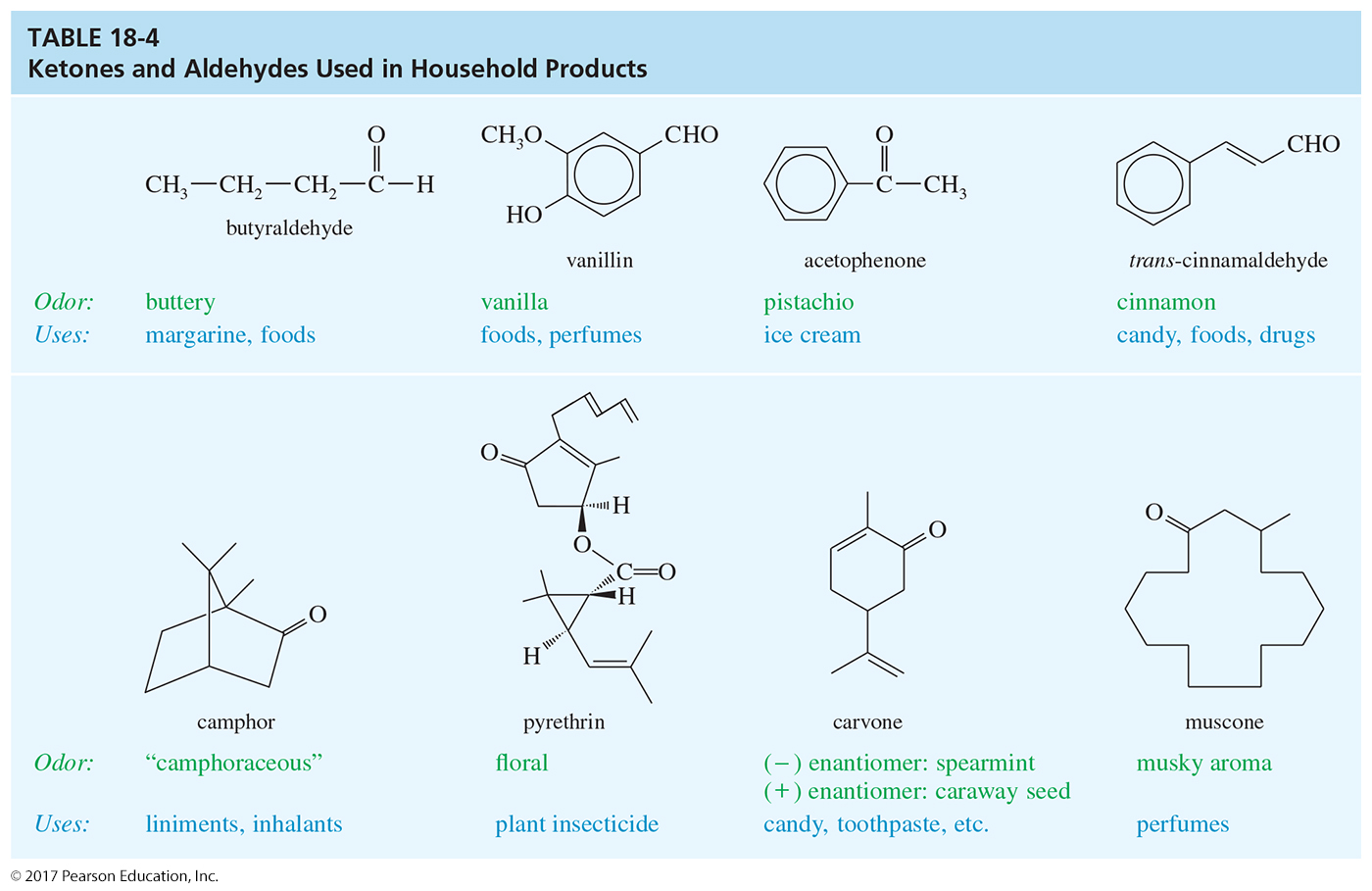

Slide 11
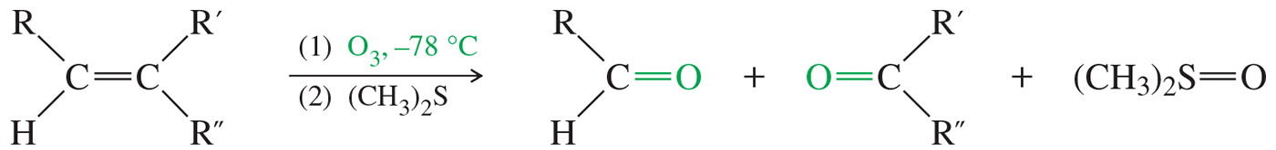
Ozonolysis of Alkenes
The double bond is oxidatively cleaved by ozone, followed by reduction.
Ketones and aldehydes can be isolated as products under these conditions.

Slide 12
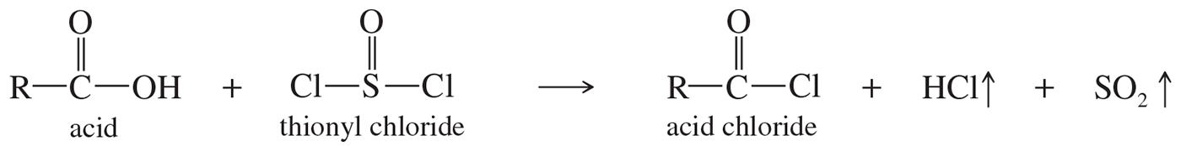
Acids to Acid Chlorides

Slide 13
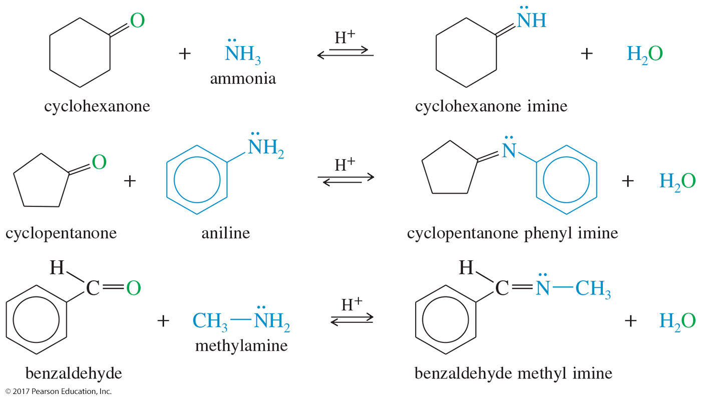
Imine Reactions

Slide 14
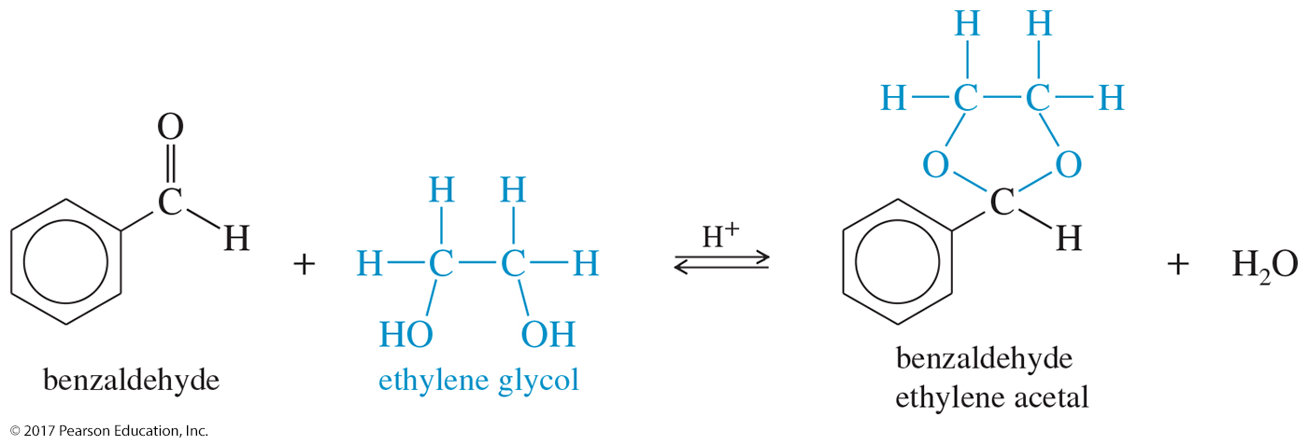
Cyclic Acetals
Addition of a diol produces a cyclic acetal.
The reaction is reversible.
This reaction is used in synthesis to protect carbonyls from reaction.

Slide 15
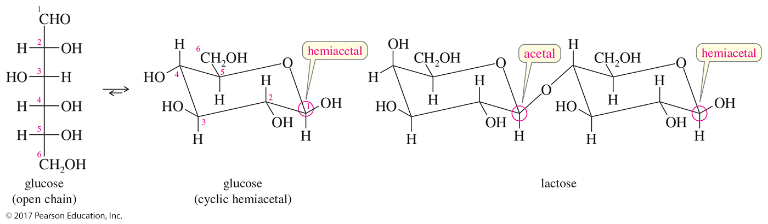
Carbohydrates

Slide 16
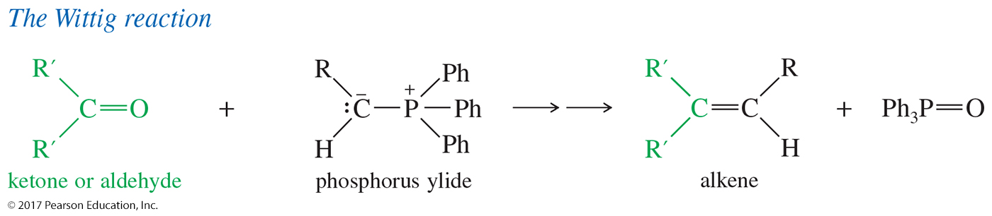
The Wittig Reaction
The Wittig reaction converts the carbonyl group into a new C═C double bond where no bond existed before.
A phosphorus ylide is used as the nucleophile in the reaction.

