Slide 1
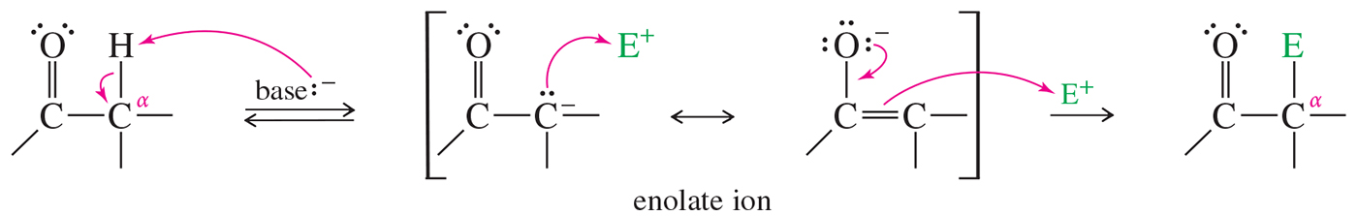
Alpha Substitution
Alpha substitution is the substitution of one of the hydrogens attached to the α carbon for an electrophile.
The reaction occurs through an enolate ion intermediate.

Slide 2
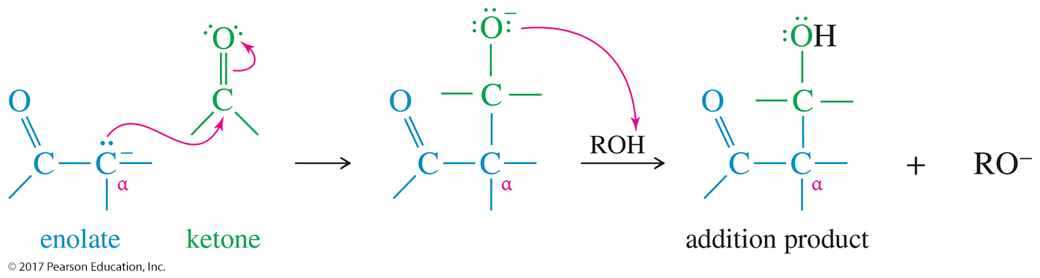
Condensation of an Enolate with an Aldehyde or Ketone
The enolate ion attacks the carbonyl group to form an alkoxide.
Protonation of the alkoxide gives the addition product: a β-hydroxy carbonyl compound.

Slide 3
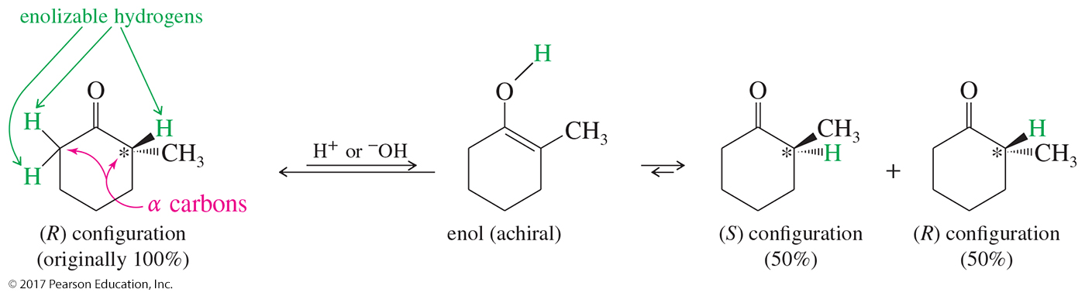
Racemization
For aldehydes and ketones, the keto form is greatly favored at equilibrium.
If a chiral α carbon has an enolizable hydrogen atom, a trace of acid or base allows that carbon to invert its configuration, with the enol serving as the intermediate. This is called racemization.

Slide 4
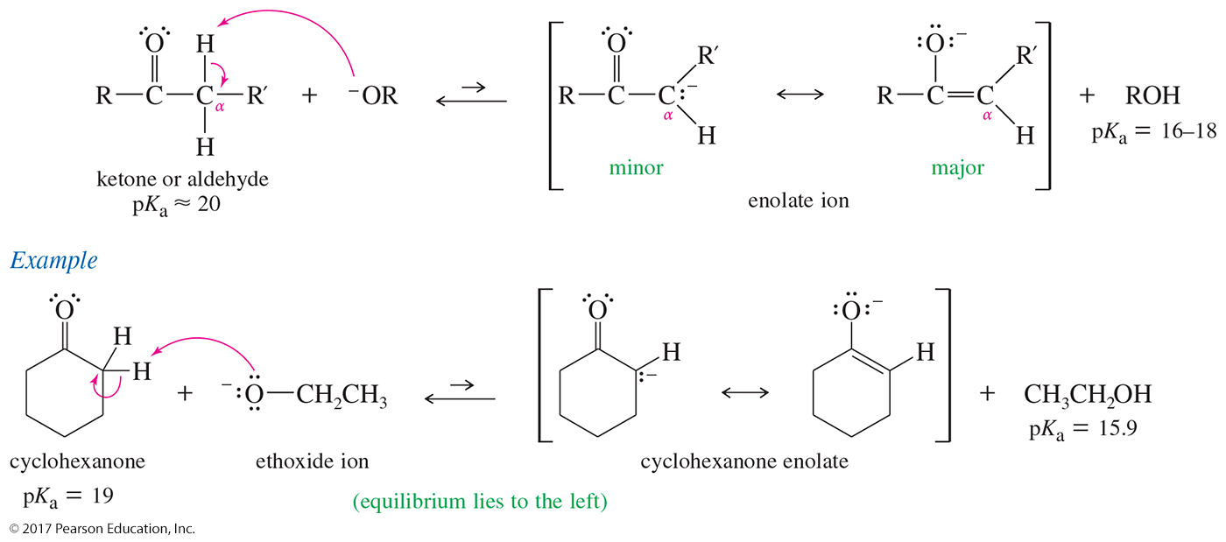
Formation and Stability of Enolate Ions
The equilibrium mixture contains only a small fraction of the deprotonated, enolate form.

Slide 5
Condensation of Ketones and Aldehydes
Condensations combine two or more molecules, often with the loss of a small molecule such as water or an alcohol.
The aldol condensation is the addition of an enolate ion to another carbonyl group. It occurs under basic conditions.

Slide 6
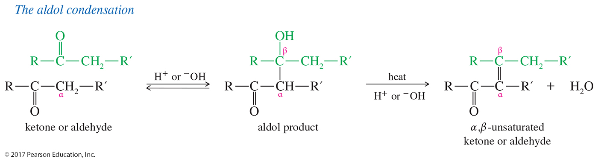
Aldol Condensation
Under basic conditions, the aldol condensation involves the nucleophilic addition of an enolate ion to another carbonyl group.
When the reaction is carried out at low temperatures, the
β-hydroxy carbonyl compound can be isolated.
Heating will dehydrate the aldol product to the α,β-unsaturated compound.

Slide 7
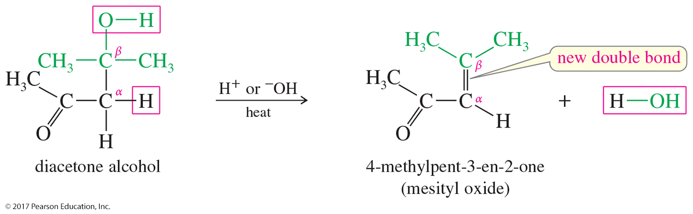
Dehydration of Aldol Products
Heating a basic or acidic aldol dehydration of the alcohol functional group
The product is an α,β-unsaturated conjugated aldehyde or ketone.

Slide 8
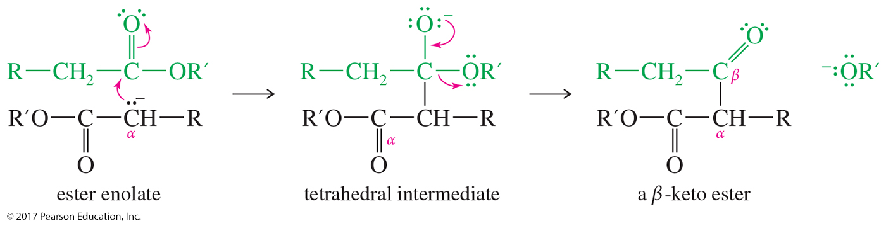
Claisen Ester Condensation
The Claisen condensation results when an ester molecule undergoes nucleophilic acyl substitution by an enolate.

