Slide 1
Classification of Carbohydrates
Monosaccharides or simple sugars:
  Polyhydroxyaldehydes or aldoses
  Polyhydroxyketones or ketoses
Disaccharides can be hydrolyzed to two monosaccharides.
Polysaccharides hydrolyze to many monosaccharide units. For example, starch and cellulose have
> 1000 glucose units.

Slide 2
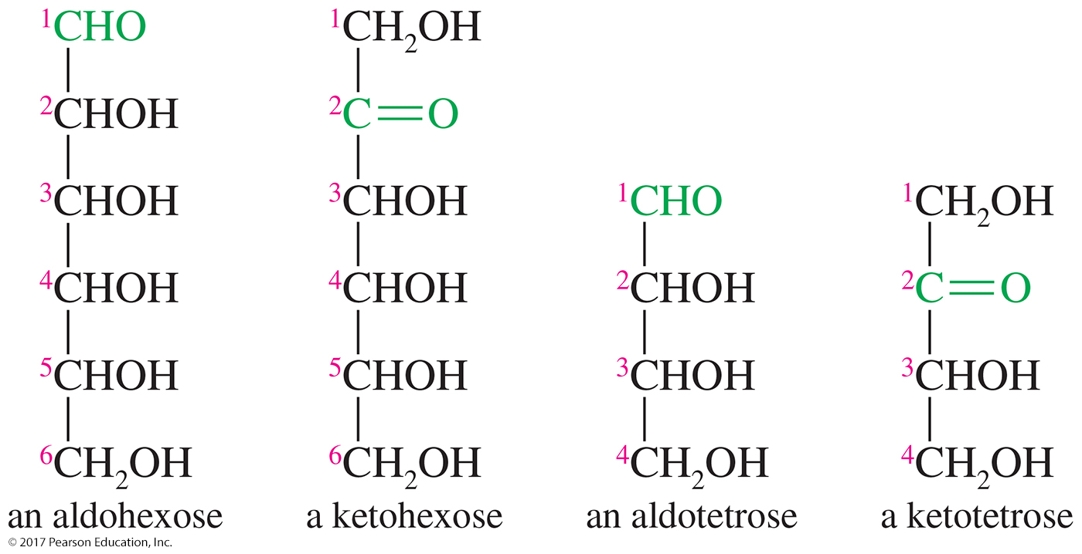
Monosaccharide Classification
Classified using three criteria:
  If it contains a ketone or an aldehyde group
  Number of carbons in the chain
  Configuration of the asymmetric carbon farthest from the carbonyl group

Slide 3
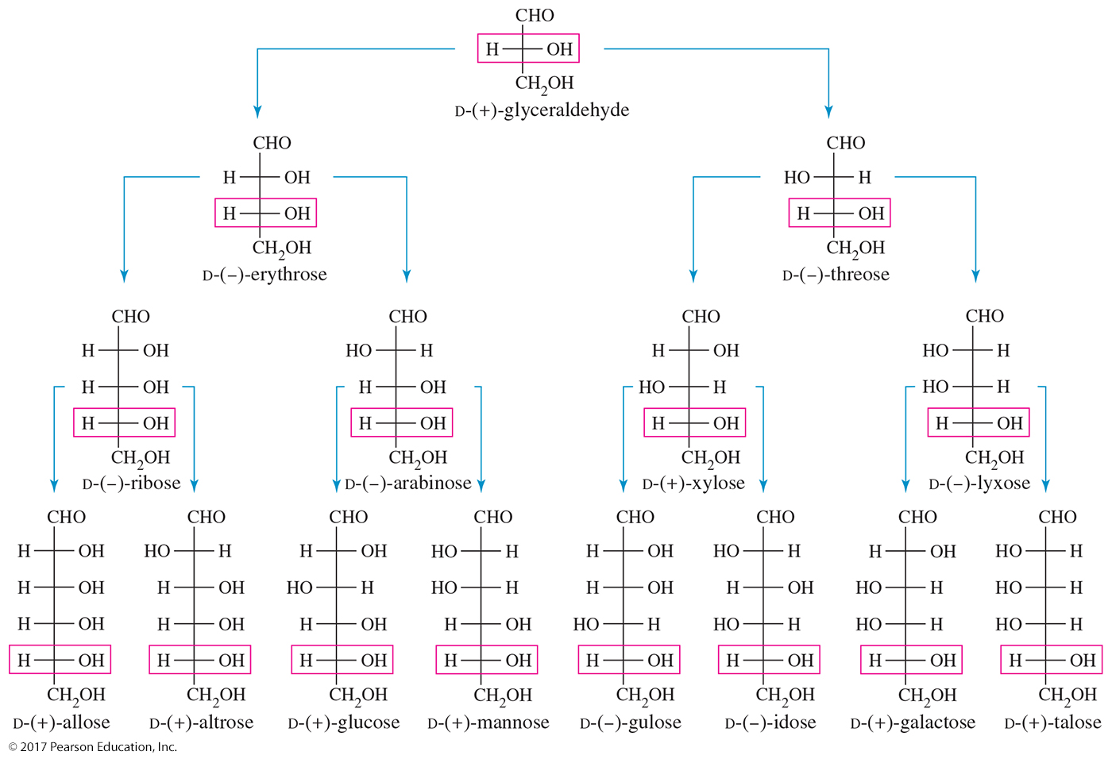
The d Aldose Family

Slide 4
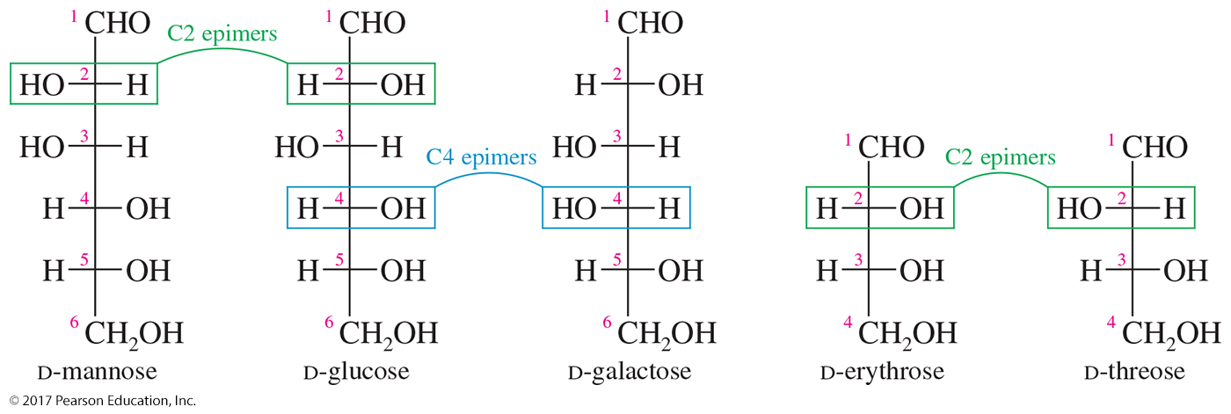
Epimers
Sugars that differ only in their stereochemistry at a single carbon
The carbon at which the stereochemistry differs is usually specified.

Slide 5
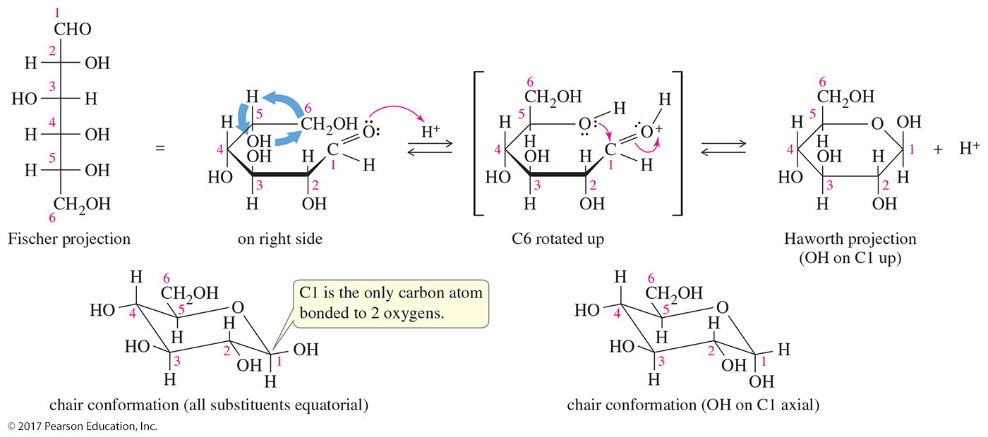
Cyclic Structure for Glucose
Glucose exists almost entirely as its cyclic
hemiacetal form.
Five- or six-membered ring hemiacetals are more stable than their open-chain forms.
The Haworth projection, although widely used, may give the impression of the ring being flat.

Slide 6
Chair Conformation for Glucose
The chair conformations give a more accurate representation of glucose.
Glucose exists almost entirely as its cyclic
hemiacetal form.

Slide 7
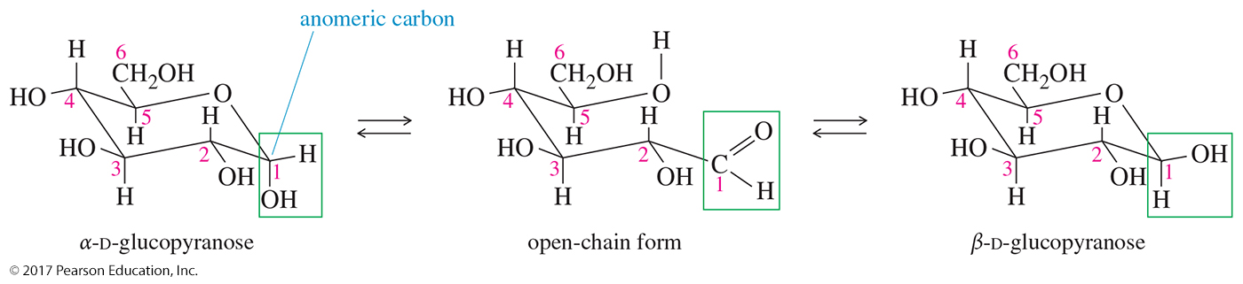
Anomers of Glucose
The hydroxyl group on the anomeric (hemiacetal) carbon is down (axial) in the α anomer and up (equatorial) in the
β anomer.
The β anomer of glucose has all its substituents in equatorial positions.
The hemiacetal carbon is easily identified as the only carbon atom bonded to two oxygens.

Slide 8
Reduction of Simple Sugars
Aldoses and ketoses can be reduced to the corresponding polyalcohols, called sugar alcohols or alditols.
The most common reagents are NaBH₄ or H₂/Ni.
Alditols are named by adding the suffix -itol to the root name of the sugar.

Slide 9
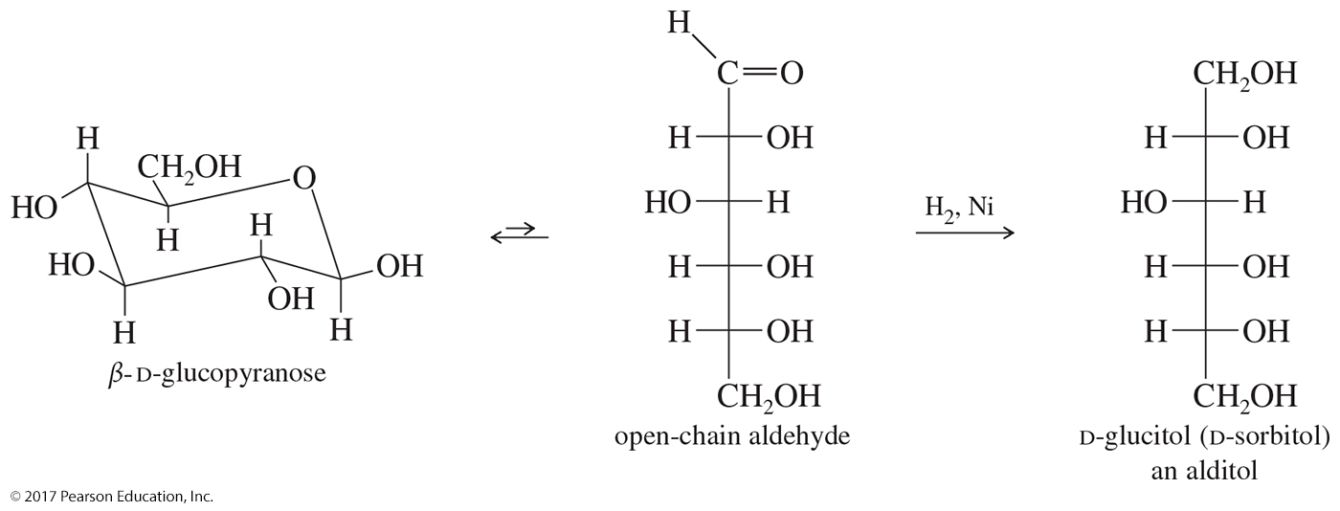
Reduction of β-D-Glucopyranose

Slide 10
Disaccharides
Three naturally occurring glycosidic linkages:
  1-4′ link: The anomeric carbon is bonded to oxygen on C4 of second sugar.
  1-6′ link: The anomeric carbon is bonded to oxygen on C6 of second sugar.
  1-1′ link: The anomeric carbons of the two sugars are bonded through an oxygen.

Slide 11
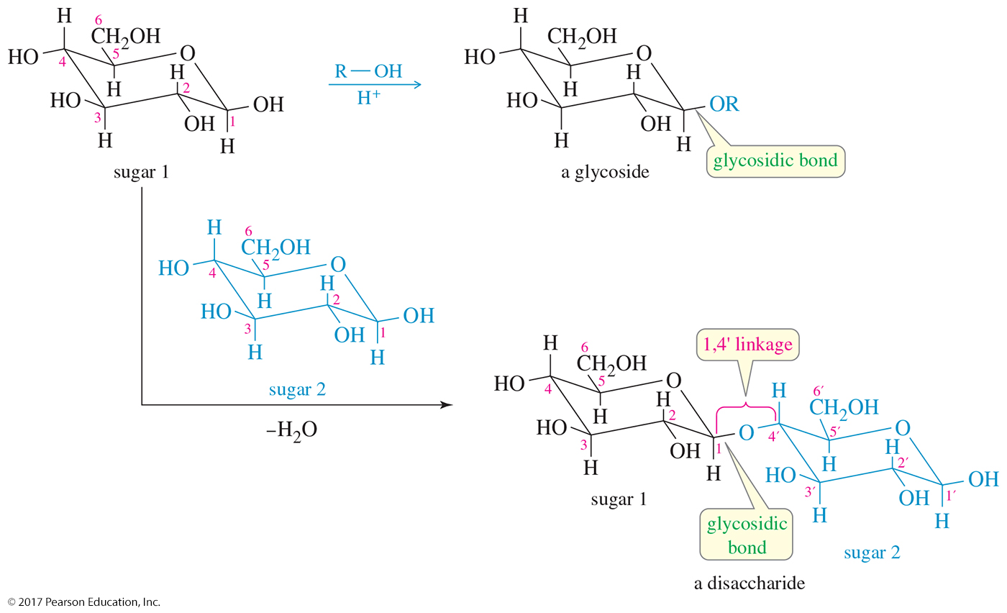
Disaccharides (Continued)

Slide 12
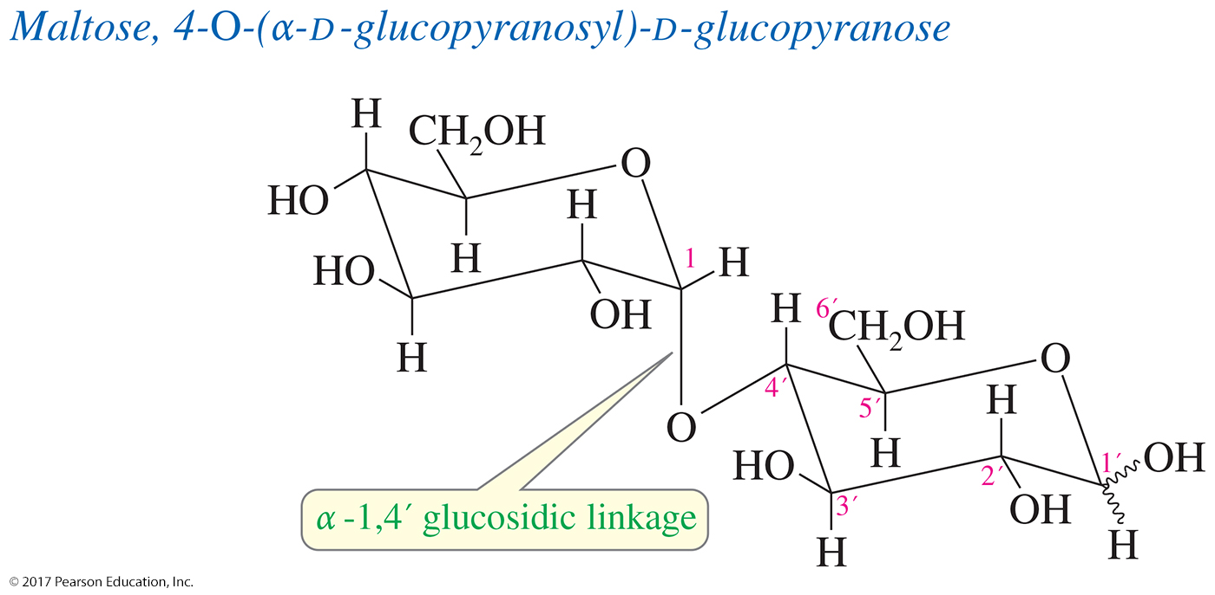
Maltose:
An α-1,4′ Glucosidic Linkage
Maltose contains an α-1,4′ glucosidic linkage between the two glucose units.
The monosaccharides in maltose are joined together by the axial position of C1 and the equatorial position of C4′.

Slide 13
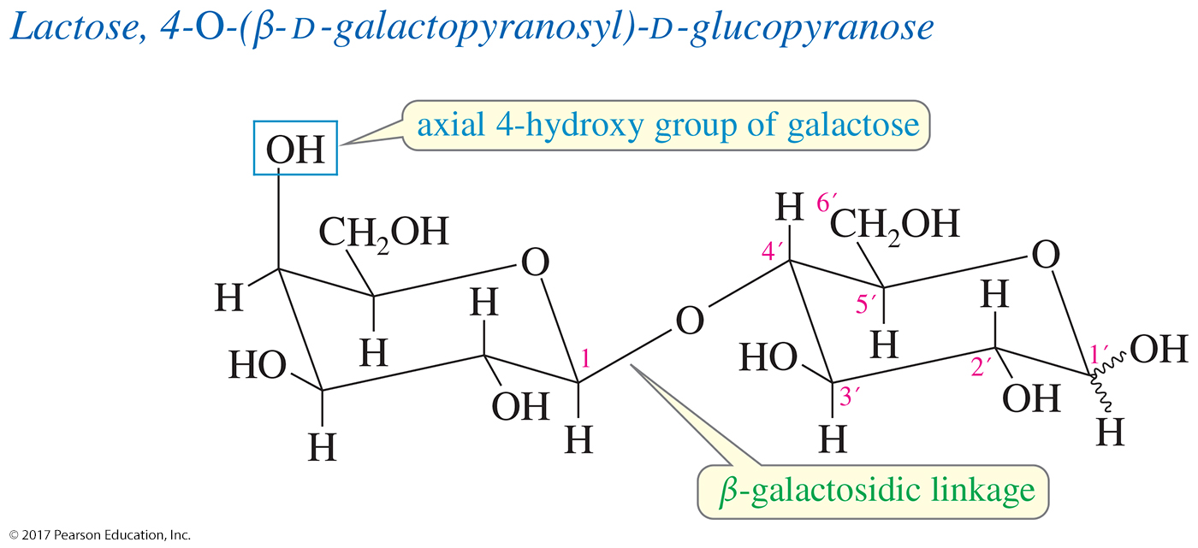
Lactose:
A β-1,4′ Galactosidic Linkage
Lactose is composed of one galactose unit and one glucose unit.
The two rings are linked by a β-glycosidic bond of the galactose acetal to the 4-position on the glucose ring: a β-1,4′ galactosidic linkage.

Slide 14
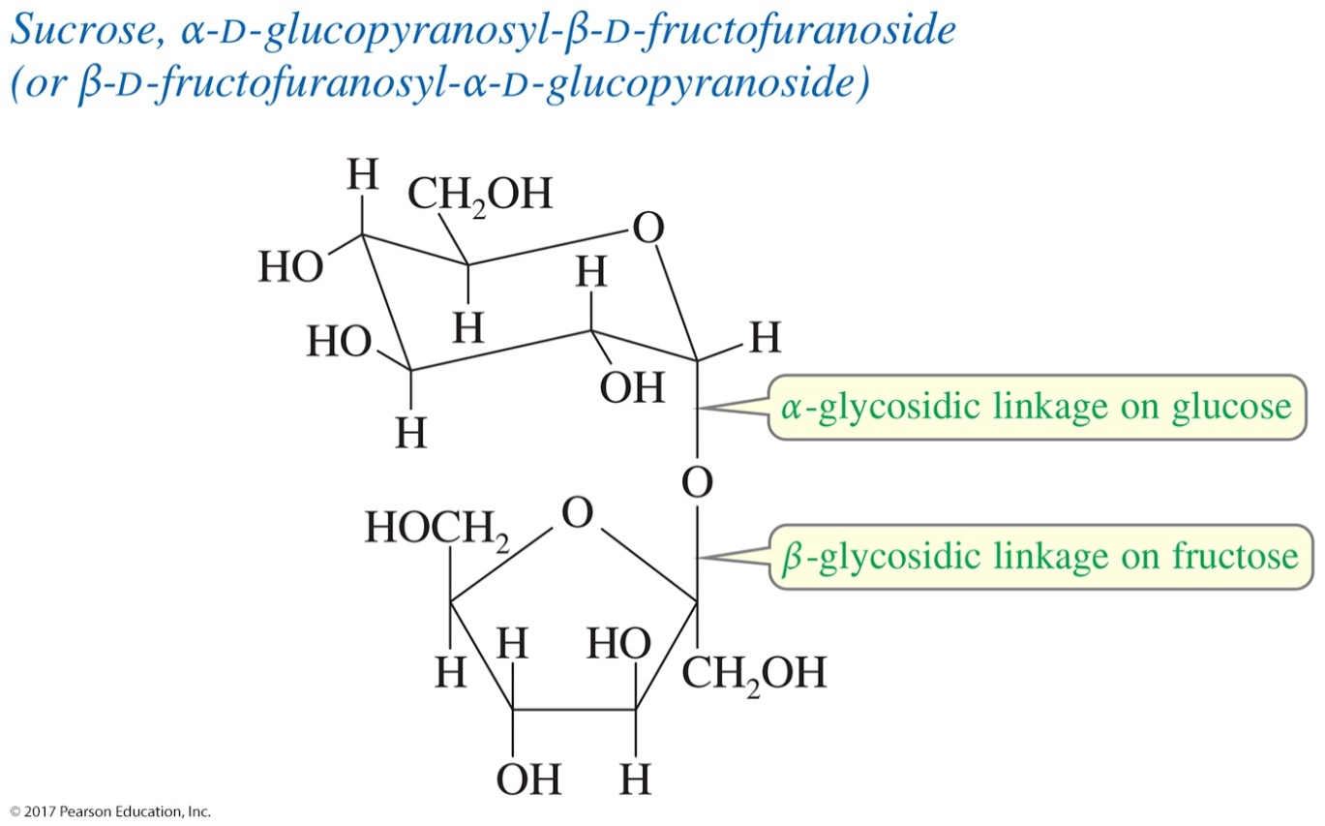
Sucrose: Linkage of Two Anomeric Carbons
Some sugars are joined by a direct glycosidic linkage between their anomeric carbon atoms: a 1,1′ linkage.

Slide 15
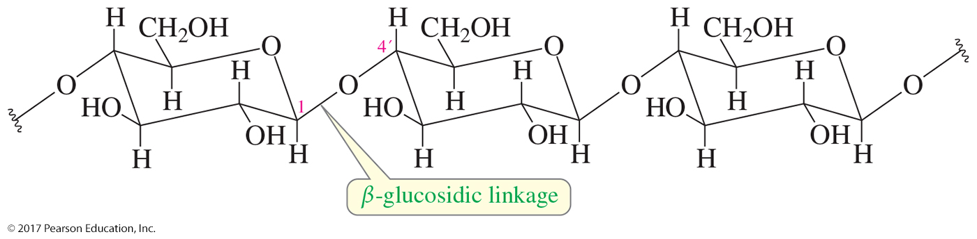
Cellulose
Cellulose is a β-1,4′ polymer of D-glucose, systematically named poly(1,4′-O-β-D-glucopyranoside).
Cellulose is the most abundant organic material.
It is synthesized by plants as a structural material to support the weight of the plant.

Slide 16
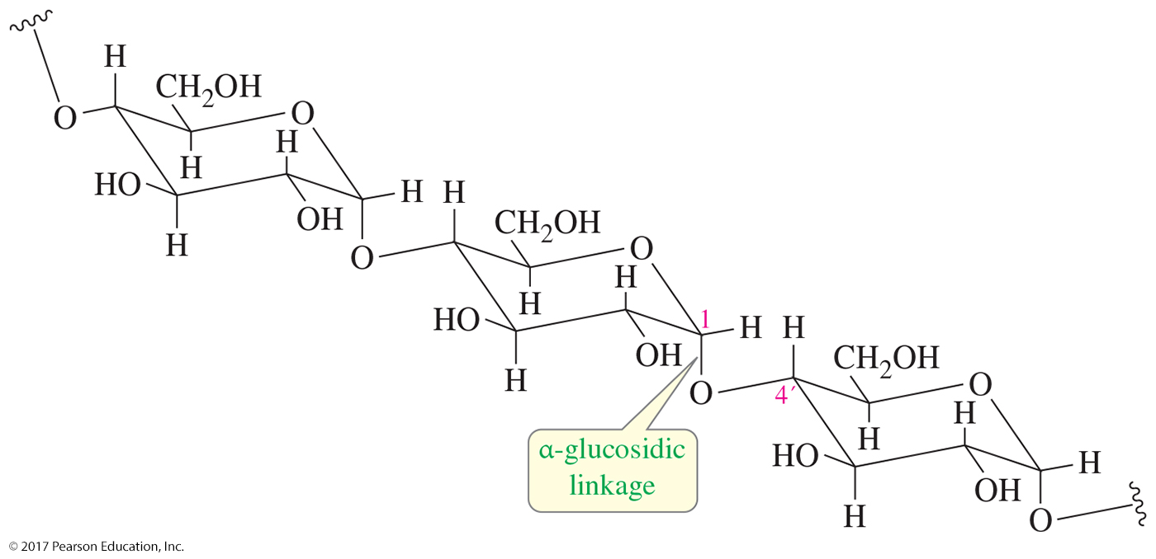
Starches: Amylose, Amylopectin, and Glycogen
Amylose is an α-1,4′ polymer of glucose, systematically named poly(1,4′-O-α-D-glucopyranoside).

Slide 17
Nucleic Acids
Polymer of ribofuranoside rings linked by phosphate ester groups
Each ribose is bonded to a base.
Ribonucleic acid (RNA)
Deoxyribonucleic acid (DNA)

Slide 18
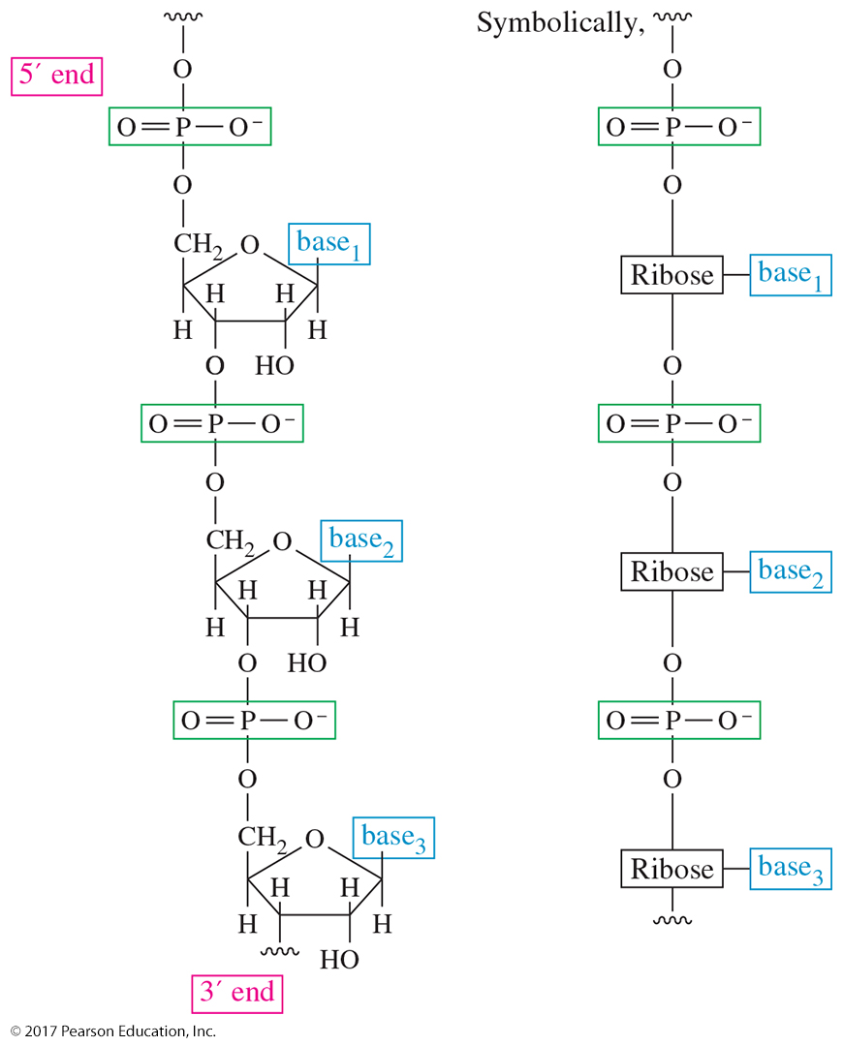
RNA Polymer
Nucleic acids are assembled on a backbone made up of ribofuranoside units linked by phosphate esters.

Slide 19
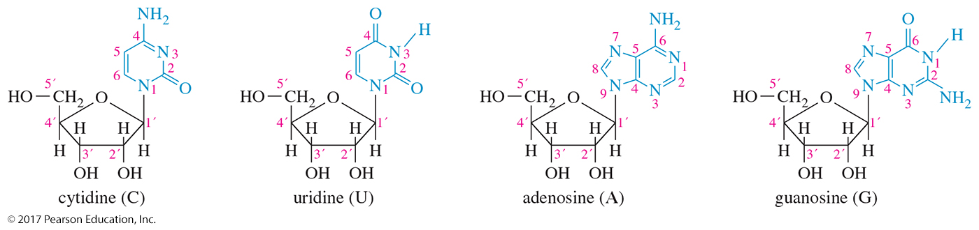
Cytidine, Uridine, Adenosine, and Guanosine
Ribonucleosides are components of RNA based on glycosides of the furanose form of d-ribose.

Slide 20
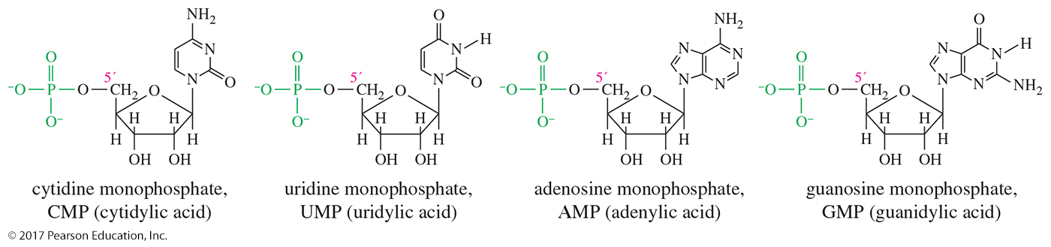
Common Ribonucleotides
Ribonucleosides are esterified by phosphoric acid at their
5′ position, the —CH₂OH at the end of the ribose chain.
Ribonucleosides are joined together by phosphate ester linkages.

Slide 21
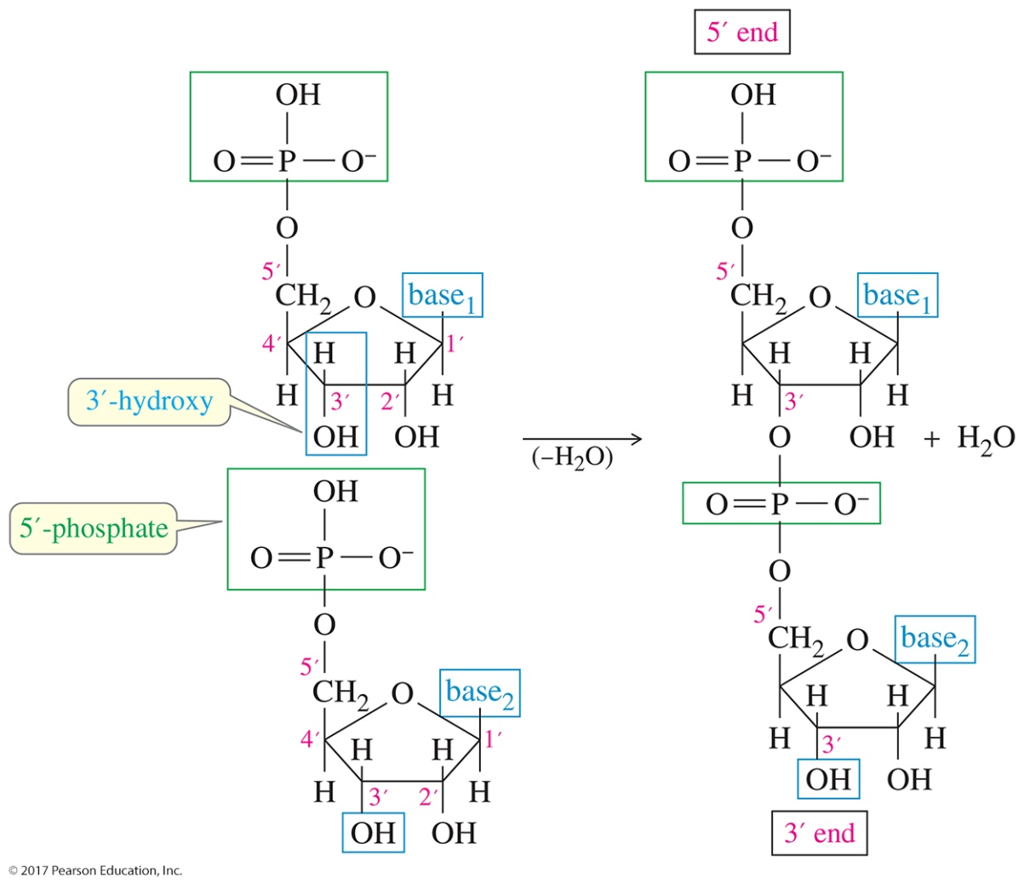
Phosphate Linkages
A molecule of RNA always has two ends (unless it is in the form of a large ring); one end has a free 3′ group, and the other end has a free 5′ group.

Slide 22
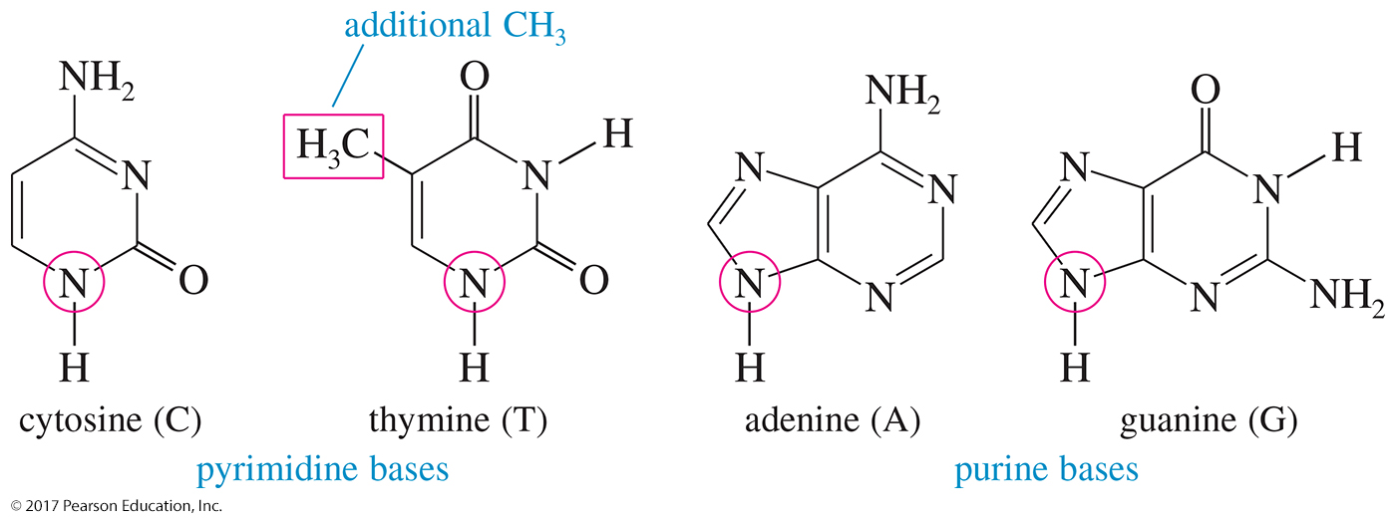
DNA Bases
The four common bases of DNA are cytosine, thymine, adenine, and guanine.

Slide 23
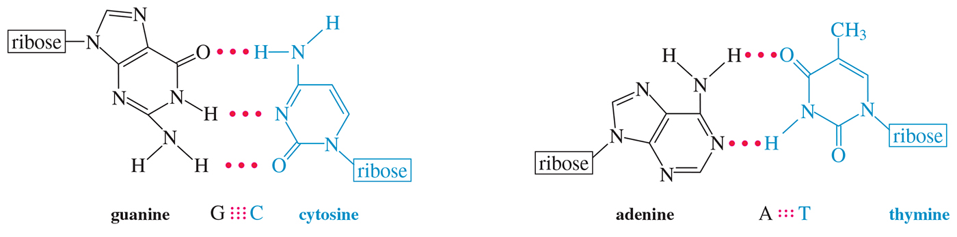
Base Pairing in DNA and RNA
Each purine forms a stable hydrogen-bonded pair with a specific pyrimidine base.
Guanine hydrogen-bonds to cytosine in three places; adenine hydrogen-bonds to thymine in two places.

Slide 24
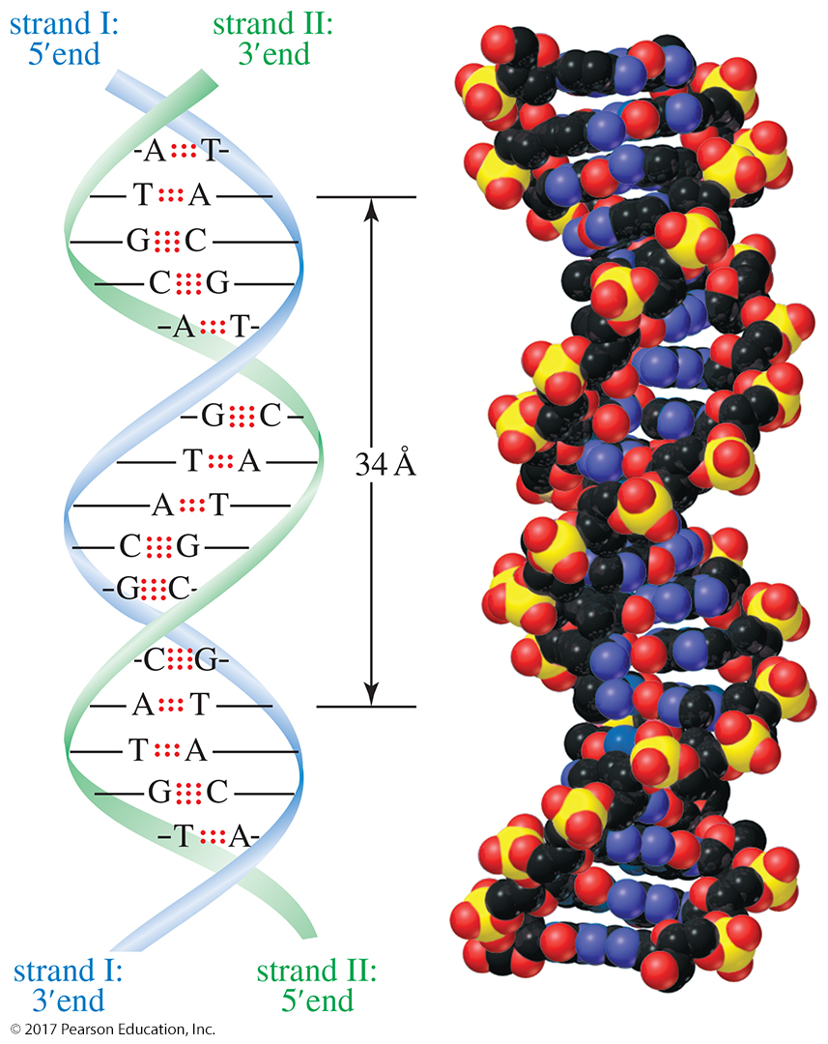
The Double Helix
Two complementary strands are joined by hydrogen bonds between the base pairs.
This double strand coils into a helical arrangement described by Watson and Crick in 1953.

