Slide 1
CHE 242 UNIT SIX
Key Topics:
Chapter 15
1,2 vs, 1,4 addition 1
Diels Alder Reaction 1
Chapters 16 and 17
Name from structure 1
Structure from name 1
Determine if aromatic, Anti-aromatic, non-aromatic 2
Predict EAS products 3
Synthesis 1

Slide 2
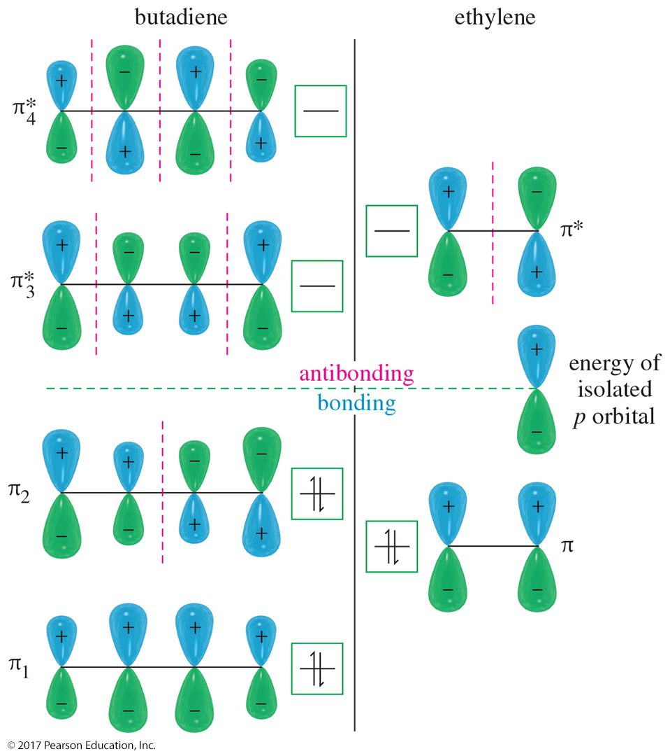
MO for Buta-1,3-diene and Ethylene
The bonding MOs of both buta-1,3-diene and ethylene are filled and the antibonding MOs are empty.
Buta-1,3-diene has lower energy than ethylene.
This lower energy is the resonance stabilization of the conjugated diene.

Slide 3
1,2- and 1,4-Addition to Conjugated Dienes
Electrophilic addition to the double bond produces the most stable intermediate.
For conjugated dienes, the intermediate is a resonance-stabilized allylic cation.
Nucleophile adds to either carbon 2 or 4, both of which have the delocalized positive charge.

Slide 4
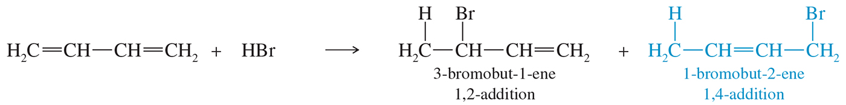
1,2- and 1,4-Addition to Dienes
Addition of HBr to buta-1,3-diene produces
3-bromobut-1-ene (1,2-addition) and
1-bromobut-2-ene (1,4-addition).

Slide 5
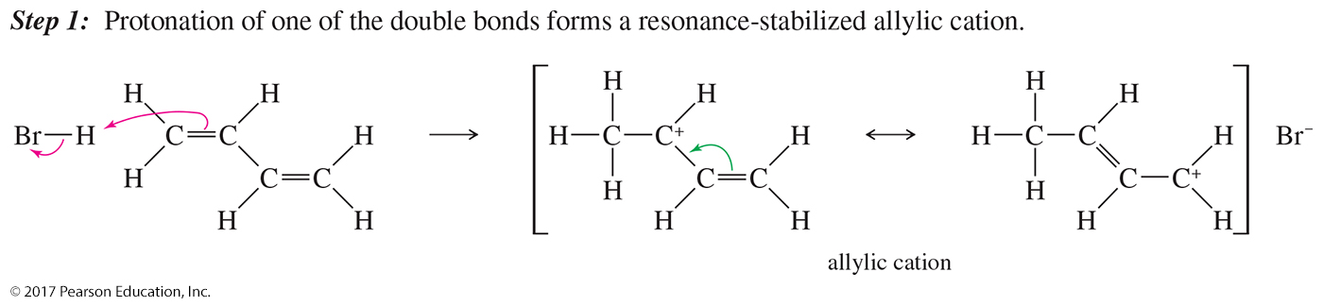
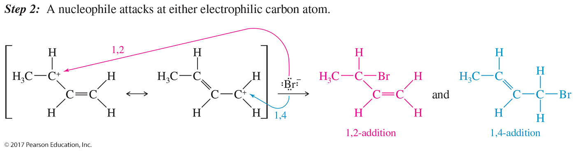
Mechanism of 1,2- and 1,4-Addition

Slide 6
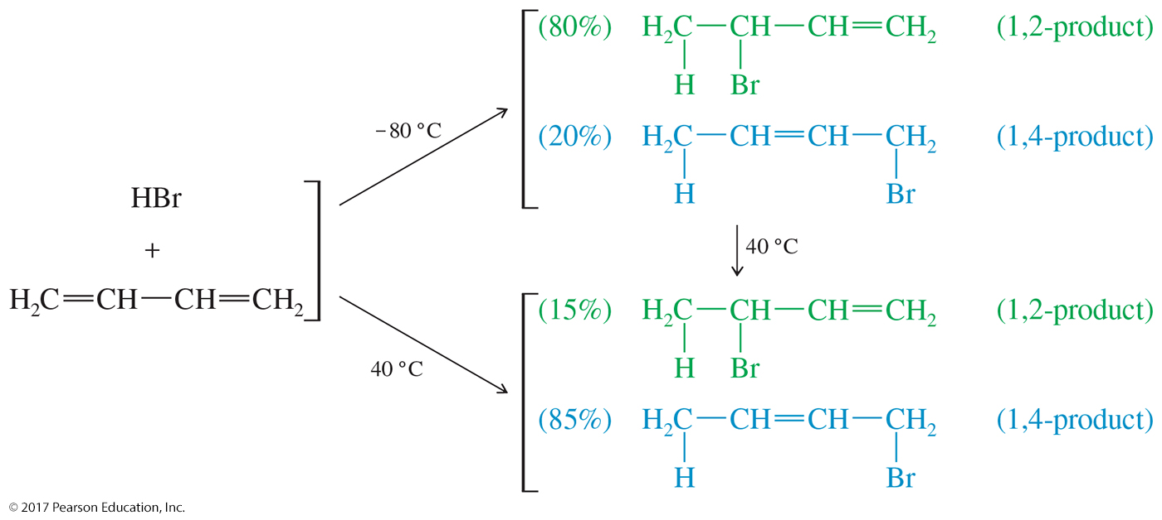
Kinetic Versus Thermodynamic
Control

Slide 7
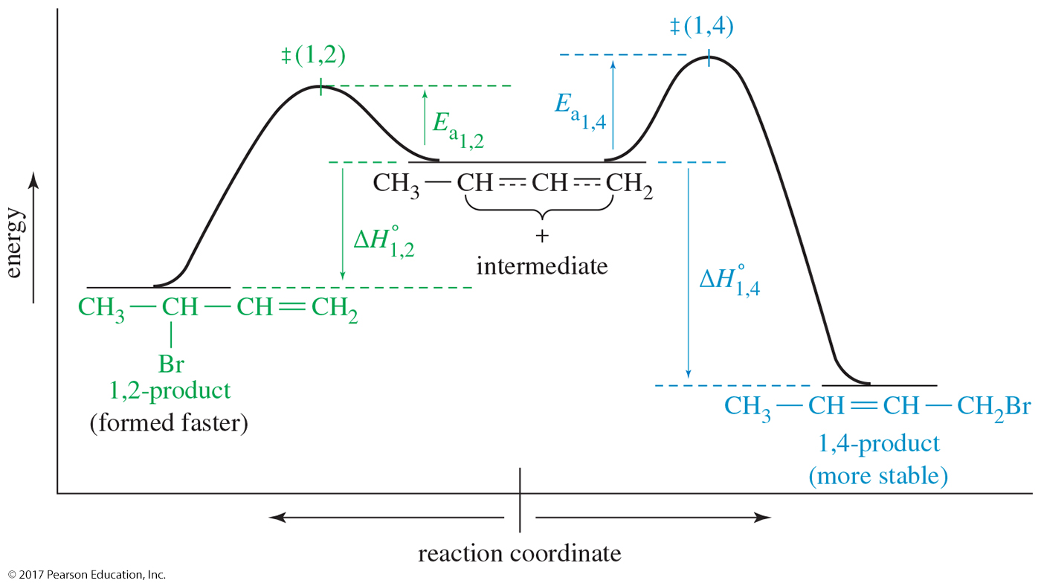
Kinetic Versus Thermodynamic
Control (Continued)

Slide 8
Kinetic Control at –80 °C
Transition state for the 1,2-addition has a lower E_{a} because it is a more stable secondary carbocation.
The 1,2-addition will be the faster addition at any temperature.
The nucleophilic attack of the bromide on the C2 allylic carbocation is irreversible at this low temperature.
The product that forms faster predominates (kinetic product).
Because the kinetics of the reaction determines the product, the reaction is said to be under kinetic control.

Slide 9
Thermodynamic Control at 40 °C
The 1,2-addition is still the faster addition, but at 40 °C, the bromide attack is reversible.
The 1,2-product ionizes back to the allylic cation.
At 40 °C an equilibrium is established, which favors the most stable product.
The 1,4-addition is the most stable product (thermodynamic product) because it has a more substituted double bond.
Because the thermodynamics of the reaction determines the product, the reaction is said to be under thermodynamic control.

Slide 10
Diels–Alder Reaction
Named after Otto Diels and Kurt Alder. They received the Nobel prize in 1950.
The reaction is between a diene and an electron-deficient alkene (dienophile).
Produces a cyclohexene ring.
The Diels–Alder is also called a [4 + 2] cycloaddition because a ring is formed by the interaction of four pi electrons of the alkene with two pi electrons of the alkene or alkyne.

Slide 11
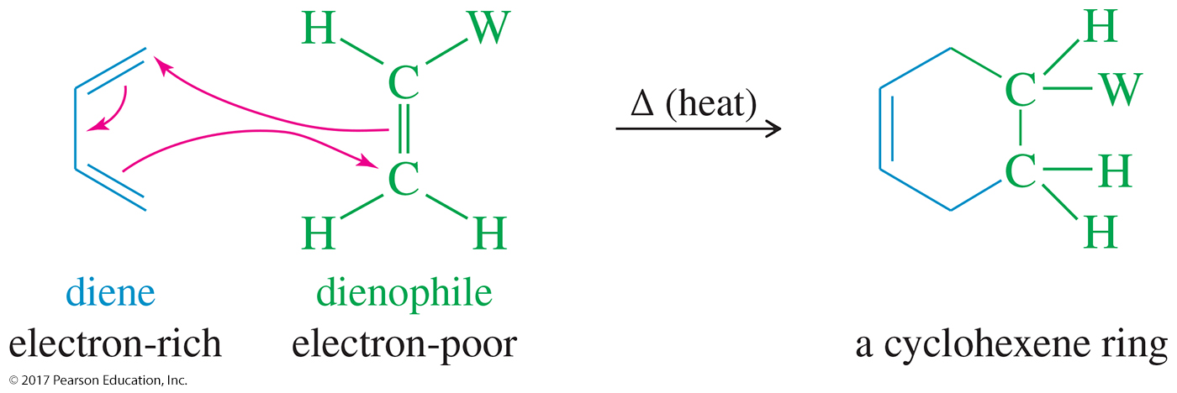
Mechanism of the
Diels–Alder Reaction
One-step, concerted mechanism
A diene reacts with an electron-poor alkene (dienophile) to give cyclohexene or cyclohexadiene rings.

Slide 12
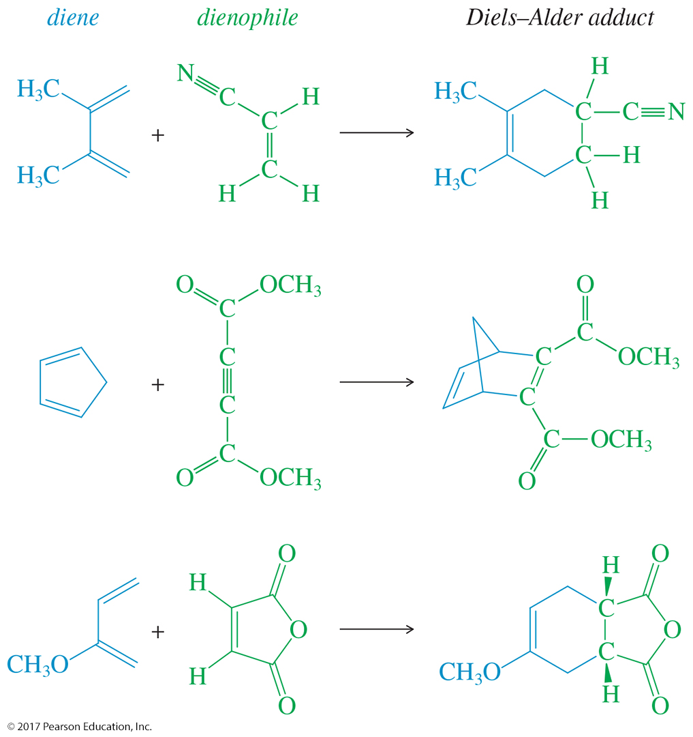
Examples of Diels–Alder Reactions

Slide 13
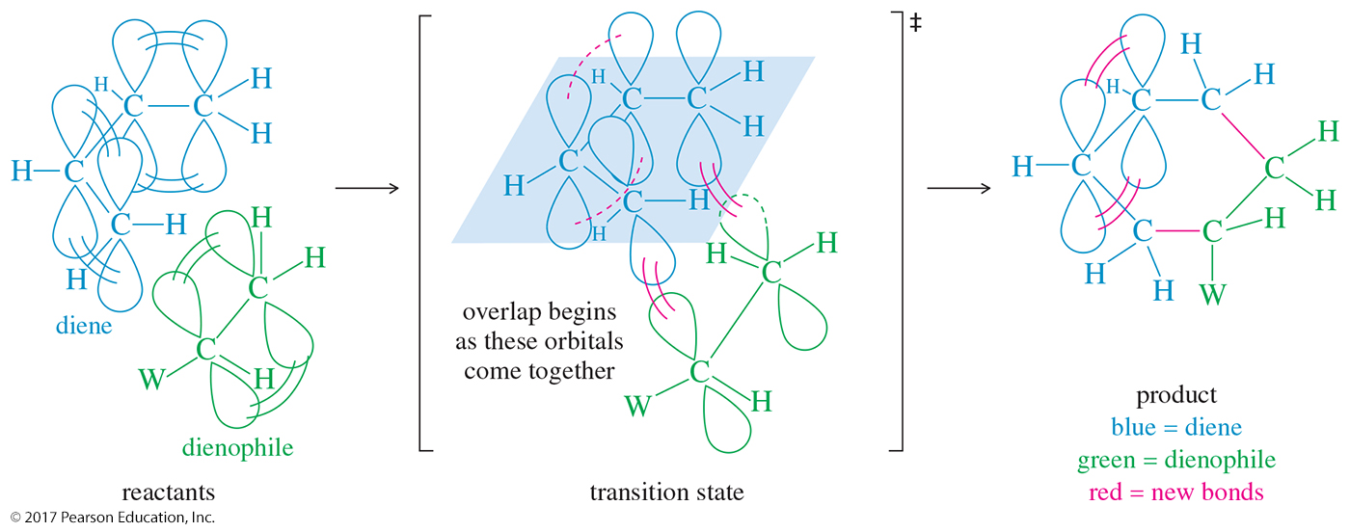
Orbital Overlap of the
Diels–Alder Reaction

Slide 14
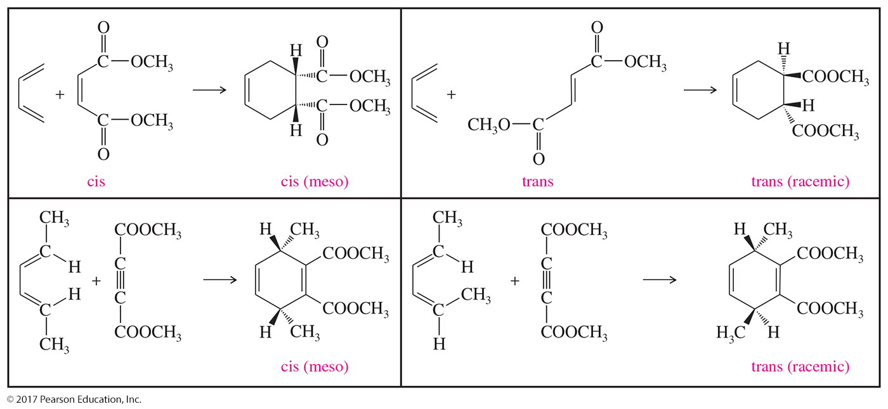
Stereochemistry of the
Diels–Alder Reaction

Slide 15
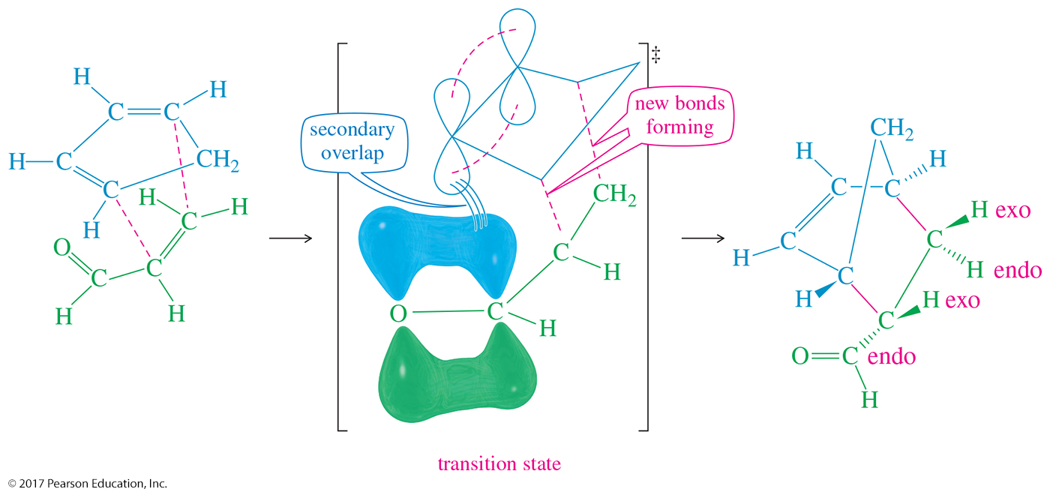
Endo Rule
The p orbitals of the electron-withdrawing groups on the dienophile have a secondary overlap with the p orbitals of C2 and C3 in the diene.

Slide 16
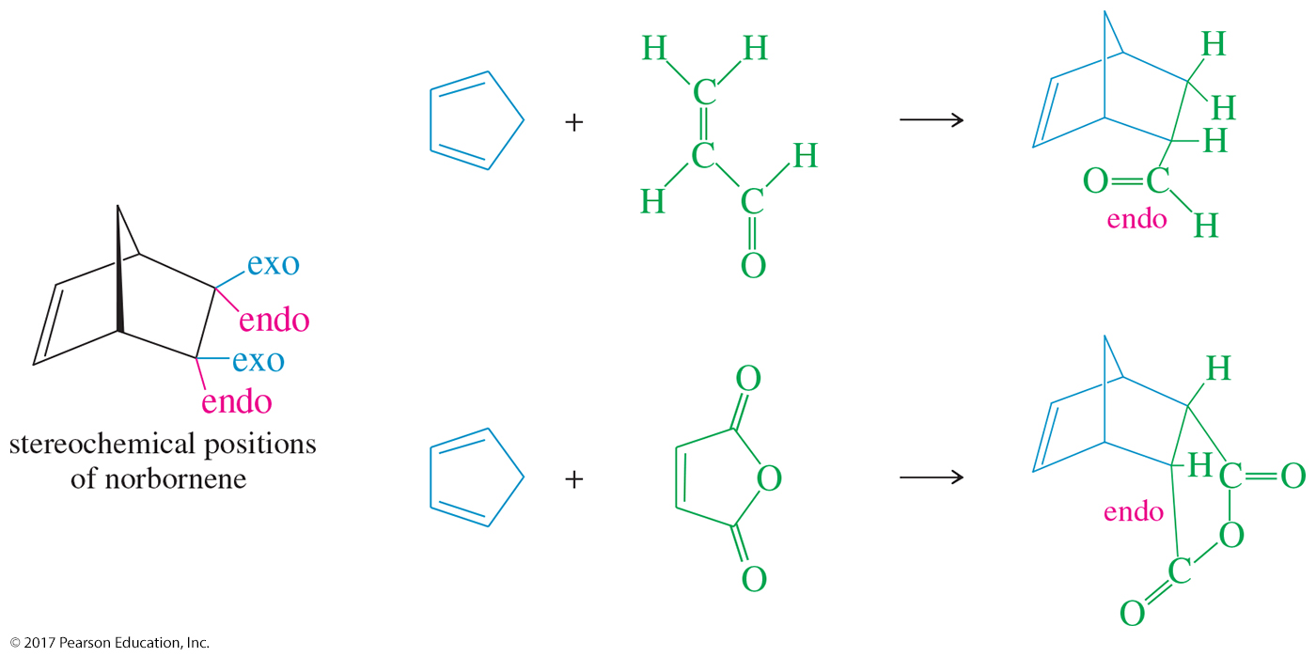
Examples of Endo Rule

Slide 17
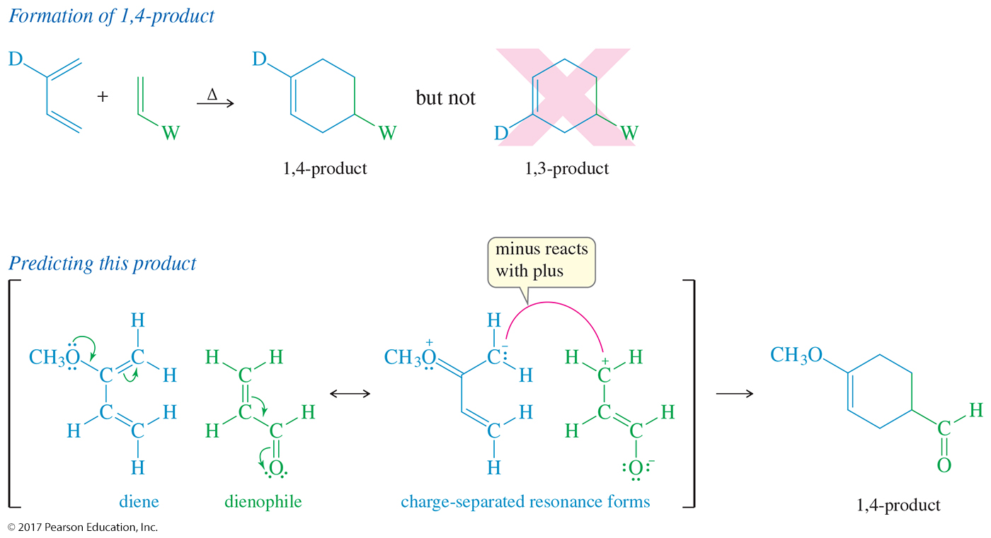
Unsymmetrical Reagents:
1,4-Product

Slide 18
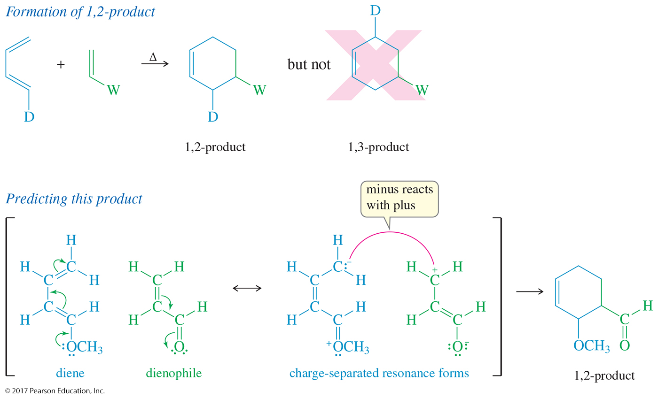
Unsymmetrical Reagents:
1,2-Product

Slide 19
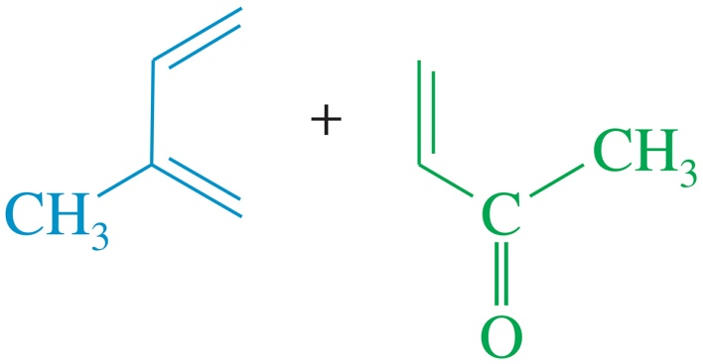
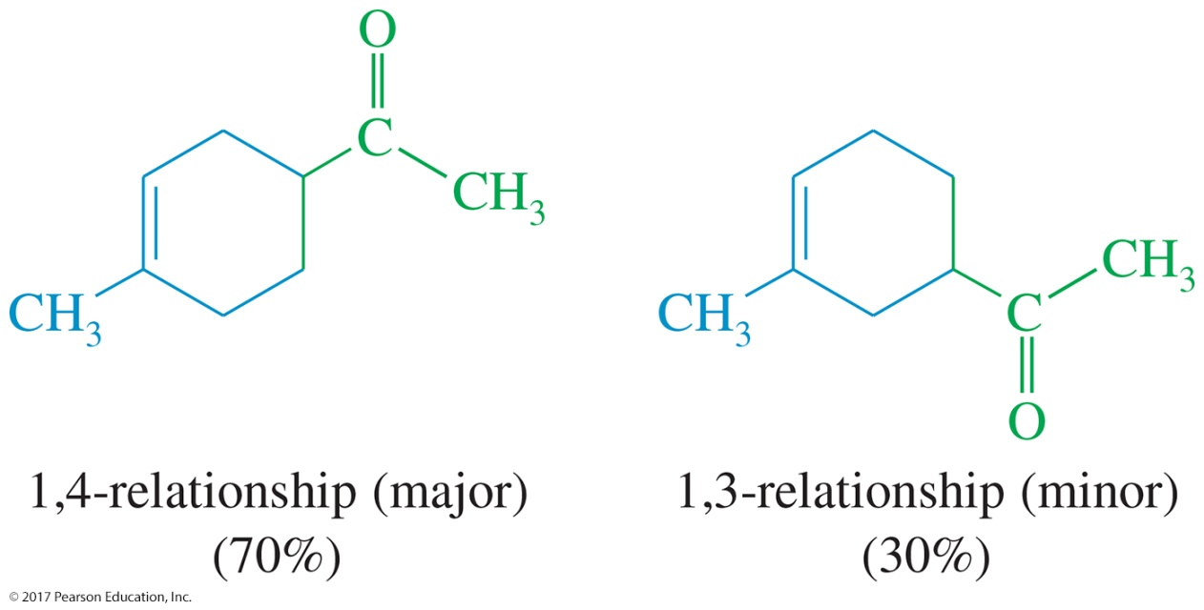
Solved Problem 1
Predict the products of the following proposed Diels–Alder reactions.
Solution

Slide 20
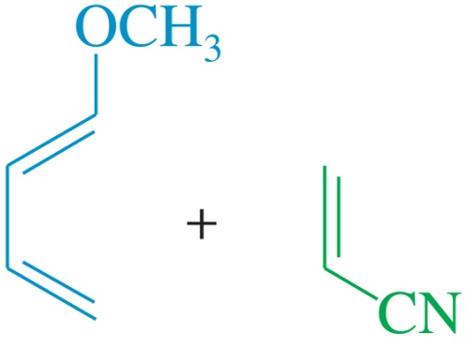
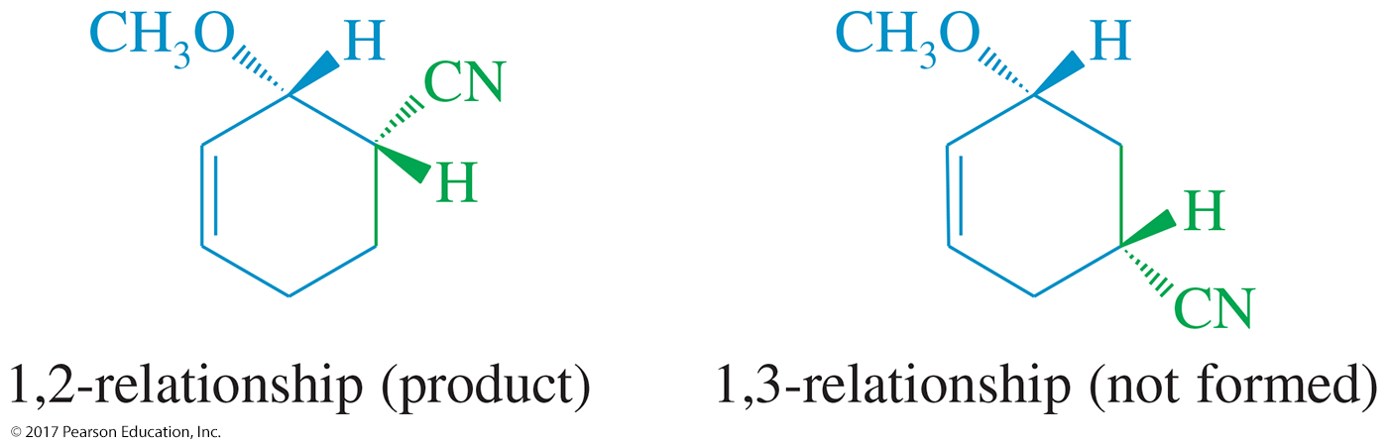
Solved Problem 1 (Continued)
Predict the products of the following proposed Diels–Alder reactions.
Solution (Continued)

Slide 21
Ultraviolet Spectroscopy
200- to 400-nm photons excite electrons from a π bonding orbital to a π* antibonding orbital.
Conjugated dienes have MOs that are closer in energy.
A compound that has a longer chain of conjugated double bonds absorbs light at a longer wavelength.

Slide 22
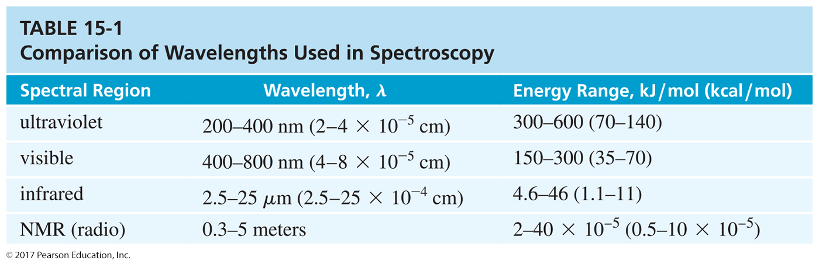
Comparison of IR and
UV Wavelengths

Slide 23
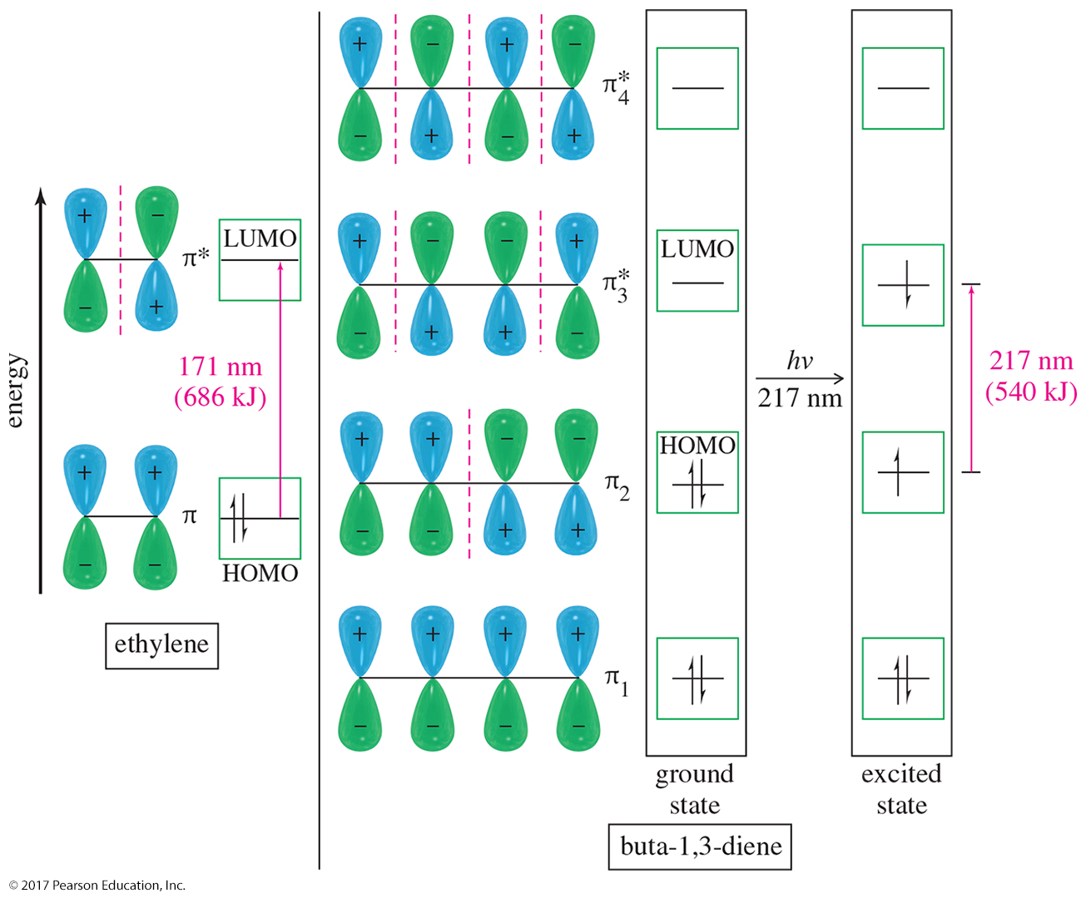
π → π* for Ethylene and Butadiene

Slide 24
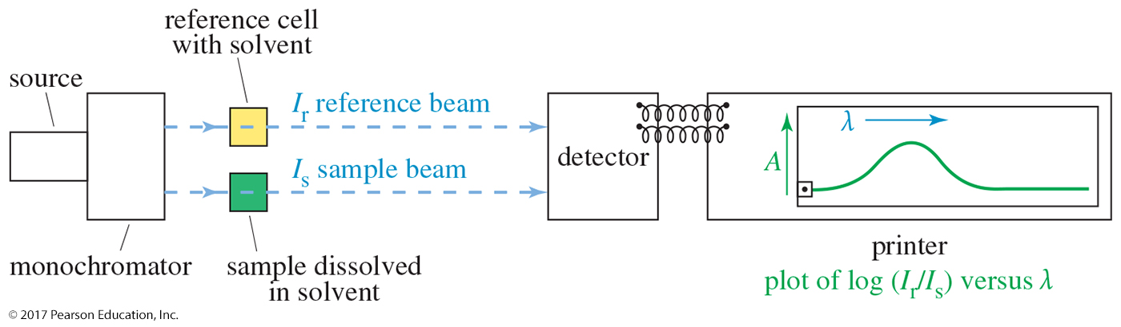
Obtaining a UV Spectrum
The spectrometer measures the intensity of a reference beam through solvent only (I_{r}) and the intensity of a beam through a solution of the sample (I_{s}).
Absorbance is the log of the ratio I_{r}/I_{s}.

Slide 25
The UV Spectrum
Usually shows broad peaks
Read λ_{max} from the graph.
Absorbance, A, follows Beer’s law:
A = εcl
where ε is the molar absorptivity, c is the sample concentration in moles per liter, and l is the length of the light path in centimeters.

Slide 26
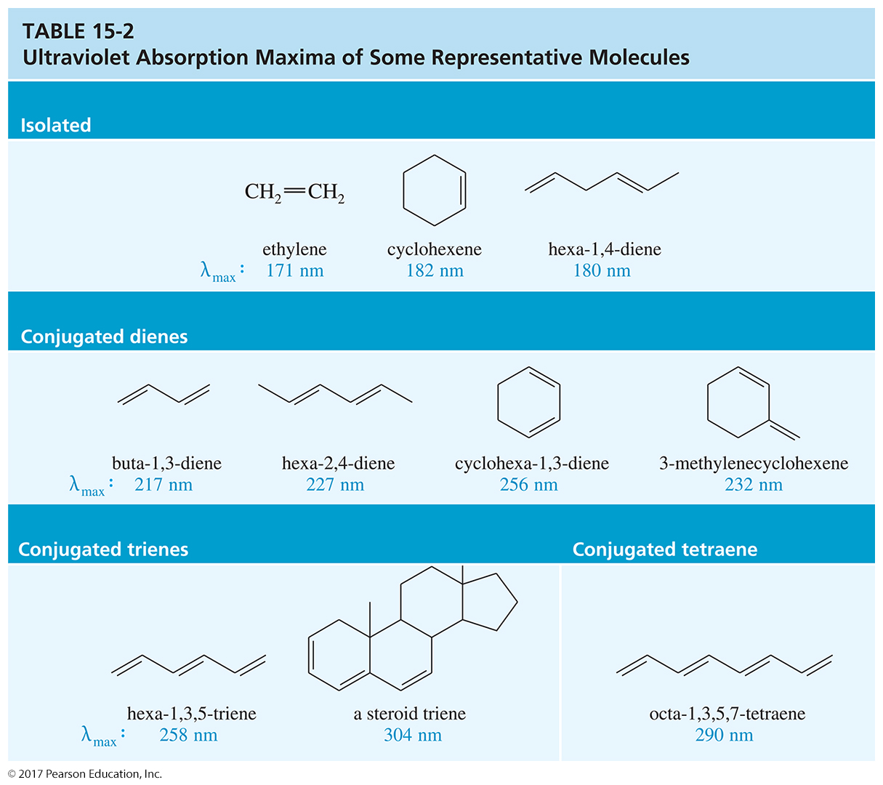
Sample UV Absorptions

Slide 27
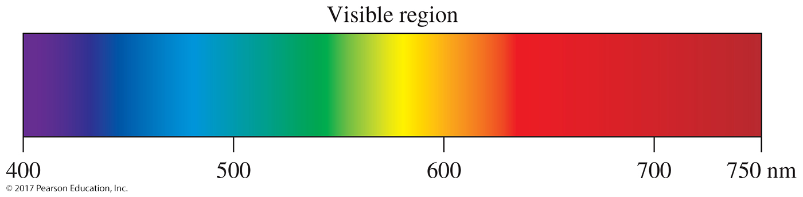
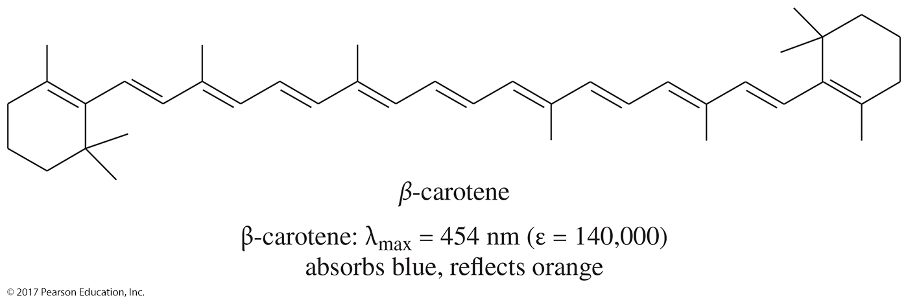
Colored Organic Compounds

Slide 28
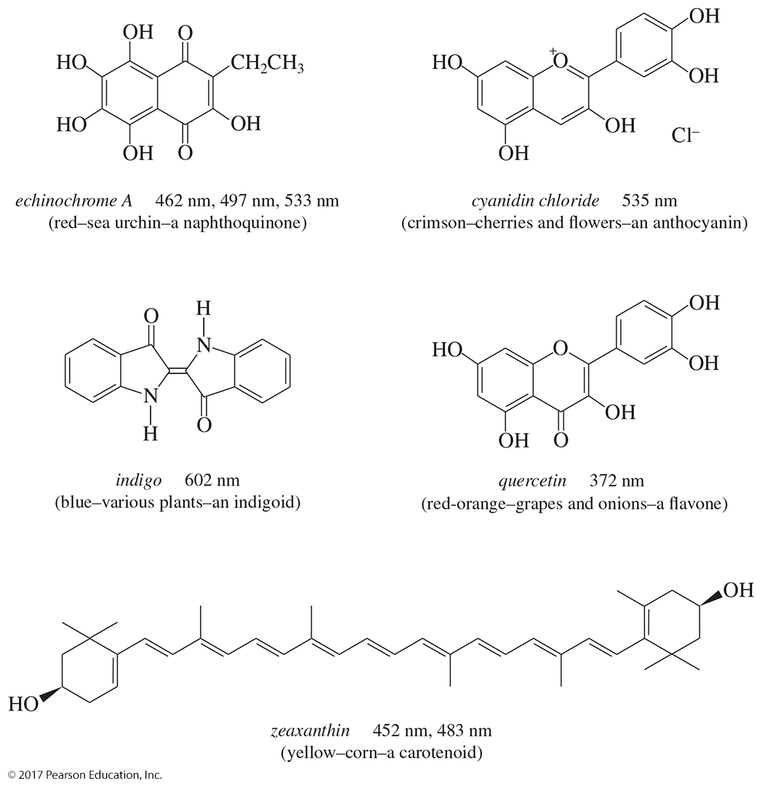
Colored Natural Products

Slide 29
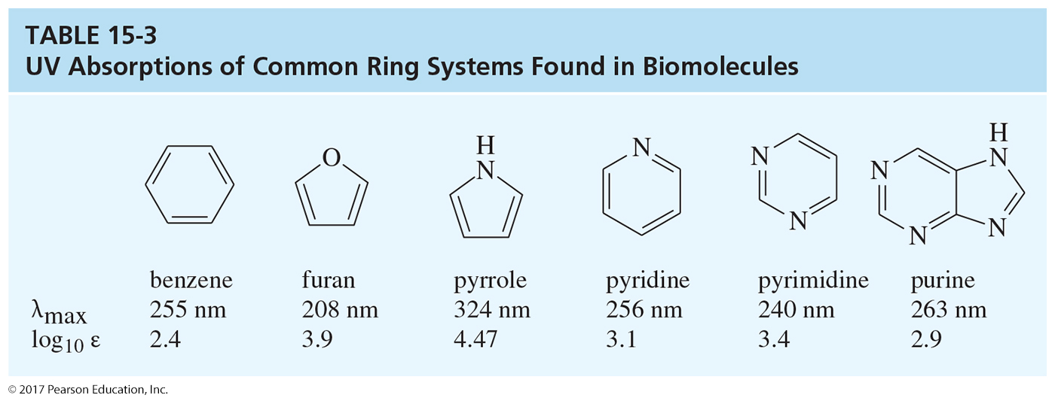
UV-Visible Analysis in
Biology and Medicine
UV-visible spectroscopy is nondestructive and exceptionally sensitive.
Can measure small concentrations of highly conjugated metabolites.

