Slide 1
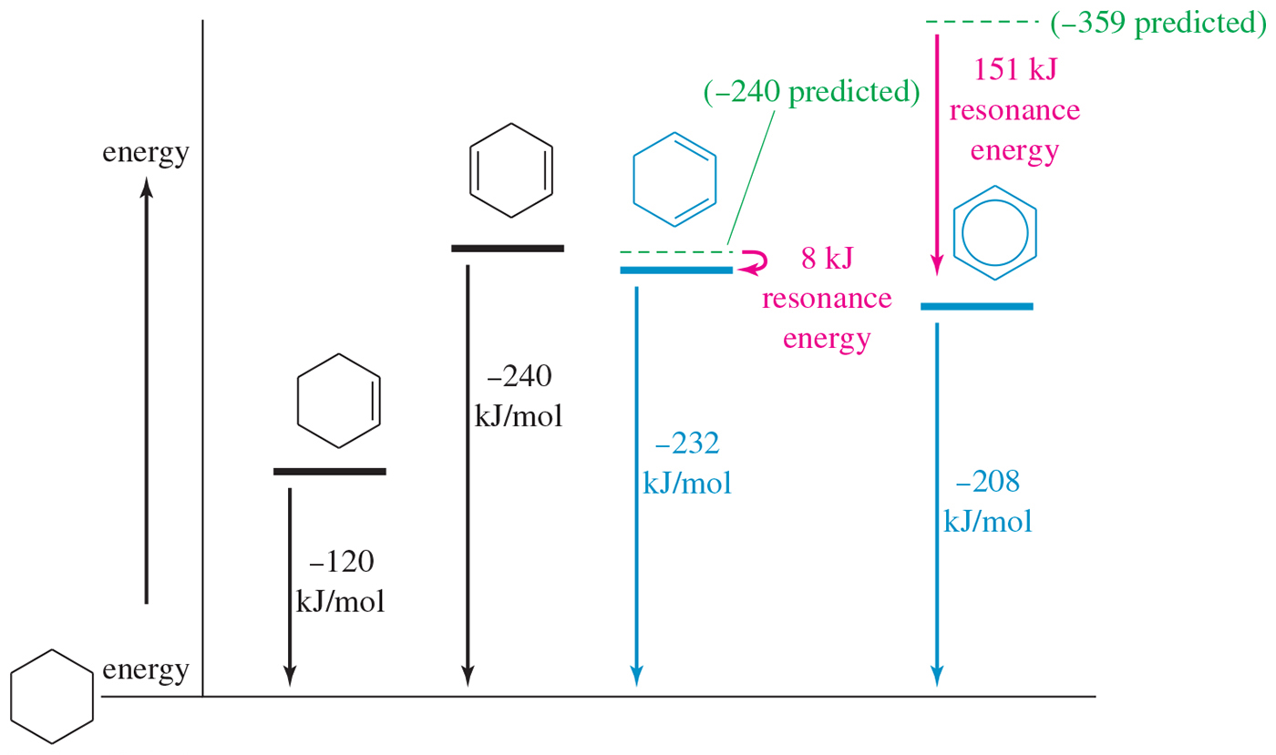
Molar Heats of Hydrogenation

Slide 2
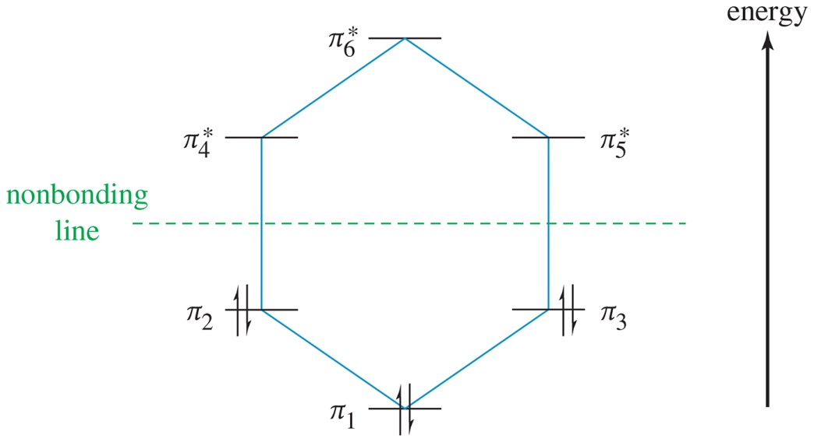
Energy Diagram for
Benzene
The six π electrons fill the three bonding pi orbitals.
All bonding orbitals are filled (“closed shell”), an extremely stable arrangement.

Slide 3
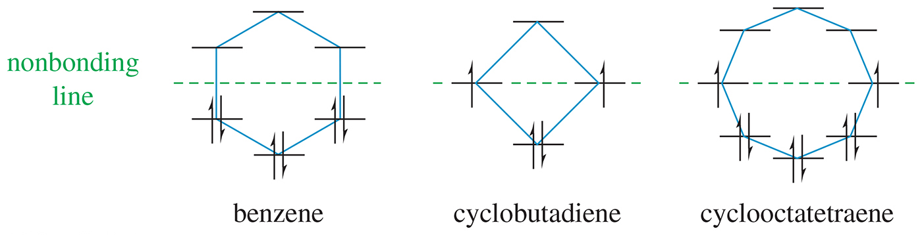
Polygon Rule
The energy diagram for an annulene has the same shape as the cyclic compound with one vertex at the bottom.

Slide 4
Aromatic Requirements
The structure must be cyclic with conjugated
pi bonds.
Each atom in the ring must have an unhybridized p orbital (sp² or sp).
The p orbitals must overlap continuously around the ring. The structure must be planar (or close to planar) for effective overlap to occur.
Delocalization of the pi electrons over the ring must lower the electronic energy.

Slide 5
Hückel’s Rule
Once the aromatic criteria are met, Hückel’s rule applies.
If the number of pi electrons is (4N + 2), the system is aromatic (where N is an integer).
If the number of pi electrons is (4N), the system is antiaromatic.

Slide 6
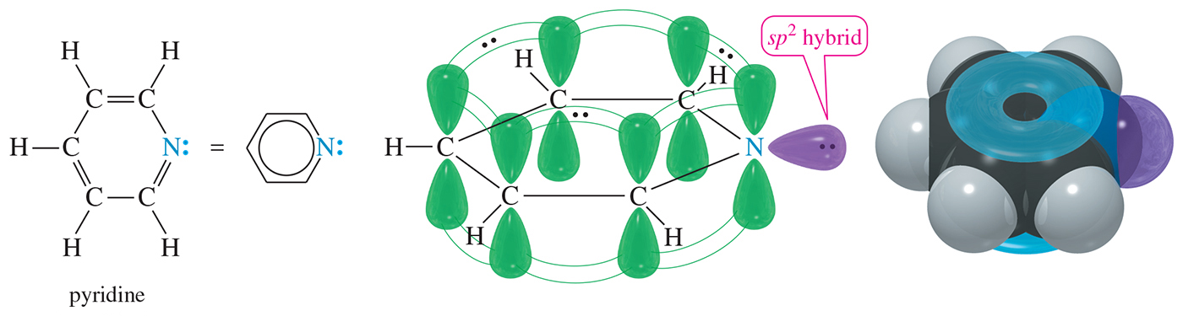
Pyridine Pi System
Pyridine has six delocalized electrons in its pi system.
The two nonbonding electrons on nitrogen are in an sp² orbital, and they do not interact with the pi electrons of the ring.

Slide 7
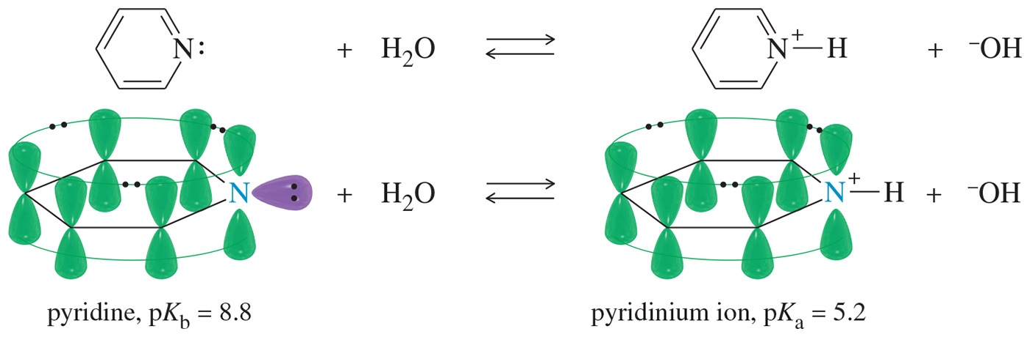
Pyridine
Pyridine is basic, with a pair of nonbonding electrons available to abstract a proton.
The protonated pyridine (the pyridinium ion) is still aromatic.

Slide 8
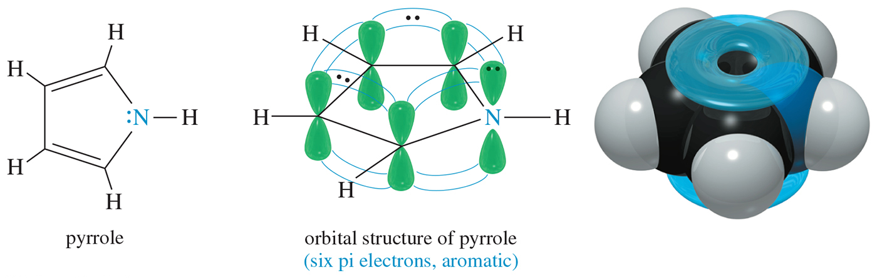
Pyrrole Pi System
The pyrrole nitrogen atom is sp² hybridized with a lone pair of electrons in the p orbital. This p orbital overlaps with the p orbitals of the carbon atoms to form a continuous ring.
Pyrrole is aromatic because it has six pi electrons (N = 1).

Slide 9
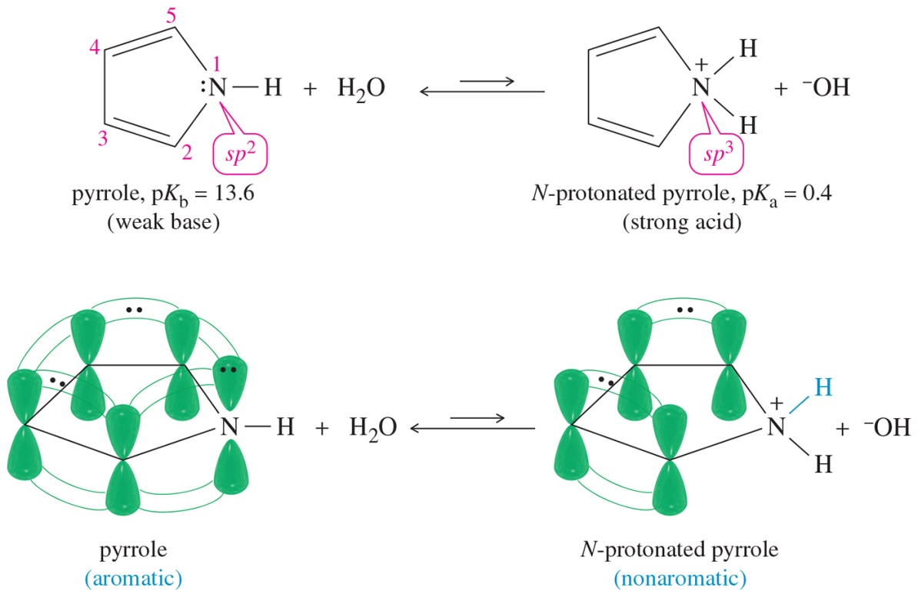
Pyrrole
Pyrrole is aromatic because the lone pair on nitrogen is delocalized.
N-protonated pyrrole is nonaromatic because the nitrogen is sp³.

Slide 10
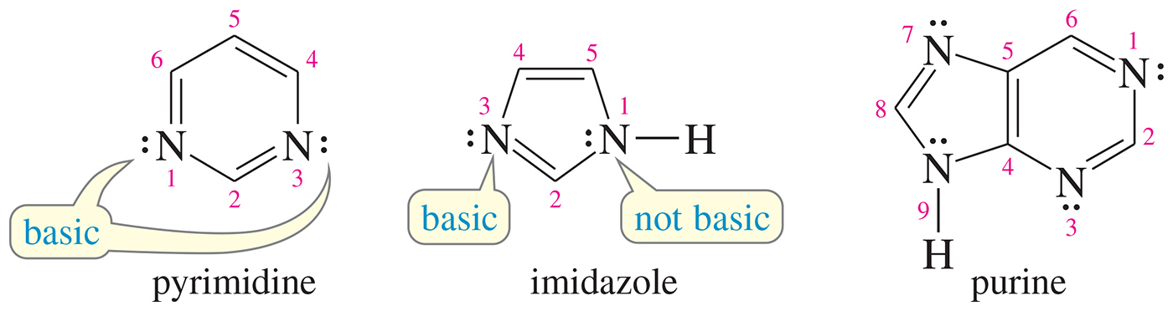
Basic or Nonbasic?
Pyrimidine has two basic nitrogens.
Imidazole has one basic nitrogen and
one nonbasic.
Only one of purine’s nitrogens is not basic.

Slide 11
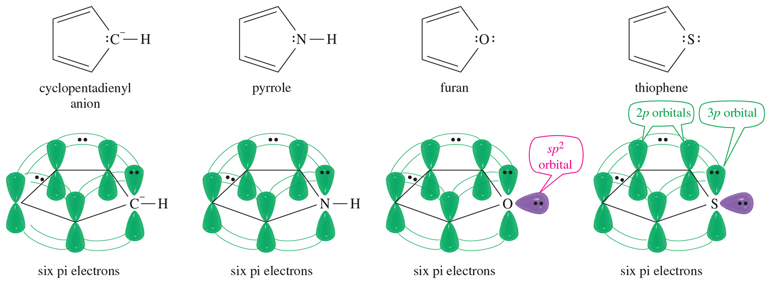
Other Heterocyclics

Slide 12
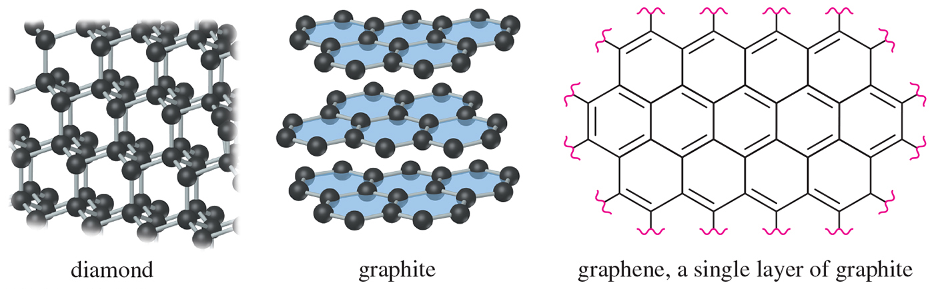
Allotropes of Carbon
Amorphous: Small particles of graphite; charcoal, soot, coal, carbon black
Diamond: A lattice of tetrahedral carbon atoms
Graphite: Layers of fused aromatic rings

Slide 13
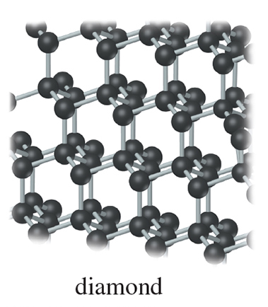
Diamond
One giant molecule
Tetrahedral carbon.
Sigma bonds, 1.54 Å
Electrical insulator

Slide 14
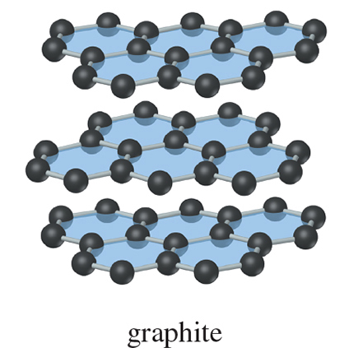
Graphite
Planar layered structure
Layer of fused benzene rings, bonds: 1.415 Å
Only van der Waals forces between layers
Conducts electrical current parallel to layers

Slide 15
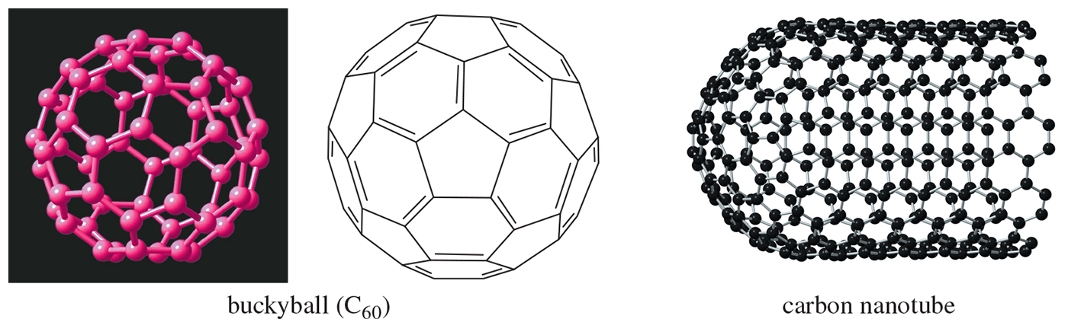
Some New Allotropes
Fullerenes: Five- and six-membered rings arranged to form a “soccer ball” structure
Nanotubes: Half of a C₆₀ sphere fused to a cylinder of fused aromatic rings

Slide 16
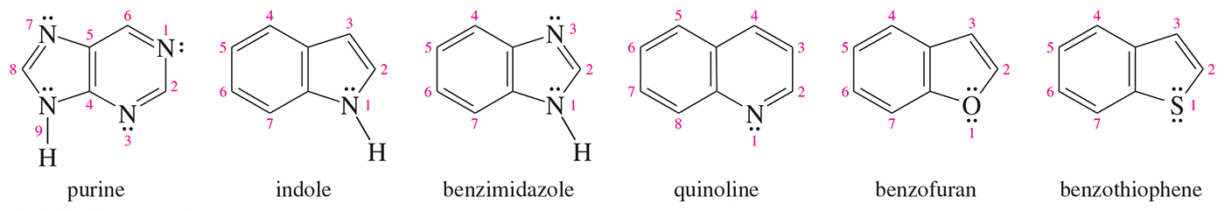
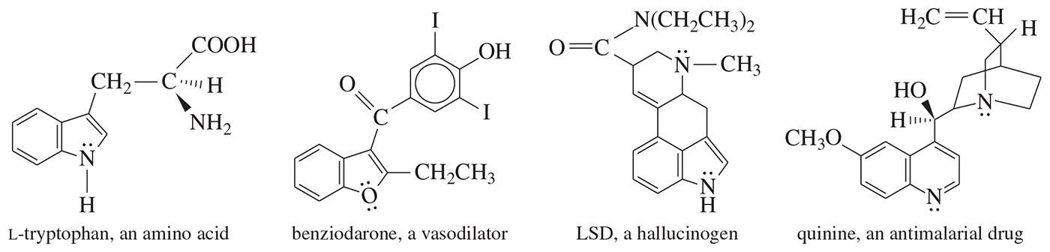
Fused Heterocyclic Compounds
Common in nature; synthesized for drugs

Slide 17
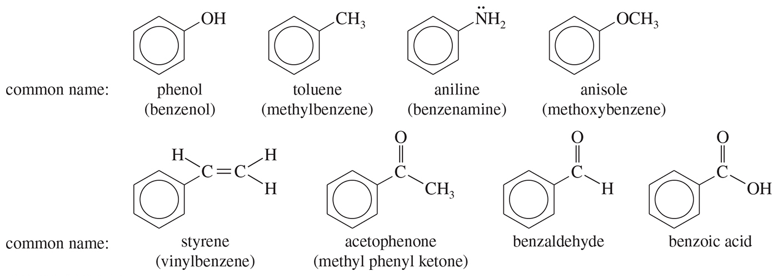
Common Names of
Benzene Derivatives

Slide 18
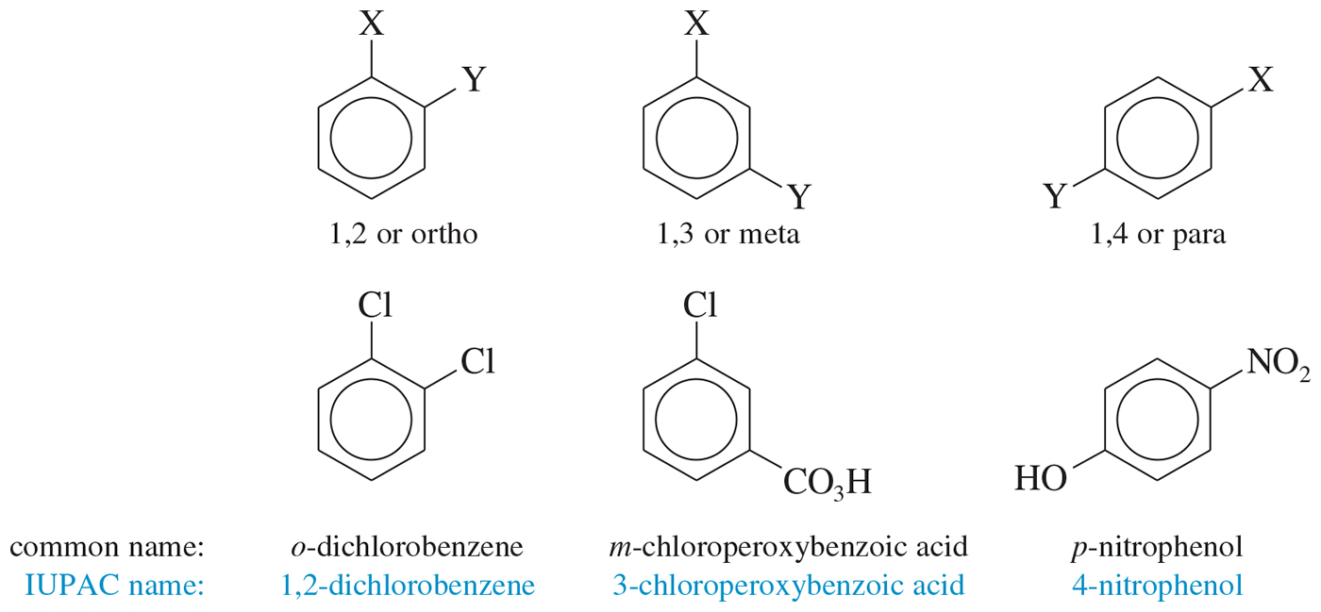
Disubstituted Benzenes
Numbers can also be used to identify the relationship between the groups; ortho- is 1,2-disubstituted, meta- is 1,3, and para- is 1,4.

Slide 19
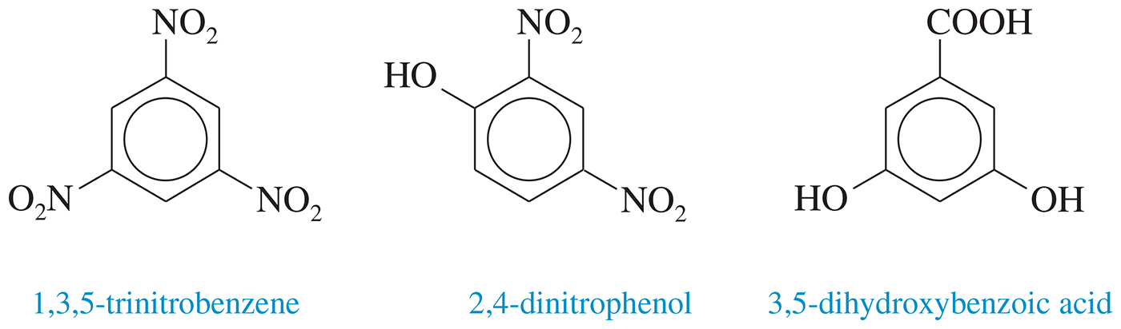
Three or More Substituents
Use the smallest possible numbers, but
the carbon with a functional group is number 1.

Slide 20
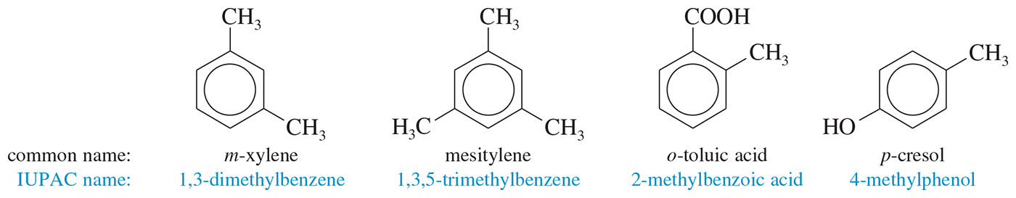
Common Names for
Disubstituted Benzenes

Slide 21
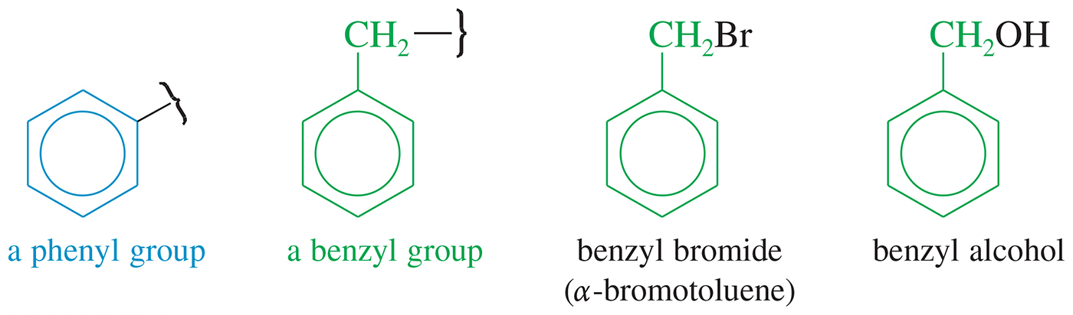
Phenyl and Benzyl
Phenyl indicates the benzene ring attachment. The benzyl group has an additional carbon.

