Slide 1
UNIT FIVE KEY TOPICS
Chapters 10/11 Alcohols
Acidity of alcohols 1
Reactions of alcohols 2
Grignard synthesis of alcohols 1
Chapter 13 NMR
Deduce structure from spectra 2
Predict spectrum from structure 2
Chapter 14 ethers
Epoxide synthesis 1
Williamson ether synthesis 1

Slide 2
Classification of Alcohols
Primary: Carbon with —OH is bonded to one other carbon.
Secondary: Carbon with —OH is bonded to two other carbons.
Tertiary: Carbon with —OH is bonded to three other carbons.
Aromatic (phenol): —OH is bonded to a benzene ring.

Slide 3
Examples of Classifications
C
H
3
O
H
C
H
C
H
C
H
O
H
C
H
3
C
H
C
H
2
C
H
3
3
*
2
*
Primary alcohol
Secondary alcohol
C
H
3
*
C
H
3
C
O
H
C
H
3

Slide 4
Phenol Nomenclature
The —OH group is assumed to be on carbon 1.
For common names of disubstituted phenols, use ortho- for 1,2; meta- for 1,3; and para- for 1,4.
Methyl phenols are cresols.
3-chlorophenol
(meta-chlorophenol)
4-methylphenol
(para-cresol)

Slide 5
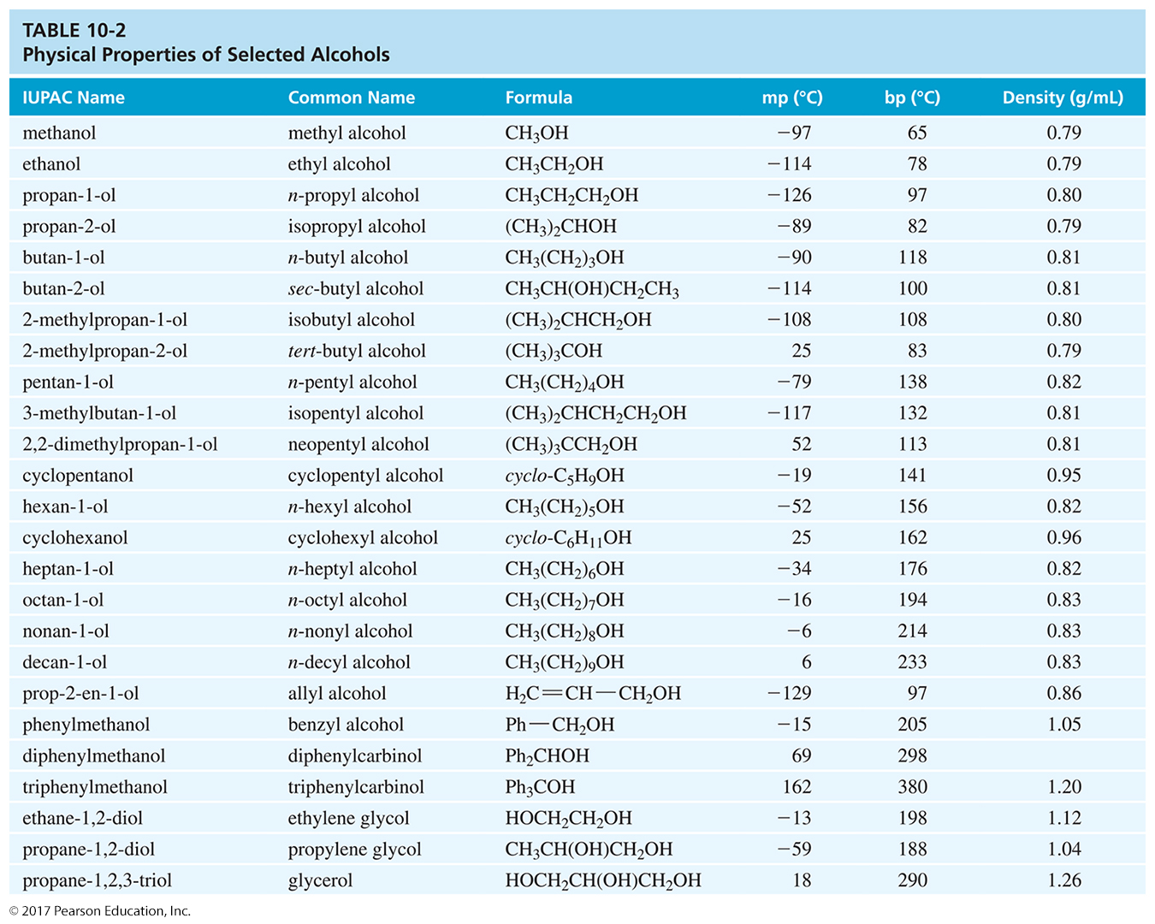
Physical Properties of Alcohols

Slide 6
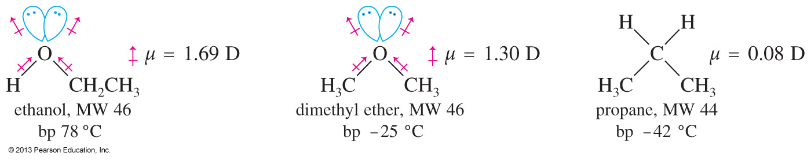
Boiling Points of Alcohols
Alcohols have higher boiling points than ethers and alkanes because alcohols can form hydrogen bonds.
The stronger interaction between alcohol molecules will require more energy to break, resulting in a higher boiling point.

Slide 7
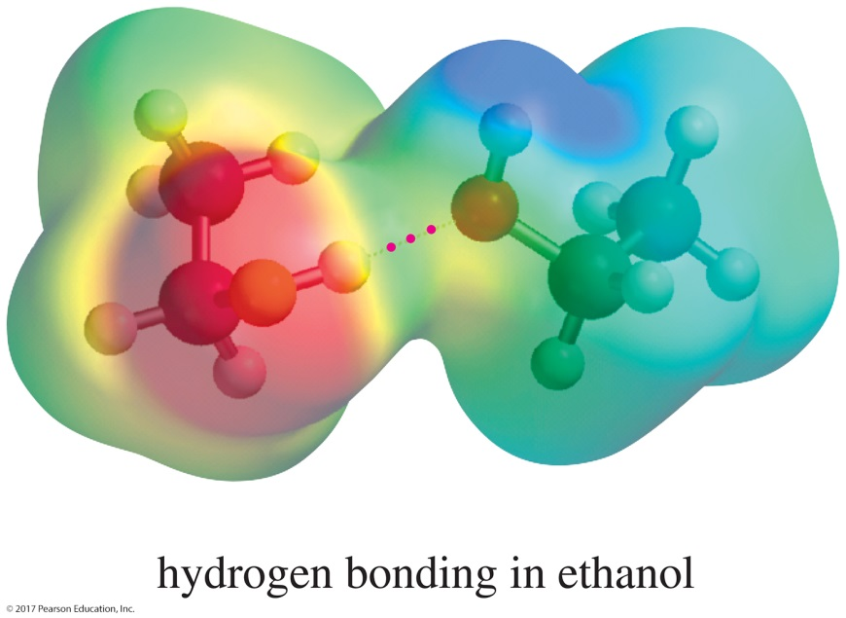
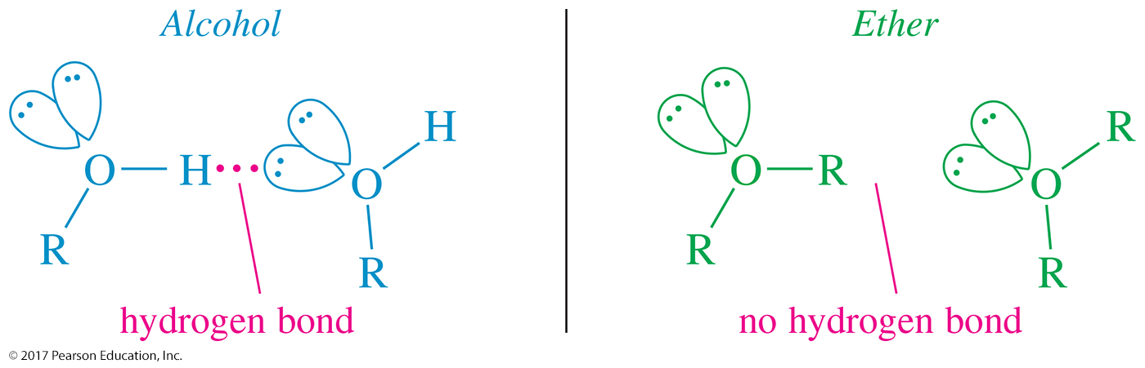
Hydrogen Bonding

Slide 8
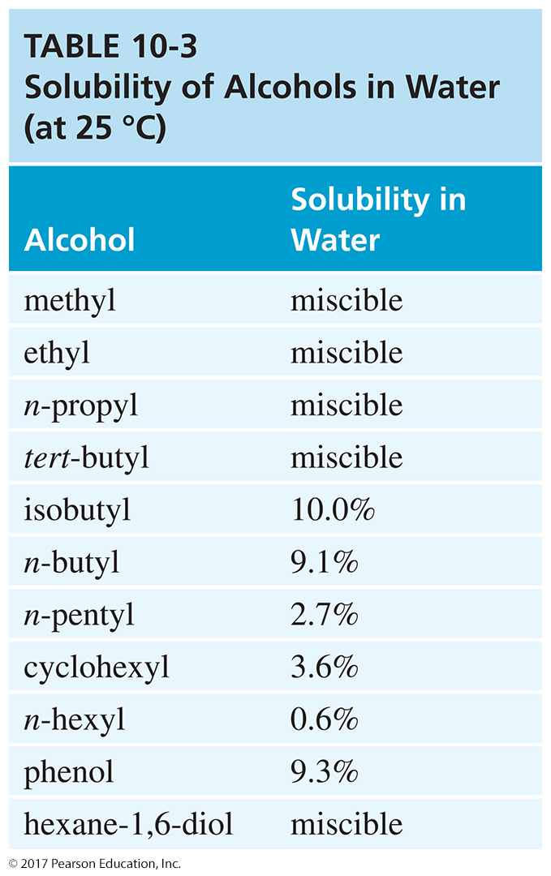
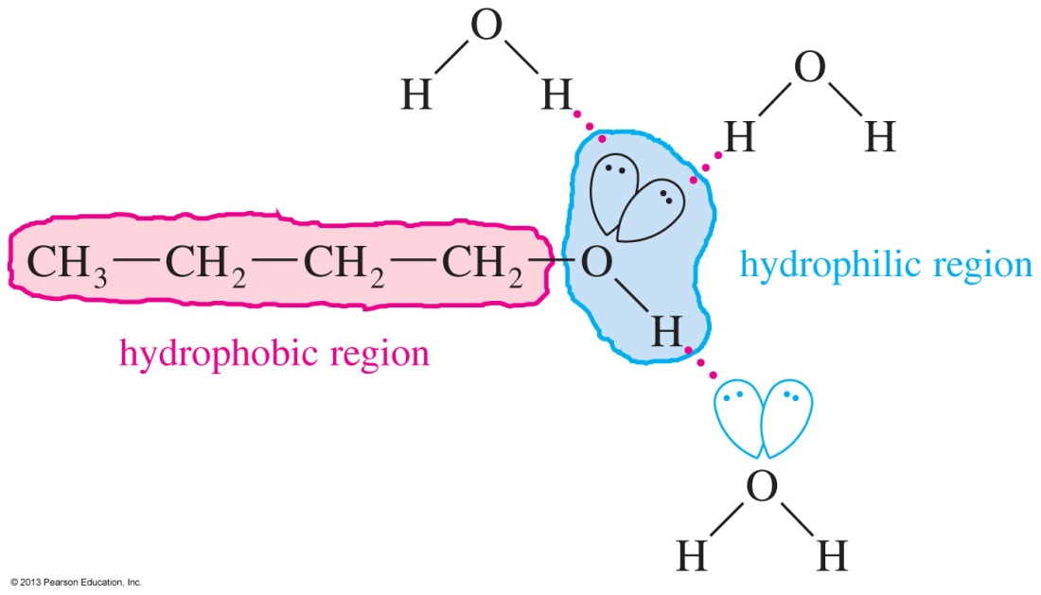
Solubility in Water
Small alcohols are miscible in water, but solubility decreases as the size of the alkyl group increases.

Slide 9
Acidity of Alcohols
pK_{a} range: 15.5–18.0 (water: 15.7)
Acidity decreases as substitution on the alkyl group increases.
Halogens and other electron-withdrawing groups increase the acidity.
Phenol is 100 million times (10⁸) more acidic than cyclohexanol!

Slide 10
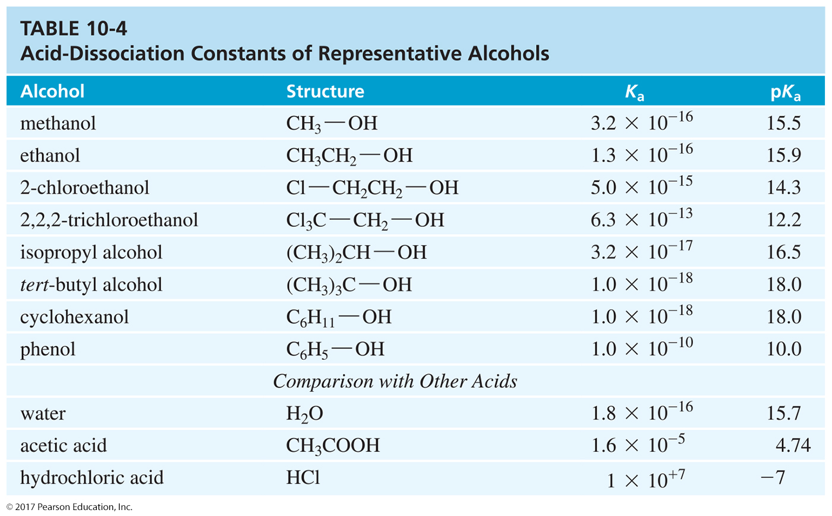
Table of K_{a} Values

Slide 11
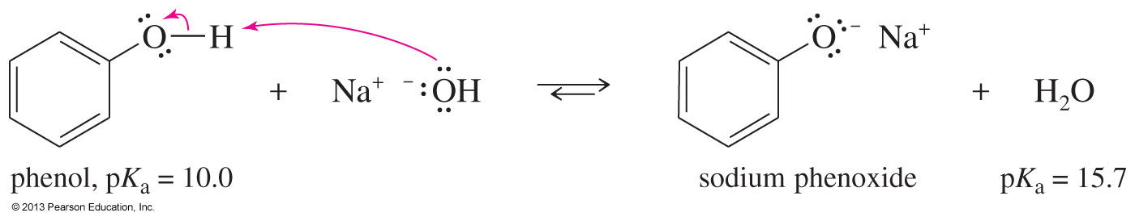
Formation of Phenoxide Ion
The aromatic alcohol phenol is more acidic than aliphatic alcohols due to the ability of aromatic rings to delocalize the negative charge of the oxygen within the carbons of the ring.

Slide 12
Organometallic Reagents
Carbon is negatively charged, so it is bonded to a metal (usually Mg or Li).
It will attack a partially positive carbon.
  C—X (alkyl halides)
  C═O (carbonyl)
Good for forming carbon–carbon bonds

Slide 13
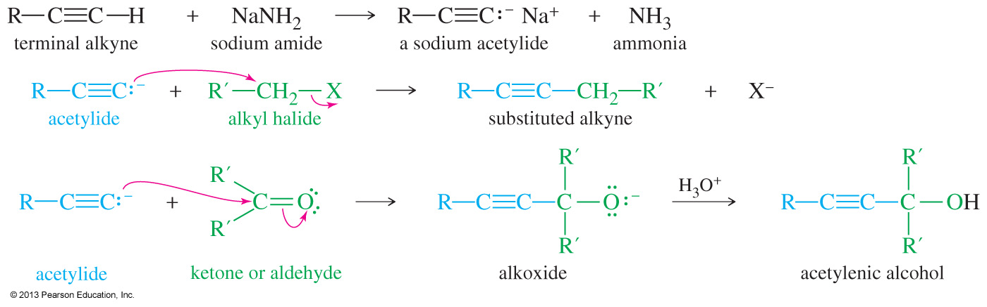
Sodium Acetylides
Terminal alkynes can be converted to sodium acetylides by treatment with an unusually strong base like sodium amide (NaNH₂).
These sodium acetylides are useful nucleophiles, reacting with alkyl halides and carbonyl compounds to form new carbon–carbon bonds.

Slide 14
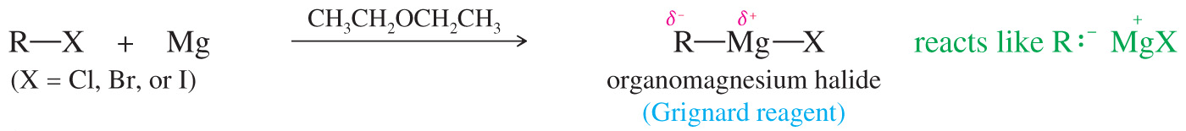
Grignard Reagents
Formula R—Mg—X (reacts like R:– ⁺MgX)
Ethers are used as solvents to stabilize the complex.
Iodides are the most reactive. Fluorides generally do not react.
May be formed from primary, secondary, or tertiary alkyl halides

Slide 15
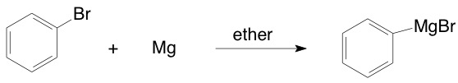

Formation of Grignards

Slide 16
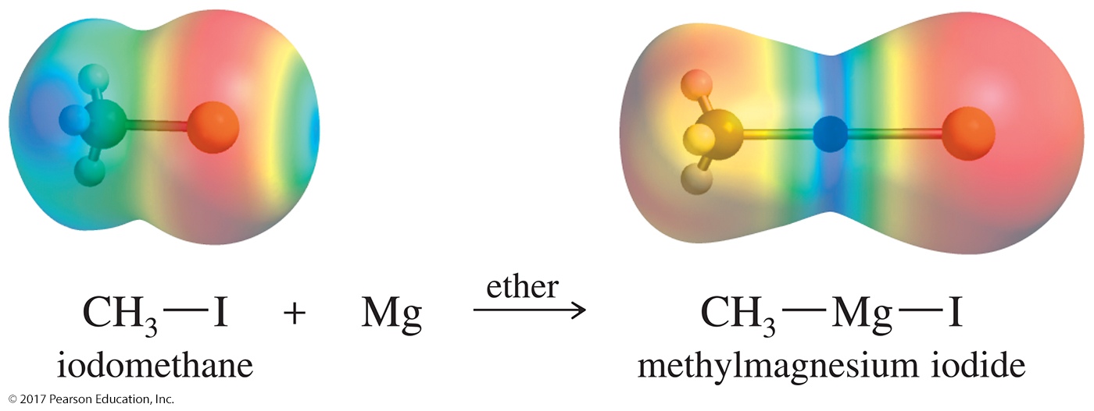
Grignards (Continued)

Slide 17
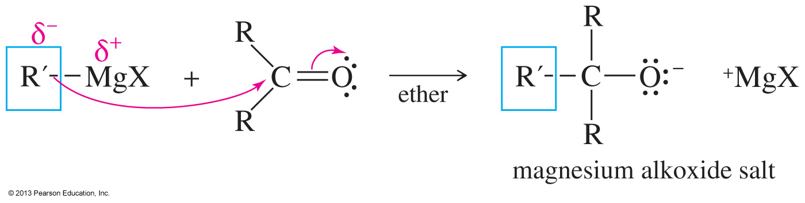
Addition to
Carbonyl Compounds
The carbonyl carbon is partial positive (electrophilic).
Nucleophiles will attack the carbonyl, forming an alkoxide.

Slide 18
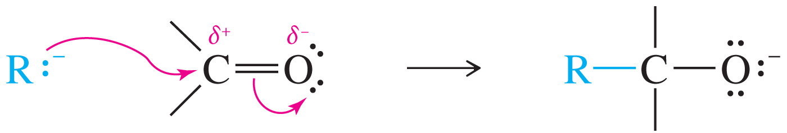
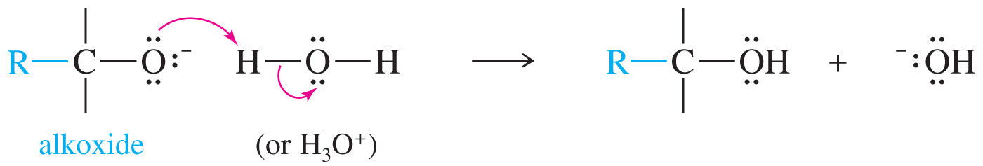
Mechanism of Addition of the Organometallic to the Carbonyl

Slide 19
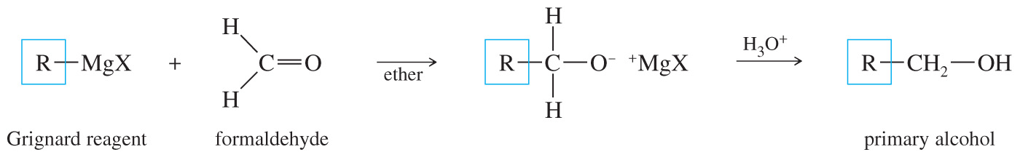
Formation of Primary Alcohols Using Organometallics
Reaction of a Grignard with formaldehyde will produce a primary alcohol after protonation.

Slide 20
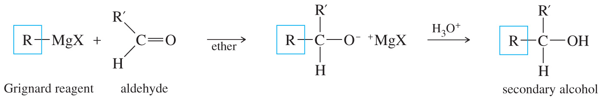
Synthesis of 2° Alcohols
Addition of a Grignard reagent to an aldehyde followed by protonation will produce a secondary alcohol.

Slide 21
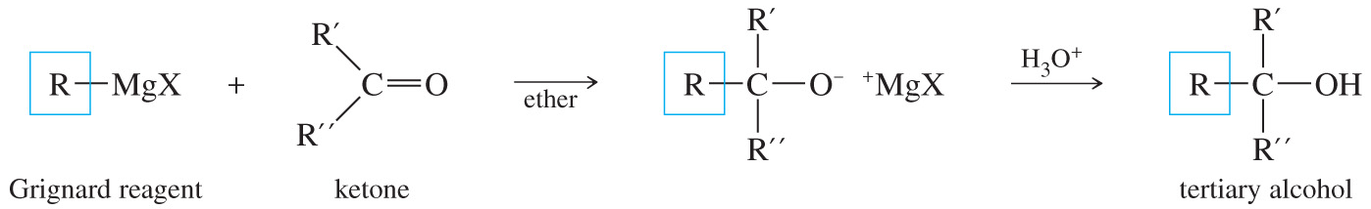
Synthesis of 3° Alcohols
Tertiary alcohols can be easily obtained by addition of a Grignard to a ketone followed by protonation with dilute acid.

Slide 22
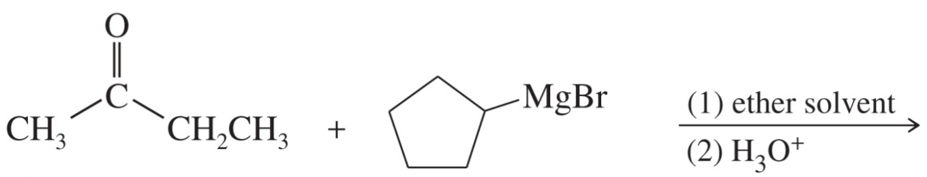
Solved Problem 2 (Continued)
Solution (Continued)
Any of these three syntheses would probably work, but only the third begins with fragments containing no more than five carbon atoms. The other two syntheses would require further steps to generate the ketones from compounds containing no more than five carbon atoms.

Slide 23
Grignard Reactions with
Acid Chlorides and Esters
Use two moles of Grignard reagent.
The product is a tertiary alcohol with two identical alkyl groups.
Reaction with one mole of Grignard reagent produces a ketone intermediate, which reacts with the second mole of Grignard reagent.

Slide 24
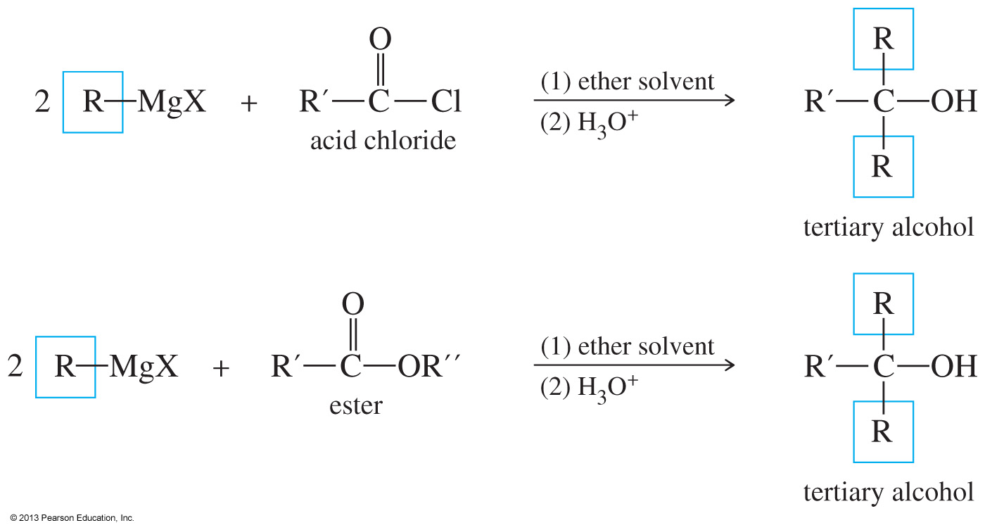
Reaction of Grignards with Carboxylic Acid Derivatives

Slide 25
Reduction of Carbonyl
Hydride reagents add a hydride ion (H–), reducing the carbonyl group to an alkoxide ion with no additional carbon atoms.
Protonation gives the alcohol.
Reduction of aldehyde yields 1° alcohol.
Reduction of ketone yields 2° alcohol.

Slide 26
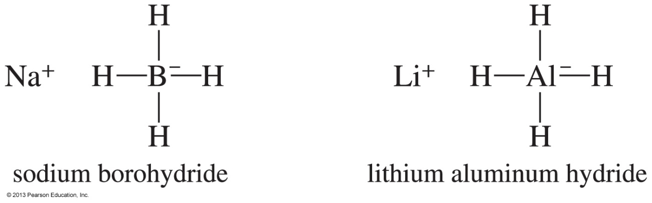
Hydride Reagents
Called complex hydrides because they do not have a simple hydride structure such as Na⁺H– or Li⁺H–
The bonding to the metal makes the hydrides more nucleophilic and less basic.

Slide 27
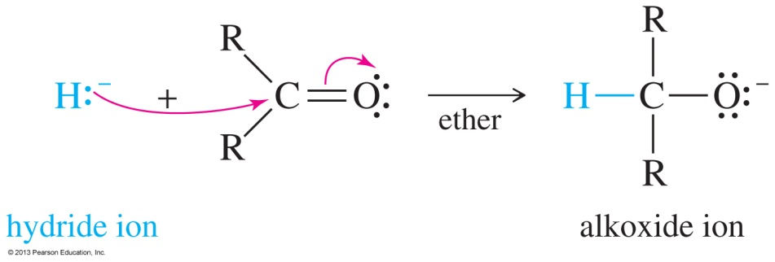
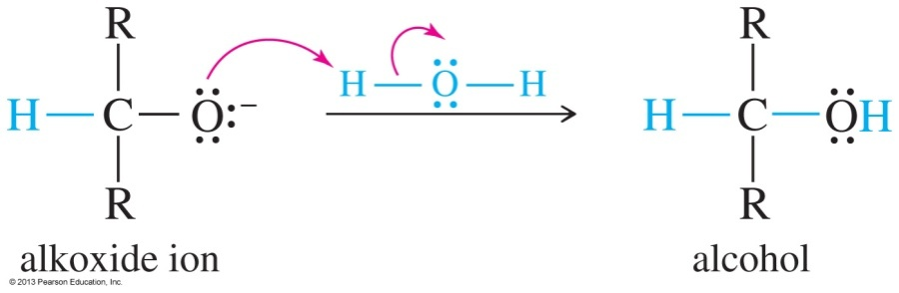
Mechanism of
Hydride Reduction
Reaction 1: The hydride attacks the carbonyl of the aldehyde or the ketone, forming an alkoxide ion.
Reaction 2: Protonation of the intermediate forms the alcohol.

Slide 28
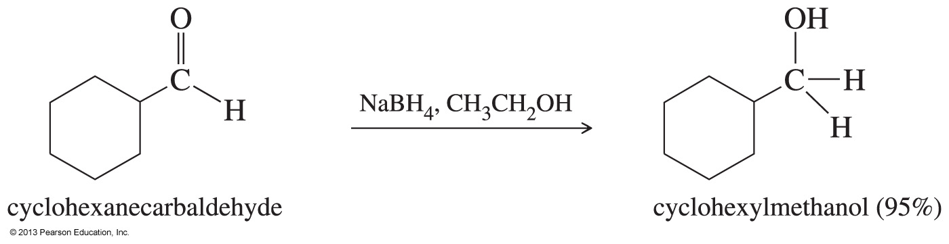
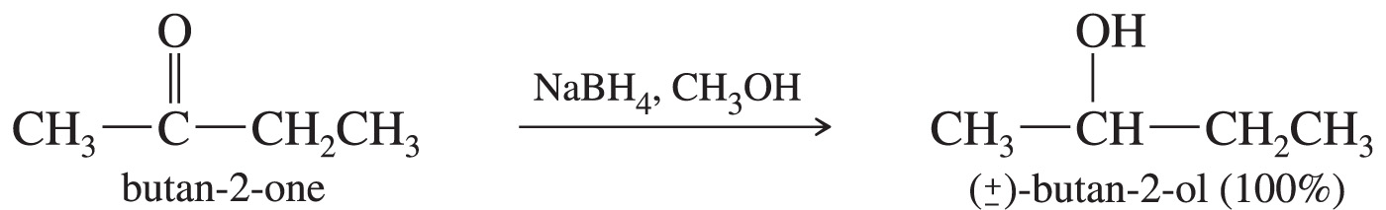
Examples of
NaBH₄ Reduction

Slide 29
Lithium Aluminum Hydride
Stronger reducing agent than sodium borohydride
Dangerous to work with
Reduces ketones and aldehydes into the corresponding alcohol
Converts esters and carboxylic acids to 1° alcohols

Slide 30
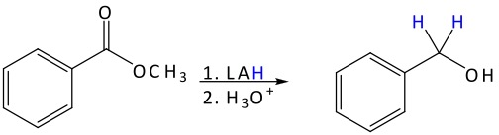
Reduction with LiAlH₄
The LiAlH₄ (or LAH) will add two hydrides to the ester to form the primary alkyl halide.
The mechanism is similar to the attack of Grignards on esters.

Slide 31
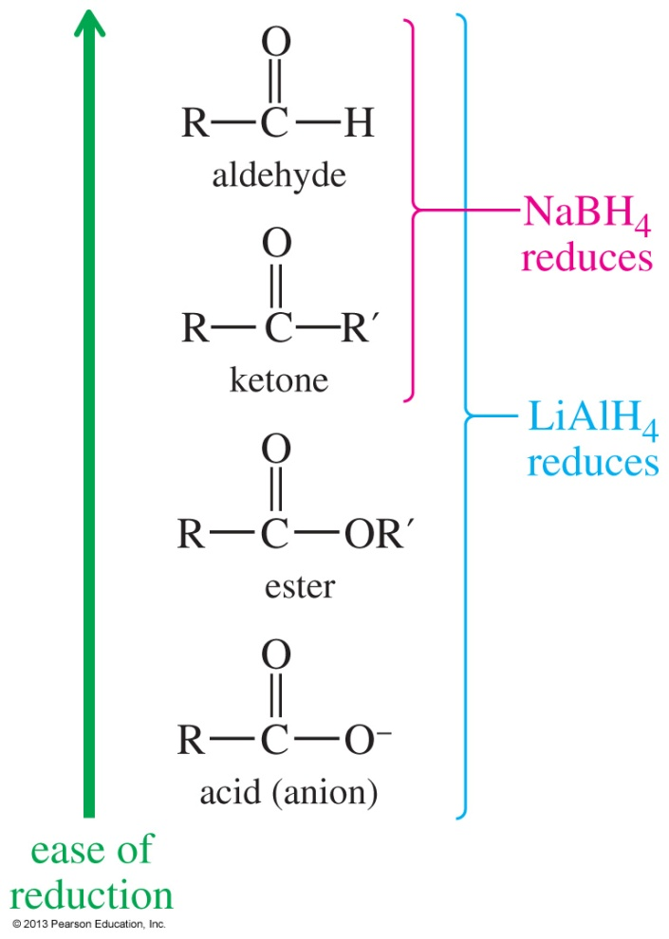
Reducing Agents
NaBH₄ can reduce aldehydes and ketones but not esters and carboxylic acids.
LiAlH₄ is a stronger reducing agent and will reduce all carbonyls.

Slide 32
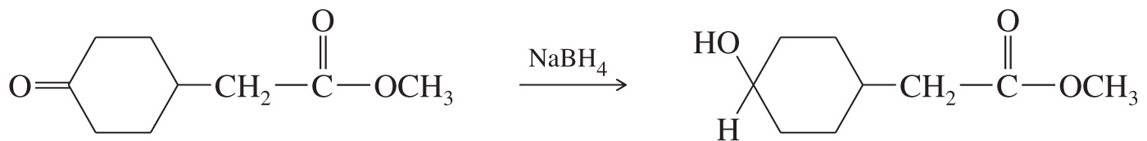
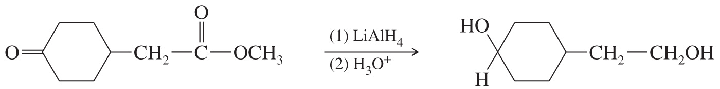
Comparison

Slide 33
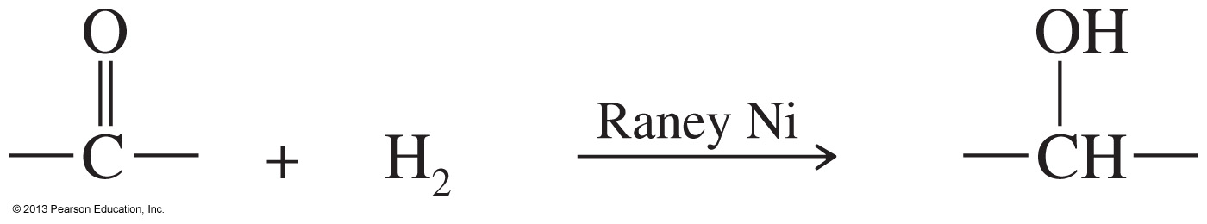
Catalytic Hydrogenation
Raney nickel is a hydrogen-rich nickel powder that is more reactive than Pd or Pt catalysts.
This reaction is not commonly used because it will also reduce double and triple bonds that may be present in the molecule.

Slide 34
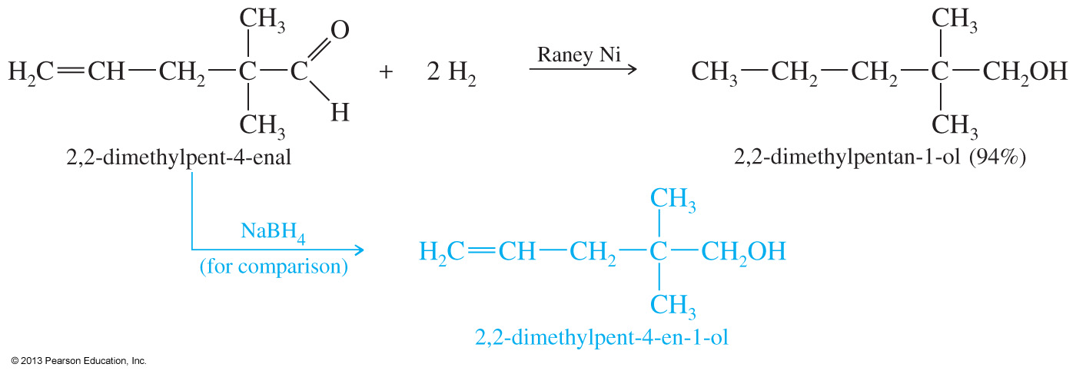
Selective Reductions
Hydride reagents are more selective, so they are used more frequently for carbonyl reductions.

