Slide 1
Chemistry
Fifth Edition
Julia Burdge
Lecture PowerPoints
Chapter 1
Chemistry: The Central Science
©2020 McGraw-Hill Education. All rights reserved. Authorized only for instructor use in the classroom. No reproduction or further distribution permitted without the prior written consent of McGraw-Hill Education.

Slide 2
CHAPTER 1
Chemistry: The Central Science
1.1 The Study of Chemistry.
1.2 Classification of Matter.
1.3 Scientific Measurement.
1.4 The Properties of Matter.
1.5 Uncertainty in Measurement.
1.6 Using Units and Solving Problems.

Slide 3
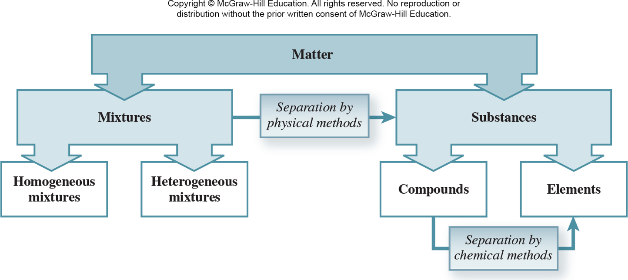
1.2 Classification of Matter 9
Mixtures

Slide 4
1.3 Scientific Measurement
Topics
SI Base Units
Mass
Temperature
Derived Units: Volume and Density

Slide 5
1.3 Scientific Measurement 1
SI Base Units
TABLE 1.2 Base SI Units.
Base Quantity | Name of Unit | Symbol
Length | meter | m
Mass | kilogram | kg
Time | second | s
Electric current | ampere | A
Temperature | kelvin | K
Amount of substance | mole | mol
Luminous intensity | candela | cd

Slide 6
1.3 Scientific Measurement 2
SI Base Units
TABLE 1.3 Prefixes Used with SI Units.
Prefix | Symbol | Meaning | Example
Tera- | T | 1 × 10¹² (1,000,000,000,000) | 1 teragram (Tg) = 1 × 10¹² g
Giga- | G | 1 × 10⁹ (1,000,000,000) | 1 gigawatt (GW) = 1 × 10⁹ W
Mega- | M | 1 × 10⁶ (1,000,000) | 1 megahertz (MHz) = 1 × 10⁶ Hz
Kilo- | k | 1 × 10³ (1,000) | 1 kilometer (km) = 1 × 10³ m
Deci- | d | 1 × 10⁻¹ (0.1) | 1 deciliter (dL) = 1 × 10⁻¹ L
Centi- | c | 1 × 10⁻² (0.01) | 1 centimeter (cm) = 1 × 10⁻² m
Milli- | m | 1 × 10⁻³ (0.001) | 1 millimeter (mm) = 1 × 10⁻³ m
Micro- | μ | 1 × 10⁻⁶ (0.000001) | 1 microliter (μL) = 1 × 10⁻⁶ L
Nano- | n | 1 × 10⁻⁹ (0.000000001) | 1 nanosecond (ns) = 1 × 10⁻⁹ s
Pico- | p | 1 × 10⁻¹² (0.000000000001) | 1 picogram (pg) = 1 × 10⁻¹² g

Slide 7
1.3 Scientific Measurement 3
Mass
Mass is a measure of the amount of matter in an object or sample.

Slide 8
1.3 Scientific Measurement 4
Temperature
There are two temperature scales used in chemistry.
The Celsius scale was originally defined using the freezing point (0 degrees C) and the boiling point (100 degrees C) of pure water at sea level.
The SI base unit of temperature is the kelvin. Kelvin is known as the absolute temperature scale, meaning that the lowest temperature possible is 0 K, a temperature referred to as “absolute zero.”

Slide 9
1.3 Scientific Measurement 5
Temperature
Units of the Celsius and Kelvin scales are equal in magnitude, so a degree Celsius is equivalent to a kelvin.

Slide 10
SAMPLE PROBLEM 1.1 Strategy
Normal human body temperature can range over the course of the day from about 36 degrees C in the early morning to about 37 degrees C in the afternoon.
Express these two temperatures and the range that they span using the Kelvin scale.
Strategy
Use K = degrees C + 273.15 to convert temperatures from the Celsius scale to the Kelvin scale.
Then convert the range of temperatures from degrees Celsius to kelvin, keeping in mind that 1 degrees C is equivalent to 1 K.

Slide 11
SAMPLE PROBLEM 1.1 Solution
Solution
36 degrees C + 273 = 309 K
37 degrees C + 273 = 310 K
The range of 1 degree C is equal to a range of 1 K.

Slide 12
1.3 Scientific Measurement 6
Temperature

Slide 13
1.3 Scientific Measurement 7
Derived Units: Volume and Density
There are many quantities, such as volume and density, that require units not included in the base SI units.
In these cases, we must combine base units to derive appropriate units for the quantity.
The derived SI unit for volume, the meter cubed (m³), is a larger volume than is practical in most laboratory settings.

Slide 14
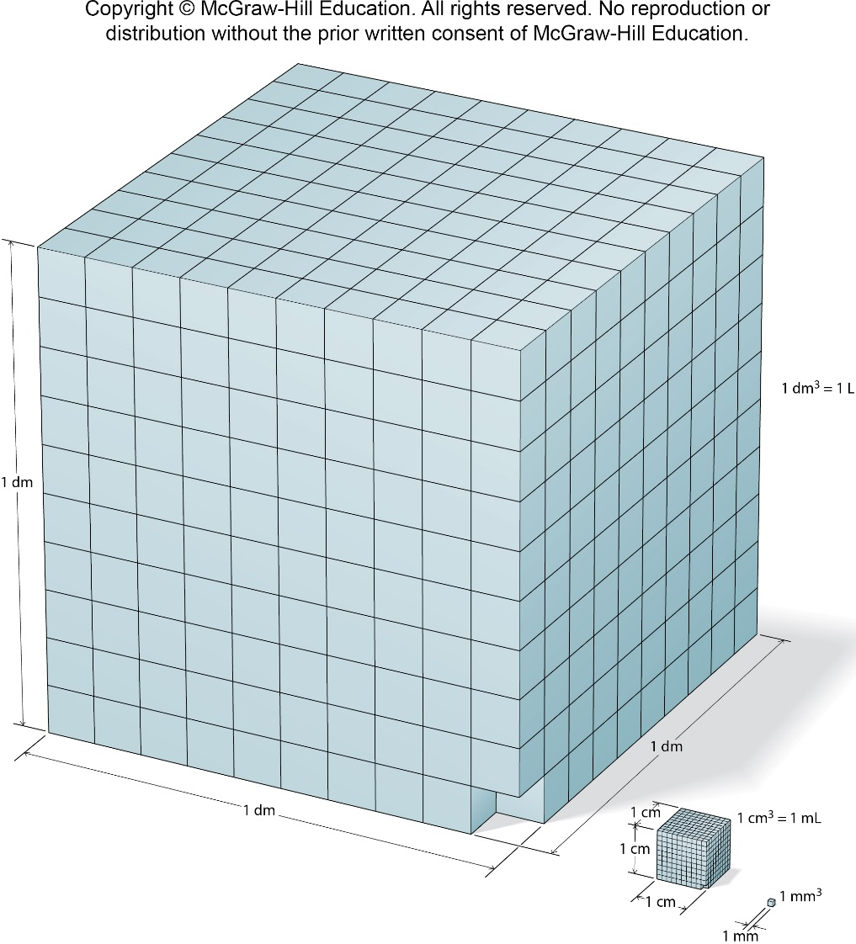
1.3 Scientific Measurement 8
Derived Units: Volume and Density
The more commonly used
metric unit, the liter (L), is
derived by cubing the
decimeter (one-tenth of a
meter) and is therefore also
referred to as the cubic
decimeter (dm³).

Slide 15
1.3 Scientific Measurement 9
Derived Units: Volume and Density
Density is the ratio of mass to volume.

Slide 16
1.4 The Properties of Matter 4
Extensive and Intensive Properties
All properties of matter are either extensive or intensive.
The measured value of an extensive property depends on the amount of matter.
Mass is an extensive property.
The value of an intensive property does not depend on the amount of matter.
Density and temperature are intensive properties.

Slide 17
1.5 Uncertainty in Measurement
Topics
Significant Figures
Calculations with Measured Numbers
Accuracy and Precision

Slide 18
1.5 Uncertainty in Measurement 1
Significant Figures
Chemistry makes use of two types of numbers: exact and inexact.
Exact numbers include numbers with defined values, such as
2.54 in the definition 1 inch (in) = 2.54 cm
1,000 in the definition 1 kg = 1,000 g
12 in the definition 1 dozen = 12 objects.
Numbers measured by any method other than counting are inexact.

Slide 19
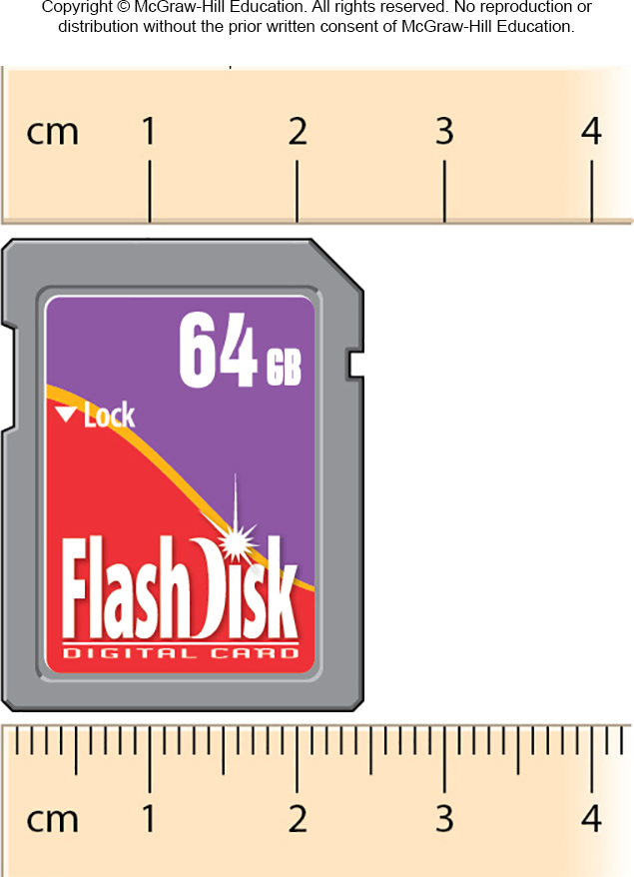
1.5 Uncertainty in Measurement 2
Significant Figures
An inexact number must be reported in such a way as to indicate the uncertainty in its value.
This is done using significant figures. Significant figures are the meaningful digits in a reported number.

Slide 20
1.5 Uncertainty in Measurement 3
Significant Figures
The number of significant figures in any number can be determined using the following guidelines:
Any digit that is not zero is significant (112.1 has four significant figures.)
Zeros located between nonzero digits are significant (305 has three significant figures, and 50.08 has four significant figures.)

Slide 21
1.5 Uncertainty in Measurement 4
Significant Figures
The number of significant figures in any number can be determined using the following guidelines:
Zeros to the left of the first nonzero digit are not significant (0.0023 has two significant figures, and 0.000001 has one significant figure.)
Zeros to the right of the last nonzero digit are significant if the number contains a decimal point (1.200 has four significant figures.)

Slide 22
1.5 Uncertainty in Measurement 5
Significant Figures
The number of significant figures in any number can be determined using the following guidelines:
Zeros to the right of the last nonzero digit in a number that does not contain a decimal point may or may not be significant (100 may have one, two, or three significant figures—it is impossible to tell without additional information.

Slide 23
1.5 Uncertainty in Measurement 6
Significant Figures
To avoid ambiguity in such cases, it is best to express such numbers using scientific notation [Appendix 1].
1.3 × 10² two significant figures
1.30 × 10² three significant figures

Slide 24
SAMPLE PROBLEM 1.5
Determine the number of significant figures in the following measurements:
443 cm.
15.03 g.
0.0356 kg.
3.000 3 10⁻⁷ L.
50 mL.
0.9550 m.

Slide 25
SAMPLE PROBLEM 1.5 Strategy
Strategy
All nonzero digits are significant, so the goal will be to determine which of the zeros is significant.
Setup
Zeros are significant if they appear between nonzero digits or if they appear after a nonzero digit in a number that contains a decimal point.
Zeros may or may not be significant if they appear to the right of the last nonzero digit in a number that does not contain a decimal point.

Slide 26
SAMPLE PROBLEM 1.5 Solution
Solution
443 cm.
15.03 g.
0.0356 kg.
3.000 3 10⁻⁷ L.
50 mL.
0.9550 m.
(a) 3; (b) 4; (c) 3; (d) 4; (e) 1 or 2, an ambiguous case; (f) 4

Slide 27
1.5 Uncertainty in Measurement 7
Calculations with Measured Numbers
In addition and subtraction, the answer cannot have more digits to the right of the decimal point than the original number with the smallest number of digits to the right of the decimal point.
102.50 | ← two digits after the decimal point
+ 0.231 | ← three digits after the decimal point
102.731 | ← round to 102.73

Slide 28
1.5 Uncertainty in Measurement 8
Calculations with Measured Numbers
143.29 | ← two digits after the decimal point
− 20.1 | ← one digit after the decimal point
123.19 | ← round to 123.2
If the leftmost digit to be dropped is less than 5, round down.
If the leftmost digit to be dropped is equal to or greater than 5, round up.

Slide 29
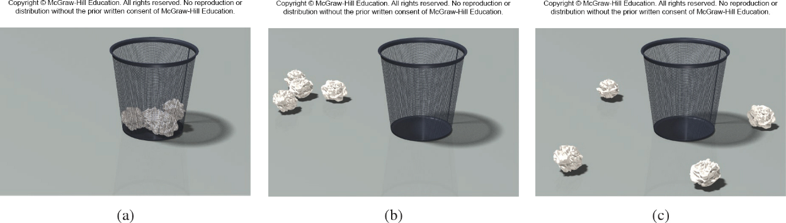
1.5 Uncertainty in Measurement 12
Accuracy and Precision
Accuracy tells us how close a measurement is to the true value.
Precision tells us how close multiple measurements of the same thing are to one another.
Access the text alternative for these images

Slide 30
1.5 Uncertainty in Measurement 13
Accuracy and Precision
 | Student A | Student B | Student C
Measurement 1 | 0.335 g | 0.357 g | 0.369 g
Measurement 2 | 0.331 g | 0.375 g | 0.373 g
Measurement 3 | 0.333 g | 0.338 g | 0.371 g

Slide 31
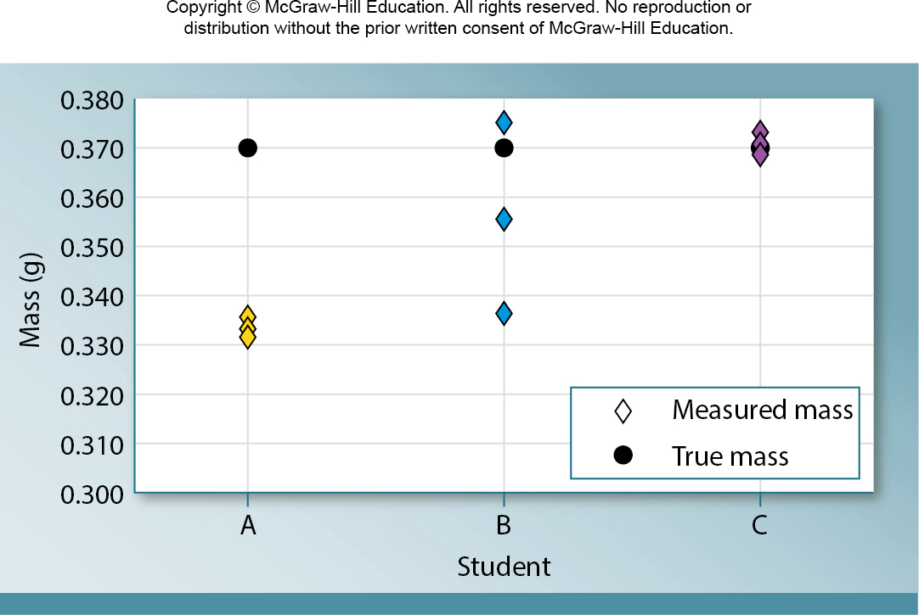
1.5 Uncertainty in Measurement 14
Accuracy and Precision

