Slide 1
Chemistry
Fifth Edition
Julia Burdge
Lecture PowerPoints
Chapter 4
Reactions in Aqueous Solutions
©2020 McGraw-Hill Education. All rights reserved. Authorized only for instructor use in the classroom. No reproduction or further distribution permitted without the prior written consent of McGraw-Hill Education.

Slide 2
4.1 General Properties of Aqueous Solutions 1
Electrolytes and Nonelectrolytes
A Solution is a homogeneous mixture of two or more substances.
Solutions may be gaseous (such as air), solid (such as brass), or liquid (such as saltwater).
Usually, the substance present in the largest amount is referred to as the solvent and any substance present in a smaller amount is called the solute.
Throughout the remainder of this chapter, unless otherwise noted, solution will refer specifically to an aqueous solution.

Slide 3
4.1 General Properties of Aqueous Solutions 2
Electrolytes and Nonelectrolytes
An electrolyte is a substance that dissolves in water to yield a solution that conducts electricity.
By contrast, a nonelectrolyte is a substance that dissolves in water to yield a solution that does not conduct electricity.
The difference between an aqueous solution that conducts electricity and one that does not is the presence or absence of ions.

Slide 4
4.1 General Properties of Aqueous Solutions 3
Electrolytes and Nonelectrolytes
Dissociation is the process by which an ionic compound, upon dissolution, breaks apart into its constituent ions.
Ionization is the process by which a molecular compound forms ions when it dissolves.

Slide 5
4.1 General Properties of Aqueous Solutions 4
Electrolytes and Nonelectrolytes
Acids constitute one of two important classes of molecular compounds that are electrolytes.
Molecular bases constitute the other one. A base is a compound that dissolves in water to produce hydroxide ions (OH–).

Slide 6
4.1 General Properties of Aqueous Solutions 5
Strong Electrolytes and Weak Electrolytes
An electrolyte that dissociates completely is known as a strong electrolyte.
All water-soluble ionic compounds dissociate completely upon dissolving, so all water-soluble ionic compounds are strong electrolytes.

Slide 7
4.1 General Properties of Aqueous Solutions 6
Strong Electrolytes and Weak Electrolytes
The list of molecular compounds that are strong electrolytes is fairly short.
TABLE 4.1 The Strong Acids
Acid | Ionization Equation
Hydrochloric acid | HCl(aq)→H⁺(aq)+Cl⁻(aq)
Hydrobromic acid | HBr(aq)→H⁺(aq)+Br⁻(aq)
Hydroiodic acid | HI(aq)→H⁺ (aq)+I⁻(aq)
Nitric acid | HNO₃(aq)→H⁺(aq)+NO₃⁻(aq)
Chloric acid | HCIO₃(aq)→H⁺(aq)+CIO₃⁻(aq)
Perchloric acid | HCIO₄(aq)→H⁺(aq)+CIO₄⁻(aq)
Sulfuric acid* | H₂SO₄(aq)→H⁺(aq)+HSO₄⁻(aq)
 | HSO₄⁻(aq)⇆H⁺(aq)+SO₄²⁻(aq)

Slide 8
SAMPLE PROBLEM 4.1-1
Classify each of the following compounds as a nonelectrolyte, a weak electrolyte, or a strong electrolyte:
methanol (CH₃OH)
sodium hydroxide (NaOH)
ethylamine (C₂H₅NH₂)
hydrofluoric acid (HF)

Slide 9
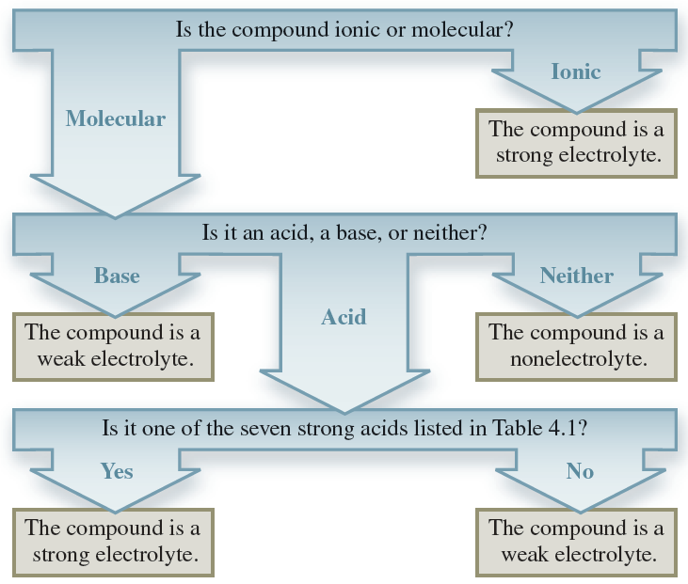
SAMPLE PROBLEM 4.1-2
Solution
(a) methanol (CH₃OH): nonelectrolyte

Slide 10
SAMPLE PROBLEM 4.1-3
Solution
(b) sodium hydroxide (NaOH): strong electrolyte

Slide 11
SAMPLE PROBLEM 4.1-4
Solution
(c) ethylamine (C₂H₅NH₂): weak electrolyte

Slide 12
SAMPLE PROBLEM 4.1-5
Solution
(d) hydrofluoric acid (HF): weak electrolyte

Slide 13
4.2 Precipitation Reactions 6
Solubility Guidelines for Ionic Compounds in Water:
TABLE 4.2 Solubility Guidelines: Soluble Compounds
Water-Soluble Compounds | Insoluble Exceptions
Compounds containing an alkali metal cation (Li⁺, Na⁺, K⁺, Rb⁺, Cs⁺) or the ammonium ion (NH₄⁺)
Compounds containing the nitrate ion (NO₃⁻), acetate ion (C₂H₃O₂⁻), or chlorate ion (ClO₃⁻)
Compounds containing the chloride ion (Cl⁻), bromide ion (Br⁻), or iodide ion (I⁻) | Compounds containing Ag⁺ , Hg₂²⁺, or Pb²⁺
Compounds containing the sulfate ion (SO₄²⁻) | Compounds containing Ag⁺ , H₂²⁺ , Pb²⁺, Ca²⁺, Sr²⁺, or Ba²⁺

Slide 14
4.2 Precipitation Reactions 7
Solubility Guidelines for Ionic Compounds in Water
TABLE 4.3 Solubility Guidelines: Insoluble Compounds
Water-Insoluble Compounds | Soluble Exceptions
Compounds containing the carbonate ion (CO₃²⁻), phosphate ion (PO₄³⁻), chromate ion (CrO₄²⁻), or sulfide ion (S²⁻) | Compounds containing Li⁺, Na⁺, K⁺, Rb⁺, Cs⁺, or NH₄⁺
Compounds containing the hydroxide ion (OH⁻) | Compounds containing Li⁺, Na⁺, K⁺, Rb⁺, Cs⁺, or Ba²⁺

Slide 15
SAMPLE PROBLEM 4.3-1
Write the molecular, ionic, and net Ionic Equations for the reaction that occurs when aqueous solutions of lead acetate [Pb(C₂H₃O₂)₂], and calcium chloride (CaCl₂), are combined.
Strategy
Predict the products by exchanging ions and balance the equation. Determine which product will precipitate based on the solubility guidelines in Tables 4.2 and 4.3.
Rewrite the equation showing strong electrolytes as ions. Identify and cancel spectator ions.

Slide 16
SAMPLE PROBLEM 4.3-2
Setup
The products of the reaction are PbCl₂ and Ca(C₂H₃O₂)₂.
PbCl₂ is insoluble, because Pb²⁺ is one of the insoluble exceptions for chlorides, which are generally soluble.
Ca(C₂H₃O₂)₂ is soluble because all acetates are soluble.

Slide 17
SAMPLE PROBLEM 4.3-3
Solution
Molecular equation:
Ionic equation:
Net ionic equation:

Slide 18
4.3 Acid-Base Reactions 1
Strong Acids and Bases
TABLE 4.4 Strong Acids and Strong Bases
Strong Acids | Strong Bases
HCl | LiOH
HBr | NaOH
HI | KOH
HN0₃ | RbOH
HC10₃ | CsOH
HClO₄ | Ca(OH)₂
H₂S0₄ | Sr(OH)₂
 | Ba(OH)₂

Slide 19
4.3 Acid-Base Reactions 2
Brønsted Acids and Bases
In Section 2.6 we defined an acid as a substance that ionizes in water to produce H⁺ ions, and a base as a substance that ionizes (or dissociates, in the case of an ionic base) in water to produce OH– ions.
These definitions are attributed to the Swedish chemist Svante Arrhenius.

Slide 20
4.3 Acid-Base Reactions 3
Brønsted Acids and Bases
More inclusive definitions were proposed by the Danish chemist Johannes Brønsted in 1932.
A Brønsted acid is a proton donor, and a Brønsted base is a proton acceptor.
In this context, the word proton refers to a hydrogen atom that has lost its electron—also known as a hydrogen ion (H⁺).

Slide 21
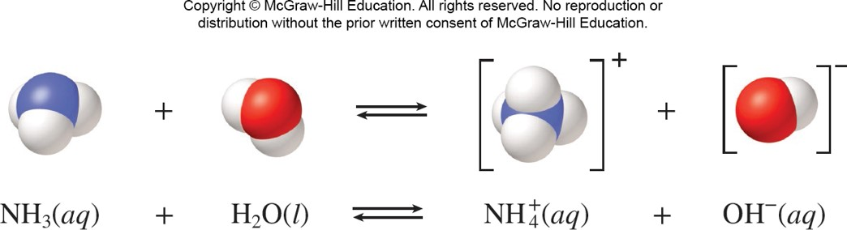
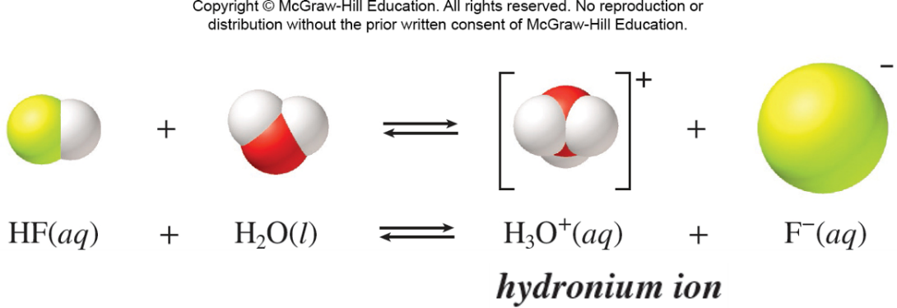
4.3 Acid-Base Reactions 4
Brønsted Acids and Bases
Access the text alternative for these images

Slide 22
4.3 Acid-Base Reactions 8
Acid-Base Neutralization
A neutralization reaction is a reaction between an acid and a base. In general, an aqueous acid- base reaction produces water and a salt, which is an ionic compound made up of the cation from a base and the anion from an acid.
HCl(aq)+NaOH(aq)⟶H₂O(l)+NaCl(aq)

Slide 23
4.4 Oxidation-Reduction Reactions
Topics
Oxidation Numbers
Oxidation of Metals in Aqueous Solutions
Balancing Simple Redox Equations
Other Types of Redox Reactions

Slide 24
4.4 Oxidation-Reduction Reactions 1
Oxidation Numbers
An oxidation-reduction reaction, or redox reaction is a chemical reaction in which electrons are transferred from one reactant to another.
Zn(s)+Cu²⁺(aq)⟶Zn²⁺(aq)+Cu(s)
In this process, zinc atoms are oxidized (they lose electrons) and copper ions are reduced (they gain electrons).

Slide 25
4.4 Oxidation-Reduction Reactions 2
Oxidation Numbers
Redox half-reactions:
Oxidation is the loss of electrons, and the gain of electrons is called reduction.
Zn is called the reducing agent because it donates electrons, causing Cu²⁺ to be reduced. Cu²⁺ is called the oxidizing agent because it accepts electrons, causing Zn to be oxidized.

Slide 26
4.4 Oxidation-Reduction Reactions 3
Oxidation Numbers
H₂(g)+F₂(g)⟶2HF(g)
Fluorine does not gain an electron per se— and hydrogen does not lose one.
Experimental evidence shows, however, that there is a partial transfer of electrons from H to F.
Oxidation Numbers provide us with a way to “balance the books” with regard to electrons in a chemical equation. The oxidation number, also called the oxidation state, is the charge an atom would have if electrons were transferred completely.

Slide 27
4.4 Oxidation-Reduction Reactions 4
Oxidation Numbers
The elements that show an increase in oxidation number—hydrogen in the preceding examples— are oxidized, whereas the elements that show a decrease in oxidation number—fluorine and nitrogen—are reduced.

Slide 28
4.4 Oxidation-Reduction Reactions 5
Oxidation Numbers
Because compounds are electrically neutral, the Oxidation Numbers in any compound will sum to zero.
For a polyatomic ion, Oxidation Numbers must sum to the charge on the ion. (The oxidation number of a monatomic ion is equal to its charge.)

Slide 29
4.4 Oxidation-Reduction Reactions 6
Oxidation Numbers
The following guidelines will help you assign Oxidation Numbers. There are essentially two rules:
The oxidation number of any element, in its elemental form, is zero.
The Oxidation Numbers in any chemical species must sum to the overall charge on the species. Oxidation Numbers must sum to zero for any molecule and must sum to the charge on any polyatomic ion. The oxidation number of a monatomic ion is equal to the charge on the ion.

Slide 30
4.4 Oxidation-Reduction Reactions 7
Oxidation Numbers
TABLE 4.5 Elements with Reliable Oxidation Numbers in Compounds or Polyatomic Ions
Element | Oxidation Number | Exceptions
Fluorine | −1
Group 1A or 2A metal | + 1 or + 2, respectively
Hydrogen | + 1 | Any combination with a Group 1A or 2A metal to form a metal hydride. Examples: LiH and CaH₂—the oxidation number of H is —1 in both examples.
Oxygen | −2 | Any combination with something higher on the list that necessitates its having a different oxidation number (see rule 2 for assigning Oxidation Numbers). Examples: H₂O₂ and K0₂—the oxidation number of O for H₂O₂ is — 1 and for K0₂ is — a.
Group 7A (other than fluorine) | −1 | Any combination with something higher on the list that necessitates its having a different oxidation number (see rule 2 for assigning Oxidation Numbers). Examples: C1F, BrO₄⁻, and IO₃⁻—the Oxidation Numbers of CI, Br, and I are +1, +7, and +5, respectively. Remember that these exceptions do not apply to fluorine, which always has an oxidation state of — 1 when it is part of a compound.

Slide 31
SAMPLE PROBLEM 4.5-1
Determine the oxidation number of each atom in the following compounds and ion:
(a) SO₂, (b) NaH, (c) CO₃^{2–}, (d) N₂O₅.
Strategy
For each compound, assign an oxidation number first to the element that appears higher in Table 4.5. Then use rule 2 to determine the oxidation number of the other element.

Slide 32
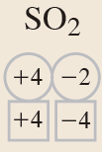
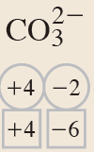
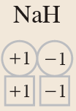
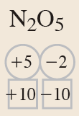
SAMPLE PROBLEM 4.5-2
Solution
a)
c)
b)
d)

Slide 33
4.4 Oxidation-Reduction Reactions 9
Oxidation of Metals in Aqueous Solutions
Cu(s) + ZnCl₂(aq)⟶no reaction
No reaction occurs between Cu(s) and Zn²⁺(aq), whereas a reaction does occur between Zn(s) and Cu²⁺(aq) because zinc is more easily oxidized than copper.

Slide 34
4.4 Oxidation-Reduction Reactions 10
Oxidation of Metals in Aqueous Solutions
TABLE 4.6 Activity Series
Element | Oxidation Half-Reaction
Lithium | Li →Li⁺ + e⁻
Potassium | K→K⁺ + e⁻
Barium | Ba→Ba²⁺ + 2e⁻
Calcium | Ca→Ca²⁺ + 2e⁻
Sodium | Na→Na⁺ + e⁻
Magnesium | Mg→Mg²⁺ + 2e⁻
Aluminum | Al→Al³⁺ + 3e⁻
Manganese | Mn→Mn²⁺ + 2e⁻
Zinc | Zn→Zn²⁺ + 2e⁻
Chromium | Cr→Cr³⁺ + 3e⁻
Iron | Fe→Fe²⁺ + 2e⁻
Cadmium | Cd→Cd²⁺ + 2e⁻
Cobalt | Co→Co²⁺ + 2e⁻
Nickel | Ni→Ni²⁺ + 2e⁻
Tin | Sn→Sn²⁺ + 2e⁻
Lead | Pb→Pb²⁺ + 2e⁻
Hydrogen | H2→2H⁺ + 2e⁻
Copper | Cu→Cu²⁺ + 2e⁻
Silver | Ag→Ag⁺ + e⁻
Mercury | Hg→Hg²⁺ + 2e⁻
Platinum | Pt→Pt²⁺ + 2e⁻
Gold | Au→Au³⁺ + 3e⁻
Increasing ease of oxidation

Slide 35
4.4 Oxidation-Reduction Reactions 11
Oxidation of Metals in Aqueous Solutions
Metals listed at the top of the activity series are called the active metals.
Metals at the bottom of the series, such as copper, silver, platinum, and gold, are called the noble metals because they have very little tendency to react.
Reactions in which hydrogen ion is reduced to hydrogen gas are known as hydrogen displacement reactions.

Slide 36
4.4 Oxidation-Reduction Reactions 12
Balancing Simple Redox Equations

Slide 37
4.4 Oxidation-Reduction Reactions 13
Balancing Simple Redox Equations
This method is known as the half-reaction method of balancing redox equations.

Slide 38
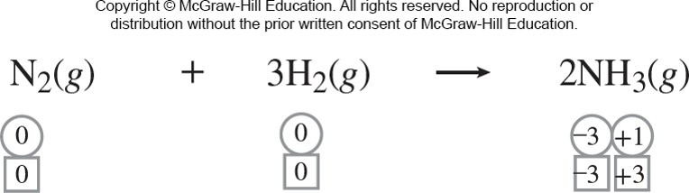
4.4 Oxidation-Reduction Reactions 14
Other Types of Redox Reactions
Combination Reactions
Combination reactions such as the formation of ammonia from its constituent elements can involve oxidation and reduction.
Access the text alternative for these images

Slide 39
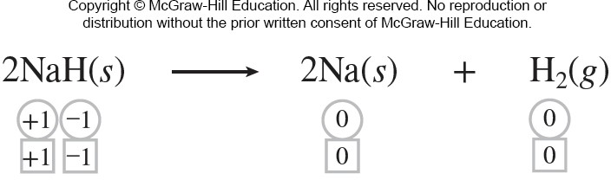
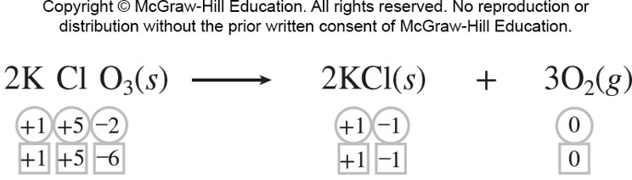
4.4 Oxidation-Reduction Reactions 15
Other Types of Redox Reactions
Decomposition
Decomposition can also be a redox reaction, as illustrated by the following examples:
Access the text alternative for these images

Slide 40
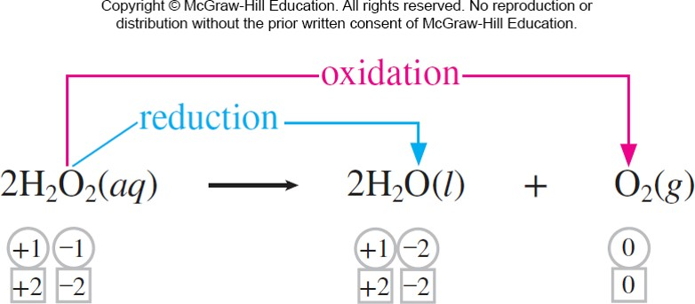
4.4 Oxidation-Reduction Reactions 16
Other Types of Redox Reactions
The decomposition of hydrogen peroxide is an example of a disproportionation reaction, in which one element undergoes both oxidation and reduction.
Access the text alternative for these images

Slide 41
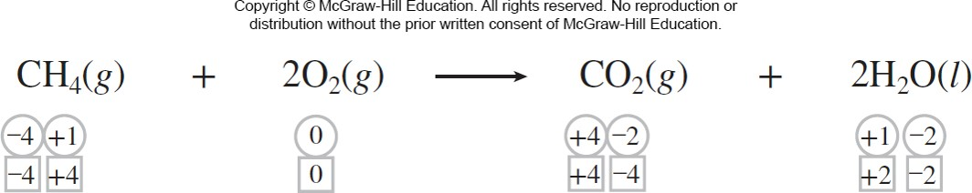
4.4 Oxidation-Reduction Reactions 17
Other Types of Redox Reactions
Combustion is a redox process.
Access the text alternative for these images

Slide 42
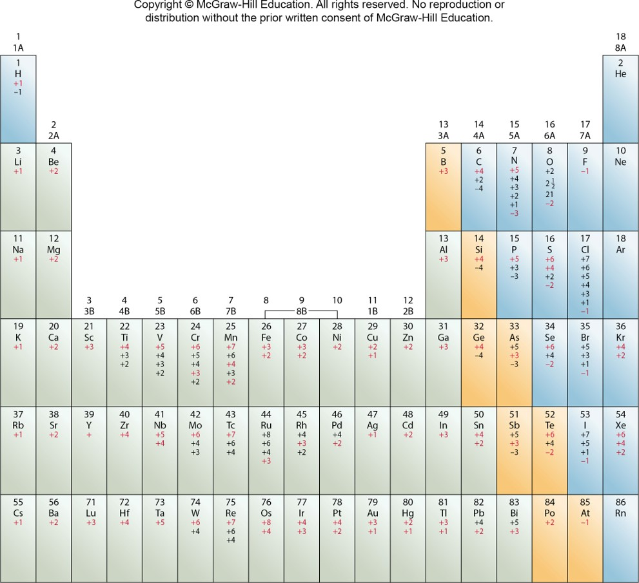
4.4 Oxidation-Reduction Reactions 18

Slide 43
4.5 Concentration of Solutions 3
Molarity
Molarity, or molar concentration, symbolized M, is defined as the number of moles of solute per liter of solution.

Slide 44
SAMPLE PROBLEM 4.8(1)
For an aqueous solution of glucose (C₆H₁₂O₆), determine
the Molarity of 2.00 L of a solution that contains 50.0 g of glucose,
the volume of this solution that would contain 0.250 mol of glucose, and
the number of moles of glucose in 0.500 L of this solution.
Strategy
Convert the mass of glucose given to moles, and use the equations for interconversions of M, liters, and moles to calculate the answers.

Slide 45
SAMPLE PROBLEM 4.8(2)
Setup
The molar mass of glucose is 180.2 g.
Solution

Slide 46
4.5 Concentration of Solutions 4
Dilution
Dilution is the process of preparing a less concentrated solution from a more concentrated one.
moles of solute before Dilution = moles of solute after Dilution
M_{c} × L_{c} = M_{d} × L_{d}
M_{c} × mL_{c} = M_{d} × mL_{d}
millimoles (mmol)

Slide 47
SAMPLE PROBLEM 4.9(1)
What volume of 12.0 M HCl, a common laboratory stock solution, must be used to prepare 250.0 mL of 0.125 M HCl?
Strategy
Use M_{c} × mL_{c} = M_{d} × mL_{d} to determine the volume of 12.0 M HCl required for the Dilution.
Setup
M_{c} = 12.0 M, M_{d} = 0.125 M, mL_{d} = 250.0 mL

Slide 48
SAMPLE PROBLEM 4.9(2)
Solution
12.0 M × mL_{C} = 0.125 M × 250.0 mL

Slide 49
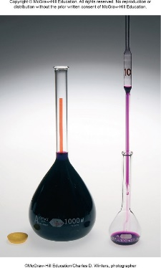
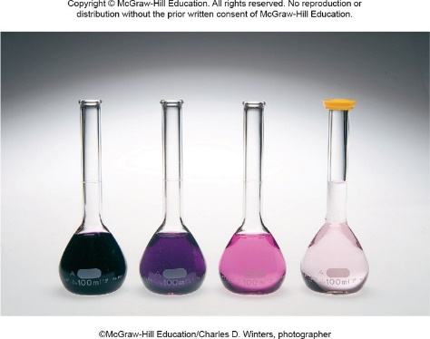
4.5 Concentration of Solutions 5
Serial Dilution
Access the text alternative for these images
©McGraw-Hill Education/ Charles D. Winters, photographer

Slide 50
SAMPLE PROBLEM 4.10(1)
Starting with a 2.00-M stock solution of hydrochloric acid, four standard solutions (1 to 4) are prepared by sequentially diluting 10.00 mL of each solution to 250.00 mL. Determine
(a) the concentrations of all four standard solutions and
(b) the number of moles of HCl in each solution.
Setup
(b) mol = M × L, 250.00 mL = 2.500 × 10⁻¹ L

Slide 51
SAMPLE PROBLEM 4.10(2)
Solution

Slide 52
SAMPLE PROBLEM 4.10(3)
Solution
mol₁ = 8.00 × 10⁻² M × 2.500 × 10⁻¹ L = 2.00 × 10⁻² mol
mol₂ = 3.20 × 10⁻³ M × 2.500 × 10⁻¹ L = 8.00 × 10⁻⁴ mol
mol₃ = 1.28 × 10⁻⁴ M × 2.500 × 10⁻¹ L = 3.20 × 10⁻⁵ mol
mol₄ = 5.12 × 10⁻⁶ M × 2.500× 10⁻¹ L = 1.28 × 10⁻⁶ mol

Slide 53
4.5 Concentration of Solutions 6
Solution Stoichiometry
Therefore, a solution that is 0.35 M in Na₂SO₄ is actually
0.70 M in Na⁺ and 0.35 M in SO₄²⁻.
Square brackets around a chemical species can be read as “the concentration of” that species. For example, [Na⁺] is read as “the concentration of sodium ion.”

Slide 54
4.6 Aqueous Reactions and Chemical Analysis 2
Acid-Base Titrations
In titration, a solution of accurately known concentration, called a standard solution, is added gradually to another solution of unknown concentration, until the chemical reaction between the two solutions is complete.
If we know the volumes of the standard and unknown solutions used in the titration, along with the concentration of the standard solution, we can calculate the concentration of the unknown solution.

Slide 55
4.6 Aqueous Reactions and Chemical Analysis 3
Acid-Base Titrations
A solution of the strong base sodium hydroxide can be used as the standard solution in a titration, but it must first be standardized, because sodium hydroxide in solution reacts with carbon dioxide in the air, making its concentration unstable over time.
We can standardize the sodium hydroxide solution by titrating it against an acid solution of accurately known concentration.

Slide 56
4.6 Aqueous Reactions and Chemical Analysis 6
Acid-Base Titrations
The point in the titration where the acid has been completely neutralized is called the equivalence point.
It is usually signaled by the endpoint, where an indicator causes a sharp change in the color of the solution. In acid-base titrations, indicators are substances that have distinctly different colors in acidic and basic media.

Slide 57
SAMPLE PROBLEM 4.13(1)
In a titration experiment, a student finds that 25.49 mL of an NaOH solution is needed to neutralize 0.7137 g of KHP. What is the concentration (in M) of the NaOH solution?
Setup
The molar mass of KHP (KHC₈H₄O₄) =
[39.1 g + 5(1.008 g) + 8(12.01 g) + 4(16.00 g)] = 204.2 g/mol.

Slide 58
SAMPLE PROBLEM 4.13(2)
Solution
Because moles of KHP = moles of NaOH, then moles of
NaOH = 0.003495 mol.

Slide 59
SAMPLE PROBLEM 4.14(1)
What volume (in mL) of a 0.203 M NaOH solution is needed to neutralize 25.0 mL of a 0.188 M H₂SO₄ solution?
Strategy
2NaOH (aq) + H₂SO₄ (aq) → 2H₂O(l) + Na₂SO₄ (aq)
Setup

Slide 60
SAMPLE PROBLEM 4.14(2)
Solution
millomoles of H₂SO₄ = 0.188 M × 25.0 mL = 4.70 mmol

Slide 61
SAMPLE PROBLEM 4.15(1)
A 0.1216-g sample of a monoprotic acid is dissolved in 25 mL water, and the resulting solution is titrated with 0.1104 M NaOH solution. A 12.5-mL volume of the base is required to neutralize the acid. Calculate the molar mass of the acid.
Strategy
Using the concentration and volume of the base, we can determine the number of moles of base required to neutralize the acid.
We then determine the number of moles of acid and divide the mass of the acid by the number of moles to get molar mass.

Slide 62
SAMPLE PROBLEM 4.15(2)
Setup
Because the acid is monoprotic, it will react in a 1:1 ratio with the base; therefore, the number of moles of acid will be equal to the number of moles of base. The volume of base in liters is 0.0125 L.
Solution
moles of base = 0.0125 L × 0.1104 mol/L = 0.00138

