Slide 1
Chemistry
Fifth Edition
Julia Burdge
Lecture PowerPoints
Chapter 6
Quantum Theory and the Electronic Structure of Atoms
©2020 McGraw-Hill Education. All rights reserved. Authorized only for instructor use in the classroom. No reproduction or further distribution permitted without the prior written consent of McGraw-Hill Education.

Slide 2
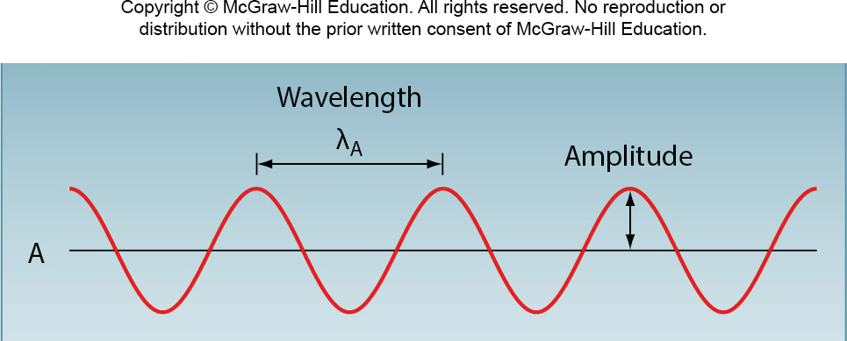
6.1 The Nature of Light 2
Properties of Waves
Wavelength λ (lambda) is the distance between identical points on successive waves (for example, successive peaks or successive troughs).

Slide 3
6.1 The Nature of Light 3
Properties of Waves
The frequency ν (nu) is the number of waves that pass through a particular point in 1 second.

Slide 4
6.1 The Nature of Light 4
Properties of Waves
Amplitude is the vertical distance from the midline of a wave to the top of the peak or the bottom of the trough.

Slide 5
6.1 The Nature of Light 5
Properties of Waves
The speed of light through a vacuum, c, is
c = 2.99792458 × 10⁸ m ∕s.
The speed, wavelength, and frequency of a wave are related by the equation
c = λν
where λ and ν are expressed in meters (m) and reciprocal seconds (s⁻¹), respectively.

Slide 6
SAMPLE PROBLEM 6.1 Setup
One type of laser used in the treatment of vascular skin lesions is a neodymium-doped yttrium aluminum garnet or Nd:YAG laser.
The wavelength commonly used in these treatments is 532 nm. What is the frequency of this radiation?
Setup
Solving for frequency gives ν = c/λ.

Slide 7
SAMPLE PROBLEM 6.1 Solution
Solution

Slide 8
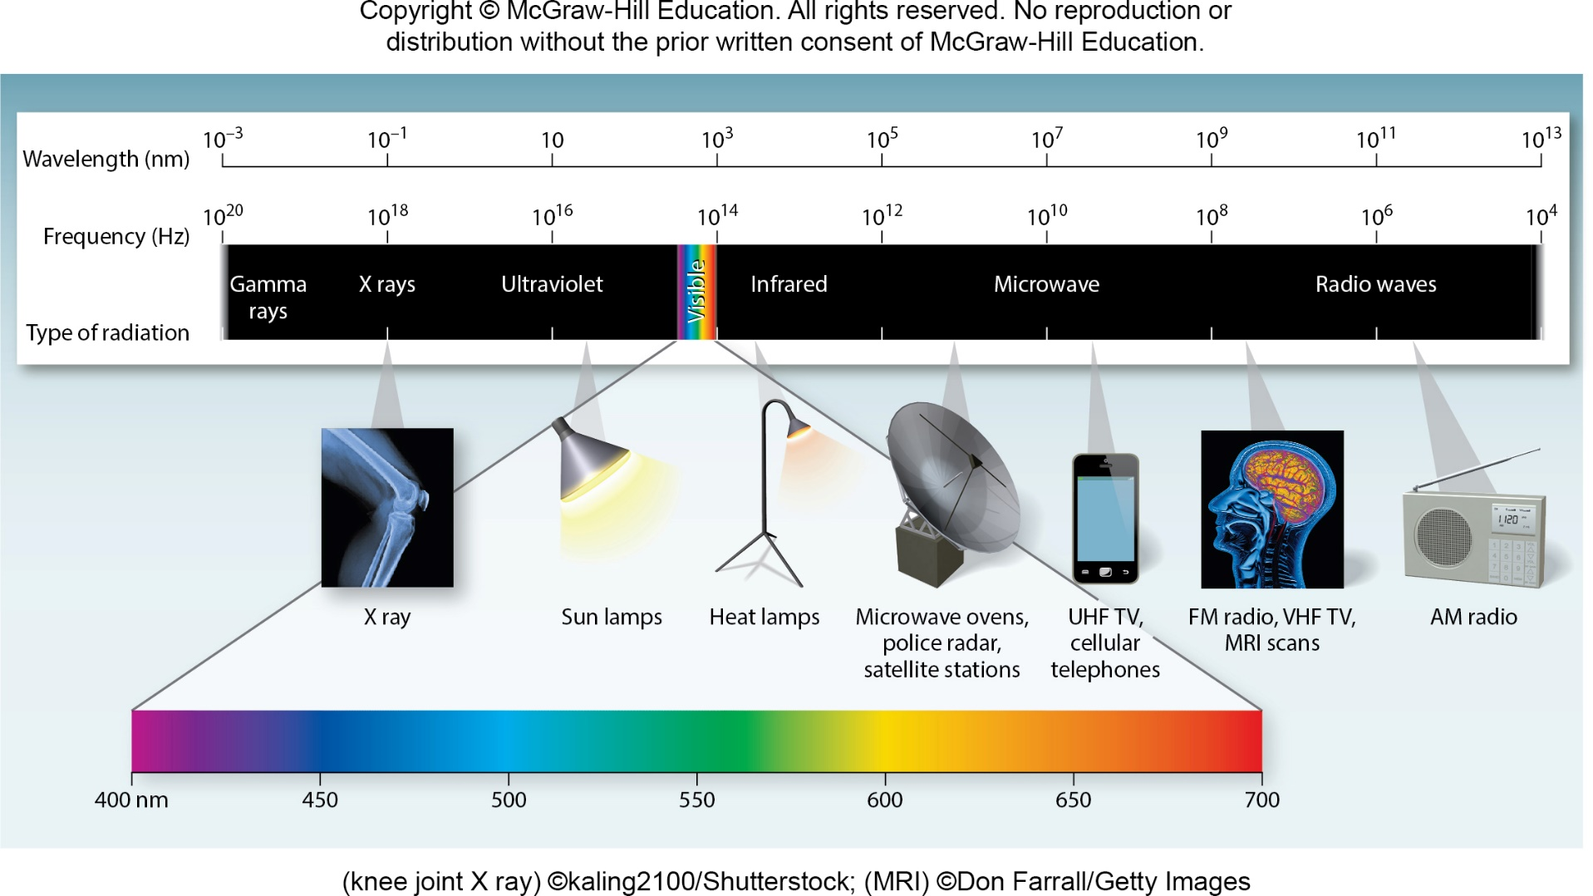
6.1 The Nature of Light 6
Properties of Waves
Access the text alternative for these images
(knee joint X ray) ©kaling2100/Shutterstock; (MRI) ©Don Farrall/Getty Images

Slide 9
6.2 Quantum Theory 2
Quantization of Energy
Planck gave the name quantum to the smallest quantity of energy that can be emitted (or absorbed) in the form of electromagnetic radiation.
The energy E of a single quantum of energy is given by
E = hν
where h is called Planck’s constant and is the frequency of the radiation.
The value of Planck’s constant is 6.63 × 10⁻³⁴ J ∙ s.

Slide 10
SAMPLE PROBLEM 6.2 Setup
How much more energy per photon is there in green light of wavelength 532 nm than in red light of wavelength 635 nm?
Setup

Slide 11
SAMPLE PROBLEM 6.2 Solution 1
Solution
The energy of a single photon with wavelength 532 nm is 3.74 × 10⁻¹⁹ J.
Following the same procedure, the energy of a photon of wavelength 635 nm is 3.13 × 10⁻¹⁹ J.

Slide 12
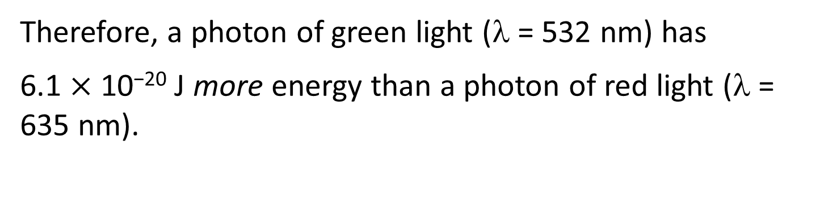
SAMPLE PROBLEM 6.2 Solution 2
Solution
The difference between them is
Therefore, a photon of green light (λ = 532 nm) has
6.1 × 10⁻²⁰ J more energy than a photon of red light (λ = 635 nm).

Slide 13
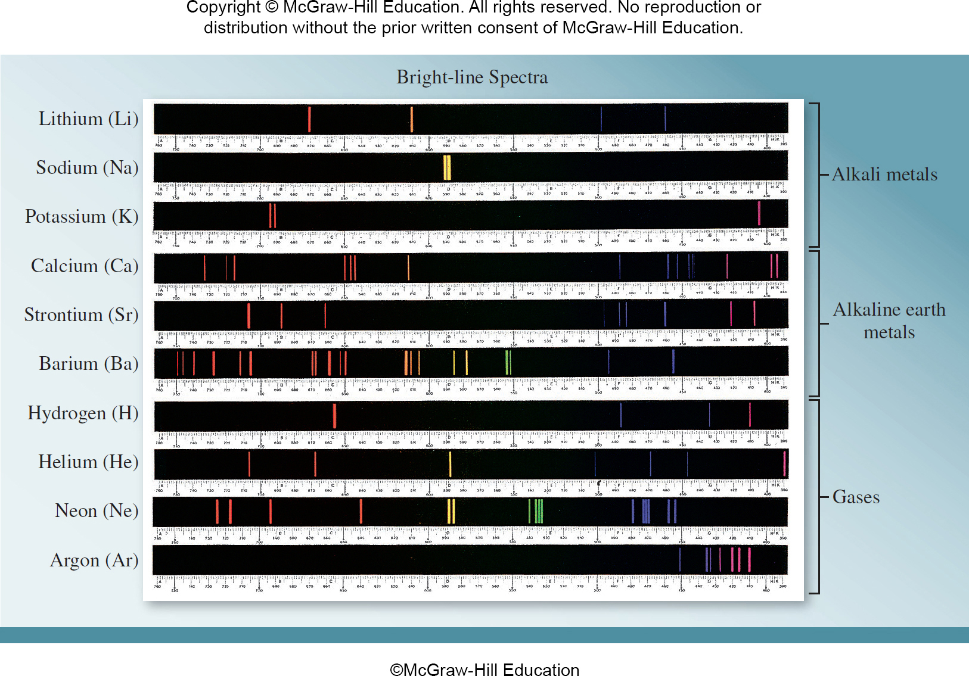
6.3 Bohr’s Theory of the Hydrogen Atom 3
©McGraw-Hill Education

Slide 14
6.3 Bohr’s Theory of the Hydrogen Atom 4
Atomic Line Spectra
Johannes Rydberg developed an equation that could calculate all the wavelengths of hydrogen’s spectral lines:
In this equation, now known as the Rydberg equation, λ is the wavelength of a line in the spectrum; R∞ is the Rydberg constant (1.09737316 ×10⁷ m⁻¹); and n₁ and n₂ are positive integers, where n₂ > n₁.

Slide 15
6.3 Bohr’s Theory of the Hydrogen Atom 5
The Line Spectrum of Hydrogen
According to the laws of classical physics, an electron moving in an orbit of a hydrogen atom would radiate away energy in the form of electromagnetic waves.
Thus, such an electron would quickly spiral into the nucleus and annihilate itself with the proton.

Slide 16
6.3 Bohr’s Theory of the Hydrogen Atom 6
The Line Spectrum of Hydrogen
Bohr postulated that the electron in atomic hydrogen is allowed to occupy only certain orbits of specific energies.
In other words, the energies of the electron are quantized.
An electron in any of the allowed orbits will not radiate energy and therefore will not spiral into the nucleus.

Slide 17
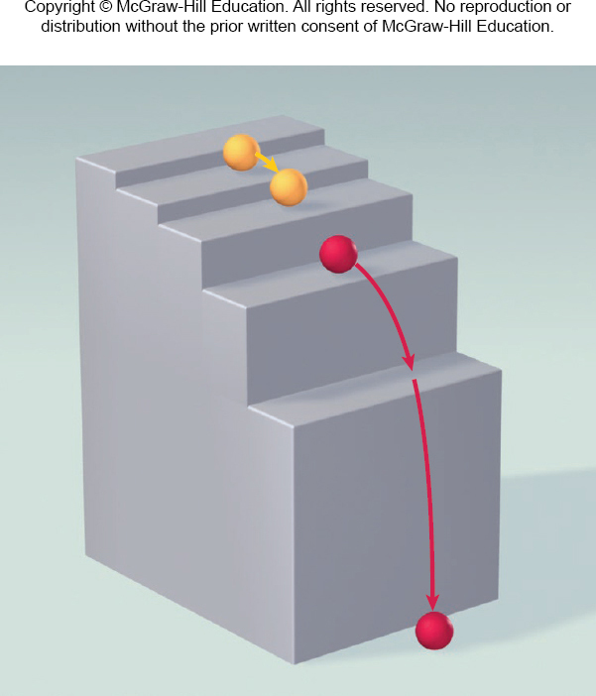
6.3 Bohr’s Theory of the Hydrogen Atom 9
The Line Spectrum of Hydrogen
Conversely, radiant energy (in the form of a photon) is emitted when the electron moves from a higher-energy excited state to a lower-energy excited state or the ground state.

Slide 18
6.3 Bohr’s Theory of the Hydrogen Atom 10
The Line Spectrum of Hydrogen
ΔE = E_{f} − E_{i}

Slide 19
6.3 Bohr’s Theory of the Hydrogen Atom 11
The Line Spectrum of Hydrogen

Slide 20
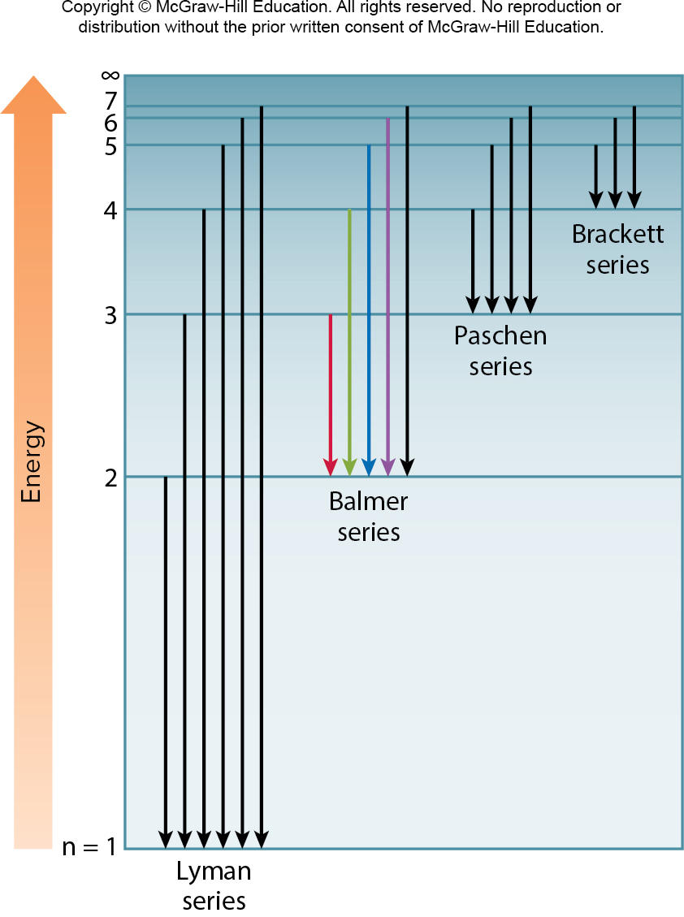
6.3 Bohr’s Theory of the Hydrogen Atom 13

Slide 21
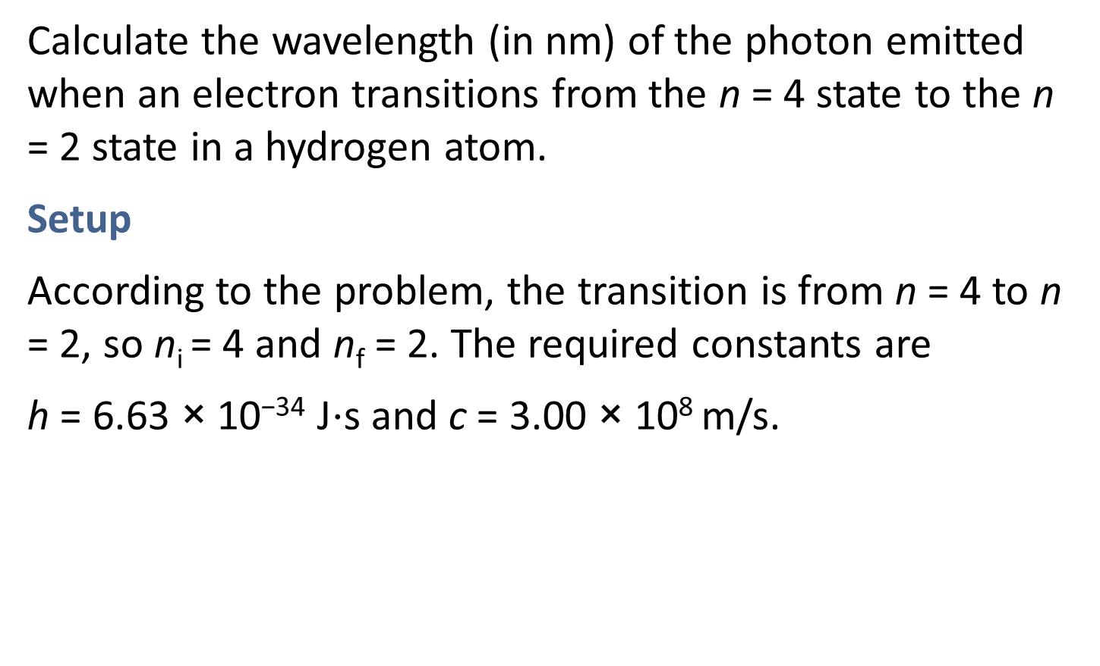
SAMPLE PROBLEM 6.4 Setup
Calculate the wavelength (in nm) of the photon emitted when an electron transitions from the n = 4 state to the n = 2 state in a hydrogen atom.
Setup
According to the problem, the transition is from n = 4 to n = 2, so n_{i} = 4 and n_{f} = 2. The required constants are
h = 6.63 × 10⁻³⁴ J⋅s and c = 3.00 × 10⁸ m/s.

Slide 22
SAMPLE PROBLEM 6.4 Solution
Solution

Slide 23
6.5 Quantum Mechanics 1
The Uncertainty Principle
To describe the problem of trying to locate a subatomic particle that behaves like a wave, Werner Heisenberg formulated what is now known as the Heisenberg uncertainty principle:
It is impossible to know simultaneously both the momentum p and the position x of a particle with certainty. Stated mathematically,

Slide 24
6.5 Quantum Mechanics 3
The Schrödinger Equation
Erwin Schrödinger, using a complex mathematical technique, formulated an equation that describes the behavior and energies of submicroscopic particles in general.
The Schrödinger equation requires advanced calculus to solve, and we will not discuss it here.
The equation, however, incorporates both particle behavior, in terms of mass m, and wave behavior, in terms of a wave function ψ (psi), which depends on the location in space of the system (such as an electron in an atom).

Slide 25
6.5 Quantum Mechanics 4
The Schrödinger Equation
The wave function itself has no direct physical meaning.
However, the probability of finding the electron in a certain region in space is proportional to the square of the wave function, ψ².
The idea of relating ψ² to probability stemmed from a wave theory analogy.

Slide 26
6.5 Quantum Mechanics 5
The Quantum Mechanical Description of the Hydrogen Atom
The Schrödinger equation specifies the possible energy states the electron can occupy in a hydrogen atom and identifies the corresponding wave functions (ψ).
These energy states and wave functions are characterized by a set of quantum numbers (to be discussed shortly), with which we can construct a comprehensive model of the hydrogen atom.

Slide 27

6.5 Quantum Mechanics 6
The Quantum Mechanical Description of the Hydrogen Atom
The square of the wave function, ψ², defines the distribution of electron density in three-dimensional space around the nucleus.
Regions of high electron density represent a high probability of locating the electron.

Slide 28
6.5 Quantum Mechanics 7
The Quantum Mechanical Description of the Hydrogen Atom
To distinguish the quantum mechanical description of an atom from Bohr’s model, we speak of an atomic orbital, rather than an orbit.
An atomic orbital can be thought of as the wave function of an electron in an atom.
When we say that an electron is in a certain orbital, we mean that the distribution of the electron density or the probability of locating the electron in space is described by the square of the wave function associated with that orbital.

Slide 29
6.6 Quantum Numbers
Topics
Principal Quantum Number (n)
Angular Momentum Quantum Number (l)
Magnetic Quantum Number (m_{l})
Electron Spin Quantum Number (m_{s})

Slide 30
6.6 Quantum Numbers 1
Principal Quantum Number (n)
In quantum mechanics, three quantum numbers are required to describe the distribution of electron density in an atom.
These numbers are derived from the mathematical solution of Schrödinger’s equation for the hydrogen atom.

Slide 31
6.6 Quantum Numbers 2
Principal Quantum Number (n)
The principal quantum number (n) designates the size of the orbital. The larger n is, the greater the average distance of an electron in the orbital from the nucleus and therefore the larger the orbital.
n = 1, 2, 3, …

Slide 32
6.6 Quantum Numbers 3
Angular Momentum Quantum Number (l)
The angular momentum quantum number (l) describes the shape of the atomic orbital.
The values of l are integers that depend on the value of the principal quantum number, n.
For a given value of n, the possible values of l range from 0 to n – 1.
l | 0 | 1 | 2 | 3
Orbital designation | s | p | d | f

Slide 33
6.6 Quantum Numbers 4
Angular Momentum Quantum Number (l)
A collection of orbitals with the same value of n is frequently called a shell.
One or more orbitals with the same n and l values are referred to as a subshell.
For example, the shell designated by n = 2 is composed of two subshells: l = 0 and l = 1 (the allowed values of l
for n = 2).
These subshells are called the 2s and 2p subshells where 2 denotes the value of n, and s and p denote the values of l.

Slide 34
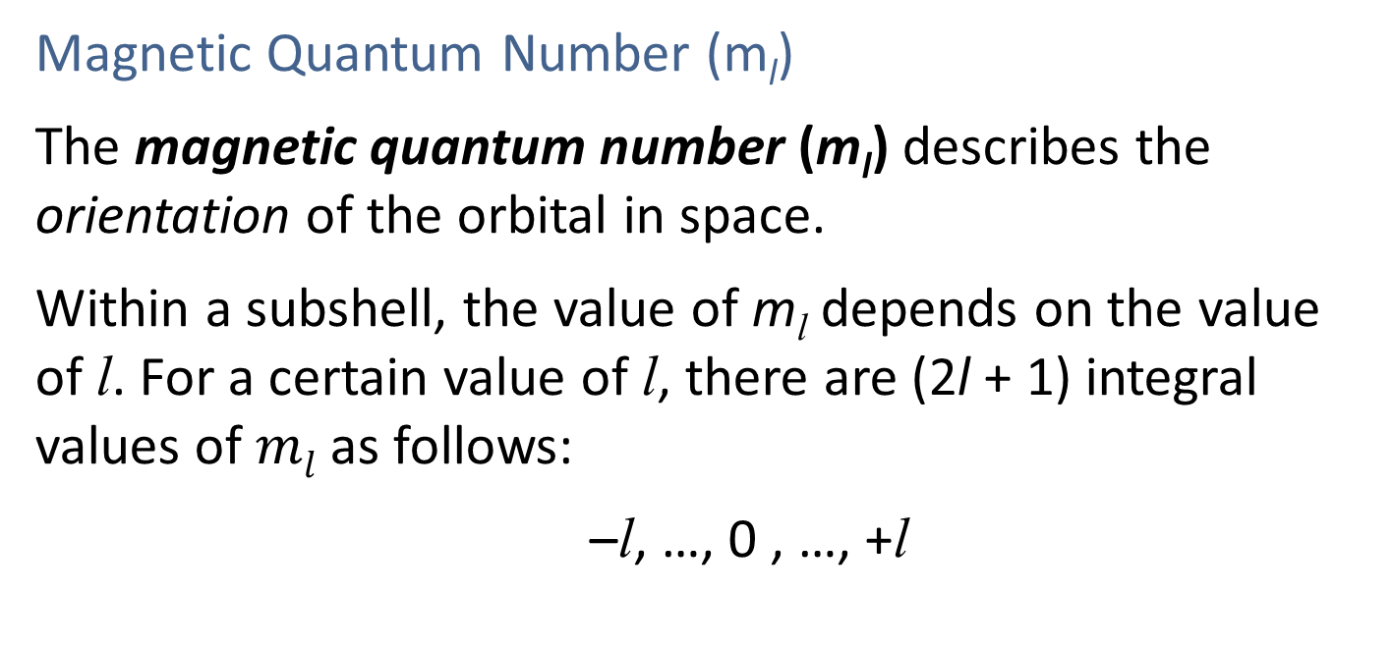
6.6 Quantum Numbers 5
Magnetic Quantum Number (m_{l})
The magnetic quantum number (m_{l}) describes the orientation of the orbital in space.
Within a subshell, the value of m_{l} depends on the value of l. For a certain value of l, there are (2l + 1) integral values of $ml$ as follows:
–l, …, 0 , …, +l

Slide 35
6.6 Quantum Numbers 6
TABLE 6.2 Allowed values of the Quantum Numbers n, l, and m_{l}
When n is | l can be | When l is | m_{l} can be
1 | Only 0 | 0 | Only 0
2 | 0 or 1 | 0 | Only 0
 |  | 1 | -1, 0, or +1
3 | 0, 1, or 2 | 0 | Only 0
 |  | 1 | -1, 0, or +1
 |  | 2 | -2,-1, 0, +1, or +2
4 | 0, 1, 2,or 3 | 0 | Only 0
 |  | 1 | -1, 0, or +1
 |  | 2 | -2,-1, 0, +1,or +2
 |  | 3 | -3,-2,-1,0,+1,+2,or +3
. | . | . | .
. | . | . | .
. | . | . | .

Slide 36
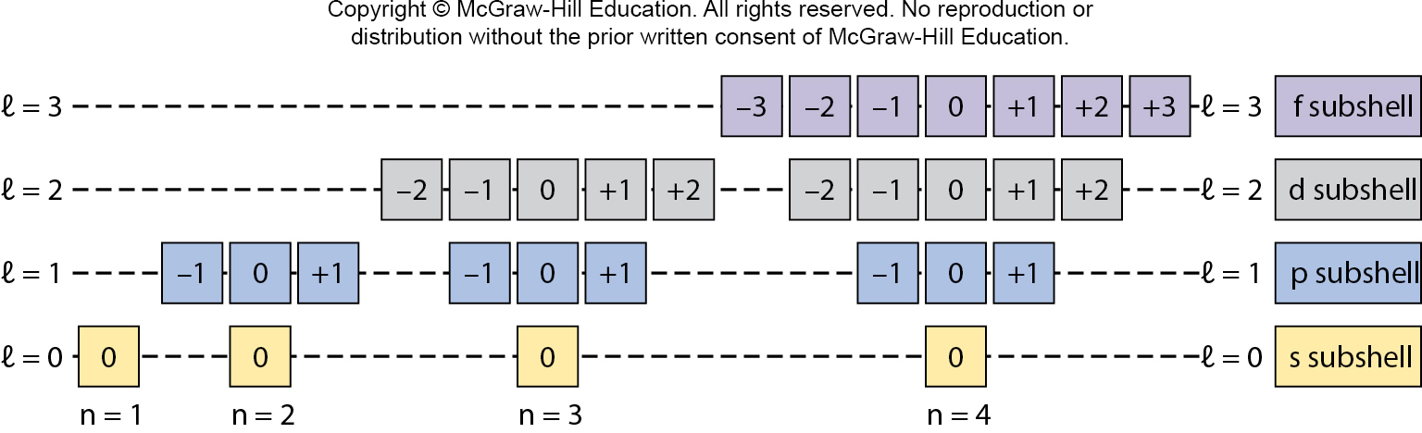
6.6 Quantum Numbers 7
Magnetic Quantum Number (m_{l})

Slide 37
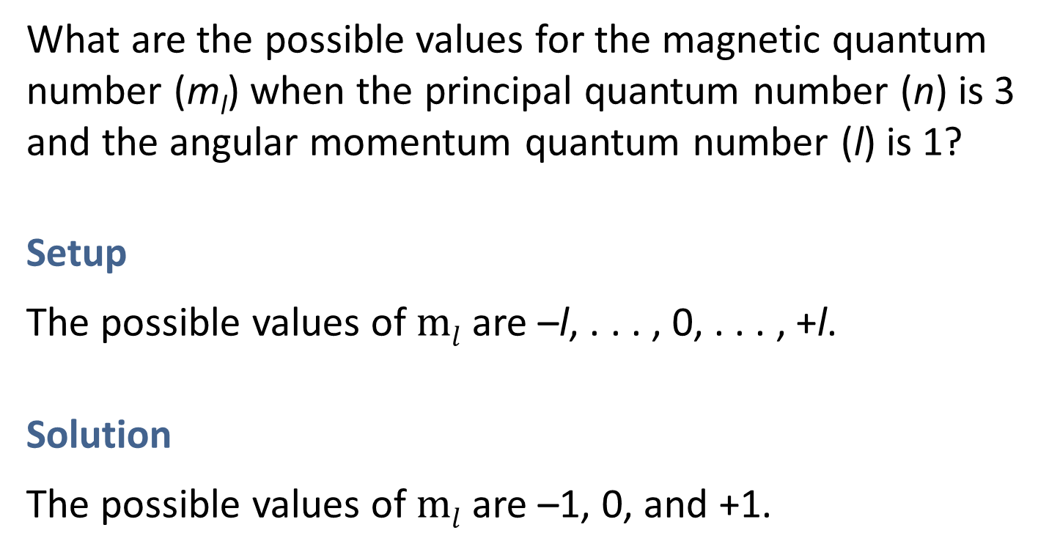
SAMPLE PROBLEM 6.7 Setup
What are the possible values for the magnetic quantum number (m_{l}) when the principal quantum number (n) is 3 and the angular momentum quantum number (l) is 1?
Setup
The possible values of $ml$ are –l, . . . , 0, . . . , +l.
Solution
The possible values of $ml$ are –1, 0, and +1.

Slide 38
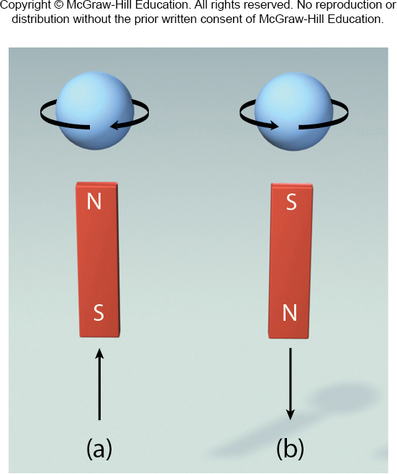
6.6 Quantum Numbers 8
Electron Spin Quantum Number (m_{s})
Whereas three quantum numbers are sufficient to describe an atomic orbital, an additional quantum number becomes necessary to describe an electron that occupies the orbital.
Electrons possess a magnetic field, as if they were spinning.

Slide 39
6.6 Quantum Numbers 9
Electron Spin Quantum Number (m_{s})
To specify the electron’s spin, we use the electron spin quantum number (m_{s}).
Because there are two possible directions of spin, opposite each other, m_{s} has two possible values: +1/2 and –1/2.
Two electrons in the same orbital with opposite spins are referred to as “paired.”

Slide 40
6.6 Quantum Numbers 10
Electron Spin Quantum Number (m_{s})
To summarize, we can designate an orbital in an atom with a set of three quantum numbers.
These three quantum numbers indicate the size (n), shape (l), and orientation (m_{l}) of the orbital.
A fourth quantum number (m_{s}) is necessary to designate the spin of an electron in the orbital.

Slide 41
6.7 Atomic Orbitals
Topics
s Orbitals
p Orbitals
d Orbitals and Other Higher-Energy Orbitals
Energies of Orbitals

Slide 42
6.7 Atomic Orbitals 1
s Orbitals
For any value of the principal quantum number (n), the value 0 is possible for the angular momentum quantum number (l), corresponding to an s subshell.
Furthermore, when l = 0, the magnetic quantum number (m_{l}) has only one possible value, 0, corresponding to an s orbital.
Therefore, there is an s subshell in every shell, and each s subshell contains just one orbital, an s orbital.

Slide 43
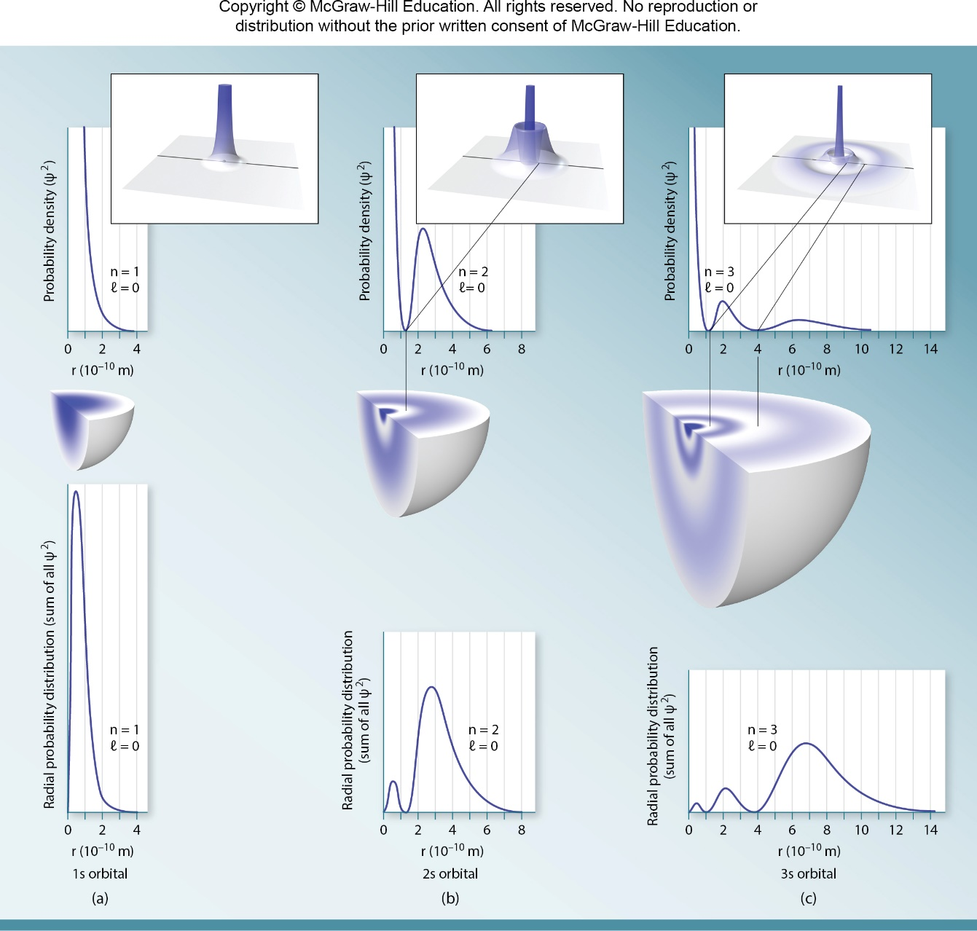
6.7 Atomic Orbitals 2

Slide 44
6.7 Atomic Orbitals 3
s Orbitals
All s orbitals are spherical in shape but differ in size, which increases as the principal quantum number increases.

Slide 45
6.7 Atomic Orbitals 4
p Orbitals
When the principal quantum number (n) is 2 or greater, the value 1 is possible for the angular momentum quantum number (l), corresponding to a p subshell.
And, when l = 1, the magnetic quantum number (m_{l}) has three possible values: –1, 0, and +1, each corresponding to a different p orbital.

Slide 46
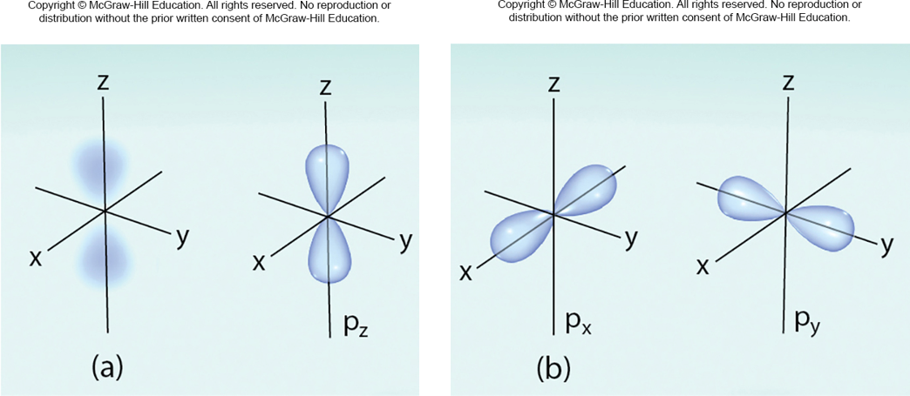
6.7 Atomic Orbitals 5
p Orbitals
Therefore, there is a p subshell in every shell for which
n ≥ 2, and each p subshell contains three p orbitals.
These three p orbitals are labeled p_{x} , p_{y} , and p_{z} .
Access the text alternative for these images

Slide 47
6.7 Atomic Orbitals 6
p Orbitals
These three p orbitals are identical in size, shape, and energy; they differ from one another only in orientation.
Like s orbitals, p orbitals increase in size from 2p to 3p to 4p orbital and so on.

Slide 48
6.7 Atomic Orbitals 7
d Orbitals and Other Higher-Energy Orbitals
When the principal quantum number (n) is 3 or greater, the value 2 is possible for the angular momentum quantum number (l), corresponding to a d subshell.
When l = 2, the magnetic quantum number (m_{l}) has five possible values, –2, –1, 0, +1, and +2, each corresponding to a different d orbital.

Slide 49
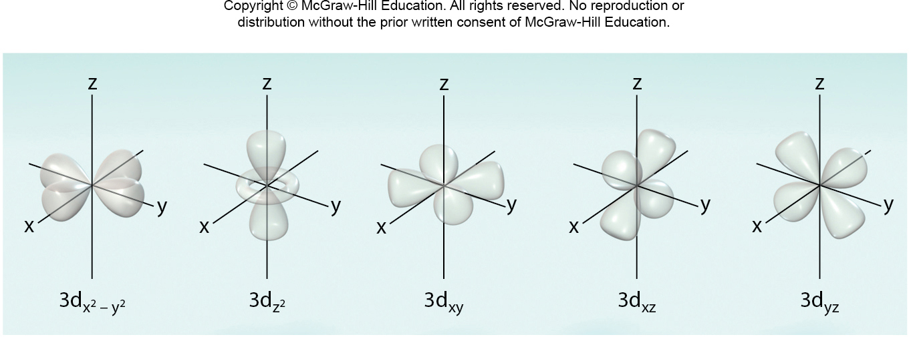
6.7 Atomic Orbitals 8
d Orbitals and Other Higher-Energy Orbitals

Slide 50
6.7 Atomic Orbitals 9
d Orbitals and Other Higher-Energy Orbitals
All the 3d orbitals in an atom are identical in energy and are labeled with subscripts denoting their orientation with respect to the x, y, and z axes and to the planes defined by them.
The d orbitals that have higher principal quantum numbers (4d, 5d, etc.) have shapes similar to those shown for the 3d orbitals .

Slide 51
6.8 Electron Configuration 1
Energies of Atomic Orbitals in Many-Electron Systems
The hydrogen atom is a particularly simple system because it contains only one electron.
The electron may reside in the 1s orbital (the ground state), or it may be found in some higher-energy orbital (an excited state).
With many-electron systems, we need to know the ground-state electron configuration—that is, how the electrons are distributed in the various atomic orbitals.

Slide 52
6.8 Electron Configuration 2
Energies of Atomic Orbitals in Many-Electron Systems
To do this, we need to know the relative energies of atomic orbitals in a many-electron system, which differ from those in a one-electron system such as hydrogen.
In many-electron atoms, electrostatic interactions cause the energies of the orbitals in a shell to split.

Slide 53
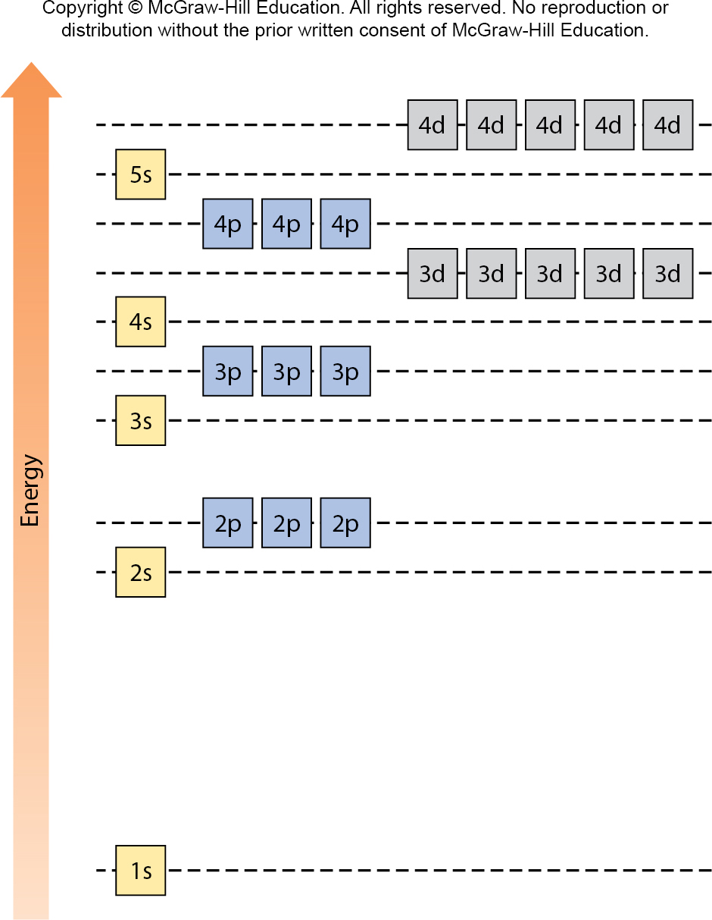
6.8 Electron Configuration 3

Slide 54
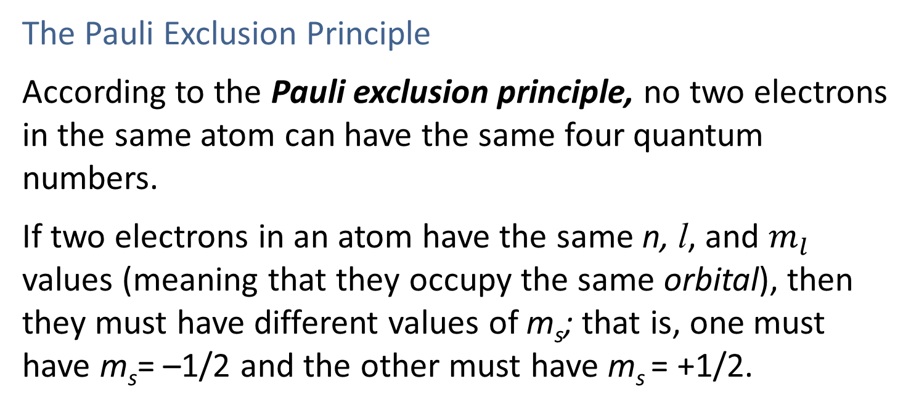
6.8 Electron Configuration 4
The Pauli Exclusion Principle
According to the Pauli exclusion principle, no two electrons in the same atom can have the same four quantum numbers.
If two electrons in an atom have the same n, l, and $m_{l}$ values (meaning that they occupy the same orbital), then they must have different values of m_{s}; that is, one must have m_{s}= –1/2 and the other must have m_{s} = +1/2.

Slide 55
6.8 Electron Configuration 5
The Pauli Exclusion Principle
Because there are only two possible values for m_{s} , and no two electrons in the same orbital may have the same value for m_{s} , a maximum of two electrons may occupy an atomic orbital, and these two electrons must have opposite spins.
Two electrons in the same orbital with opposite spins are said to have paired spins.

Slide 56
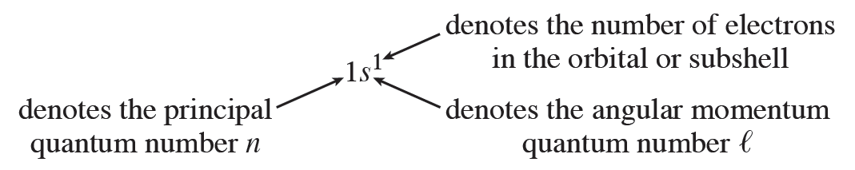
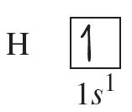
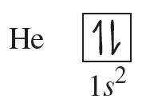
6.8 Electron Configuration 6
The Pauli Exclusion Principle
Orbital Notation and Orbital Diagrams

Slide 57
6.8 Electron Configuration 7
The Aufbau Principle
We can continue the process of writing electron configurations for elements based on the order of orbital energies and the Pauli exclusion principle.
This process is based on the Aufbau principle, which makes it possible to “build” the periodic table of the elements and determine their electron configurations by steps.
Each step involves adding one proton to the nucleus and one electron to the appropriate atomic orbital.

Slide 58
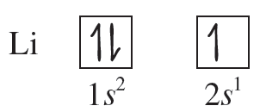
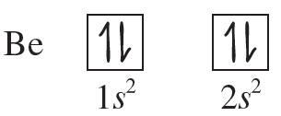
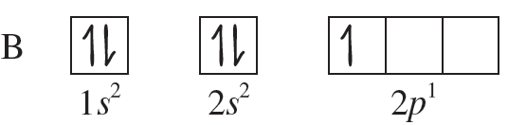
6.8 Electron Configuration 8
The Aufbau Principle
1s²2s¹
1s²2s²
1s²2s²2p¹

Slide 59
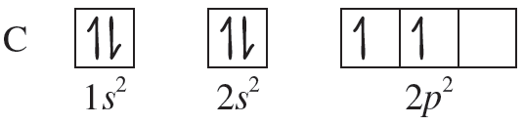
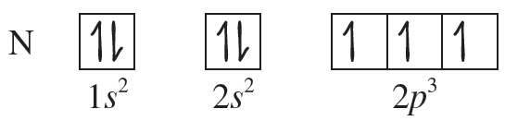
6.8 Electron Configuration 9
Hund’s Rule
According to Hund’s rule, the most stable arrangement of electrons in orbitals of equal energy is the one in which the number of electrons with the same spin is maximized.
1s²2s²2p²
1s²2s²2p³

Slide 60
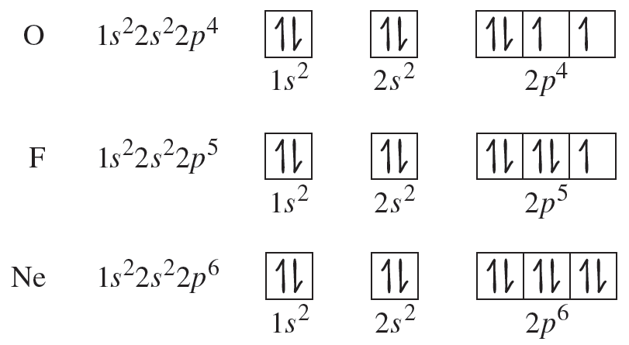
6.8 Electron Configuration 10
Hund’s Rule

Slide 61
6.8 Electron Configuration 11
General Rules for Writing Electron Configurations
Electrons will reside in the available orbitals of the lowest possible energy.
Each orbital can accommodate a maximum of two electrons.
Electrons will not pair in degenerate orbitals if an empty orbital is available.
Orbitals will fill in the order indicated in the following figure.

Slide 62
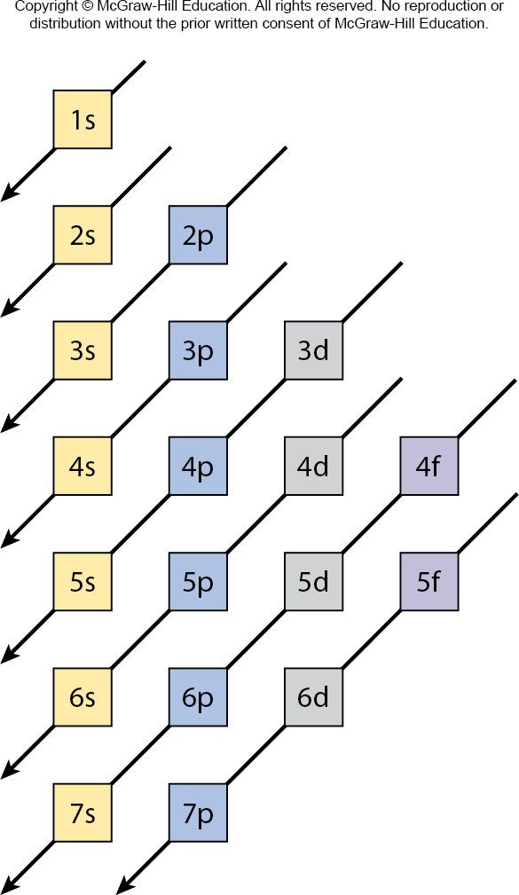
6.8 Electron Configuration 12
Access the text alternative for these images

Slide 63
SAMPLE PROBLEM 6.9 Strategy
Write the electron configuration and give the orbital diagram of a calcium (Ca) atom (Z = 20).
Strategy
Use the general rules given and the Aufbau principle to “build” the electron configuration of a calcium atom and represent it with an orbital diagram.
Setup
Because Z = 20, we know that a Ca atom has 20 electrons.

Slide 64
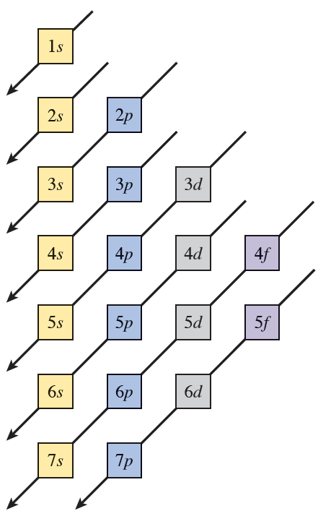
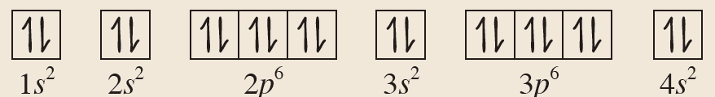
SAMPLE PROBLEM 6.9 Solution
Solution
Ca 1s² 2s² 2p⁶ 3s² 3p⁶ 4s²
Access the text alternative for these images

Slide 65
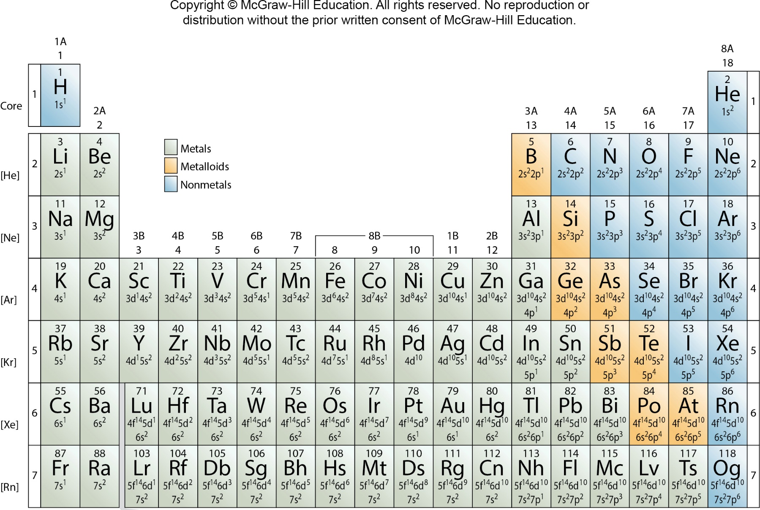
6.9 Electron Configurations and the Periodic Table 2

Slide 66
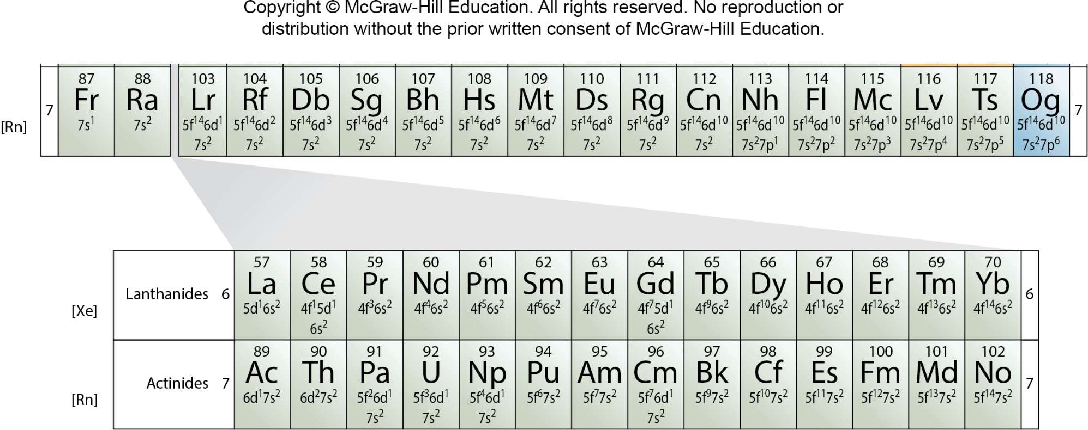
6.9 Electron Configurations and the Periodic Table 3

Slide 67
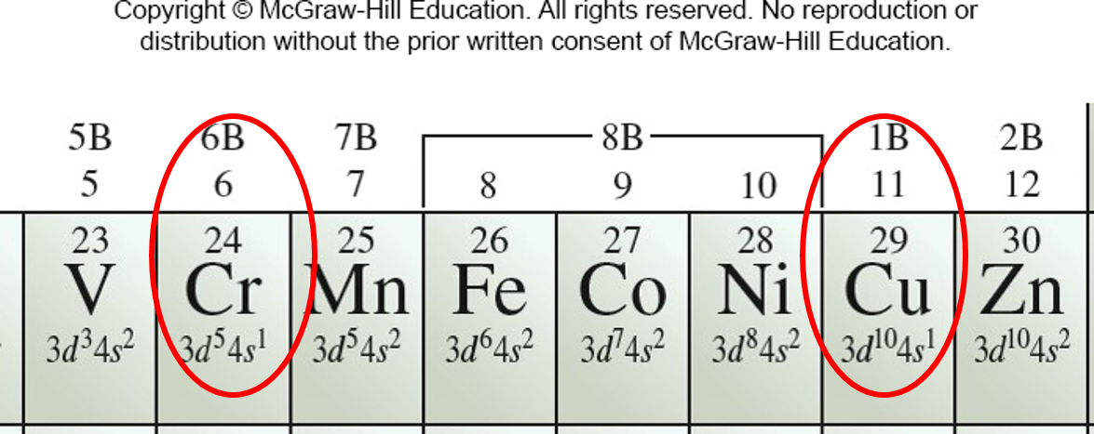
6.9 Electron Configurations and the Periodic Table 4
Electron Configurations and the Periodic Table
Anomalies

Slide 68
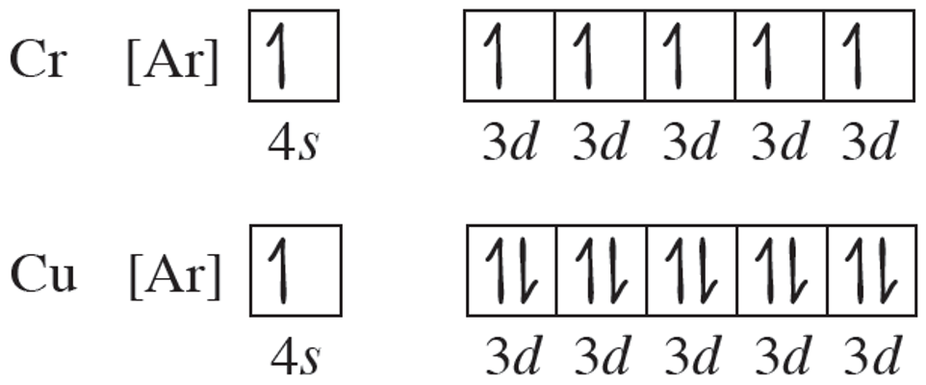
6.9 Electron Configurations and the Periodic Table 5
Electron Configurations and the Periodic Table
Anomalies
The reason for these anomalies is that a slightly greater stability is associated with the half-filled (3d⁵) and completely filled (3d¹⁰) subshells.

