Slide 1
Chemistry
Fifth Edition
Julia Burdge
Lecture PowerPoints
Chapter 9
Chemical Bonding II: Molecular Geometry and Bonding Theories
©2020 McGraw-Hill Education. All rights reserved. Authorized only for instructor use in the classroom. No reproduction or further distribution permitted without the prior written consent of McGraw-Hill Education.

Slide 2
9.1 Molecular Geometry 2
The VSEPR Model
The basis of the VSEPR model is that electron pairs in the valence shell of an atom repel one another.
For clarity, we will refer to electron domains instead of electron pairs when we use the VSEPR model.
An electron domain in this context is a lone pair or a bond, regardless of whether the bond is single, double, or triple.

Slide 3
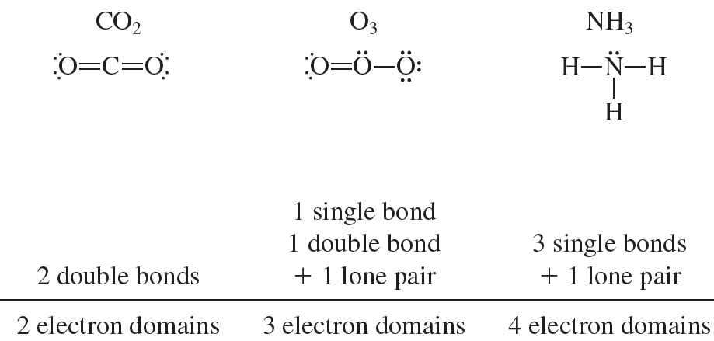
9.1 Molecular Geometry 3
The VSEPR Model
Access the text alternative for these images

Slide 4
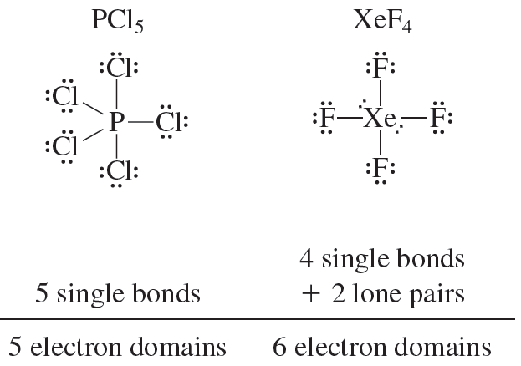
9.1 Molecular Geometry 4
The VSEPR Model

Slide 5
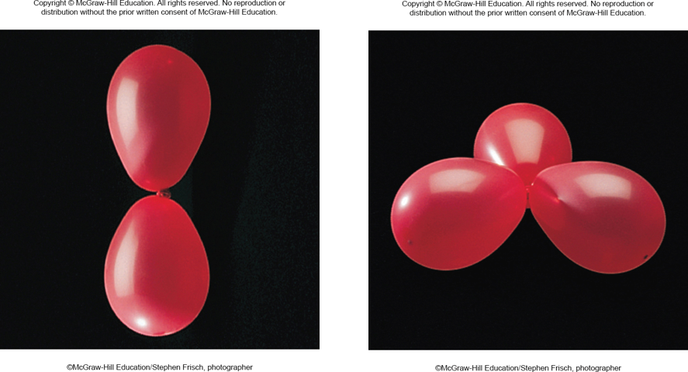
9.1 Molecular Geometry 5
The VSEPR Model
The VSEPR model predicts that because these electron domains repel one another, they will arrange themselves to be as far apart as possible, thus minimizing the repulsive interactions between them.
©McGraw-Hill Education/Stephen Frisch, photographer

Slide 6



9.1 Molecular Geometry 6
The VSEPR Model
©McGraw-Hill Education/Stephen Frisch, photographer

Slide 7
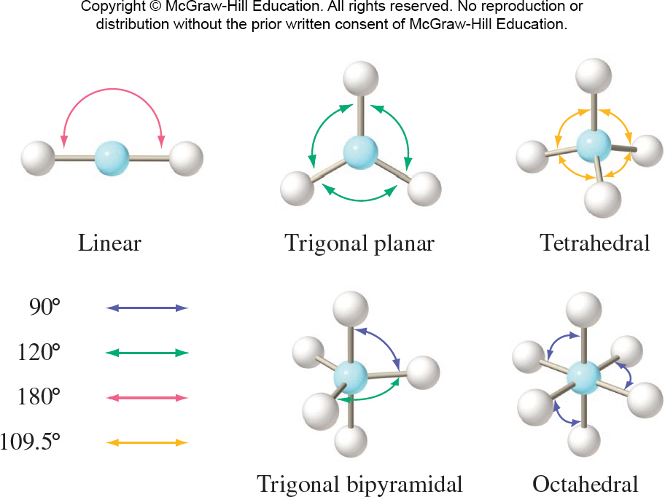
9.1 Molecular Geometry 7
The VSEPR Model
Access the text alternative for these images

Slide 8
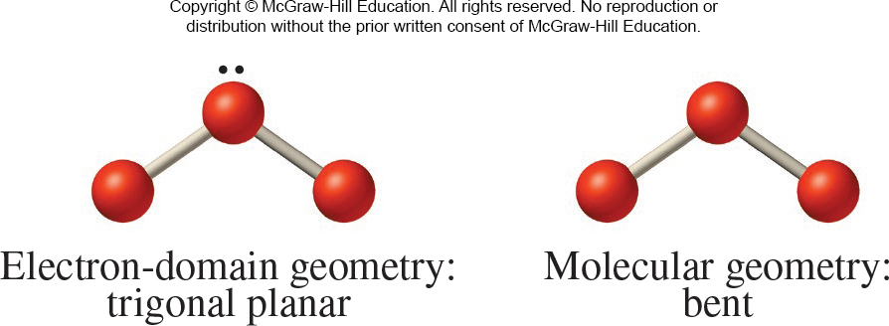
9.1 Molecular Geometry 8
Electron-Domain Geometry and Molecular Geometry
It is important to distinguish between the electron-domain geometry, which is the arrangement of electron domains (bonds and lone pairs) around the central atom, and the molecular geometry, which is the arrangement of bonded atoms.
Access the text alternative for these images

Slide 9
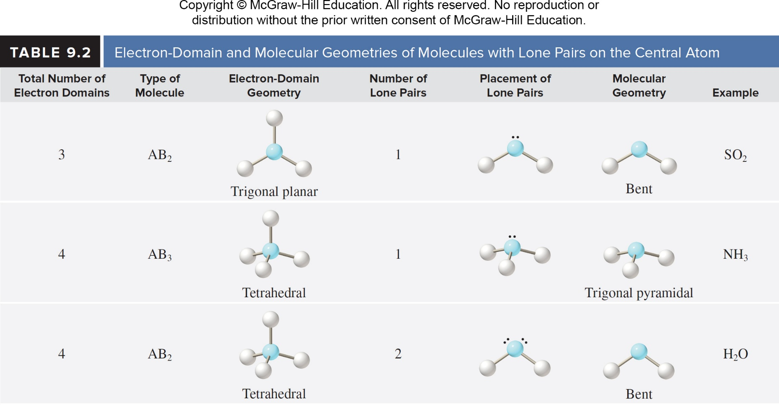
9.1 Molecular Geometry 9
Electron-Domain Geometry and Molecular Geometry
Access the text alternative for these images

Slide 10
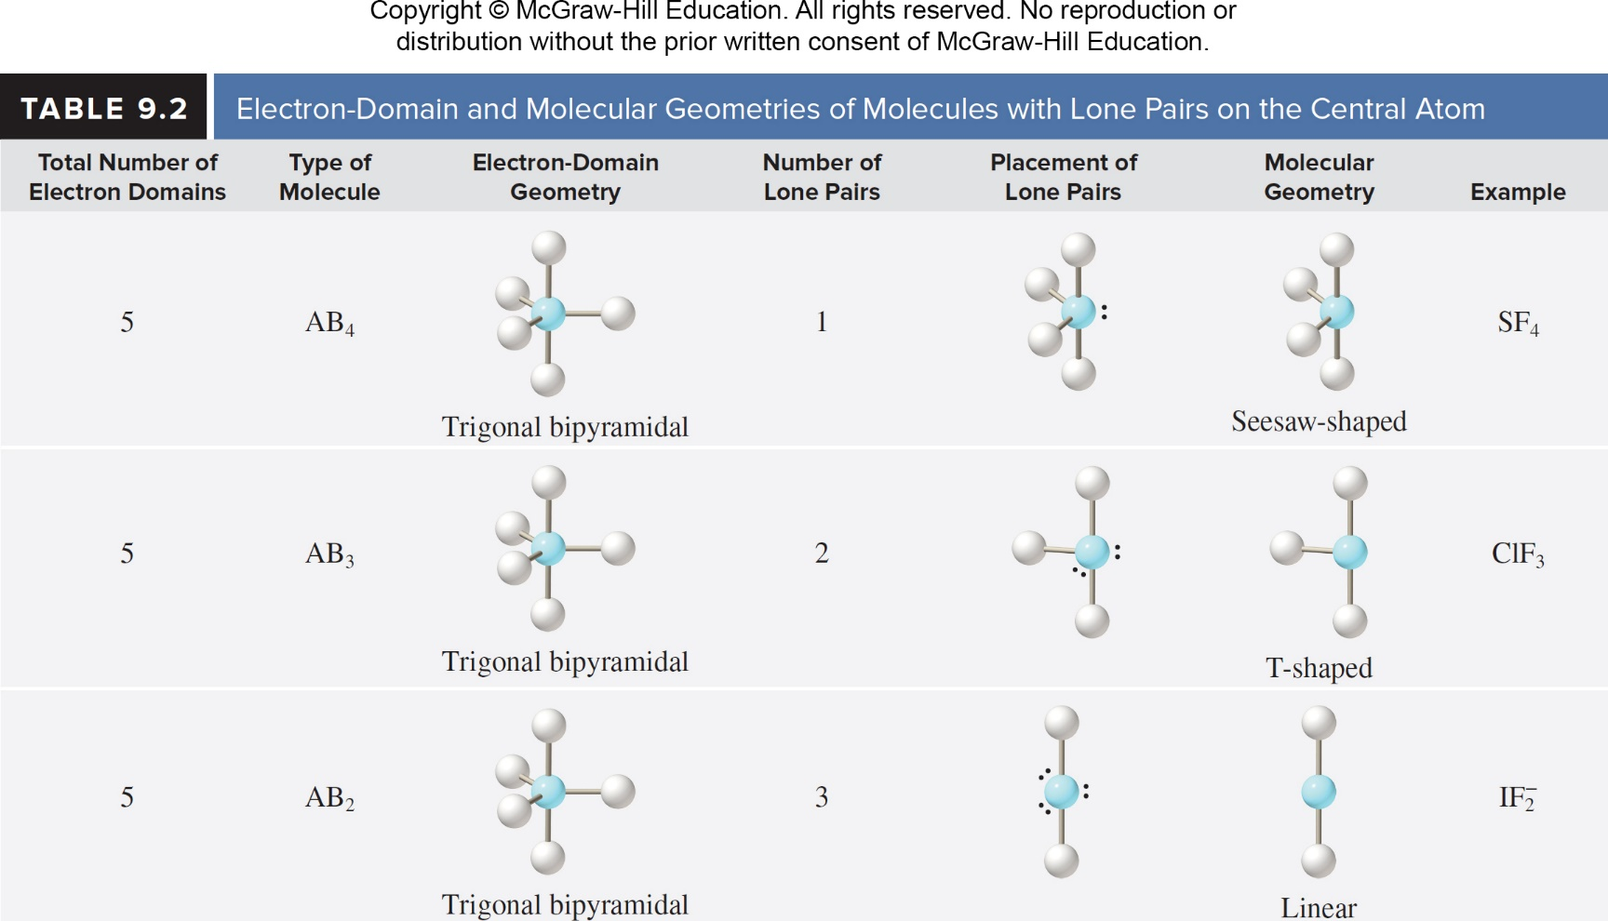
9.1 Molecular Geometry 10
Electron-Domain Geometry and Molecular Geometry
Access the text alternative for these images

Slide 11
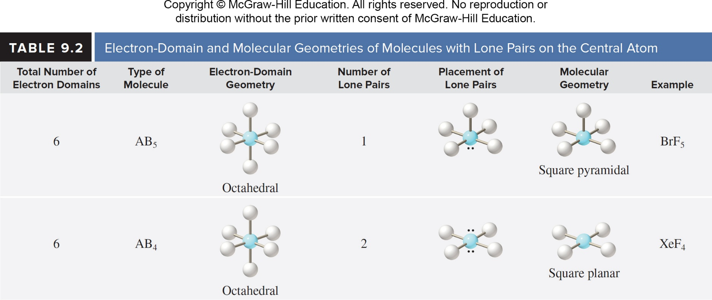
9.1 Molecular Geometry 11
Electron-Domain Geometry and Molecular Geometry
Access the text alternative for these images

Slide 12
9.1 Molecular Geometry 12
Electron-Domain Geometry and Molecular Geometry
In summary, the steps to determine the electron-domain and molecular geometries are as follows:
Draw the Lewis structure of the molecule or polyatomic ion.
Count the number of electron domains on the central atom.
Determine the electron-domain geometry by applying the VSEPR model.
Determine the molecular geometry by considering the positions of the atoms only.

Slide 13
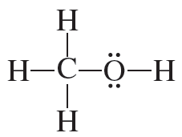
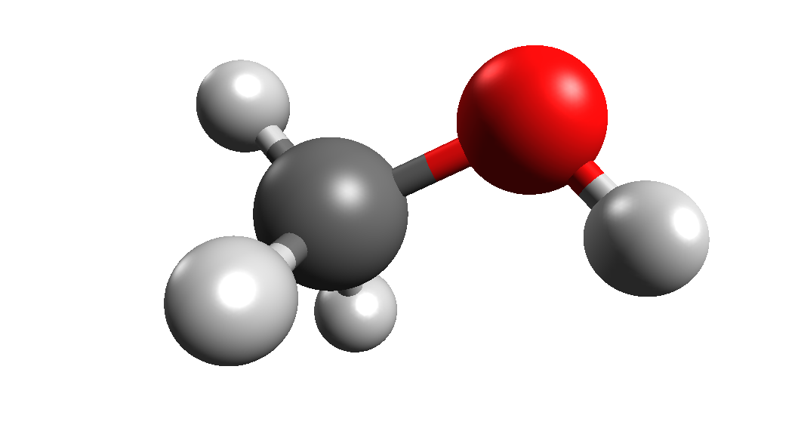
9.1 Molecular Geometry 14
Geometry of Molecules with More Than One Central Atom
Access the text alternative for these images

Slide 14
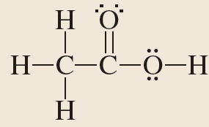
SAMPLE PROBLEM 9.2
Determine the molecular geometry about each of the central atoms, and determine the approximate value of each of the bond angles in the molecule.
Which if any of the bond angles would you expect to be smaller than the ideal values?
Access the text alternative for these images

Slide 15
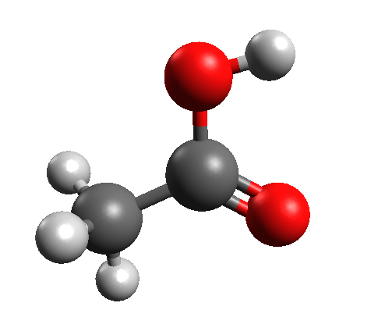
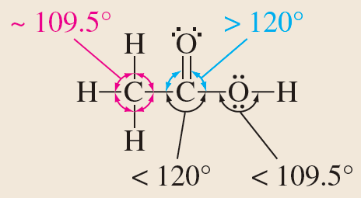
SAMPLE PROBLEM 9.2 Solution
Solution
Access the text alternative for these images

Slide 16
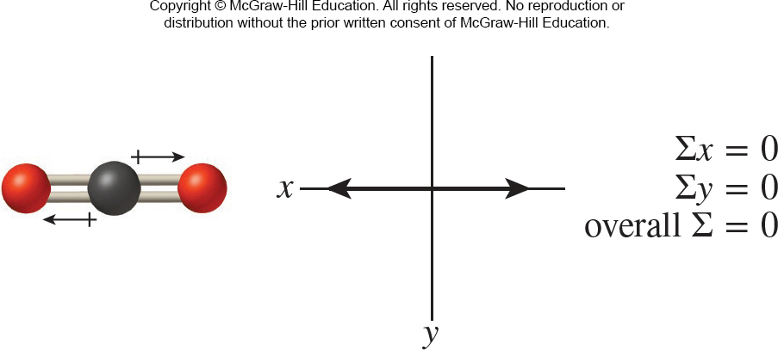
9.2 Molecular Geometry and Polarity 1
Molecular Geometry and Polarity
Whether a molecule made up of three or more atoms is polar depends not only on the polarity of the individual bonds, but also on its molecular geometry.

Slide 17
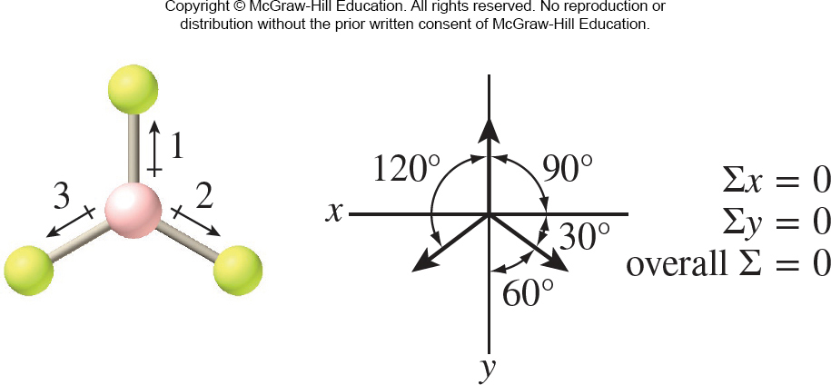
9.2 Molecular Geometry and Polarity 2
Molecular Geometry and Polarity

Slide 18
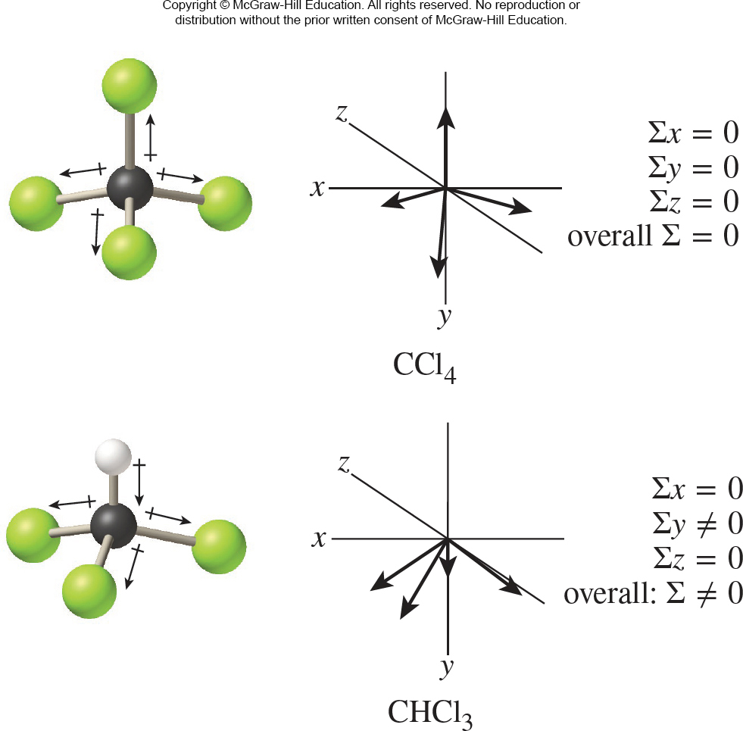
9.2 Molecular Geometry and Polarity 4
Access the text alternative for these images

Slide 19
9.3 Valence Bond Theory 9
Energetics and Directionality of Bonding
In summary, the important features of valence bond theory are as follows:
A bond forms when singly occupied atomic orbitals on two atoms overlap.
The two electrons shared in the region of orbital overlap must be of opposite spin.
Formation of a bond results in a lower potential energy for the system.

Slide 20
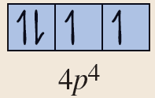
SAMPLE PROBLEM 9.3 Setup
Hydrogen selenide (H₂Se) is a foul-smelling gas that can cause eye and respiratory tract inflammation. The H - Se - H bond angle in H₂Se is approximately 92°.
Use valence bond theory to describe the bonding in this molecule.
Setup
Se: [Ar] 4s² 3d¹⁰ 4p⁴

Slide 21
SAMPLE PROBLEM 9.3 Solution
Solution
Two of the 4p orbitals are singly occupied and therefore available for bonding.
The bonds in H₂Se form as the result of the overlap of a hydrogen 1s orbital with each of these orbitals on the Se atom.

Slide 22
9.4 Hybridization of Atomic Orbitals
Topics
Hybridization of s and p Orbitals
Hybridization of s, p, and d Orbitals

Slide 23
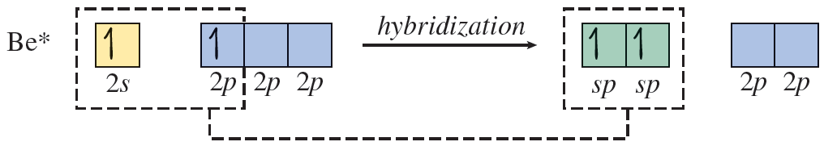
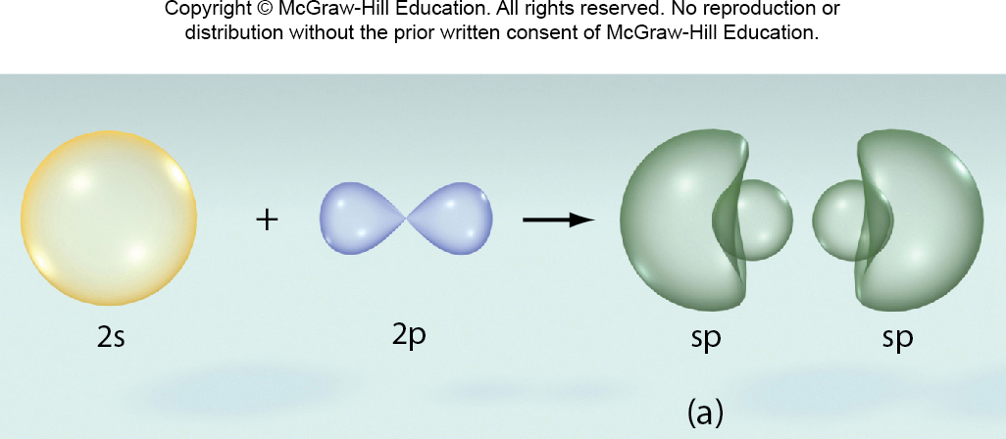
9.4 Hybridization of Atomic Orbitals 1
Hybridization of s and p Orbitals
Access the text alternative for these images

Slide 24
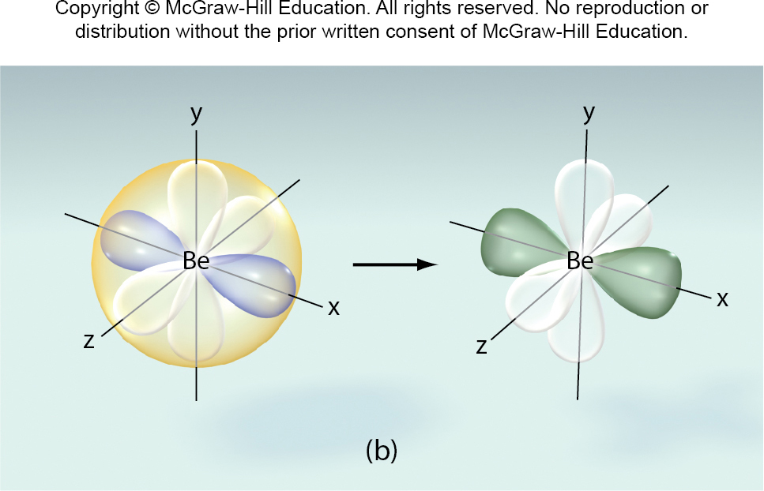
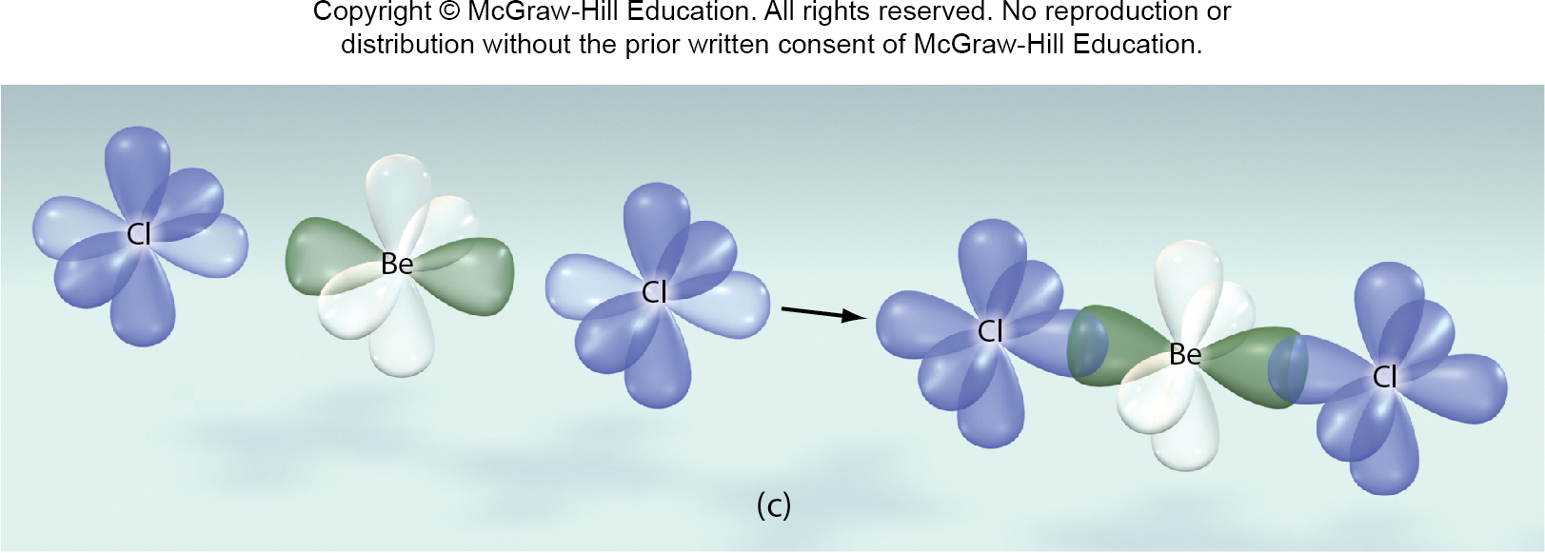
9.4 Hybridization of Atomic Orbitals 2
Hybridization of s and p Orbitals
Access the text alternative for these images

Slide 25
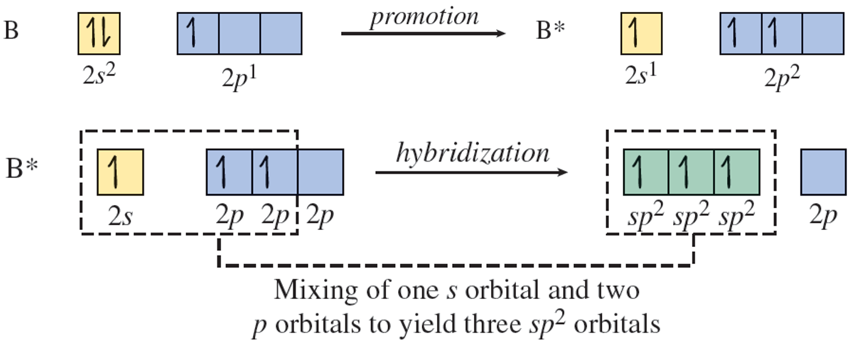
9.4 Hybridization of Atomic Orbitals 3
Hybridization of s and p Orbitals

Slide 26
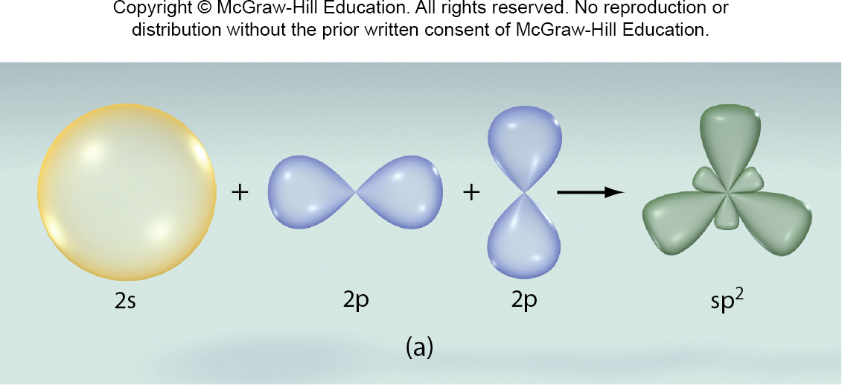
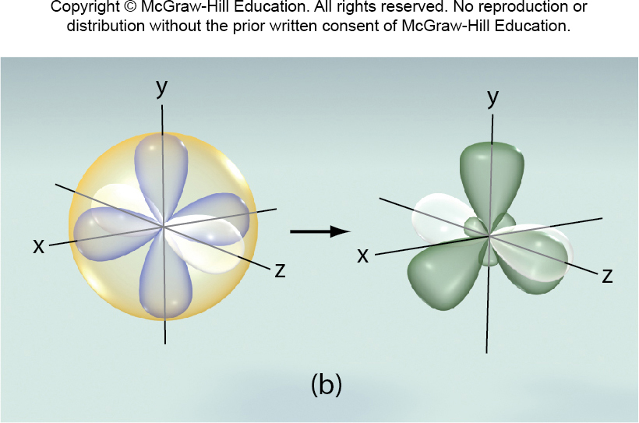
9.4 Hybridization of Atomic Orbitals 4
Hybridization of s and p Orbitals

Slide 27
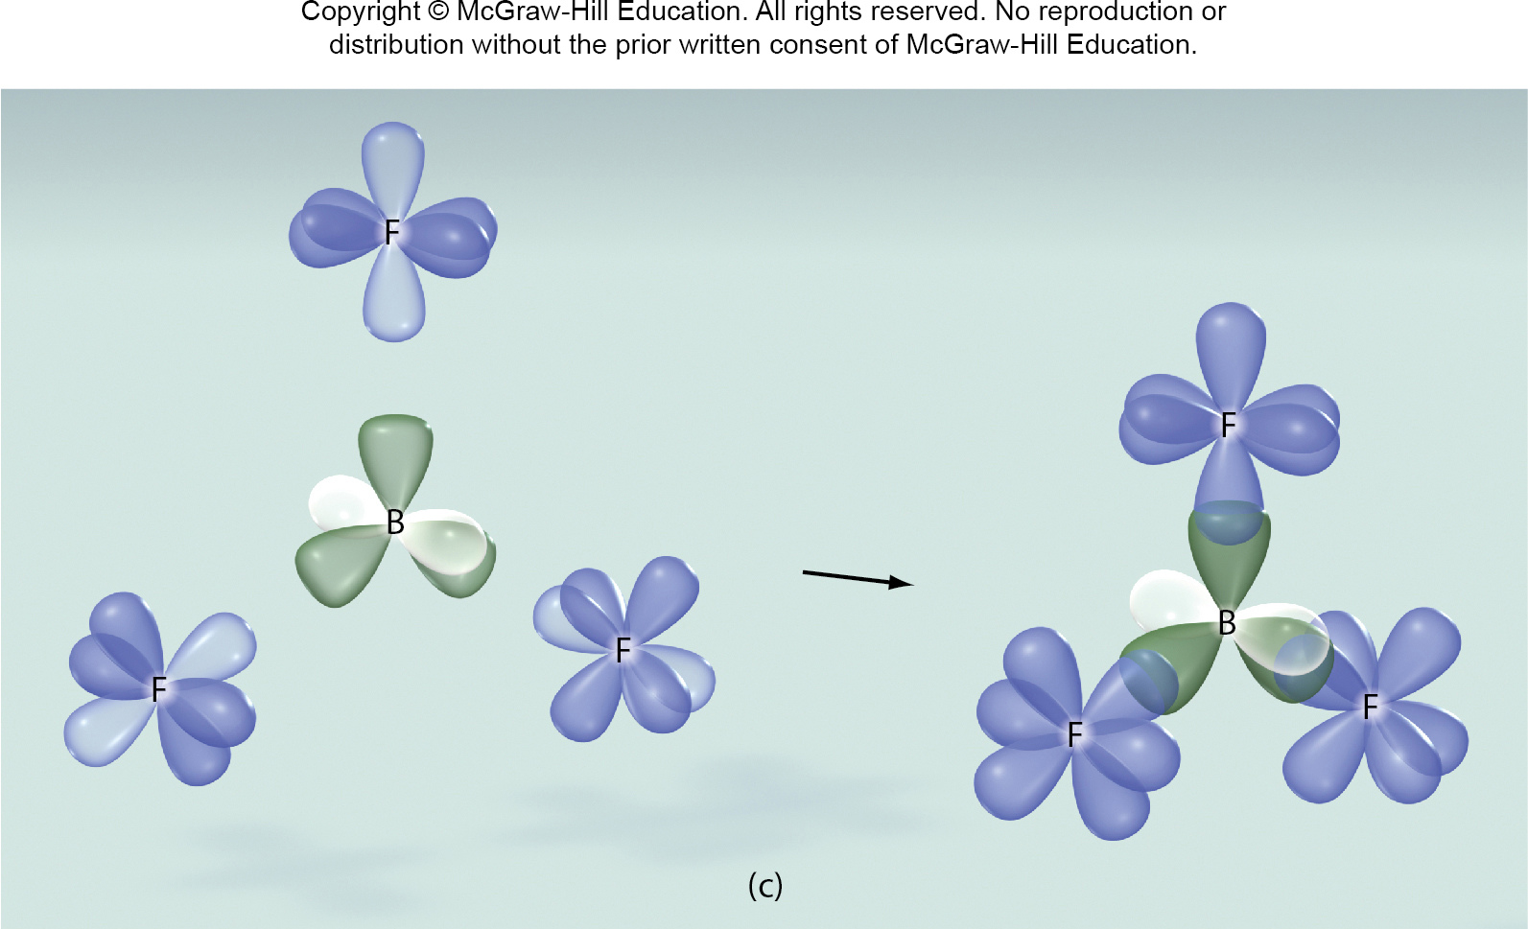
9.4 Hybridization of Atomic Orbitals 5
Hybridization of s and p Orbitals

Slide 28
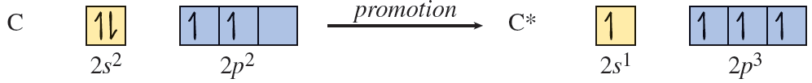
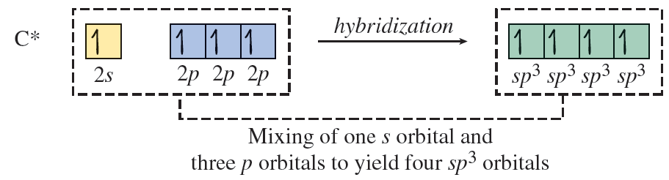
9.4 Hybridization of Atomic Orbitals 6
Hybridization of s and p Orbitals

Slide 29
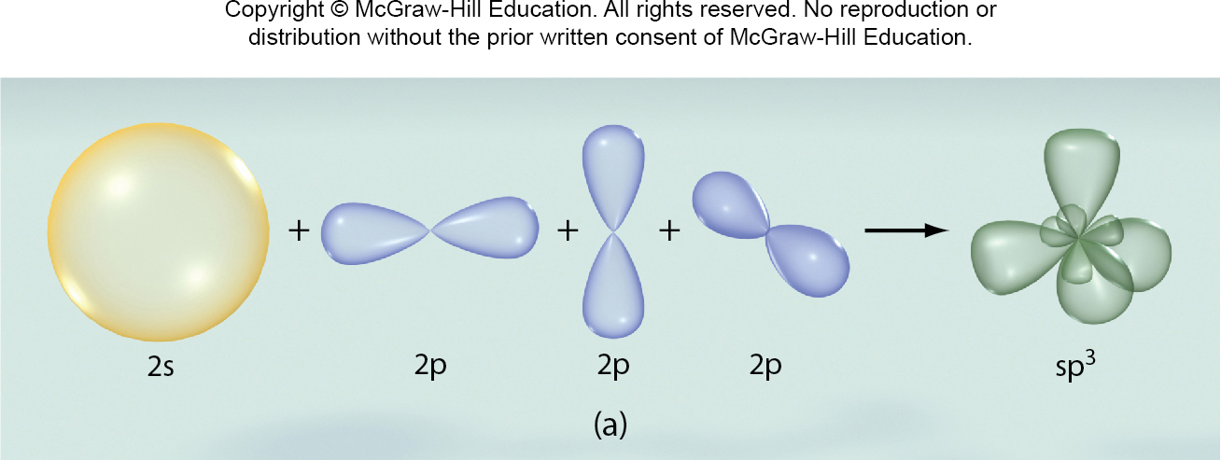
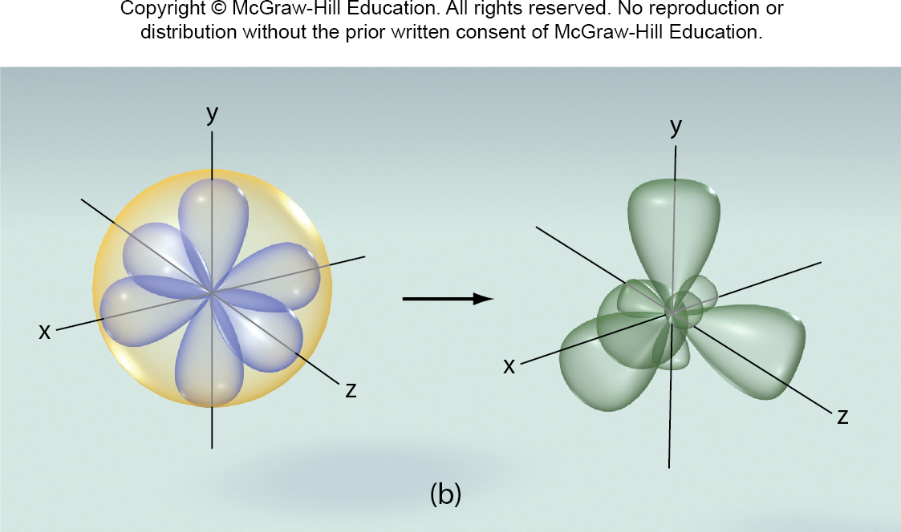
9.4 Hybridization of Atomic Orbitals 7
Hybridization of s and p Orbitals

Slide 30
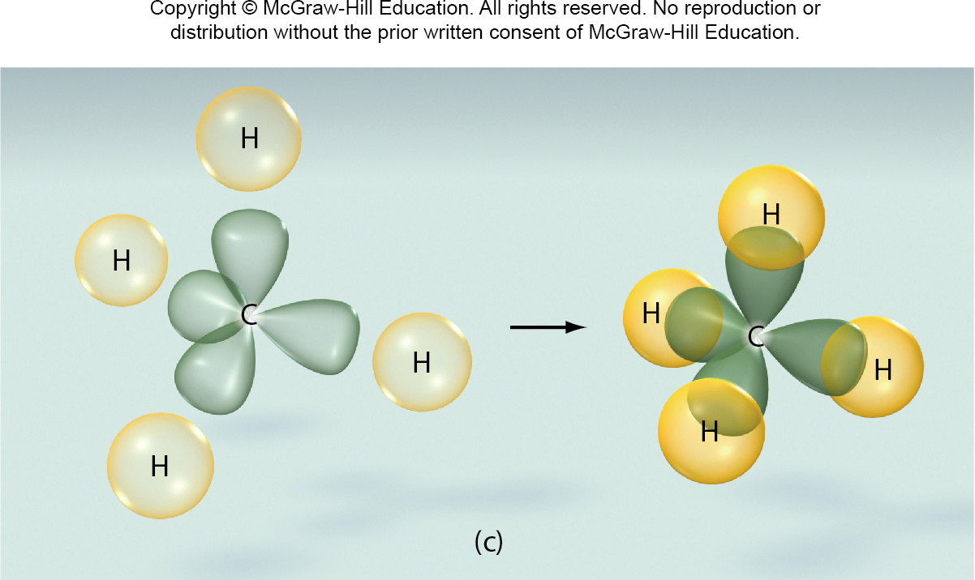
9.4 Hybridization of Atomic Orbitals 8
Hybridization of s and p Orbitals

Slide 31
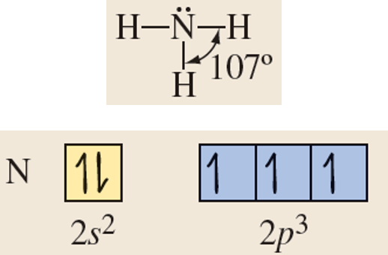
SAMPLE PROBLEM 9.4 Setup
Ammonia (NH₃) is a trigonal pyramidal molecule with
H—N—H bond angles of about 107°.
Describe the formation of three equivalent N H bonds, and explain the angles between them.
Setup

Slide 32
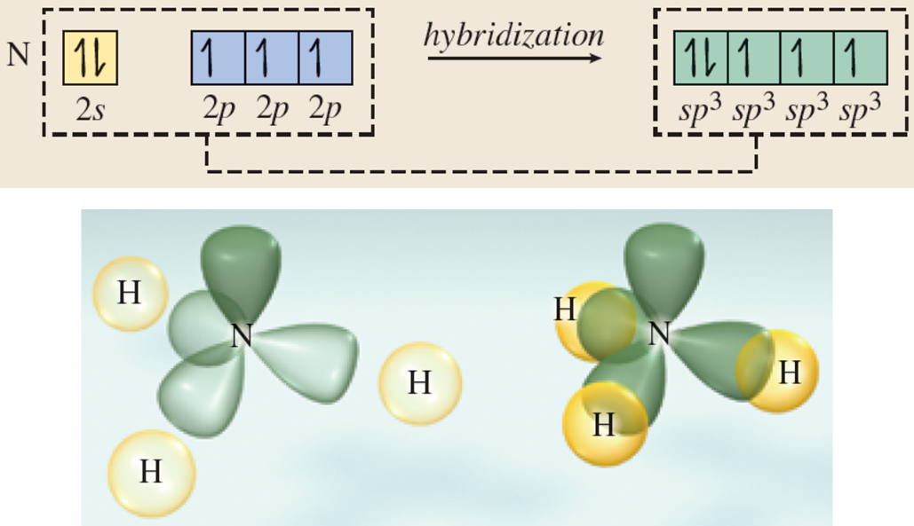
SAMPLE PROBLEM 9.4 Solution
Solution

Slide 33
9.5 Hybridization in Molecules Containing Multiple Bonds 1
Topics
Hybridization in Molecules Containing Multiple Bonds

Slide 34
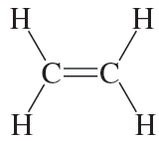
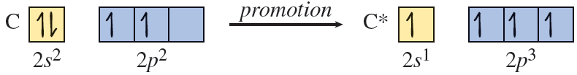
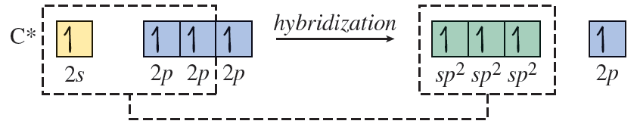
9.5 Hybridization in Molecules Containing Multiple Bonds 2
Hybridization in Molecules Containing Multiple Bonds

Slide 35
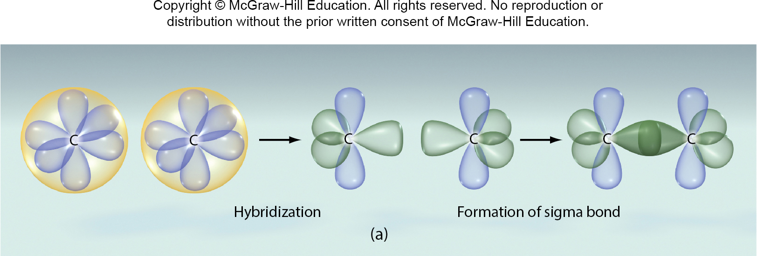
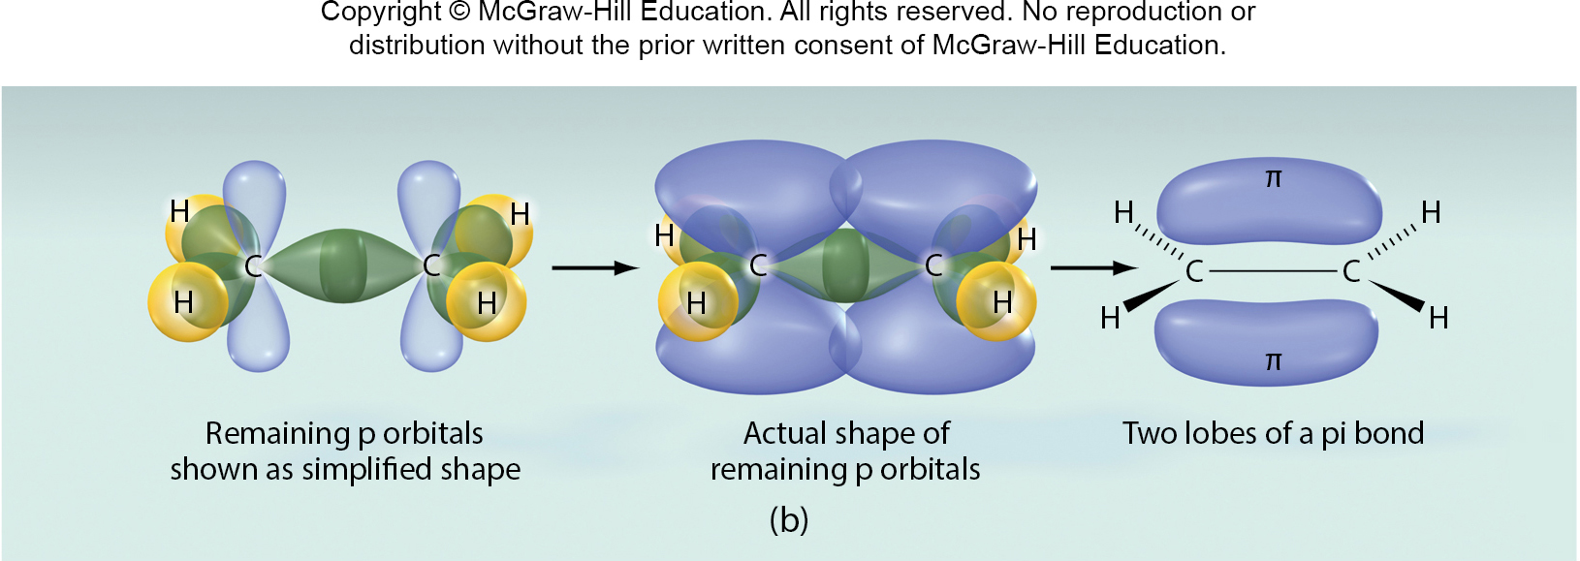
9.5 Hybridization in Molecules Containing Multiple Bonds 3
Hybridization in Molecules Containing Multiple Bonds

Slide 36
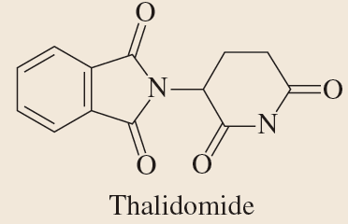
SAMPLE PROBLEM 9.5 Setup
Determine the number of carbon-carbon sigma bonds and the total number of pi bonds in thalidomide.
Setup
There are nine carbon-carbon single bonds and three carbon-carbon double bonds. Overall there are seven double bonds in the molecule (three C=C and four C=O).

Slide 37
SAMPLE PROBLEM 9.5 Solution
Solution
Thalidomide contains 12 carbon-carbon sigma bonds and a total of seven pi bonds (three in carbon-carbon double bonds and four in carbon-oxygen double bonds).

Slide 38
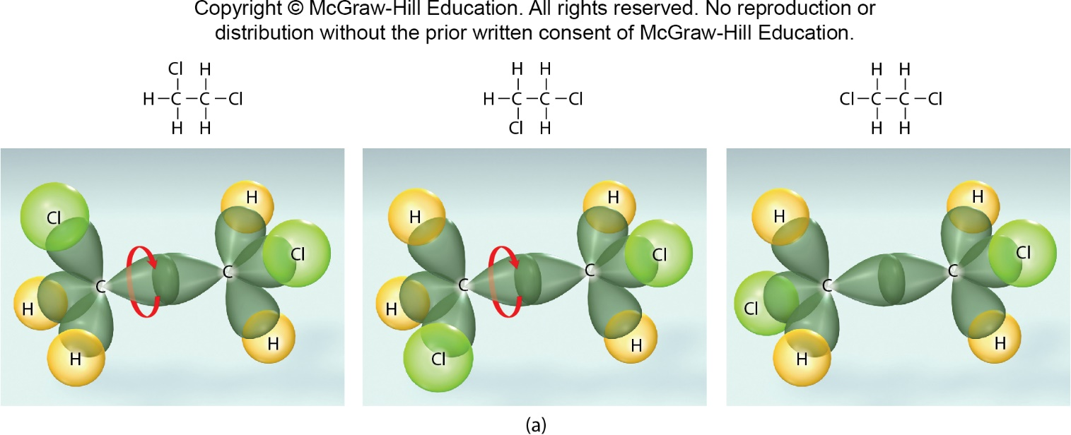
9.5 Hybridization in Molecules Containing Multiple Bonds 4
Hybridization in Molecules Containing Multiple Bonds
Since there is rotation about the C-C single bond, 1,2- dichloroethane exists as a single isomer.

Slide 39
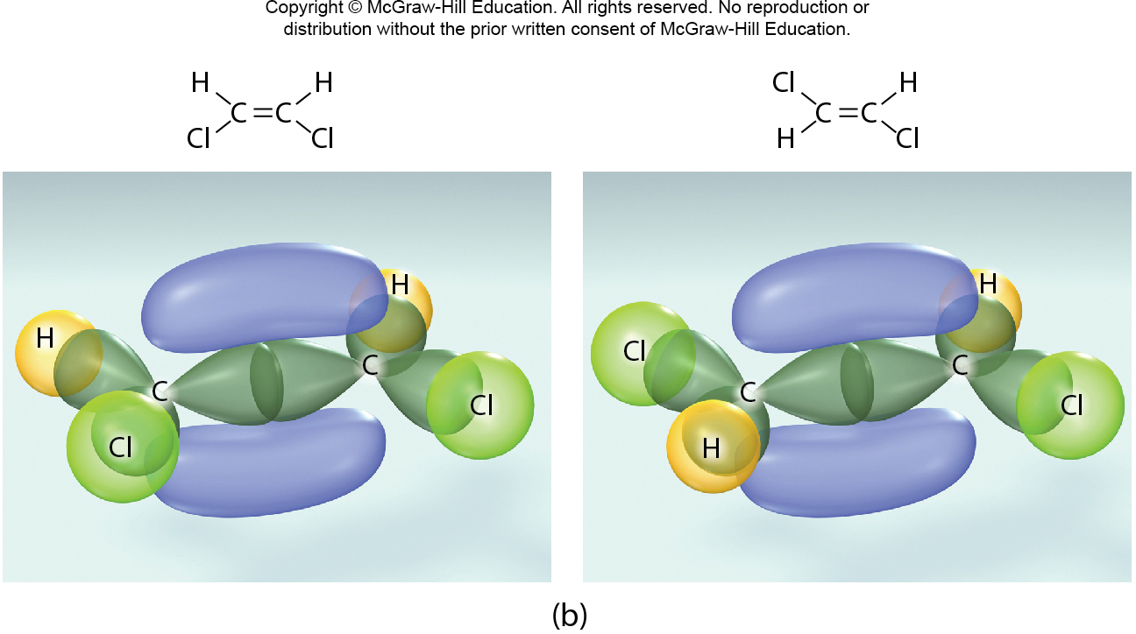
9.5 Hybridization in Molecules Containing Multiple Bonds 5
Hybridization in Molecules Containing Multiple Bonds
No rotation about the C=C double bond, and 1,2- dichloroethene exists as two structural isomers.

Slide 40
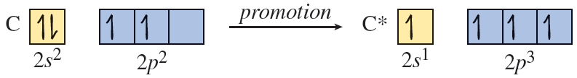
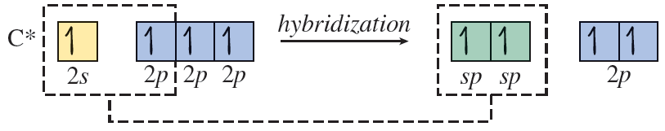
9.5 Hybridization in Molecules Containing Multiple Bonds 6
Hybridization in Molecules Containing Multiple Bonds

Slide 41
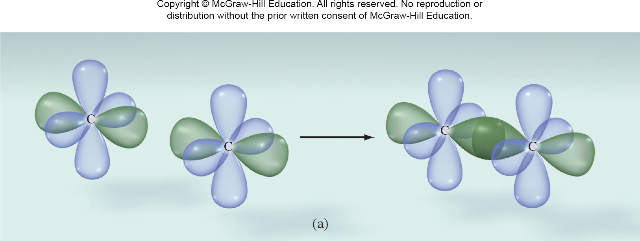
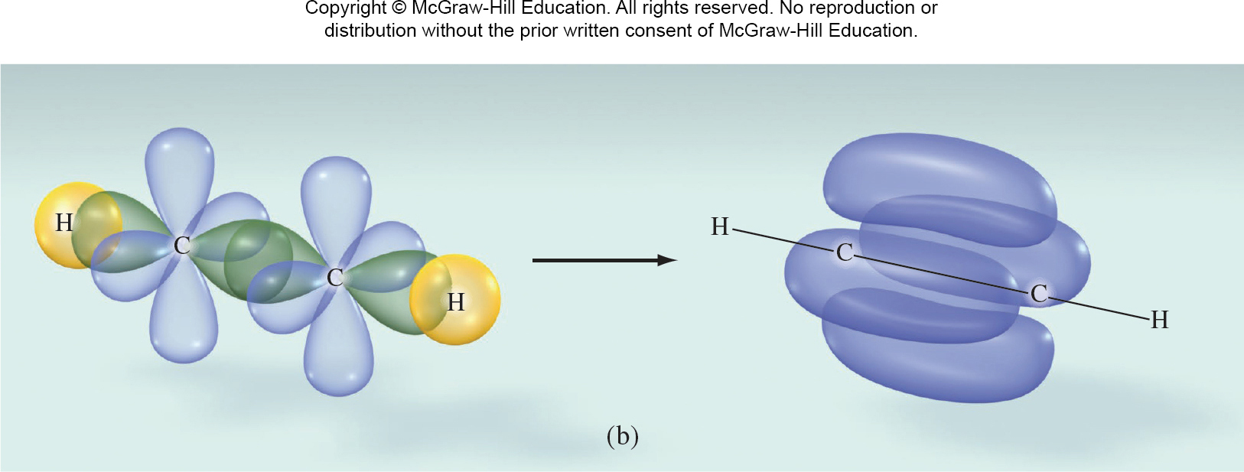
9.5 Hybridization in Molecules Containing Multiple Bonds 7
Hybridization in Molecules Containing Multiple Bonds

Slide 42

SAMPLE PROBLEM 9.6 Setup
Use hybridization to explain the bonding in formaldehyde (CH₂O).
Setup
The C and O atoms each have three electron domains around them. [Carbon has two single bonds (C-H) and a double bond (C=O); oxygen has a double bond (O=C) and two lone pairs.]

Slide 43
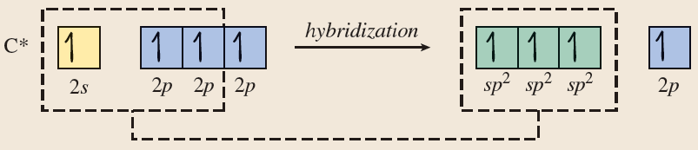
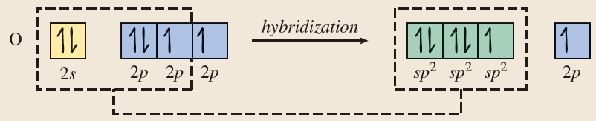
SAMPLE PROBLEM 9.6 Solution 1
Solution

Slide 44
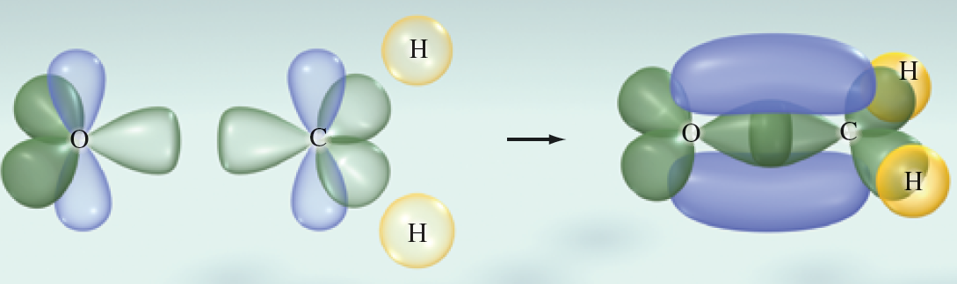
SAMPLE PROBLEM 9.6 Solution 2
Solution
Access the text alternative for these images

Slide 45
9.6 Molecular Orbital Theory 1
Bonding and Antibonding Molecular Orbitals
Lewis structures and valence bond theory do not enable us to describe or predict some important properties of molecules.
Diatomic oxygen, for example, exhibits a property called paramagnetism.
Paramagnetic species are attracted by magnetic fields, whereas diamagnetic species are weakly repelled by them.
Such magnetic properties are the result of a molecule’s electron configuration.

Slide 46
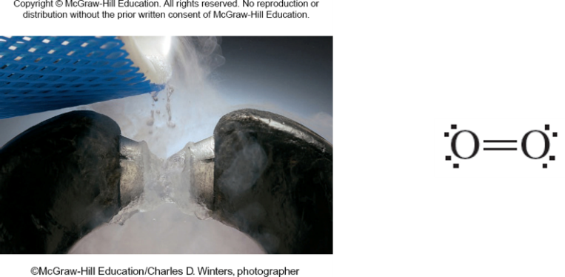
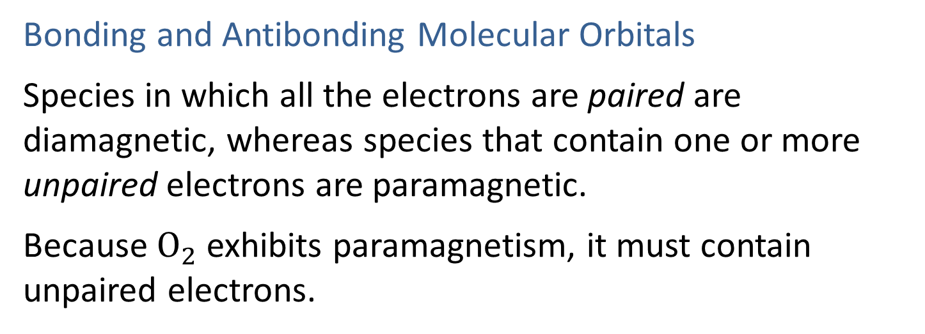
9.6 Molecular Orbital Theory 2
Bonding and Antibonding Molecular Orbitals
Species in which all the electrons are paired are diamagnetic, whereas species that contain one or more unpaired electrons are paramagnetic.
Because $O_{2}$ exhibits paramagnetism, it must contain unpaired electrons.
©McGraw-Hill Education/Charles D. Winters, photographer

Slide 47
9.6 Molecular Orbital Theory 3
Bonding and Antibonding Molecular Orbitals
According to molecular orbital theory, the atomic orbitals involved in bonding actually combine to form new orbitals that are the “property” of the entire molecule, rather than of the atoms forming the bonds.
These new orbitals are called molecular orbitals. In molecular orbital theory, electrons shared by atoms in a molecule reside in the molecular orbitals.

Slide 48
9.6 Molecular Orbital Theory 4
Bonding and Antibonding Molecular Orbitals
Molecular orbitals are like atomic orbitals in several ways: they have specific shapes and specific energies, and they can each accommodate a maximum of two electrons.
As was the case with atomic orbitals, two electrons residing in the same molecular orbital must have opposite spins, as required by the Pauli exclusion principle.
And, like hybrid orbitals, the number of molecular orbitals we get is equal to the number of atomic orbitals we combine.

Slide 49
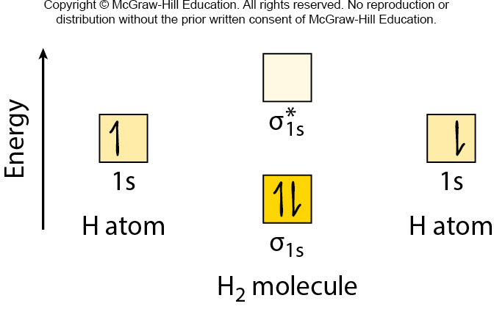
9.6 Molecular Orbital Theory 7
σ Molecular Orbitals
Access the text alternative for these images

Slide 50

9.6 Molecular Orbital Theory 8
σ Molecular Orbitals
Access the text alternative for these images

Slide 51
9.6 Molecular Orbital Theory 9
Bond Order
bond order = | number of electrons in bonding molecular orbitals | − | number of electrons in antibonding molecular orbitals
 |  | 2
The value of the bond order indicates, qualitatively, how stable a molecule is.

Slide 52
9.6 Molecular Orbital Theory 10
Bond Order
bond order = 1
bond order = 0

Slide 53
9.6 Molecular Orbital Theory 16
Molecular Orbital Diagrams
Lower-energy orbitals fill first.
Each orbital can accommodate a maximum of two electrons with opposite spins.
Hund’s rule is obeyed.

Slide 54

9.6 Molecular Orbital Theory 17
Molecular Orbital Diagrams

Slide 55
9.6 Molecular Orbital Theory 18
Molecular Orbitals in Heteronuclear Diatomic Species
Heteronuclear diatomic species contain two different atoms, such as NO.
The atomic orbitals of the more electronegative atom are lower in energy than the corresponding atomic orbitals of the less electronegative atom.
The lower-energy atomic orbital contributes more to the bonding molecular orbital; and the higher-energy atomic orbital contributes more to the antibonding molecular orbital.

Slide 56
9.6 Molecular Orbital Theory 19
Molecular Orbitals in Heteronuclear Diatomic Species
The bonding molecular orbital more closely resembles the atomic orbital of the more electronegative atom, and the antibonding molecular orbital more closely resembles the atomic orbital of the less electronegative atom.
The electron density in the resulting bonding molecular orbital is greater in the vicinity of the more electronegative atom.

Slide 57

9.7 Bonding Theories and Descriptions of Molecules with Delocalized Bonding 1
Bonding Theories and Descriptions of Molecules with Delocalized Bonding
Lewis Theory
Strength: Enables us to make qualitative predictions about bond strengths and bond lengths. Lewis structures are easy to draw and are widely used by chemists.
Weakness: Lewis structures are two dimensional, whereas molecules are three dimensional. In addition, Lewis theory fails to account for the differences in bonds in compounds such as H₂, F₂, and HF. It also fails to explain why bonds form.

Slide 58
9.7 Bonding Theories and Descriptions of Molecules with Delocalized Bonding 2
Bonding Theories and Descriptions of Molecules with Delocalized Bonding
The Valence-Shell Electron-Pair Repulsion Model
Strength: The VSEPR model enables us to predict the shapes of many molecules and poly- atomic ions.
Weakness: Because the VSEPR model is based on the Lewis theory of bonding, it also fails to explain why bonds form.

Slide 59
9.7 Bonding Theories and Descriptions of Molecules with Delocalized Bonding 3
Bonding Theories and Descriptions of Molecules with Delocalized Bonding
Valence Bond Theory
Strength: Describes the formation of covalent bonds as the overlap of atomic orbitals. Bonds form because the resulting molecule has a lower potential energy than the original, isolated atoms.
Weakness: Fails to explain the bonding in many molecules such as Becl₂, BF₃, and CH₄, in which the central atom in its ground state does not have enough unpaired electrons to form the observed number of bonds.

Slide 60
9.7 Bonding Theories and Descriptions of Molecules with Delocalized Bonding 4
Bonding Theories and Descriptions of Molecules with Delocalized Bonding
Hybridization of Atomic Orbitals
Strength: The hybridization of atomic orbitals is not a separate bonding theory; rather, it is an extension of valence bond theory. Using hybrid orbitals, we can understand the bonding and geometry of more molecules, including Becl₂, BF₃, and CH₄.
Weakness: Fail to predict some of the important properties of molecules, such as the paramagnetism of O₂.

Slide 61
9.7 Bonding Theories and Descriptions of Molecules with Delocalized Bonding 5
Bonding Theories and Descriptions of Molecules with Delocalized Bonding
Molecular Orbital Theory
Strength: Molecular orbital theory enables us to predict accurately the magnetic and other properties of molecules and ions.
Weakness: Pictures of molecular orbitals can be very complex.

Slide 62



9.7 Bonding Theories and Descriptions of Molecules with Delocalized Bonding 7
Delocalized π Orbitals
Access the text alternative for these images

Slide 63

SAMPLE PROBLEM 9.8
It takes three resonance structures to represent the carbonate ion (CO₃²⁻):
None of the three, though, is a completely accurate depiction. As with benzene, the bonds that are shown in the Lewis structure as one double and two single are actually three equivalent bonds. Use a combination of valence bond theory and molecular orbital theory to explain the bonding in CO₃²⁻.
Access the text alternative for these images

Slide 64
SAMPLE PROBLEM 9.8 Setup
Setup
The Lewis structure of the carbonate ion shows three electron domains around the central C atom, so the carbon must be sp² hybridized.

Slide 65
SAMPLE PROBLEM 9.8 Solution 1
Solution
Each sp² hybrid orbital on the C atom overlaps with a singly occupied p orbital on an O atom, forming the three s bonds.
Each O atom has an additional, singly occupied p orbital, perpendicular to the one involved in s bonding.

Slide 66
SAMPLE PROBLEM 9.8 Solution 2
Solution
The unhybridized p orbital on C overlaps with the p orbitals on O to form p bonds, which have electron densities above and below the plane of the molecule.
Because the species can be represented with resonance structures, we know that the p bonds are delocalized.

