Slide 1
Chemistry
Fifth Edition
Julia Burdge
Lecture PowerPoints
Chapter 10
Gases
©2020 McGraw-Hill Education. All rights reserved. Authorized only for instructor use in the classroom. No reproduction or further distribution permitted without the prior written consent of McGraw-Hill Education.

Slide 2
10.1 Properties of Gases 2
Gas Pressure: Definition and Units
Pressure is defined as the force applied per unit area:
The SI unit of force is the newton (N), where
1N = 1kg ∙ m/s²
The SI unit of pressure is the pascal (Pa), defined as 1 newton per square meter
1Pa = 1N/m²
1Pa = 1kg/m ∙ s²

Slide 3
10.1 Properties of Gases 3
Gas Pressure: Definition and Units
TABLE 10.2 Units of Pressure Commonly Used in Chemistry
Unit | Origin | Definition
standard atmosphere (atm) | Pressure at sea level | 1 atm = 101,325 Pa
mmHg | Barometer measurement | 1 mmHg = 133.322 Pa
torr | Name given to mmHg in honor of Torricelli, the inventor of the barometer | 1 torr = 133.322 Pa
bar | Same order of magnitude as atm, but a decimal multiple of Pa | 1 bar = 1 × 10⁵ Pa

Slide 4
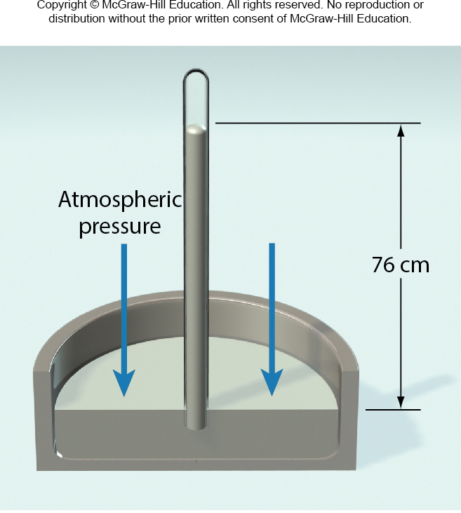
10.1 Properties of Gases 5
Measurement of Pressure
A simple barometer, an instrument used to measure atmospheric pressure
Standard atmospheric pressure
(1 atm) was originally defined as the pressure that would support a column of mercury exactly 760 mm high at 0°C at sea level.

Slide 5
10.2 The Gas Laws 10
The Combined Gas Law: The Pressure-Temperature-Amount-Volume Relationship
For a fixed amount of gas (n₁ = n₂):

Slide 6
10.3 The Ideal Gas Equation 1
Deriving the Ideal Gas Equation from the Empirical Gas Laws

Slide 7
10.3 The Ideal Gas Equation 2
Deriving the Ideal Gas Equation from the Empirical Gas Laws
TABLE 10.4 Various Equivalent Expressions of the Gas Constant, R
Numerical Value | Unit
0.08206 | L ∙ atm/K ∙ mol
62.36 | L ∙ torr/K ∙ mol
0.08314 | L ∙ bar/K ∙ mol
8.314 | m³ ∙ Pa/K ∙ mol
8.314 | J/K ∙ mol
1.987 | cal/K ∙ mol

Slide 8
10.3 The Ideal Gas Equation 3
Deriving the Ideal Gas Equation from the Empirical Gas Laws
The volume of 1 mole of an ideal gas at 0°C and 1 atm (conditions known as standard temperature and pressure (STP)) is :

Slide 9
SAMPLE PROBLEM 10.6 Setup
Calculate the volume of a mole of ideal gas at room temperature (25°C) and 1 atm.
Setup
The data given are n = 1 mol, T = 298.15 K, and P = 1.00 atm.
Because the pressure is expressed in atmospheres, we use
R = 0.08206 L · atm/K · mol to solve for volume in liters.

Slide 10
SAMPLE PROBLEM 10.6 Solution
Solution

Slide 11
10.3 The Ideal Gas Equation 4
Applications of the Ideal Gas Equation

Slide 12
SAMPLE PROBLEM 10.7 Setup
Carbon dioxide is effective in fire extinguishers partly because its density is greater than that of air, so CO₂ can smother the flames by depriving them of oxygen. (Air has a density of approximately 1.2 g/L at room temperature and 1 atm.)
Calculate the density of CO₂ at room temperature (25°C) and 1.0 atm.
Setup
The molar mass of CO₂ is 44.01 g/mol.

Slide 13
SAMPLE PROBLEM 10.7 Solution
Solution

Slide 14
10.4 Reactions with Gaseous Reactants and Products
Topics
Calculating the Required Volume of a Gaseous Reactant
Determining the Amount of Reactant Consumed Using Change in Pressure
Predicting the Volume of a Gaseous Product

Slide 15
10.4 Reactions with Gaseous Reactants and products 1
Calculating the Required Volume of a Gaseous Reactant
2CO (g) + O₂ (g) → 2CO₂ (g)
At constant pressure and temperature:

Slide 16
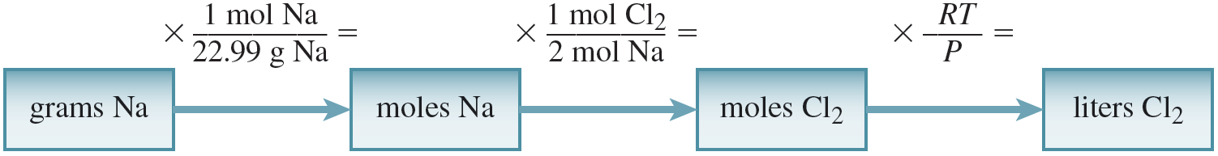
10.4 Reactions with Gaseous Reactants and Products 2
Calculating the Required Volume of a Gaseous Reactant
2Na (s) + Cl₂ (g) → 2NaCl (s)
Access the text alternative for these images

Slide 17
SAMPLE PROBLEM 10.11
The air bags in cars are inflated when a collision triggers the explosive, highly exothermic decomposition of sodium azide (NaN₃):
2NaN₃(s) → 2Na(s) + 3N₂(g)
A typical driver-side air bag contains about 50 g of NaN₃. Determine the volume of N₂ gas that would be generated by the decomposition of 50.0 g of sodium azide at 85.0°C and 1.00 atm.

Slide 18
SAMPLE PROBLEM 10.11 Setup
Setup
The molar mass of NaN₃ is 65.02 g/mol.
Solution

Slide 19
10.5 Gas Mixtures 2
Mole Fractions
The mole fraction of a mixture component is always less than 1.
The sum of mole fractions for all components of a mixture is always 1.
Mole fraction is dimensionless.

Slide 20
10.5 Gas Mixtures 3
Mole Fractions
X_{i} × n_{total} = n_{i}
X_{i} × P_{total} = P_{i}

Slide 21
SAMPLE PROBLEM 10.13 Setup
Calculate the mole fraction of NO in a 10.00-L gas cylinder at room temperature (25°C) that contains 6.022 mol N₂ and in which the total pressure is 14.75 atm.
Setup
The temperature is 298.15 K.

Slide 22
SAMPLE PROBLEM 10.13 Solution
Solution
mol NO = total moles − mol N₂ = 6.029 − 6.022 = 0.007 mol NO

Slide 23
SAMPLE PROBLEM 10.14 Setup
Calcium metal reacts with water to produce hydrogen gas:
Ca(s) + 2H₂O(l) → Ca(OH)₂(aq) + H₂(g)
Determine the mass of H₂ produced at 25 degrees C and 0.967 atm when 525 mL of the gas is collected over water
Setup
V = 0.525 L and T = 298.15 K.
The partial pressure of water at 25 degrees C is 23.8 torr or
23.8 torr · (1 atm/760 torr) = 0.0313 atm.
The molar mass of H₂ is 2.016 g/mol.

Slide 24
SAMPLE PROBLEM 10.14 Solution
Solution
P_{H2} = P_{total} − P_{H2O} = 0.967 atm − 0.0313 atm = 0.936 atm
mass of H₂ = (2.008 × 10⁻² mol)(2.016 g/mol) = 0.0405 g H₂

