Slide 1
Chemistry
Fifth Edition
Julia Burdge
Lecture PowerPoints
Chapter 11
Intermolecular Forces and the Physical Properties of Liquids and Solids
©2020 McGraw-Hill Education. All rights reserved. Authorized only for instructor use in the classroom. No reproduction or further distribution permitted without the prior written consent of McGraw-Hill Education.

Slide 2
11.1 Intermolecular Forces 2
We will begin our discussion of intermolecular forces with the attractive forces that act between atoms or molecules in a pure substance.
These forces are known collectively as van der Waals forces, and they include dipole-dipole interactions, including hydrogen bonding and dispersion forces.

Slide 3
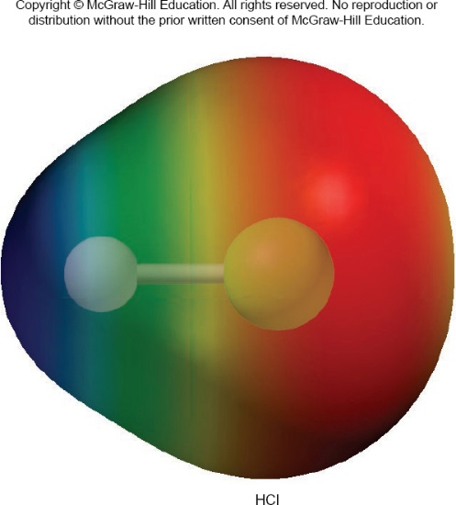
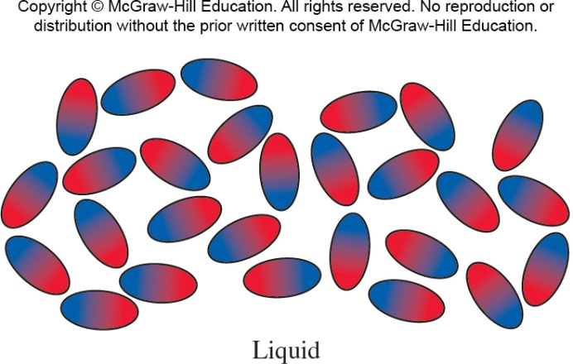
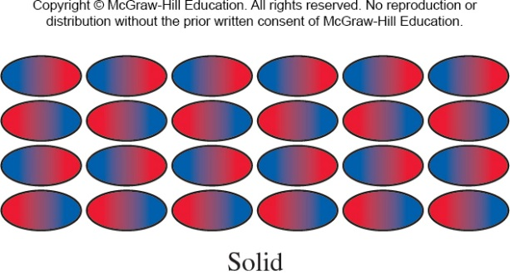
11.1 Intermolecular Forces 3
Dipole-Dipole Interactions
Dipole-dipole interactions are attractive forces that act between polar molecules.

Slide 4
11.1 Intermolecular Forces 4
Dipole-Dipole Interactions
TABLE 11.1 Dipole Moments and Boiling Points of Compounds with Similar Molecular Masses.
Compound | Structural Formula | Dipole Moment (D) | Boiling Point (°C)
Propane | CH₃CH₂CH₃ | 0.1 | −42
Dimethyl ether | CH₃OCH₃ | 1.3 | −25
Methyl chloride | CH₃Cl | 1.9 | −24
Acetaldehyde | CH₃CHO | 2.7 | 21
Acetonitrile | CH₃CN | 2.9 | 82

Slide 5
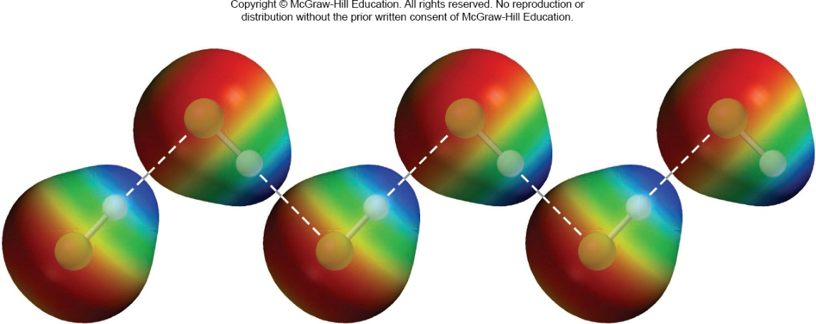
11.1 Intermolecular Forces 5
Hydrogen Bonding
Hydrogen bonding is a special type of dipole-dipole interaction.
But, whereas dipole-dipole interactions act between any polar molecules, hydrogen bonding occurs only in molecules that contain H bonded to a small, highly electronegative atom, such as N, O, or F.

Slide 6
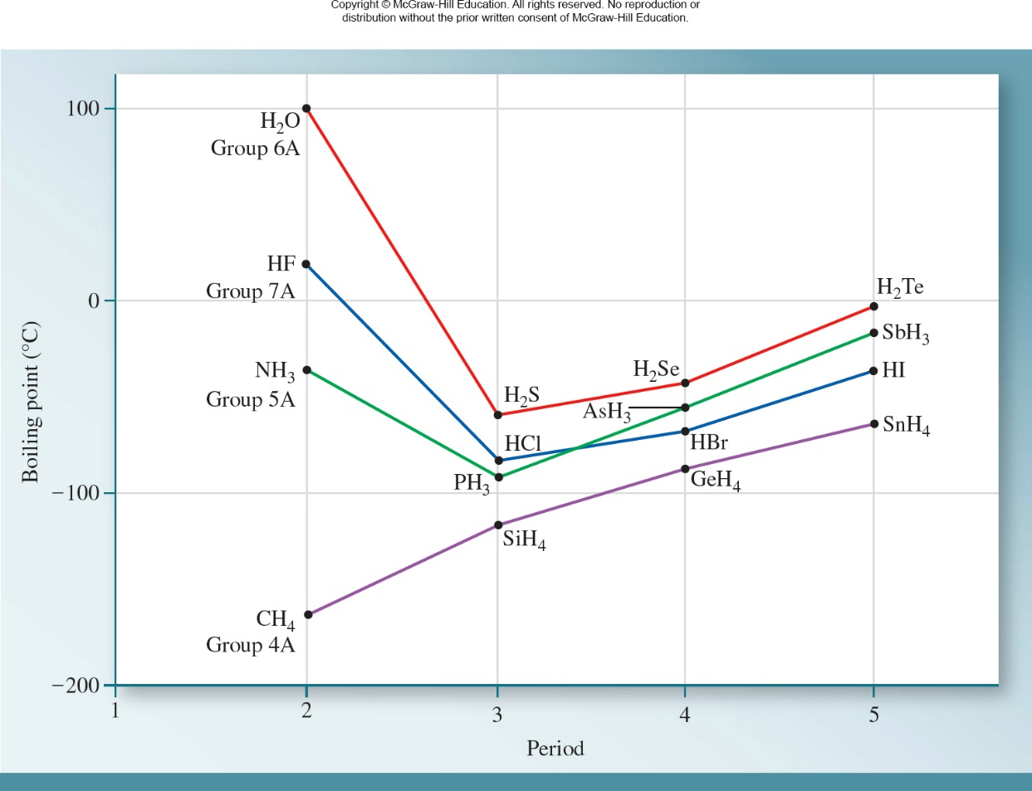
11.1 Intermolecular Forces 6
Hydrogen Bonding
Access the text alternative for these images

Slide 7
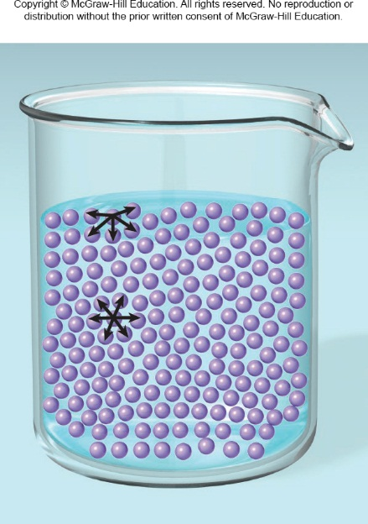
11.2 Properties of Liquids 1
Surface Tension
A quantitative measure of the elastic force in the surface of a liquid is the surface tension, the amount of energy required to stretch or increase the surface of a liquid by a unit area (for example, by 1 cm²).
A liquid with strong intermolecular forces has a high surface tension.

Slide 8
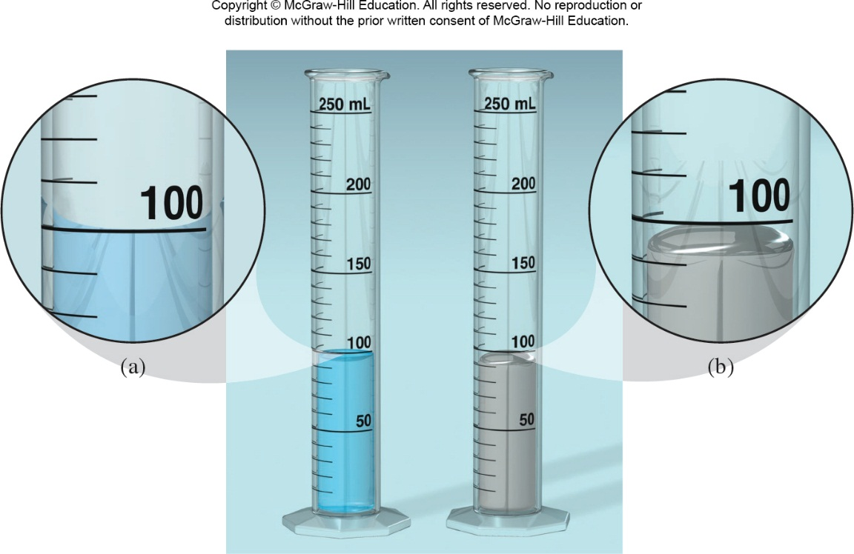
11.2 Properties of Liquids 2
Surface Tension
An illustration of surface tension is the meniscus, the curved surface of a liquid contained in a narrow tube.
Access the text alternative for these images

Slide 9
11.2 Properties of Liquids 3
Surface Tension
Surface tension is responsible for capillary action, in which water is pulled up into a narrow glass cylinder.
Two types of forces bring about capillary action. One is cohesion, the attractions between like molecules (in this case, between water molecules). The other is adhesion, the attractions between unlike molecules.

Slide 10
11.2 Properties of Liquids 4
Viscosity
Another property determined by the magnitude of intermolecular forces in a liquid is viscosity.
Viscosity, with units of N · s/m², is a measure of a fluid’s resistance to flow.
The higher the viscosity, the more slowly a liquid flows.
Liquids that have strong intermolecular forces have higher viscosities than those that have weaker intermolecular forces.

Slide 11
11.6 Phase Changes 1
Liquid-Vapor Phase Transition
A phase is a homogeneous part of a system that is separated from the rest of the system by a well- defined boundary.
When a substance goes from one phase to another phase, we say that it has undergone a phase change.
Phase changes in a system are generally caused by the addition or removal of energy, usually in the form of heat.

Slide 12
11.6 Phase Changes 2
Liquid-Vapor Phase Transition
Example | Phase Change
Freezing of water | H₂O(l) → H₂O(s)
Evaporation (or vaporization) of water | H₂O(l) → H₂O(g)
Melting (fusion) of ice | H₂O(s) → H₂O(l)
Condensation of water vapor | H₂O(g) → H₂O(l)
Sublimation of dry ice | CO₂(s) → CO₂(g)

Slide 13
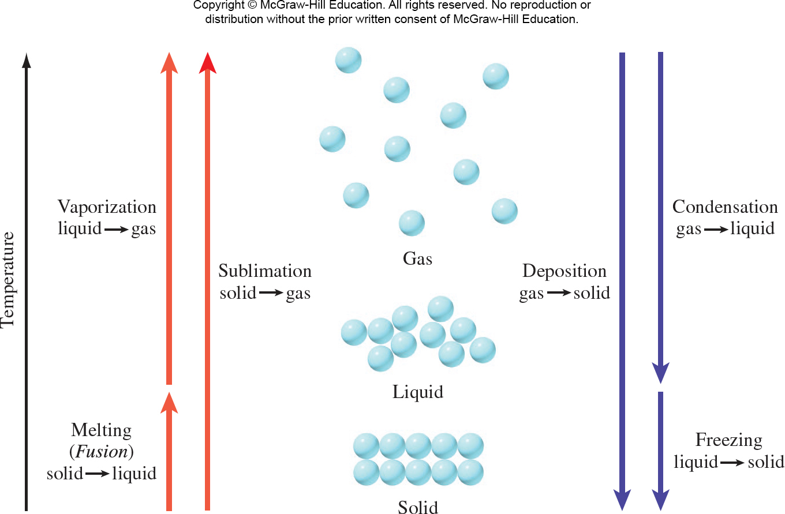
11.6 Phase Changes 3
Liquid-Vapor Phase Transition
Access the text alternative for these images

Slide 14
11.6 Phase Changes 4
Liquid-Vapor Phase Transition
The boiling point of a substance is defined as the temperature at which its vapor pressure equals the external, atmospheric pressure.
The temperature at which the vapor pressure of a liquid is equal to 1 atm is called the normal boiling point.

Slide 15
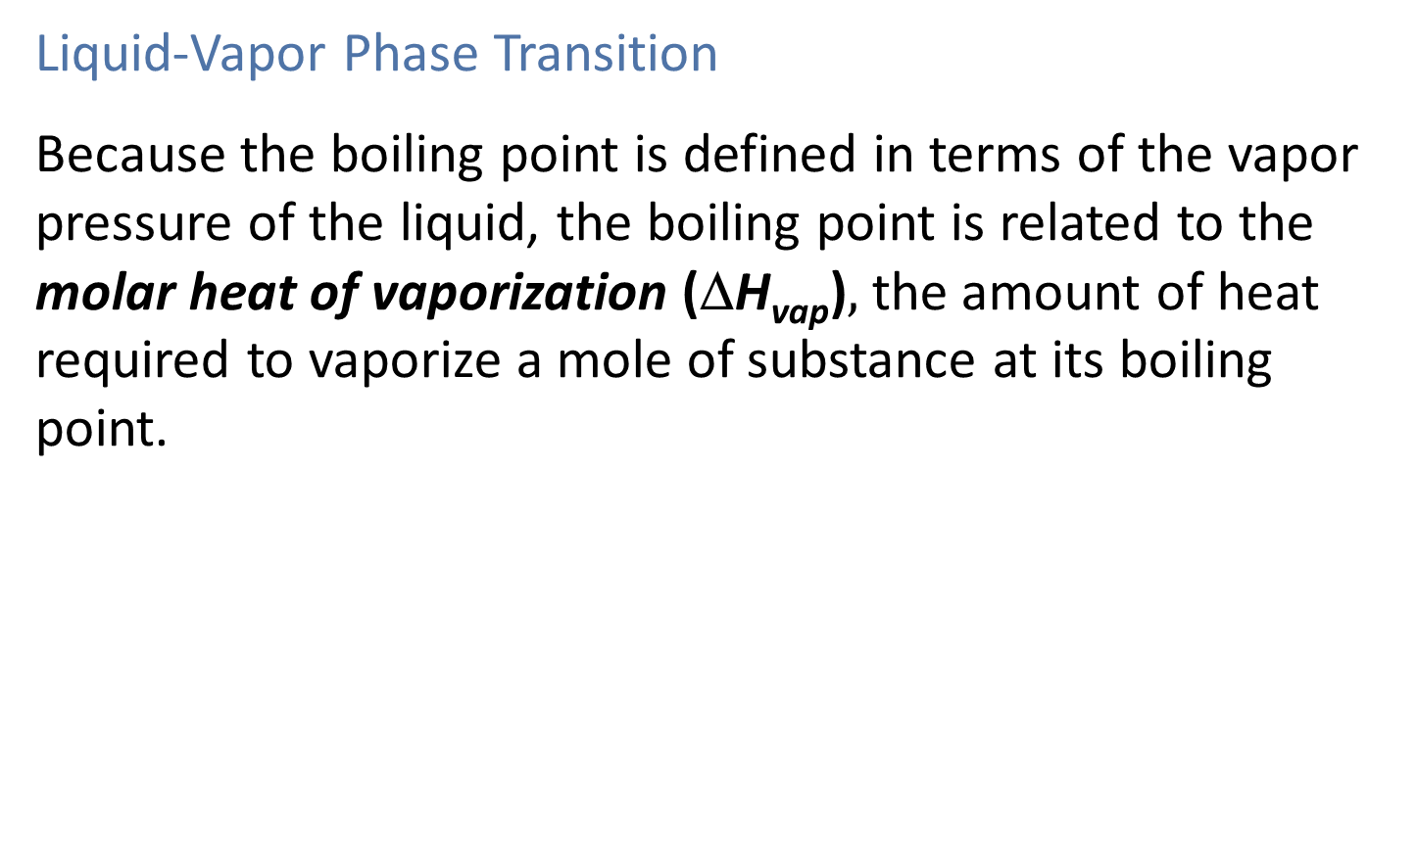
11.6 Phase Changes 5
Liquid-Vapor Phase Transition
Because the boiling point is defined in terms of the vapor pressure of the liquid, the boiling point is related to the molar heat of vaporization (ΔH_{vap})$,$the amount of heat required to vaporize a mole of substance at its boiling point.

Slide 16
11.6 Phase Changes 9
Liquid-Vapor Phase Transition
The transformation of liquid to solid is called freezing, and the reverse process is called melting, or fusion.
The melting point of a solid or the freezing point of a liquid is the temperature at which solid and liquid phases coexist in equilibrium.
The normal melting (or freezing) point of a substance is the temperature at which it melts (or freezes) at 1 atm.

Slide 17
11.6 Phase Changes 10
Solid-Liquid Phase Transition
The molar heat of fusion (ΔH_{fus}) is the energy, usually expressed in kJ/mol, required to melt 1 mole of a solid.
TABLE 11.8 Molar Heats of Fusion for Selected Substances.
Substance | Melting Point (°C) | ΔH_{fus} (kJ/mol)
Argon (Ar) | −190 | 1.3
Benzene (C₆H₆) | 5.5 | 10.9
Ethanol (C₂H₅OH) | −117.3 | 7.61
Diethyl ether (C₂H₅OC₂H₅) | −116.2 | 6.90
Mercury (Hg) | −39 | 23.4
Methane (CH₄) | −183 | 0.84
Water (H₂O) | 0 | 6.01

Slide 18
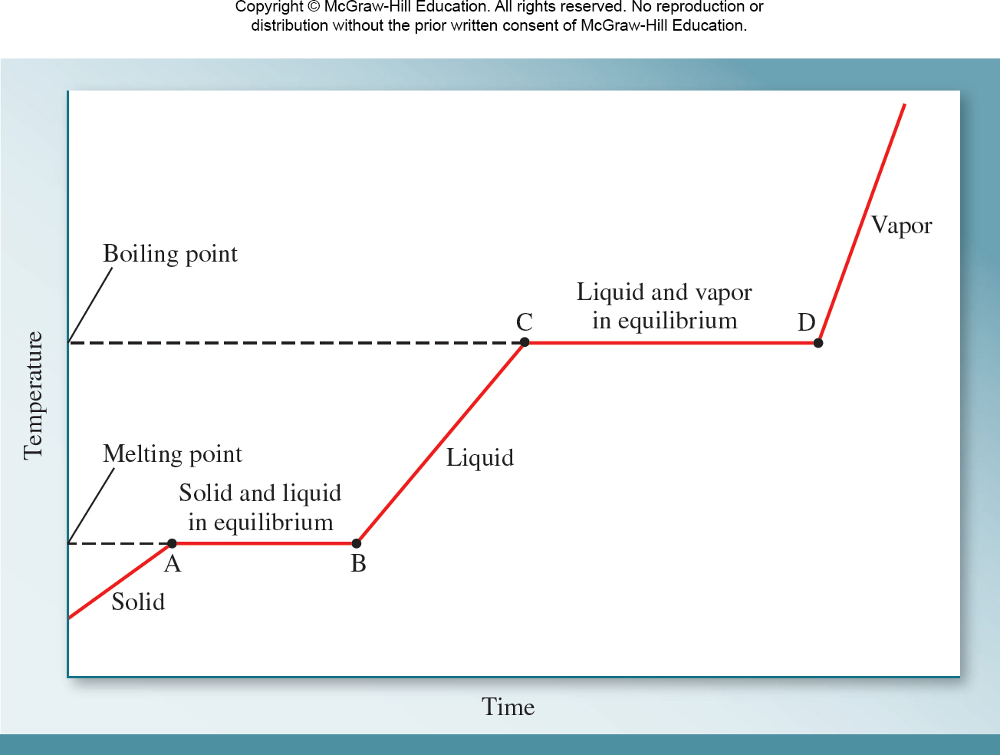
11.6 Phase Changes 12
Solid-Liquid Phase Transition
Access the text alternative for these images

Slide 19
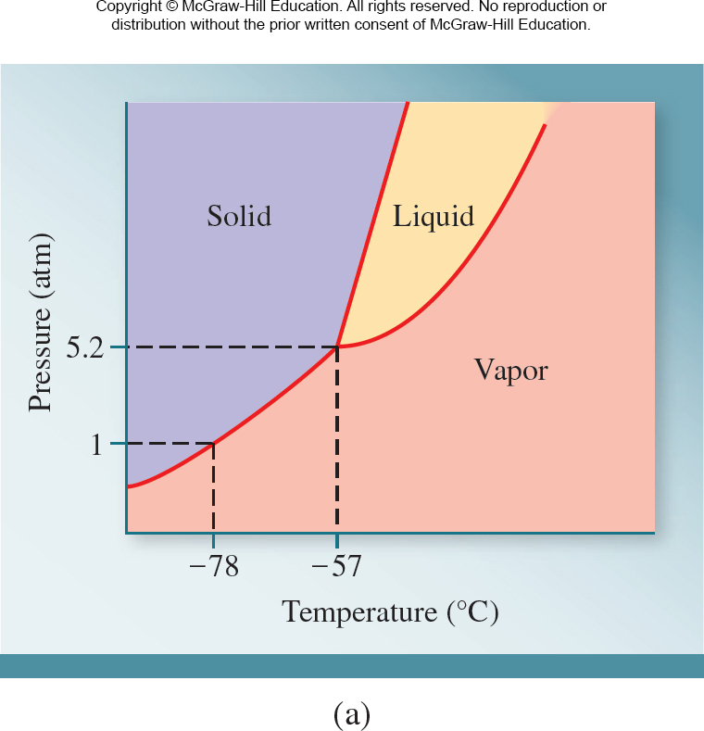
11.7 Phase Diagrams 1
Phase Diagrams
A phase diagram summarizes the conditions (temperature and pressure) at which a substance exists as a solid, liquid, or gas.

Slide 20
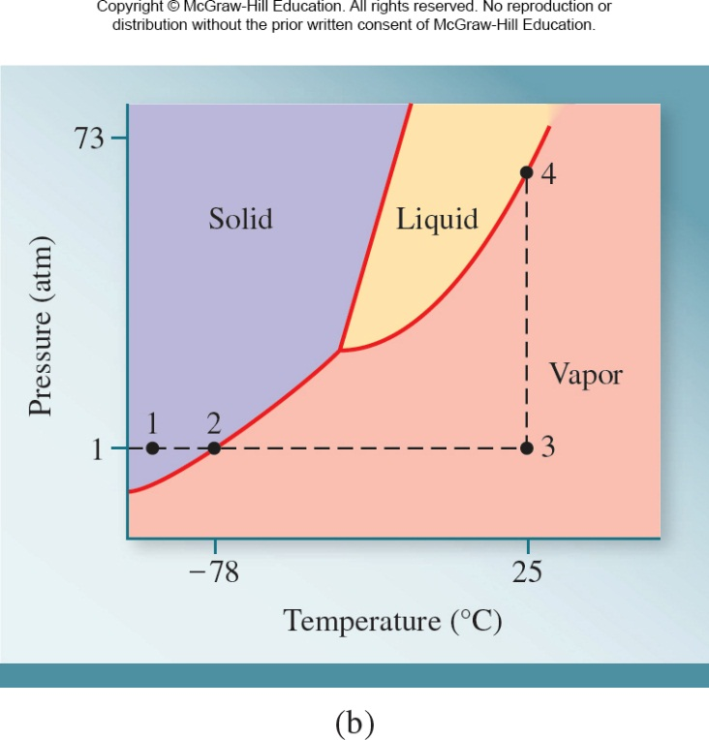
11.7 Phase Diagrams 2
Phase Diagrams
Heating solid CO₂ initially at −100 degrees C and 1 atm (point 1) causes it to sublime when it reaches −78 degrees C (point 2). At 25 degrees C, increasing the pressure
from 1 atm (point 3) to about
70 (point 4) will cause
CO₂ to condense to a liquid.

Slide 21
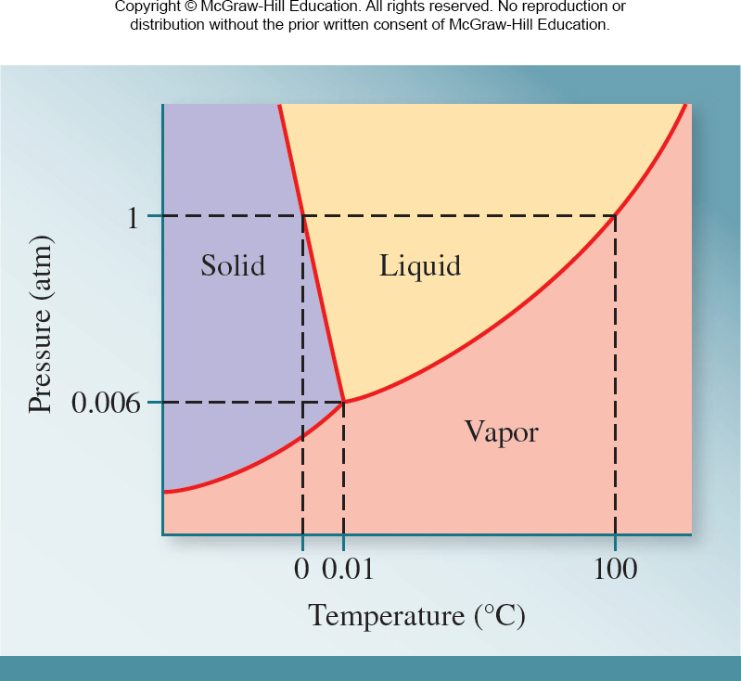
11.7 Phase Diagrams 3
Phase Diagrams
The Unusual Phase Diagram of Water.
Access the text alternative for these images

Slide 22
SAMPLE PROBLEM 11.8 (1)
Using the following phase diagram,
determine the normal boiling point and the normal melting point of the substance,
determine the physical state of the substance at 2 atm and 110 degrees C, and.
determine the pressure and temperature that correspond to the triple point of the substance.

Slide 23
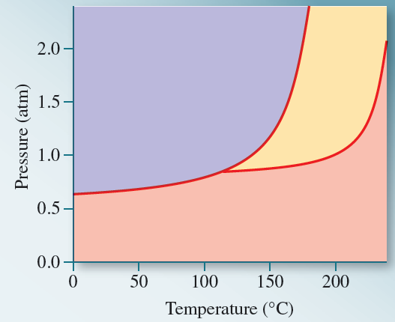
SAMPLE PROBLEM 11.8 (2)
Access the text alternative for these images

Slide 24
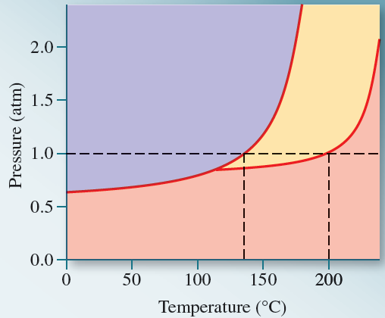
SAMPLE PROBLEM 11.8 Solution 1
Solution
The normal boiling and melting points are ∼140°C and ∼205°C, respectively.
Access the text alternative for these images

Slide 25
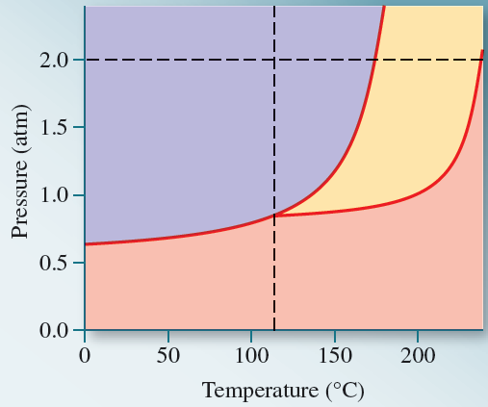
SAMPLE PROBLEM 11.8 Solution 2
Solution
At 2 atm and 110 degrees C the substance is a solid.

Slide 26
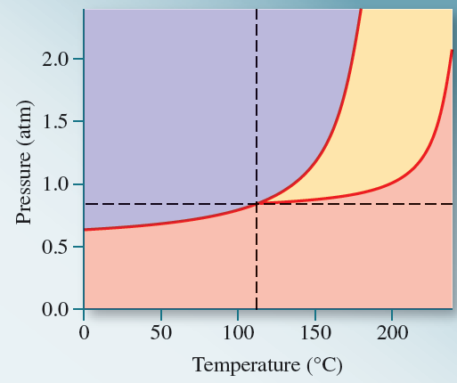
SAMPLE PROBLEM 11.8 Solution 3
Solution
The triple point occurs at ∼0.8 atm and ∼115°C.

