Slide 1
Chemistry
Fifth Edition
Julia Burdge
Lecture PowerPoints
Chapter 13
Physical Properties of Solutions
©2020 McGraw-Hill Education. All rights reserved. Authorized only for instructor use in the classroom. No reproduction or further distribution permitted without the prior written consent of McGraw-Hill Education.

Slide 2
13.1 Types of Solutions 3
Types of Solutions
TABLE 13.1 Types of Solutions
Solute | Solvent | State of Resulting Solution | Example
Gas | Gas | Gas* | Air
Gas | Liquid | Liquid | Carbonated water
Gas | Solid | Solid | H₂ gas in palladium
Liquid | Liquid | Liquid | Ethanol in water
Liquid | Solid | Solid | Mercury in silver
Solid | Liquid | Liquid | Saltwater
Solid | Solid | Solid | Brass (Cu/Zn)

Slide 3
13.2 The Solution Process 2
Intermolecular Forces and Solubility
The ease with which solute molecules are separated from one another and surrounded by solvent molecules depends on the relative strengths of three types of interactions:
Solute-solute interactions.
Solvent-solvent interactions.
Solute-solvent interactions.

Slide 4
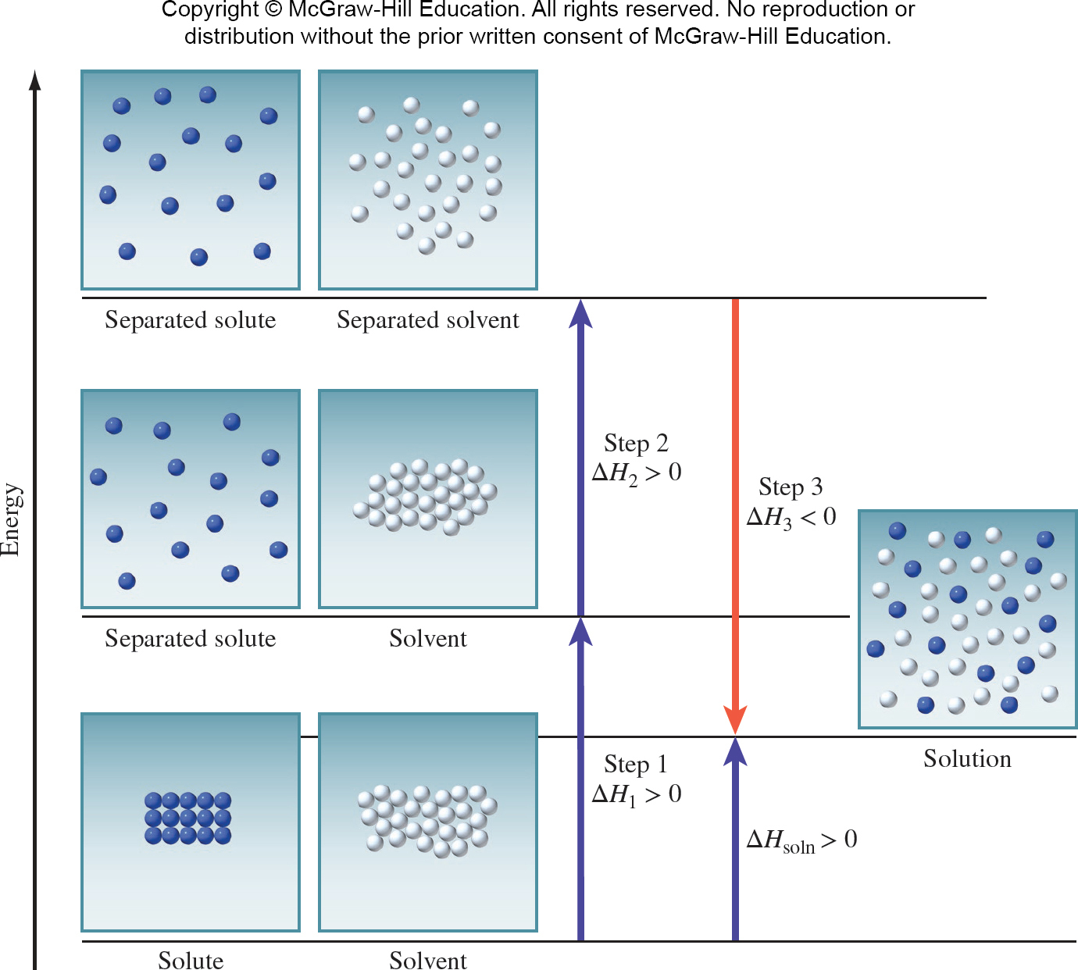
13.2 The Solution Process 4
Access the text alternative for these images

Slide 5
13.2 The Solution Process 5
Intermolecular Forces and Solubility
The thermicity of the dissolving process is one factor that influences solubility.
Dissolution tends to be encouraged when it is exothermic and discouraged when it is endothermic.

Slide 6
13.2 The Solution Process 6
Intermolecular Forces and Solubility
The saying “like dissolves like” is useful in predicting the solubility of a substance in a given solvent.
What this expression means is that two substances with intermolecular forces of similar type and magnitude are likely to be soluble in each other since their mixing is probably not endothermic.

Slide 7
13.2 The Solution Process 7
Intermolecular Forces and Solubility
For example, both carbon tetrachloride (CCl₄) and benzene (C₆H₆) are nonpolar liquids.
When these two liquids are mixed, they readily dissolve in each other, because the attraction between CCl₄ and C₆H₆ molecules is comparable in magnitude to the forces between molecules in pure CCl₄ and those between molecules in pure C₆H₆.
Two liquids are said to be miscible if they are completely soluble in each other in all proportions.

Slide 8
SAMPLE PROBLEM 13.1
Determine for each solute whether the solubility will be greater in water, which is polar, or in benzene (C₆H₆), which is nonpolar:
bromine (Br₂)
sodium iodide (NaI)
carbon tetrachloride (CCl₄)
formaldehyde (CH₂O)

Slide 9
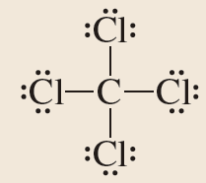
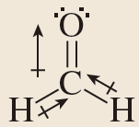
SAMPLE PROBLEM 13.1 Setup
Setup
(a) Bromine is a homonuclear diatomic molecule and is nonpolar.
(b) Sodium iodide is ionic.
(c)
(d)
Access the text alternative for these images

Slide 10
SAMPLE PROBLEM 13.1 Solution
Solution
Bromine is more soluble in benzene.
Sodium iodide is more soluble in water.
Carbon tetrachloride is more soluble in benzene.
Formaldehyde is more soluble in water.

Slide 11
13.3 Concentration Units
Topics
Molality
Percent by Mass
Comparison of Concentration Units

Slide 12
13.3 Concentration Units 1
Molarity and Mole Fraction

Slide 13
13.3 Concentration Units 2
Molarity
Molality (m) is the number of moles of solute dissolved in 1 kg (1000 g) of solvent:

Slide 14
13.3 Concentration Units 3
Percent by Mass
The percent by mass (also called percent by weight) is the ratio of the mass of a solute to the mass of the solution, multiplied by 100 percent.
The term percent literally means “parts per hundred.” If we were to the equation but multiply by 1000 instead of 100, we would get “parts per thousand”; multiplying by 1,000,000 would give “parts per million” or ppm; and so on.

Slide 15
SAMPLE PROBLEM 13.2 Setup
A solution is made by dissolving 170.1 g of glucose (C₆H₁₂O₆) in enough water to make a liter of solution. The density of the solution is 1.062 g/mL.
Express the concentration of the solution in (a) molality, (b) percent by mass, and (c) parts per million.
Setup
The molar mass of glucose is 180.2 g/mol; the density of the solution is 1.062 g/mL.

Slide 16
SAMPLE PROBLEM 13.2 Solution 1
Solution

Slide 17
SAMPLE PROBLEM 13.2 Solution 2
Solution

Slide 18
13.3 Concentration Units 4
Comparison of Concentration Units
The advantage of molarity is that it is generally easier to measure the volume of a solution, using precisely calibrated volumetric flasks, than to weigh the solvent.
Molality, on the other hand, has the advantage of being temperature independent.
Percent by mass is similar to molality in that it is independent of temperature. Furthermore, we do not need to know the molar mass of the solute to calculate the percent by mass.

Slide 19
SAMPLE PROBLEM 13.3 Setup
“Rubbing alcohol” is a mixture of isopropyl alcohol (C₃H₇OH) and water that is 70 percent isopropyl alcohol by mass (density = 0.79 g/mL at 20 degrees C).
Express the concentration of rubbing alcohol in (a) molarity and (b) molality.
Setup
The mass of a liter of rubbing alcohol is 790 g, and the molar mass of isopropyl alcohol is 60.09 g/mol.

Slide 20
SAMPLE PROBLEM 13.3 Solution
Solution
Rubbing alcohol is 9.2 M and 39 m in isopropyl alcohol.

Slide 21
13.4 Factors That Affect Solubility
Topics
Temperature
Pressure

Slide 22
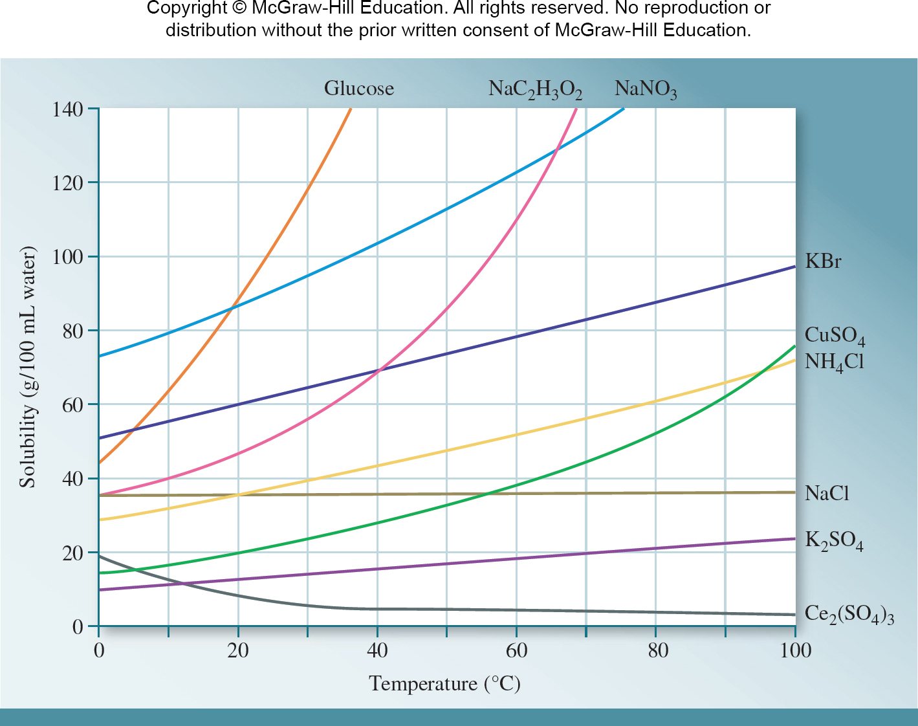
13.4 Factors That Affect Solubility 1
Temperature
Access the text alternative for these images

Slide 23
13.5 Colligative Properties
Topics
Vapor-Pressure Lowering
Boiling-Point Elevation
Freezing-Point Depression
Osmotic Pressure
Electrolyte Solutions

Slide 24
13.5 Colligative Properties 1
Vapor-Pressure Lowering
Colligative properties are properties that depend on the number of solute particles in solution but do not depend on the nature of the solute particles.
That is, colligative properties depend on the concentration of solute particles regardless of whether those particles are atoms, molecules, or ions.

Slide 25
13.5 Colligative Properties 2
Vapor-Pressure Lowering
When a non-volatile solute (one that does not exert a vapor pressure) is dissolved in a liquid, the vapor pressure exerted by the liquid decreases.
This relationship is expressed by Raoult’s law,

Slide 26
SAMPLE PROBLEM 13.5 Setup
Calculate the vapor pressure of water over a solution made by dissolving 225 g of glucose in 575 g of water at 35 degrees C. (At 35 degrees C, P degrees (H₂O)
= 42.2 mmHg.)
Setup
The molar masses of glucose and water are 180.2 and 18.02 g/mol, respectively.

Slide 27
SAMPLE PROBLEM 13.5 Solution
Solution
The vapor pressure of water over the solution is 40.6 mmHg.

Slide 28
13.5 Colligative Properties 4
Vapor-Pressure Lowering
If both components of a solution are volatile (that is, have measurable vapor pressure), the vapor pressure of the solution is the sum of the individual partial pressures exerted by the solution components.
Raoult’s law holds equally well in this case:

Slide 29
13.5 Colligative Properties 5
Vapor-Pressure Lowering

Slide 30
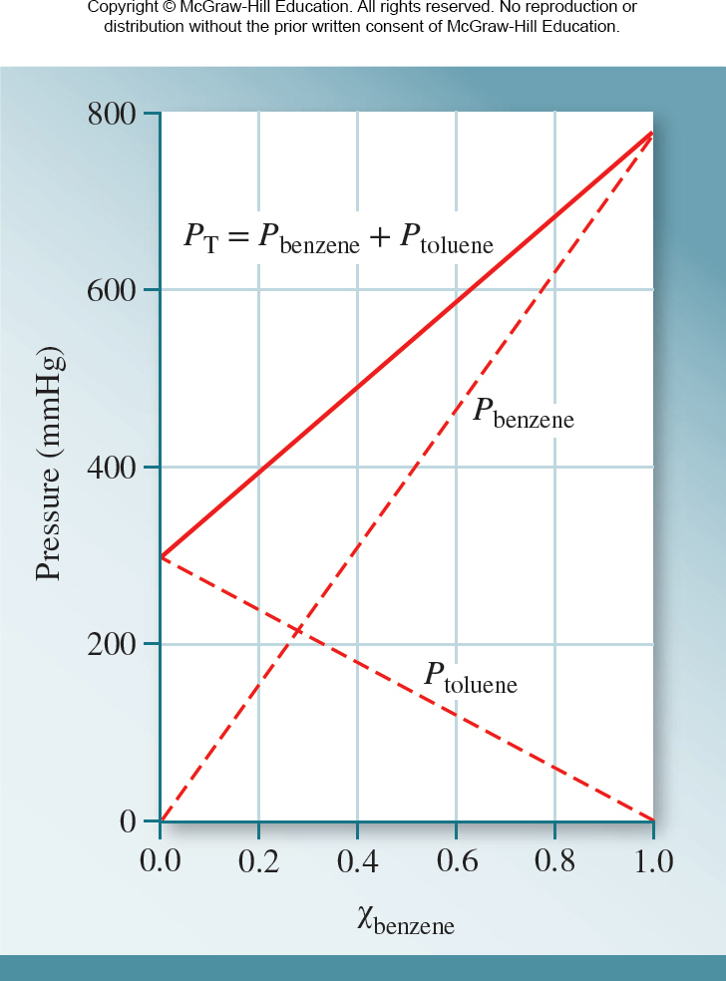
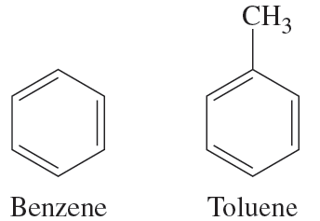
13.5 Colligative Properties 6
Vapor-Pressure Lowering
Access the text alternative for these images

Slide 31
13.5 Colligative Properties 7
Vapor-Pressure Lowering
The benzene-toluene solution is an example of an ideal solution, which is simply a solution that obeys Raoult’s law.

Slide 32
13.5 Colligative Properties 8
Boiling-Point Elevation
Recall that the boiling point of a substance is the temperature at which its vapor pressure equals the external atmospheric pressure.
Because the presence of a nonvolatile solute lowers the vapor pressure of a solution, it also affects the boiling point of the solution—relative to that of the pure liquid.

Slide 33
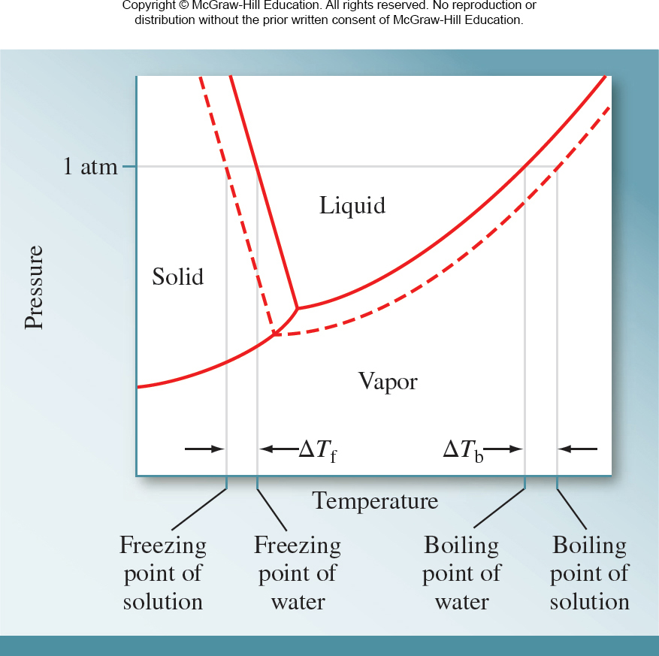
13.5 Colligative Properties 9
Boiling-Point Elevation
Access the text alternative for these images

Slide 34
13.5 Colligative Properties 10
Boiling-Point Elevation
The value of ΔT_{b} is proportional to the concentration, expressed in molality, of the solute in the solution.
∆T_{b} ∝ m
∆T_{b} = K_{b} m
where m is the molality of the solution and K_{b} is the molal boiling-point elevation constant.
The units of K_{b} are degrees C/m.

Slide 35
13.5 Colligative Properties 11
Boiling-Point Elevation
TABLE 13.2 Molal Boiling-Point Elevation and Freezing-Point Depression Constants of Several Common Solvents
Solvent | Normal Boiling Point (°C) | K_{b}(°C/m) | Normal Freezing Point (°C) | K_{f}(°C/m)
Water | 100.0 | 0.52 | 0.0 | 1.86
Benzene | 80.1 | 2.53 | 5.5 | 5.12
Ethanol | 78.4 | 1.22 | −117.3 | 1.99
Acetic acid | 117.9 | 2.93 | 16.6 | 3.90
Cyclohexane | 80.7 | 2.79 | 6.6 | 20.0

Slide 36
13.5 Colligative Properties 12
Boiling-Point Elevation
The boiling point of a 1.00-m aqueous solution of a nonvolatile, nonelectrolyte:

Slide 37
13.5 Colligative Properties 13
Freezing-Point Depression
Access the text alternative for these images

Slide 38
13.5 Colligative Properties 14
Freezing-Point Depression
∆T_{f} ∝ m
∆T_{f} = K_{f} m
where m is the concentration of solute expressed in molality and K_{f} is the molal freezing-point depression constant.
Like K_{b}, K_{f} has units of degrees C/m.

Slide 39
SAMPLE PROBLEM 13.6 Setup
Ethylene glycol [CH₂(OH)CH₂(OH)] is a common automobile antifreeze. It is water soluble and fairly nonvolatile (b.p. 197 degrees C).
Calculate (a) the freezing point and (b) the boiling point of a solution containing 685 g of ethylene glycol in 2075 g
of water.
Setup
The molar mass of ethylene glycol (C₂H₆O₂) is 62.07 g/mol.
K_{f} and K_{b} for water are 1.86 degrees C/m and 0.52 degrees C/m, respectively.

Slide 40
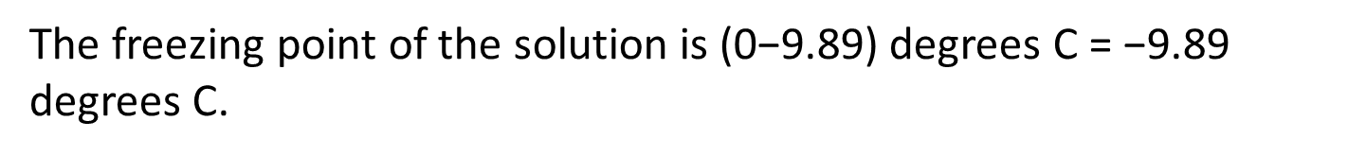
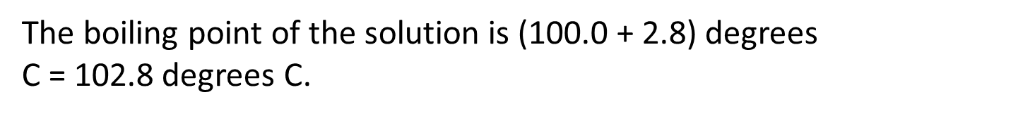
SAMPLE PROBLEM 13.6 Solution
Solution
The freezing point of the solution is (0−9.89) degrees C = −9.89 degrees C.
The boiling point of the solution is (100.0 + 2.8) degrees
C = 102.8 degrees C.

Slide 41
13.5 Colligative Properties 15
Osmotic Pressure
Many chemical and biological processes depend on osmosis, the selective passage of solvent molecules through a porous membrane from a more dilute solution to a more concentrated one.

Slide 42
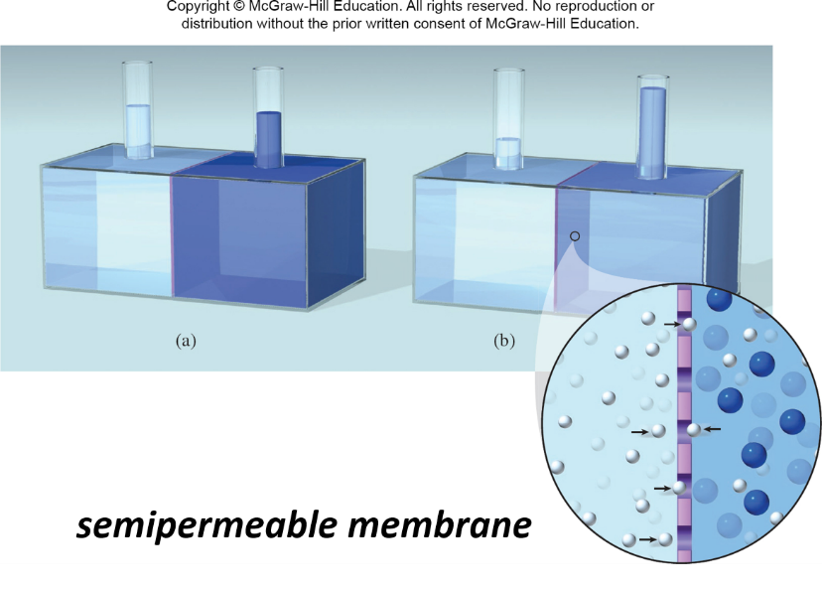
13.5 Colligative Properties 16
Osmotic Pressure

Slide 43
13.5 Colligative Properties 17
Osmotic Pressure
The osmotic pressure (π ) of a solution is the pressure required to stop osmosis.
The osmotic pressure of a solution is directly proportional to the concentration, expressed in molarity, of the solute in solution:
π ∝ M
π = MRT
where M is the molarity of the solution, R is the gas constant (0.08206 L · atm/K · mol), and T is the absolute temperature.

Slide 44
13.5 Colligative Properties 18
Osmotic Pressure
Two solutions of equal concentration have the same osmotic pressure and are said to be isotonic to each other.

Slide 45
13.5 Colligative Properties 19
Electrolyte Solutions
For every mole of CaCl₂ dissolved, we get three moles of ions in solution.
Colligative properties depend only on the number of dissolved particles—not on the type of particles.
The van’t Hoff factor (i):

Slide 46
13.5 Colligative Properties 20
Electrolyte Solutions

Slide 47
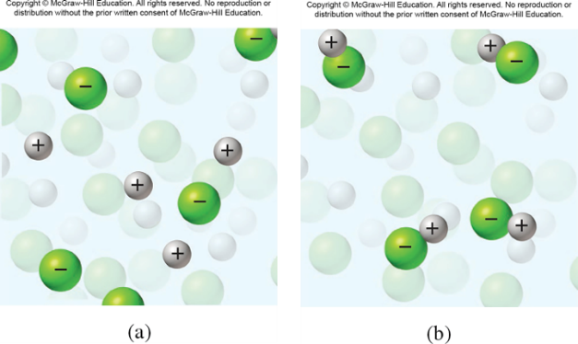
13.5 Colligative Properties 21
Electrolyte Solutions
In reality, the colligative properties of electrolyte solutions are usually smaller than predicted by the previous equations, especially at higher concentrations, because of the formation of ion pairs.
An ion pair is made up of one or more cations and one or more anions held together by electrostatic forces.

Slide 48
13.5 Colligative Properties 22
Electrolyte Solutions
TABLE 13.3 Calculated and Measured van’t Hoff Factors of 0.0500-M Electrolyte Solution at 25 degrees C
Electrolyte | i (Calculated) | i (Measured)
Surcrose* | 1 | 1.0
HCl | 2 | 1.9
NaCl | 2 | 1.9
M_{g}SO₄ | 2 | 1.3
M_{g}Cl₂ | 3 | 2.7
FeCl₃ | 4 | 3.4

Slide 49
13.5 Colligative Properties 23
Electrolyte Solutions
TABLE 13.4 Experimentally Measured van’t Hoff factors of Sucrose and NaCl Solutions at 25 degrees C
Compound | Concentration 0.100 m | Concentration 0.00100 m | Concentration 0.000100 m
Sucrose | 1.00 | 1.00 | 1.00
NaCl | 1.87 | 1.94 | 1.97

Slide 50
SAMPLE PROBLEM 13.7 Setup
The osmotic pressure of a 0.0100 M potassium iodide (KI) solution at 25 degrees C is 0.465 atm. Determine the experimental van’t Hoff factor for KI at this concentration.
Setup
R = 0.08206 L · atm/K · mol, and T = 298 K.

Slide 51
SAMPLE PROBLEM 13.7 Solution
Solution
The experimental van’t Hoff factor for KI at this concentration is 1.90.

Slide 52
13.6 Calculations Using Colligative Properties 2
Calculations Using Colligative Properties
From the experimentally determined freezing-point depression or osmotic pressure, we can calculate the solution’s molality or molarity, respectively.
Knowing the mass of dissolved solute, we can readily determine its molar mass.

Slide 53
SAMPLE PROBLEM 13.9 Setup
Quinine was the first drug widely used to treat malaria, and it remains the treatment of choice for severe cases.
A solution prepared by dissolving 10.0 g of quinine in 50.0 mL of ethanol has a freezing point 1.55 degrees C below that of pure ethanol.
Determine the molar mass of quinine. (The density of ethanol is 0.789 g/mL.) Assume that quinine is a nonelectrolyte.
Setup
mass of ethanol = 50.0 mL × 0.789 g/mL = 39. or
3.95 × 10⁻² kg

Slide 54
SAMPLE PROBLEM 13.9 Solution
Solution

Slide 55
SAMPLE PROBLEM 13.10 Setup
A solution is prepared by dissolving 50.0 g of hemoglobin (Hb) in enough water to make 1.00 L of solution. The osmotic pressure of the solution is measured and found to be 14.3 mmHg at 25 degrees C.
Calculate the molar mass of hemoglobin. (Assume that there is no change in volume when the hemoglobin is added to the water.)
Setup
R = 0.08206 L · atm/K · mol, T = 298 K, and
π = 14.3 mmHg/(760 mmHg/atm) = 1.88 × 10^{–2} atm.

Slide 56
SAMPLE PROBLEM 13.10 Solution
Solution

