Slide 1

Chemistry
Fifth Edition
Julia Burdge
Lecture PowerPoints
Chapter 5
Thermochemistry
Copyright © McGraw-Hill Education. All rights reserved. No reproduction or distribution without the prior written consent of McGraw-Hill Education.

Slide 2
Thermochemistry
5
CHAPTER
5.1 Energy and Energy Changes
5.2 Introduction to Thermodynamics
5.3 Enthalpy
5.4 Calorimetry
5.5 Hess's Law
5.6 Standard Enthalpies of Formation

Slide 3
5.1 Energy and Energy Changes (7)
Energy Changes in Chemical Reactions
The system is defined as the specific part of the universe that is of interest to us.
The rest of the universe outside the system constitutes the surroundings.

Slide 4
5.1 Energy and Energy Changes (8)
Energy Changes in Chemical Reactions
Heat is the transfer of thermal energy between two bodies that are at different temperatures.
Although the term heat by itself implies the transfer of energy, we customarily talk of “heat flow,” meaning “heat absorbed” or “heat released,” when describing the energy changes that occur during a process.
Thermochemistry is the study of heat (the transfer of thermal energy) in chemical reactions.

Slide 5
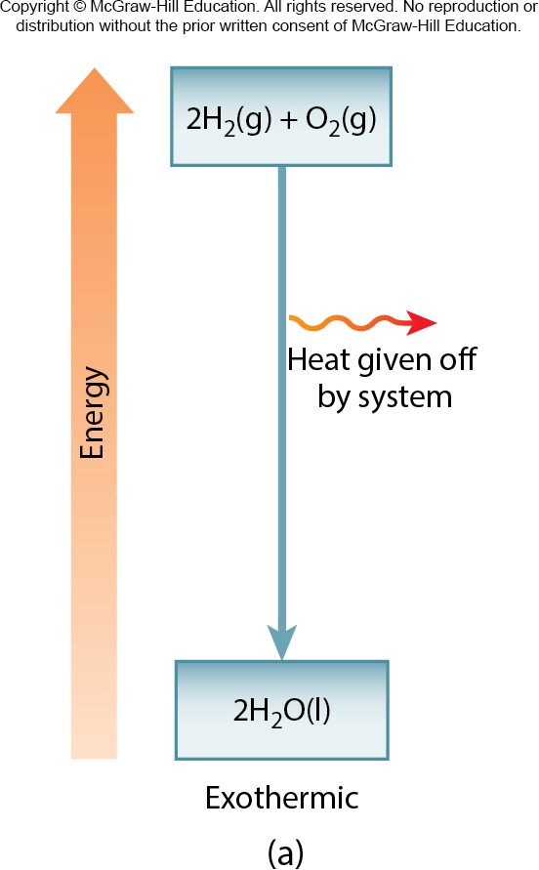
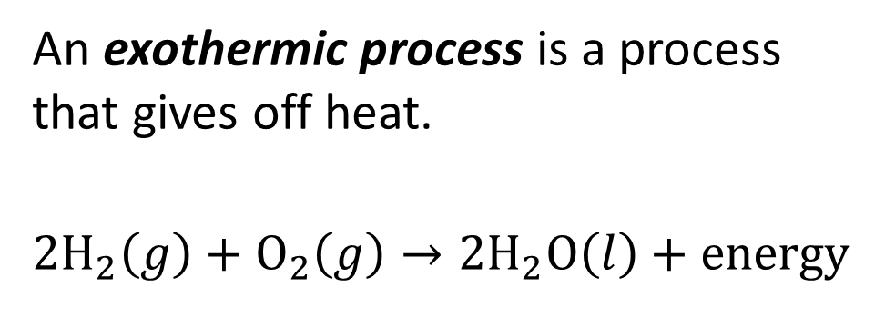
5.1 Energy and Energy Changes (9)
Energy Changes in Chemical Reactions
An exothermic process is a process that gives off heat.
$${2H}_{2}\left(g\right)+O_{2}\left(g\right)→{2H}_{2}O\left(l\right)+energy$$

Slide 6
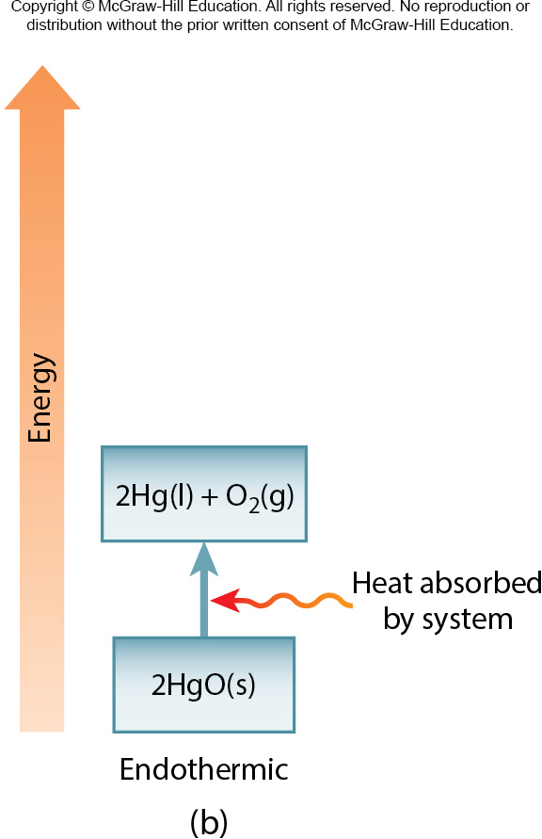
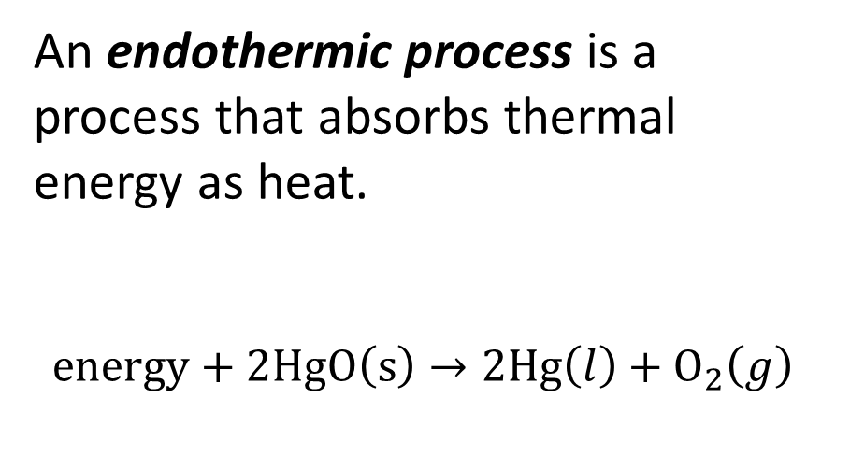
5.1 Energy and Energy Changes (10)
Energy Changes in Chemical Reactions
An endothermic process is a process that absorbs thermal energy as heat.
$energy+2HgO\left(s\right)→2Hg\left(l\right)+O_{2}\left(g\right)$

Slide 7
5.2 Introduction to Thermodynamics (1)
States and State Functions
Thermochemistry is part of a broader subject called thermodynamics, which is the scientific study of the interconversion of heat and other kinds of energy.
An open system can exchange mass and energy with its surroundings.
A closed system allows the transfer of energy but not mass.
An isolated system does not exchange either mass or energy with its surroundings.

Slide 8
5.2 Introduction to Thermodynamics (2)
States and State Functions
In thermodynamics, we study changes in the state of a system, which is defined by the values of all relevant macroscopic properties, such as composition, energy, temperature, pressure, and volume.
Energy, pressure, volume, and temperature are said to be state functions—properties that are determined by the state of the system, regardless of how that condition was achieved.

Slide 9
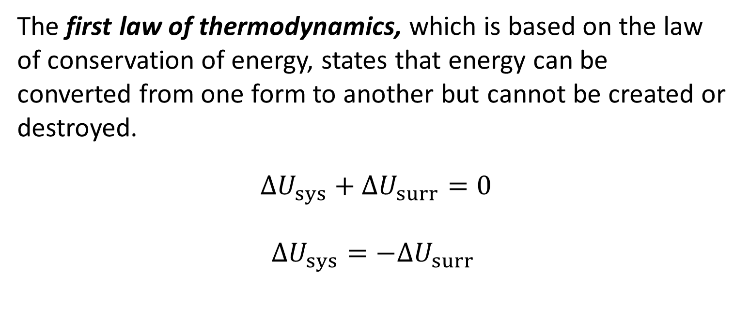
5.2 Introduction to Thermodynamics (4)
The First Law of Thermodynamics
The first law of thermodynamics, which is based on the law of conservation of energy, states that energy can be converted from one form to another but cannot be created or destroyed.
$∆U_{sys}+∆U_{surr}=0$
$$∆U_{sys}=−∆U_{surr}$$

Slide 10

5.2 Introduction to Thermodynamics (5)
The First Law of Thermodynamics
The change in internal energy of a system, $∆U$, is given by
$∆U=U_{f}−U_{i}$

Slide 11
5.2 Introduction to Thermodynamics (6)
Work and Heat
Energy is defined as the capacity to do work or transfer heat.
When a system releases or absorbs heat, its internal energy changes.
Likewise, when a system does work on its surroundings, or when the surroundings do work on the system, the system’s internal energy also changes.

Slide 12
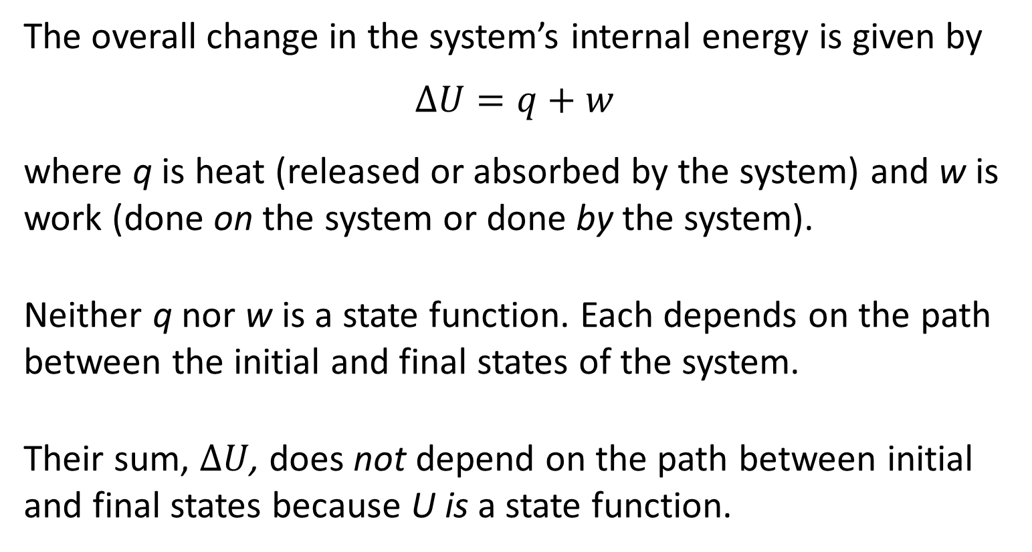
5.2 Introduction to Thermodynamics (7)
Work and Heat
The overall change in the system’s internal energy is given by
$$∆U=q+w$$
where q is heat (released or absorbed by the system) and w is work (done on the system or done by the system).
Neither q nor w is a state function. Each depends on the path between the initial and final states of the system.
Their sum, $∆U$, does not depend on the path between initial and final states because U is a state function.

Slide 13
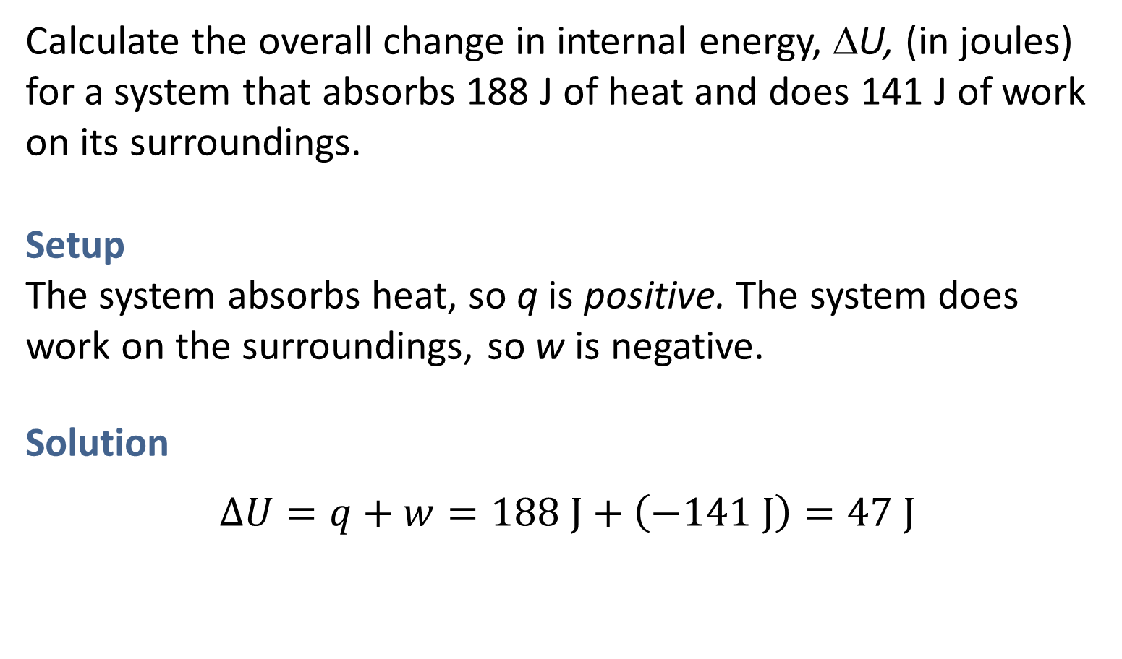
SAMPLE PROBLEM 5.2 Setup
Calculate the overall change in internal energy, ΔU, (in joules) for a system that absorbs 188 J of heat and does 141 J of work on its surroundings.
Setup
The system absorbs heat, so q is positive. The system does work on the surroundings, so w is negative.
Solution
$∆U=q+w=188 J+\left(−141 J\right)=47 J$

Slide 14
5.2 Introduction to Thermodynamics (8)
Work and Heat
TABLE 5.1 Sign Conventions for Heat(q) and work(w)
Process | Sign
Heat absorbed by the system(endothermic process) | q is positive
Heat released by the system(exothermic process) | q is negative
Work done on the system by the surroundings(e.g., a volume decrease) | w is positive
Work done on the system by the surroundings(e.g., a volume increase) | w is negative

Slide 15
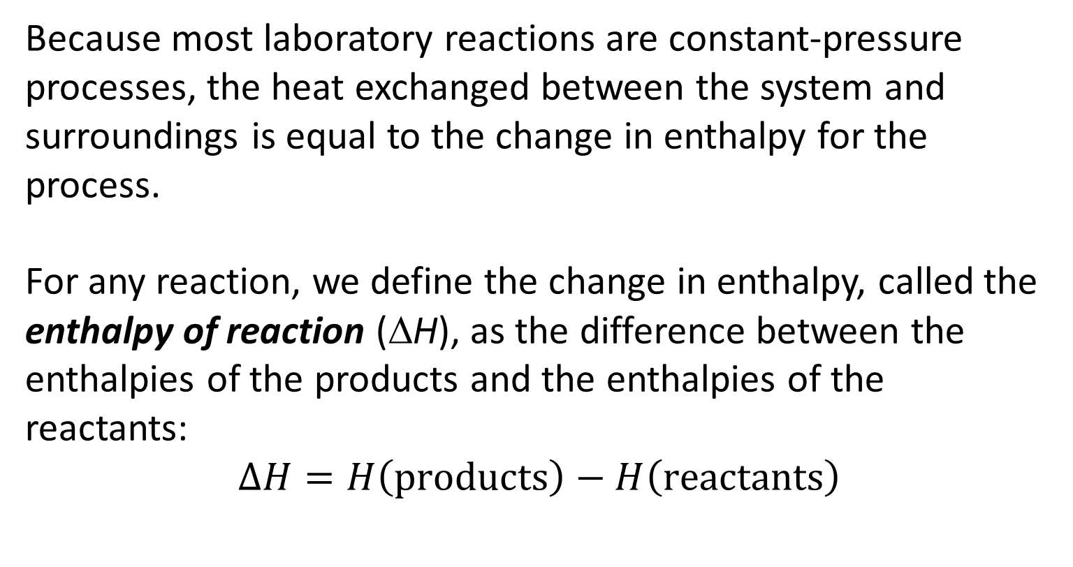
5.3 Enthalpy (6)
Enthalpy and Enthalpy Changes
Because most laboratory reactions are constant-pressure processes, the heat exchanged between the system and surroundings is equal to the change in enthalpy for the process.
For any reaction, we define the change in enthalpy, called the enthalpy of reaction (ΔH), as the difference between the enthalpies of the products and the enthalpies of the reactants:
$$∆H=H\left(products\right)−H\left(reactants\right)$$

Slide 16
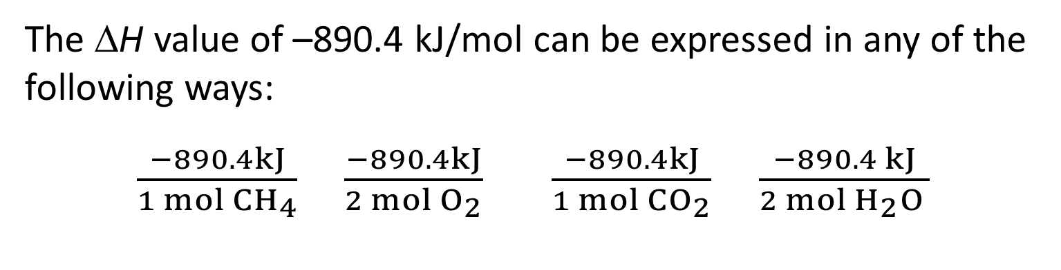
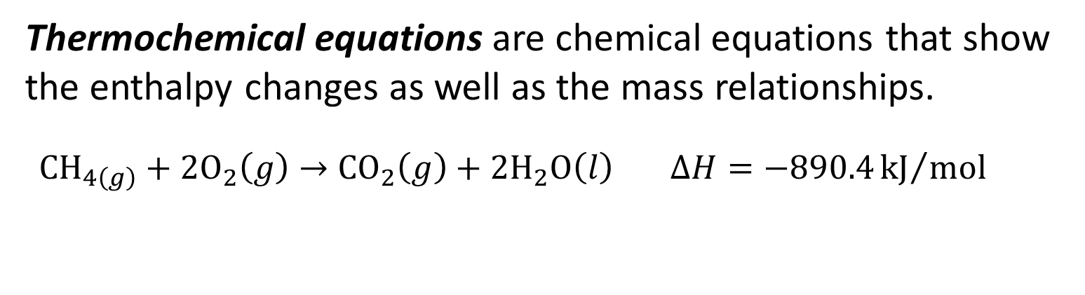
5.3 Enthalpy (7)
Thermochemical Equations
Thermochemical equations are chemical equations that show the enthalpy changes as well as the mass relationships.
${CH}_{4\left(g\right)}+{2O}_{2}\left(g\right)→{CO}_{2}\left(g\right)+{2H}_{2}O\left(l\right)$ $∆H=−890.4{kJ}/{mol}$
The ΔH value of –890.4 kJ/mol can be expressed in any of the following ways:
$\frac{−890.4kJ}{1 mol {CH}_{4}}$ $\frac{−890.4kJ}{2 mol O_{2}}$ $\frac{−890.4kJ}{1 mol {CO}_{2}}$ $\frac{−890.4 kJ}{2 mol H_{2}O }$

Slide 17
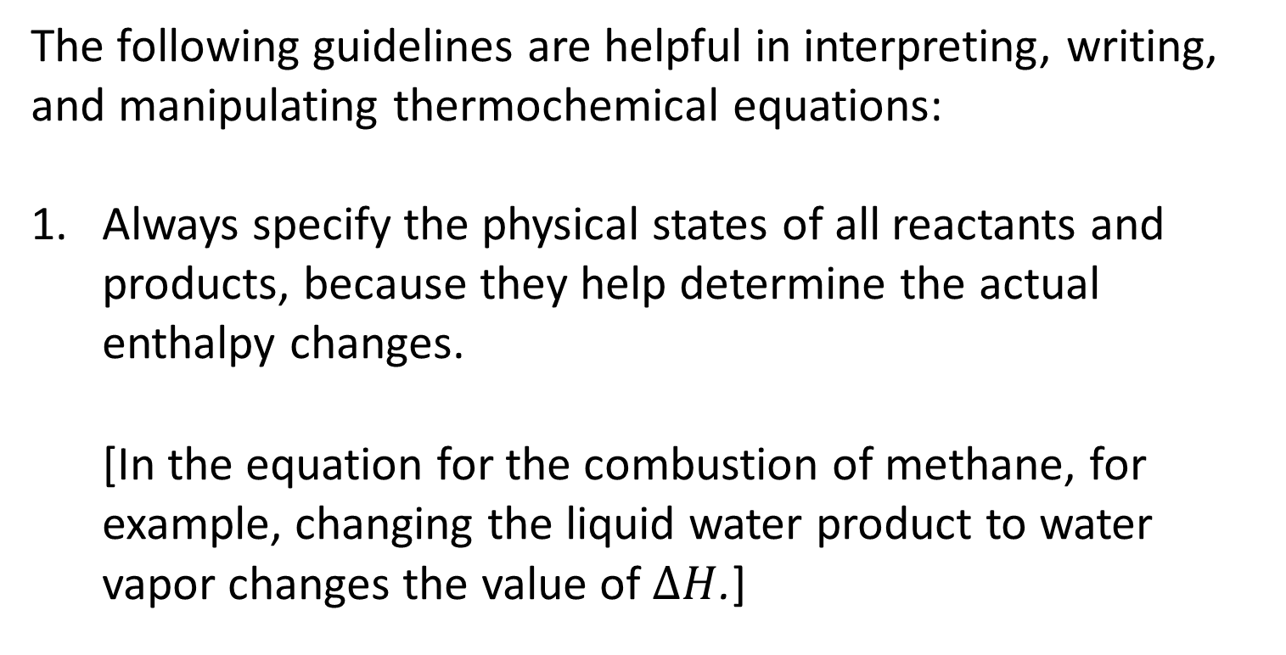
5.3 Enthalpy (8)
Thermochemical Equations
The following guidelines are helpful in interpreting, writing, and manipulating thermochemical equations:
Always specify the physical states of all reactants and products, because they help determine the actual enthalpy changes.
[In the equation for the combustion of methane, for example, changing the liquid water product to water vapor changes the value of $∆H$.]

Slide 18
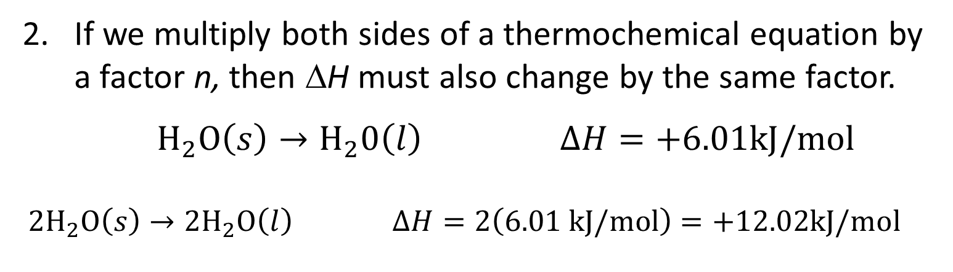
5.3 Enthalpy (9)
Thermochemical Equations
If we multiply both sides of a thermochemical equation by a factor n, then ΔH must also change by the same factor.
$H_{2}O\left(s\right)→H_{2}0\left(l\right)$ $∆H=+6.01kJ/mol$
${2H}_{2}O\left(s\right)→{2H}_{2}O\left(l\right)$ $∆H=2\left(6.01 kJ/mol\right)=+12.02kJ/mol$

Slide 19
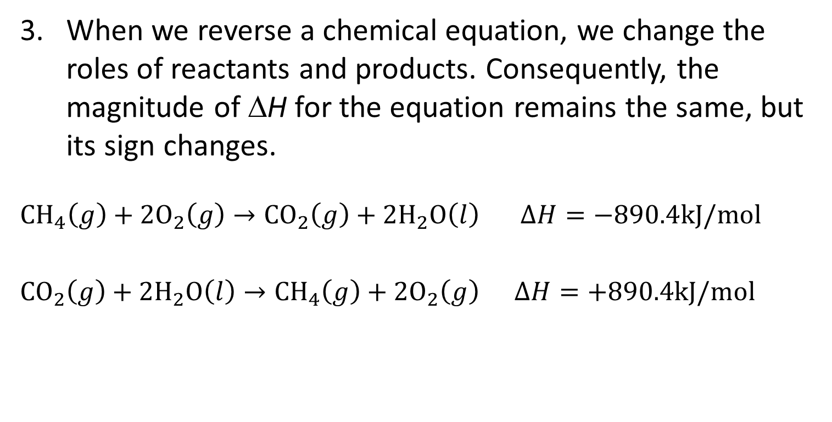
5.3 Enthalpy (10)
Thermochemical Equations
When we reverse a chemical equation, we change the roles of reactants and products. Consequently, the magnitude of ΔH for the equation remains the same, but its sign changes.
${CH}_{4}\left(g\right)+{2O}_{2}\left(g\right)→{CO}_{2}\left(g\right)+{2H}_{2}O\left(l\right)$ $∆H=−890.4kJ/mol$
${CO}_{2}\left(g\right)+{2H}_{2}O\left(l\right)→{CH}_{4}\left(g\right)+{2O}_{2}\left(g\right)$ $∆H=+890.4kJ/mol$

Slide 20
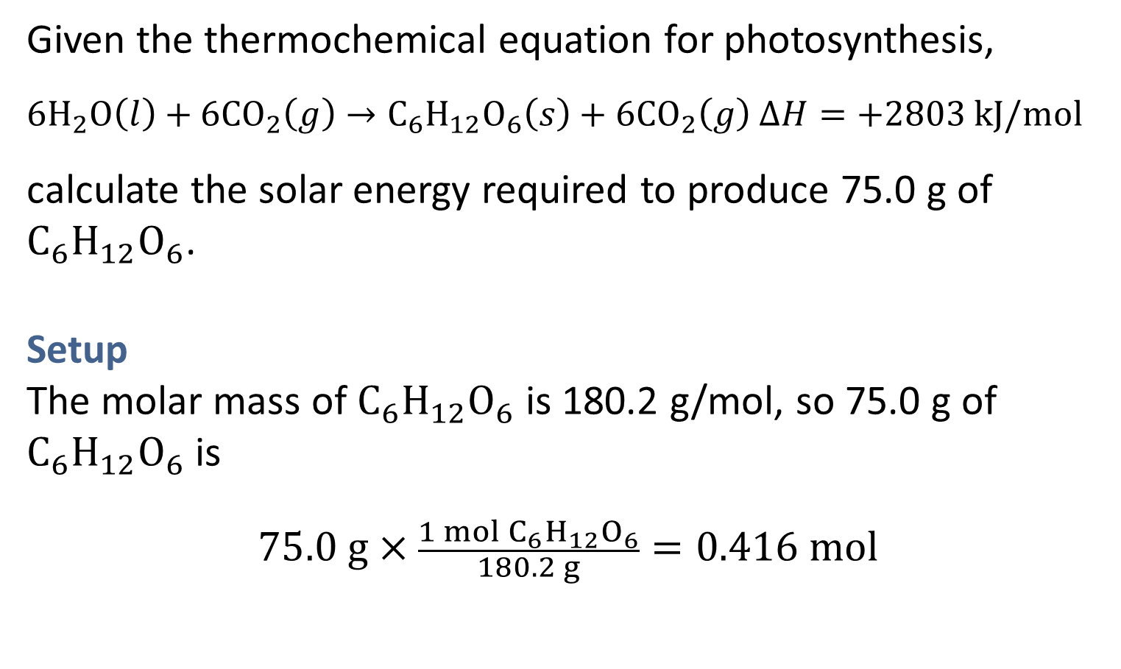
SAMPLE PROBLEM 5.3 Setup
Given the thermochemical equation for photosynthesis,
${6H}_{2}O\left(l\right)+{6CO}_{2}\left(g\right)→C_{6}H_{12}O_{6}\left(s\right)+{6CO}_{2}\left(g\right)$ $∆H=+2803 kJ/mol$
calculate the solar energy required to produce 75.0 g of $C_{6}H_{12}O_{6}$.
Setup
The molar mass of $C_{6}H_{12}O_{6}$ is 180.2 g/mol, so 75.0 g of $C_{6}H_{12}O_{6}$ is
$$75.0 g×\frac{1 mol C_{6}H_{12}O_{6}}{180.2 g}=0.416 mol$$

Slide 21
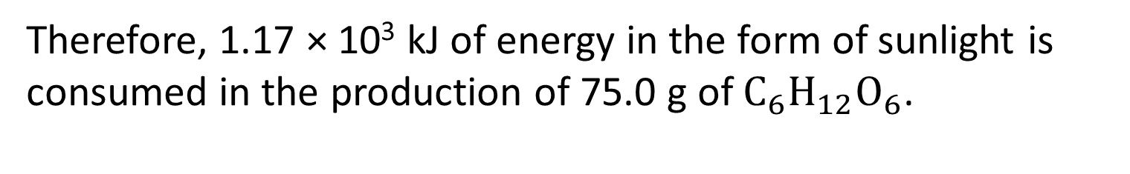
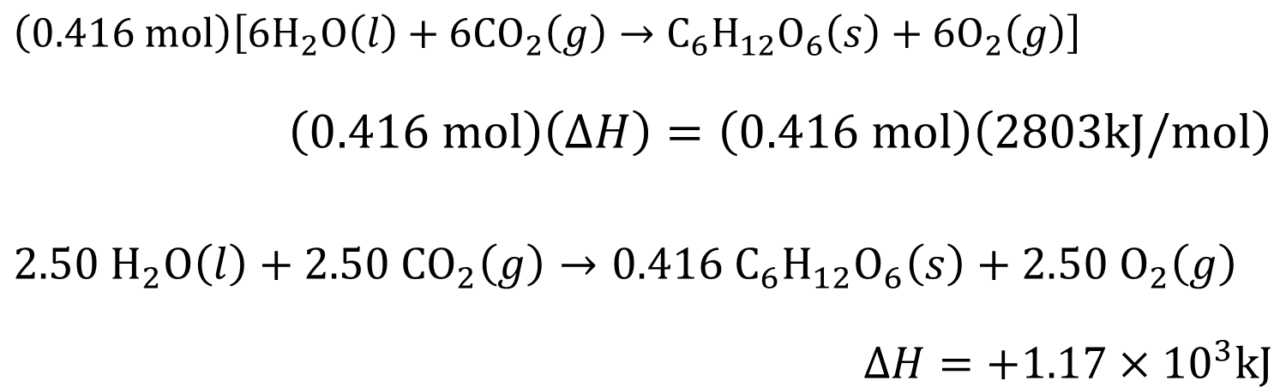
SAMPLE PROBLEM 5.3 Solution
Solution
$$\left(0.416 mol\right)\left[{6H}_{2}O\left(l\right)+{6CO}_{2}\left(g\right)→C_{6}H_{12}O_{6}\left(s\right)+{6O}_{2}\left(g\right)\right]$$
$$\left(0.416 mol\right)\left(∆H\right)=\left(0.416 mol\right)\left(2803kJ/mol\right)$$
$$2.50 H_{2}O\left(l\right)+2.50{ CO}_{2}\left(g\right)→0.416{ C}_{6}H_{12}O_{6}\left(s\right)+2.50 O_{2}\left(g\right)$$
$$∆H=+1.17×{10}^{3}kJ$$
Therefore, 1.17 × 10³ kJ of energy in the form of sunlight is consumed in the production of 75.0 g of $C_{6}H_{12}O_{6}$.

Slide 22
5.4 Calorimetry (1)
Specific Heat and Heat Capacity
The specific heat (s) of a substance is the amount of heat required to raise the temperature of 1 g of the substance by 1°C.
The heat capacity (C) is the amount of heat required to raise the temperature of an object by 1°C.

Slide 23
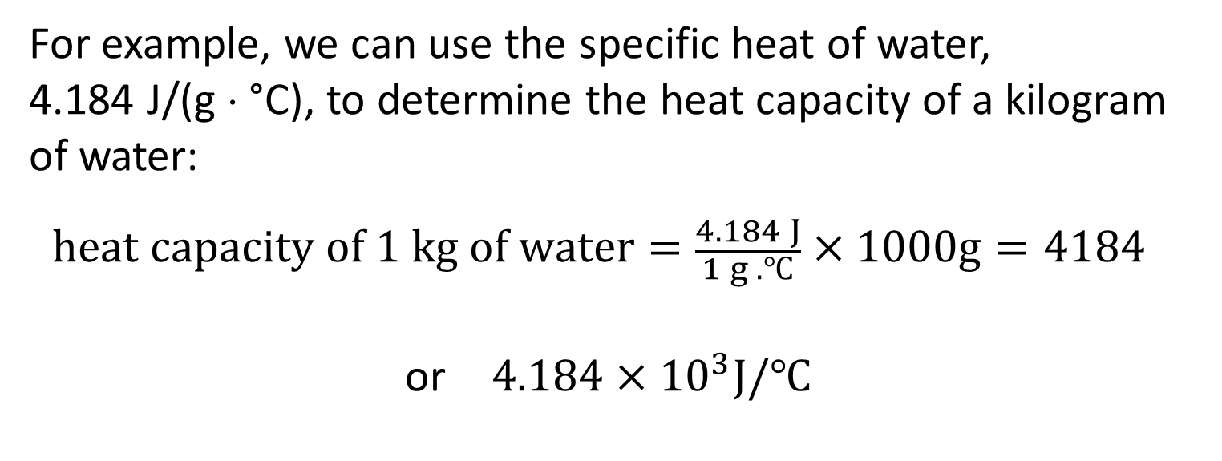
5.4 Calorimetry (2)
Specific Heat and Heat Capacity
For example, we can use the specific heat of water,
4.184 J/(g ⋅ °C), to determine the heat capacity of a kilogram of water:
$$heat capacity of 1 kg of water=\frac{4.184 J}{1 g . ℃}×1000g=4184$$
or $4.184×{10}^{3}J/℃$
Note that specific heat has the units J/(g ⋅ °C) and heat capacity has the units J/°C.

Slide 24
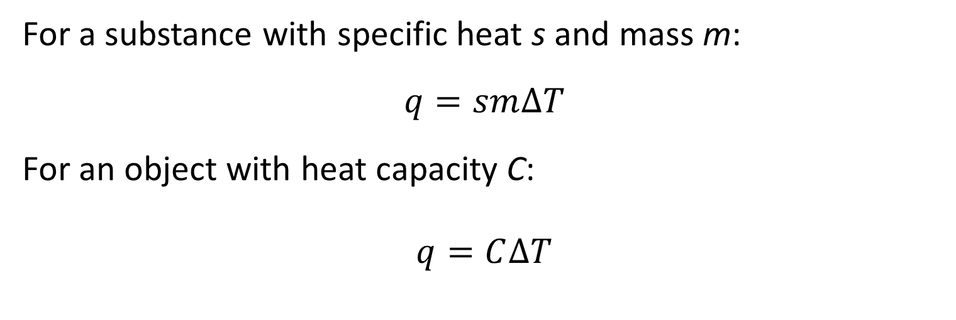
5.4 Calorimetry (3)
Specific Heat and Heat Capacity
For a substance with specific heat s and mass m:
$$q=sm∆T$$
For an object with heat capacity C:
$$q=C∆T$$

Slide 25
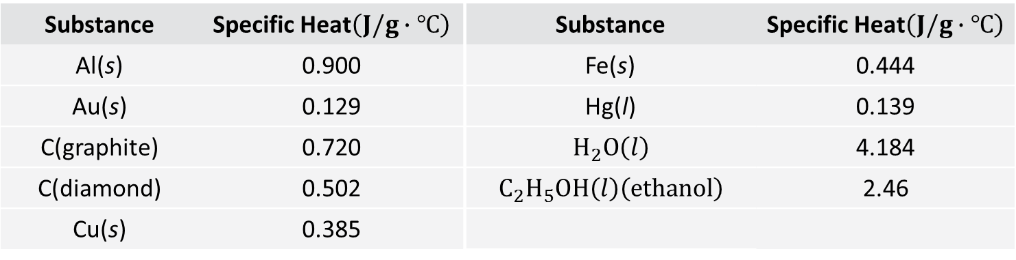
5.4 Calorimetry (4)
Specific Heat and Heat Capacity
TABLE 5.2 Specific Heat Values of Some Common Substances
Substance | Specific Heat$\left(J/g∙℃\right)$ | Substance | Specific Heat$\left(J/g∙℃\right)$
Al(s) | 0.900 | Fe(s) | 0.444
Au(s) | 0.129 | Hg(l) | 0.139
C(graphite) | 0.720 | $$H_{2}O\left(l\right)$$ | 4.184
C(diamond) | 0.502 | $$C_{2}H_{5}OH\left(l\right)\left(ethanol\right)$$ | 2.46
Cu(s) | 0.385

Slide 26
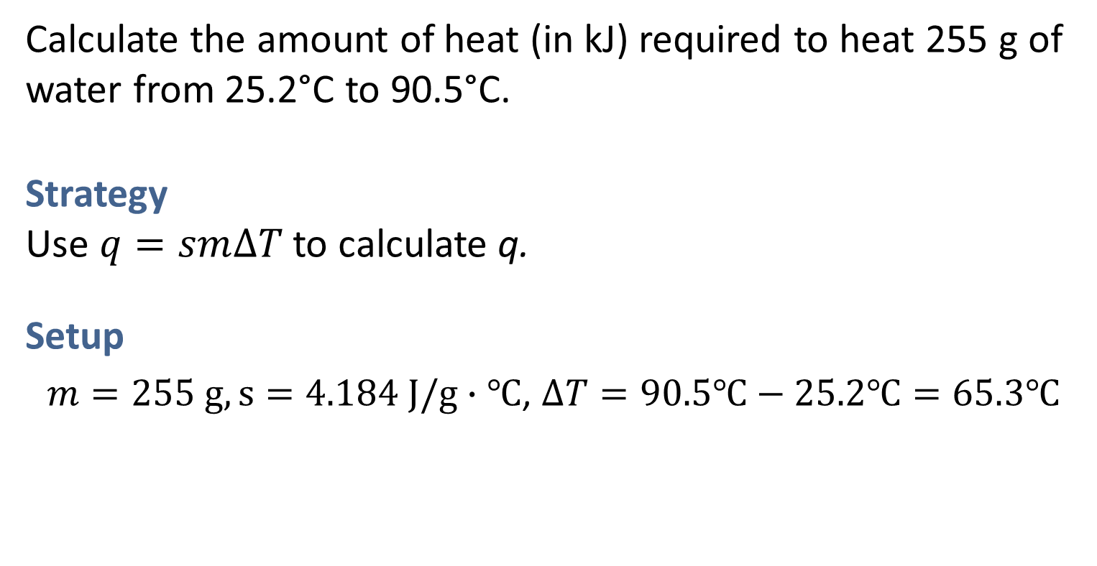
SAMPLE PROBLEM 5.4 Strategy
Calculate the amount of heat (in kJ) required to heat 255 g of water from 25.2°C to 90.5°C.
Strategy
Use $q=sm∆T$to calculate q.
Setup
$m=255 g,s=4.184 J/g∙℃$, $∆T=90.5℃−25.2℃=65.3℃$

Slide 27
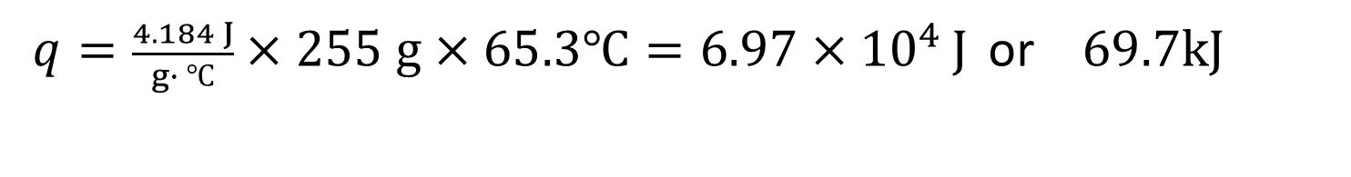
SAMPLE PROBLEM 5.4 Solution
Solution
$q=\frac{4.184 J}{g∙ ℃}×255 g×65.3℃=6.97×{10}^{4 }J$ or $69.7kJ$

Slide 28
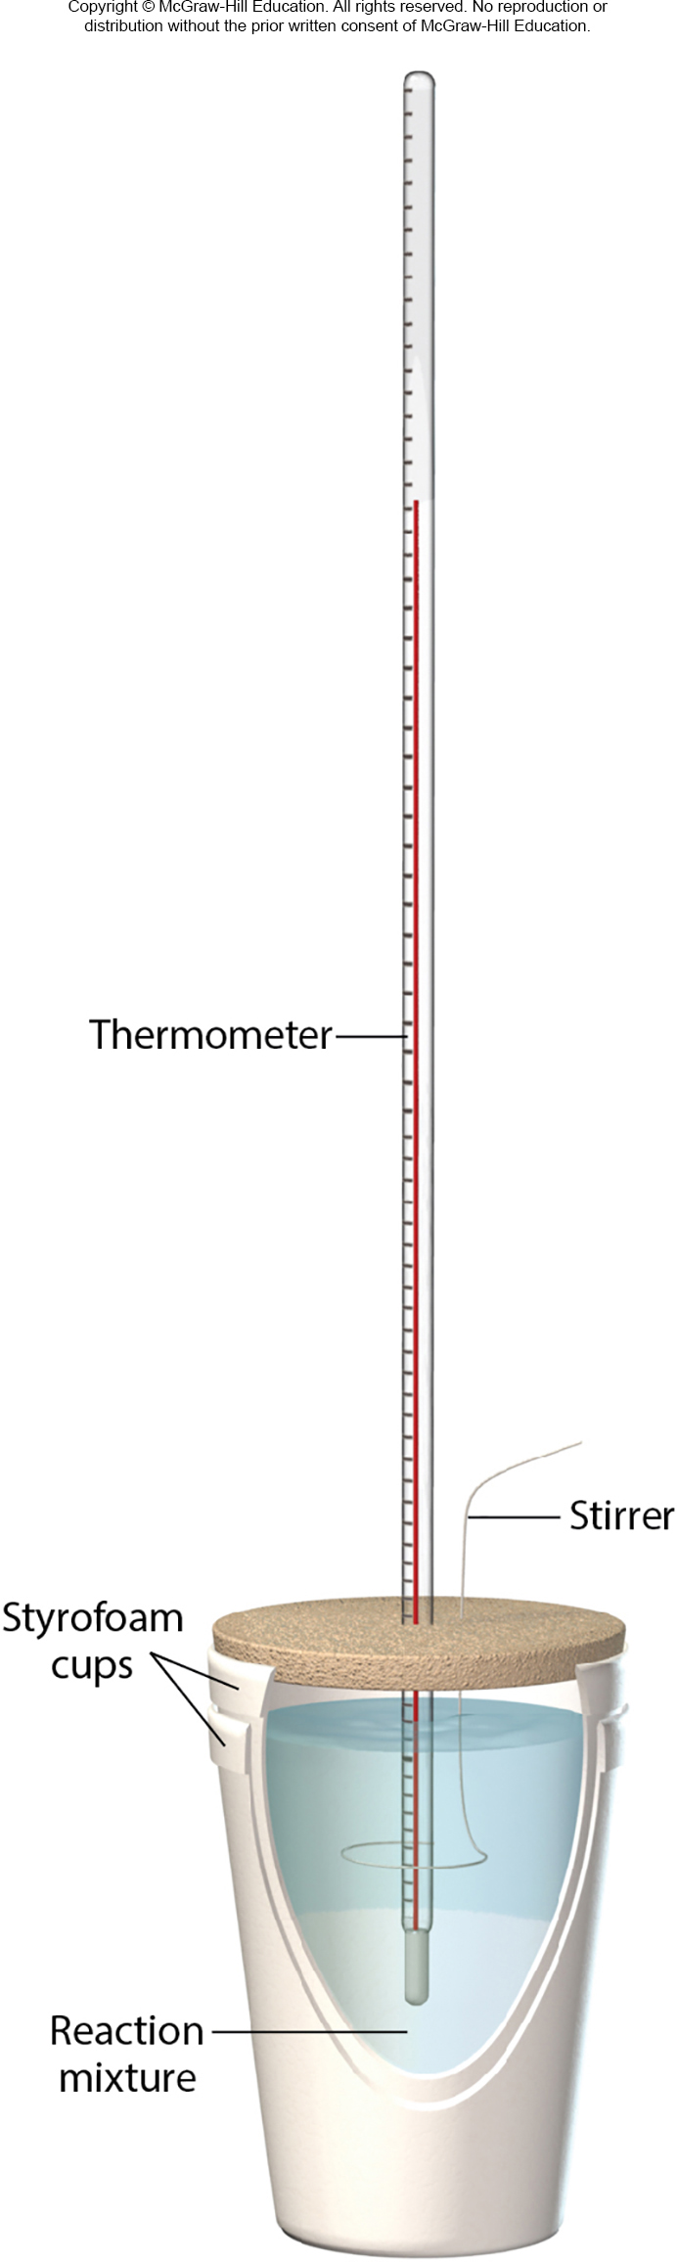

5.4 Calorimetry (5)
Constant-Pressure Calorimetry
$$q_{sys}=−sm∆T$$
$$q_{sys}=−q_{surr}$$
$$q_{surr}=sm∆T$$

Slide 29
SAMPLE PROBLEM 5.5 Strategy
A metal pellet with a mass of 100.0 g, originally at 88.4°C, is dropped into 125 g of water originally at 25.1°C.
The final temperature of both the pellet and the water is 31.3°C.
Calculate the heat capacity C (in J/°C) of the pellet.
Strategy
Use q = smΔT to determine the heat absorbed by the water; then use q = CΔT to determine the heat capacity of the metal pellet.

Slide 30
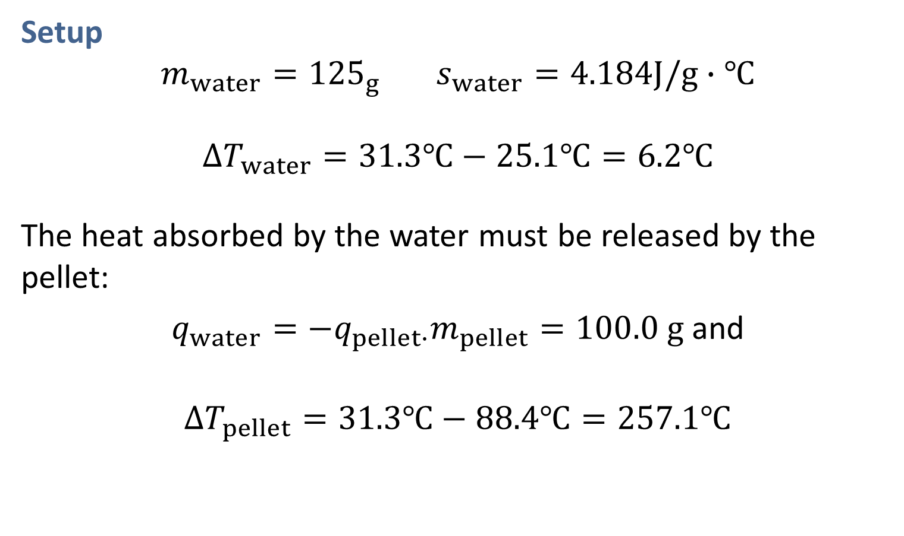
SAMPLE PROBLEM 5.5 Setup
Setup
$m_{water}={125}_{g}$ $s_{water}=4.184J/g∙℃$
$$∆T_{water}=31.3℃−25.1℃=6.2℃$$
The heat absorbed by the water must be released by the pellet:
$q_{water}=−q_{pellet∙}m_{pellet}=100.0 g$and
$$∆T_{pellet}=31.3℃−88.4℃=257.1℃$$

Slide 31

SAMPLE PROBLEM 5.5 Solution
Solution
$$q_{water}=\frac{4.184 J}{g∙℃}×125 g×6.2℃=3242.6 J$$
$$q_{pellet}=−3242.6 J$$
$$−3242.6 J=C_{pellet}×\left(−57.1℃\right)$$
$$C_{pellet}=57 J/℃$$

Slide 32
5.4 Calorimetry (6)
Constant-Pressure Calorimetry
Table 5.3 Heats of Some Typical Reactions and Physical Processes Measured at Constant Pressure
Type of Reaction | Example | ΔH (kJ/mol)
Heat of neutralization | HCl(aq) + NaOH(aq) → H₂O(l) + NaCl(aq) | −56.2
Heat of ionization | H₂O(l) → H⁺(aq) + OH⁻(aq) | +56.2
Heat of fusion | H₂O(s) → H₂O(l) | +6.01
Heat of vaporization | H₂O(l) → H₂O(g) | +44.0*
*Measured at 25°C. At 100°C, the value is +40.79 kJ.

Slide 33
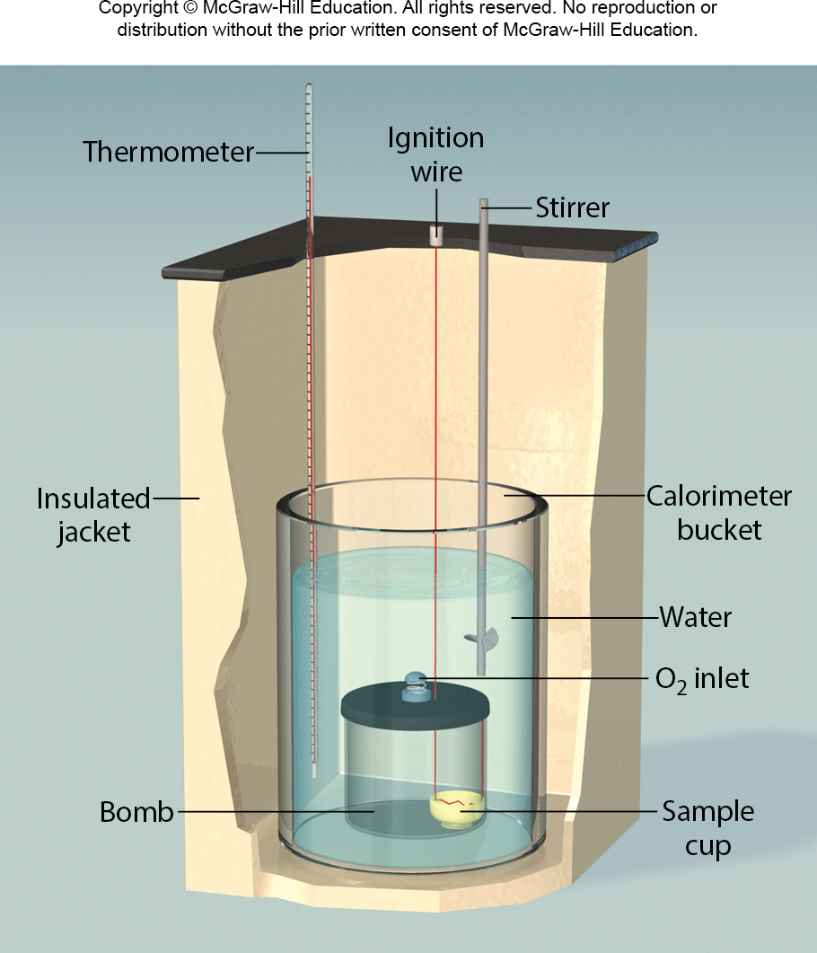
5.4 Calorimetry (7)
Constant-Volume Calorimetry

Slide 34
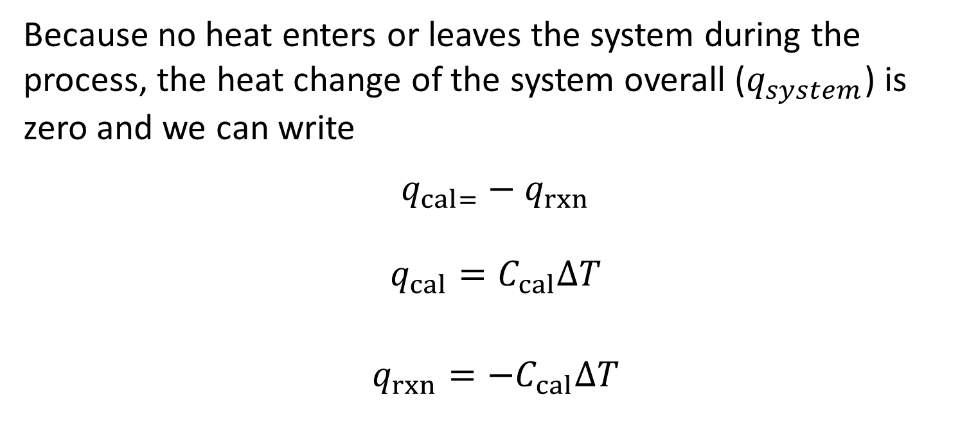
5.4 Calorimetry (8)
Constant-Volume Calorimetry
Because no heat enters or leaves the system during the process, the heat change of the system overall ($q_{system}$) is zero and we can write
$$q_{cal=}−q_{rxn}$$
$$q_{cal}=C_{cal}∆T$$
$$q_{rxn}=−C_{cal}∆T$$

Slide 35
SAMPLE PROBLEM 5.6
A Famous Amos bite-sized chocolate chip cookie weighing 7.25 g is burned in a bomb calorimeter to determine its energy content.
The heat capacity of the calorimeter is 39.97 kJ/°C.
During the combustion, the temperature of the water in the calorimeter increases by 3.90°C.
Calculate the energy content (in kJ/g) of the cookie.

Slide 36
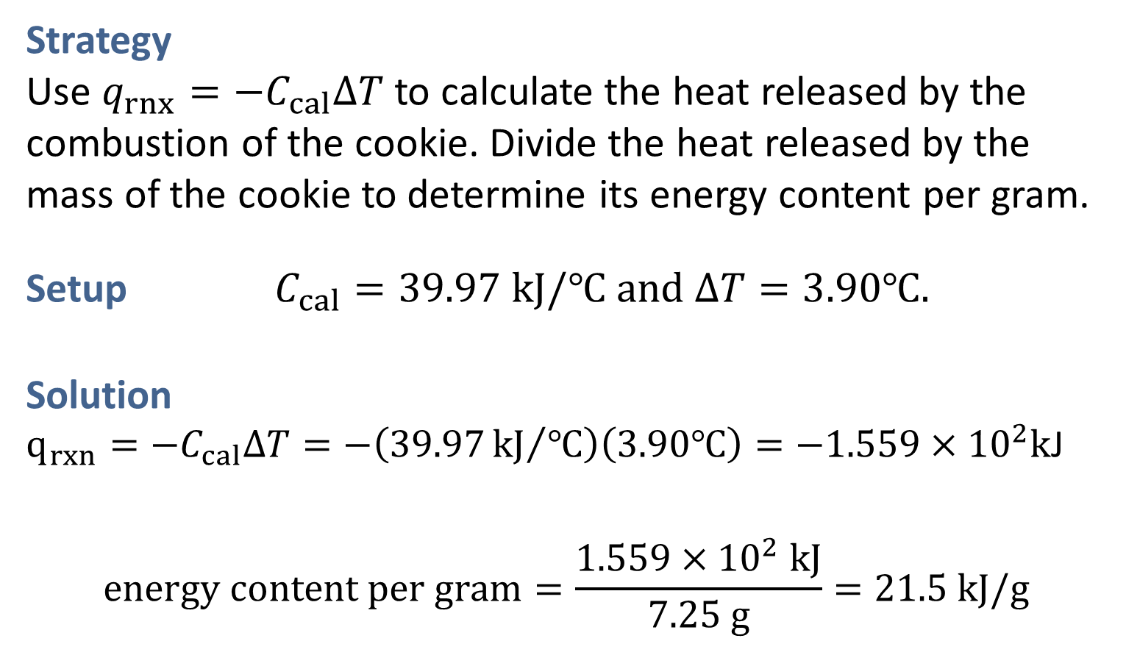
SAMPLE PROBLEM 5.6 Strategy
Strategy
Use $q_{rnx}={−C}_{cal}∆T$ to calculate the heat released by the combustion of the cookie. Divide the heat released by the mass of the cookie to determine its energy content per gram.
Setup $C_{cal}=39.97 kJ/℃$ $and ∆T=3.90℃.$
Solution
$q_{rxn}=−C_{cal}∆T=−\left(39.97{kJ}/℃\right)\left(3.90℃\right)=−1.559×{10}^{2}k$J
$$energy content per gram=\frac{1.559×{10}^{2} kJ}{7.25 g}=21.5 kJ/g$$

Slide 37
5.5 Hess’s Law
Topics
Hess’s Law

Slide 38
5.5 Hess’s Law (1)
Hess’s Law
Because enthalpy is a state function, the change in enthalpy that occurs when reactants are converted to products in a reaction is the same whether the reaction takes place in one step or in a series of steps.
This observation is called Hess’s law.

Slide 39
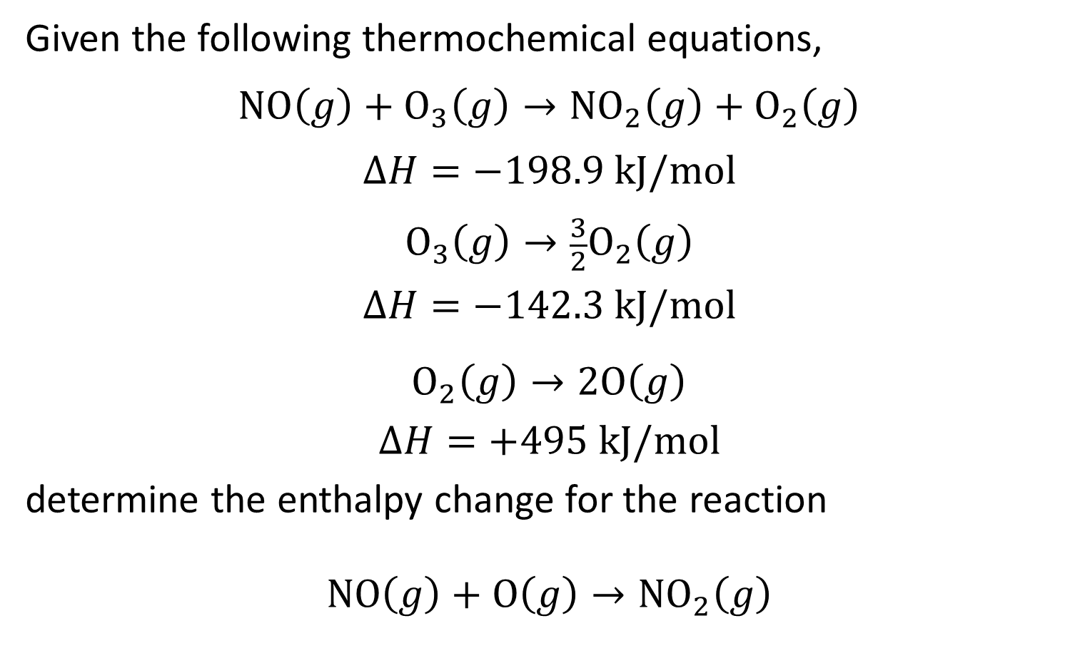
SAMPLE PROBLEM 5.7
Given the following thermochemical equations,
$$NO\left(g\right)+O_{3}\left(g\right)→{NO}_{2}\left(g\right)+O_{2}\left(g\right)$$
$$∆H=−198.9 kJ/mol$$
$$O_{3}\left(g\right)→\frac{3}{2}O_{2}\left(g\right)$$
$$∆H=−142.3 kJ/mol$$
$$O_{2}\left(g\right)→2O\left(g\right)$$
$$∆H=+495 kJ/mol$$
determine the enthalpy change for the reaction
$$NO\left(g\right)+O\left(g\right)→{NO}_{2}\left(g\right)$$

Slide 40
SAMPLE PROBLEM 5.7 Strategy
Strategy
Arrange the given thermochemical equations so that they sum to the desired equation.
Make the corresponding changes to the enthalpy changes, and add them to get the desired enthalpy change.

Slide 41
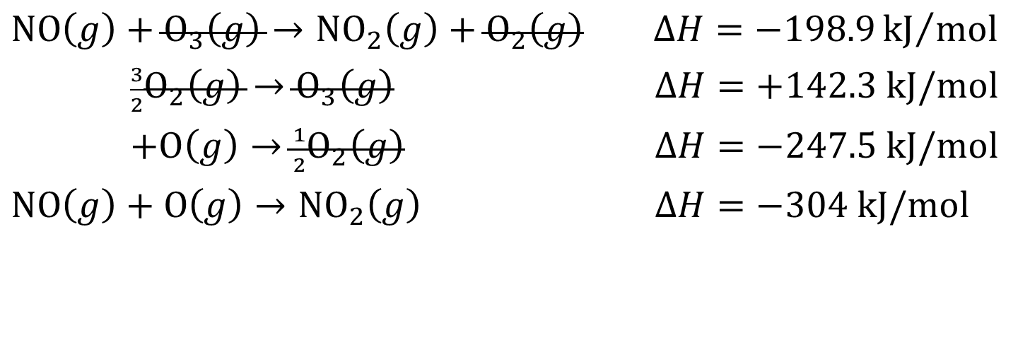
SAMPLE PROBLEM 5.7 Solution
Solution
$NO\left(g\right)+O_{3}\left(g\right)→{NO}_{2}\left(g\right)+O_{2}\left(g\right)$ $∆H=−198.9{kJ}/{mol}$
$\frac{3}{2}O_{2}\left(g\right)→O_{3}\left(g\right)$ $∆H=+142.3 kJ/mol$
$+O\left(g\right)→\frac{1}{2}O_{2}\left(g\right)$ $∆H=−247.5 kJ/mol$
$NO\left(g\right)+O\left(g\right)→{NO}_{2}\left(g\right)$ $∆H=−304 kJ/mol$

Slide 42
5.6 Standard Enthalpies of Formation (1)
Standard Enthalpies of Formation
There is no way to measure the absolute value of the enthalpy of a substance.
Only changes in enthalpy are measureable; that is, only values relative to an arbitrary reference can be determined.

Slide 43
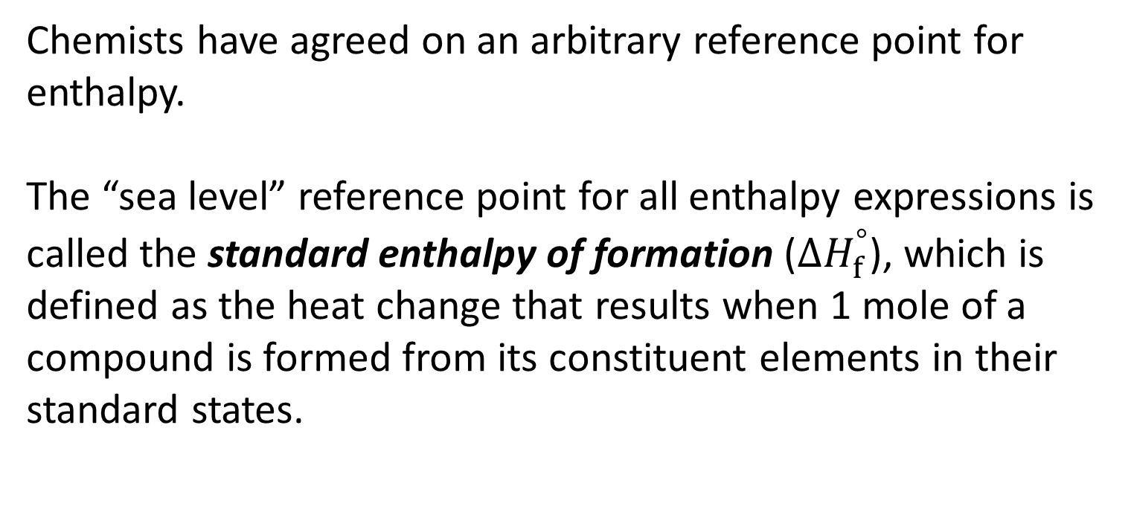
5.6 Standard Enthalpies of Formation (2)
Standard Enthalpies of Formation
Chemists have agreed on an arbitrary reference point for enthalpy.
The “sea level” reference point for all enthalpy expressions is called the standard enthalpy of formation (${∆H}_{f}^{°}$), which is defined as the heat change that results when 1 mole of a compound is formed from its constituent elements in their standard states.

Slide 44
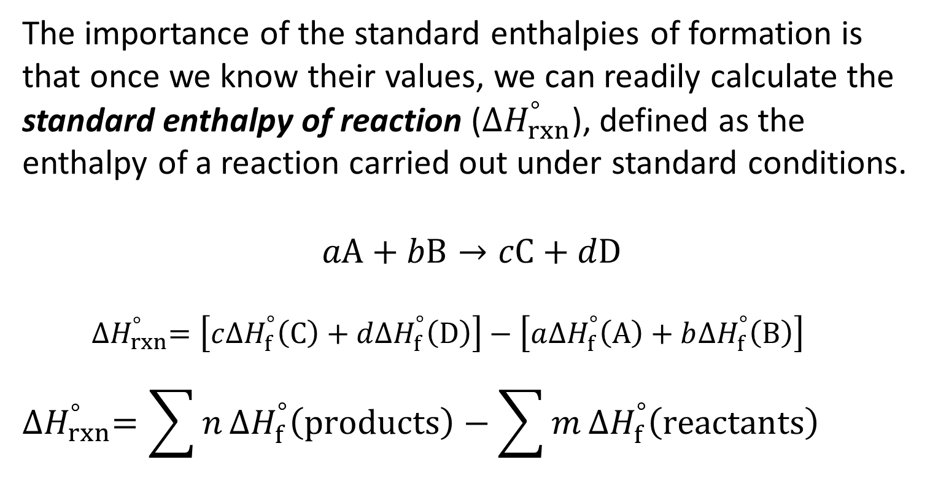
5.6 Standard Enthalpies of Formation (3)
Standard Enthalpies of Formation
The importance of the standard enthalpies of formation is that once we know their values, we can readily calculate the standard enthalpy of reaction (${∆H}_{rxn}^{°}$), defined as the enthalpy of a reaction carried out under standard conditions.
$aA+bB→cC+dD$
${∆H}_{rxn}^{°}=\left[c{∆H}_{f}^{°}\left(C\right)+d{∆H}_{f}^{°}\left(D\right)\right]−\left[a{∆H}_{f}^{°}\left(A\right)+b{∆H}_{f}^{°}\left(B\right)\right]$
$${∆H}_{rxn}^{°}=\sum{n}{∆H}_{f}^{°}\left(products\right)−\sum{m}{∆H}_{f}^{°}\left(reactants\right)$$

Slide 45
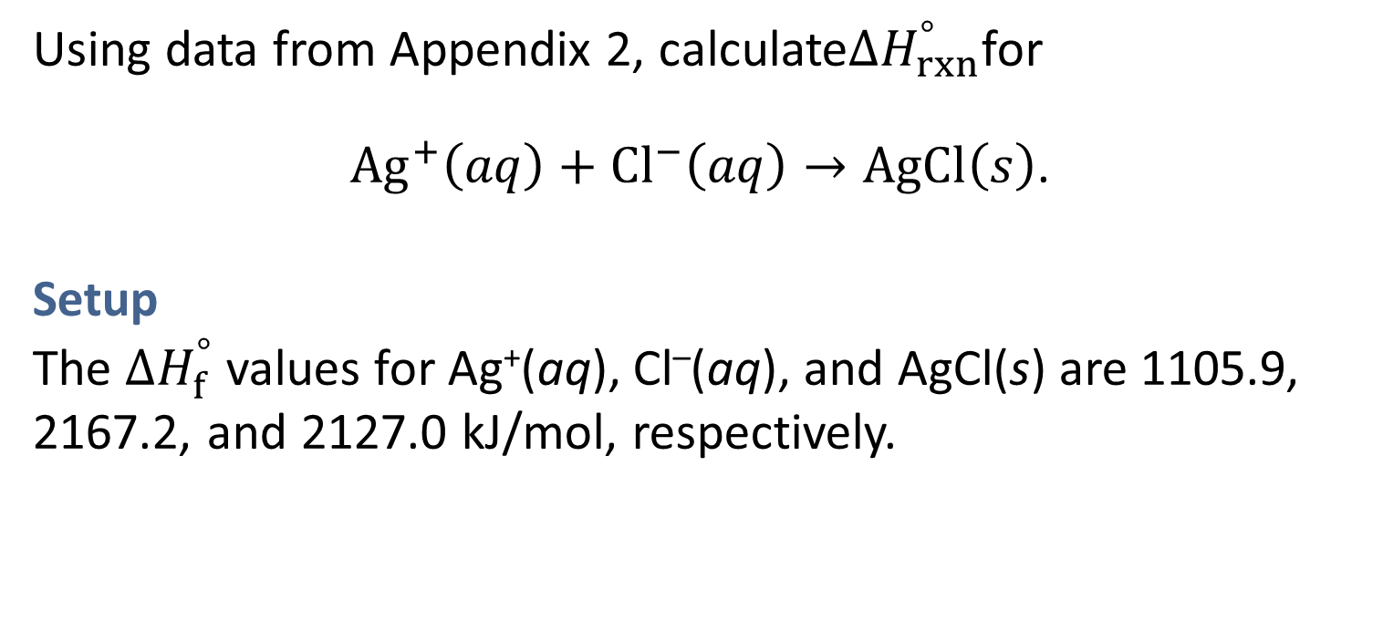
SAMPLE PROBLEM 5.8 Setup
Using data from Appendix 2, calculate${∆H}_{rxn}^{°}$for
$Ag^{+}\left(aq\right)+Cl^{−}\left(aq\right)→AgCl\left(s\right)$.
Setup
The ${∆H}_{f}^{°}$ values for Ag⁺(aq), Cl–(aq), and AgCl(s) are 1105.9, 2167.2, and 2127.0 kJ/mol, respectively.

Slide 46
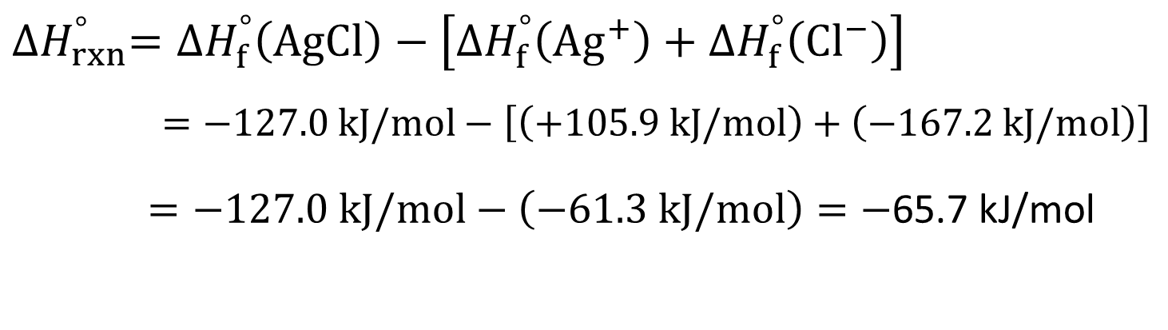
SAMPLE PROBLEM 5.8 Solution
Solution
$${∆H}_{rxn}^{°}={∆H}_{f}^{°}\left(AgCl\right)−\left[{∆H}_{f}^{°}\left(Ag^{+}\right)+{∆H}_{f}^{°}\left(Cl^{−}\right)\right]$$
$=−127.0 kJ/mol−\left[\left(+105.9 kJ/mol\right)+\left(−167.2 kJ/mol\right)\right]$
$=−127.0 kJ/mol−\left(−61.3 kJ/mol\right)=−$65.7 kJ/mol

Slide 47
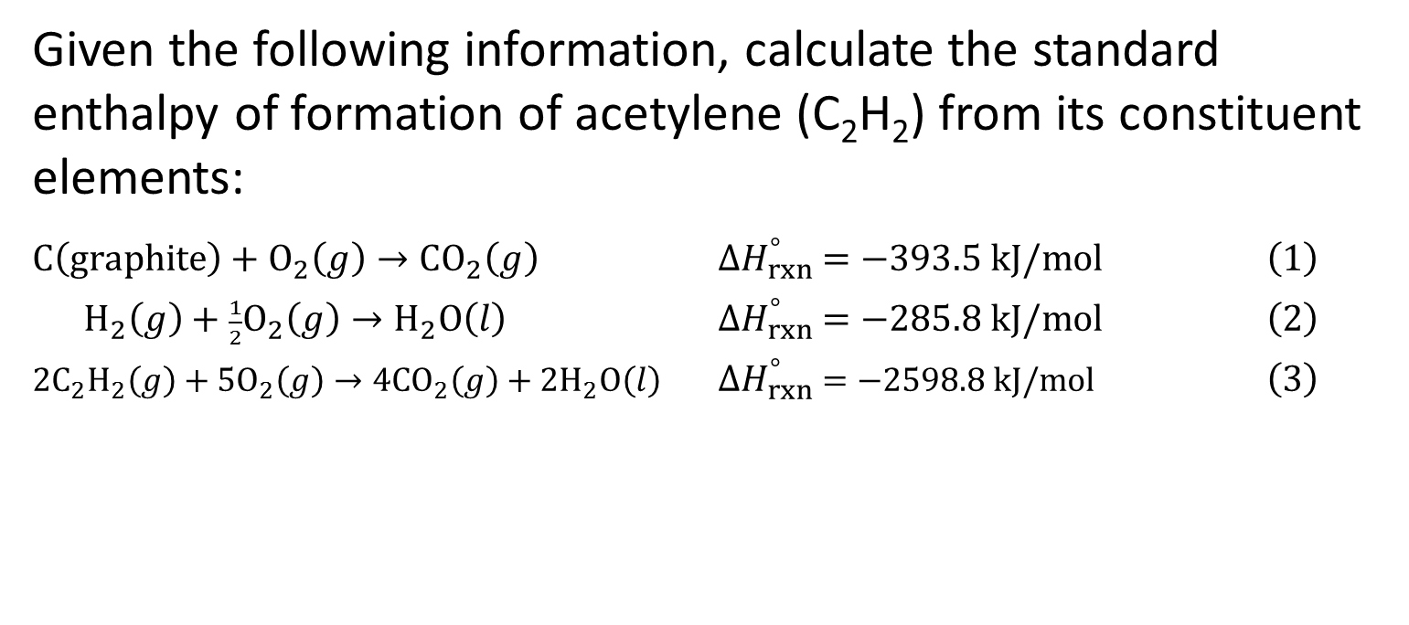
SAMPLE PROBLEM 5.9
Given the following information, calculate the standard enthalpy of formation of acetylene (C₂H₂) from its constituent elements:
$C\left(graphite\right)+O_{2}\left(g\right)→{CO}_{2}\left(g\right)$ ${∆H}_{rxn}^{°} =−393.5 kJ/mol$ $\left(1\right)$
$H_{2}\left(g\right)+\frac{1}{2}O_{2}\left(g\right)→H_{2}O\left(l\right)$ ${∆H}_{rxn}^{°} =−285.8 kJ/mol$ $\left(2\right)$
${2C}_{2}H_{2}\left(g\right)+{5O}_{2}\left(g\right)→{4CO}_{2}\left(g\right)+{2H}_{2}O\left(l\right)$ ${∆H}_{rxn}^{°} =−2598.8 kJ/mol$ $\left(3\right)$

Slide 48
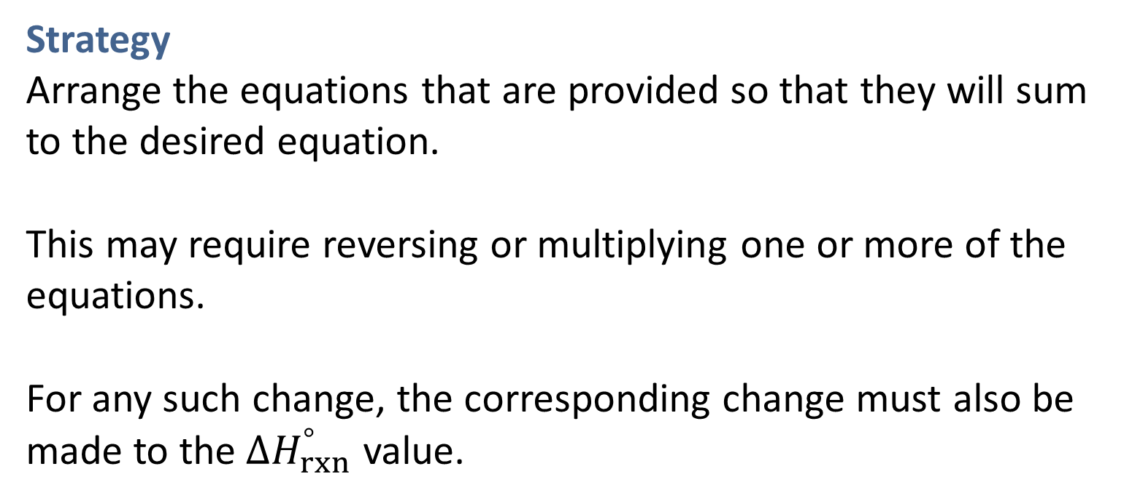
SAMPLE PROBLEM 5.9
Strategy
Arrange the equations that are provided so that they will sum to the desired equation.
This may require reversing or multiplying one or more of the equations.
For any such change, the corresponding change must also be made to the${ ∆H}_{rxn}^{°}$ value.

Slide 49
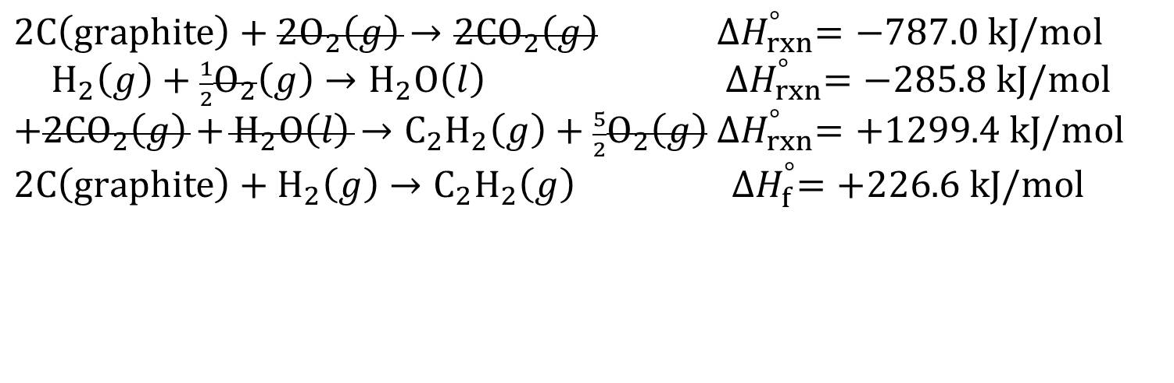
SAMPLE PROBLEM 5.9 Solution
Solution
$2C\left(graphite\right)+2O_{2}\left(g\right)→2{CO}_{2}\left(g\right)$ ${∆H}_{rxn}^{°}=−787.0 kJ/mol$
$H_{2}\left(g\right)+\frac{1}{2}O_{2}\left(g\right)→H_{2}O\left(l\right)$ ${∆H}_{rxn}^{°}=−285.8 kJ/mol$
$+2{CO}_{2}\left(g\right)+H_{2}O\left(l\right)→C_{2}H_{2}\left(g\right)+\frac{5}{2}O_{2}\left(g\right)$ ${∆H}_{rxn}^{°}=+1299.4 kJ/mol$
$2C\left(graphite\right)+H_{2}\left(g\right)→C_{2}H_{2}\left(g\right)$ ${∆H}_{f}^{°}=+226.6 kJ/mol$

